Slide 1




Entanglement of astrophysical neutrinos
A.B. Balantekin
CETUP* 2025

Slide 2
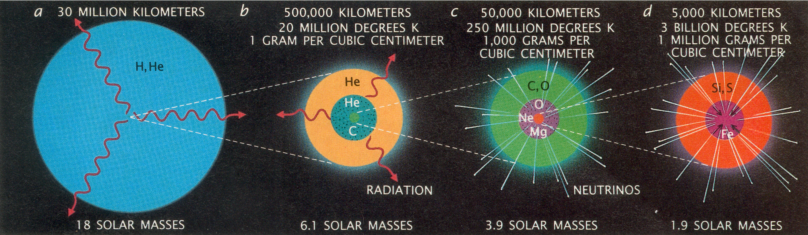
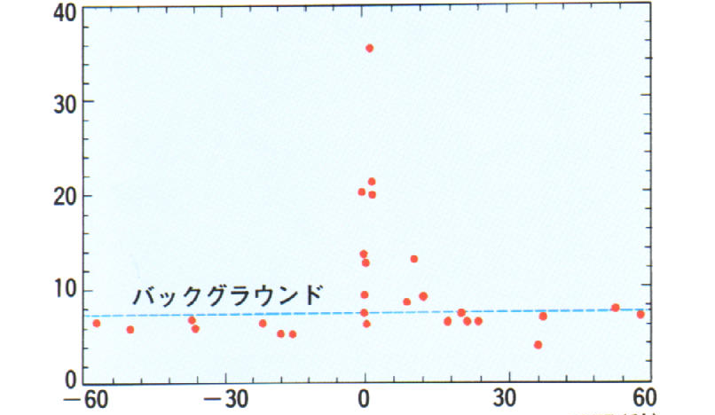
M_{prog} ≥ 8 M_{sun} better if 12 M_{sun}
ΔE ≈ 10⁵³ ergs ≈ 10⁵⁹ MeV
99% of the energy is carried away by neutrinos and antineutrinos with 10 ≤ E_{ν} ≤ 30 MeV
10⁵⁸ Neutrinos!
..and those ν’s were observed!
CCSN are “factories” that convert gravitational binding energy into neutrinos!

Slide 3
The origin of elements
Neutrinos not only play a crucial role in the dynamics of these sites, but they also control the value of the electron fraction, the parameter determining the yields of the r-process nucleosynthesis.
Balantekin et al., arXiv:1401.6435 [nucl-th]
Possible sites for the r-process

Slide 4
MSW oscillations
(low neutrino density)
Collective oscillations (high neutrino density)
Proto-neutron star
Neutrinos forward scatter from each other
Neutrinos forward scatter from background particles

Slide 5
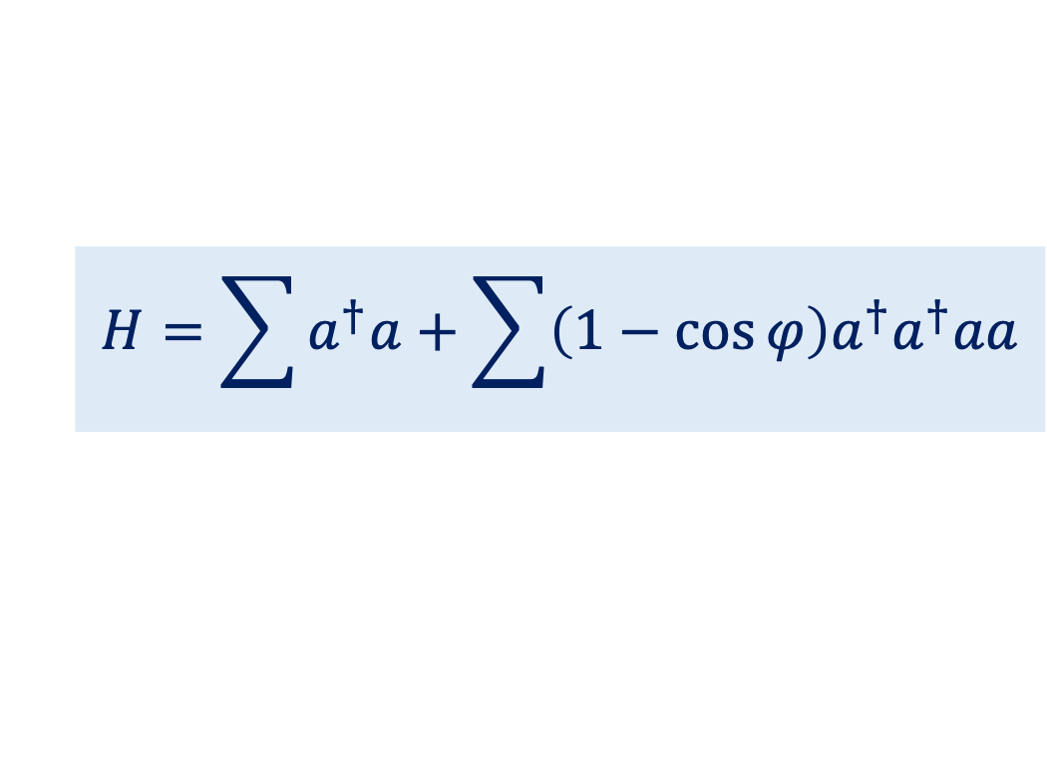
ν
Energy released in a core-collapse SN: ΔE ≈ 10⁵³ ergs ≈ 10⁵⁹ MeV
99% of this energy is carried away by neutrinos and antineutrinos!
~ 10⁵⁸ Neutrinos!
This necessitates including the effects of νν interactions (“collective neutrino oscillations”)!
ν
ν
Proto neutron star
ν
ν
$$H=\sum{a^{†}a+\sum{\left(1−\cos{φ}\right)a^{†}a^{†}aa}}$$
oscillations
MSW effect
neutrino-neutrino interactions
The second term makes the physics of a neutrino gas in a core-collapse supernova a very interesting many-body problem, driven by weak interactions.
Neutrino-neutrino interactions lead to novel collective and emergent effects, such as conserved quantities and interesting features in the neutrino energy spectra (spectral “swaps” or “splits”).

Slide 6
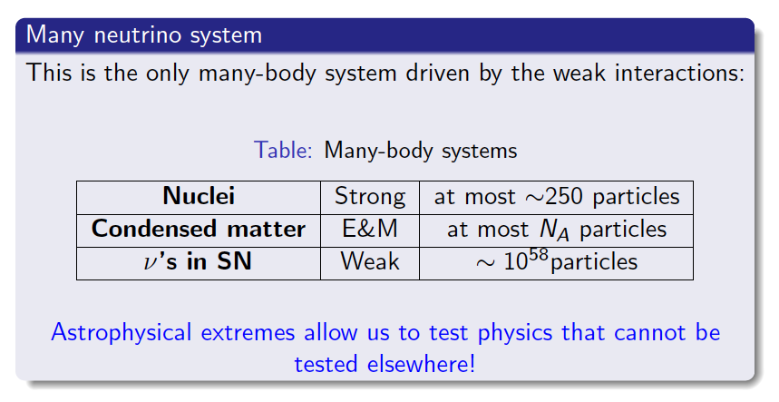

Slide 7
$$\frac{∂ρ}{∂t}=−i\left[H,ρ\right]+C(ρ)$$
H = neutrinos
C = collisions

Slide 8
$$\frac{∂ρ}{∂t}=−i\left[H,ρ\right]+C(ρ)$$
H = neutrino mixing
+ forward scattering of neutrinos off other background particles (MSW) + forward scattering of neutrinos off each other
C = collisions

Slide 9
Neutrino flavor isospin
ν_{e}
ν_{μ}
These operators can be written in either mass or flavor basis
Neutrino-neutrino interactions lead to novel collective and emergent effects, such as conserved quantities and interesting features in the neutrino energy spectra (spectral “swaps” or “splits”).

Slide 10
Mean Field: Each neutrino moves independently interacting with a mean-field created by other neutrinos. Momenta of these neutrinos do not change.
Many-body: Momentum changing interactions are possible, but they vanish in the mean-field limit. For simplicity in this talk we will only consider forward scattering.

Slide 11
Number of neutrinos is irrelevant for the mean-field approximation, since it is basically one-body limit. Once you go beyond the mean field we need to explore the consequences of this Hamiltonian for very large number of neutrinos, N. There are two possibilities:
Solve the exact problem for a small number of neutrinos (computational difficulty increases exponentially with N) and look for scaling behavior. Here at each step you can test how much many-body solution differs from the mean-field solution. Wisconsin
Try to estimate large N limit from thermodynamic considerations Martin, Roggero, Carlson, Duan, …
Alternatives to many-body formulation Lacroix, Roggero, ABB, …

Slide 12
A system of N interacting particles each of which can occupy k states (k = number of flavors)
Exact Solution
Mean-field approximation
Entangled and unentangled states
Only unentangled states
Dimension of Hilbert space: k^{N}
Dimension of the diagonalizing space: kN
von Neumann entropy
S = - Tr (ρ log ρ)
 | Pure State | Mixed State
Density matrix | ρ² = ρ | ρ² ≠ ρ
Entropy | S = 0 | S ≠ 0

Slide 13
BETHE ANSATZ
Bethe ansatz equations
Pehlivan, ABB, Kajino, & Yoshida
Phys. Rev. D 84, 065008 (2011)

Slide 14
Techniques to solve the exact evolution
Bethe ansatz method has numerical instabilities for larger values of N. However, it is very valuable since it leads to the identification of conserved quantities.
Patwardhan et. al., PRD 99, 123013 (2019); Cervia et al., PRD 100, 083001 (2019)
Runge Kutta method (RK4)
Patwardhan et. al., PRD 104, 123035 (2021), Siwach et. al. PRD 107, 023019 (2023)
Tensor network techniques
Cervia et al., PRD 105, 123025 (2022)
Hybrid methods on noisy quantum computers
Siwach et. al., 2308.09123 [quant-ph], PRD 108 (2023) 8, 083039
Quantum computers
Spagnoli et al. arXiv:2503.00607 [quant-ph]

Slide 15
Computation times:
Cervia, Siwach, Patwardhan, Balantekin, Coppersmith, Johnson, arXiv:2202.01865

Slide 16
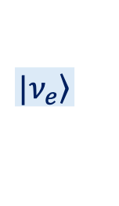

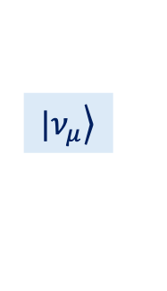
Bloch sphere for a single neutrino
$$|\left.ν_{e}\right\rangle$$
P
P
$$|\left.ν_{μ}\right\rangle$$
$$ρ=\frac{1}{2}\left(1+\vec{σ}∙\vec{P}\right)$$

Slide 17
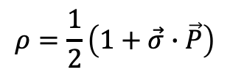
ω_{Ν} = Νω₀
Initial state:
all electron neutrinos
$$ρ=\frac{1}{2}\left(1+\vec{σ}∙\vec{P}\right)$$
One-neutrino density matrix in the two-flavor limit
Note: S = 0 for mean-field approximation
Cervia, Patwardhan, Balantekin, Coppersmith, Johnson,
arXiv:1908.03511
PRD, 100, 083001 (2019)

Slide 18
Cervia, Patwardhan, Balantekin, Coppersmith, Johnson,
arXiv:1908.03511
PRD 100, 083001 (2019)
Patwardhan, Cervia, Balantekin, arXiv:2109.08995
PRD 104, 123035 (2021)

Slide 19
We find that the presence of spectral splits is a good proxy for deviations from the mean-field results
Probability of observing the first mass eigenstate
Entanglement entropy
mean field
many body
ω
Split frequency

Slide 20
Probability of observing the first mass eigenstate starting with all ν_{e} (N=16)
Value of total J_{z} (conserved
θ = 0.584
Patwardhan, Cervia, Balantekin, arXiv:2109.08995
Phys. Rev. D 104, 123035 (2021)

Slide 21
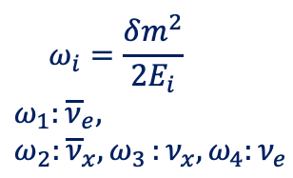
The impact of two different treatments of collective neutrino oscillations (with and without entanglement)
$$ω_{i}=\frac{δm^{2}}{2E_{i}}$$
$ω_{1}:{\overline{ν}}_{e},$ $ω_{2}:{\overline{ν}}_{x}{, ω}_{3}:ν_{x},ω_{4}:ν_{e}$
Balantekin, Cervia, Patwardhan, Surman, Wang; 2311.02562 [astro-ph.HE]
Astrophys. J. 967 (2024) 2, 146
Considerations of collective effects unveiled a new kind of nucleosynthesis: ”The νi process”.

Slide 22
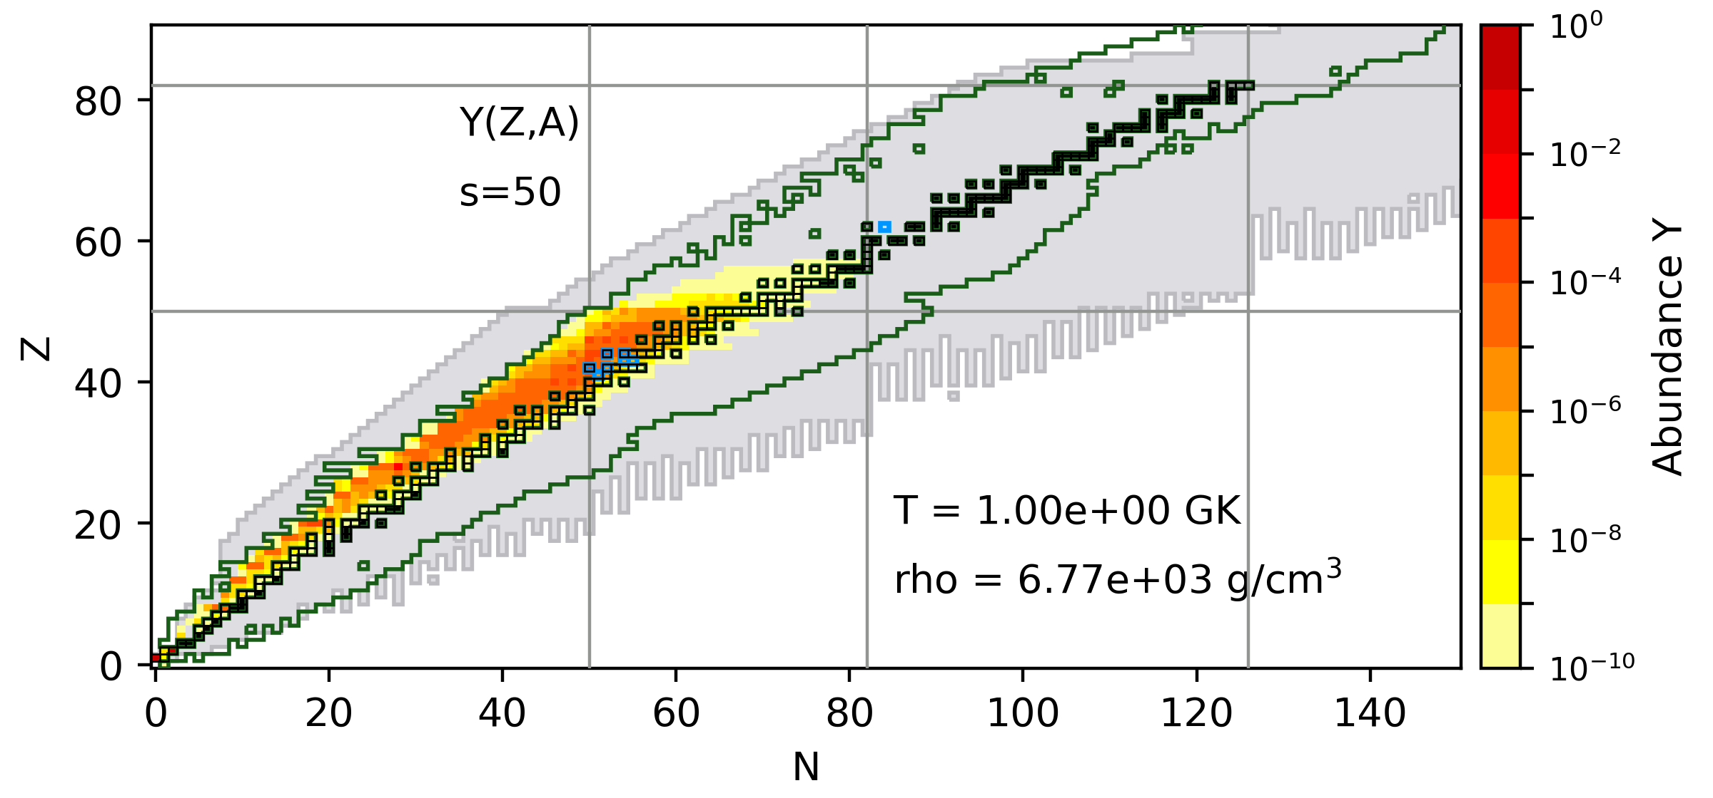
The final abundance patterns of simulations with the Wanajo2011 matter trajectory
Extent of nucleosynthesis

Slide 23
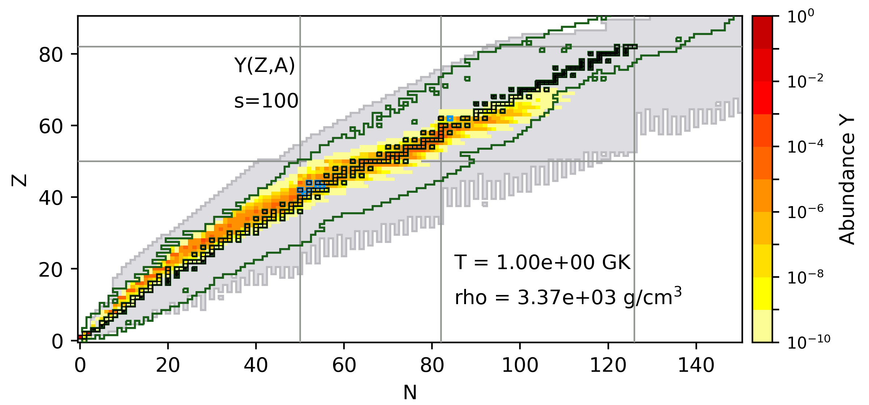
The final abundance patterns of simulations with the Wanajo2011 matter trajectory

Slide 24
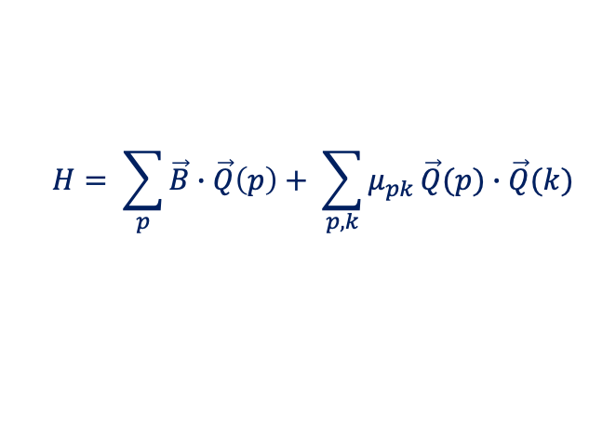
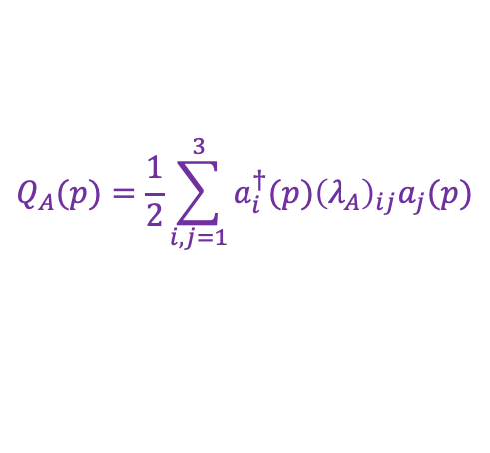

Entanglement in three-flavor collective oscillations
$$H= \sum_{p}{\vec{B}∙\vec{Q}\left(p\right)+ \sum_{p,k}{μ_{pk }\vec{Q}(p)∙\vec{Q}(k)}}$$
$$Q_{A}(p)=\frac{1}{2}\sum_{i,j=1}^{3}{a_{i}^{†}(p){\left(λ_{A}\right)}_{ij}a_{j}(p)}$$
$$B=\frac{1}{2E}\left(0,0,m_{1}^{2}−m_{2}^{2},0,0,0,0,−\left|m_{3}^{2}−m_{1}^{2}\right|\right)$$
Pooja Siwach, Anna Suliga, A.B. Balantekin
Physical Review D 107 (2023) 2, 023019

Slide 25
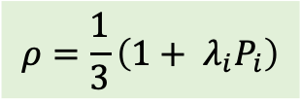
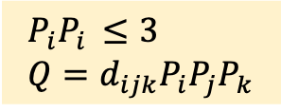
Qutrits are more complicated than qubits
Density matrix for a single qutrit
$$ρ=\frac{1}{3}\left(1+ λ_{i}P_{i}\right)$$
$$P_{i}P_{i }≤3$$
$$Q=d_{ijk}P_{i}P_{j}P_{k}$$
Positive semi-definite condition
Pure state only if
$$P^{2}=P_{i}P_{i}=3 \text{and} P_{i}=d_{ijk}P_{j}P_{k}$$
In the above equations d_{ijk} is the completely symmetric tensor of SU(3). Note the duality between SU(3) Casimir operators and invariants of the density matrix.
A.B. Balantekin and A. Suliga, Eur. Phys. J .A 60 (2024) 6

Slide 26
Mean-Field
Three-flavor mixed initial state with six neutrinos
Many-Body
Siwach, Balantekin, Patwardhan, Suliga. 2411. 05169 [hep-th] PRD 111, 063038 (2025)

Slide 27
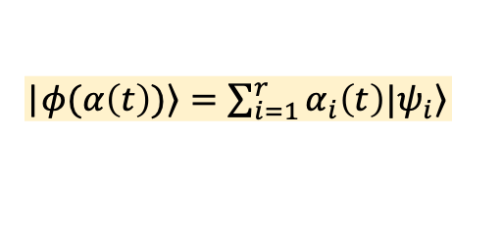
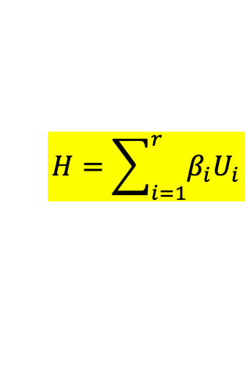
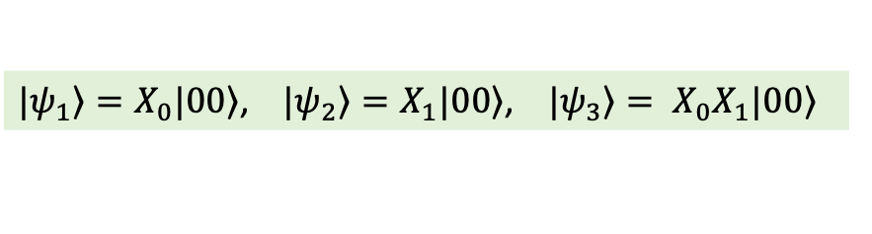
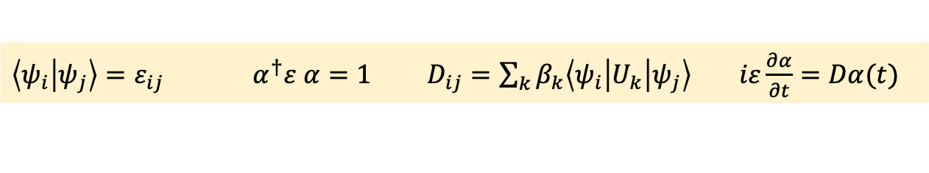
Putting on a quantum computer, baby steps
The hybrid approach of Bharti and Haug, PRA 104, 042418 (2022).
$$H=\sum_{i=1}^{r}{β_{i}U_{i}}$$
Hamiltonian is a sum of unitaries
Ansatz for the state
|$\left.φ(α\left(t\right))\right\rangle =\sum_{i=1}^{r}{α_{i}\left(t\right)|\left.ψ_{i}\right\rangle }$
$\left\langle ψ_{i} | ψ_{j}\right\rangle =ε_{ij}$ $α^{†}ε α=1 D_{ij}=\sum_{k}{β_{k}\left\langle ψ_{i} | U_{k} | ψ_{j}\right\rangle } iε\frac{∂α}{∂t}=Dα(t)$
Choose three basis states
$|\left.ψ_{1}\right\rangle =X_{0}|\left.00\right\rangle$, $|\left.ψ_{2}\right\rangle =X_{1}|\left.00\right\rangle$, $|\left.ψ_{3}\right\rangle = X_{0}X_{1}|\left.00\right\rangle$
ε and D are calculated using a quantum computer, rest is done on a classical computer
Pooja Siwach, Katie Harrison, and A.B. Balantekin, Phys. Rev. D 108 (2023) 8, 083039

Slide 28
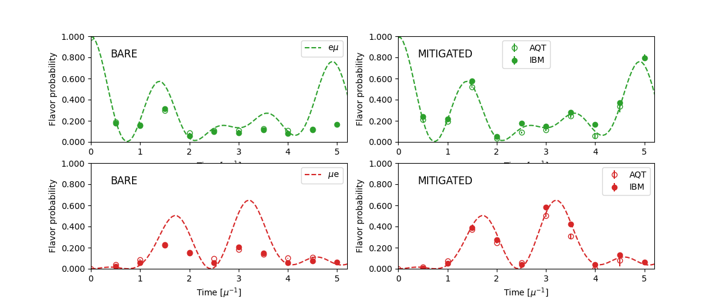
Putting on a quantum computer
arXiv:2503.00607 [quant-ph]

Slide 29
CONCLUSIONS
Calculations performed using the mean-field approximation have revealed a lot of interesting physics about collective behavior of neutrinos in astrophysical environments. Our goal is to explore possible scenarios where further interesting features can arise by going beyond this approximation.
The deviation of the adiabatic many-body results from the mean field results is largest for neutrinos with energies around the spectral split energies. In our single-angle calculations we observe a broadening of the spectral split region. This broadening does not appear in single-angle mean-field calculations and seems to be larger than that was observed in multi-angle mean-field calculations (or with BSM physics).
(From the QIS perspective) For simplicity originally two neutrino flavors were mapped onto qubits. But since neutrinos come in three flavors, neutrinos should be mapped onto qutrits. The description of qutrits is much more involved than that of qubits.

Slide 30
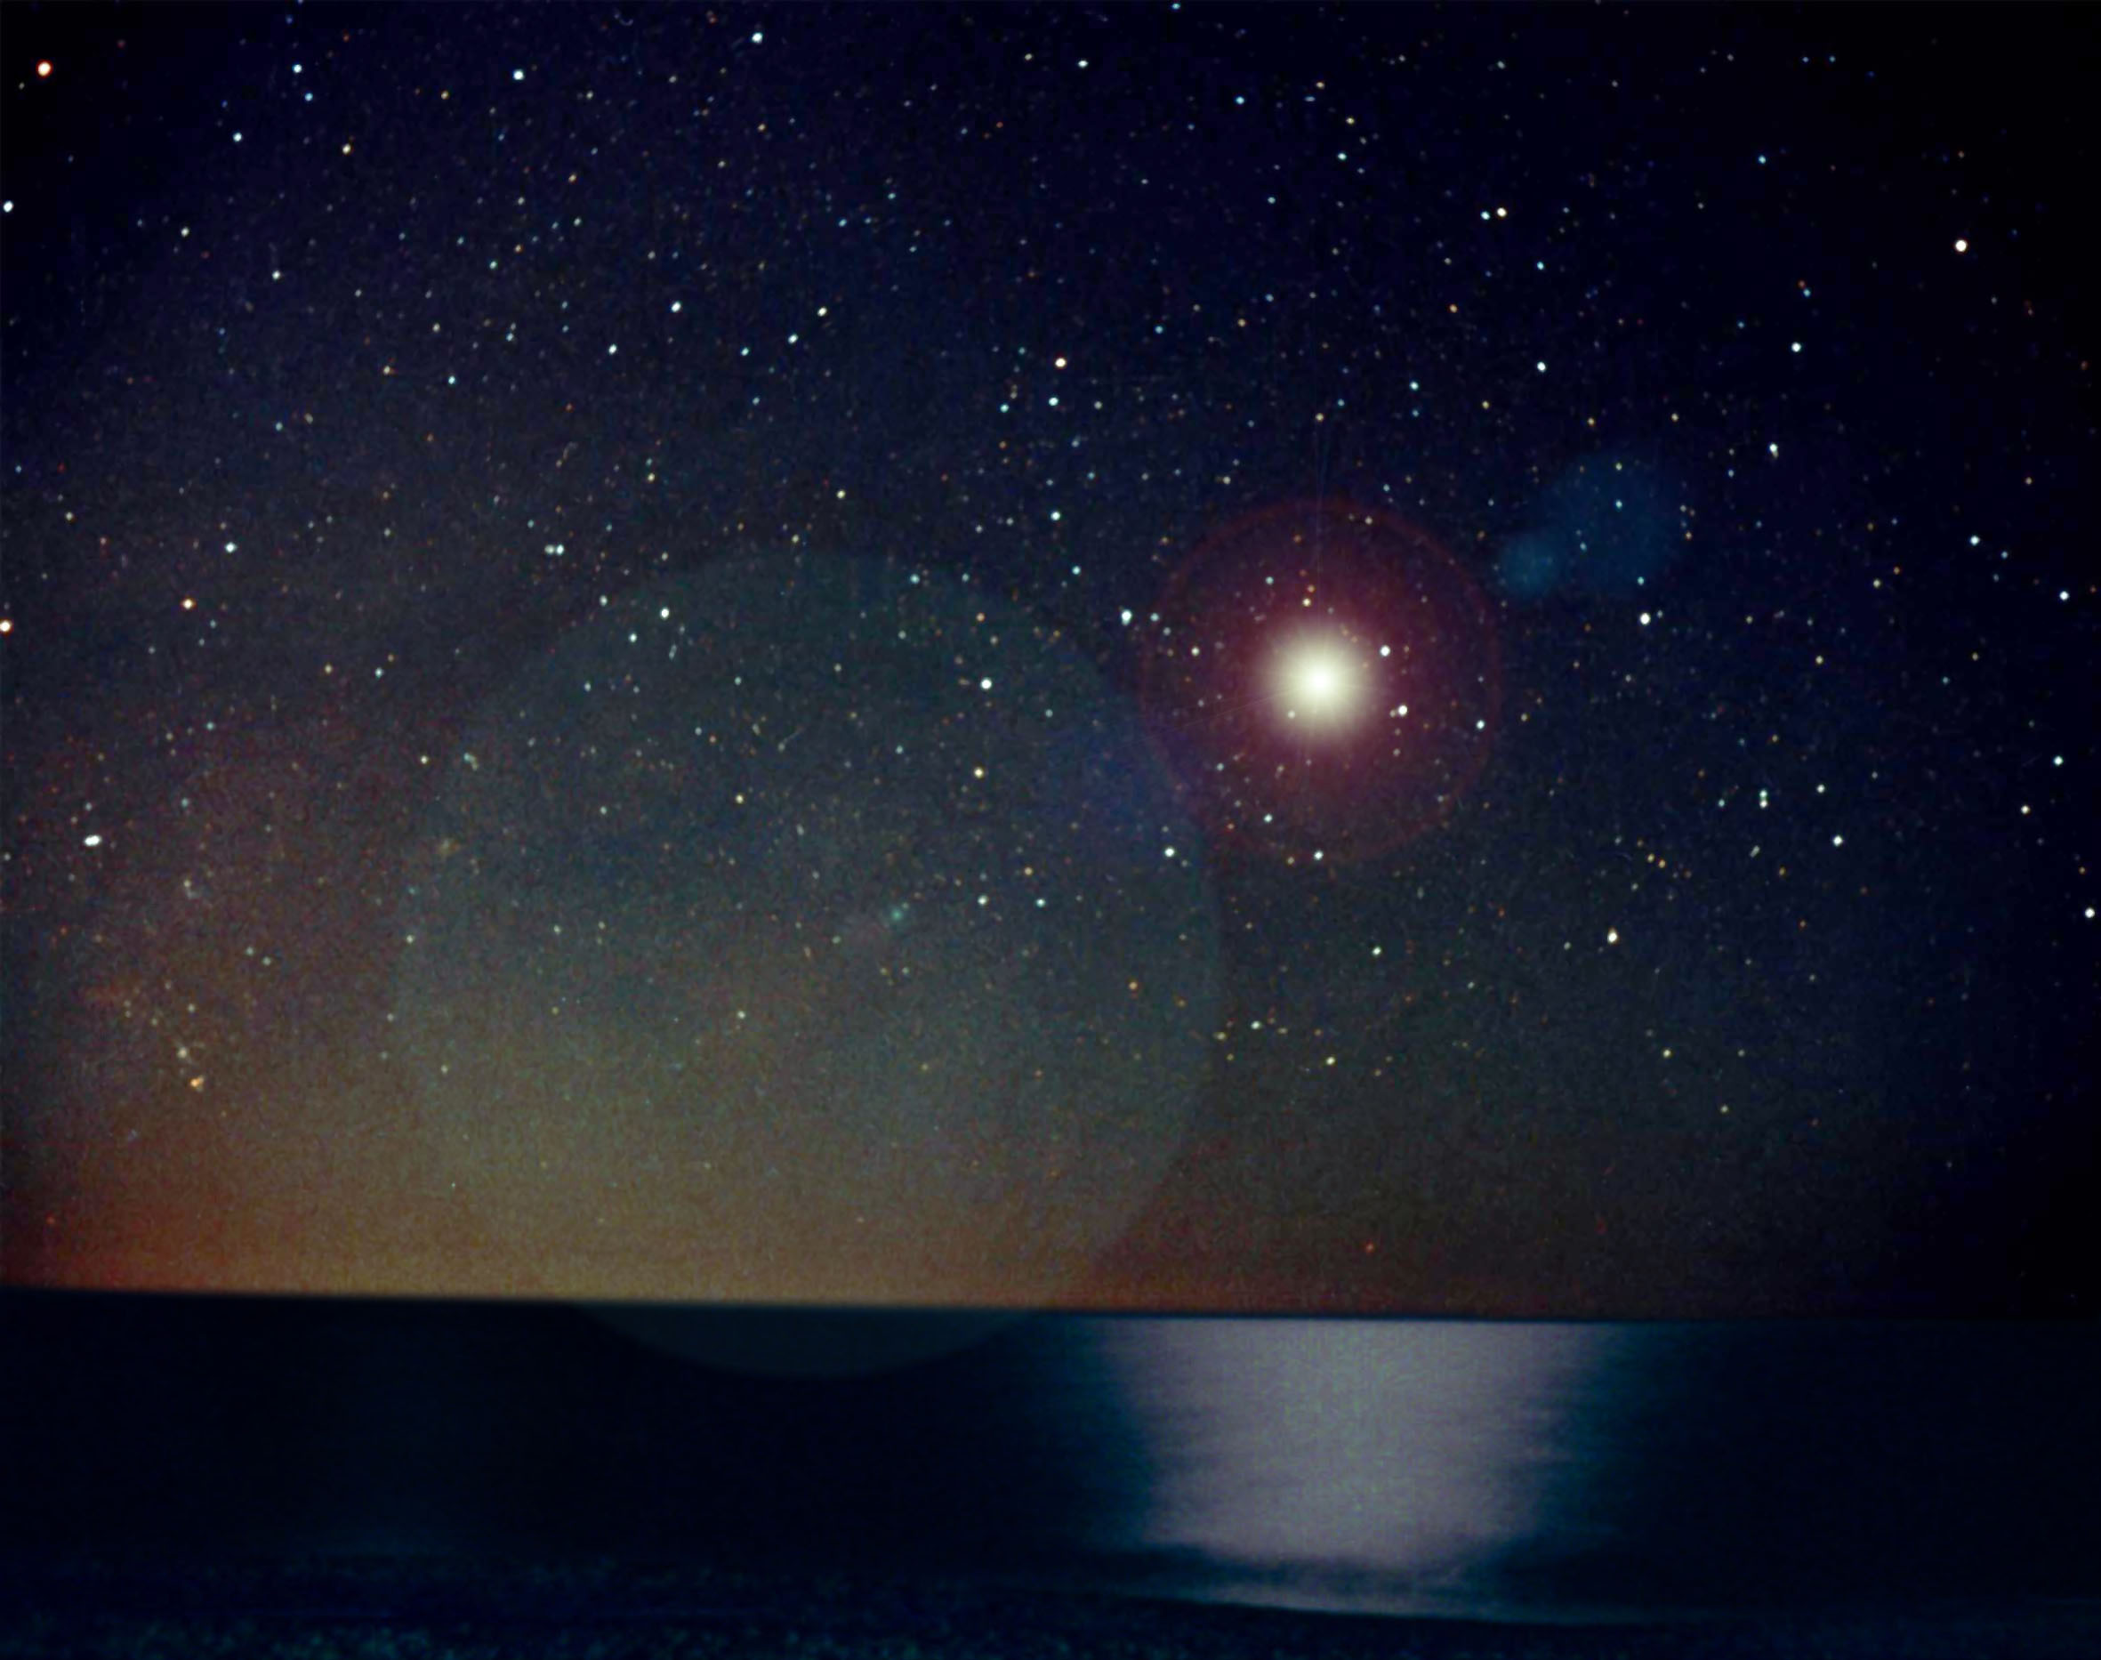
Thank you very much!

Slide 31
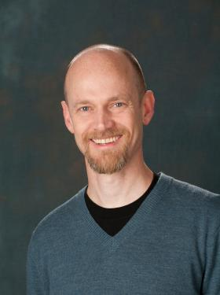

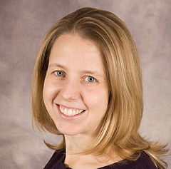




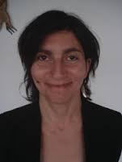







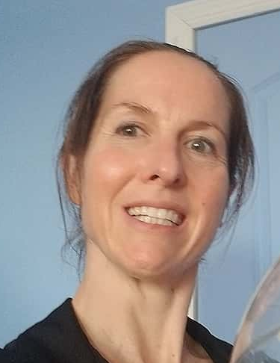

I am grateful to all these talented young people (my students, postdocs and young collaborators) I worked with over the years.

