Slide 1


Solar neutrinos: history and observations
Aldo Ianni, INFN LNGS
CETUP Neutrino Workshop 2025
July 9th, Deadwood (SD)

Slide 2
Outline of this talk
solar neutrinos and historical remarks
detection techniques for solar neutrinos
solar neutrinos: results
perspectives

Slide 3
solar neutrinos and historical remarks

Slide 4
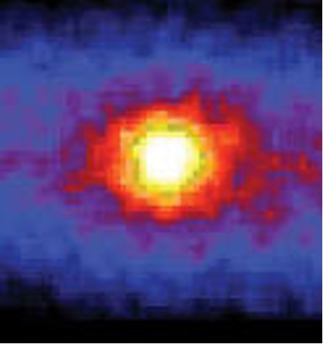
Solar Neutrinos
Our sun viewed through neutrinos
Fundamental paradigm:
The source of energy in the sun makes neutrinos:
4p → ⁴He + 2e⁺ + 2ν_{e} +(24.69+2·1.022)MeV
Hydrogen burning works through:
pp-chain
CNO bi-cycle
SK collaboration

Slide 5
Sun observations and the solar energy paradigm in recent history
1610 Galileo Galilei observes sunspots and determines the rotational velocity: 1st experimental study of the Sun
William Herschel (1738-1822) believes the Sun has a solid surface with a shining atmosphere
1862, Hermann von Helmholtz proposes the energy of the Sun is due to gravitation and makes an estimation for the age of 20×10⁶ years
1868, Jules Janssen and Joseph N. Lockyer, independently, discover a new element on the surface of the Sun. Lockyer names it helium after Helios.
1905, Einstein E = mc²
1920, Arthur Eddington proposes hydrogen to helium fusion as the main source of energy in the Sun
1928, George Gamow proposes the tunneling effect
1938, Hans Bethe in “Energy production in stars” proposes the reaction chains to transform hydrogen into helium
1956, the age of the Earth is established to be (4.55±0.07) ×10⁹ years and ν observed

Slide 6
The pp-chain
3 different terminations
26.2 MeV effective thermal energy/termination (pp-I)
9.2x10³⁷ hydrogen/sec
612x10⁶ ton/sec of H into He
assuming 10% of solar mass involved in energy production: timescale ~ 10¹⁰ years
Dominant in 1st generation stars
2nd generation stars might have a different mechanism at work

Slide 7
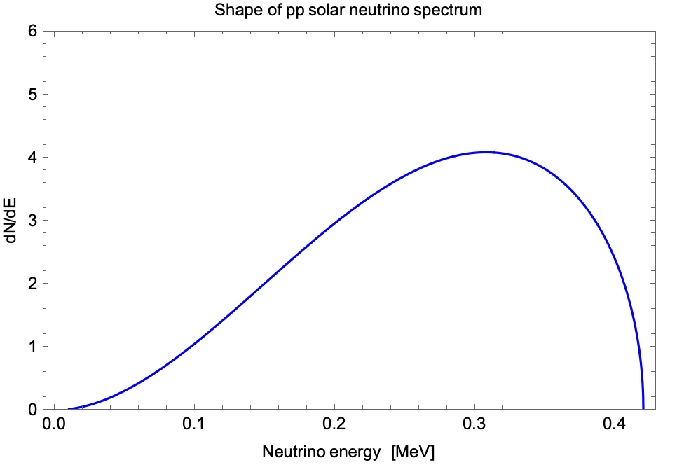
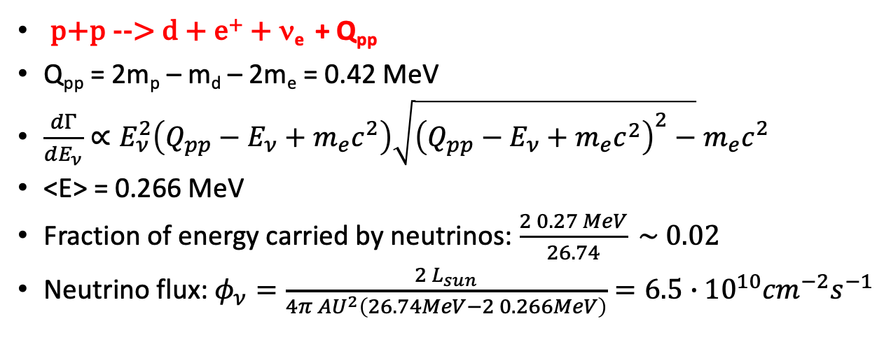
Energy spectrum and flux of pp solar neutrinos
p+p --> d + e⁺ + ν_{e} + Q_{pp}
Q_{pp} = 2m_{p} – m_{d} – 2m_{e} = 0.42 MeV
$\frac{dΓ}{dE_{ν}}∝E_{ν}^{2}\left(Q_{pp}−E_{ν}+m_{e}c^{2}\right)\sqrt{{\left(Q_{pp}−E_{ν}+m_{e}c^{2}\right)}^{2}−}$ $m_{e}c^{2}$
<E> = 0.266 MeV
Fraction of energy carried by neutrinos: $\frac{2 0.27 MeV}{26.74} \sim 0.02$
Neutrino flux: $φ_{ν}=\frac{2 L_{sun}}{4π {AU}^{2}\left(26.74MeV−2 0.266MeV\right)}=6.5∙{10}^{10}{cm}^{−2}s^{−1}$

Slide 8
A different hydrogen burning mechanism in 2nd generation stars may involve light elements such as carbon and nitrogen
This idea was originally introduced independently by von Weizsaker and Bethe between 1937 and 1939
¹²C can indirectly induce fusion of 4 protons to form helium
The total energy released is the same as for the pp-chain

Slide 9
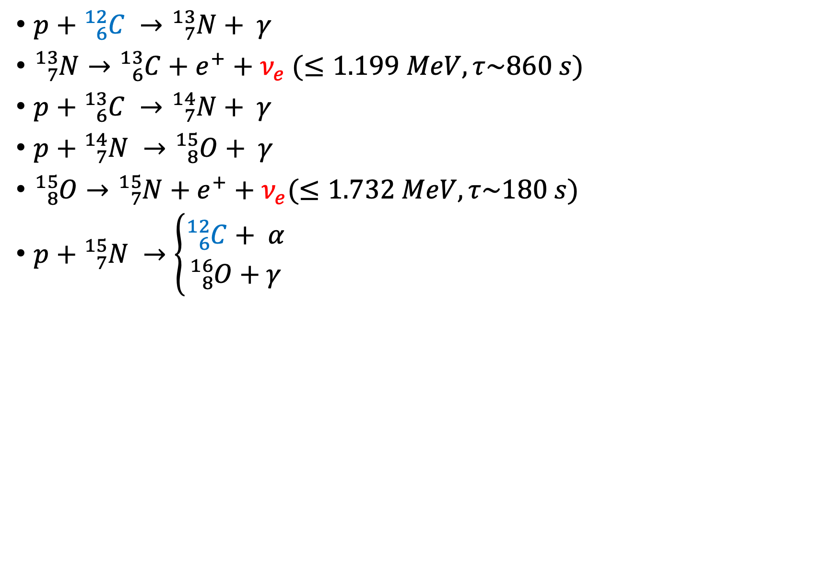
The CN cycle
$p+{}_{6}^{12}C →{}_{7}^{13}N+ γ$
${}_{7}^{13}{N→{}_{6}^{13}C+e^{+}+ν_{e}} (≤1.199 MeV, τ\sim 860 s)$
$p+{}_{6}^{13}C →{}_{7}^{14}N+ γ$
$p+{}_{7}^{14}N →{}_{8}^{15}O+ γ$
${}_{8}^{15}{O→{}_{7}^{15}N+e^{+}+ν_{e}}(≤1.732 MeV,τ\sim 180 s)$
$p+{}_{7}^{15}{N →\left\{\begin{aligned}{}_{6}^{12}{C+ α} \\ {}_{8}^{16}O+γ\end{aligned}\right.}$
This cycle consumes only hydrogen
It starts and ends with ¹²C which is used as a catalyst
It transforms 4p into helium producing the same energy as
from the pp-chain
It produces two electron neutrinos
More efficient at higher internal energy

Slide 10
Slowest reaction from ¹⁴N interaction since it has the highest Coulomb barrier
  pp : ¹²C(p,γ) : ¹⁴N(p,γ) = 1 : 3.5 : 4.2
In addition (p,γ) slower than (p,α)
Till 1950 CN cycle was considered the primary energy source in the sun
Later it was understood that:
  This cycle is not dominat in the sun
  There exist additional cycles

Slide 11
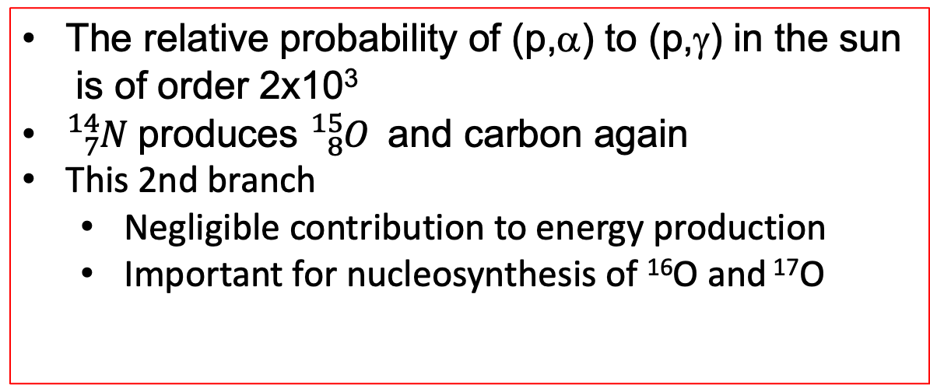
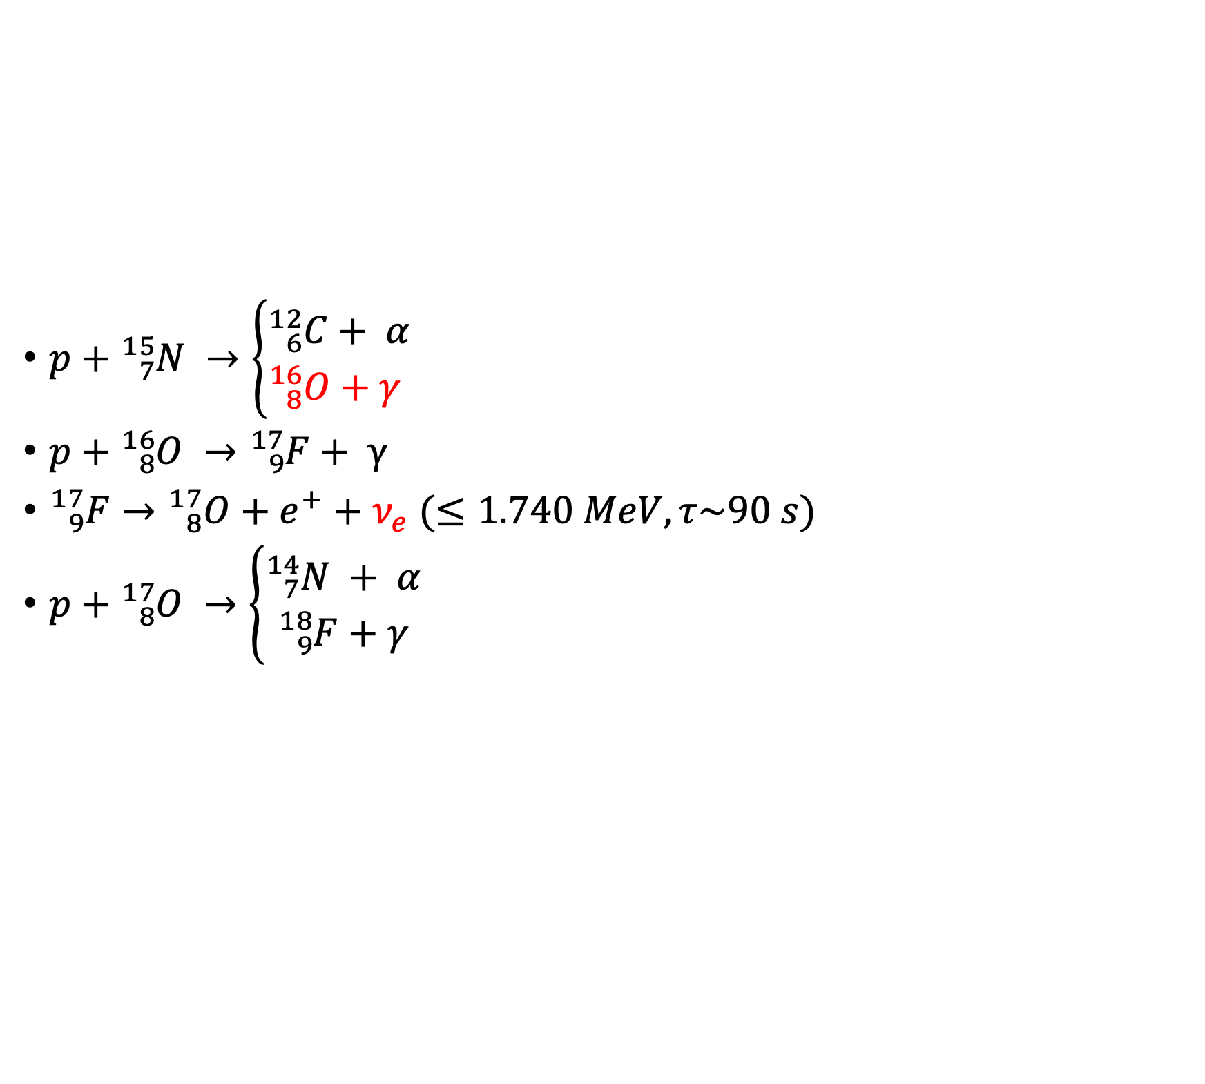
The CNO bi-cycle
$p+{}_{7}^{15}{N →\left\{\begin{aligned}{}_{6}^{12}{C+ α} \\ {}_{8}^{16}O+γ \end{aligned}\right. }$
$p+{}_{8}^{16}{O →{}_{9}^{17}F}+ γ$
${}_{9}^{17}F→{}_{8}^{17}{O+e^{+}+ν_{e}}$ $(≤1.740 MeV, τ\sim 90 s)$
$p+{}_{8}^{17}{O →\left\{\begin{aligned}{}_{7}^{14}{N + α} \\ {}_{9}^{18}{F+γ}\end{aligned}\right.}$
The relative probability of (p,α) to (p,γ) in the sun
is of order 2x10³
${}_{7}^{14}N$produces ${}_{8}^{15}{O }$and carbon again
This 2nd branch
  Negligible contribution to energy production
  Important for nucleosynthesis of ¹⁶O and ¹⁷O

Slide 12
All together:
CNO bi-cycle H burning in the Sun
¹³C
(p,γ)
¹⁴N
(p,α)
¹⁷O
e⁺+ν_{e}
(p,γ)
e⁺+ν_{e}
¹³N
¹⁵O
¹⁷F
CN
NO
e⁺+ν_{e}
(p,γ)
(p,γ)
(p,α)
¹⁵N
(p,γ)
¹⁶O
¹²C
10⁻²

Slide 13
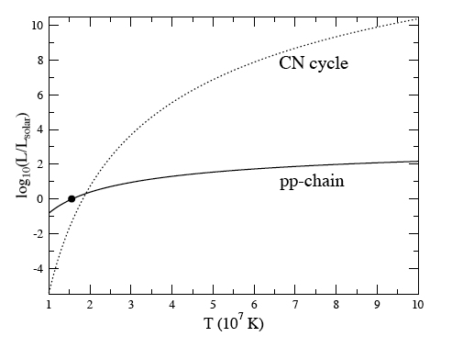
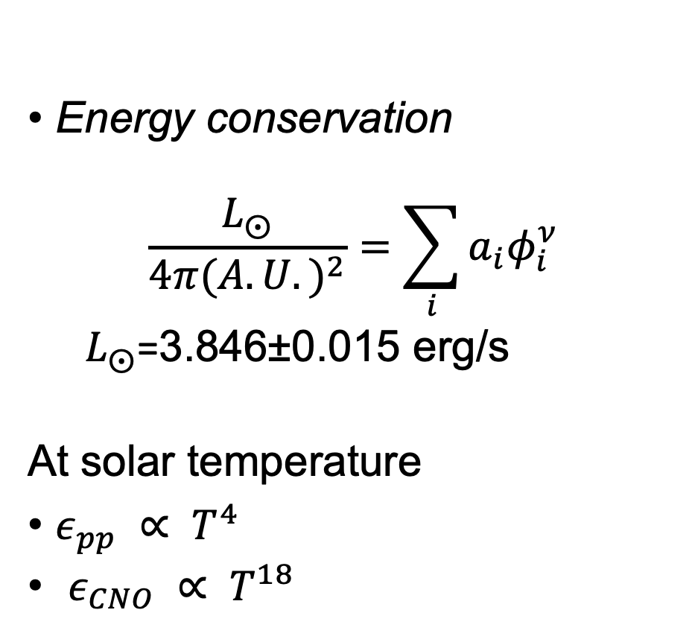
Solar neutrinos and energy production
Energy conservation
$$\frac{L_{⨀}}{4π{(A.U.)}^{2}}=\sum_{i}{a_{i}φ_{i}^{ν}}$$
${ L}_{⨀}$=3.846±0.015 erg/s
At solar temperature
$ε_{pp} ∝ T^{4}$
$ε_{CNO} ∝ T^{18}$
Sun

Slide 14
Fundamental conjecture
Properties and evolutions of stars are fully determined by the initial mass
and chemical composition
Application of this conjecture allows to determine stars observable parameters:
surface temperature
radius
luminosity
surface metal abundace
neutrino flux

Slide 15
The Solar Standard Model (SSM)
Theoretical framework to explain the sun
Assumptions of the SSM
  Hydrostatic equilibrium
  Energy generation by H burning
  Homogeneous zero-age Sun: primordial core metal abundance equal to today’s surface metal abundance
Boundary conditions: present luminosity, radius, (Z/X)_{surf}
Fixed parameters: age, mass
    evolution should match age and mass

Slide 16
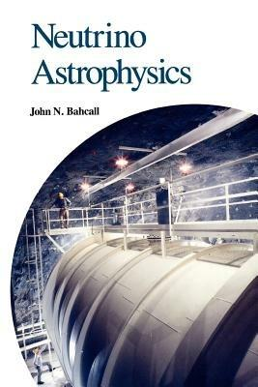
The first systematic work to put together a SSM facing
solar neutrino observations was carried out by John Bahcall
John Bahcall supported experimental projects and provided
a theory framework to compare with data
Evolution of the SSM neutrino flux predictions (better opacity, cross sections, diffusion model, metalicity) over 30 years

Slide 17
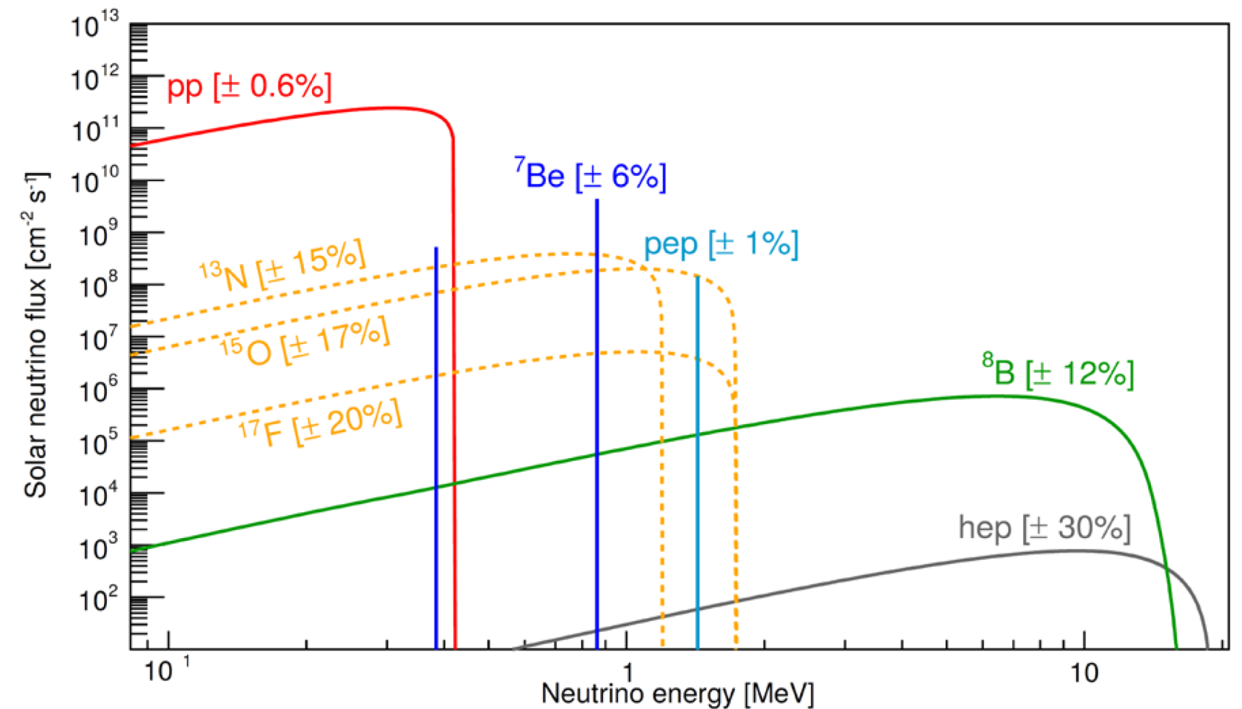
Outcome of the SSM:Solar neutrino spectra
A. Serenelli et al, Astrophys.J. 835 (2017) no.2, 202

Slide 18
Solar neutrinos from SSM 2016
ν source | SSM-HZ SSM-LZ [cm⁻² s⁻¹]
pp | 5.98(1±0.006)x10¹⁰ 6.03(1±0.006)x10¹⁰
pep | 1.44(1±0.01)x10⁸ 1.46(1±0.01)x10⁸
⁷Be | 4.93(1±0.06)x10⁹ 4.50(1±0.06)x10⁹
⁸B | 5.46(1±0.12)x10⁶ 4.50(1±0.12)x10⁶
hep | 7.98(1±0.30)x10³ 8.25(1±0.30)x10³
CNO | 4.88(1±0.16)x10⁸ 3.51(1±0.14)x10⁸

Slide 19
detection techniques for solar neutrinos

Slide 20
Experimental Search of Solar Neutrinos
1946, B. Pontecorvo proposes a method to measure neutrinos by ³⁷Cl(ν,e)³⁷Ar
1949, L. Alvarez proposes to make use of Pontecorvo’s method to
search for neutrinos from a reactor source
1963, J. Bahcall determines the solar neutrino fluxes
1964, J. Bahcall and R. Davis propose the Homestake experiment
1968, the first data on solar neutrinos from Homestake
1984, Herb Chen proposes the use of heavy water to detect solar neutrinos
1991, SAGE, GALLEX in operation with ⁷¹Ga(ν,e)⁷¹Ge (pp neutrinos)
1996, SuperKamiokande starts data taking and discovers neutrino oscillations in 1998
1998, SNO construction completed
2002, SNO discovers flavor change in solar neutrino propagation
2007, Borexino starts data taking
2020, Borexino measures CNO neutrinos

Slide 21
Detecting Solar Neutrinos
Neutrino capture: ν_{e}+(A,Z-1)→(A,Z)+e⁻ (σ~10⁻⁴²cm²)
  charged-current interaction
  can be associated with a correlated delayed event from the produced (A,Z) nucleus
Elastic Scattering: ν_{x} + e⁻ → ν_{x} + e⁻ (σ~10⁻⁴⁴cm²)
  Mixed charged and neutral current interaction
  Specific signature for monenergetic neutrinos
ν_{e} + d → e⁻ + p + p (E_{ν} ≥ 1.44 MeV) (σ~10⁻⁴²cm²)
ν_{x} + d → ν_{x} + p + n (E_{ν} ≥ 2.74 MeV)
  Associated with neutron capture
  n+p →d+ γ(2.22 MeV)
  n+d→³H+γ(6.25 MeV)
  n+³⁵Cl→³⁶Cl+∑γ(8.6 MeV)

Slide 22
Solar Neutrino Experiments: past and present
Detector | Target mass | Threshold [MeV] | Data taking | Main neutrino source
Homestake | 615 tons C₂Cl₄ | 0.814 | 1967-1994 | ⁷Be, ⁸B
Kamiokande II/III | 3kton H₂O | 9/7.5 / 7.0 | 1986-1995 | ⁸B
SAGE | 50tons molted metal Ga | 0.233 | 1990-2007 | pp
GALLEX | 30.3tons GaCl₃-HCl | 0.233 | 1991-1997 | pp
GNO | 30.3tons GaCl₃-HCl | 0.233 | 1998-2003 | pp
Super-Kamiokande | 22.5ktons | 5 7 4.5 3.5 3.5 Gd loading 0.01% Gd loading 0.03% | 1996-2001 2003-2005 2006-2008 2008-2018 2019-2020 2020-2022 2022-present | ⁸B
SNO | 1kton D₂O | 6.75/5/6/3.5 | 1999-2006 | ⁸B
Borexino | 300ton C₉H₁₂ | 0.2 MeV | 2007-2019 | ⁷Be, pep, pp, CNO

Slide 23
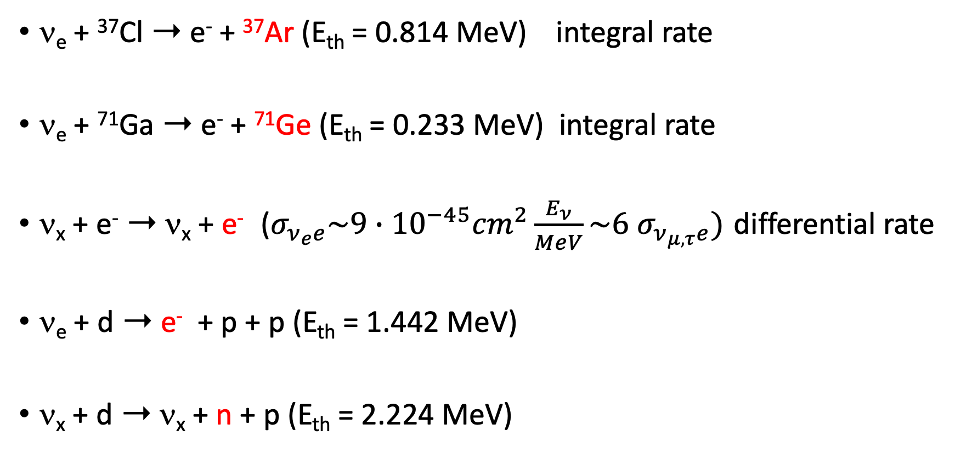
Closer look at the detection channels
ν_{e} + ³⁷Cl ➝ e⁻ + ³⁷Ar (E_{th} = 0.814 MeV) integral rate
ν_{e} + ⁷¹Ga ➝ e⁻ + ⁷¹Ge (E_{th} = 0.233 MeV) integral rate
ν_{x} + e⁻ ➝ ν_{x} + e⁻ ($σ_{ν_{e}e}\sim 9∙{10}^{−45}{cm}^{2}\frac{E_{ν}}{MeV}\sim 6$ $σ_{ν_{μ,τ}e})$ differential rate
ν_{e} + d ➝ e⁻ + p + p (E_{th} = 1.442 MeV)
ν_{x} + d ➝ ν_{x} + n + p (E_{th} = 2.224 MeV)
Heavy water, differential rate

Slide 24
A matter of background
Since Alvarez’s work in 1949 it was understood that detection of neutrinos deals with a deep knowledge and reduction of the background sources
How do we classify these sources ?

Slide 25
Classification of radio-isotopes
Primordial: longlived, ²³⁸U, ⁸⁷Rb, ⁴⁰K, ²³²Th…
Cosmogenic: produced by cosmic rays (primary and secondary) interactions, ¹⁴C, ³H, ⁷Be, ¹¹C, ³⁹Ar, …
Anthropogenic: produced by nuclear tests, ⁸⁵Kr, ⁹⁰Sr, ¹³¹I, ¹³⁷Cs…

Slide 26
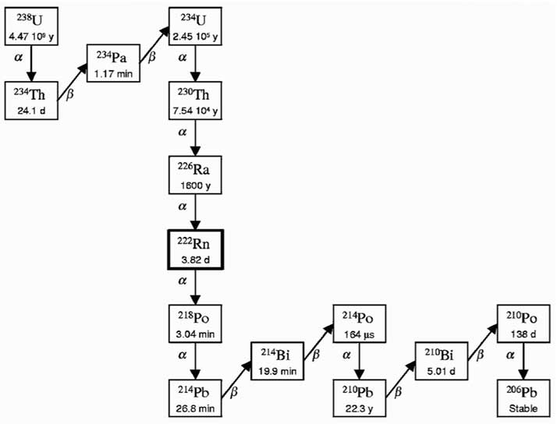
²³⁸U radioactive chain
²³⁸U is one of the longlived radioactive elements on Earth
T_{1/2} = 4.47x10⁹ anni
²³⁸U → ²⁰⁶Pb+8α+6β+51.7MeV
²²²Rn (noble gas) → ²¹⁴Bi (3.2MeV β with many γ-rays)

Slide 27
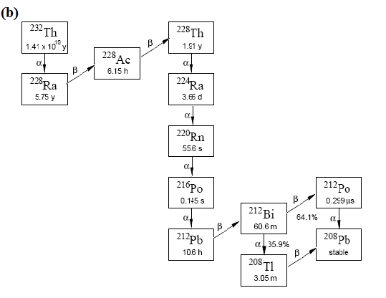
²³²Th radioactive chain
²³²Th is another of the long-lived radioactive elements on Earth
T_{1/2} = 14x10⁹ years
²³²Th--> ²⁰⁸Pb+6α+4β+42.8MeV
²³²Th -> ²⁰⁸Tl (2.6 MeV γ-ray largest in natural radioactivity, + 5 MeV β)

Slide 28
results

Slide 29

Homestake experiment
$ν_{e}+{}_{17}^{37}{Cl→e^{−}+{}_{18}^{37}{Ar, Q=0.814 MeV}}$
³⁷Ar decays back to ³⁷Cl with T_{1/2} = 35 days
615 tons of C₂Cl₄ (tetracloroethylene) in the Homestake mine (1500m depth) in South Dakota, USA
40 days exposure followed by ³⁷Ar extraction by means of He purging
$N\left({}_{17}^{37}{Cl}\right)\sum_{i}{\int_{0.814 MeV}^{15 MeV}{dE_{ν}φ_{i}\left(E_{ν}\right)σ\left(E_{ν}\right)=\frac{λN\left({}_{18}^{37}{Ar,t_{run}}\right)}{ε_{e}ε_{c}\left(1−e^{−λt_{run}}\right)}}} −b$
  ε_{e} = extraction efficiency
  ε_{c} = counting efficiency
  b = Ar background rate
Within the exposure time 41 atoms are expected in 2x10³⁰
  this corresponds to 8 SNU (1 SNU = 10⁻³⁶ captures/target nucleus/sec)

Slide 30
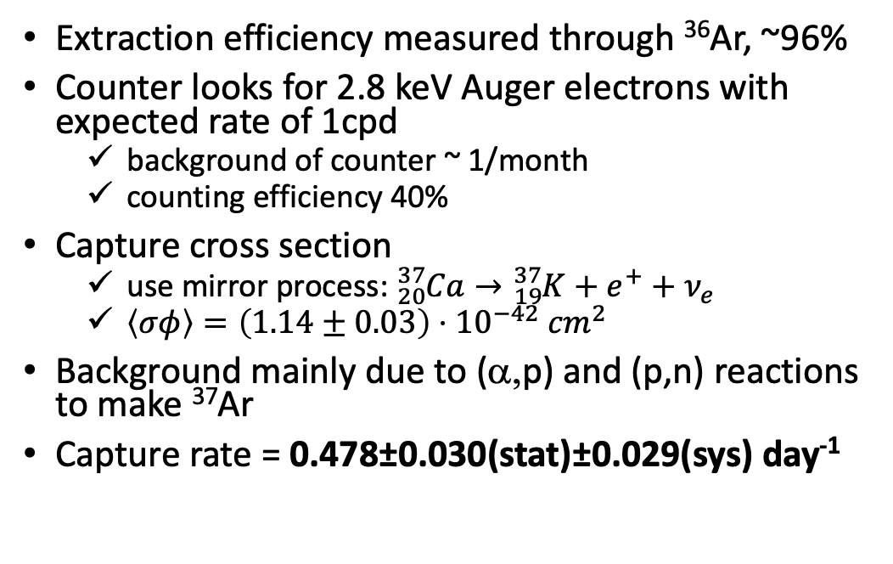
Signal vs background in the
Homestake experiment
Extraction efficiency measured through ³⁶Ar, ~96%
Counter looks for 2.8 keV Auger electrons with expected rate of 1cpd
  background of counter ~ 1/month
  counting efficiency 40%
Capture cross section
  use mirror process: ${}_{20}^{37}{Ca→{}_{19}^{37}{K+e^{+}+ν_{e}}}$
  $\left\langle σφ\right\rangle =\left(1.14±0.03\right)⋅{10}^{−42} {cm}^{2}$
Background mainly due to (α,p) and (p,n) reactions to make ³⁷Ar
Capture rate = 0.478±0.030(stat)±0.029(sys) day⁻¹
Measured/Expected = 0.32 ± 0.05
The Solar Neutrino Problem was born

Slide 31
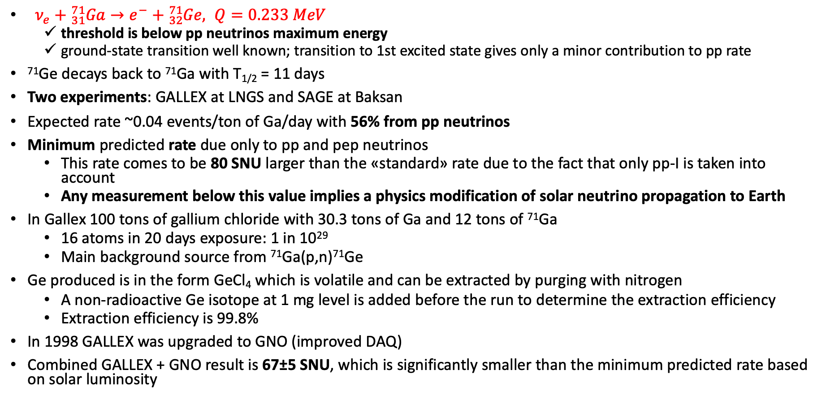
Gallium experiments
$ν_{e}+{}_{31}^{71}{Ga→e^{−}+{}_{32}^{71}{Ge, Q=0.233 MeV}}$
  threshold is below pp neutrinos maximum energy
  ground-state transition well known; transition to 1st excited state gives only a minor contribution to pp rate
⁷¹Ge decays back to ⁷¹Ga with T_{1/2} = 11 days
Two experiments: GALLEX at LNGS and SAGE at Baksan
Expected rate ~0.04 events/ton of Ga/day with 56% from pp neutrinos
Minimum predicted rate due only to pp and pep neutrinos
  This rate comes to be 80 SNU larger than the «standard» rate due to the fact that only pp-I is taken into account
  Any measurement below this value implies a physics modification of solar neutrino propagation to Earth
In Gallex 100 tons of gallium chloride with 30.3 tons of Ga and 12 tons of ⁷¹Ga
  16 atoms in 20 days exposure: 1 in 10²⁹
  Main background source from ⁷¹Ga(p,n)⁷¹Ge
Ge produced is in the form GeCl₄ which is volatile and can be extracted by purging with nitrogen
  A non-radioactive Ge isotope at 1 mg level is added before the run to determine the extraction efficiency
  Extraction efficiency is 99.8%
In 1998 GALLEX was upgraded to GNO (improved DAQ)
Combined GALLEX + GNO result is 67±5 SNU, which is significantly smaller than the minimum predicted rate based on solar luminosity

Slide 32
The Solar Neutrino Problem must have a physics solution dealing with neutrinos (~1995) neutrino propagation? neutrino interactions? neutrino magnetic moment?
In 1998 LUNA at LNGS measures ³He(³He,2p)⁴He below Gamow peak at 22 keV

Slide 33

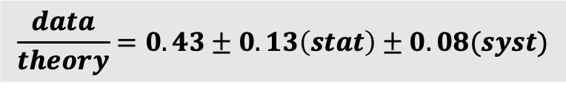
Kamiokande-II experiment
Exploit neutrino-electron ES in a water Charenkov detector underground
$R=A\int_{T_{th}}^{T_{max}\left(E_{ν}\right)}{dT η\left(T\right)\int_{E_{min}\left(T\right)}^{E_{ν}^{max}}{dE_{ν}}} φ\left(E_{ν}\right)\frac{dσ}{dT}\left(E_{ν},T\right)$
High radio-pure water required ~ 10⁻¹⁴ g/g
Main backgrounds from ²²²Rn and ²⁰⁸Tl and from muon spallation on ¹⁶° producing β decays from ⁸B, ⁸Li, ¹⁶N, ¹²B
  Threshold > 7 MeV due to Radon background
$$\frac{data}{theory}=0.43±0.13\left(stat\right)±0.08(syst)$$

Slide 34
The Super-Kamiokande experiment
World leading water Cherenkov detector
50 kton of water in total and 32 kton in inner detector
22.5kton Fiducial Volume
11,146 50cm PMTs with 40% coverage
Outer detector with 3m water and 1885 20cm PMTs
Energy scale, angular distribution, and vertex position calibrate by a LINAC, injecting e⁻ from 5 to 16 MeV
¹⁶O(n,p)¹⁶N and ¹⁶N decay (Q_{β}=10.4 MeV) used for energy calibration
Initial threshold at 5 MeV was reduced to 4 MeV by removing convection currents in inner detector, reducing Radon propagation
In 2020 detector loaded with Gd₂(SO₃)₃ at 0.01% wt
Improved water
radio-purity and
circulation
3.5-4 MeV

Slide 35
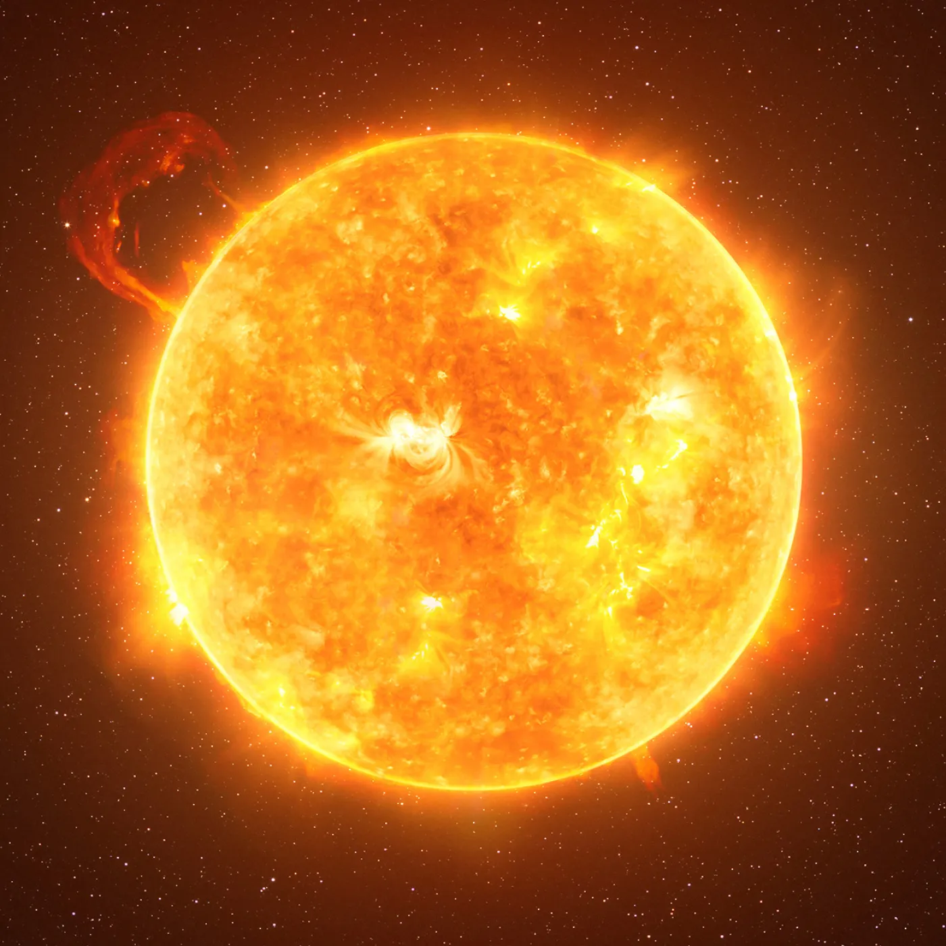
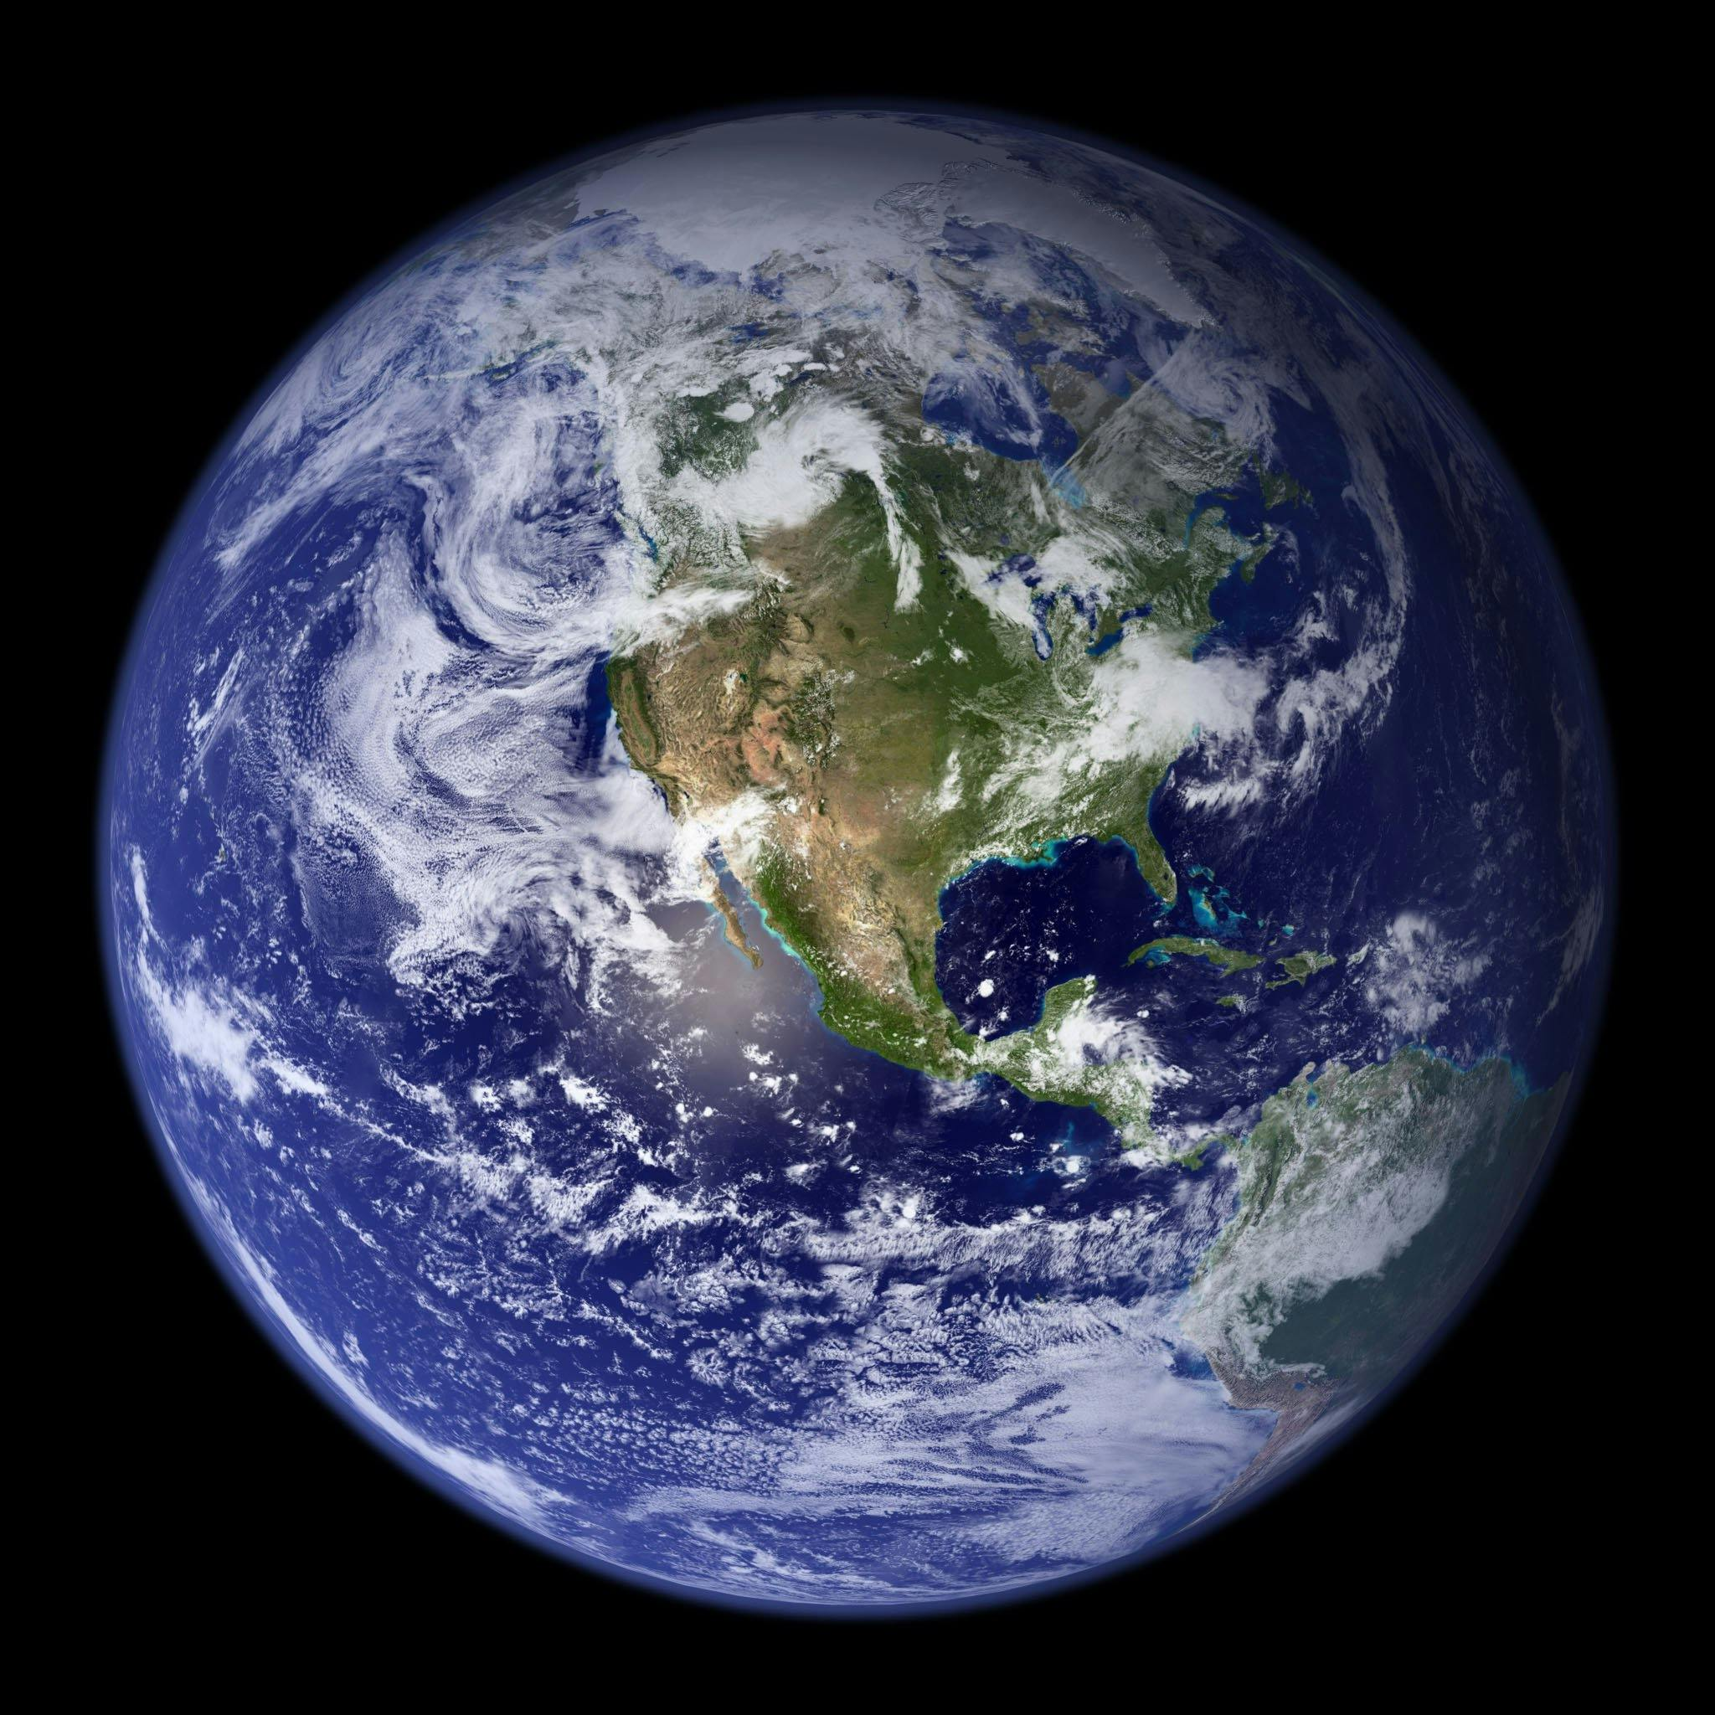
Neutrino oscillations
The Solar Neutrino Problem can be explained in the framework of neutrino oscillations
  Neutrinos have a non-zero mass
  Neutrino flavor can change from the source to the detector
Observables
  Disappearance or appearance effects
  Vacuum and matter effects
  Day-Night asymmetry, A_{DN} = 2(D-N)/(D+N)
Day
time
Night
time
ν_{e} → ν_{μ}
ν_{μ} → ν_{e}

Slide 36
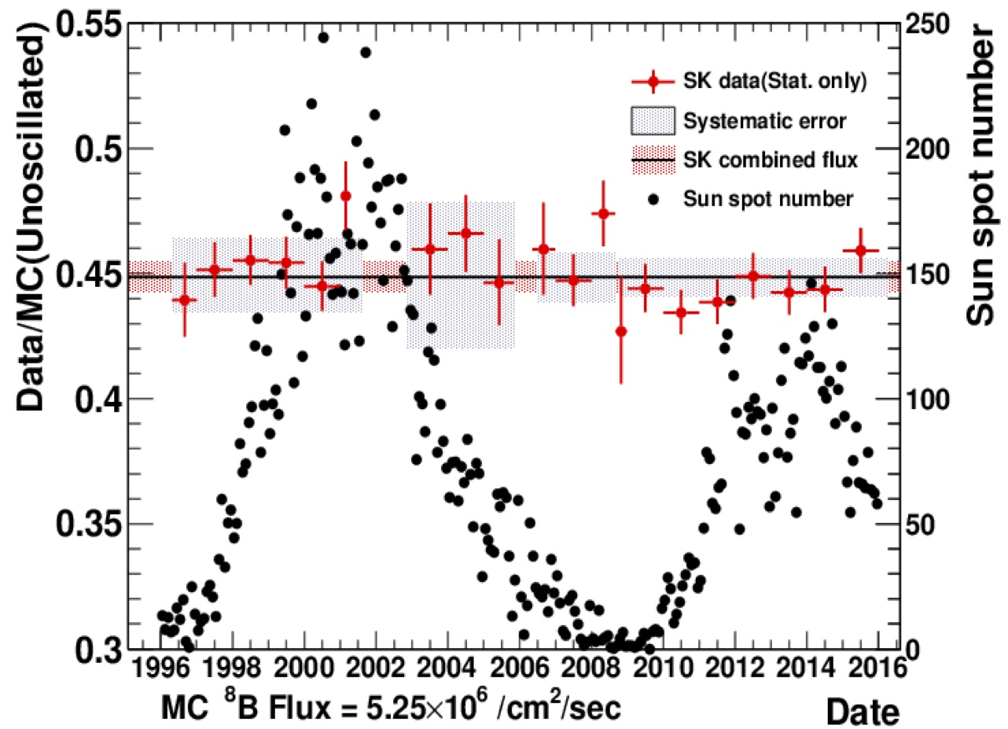
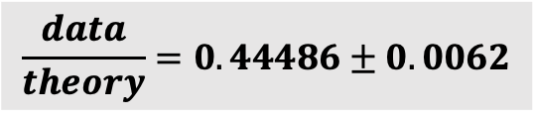
Expected events in Super-Kamiokande
$$\frac{data}{theory}=0.44486±0.0062$$
Most precise ⁸B flux measurement, 1.4%
Day-Night asymmetry = -3.3±1.0±0.5 %

Slide 37
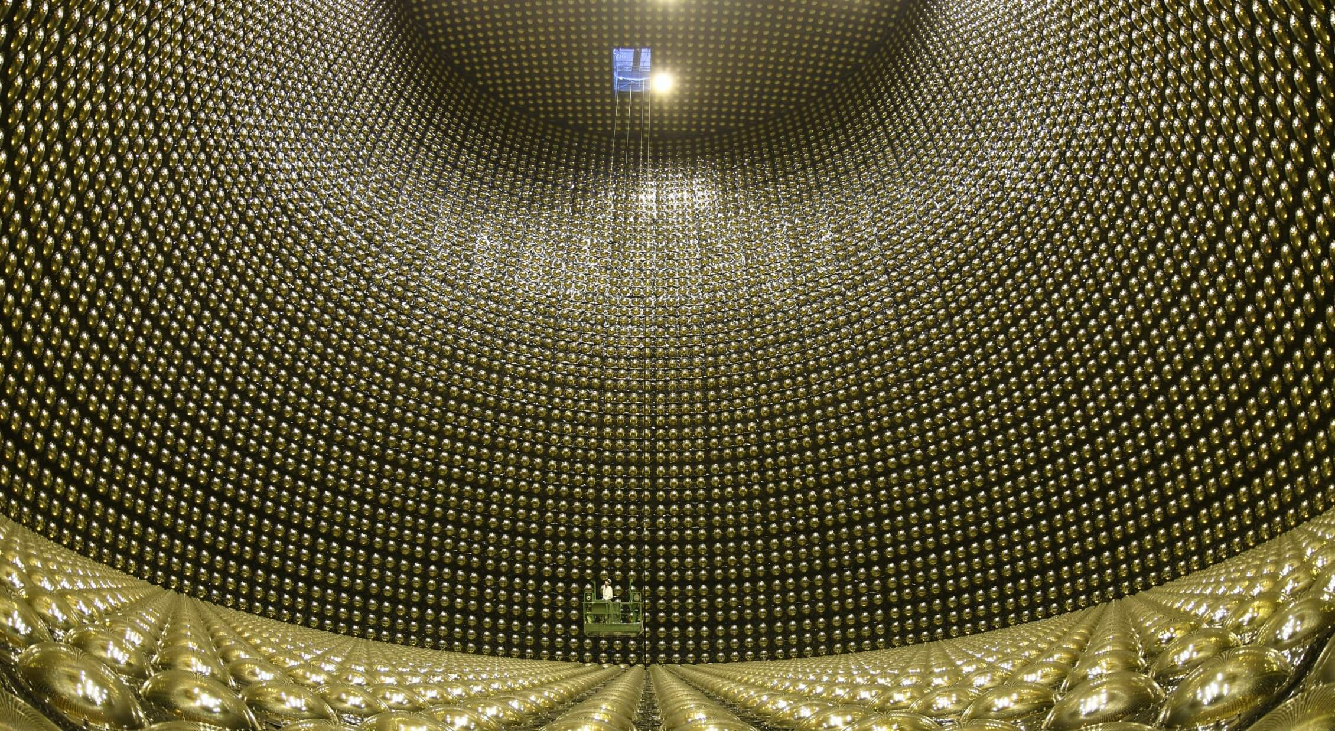

Slide 38

Sun through the neutrinos light from Super-Kamiokande

Slide 39
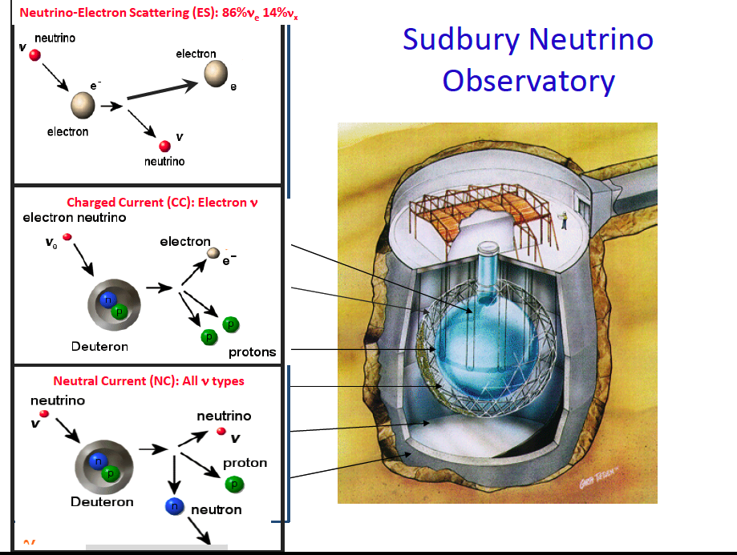
Build at 6000 m.w.e.
1kton D₂O in 12m acrylic
vessel
9456 20cm PMTs
55% coverage
7kton H₂O shielding with
91 PMTs
3 phases
  Pure D₂O
  Salt
  40 vertical Neutral
  Current Detectors

Slide 40
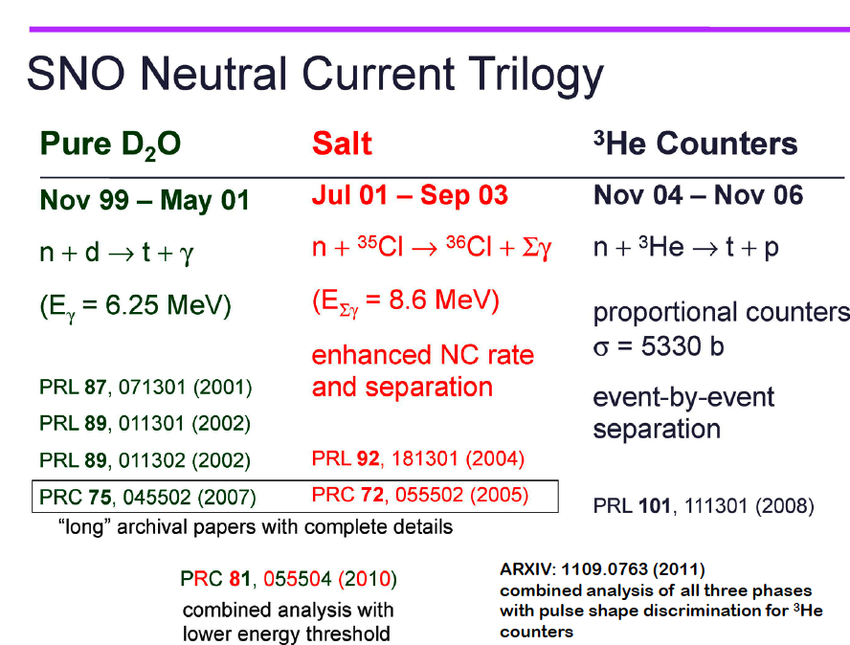

Slide 41

A few considerations on SNO (2002)
Probe at the same time CC, ES, and NC
$φ_{ν_{e}}^{CC} ≤$ $φ_{ν_{e}}^{ES}$
$φ_{ν_{x}}^{NC}$ $≤$ $φ_{ν_{e}}^{SSM}$
SNO CC
In 2001 combining SK and SNO data it was
possible to establish a flavor change in solar
neutrino propagation
SNO NC
SK ES

Slide 42
Solar Neutrino Problem (SNP)

Slide 43
How to detect sub-MeV solar neutrinos in real time
Make use of an organic liquid scintillator
Material reach in hydrogen and electrons
  Good for neutrino-electron ES and inverse-beta decay
Scintillator = solvent(bulk) + solute
  Solvent needs to be transparent (low light quenching), high radio-purity
Light yield ~ 10⁴ photons/MeV
  N_{p.e.}~10⁴ e^{-6/10} 0.25 0.9 0.3 = 370 p.e./MeV
  Energy resolution ~ 0.05/√T_{e}

Slide 44
What level of radio-purity ?
Goal: observe ⁷Be solar neutrinos
σ ~ 5x10⁻⁴⁵ cm² and φ ∼ 5x10⁹ cm⁻²s⁻¹
Use 100 tons of C₉H₁₂ with 4.2x10³¹ electrons
Expected events ~ 70 cpd
With 100% PSD and 10⁻¹⁶ g/g of ²³⁸U and ²³²Th: ~76 cpd
S/B ~ 1 requires extreme radio-purity

Slide 45
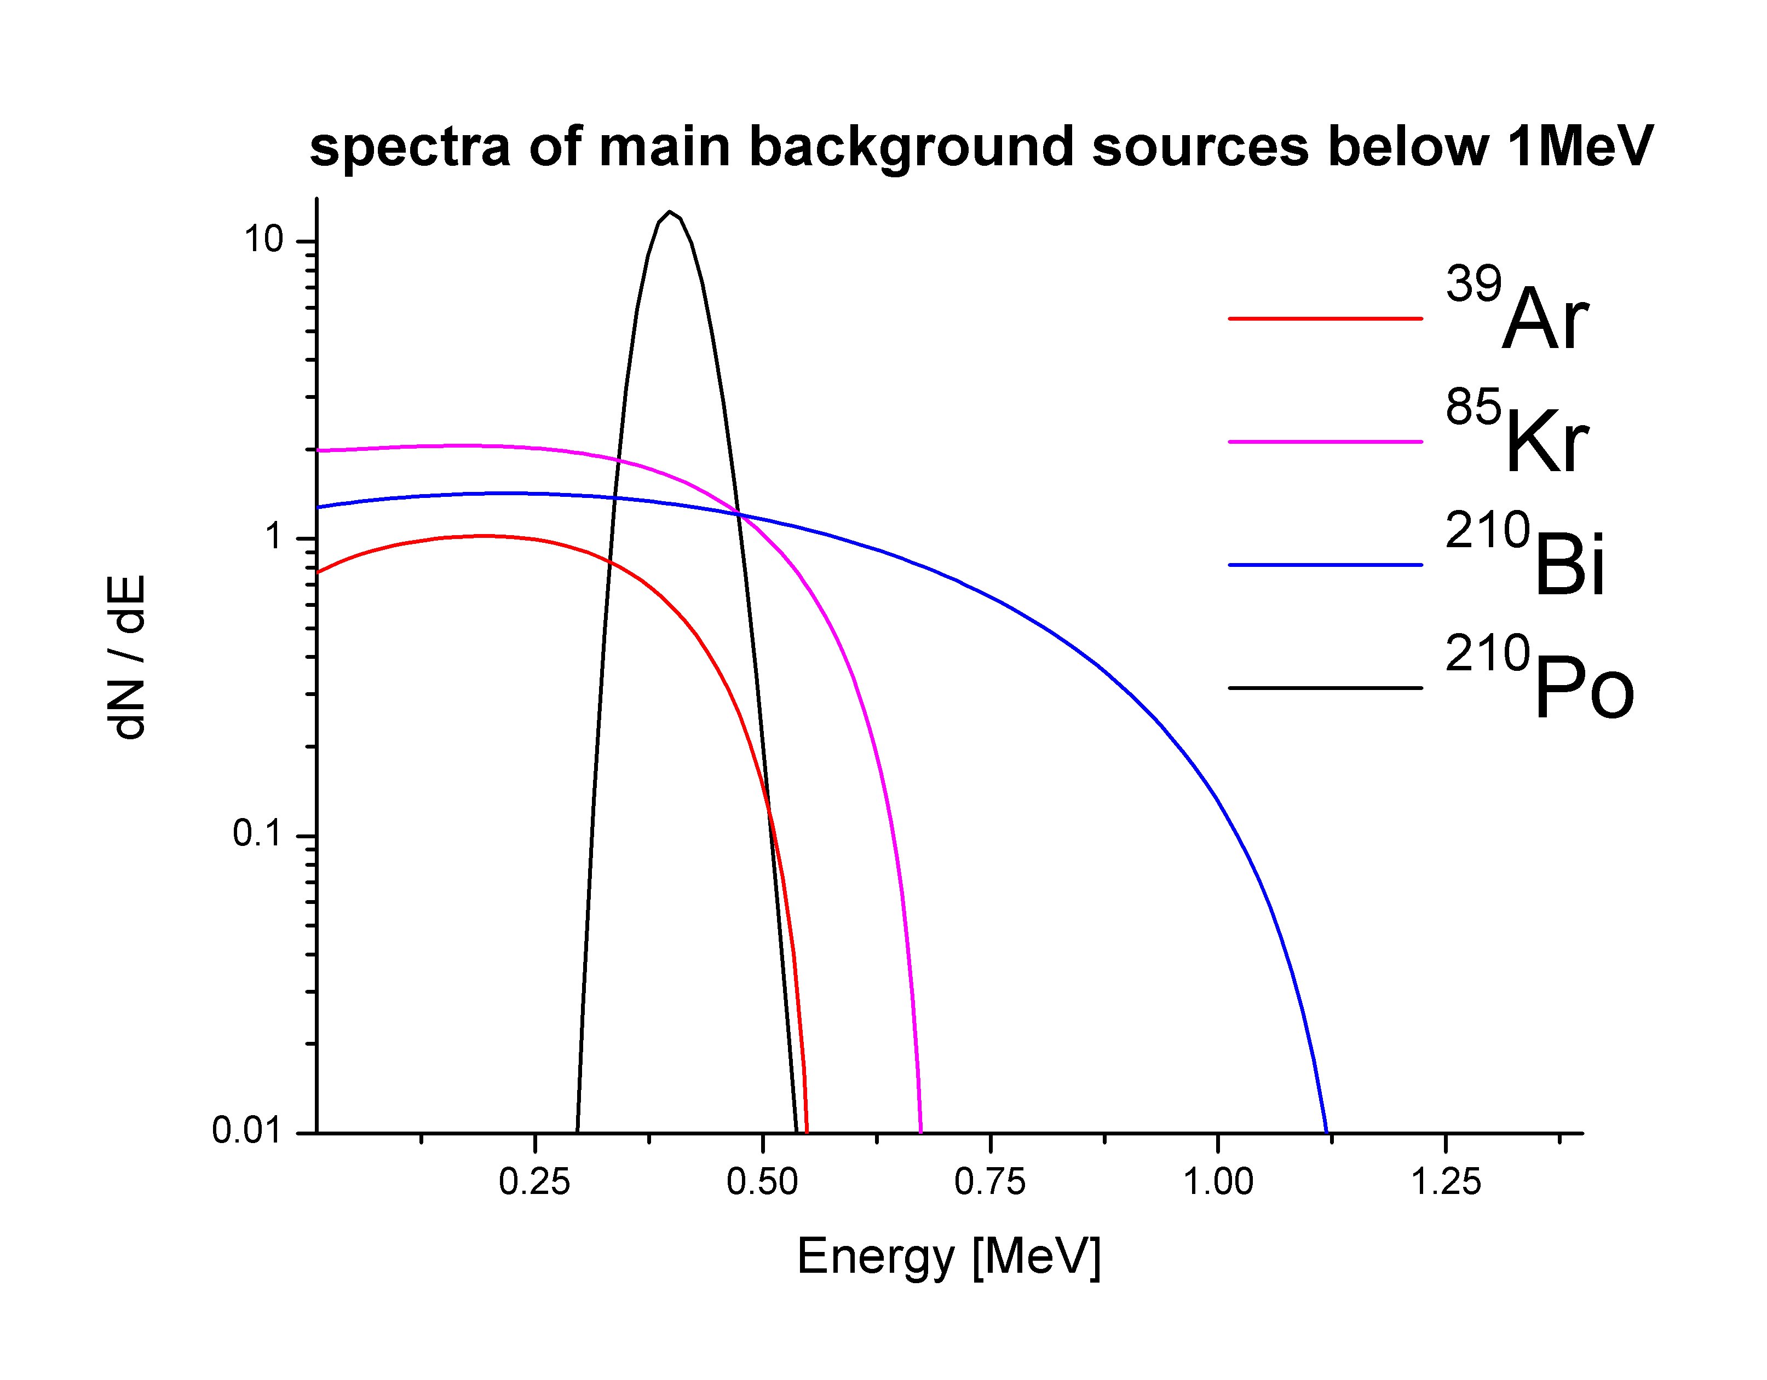
Beyond U and Th: ³⁹Ar, ⁸⁵Kr, ²¹⁰Pb
Asking for 1cpd/100tons
[0.1 μBq/m³ in LS] it implies:
System sealed against ²²²Rn ~10⁻⁴ Bq/ton
0.4 ppm ³⁹Ar in N₂
0.2 ppt ⁸⁵Kr in N₂
²¹⁰Pb and ²¹⁰Po are
often found not in equlibrium
due to a different chemistry
All spectra normalized to 1

Slide 46
Borexino strategy
Advance cleaning of as-built systems
Purification of the liquid scintillator
Use of a prototype (the CTF detector) to assess the performance of the proposed strategy:
  test cleanlinesss
  test purification and filling strategy

Slide 47
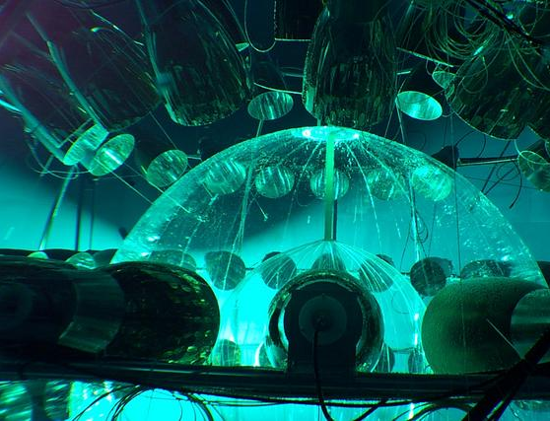
The idea of Borexino
In late 1980s it was proposed the idea that an organic liquid scintillator could have been purified to levels below 10⁻¹⁵ g/g
This idea was put forward in an experimental effort running a 4 ton liquid scintillator detector at the Gran Sasso Laboratory: The Counting Test Facility (CTF)
The success of the CTF paved the way to build Borexino
The CTF showed that 10⁻¹⁶ g/g radio-purity was feasible and that the ¹⁴C contaminations was low enough to set a threshold at 200 keV

Slide 48
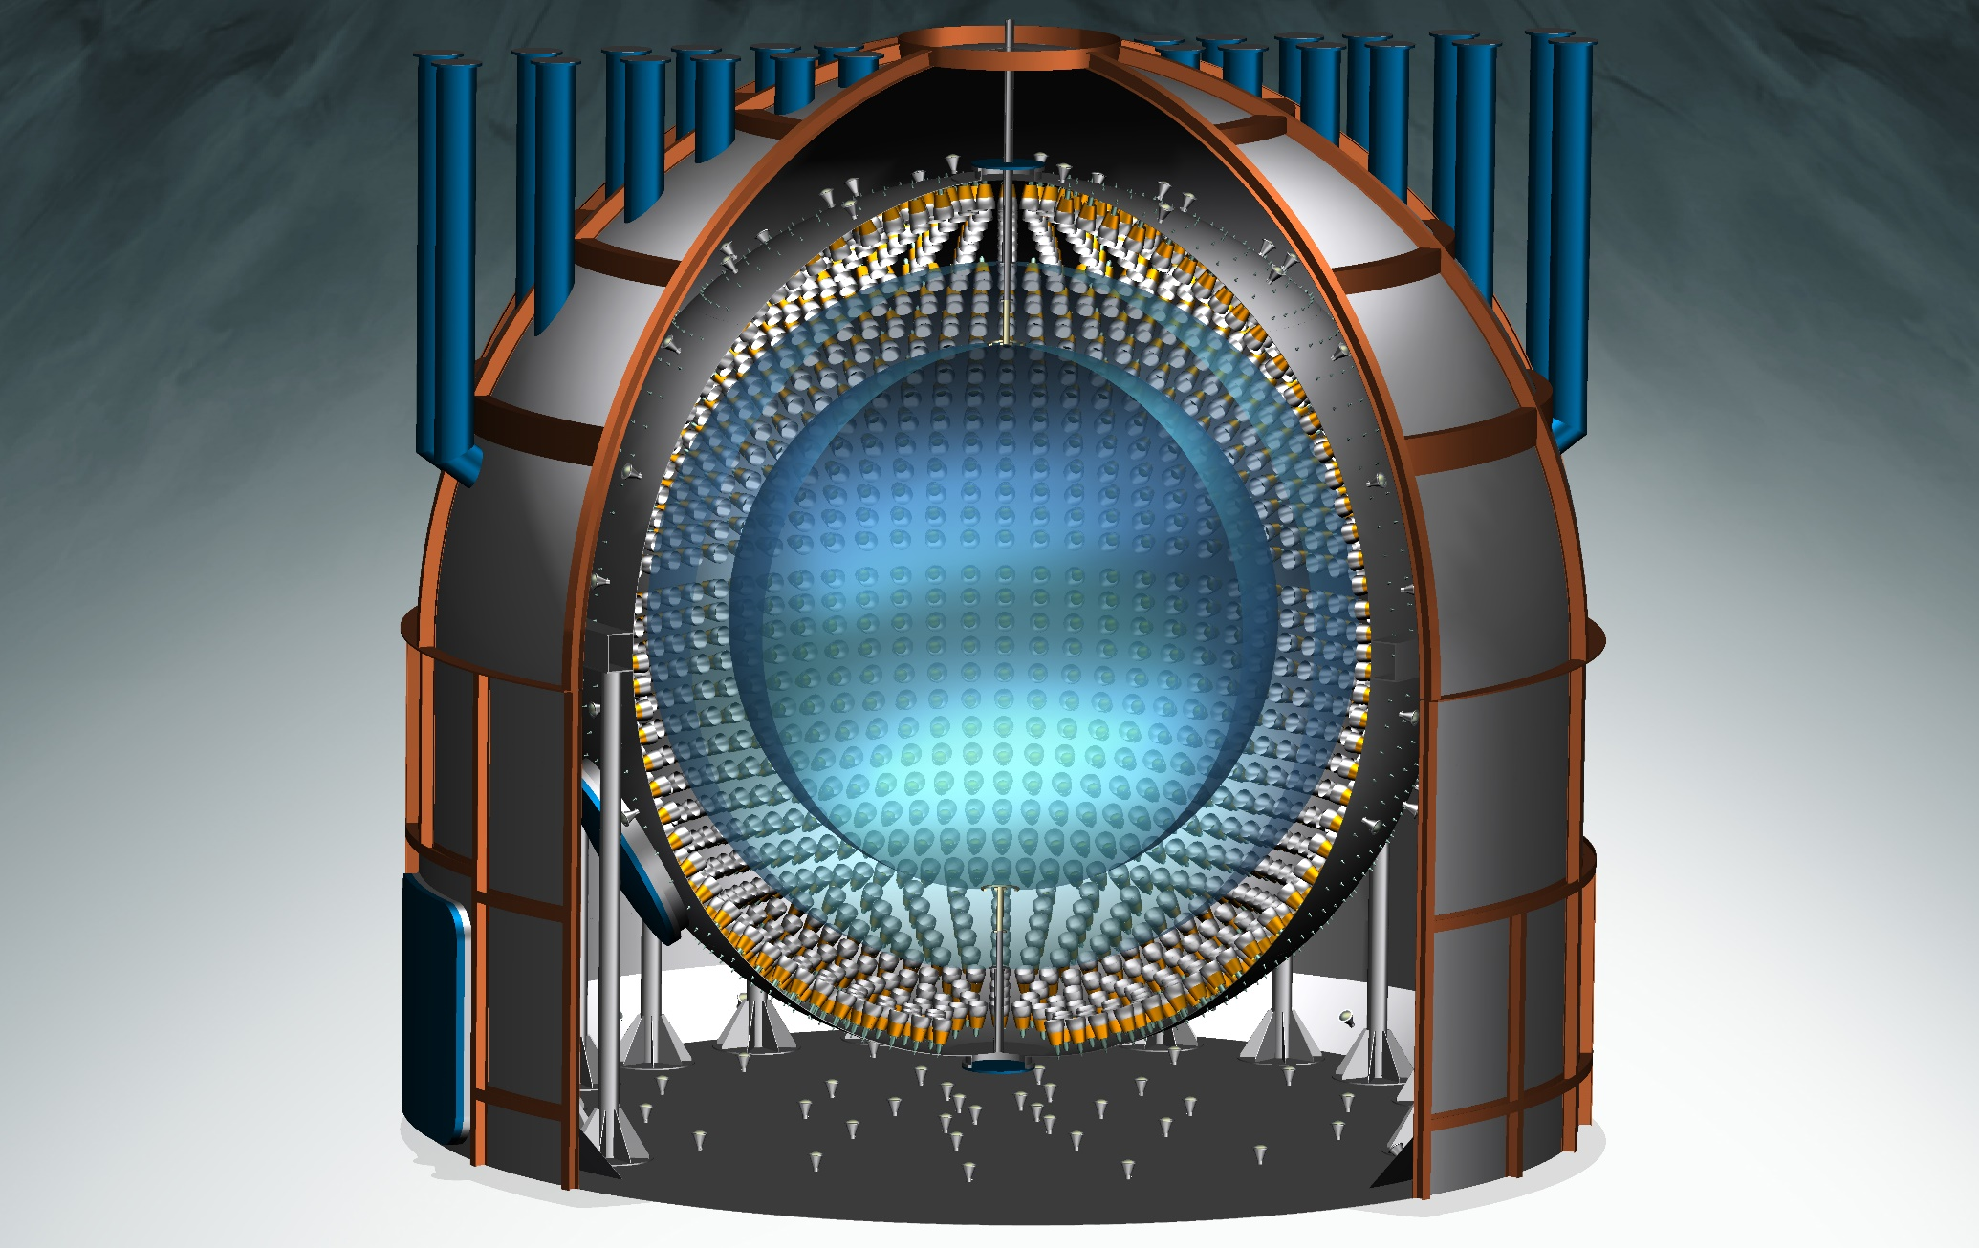
Borexino experiment overview

Slide 49
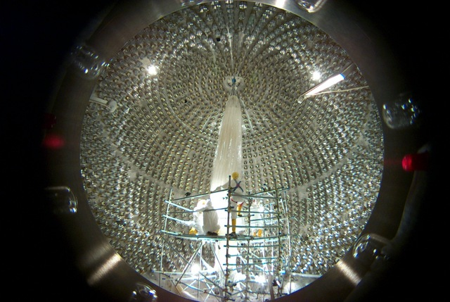
Borexino: nylon vessel installation

Slide 50
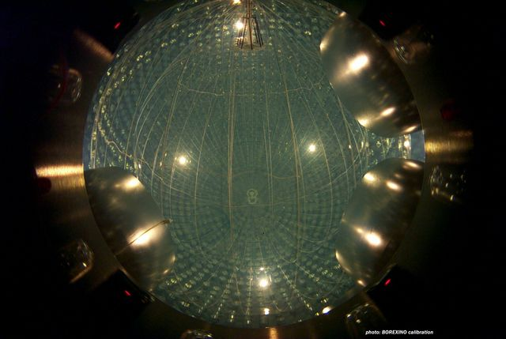
Borexino: liquid scintillator filling

Slide 51
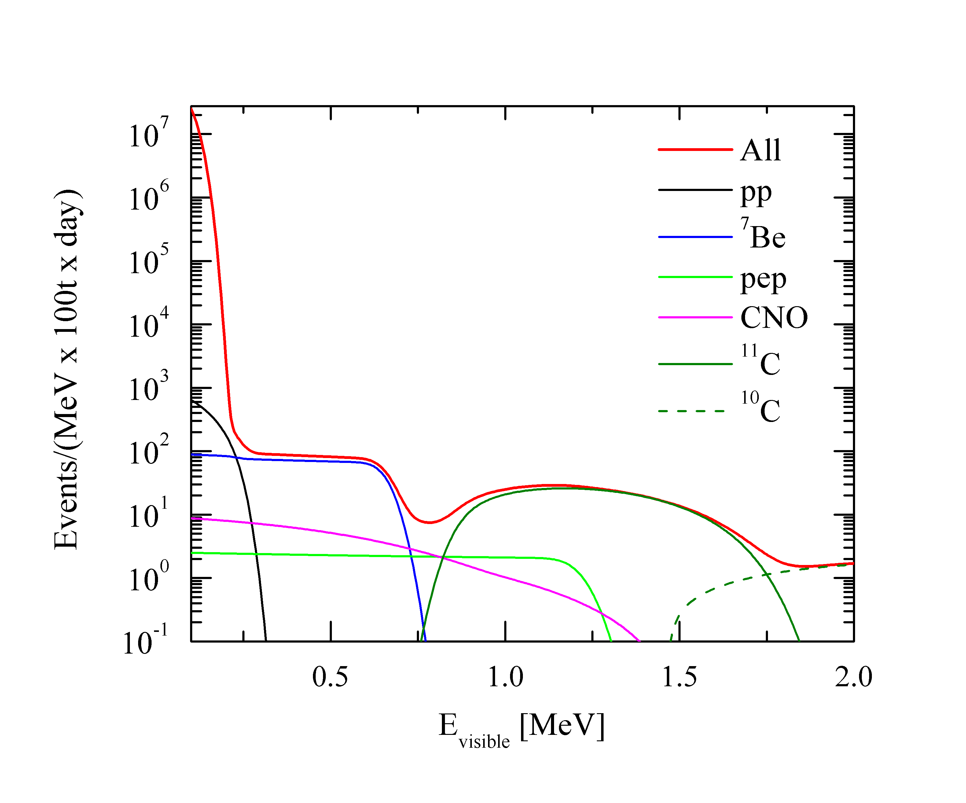
Borexino Expected Solar ν Spectrum
Spectrum with irreducible backgrounds
¹⁴C

Slide 52
Borexino radio-purity
Isotope | Spec. in LS | After filling | After purification
²³⁸U | ≤ 10⁻¹⁶ g/g | (5.3±0.3) 10⁻¹⁸ g/g | ≤ 9.4 10⁻²⁰ g/g
²³²Th | ≤ 10⁻¹⁶ g/g | (3.8±0.8) 10⁻¹⁸ g/g | < 5.7 10⁻¹⁹ g/g
¹⁴C/¹²C | ≤ 10⁻¹⁸ | (2.7±0.1) 10⁻¹⁸ g/g | no change
⁴⁰K | ≤ 10⁻¹⁸ g/g | ≤ 0.4 10⁻¹⁸ g/g
⁸⁵Kr | ≤ 1 cpd/100ton | 30± 5 cpd/100ton | ≤ 5 cpd/100ton
³⁹Ar | ≤ 1 cpd/100ton | << ⁸⁵Kr | << ⁸⁵Kr
²¹⁰Po | not specified | ~ 8000 cpd/100ton | no change
²¹⁰Bi | not specified | ~ 20-70 cpd/100ton | 20±5 cpd/100ton
A_{BX} ~ 40 cpd/100ton
in ⁷Be ROI
A_{BX} ~ 5x10⁻⁹ Bq/kg
???

Slide 53
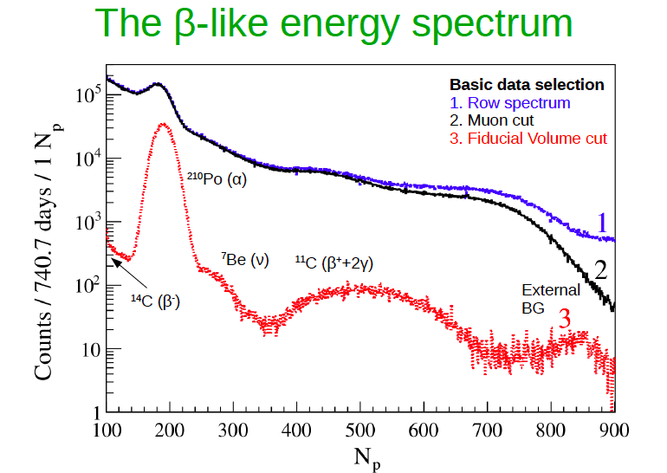
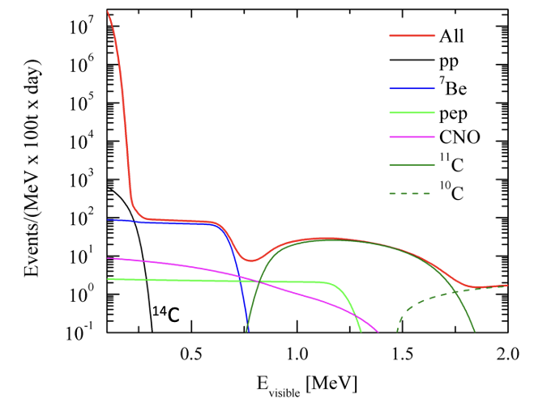
Ideal spectrum

Slide 54
How to deal with ¹¹C and ²¹⁰Po ?

Slide 55
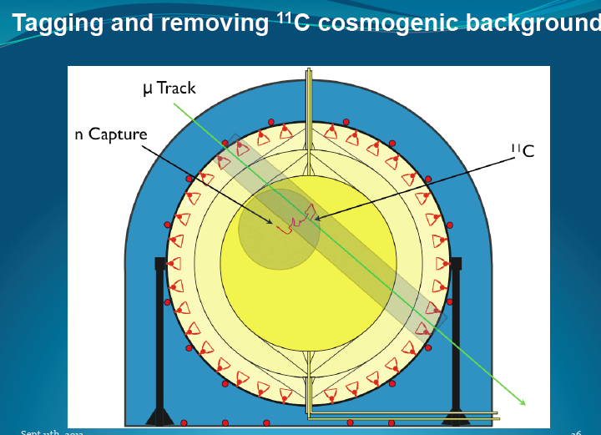

Slide 56
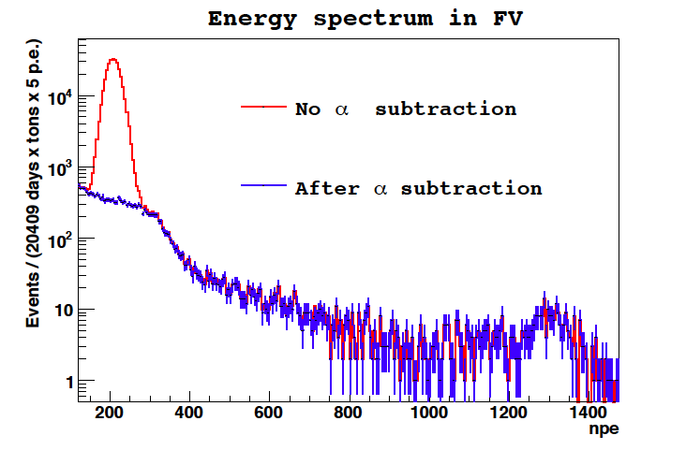
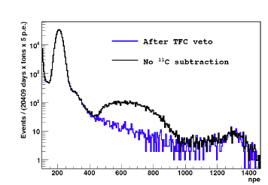
Remove ¹¹C

Slide 57
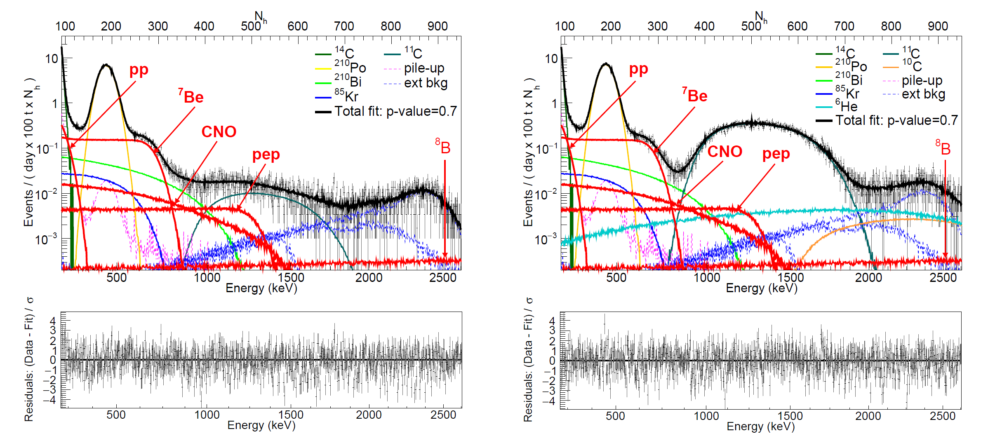
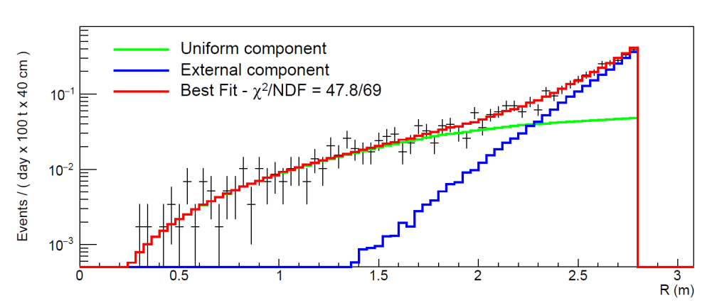
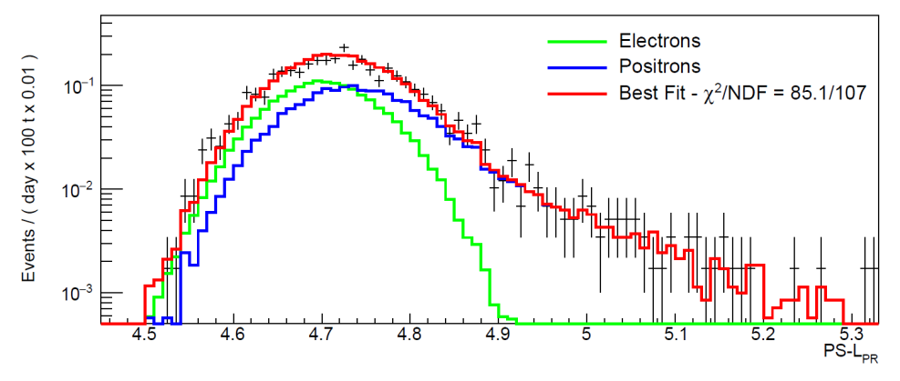
Multivariate fit example
L(¹¹C_{sub})
L(¹¹C_{tag})
L(Rad)
L(PS)

Slide 58

Solar Neutrinos Survival Probability
$$R\sim φ_{e} \left[\left\langle σ_{e}\right\rangle {\overline{P}}_{ee}+\left\langle σ_{x}\right\rangle (1−{\overline{P}}_{ee})\right]$$
With Borexino data probes vacuum-matter transition at 98% CL

Slide 59
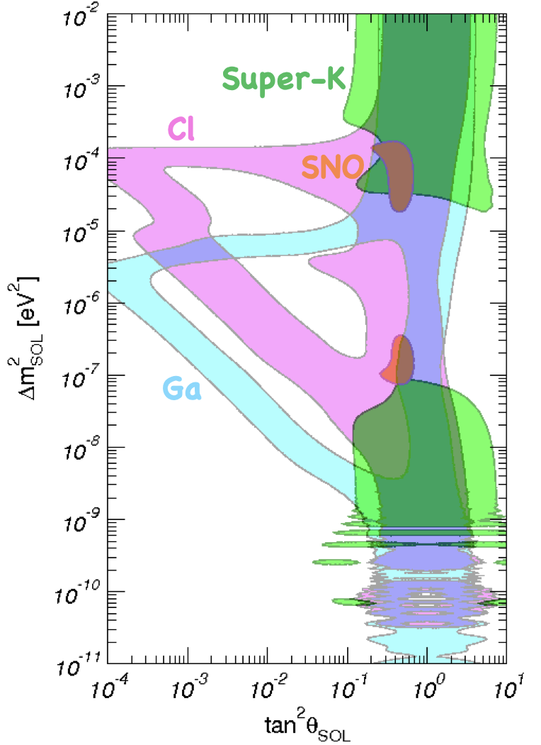
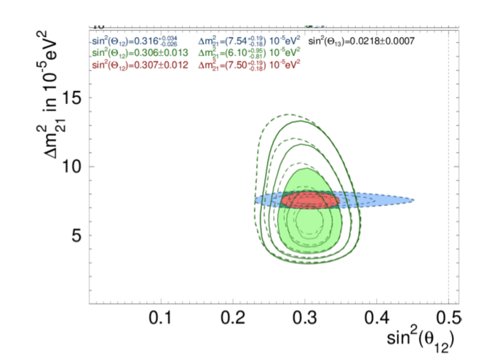
Solar neutrinos and neutrino oscillations
Solar neutrinos
KamLAND

Slide 60

The challeng to probe 1% of Sun’s energy production

Slide 61
Background in Borexino from nylon vessel
Nylon vessel has ppt level of U, Th
plus out-of-equilibrium ²¹⁰Pb and surface
²¹⁰Po contamination
Some isotopes can leach off the surface
and move to the FM
²¹⁰Po in LS has two components:
  Intrinsic (supported by ²¹⁰Pb)
  Due to convection
  Diffusion length is order of 20 cm
²¹⁰Po
²¹⁰Bi_{LS}
²¹⁰Po_{LS}
Convective currents can carry radioactive isotopes from the nylon vessel into
the Fiducial Mass
Use Polonium to constrain Bismuth background
F. Villante et al.,J.Phys.Conf.Ser. 375 (2012) 042035

Slide 62
Towards the measurement of CNO neutrinos

Slide 63
Thermal insulation and temperature control
Deployment of T probes
Borexino Water Tank with insulation
~15.8ºC
~ 0.5⁰C/m
~7.5ºC
Temperature as a function of time in different
volumes of the detector
Goal: reduce seasonal and external activity
effects to avoid convective currents

Slide 64
²¹⁰Po background in Borexino
²¹⁰Po rate in Borexino in
cpd/100tons from bottom to top
3 tons cubes within 3m sphere
Beginning of thermal insulation
Water re-circulation loop in Water Tank off
Active temperature control system on
Change set point in the active control system
Air temperature control system in underground Hall
R(²¹⁰Po_{min}) = R(²¹⁰Bi) + R(²¹⁰Po^{Vessel})

Slide 65
CNO solar neutrinos
Reduction of convective currents and supported ²¹⁰Po identification allows to determine CNO neutrinos
Expected CNO rate: 3 – 5 cpd/100ton
main background ²¹⁰Bi
  constraint from ²¹⁰Po
  study uniformity and stability
  R(²¹⁰Bi)≤11.5±1.3 cpd/100ton
Borexino coll., Nature 587 (2020) 577-582

Slide 66
Solar neutrinos: observations vs theory
Sorgente | Flusso [cm⁻²s⁻¹] SSM-HZ | Flusso [cm⁻²s⁻¹] SSM-LZ | Flusso [cm⁻²s⁻¹] Data
pp (BX) | 5.98(1±0.006)×10¹⁰ | 6.03(1±0.005)×10¹⁰ | 6.1(1±0.10)×10¹⁰ w/o luminosity constraint
pep (BX) | 1.44(1±0.009)×10⁸ | 1.46(1±0.009)×10⁸ | 1.27(1±0.17)×10⁸ (HZ CNO) 1.39(1±0.15)×10⁸ (LZ CNO)
⁷Be (BX) | 4.93(1±0.06)×10⁹ | 4.50(1±0.06)×10⁹ | 4.99(1±0.03)×10⁹
⁸B (SK+SNO) | 5.46(1±0.12)×10⁶ | 4.50(1±0.12)×10⁶ | 5.35(1±0.03)×10⁶
CNO (BX) | 4.88(1±0.11)×10⁸ | 3.51(1±0.10)×10⁸ | 6.6^{+2.0}_{-0.9}×10⁸
p-value (pp, Be, B) | 0.96 | 0.43

Slide 67
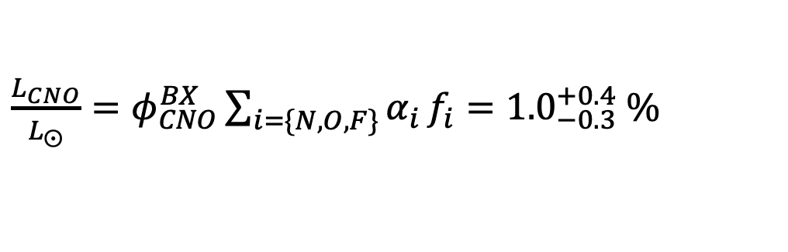
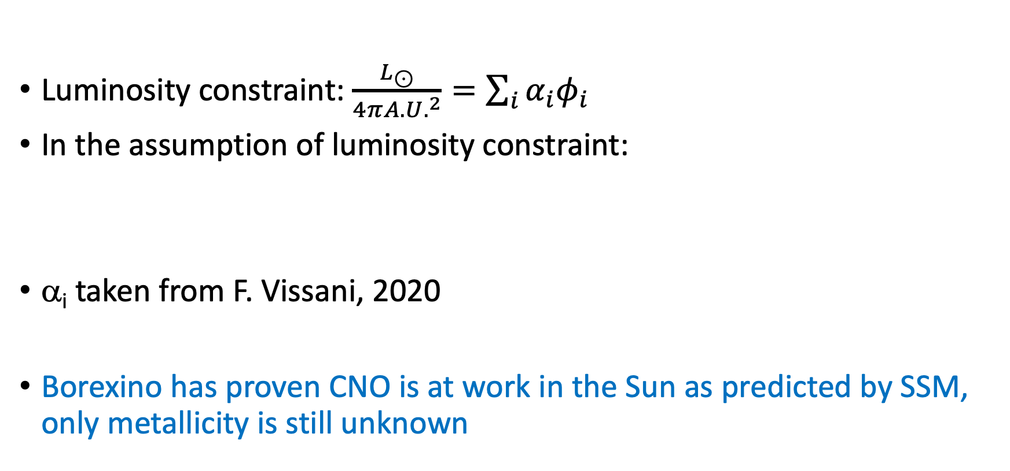
CNO luminosity from Borexino
Luminosity constraint: $\frac{L_{⊙}}{4π{A.U.}^{2}}=\sum_{i}{α_{i}φ_{i}}$
In the assumption of luminosity constraint:
α_{i} taken from F. Vissani, 2020
Borexino has proven CNO is at work in the Sun as predicted by SSM, only metallicity is still unknown
$\frac{L_{CNO}}{L_{⨀}}=φ_{CNO}^{BX}\sum_{i=\{N,O,F\}}{α_{i}}f_{i}={1.0}_{−0.3}^{+0.4} \%$

Slide 68
Borexino selected scientific achievements on solar neutrinos
2007, data taking starts and ⁷Be solar neutrino flux observed
2010, first observation on ⁸B solar neutrinos in a massive LS
2010, observation of geo-neutrinos
2012, measurement of the ⁷Be flux at 5%
2012, observation of pep solar neutrinos
2012, observation of null day-night effect for ⁷Be neutrinos
2014, measurement of the pp flux at 11%
  Top 10 breakthrough
2017, seasonal modulation of ⁷Be solar neutrinos
2019, simultaneously measurement of pp(10%), 7Be(3%), and pep solar neutrinos
2020, observations of CNO solar neutrinos
  Top 10 breakthrough
2022, CNO neutrino observation including directionality

Slide 69
perspectives

Slide 70
Why solar neutrinos in the future?
Particle physics
  Accurate measurement of expected matter-vacuum upturn
  Accurate measurement of day-night asymmetry
Astrophysics
  Use solar neutrinos to better understand the Sun (inverse problem)

Slide 71
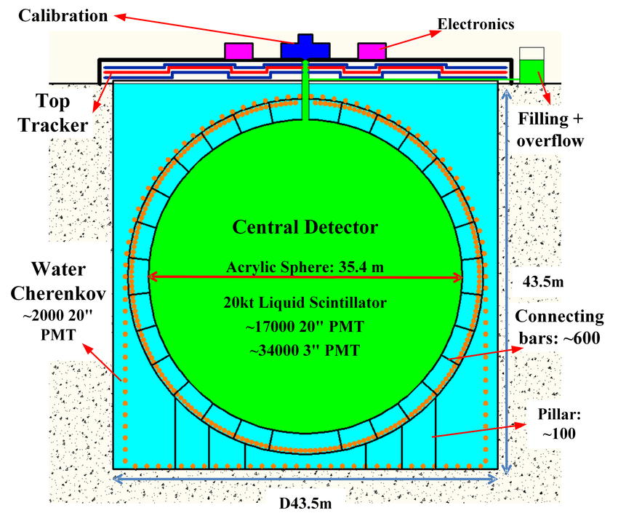
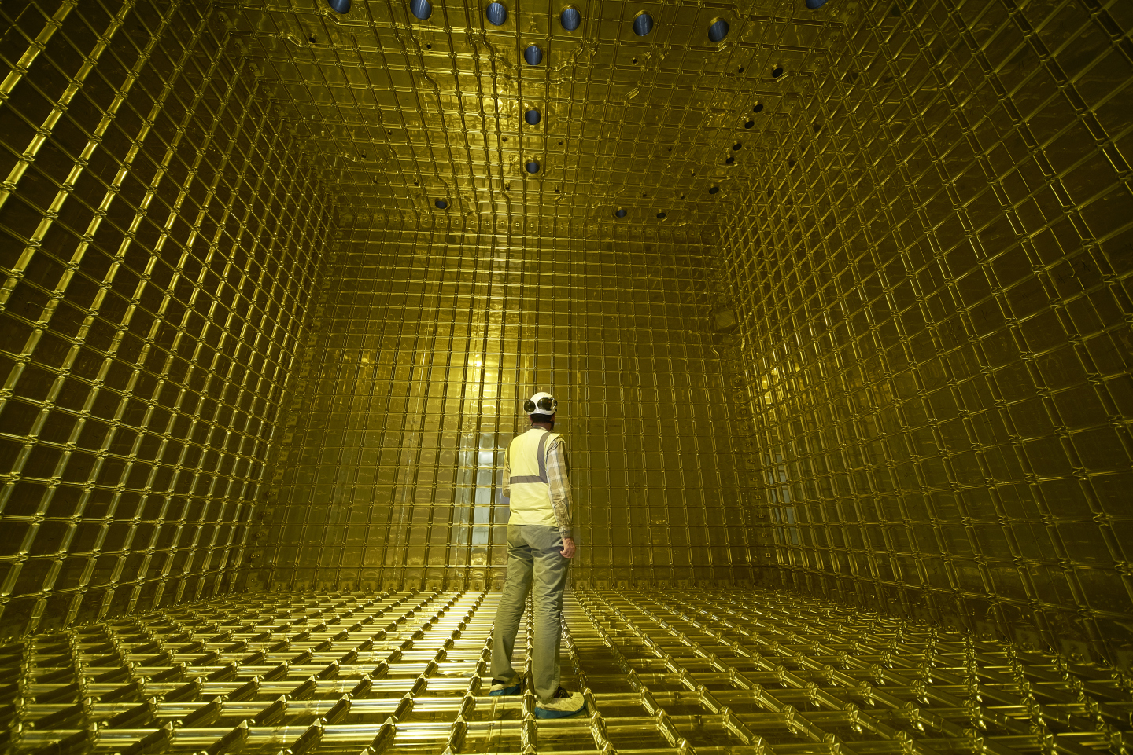

Next future for solar neutrino detection
SNO+ 780 tons of LAB
Running/Upcoming: SNO+/JUNO
2028/2030: HyperKamiokande/DUNE
Probe:
Upturn of P_{ee} at 3σ
Day/Night at 4-5σ
Observation of Hep neutrinos
HyperKamiokande 187kton H₂O FM
DUNE x4 10ktons of LAr
$$ν_{e}+{}_{}^{40}{Ar}→e^{−}+{}_{}^{40}K$$
JUNO 20 ktons of LAB

Slide 72
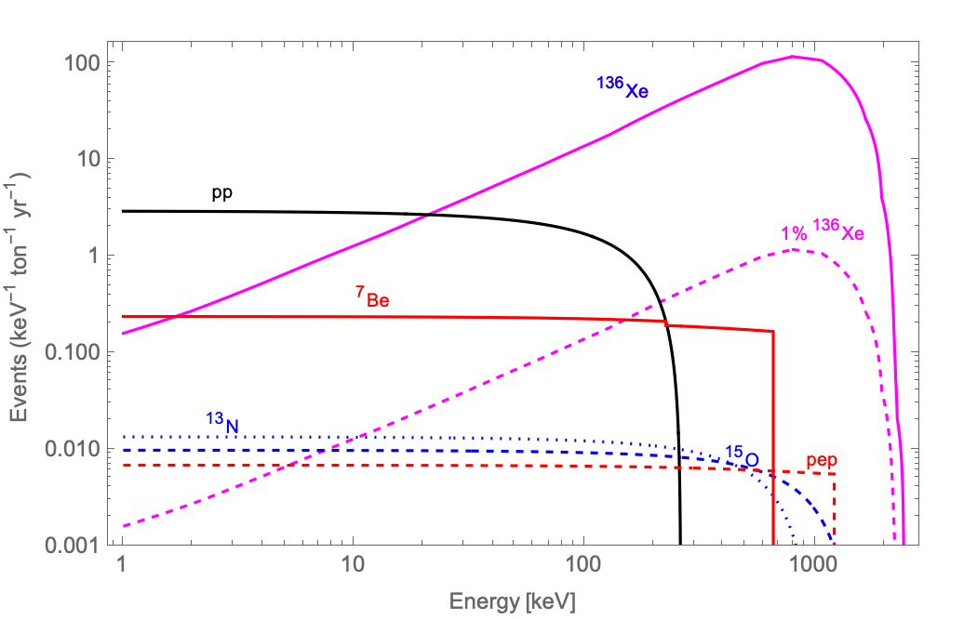
Solar neutrinos in LXe
Electron Recoils channel
  pp neutrinos in [1,10] keV ~ 26/ton/yr
  ~2% stat in 100 ton x year
  Sensitivity to CNO and pep neutrinos limited by ¹³⁶Xe
Nuclear Recoils channel
  Already proved to probe ⁸B solar neutrinos

Slide 73
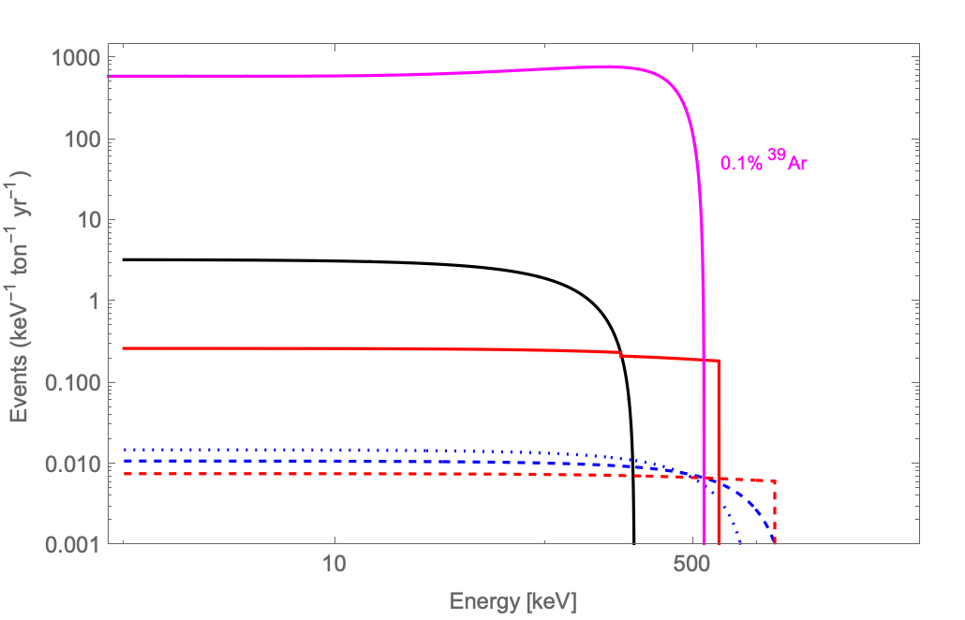
Solar neutrinos in LAr
For E > Q_{β} pep ~ 5% and CNO ~6% stat
in 100 ton x year

Slide 74
Conclusions
57 years of solar neutrino observations
Fundamental results on neutrino physics and astrophysics
More to come with SuperKamiokande
Future observations with SNO+, HyperKamiokande, DUNE, and JUNO
The observation of solar neutrinos with dark matter detectors it is already a reality

Slide 75
Thank you for your attention!

Slide 76
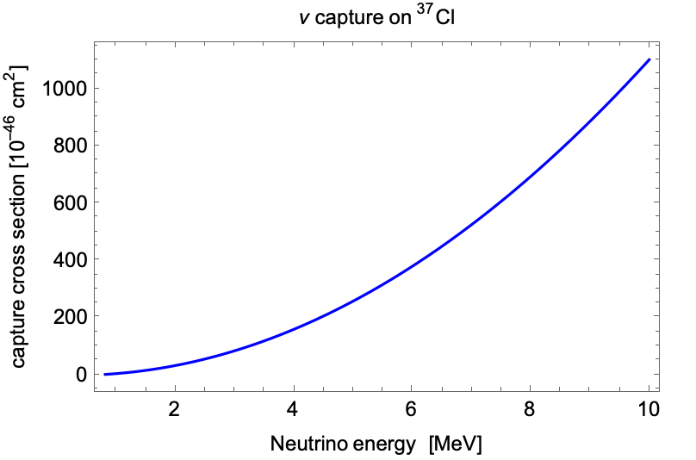


Neutrino capture on ³⁷Cl
3/2⁺
3/2⁺
3/2⁺
1/2⁺
3/2⁺
3/2⁺
0.814 MeV
${}_{17}^{37}{Cl}$ ${}_{18}^{37}{Ar {}_{19}^{37}K{}_{ 20}^{ 37}{Ca}}$
Cross section to ground state ~ 3.3 x 10⁻⁴⁵ cm² at 2 MeV
$σ_{gs}=\frac{2π^{2} ln2 {\left(ℏc\right)}^{3}}{f_{t} {\left(m_{e}c^{2}\right)}^{5}} E_{e}p_{e}F\left(Z,E_{e}\right)\frac{2J_{f}+1}{2J_{i}+1}$
Log f_{t} = 5.1 for ³⁷Ar
GT matrix elements to excited states from mirror beta decay of ³⁷Ca

Slide 77



Borexino operations and achievements
PHASE-III
2016
2015
CNO campaign
Filling and
purification
(distillation)
LS purification campaign
6 cycles of water extraction
Thermal insulation
and active temperature
Control system
R$({}_{}^{7}{Be)}$+ D/N
R$(pep)$ – first observation
R$({}_{}^{8}{B)}$– first with LS
R$(CNO)$ – limit
geo- $ν$ – first robust observation
R$\left(pp\right)$ first in real time
Seasonal variations of R$({}_{}^{7}{Be)}$
Simultaneous spectroscopy of pp, ⁷Be and pep $ν$
R$({}_{}^{8}{B)}$–improved
geo- $ν$

Slide 78

Paradigm of the Luminosity Constraint
Spiro and Vignaud, 1990
$$4p →\left\{\begin{aligned}{}_{2}^{4}{He+2ν_{pp}+26.20 MeV} \\ {}_{2}^{4}{He+ν_{pp}+ν_{Be}+25.60 MeV} \\ {}_{2}^{4}{He+ν_{pp}+ν_{B}+19.70 MeV}\end{aligned}\right.$$
$\frac{L_{sun}}{4π d^{2}}=8.4946∙{10}^{11}\frac{MeV}{{cm}^{2}s}=\sum_{i}{a_{i}φ_{i}}$=$19.7 MeV φ_{B}+25.6 MeVφ_{Be}+\frac{26.2 MeV}{2} \left(φ_{pp}−φ_{Be}−φ_{B}\right)$
1 = 0.922 f_{pp} + 0.07 f_{Be} + 0.00004 f_{B} with f_{i} = φ_{i} / φ_{SSM}

Slide 79


Solar neutrinos in DUNE
100 kt-year solar ν interactions
Two detection channels:
CC on ⁴⁰Ar
ES
This breaks the degeneracy
between sin²θ and φ(⁸B)
These channels can be separated exploiting the imaging capabilities
DN asymmetry can be probed
⁸B+hep, from
SNOwGLoBES
w/smearing from
Amoruso et al., 2003
[not DUNE smearing]
theoretical studies: A. Ioannisian et al., Phys.Rev. D96 (2017) no.3, 036005
new paper
arXiv:1808.08232
Adapted from K. Scholberg

Slide 80


Solar neutrino measurements in HK
Day/Night sensitivity
Spectrum upturn
Sensitivity to no asymmetry
Sensitivity to KamLAND
Solid: 4.5 MeV threshold
Dotted: 3.5 MeV threshold
Solid: 0.3% syst. err.
Dotted: 0.1% syst. err.
(at solar best parameters)
Day/Night (solar vs reactor): 4~5 sigma in 10 years
Spectrum upturn: ~3 sigma in 10 years
Adapted from M. Shizowa

Slide 81


Solar hep neutrino at HK
Adapted from M. Shizowa
Integrated # of expected solar neutrino events
Non-zero significance of hep ν detection from a spectrum analysis
HK 10 years
(signal efficiency, spallation BG, major syst. uncertainties are estimated from SK-IV)
(100% signal efficiency)
E_{total} [MeV] | ⁸B [/1.9 Mt yr] | Hep [/1.9 Mt yr] | Hep / ⁸B
18-25 | 0.56 | 6.04 | 10.6
Black solid: at Tochibora site
Red solid: at Mozumi site
Red dotted: at Mozumi, no spallation BG
First direct observation of hep solar ν could be done at 2~3 sigma with a few Mton year data

Slide 82
The Selena proposal
Selenium deposited on a CMOS active pixel charge sensor

Slide 83
The SAGE detector
It made use of 30 tons of liquid metallic gallium in 4 containers holding 7 tons of target mass
Metallic gallum is kept at 30C to remain molten
A runs starts by adding 160 μg of stable Ge into each container
After 3 weeks exposure hydlochloric acid solution is mixed with the metallic gallium
Ge is extracted into aqueous phase and later vacuum evaporated
  Extraction efficiency is ~95%
GeH₄ is mixed with Xe and measured for six months in a proportional counter
SAGE has also performed a calibration with a ⁵¹Cr source of 19 PBq giving A_{measured}/A_{predicted} = 0.95±0.12±0.03
Combined all gallium measurements give: 66.2±3.1 SNU

Slide 84


The GALLEX source experiment
To very the extraction procedure a neutrino source experiment was carried out in GALLEX
A ⁵¹Cr neutrino source was was twice in 1994 and 1995
  ⁵¹Cr is produced by neutron activation on CrO₃ enriched in ⁵⁰Cr at 38.6% level
  Neutron activation was done at Grenoble with a 35 MW reactor
  ⁵¹Cr decays with T_{1/2} = 27.7 days emitting neutrinos at 746(81%)keV
  The source activity was ~65 PBq
  The source was located at the center of the detector in a special hole
  Result: A_{measured}/A_{predicted} = 0.882±0.078
Gallex coll., PL B 420 (1998)
SAGE coll., PRC 59 (1999) 2246

Slide 85
Background and operation for the Homestake experiment
Cavity around the tank can be flooded with water for n shielding
0.2 cm³ of ³⁶Ar / ³⁸Ar (~10¹⁹ atoms) added before each run
40 days exposure
Purging with helium for 20h which carries gas to a condenser to freeze
C₂Cl₄ vapors
Gas is sent to a charcoal trap at 77K to adsorb argon (melting point 83.8K)
Extraction of Ar from the charcoal (heating a 200C) and purification (exposure
to hot metal surface for O and N)
Remove heavy elements (Xe, Kr, Rn) by gas chromatography
Gas into small charcoal trap to remove traces of helium by pumping off at 77K
Gas into a 0.5 cm³ proportional counter

