Slide 1

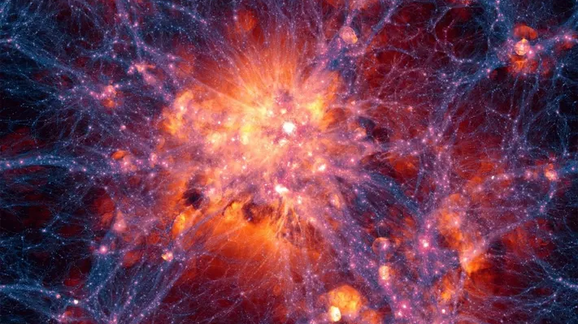



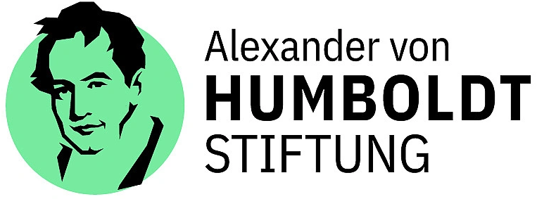
Neutrino-Dark Matter Connection
Bhupal Dev
Washington University in St. Louis
CETUP* 2025
The Institute for Underground Science at SURF
Lead/Deadwood, South Dakota
July 02, 2025

Slide 2

Does Dark Matter interact with Neutrinos?
How to see the ‘invisible’?

Slide 3
arXiv: 2507.01000 (today)
50+ pages (enjoy)
Three types of constraints on “light” dark sector:
Cosmological (BBN, CMB, Collisional Damping, Relic Density*, Neutrino Self-interaction)
Astrophysical (Stellar and Supernova, High-Energy Neutrinos, Self-interacting DM)
Laboratory (Meson, mu, tau and Z decays, double beta decays)

Slide 4
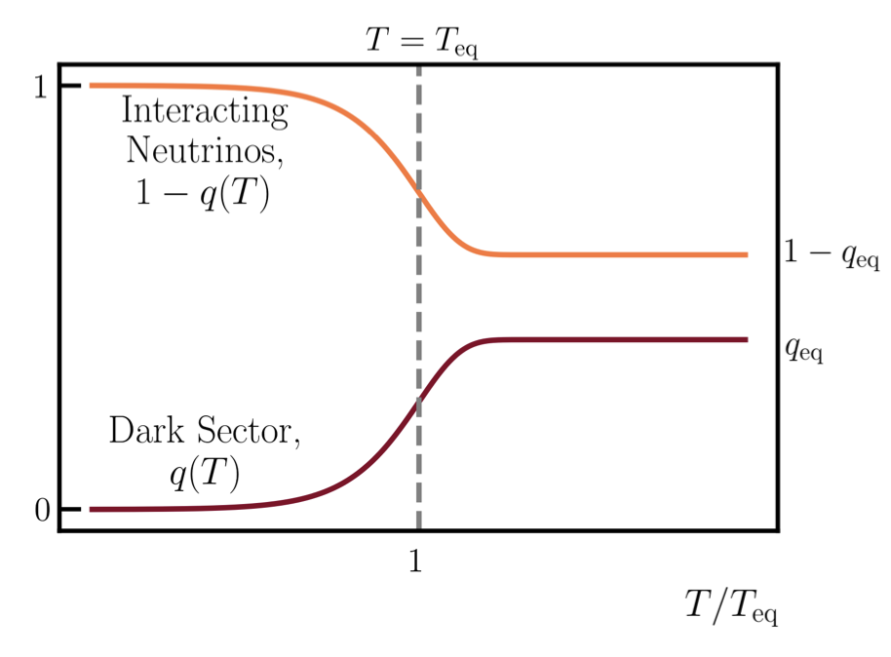
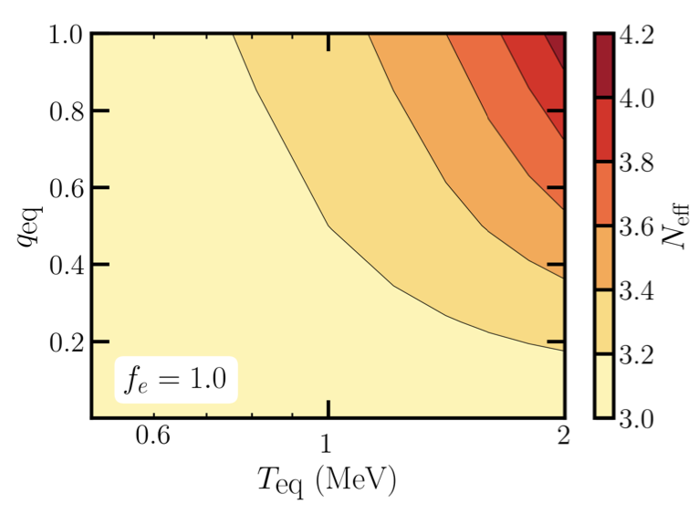
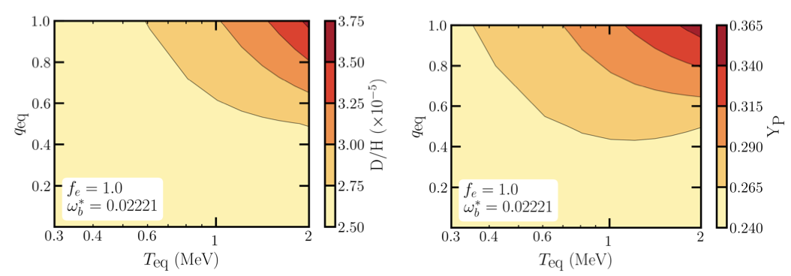
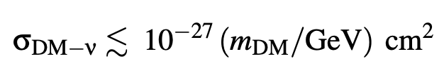


Effects on CMB and BBN
Complete cooling
1-$q\left(T\right)=ρ_{ν,int}/(Nint ρν0$)
$q\left(T\right)=ρ_{d}/(Nint ρν0$)
SM
(T-independent)
Wilkinson, Bœhm, Lesgourgues, 1401.7597
Giovanetti, Schmaltz, Weiner, 2402.10264

Slide 5
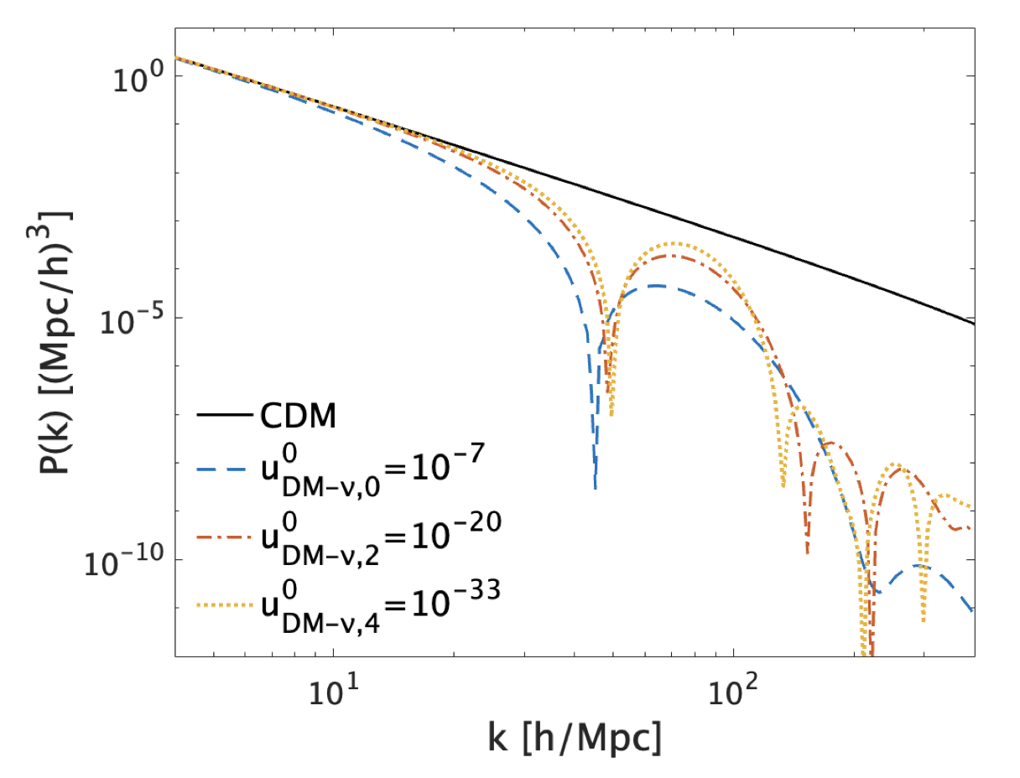
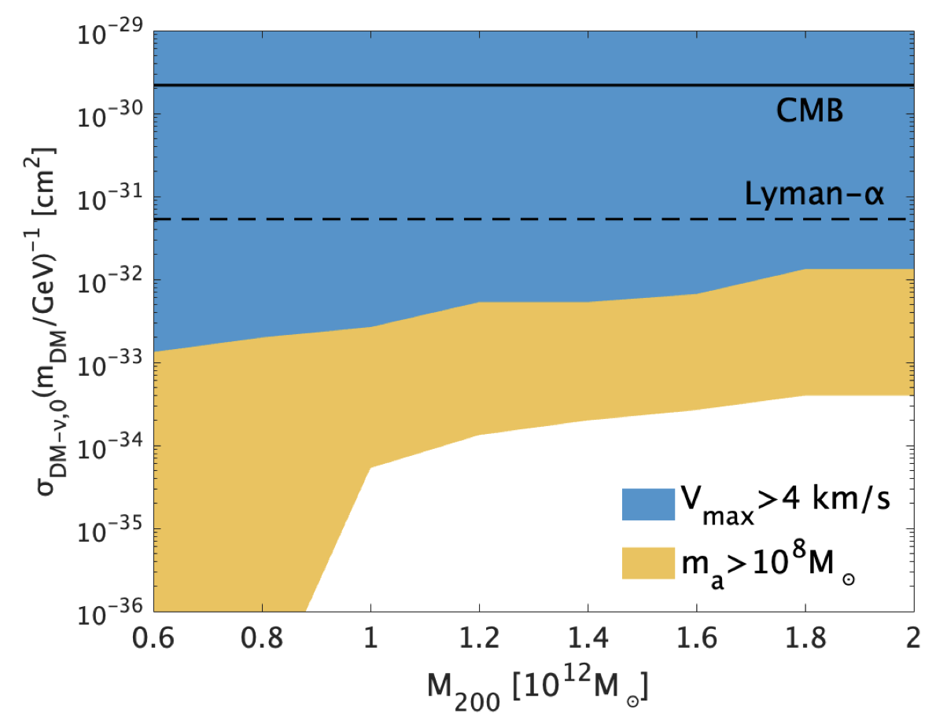
Collisional Damping
Akita, Ando, 2305.01913
Deviation from linear matter power spectrum.
Erases small-scale structure in galaxies.
Constraints from Milky-Way satellite galaxy observations.

Slide 6
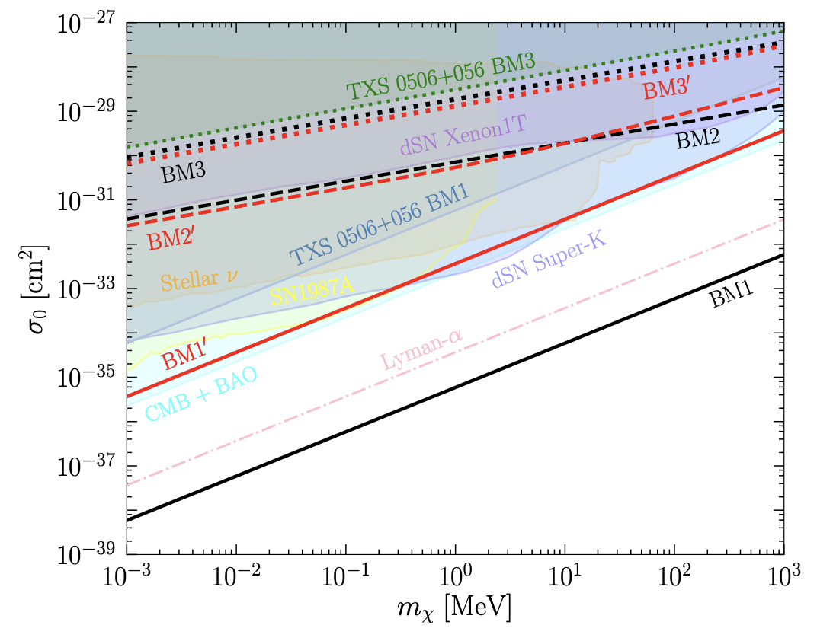
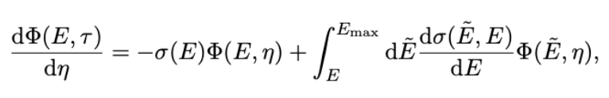
Flux Attenuation
NGC 1068 bound: Cline, Puel, 2301.08756
Large column density and/or large number density helps.
Depends on DM density profile.
Stronger constraints for spike profile.
Flux attenuation:

Slide 7
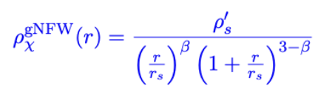

DM Density Profiles
Existence of spike profile still debatable.
Gondolo, Silk, 9906391
Ullio, Zhao, Kamionkowski, 0101481
Lacroix, 1801.01308
Strong limits from high-energy neutrino point sources using spike profile
Cline et al, 2209.02713
Ferrer, Herrera, Ibarra, 2209.06339
Cline, Puel, 2301.08756
Galactic supernova directly behind the GC along line-of-sight will be an ideal source to see the flux attenuation effect.

Slide 8
Modeling Neutrino-DM Interactions
Use a simplified model framework. UV-completion possible.
Categorize into DM and mediator types: Scalar, Fermion, Vector.
Only 4 (or 3) free parameters: DM and mediator masses and couplings.
t-channel
s-channel
u-channel
Differential scattering cross section

Slide 9
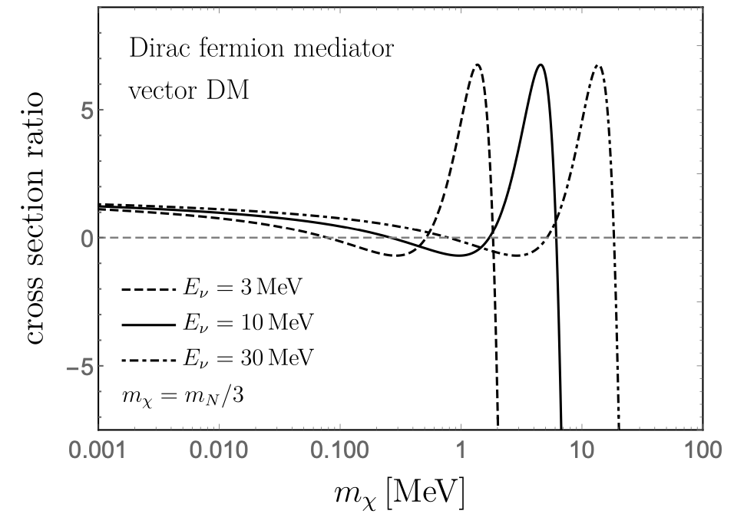
Comparison with Previous Results
BD, Kim, Sathyan, Sinha, Zhang,
2507.01000
[54] Campo, Boehm, Palomares-Ruiz, Pascoli, 1711.05283
[32] Arguelles, Kheirandish, Vincent,
1703.00451

Slide 10
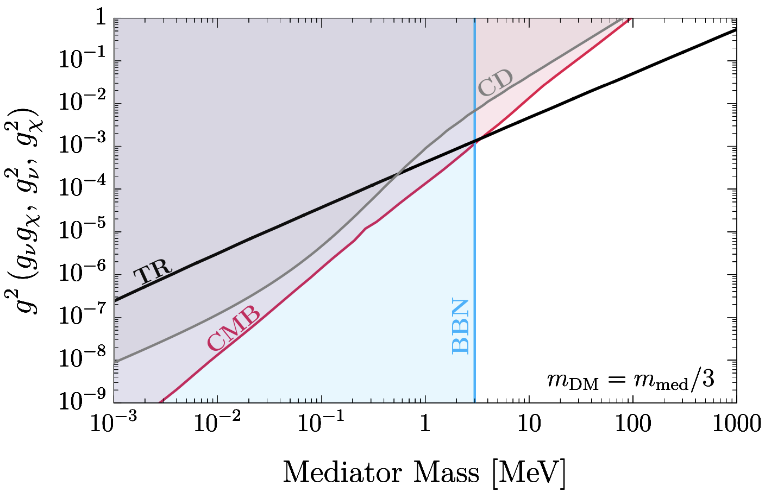
Recast Cosmological Constraints
Dirac fermion DM,
Scalar mediator

Slide 11
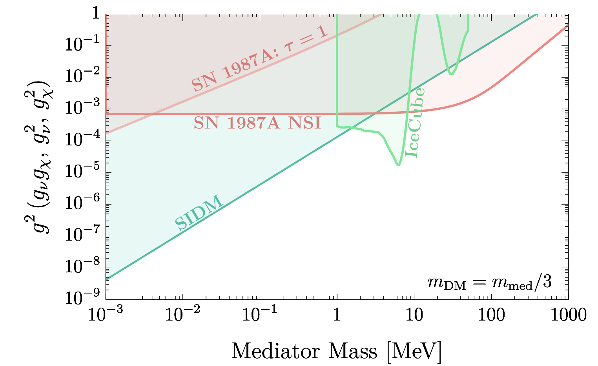
Recast Astrophysical Constraints
Dirac fermion DM,
Scalar mediator

Slide 12
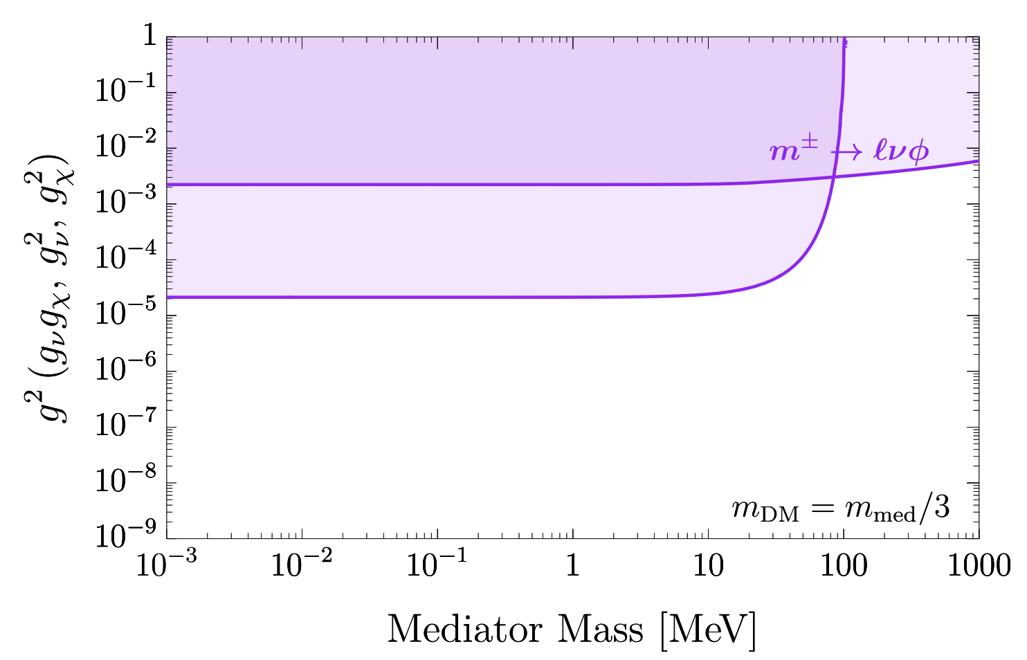
Updated Laboratory Constraints
BD, Kim, Sathyan, Sinha, Zhang, 2407.12738
Updated from
Berryman, de Gouvea, Kelly, Zhang, 1802.00009
de Gouvea, BD, Dutta, Ghosh, Han, Zhang, 1910.01132
Dirac fermion DM,
Scalar mediator

Slide 13
Tree versus Tree+Loop
Brdar, Lindner, Vogl, Xu, 2003.05339
BD, Kim, Sathyan, Sinha, Zhang, 2407.12738

Slide 14
Combined Limits
Benchmarks
Dirac fermion DM,
Scalar mediator
BD, Kim, Sathyan, Sinha, Zhang,
2507.01000

Slide 15
$ν$ Flux Attenuation
BD, Kim, Sathyan, Sinha, Zhang, 2507.01000

Slide 16
DM Production in Supernova
Highest DM emission around 1 sec post-bounce.
Location of highest emission depends on the coupling (trapping).
Using Garching Core-Collapse Supernova Data Archive
Cappiello, BD, Patwardhan, 2503.09691

Slide 17
New SN1987A Limit on Neutrino-DM Interaction
Preliminary
Heavy mediator limit
Cappiello, BD, Patwardhan (work in progress);
See also
Suliga, Tamborra, 2010.14545;
Manzari, Camalich, Spinner, Ziegler, 2307.03143
Cappiello, BD, Patwardhan, 2503.09691

Slide 18
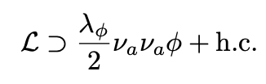


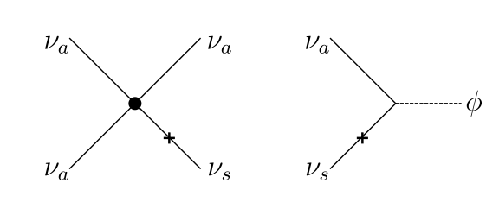
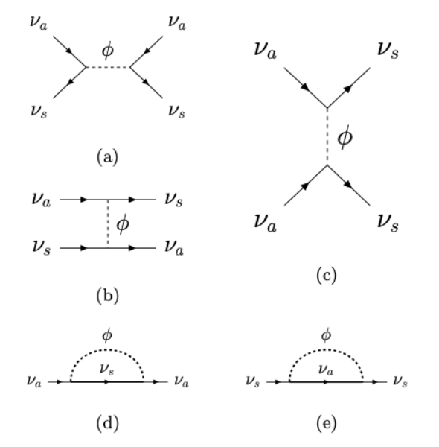
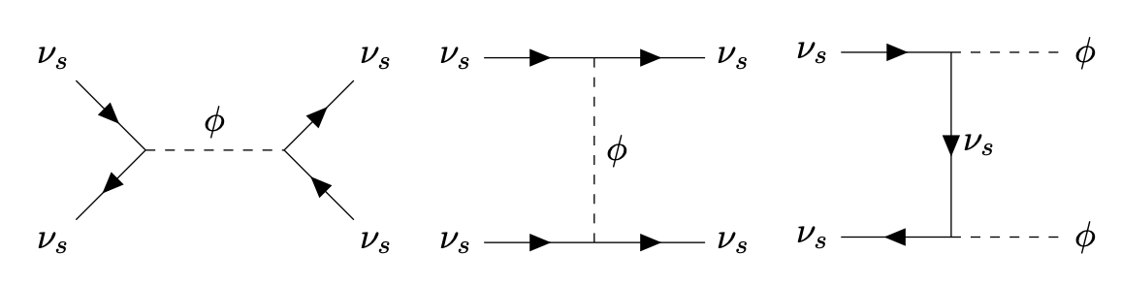
Sterile Neutrino DM Production in Early Universe
Minimal Dodelson-Widrow mechanism is ruled out by X-ray constraints.
Neutrino NSI can enhance the DM production.
Active self-interaction
Sterile self-interaction
Active-sterile NSI
de Gouvêa, Sen, Tangarife, Zhang, 1910.04901
Kelly, Sen, Tangarife, Zhang, 2005.03681;
Alonso-Alvarez, Cline, 2107.07524;
An, Gluscevic, Nadler, Zhang, 2301.08299
Johns, Fuller, 1903.08296;
Bringmann, Depta, Hufnagel, Kersten, Ruderman, Schmidt-Hoberg, 2206.10630;
Astros, Vogl, 2307.15565;
Balantekin, Fuller, Ray, Suliga, 2310.07145
BD, Dutta, Goswami, Tang, Ramachandran, 2505.22463

Slide 19
DM Production from Active-Sterile NSI
BD, Dutta, Goswami, Tang, Ramachandran, 2505.22463

Slide 20
Dark Radiation Mimicking Self-Interacting Neutrinos
Das, BD, Gao, Ghosh, Kim, 2506.08085
Resonant conversion of ν to χ
Free-streaming ν
Free-streaming ν +Free-streaming χ
Behaves as flavor-specific or flavor-universal neutrino self-interactions, depending on n_{χ .}
Ameliorates tension between cosmology and neutrino oscillation experiments, while avoiding lab constraints.

Slide 21
Cosmological Preference for $ν$-DR Interaction
Das, BD, Gao, Ghosh, Kim, 2506.08085
See also Escudero, Schwetz, Terol-Calvo, 2211.01729

Slide 22

Conclusions
Neither Neutrino nor Dark Sector is well understood.
Neutrinos could have nonstandard interactions with Dark Sector.
Observable consequences in cosmological and astrophysical data.
Complementary laboratory constraints on mediator mass and coupling.
Potentially observable effects in neutrino experiments.
Dark matter can also be produced from its interactions with neutrinos.
Preference for neutrino-dark sector interaction from cosmological data.
The future of dark is bright.

Slide 23
Backup Slides

Slide 24
Cosmological Fits

Slide 25
Details of Lab Constraints

Slide 26
BBN Constraints

