Slide 1


Non-Abelian Flavor Symmetry and
Neutrino Oscillations
Based on work: arXiv: 2507.???? (Z.T.)
Zurab Tavartkiladze
(Ilia State Univ, Tbilisi, Georgia)
July 1, 2025
2023.07.30-12 Lead (SD), CETUP* 2025. Neutrino Physics Workshop
Notes:
Titlepage

Slide 2
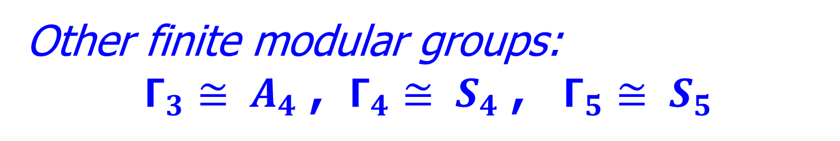

SM Extension with:
Modular Flavor group $Γ_{2}≅ S_{3}$
Minimal (6 elements)
non-Abelian finite discrete group
Other finite modular groups:
$Γ_{3}≅ A_{4}$ , $Γ_{4}≅ S_{4}$ , $Γ_{5}≅ S_{5}$

Slide 3
Aim:
● Build SM extension (non-SUSY) with modular flavor symmetry
(Giving successful neutrino sector)
● Have economical setup
● Examine: naturalness, predictive power

Slide 4
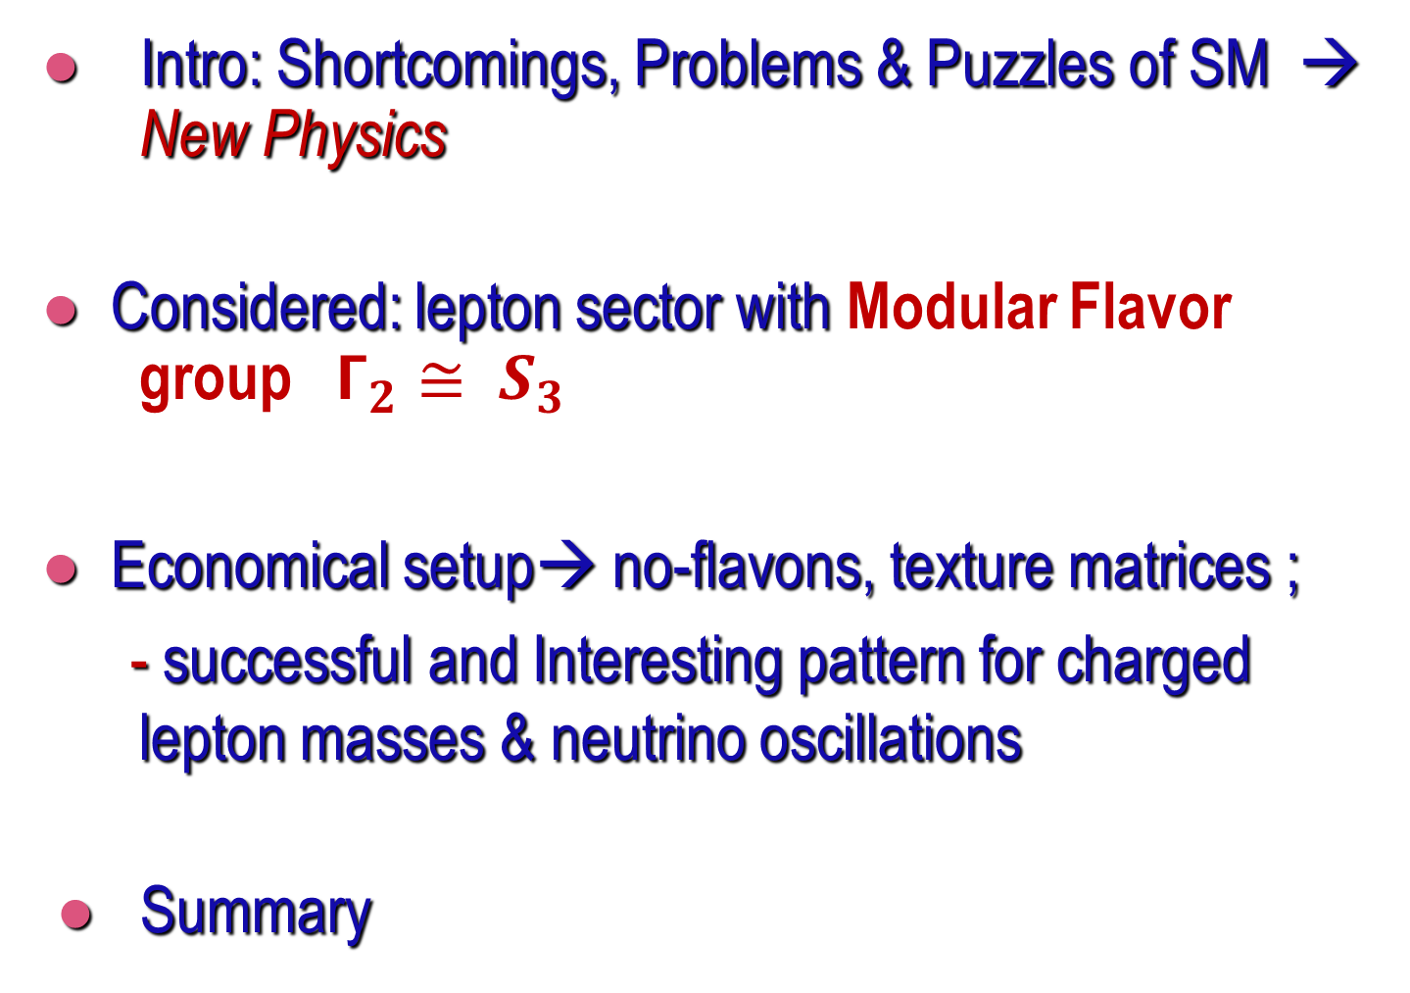
Outline
● Intro: Shortcomings, Problems & Puzzles of SM → New Physics
● Considered: lepton sector with Modular Flavor group $Γ_{2}≅ S_{3}$
● Economical setup→ no-flavons, texture matrices ;
- successful and Interesting pattern for charged lepton masses & neutrino oscillations
● Summary

Slide 5
Some shortcomings / puzzles of SM:
Within the SM
● Hierarchies of Ch. fermion masses / mixings
● Neutrino oscillations masses / mixings -
unexplained
● Needed amount of the baryon asymmetry
can’t be generated
…

Slide 6
● Charged fermion masses & mixings
Observed Noticeable Hierarchies:
With λ=0.2
What is origin of these hierarchies?

Slide 7
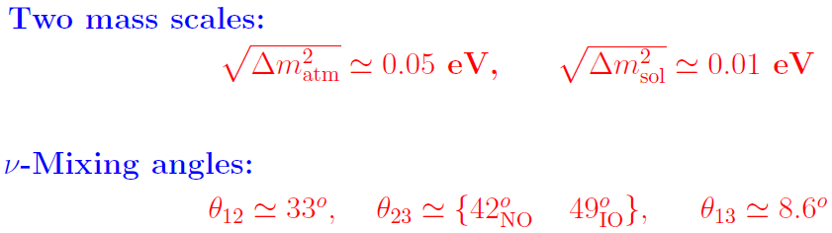

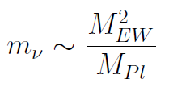
Evidences for New Physics: Neutrino Data
● Origin of these scales and mixings?
Unexplained in SM
Without New
Physics
Within SM no answer to these questions…

Slide 8
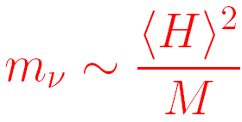

Neutrino masses via see-saw
Oscillations
Leptogenesis
+ RHN - νR
SM singlet
→ Δ L=2 Lepton number viol.

Slide 9



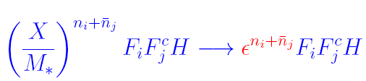



Extension With Flavor Symmetry
Flavor symmetry GF distinguishing families can explain hierarchies
Simplest possibility: GF=U(1)F (Froggatt, Nielsen’79)
‘flavon’
With
coupling
forbidden!
Suppressed
couplings emerge
- cut off scale
(simplest possibility )
Several/multiple flavons also can be considered

Slide 10
Non Abelian , finite, discrete flavor Symmetries
– More economical & predictive
→ Realized by modular transformations
See for reviews:
F. Feruglio, hep-ph/1706.08749;
T. Kobayashi, M. Tanimoto, 2307.03384 [hep-ph]
G.J. Ding, S. King, 2311.09282 [hep-ph]
& refs. therein

Slide 11




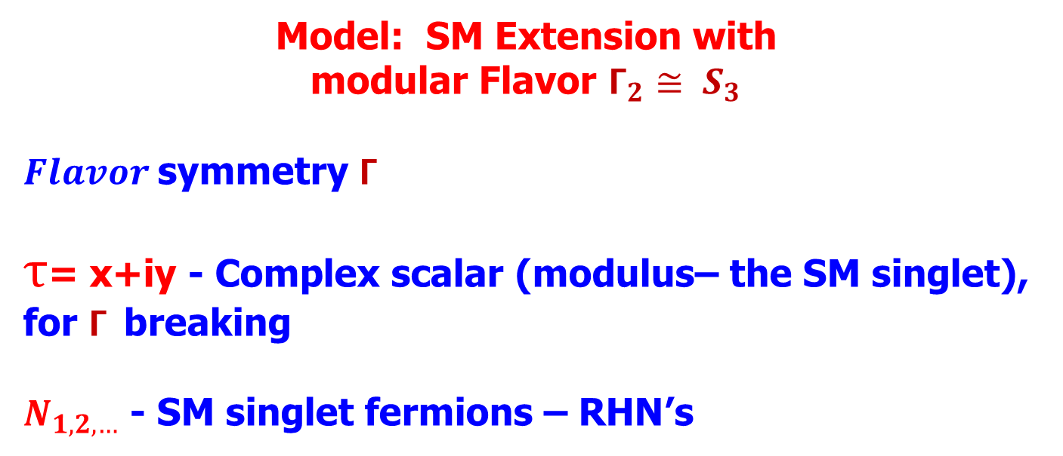
Model: SM Extension with
modular Flavor $Γ_{2}≅ S_{3}$
$Flavor$symmetry $Γ$
$τ$= x+iy - Complex scalar (modulus– the SM singlet), for $Γ$breaking
$N_{1,2,…}$ - SM singlet fermions – RHN’s

Slide 12
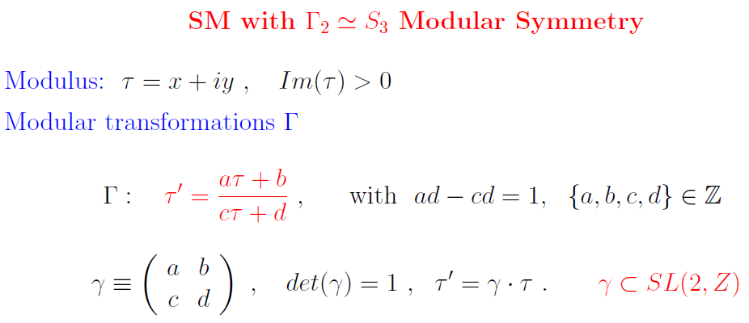
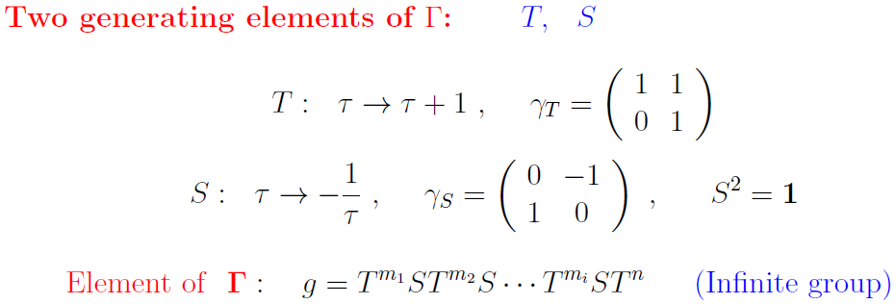

Slide 13
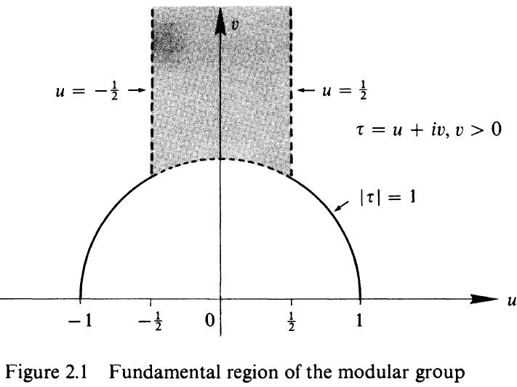

Fundamental Domain of $Γ$
From: T.M. Apostol, “Modular Functions &…”, 2nd ed., Springer

Slide 14
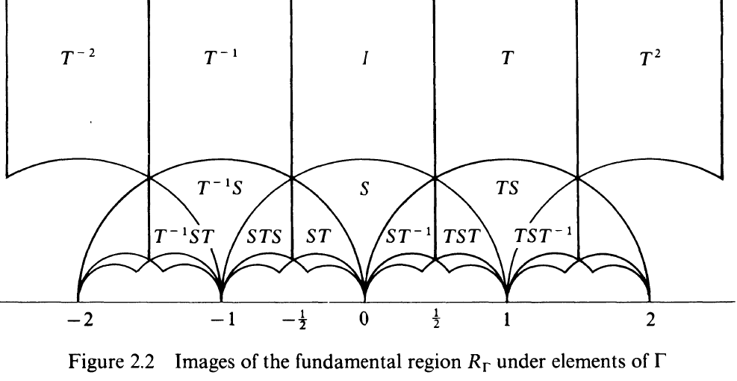
Upper plane can be covered
by T & S actions
From: T.M. Apostol, “Modular Functions &…”, 2nd ed, Springer

Slide 15
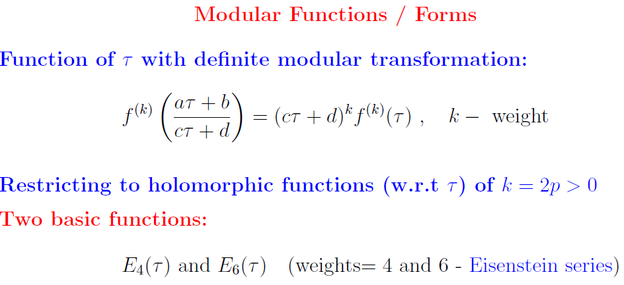
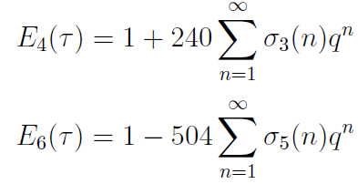



Slide 16
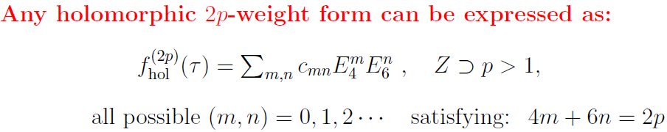
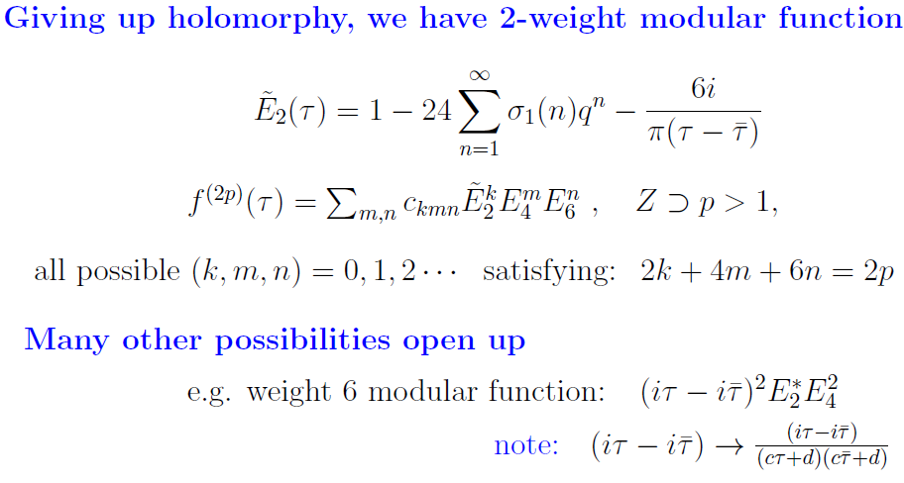

Slide 17
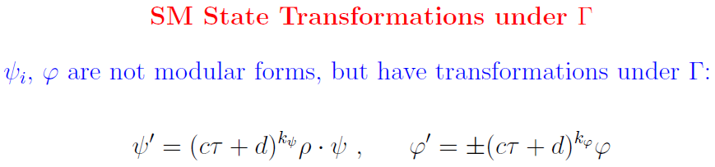

Slide 18
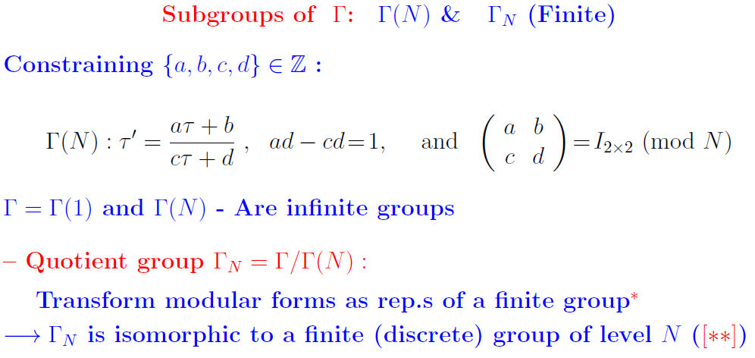
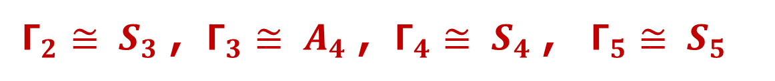
$Γ_{2}≅ S_{3}$ , $Γ_{3}≅ A_{4}$ , $Γ_{4}≅ S_{4}$ , $Γ_{5}≅ S_{5}$
[**] F. Feruglio, hep-ph/1706.08749; & Refs. therein

Slide 19
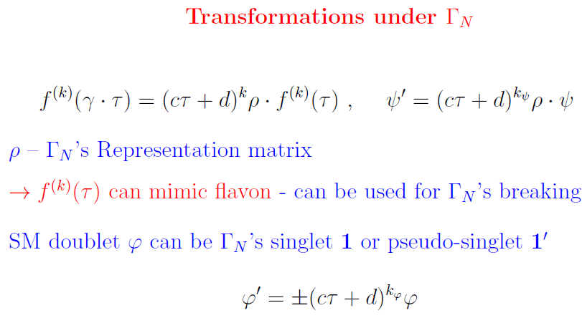

Slide 20
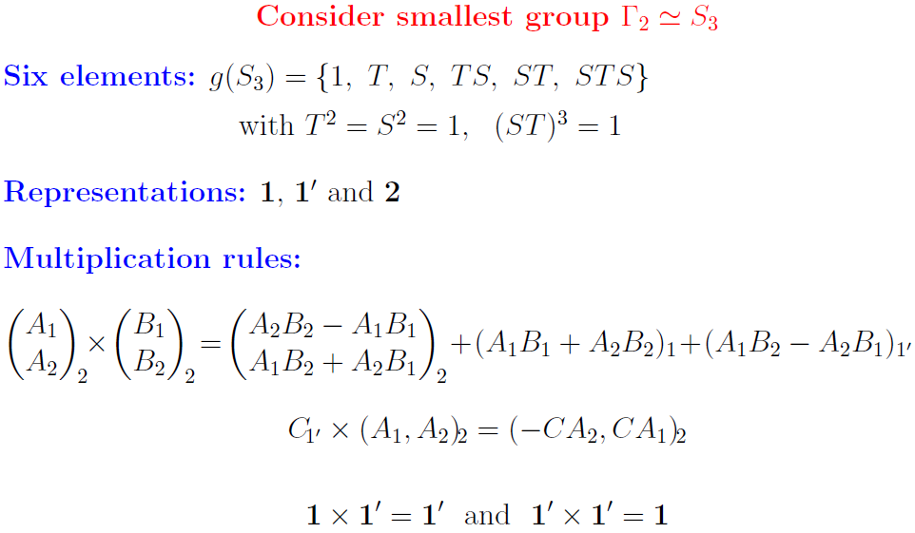

Slide 21
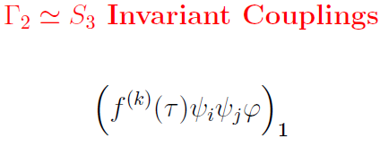
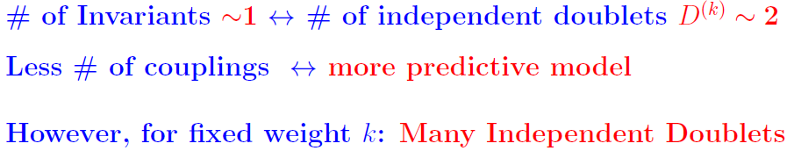
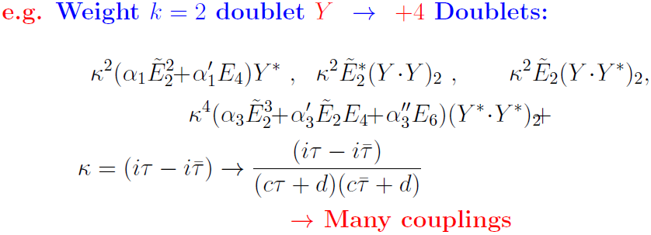

$S_{3}$ singlet

Slide 22
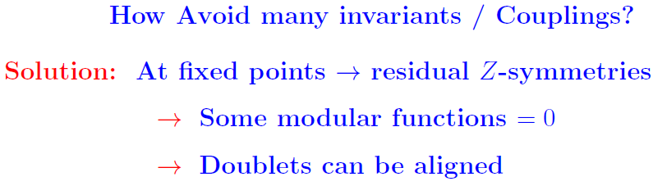
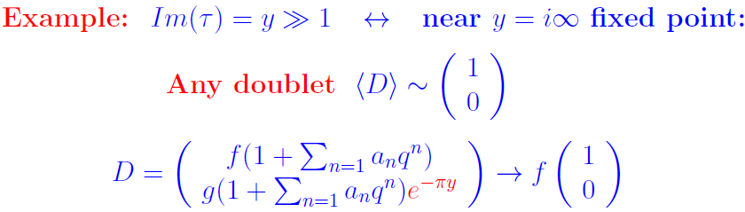

Slide 23



Fixed Points

Slide 24
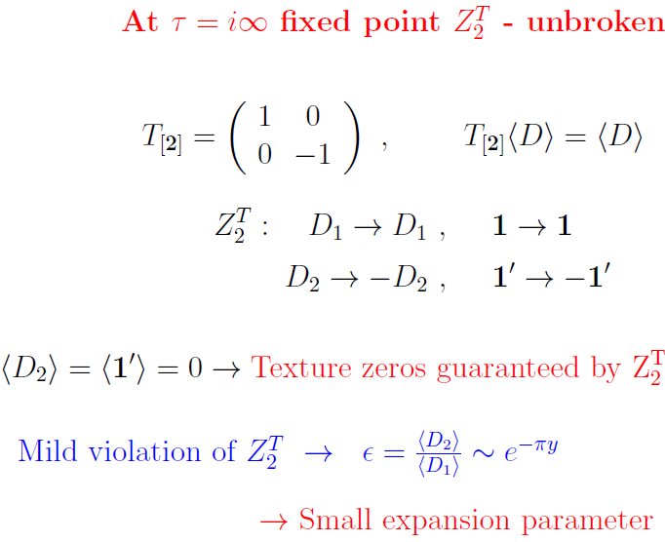

Slide 25
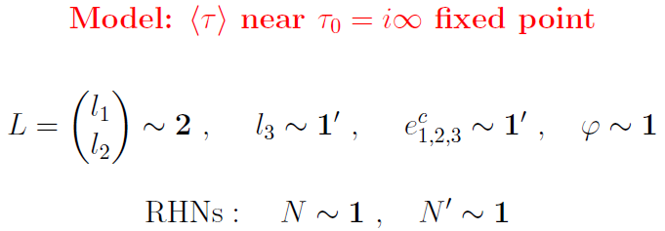
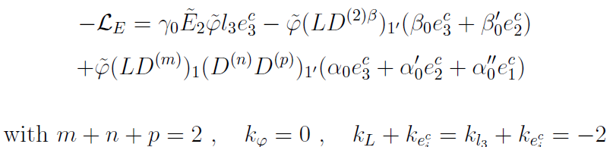

Slide 26
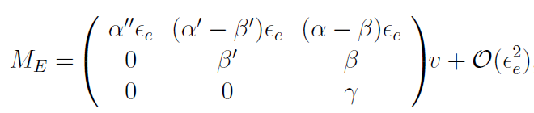



Charged Lepton Mass Matrix
Not explained
Approximate

Slide 27
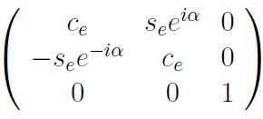
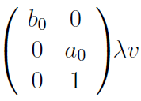




Neutrino Mass Matrix
From lepton number viol. Sector –
Can be larger than

Slide 28

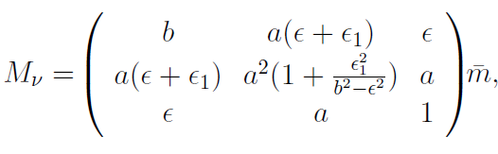
Neutrino Mass Matrix
This structure can wotk for both:
NO and IO neutrinos
However, IO is natural – approximate

Slide 29
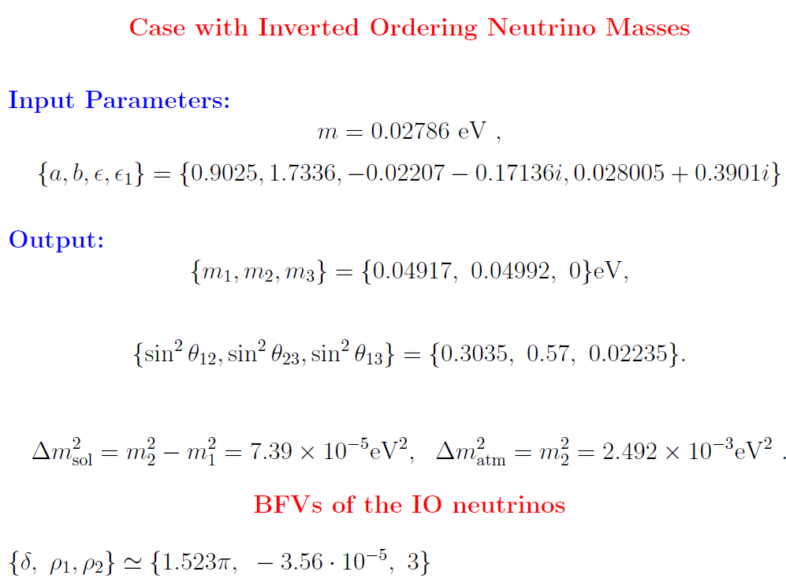

Slide 30
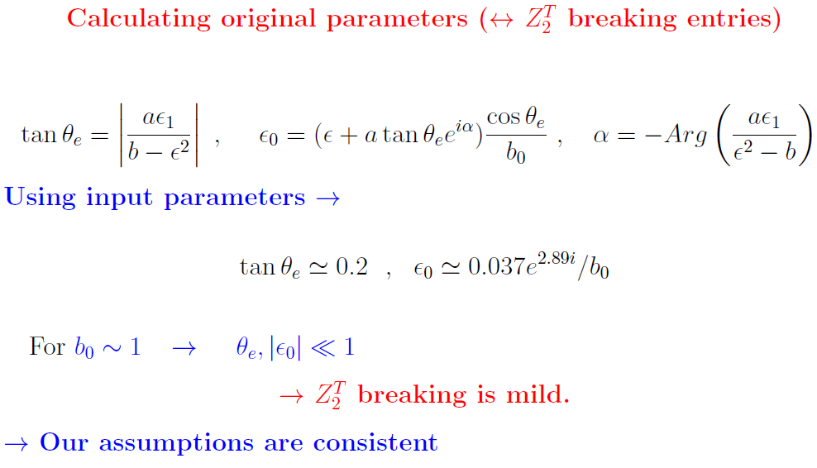

Slide 31
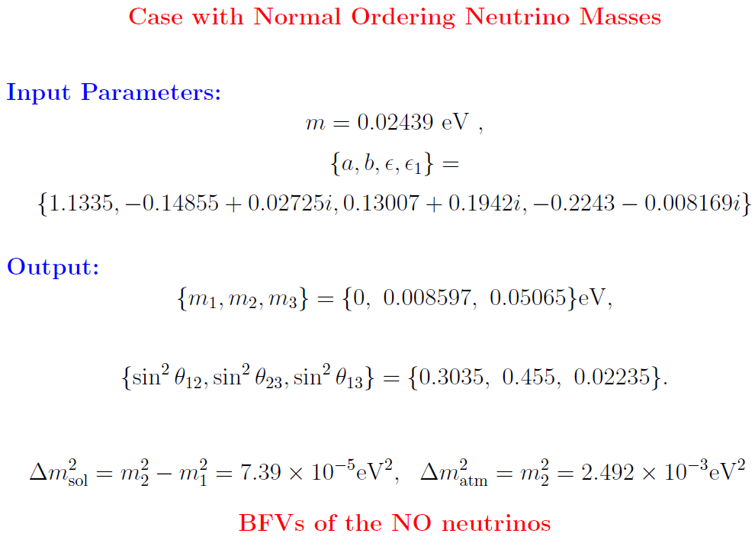

Slide 32
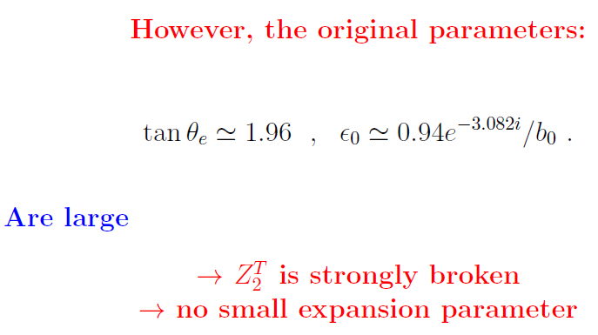

Slide 33
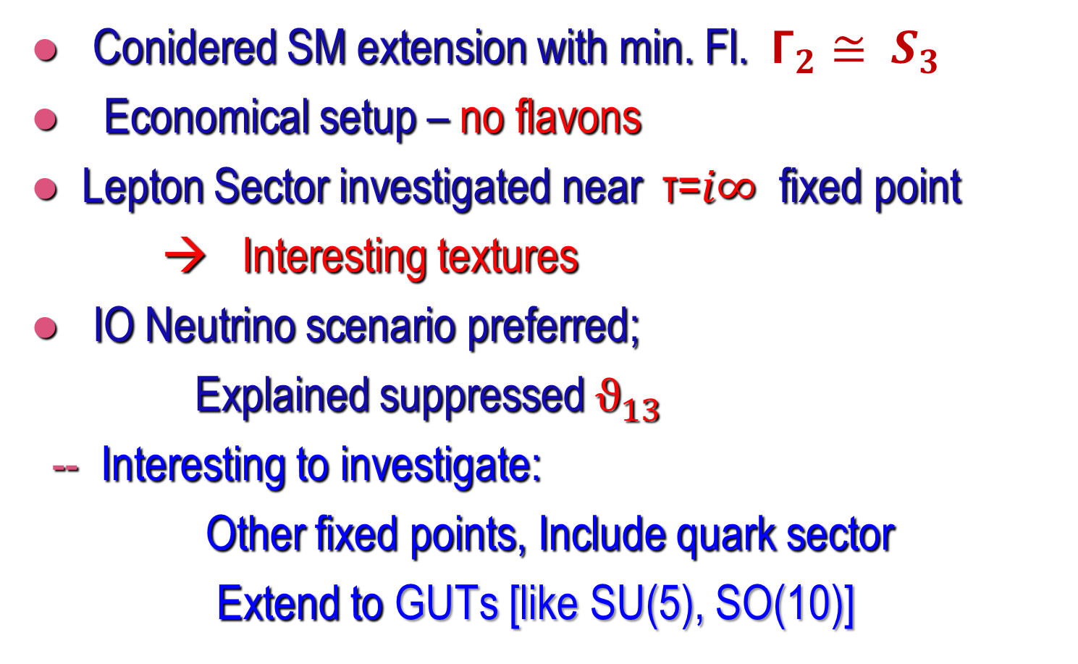
SUMMARY
● Conidered SM extension with min. Fl. $Γ_{2}≅ S_{3}$
● Economical setup – no flavons
● Lepton Sector investigated near τ=$i∞$ fixed point
→ Interesting textures
● IO Neutrino scenario preferred;
Explained suppressed $ϑ_{13}$
-- Interesting to investigate:
Other fixed points, Include quark sector
Extend to GUTs [like SU(5), SO(10)]
Thank You

Slide 34
Backup Slides

Slide 35
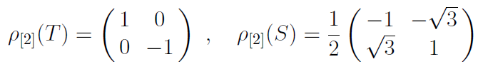
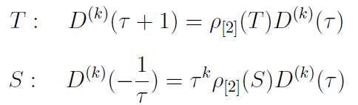
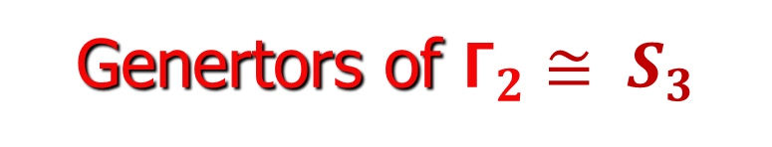
Genertors of $Γ_{2}≅ S_{3}$
Transformations:

Slide 36


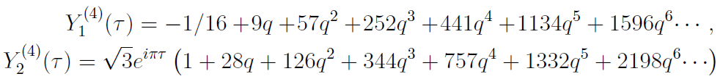
Holomorphic weight 2 doublet:
Expansions:
Holom. weight 4 doublet:

Slide 37
