Slide 1

Education & Outreach Sanford Underground Research Facility
Communicating Cutting-Edge Science to Curious Students
Ashley Armstrong, PhD, Science Education Specialist
Julie Dahl, Science Education Specialist
Notes:
Quick intros- us

Slide 2
Who’s in the room?
Neutrino theorist
Experimentalist
Faculty
Post-doc
Undergraduate
Educator
Notes:
Quick poll participants

Slide 3
Experience (or thing) that got you interested in science?
Notes:
A few volunteers share…
Why is it crucial to communicate cutting-edge science to students?
Inspiring the next generation: Introducing them to exciting research can spark curiosity and encourage future careers in STEM.
Promoting scientific literacy: Helping students understand complex topics early on is vital for informed decision-making in a world increasingly driven by science.
Demystifying science: Making cutting-edge research accessible can combat mistrust and make scientists more relatable.

Slide 4
Goals of the SURF Education & Outreach Program
Provide direct services to teachers, students, and schools
Create general awareness of SURF
Develop appreciation, excitement, and curiosity about the cutting-edge science/research
Serve as a model for exemplary science education resources
Offer a window into the science opportunities that are available for students

Slide 5
Educational Opportunities
for K-12⁺ Students and Educators
School Presentations
Field Trips
Curriculum Units
Professional Development
Work with Undergraduates
Career and Workforce Development

Slide 6

Exploring the Unseen
Notes:
Unit built around using indirect evidence. (How do you study things you cannot see?)

Slide 7
Learning Agreements
Participate actively and listen intently. Speak with the promise of being heard, and listen with the possibility of being changed.
Invite all voices. Share airtime. Everyone has expertise to offer.
Be curious rather than certain. Everyone has something to learn.

Slide 8
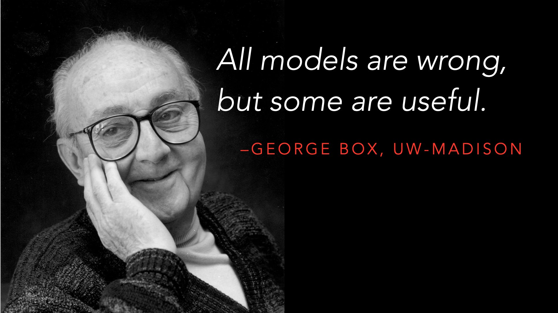
Notes:
Clarity beats accuracy

Slide 9

Black Boxes

Slide 10
Challenge
Each pair will receive a lettered mystery box. The challenge is to determine what the interior of the box looks like, without opening the box.
Concentrate on the LOCATIONS and SHAPES of the things inside the boxes. (Do not worry about what they are made of.)
If you could see through the top, what would the inside look like? Draw this on a slip of paper.

Slide 11
What happens when you have competing claims?
A
B
C
D
Notes:
Each team should put the drawing of the inside of the box on the wall. (Group same letters with same letters)

Slide 12

Thinking Like Scientists
Notes:
Lots of things took place during this exploration.
Make multisensory observations.
Distinguish between observations and inferences.
Use indirect evidence to develop conceptual models.
Modify and revise models based on additional evidence.
Communicate models through discussion and drawing.
Real-life skills
Teamwork, data collection, plan and carry out investigation, analyze

Slide 13
Researchers
Teachers
Notes:
Researchers provide the knowledge about cutting edge research.
Teachers provide an approachable pathway for students - captivating metaphor, interactive elements, time for questions, resources for further study/curiosities
What are some of the things that go in the arrow? - learning, student experiences….. compelling hook

Slide 14
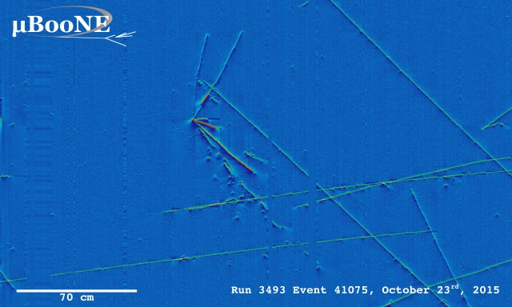
Neutrino event in liquid argon
Notes:
A neutrino can travel through the Earth without interacting with a single atom, therefore most leave no trace of their passage. To observe even just a few of the extremely rare interactions of neutrinos with matter, physicists build detectors with massive amounts of target material and run the experiments for several years. The detectors record signals from the detectable particles that have emerged from these rare collisions of neutrinos with atoms of the target material.
A Liquid Argon Time-Projection Chamber (LArTPC) is the type of neutrino detector planned for LBNE. LArTPC technology uses liquid argon (LAr) as a target material. Argon, a gas at room temperature, condenses to a liquid when cooled to cryogenic temperatures. The detection method is based on the collection of ionization electrons, resulting from particle interactions in the liquid argon. Under the influence of an electric field, the electrons drift to wire planes, thereby creating a signal. Three planes of wires allow 3D reconstruction of the electron's track.
Deep underground placement of a neutrino detector will shield it from cosmic rays, which are abundant and would generate signals in the detector that serve only to complicate the data analysis. Most cosmic rays will get absorbed by the matter above the detector. http://lbne-old.fnal.gov/neutrino-detectors.shtml

Slide 15
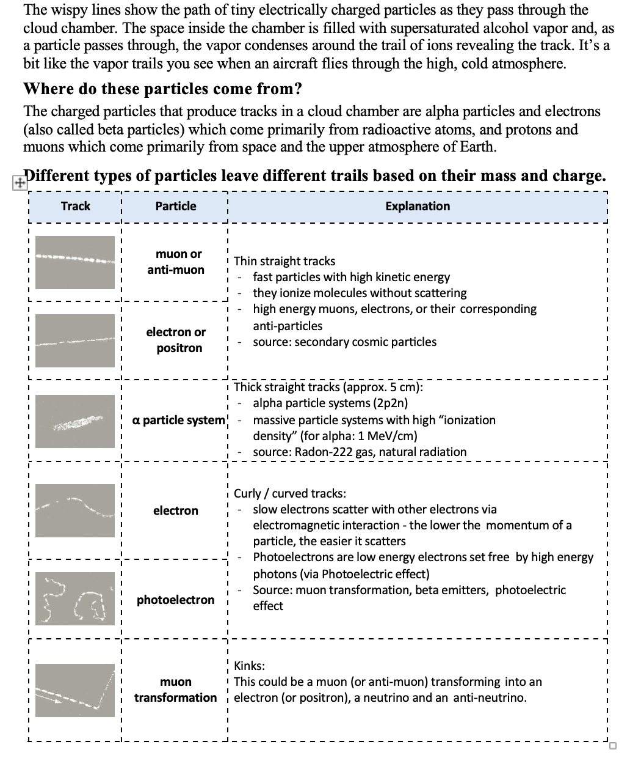
Making the Invisible Visible

Slide 16

Notes:
Playing in a scientifically rigorous way

Slide 17
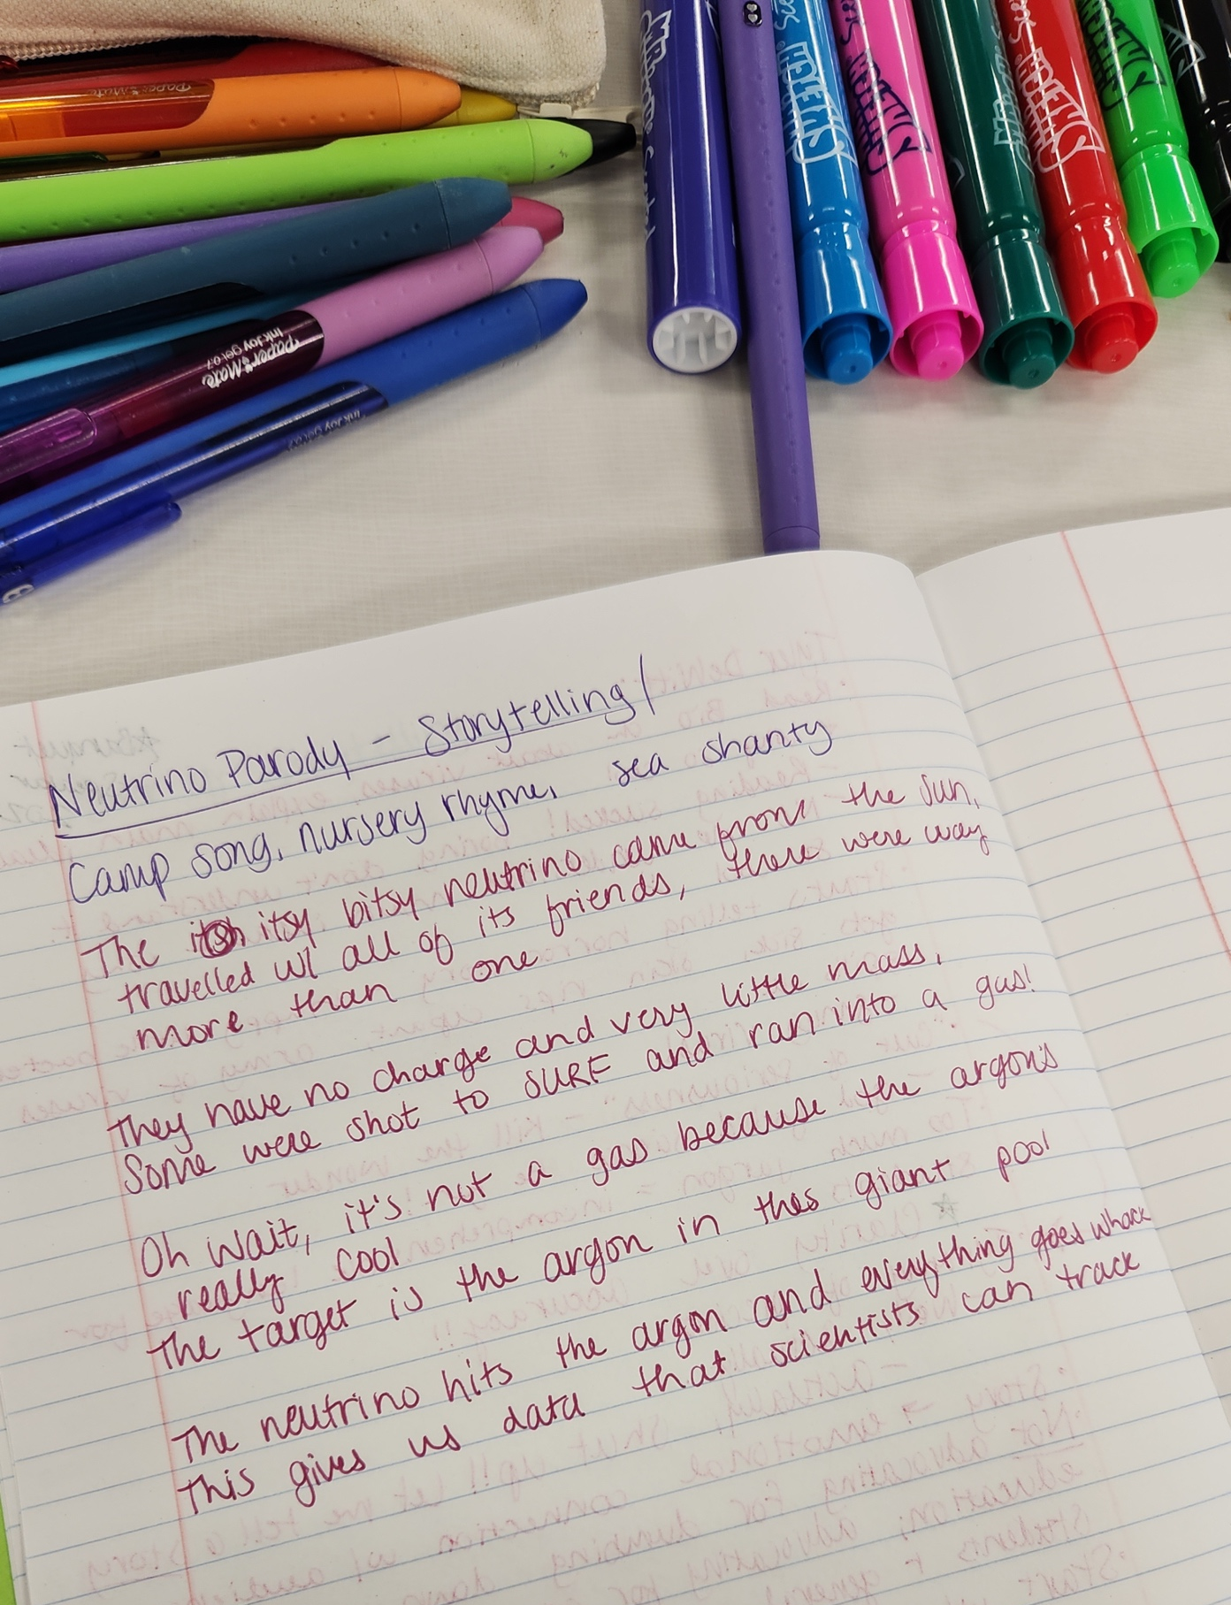
Science Communication Creativity

Slide 18
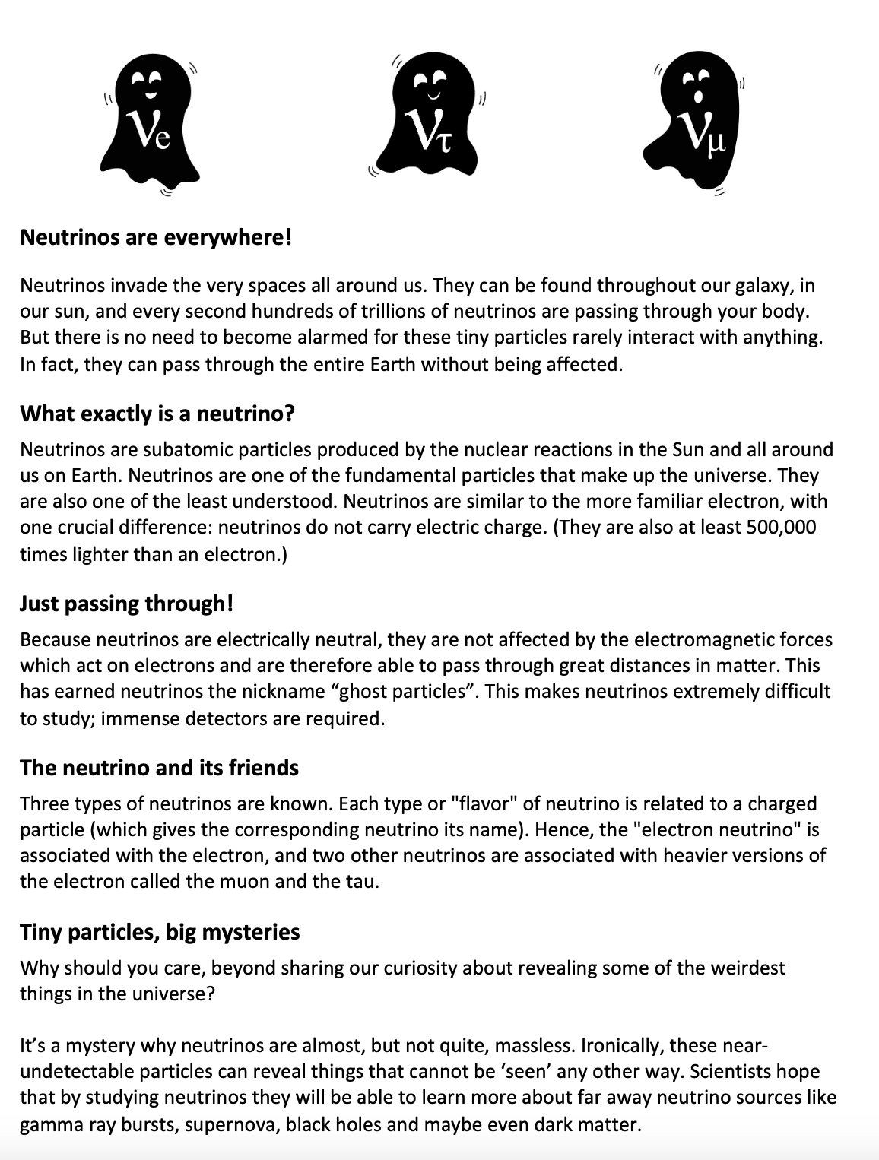
Ghost Particles

Slide 19
Broader Impacts
Full participation of women, persons with disabilities, and underrepresented minorities in STEM
Improved STEM education and educator development
Increased public scientific literacy and public engagement with science and technology
Increased partnerships between academia, industry, and others

Slide 20
Actionable Hooks
Start with a captivating hook: Grab their attention with a surprising fact or an intriguing question.
Use analogies and metaphors: Help students grasp complex ideas by comparing them to familiar concepts.
Incorporate interactive elements: Consider polls, quizzes, or Q&A sessions.
Leave time for questions: Encourage a dialogue and address their specific interests.
Provide resources for further exploration: Share links to websites, videos, or books that can extend their learning.

Slide 21

Questions
education@sanfordlab.org

