Slide 1
CETUP* 2025
Hosted by The Institute
for Underground Science at SURF

Slide 2
Welcome
Center for Theoretical Physics and Other Areas (CETUP*)
Notes:
Who’s attending for the 1st time?
Thank you to organizing committee: Jaret Heise, Barbara Szserbinska, Louis Strigari, Bhaskar Dutta, Kaladi Babu
Also: Christopher Kreitzinger and Becky Wilcox

Slide 5
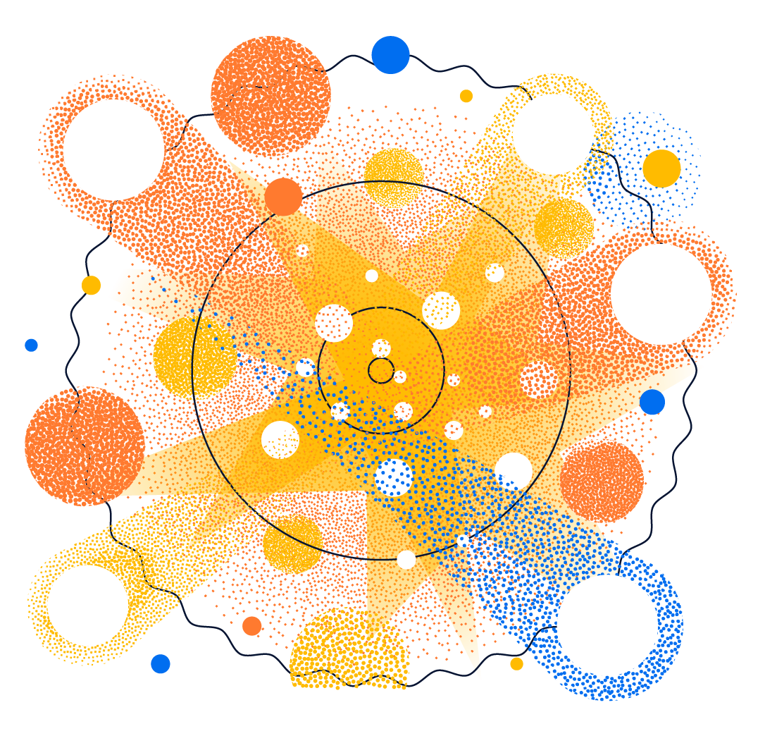
WORKSHOP
WELCOME
Introductions
New Venue
CETUP* Workshop Rooms
Meals
Transportation
Communication
Schedule

Slide 6
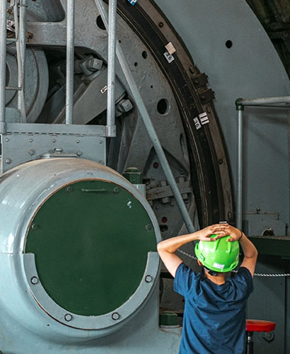
Introductions
Organizing Committee
Staff (SURF and School)
Workshop Attendees
Notes:
Full name and affiliation

Slide 7
New Venue
LEAD/DEADWOOD ELEMENTARY SCHOOL
Notes:
Touch on renovations; 2025
Turning off the power; Wifi should be fine
Separate from Summer Camps and other Youth Programs – school requirement

Slide 8
CETUP* Workshop Rooms
Room 132
Science Talks
Room 131
Meals
Coffee + Water
Refrigerator
Breakout Rooms
201 – 203
209 – 213
2nd Floor
Doors Labeled
Cafeteria and Library
available from 12:30 – 5:00 p.m. ONLY
Well-Being Room
Room 236
2nd Floor
Small Corner Office
Notes:
Entrances and Exits:
Workshop outside entrance; workshop exits (two – main and side; science talk room is an exit also)
Water fountains and water bottle filling stations
Water container in meal room
Bathrooms

Slide 9
IMPORTANT INFORMATION
MEALS
TRANSPORTATION
COMMUNICATION
Notes:
Meals:
Breakfast provide at hotel
Lunch provided at workshop Monday – Friday
Dinner per diem provided
Weekend per diem includes multiple meals
Transportation:
SURF Shuttle to and from Hampton Inn – pick up and drop off times on Indico Timetable (AM and PM schedule only)
Please check timetable daily and become familiar (i.e. Tuesday social – transportation from school to VC; Thursday Pub Talk and Trivia – transportation from school to Dakota Shivers Brewery – will take people to hotel also)
Hampton Inn shuttle – available for $10 per person per ride; check with hotel for availability – both operation time and distance
Airport shuttle – BH Shuttle service; hopefully everyone reserved for return to airport, if not reach out to them
Communication:
Indico workshop site – please use this for resources, timetable, and other helpful information and announcements
CETUP* Slack Channel – invites sent out, let me know if you didn’t get one – USE TO STAY UP TO DATE, ENGAGED WITH OTHER ATTENDEES AND TO COORDINATE evening and weekend activities and meals
If you notice someone here that is new to CETUP* please help ensure they have a great experience
My phone number on the Indico site – please use in case of emergency or if you need help; within workshop hours
Preprints:
Submit via the link on Indico event site
Reference 2024 or 2025; submit and we’ll assign a number

Slide 10
Please Remember
Underground Tour on June 17
Support of CETUP* - New Foundation Director
Complete Survey – Your Input is Important
Notes:
UG – submitted forms, approved; passports and/or U.S. ID
Share and Connect us with others for support of CETUP* - travel support and expand number of attendees
Survey - End of week – slack, email and on Indico – your feedback is helpful

Slide 11
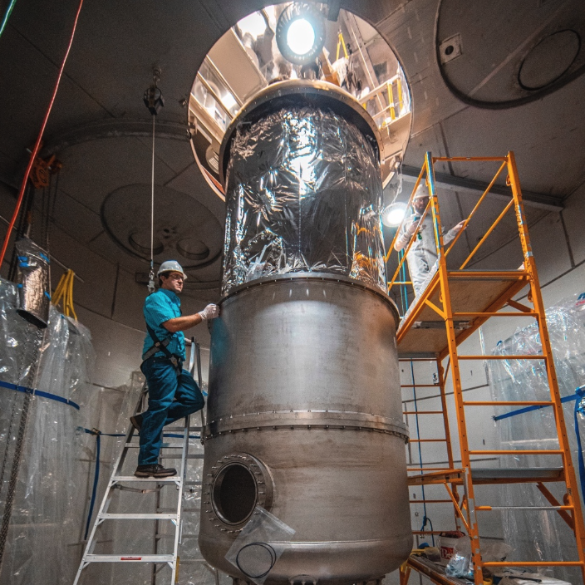
Noteworthy:
This Week’s Schedule
Monday: Getting Familiar
Tuesday: Underground Tour
Wednesday: Deep Roots and Ethnobotanical Garden
Thursday: Pub Talks & Trivia
Friday: Student Day

Slide 12
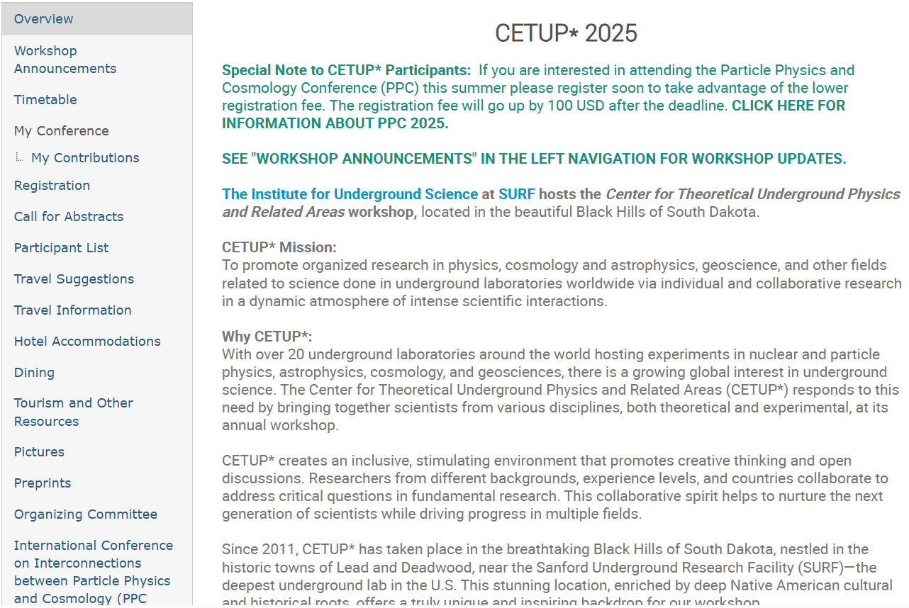

Slide 13
Experience Lead and Deadwood communities
and the Black Hills and Badlands area!
Indico Tourism Resources page
www.BlackHillsBadlands.com

Slide 15
CONNECT WITH SURF
@sanfordlab
SUBSCRIBE TO OUR NEWSLETTER

