Slide 1
Education & Outreach
Nicol Reiner
Director of Education & Outreach
Cultural Advisory Committee
January 11, 2024

Slide 2
Education and Outreach

Slide 3
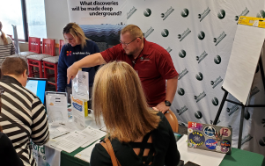
Sparking Conversations: Conference Exhibition
February 1-3, 2024

Slide 4
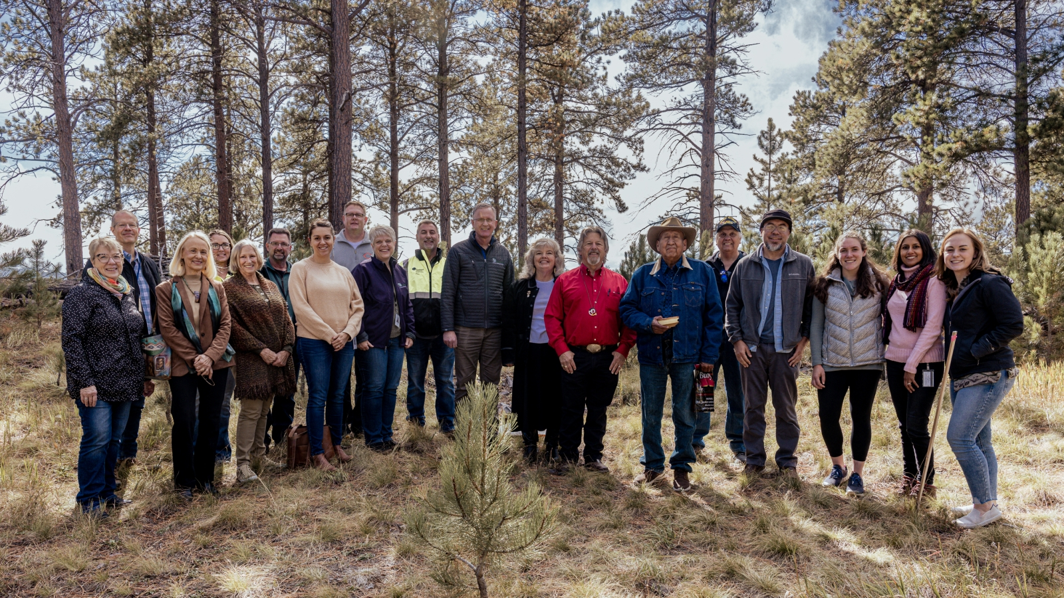
Building Relationships: Teacher Professional Development

Slide 5
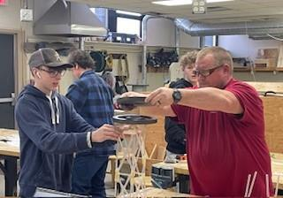
Connecting Content: Douglas

Slide 6
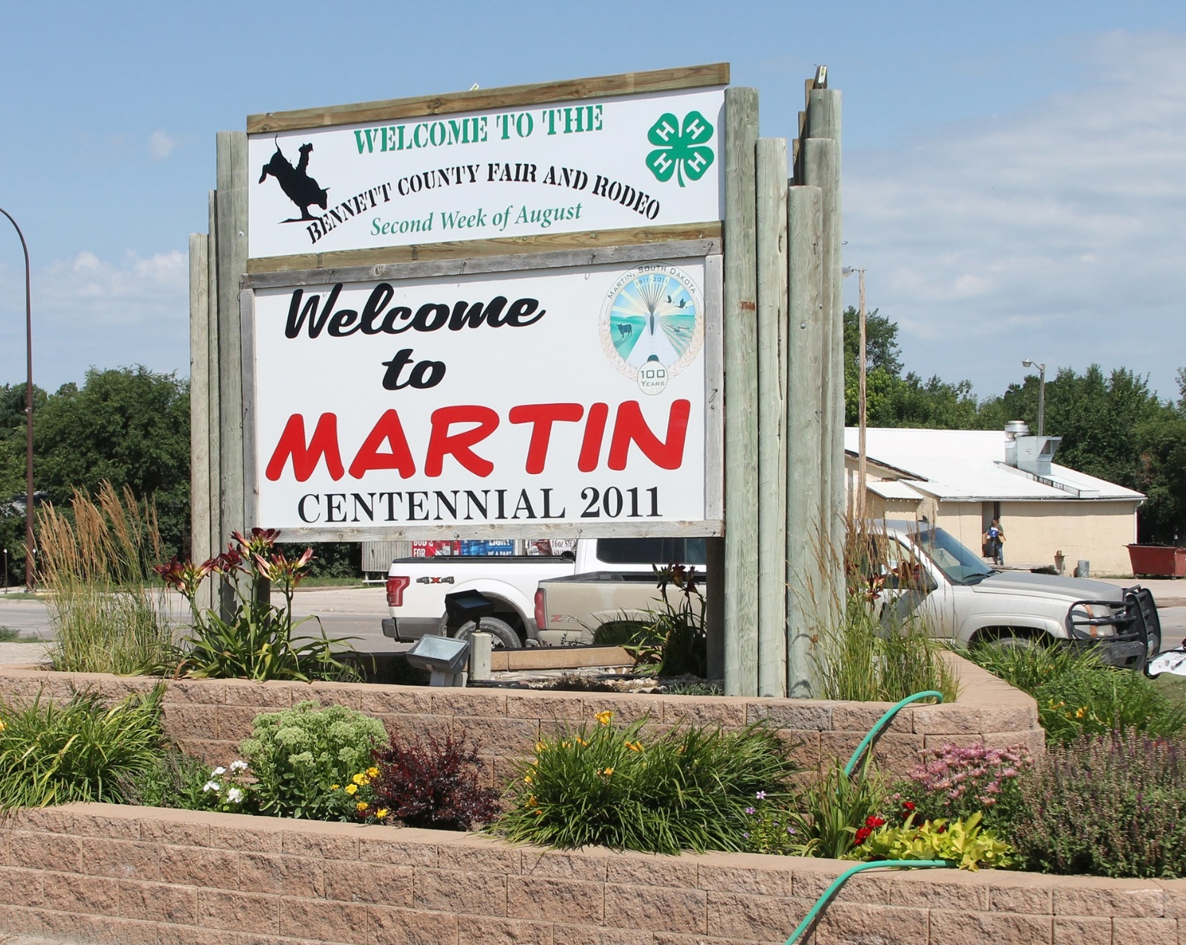
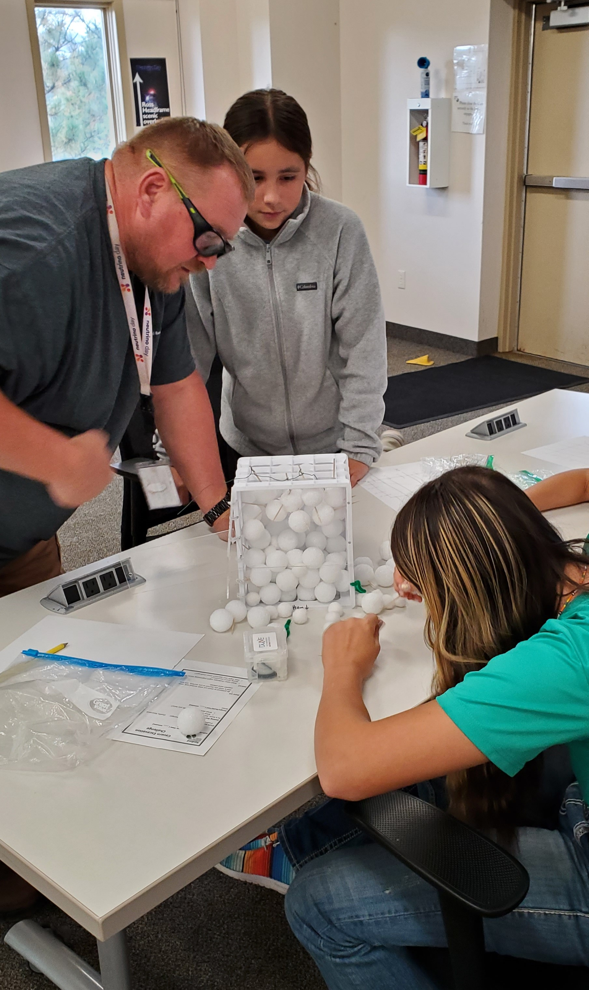
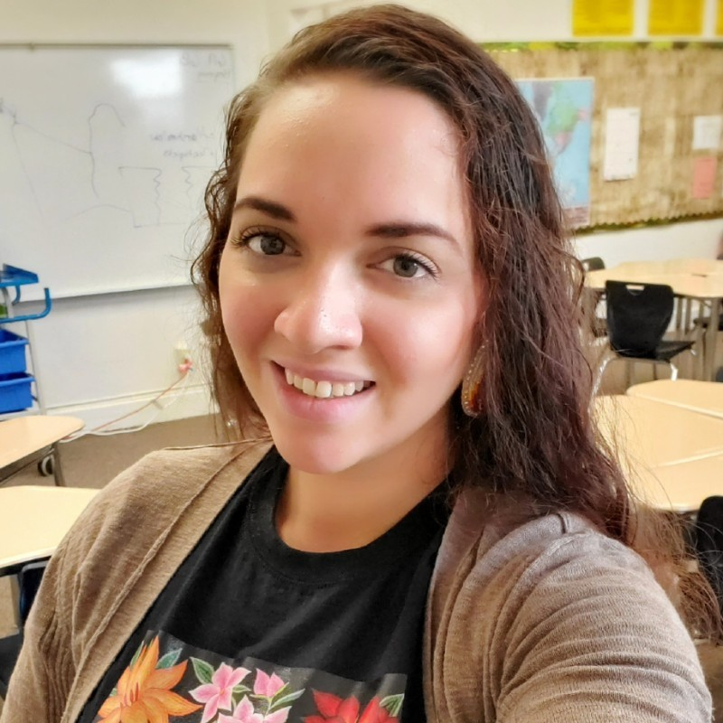
Cultivating Curiosity: Bennett County

Slide 7
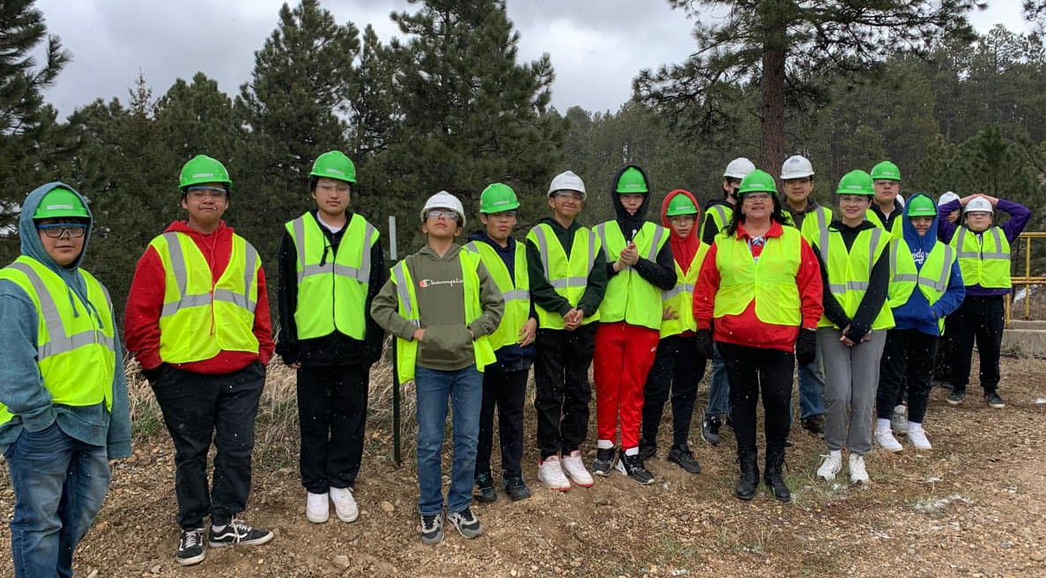
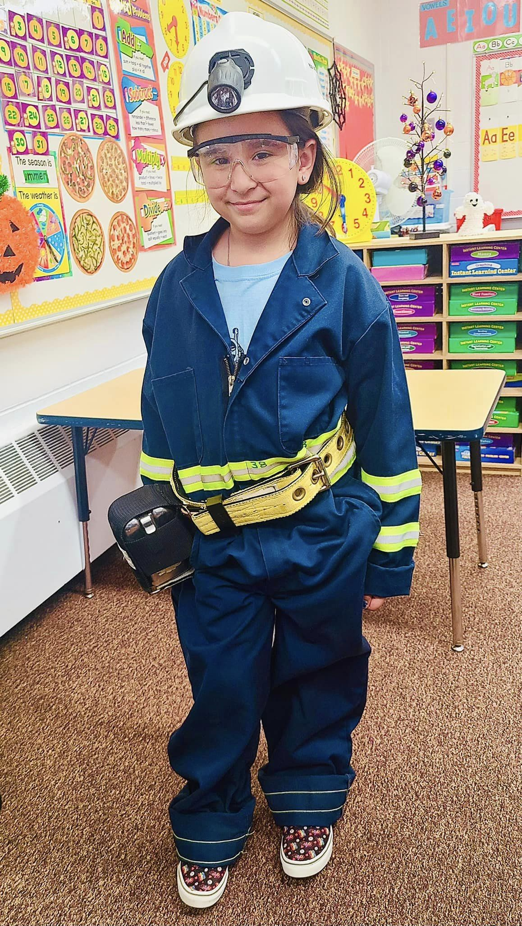
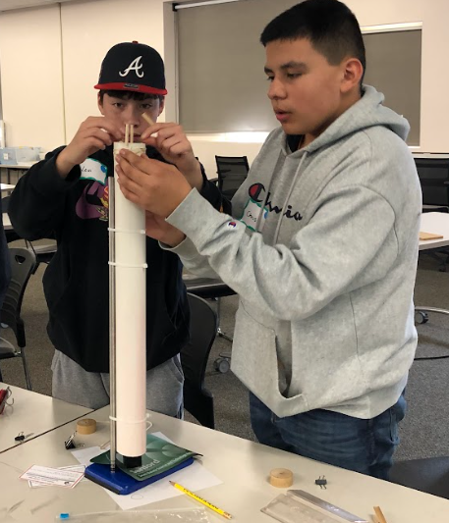
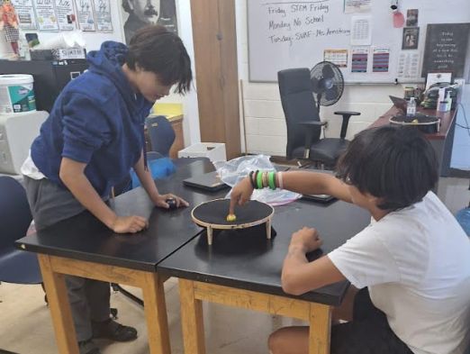
Supporting Communities: Cheyenne Eagle Butte

Slide 8
E&O: Breadth vs. Depth – Yes!

Slide 9
E&O: Learning and Next Steps

Slide 10
Education and Outreach: By the Numbers
School Year | 2018-2019 (pre-COVID) | 2019-2020 (COVID begins) | 2020-2021 (during COVID) | 2021-2022 | 2022-2023 | 2023-2024 (July – Dec)
Field Trips | 1,117 | 254 | 58 | 485 | 972 | 530
Classroom Presentations | 6,704 | 3,704 | 2,005 | 14,038 | 12,799 | 5,828
Curriculum Units | 3,598 | 3,236 | 3,384 | 3,718 | 2,554 | 2,100
Other | 1,055 | 918 | 298 | 1,468 | 1,596 | 795
Total Student Contacts | 12,474 | 8,112 | 5,745 | 19,709 | 17,921 | 9,253

Slide 11
CAC Review Recommendations Status
ID # | Recommendation | Status
10 | Visit universities to discuss the types of internships available at SURF with an emphasis on American Indian universities and colleges. | On-going collaboration with IDEA for “best” next steps Updated process created with HR for Jack Headley Internship Continued work to connect with SD’s Native students – IES, LNI, TCUs
36 | Develop a process to evaluate the specific needs of each school when giving presentations. | Standardizing with ISO Curriculum Standard is highest priority Moving to guidance for presentations next

