Slide 1

Detection of
Cosmogenic (B)SM Signals with
Nuclear Inelastic Scattering
Detection of
Cosmogenic BDM Signals with
Nuclear Inelastic Scattering
Doojin Kim
(doojin.kim@tamu.edu)
CETUP* 2024 Workshop
SURF, Lead/Deadwood, SD, July 1st, 2024

Slide 2
Outline
Motivations for Boosted Dark Matter (BDM)
  Status of weakly interacting massive particle (WIMP) searches
  Conventional WIMP searches vs. BDM searches
Search for Boosted Dark Matter
  Motivations for inelastic scattering of BDM
  Scenarios of energetic cosmic-ray BDM (CRDM)
Inelastic Scattering of Target Nucleus by BDM
  Advantages of nuclear inelastic scattering of BDM
  Nuclear inelastic scattering and Gamow-Teller (GT) transitions
Nuclear Inelastic Scattering of CRDM at Neutrino Detectors
  Background considerations: 𝜈-induced nuclear inelastic scattering
  Search prospects of CRDM at neutrino detectors

Slide 3
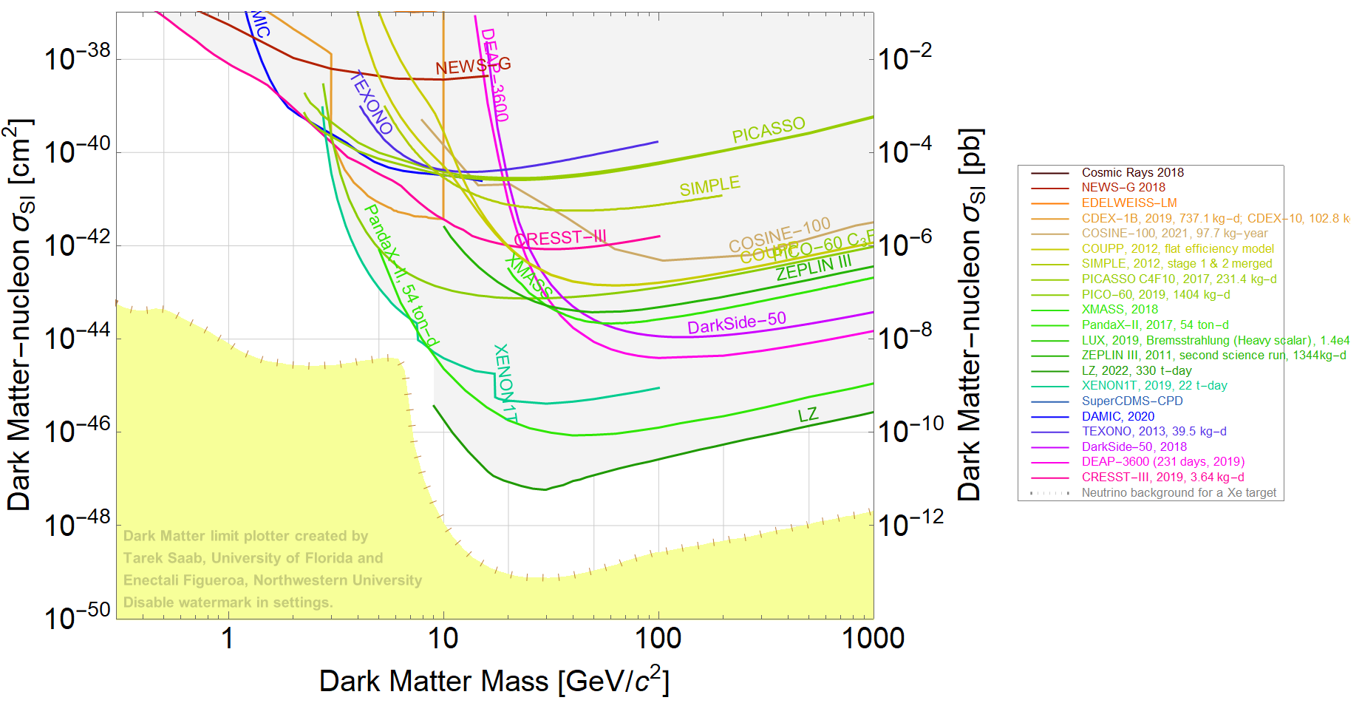
Nonrelativistic Dark Matter Searches
[Dark matter limit plotter]
No observation of DM signatures via non-gravitational interactions while many searches/ interpretations are designed/performed under NONrelativistic WIMP/WIMP-like scenarios

Slide 4
Alternative Ideas
Non-conventional DM production: relativistic DM, etc
Lower mass: MeV-range light dark matter, super-/ultra-light dark matter etc
Higher mass: primordial black holes, extended objects etc
Lower cross-section: increasing the volume of detectors (e.g., XENONnT, DarkSide20k, LZ etc)

Slide 5
Conventional vs. Alternative Approach
Traditional approaches for DM searches:
  Weak-scale mass
  Weakly-coupled
  Minimal dark sector
  Elastic scattering
  Non-relativistic
Modified approaches for DM searches:
  Other mass scale: e.g., PeV, sub-GeV, MeV, keV, meV, …
  (Possibly) weaker coupling to the SM: e.g., vector portal, scalar portal, axion-like particle portal, …
  “Flavorful” dark sector: e.g., more dark-sector species, unstable heavier dark sector states, …
  (In)elastic scattering
  Relativistic

Slide 6
Conventional vs. Alternative Approach
Traditional approaches for DM searches:
  Weak-scale mass
  Weakly-coupled
  Minimal dark sector
  Elastic scattering
  Non-relativistic
Modified approaches for DM searches:
  Other mass scale: e.g., PeV, sub-GeV, MeV, keV, meV, …
  (Possibly) weaker coupling to the SM: e.g., vector portal, scalar portal, axion-like particle portal, …
  “Flavorful” dark sector: e.g., more dark-sector species, unstable heavier dark sector states, …
  (In)elastic scattering
  Relativistic
⇒ Inelastic scattering of boosted dark matter (this talk)!

Slide 7
Outline
Motivations for Boosted Dark Matter (BDM)
  Status of weakly interacting massive particle (WIMP) searches
  Conventional WIMP searches vs. BDM searches
Search for Boosted Dark Matter
  Motivations for inelastic scattering of BDM
  Scenarios of energetic cosmic-ray BDM (CRDM)
Inelastic Scattering of Target Nucleus by BDM
  Advantages of nuclear inelastic scattering of BDM
  Nuclear inelastic scattering and Gamow-Teller (GT) transitions
Nuclear Inelastic Scattering of CRDM at Neutrino Detectors
  Background considerations: 𝜈-induced nuclear inelastic scattering
  Search prospects of CRDM at neutrino detectors

Slide 8
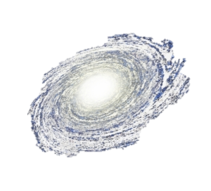




“Vanilla” BDM Scenario: Elastic BDM (eBDM)
Somehow boosted (will discuss later)
$$χ_{1}$$
$$χ_{1}$$
$$e/N$$
$$e/N$$
Simple electron/nucleon recoil
⇒ Featureless signal (significantly) suffering from BGs.
A way out?⇒ Inelastic Scattering of Boosted Dark Matter (BDM)

Slide 9









INelastic Scattering Channels
Inelastic scattering of BDM (iBDM) itself
$χ_{1}$: dark matter
$χ_{2}$: heavier unstable dark-sector state
$$χ_{1}$$
[DK, Park, Shin, PRL (2017)]
$$χ_{2}$$
Additional visible decay products & possibly displaced decay vertex
$$χ_{1}$$
$$e/N$$
$$e/N$$
Inelastic scattering of target particle (nuclear inelastic scattering, this talk)
$$χ_{1}$$
$$χ_{1}$$
Characteristic photon lines
$$N$$
$$N^{∗}$$
$$N$$
Incoming dark matter should carry a large enough energy to
induce inelastic scattering!

Slide 10
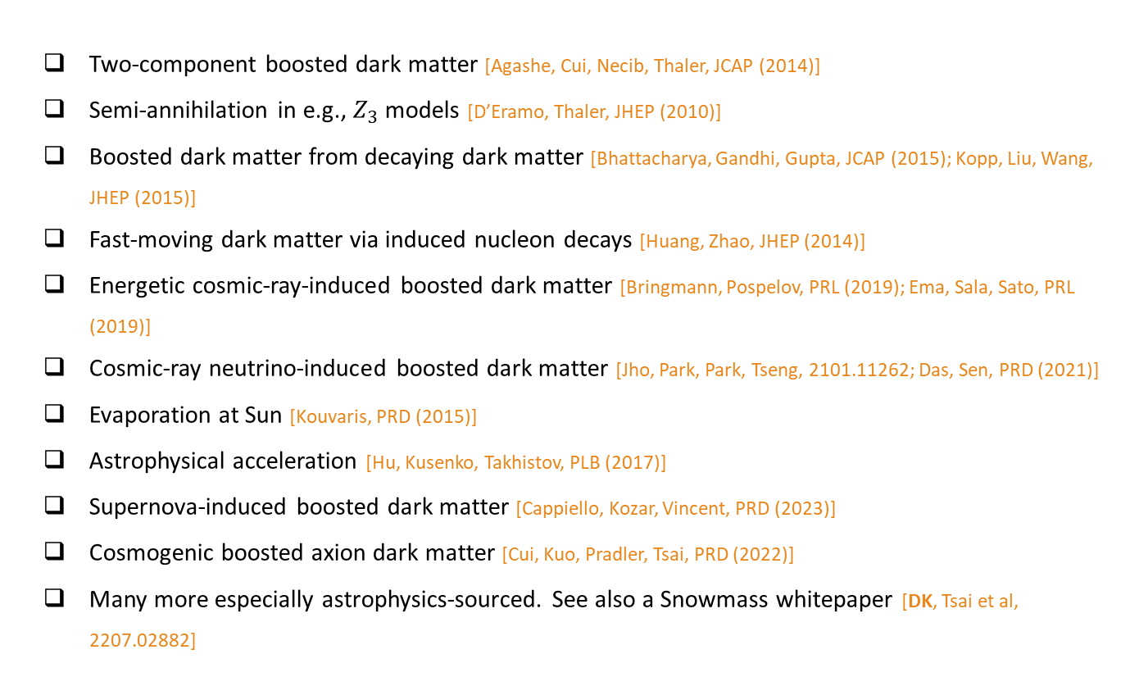
How to Boost Dark-Matter Particles
Two-component boosted dark matter [Agashe, Cui, Necib, Thaler, JCAP (2014)]
Semi-annihilation in e.g., $Z_{3}$ models [D’Eramo, Thaler, JHEP (2010)]
Boosted dark matter from decaying dark matter [Bhattacharya, Gandhi, Gupta, JCAP (2015); Kopp, Liu, Wang, JHEP (2015)]
Fast-moving dark matter via induced nucleon decays [Huang, Zhao, JHEP (2014)]
Energetic cosmic-ray-induced boosted dark matter [Bringmann, Pospelov, PRL (2019); Ema, Sala, Sato, PRL (2019)]
Cosmic-ray neutrino-induced boosted dark matter [Jho, Park, Park, Tseng, 2101.11262; Das, Sen, PRD (2021)]
Evaporation at Sun [Kouvaris, PRD (2015)]
Astrophysical acceleration [Hu, Kusenko, Takhistov, PLB (2017)]
Supernova-induced boosted dark matter [Cappiello, Kozar, Vincent, PRD (2023)]
Cosmogenic boosted axion dark matter [Cui, Kuo, Pradler, Tsai, PRD (2022)]
Many more especially astrophysics-sourced. See also a Snowmass whitepaper [DK, Tsai et al, 2207.02882]

Slide 11
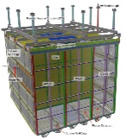
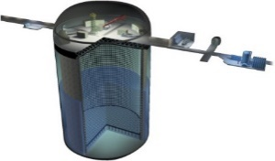
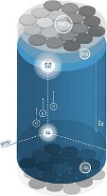
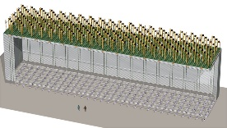
Cosmogenic Boosted/Relativistic Dark Matter
Dark matter
Dark matter
Dark matter
Surface detectors,
e.g., ProtoDUNE, SBN
Earth surface
Underground detectors, e.g., DUNE, JUNO, SK/HK
Simply waiting for signals coming from the universe today
Models of creating boosted dark matter predict other particles
(Often) probing cosmological/ambient dark matter (nonrelativistic) through its boosted “partners/population”

Slide 12







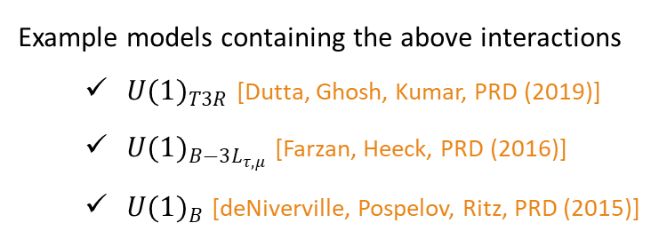
Benchmark Dark-Matter Interactions
$$ℒ⊃g_{D}A_{μ}^{′}\overline{χ}γ^{μ}χ+εQ_{b}A_{μ}^{′}\overline{q}γ^{μ}q$$
$$χ$$
$$\overline{q }$$
$$A′$$
$$A′$$
$$\overline{χ }$$
$$q$$
Example models containing the above interactions
  ${U(1)}_{T3R}$ [Dutta, Ghosh, Kumar, PRD (2019)]
  ${U(1)}_{B−3L_{τ,μ}}$ [Farzan, Heeck, PRD (2016)]
  ${U(1)}_{B}$ [deNiverville, Pospelov, Ritz, PRD (2015)]

Slide 13
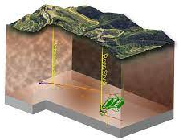




Cosmic-Ray Boosted Dark Matter (CRDM)
Energetic SM (cosmic rays)
SM
Same interaction structure is used, (ignoring other dark-sector species)
Non-relativistic $χ$
Boosted $χ$
…
Boosted $χ$
$$χ$$
Target in
detector
Energetic recoil etc.

Slide 14
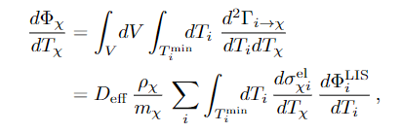
CRDM Flux Distributed
Effective diffusion zone ≈ 0.997 kpc
Local interstellar flux of cosmic ray species i
Dark-matter number density
DM-cosmic ray elastic scattering
The CRDM flux is not single-valued but distributed.

Slide 15
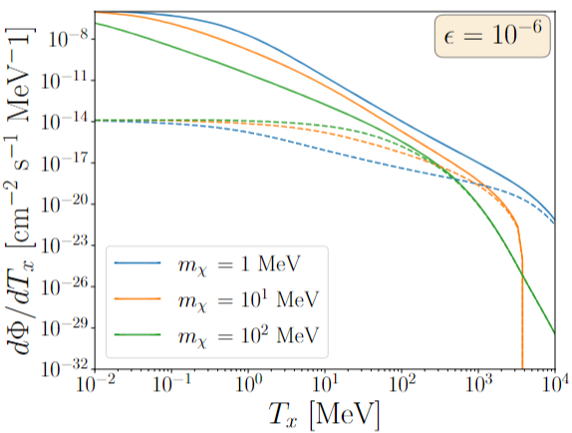
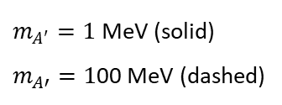
CRDM Fluxes of Two Benchmark Study Points
$m_{A′}=1$ MeV (solid)
$m_{A′}=1$00 MeV (dashed)
Contributions from cosmic protons and helium are considered.
The CRDM flux is not significantly large.

Slide 16
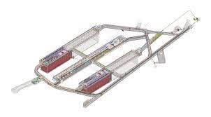
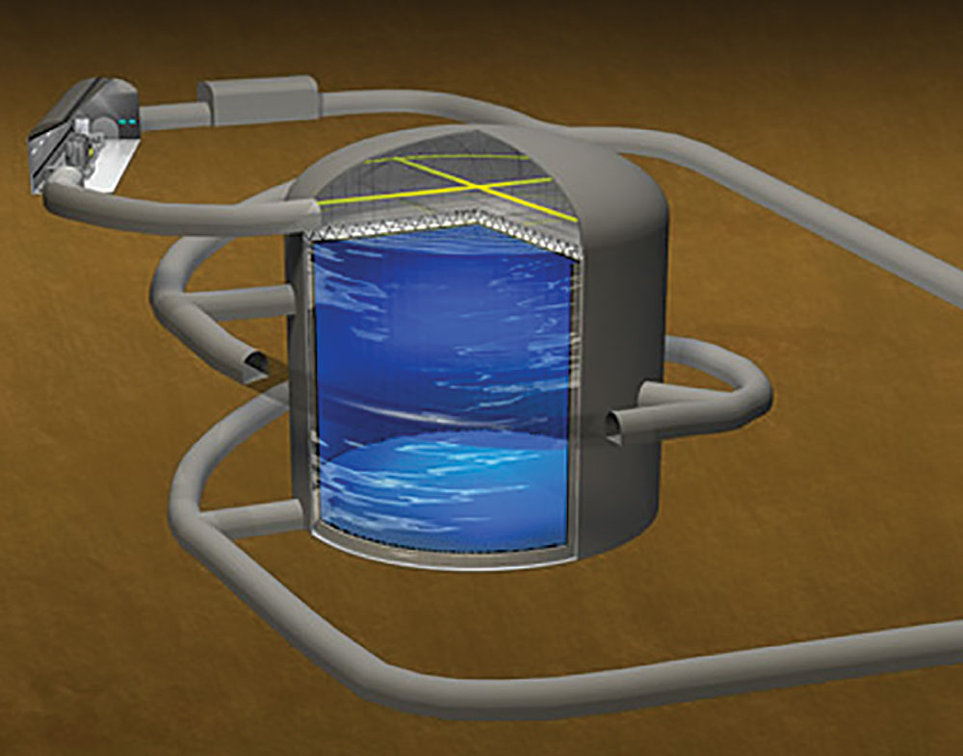
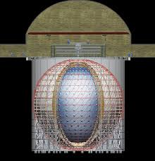
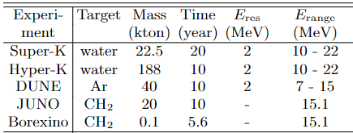
Benchmark Experiments: Large-Volume Neutrino Detectors
Past/existing
Upcoming
𝜈 detectors: Large fiducial masses

Slide 17
Outline
Motivations for Boosted Dark Matter (BDM)
  Status of weakly interacting massive particle (WIMP) searches
  Conventional WIMP searches vs. BDM searches
Search for Boosted Dark Matter
  Motivations for inelastic scattering of BDM
  Scenarios of energetic cosmic-ray BDM (CRDM)
Inelastic Scattering of Target Nucleus by BDM
  Advantages of nuclear inelastic scattering of BDM
  Nuclear inelastic scattering and Gamow-Teller (GT) transitions
Nuclear Inelastic Scattering of CRDM at Neutrino Detectors
  Background considerations: 𝜈-induced nuclear inelastic scattering
  Search prospects of CRDM at neutrino detectors

Slide 18
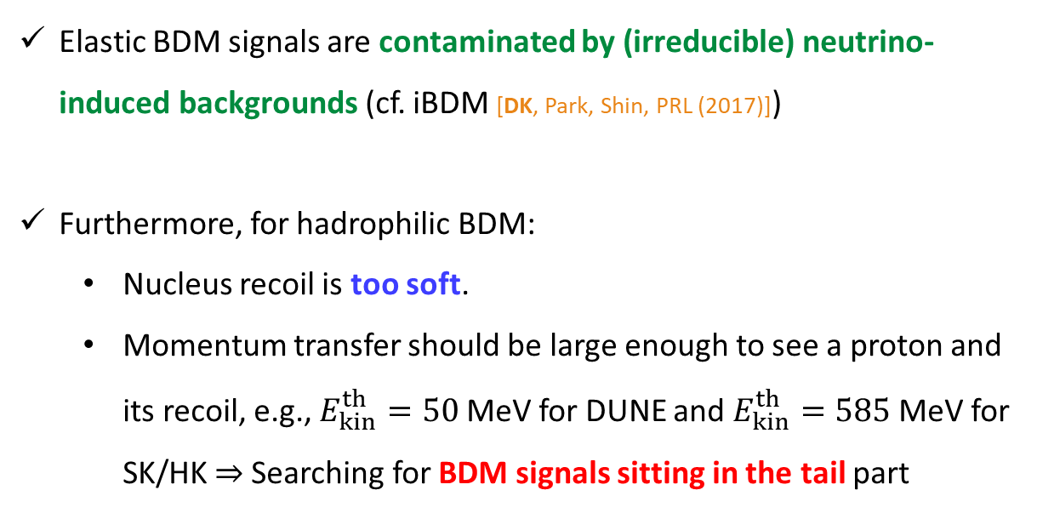
Challenges in BDM Detection
Elastic BDM signals are contaminated by (irreducible) neutrino-induced backgrounds (cf. iBDM [DK, Park, Shin, PRL (2017)])
Furthermore, for hadrophilic BDM:
  Nucleus recoil is too soft.
  Momentum transfer should be large enough to see a proton and its recoil, e.g., $E_{kin}^{th}=50$ MeV for DUNE and $E_{kin}^{th}=585$ MeV for SK/HK ⇒ Searching for BDM signals sitting in the tail part

Slide 19
BDM Detection with Nuclear Inelastic Scattering
By contrast, with nuclear inelastic scattering,
  Larger chunk of phase space is accessible: photon detection threshold is small.
  Much less background contamination is expected: line-like signal vs. energy range

Slide 20






Inelastic Scattering of Target Nucleus
$$χ$$
$$χ$$
Cross-section using the multipole expansion formalism [Dutta, Huang, Newstead, Pandey, PRD (2022)]
$$N$$
Characteristic de-excitation photon line signature
$$N^{∗}$$
$$γ$$

Slide 21



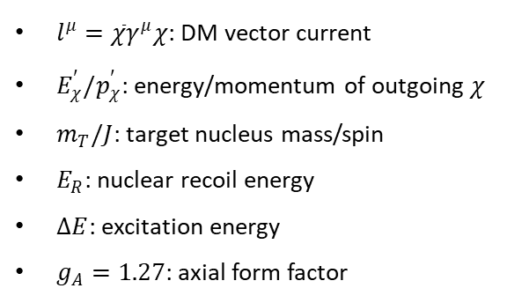
Nuclear Inelastic Scattering and Gamow-Teller Transitions
$l^{μ}=\overline{χ}γ^{μ}χ$: DM vector current
$E_{χ}^{′}/p_{χ}^{′}$: energy/momentum of outgoing $χ$
$m_{T}/J$: target nucleus mass/spin
$E_{R}$: nuclear recoil energy
$ΔE$: excitation energy
$g_{A}=1.27$: axial form factor
Gamow-Teller (GT)
transition strength
(Dominant nuclear inelastic scattering processes [Dutta, Huang, Newstead, Pandey, PRD (2022)])

Slide 22
Calculating Gamow-Teller Transition Strengths
¹⁶O: GT strengths derived from magnetic dipole measurements [Küchler, Richter, Spamer, Steffen, Knüpfer, NPA (1983); Tilley, Weller, Cheves, NPA (1993)]
¹²C: GT strengths derived from the neutrino-nucleus scattering measurement at KARMEN [Drexlin et al, PLB (1991); Suliga, Beacom, PRD (2023)]
⁴⁰Ar: GT strengths calculated with the shell model-based code package BIGSTICK [Johnson, Ormand, McElvain, Shan, arXiv:1801.08432] and rescaled with experimental measurement data [Tornow, Tonchev, Finch, Krishichayan, Wang, Hayes, Yeomans, Newmark, PLB (2022)]
  The strengths of individual lines are not measured.

Slide 23
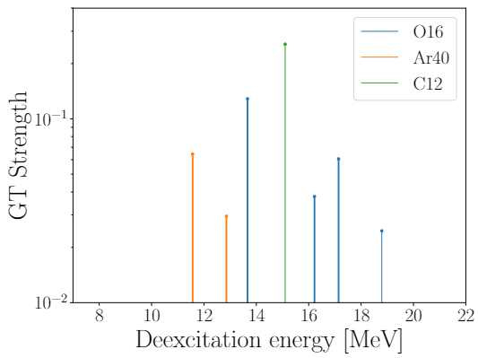
Gamow-Teller Transition Strengths
Major lines involve MeV-scale energy deposits.

Slide 24
Benchmark Experiments: Large-Volume Neutrino Detectors
Past/existing
Upcoming
𝜈 detectors: Large fiducial masses & MeV-range energy thresholds

Slide 25
Outline
Motivations for Boosted Dark Matter (BDM)
  Status of weakly interacting massive particle (WIMP) searches
  Conventional WIMP searches vs. BDM searches
Search for Boosted Dark Matter
  Motivations for inelastic scattering of BDM
  Scenarios of energetic cosmic-ray BDM (CRDM)
Inelastic Scattering of Target Nucleus by BDM
  Advantages of nuclear inelastic scattering of BDM
  Nuclear inelastic scattering and Gamow-Teller (GT) transitions
Nuclear Inelastic Scattering of CRDM at Neutrino Detectors
  Background considerations: 𝜈-induced nuclear inelastic scattering
  Search prospects of CRDM at neutrino detectors

Slide 26
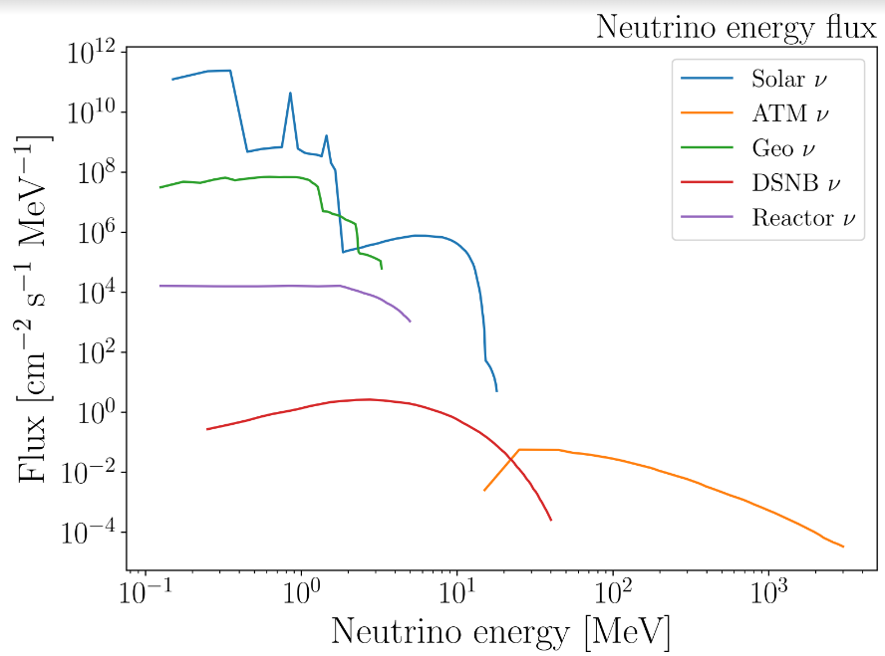
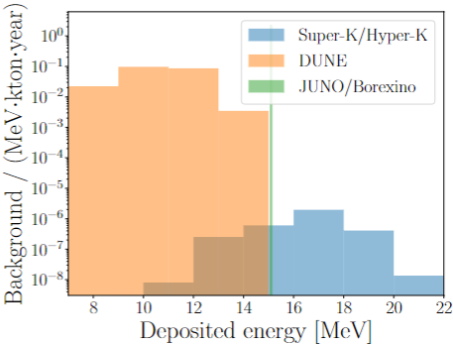
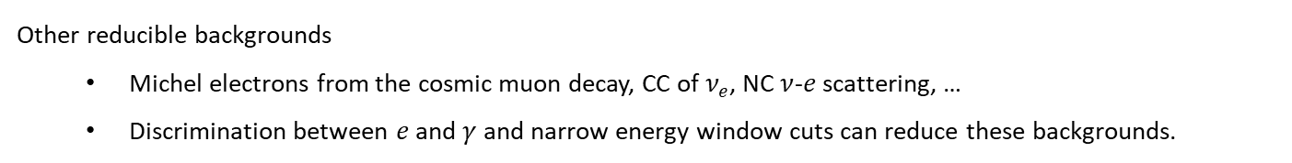
Background Considerations
Irreducible background: nuclear inelastic scattering of 𝜈’s (i.e., $νN→νN^{∗},N^{∗}→Nγ$)
Relevant
Other reducible backgrounds
  Michel electrons from the cosmic muon decay, CC of $ν_{e}$, NC $ν$-$e$ scattering, …
  Discrimination between $e$ and $γ$ and narrow energy window cuts can reduce these backgrounds.

Slide 27
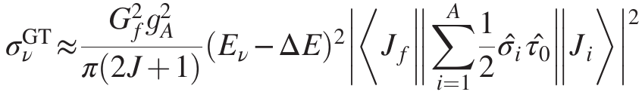
Inelastic Neutrino-Nucleus Scattering
Same GT transition strength
Measuring inelastic 𝜈-N scattering itself is an interesting opportunity.
  Carbon lines at JUNO [Suliga, Beacom, PRD (2023)]
  Oxygen lines at HK [work in progress]

Slide 28

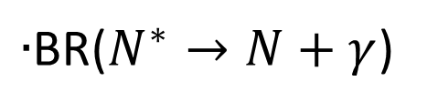
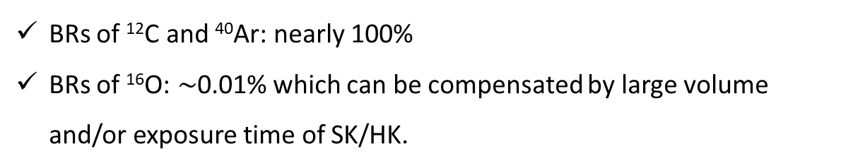
Estimating Sensitivity Reaches
$∙$BR($N^{∗}→N+γ$)
BRs of ¹²C and ⁴⁰Ar: nearly 100%
BRs of ¹⁶O: $\sim$0.01% which can be compensated by large volume and/or exposure time of SK/HK.

Slide 29
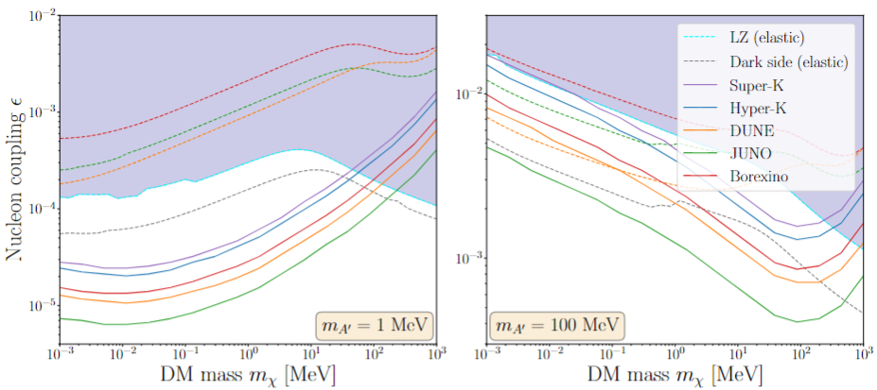
Results: Sensitivity in Coupling Space
[Dutta, Huang, DK, Newstead, Park, Shaukat Ali, arXiv:2402.04184]
Nuclear inelastic scat. allowing probing more parameter space than elastic scat.

Slide 30
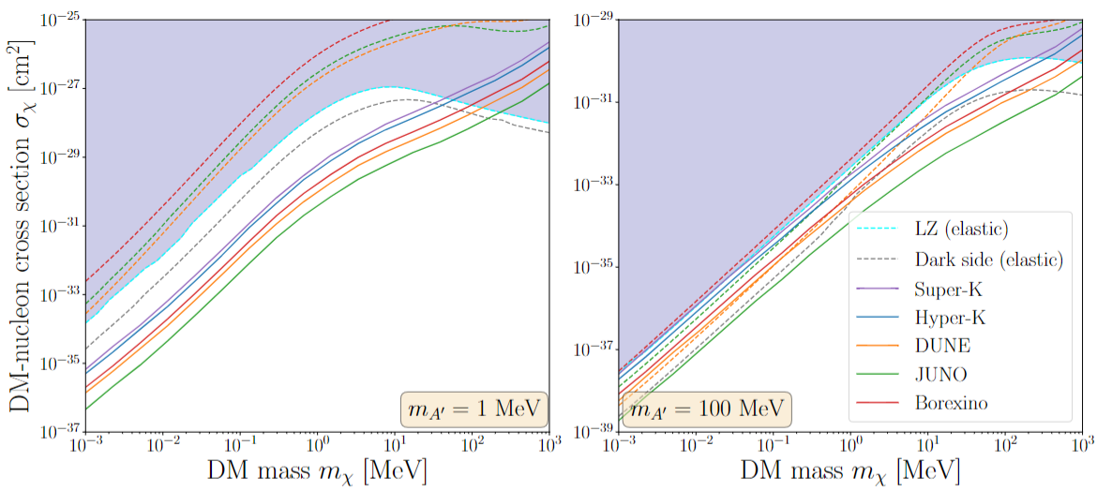
Result: Comparison with Existing Limits
CRESST-III
CRESST-III
[Dutta, Huang, DK, Newstead, Park, Shaukat Ali, arXiv:2402.04184]
Nuclear inelastic scat. allowing probing more parameter space than direct detection exp.

Slide 31
Conclusions
Cosmogenic boosted dark matter searches in neutrino experiments are promising.
  They can provide an alternative avenue to explore dark sector physics (including dark matter).
  There are many ongoing and projected large-volume neutrino experiments including DUNE in which they can be tested.
Inelastic scattering channels can provide unique opportunities.
  Inelastic scattering of target nucleus
Thank you!

Slide 32
Bonus Slides

Slide 33
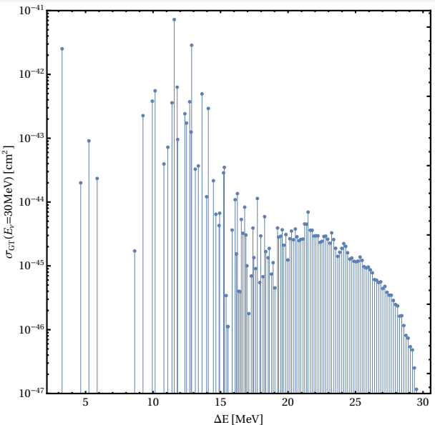
Transition Lines of Argon
[Dutta, Huang, Newstead, Pandey, PRD (2022)]

