Slide 1
Introduction to DAMSA Experiment
CETUP*2024
The Institute @ SURF, Lead, SD
June 28, 2024
Jaehoon Yu
Univ. of Texas, Arlington
For DAMSA Collaboration

Slide 2
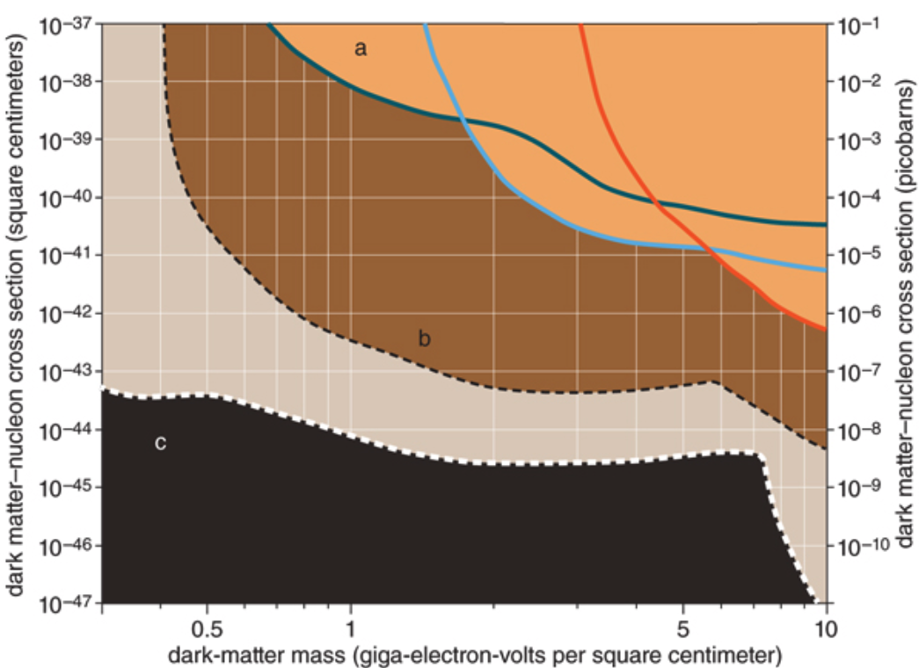
Physics Motivation For DSP
Direct searches have challenges in kinematic reach, leaving low mass range un-explored
Strategy:
  Search for dark sector particles in unexplored kinematic regime
  Make and discover DSPs in an accelerator
  Establish infra to better understand DM
No DM
Focus
here
Future: SuperCDMS SNOLAB
Solar Neutrino Background

Slide 3
What is DAMSA?
A very short baseline dark sector particle (DSP) search and discovery experiment at high intensity p beams
Stands for Dump produced Aboriginal Matter Searches at an Accelerator (DAMSA)
  담사 (潭思) = 깊은생각 – Rumination or Reflection
    J. Yu et al., PRD 107, L031901 (2023)
Aims to discover DSP’s in the low mass regime at an accelerator ➔ E_{beam} below the pion threshold beneficial
  Originally developed for 600MeV proton beams at a nuclear rare isotope facility
  The 800MeV PIP-II and the ACE beams at Fermilab fit the bill
DAMSA can be at any accl. facility, including CERN

Slide 4
Unique Opportunity on Dark Sector
Many DM search experiments in beams BUT
None of them at a super-short baseline (~<1m)!
  Yes, it presents a huge challenge
This makes DAMSA unique!
Beam dump facility at Fermilab will be designed to take advantage of this uniqueness.

Slide 5
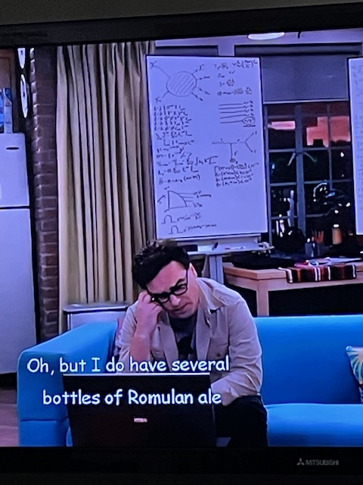
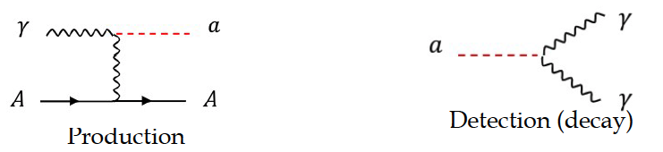
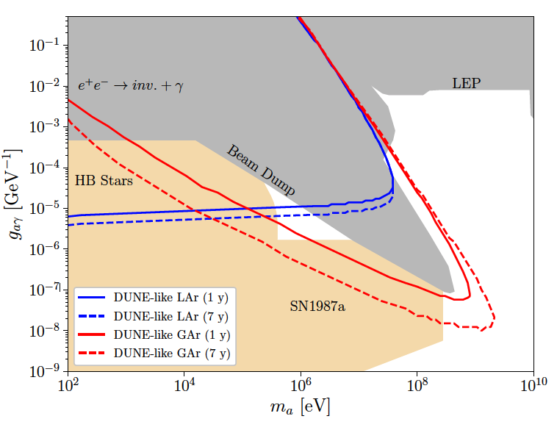
DAMSA Physics Strategy
Photons are the sources for dark sector particle production
  Use case: Search for Axion-like particles (ALP) in two-photon final state via the Primakoff process
  Brdar, et al., PRL126, 201801 (2021)
What is the most peculiar feature of the DUNE sensitivity reach?
This edge limited (ceiling) by the distance from the source to the detector
  Kim, Yu et al., 2401.09529 (2024)

Slide 6
DAMSA Physics Strategy
Photons are the sources for dark sector particle production
  Use case: Axion-like particles (ALP) in two-photon final state via the Primakoff process
Produce as many photons as possible from the beam
Capture as many ALPs in as wide a mass range as possible
Mitigate the backgrounds from neutral particles, using two EM particle final states
Place the detector very close to the beam
Note : ND-GAr only in DUNE Phase-II
Focus here
  Brdar, et al., PRL126, 201801 (2021)

Slide 7
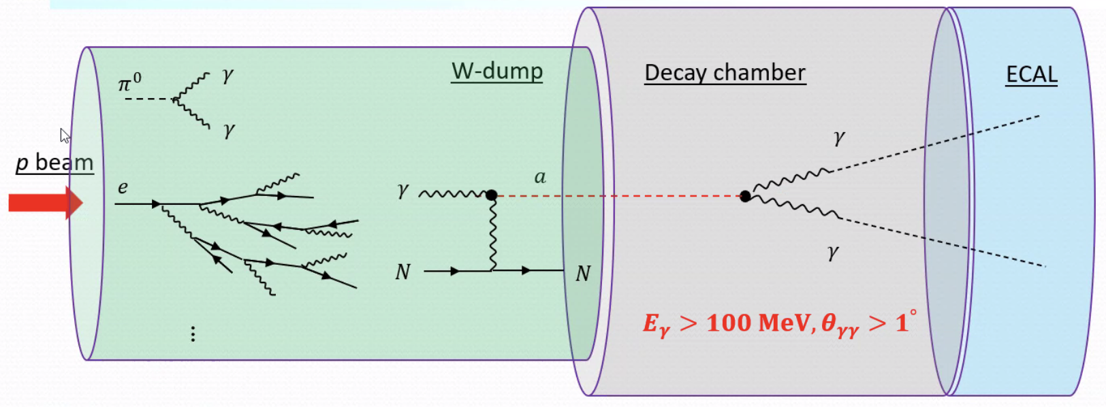
DAMSA Exp. Concept
Inject and absorb as many protons and produce as large number of γ in the dump as possible
Allow higher coupling ALP’s to decay in the vacuum w/ as small number of neutrons escaping the dump as possible
Place the detector as close to the dump as possible on axis to expand the mass reach to higher mass region
NOT TO SCALE
D=10m, L = full containment
D=1m, L=1m
D=10m, L=10m

Slide 8





The three key elements
The bad
The ugly
The good
The beam
The dump
The detector

Slide 9
Accelerator Complex in the PIP-II Era
PIP-II (Proton Improvement Plan – II) provides
  New SRF LINAC for proton injection into Booster at 800MeV
  Booster cycle rates upgrade for increased proton beam intensity at 8GeV for 1.2MW beam power from main injector
PIP-II LINAC is the essential first element for DUNE
  Total proton current of 2mA ➔up to ~4x10²³ PoT/yr
  <2% used for down stream
PIP-II era begins in 2029, DUNE 2031
  Mu2e (8GeV)
  Fixed target, test beams (120 GeV)
  0.8 GeV beam available for other exp, such as beam dump experiments like DAMSA
TeV Field
B. Flauger

Slide 10
Physics Driven DAMSA Detector
Discover dark sector particles beyond 2γ ALP, such as
  Dark photon / ALP to e+e-
  Low mass dark matter, etc
Based on the signal and neutron background mitigation studies, using GEANT4 ➔ Detector assumptions
  Fine granularity for a superb shower position and angular resolutions for 2 EM particle vertex pointing & DCA precision better than 1cm in the vacuum decay volume
  Fast timing capability at sub-ns level (~100ps) for two EM particle arrival time differences
  Capability of measuring up to 500 MeV photons with as fine a mass resolution as accomplishable

Slide 11
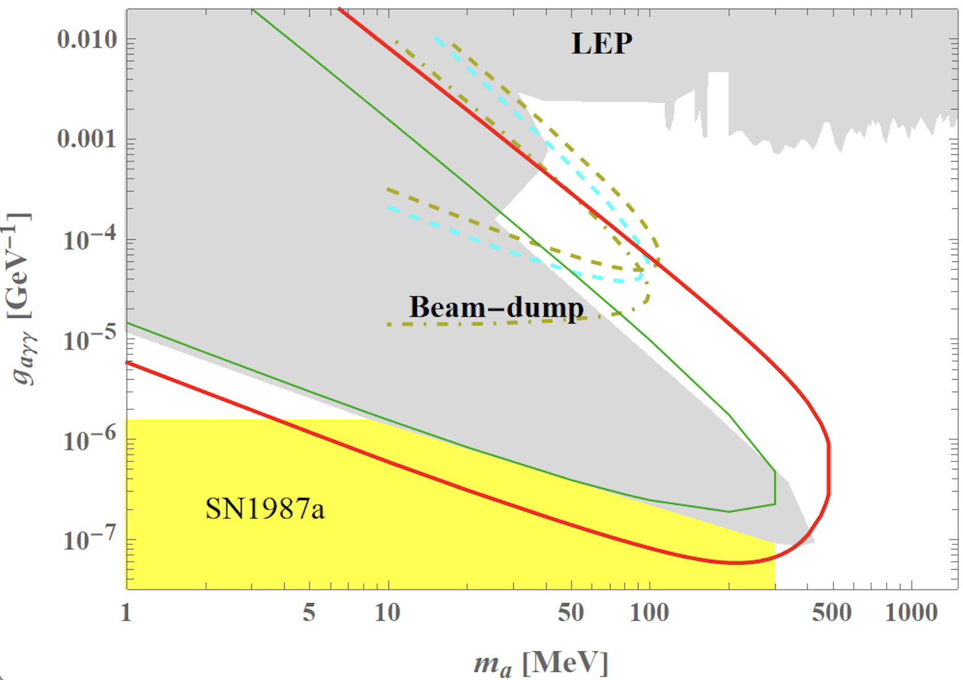
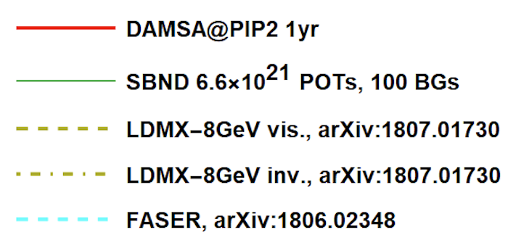
DAMSA Sensitivity – Running Experiments
Year 2031

Slide 12
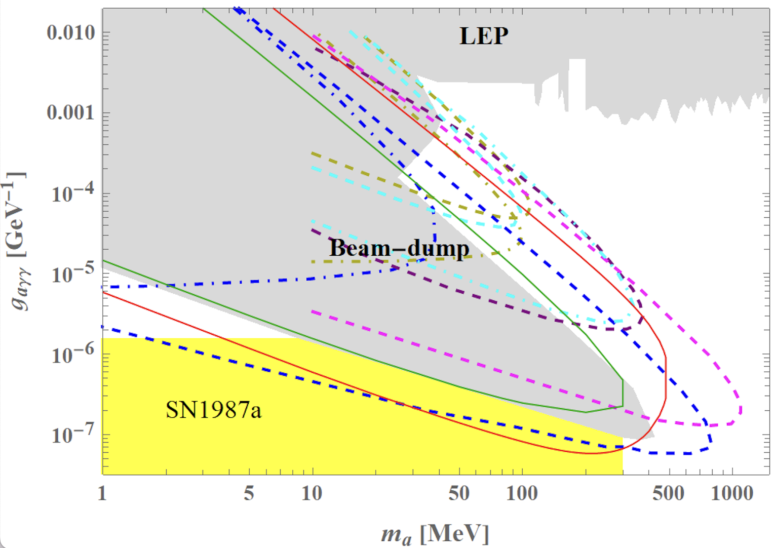
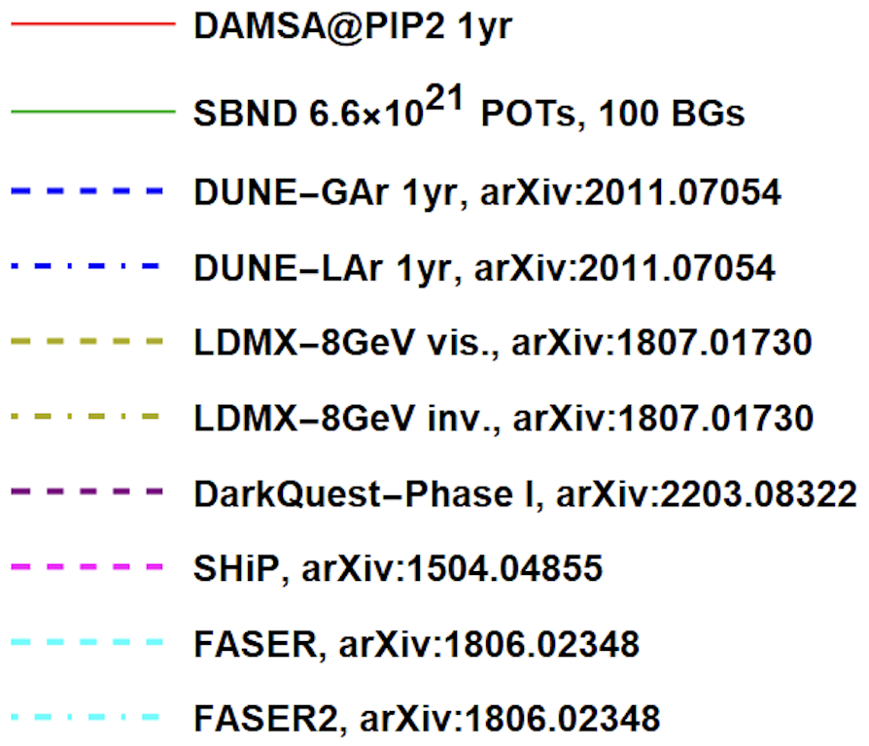
DAMSA Sensitivity – All Experiments
Apologize for missing ones

Slide 13
Detector Design Concept
2DST W-Scint
ECAL (~13 X₀)
Tail catcher
ECAL (~5 X₀)
Vacuum Decay Chamber
HD HG-ECAL - γ converter
(4 low X₀ layers ~3X₀)
6 layers of Si trk
Magnet

Slide 14
The Little DAMSA
The question: Can we access the targeted parameter space with a dramatically smaller scale experiment (2401.09529)?
  Concept Study: L_{dump}=1m, L_{vac}=10m, θ_{det}=0.5rad, N_{yr}=1yr
  Smaller scale: L_{dump}=1m, L_{vac}=1m, θ_{det}=0.05rad, N_{yr}=3mo

Slide 15
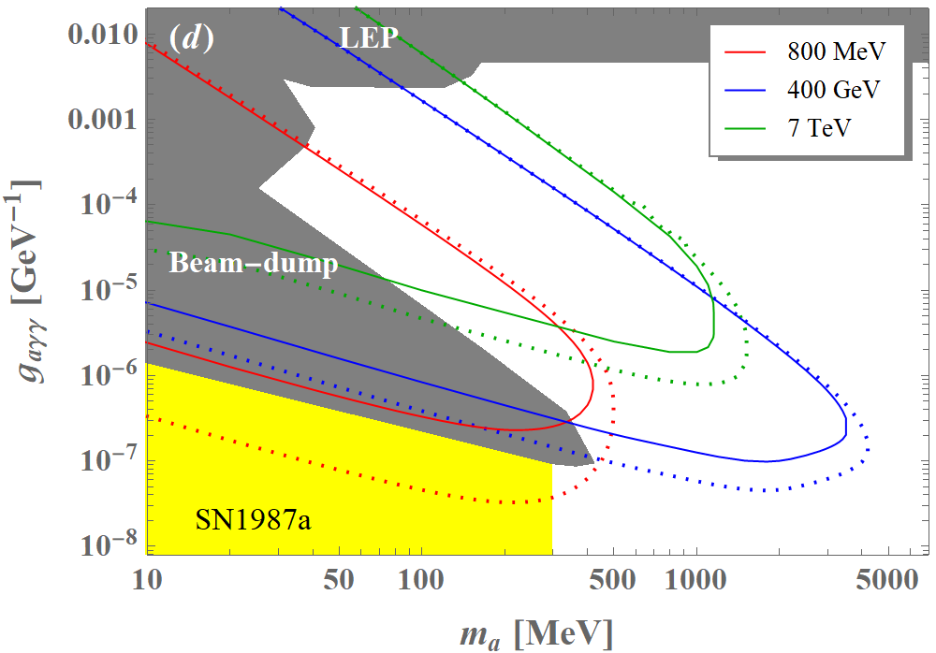
Small Scale DAMSA Sensitivity
Solid lines w/
Smaller dimensions
3mo data taking
D.Kim, Yu, et. al,
arxiv:2401.09529

Slide 16



The Little DAMSA That Could!
The question: Can we access the targeted parameter space with a dramatically smaller scale experiment (2401.09529)?
Further studied the combinations of the following cases
  Reduce the detector radius to 0.1m from 1.1m, same depth (10⁻²)
  Reduce the vacuum chamber radius and length to 0.1m from 1m (10⁻³)
  Reduce the W dump length to 0.5m (case 1) & 0.25m (case 2)
W Dump
L=0.5/0.25m
R=0.5m
Vacuum
L=0.1m,
R=0.1m
Proton
Detector
R=0.1m

Slide 17
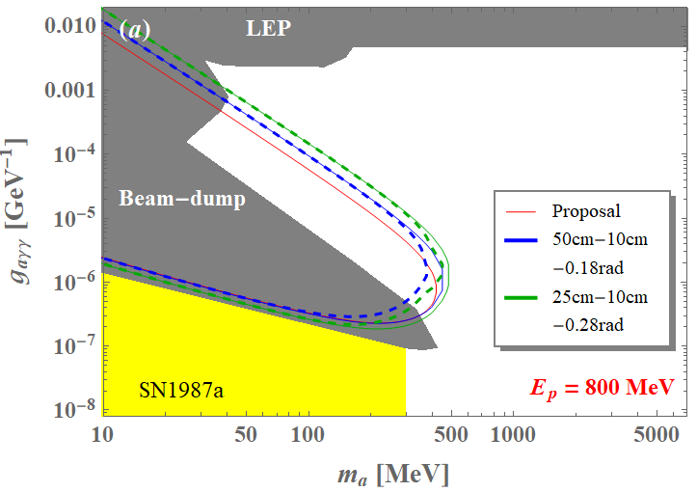
The Little DAMSA Sensitivity
3mo data taking
1m-1m-0.05rad

Slide 18
Why Pilot DAMSA?
Given the results of the Little DAMSA sensitivity study, it is possible for us to think about very small pilot detector
Primary issues to demonstrate
  Physics case feasibility
  Background validation and handling
  Necessity for beam dump facility
Strategy for pilot
  Find a pathway to focus on physics case feasibility test
    Need a facility that has as little neutron background from the dump as possible
  Focus on the fast-decaying particles with high coupling

Slide 19
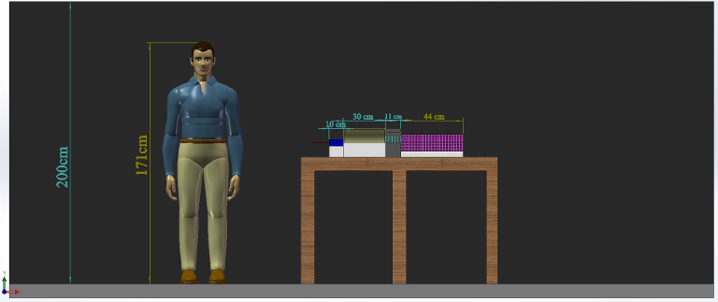
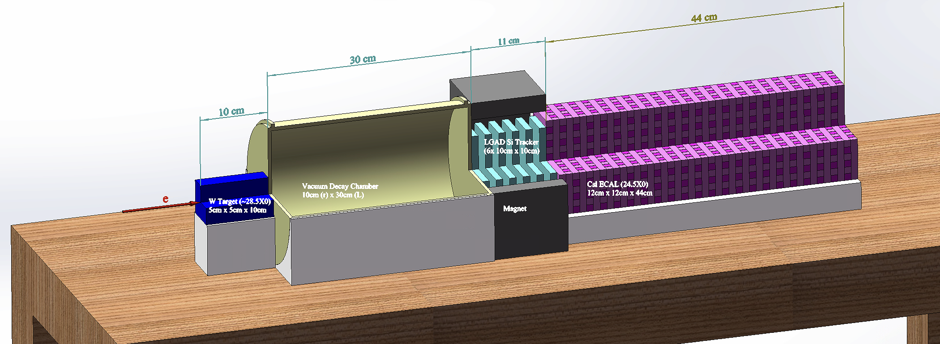
The Little DAMSA Pilot Experiment!
Goal: Mount and complete a physics demonstrator in the next 2 yrs
Beam: 300MeV e-beams at Fermilab FAST or 1GeV e-beams @ANL LEA ➔ greatly reduced neutron backgrounds, compared to proton beams
Target: 5cm x 5cm x 10cm W target (~28.5X₀)
Vacuum decay chamber : 10cm (r) x 30cm (L)
  Enable the two EM particles from the vertex in vacuum to be separated
Detector: 6 layers of 10cx10cm² Si tracker under B=1T w/ permanent magnet + 44 layers of 12cm x 12cm x 1cm (24.5X₀) 4D CsI total absorption ECal
e
W
Detector array
Si trk ( 6 x 0.1x0.1 m²) + B Field
ECAL: 44 x 0.12x0.12x0.01 m³
Vacuum
R=0.1m, L=0.3m
Target
0.05x0.05x0.1m³

Slide 20
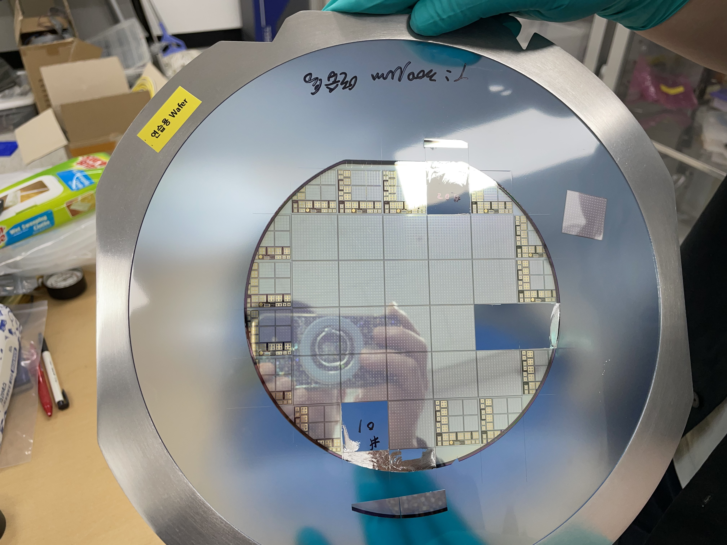
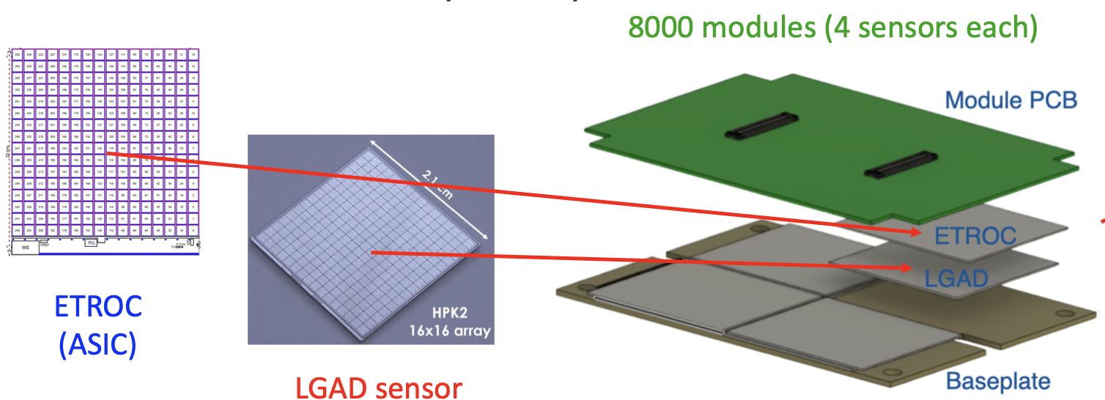
DAMSA – The Tracker
KNU in SK responsible for CMS forward LGAD detector
The Low Gain Avalanche Diode (LGAD) consists of 16x16 pixels of 1.3x1.3mm²
  Position resolution of 35 – 50 μm
  Timing resolution per track <35ps (single hit resolution <50ps)
High radiation tolerance

Slide 21
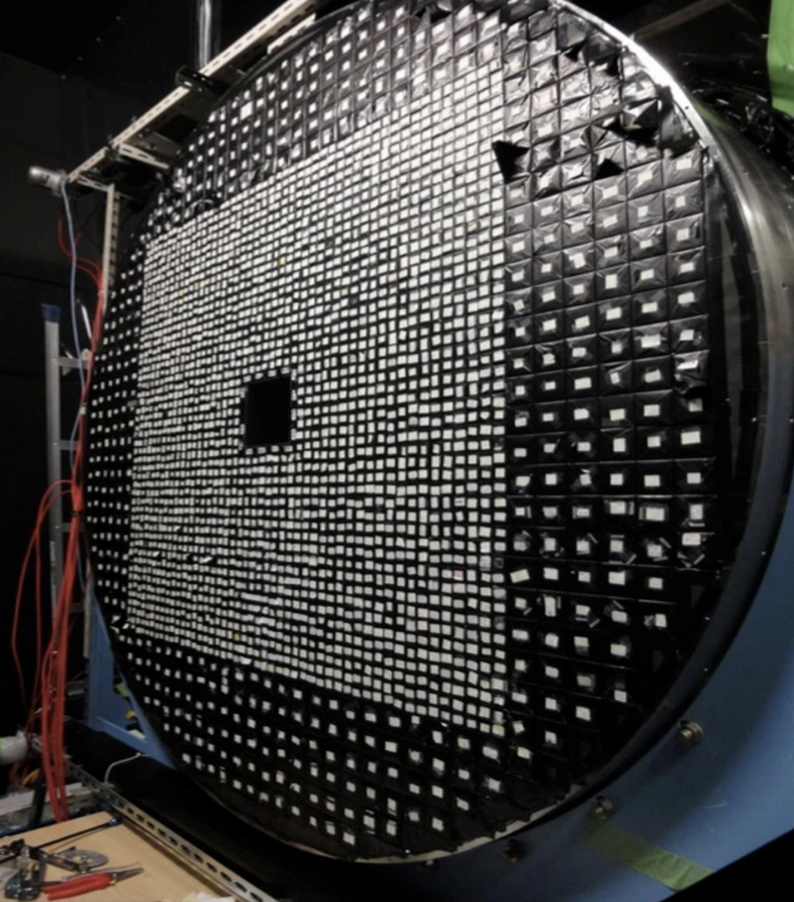
DAMSA – The ECAL
U. of Chicago built CsI ECAL for K-TeV experiment at Fermilab and the KOTO experiment at KEK
  Timing resolution of 200ps accomplished
  Has 16 of 5x5x50cm³ undoped CsI crystal bars in hand
  Each of these bars can be cut into 80 or so 1x1x12cm³ bars, read out by 2 SiPM’s mounted on either ends ➔ could provide ~mm level shower position resolution
  These bars need to be cut, polished, wrapped and SiPM mounted ➔ Working with the Ukrainian company, ISMa (Institute for Scintillation Materials) for initial evaluation of UC Crystals and the performance of the cut pieces

Slide 22
Little DAMSA – Staged Plan
Stage 0 ➔ e-beam background validator
  Measure and validate the MC neutron and photon bck counts
Stage 1 ➔ The a2γ demonstrator @ e-beam
  Build a demonstrator with only W target, vacuum decay chamber and an ECAL (CsI would be ideal but this could be made of scintillators) + charged particle veto counters
Stage 2 ➔ The a2e demonstrator @ e-beam
  Upgrade the stage 1 demonstrator with Si tracker (and magnet)
  Demonstrate the expanded signal capture
Stage 3 ➔ The neutron bck demonstrator @ p-beams
  Move the demonstrator to a low E, low power proton beams
  Demonstrate neutron background handling
Stage 4 ➔ The full scale DAMSA @ p-beams
  Move the complete detector to available proton beam facilities
  Perform search and discovery

Slide 23
Where is the DAMSA experiment?
DAMSA has been introduced to the community throughout the past >2.5 years, more intensely since 2023
  Concept included in a few Snowmass2021 white papers
  Physics case study published on PRD107, L031901 (2023)
  Multiple presentations made at conferences, workshops and seminars in the U.S., SK and CERN in 2023 and 2024
    Presented at a couple of P5 townhall meetings
  Met w/ Fermilab directorate in April, May, Aug, Sept. 2023 & Jan. 2024
  Updated the US DOE funding managers twice
DAMSA collaboration building ongoing
  Lead Investigators: J. Yu (UTA), J. Estrada (FNAL), UK Yang (SNU)
    12 US + 11 SK institutions on DAMSA
  Facility and experiment are being defined
  Funding applications being submitted (some successes!!)
DAMSA can be a network of experiments at different facilities

Slide 24
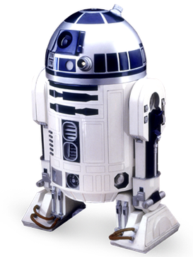
Potential Fermilab Experimental Facility
Proposed Name: F2D2
  Fermilab Facility for Dark matter Discovery
  Sited in the Tevatron field, out of any ACE plan
Requirements
  Basic assumption : multiple experiments operate simultaneously, mixture of on and off-axis
  Sufficient overburden (>=40.m.w.e.)
  Sufficient footprint per experiment
  Sufficient height of the hall w/ a large capacity crane coverage

Slide 25
DAMSA @ PIP-II Timeline
Project establish, Det. Design, Demo & prototyping
Experiment Construction
Experiment
Design studies, CDR & TDR, Tech. Publications
Sim, analysis, recon. software development,
Tech. publications
Commissioning & Data taking
Facility Design
Data analysis & Tech & Phys. publications
Facility Construction
Facility
Fermilab TF announced @ the PAC
Facility Commissioning
Seed Funds for design and prototyping
Construction
funds
Operations
funds
Yr 0 2024
Yr 1 2025
Yr 2 2026
Yr 3 2027
Yr 4 2028
Yr 5 2029
Yr 6 2030
Yr 7 2031

Slide 26
Conclusions
DAMSA is a DSP search and discovery experiment
DAMSA has been making serious and steady progress
  Aim to be ready for PIP-II LINAC beam in 2029
  Perfect fit to ASTAE program in the recently released P5 report

Slide 27
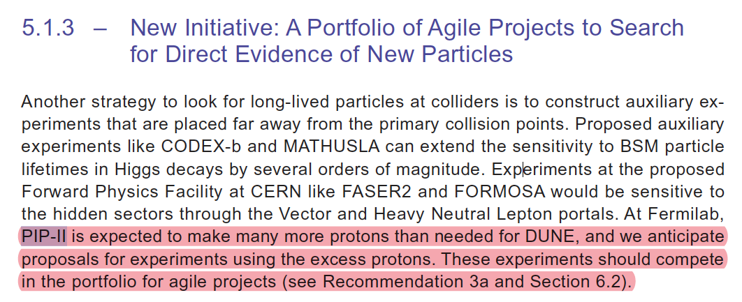
From the P5 Report – 1
Explicit recommendation on leveraging PIP-II LINAC and support for ASTAE program

Slide 28
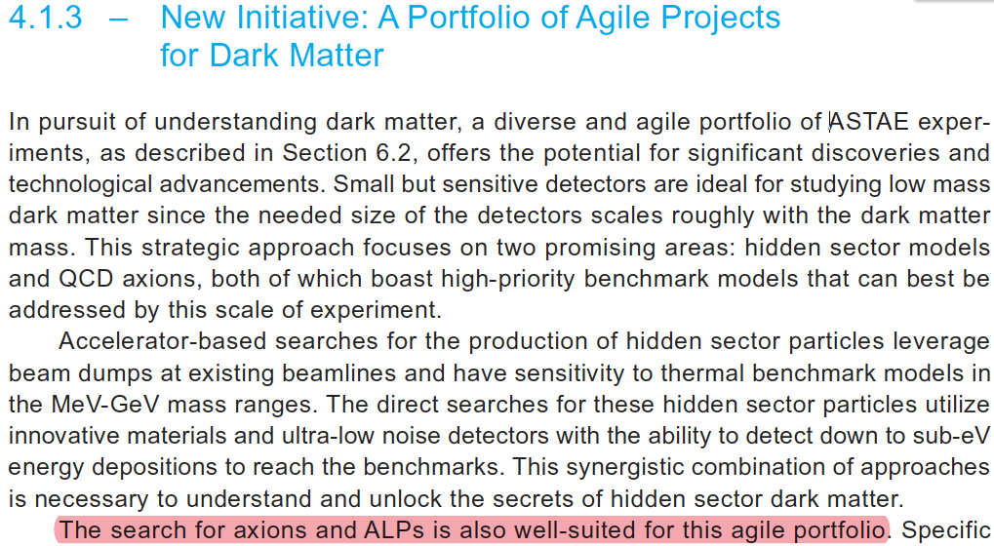
From the P5 Report – 2
Search for ALP well-suited for agile portfolio

Slide 29
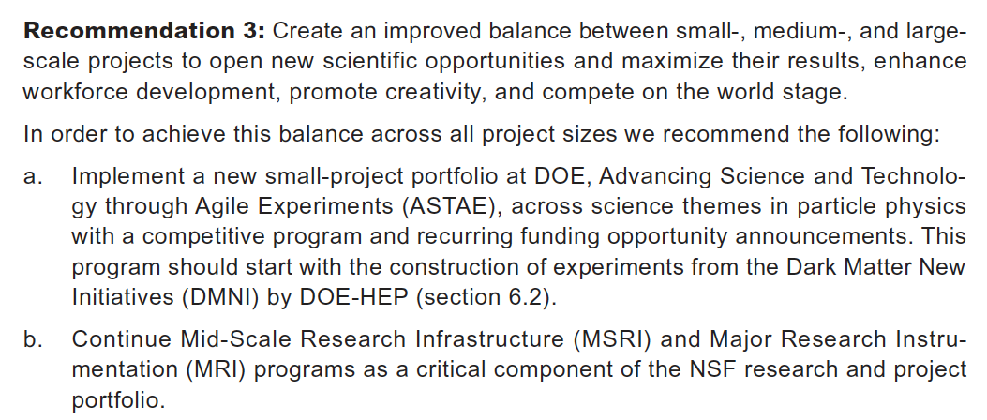
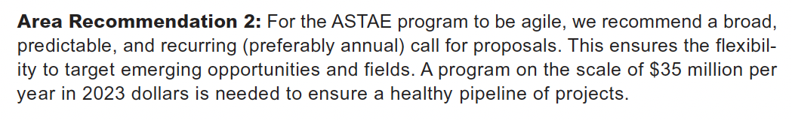
From the P5 Report – 3
ASTAE – Advancing Science and Technology through Agile Experiments – A portfolio of small-scale DOE experiments and funding
  Definition of Agile: timeline of 5 years and cost $5M – $25M

Slide 30
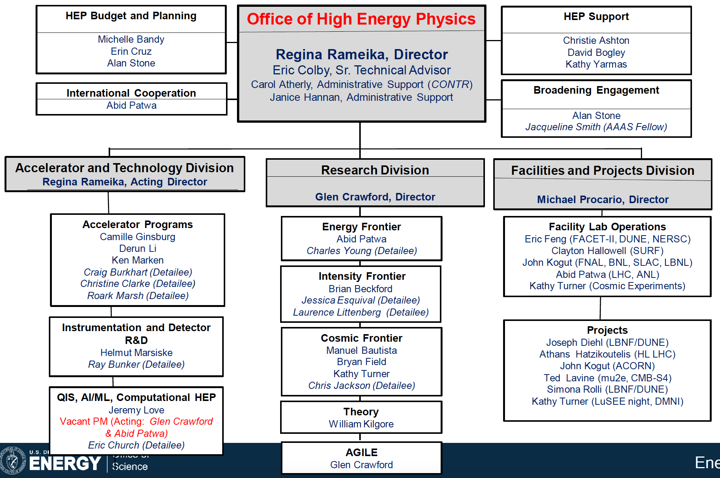
Funding Agency Response to P5

Slide 31
Conclusions
DAMSA is a DSP search and discovery experiment
DAMSA has been making serious and steady progress
  Aim to be ready even for PIP-II LINAC beam in 2029
  Perfect fit to ASTAE program in the recently released P5 report
  Staged demonstrator experiment is being developed ➔ first test for background validation completed June 25 @ Fermilab
    Wooyoung Jang (UTA), Joe Pastika (FNAL) & 2 students from SK
A strong collaboration has been built, window closing fast
Fermilab TF established and is working on defining F2D2

Slide 32
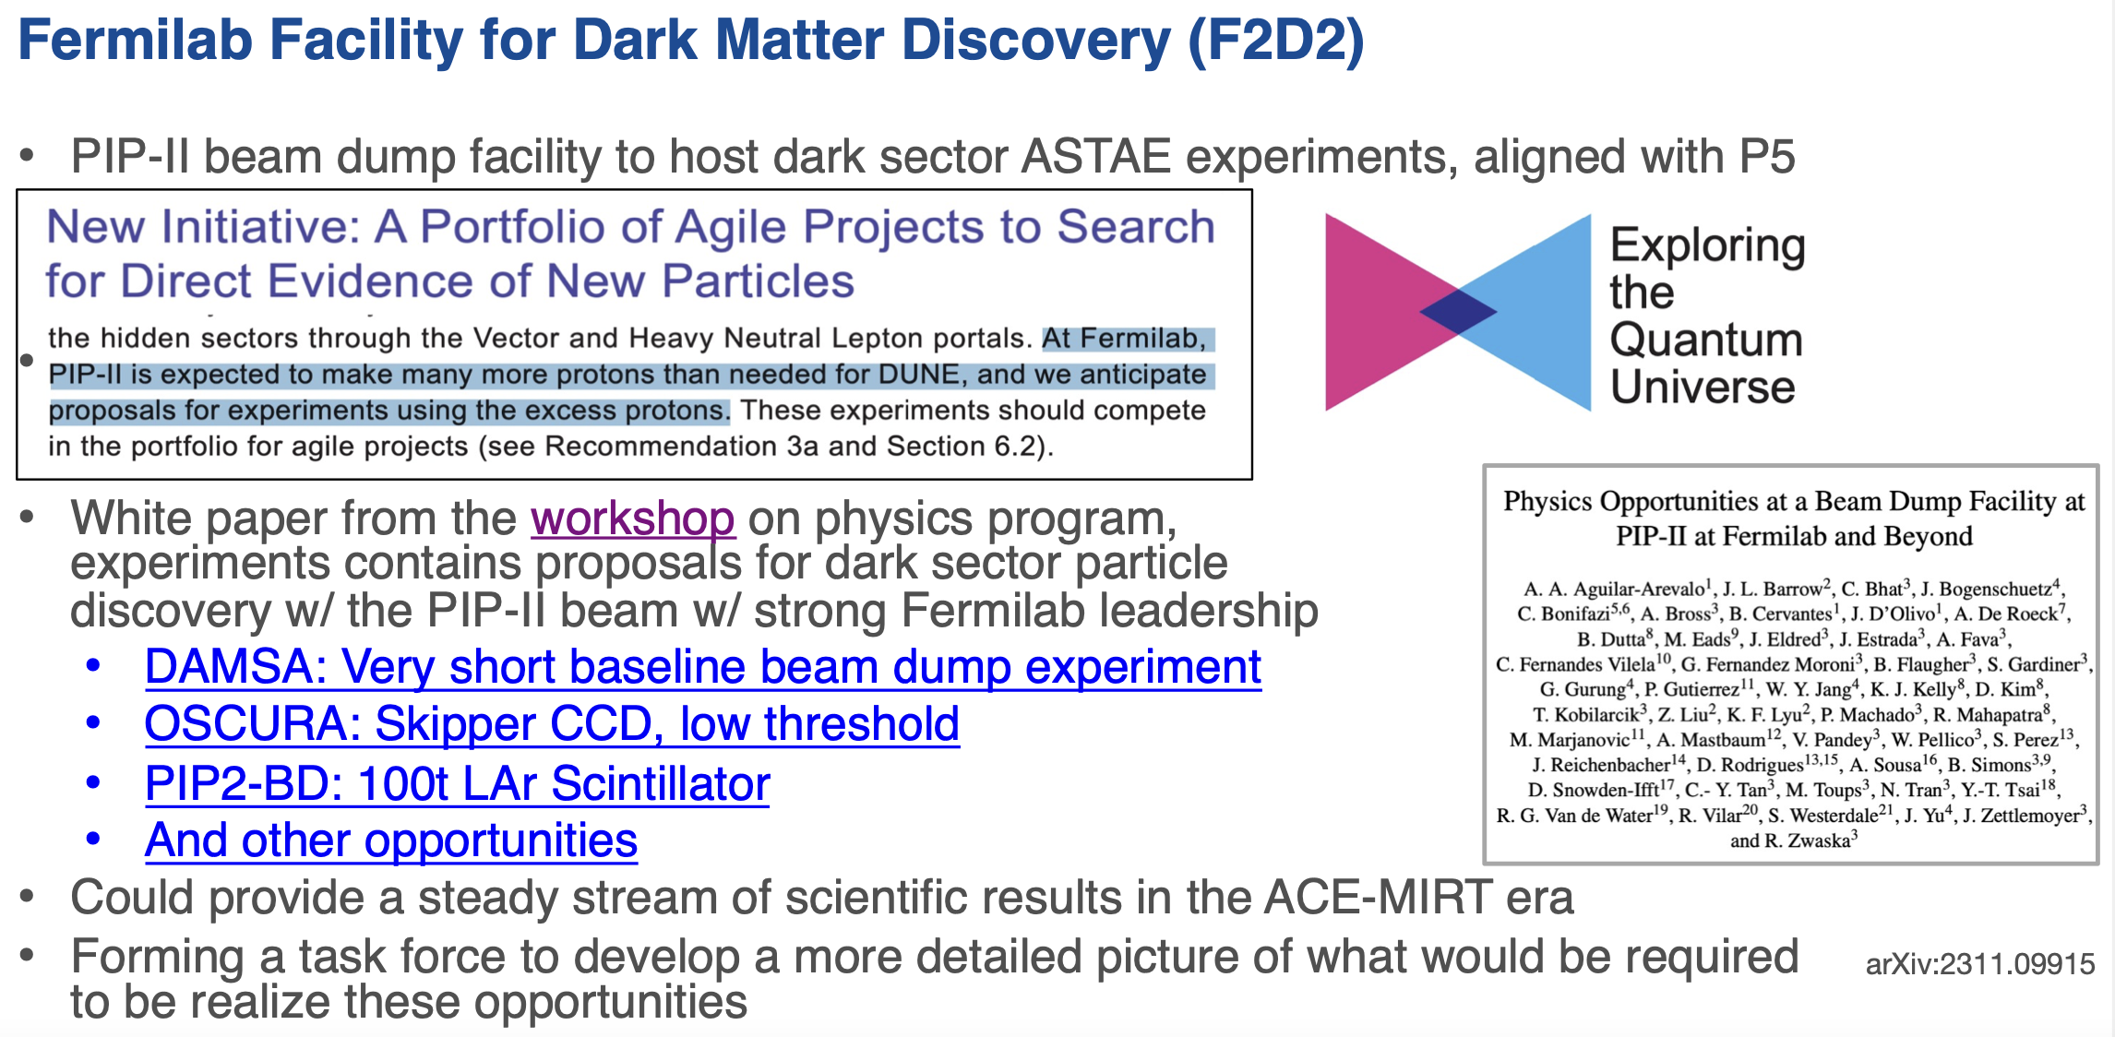
K. Burkett, PPD head
Fermilab PAC, 1/9/24

Slide 33
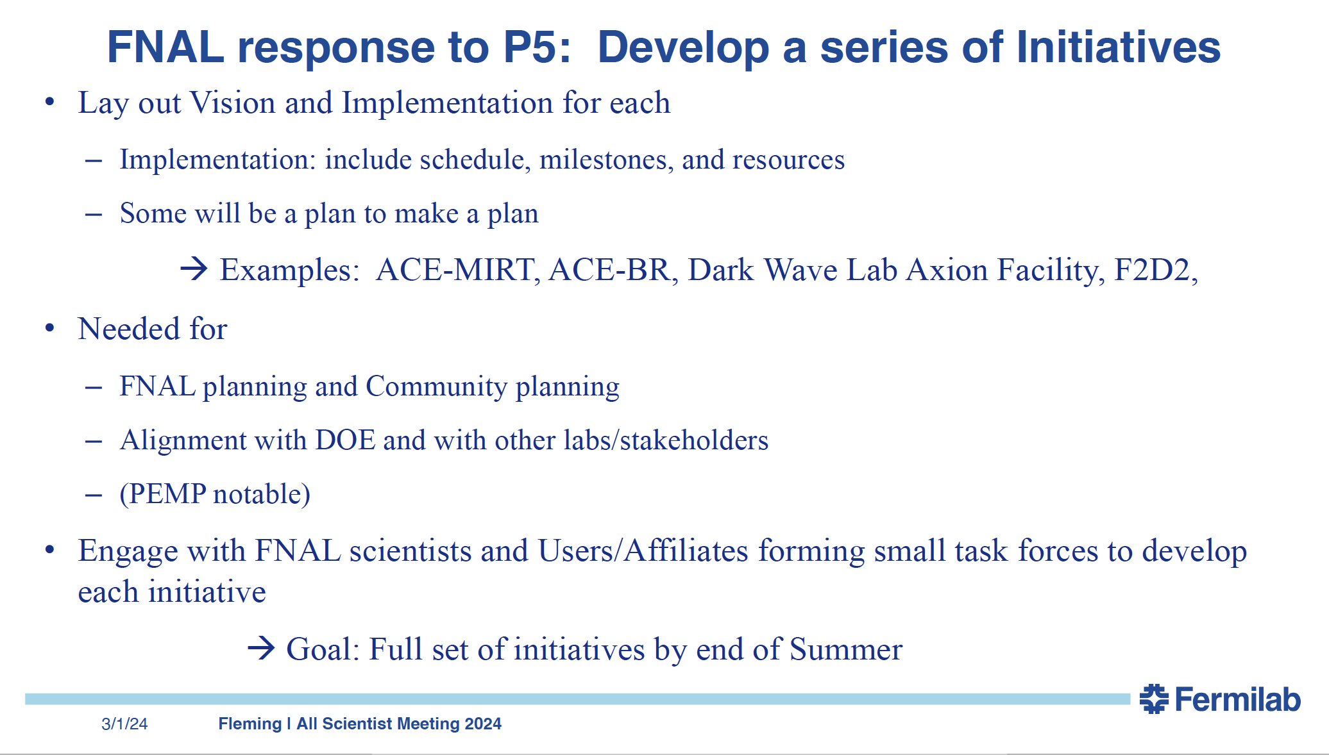
Fleming, CRO Fermilab ASC, 3/1/24
Performance Evaluation and Management Plan

Slide 34
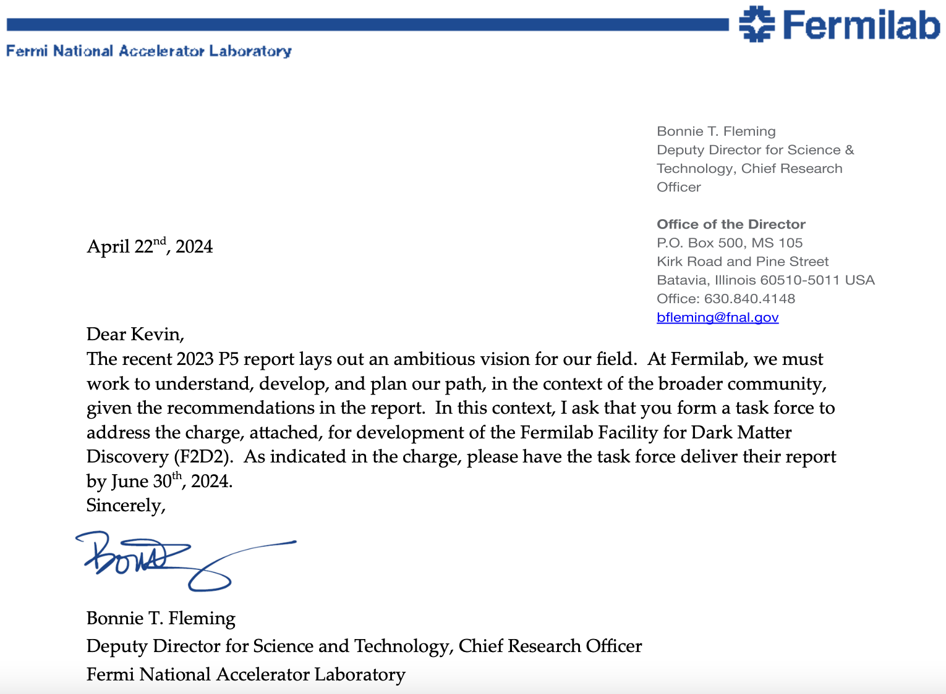
Fleming, CRO Fermilab, 4/22/24

Slide 35
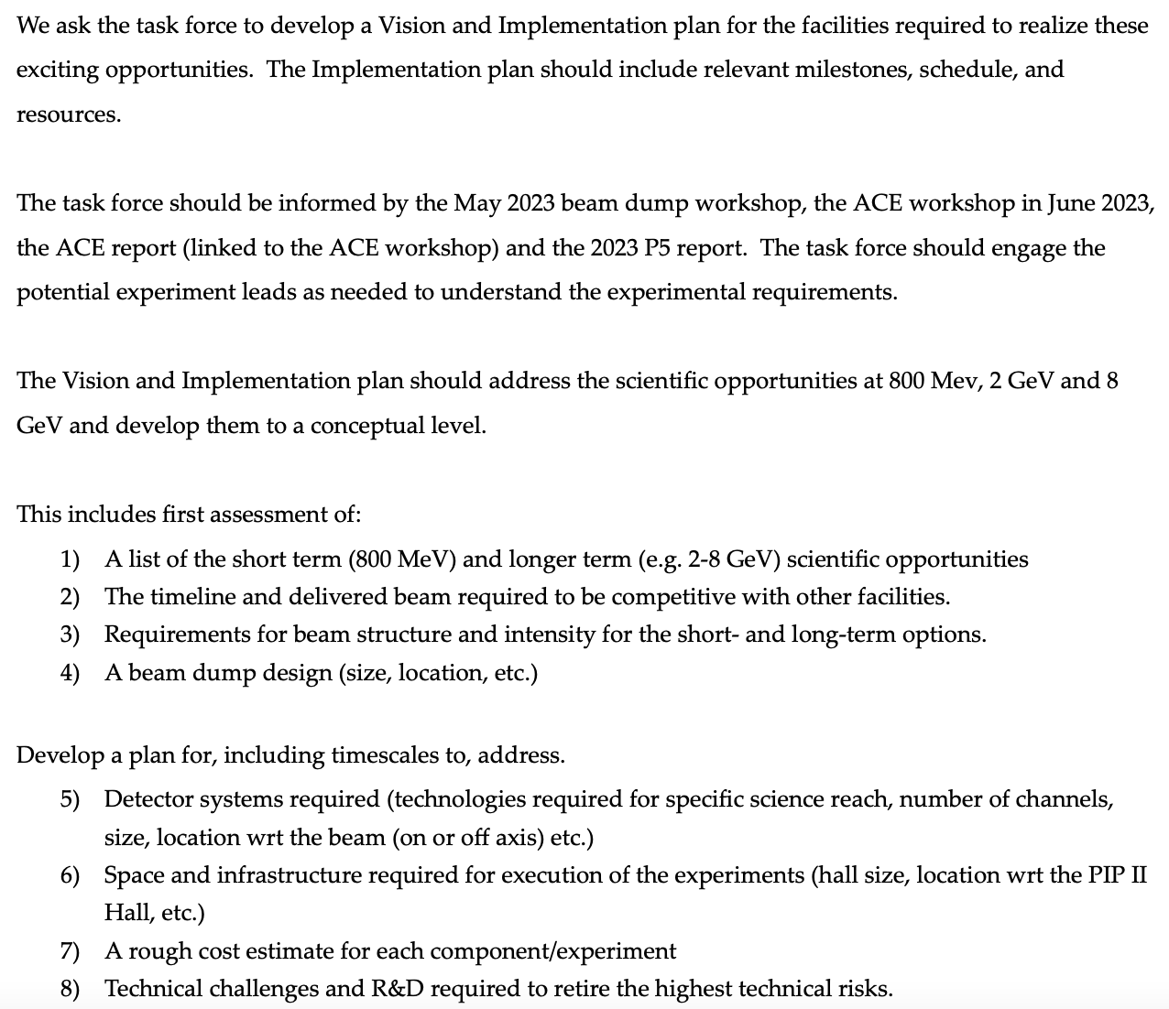

Slide 36
Conclusions
DAMSA is a DSP search and discovery experiment
DAMSA has been making serious and steady progress
  Aim to be ready even for PIP-II LINAC beam in 2029
  Perfect fit to ASTAE program in the recently released P5 report
  Staged demonstrator experiments developed ➔ first test for background validation completed June 25 @ Fermilab
    Wooyoung Jang (UTA), Joe Pastika (FNAL) & 2 students from SK
A strong collaboration has been built, window closing fast
Fermilab TF established and is working on defining F2D2
  Community engagement essential
    Whitepaper on PIP-II Beam Dump physics opportunities (2311.09915)
DAMSA presents an excellent opportunity for US & Korea to take the leadership in DSP search and discovery in beams

Slide 37
CETUP*2023 Parting Questions
What other physic topics can we do with the DAMSA experiment configuration?
  Is there a SM measurement DAMSA can contribute?
What modifications to DAMSA experimental configuration that could dramatically expand the physics reach? – B field? μ-detector?
What is the impact to the physics reach as a function of detector dimensional change?
What are the tools necessary to assess DAMSA physics reach in a timely manner?

Slide 38
CETUP*2024 Parting Questions
The strength of DAMSA experiment cetup
  Extremely short baseline ➔ Capture prompt decays
What other physic topics can we do with the cetup like DAMSA experiment?
  Is there a SM measurement DAMSA can contribute?
What modifications to DAMSA experimental configuration that could dramatically expand the physics reach? – μ-detector?
What are the tools necessary to assess DAMSA physics reach in a timely manner?

