Slide 1




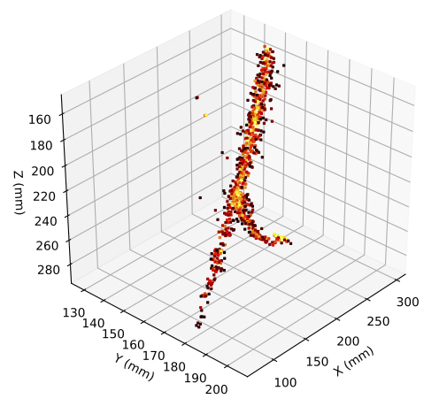
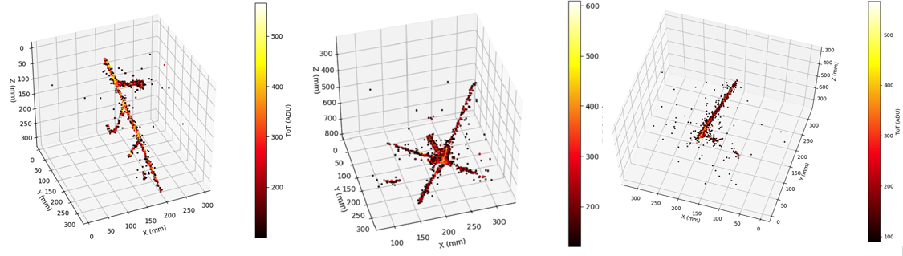
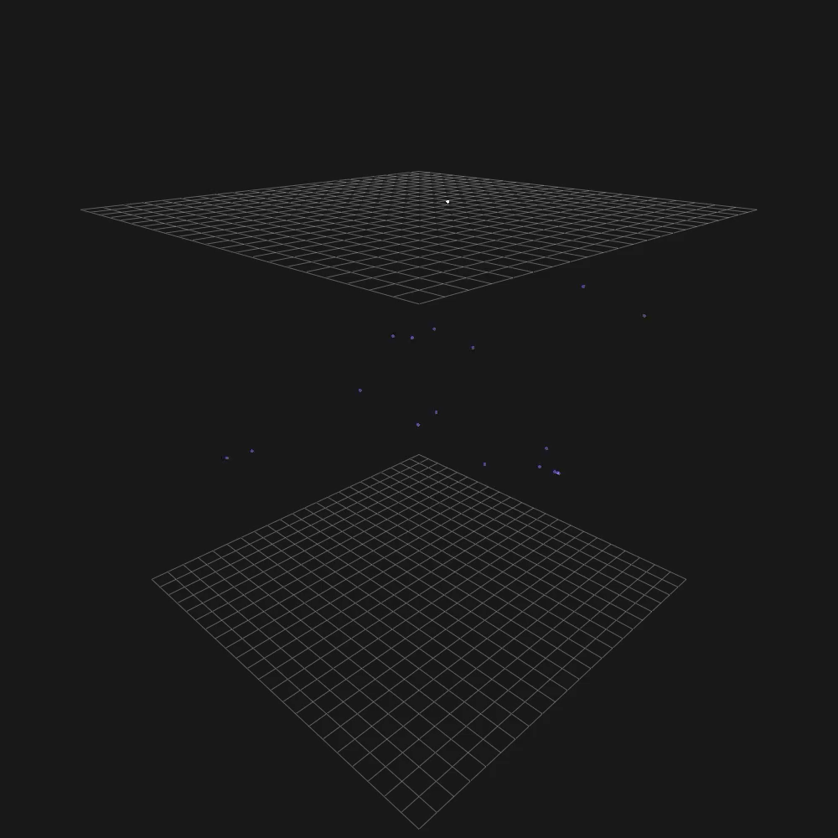

The ARIADNE⁺ Program &
Technology for DUNE
+
Kostas Mavrokoridis
(on behalf of the ARIADNE+ collaboration)
CoSSURF 2024, Rapid City, May 2024
k.mavrokoridis@liv.ac.uk
http://hep.ph.liv.ac.uk/ariadne

Slide 2
Talk Outline
Background to the ARIADNE program
  TPX3Cam results taken with the ARIADNE⁺ 15-ton dual phase LAr detector at the CERN neutrino platform
Dual phase Optical protoDUNE run proposal
  Design progress and technical coordination
  Preparing the LoI to SPSC
ARIADNE: New results, 1-ton LAr run in Liverpool

Slide 3
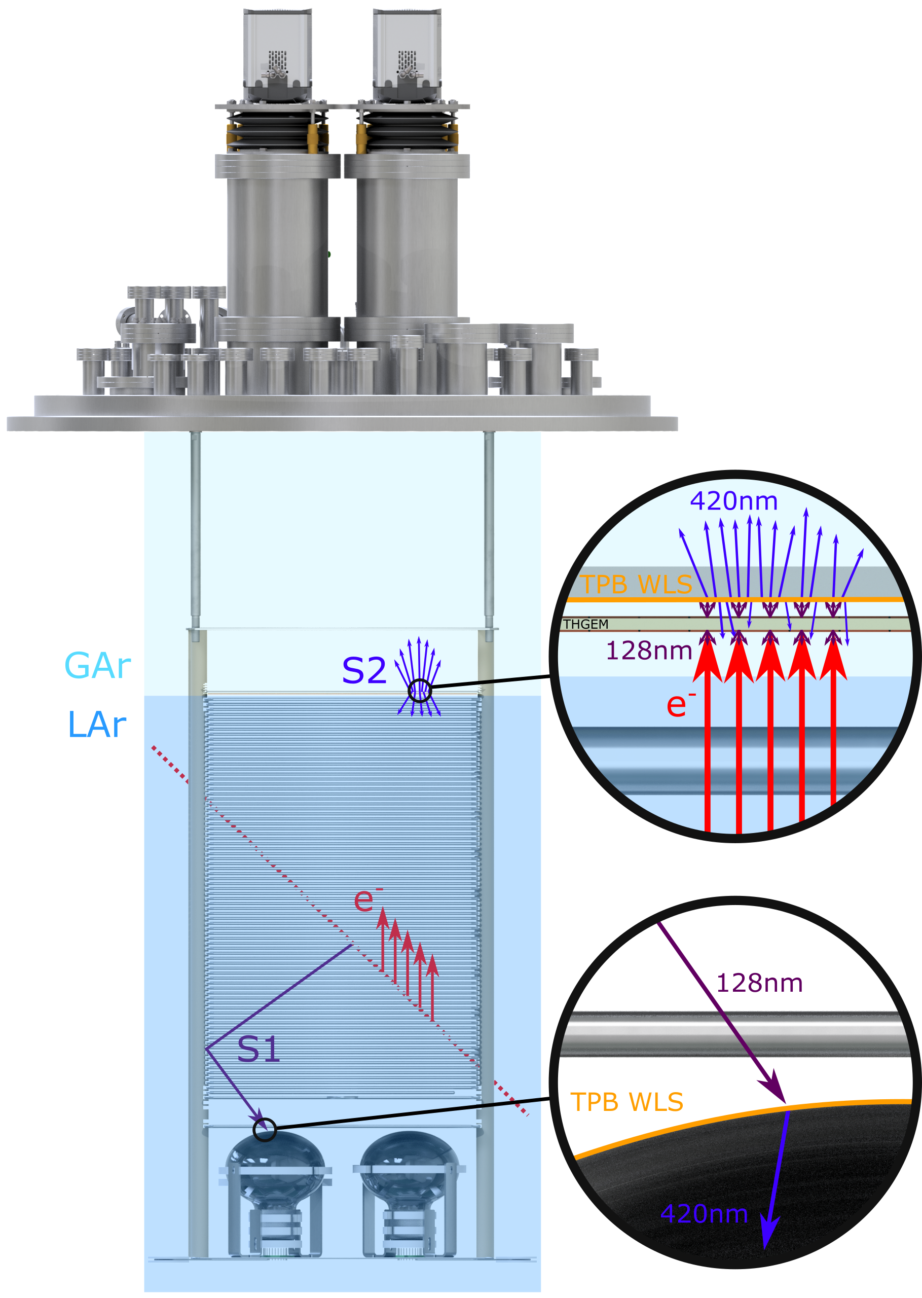
ARIADNE Detection Principle
Cameras
ARIADNE has demonstrated light readout as a viable alternative to charge in dual-phase TPC neutrino experiments
Benefits over previous charge readout techniques:
High resolution
Sensitivity to low energies
Very low noise, decoupled from TPC
Ease of access
Cost efficient
Incoming particles ionise LAr and create prompt scintillation light (S1)
Electrons drift towards the extraction grid situated below the liquid level
A THGEM (THick-Gaseous Electron Multiplier) amplifies drift charge (capable of >30 kV/cm in LAr) generating secondary scintillation light (S2)
WLS (Wavelength Shifting) before imaging with ultrafast Timepix3 camera
Full 3D optical TPC
TPX3 provides simultaneous time-over-threshold (ToT) and time-of-arrival (ToA). Complete (x,y,z,E) event reconstruction using a single device.
https://iopscience.iop.org/article/10.1088/1748-0221/14/06/P06001
https://www.mdpi.com/2410-390X/4/4/35
ARIADNE (ARgon ImAging DetectioN chambEr)

Slide 4
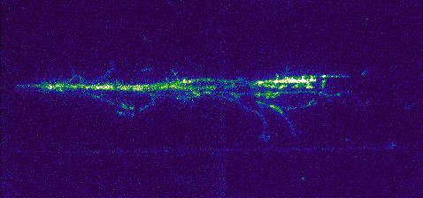
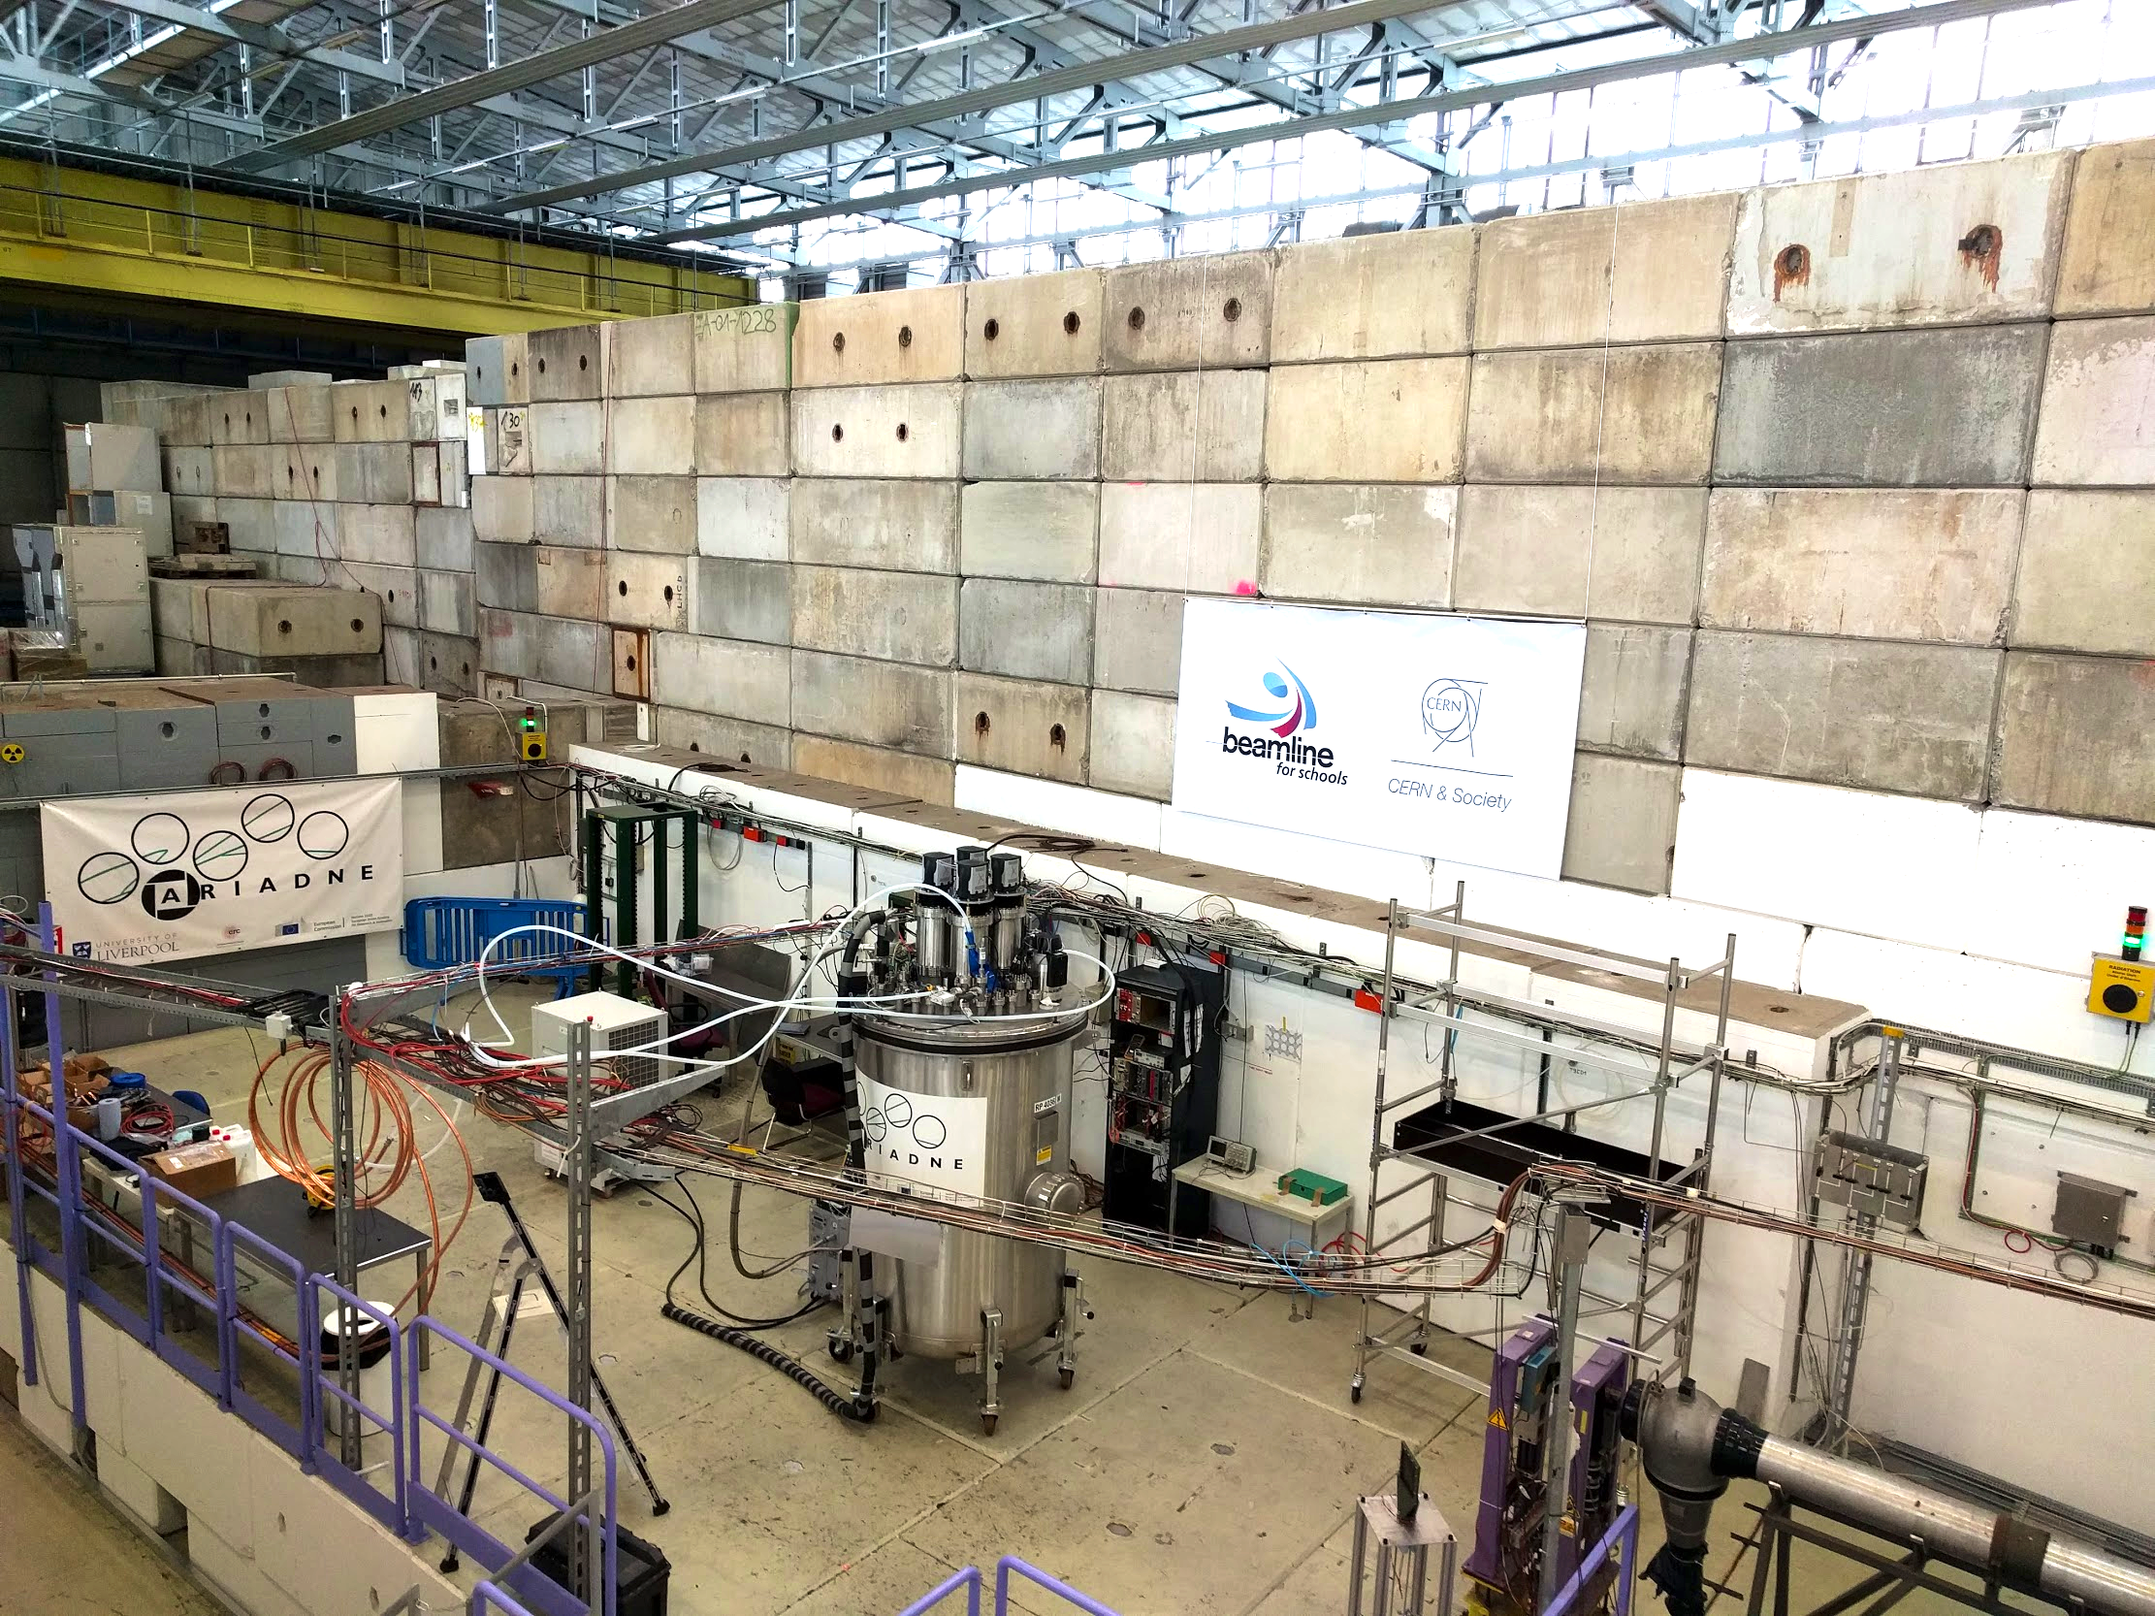
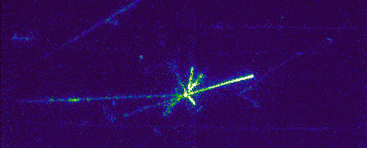
ARIADNE at CERN T9
EMCCD data taking 3 weeks April 2018.
T9 Beamline, East Area, CERN.
Mix of particles: e ±, μ ±, π ±, p±. (0.5 – 8 GeV/c.)
43 cm
35 cm

Slide 5
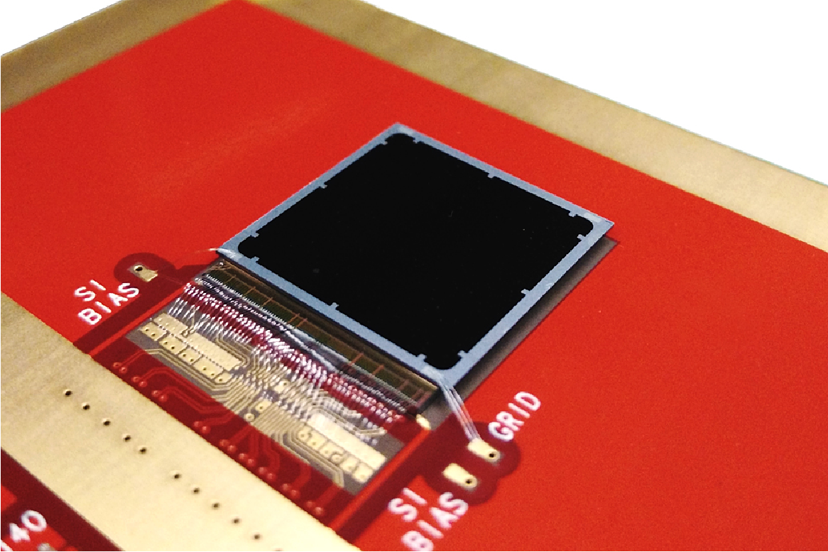
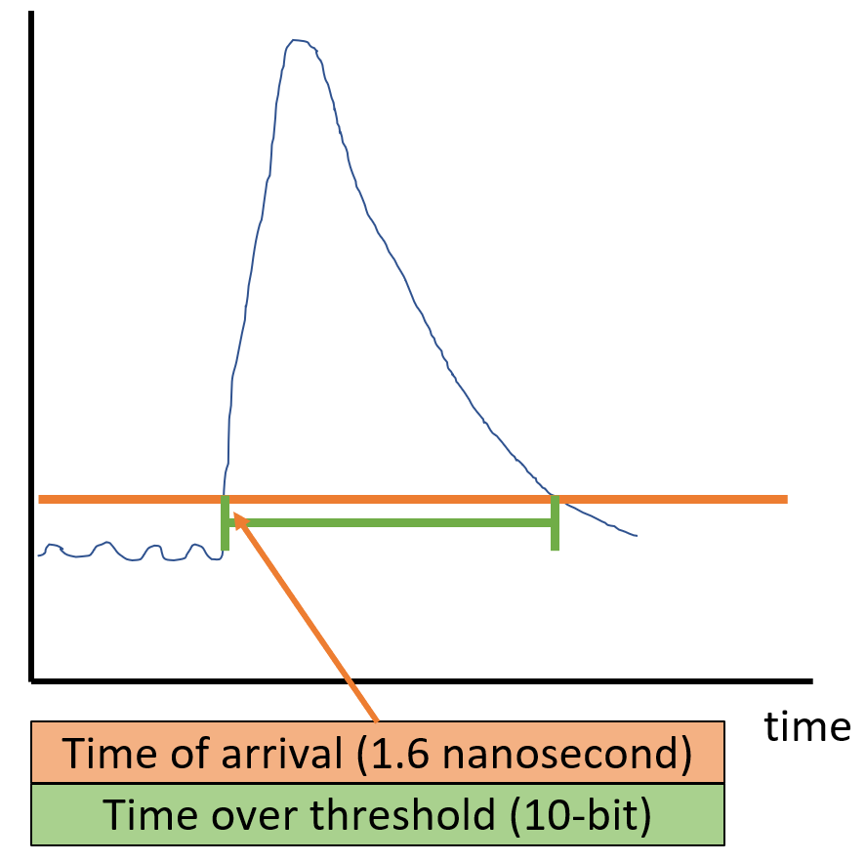
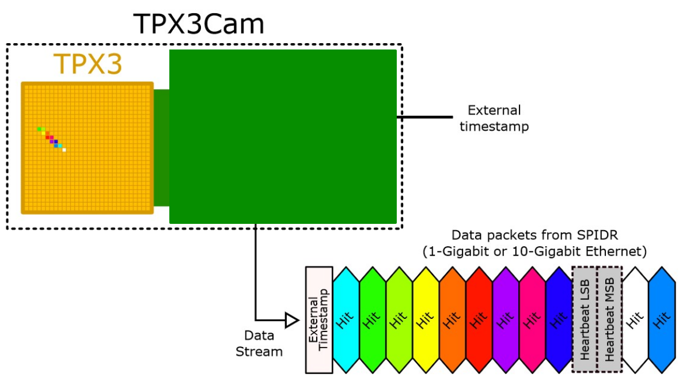
2D -> Full 3D Optical Readout
Silicon pixel readout chip developed by the Medipix collaboration. Very well established technology at CERN.
TPX3 ASIC bonded to optical sensor
TPX3 provides simultaneous time-over-threshold (ToT) and time-of-arrival (ToA). Complete (x,y,z,E) event reconstruction using a single device.
Time over threshold provides intensity / energy measurement ->10-bit resolution.
Time of arrival provides z (drift) axis position information -> 1.6 nanosecond resolution.
Data driven readout -> Event streaming with native zero suppression.
Efficient raw data storage. Triggerless operation.
Sensor resolution | 256x256 pixels
Pixel size | 55µm x 55µm
Max readout rate | 40Mhits•cm⁻² •sec⁻¹
Time resolution | 1.6 ns

Slide 6
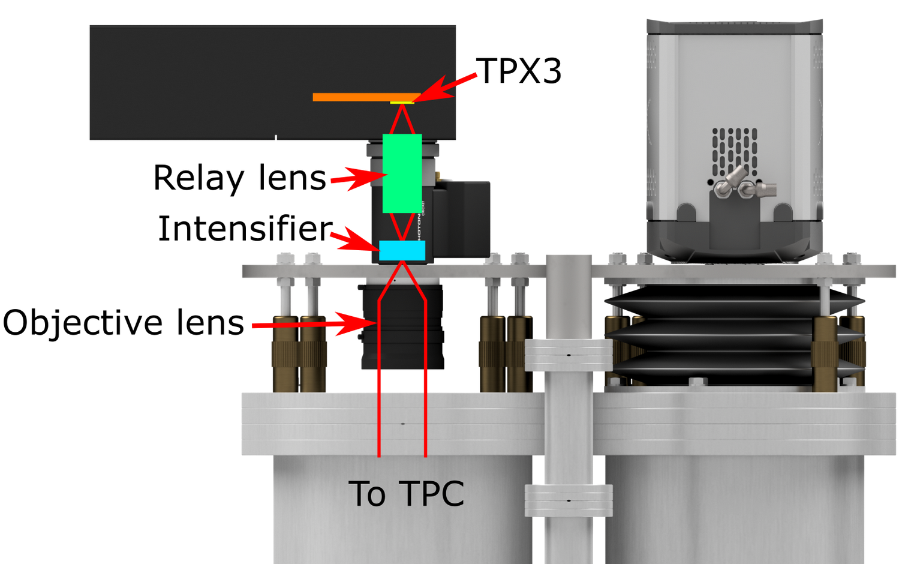
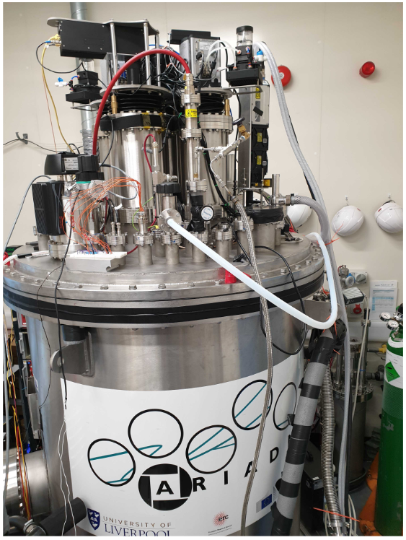
TPX3Cam Optical Readout
Single photon sensitivity when combined with image intensifier.
Intensifier gain ~1E6 photons/photon.
Relay lens couples intensified image onto light sensitive
sensor which is bump bonded onto TPX3 ASIC.
Intensifier provides flexibility -> Many photocathode options are available to customise spectral sensitivity.
– Now also Direct VUV!
Timepix3 camera installed in place of an EMMCD camera.
~ 30cm x 30cm field of view
Photonis Cricket image intensifier with Hi-QE green photocathode.
30% quantum efficiency at 430nm (TPB peak emission)
Coldbox Intensifier
ARIADNE results
TPB emission

Slide 7
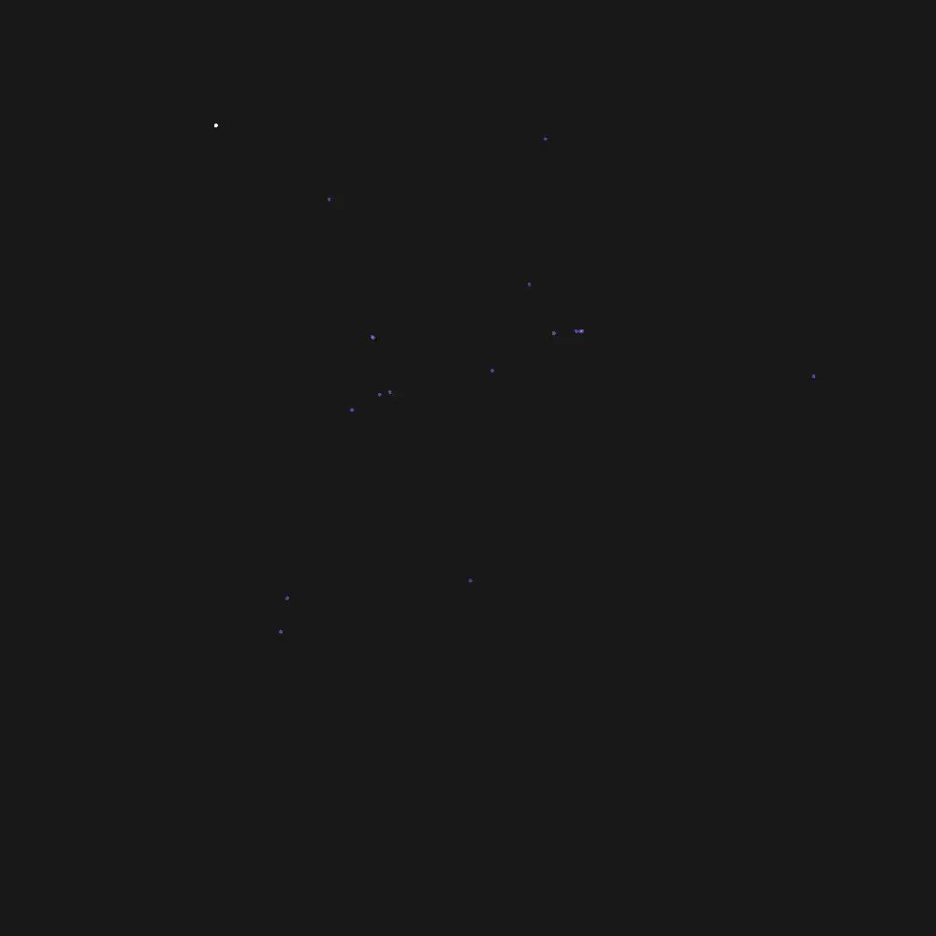
TPX3Cam 3D Cosmics LAr
Continuous streaming, 10 msec slice (playing 1ms jump per frame)
Side View
Top View

Slide 8
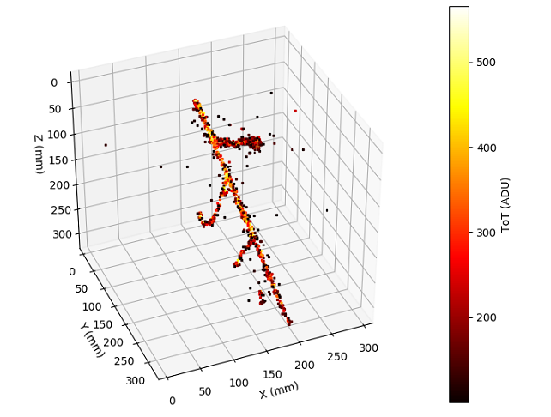
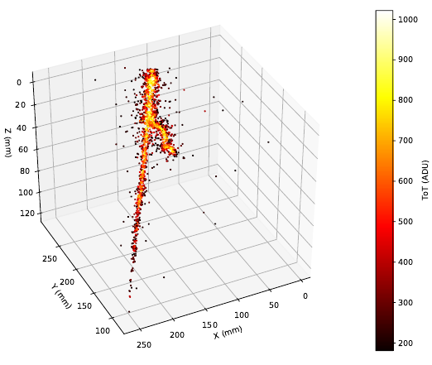
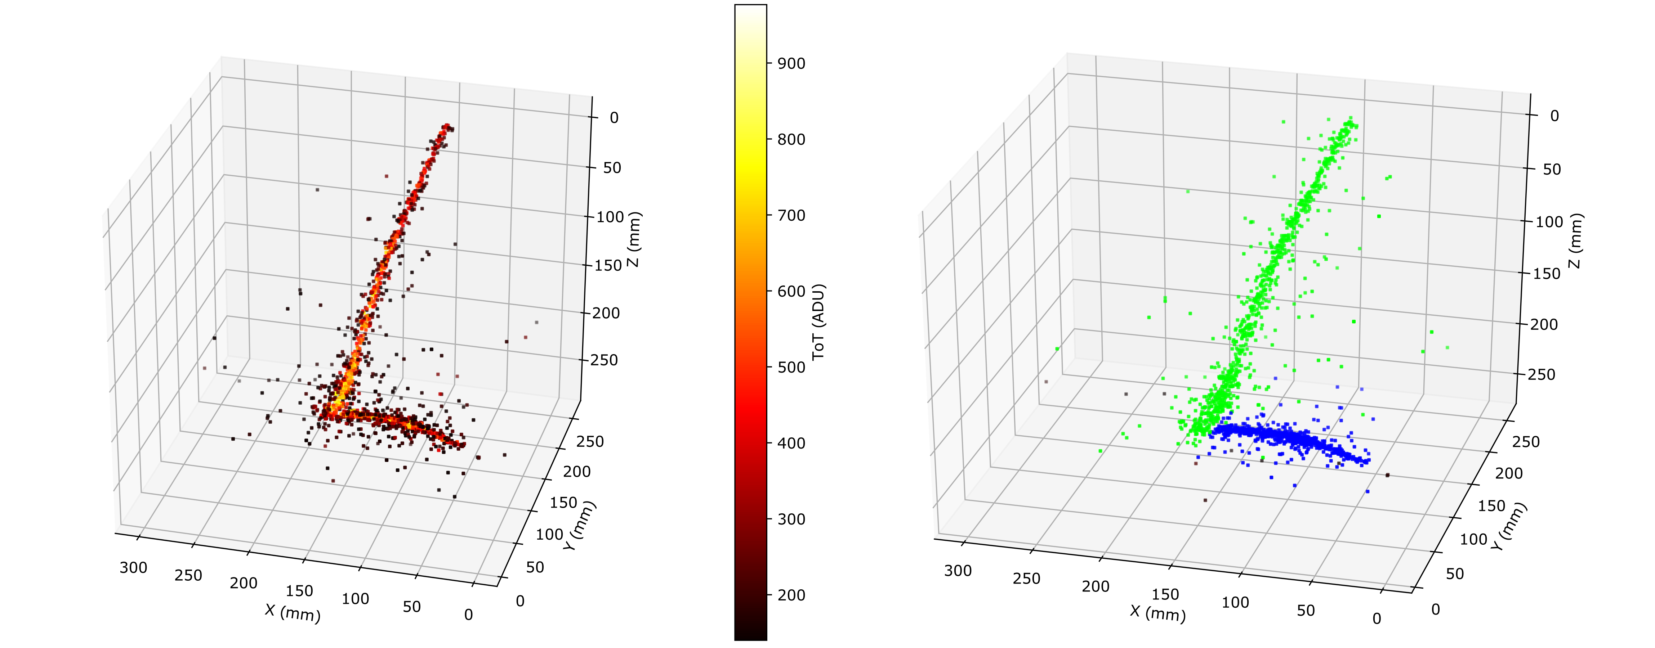
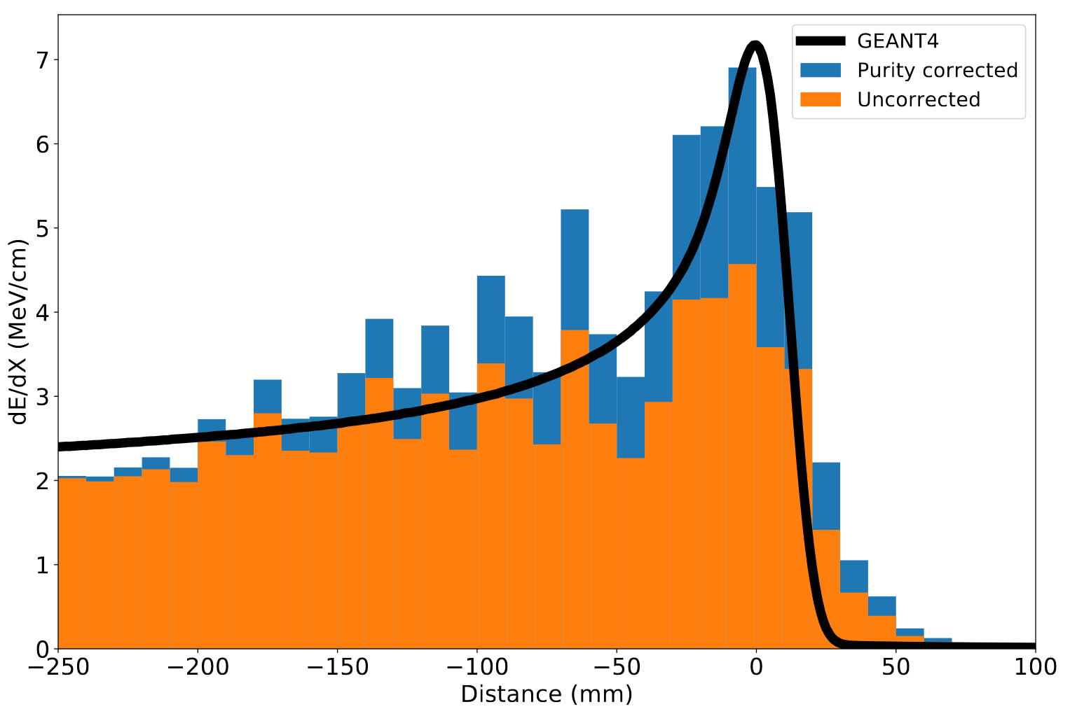
ARIADNE TPX3 Results
https://www.mdpi.com/2410-390X/4/4/35
Stopping Muon
MIP Energy Calibration
ADU (ToT) vs. THGEM Bias
11% energy resolution
Cameras are sensitive to the linear light production regime

Slide 9
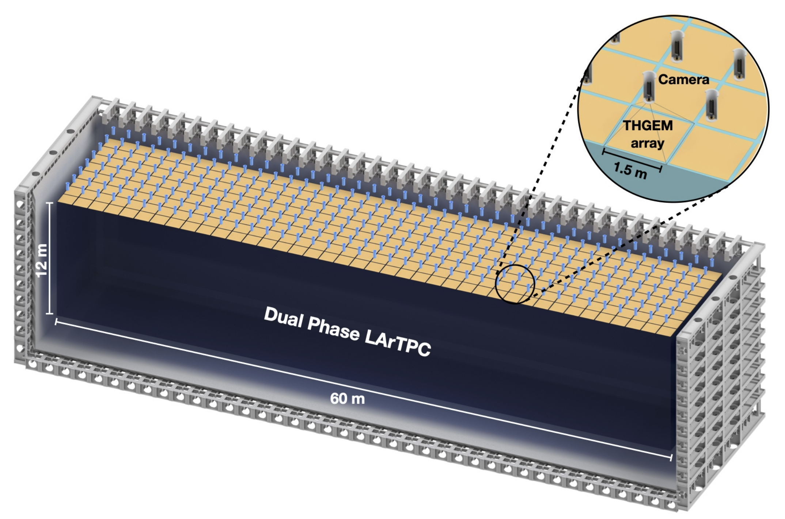
Module of Opportunity Workshops
Conceptual DUNE Dual Phase with Optical Readout
320 TPX4Cams within the cryostat chimneys
Each camera images 1.5mx1.5m with 3mm/pixel resolution
Total camera commercial cost with optics ~3M Euro
Table: As an example, demonstration figures for use of TimePix within Dune - 720m², 60m x 12m
Camera type | Sen. Size (pixels) | Cameras to cover 1m² | Resolution (mm/pix) | Total cameras (to cover 720m²) | Total cost (assuming €5k /camera*)
TPX3 | 256x256 | 9 | 1.3 (~ARIADNE) | 6480 | 32.4M
TPX3 | 256x256 | 4 | 2 | 2880 | 14.4M
TPX3 | 256x256 | 1 | 4 (~ARIADNE⁺) | 720 | 3.6M
TPX4 | 512x448 | 4 | 1 | 2880 | 14.4M
TPX4 | 512x448 | 1 | 2 | 720 | 3.6M
TPX4 | 512x448 | 0.66 (1.5m/cam) | 3 | 320 | 1.6M
* Cost is a place holder based on discussions with ASI, assumes large production. Intensifiers and optics will double total cost

Slide 10


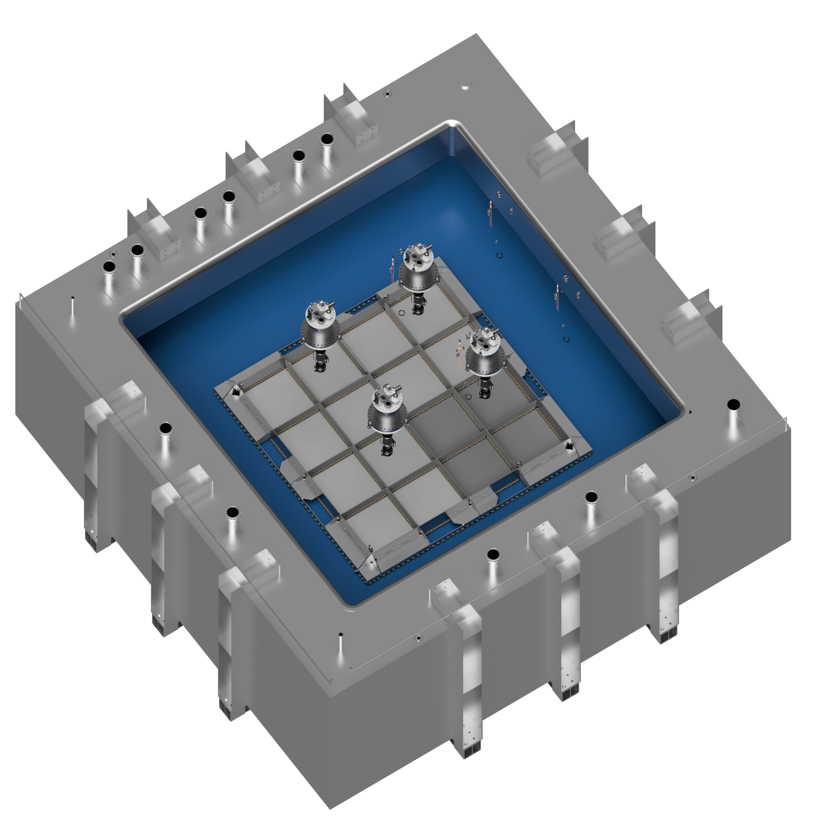
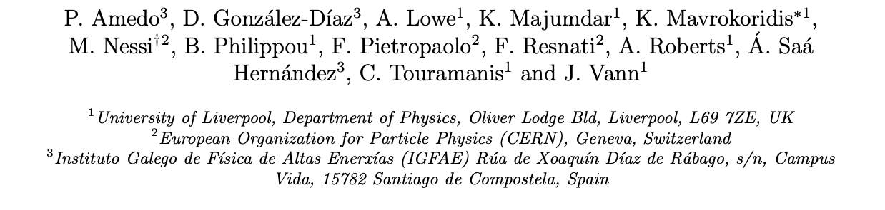
Larger Scale Demonstration at the CERN Neutrino Platform
Operation March/April 2022
Test optical readout on a scale relevant for DUNE using the existing cold box
CERN LOI: https://cds.cern.ch/record/2739360

Slide 11
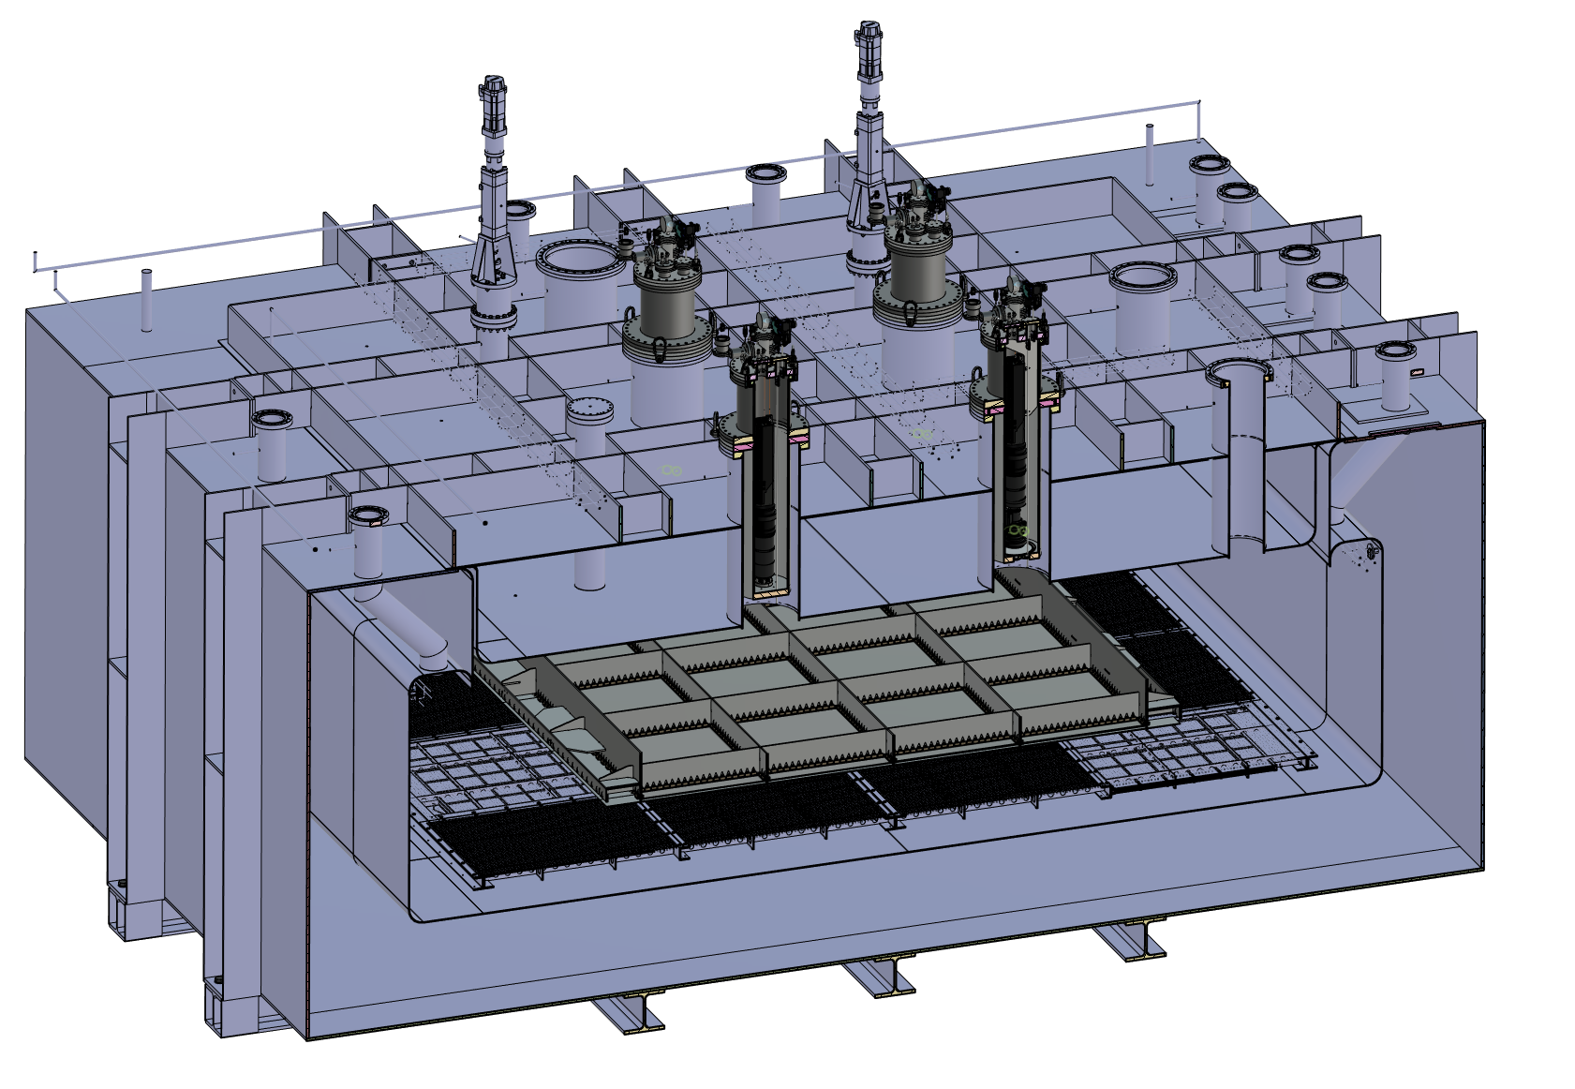
ARIADNE⁺: Cryostat Optical Configuration
TPX3 Camera
Assembly (1 x VUV)
TPX3 Camera
Assembly (3 x visible)
Large scale test of ARIADNE optical readout principle for dual-phase LArTPCs.
Four Timepix3 based cameras, each covering 1m x 1m readout area.
Three cameras detect visible light (wavelength shifter installed above THGEMs)
One camera directly detects VUV.
Light Readout Plane (LRP)
Cathode

Slide 12
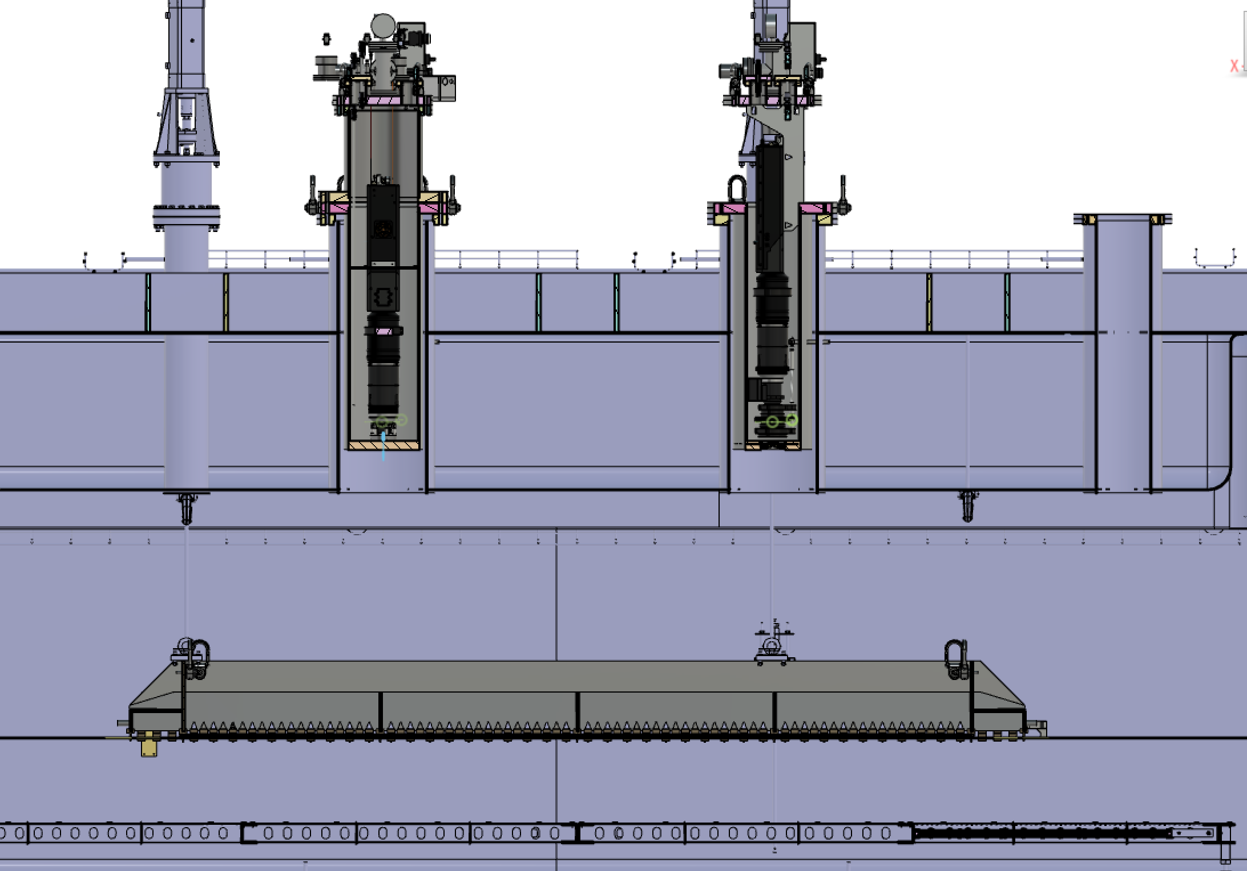
ARIADNE⁺: Cryostat Optical Configuration
Reentrance viewports, cameras in gas nitrogen
20 cm electron drift

Slide 13
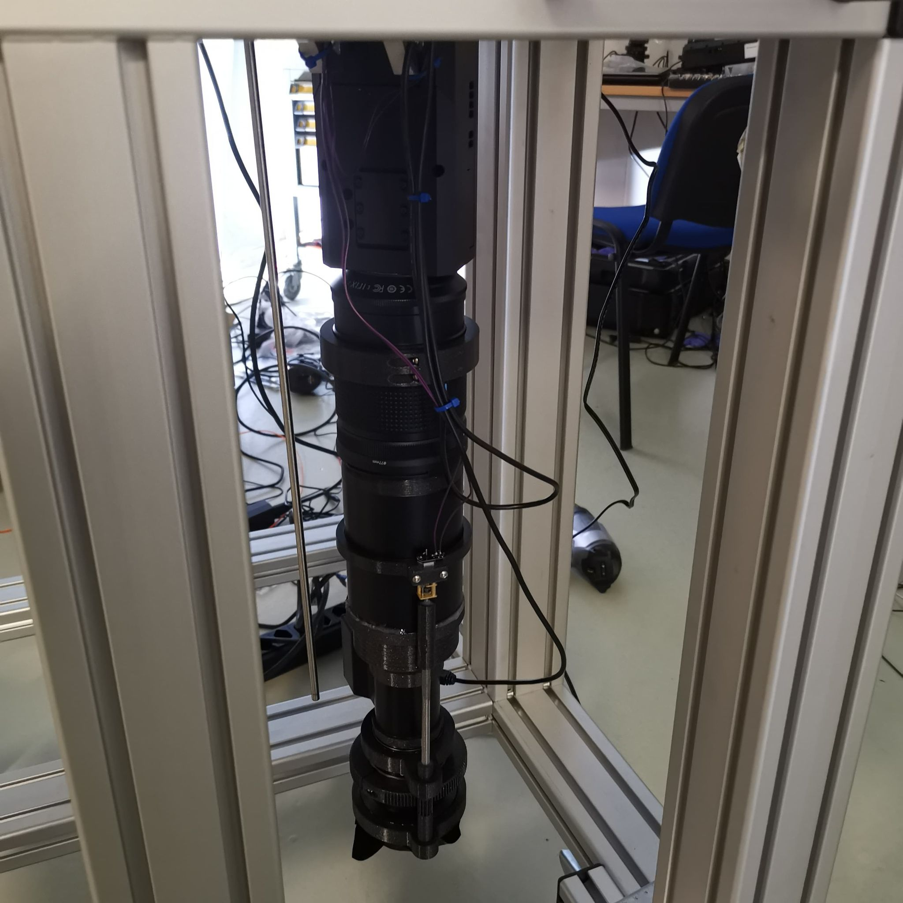
TPX3 Camera System
Timepix 3 Camera
Relay optics
Image intensifier
Objective lens

Slide 14
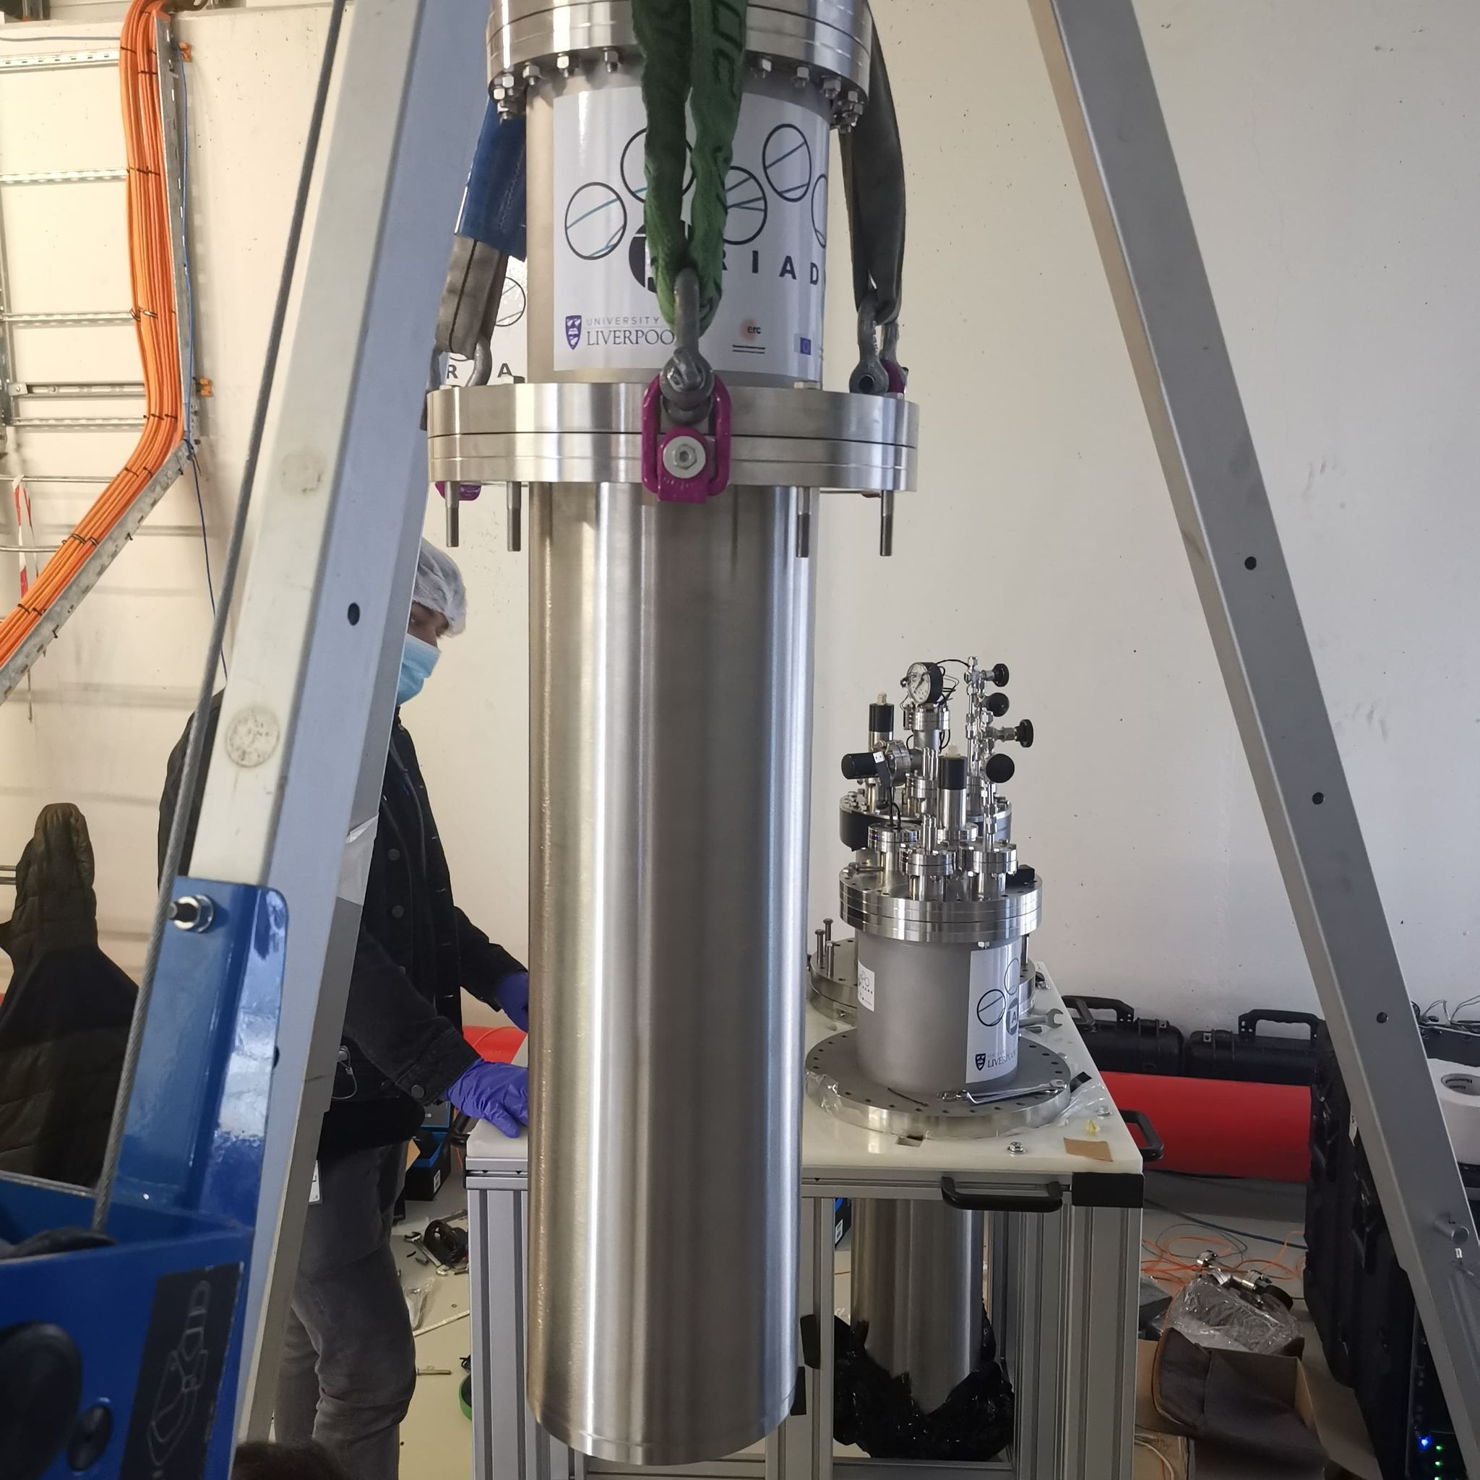
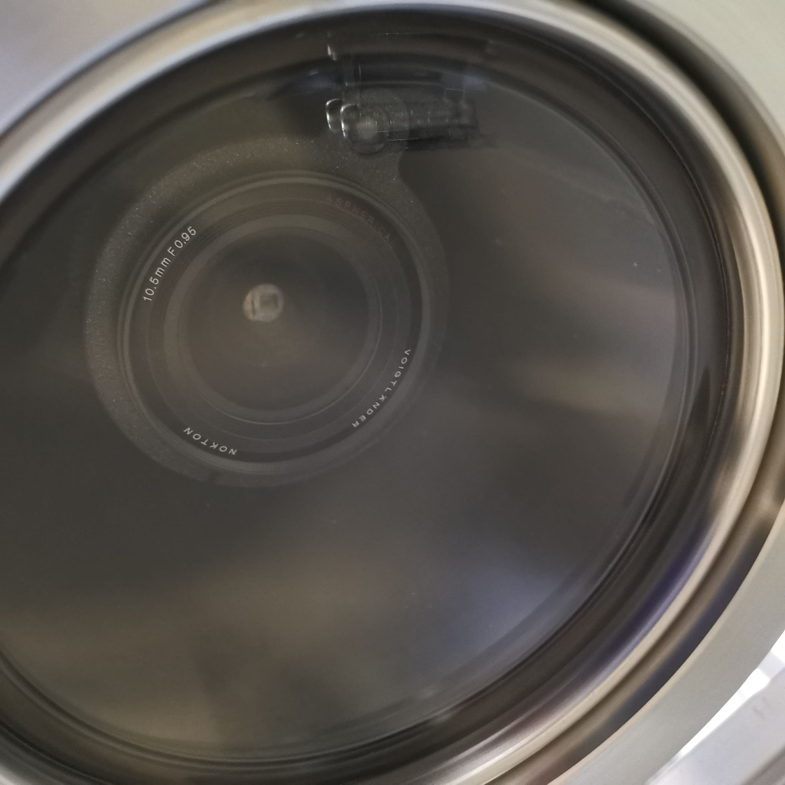
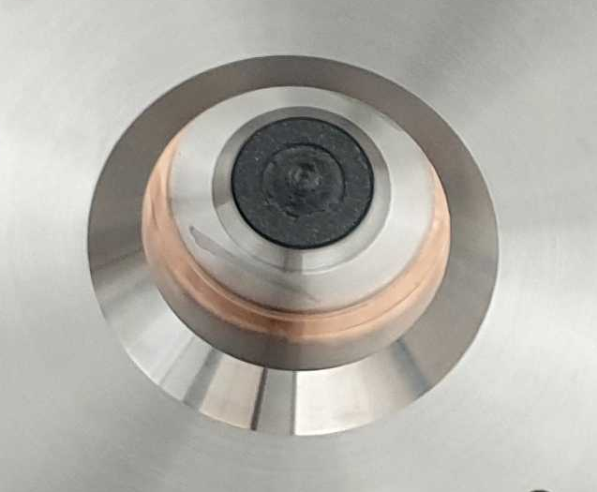
Re-entrance Viewport
Visible lenses (f0.95, 10.5 mm)
Custom made VUV MgF₂ Lens (f3, 11mm, 5mm diameter)

Slide 15
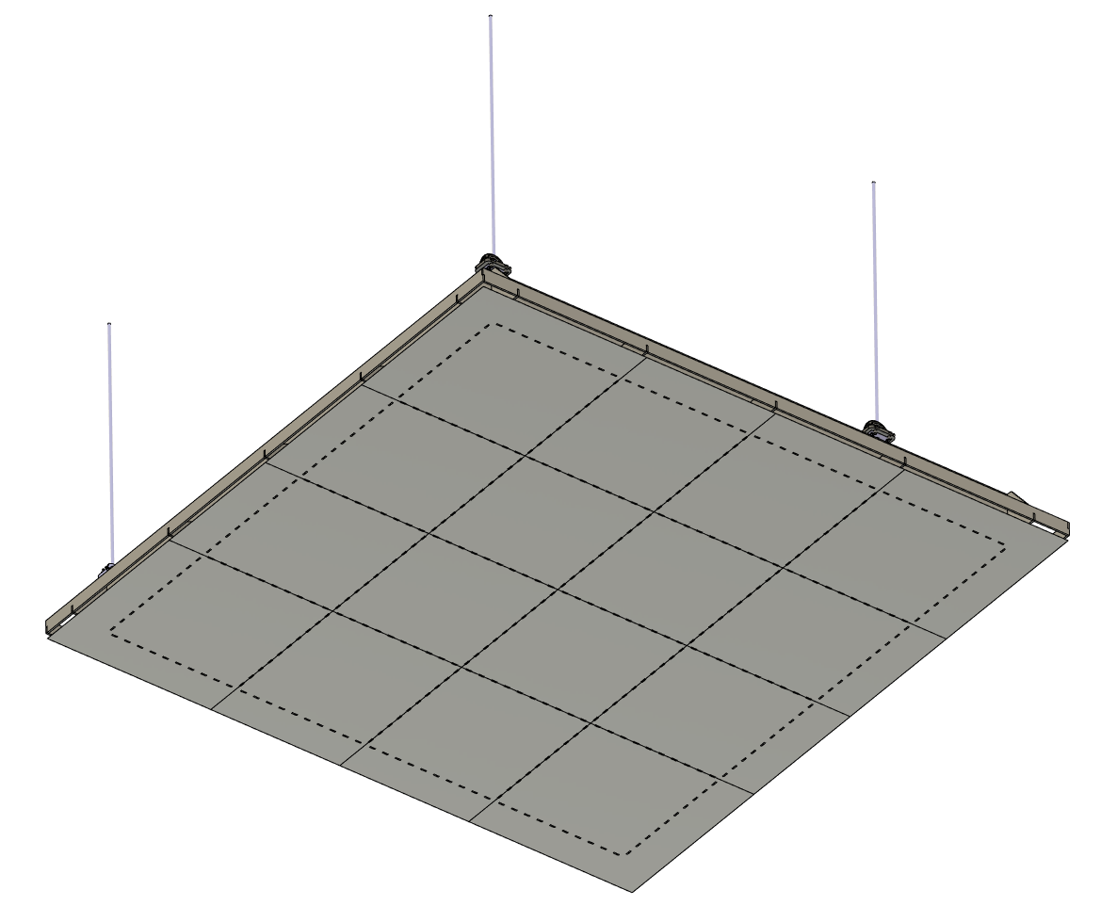
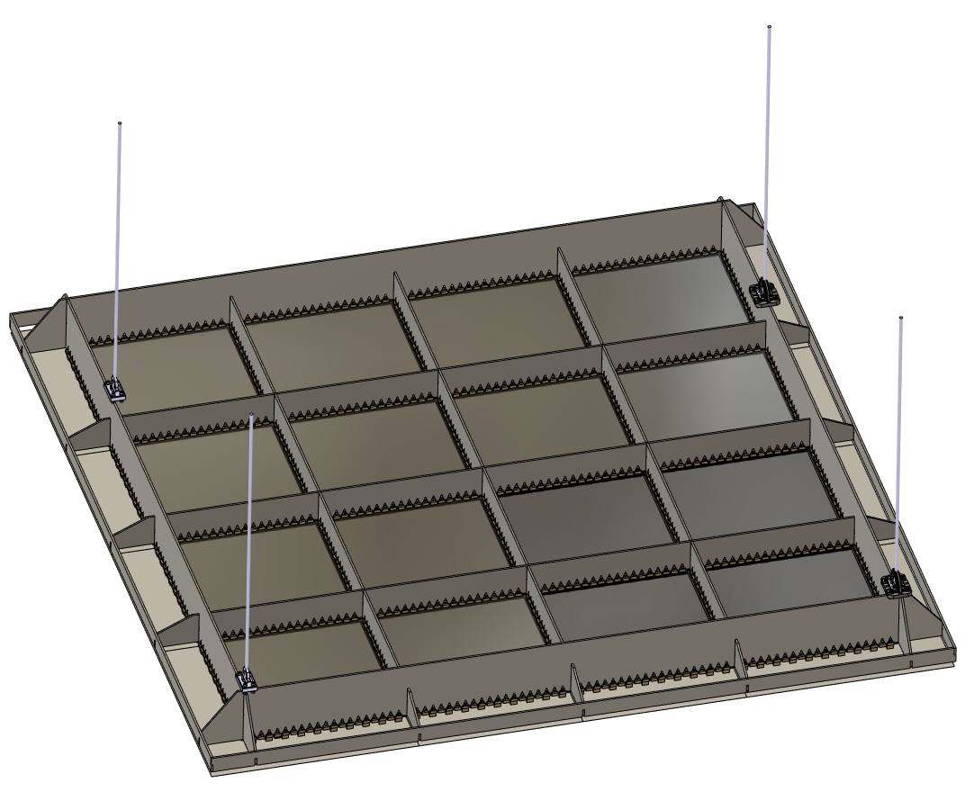
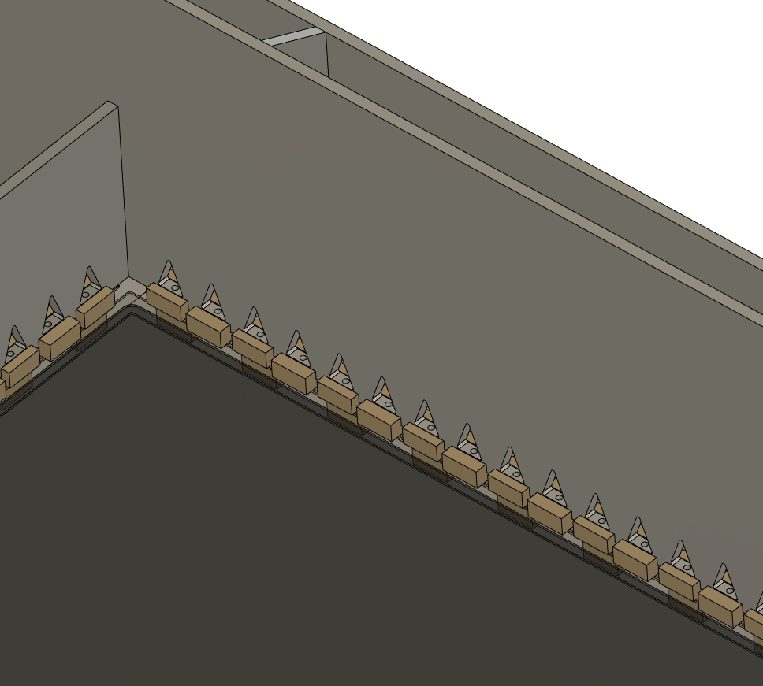
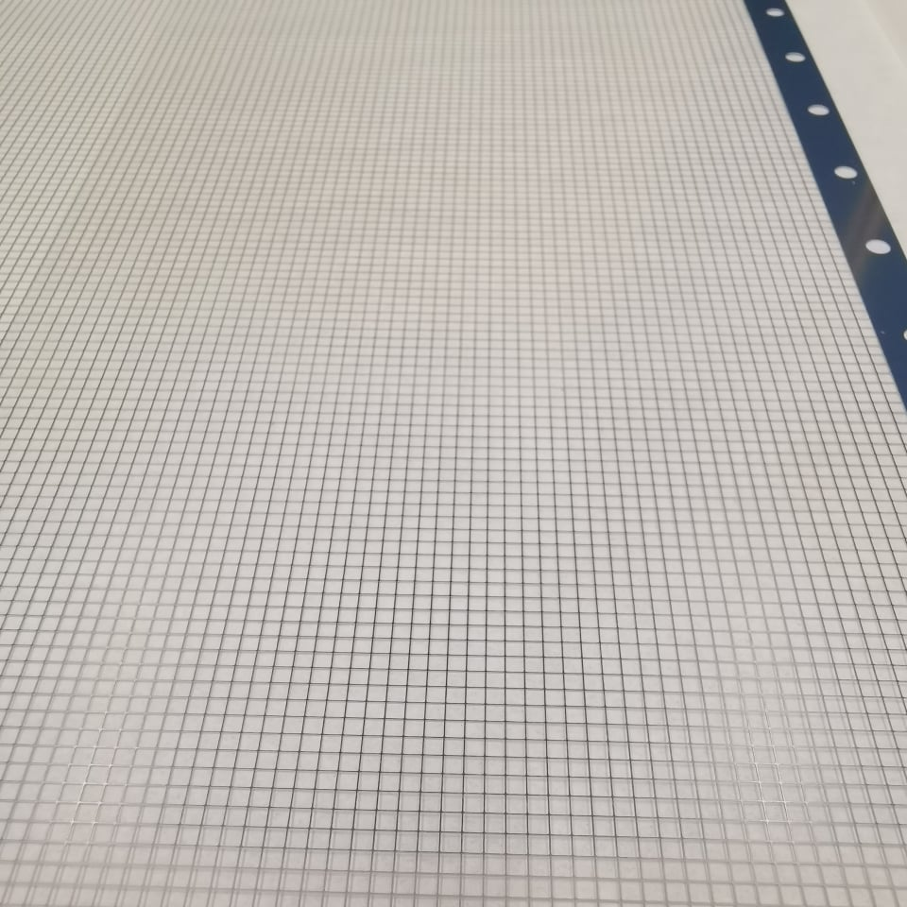
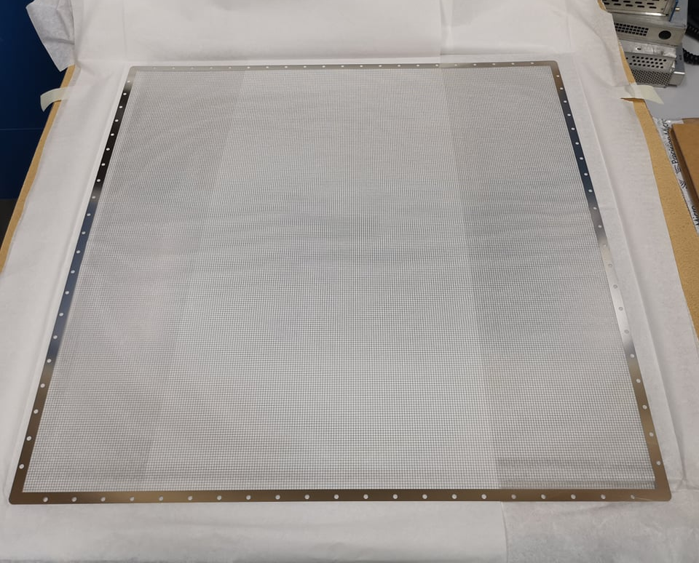
Light Readout Plane (LRP) Design
Modular design and can be applied directly to a DUNE module
Bottom view
Welded Invar structure (Uniquely low coefficient of thermal contraction)
16x 50cm square G-THGEMs
2.3m
Photochemically etched extraction grids
THGEMs/Extraction grids supported by PEEK Spacers

Slide 16
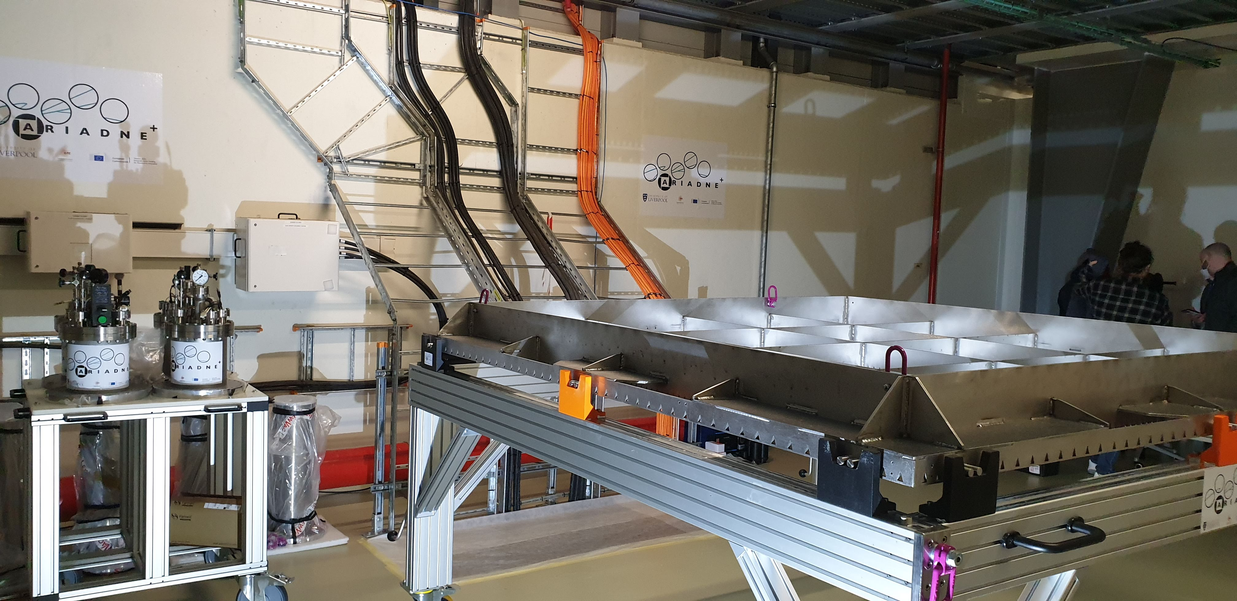
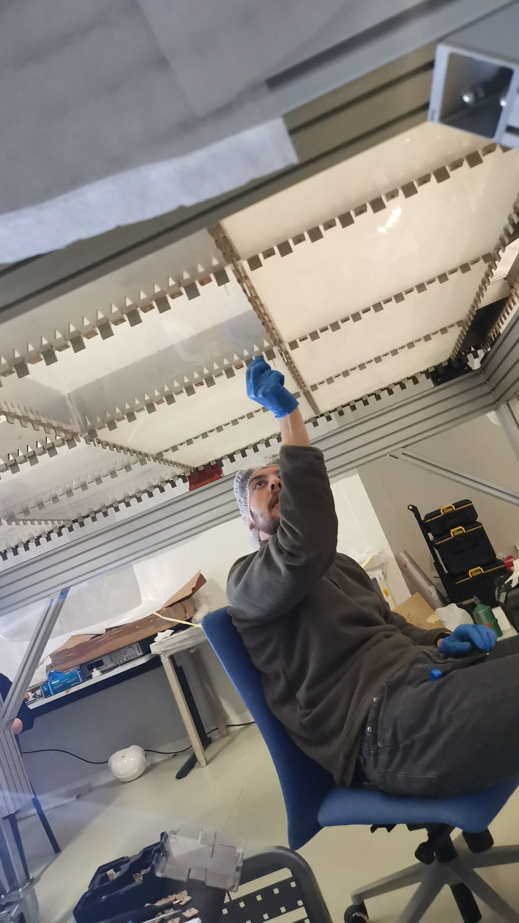
Light Readout Plane (LRP)
LRP assembly at CERN

Slide 17
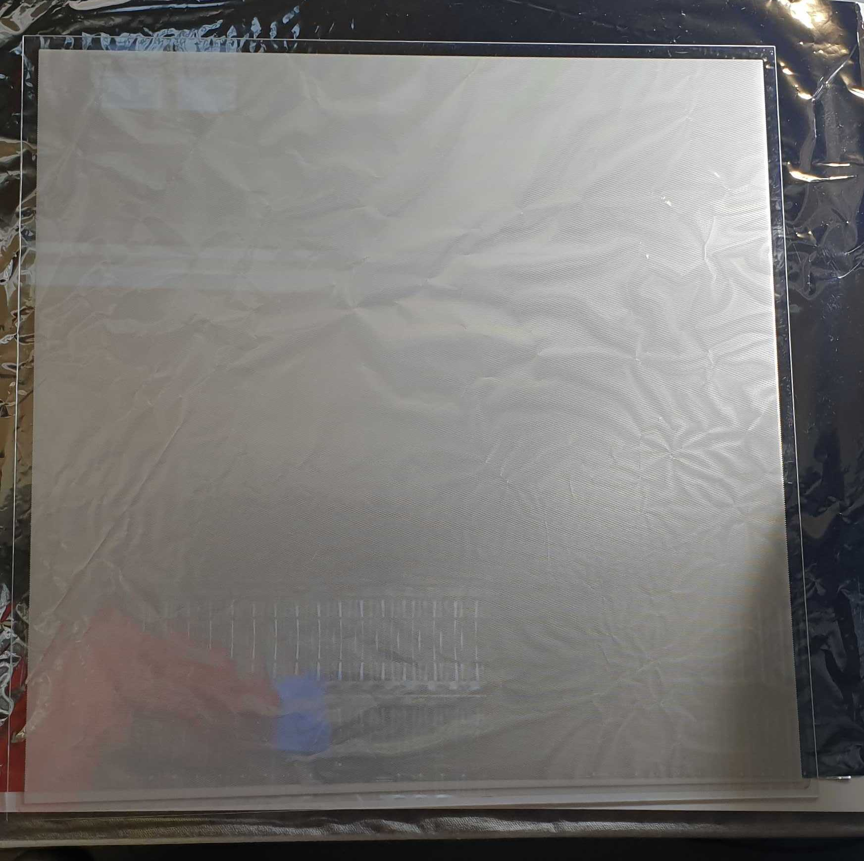
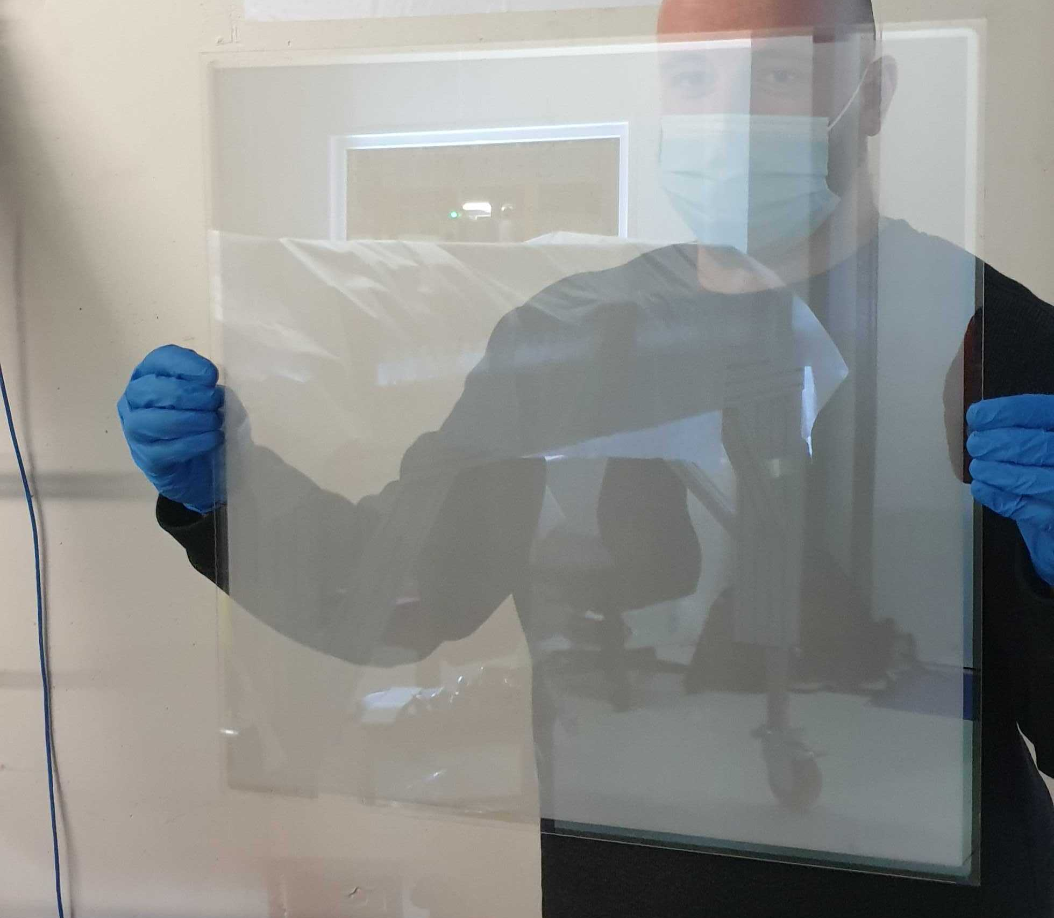
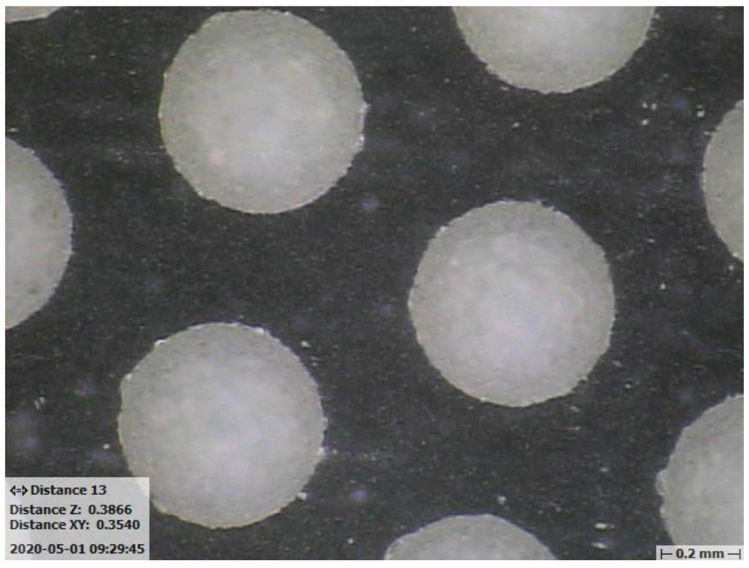
50cm Glass THGEMs
Novel Glass THGEMs developed at Liverpool (Patent accepted GB2019563.2)
Sixteen 50cm x 50cm glass THGEMs
1.1mm thick,
500μm ID holes,
800μm pitch hexagonal array
See for more details:
https://www.mdpi.com/2076-3417/11/20/9450

Slide 18
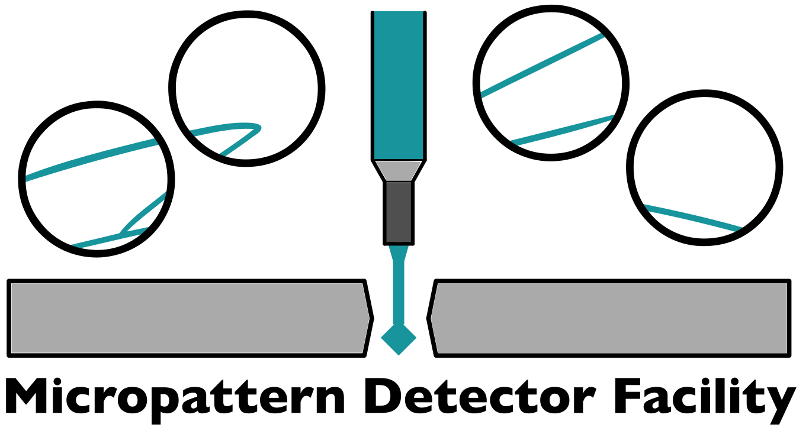
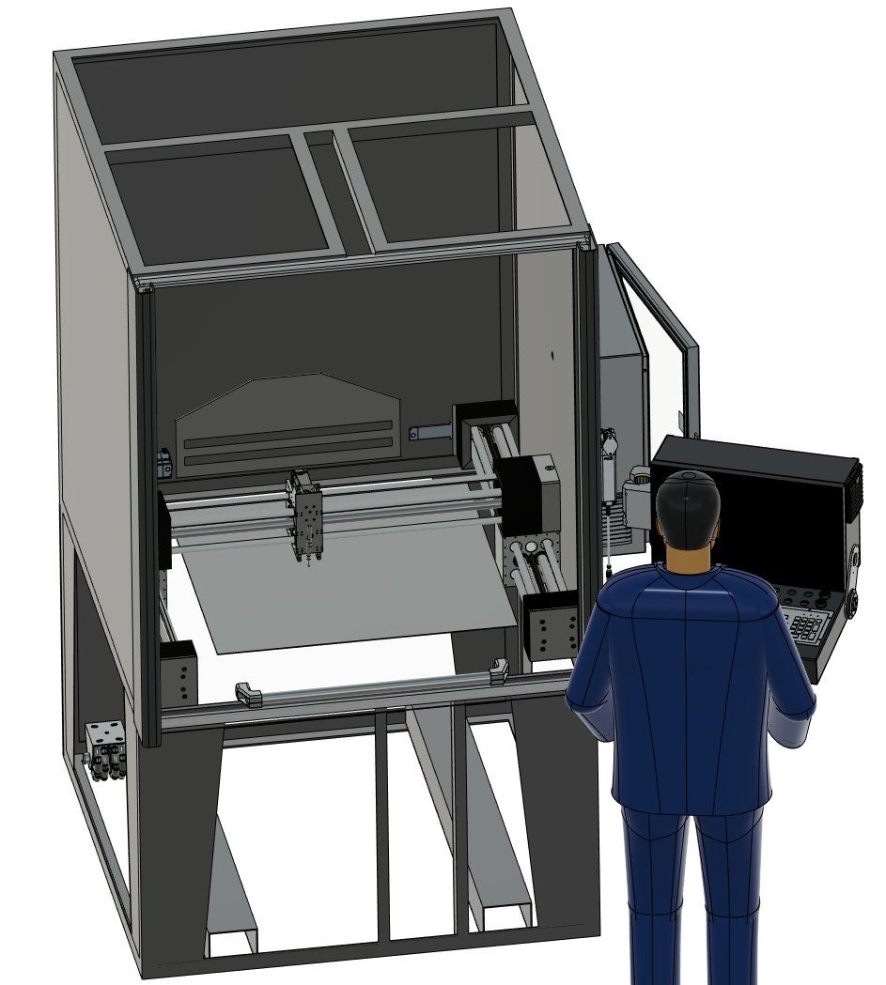
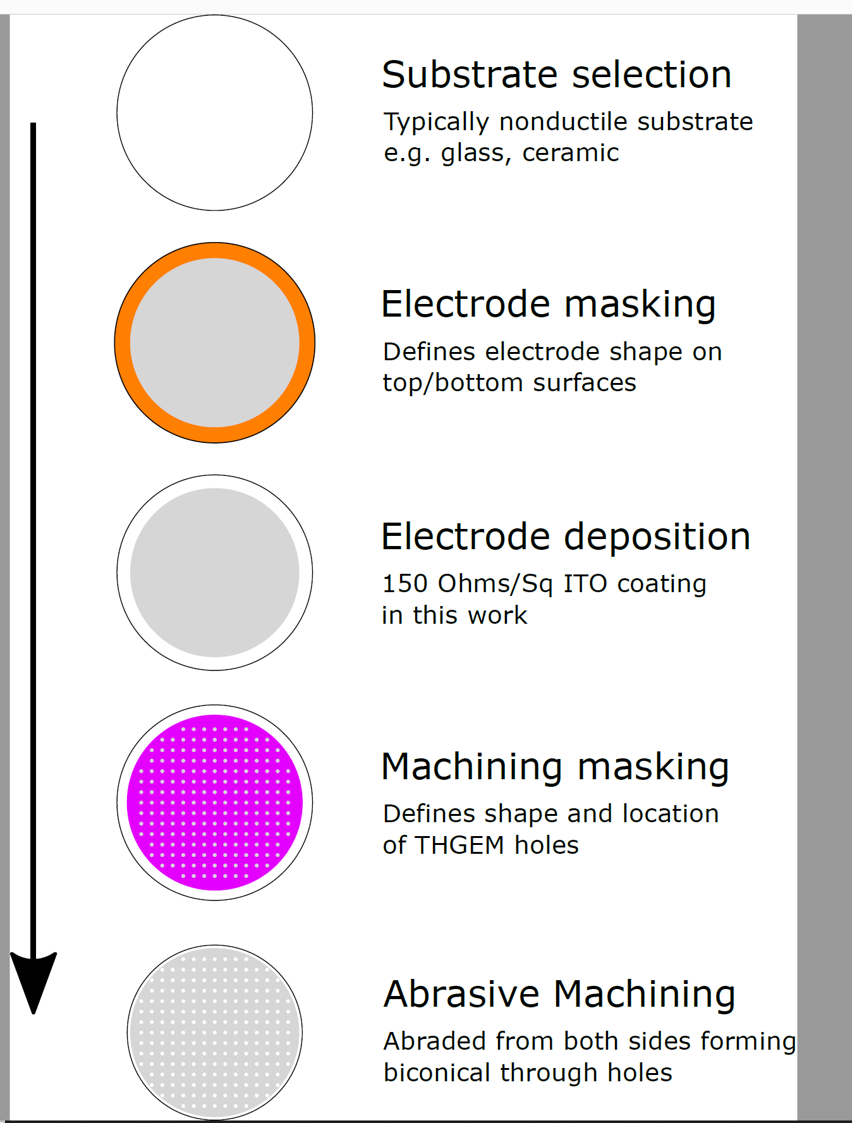
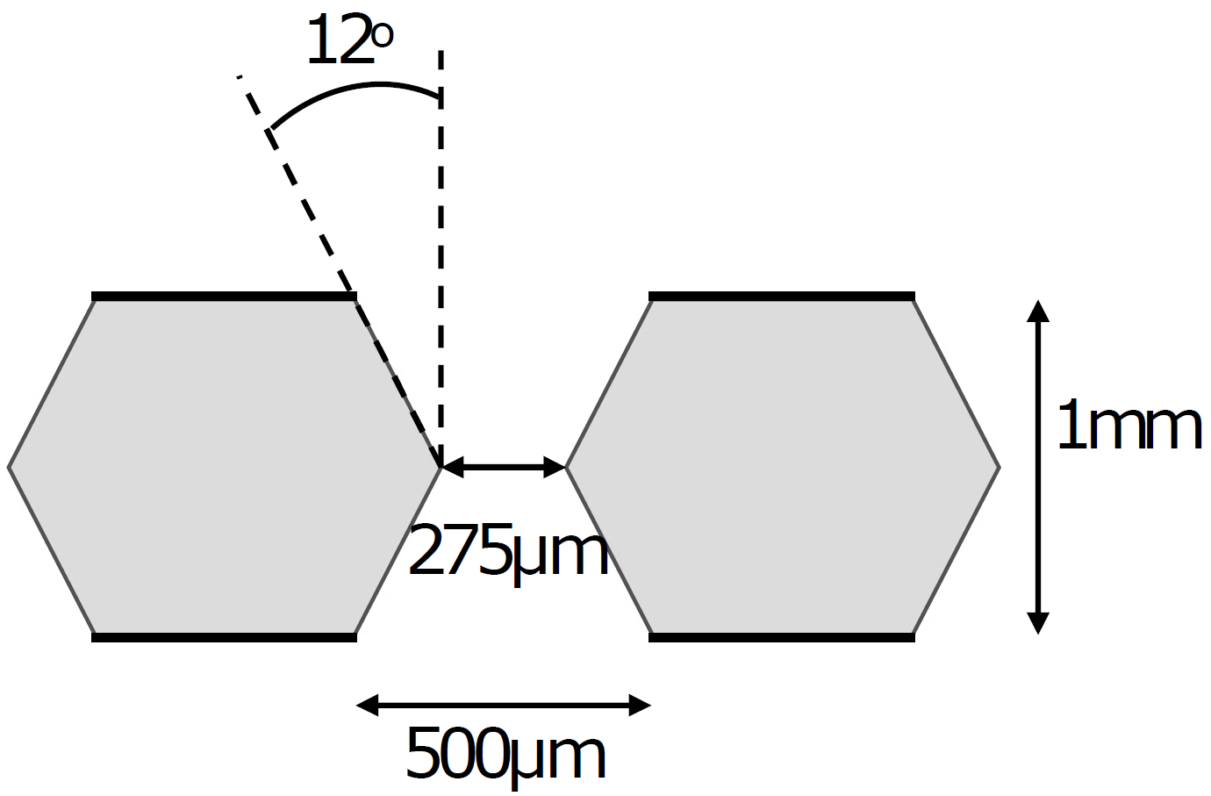
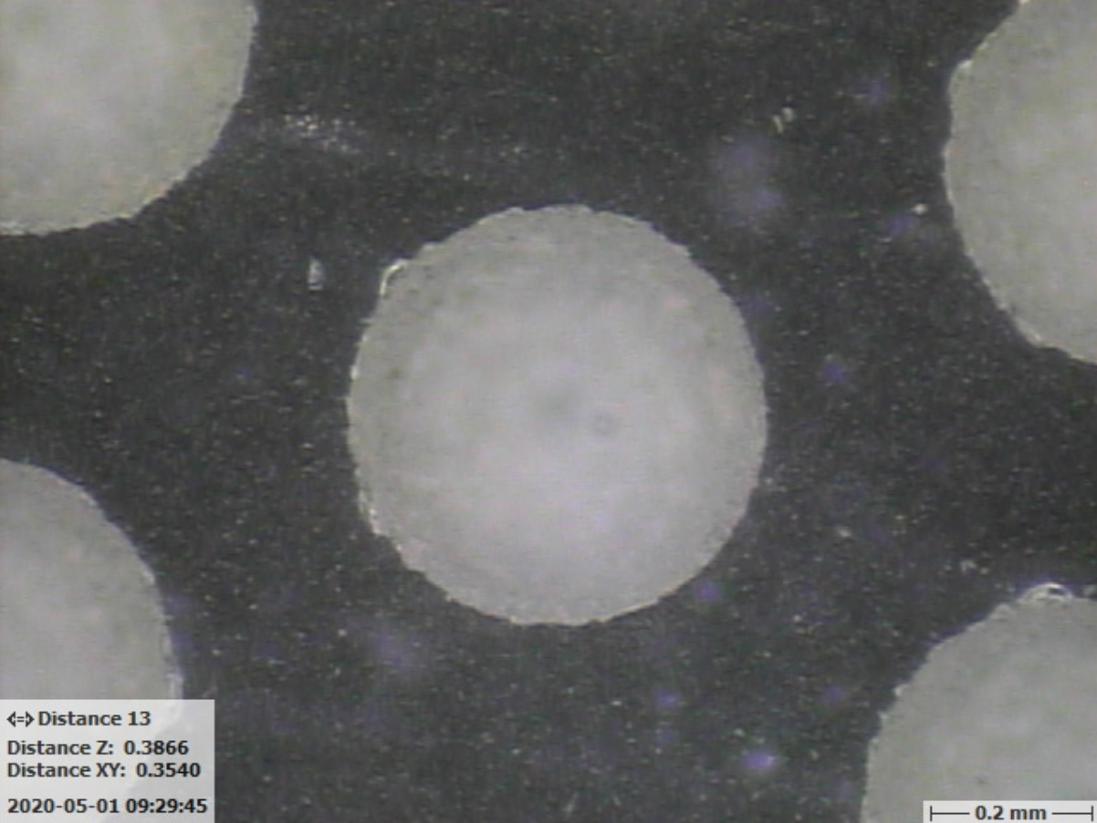
Glass THGEM Facility
G-THGEM: https://www.mdpi.com/2076-3417/11/20/9450
Abrasive machining facility in the University of Liverpool physics building
Fully automated
Capable of machining 850mmx850mm active area
Not limited to glass, any brittle material i.e. ceramic, carbon fibre etc.
Will lead glass THGEM R&D
And capable of protoDUNE large scale THGEMs
G-THGEM with ITO electrodes and holes formed by abrasive machining.

Slide 19
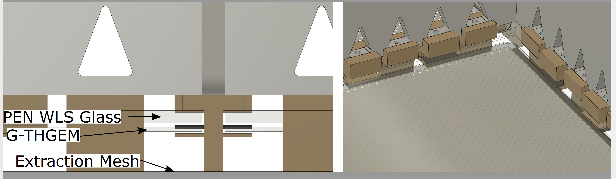
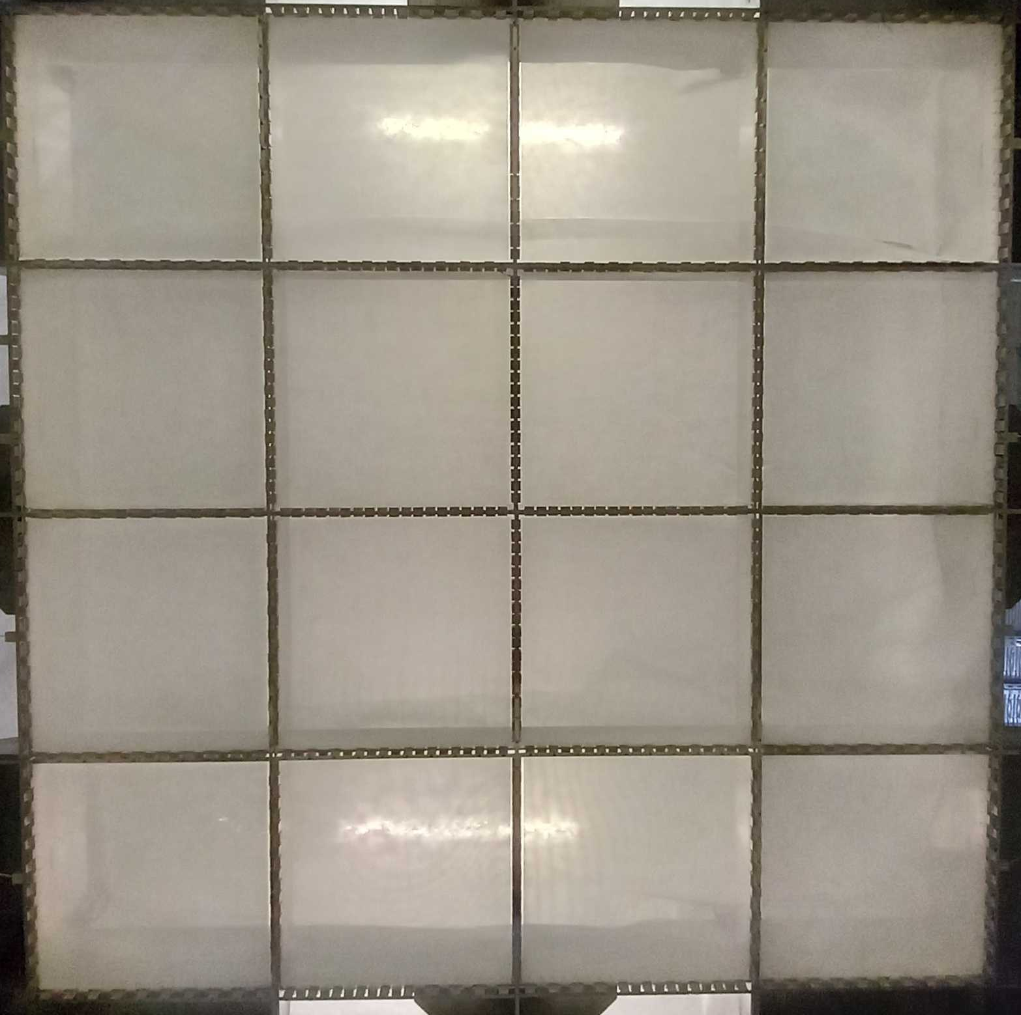
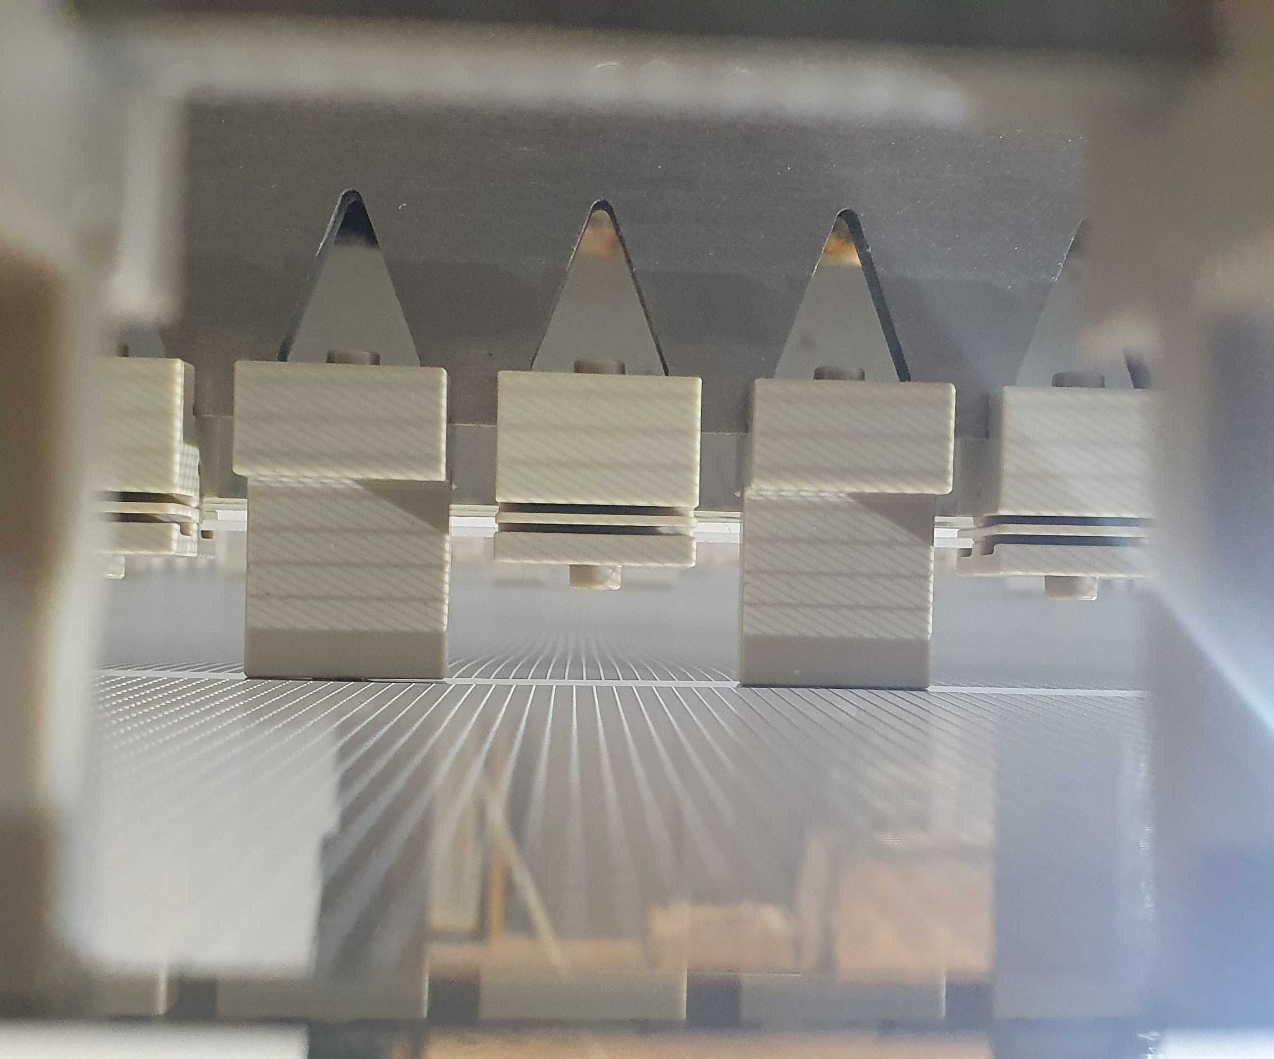
Light Readout Plane
LRP CAD
LRP grids, G-THGEMs and WLS
2x2m LRP G-THGEMs from underneath
The 15mm modular extraction region provided a very stable extraction field!

Slide 20
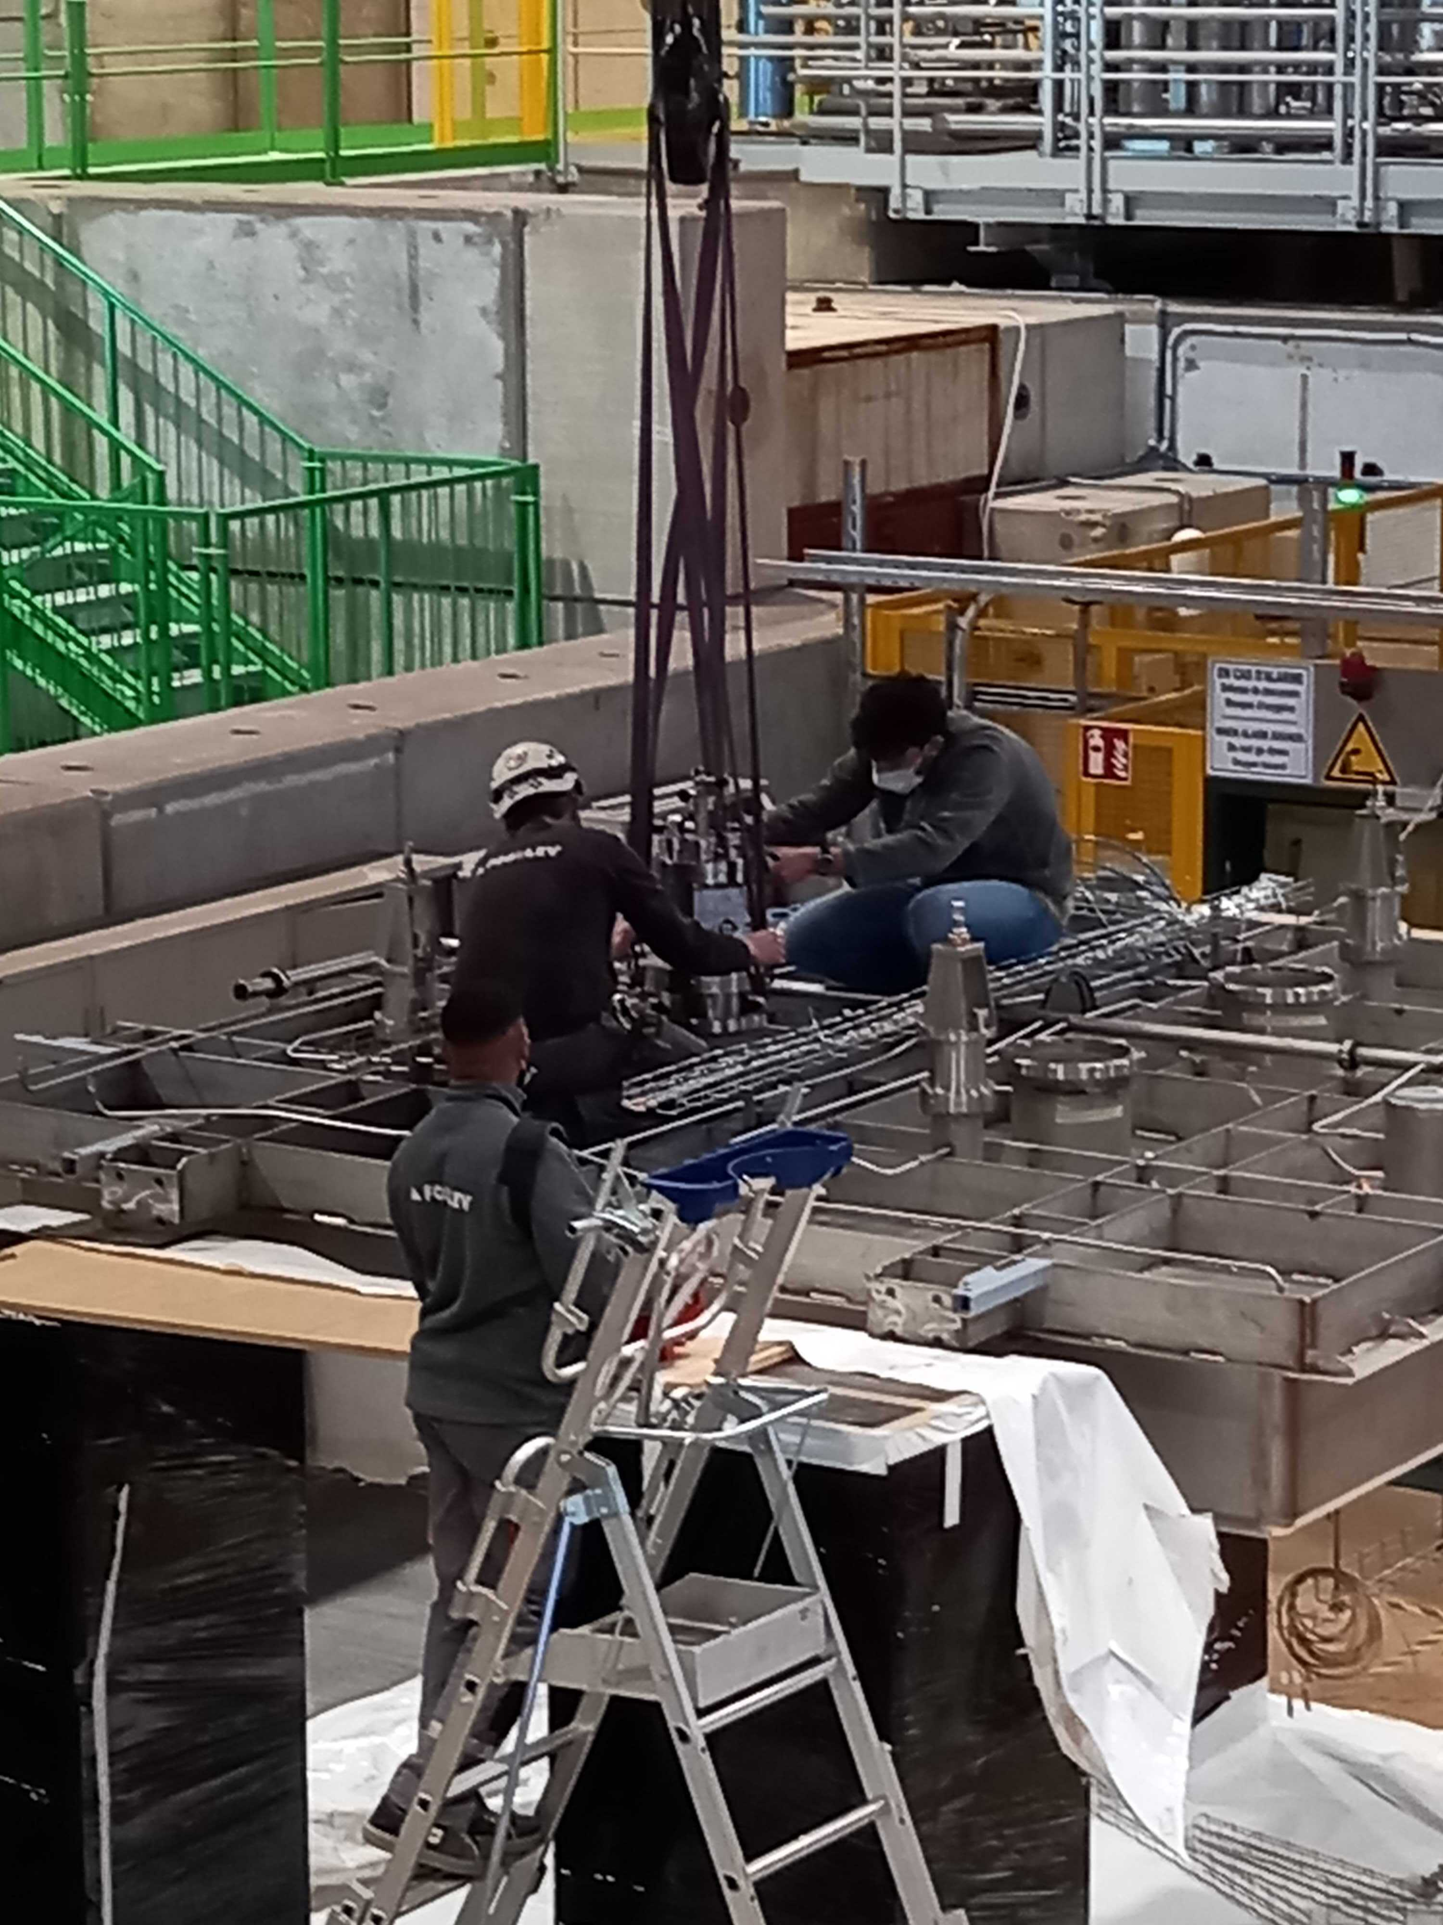
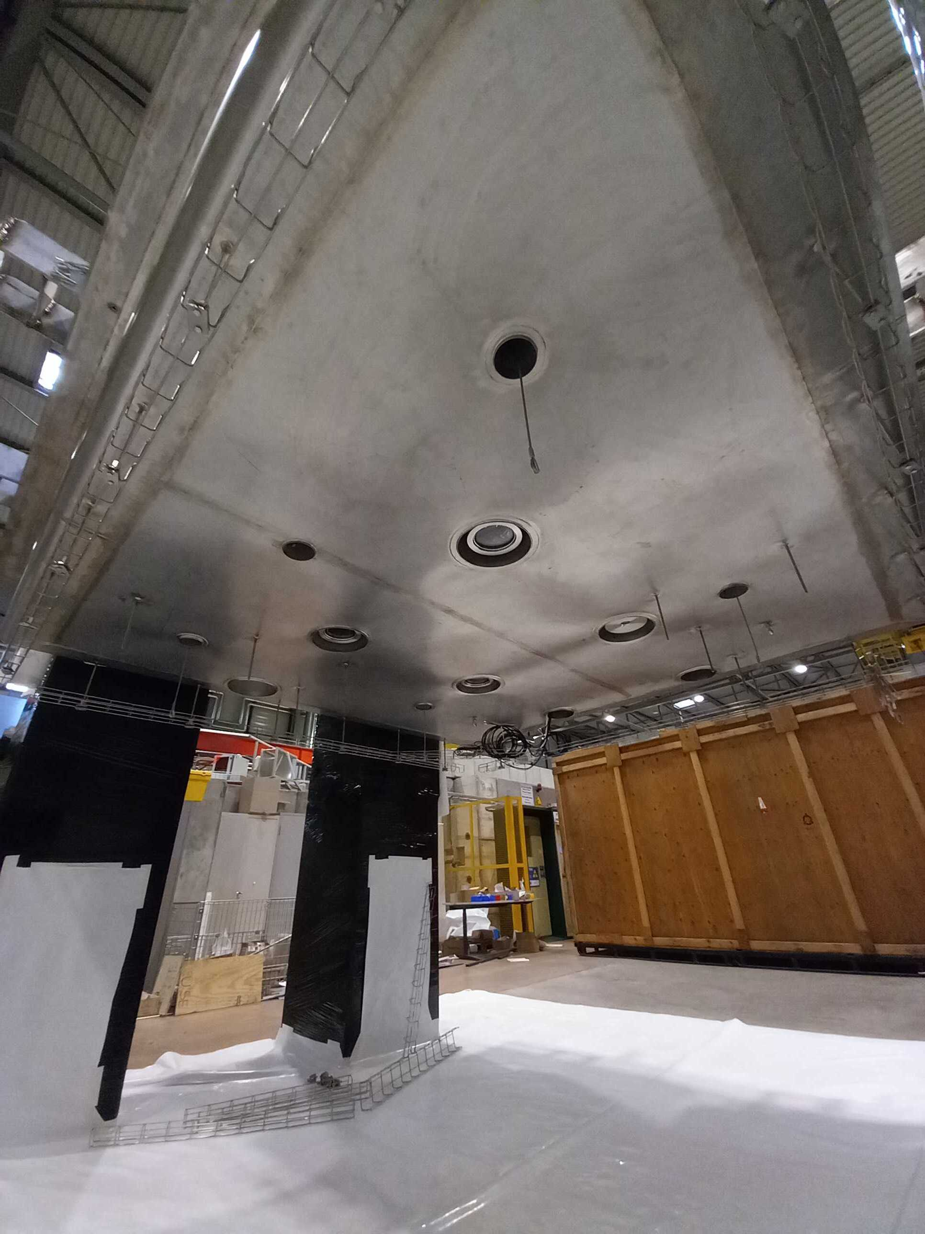
Cold box Integration

Slide 21
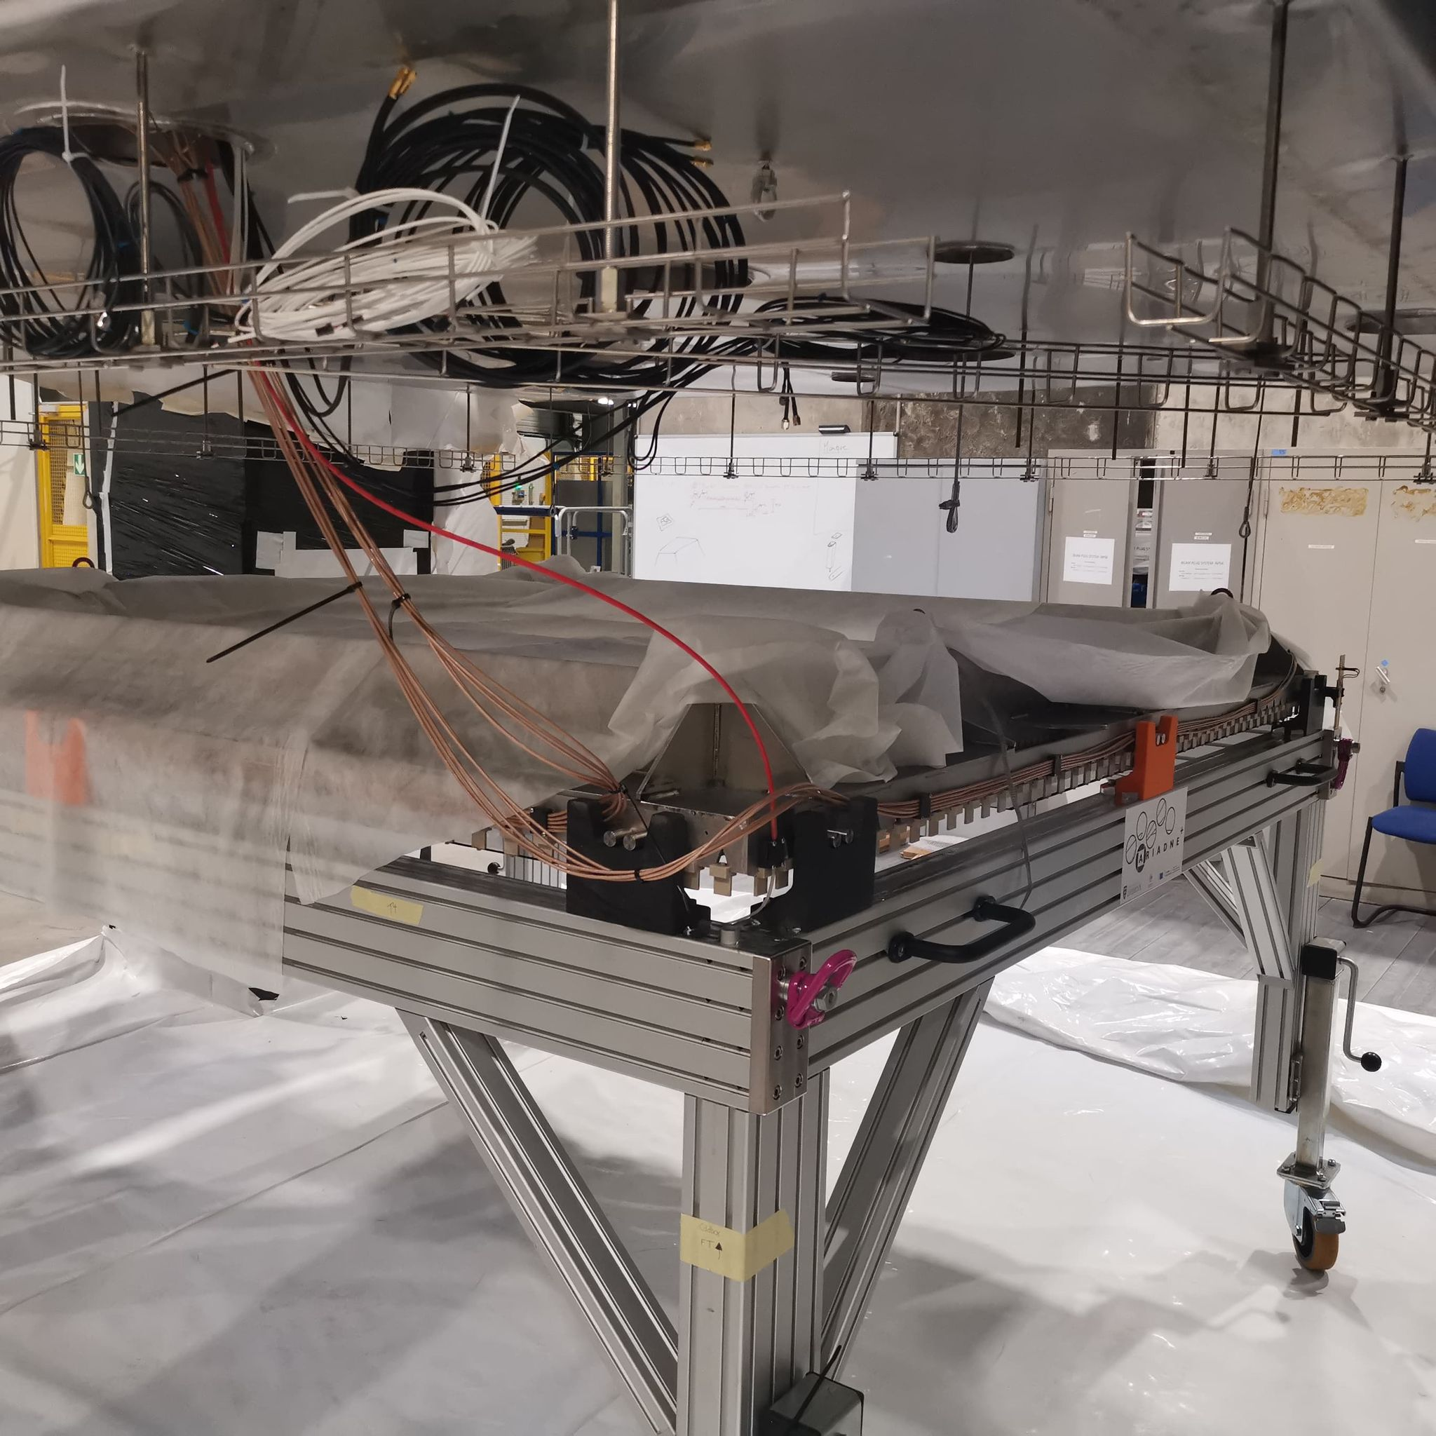
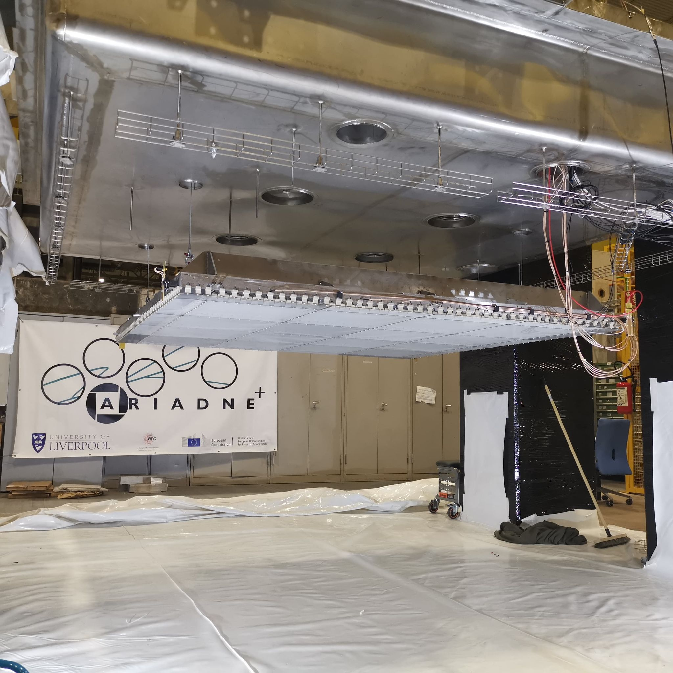
Cold box Integration

Slide 22
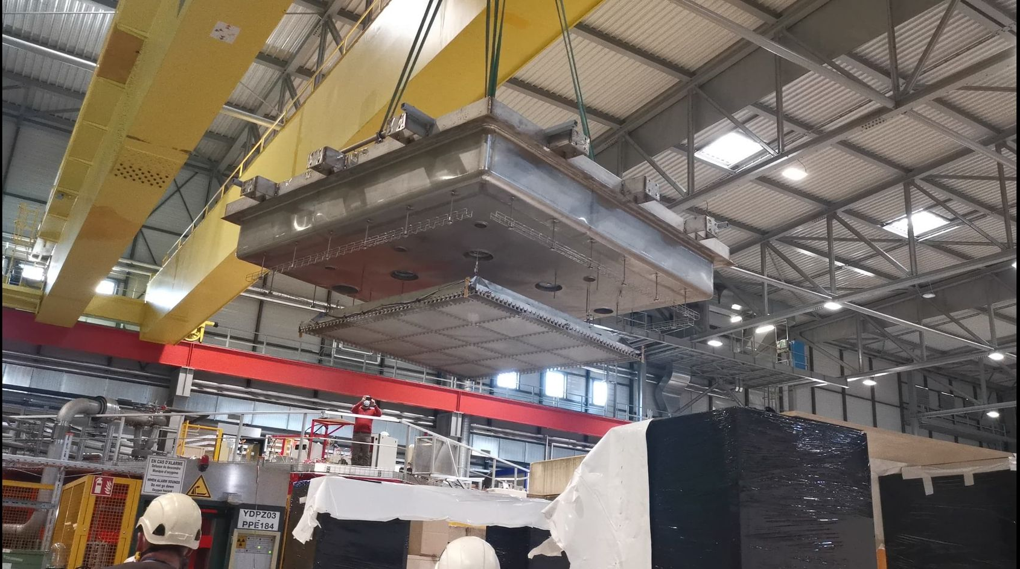
Closing the Detector

Slide 23
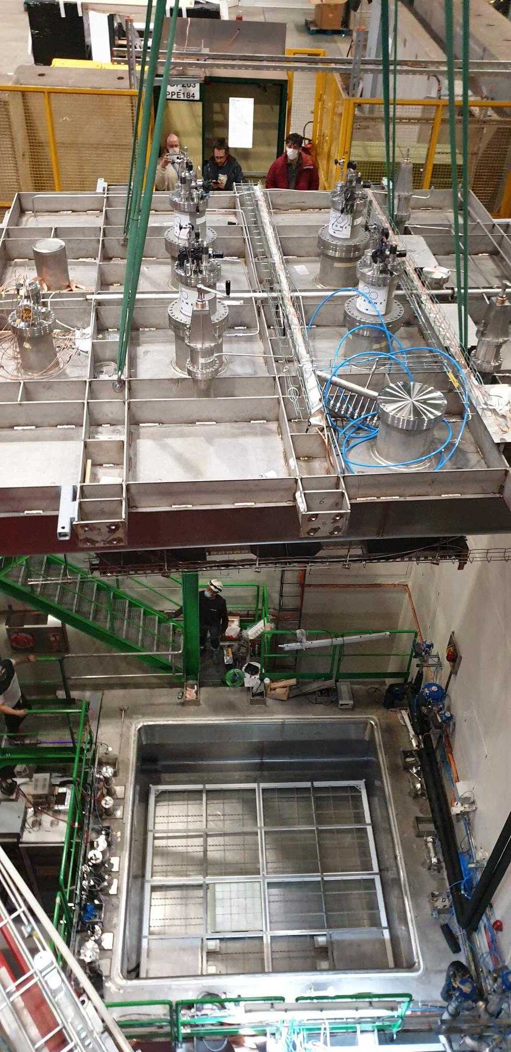



Commissioning at CERN
3 weeks data collection

Slide 24


Glass THGEM Light Gain Study
Visible intensifier
VUV Intensifier

Slide 25



TPX3Cam Cosmics
cosmics 30 sec exposure
Visible
VUV
Visible intensifier:
VUV intensifier:
(vignetting effect needs correction)
Energy Calibration
https://arxiv.org/pdf/2301.02530v2.pdf

Slide 26
ARIADNE+ Conclusions
Optical readout achieved with stable detector conditions has been demonstrated at the same scales as that for vertical drift tests (CERN Neutrino Platform Cold Box)
Dual phase extraction region very stable at large scale!
TPX3 and Glass THGEM technology is ready for deployment now
TPX3Cam TPC Benefits
Raw data is natively 3D
Huge readout rates possible (80 MHits/s)
Zero suppressed readout (approx. few kbytes per event)
Technology | Physics enables | TRL | Cost (DUNE 12mx60m FD) | R&D plans
TPX3 CAM | Very low energy threshold & excellent tracking | 9 | 7.2M (1 cam/m², 4mm/pix) | Lens and image intensifier testing
LRP (GTHGEM Array) |  | 7-8 | 10M (assumes 14k/m², mass production cost reduction is not included) | Larger scale tests (protoDUNE)
TPX4 CAM | Improved time & energy resolution | 7 | 3.2M (0.6 cam/m², 3mm/pix) | Full characterization
High resolution with approx. 1 mm per pixel
Easy access for swapping in/out technologies
Same readout is possible for dual phase or gas TPCs
Comparatively low cost to other readout methods
ProtoDUNE will be the natural platform to perform the next essential step

Slide 27


Using ProtoDUNE dual phase to test optical readouts for Neutrinos and DM; TPX3Cams, DarkSide type PDUs & X-Arapucas
Planned Proposal to SPSC:
TPX Cameras

Slide 28

ProtoDUNE dual phase instrumentation with optical readout
Darkside PDUs, along the beam line
TPX3 Cams in the existing cryostat ports
X-ARAPUCAs
Two LRPs with glass THGEMs, similar to the ARIADNE cold box test
Modify partially existing field cage, with embedded X-ARAPUCAS in CT shape profile. Low energy threshold S1 (Flavio C et al)
Cathode remains middle of TPC
CRPs (or other technology)

Slide 29

TOP VIEW Optical protoDUNE
12 Darkside-20k type PDUs produced in the UK/Naples
In dark green shade is the FoV of the TPX cameras(1mx1m) using the current cryostat ports
TPX3Cams ports
Space to test more optical sensors for very low energy thresholds such as Darkside20k SiPMs
X- Arapucas will be used to cover the field cage (sides only and retain the rest of the field cage). X-Arapucas in the Field cage are of high importance to correlate S2/S1 signals for DM
X-ARAPUCAs
Cathode can remain in the middle

Slide 30

Design effort -LRP
One LRP to contain 6x5 Glass THGEMS (very similar design concept as the ARIADNE cold box test)
Made out of Invar
Similar size to a vertical drift CPR
Will hang from four top cryostat ports and will be able to move up down using the existing levelling motors
CAD Models By George Stavrakis

Slide 31

Design effort –LRP FEA
FEA weight of LRP
CAD Models & FEA By George Stavrakis

Slide 32

Design effort –LRP FEA
Hanging from four points under cryostat ports (not ideal positions)
Max deflection 0.7mm
CAD Models & FEA By George Stavrakis

Slide 33

Design Effort -Assembly
Field cage support structure (hangs from cryostat ports)

Slide 34

Design Effort -Assembly
First LRP installation (independently hangs from cryostat ports)

Slide 35

Design Effort -Assembly
Second LRP (hangs also independently)

Slide 36



Design Effort -Assembly
Cathode planes hangs from field cage structure
Custom made add on cathode holders (installed without any drilling).

Slide 37


Design Effort -Assembly
Field cage installation (mixture of the old and new square X-ARAPUCAs)
(APEX, Flavio Cavanna et.al)

Slide 38



ARIADNE 1-ton Run @Liverpool
ARIADNE run just finished, tested some of the proposed instrumentation for protoDUNE.
Three TPX cameras installed, with the remaining ¼ of the detector dedicated to Darkside SiPMs.
Measure the response of Darkside SiPMs to varying THGEM bias and determine the correct gain for ProtoDUNE operation (in collaboration with Naples)
Test different types of intensifier - one previously used on ARIADNE and the new intensifier on ARIADNE⁺
Test TPB coated glass for WLS instead of PEN - assessing difference in light quantity
Calibration gamma sources tests

Slide 39







LAr Tracks with new G-THGEM

Slide 40






Calibration sources on ARIADNE
Co60 Heatmap - 14 mins long
Individual 1.2 MeV gamma
SIPM tiles above the glass THGEM
1sec stream gamma source
0.5 msec

Slide 41





Installing SiPM tiles on ARIADNE
Breakdown voltage
SPE
2 SIPM tiles from Naples (Giuliana Fiorillo et al) installed in one of the ARIADNE ports.
To observe performance in a dual phase operation S2 light.
SIPM tiles above the glass THGEM
S1
S2
THGEM@3.1kV, PDM bias @63.7 V

Slide 42
Proposed Timeline
2024
2025
2026
2027
Testing of Darkside type SiPMs in ARIADNE ☑️
Design of LRPs/TPC for protoDUNE
VD Run End
Submit LoI to SPSC/PBC
Facility at Liverpool for GTHGEM production
Finalise all LRP design and start procurement
Finalise all APEX FC design and start procurement
Installation of TPC components in ProtoDUNE
Start Run

Slide 43

Thank you
The A. Team

Slide 44
Extra Slides

Slide 45


TPX3 -> TPX4

Slide 46


THGEM S2 light production
VUV (126nm) light produced through de-excitation of Argon gas.
TPB Wavelength shifter above THGEM converts to 430nm.
At low field (<2kV/cm), S2 light production is linearly proportional to THGEM field. No charge gain. Very stable operation without discharges. No ion production.
At higher fields, electron multiplication occurs (Townsend avalanche).
Exponentially increasing S2 light production -> Improved sensitivity/threshold
Simulation

Slide 47



G-THGEM Characterisation
THGEM charging behaviour
Bi-conical holes lead to “upwards” charging over time.
Straight wall holes lead to “downwards” charging over time
The charging behaviour of fused silica THGEMs results in greater light production for the same applied field.
All circle hole glass THGEMs produced more light than the equivalent FR4 THGEM.
THGEM bias scan
https://www.mdpi.com/2076-3417/11/20/9450

Slide 48


PEN WLS
Two grades of TEONEX PEN foil investigated Q51 and Q53.
Thinner PEN consistently found to have a better conversion efficiency than thicker sheets (surface interaction).
Q51 consistently found to have a better conversion efficiency than Q53.
50cmx50cm Q51 25μm PEN film glued on glass panel

Slide 49





Focusing VUV Intensifier using GAr TPC
Alphas from Am-241 in 1100mb pure argon
+1mm
+2mm
Spacer rings
MgF₂ objective lens position is fixed into viewport.
Spacers change focal length position between objective lens and intensifier photocathode.
+2mm found produce sharpest image (in GAr).
+3mm
Intensifier photocathode QE

Slide 50
ProtoDUNE new FCage
Drawing by G. Stavrakis

Slide 51

ProtoDUNE cathode, X-ARAPUCAS

