Slide 1

Innovative Purification Techniques for Producing High-Quality Germanium Detectors for Low-Mass Dark Matter Searches
By: Austin Warren
Austin Warren (USD) – austin.warren@coyotes.usd.edu
This work is sponsored by DOE DE-Sc0024519 and NSF PHY-2310027 and NSF OISE-1743790.

Slide 2
Motivations
For crystal growth and quality grade detectors we need a germanium purity of ~10¹⁰
BUT commercial grade germanium only comes at 10¹³ at best and typically 10¹⁴
Purification of commercial ingots is required before growing crystals for making Ge detectors
Next generation dark matter experiments require a low-energy threshold
Ge detectors provide the low-energy threshold due to its low-energy band gap – 0.7 eV
Ge detectors are very competitive in searching for dark matter

Slide 3
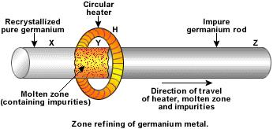
Fundamental Idea
Simply take most impurities to one side by passing an induction coil through an ingot of material in a controlled environment
Impurities are more soluble in the liquid/molten state so you “pass” them through the material slowly over time.

Slide 4
Types of impurities and how they react.
An impurity with 𝑘 > 1, such as boron (𝑘 ≈ 1.7 − 1.9), will move in the opposite direction of the molten zone, and collect near the head
Segregation Coefficient (k) is the ratio of the impurities in the solid phase to the impurities in the liquid phase
An impurity with 𝑘 < 1, such as aluminum (𝑘 ≈ 0.1) , phosphorous (𝑘 ≈ 0.2 − 0.3), and gallium (𝑘 ≈ 0.2 − 0.3), will prefer to stay in the Ge liquid and move away from the head and collect near the opposite end of the ingot – the “tail”

Slide 5




Fundamental Equations
Equilibrium
Not in equilibrium (Very similar, but now you use the “effective” segregation coefficient)

Slide 6
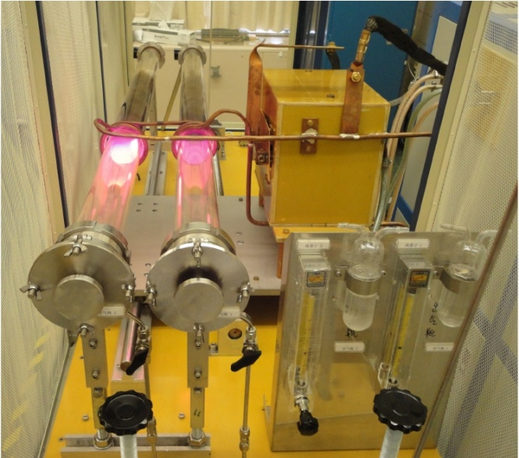
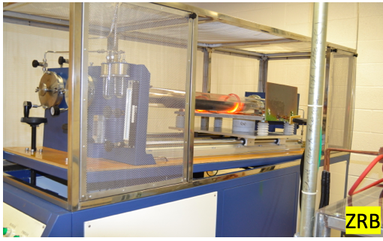
USD Setup Parameters
Vacuum level- 10⁻⁵ or 10⁻⁶
Zone Width – 2-4 cm
Number of passes – 14
Zone Travel Speed - (4cm/hour)
H₂ flow rate – 40-50 m³/hour
Pressure - .02 Mpa
Etch the materials with acid at the start and at 7 passes to prevent surface impurities
Coat quartz boat with ethylene gas and place inside graphite boat.

Slide 7
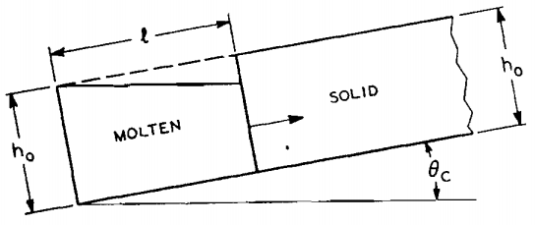
Adjustments and Logging
Slant of the boat.
New Power supply and Fix Hydrogen Generator
All parameters are kept in a log so we can tell what has changed and what problems occur.

Slide 8
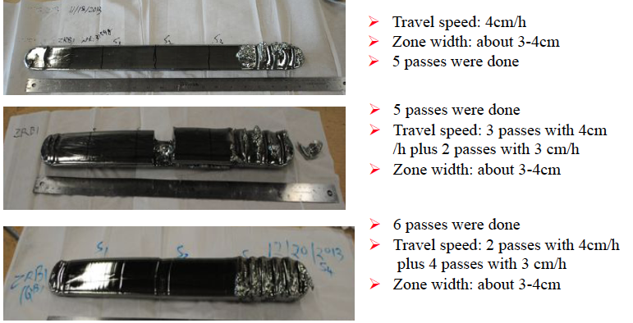
Results and Discussion

Slide 9

The “After” Process
After the 14 passes the solidified ingot is removed and cut into sections that generally are by expected purity levels.
The Hall Effect measurement system is then used to check the impurity level, whether the germanium is N-type or P-type, the mobility, and the resistivity.
• Mobility: $μ=\frac{1}{qnρ}=\frac{\left|V_{H}d\right|}{IBρ}$
• Resistivity: $ρ=R_{s}∙d$
• Net carrier concentration: $n=−\frac{IB}{qtV_{H}}$

Slide 10
Results form Hall Effect Measurements
 | Samples | Impurity level of purified ingots (1/cm³) | Mobility (cm²/Vs) | Resistivity (Ω·cm) | Impurity level of raw materials (1/cm³)
ZRB1 on 11/18/2013 | S1 | 5.66E+11 | 3.42E+04 | 3.23E+02 | 2.17E+12
 | S2 | 3.57E+11 | 3.45E+04 | 5.07E+02
 | S3 | 8.58E+11 | 1.11E+04 | 6.58E+02
ZRB1 on 12/04/2013 | S1 | 3.88E+11 | 2.95E+04 | 5.46E+02 | 2.15E+12
 | S2 | 8.89E+11 | 2.90E+04 | 2.42E+02
 | S3 | 8.76E+11 | 3.19E+04 | 2.24E+02
ZRB1 on 12/20/2013 | S1 | 4.44E+11 | 4.10E+04 | 3.43E+02 | 3.43E+12
 | S2 | 2.08E+11 | 4.67E+04 | 6.41E+02
 | S3 | 1.68E+11 | 4.74E+04 | 7.86E+02

Slide 11
Conclusion
Recently, the influences of zone travel speed on quality of ingots have been investigated.
Previous results show that some samples cut from the head part of ingots can reach 10¹¹/cm³, but those results are not consistent.
After we decreased the travel speed significantly, impurity levels for the entire ingots have consistently reached 10¹¹/cm³. The best one is 1.6x10¹¹/cm³.
Our final goal is 10¹⁰/cm³, further investigation is on-going.
In the future, we will investigate the influence of zone width and the number of passes on the quality of ingots when the travel speed is fixed.

Slide 12
Thank You

