Slide 1
Automated continuous industrial platform for fuel bioethanol using Clostridium with co-production of high-value peptides via clostridial IVTT
Stephen Hughes, PhD Chief Technology Officer Integrated Biorefining Corporation
(Research Division of CleanFlex Energy Systems LLC) 4816 Duxhall Drive
Lincoln, NE 68516

Slide 2
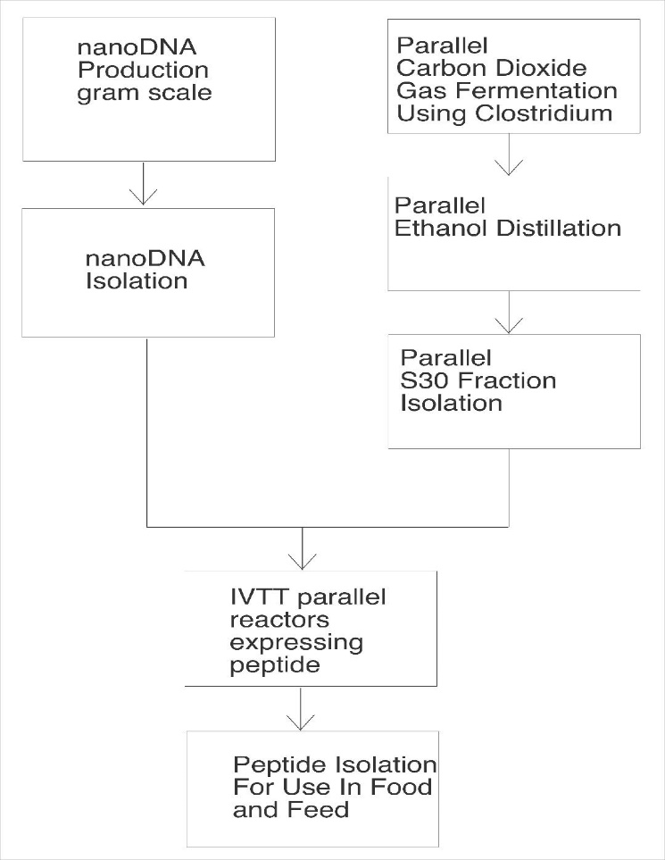
Main Discussion Points
Integrated Biorefining Corporation (IBC) Background
Continuous DNA Production
Continuous Biofuel Production
Continuous Valuable Peptide Co-production (non-caloric sweetener)

Slide 3
Section 1: IBC Background

Slide 4
IBC Sites - Phase 1
Headquarters in Broomfield, CO site of IBC research division
Continuous graphene production and fish production in Cameron County, TX with completely off-grid electrical production in South Padre Island, TX
Continuous nonGMO corn production and yellow perch production with water purification and completely off-grid electrical production in city of Superior, NE
Continuous GMO lettuce growth to produce proteins for synthetic milk production with completely off-grid electrical generation in Las Vegas, NV
Other sites planned in Phase 2

Slide 5
IBC Continuous Operations
LEED platinum facility with fully sustainable biofuel-electrical operations including complete carbon capture on site
Fully automated aquaponics with high-density fish operations providing 1500 fish daily, fertilizer, and clean water for operations and drinking
Fully automated hydroponic plant-growth operations for ultra-high production of nonGMO corn (3000 bushels/week) and soybeans; could be adapted for coffee, hemp, tobacco, lettuce, tomato, or cacao
IBC automated nanoDNA production facility (yields 1000 maxipreps for 1-gram nanoDNA per 24-hours operated continuously)
Continuous production of high-value peptide via clostridial IVTT

Slide 6
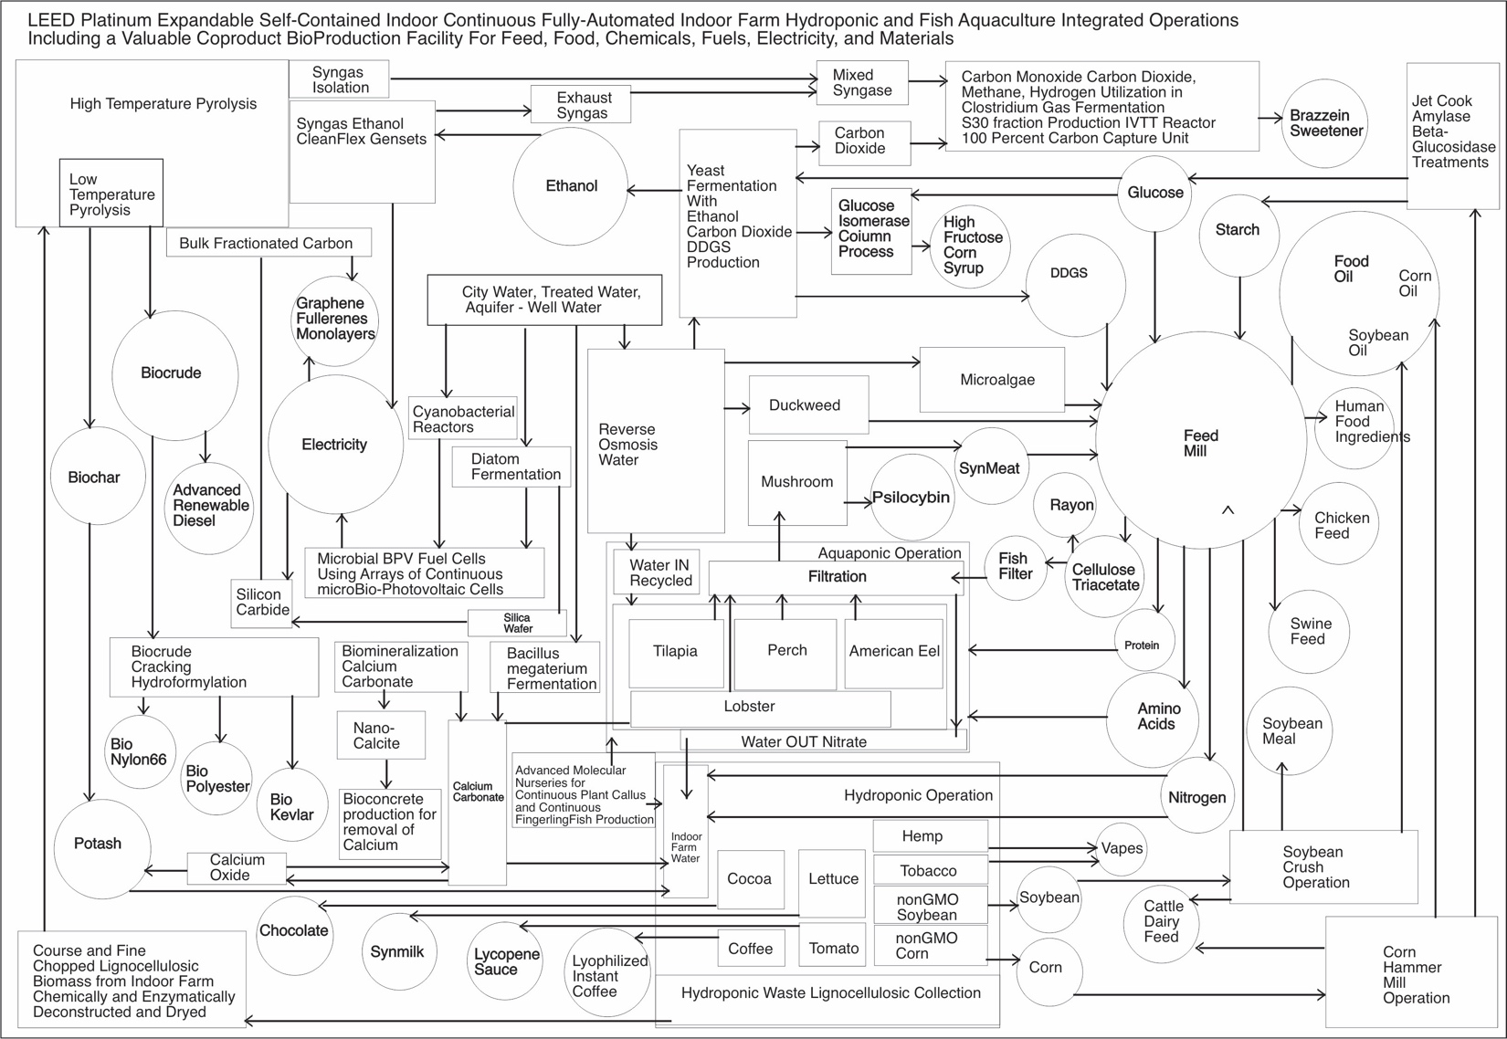
IBC Facility

Slide 7
Section 2: IBC Continuous DNA Production

Slide 8
Plasmid Use for Cell and Gene Therapies (CGTs)
Plasmid DNA use increased sharply in the past 20 years due to development of CGTs, and it surged dramatically during the COVID-19 pandemic
Plasmid manufacturing is major challenge for safe and cost-effective production of CGTs as well as food, feed, cosmetics, and other products
Sufficient high-quality plasmids to meet demand will require robust automated clean manufacturing platforms such as the IBC facilities

Slide 9
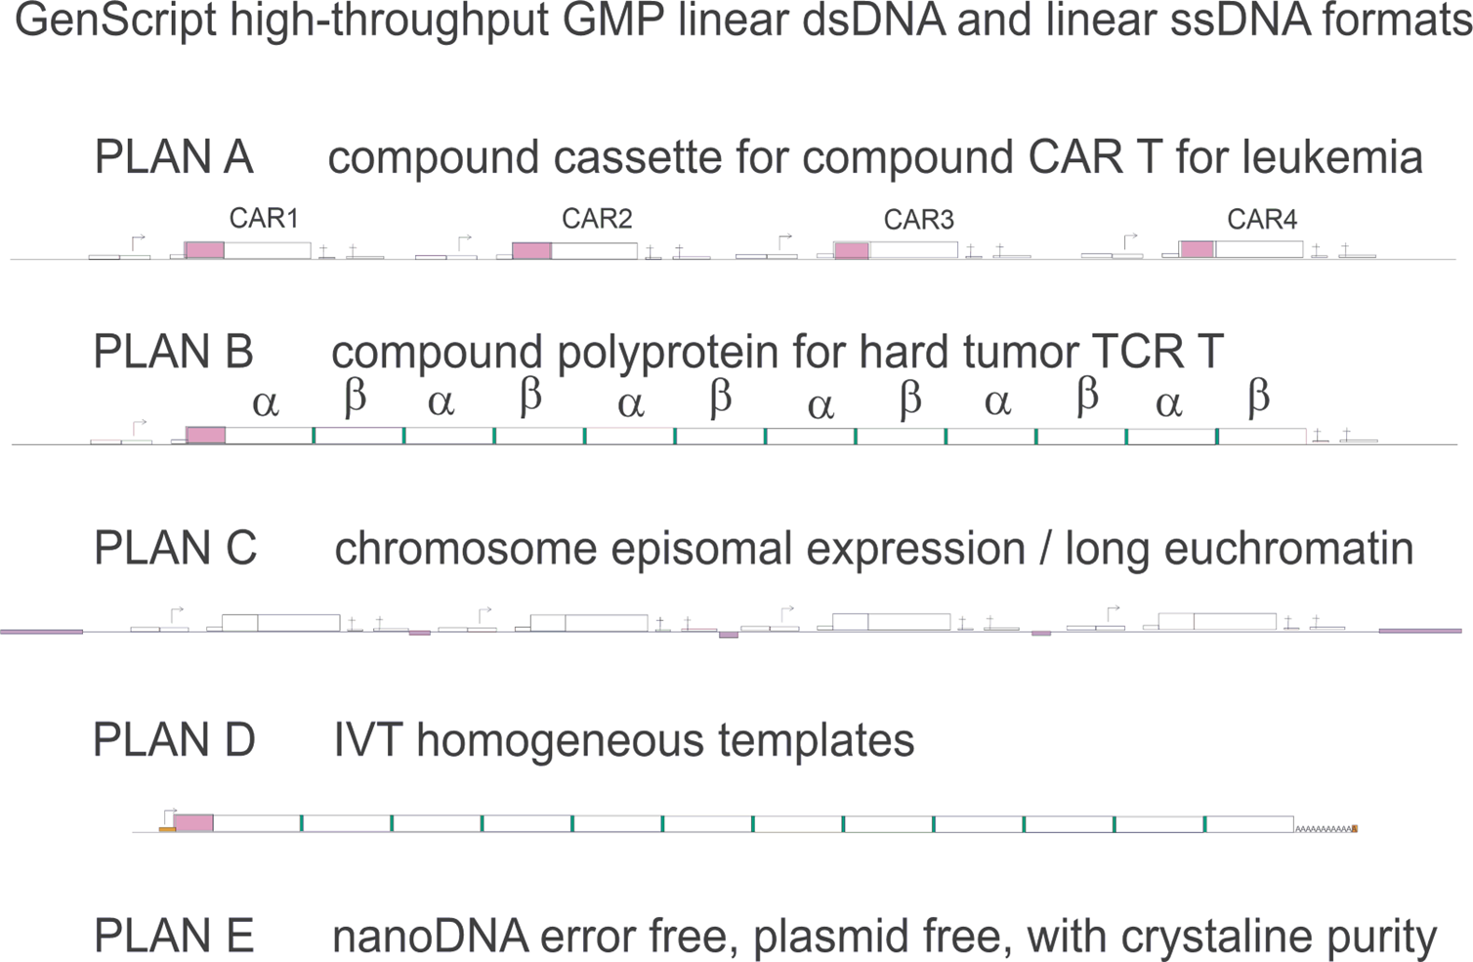
IBC High-Throughput GMP Linear dsDNA and ssDNA Expression Formats for 3D nanoDNA Assemblies

Slide 10
Plasmid Production Amounts Required for Scale Up for Use in Food-Grade Products
Research grade: 10,000 of the 20-µg samples per day required to screen variants for development of technological advances
Preclinical grade: 1,000 of the 1-mg samples per day or 10 of the 100-mg samples per day needed for safety testing
GMP food grade: 1 gram per day required for manufacturing of commercial IVTT templates

Slide 11
Areas Important for Increased Interest in Clostridial S30 Fraction Continuous DNA Template Production
Improved error-free long-length oligo production
Optimized large-scale DNA assembly strategies
DNA ligation and plasmid transformation for Master Cell Bank production
Automated plasmid maxiprep process
Resulting DNA used for large-scale IVTT nanoDNA templates for very high-level gene expression and extraction

Slide 12
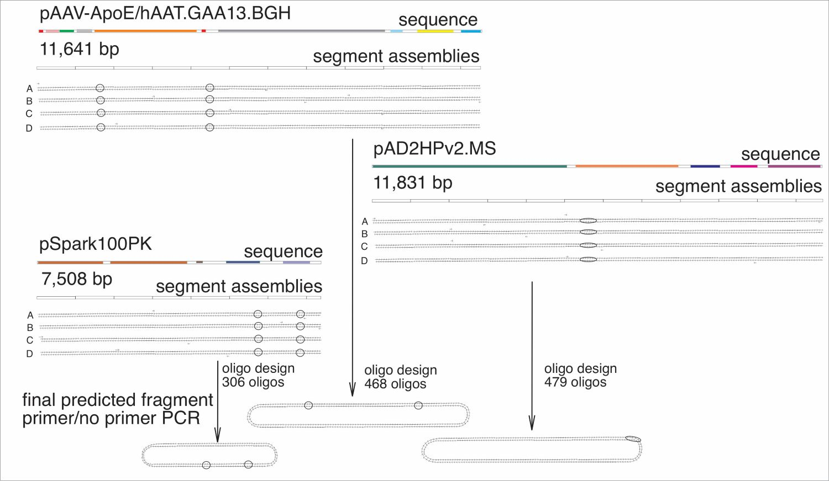
Informatic DNA Assembly Strategy
[bottom row: Left - AAV helper plasmid;
Center - payload plasmid; Right - adenovirus helper plasmid]

Slide 13
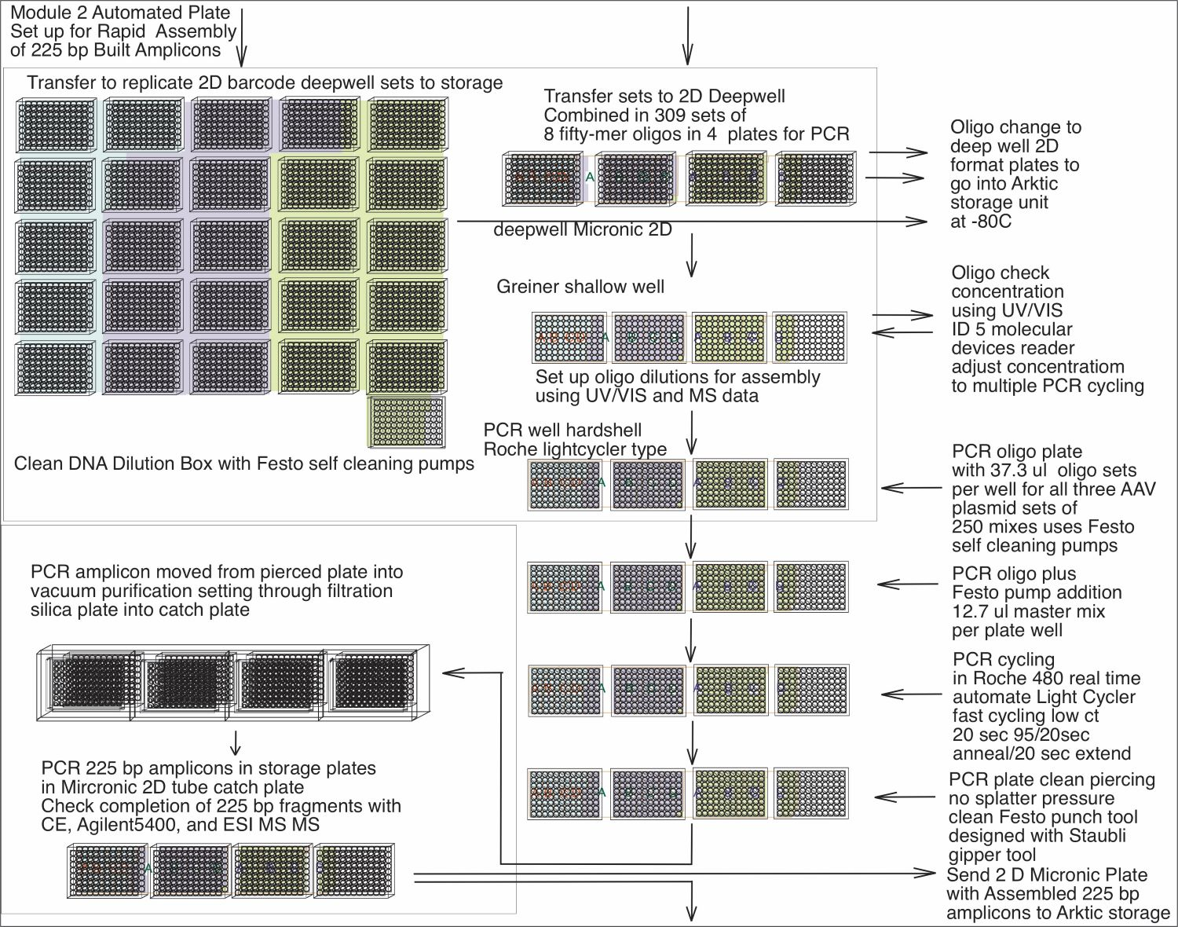
Assembly of 225 bp Amplicons

Slide 14
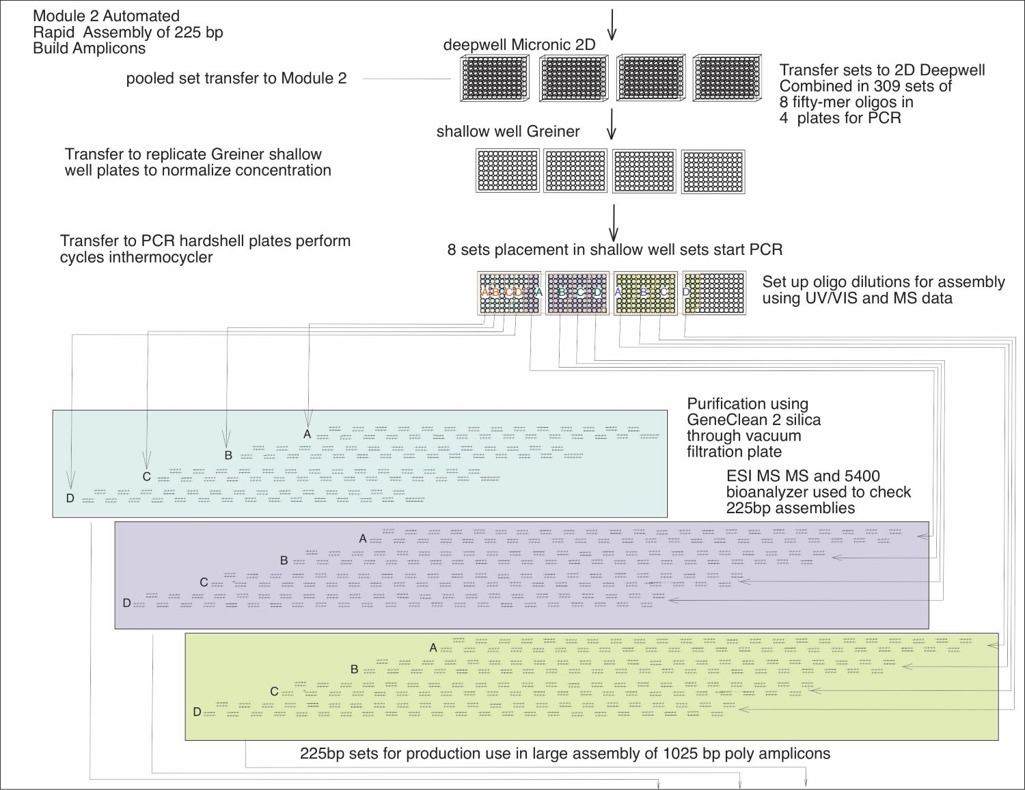
Assembly of 225s (cont.)

Slide 15
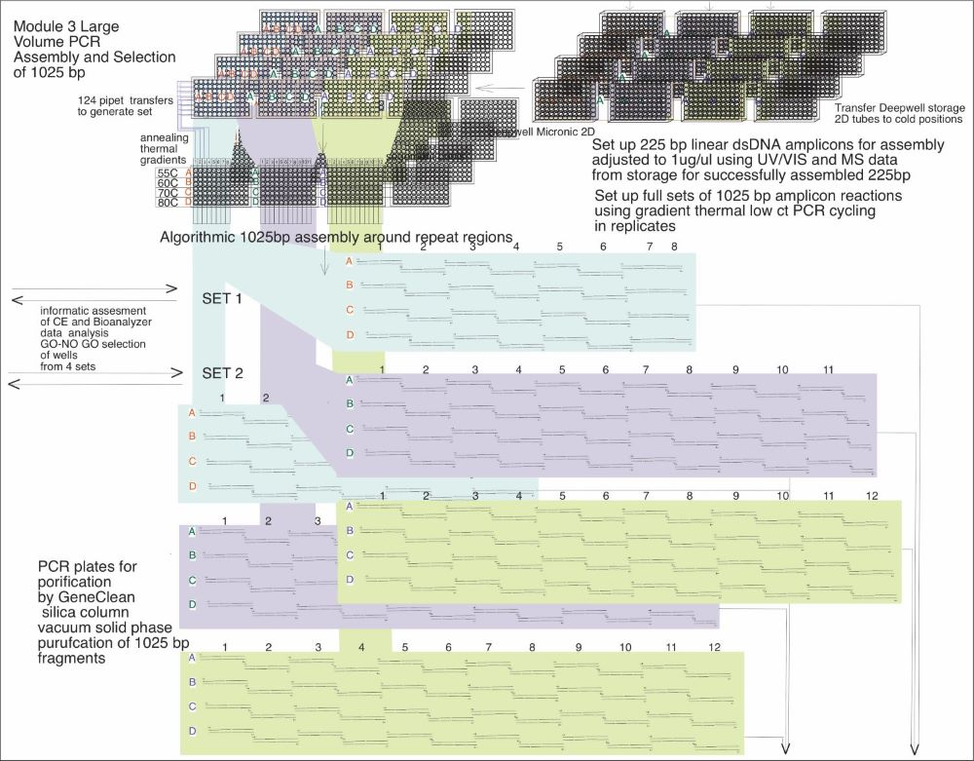
Assembly of 1025s

Slide 16
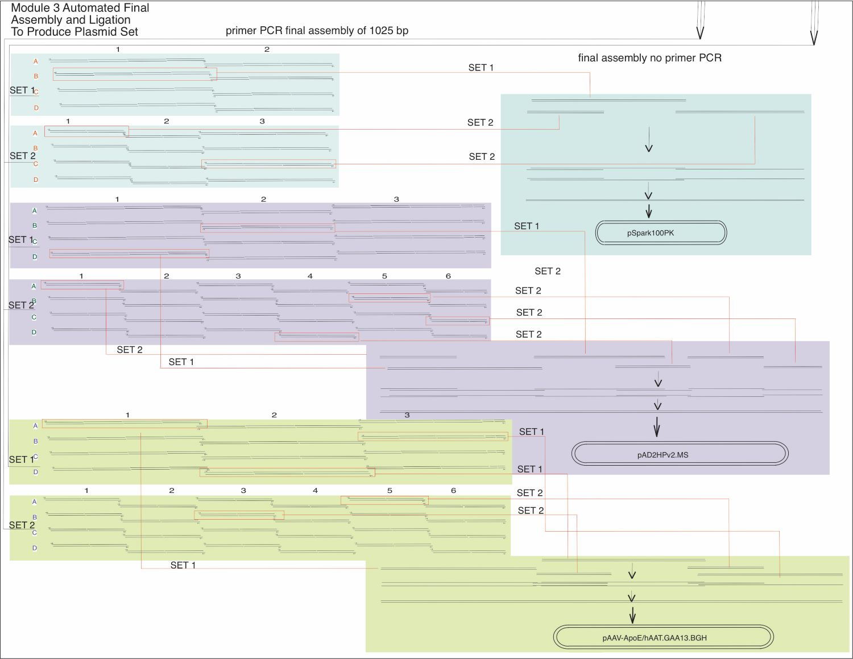
Final PCR
Assembly
and Ligation

Slide 17
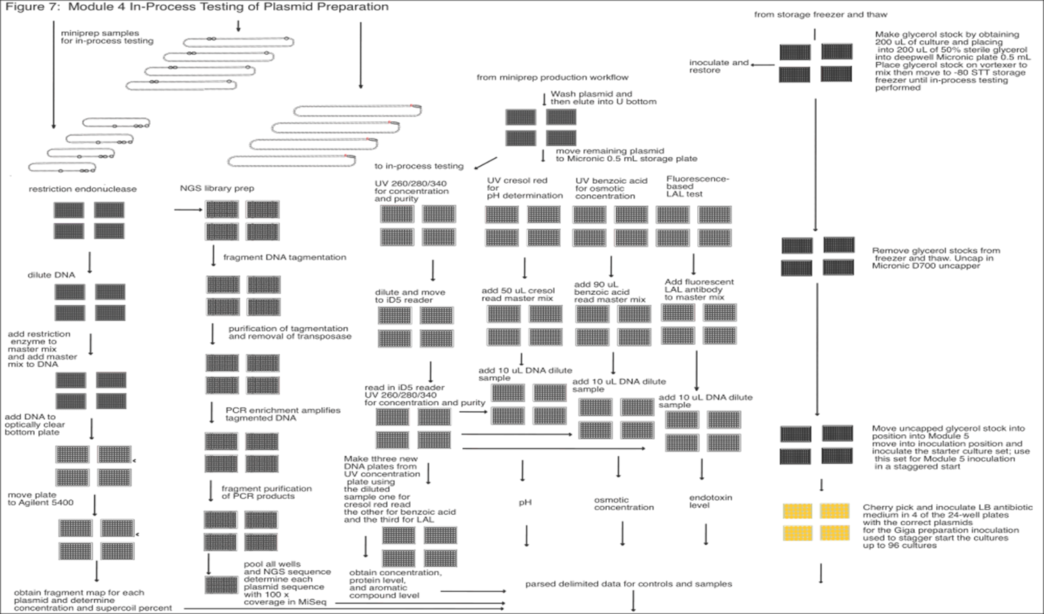
Ligation
Transformation
Miniprep

Slide 18
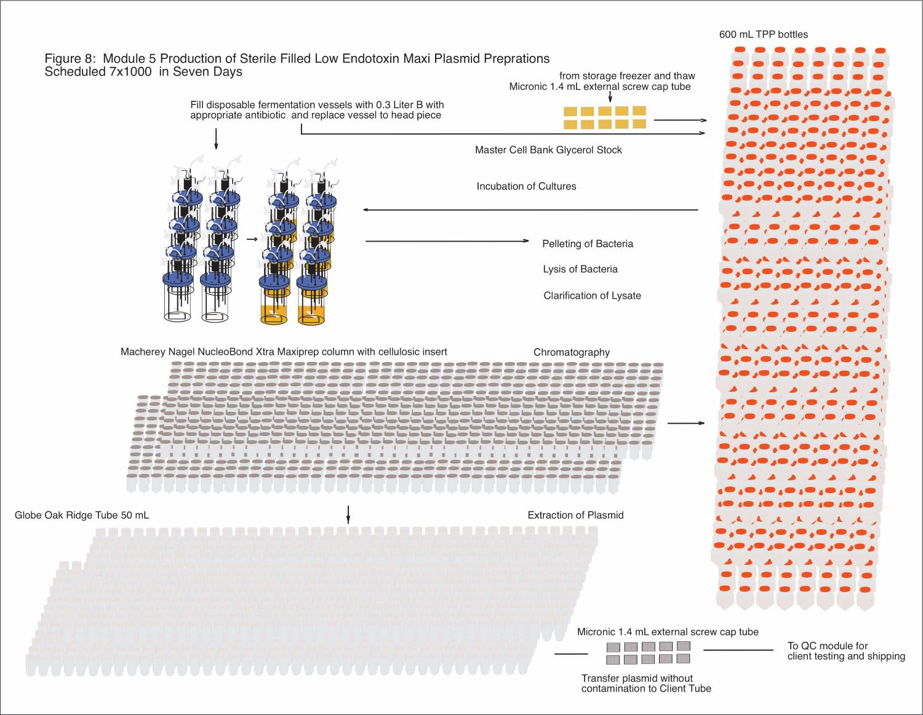
Large-Scale Clean Manufacture
of Preclinical Plasmid
118

Slide 19
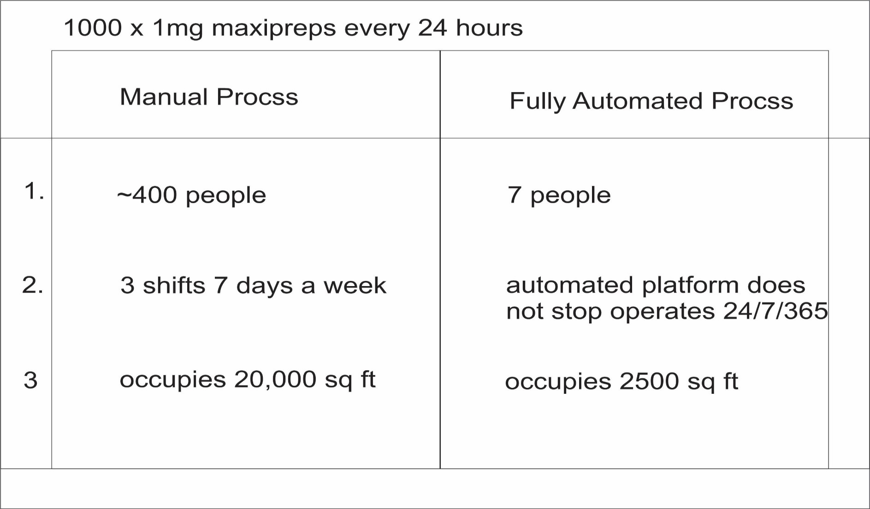
Number of Large-Scale Samples Per Day

Slide 20
Key to 1000 DNA Samples Per Day
Hyper scheduling
Modular platform allows for parallel operations using SCARA and 5, 6, or 7-axis robots
Continuous 24/7/365 operations
Replenish reagents and plasticware while in operation
Continuous client samples coming in and continuous finished plasmid shipping out
Barcoded operation keeps chain of custody
Machine learning allows optimum plasmid operation

Slide 21
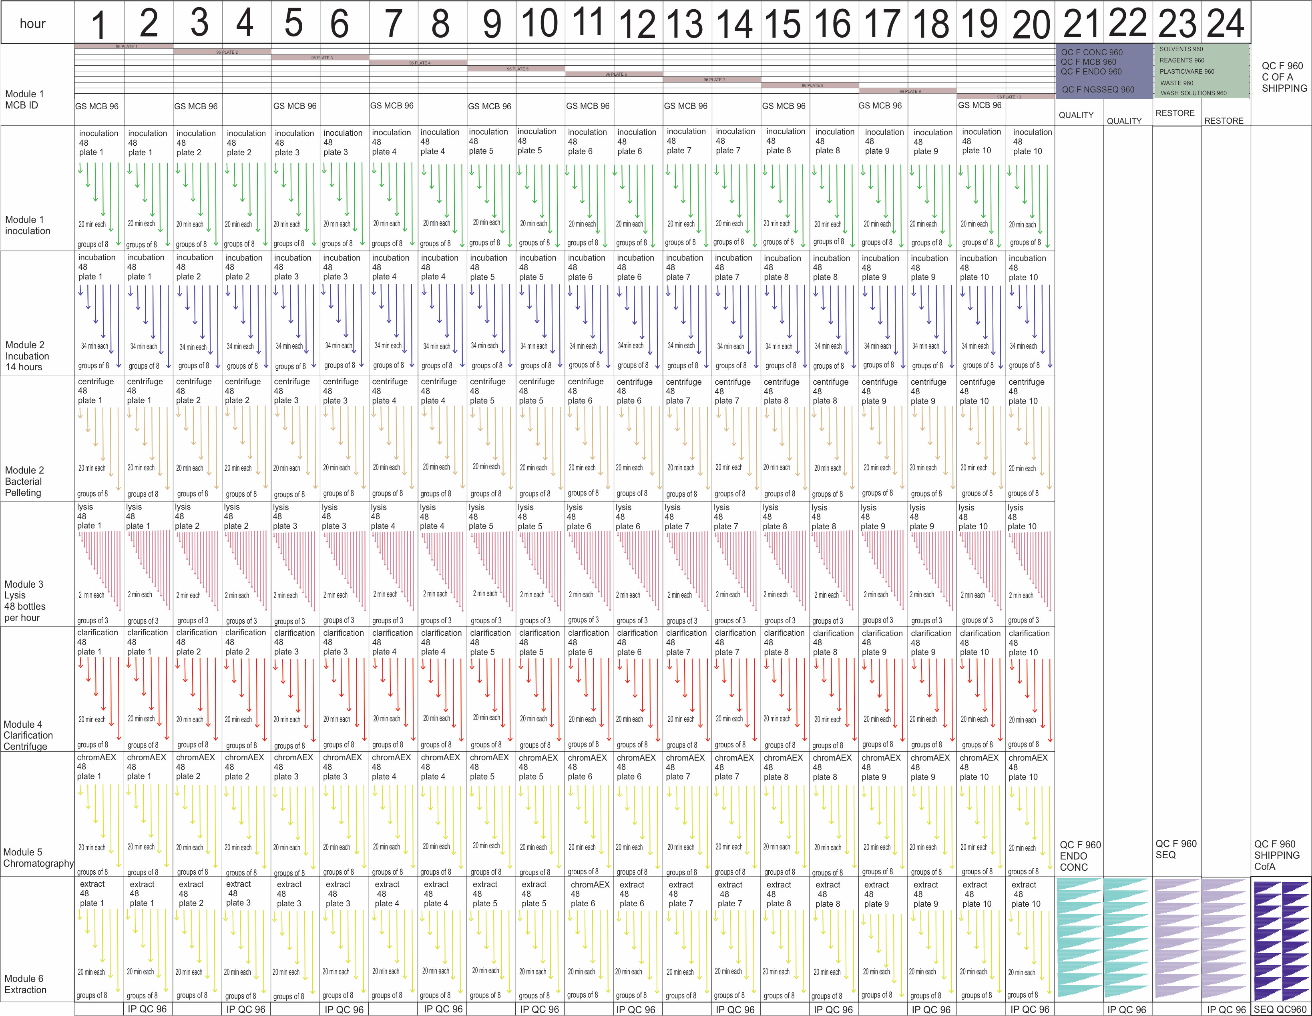
Hyper Scheduling 960 Maxiprep Platform
Module 1
Load MCB
Module 1
Inoculation
Module 2A
Incubation Shaker
Module 2B
Bacterial Pelleting
Module 3
Lysate Formation
Module 4
Clarification Lysate
Module 7
Quality Control
Testing
Module 5
Chromatography
Module 6
Plasmid Extraction

Slide 22
Commercial Large-Scale Automated Plasmid Production
Requires industrial automation components more durable, dynamic, and powerful than lab instruments
Was essentially a collaboration between GenScript USA and Universal Machine and Engineering Corp.
Produces 1000 maxiprep plasmids/day using fully robotic manufacturing lines
Has capacity for 150 GMP batches/year of 10-mg linear dsDNA and 20 GMP batches/year of 10-mg linear ssDNA for gene therapy
Combines strength in gene assembly with seamless plasmid DNA production for lentiviral and AAV production for CAR T, TCR T, IVT, and episomal DNA
Provides enough material for large-scale AAV doses for preclinical studies

Slide 23
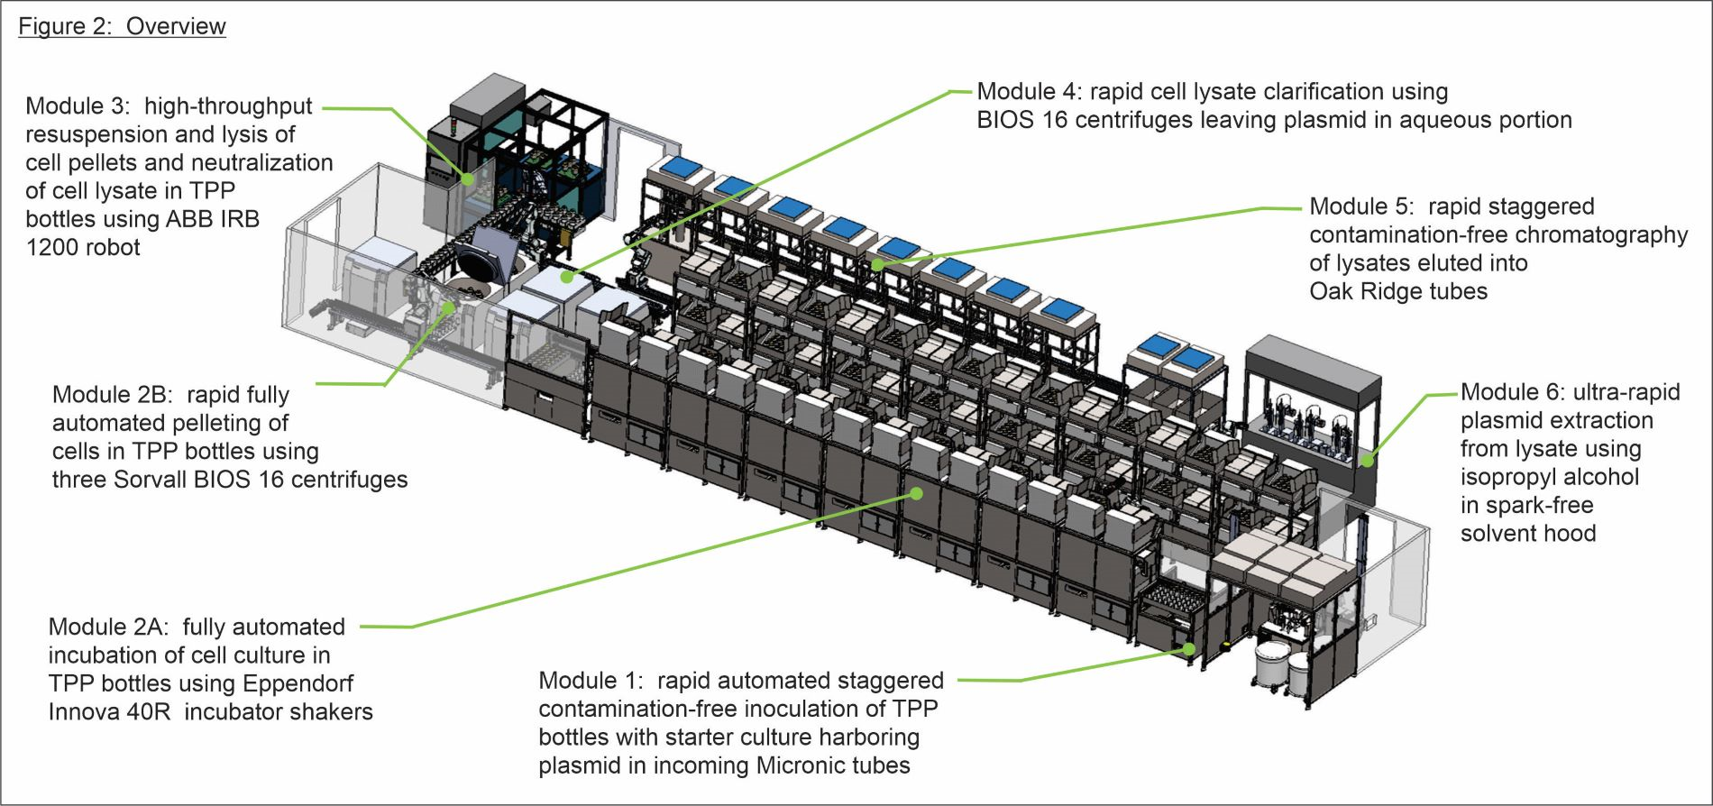
Layout of Commercial Automated Large-Scale Plasmid Production Platform

Slide 24
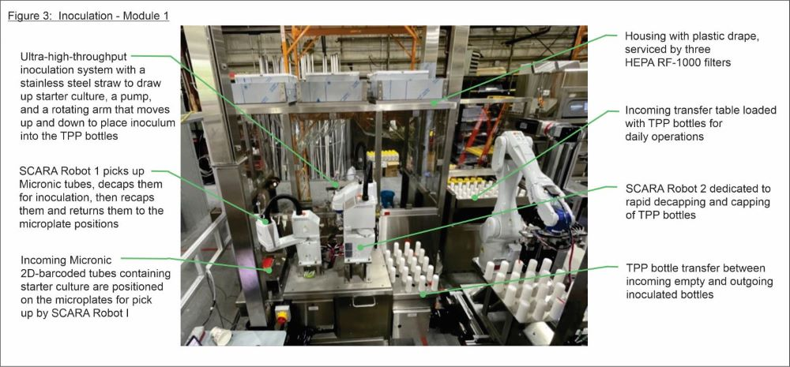
Module 1: High-Throughput Inoculation

Slide 25
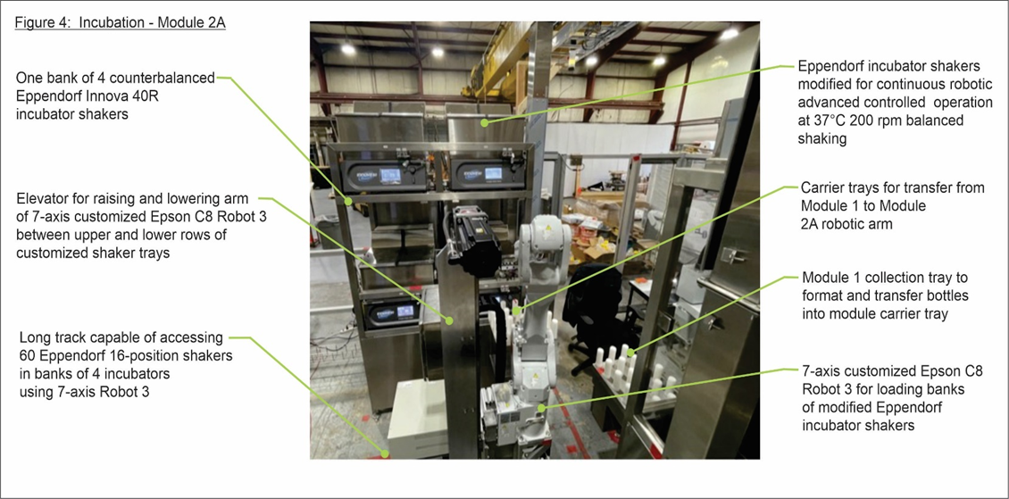
Module 2A: Incubation of Bacterial Cell Culture

Slide 26
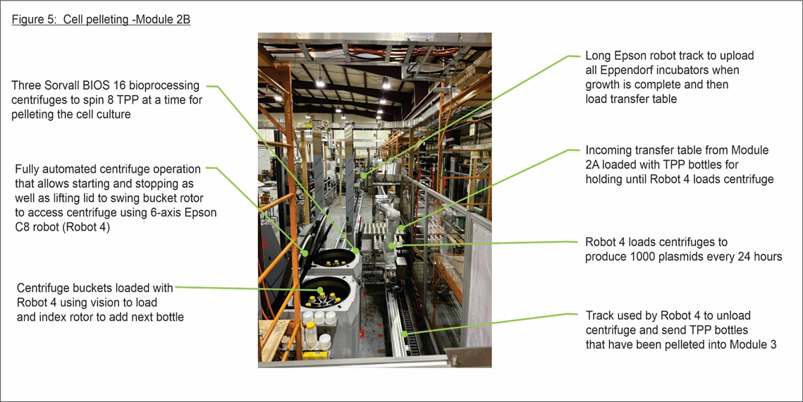
Module 2B: Pelleting of Bacterial Cells

Slide 27
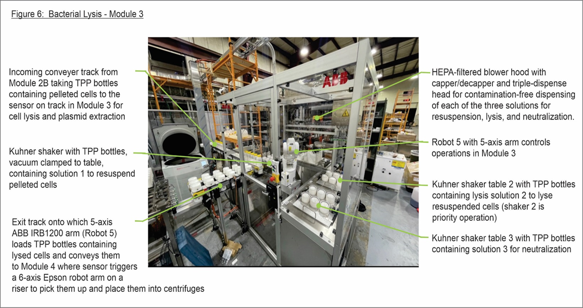
Module 3: Resuspension and Lysis of Cell Pellets

Slide 28
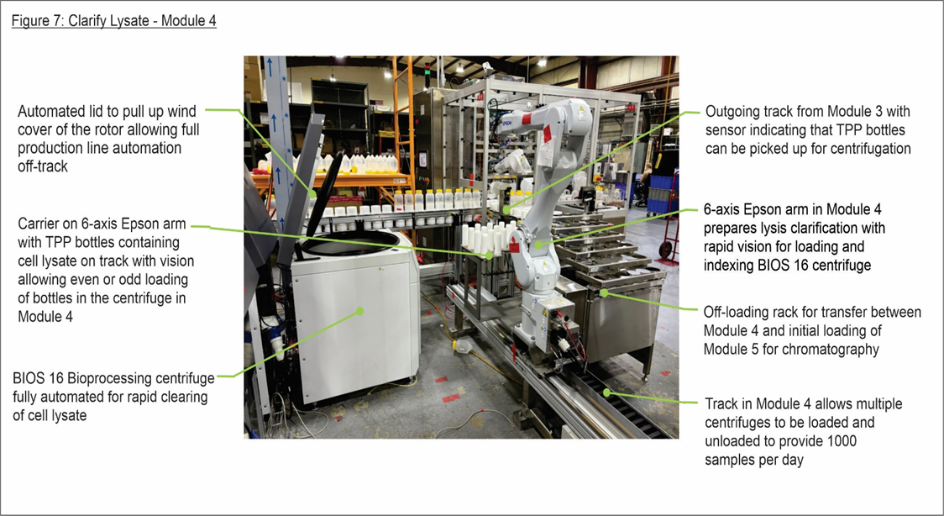
Module 4: Clarification of Cell Lysate

Slide 29
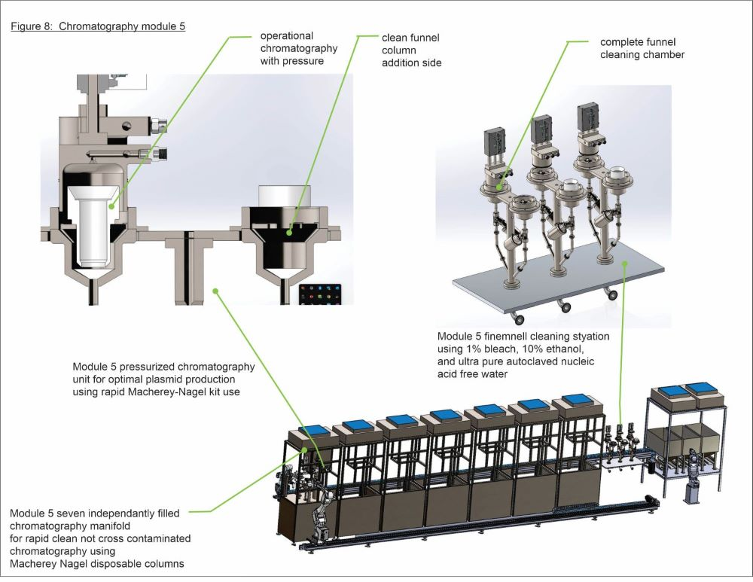
Module 5: Purification Using Column Chromatography

Slide 30
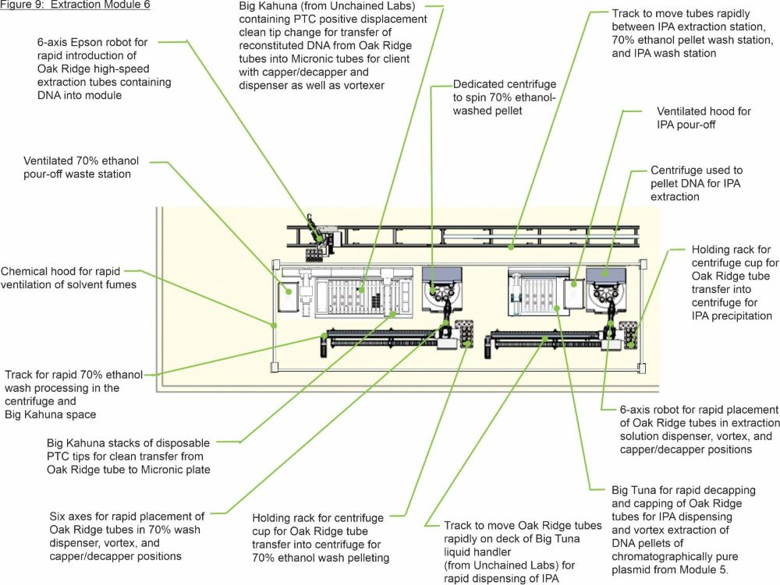
Module 6: Extraction

Slide 31
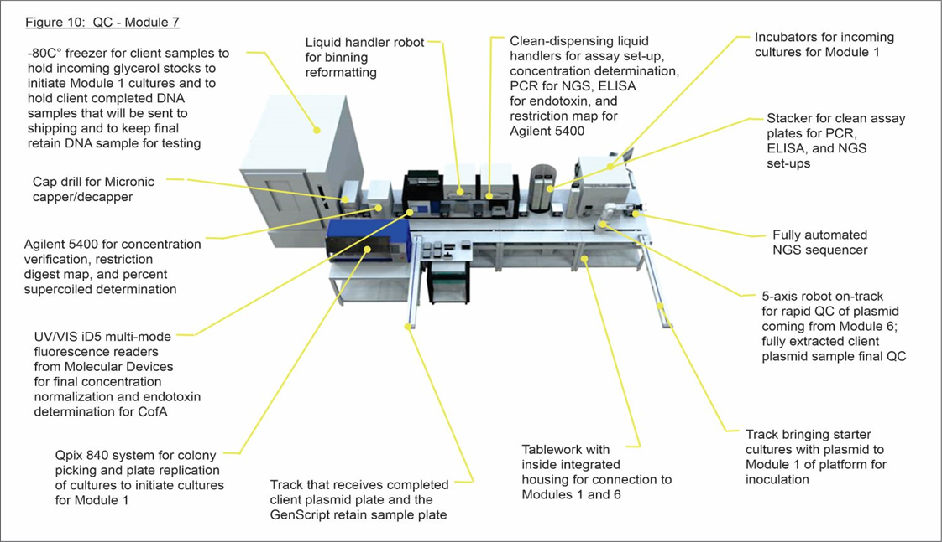
Module 7: QA/QC Testing and Storage

Slide 32
Section 3: IBC Continuous Biofuel Production
(using Clostridium to capture CO₂ from ethanol yeast biorefinery and from pyrolysis syngas )

Slide 33
Diagram of Facility
Clostridium utilized to capture CO₂/H₂ and CO from ethanol yeast biorefinery and from biomass pyrolysis syngas

Slide 34
Characteristics of Clostridia
Live on organic matter in anaerobic habitats and ferment a wide variety of organic compounds
C. autoethanogenum unique because it grows on xylose from cellulosic biomass
Produce compounds used as biofuels and industrial chemicals
Utilize CO₂/H₂, CO, and compounds, such as formate, ethanol, and methanol, via the Wood–Ljungdahl pathway (WLP) by which 2 moles of CO₂ produce 1 mole of acetyl-CoA
Studies of effects of pH and syngas flow rate on C. ljungdahlii and C. autoethanogenum show that C. ljungdahlii achieved higher cell densities, greater ethanol concentration, and greater acetate production at pH 6.8 than pH 5.5, and C. autoethanogenum gave greater product formation at pH 6.8 and at higher syngas flow rates
Growth on syngas was slower than growth on sugars
Tracy BP, Jones SW, Fast AG, Indurthi DC, Papoutsakis ET. Current Opinion in Biotechnology. 2012, 23(3) 364-381. https://doi.org/10.1016/j.copbio.2011.10.008
Cotter JL, Chinn MS, Grunden AM. Enzyme and Microbial Technology. 2009, 44(5);281-288. https://doi.org/10.1016/j.enzmictec.2008.11.0024

Slide 35
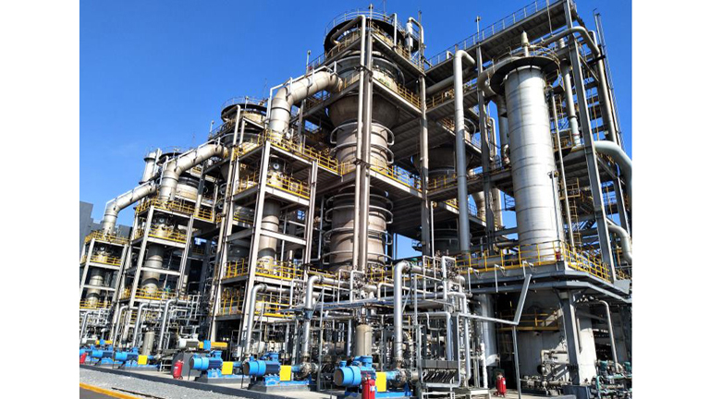
Industrial Clostridial Bioethanol Production
First commercial facility converting waste gas into fuel and chemicals by clostridial fermentation is the Beijing Shougang LanzaTech (SGLT) New Energy Technology plant that produces ethanol using waste gas from steelworks with technology developed by LanzaTech
Since May 2018 facility has produced 20M gallons (60,000 metric tons) of ethanol from recycled steel mill emissions, equal to over 100,000 tons of CO₂
In January 2021 this Carbon Capture and Utilization (CCU) plant was certified by the Roundtable on Sustainable Biomaterials (RSB) as meeting their principles and criteria for sustainable production
https://www.biofuelsdigest.com/bdigest/2021/01/31/commercial-ccu-plant-using-lanzatech-tech-receives-rsb-advanced-products-certification/

Slide 36
Bioethanol in the CleanFlex Process Recycled into Gensets
Ethanol from Clostridium production is continuously fed into CleanFlex units for complete utilization and sequestration of CO₂
The CleanFlex Power System mixes ethanol into a diesel cycle at the point of combustion, resulting in a diesel engine that runs cooler and more efficiently
Currently, CleanFlex is being tested in a stationary John Deere power system and is working well
In addition to the diesel fuel (which could also be renewable diesel), the ethanol used in CleanFlex is cut to 60 percent with water (called EM60)

Slide 37
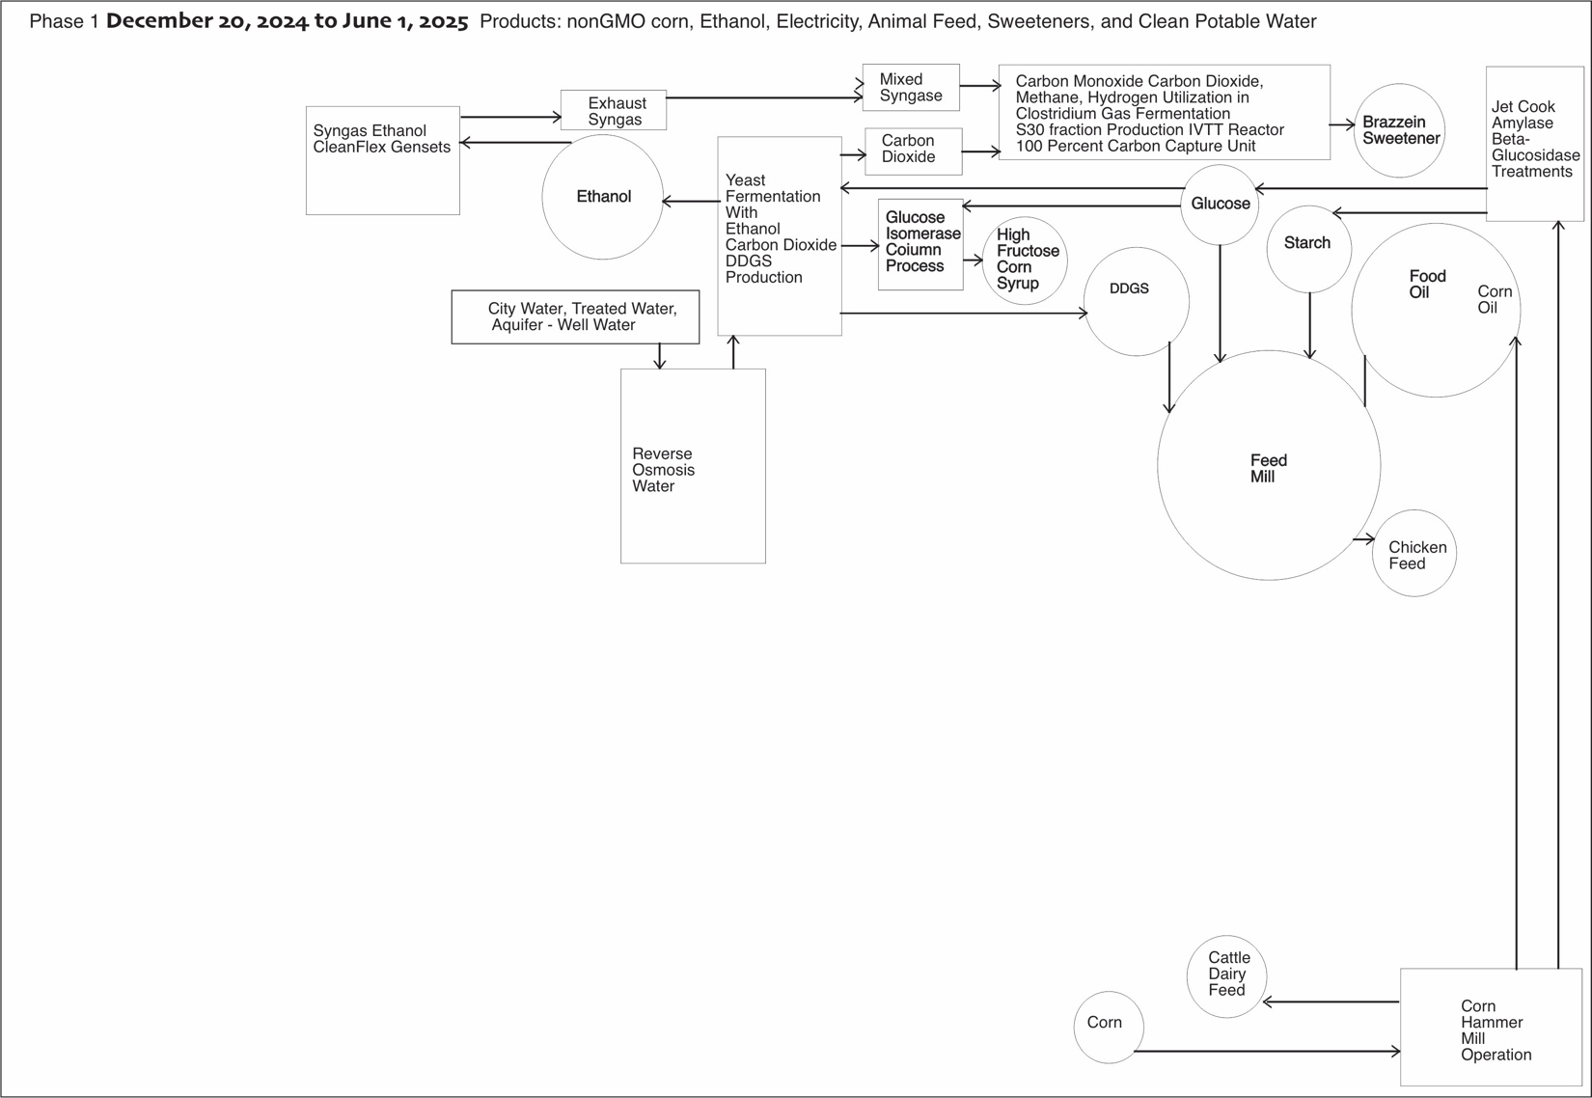
IBC Continuous Bioethanol Production and Co-products

Slide 38
Section 4: Continuous Valuable Peptide Co-production
(sweetener produced in clostridial S30 fraction)

Slide 39
Steps to Develop Non-caloric Peptide Sweetener
Develop continuous production of synthetic sweetener with sequence based on natural sweetener
Strain Improvement
Continuous nanoDNA template production
Continuous S30 fraction production
Continuous peptide production
Two animals for safety study
FDA review of safety data
Human sweetness and palatability testing

Slide 40
Market for Industrial-Scale Brazzein
Brazzein Structure
Potential use as non-caloric natural sweetener in pharmaceutical, food, and feed applications, including soft drinks, chewing gum, flour, syrups, and as a supplement or replacement for fructose, sucrose, and artificial sweeteners
Commercialization efforts ongoing; regulatory acceptance not yet obtained
Many manufacturers trying to develop large-scale economical process to produce brazzein
Global sweeteners market was valued at $80B in 2022 and is expected to expand at a CAGR of 2.4% from 2022 to 2030 with revenue forecast to be $98B in 2030
Brazzein sales are expected to grow rapidly after its launch in the retail market
https://www.grandviewresearch.com/industry-analysis/sweeteners-market-report

Slide 41
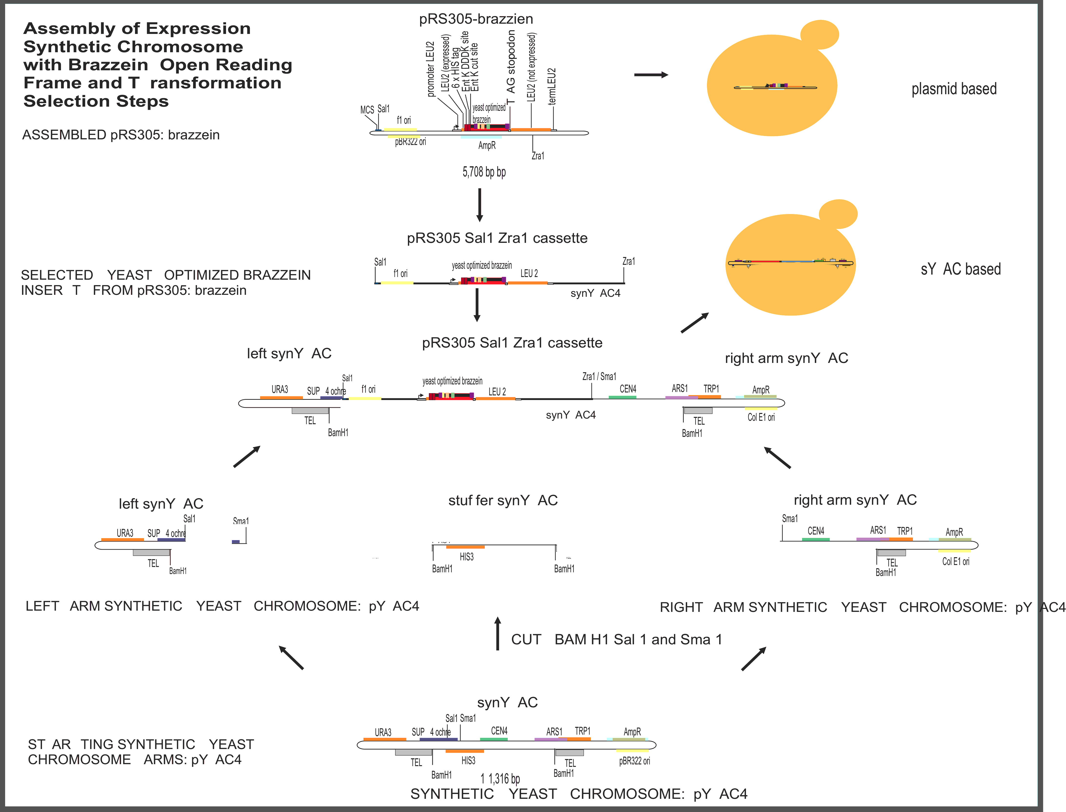
Brazzein Variant Improvement

Slide 42
Features of Non-caloric Sweet Peptide Brazzein
Small size (6.473 kD)
Water-soluble up to 50 mg/mL
Heat- and pH-stable, retains sweetness at 98°C for 2 hours and at 80°C for 4.5 hours in pH range of 2.5 to 8.0 and at baking temperatures
Sweet taste without sourness, saltiness, or bitterness
500 times sweeter than sucrose compared to 10% sucrose solution and 2000 times sweeter compared to 2% sucrose solution
Residues 29–33 and 39–43, residue 36, and the C-terminus are involved in sweet taste
Charge on Arg-43 also plays an important role in its sweet taste

Slide 43
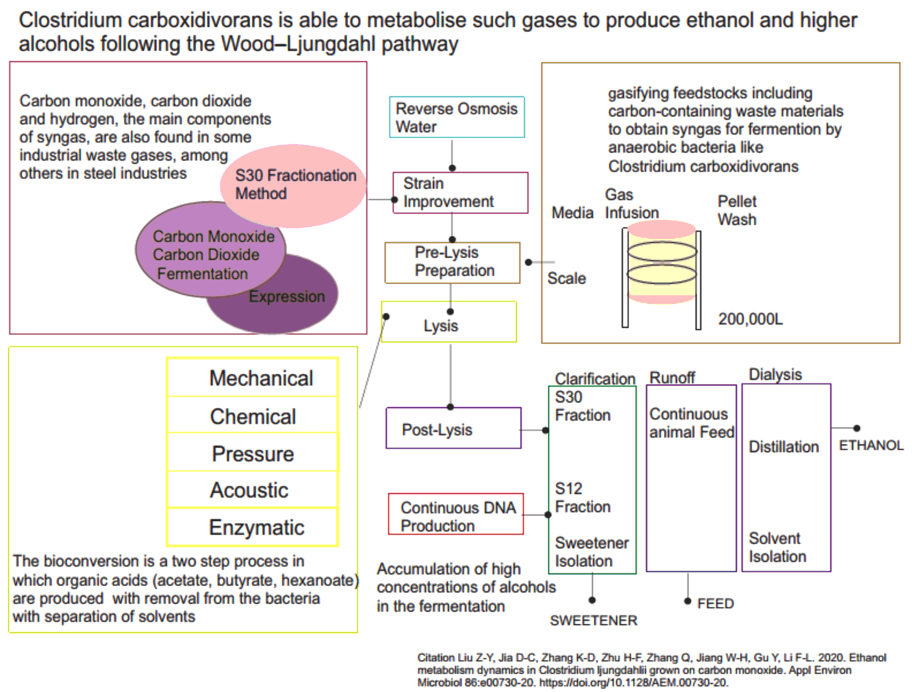
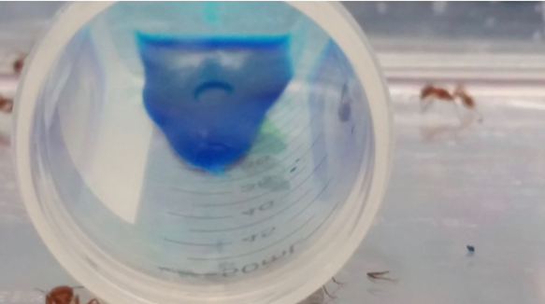
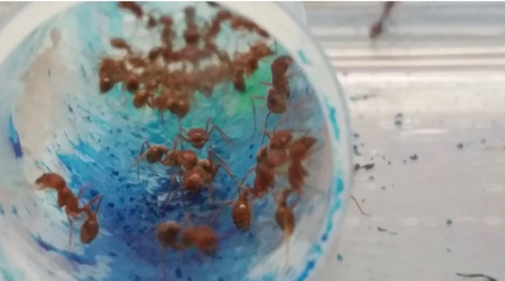
Continuous Non-caloric Sweetener Production
Ants as Screening Tool
for Peptide Sweetness
CONTROL YEAST
BRAZZEIN YEAST

Slide 44
Cell-Free Protein Synthesis Platform with Clostridium S30 Fraction
This patent relates to materials for performing cell-free RNA transcription and/or cell-free protein synthesis (CFPS) using components prepared from naturally occurring or recombinant species of Clostridia, including Clostridium autoethanogenum
It describes a cell-free protein synthesis platform for in vitro transcription of mRNA and in vitro translation of polypeptides containing a cell extract prepared from a cell culture of Clostridia species, which may be Clostridium autoethanogenum
The platform may use cellular extract that contains an S12 fraction and/or S30 fraction of the Clostridium cell culture
Jewett MC, Kruger-Gericke A, Mueller AP, Koepke M. Cell-free protein synthesis platforms derived from clostridia. International Publication Number: WO2020176522A1. International Publication Date: 03 September 2020. World Intellectual Property Organization (Patent Cooperation Treaty)
https://patentimages.storage.googleapis.com/cb/60/ba/3b3678f3293b9c/WO2020176522A1.pdf

Slide 45
Continuous Sweetener Peptide Production

Slide 46
IBC Continuous Automated Industrial Biofuel and Sweetener Production
Ethanol biofuel production from S30 fraction from a novel Clostridium grown on carbon dioxide or carbon monoxide
Resulting S30 fraction from bacterial extract used in industrial IVTT to make high-value peptides (such as natural sweetener brazzein) and proteins in massively parallel anaerobic production
DNA production line has no waste streams
Solid coproduct material gasified into graphene parts
Syngas used for Genset electrical production for LEED platinum operation

Slide 47
Summary
Industrial robots enabling continuous large-scale plasmid production can revolutionize industrial sweetener production
Continuous S30 fraction production from Clostridium grown on carbon dioxide or carbon monoxide is sustainable and can provide green-certified (LEED platinum) facilities to produce high-value sweetener peptides and animal feed containing sweetener
Screening purified wild-type and yeast-expressed sweetener peptides side-by-side suggests several possible marketing approaches
Non-caloric natural sweeteners for use in food and drink are profitable and help reduce obesity
Feed (DDGS) from biorefinery is more attractive to animals if it contains sweetener peptide expressed in ethanologenic Clostridium S30 fraction

Slide 48
Thank you

