Slide 1

Long-Lived Particles, Dark Matter, and
Matter-Antimatter Asymmetry
Rouzbeh Allahverdi
CETUP* 2023
June 19-July 14, 2023

Slide 2
Outline:
Introduction
Thermal histories with EMD
EMD from the visible sector
An explicit model
Conclusion

Slide 3
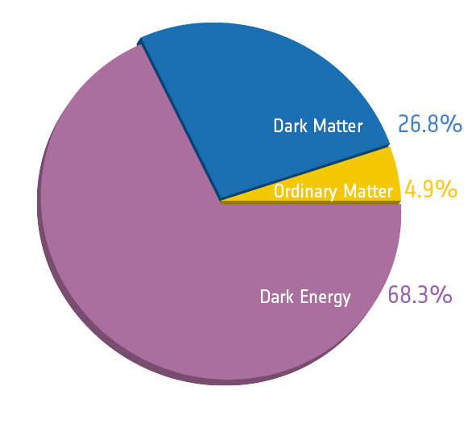
The present universe according to observations:
BSM needed to explain 95% of the universe.
Important questions:
- Nature of DM?
- Origin of matter-antimatter asymmetry?
→ Particle Physics (BSM)
- Generating the observed DM and BAU abundances?
→ Cosmology (thermal history)
What do we know about the early universe?
Introduction:

Slide 4
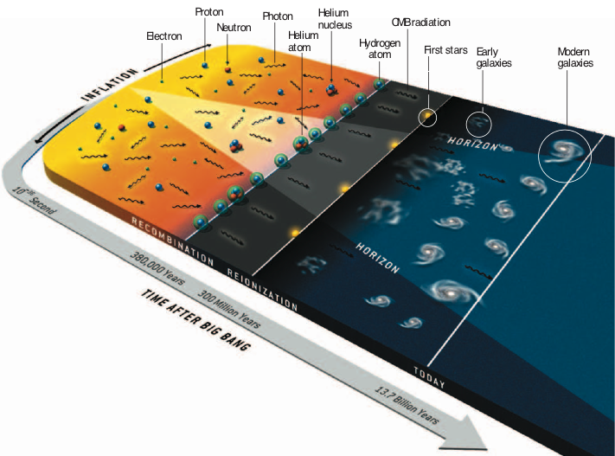
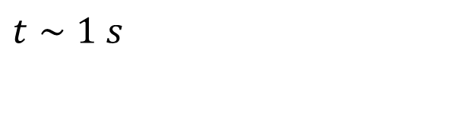
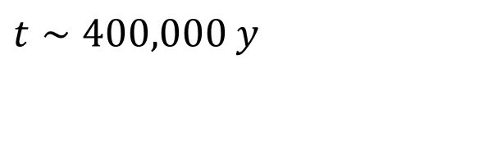
Observational probes of the early universe:
Big Bang Nucleosynthesis
$$t∼1 s$$
Cosmic Microwave Background
$$t∼400,000 y$$

Slide 5







What was the state of the universe before 1 second?
$${10}^{18}GeV$$
Planck
Standard thermal history:
Transition from inflation to radiation (reheating),
Radiation domination until .
$${10}^{15}GeV$$
Inflation
$$t_{eq}\sim 50,000 yr$$
Simple extrapolation from observations.
Attractive & predictive, but an assumption.
radiation
$${10}^{3}GeV$$
Hints from experiment?
Guidance from theory?
$$GeV$$
BBN
$$MeV$$
Alternative thermal histories!
$$eV$$
CMB
“The First Three Seconds” 2006.16182 [astro-ph.CO]
G. Kane, K. Sinha, S. Watson
IJMPD 8, 1530022 (2015)

Slide 6
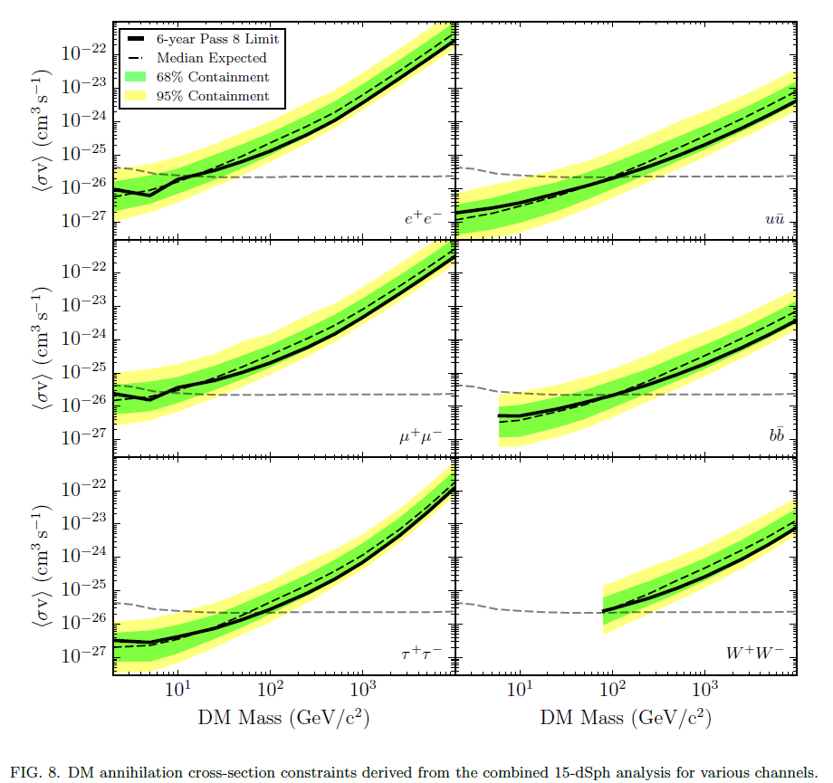
Indirect detection experiments:
Fermi Collaboration PRL 115, 231301 (2015)
For DM masses < 20 GeV:
(assuming S-wave annihilation)
R. Leanne, T. Slatyer, J. Beacom, K. Ng PRD 98, 023016 (2018)

Slide 7












A well-motivated alternative thermal history:
Standard
Non-standard
$${10}^{18}GeV$$
Planck
$${10}^{18}GeV$$
Planck
$${10}^{15}GeV$$
Inflation
$${10}^{15}GeV$$
Inflation
Long-lived massive
fields/particles
radiation
EMD
$${10}^{3}GeV$$
$${10}^{3}GeV$$
$$GeV$$
$$GeV$$
BBN
$$MeV$$
$$MeV$$
BBN
$$eV$$
CMB
$$eV$$
CMB
G. Kane, K. Sinha, S. Watson IJMPD 8, 1530022 (2015)

Slide 8



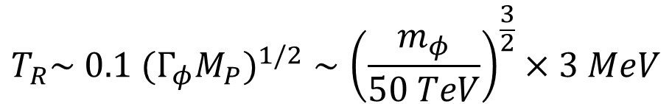




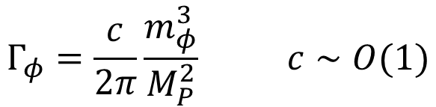
Thermal Histories with EMD:
String moduli are well-motivated candidates.
Consider a scalar field with mass and decay width .
$$φ$$
$$m_{φ}$$
$$Γ_{φ}$$
Modulus fields in string theory are natural candidates of :
$$φ$$
$$Γ_{φ}=\frac{c}{2π}\frac{m_{φ}^{3}}{M_{P}^{2}} c∼O(1)$$
Modulus dynamics in the early universe:
$$H≫m_{φ}$$
: Displacement from the minimum during inflation
$$H≃m_{φ}$$
: Oscillations about the minimum start, dominate the universe
$$H≃Γ_{φ}$$
: Oscillations decay and form a RD universe
$$T_{R}\sim {0.1 (Γ_{φ}M_{P})}^{1/2}∼{\left(\frac{m_{φ}}{50 TeV}\right)}^{\frac{3}{2}}×3 MeV$$

Slide 9
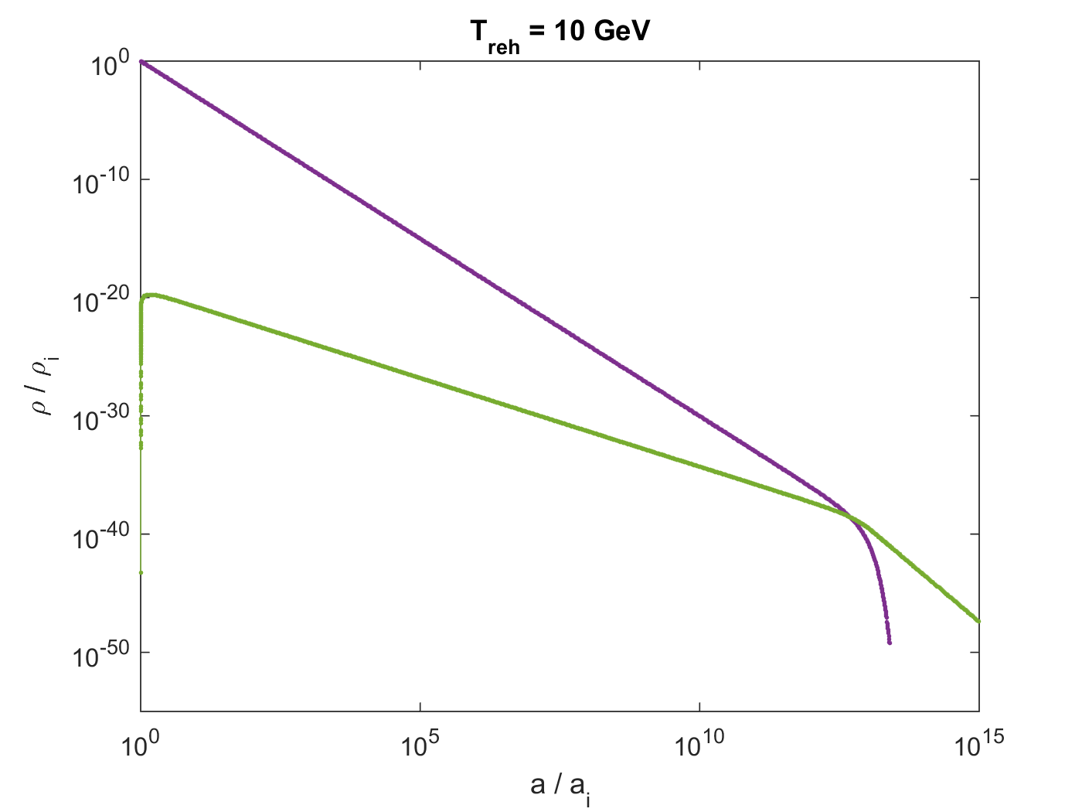




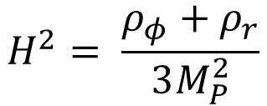

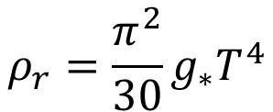



Evolution of matter and radiation energy densities:
$${\dot{ρ}}_{φ}+3Hρ_{φ}=−Γ_{φ}ρ_{φ}$$
$$ρ_{r}=\frac{π^{2}}{30}g_{∗}T^{4}$$
$$H^{2}= \frac{ρ_{φ}+ρ_{r}}{3M_{P}^{2}}$$
$${\dot{ρ}}_{r}+4Hρ_{r}=+Γ_{φ}ρ_{φ}$$
$$ρ_{φ}$$
EMD
$$ρ_{r}$$
RD
$$T∝a^{−3/8}$$
$$T∝a^{−1}$$
BBN constraint:
$$T_{R}>3 MeV⟹$$
$$m_{φ}>50 TeV$$

Slide 10


Successful scenario:
(1) Obtaining the correct DM abundance.
$${\dot{n}}_{χ}+3Hn_{χ}={<σ_{ann}v>}_{f}(n_{χ,eq}^{2}−n_{χ}^{2}) + {Br}_{χ}Γ_{φ}n_{φ}$$
number of DM quanta produced per decay of quanta
$${Br}_{χ}:$$
$$φ$$
- Production from the instantaneous thermal bath (1st term on the RH).
G. Giudice, E. Kolb, A. Riotto PRD 64, 043512 (2001)
A. Erickcek PRD 92, 103505 (2015)
…
- Production from direct decay (2nd term on the RH).
G. Gelmini, P. Gondolo PRD 74, 023510 (2006)
R.A., B. Dutta, K. Sinha PRD 83, 083502 (2011)
…
- Production from the interplay between the two terms.
M. Kawasaki, T. Moroi, T. Yanagida PLB 370, 52 (1996)
T. Moroi, L. Randall NPB 570, 455 (2000)
…

Slide 11
(2) Generating the observed baryon asymmetry.
Dilution factor due to modulus decay:
Pre-existing asymmetry will be washed out.
- Baryogenesis at the end of EMD:
Non-thermal post-sphaleron baryogenesis
R.A., B. Dutta, K. Sinha PRD 81, 053538 (2010)
…
- Baryogenesis mechanism with associated entropy production:
Affleck-Dine baryogenesis
G. Kane, J. Shao, S. Watson, H-B Yu JCAP 1111, 012 (2011)
R.A., M. Cicoli, F. Muia JHEP 1606, 153 (2016)
…

Slide 12
(3) Gravitino production must be suppressed.
is the main source of gravitino production.
Helicity-1/2 gravitinos pose the main threat.
M. Endo, K. Hamaguchi, F. Takahashi PRL 96, 211301 (2006)
M. Dine, R. Kitano, A. Morisse, Y. Shirman PRD 73, 123518 (2006)
(4) Modulus decay must successfully reheat the visible sector.
No excess of DR, etc.
Challenge: successful realization in explicit models.
R.A., M. Cicoli, B. Dutta, K. Sinha PRD 88, 095015 (2013)
R.A., M. Cicoli, B. Dutta, K. Sinha JCAP 10, 002 (2014)
R.A., I. Broeckel, M. Cicoli, J. Osinski JHEP 02, 026 (2021)
…

Slide 13




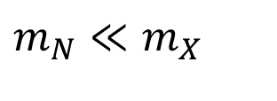

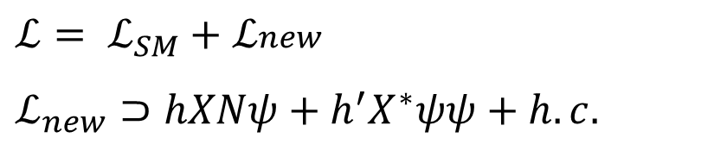
EMD from the Visible Sector:
Can we possibly test the physics responsible for EMD in the lab?
Not possible for string moduli (large masses & very weak couplings).
EMD driven by the visible sector?
Can naturally address the gravitino and DR production issues!
Consider a minimal extension of the SM with two new fields and :
$$X$$
$$N$$
$$ℒ= ℒ_{SM}+ℒ_{\begin{aligned}new \\ \end{aligned}}$$
$ℒ_{new}⊃$ $hXNψ+h^{′}X^{∗}ψψ+h.c.$
R.A., J. Osinski PRD 105, 023502 (2022)
$$ψ:$$
SM fermions
$$X:$$
New scalar with SM charges
$$m_{N}≪m_{X}$$
$$N:$$
Majorana fermion (SM singlet)

Slide 14





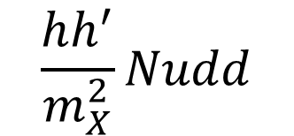

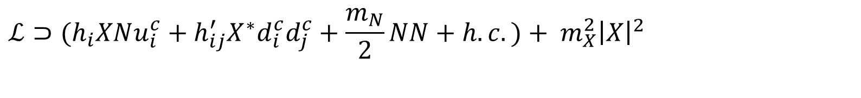
Example:
$$ℒ⊃{{(h}_{i}XNu_{i}^{c}+h}_{ij}^{′}{X^{∗}d}_{i}^{c}d_{j}^{c}+\frac{m_{N}}{2}NN+h.c.)+ m_{X}^{2}{\left|X\right|}^{2}$$
K. Bsabu, R. Mohapatra, S. Nasri PRL 98, 161301 (2007)
R.A., B. Dutta PRD 88, 023525 (2013)
$$X:$$
Iso-singlet color-triplet scalar, Y = 4/3
u$:$
Right-handed up-type quarks
$$m_{N}≪m_{X}$$
d$:$
Right-handed down-type quarks
4-fermion interaction at low energies :
$$E≪ m_{X}$$
$$\frac{hh^{′}}{m_{X}^{2}}Nudd$$
This operator results in N decay to three SM fermions.
Other possibilities: ,
$$NQLd$$
$$NLLe$$
All of them violate baryon and/or lepton number.

Slide 15
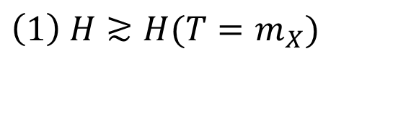

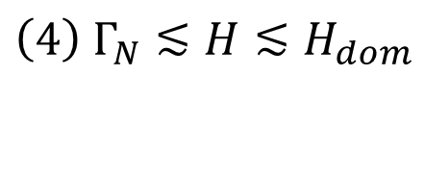
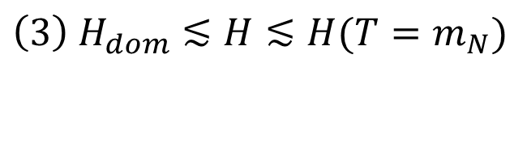
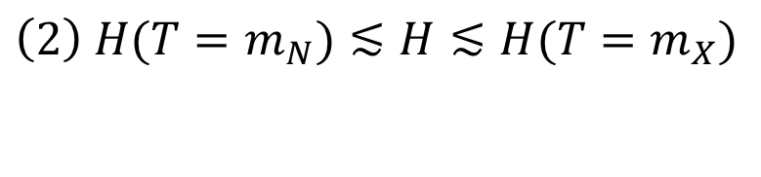
N can drive an epoch of EMD!
Assuming RD at :
$$T≳m_{X}$$
$$\left(1\right) {H≳H(T=m}_{X})$$
RD: X in equilibrium, brings N into equilibrium via decays/inverse decays.
$${\left(2\right) H(T=m_{N})≲H≲H(T=m}_{X})$$
RD: N is relativistic with frozen comoving number density.
$${{\left(3\right) H}_{dom}≲H≲H(T=m}_{N})$$
RD: N becomes nonrelativistic, starts to dominate radiation.
$${{\left(4\right) Γ}_{N}≲H≲H}_{dom}$$
EMD: N dominates, eventually decays to establish RD.

Slide 16
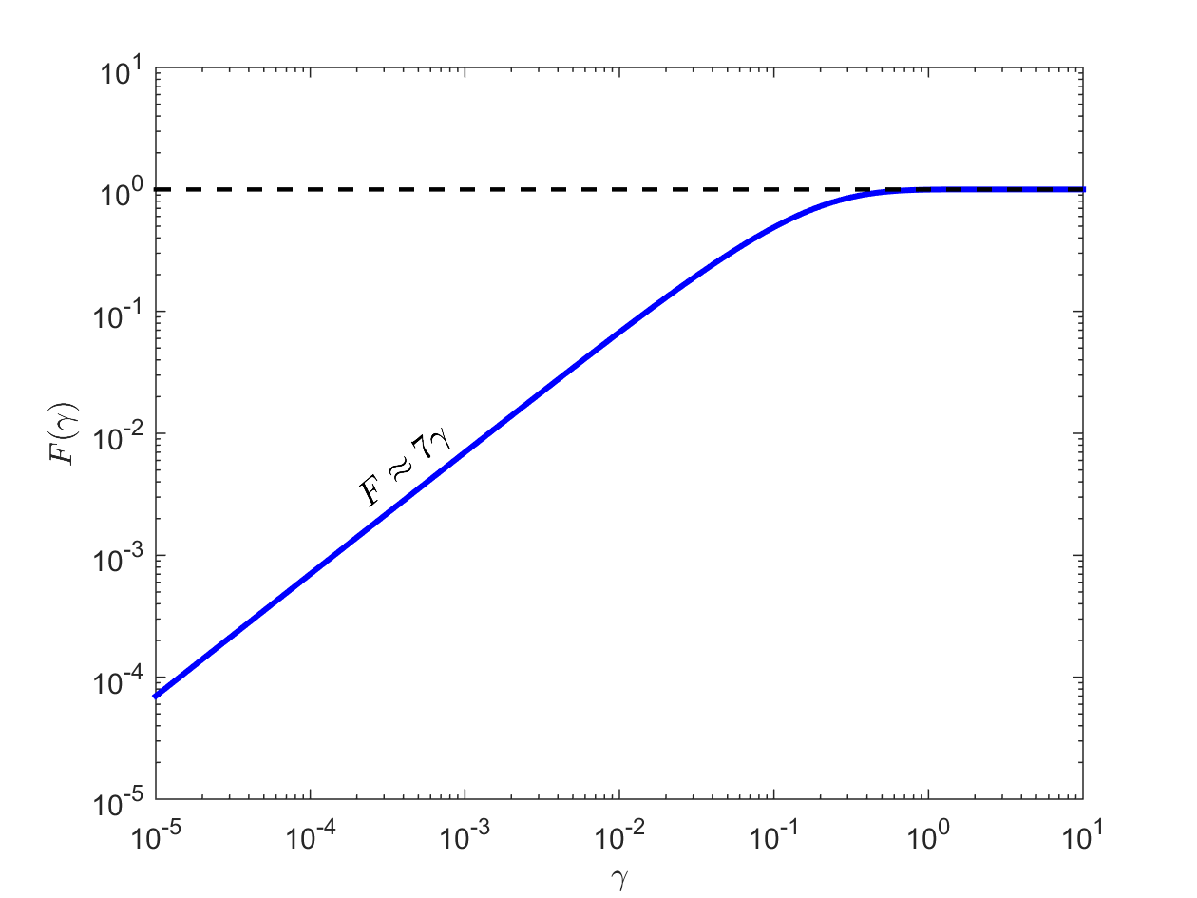
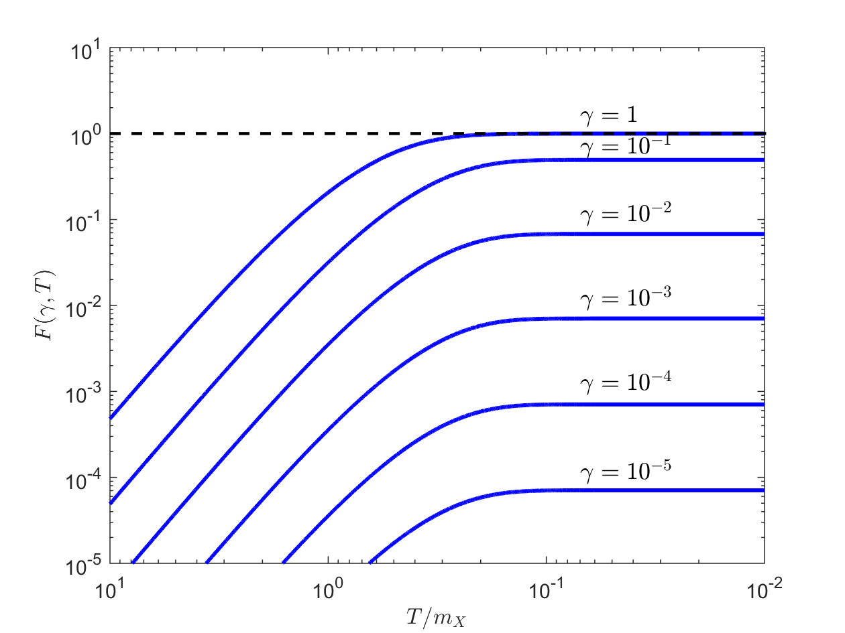
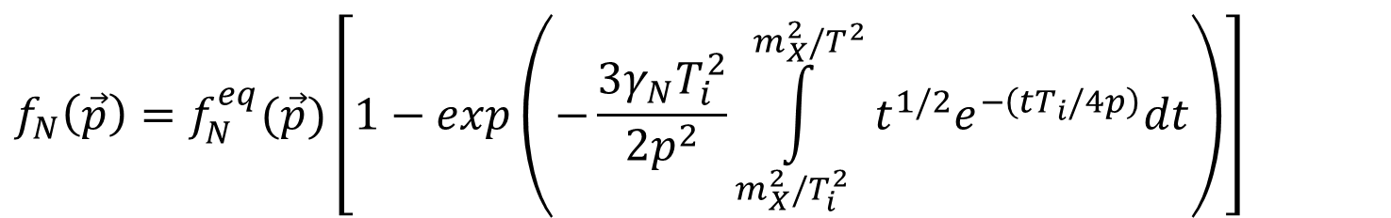
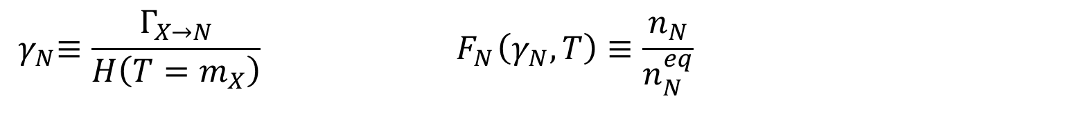
$${f_{N}\left(\vec{p}\right)=f_{N}^{eq}(\vec{p})\left[1−exp\left(−\frac{3γ_{N}T_{i}^{2}}{2p^{2}}\int_{m_{X}^{2}/T_{i}^{2}}^{m_{X}^{2}/T^{2}}{t^{1/2}e^{−\left(tT_{i}/4p\right)}dt}\right)\right]}_{}$$
$${ γ}_{N}≡{\frac{Γ_{X→N}}{H\left(T=m_{X}\right)}}_{} { F}_{N}\left(γ_{N},T\right)≡\frac{n_{N}}{n_{N}^{eq}}$$

Slide 17
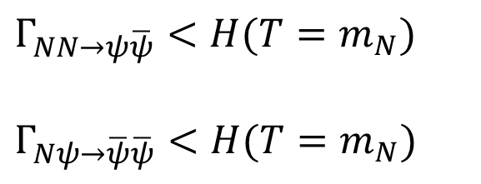
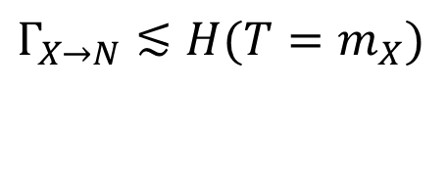
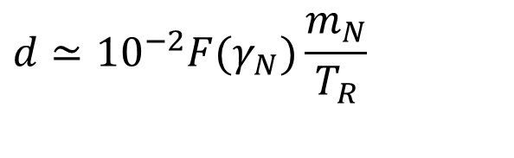
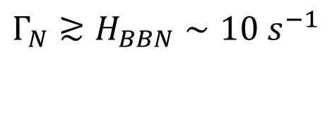
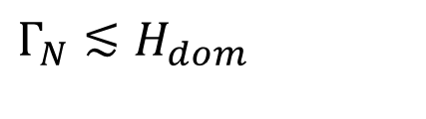
Necessary conditions for having an EMD epoch:
- N must reach equilibrium:
$${Γ_{X→N}≲H(T=m_{X})}_{}$$
- N self-annihilation and annihilation must be inefficient:
$${Γ_{NN→ψ\overline{ψ}}<H(T=m_{N})}_{}$$
$$Γ_{Nψ→\overline{ψ}\overline{ψ}}<H(T=m_{N})$$
- N must dominate before decaying:
$${Γ_{N}≲H_{dom}}_{}$$
- N decay must happen before BBN:
$${Γ_{N}≳H_{BBN}∼10{ s}^{−1}}_{}$$
$$d≃{10}^{−2}F(γ_{N})\frac{m_{N}}{T_{R}}$$
Dilution factor:

Slide 18

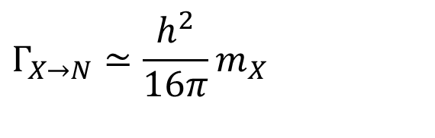

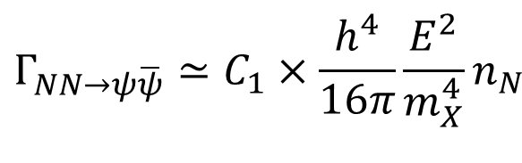

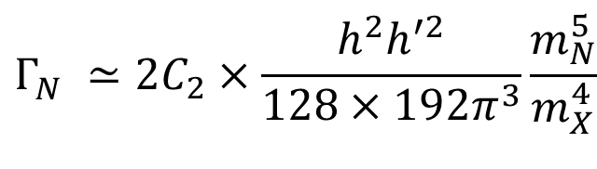
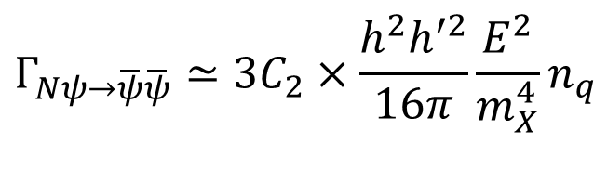

For a given flavor combination of :
$$ψψψ$$
$${Γ_{X→N}≃\frac{h^{2}}{16π}m}_{X}$$
$${Γ_{NN→ψ\overline{ψ}}≃C_{1}×\frac{h^{4}}{16π}\frac{E^{2}}{m_{X}^{4}}n}_{N}$$
$$(E≪ m_{X})$$
$${Γ_{Nψ→\overline{ψ}\overline{ψ}}≃3C_{2}×\frac{h^{2}h^{′2}}{16π}\frac{E^{2}}{m_{X}^{4}}n}_{q}$$
$${Γ_{N}^{}≃2C_{2}×\frac{h^{2}h^{′2}}{128×192π^{3}}\frac{m_{N}^{5}}{m_{X}^{4}}}_{}$$
$$C_{1},$$
$$C_{2} :$$
multiplicity factors

Slide 19

The allowed parameter space in plane:
$$h−h^{′}$$

Slide 20


The allowed parameter space in the plane:
$${m_{N}−τ}_{N}$$
Conditions 4 & 5 are comfortably satisfied in the shaded regions here.
The resulting dilution factor is:
$$d≲{10}^{5}$$

Slide 21
DM relic abundance can be accommodated for small annihilation rates:

Slide 22
DM relic abundance can be accommodated for large annihilation rates:

Slide 23





Prospects for LLP searches:
N is an example of a neutral LLP.
Such LLPs with difficult to detect at the LHC main detectors.
$$l_{N}>100 m$$
Dedicated searches will look for LLPs with up to .
$$l_{N}$$
$$τ_{N} \sim 0.1 sec$$
$$l_{N}=\overline{b}cτ_{N}$$
$$\overline{b}\sim \frac{m_{X}}{2m_{N}}$$
Example: MATHUSLA (MAssive Timing Hodoscope for Ultra Stable neutraL pArticles).
J. Chou, D. Curtin, H. Lubatti PLB 767, 29 (2017)
The most important MATHUSLA target: hadronically decaying LLPs with mass in the 10-100 GeV range.
C. Alpigiani et al. [MATHUSLA Collaboration] 2009.01693 [physics.ins-det]

Slide 24
D. Curtin et al Rep. Prog. Physics 82, 116201 (2019)

Slide 25
MATHUSLA Collaboration 2009.01693 [physics.ins-det]

Slide 26
The dark shaded band corresponds to the most important MATHUSLA target for hadronically decaying LLPs.
It overlaps with the DM allowed regions!

Slide 27
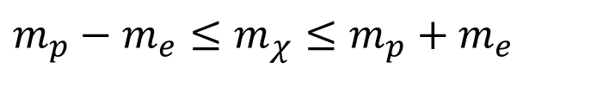
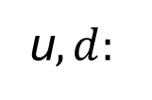
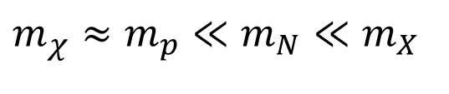


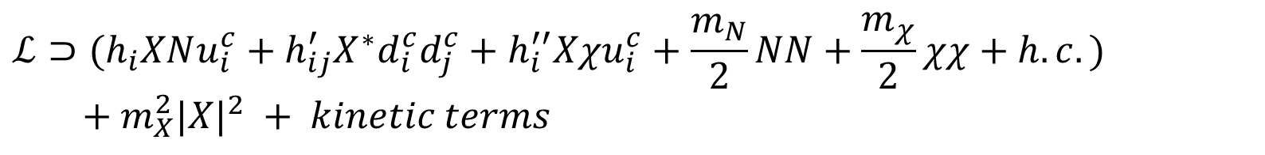

An Explicit Model:
$$ℒ⊃{{(h}_{i}XNu_{i}^{c}+h}_{ij}^{′}{X^{∗}d}_{i}^{c}d_{j}^{c}+h_{i}^{′′}Xχu_{i}^{c}+\frac{m_{N}}{2}NN+\frac{m_{χ}}{2}χχ+h.c.)$$
$$+ m_{X}^{2}{|X|}^{2} + kinetic terms$$
R.A., N. Loc, J. Osinski PRD 107, 123510 (2023)
$$X:$$
Iso-singlet color-triplet scalar, Y = 4/3
$$N,χ:$$
SM singlet Majorana fermions
$$m_{χ}≈m_{p}≪m_{N}≪m_{X}$$
u$,d:$
Right-handed up-type and down-type quarks
$$χ$$
is stable if .
$$m_{p}−m_{e}≤m_{χ}≤m_{p}+m_{e}$$
“Natural GeV DM”
R.A., B. Dutta PRD 88, 023525 (2013)
Thermally overproduced nonthermal mechanism needed.
Can be achieved from modulus decay (also baryogenesis).
R. A., P. S. B. Dev, B. Dutta Phys. Lett. B 779, 262 (2018)

Slide 28



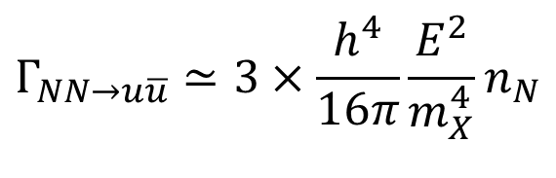

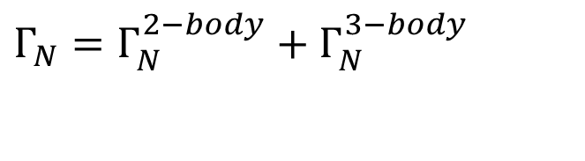


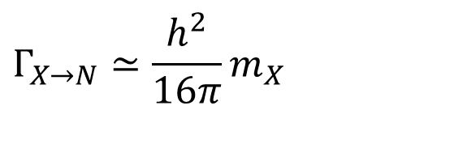


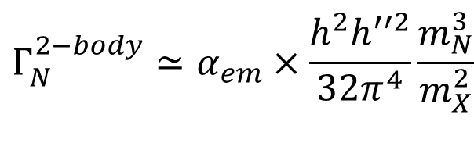

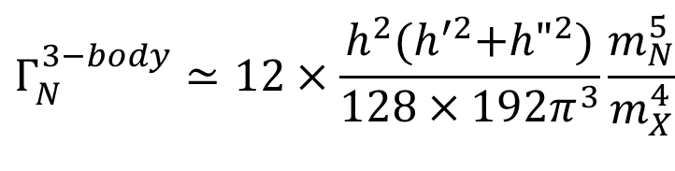



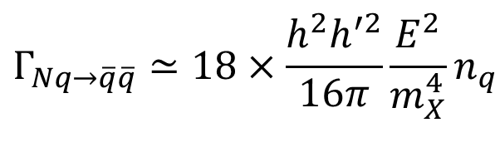


$${Γ_{X→N}≃\frac{h^{2}}{16π}m}_{X}$$
$${Γ_{N}={Γ_{N}^{2−body}+Γ_{N}^{3−body}}_{}}_{}$$
$$u$$
$$u$$
$${Γ_{N}^{3−body}≃12×\frac{h^{2}{(h}^{′2}+{h"}^{2})}{128×192π^{3}}\frac{m_{N}^{5}}{m_{X}^{4}}}_{}$$
$$N$$
$$N$$
$$d$$
$$\overline{u}$$
$$d$$
$$χ$$
$$γ$$
$$Xu$$
$${Γ_{N}^{2−body}≃α_{em}×\frac{h^{2}h^{′′2}}{32π^{4}}\frac{m_{N}^{3}}{m_{X}^{2}}}_{}$$
$$N$$
$$u$$
$$χ$$
$${Γ_{NN→u\overline{u}}≃3×\frac{h^{4}}{16π}\frac{E^{2}}{m_{X}^{4}}n}_{N}$$
$${Γ_{Nq→\overline{q}\overline{q}}≃18×\frac{h^{2}h^{′2}}{16π}\frac{E^{2}}{m_{X}^{4}}n}_{q}$$
$$(E≪ m_{X})$$

Slide 29
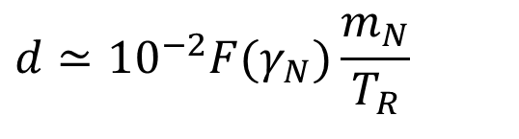
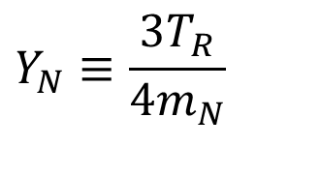
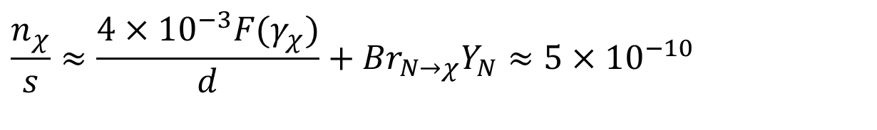


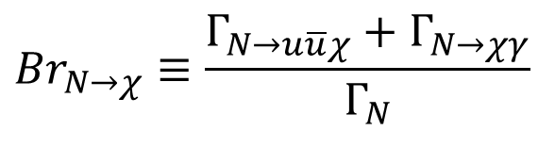
DM relic abundance:
$$\frac{n_{χ}}{s}≈{\frac{4×{10}^{−3}F(γ_{χ})}{d}+{Br}_{N→χ}Y_{N}≈5×{10}^{−10}}_{}$$
X decay & dilution by EMD
N decay
Desired value
$$Y_{N}≡\frac{3T_{R}}{4m_{N}}$$
$$d≃{10}^{−2}F(γ_{N})\frac{m_{N}}{T_{R}}$$
$${Br}_{N→χ}≡\frac{Γ_{N→u\overline{u}χ}+Γ_{N→χγ}}{Γ_{N}}$$
$m_{N}≲O(TeV)$
For , we need:
$$F\left(γ_{χ}\right)≪1 { Br}_{N→χ}≪1$$
Freeze-in production

Slide 30






















Baryon asymmetry:
Three-body decays with the help of electroweak loops:
$$m_{u}$$
$$u$$
$$d$$
$$×$$
$$u$$
$$m_{d}$$
$$N$$
$$×$$
$$W$$
$$d$$
$$N$$
$$u$$
$$×$$
$$×$$
$$d$$
$$m_{u}$$
$$m_{d}$$
$$d$$
$$d$$
$$η_{B}≡\frac{n_{B}−n_{\overline{B}}}{s}=ε_{B}Y_{N}\frac{Γ_{N→udd}+Γ_{N→\overline{u}\overline{d}\overline{d}}}{Γ_{N}}≈9×{10}^{−11}$$
$$ε_{B}∼\frac{α_{2}}{4}\frac{m_{c}m_{s}m_{t}m_{b}}{m_{W}^{2}m_{N}^{2}}$$
K. S. Babu, R. N. Mohapatra, S. Nasri PRL 98, 161301 (2007)
$m_{N}∼100 GeV$
The maximum asymmetry is obtained for .

Slide 31



The allowed parameter space set by DM and baryogenesis:
Corresponding decay length of N:
$$4×{10}^{3} m≲l_{N}≲1.5×{10}^{8} m$$
$$1.6×{10}^{3} m≲l_{N}≲6×{10}^{7} m$$

Slide 32




$$ΔB=2$$
Low energy probes: processes.
(1) Double proton decay.
$$τ_{pp→K^{+}K^{+}}$$
$$τ_{pp→K^{+}K^{+}}>1.7×{10}^{32}y$$
P. S. B. Dev, R. N. Mohapatra Phys. Rev. D 92, 016007 (2015)
$h_{1}{h′}_{12}≲3×{10}^{−6} (m_{X}=3 TeV, m_{N}=100 GeV)$
$h_{1}{h′}_{12}≲3×{10}^{−7} (m_{X}=1 TeV, m_{N}=100 GeV)$
(2) Neutron-antineutron oscillations.
$$3×{10}^{8} s ≤τ_{n−\overline{n}}≤5×{10}^{10}s$$
current limit
next generation experiments
R. A., P. S. B. Dev, B. Dutta Phys. Lett. B 779, 262 (2018)
$3×{10}^{−6}≲h_{1}{h^{′}}_{13}^{2}≲4×{10}^{−5} (m_{X}=3 TeV, m_{N}=100 GeV)$
${10}^{−7}≲h_{1}{h^{′}}_{13}^{2}≲2×{10}^{−6} (m_{X}=1 TeV, m_{N}=100 GeV)$

Slide 33

The allowed parameter space with low energy constraints included:
All requirements and bounds can be satisfied simultaneously.
The small h and large h’ corner is particularly interesting!

Slide 34

Conclusion:
Nonstandard thermal histories with EMD are well motivated.
EMD may be driven by LLPs in the HS (string moduli) or the VS.
Sub-TeV VS LLPs can arise in minimal extensions of the SM.
An explicit model with a hadronically decaying LLP presented.
It can lead to the correct DM abundance and successful baryogenesis.
It could be probed by the proposed LLP searches like MATHUSLA.
Within the reach of low-energy experiments like oscillation.
$$n−\overline{n}$$

