Slide 1
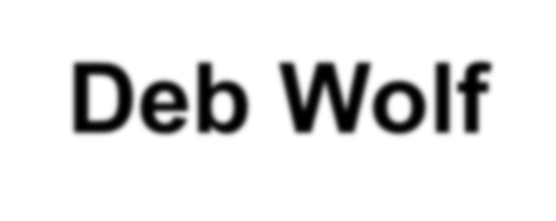
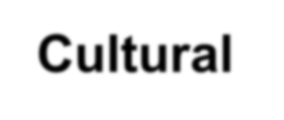
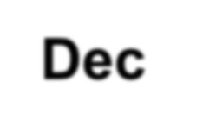
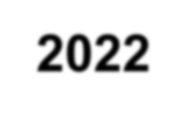
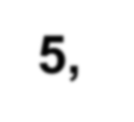
Deb Wolf Director for Outreach and Culture
dwolf@sanfordlab.org
Cultural Advisory Committee - Dec 5, 2022

Slide 2
Institute Development Process
STEM Institute Study (December 2019): study of related global institutes.
SURF Institute Program Study (December 2020): Interviewed SURF users and leaders in various fields related to UG science to identify community needs.
Working Group defined Institute scope (April – June 2021):
Ms. Elizabeth Freer, dialogue LLC
Mr. Mike Headley, SDSTA
Dr. Jaret Heise, SDSTA
Dr. Barbara Szczerbinska, Texas A&M Univ – Corpus Christi
Dr. Bob Wilson, Colorado State University
Ms. Deb Wolf, SDSTA
Completed Institute development study in December 2021.
Kick-off planning currently underway.

Slide 3
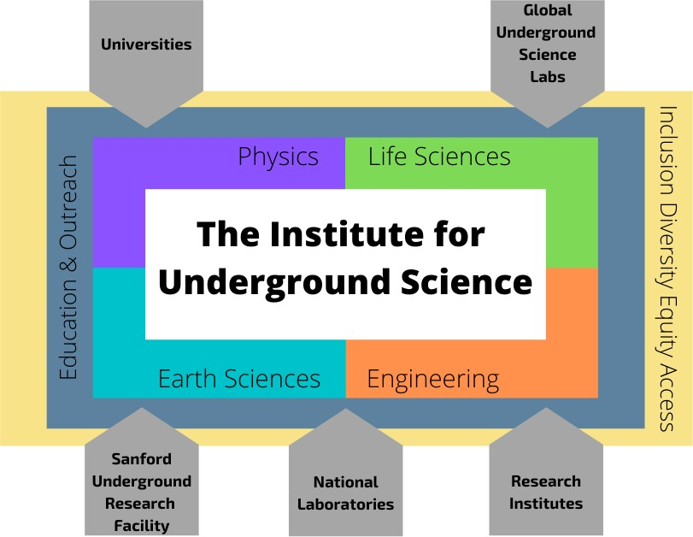
Institute Vision
Establish the world-leading center for underground science collaboration and intellectual community.
Provide leadership in long-term science community planning.
Engage with the global community for vision and leadership in a range of disciplines.
Serve as the “hub” for information on global underground science.
Foster close collaboration and integration with the science and outreach programs.
Establish world leadership in K-12 and public E&O programs.

Slide 4
Institute Vision
“The Institute will be a leader in the advancement of Inclusion, Diversity, Equity, and Access (IDEA) in science and science education. Its IDEA focus will be intentional from the start and a priority in all aspects of the Institute’s work. The Institute will also foster a close collaboration and integration of K–12 Science, Technology, Engineering, and Mathematics (STEM) education and public outreach programs with the science and engineering of the Institute and SURF. These programs will engage globally, regionally and locally to provide high–quality science education resources for students and professional development opportunities for teachers.”
-Institute Scoping Document 2021

Slide 5
Building Intellectual Community
Intellectual community is an intangible asset and its success at the Institute will require careful and intentional consideration.
The Institute’s culture must be intentionally structured from the start to include diverse voices and amplify not just the voices of renowned scientists.
Foster and develop the intellectual community for those participating in:
Institute programs;
Researchers actively working on experiments at SURF; and
The broader underground science community.
A critical level of activities and robust plan for programs are required to foster an intellectual community.
Critical understanding: there is intellectual merit in the underground science, AND the science education, AND the intersection of IDEA with science and science education.

Slide 6
Science Program Goals
The goal for the Institute’s science program is to establish a scientific community for underground science, which includes:
Providing resources to promote long-term community planning (planning for future experiments and connecting underground science communities);
Establishing professional development avenues for early-career scientists and those from historically under-represented groups;
Ensuring diversity of representation when planning for and connecting underground science communities.
The Institute’s international science advisory committee will recommend the long-term strategic vision for the Institute science program goals (10+ year vision).
The Institute staff scientists will develop and build programs on a 2-to-5-year planning cycle to address the research goals. The planning process will also be flexible enough to be responsive to new science developments.

Slide 7
Science Interaction Model
Interactions amongst fall into three general categories:
Meetings: Conferences, workshops and topical meetings as well as experiment-related meetings and workshops;
Visiting Scientist Program: Brings a range of scientists to the Institute via a scientist-in- residence program, fellowships, schools;
Synergies: Leverage meetings and visiting scientists to foster communication within and between disciplines.
The Institute will also maintain access to cohesive collection of publications and presentations on the scientific fields working at the Institute.
The Institute will build a virtual community to connect researchers not only to the Institute, but also across the broader community including a resource-rich website to support the science interaction model.

Slide 8
Science Program Summary
Science Program Elements | # of Events Annually | Participants / Event & Year | Timeframe | Annual Subtotals
Conferences | 5 | 100-300/event 700 / year | 3-7 days As scheduled | 71 Events 2620 people engaged
Workshops & Topical Meetings | 16 | 20-50 / event 370 / year | 1-3 weeks Quarterly
Experiment Mtgs & Workshops | 10 | 50-300 / event 1000 / year | 1-2 weeks As Scheduled
Seminars & Colloquia | 40 | 10-15 / event 450 / year | 2-4 hours Weekly
Scientists in Residence | -- | 20-40 / year | 6-24 months | 6 Events 160 people engaged
Fellowships (Fall & Spring) | 2 | 20 / year | 4-6 months
Science School (Summer) | 2 | 30 / year | 1-4 weeks
Semester Courses (Fall / Spring) | 2 | 60 / year | 12 weeks

Slide 9
Education & Outreach Overview
While SURF will continue to serve as an inspiration for the Education and Outreach (E&O) program, the E&O program will move under the umbrella of the Institute.
To ensure effective connections between research and the public, the E&O team will offer trainings in best-practices for communicating their research to the general public.
The Institute will also jointly bring together science education researchers, faculty, and practitioners, to positively impact how science is taught, learned, and experienced by students and the general public.
The existing K-12 student education opportunities will continue and expand to serve a broader audience at national and international scales.

Slide 10
E&O Program Model
E&O team direct interactions with K-12 students falls into three general categories: Curriculum Resource Support, Classroom Presentations, and Field Trips.
Institute will also provide training opportunities for educators:
Regional, state, and national science education conferences;
Education workshops and topical meetings;
Continuing education opportunities;
Graduate Education Summer School;
Critical Topics in Science Education.
General Public Outreach, including teaching science communication skills.
Additional student interactions (K-16):
Robotics program;
Davis-Bahcall Scholars;
Internships, Shadowing, and Mentoring;
STEAM Programs.

Slide 11
Education Program Summary
Education Program Elements (beyond direct student experiences) | Annual Events | Participants / Event & Year | Timeframe | Annual Subtotals
Conferences Workshops and Topical Meetings | 8 | 30-200 /event 530 / year | 3-5 days June, Fall, Winter, Spring | 14 Events 720 People
Continuing Education Opportunities | 6 | 20 / event 120 / year | 3 days Summer
Graduate Education Summer School | 1 | 20 / year | 10 weeks Summer
Critical Topics in Science Education | 2 | 25 / event 50 / year | 1 week Spring & Fall
Science Educator Fellow |  | 2 / year | 8 - 12 months
Public Outreach Events | 12 | 100 / event 1200 / year | 1.5 hours Monthly | 45 Events 2440 People
IDEA & STEM Topical Meetings | 3 | 350 /year | 1-5 days
Students (K-16): (Robotics, Interns, STEAM, etc.) | 30 | 10-100 /event 890 / year | 1 day to 5 weeks Monthly & Summer

Slide 12
Public Outreach
Over the next year, public outreach efforts will transition under the umbrella of the Institute. Events such as Deep Talks, Dark Matter Day, Nobel Day, etc. will continue to be a focus.
The Sanford Lab Homestake Visitor Center’s public outreach events will allow us to expand public outreach offerings. These include:
Ask a Scientist
Educational “Pop-Ups”
Culturally Responsive offerings
Artist-In-Residence (AiR) program will remain with SURF. The AiR serves as a connector between the science happening at SURF, the Institute, and the public’s understanding and appreciation of that work.

Slide 13
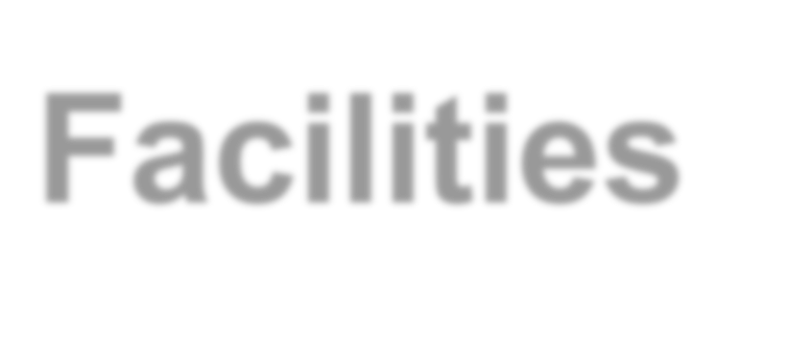
Facilities
Recommend the Institute be located at or immediately adjacent to SURF, close to where the science is happening at SURF to further facilitate genuine interactions and build intellectual community.
Facilities will include the following key components:
Auditorium to seat up to 300 people and 11 formal presentation spaces;
Working spaces for up to 300 researchers, educators, and program participants;
6 designated spaces for spontaneous or informal discussions;
Centralized free and quality coffee;
A cafe to seat at least 100 people, plus outdoor seating;
State–of–the–art audiovisual infrastructure in all conference areas;
Onsite guest house style housing to accommodate 100 people.

Slide 14
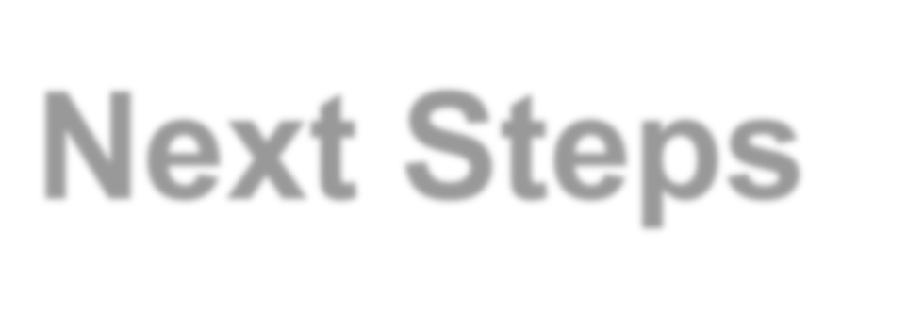
Next Steps
Planning underway to kick off the Institute in 2023. Report due to SDSTA and SURF Foundation Boards of Directors on Dec 15, 2022.
Institute branding and social media presence will be established.
Discussions are underway with Dr. Barbara Szczerbinska to plan and host a 4-6 week CETUP theoretical physics workshop in summer 2023.
“Science talks for scientists” will begin in March 2023 to help build intellectual community. (zoom format to increase reach)
Discussions underway with other labs and universities on science programming partnerships.
Current K-12 E&O efforts, Sanford Lab Homestake Visitor Center, and Public Outreach will transition under the Institute’s branding.
Focused, national-level fundraising effort for Institute will begin in 2023.
SLHVC, SURF, and Elevate Rapid City facilities will provide initial space for programs.

