Slide 1
IDEA (Inclusion, Diversity, Equity and Access) Office Update
Rochelle Zens
IDEA Program Lead
Cultural Advisory Committee December 5, 2022

Slide 2
IDEA Office
SURF Culture and Diversity efforts expand into Inclusion, Diversity, Equity and Access Office in February 2021
IDEA team is comprised of:
Deb Wolf, transitioned into IDEA Program Manager role in February 2021
Rochelle Zens hired as IDEA Program Lead in March 2021
Emily Berry, hired as Culture, Diversity and Outreach Coordinator in September 2022

Slide 3
IDEA Goals and Objectives
Creating an environment that is welcoming to all employees, contractors, and other visitors at SURF
Remove barriers (physical and imagined) that prevent underrepresented groups from visiting and/or working at SURF
Build leaders who know how to build their people
Build relationships with underrepresented groups in the region

Slide 4
Manager Trainings
Designed to support our managers and future leaders to create inclusive spaces for their employees. Topics have included:
Listening – How can improved listening skills support employee voice?
Psychological Safety – a shared belief that it’s safe to discuss ideas, experiment, take risks, give feedback, and learn from mistakes. It is feeling safe to be yourself and not be judged negatively by others for differences.
Systems framework – How do the elements and interconnections of our systems at SURF impact the functions of our organization?
Future work will make connections between our core values and IDEA topics

Slide 5
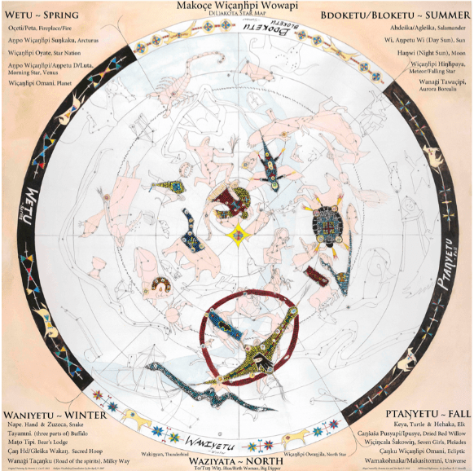
Star Knowledge Working Group
Meets quarterly
Comprised by IDEA staff, Nicol Reiner, Jaret Heise, Kelly Kirk, and several members from the User Association.
Discussed Indigenous Star Stories and different ways of understanding our world
Recommendations 23, 24 and 29 being considered by the group
Notes:
https://www.sciencefriday.com/articles/indigenous-peoples-astronomy/ and I Know the Moon – Stephen Axel Anderson
Recommendation 23: Encourage the staff to consider and articulate the ways in which research undertaken at SURF connects to global and historical attempts to understand the origins of the universe and humanity and then leverage those connections to strengthen relationships with the communities surrounding SURF and to engage visitors and stakeholders in conversation.
Recommendation 24: Encourage the staff to look for ways to emphasize the connectivity between STEM education and the arts and humanities in outreach, programming, and visitor center experiences.
Recommendation 29: In addition to increasing use of technology to enhance individual experiences, develop ways to use the visitor center exhibits and space to facilitate intergenerational conversation about the intersections of place, history, culture, and STEM.

Slide 6
Cangleska Wakan (Sacred Circle) Garden
Construction slated to begin Spring 2023
Working with Racing Magpie on a call to artists for sculptors
IDEA staff are working toward development of programming for the first year of the garden
Notes:
Construction – funds raised to begin construction, through a loan by SDSTA and in-kind contributions by RCS construction
Racing Magpie will develop the call to artists and help us get the word out to find a group or individual to develop the sculptures on the garden site

Slide 7
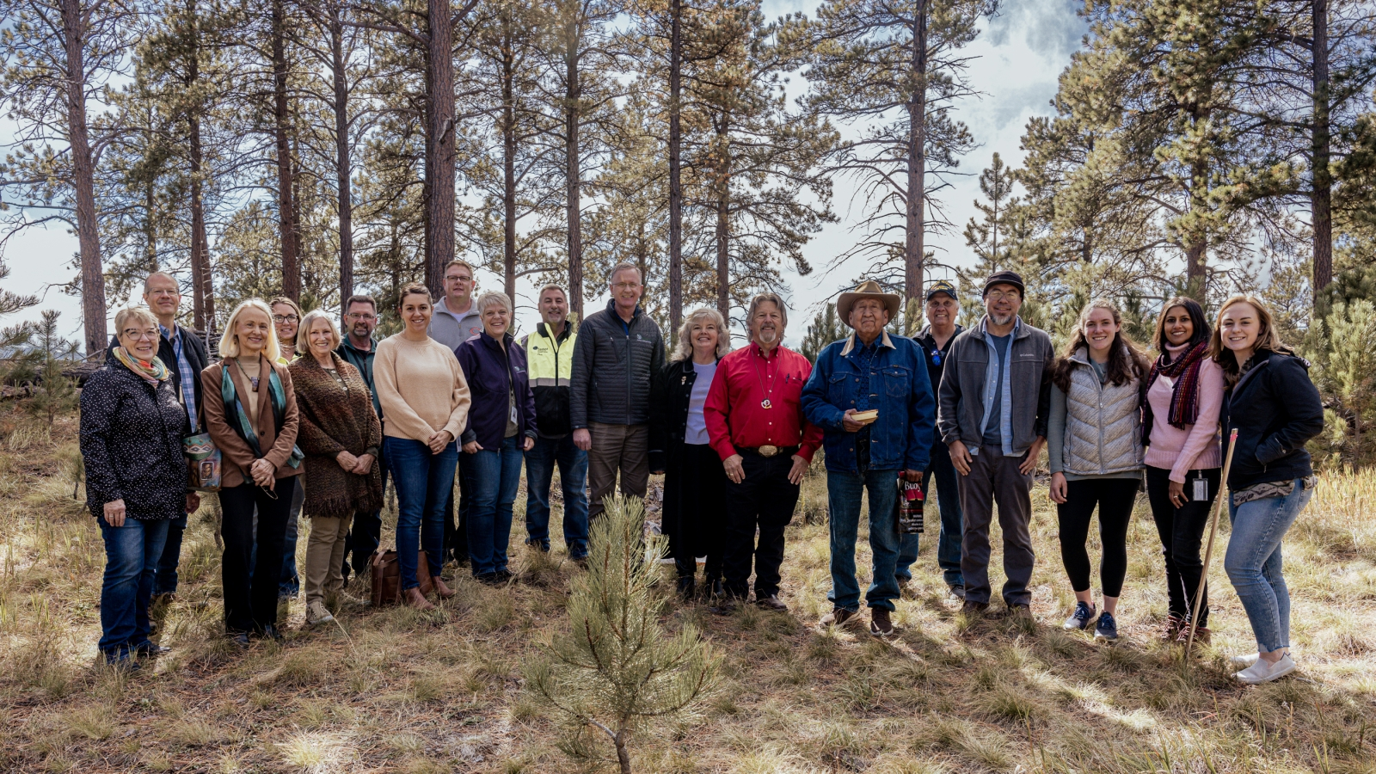
Blessing of the Garden

Slide 8
CIRCLES Alliance
Emily Berry and Deb Wolf traveled to Denver to attend a strategic planning meeting for the Cultivating Indigenous Research Communities for Leadership in Education and STEM (CIRCLES) Alliance.
The CIRCLES Alliance is a National Science Foundation-funded initiative to develop Native-based STEM education activities for K-12, science teachers, and pre-service educators in Idaho, Montana, New Mexico, North Dakota, South Dakota, and Wyoming.

Slide 9
CAC Review Recommendations Status
ID # | Recommendation | Status
3 | Discuss the medicine wheel and its use for: quiet time, education, celebrations, gatherings and to help remember to show respect for this sacred land. | Rochelle and Emily are currently working to develop a group to shape the planning for the first year of programming at the garden.
4 | Coordinate with the Universities' Centers for American Indian Studies in the initial use of the Ethnobotanical Garden/Medicine Wheel. | Combined with #3.
18 | Provide a copy of what will be on the website and what will be used internally for the strategic plan. | Awaiting feedback from the Cultural Advisory Committee on what information should be included on the CAC website.
23 | Encourage the staff to consider and articulate the ways in which research undertaken at SURF connects to global and historical attempts to understand the origins of the universe and humanity and then leverage those connections to strengthen relationships with the communities surrounding SURF and to engage visitors and stakeholders in conversation. | In progress. This topic was shared with the Star Knowledge Working Group and events/topics relating to this will be further discussed at subsequent meetings.
26 | All things being equal consider giving preference to a Native American for the diversity outreach and culture coordination position. | Closed – efforts are currently being implemented to ensure SURF reaches a more diverse applicant pool for future openings.
32 | Continue to facilitate IDEA training for all managers on a monthly basis and develop a strategy for involving more staff in IDEA efforts and training. | In progress. The IDEA Office is currently working to develop trainings that make connections between the core values at SURF (especially safety) and IDEA topics.

