Slide 1
BHUC:
Ultra-low Background Counting
At the Davis (for now)!
Brianna Mount
SURF User Association Annual General Meeting
October 26, 2022

Slide 2
Low Background Counting
BHSU Underground Campus (BHUC) is a user facility that currently hosts low background counting systems
These High-purity Germanium (HPGe) detectors measure U, Th, K (and others) very sensitively

Slide 3
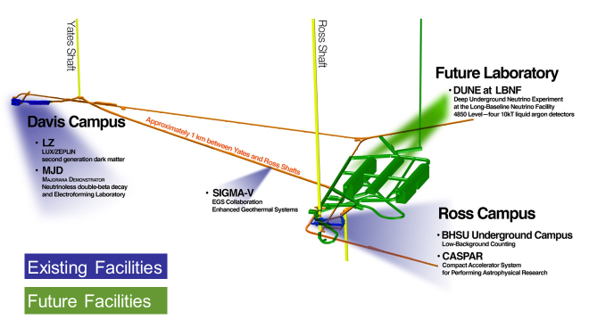
Currently at Davis, Back at Ross (2023)

Slide 4
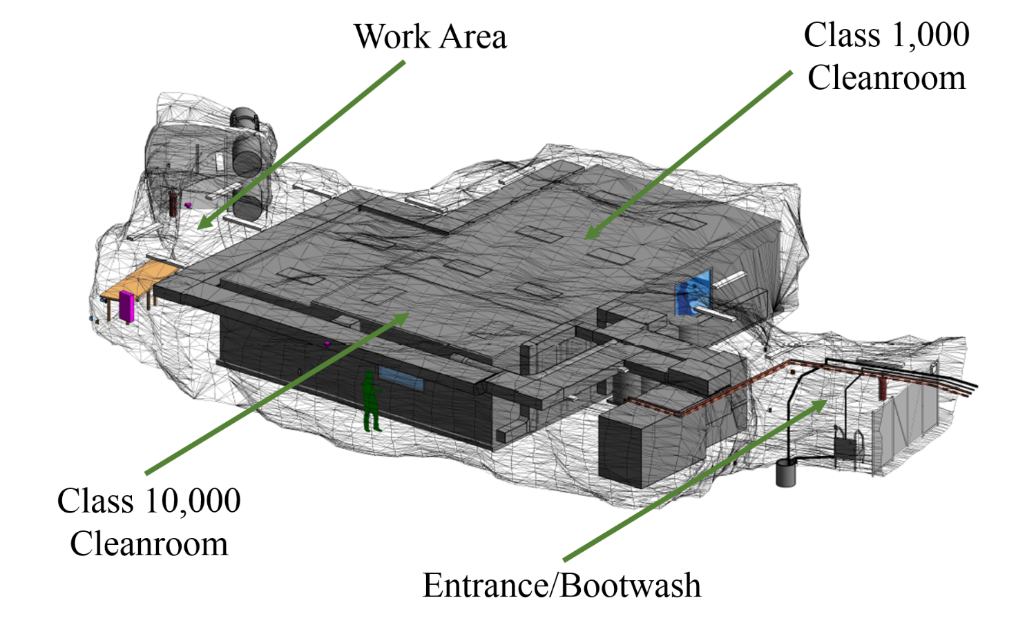
oldBHUC at Ross:
Sleeping Beauty re-awakens Winter 2023

Slide 5
oldBHUC Program
From 2015-2020, counted ~500 samples
  Counters were fully subscribed almost the entire lifetime
Black Hills State University Underground Campus, B.J. Mount et al., Appl Radiat Isot., 126, 130 (2017).
The LUX-ZEPLIN (LZ) radioactivity and cleanliness control programs, June 3, 2020. Published in Eur.Phys.J. C 80 (2020) 1044.

Slide 6
Future uses of oldBHUC
Exciting new life for small-scale experiments?
  Pre-set up for “stations”
    Electrical, network, LN2, N2 purge
    600 sq ft. class 1,000 space
  200 sq ft class 10,000 space
    With workbench, laminar flow hood
  Soft-walled gowning area
  Outside work area

Slide 7
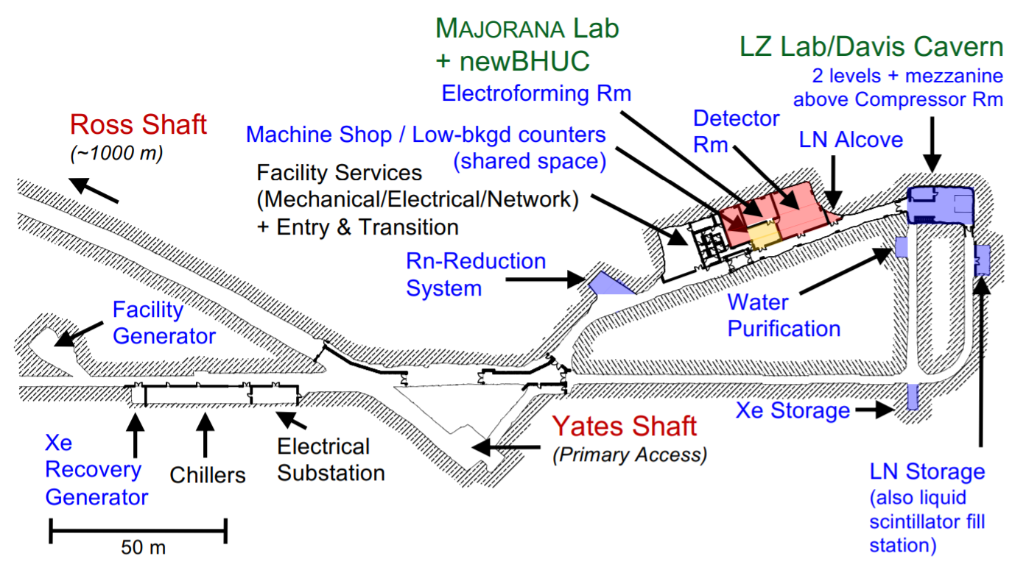
Current space at the Davis
J. Heise, SURF General User Meeting 2021

Slide 8
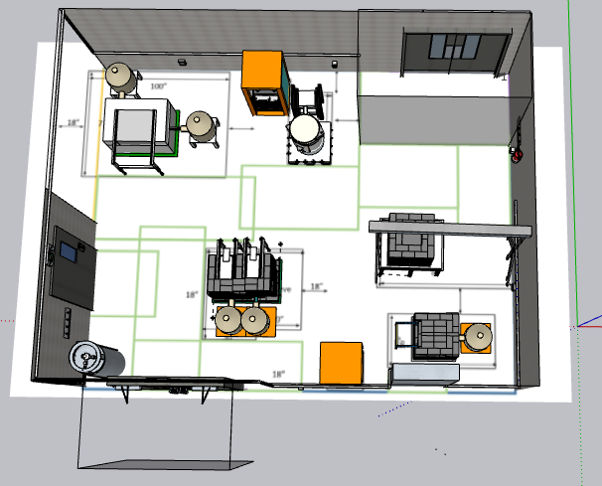
newBHUC: Davis Campus
To e-forming
Twins
RHYM/RESN
To MJD Detector
To Machine Shop
GeIV
Maeve/Morgan
Emergency exit to transition area
Mordred
Entrance to newBHUC from Common Corridor

Slide 9
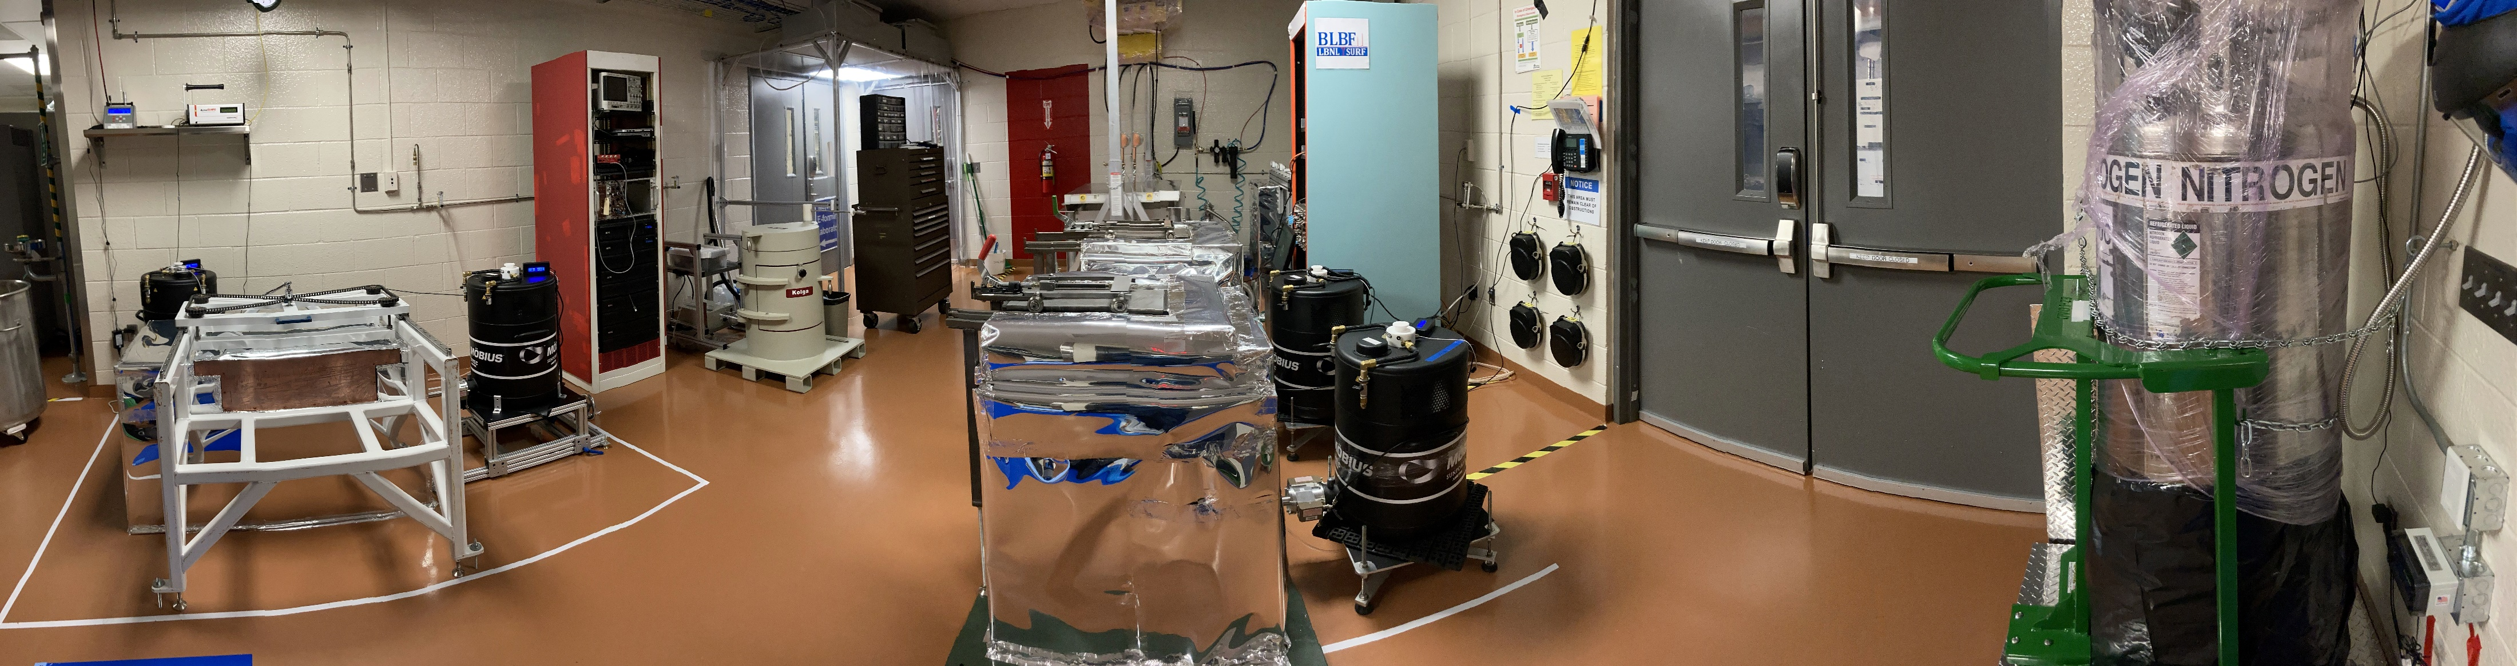
newBHUC wrap-around view

Slide 10
Detectors and Collaborators
Maeve, Morgan, Mordred, Twins
  Kevin Lesko (LBNL), Doug Tiedt (SDSTA)
RHYM/RESN
  Keenan Thomas (LLNL)
GeIV
  Andreas Piepke (Univ. Alabama), Ryan MacLellan (UKy)

Slide 11
Current, planned and nearby low background capabilities
Detector | Detector Type | [U] mBq/kg | [Th] mBq/kg | Owner
Morgan | 2.1 kg p-type | 0.2 | 0.2 | BLBF
Maeve | 1.7 kg p-type | 0.1 | 0.1 | BLBF
Mordred | 1.4 kg n-type | 0.7 | 0.7 | USD/BLBF
Twins | 2 x 2.1 kg, p-type |  |  | BHSU/BLBF
Ge IV | p-type |  |  | nEXO
LLNL | 2 x 1.1 kg, BEGe |  |  | LLNL
Limits listed above are average sensitivities for ~1-2 kg sample for 2 weeks sample time

Slide 12
Current, planned and nearby low background capabilities
Detector | Detector Type | [U] mBq/kg | [Th] mBq/kg | Owner
Morgan | 2.1 kg p-type | 0.2 | 0.2 | BLBF
Maeve | 1.7 kg p-type | 0.1 | 0.1 | BLBF
Mordred | 1.4 kg n-type | 0.7 | 0.7 | USD/BLBF
Twins | 2 x 2.1 kg, p-type |  |  | BHSU/BLBF
Ge IV | p-type |  |  | nEXO
RHYM/RESN | 2 x 1.1 kg, BEGe |  |  | LLNL
Dual detectors will have increased sensitivity, results to follow shortly

Slide 13
How to get something counted at the BHUC
Contact: Brianna Mount: brianna.mount@bhsu.edu
Normal sampling time is two weeks
Right now, the cost is cheap

