Slide 1
SURF User Association
Brittany Kruger
User Association Executive Committee Chair
User Association Annual Meeting 2022

Slide 2
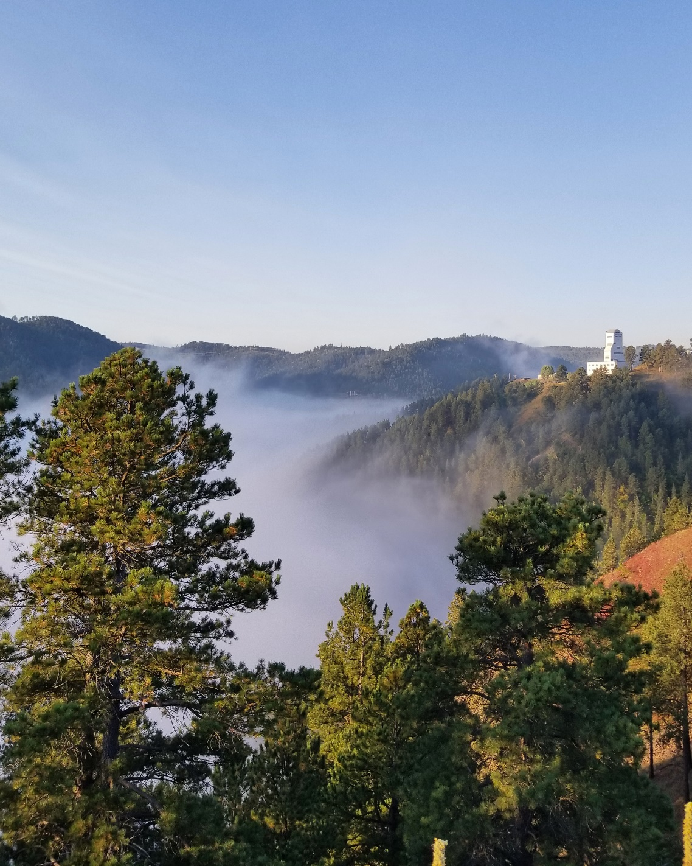
SURF User Association
Purpose
Two-way communication on topics important to users/researchers.
Promotes a sense of community amongst SURF experiments and researchers.
Articulates and promotes scientific case for UG science and significance to society, provides channel for advocacy.
Organization
Membership open to Underground Science Community (initially was limited to active SURF researchers). General meetings held at least annually.
Executive Committee consists of 9 individuals across scientific disciplines, incl early career. Two-year terms (with term overlap), limits per experiment and institution. Quarterly meetings held with SURF Mgmt.

Slide 3
SURF User Association Executive Committee
Timeline
Established Dec 2020. Two rounds of Executive Committee elections conducted successfully (2020, 2021).
Name | Field | Experiment | Institution | Notes | Term Expiry
Mark Hanhardt | Physics | CASPAR | SURF | Early Career | Dec 2022
Brittany Kruger | Biology | DeMMO | Desert Research Institute | Chair | Dec 2023
Kevin Lesko | Physics | LZ | Lawrence Berkeley Natl Lab |  | Dec 2022
Rachel Mannino | Physics | LZ | Lawrence Livermore Natl Lab | Early Career | Dec 2022
*Ralph Massarczyk | Physics | MJD/LEGEND | Los Alamos Natl Lab | Post-Chair | Dec 2022
Sam Meijer | Physics | MJD/LEGEND | Los Alamos Natl Lab |  | Dec 2023
Brianna Mount | Physics | BHUC | Black Hills State University |  | Dec 2022
Megan Smith | Geology | EGS Collab | Lawrence Livermore Natl Lab | Secretary | Dec 2023
Frank Strieder | Physics | CASPAR | South Dakota Mines |  | Dec 2023
Wenqin Xu | Physics | MJD | University of South Dakota |  | Dec 2022

Slide 4
SURF User Association Executive Committee
Timeline
Established Dec 2020. Two rounds of Executive Committee elections conducted successfully (2020, 2021).
Name | Field | Experiment | Institution | Notes | Term Expiry
Mark Hanhardt | Physics | CASPAR | SURF | Early Career | Dec 2022
Brittany Kruger | Biology | DeMMO | Desert Research Institute | Chair | Dec 2023
Kevin Lesko | Physics | LZ | Lawrence Berkeley Natl Lab |  | Dec 2022
Rachel Mannino | Physics | LZ | Lawrence Livermore Natl Lab | Early Career | Dec 2022
*Ralph Massarczyk | Physics | MJD/LEGEND | Los Alamos Natl Lab | Post-Chair | Dec 2022
Sam Meijer | Physics | MJD/LEGEND | Los Alamos Natl Lab |  | Dec 2023
Brianna Mount | Physics | BHUC | Black Hills State University |  | Dec 2022
Megan Smith | Geology | EGS Collab | Lawrence Livermore Natl Lab | Secretary | Dec 2023
Frank Strieder | Physics | CASPAR | South Dakota Mines |  | Dec 2023
Wenqin Xu | Physics | MJD | University of South Dakota |  | Dec 2022
Charter updated in Aug 2021 to broaden membership to global underground science community. Subcommittee ratified new registration process in Apr 2022, form linked on SURF website.
Charter update ratified in Apr 2022 re: minimum representation from various disciplines.
Association organized SURF Vision Workshop Sept, 2021, first General Meetings Sept, 2021, Oct, 2022

Slide 5
SURF User Association Executive Committee
2022 General Meeting Goals:
Provide current facility and science updates to users,
Invite potential new users to contribute:
G3 Dark Matter
Atom Interferometry
Microbial Metabolomics
Continue the SURF long-term planning discussion,
Provide instruction for new users on starting a project at SURF.
Reminders:
We encourage broad participation in the user association- share with your colleagues.
Next round of Executive Committee elections in Dec 2022, please email if interested.

