Slide 1
Outreach and Culture
Deb Wolf
Director of Outreach and Culture
SURF User Association
General Meeting
October 26, 2022

Slide 2
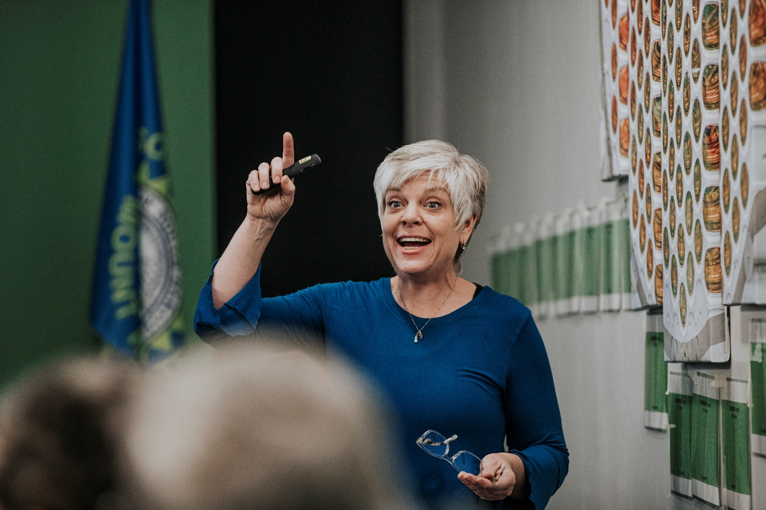
Deb Wolf - Director of Outreach and Culture
Experience includes over 30 years serving K12 education:
Work in K12 schools as an instructional coach, administrator and secondary science teacher
Work at state level – SD Dept of Education – Education Innovationist
Professional development facilitator for educators - in the areas of effective instruction, student engagement and equity
Director of Education & Outreach 2018-21
Deb Wolf | SURF User Association General Meeting October 26-27, 2022

Slide 3
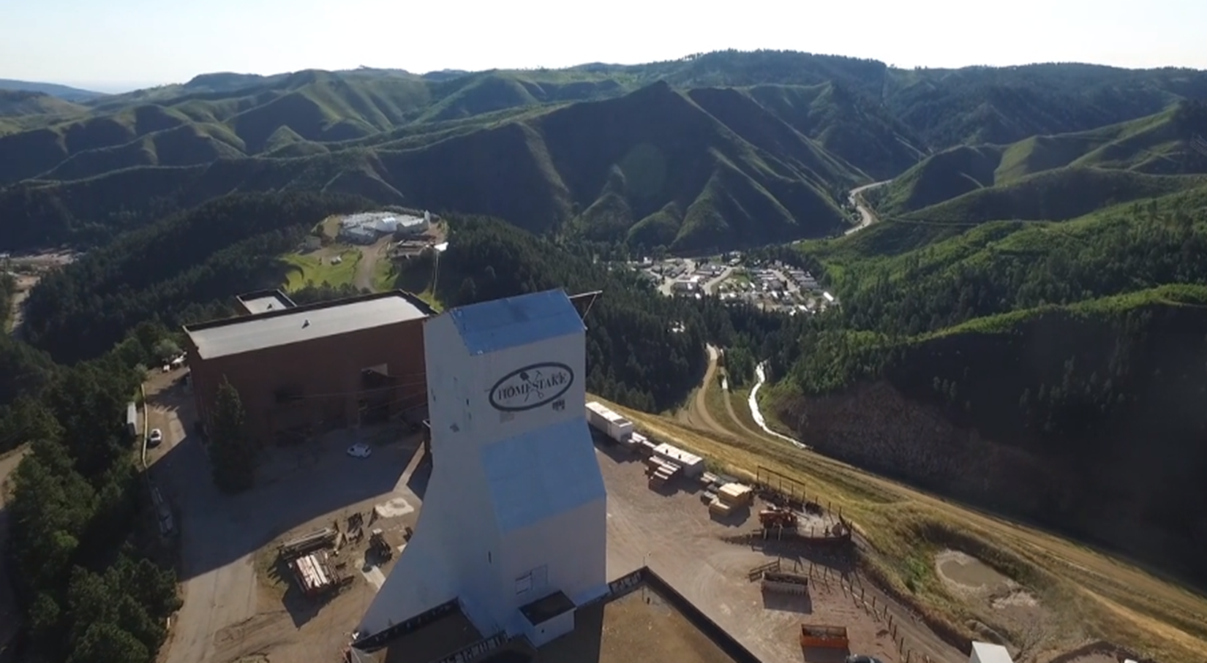
Context Matters: Footprint and Landscape
9 Native Nations share the same geography as South Dakota
SURF occupies the physical footprint of the former Homestake gold mine in the Black Hills - land that is considered sacred by regional tribes
American Indian students represent SD’s largest underserved population
Five of the 50 counties having the highest childhood poverty rates in the US are in SD and coincide with reservation land
In many counties in western SD, the population density is less than 2 residents per square mile
Deb Wolf | SURF User Association General Meeting October 26-27, 2022

Slide 4
Outreach and Culture: Scope of Work
Inclusion, Diversity, Equity and Access (IDEA) Office
Supporting a welcoming work environment in collaboration with HR office
Professional growth for leadership
Coordinating communication and relationship with Tribal Nations
Living the SDSTA core values
Education and Outreach Department (E&O)
STEM education experiences for K12 students and teachers
Supporting the transition to post-secondary
Internships, Davis-Bahcall Scholars, and university teacher preparation programs
Communications Department (Comms)
Internal communications and crisis communication
Public outreach, media relations and marketing
Sanford Lab Homestake Visitor Center (SLHVC)
Location for outreach and events
Opportunities for inter-generational learning
Connecting to broader community
Overarching Question:
Does SDSTA have an effective outreach and inclusion effort specifically designed to increase demographic diversity of its staff and the user community?
Deb Wolf | SURF User Association General Meeting October 26-27, 2022
Notes:
One of the major goals of all outreach is to increase the demographic diversity of the community – staff, students, users, future users, etc.
When we think about the complex challenge of increasing demographic diversity, we need to approach that work holistically and that EVERY department at SURF plays a critical role in realizing the outcome. Specifically, the Outreach and Culture division leans into its unique areas of expertise.

Slide 5
Inclusion, Diversity, Equity and Access
Diversity, Outreach and Culture Coordinator –
Emily Berry
Efforts focus on OUT-Reach
Support to Education & Outreach on developing NA cultural knowledge
Work with SLHVC on inclusivity of gift shop merchandise
Liaison with Tribal Communities
Serves on the CIRCLES Alliance grant working group
Sacred Circle Garden planning and programming
Support for communications – social media
Recruitment of diverse applicant pool of summer interns, D-B scholars, etc.
Identifying and coordinating new outreach/support opportunities
IDEA Project Lead –
Rochelle Zens
Efforts focus on IN-Reach
Staff engagement data collection and analysis
Manager Training planning and facilitation
Close work with HR on onboarding, policies and benefits
Social gatherings – monthly “coffee breaks”
Coordinate the Cultural Advisory Committee
Lunch and Learns (ex. history of Indian boarding schools)
Sacred Circle Garden planning and programming
Wellness room planning and execution
Coordinating the Star Knowledge Working Group
Deb Wolf | SURF User Association General Meeting October 26-27, 2022

Slide 6
Cangleska Wakan (Sacred Circle) Garden
Learning across generations
Stargazing on clear nights
Gardening alongside master gardeners
Presentations from local experts
Connecting our communities
Events with regional Native American Tribes
A gathering space to bring people together
A stop on Visitor Center’s trolley tours
Cultivating cultural awareness
Learn about the culture of the region
Care for others
Create a better community
Deb Wolf | SURF User Association General Meeting October 26-27, 2022

Slide 7
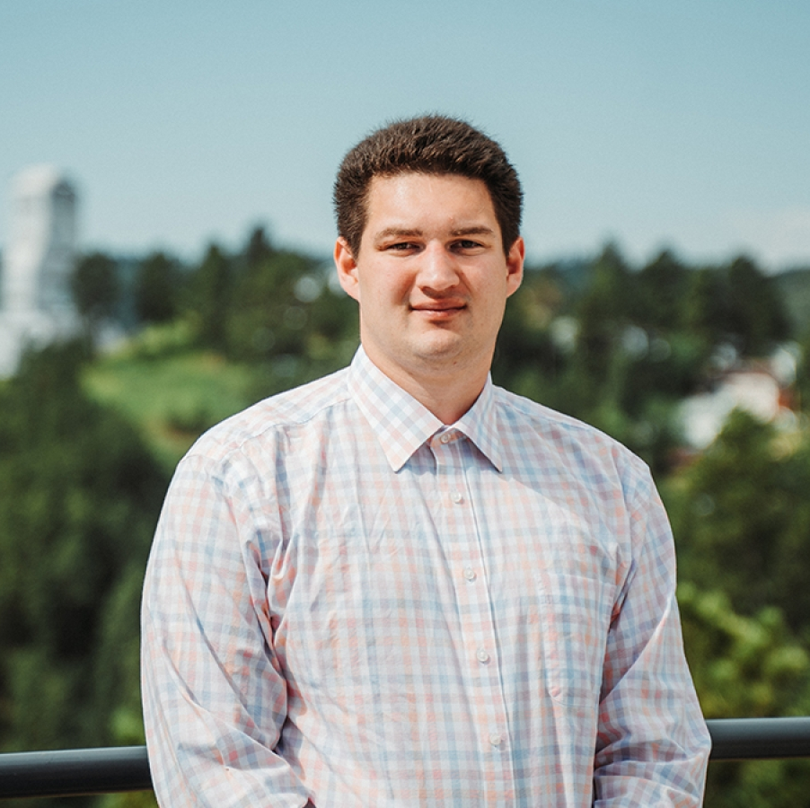
Supporting Our Future!
Curtis Petersen – Black Hills State University
Math Education Major – Earth Science Endorsement, Minor in American Indian Studies
Member of the Cheyenne River Sioux Tribe
2019 - Davis-Bahcall Scholar
2021 - REU program at BHSU
2022 – GEMADARC STEM exploration program
2022 - Summer Education Intern at SURF
2022 – Current Cultural Advisory Committee member
Future plans to return to home community and teach on the reservation

Slide 8
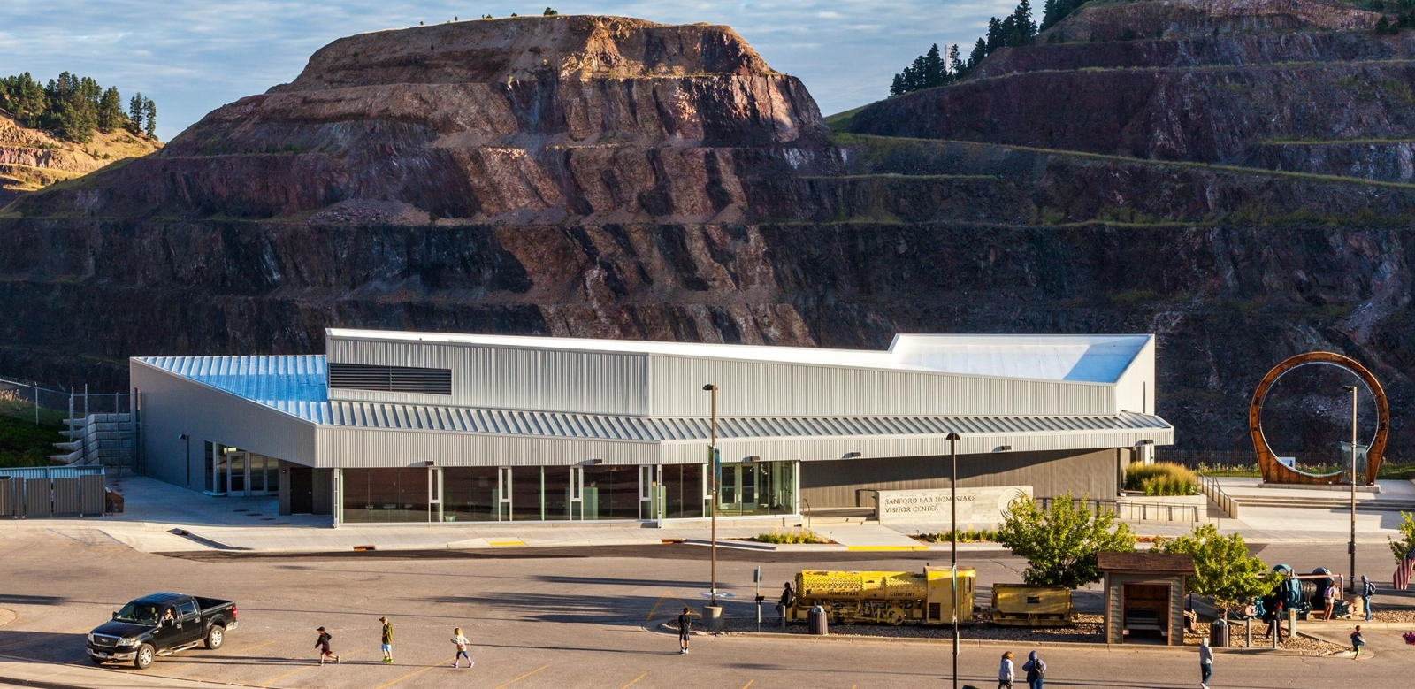
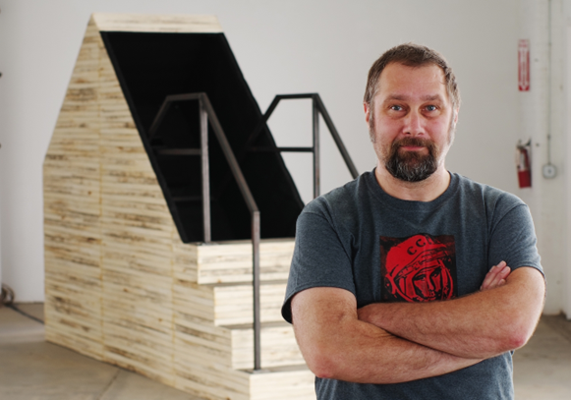
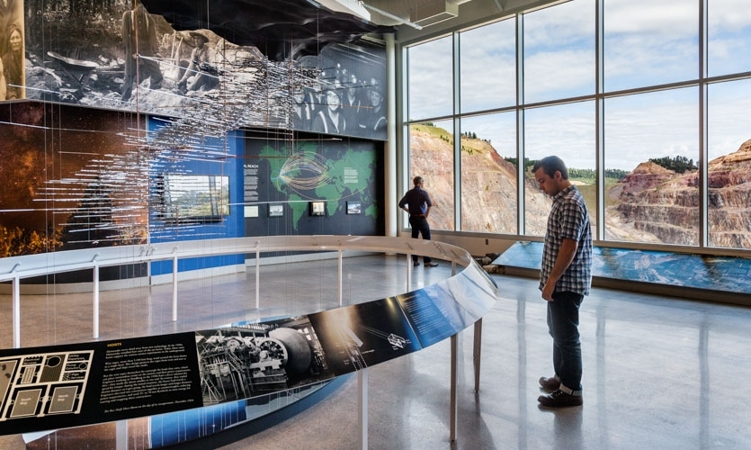
Sanford Lab Homestake Visitor Center & Public Outreach
SLHVC acquired January 7, 2022
Opportunities:
Amazing site for outreach & events
Deep Talks
Ask-A-Scientist
Interactive Pop-Ups
Inter-generational learning
Updating and creation of interactive exhibits
Other Public Events
Neutrino Day
Artist-in-Residence
Gary Sczerbaniewicz
Honor the Past
Showcase the Present
Inspire the Future
Deb Wolf | SURF User Association General Meeting October 26-27, 2022

Slide 9
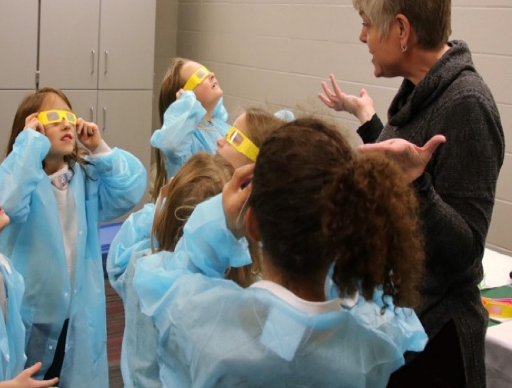
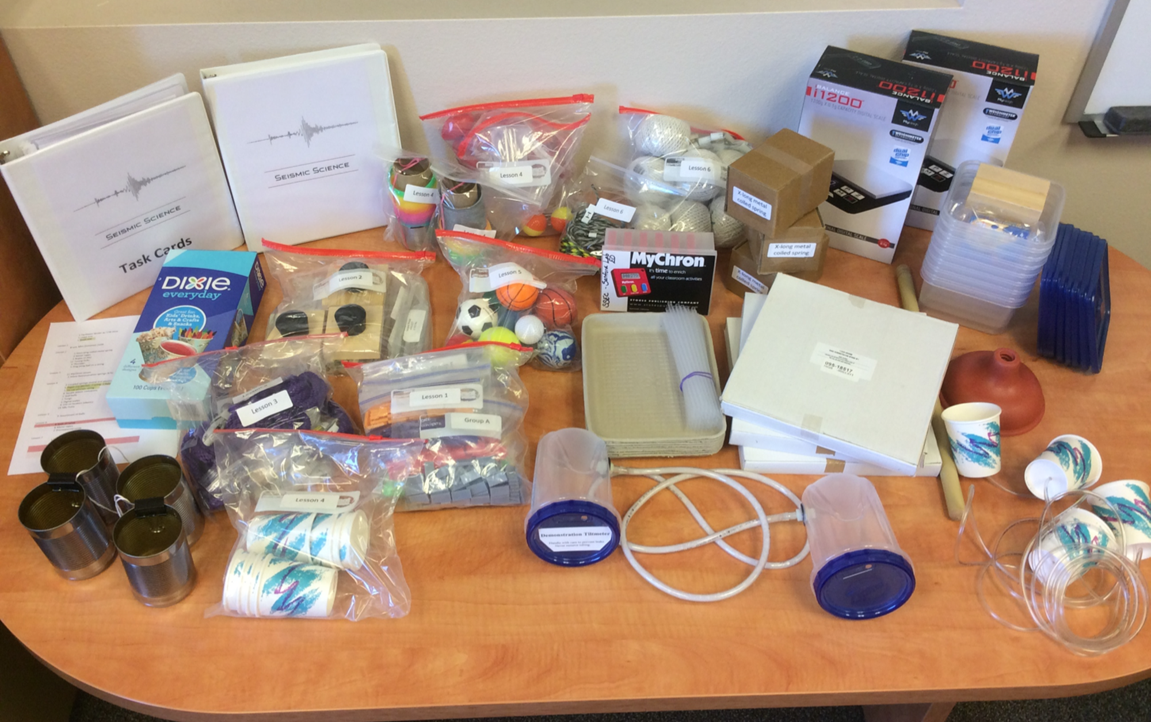
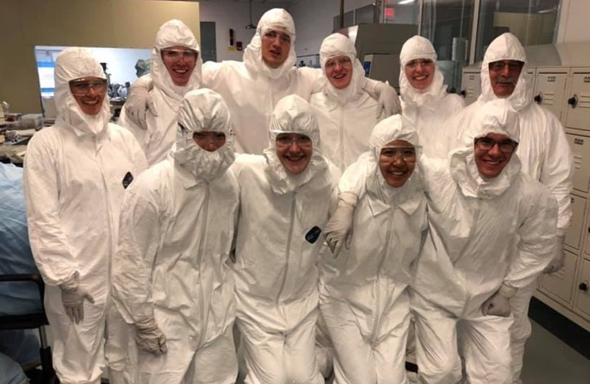
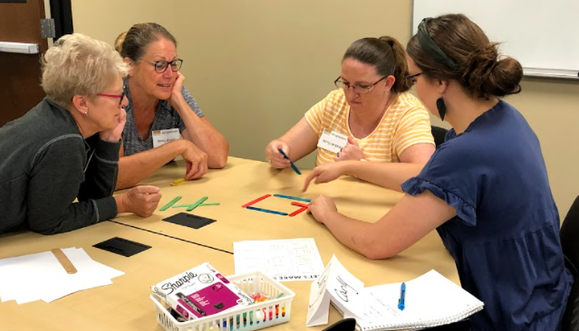
Education & Outreach: Scope of Work
Presentations & Field Trips | Curriculum Units and Resources | Career Exploration and Development | Supporting Teachers
K12 presentations Face to Face Virtual Options | 5-15 hours of fully designed and resourced science curriculum 17 unique curriculum units available for checkout | Davis-Bahcall Scholars Program Summer Internship Opportunities Pre-Service Educator Program Support | Professional Development Offerings Curriculum Resources Science Content Support Just-In-Time Support
Deb Wolf | SURF User Association General Meeting October 26-27, 2022
Notes:
I share this work with you because I want you to know that you are invited. You are invited to connect with our education and outreach team. They would love to learn from you – to build their capacity in better and more fully understanding the science and engineering research that is happening here. And, they would like to brainstorm with you…how do we translate the complexity of the kinds of questions that your research is trying to answer to something that is an approachable level of complexity and wonder to a middle school student?

Slide 10
Education and Outreach: By the Numbers
School Year | 2018-2019 (pre-COVID) | 2019 – 2020 (COVID begins) | 2020-2021 (during COVID) | 2021-2022
Field Trips | 1,117 | 254 | 58 | 485
Classroom Presentations | 6,704 | 3,704 | 2,005 | 14,038
Curriculum Units | 3,598 | 3,236 | 3,384 | 3,718
Other | 1,055 | 918 | 298 | 1,468
Total Student Contacts | 12,474 | 8,112 | 5,745 | 19,709
Provided professional development for nearly 1,000 educators over the past 2 years.
Deb Wolf | SURF User Association General Meeting October 26-27, 2022
Notes:
Update for as of May 30

Slide 11
Does SDSTA have an effective outreach and inclusion effort specifically designed to increase demographic diversity of its staff and the user community?
SDSTA recognizes that increasing demographic diversity is a complex challenge, that it is of critical importance, and that short-term fixes are not the answer. Increasing demographic diversity requires all departments – especially those that focus on outreach and people – all working collaboratively in service of this goal.
The E&O department addresses the challenge by focusing their efforts on growing the next generation of scientifically literate, engaged learners that value STEM and believe they are capable. The focus is on EVERY student.
The IDEA office addresses the challenge by nurturing trusting relationships with the nine Native Nations that occupy the same geography as SD. Additionally, promoting and supporting an inclusive work environment (with policies and practices in place to support), building leadership expertise in inclusive practices through manager training, all to ensure a welcoming environment where every individual belongs.
The Communications department addresses the challenge by providing many entry points for the community to connect with SURF – through Deep Talks, Neutrino Days, the AiR program, and many others.
The SLHVC is a new opportunity for SURF to connect with the community, to celebrate the cultures that intersect in this place and space, and to offer a unique venue for learning together.
Deb Wolf | SURF User Association General Meeting October 26-27, 2022

Slide 12
Questions?
Deb Wolf | SURF User Association General Meeting October 26-27, 2022

