Slide 1
Communications
Constance Walter, Communications Director
Sanford Underground Research Facility
‘America’s Underground Science Laboratory’
Cultural Advisory Committee, Nov. 18, 2021

Slide 2
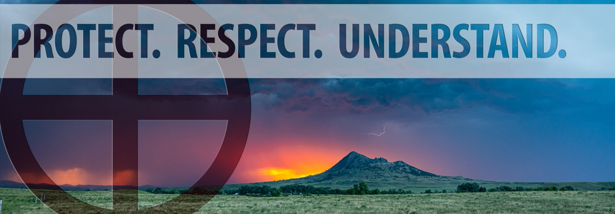
Working with SURF Foundation to continue promotion efforts of the Sacred Circle Garden.
Updating the Sacred Circle Garden web page.
Developing one-page handout for promotional purposes.
Corrections:
Communications reshot the Sacred Circle Garden video to correct mispronunciation of Cangleska Wakan.
Removed image of prayer bundles from Sacred Circle Garden webpage.

Slide 3
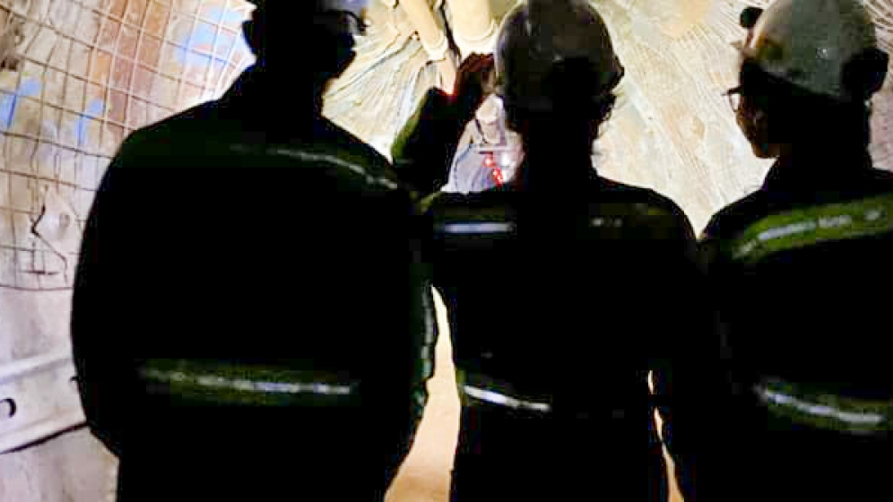
Davis-Bahcall, Internships
Updated webpage and application process
Developing ads for Native news outlets in South Dakota

Slide 4
New website and marketing strategy
Website
Currently reviewing proposals to build a new website.
Features:
Accessibility commitment (508 compliance)
Robust Education and Outreach page
Registration for teacher PD
Digital curriculum modules (educators can log in and check out units)
Updated Foundation page
Create a unique page designed for fundraising
Inclusion, Diversity, Equity and Access page
Marketing strategy
Strengthen SURF brand and promote globally and locally
Promote SURF science, E&O and the Foundation
Relationship building with diverse communities
Develop advertising for Native media outlets
Notes:
508 compliance: website standards that allow people with disabilities to use our website.

Slide 5
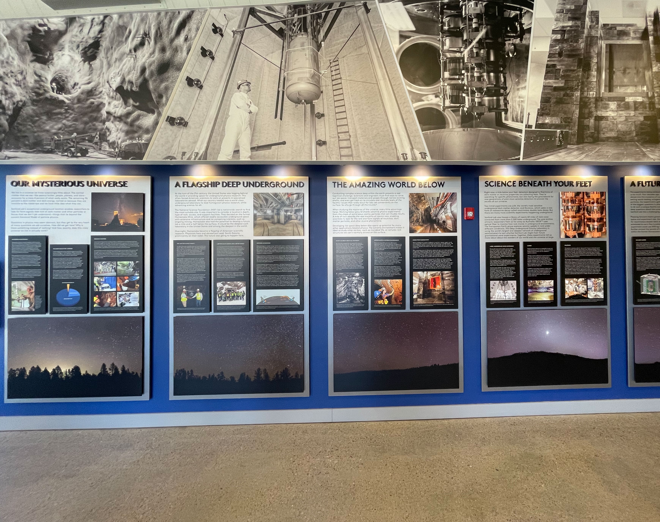
SLHVC Exhibit Updates
Science panels:
Updated text: wall panels and mine model info panels
New images to highlight progress on experiments
Future projects
Vestibule
New videos
Rail around mine model
Visiting/moveable exhibits?
Exploring ways to incorporate more information about Indigenous Peoples of the region.

Slide 6
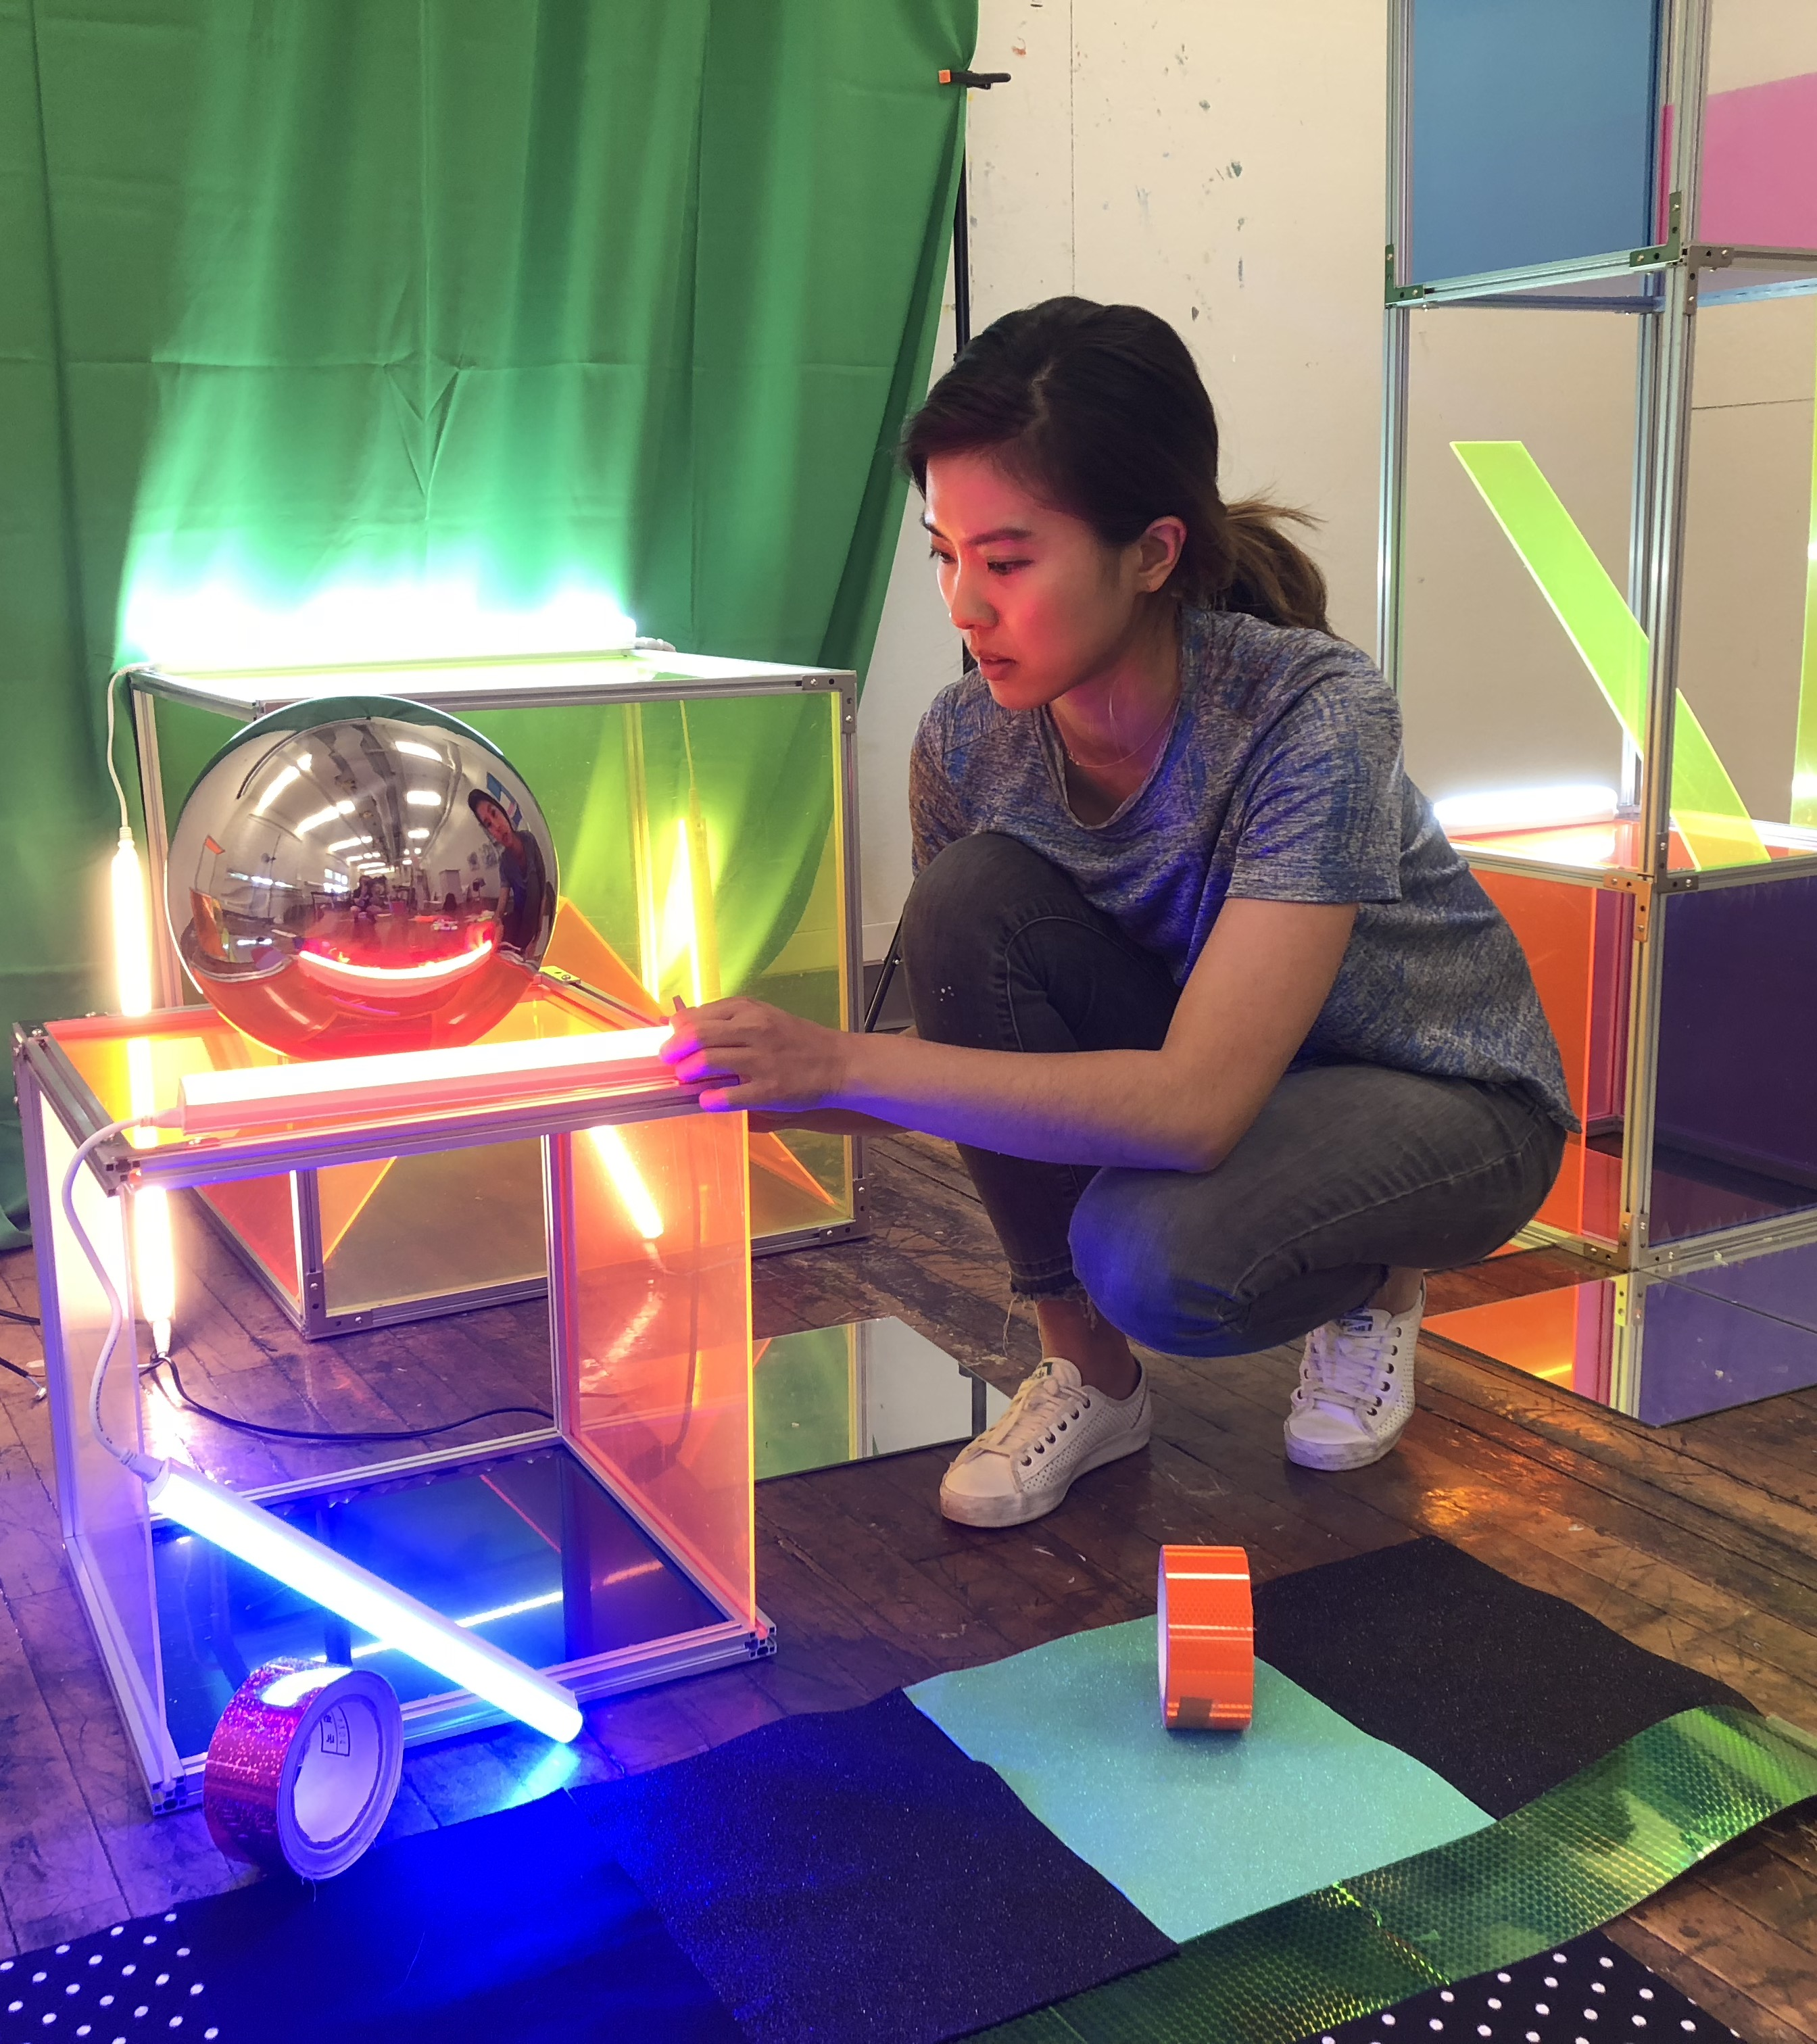
SURF Artist in Residence. Exhibit in October 2021 at Lead-Deadwood Arts Center.

Slide 7
Interactions Collaboration
“Conscious Language”
Kathryn Jepsen, editor of Symmetry Magazine, working on a style guide for science communicators
Focuses on inclusive language, critical thinking and compassion when discussing/writing about (not a complete list):
Marginalized communities
Underrepresented groups
Gender
Pronoun usage
Ethnicity
Disabilities
Sexual orientation
Culture
Language

Slide 8
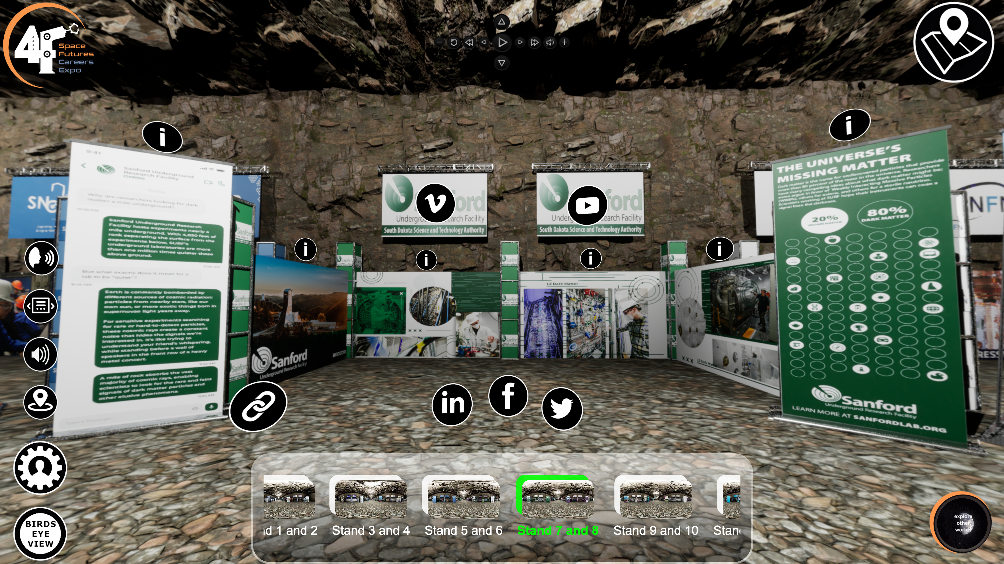
Interactions International Dark Matter Day
SURF activities: Deep Talks and Space Expo
13 institutions/experiments and 29 countries
Notes:
Comms serves on International DMD planning committee
Spring: Sacred Circle Garden: the botany and medicine wheel

Slide 9
Neutrino Day 2022
Notes:
Working on contract with potential speaker
Seeking input from the CAC on finding a Native speaker working in the sciences

