Slide 1
Cultural Advisory Committee Update: E&O
Peggy Norris
November 12, 2021

Slide 2
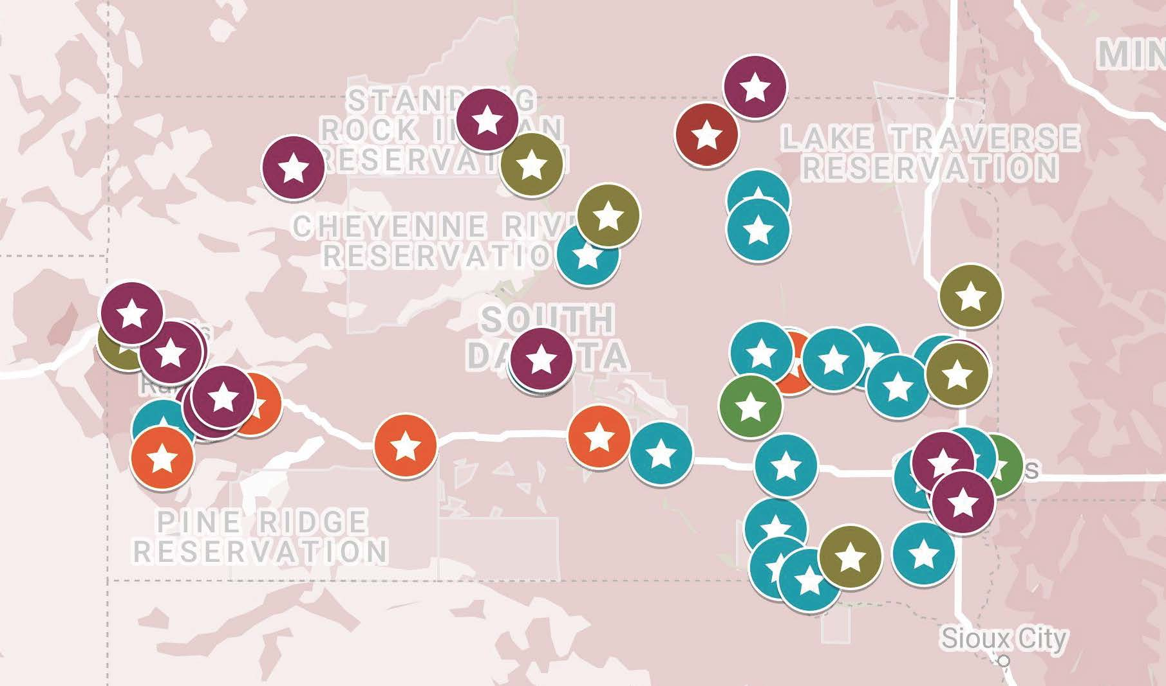
K-12 Students
Notes:
Talking Points:
Trip this past week
Differences between the schools
What they need

Slide 3
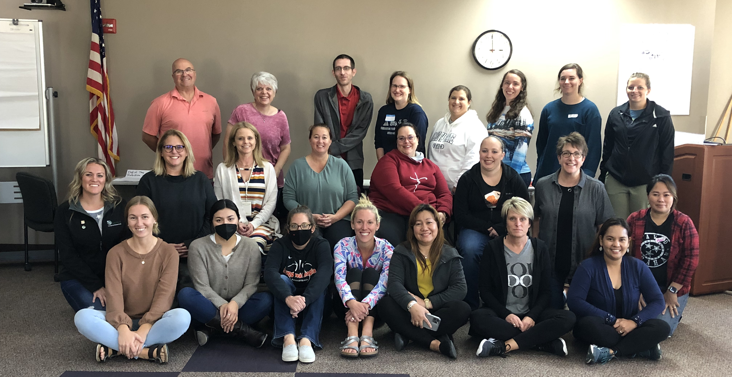
South Dakota Teachers
SDMath/SDSci Cohort 5 – 9/2021
Notes:
Talking points:
Our PD teachers transitioning to leadership
Loneman teachers
Lakota Tech teacher

Slide 4
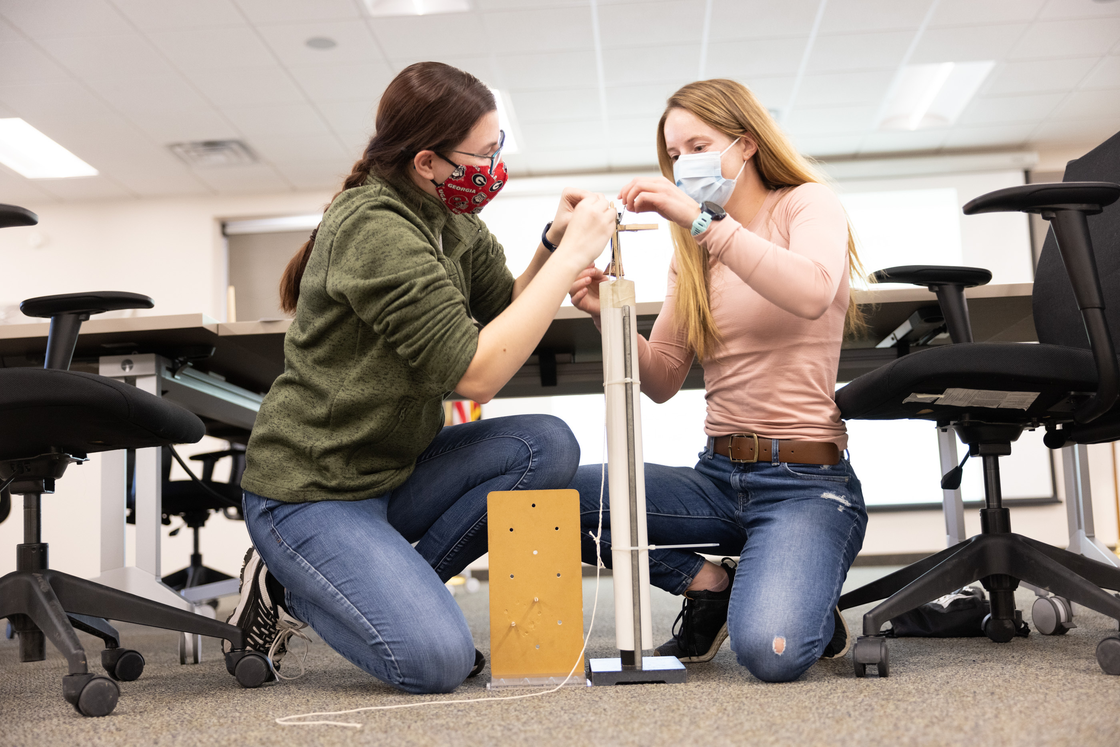
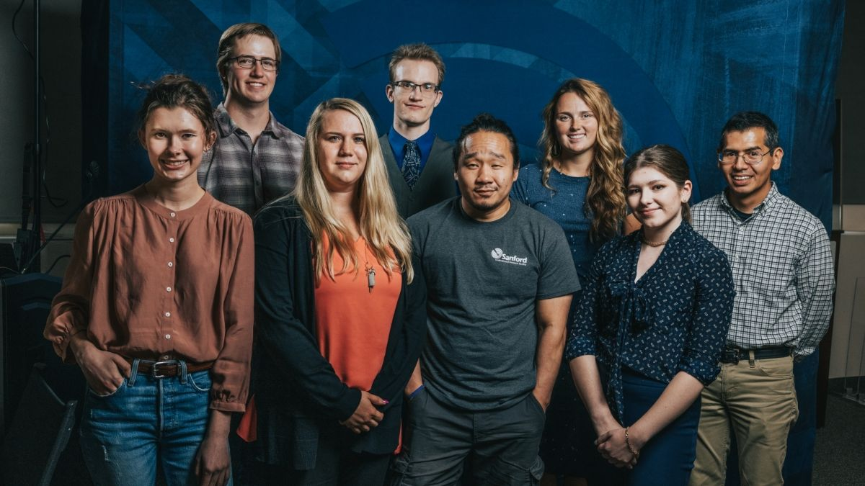
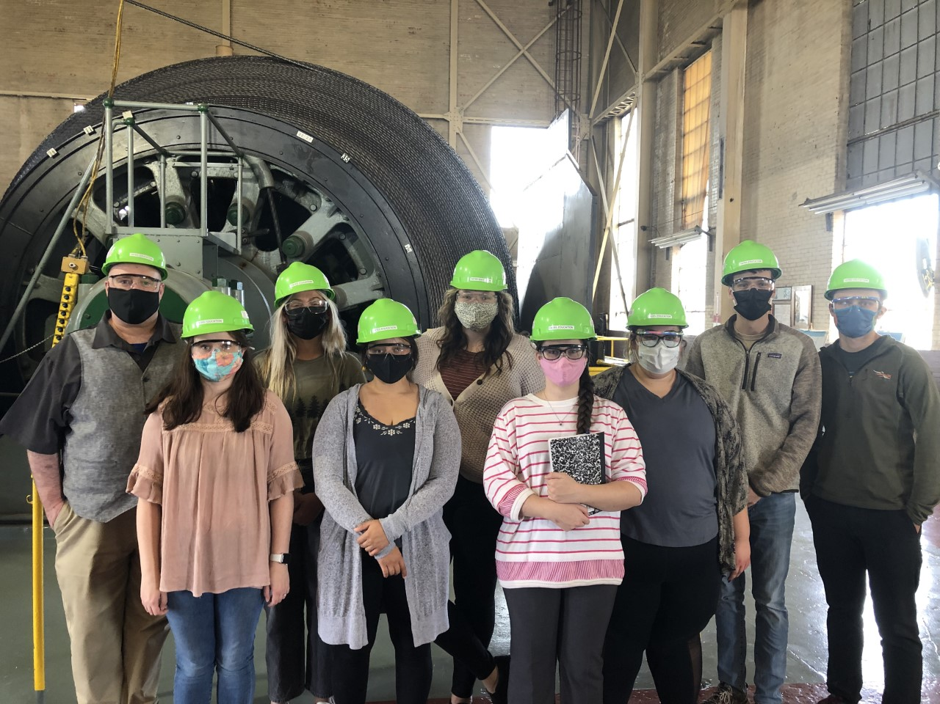
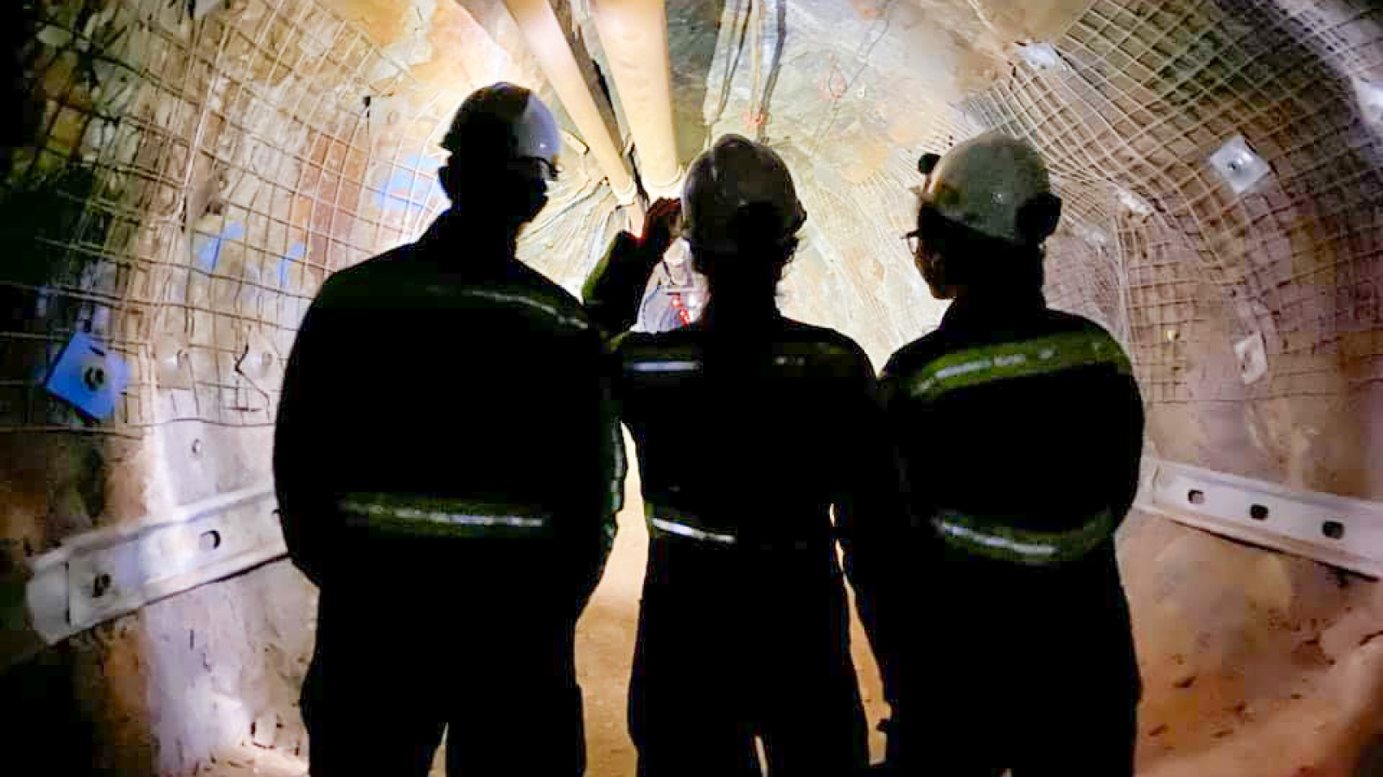
Post-secondary
Notes:
Talking points:
Continued success of D-B and Internship programs
New efforts to serve preservice teachers

