Slide 1
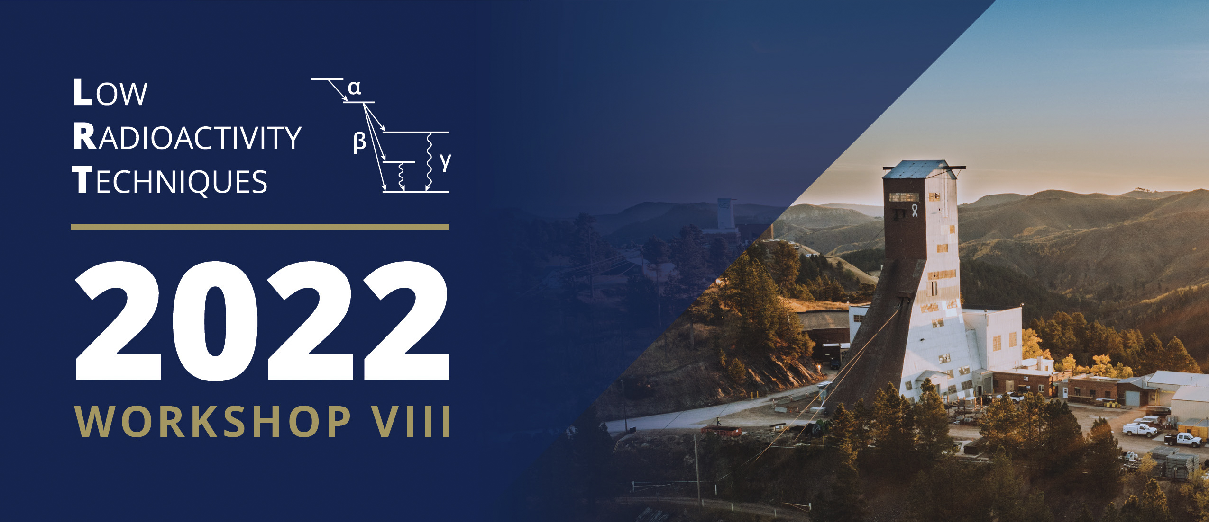
LRT2022 Closeout
Co-Hosted by SD Mines & SURF

Slide 2
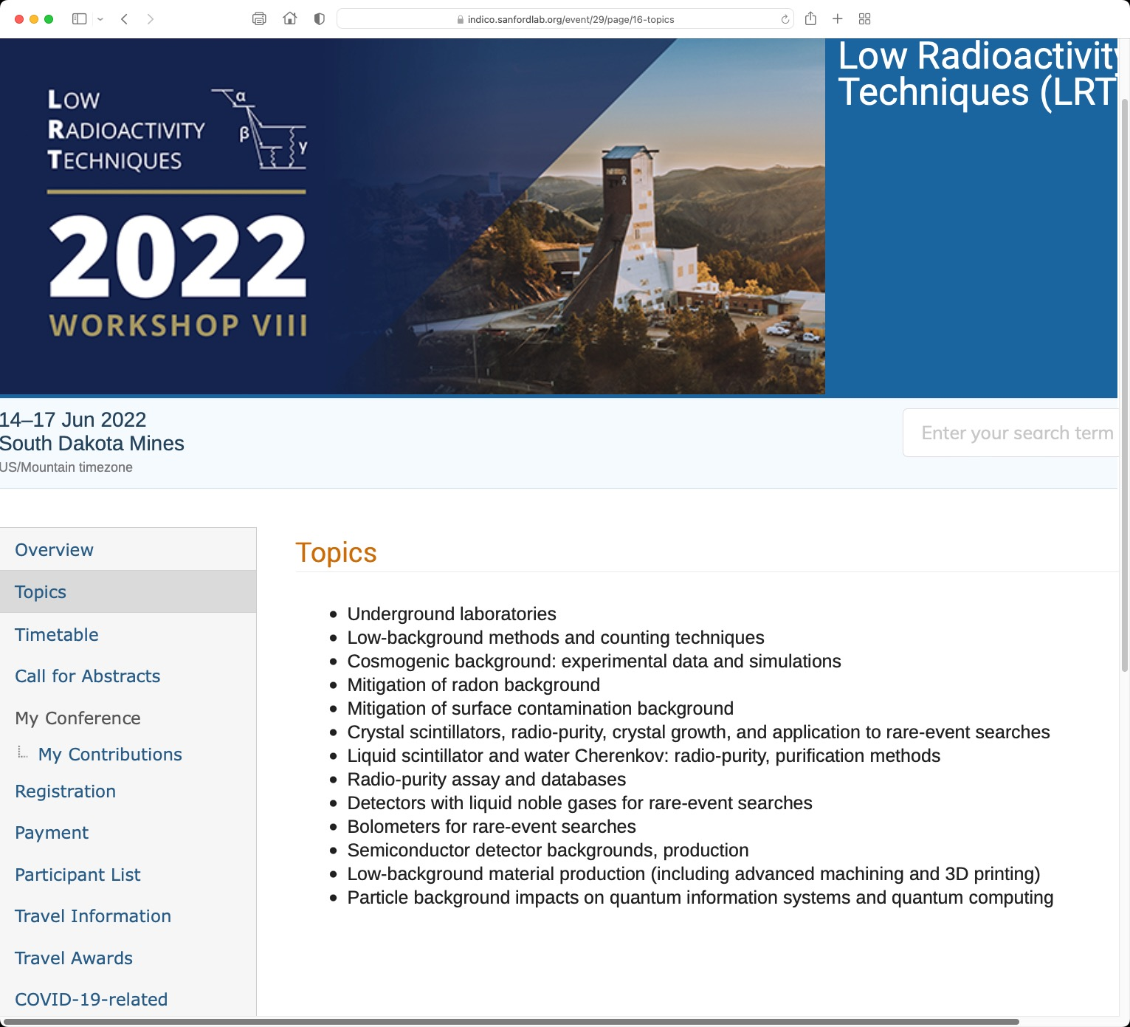
LRT2022 – Topics
Congrats SUPL!
(And Yemilab this summer!)
Also: Stanley Howard rembrance
8th Workshop on Low Radioactivity Techniques June 14-17, 2022
2

Slide 3
LRT – Recent Years
 | 2022 Rapid City, USA | 2019 Jaca, Spain | 2017 Seoul, South Korea | 2015 Seattle, USA | 2013 Assergi, Italy
Participants | 88 | 96 | 68 | 118 | 83
Presentations | 74 | 75 | 65 | 72 | 65
Talks | 53 (1020 min) | 66 (1390 min) | 53 (1060 min) | 51 (1020 min) | 40 (840 min)
Posters | 21 | 9 | 12 | 21 | 25
Excursions | SURF (44); Rushmore/ Badlands/ Custer (~55) | LSC; Train Station, Castle | Y2L | N/A | LNGS
…
8th Workshop on Low Radioactivity Techniques June 14-17, 2022
3
Notes:
Average participants past 4 years prior to LRT2022: 91.25
Average # presentations past 4 years prior to LRT2022: 69.25

Slide 4
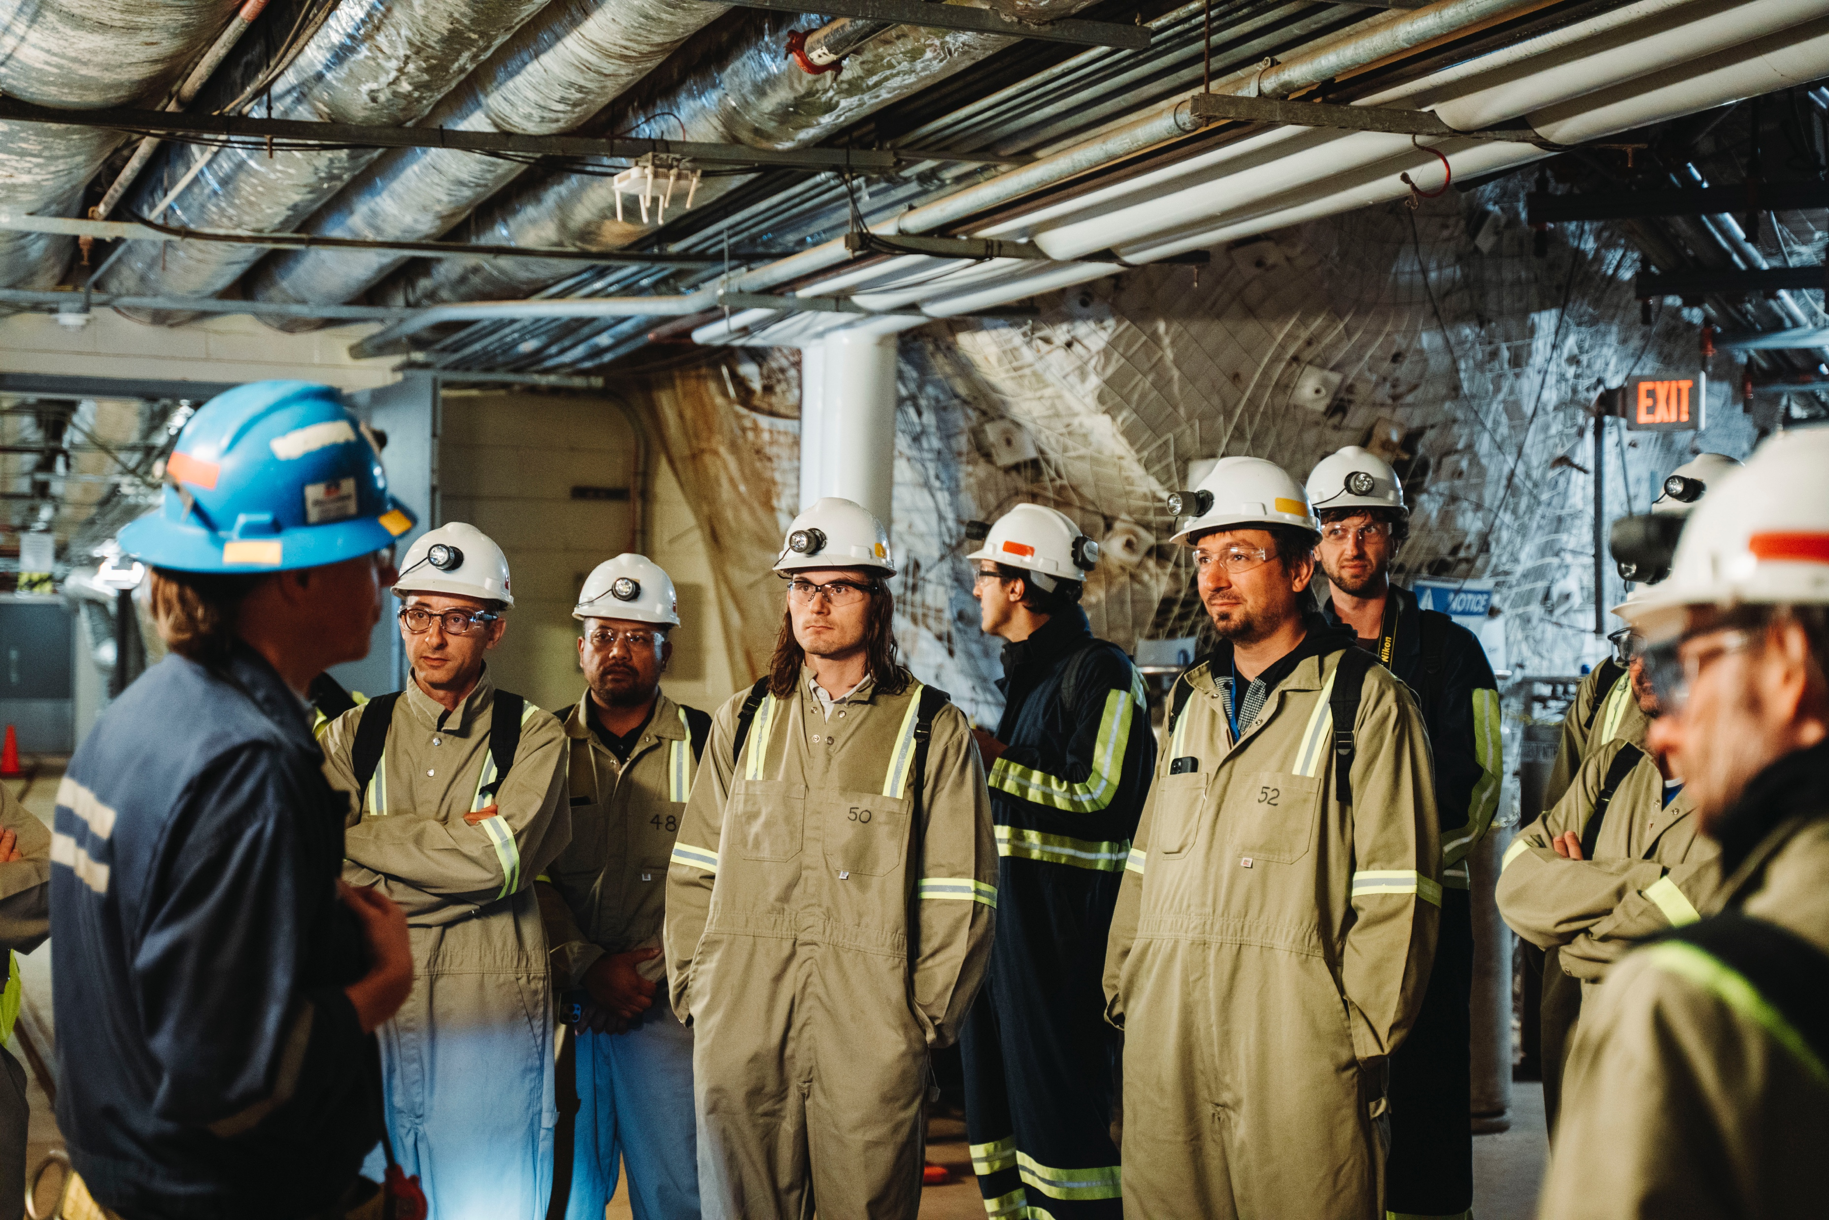
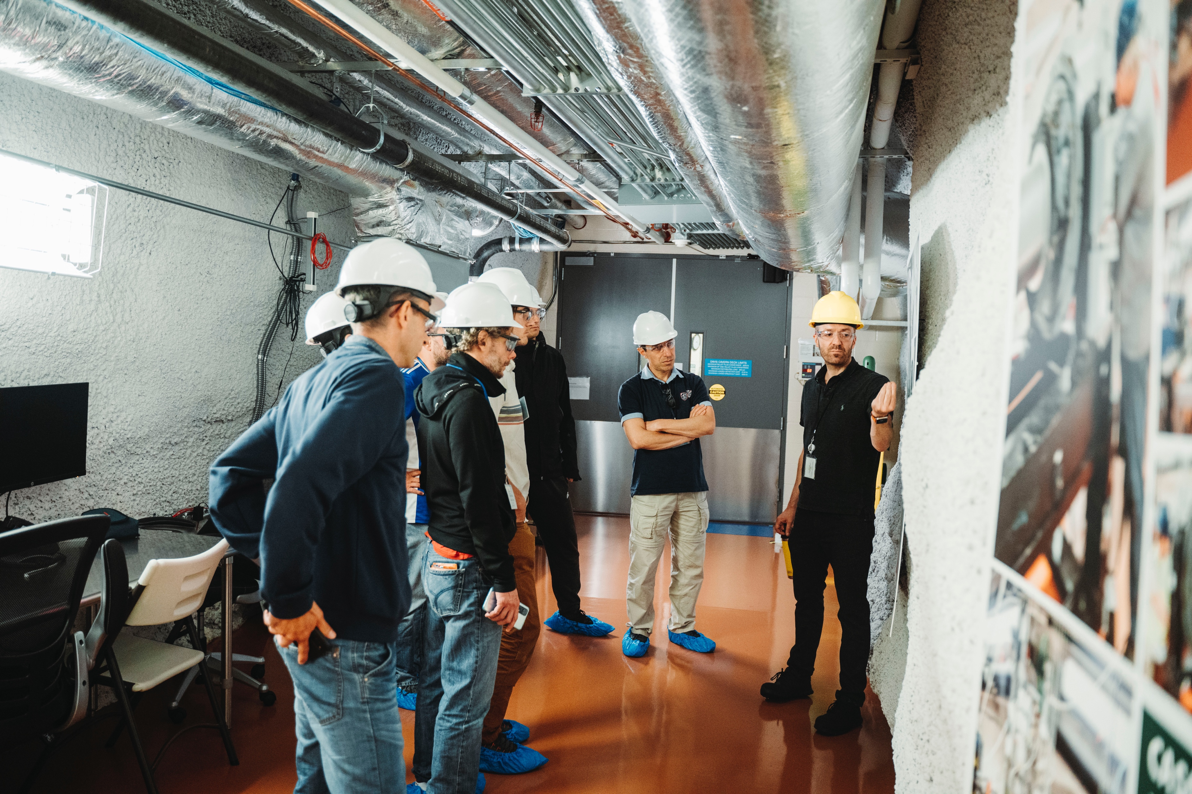
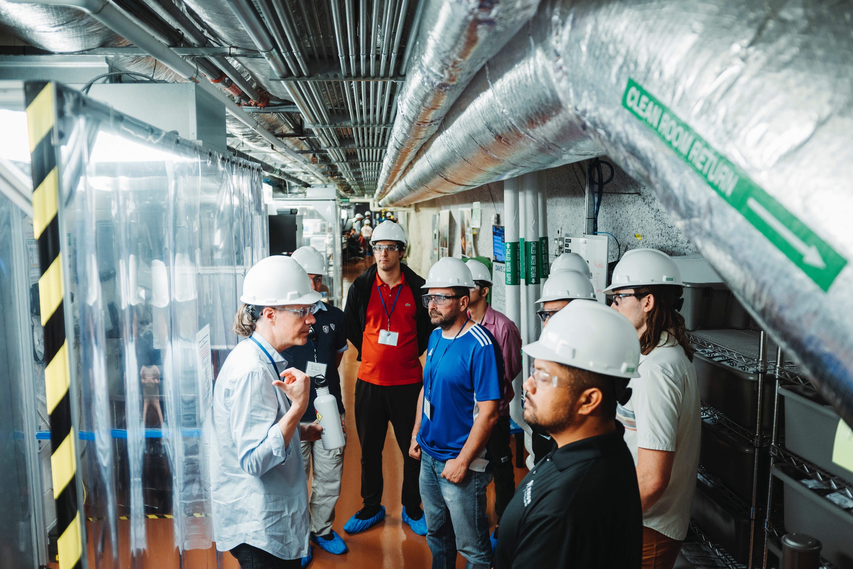
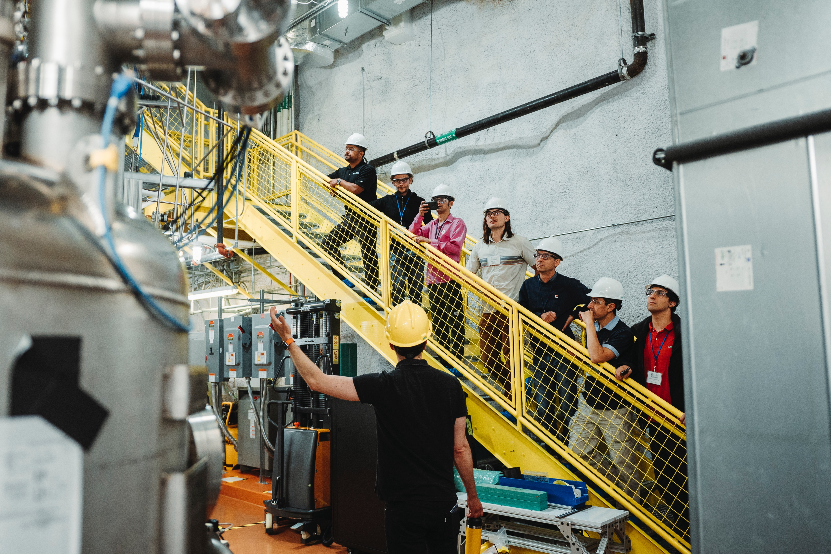
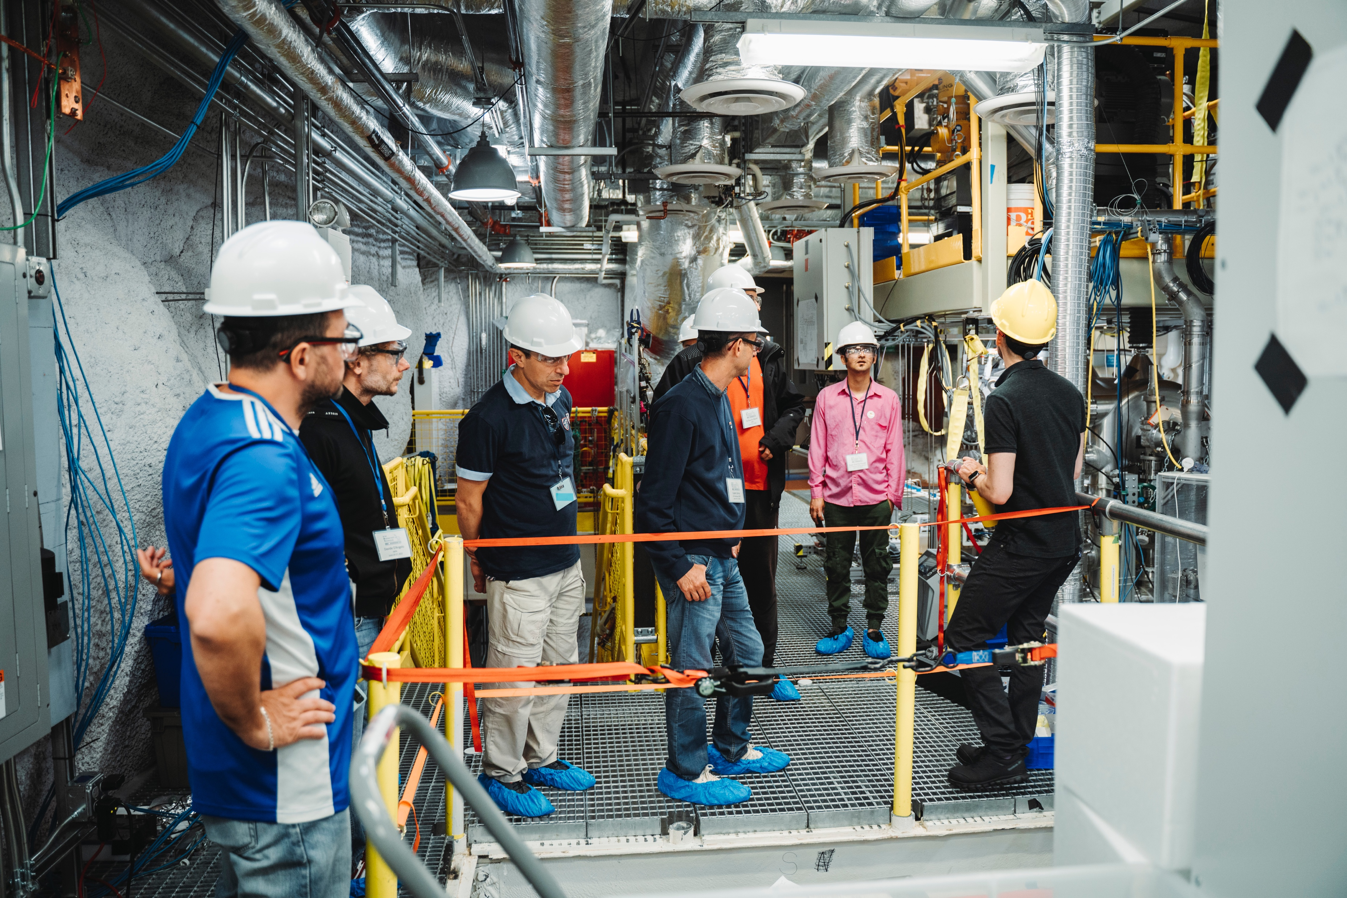
LRT2022 – SURF Tours
8th Workshop on Low Radioactivity Techniques June 14-17, 2022
4

Slide 5
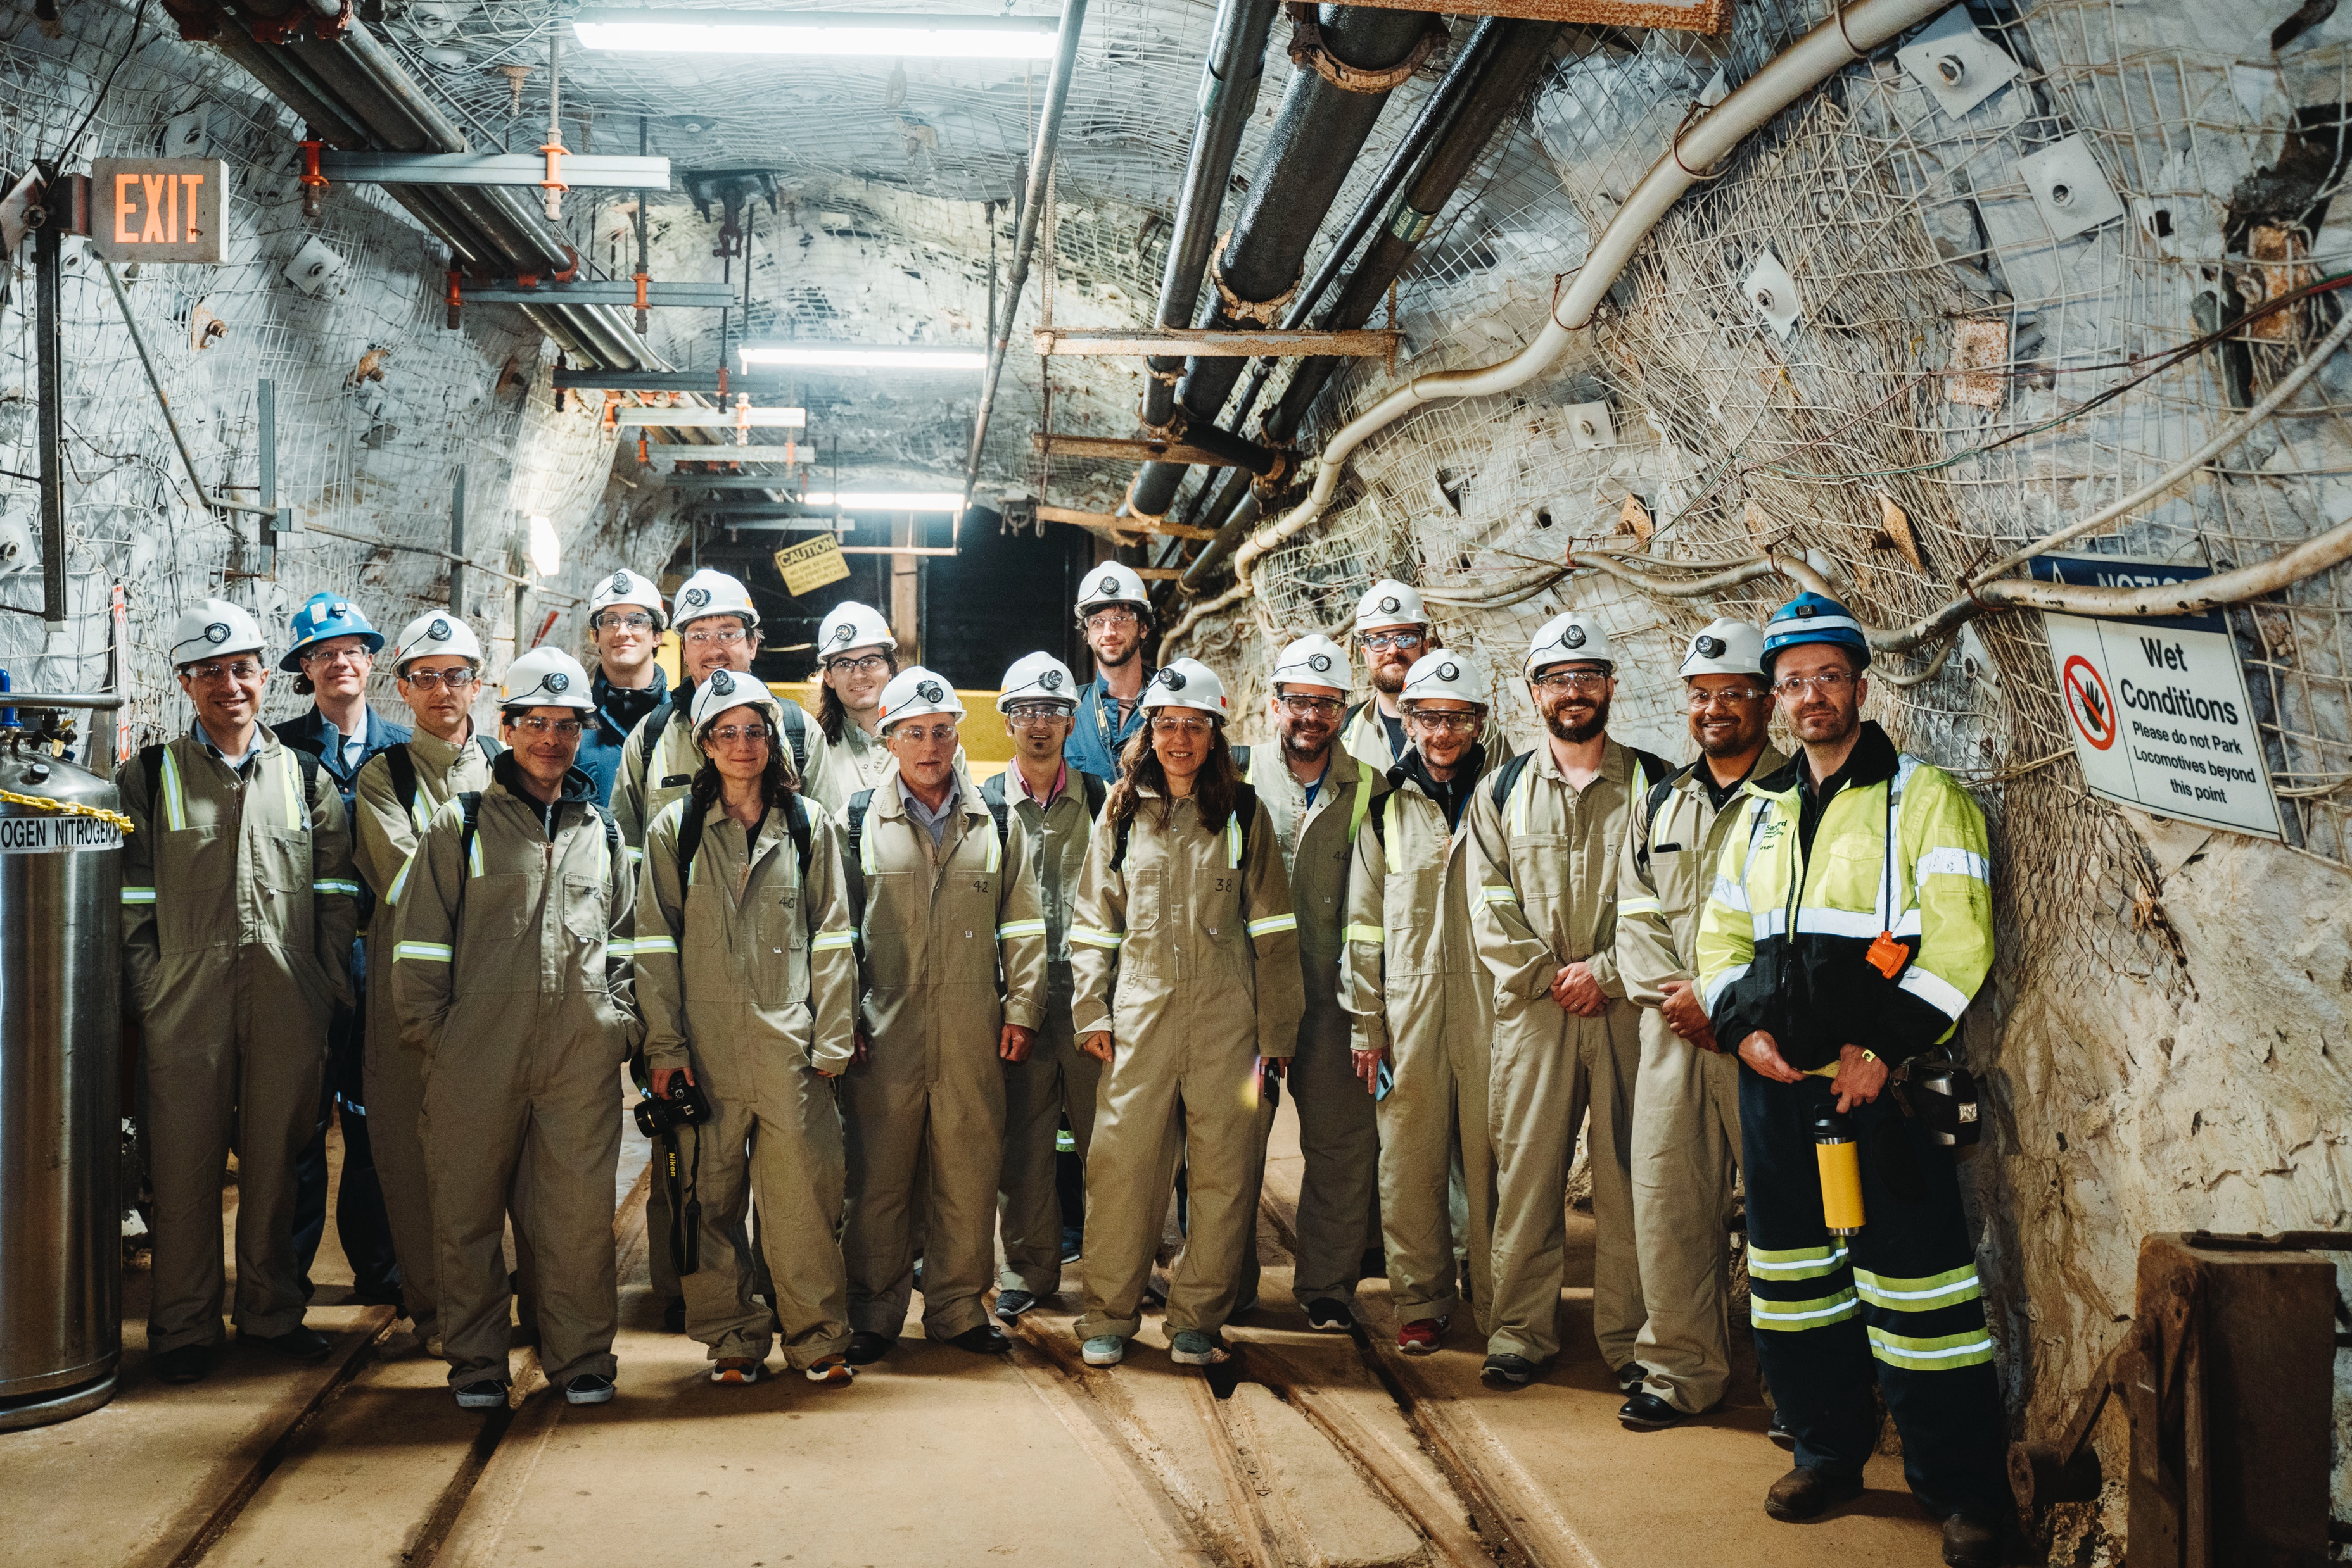
LRT2022 – SURF Tours
8th Workshop on Low Radioactivity Techniques June 14-17, 2022
5

Slide 6
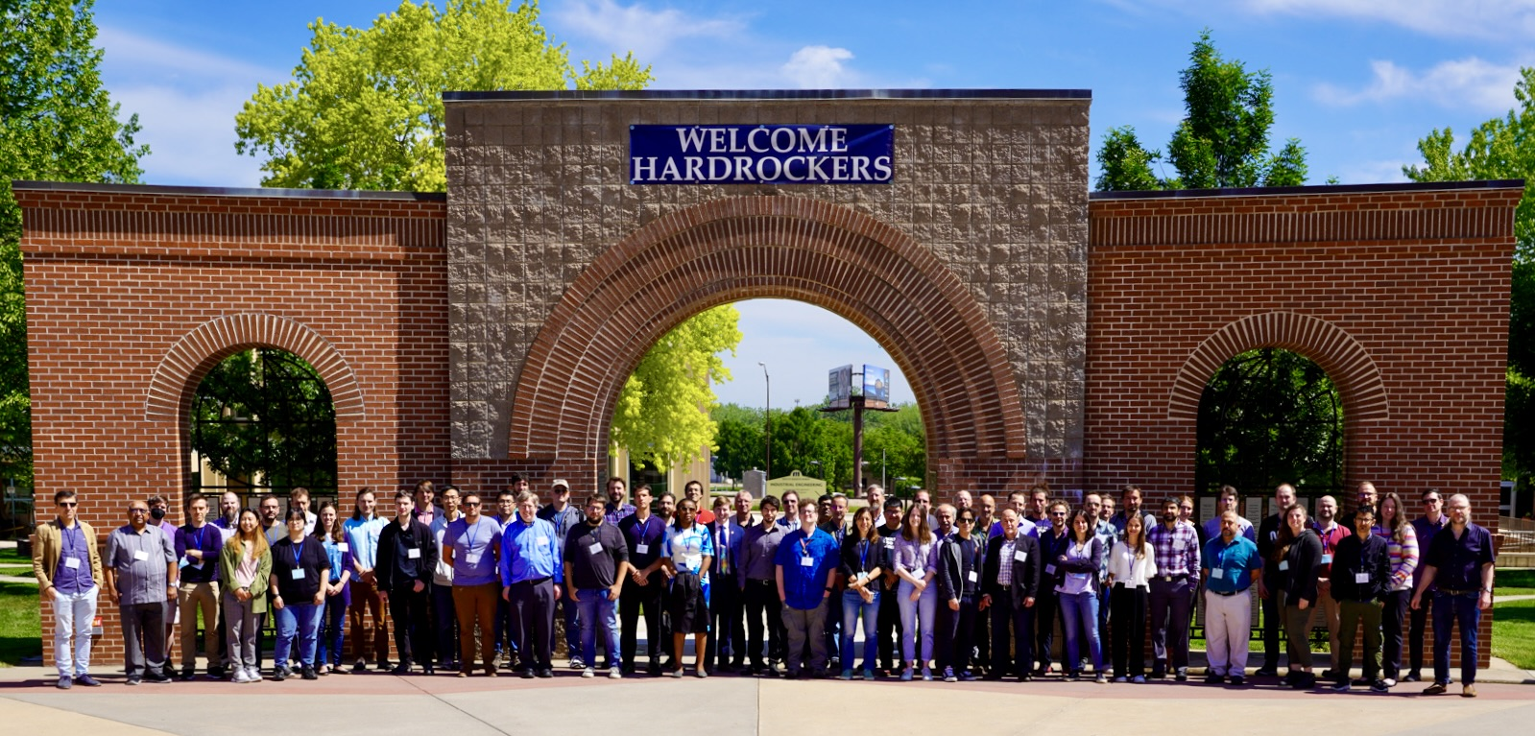
LRT2022 – Workshop Photo
8th Workshop on Low Radioactivity Techniques June 14-17, 2022
6

Slide 7
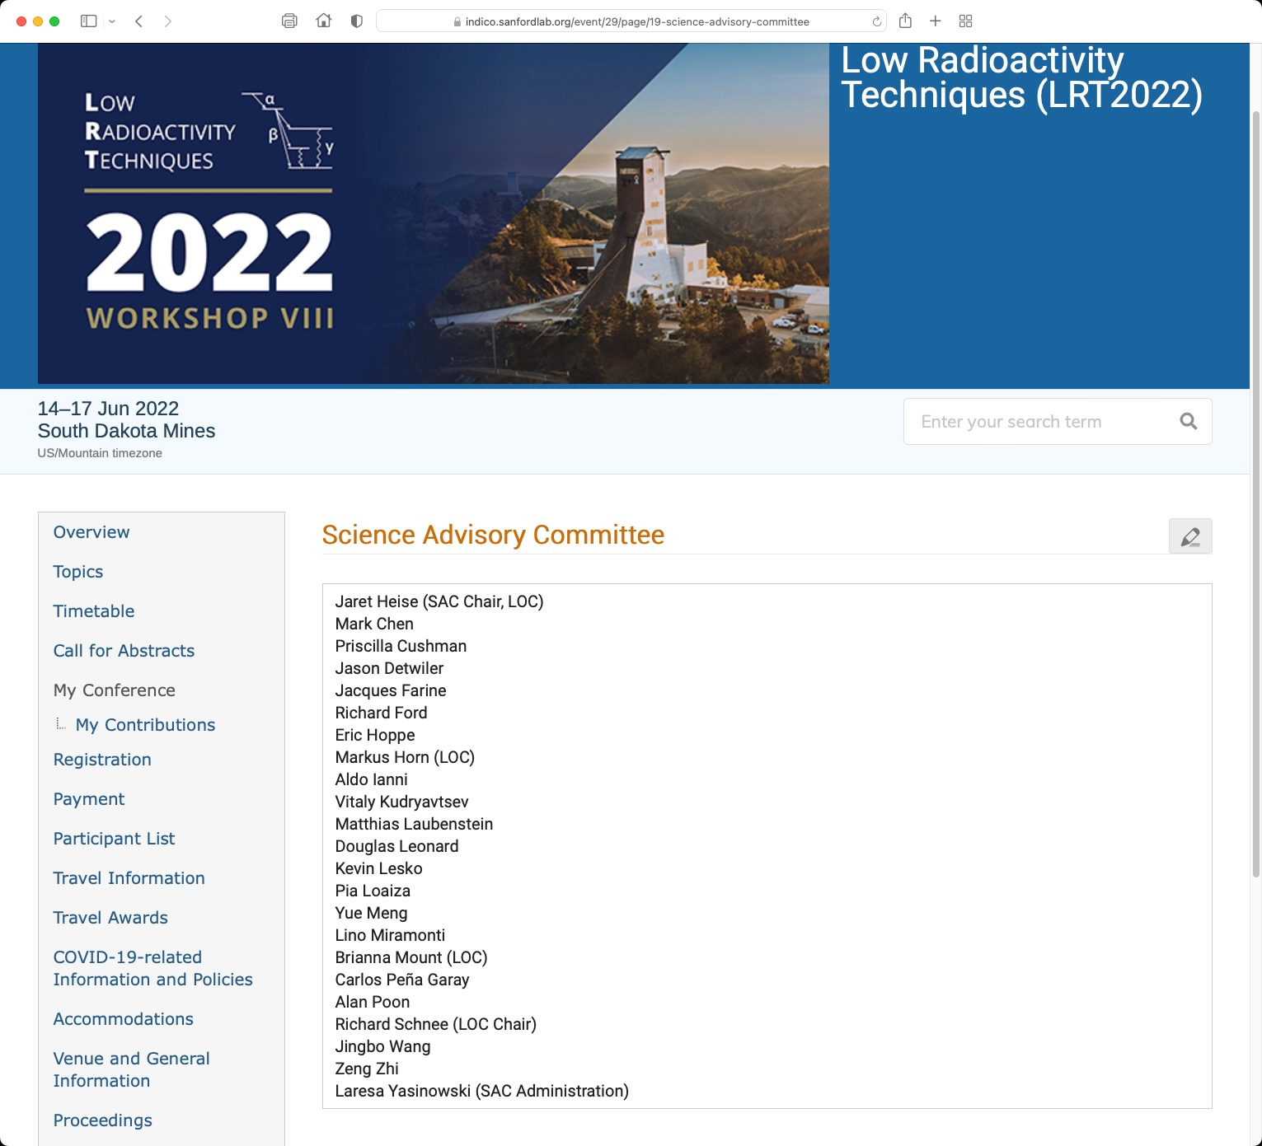
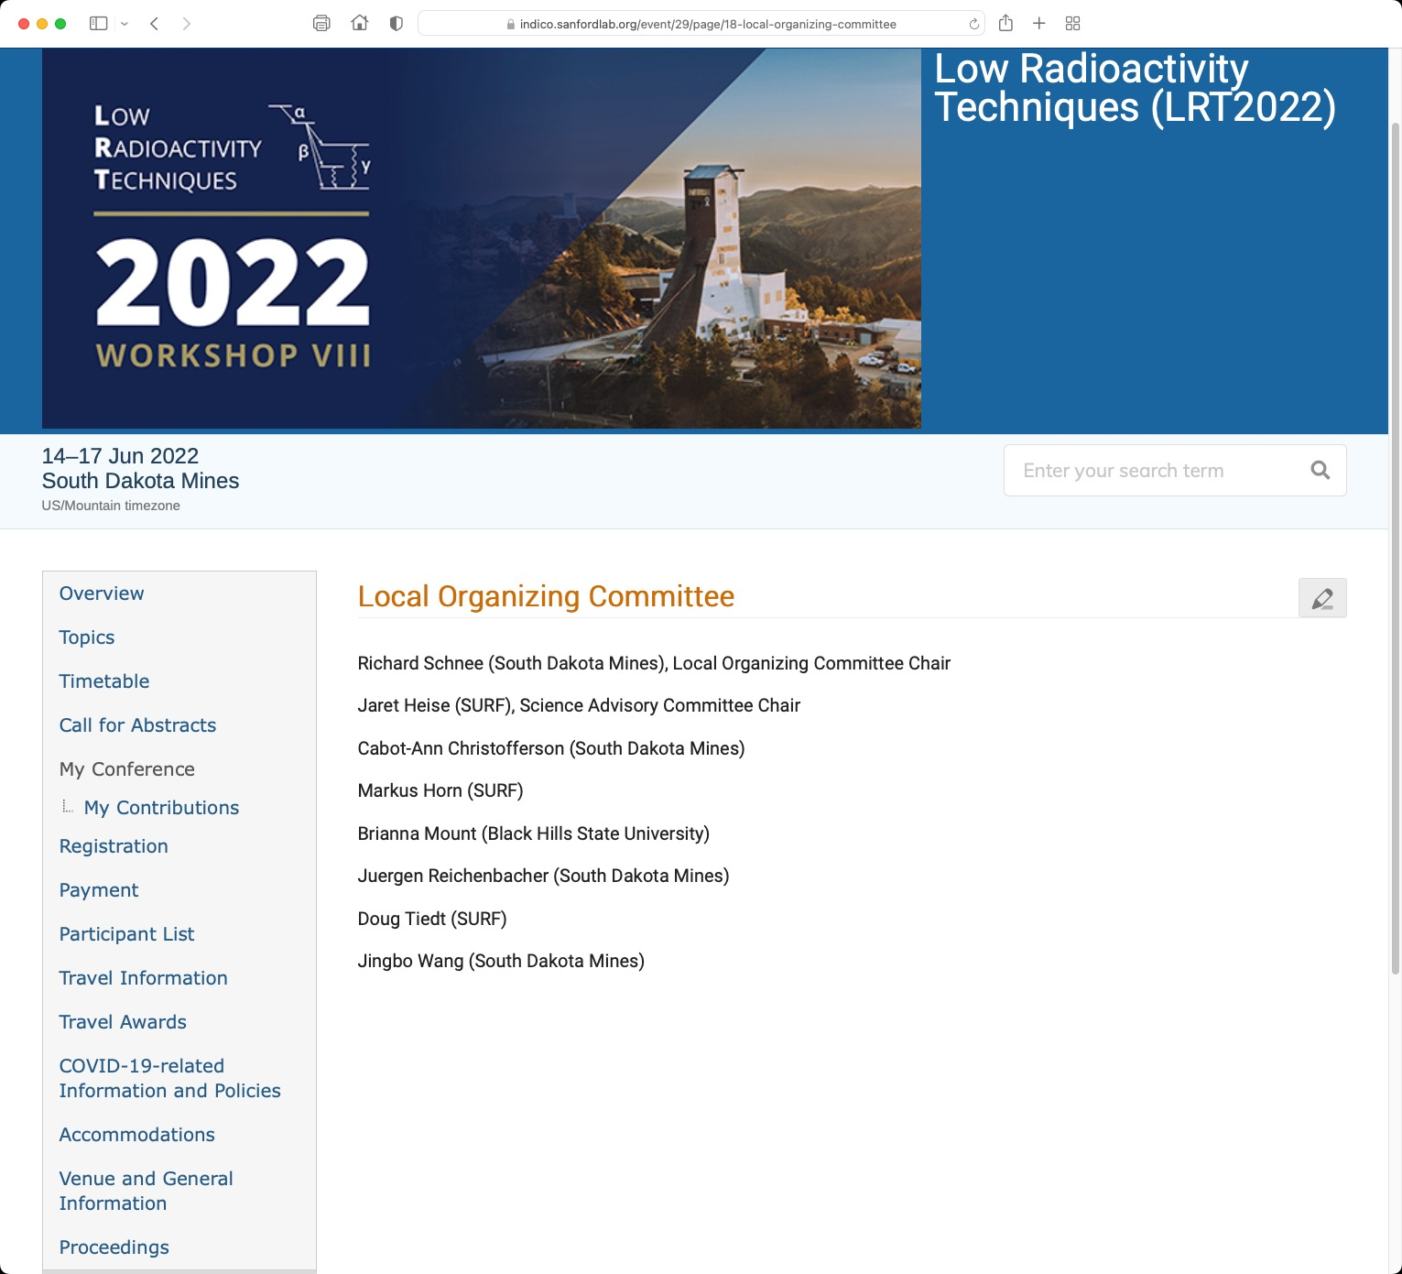
LRT2022 Help – Committees
8th Workshop on Low Radioactivity Techniques June 14-17, 2022
7

Slide 8

LRT2022 Help – SD Mines + SURF
SD Mines
Acharya, Khimananda
Dowding, Michael
Finnesand, Dane
Genovesi, Jack
Haiston, James
Haque, Nurul
Johnson, Walker
Kadlecek, Thomas
Krosschell, Connie
Lama, Bhubnesh
Leon Siverio, Diana
Lindsey, Stephanie
Rodriguez, Jairo
Schleich, Sam
Sharma Timalsina, Madan
White, Paul
Wykoff, Kevin
SURF
Berry, Amanda
Hanhardt, Mark
Hansen, Ashley
Hockhalter, Jay
Johnston, Melissa
Knight, Chad
Knight, Mandy
Olsen, Calvin
Varland, Robyn
8th Workshop on Low Radioactivity Techniques June 14-17, 2022
8

Slide 9
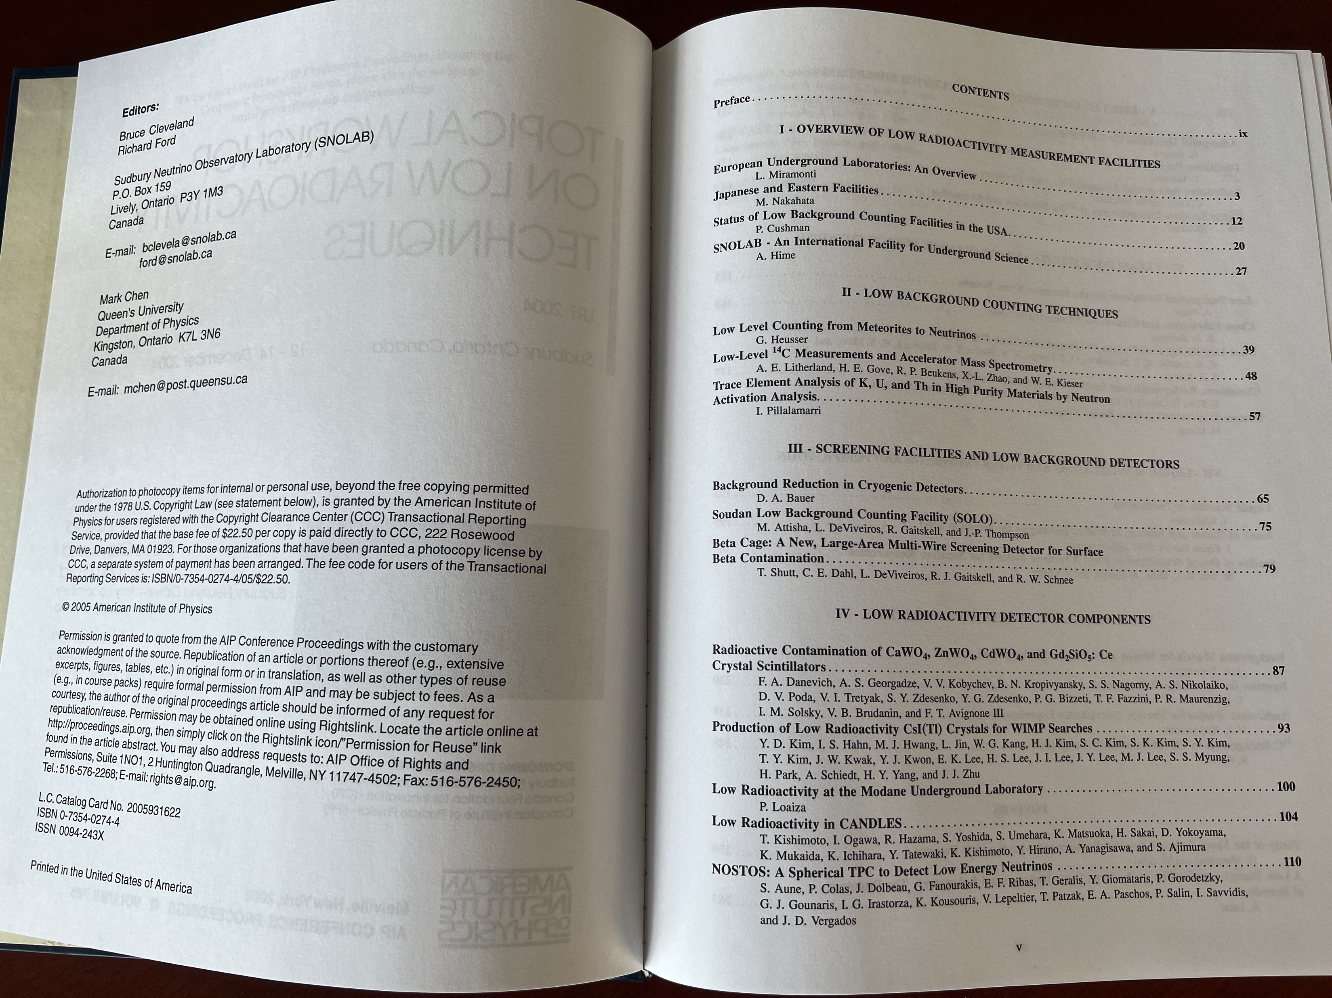
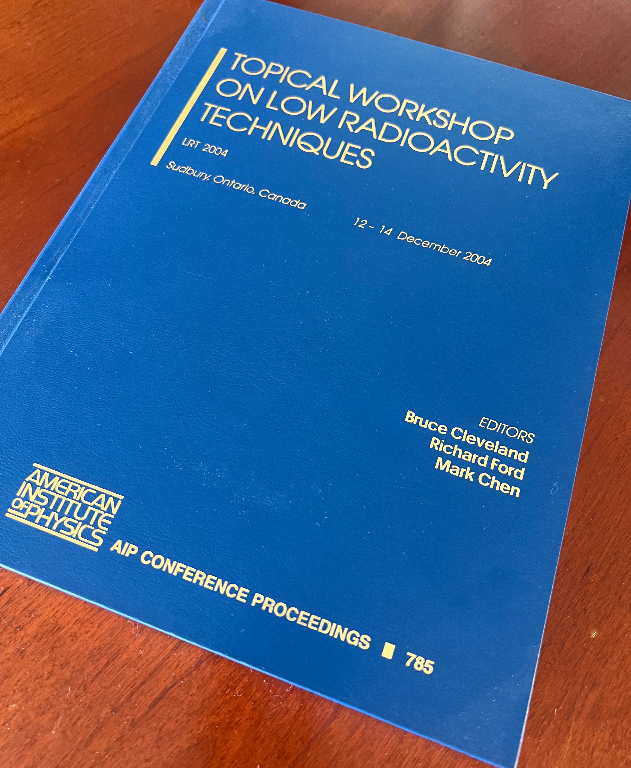
LRT2022 Next Steps – Proceedings
8th Workshop on Low Radioactivity Techniques June 14-17, 2022
9

Slide 10
LRT2022 Next Steps – Proceedings
Schnee LRT message Jun 11:
It is not too early to be thinking about the workshop proceedings. Based on the results of our registration survey, which indicated over 70% of registrants favored our having refereed proceedings, we have decided to have refereed proceedings. The expectation will be that each paper author whose rank is post-doc or higher will referee two other papers. In order to publish the proceedings in a timely manner, we would like paper submissions by July 29, 2022, with the goal of completing the refereeing process by the end of August.
Stay tuned for more information…
8th Workshop on Low Radioactivity Techniques June 14-17, 2022
10

Slide 11
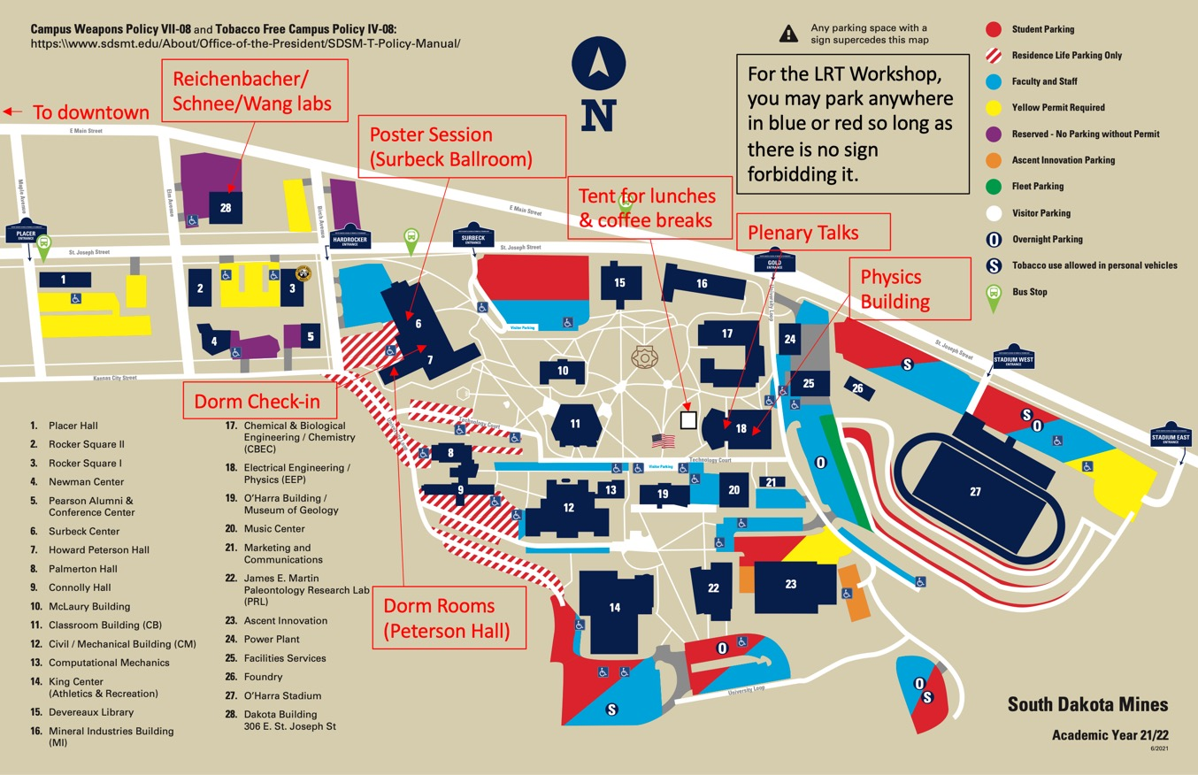
LRT2022 – SD Mines Physics Lab Tour (~Now)
8th Workshop on Low Radioactivity Techniques June 14-17, 2022
11

