Slide 1
The nEXO Background Control Program
A. Piepke
University of Alabama
For the nEXO background control and analysis teams

Slide 2
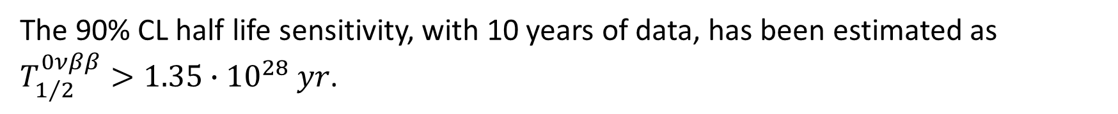
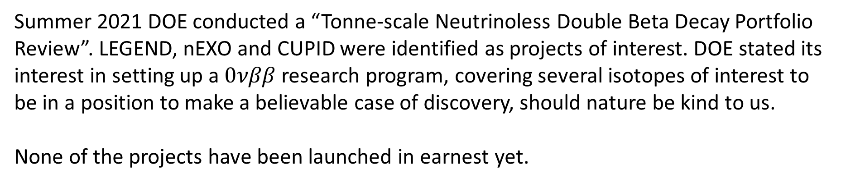
Introduction
nEXO is a planned next-generation search for $0νββ$ decay of ¹³⁶Xe.
nEXO plans to utilize 5000 kg of isotopically enriched liquefied xenon (90% ¹³⁶Xe).
The 90% CL half life sensitivity, with 10 years of data, has been estimated as $T_{1/2}^{0νββ}>1.35∙{10}^{28} yr$.
Summer 2021 DOE conducted a “Tonne-scale Neutrinoless Double Beta Decay Portfolio Review”. LEGEND, nEXO and CUPID were identified as projects of interest. DOE stated its interest in setting up a $0νββ$ research program, covering several isotopes of interest to be in a position to make a believable case of discovery, should nature be kind to us.
None of the projects have been launched in earnest yet.
G. Adhikari et al., J. Phys. G: Nucl. Part. Phys. 49 (2022) 015104.

Slide 3
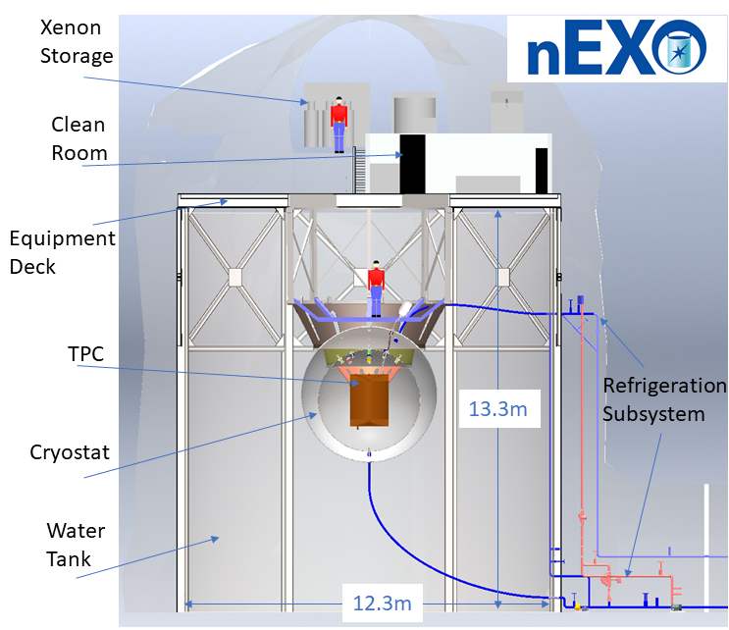
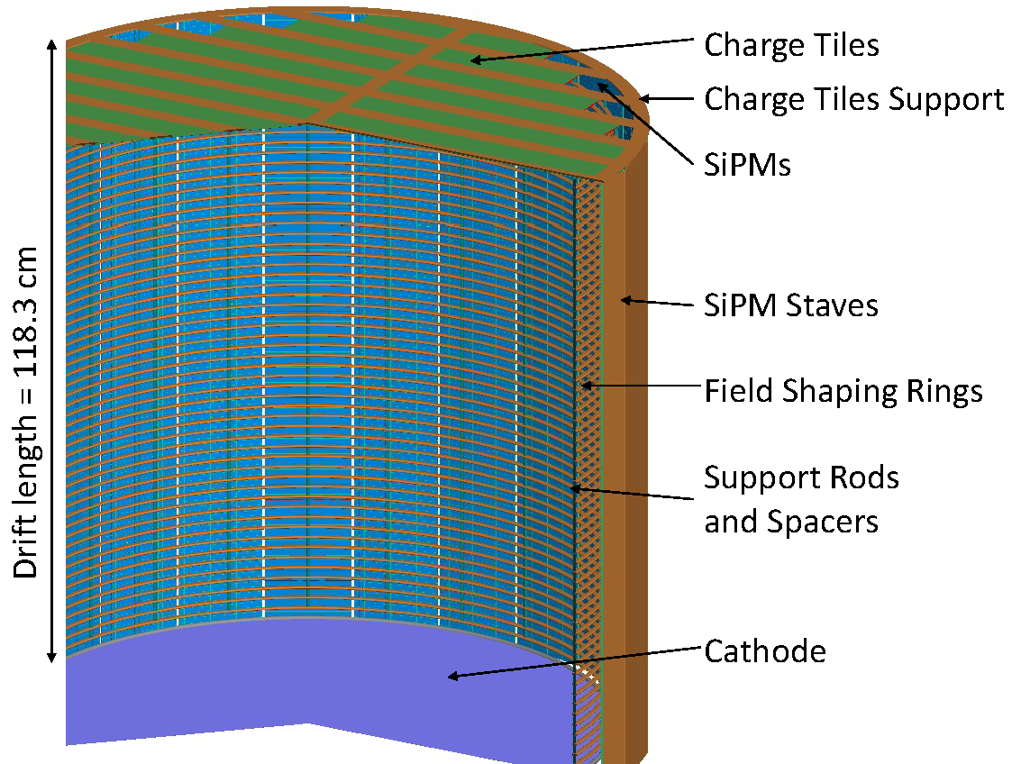
Sketch of the nEXO experiment in the cryopit at SNOLAB

Slide 4

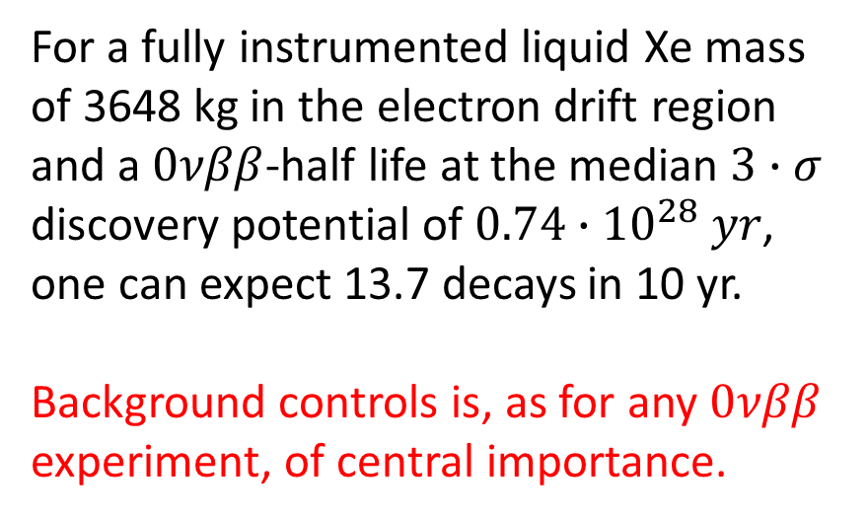
The $0νββ$ decay challenge
$0νββ$ of ¹³⁶Xe has a Q-value of $Q_{ββ}=2458.07±0.31 keV$, within the energy domain of natural, cosmogenic and man-made radioactivity.
For a fully instrumented liquid Xe mass of 3648 kg in the electron drift region and a $0νββ$-half life at the median $3∙σ$ discovery potential of $0.74∙{10}^{28} yr$, one can expect 13.7 decays in 10 yr.
Background controls is, as for any $0νββ$ experiment, of central importance.

Slide 5
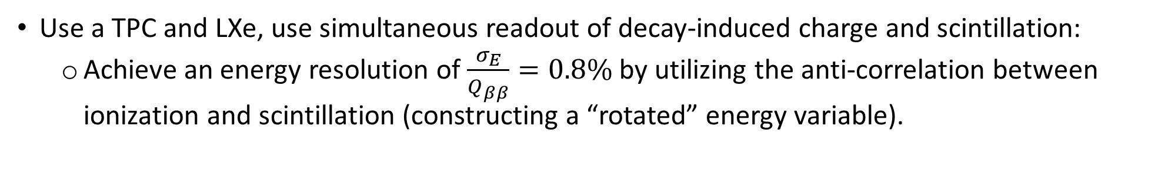
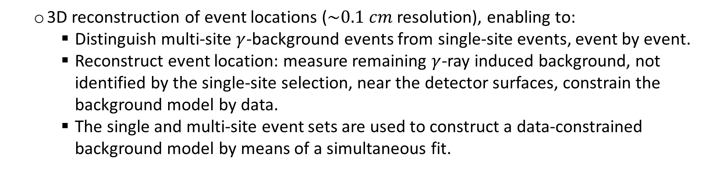
The nEXO Approach
Use a TPC and LXe, use simultaneous readout of decay-induced charge and scintillation:
  Achieve an energy resolution of $\frac{σ_{E}}{Q_{ββ}}=0.8\%$ by utilizing the anti-correlation between ionization and scintillation (constructing a “rotated” energy variable).
  3D reconstruction of event locations ($\sim 0.1 cm$ resolution), enabling to:
    Distinguish multi-site $γ$-background events from single-site events, event by event.
    Reconstruct event location: measure remaining $γ$-ray induced background, not identified by the single-site selection, near the detector surfaces, constrain the background model by data.
    The single and multi-site event sets are used to construct a data-constrained background model by means of a simultaneous fit.
Identify single site $α$-events via characteristic ionization-to-scintillation ratio.
In case a $0νββ$ signal is identified above background with sufficiently short half life, perform a control experiment with natural xenon.

Slide 6
The nEXO Approach
Build the experiment only from components with known radioactivity content. Component acceptance decisions are made based on a quantitative Monte Carlo background model.
The approach of active background recognition, coupled with a rigorous materials screening program has been demonstrated by the predecessor experiment EXO-200. nEXO plans to utilize the same approach, with even more attention to detail.
In EXO-200 it was found that the pre-data taking background prediction essentially agreed with what was measured by the experiment eventually.

Slide 7
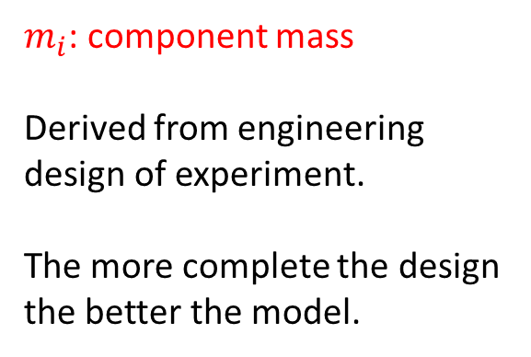
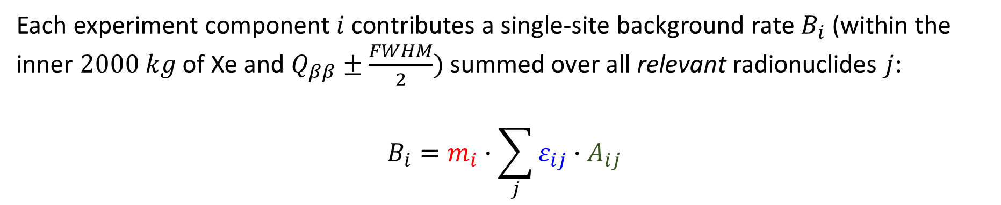
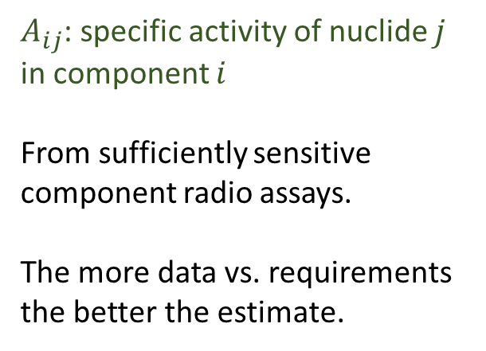
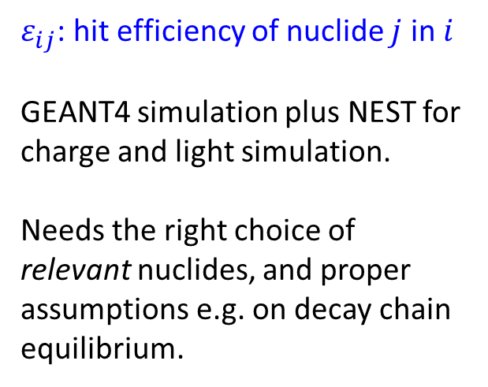
nEXO background estimation
Each experiment component $i$ contributes a single-site background rate $B_{i}$ (within the inner $2000 kg$ of Xe and $Q_{ββ}±\frac{FWHM}{2})$ summed over all relevant radionuclides $j$:
$$B_{i}=m_{i}∙\sum_{j}{ε_{ij}∙A_{ij}}$$
$m_{i}$: component mass
Derived from engineering design of experiment.
The more complete the design the better the model.
$ε_{ij}$: hit efficiency of nuclide $j$ in $i$
GEANT4 simulation plus NEST for charge and light simulation.
Needs the right choice of relevant nuclides, and proper assumptions e.g. on decay chain equilibrium.
$A_{ij}$: specific activity of nuclide $j$ in component $i$
From sufficiently sensitive component radio assays.
The more data vs. requirements the better the estimate.

Slide 8
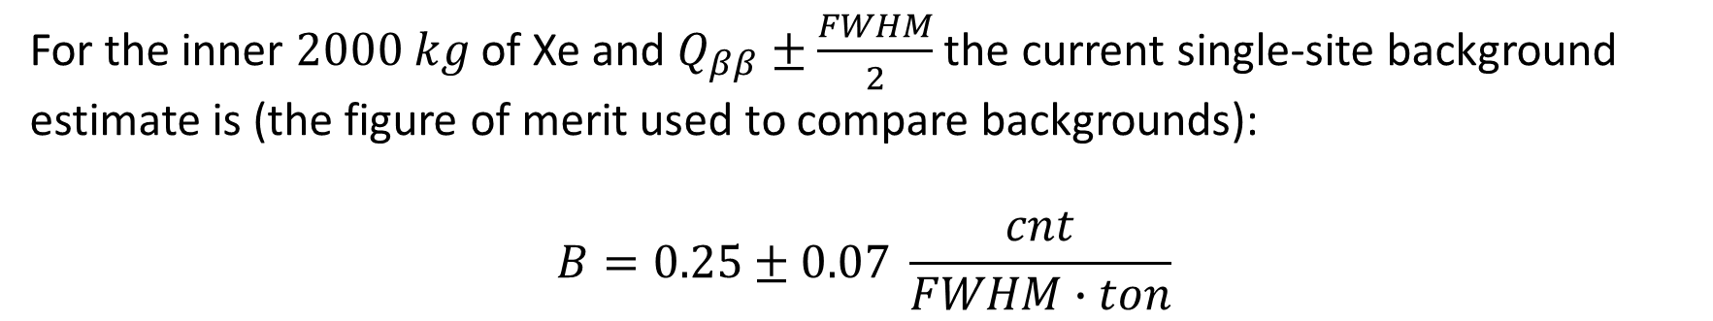
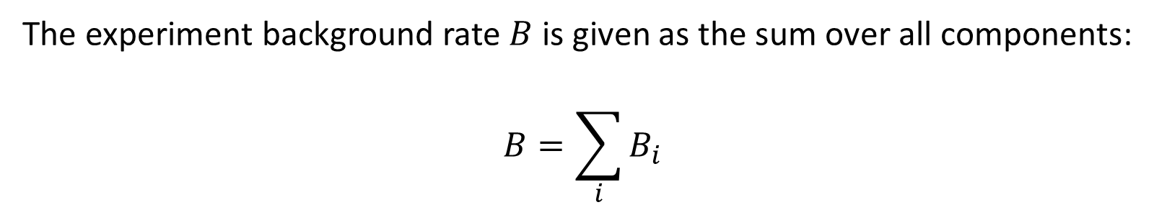
nEXO background estimation
The experiment background rate $B$ is given as the sum over all components:
$$B=\sum_{i}{B_{i}}$$
For the inner $2000 kg$ of Xe and $Q_{ββ}±\frac{FWHM}{2}$ the current single-site background estimate is (the figure of merit used to compare backgrounds):
$$B=0.25±0.07 \frac{cnt}{FWHM∙ton}$$
Extremely low background rate

Slide 9
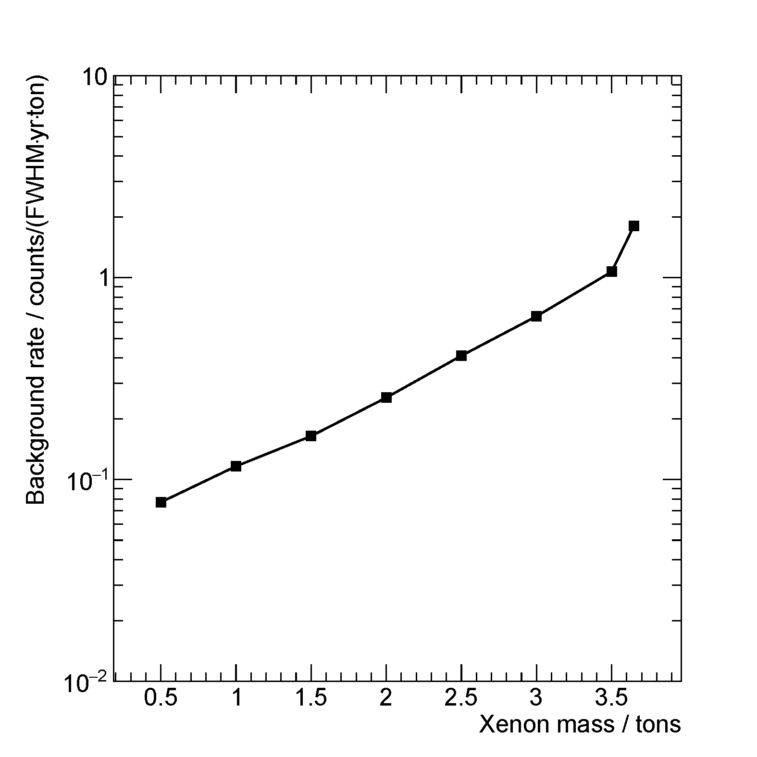
nEXO background estimation
In reality, for a detector as big as nEXO compared to the mass attenuation length of γ-radiation, the background is a function of location and not characterized by a single number.
Experiment sensitivity estimation requires this function and cannot be condensed to one simple value, without loosing effectiveness.

Slide 10
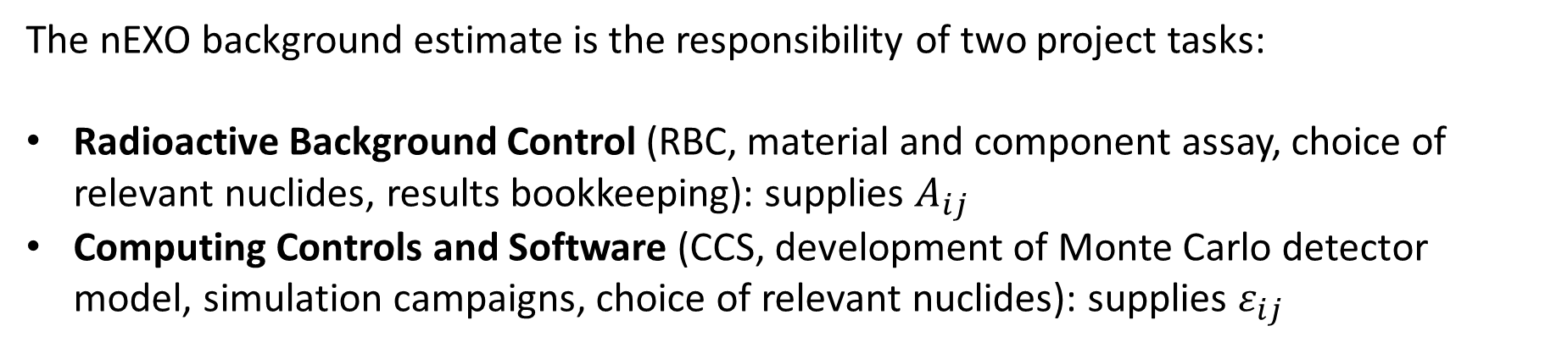
nEXO background estimation
The nEXO background estimate is the responsibility of two project tasks:
Radioactive Background Control (RBC, material and component assay, choice of relevant nuclides, results bookkeeping): supplies $A_{ij}$
Computing Controls and Software (CCS, development of Monte Carlo detector model, simulation campaigns, choice of relevant nuclides): supplies $ε_{ij}$
The work of both tasks is systematically recorded in a database, reporting assay results, hit efficiencies. It outputs background estimates in form of a spreadsheet. A rate calculator, reading the database, enables quick background estimations for planning purposes.
Most important nuclides: ²³²Th and ²³⁸U, ²²²Rn, plus others as needed

Slide 11
The Assay Aspect of nEXO
The work of the RBC is organized itself around the following problems:
What radioactivity is in materials?
What radioactivity (in form of radon) comes out of materials?
What radioactivity is put into (cosmic ray activation) or onto (surface contamination, radon progeny plate-out) materials during handling?
How can one clean surfaces to reset the effect of handling but preserve full technical functionality?
In case no suitable commercial material can be found: work with vendors to obtain clean product, worst case: make custom material

Slide 12
The Assay Aspect of nEXO
The nEXO RBC program utilizes the following methods and labs (²³²Th, ²³⁸U sensitivity):
Above ground Ge counting (270 ppt, 120 ppt): 0.4 devices at UA
Underground Ge counting (best 2.3 ppt, 1.2 ppt): 4.8 devices at SURF, SNOLAB Started working with LNGS too.
ICP-MS (best 0.0008 ppt, 0.0026 ppt): 2.2 devices at PNNL, IHEP, CUP
NAA (best 0.015 ppt, 0.015 ppt): 2.6 setups at UA
α-counting (²¹⁰Po surface, 5 mBq/m² Si-det, 0.1 mBq/m² XIA): 4 Si-det, 1.5 XIA at UA, PNNL, SLAC
Rn counting (²²²Rn steady state activity, 0.1 mBq or 8.6 atoms/d): 8.8 Si-diodes with electro-static collection at SNOLAB/Laurentian, SLAC plus LS counting at UA
AMS (Th, U and ²¹⁰Pb): under development at Carleton

Slide 13
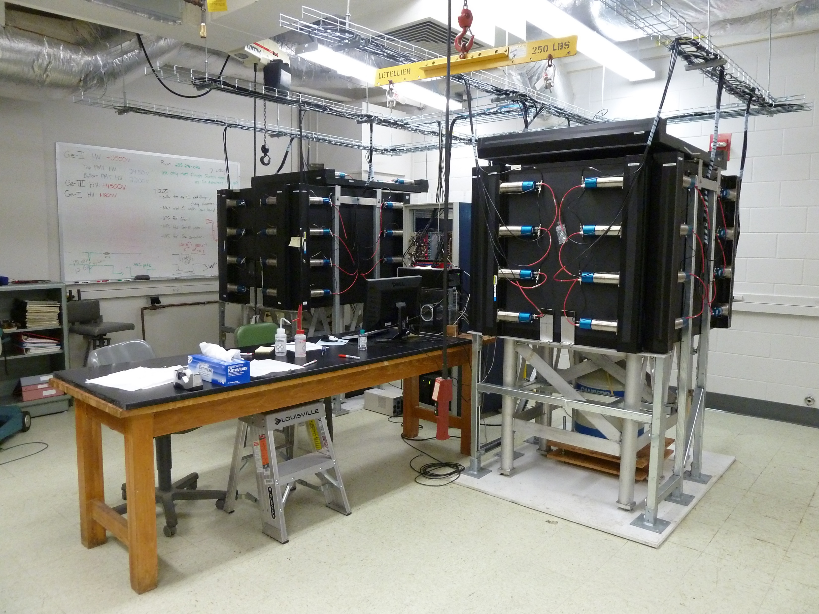
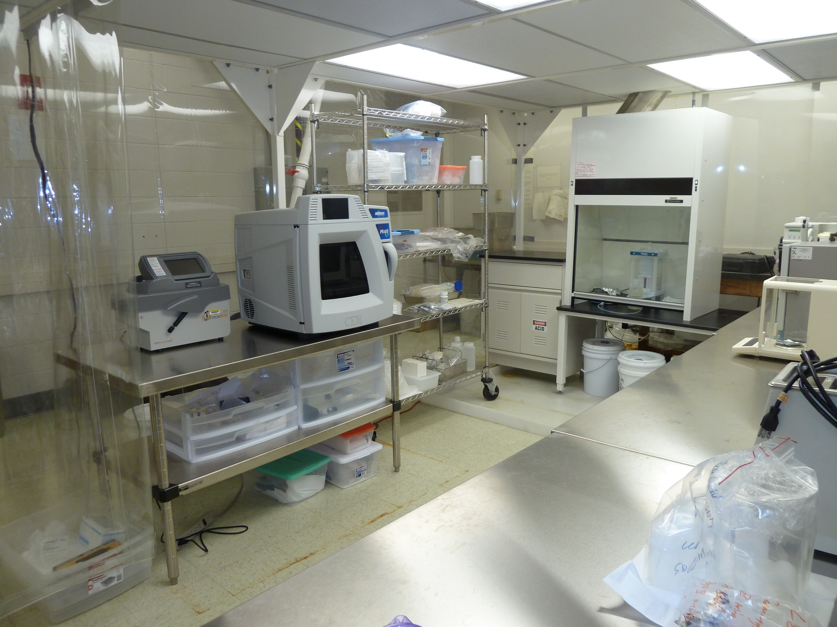
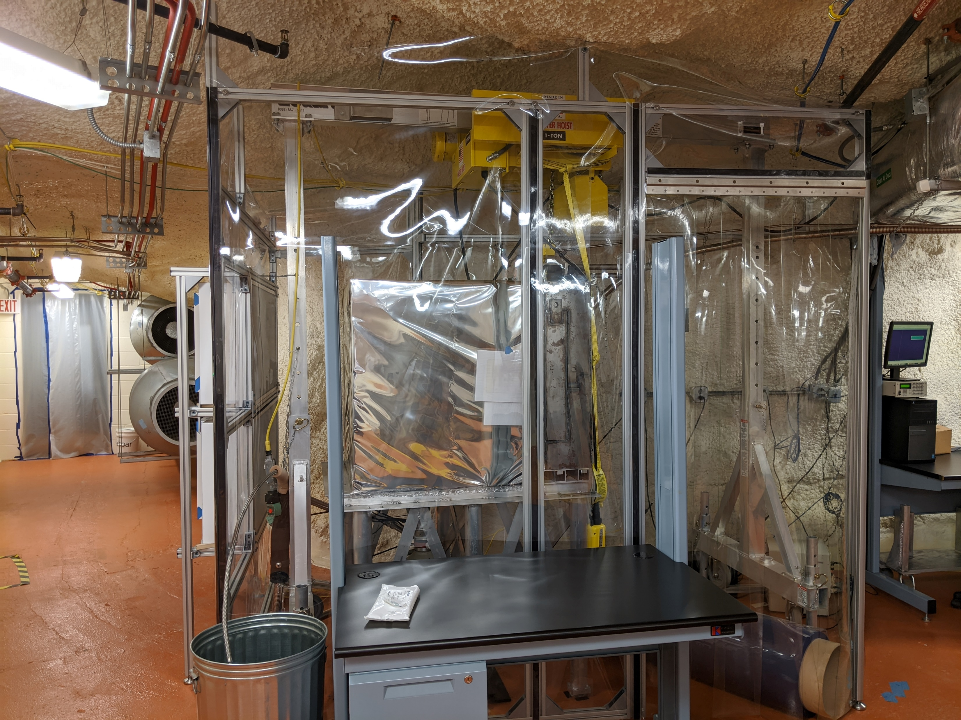
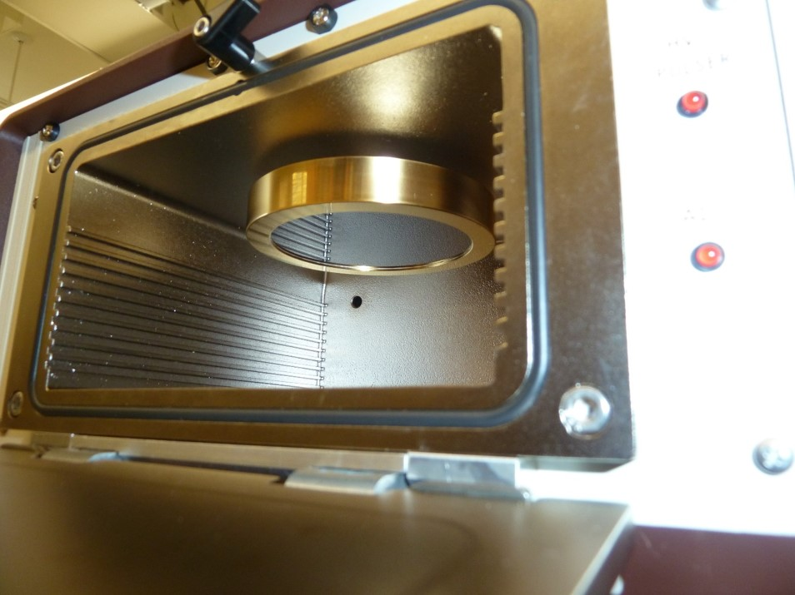
UA Ge detectors
UA clean room
SURF Ge detector
UA α-counting

Slide 14
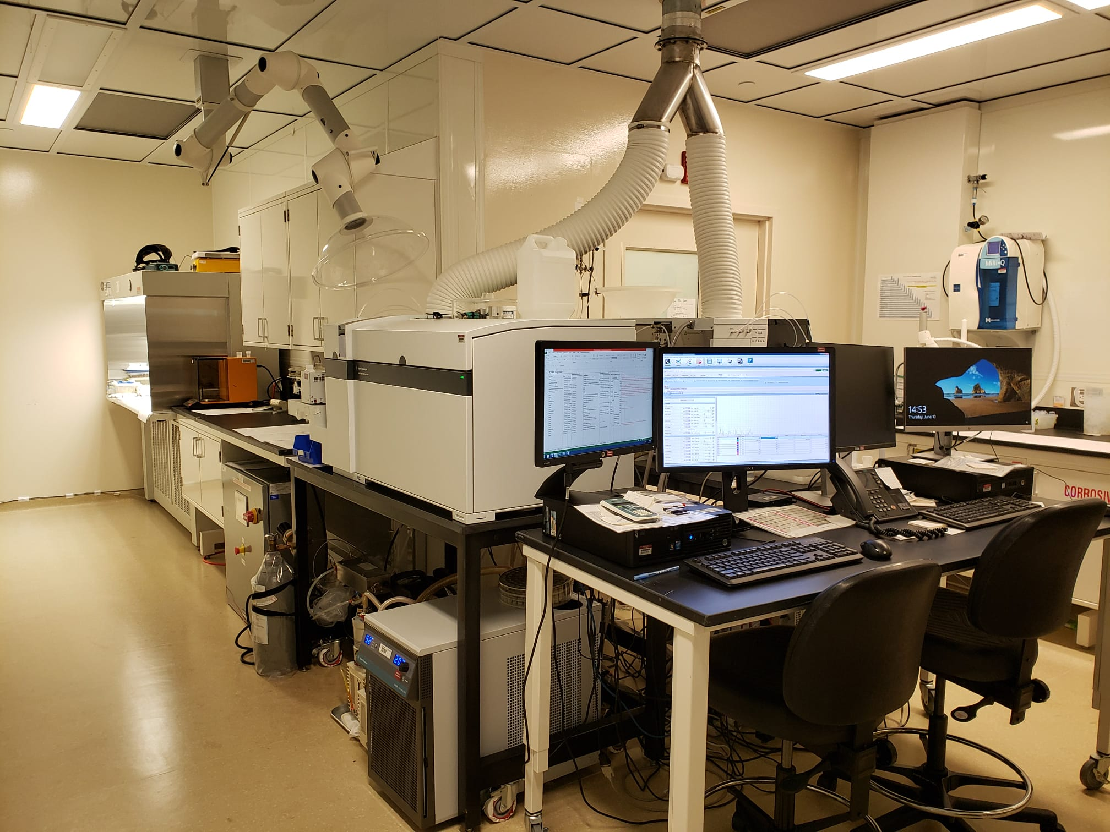
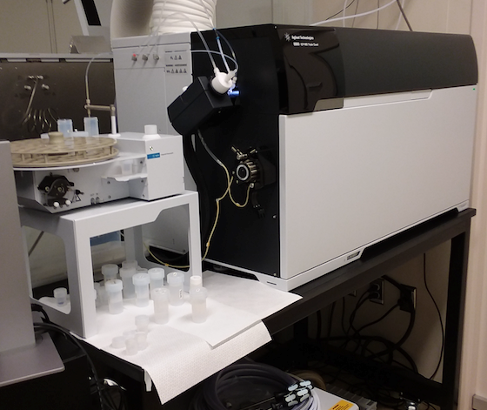
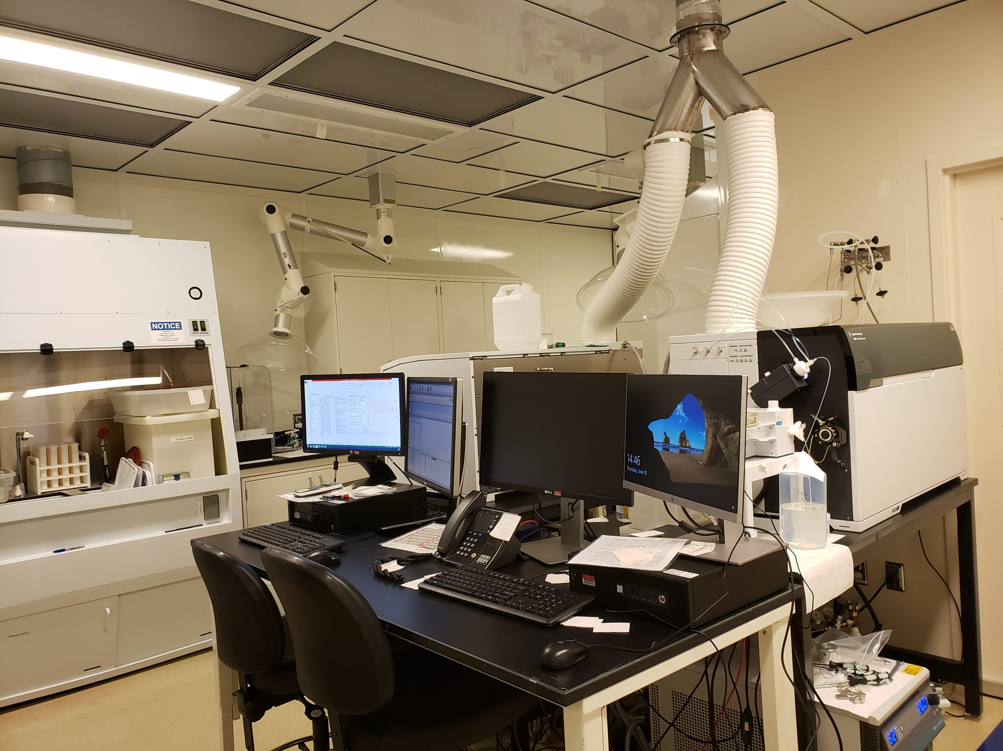
ICP-MS facility at PNNL

Slide 15
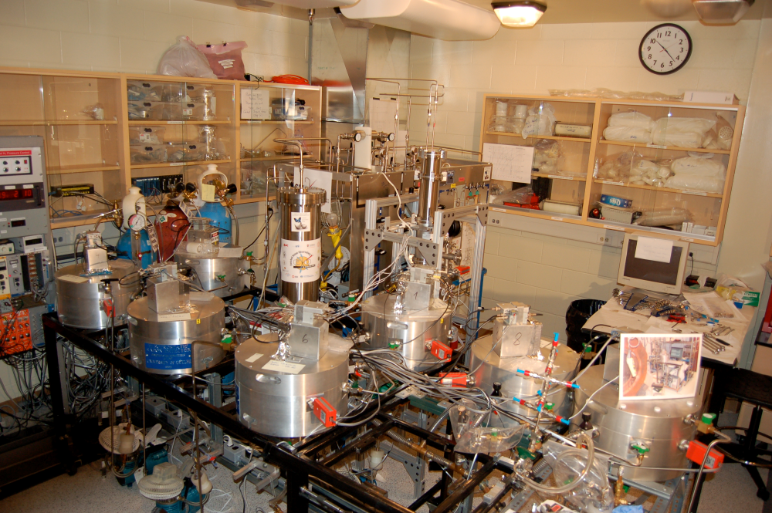
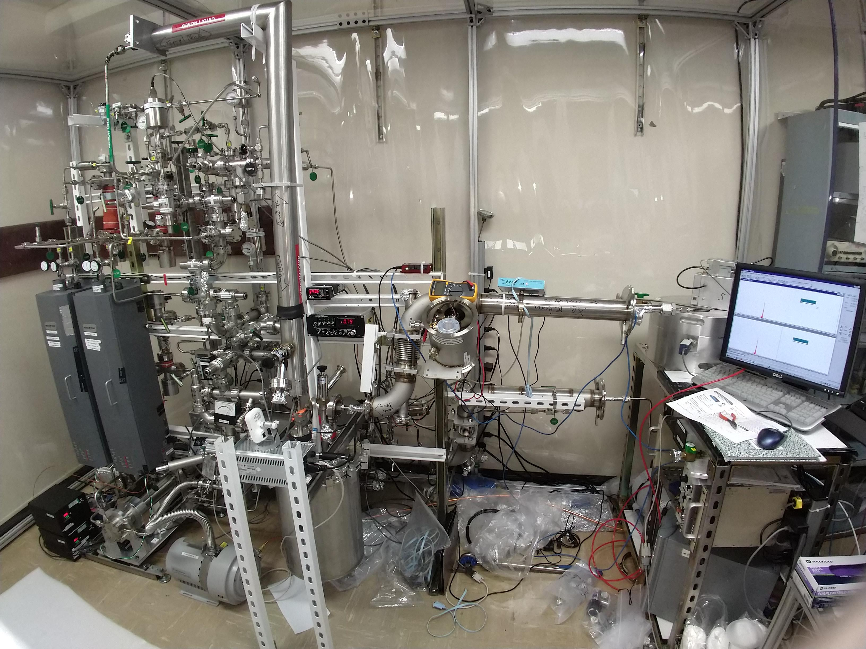
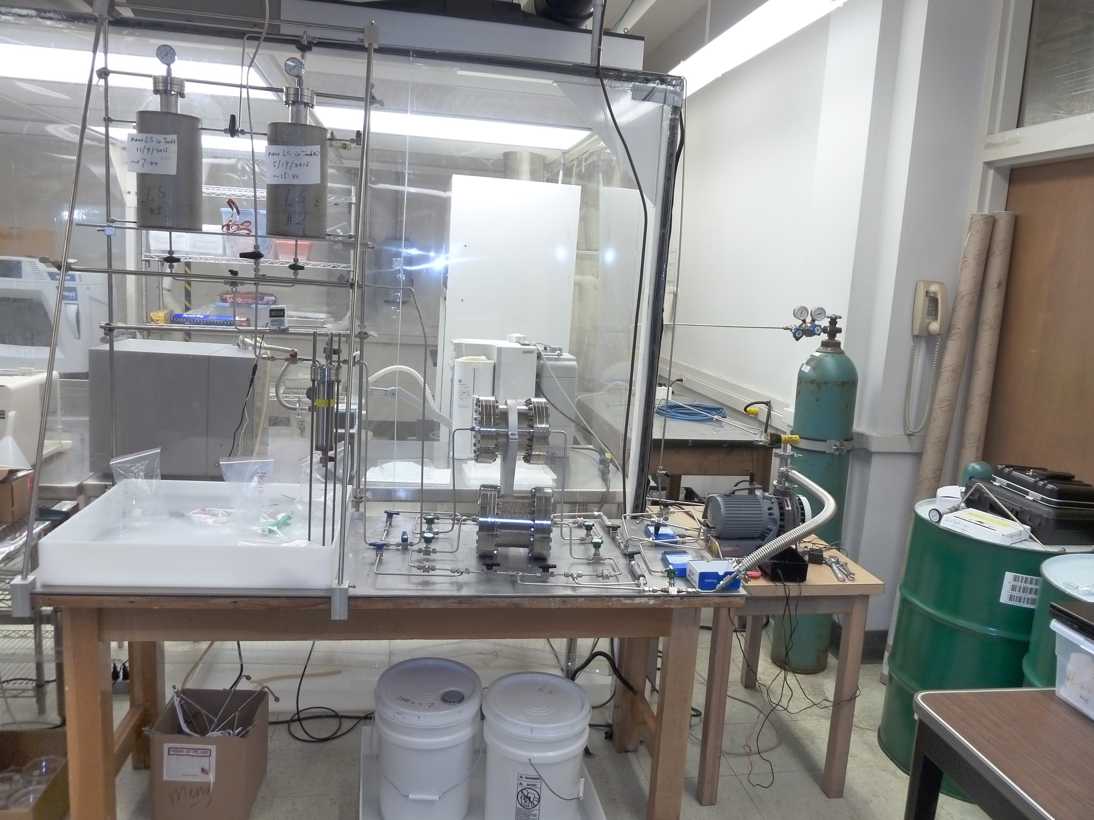
Rn detection at SLAC
Radon detectors at SNOLAB
UA radon outgassing setup

Slide 16
The modelling aspect of nEXO
The nEXO background estimate is based on a GEANT4 model, coupled with NEST.
Implements realistic detector response to interactions in the detector via 3 variables:
Energy resolution
Topological discrimination
Standoff distance
This is not a classical one-dimensional peak search with a calorimetric detector. nEXO resolves events in more than one event dimension.
Model background contributions by:
Intrinsic radioactivity in materials (Th/U chains, ⁴⁰K, ⁶⁰Co, ²⁶Al in sapphire, ⁴²Ar in Xe)
²²²Rn emanation (steady state in xenon and in HFE)
Exposure based backgrounds (¹³⁷Xe from cosmogenic n and from ²¹⁰Po, cosmogenic activation above ground, dust fall out)
Currently the model tracks about 140 background components.

Slide 17
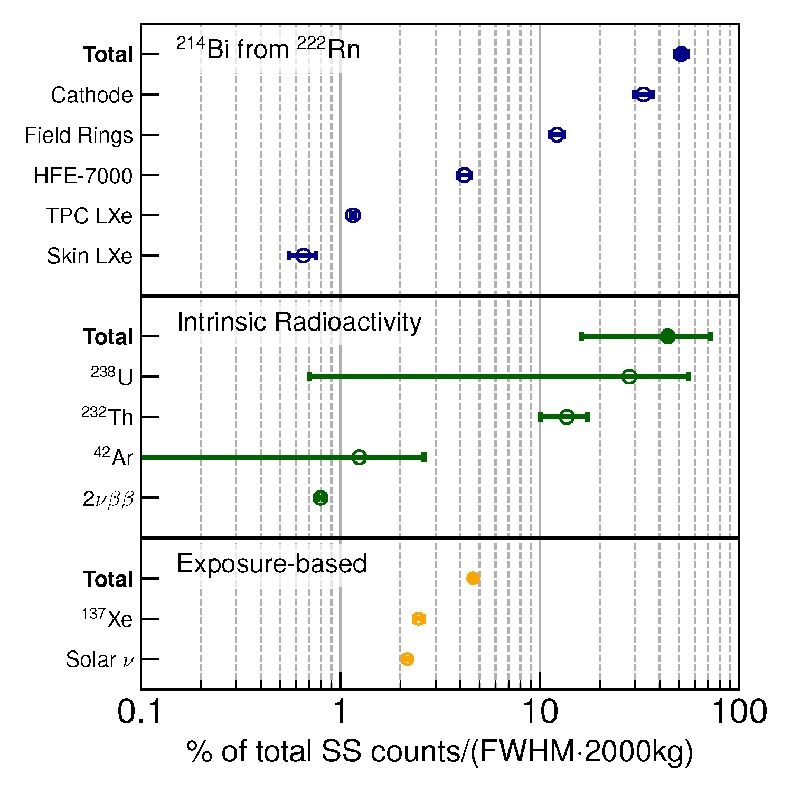
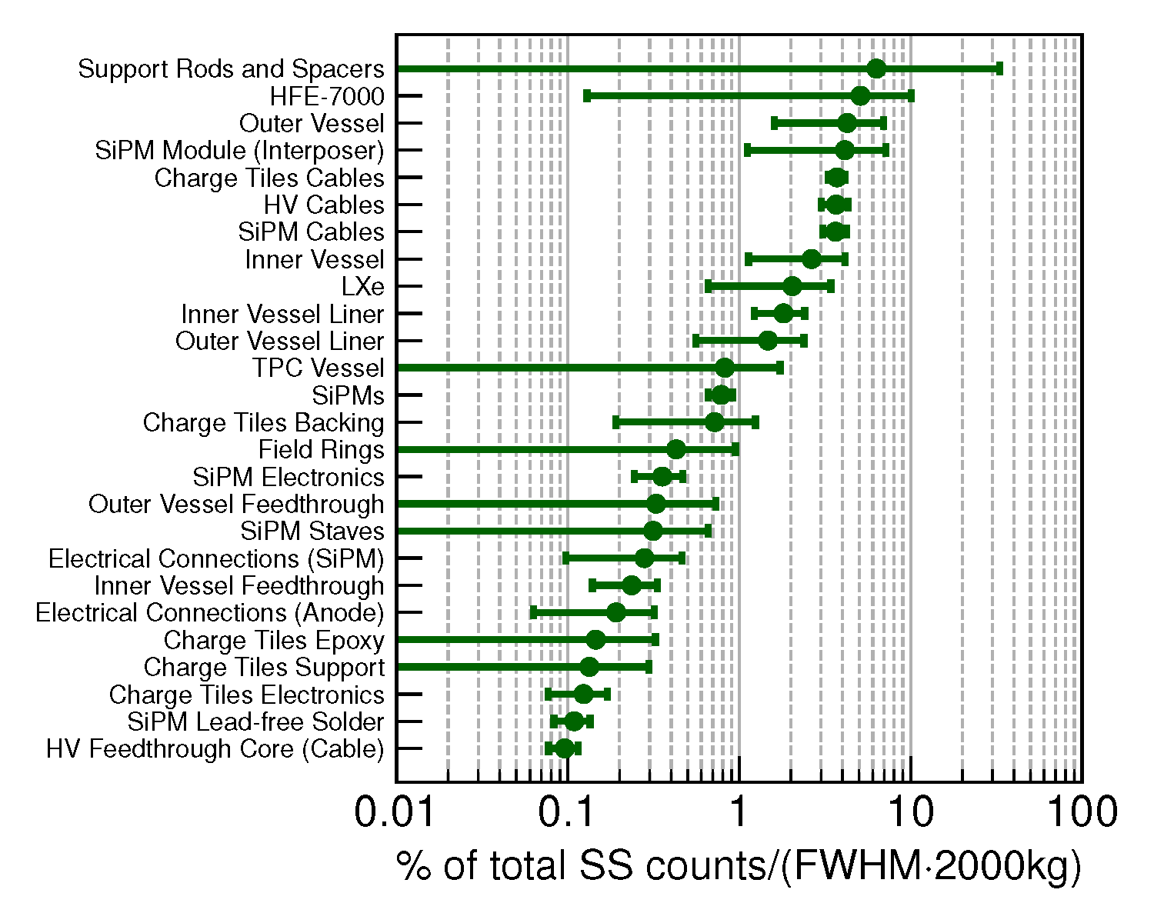
Assay focus areas
The assay program assigns analysis priorities according to the importance ranking of the background contribution.

Slide 18
Some analytical highlights

Slide 19
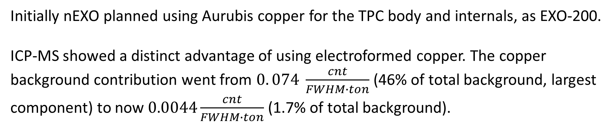
Copper (790 kg)
Initially nEXO planned using Aurubis copper for the TPC body and internals, as EXO-200.
ICP-MS showed a distinct advantage of using electroformed copper. The copper background contribution went from $0. 074 \frac{cnt}{FWHM∙ton}$ (46% of total background, largest component) to now $0.0044\frac{cnt}{FWHM∙ton}$ (1.7% of total background).
Material | Analysis | ID | ²³²Th [ppt] | ²³⁸U [ppt]
Aurubis cathode | Ge (Bern) | R-002.8.1 | <2.3 | <1.2
Aurubis cathode | ICP-MS (PNNL) | R-002.11.1 | 0.127±0.06 | 0.254±0.008
PNNL electroformed | ICP-MS (PNNL) | R-168.1.1 | 0.006±0.001 | <0.0094
PNNL electroformed | ICP-MS (IHEP) | R-168.1.2 | 0.13±0.04 | <0.11
Electroformed copper is now the baseline material.

Slide 20
HFE heat transfer fluid (31800 kg)
The HFE-7000 or HFE-7200 heat transfer fluid also serves as innermost radiation shield. Because of the large amount it needs to be very clean.
Material | Analysis | ID | ²³²Th [ppt] | ²³⁸U [ppt]
HFE-7000 | NAA (UA) | P-139 | <0.015 | <0.015
HFE-7000 | ICP-MS (PNNL) | R-181.1.1 | <0.0013 | 0.0034±0.0005
HFE-7200 | ICP-MS (PNNL) | R-182.1.1 | <0.0013 | <0.0043
Extreme purity found by NAA was confirmed and improved by ICP-MS. A ²¹⁰Po analysis is under way.
Fractional background contribution went from 9.3% to 6.3%.

Slide 21
SiPM light readout (2.9 kg)
Products by FBK and Hamamatsu were found to meet the nEXO technical specs. Both were assayed for radioactivity.
Material | Analysis | ID | ²³²Th [ppt] | ²³⁸U [ppt]
FBK early | NAA (UA) | R-003.2.4 | <0.37 | <11
FBK VUV SF | ICP-MS (PNNL) | R-076.2.1 | 0.44±0.05 | 0.99±0.02
FBK VUV SF | ICP-MS (IHEP) | R-076.2.2 | 0.11±0.03 | 0.07±0.02
FBK VUV LF | ICP-MS (PNNL) | R-076.1.1 | 0.45±0.12 | 0.86±0.05
Hamamatsu VUV3 (no trenches) | ICP-MS (PNNL) | R-096.1.1 | <0.63 | 0.72±0.19
Hamamatsu VUV3 (no trenches) | ICP-MS (IHEP) | R-096.1.2 | 0.31±0.03 | 0.21±0.03
Radioactivity wise both FBK and Hamamatsu products were found suitable for nEXO. SiPM background contribution is small, about 0.8%.

Slide 22
Dielectric TPC internals
Baseline for TPC field cage: sapphire holding rods and spacers. Sapphire (Al₂O₃) is difficult to assay: (a) doesn’t dissolve in mineral acids (ICP-MS), (b) when n-activated forms large side activities via ²⁷Al(n, α)²⁴Na, limiting NAA sensitivity to ²³⁸U.
Assayed structural polymers by NAA to explore design alternatives
Developed a γ-γ-coincidence counting approach: boosts sensitivity for ²³⁸U 8-fold
Material | Analysis | ID | ²³²Th [ppt] | ²³⁸U [ppt]
GTAT (Ligo) | NAA (UA) | R-046.1.1 | 6±1 | <8.9
Saint Gobain | NAA (UA) | R-048.6.1 | <0.49 | <10.5
Precision Sapphire | NAA (UA) | R-084.1.1 | 410±41 | 985±99
PEI Sabic 1000 Advanced Polymer | NAA (UA) | R-146.1.1 | 84±10 | 21±13
PEI Sabic 1000 Ensinger | NAA (UA) | R-147.1.1 | 9.5±2.3 | <15
PAI Mitsubishi Duratron | NAA (UA) | R-145.1.1 | <28 | <579
PEI Mitsubishi Ultem 1000 | NAA (UA)
6.3%
Notes:
PEI: polyetherimide
PAI: polyamide-imide

Slide 23
Radon outgassing
²²²Rn contained in the xenon is currently the largest background component (51.4%)
It is based on a requirement of 600 atoms contained in the xenon
EXO-200 observed 200 atoms of ²²²Rn in its 100 kg active mass.
²²²Rn measurements done with the recirculation and purification loop of EXO-200, reconstructed at SLAC, indicate that the SAES purifier contributed about 75% of the radon.
nEXO is planning to capitalize on the success of EXO-200 in the area of radon. The collaboration is working on a bottom up estimate, built from assays of components, similar to the effort of Radioactivity in Materials.
Radioactivity and ²²²Rn measurements with SAES pellets are roughly compatible with above observation. Large ²³⁸U activity, broken chain equilibrium is observed. We are studying alternative media.

Slide 24
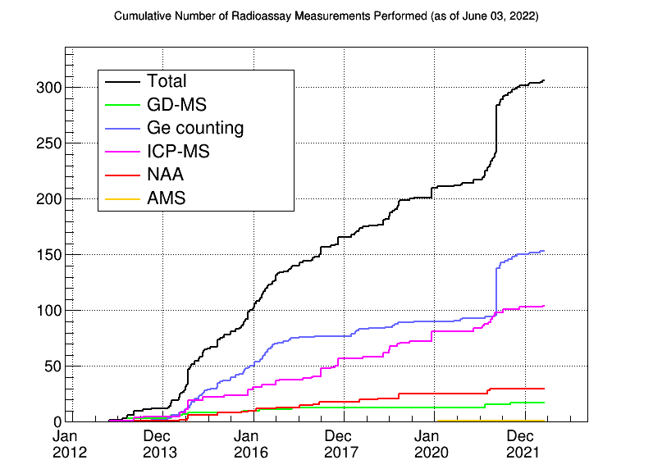
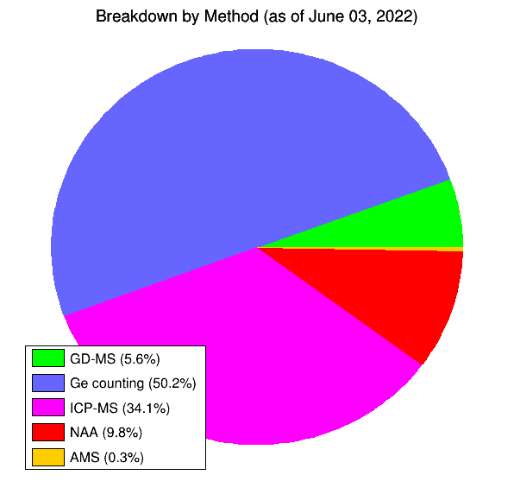
Productivity of the program
The nEXO materials database contains more than 300 sample measurements. In addition, 316 EXO-200 materials and 27 radon outgassing measurements have been migrated into the database and can be used for background model building.
The nEXO assay program is actively supporting the project

Slide 25
Other subjects being studied by nEXO
⁴²Ar in xenon (V. Veeraraghavan)
(α, n)-induced background and radon progeny attachment to surfaces (R. Tsang and D. Chernyak)
Dust contribution and fall-out modelling (M.L. di Vacri)
Rn removal by distillation (B. Mong)
Low activity flexible cables (R. Saldanha)
Cu electroforming (E. Hoppe)

Slide 26
Conclusion
The nEXO background estimation and management effort is organized as a collaboration between radio assay and simulation.
The background estimate is, with few exceptions, normalized by radioactivity measurements of relevant materials and components.
Data and background estimates are organized in an online database.
These task groups are quite active and a key aspect of nEXO and project development.

Slide 27
The nEXO RBC Team
Participating groups from:
Carleton University, Ottawa (Canada)
Center for Underground Physics, Daejeon (Korea)
Colorado School of Mines, Golden (Colorado)
Institute for High Energy Physics, Beijing (China)
Pacific Northwest National Laboratory, Richland (Washington)
SLAC National Accelerator Laboratory, Menlo Park (California)
SNOLAB / Laurentian University, Sudbury (Canada)
University of Alabama, Tuscaloosa (Alabama)
University of Bern, Bern (Switzerland)
University of Kentucky, Lexington (Kentucky)

Slide 28
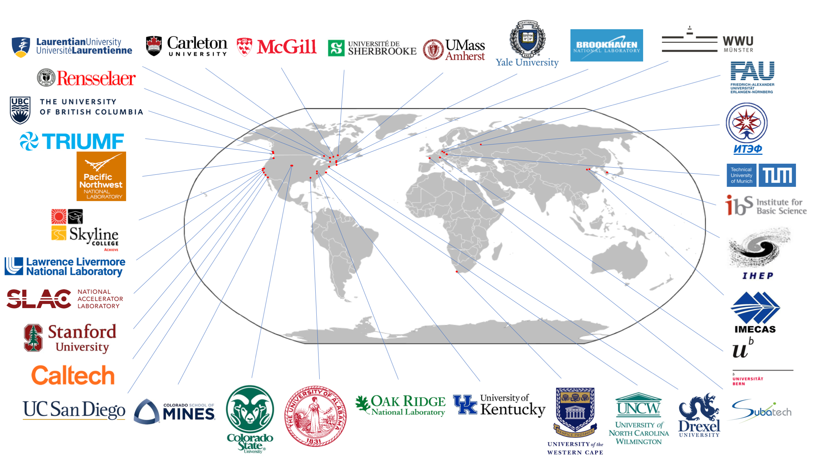

Slide 29
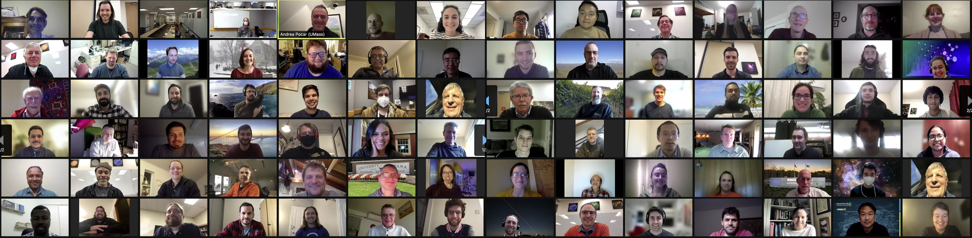
January 2022, virtual collaboration meeting

