Slide 1
Homage to Stanley M. Howard June 14, 2022 Jon Kellar

Slide 2
I had the honor of being an undergraduate student (1980-1984), graduate student (1984-1986) and faculty colleague (1990-2021) with Stan. This presentation is based upon my interactions with Stan over those 37 years.

Slide 3
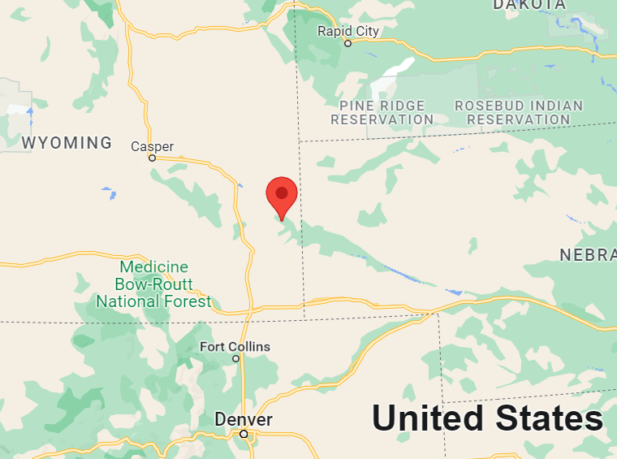
Born in 1945 in Torrington, WY (family ranch was in Lingle, WY).
As a young man Stan build a mini blast furnace in his basement.
Lingle, Wyoming

Slide 4
After graduating from high school Stan’s interest in high temperature thermodynamics and pyrometallurgy drew him to the Colorado School of Mines (CSM).
Colorado School of Mines
SMH Professional

Slide 5
Stan completed his B.S. (1967) degree at CSM in Metallurgical Engineering.
Worked as an intern for Dow Chemical, Kennecott Copper and USGS.
Colorado School of Mines
SMH Professional

Slide 6
Stan completed his Ph.D. degree with Dr. John Hager as Major Professor.
It only took Stan four years to complete his Ph.D., which was quite remarkable during that era.
Colorado School of Mines
SMH Professional

Slide 7
Stan began his academic year in 1971 at the South Dakota School of Mines & Technology (SDSM&T).
Stan was only 26 years old at this time!
South Dakota School of Mines

Slide 8
Stan (far right) as a newly minted Ph.D., with the faculty from Metallurgical Engineering.
Stan served on the faculty for 50 years!
SMH Professional

Slide 9
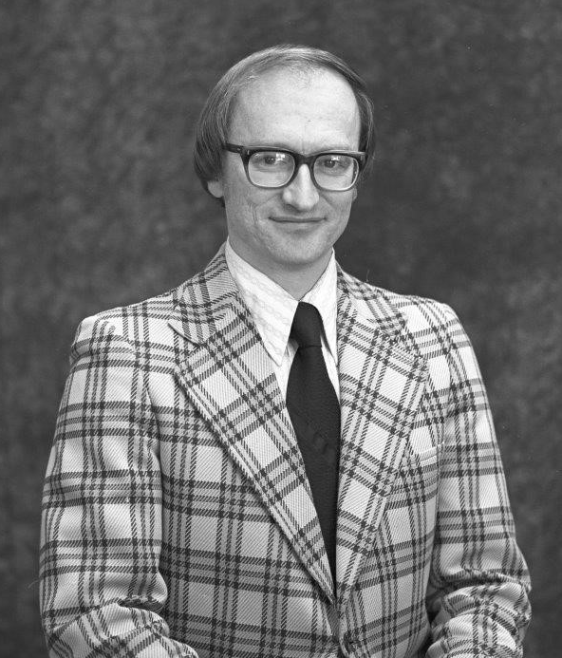
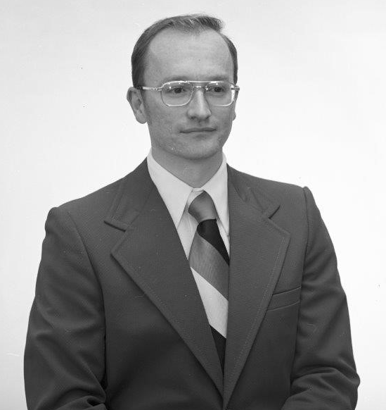
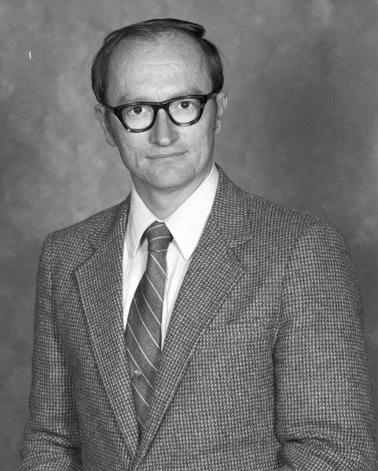
Stan rose through the ranks and was a full Professor by 1981.
Served as Dept. Chair, Chair of the Faculty Senate, and received the Presidential Award for outstanding performance in1990).
SMH Professional

Slide 10
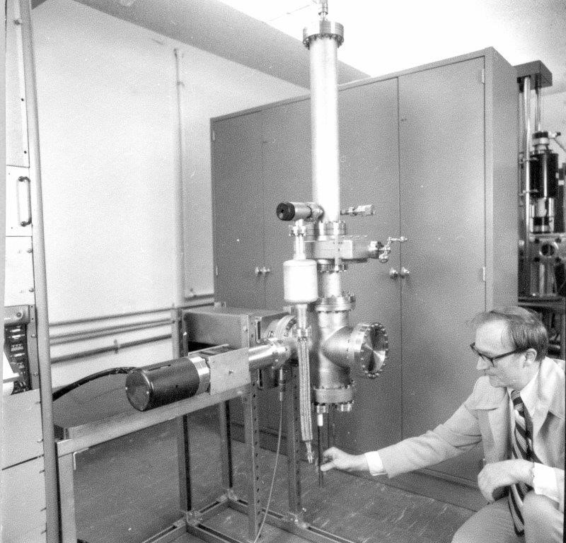
Stan had a passion for research, particularly high temperature thermodynamics and mixing of metal alloys, and published extensively on this topic.
SMH Professional

Slide 11
Stan shared his extensive expertise with many organizations, including Caterpillar, Kerr-McGee, Group V Metals, Stanford Research Center and Oak Ridge National Lab.
SMH Professional

Slide 12
Stan was a career-long member of the The Minerals, Metal and Materials Society (TMS).
Stan first served on the TMS Board of Directors in 2009, and received the TMS Alexander Scott Distinguished Service Award for his dedication to the Society.
SMH Professional

Slide 13
In 2016 Stan was elected as the TMS President.
Stan’s TMS Presidential accomplishments were vast and included expanded international collaborations, creation of new digital access to information and TMS Foundation growth.
SMH Professional

Slide 14
Stan was the consummate educator, friend and collaborator to so many people.
Some poignant examples----
“I remember Dr. Howard from the point of view of a 20 yr old student taking a course in Thermodynamics. The immediate impression from the first day of school was the dedication he had to getting things right. The entire first lecture was spent correcting our textbooks. He had more than 100 corrections for us to make in the textbook fixing errors that he had found.”
Bill Rausch (former student)
“I always found him extremely helpful and I enjoyed his enthusiasm for the electroforming process we were setting up at SURF and his interest in how we developed it through the years previous at PNNL. He was a fountain of information and I loved tapping into that as much as he liked sharing it. He was always friendly to me and made me feel so welcome when I visited campus.”
Eric Hoppe (collaborator)
SMH Personal

Slide 15
Stan was the ultimate professional and friend………..and had an incredible sense of humor. I am miss him each and every day.
SMH Personal

Slide 16
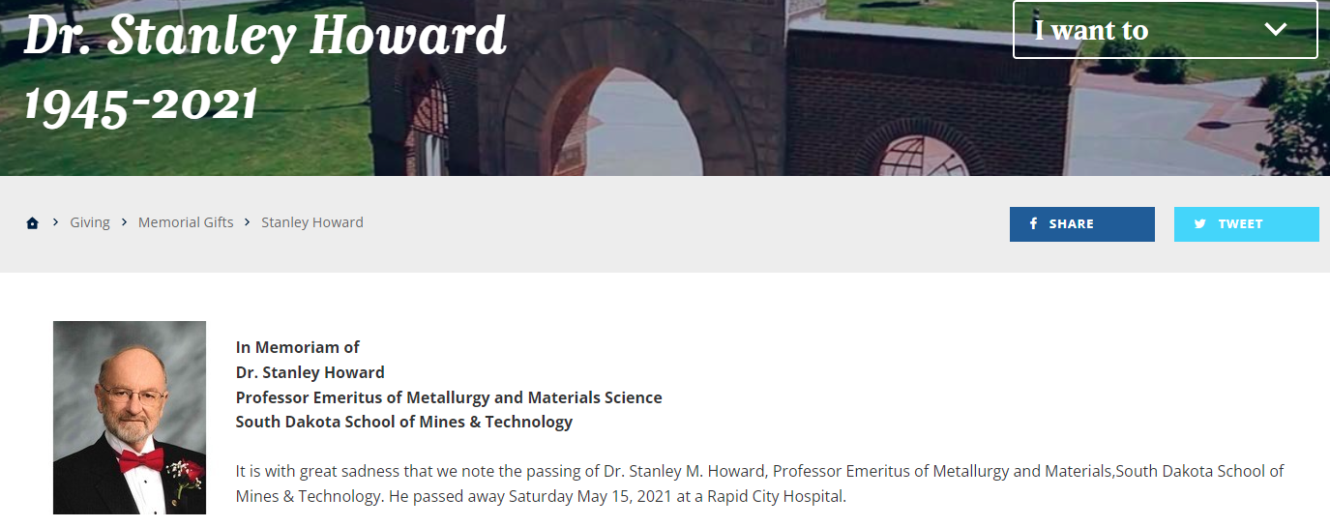
50-for-50 Campaign
https://cara.sdsmt.edu/dr.-stanley-howard
SMH Personal

