Slide 1
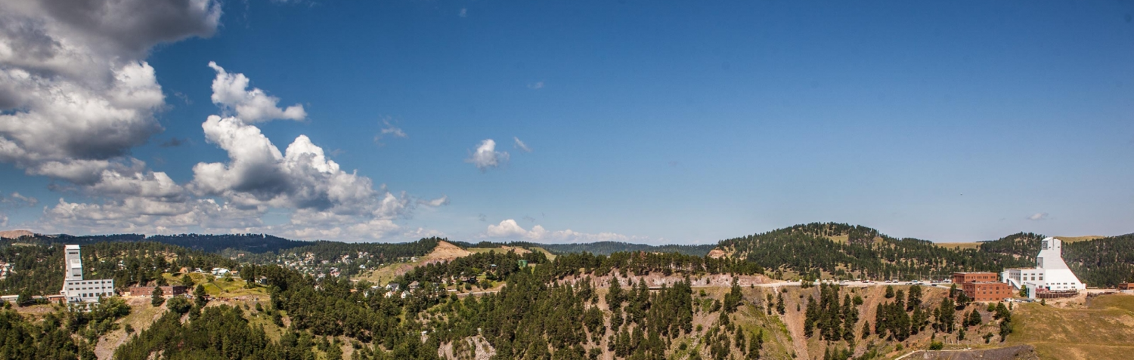
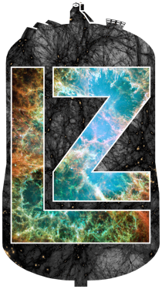
Radon Emanation Techniques and Measurements for LZ
Nicholas Chott - South Dakota Mines
Low Radioactivity Techniques Workshop 2022
June 16, 2022

Slide 2
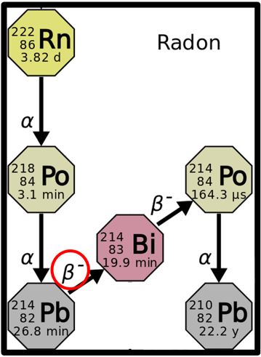
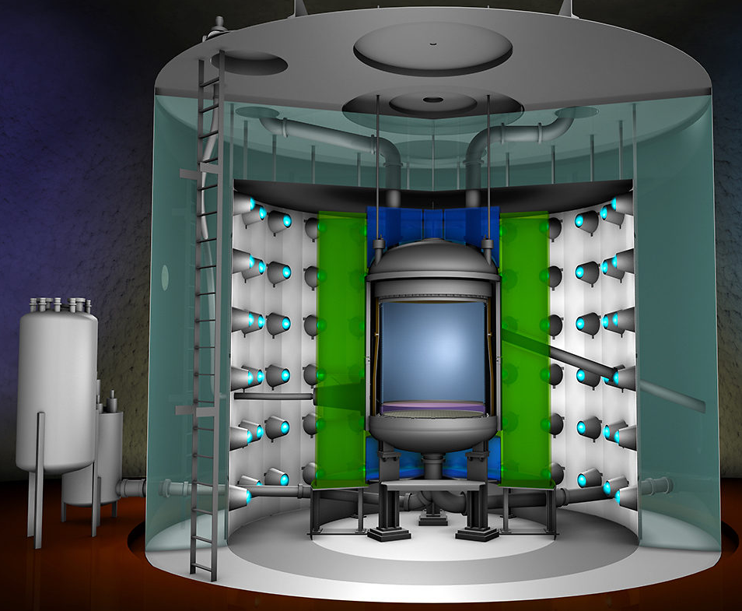
The LUX-ZEPLIN (LZ) Experiment
Radon emanation: ≈66% of the projected electron recoil (ER) background
  Dominated by β-emission from the ²¹⁴Pb progeny of the ²²²Rn sub-chain as it decays to ²¹⁴Bi
Xenon Circulation
System (not shown):
Getter
Compressor 1
Compressor 2
Main circulation panel
Xenon transfer lines
Radon removal system
Radon reduction panel
See Poster by
Carter Hall
Inner cryostat:
Top array 3” PMT & bases
Top 1” PMT & bases (skin)
Bottom array 3” PMT & bases
Bottom 2” PMT & bases (skin)
Top cables
Bottom cables
HV-Umbilical cable
PTFE
Titanium
Cryostat
Xenon
Tower
Xenon TPC
Xenon Tower:
Sub-cooler
Weir reservoir
Heat exchanger
Cryo-valves
All components that
touch the liquid xenon
were screened for radon
(80+ samples were assayed)
https://www.symmetrymagazine.org/article/dark-matter-hunt-with-lux-zeplin
Notes:
Naked Beta:
Cannot be tagged on an event-by-event basis
9.2% No associated gamma emission
Potentially indistinguishable from a dark-matter-induced nuclear recoil
0.5%: possibly mistaken for nuclear recoil in the WIMP ROI
Uniform ER background, β- spectrum up to 1019 keV
Projected specific activity of 2μBq/kg
Approx. 20mBq in the 10 tonnes of xenon
11 mBq is in the fiducial volume (5.6 tonnes)
7t active LXe
5.6t fiducial LXe
Field cage
Top/bottom PMT array
Cathode/gate/anode grids
Instrumented Xe skin detector

Slide 3
LZ Radon Screening Facilities
System | Technology | Emanation Chamber Volume
University College London | Electrostatic PIN-diode | 2.6 liters 2.6 liters
University of Maryland | Electrostatic PIN-diode | 4.7 liters
SD Mines | Electrostatic PIN-diode | 13 liters 300 liters
University of Alabama | Liquid Scintillator Coincidence | 2 x 2.6 liters

Slide 4
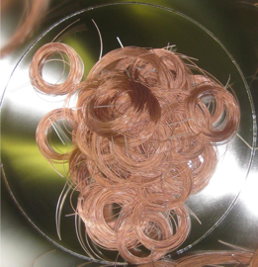
Radon Emanation Basics (Electrostatic PIN-diode Detector)
Low-radon carrier gas
(Helium or Nitrogen)
Carbon trap
(Cooled w/ Dry Ice + Iso, traps radon)
Carbon trap
(Cooled w/ Dry Ice + Iso, traps radon)
Emanation
Chamber
750 meters of PMT cable
Emanation
Chamber
Emanation
Chamber
750 meters of PMT cable
Brass/copper trap
(Cooled w/ LN to 77K, traps radon)
Brass/copper trap
(Cooled w/ LN to 77K, traps radon)
Brass/copper trap
(Cooled w/ LN to 77K, traps radon)
Vacuum Pump
Brass/copper trap
(Cooled w/ LN to 77K, traps radon)
Detection Chamber
Rn
Rn
Rn
Rn
Rn
Rn
Rn

Slide 5
Radon Emanation Basics (Electrostatic PIN-diode Detector)
Low-radon carrier gas
(Helium or Nitrogen)
Carbon trap
(Cooled w/ Dry Ice + Iso, traps radon)
Emanation
Chamber
750 meters of PMT cable
Vacuum Pump
Brass/copper trap
(Cooled w/ LN to 77K, traps radon)
Detection Chamber
Rn
+
Rn
87% of ²¹⁸Po positively charged
50% chance to deposit energy
  Second chance with ²¹⁴Po alpha
²¹⁸Po and ²¹⁴Po events characterized by energy from alphas; 6.1 MeV and 7.9 MeV
Collection efficiencies ~50%
  Detector geometry
  Charge neutralization
  Detector efficiencies of approx. 25%
+
Rn
Rn
+
Rn
-
Rn
Rn
+
Pb
α
-2 kV

Slide 6
LZ Radon Screening Facilities
System | Technology | Emanation Chamber Volume | Blank Rate | Transfer & Detection Efficiencies
University College London | Electrostatic PIN-diode | 2.6 liters 2.6 liters | 0.2 mBq 0.4 mBq | 97% | 30% 97% | 30%
University of Maryland | Electrostatic PIN-diode | 4.7 liters | 0.2 mBq | 96% | 24%
SD Mines | Electrostatic PIN-diode | 13 liters 300 liters | 0.2 mBq 0.2 mBq | 94% | 25% 80% | 25%
University of Alabama | Liquid Scintillator Coincidence | 2 x 2.6 liters | 0.3 mBq | 34% | 36%

Slide 7
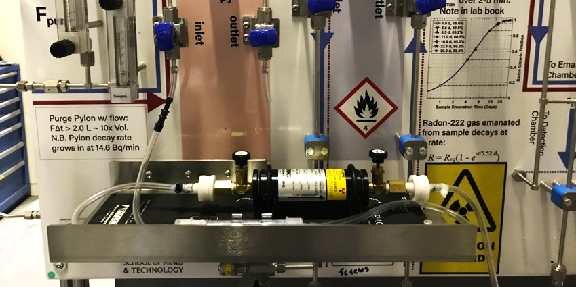
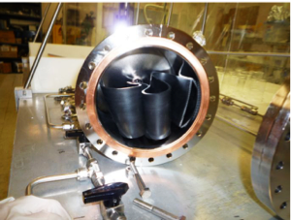
Calibration of LZ Emanation Systems
Independent system calibration:
  Known amounts of radon added to emanation chamber
  Calibrated flow-through source (²²⁶Ra Pylon)
Cross-calibration campaign
  Each emanation chamber measured (blind) two samples
  Strip of rubber: O(10) mBq
    Higher rate: calibrate efficiency w/o interference from backgrounds
  Set of thoriated TIG welding rods: O(1) mBq
    Lower rate: check understanding of backgrounds
Pylon source connected to SD Mines emanation gas panel
Rubber sample in UA emanation chamber

Slide 8
LZ Radon Screening Facilities
System | Technology | Emanation Chamber Volume | Blank Rate | Transfer & Detection Efficiencies | Cross-calibration [Measured / EXO activity]
University College London | Electrostatic PIN-diode | 2.6 liters 2.6 liters | 0.2 mBq 0.4 mBq | 97% | 30% 97% | 30% | 1.49 ± 0.15
University of Maryland | Electrostatic PIN-diode | 4.7 liters | 0.2 mBq | 96% | 24% | 1.13 ± 0.19
SD Mines | Electrostatic PIN-diode | 13 liters 300 liters | 0.2 mBq 0.2 mBq | 94% | 25% 80% | 25% | 0.89 ± 0.15 1.11 ± 0.28
University of Alabama | Liquid Scintillator Coincidence | 2 x 2.6 liters | 0.3 mBq | 34% | 36% | 0.83 ± 0.17

Slide 9
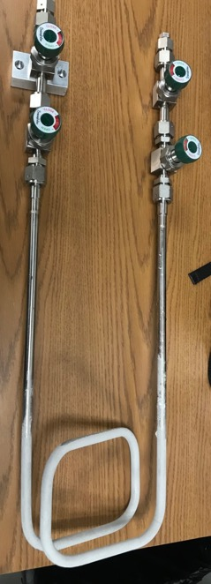
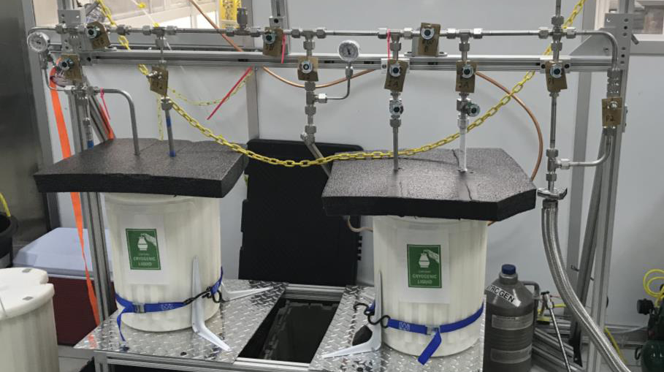
Portable radon systems
LZ used two portable radon collection systems (Maryland and SD Mines)
  For equipment too large or delicate to move to the radon emanation facilities
  Equipment used as own emanation volume
    Inner cryostat vessel (ICV), Circulation compressors, Xenon tower, etc.
After transfer: Radon cold trap is double sealed, removed from portable
system, and transported to a radon screening facility for counting
Carbon Trap
Radon Cold Trap
Connection
to the ICV
Pumping line
SD Mines portable radon system at SURF Surface Assembly Lab
Radon Cold Trap

Slide 10
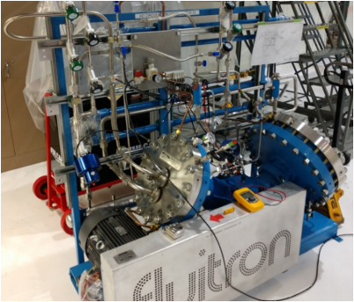
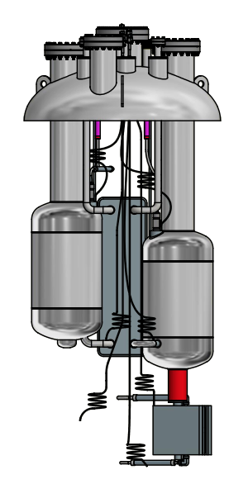
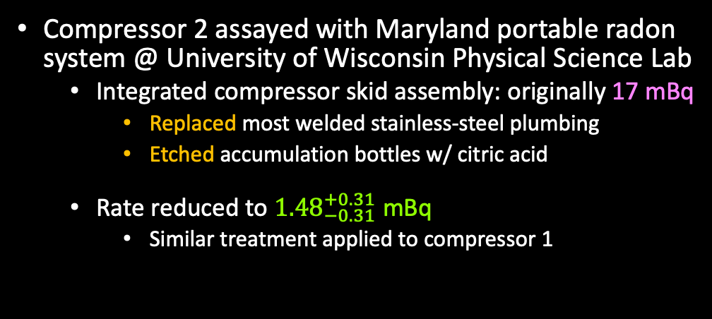

Xenon Circulation System
Compressor 2 assayed with Maryland portable radon
system @ University of Wisconsin Physical Science Lab
  Integrated compressor skid assembly: originally 17 mBq
    Replaced most welded stainless-steel plumbing
    Etched accumulation bottles w/ citric acid
  Rate reduced to ${1.48}_{−0.31}^{+0.31}$ mBq
    Similar treatment applied to compressor 1
Circulation Compressor 2
Xenon Tower
Xenon tower assayed after integration with the
SD Mines portable radon system @ SURF
  High radon activity originally measured
    Possibly due to leak into system from lab air
    Precautionary cleaning:
      Flushed with RadiacwashTM (concentrated solution to remove radioactive contamination)
      Rinsed with deionized water
  Complete xenon tower (post cleaning): ${3.14}_{−0.81}^{+0.86}$ mBq

Slide 11
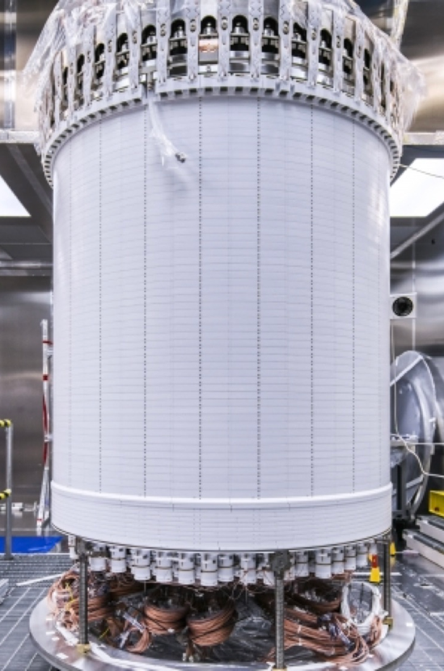

Inner Cryostat Vessel with Full Detector
Assayed with SD Mines portable radon trap
Problem: Outgassed molecules neutralize positively charged radon daughters, significantly lowering collection efficiency.
Solution: Separate radon from contaminates via additional cold trap
  Transfer sample from a cold trap cooled w/ Dry ice + Iso to second trap cooled with LN
  Residual gas analyzer (RGA) used to confirm reduction in contaminant concentration
Results indicate a room-temperature emanation rate of ${46.1}_{−3.8}^{+4.0}$ mBq
  Assumes an even sampling of radon within the ICV
Complete TPC before insertion into ICV

Slide 12
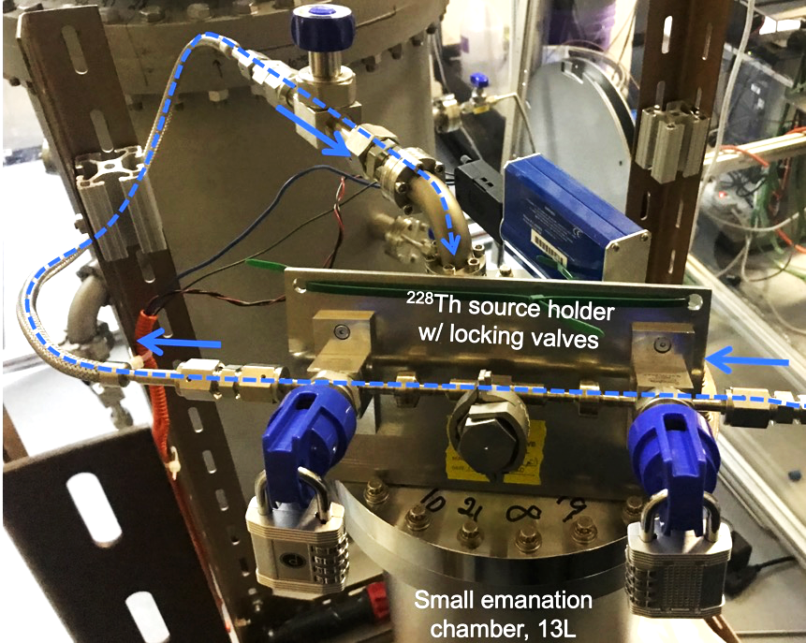

LZ ²²⁸Th Calibration Source (20.11 KBq)
Used to inject short-lived ²²⁰Rn into the TPC for calibration
Assayed to ensure the ²²²Rn contribution is acceptably small
  Setup: Connect to emanation chamber (EC) and allow sample to emanate
  After emanation: Boil-off LN2 injects radon into the EC; proceed with transfer
The ²²²Rn emanation rate
of the LZ ²²⁸Th source is
${0.8}_{−0.2}^{+0.2}$ mBq
Acceptably small compared
to the LZ ²²²Rn background

Slide 13
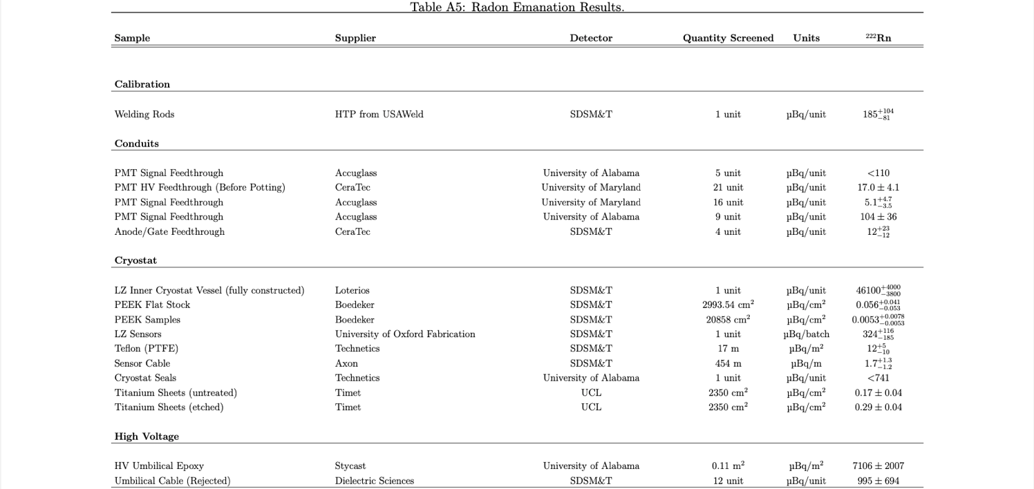
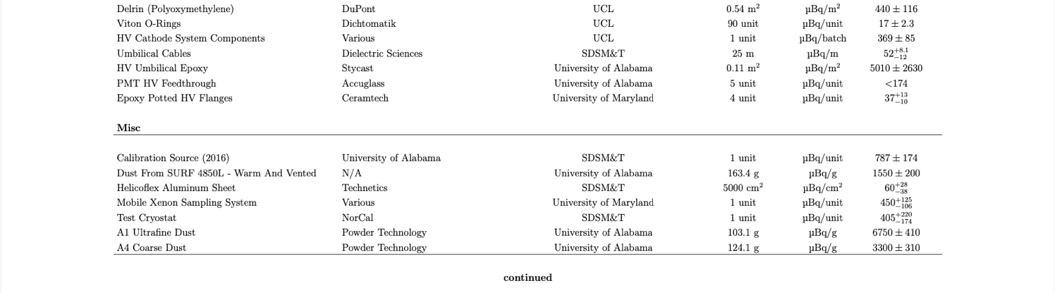
Table of TPC measurement?
Eur.Phys.J.C 80 (2020) 11, 1044
…Only 2 of 6 pages shown here, see paper for more results!!

Slide 14
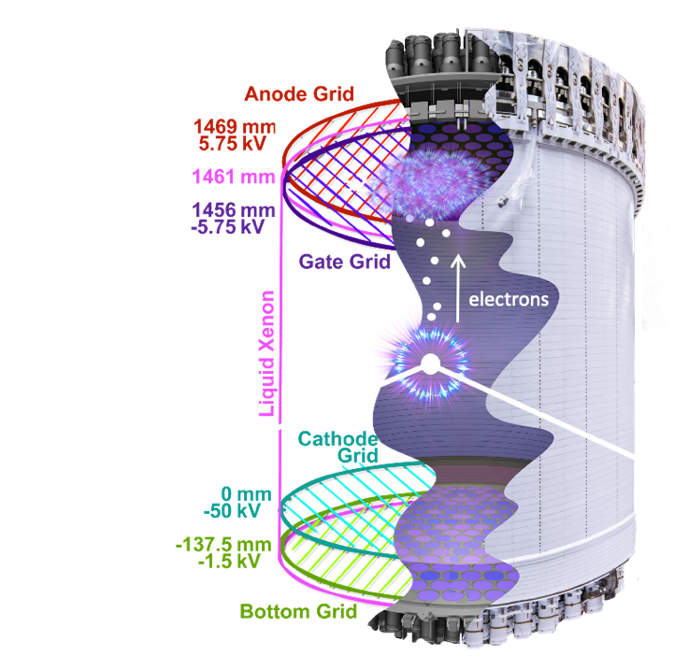





Thank you! Questions?
Thanks to our sponsors and
35 participating institutions!
U.S. Department of Energy Office of Science
Graphic © SLAC, picture overlay N. Angelides

