Slide 1
Use of QQQ-ICP-MS for Ultra Low Background Measurements
Amanda French, Kali Melby, Maria Laura di Vacri, Eric Hoppe, Isaac Arnquist​, Chelsie Beck, Brienne Seiner, Greg Eiden, Khadouja Harouaka
PNNL-SA-174161
Notes:
This is a “trick” mass spectrometrists can use to shift to “domain spaces” to lower backgrounds. May be equivalent to looking at a more minor gamma peak in HPGe…for example….when the dominant peaks are littered by backgrounds

Slide 2
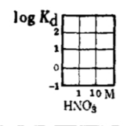
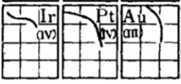
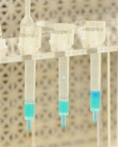
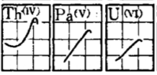
Motivation
Samples containing high concentrations of Mo, Sn, W, Pt, Au and Pb (among others) can create significant interferences for U and Th
Solders
Device Metallization Layers
Capacitors
And many more…
Measuring ²³⁸U and ²³²Th in these complicated matrices is valuable in many fields, including physics and nuclear forensics
Extensive sample pre-processing typically required for ICP-MS analyses
Due to spectral overlap on analytes of interest
Contamination risk for ultra high purity samples
Prevent carry over/damage to interface
Chemical separations not always possible
$$K_{d}= \frac{conc. bound to resin}{conc. in solution}$$
Ichikawa et al 1961
Notes:
Our team at PNNL analyze a variety of electronic samples that often contain high concentrations of W, Au, Sn, etc which are problematic when measuring U.Th using ICP-MS
In order to achieve the best LODs possible, we need to run samples as concentrated as possible. High levels of matrix materials (e.g, Mo, W, Au, Sn, etc) can cause interferences in ICP-MS and/or cause build up on the interface of the instrument.
One way we can deal with high matrix samples is by pre-preprocessing to separate the matrix from the analyte of interest.
We regularly do this for Cu matrices in our lab using column separation – we use resin packed columns where Th/U prefer to stick to the resin and elements like Cu stay in solution. This allows us to elute the U/Th off the resin after passing the entire sample through.
This works with Cu because Cu has a low distribution coefficient (or Kd value) compared to U/Th on the resin we use. This coefficient is used to gain an understanding of how much the element prefers to stick to the resin or stay in solution – elements such as Ir, Pt, Au have similar Kds to that of U/Th, making it difficult to separate using this technique.
This is where ICP-MS/MS comes in…where we can do inline separation of elements that interfere with U/Th analyses (and with in line, it means less sample prep and equates to a faster analysis which is ideal for many different fields and sample types)

Slide 3
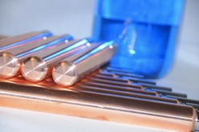
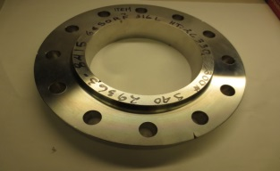
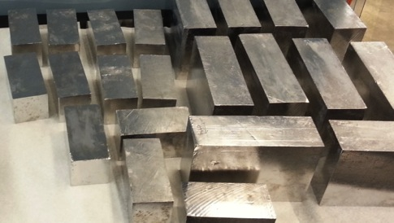
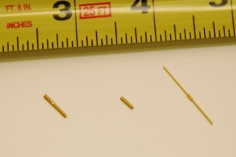
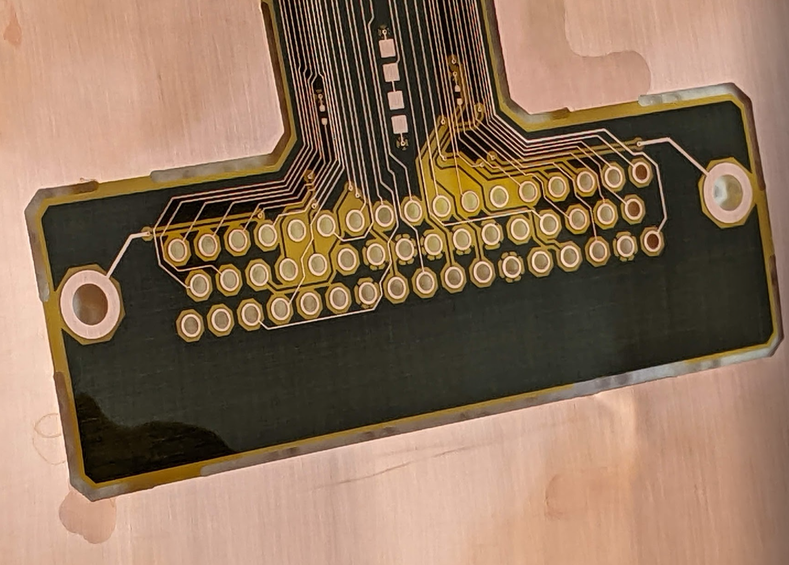
PNNL ICP-MS Sensitivities
Material | Th/U Detection Limits
 | μBq/kg | ppt | ppt
Copper† | <0.1 | <0.01 | <0.01
Titanium, Steel, Brass, Bronze, Lead | <1 | <0.1 | <0.1
Polymers‡ (HDPE, PTFE, Acrylic, Kapton®, etc.) | <1 | <0.1 | <0.1
Nonpolar Liquids (LAB, Refrigerants) | <0.1 | <0.01 | <0.01
Silicon, Quartz, Fused Silica | <1 | <0.1 | <0.1
Cables and Connectors | <1 | <0.1 | <0.1
Electronic Components (resistors, capacitors, etc.) | <0.1 pg/piece <1 nanoBq/piece
Solutions | <0.01 |  | <0.001
Need to go even lower!?!?
We can probably do it with more R&D.
For Reference
1 ppt Th = 4.1 μBq ²³²Th/kg
1 ppt U = 12.4 μBq ²³⁸U/kg
†B.D. LaFerriere, T.C. Maiti, I.J. Arnquist, E.W. Hoppe. NIM A (2015)
‡I.J. Arnquist, J.W. Grate, M. Bliss, E.W. Hoppe. Analytical Chemistry (2017)
Notes:
Here I wanted to show our current DLs achieved with a variety of different materials; typically we can achieve DLs < 0.1 ppt (or 100 ppq).
Our team has presented ICP-MS methods and results over the last 4+ LRTs and we continue to “push the envelope” striving for even better DLs
One of the methods we are currently using to improve these DLs is through use of the QQQ-ICP-MS.

Slide 4
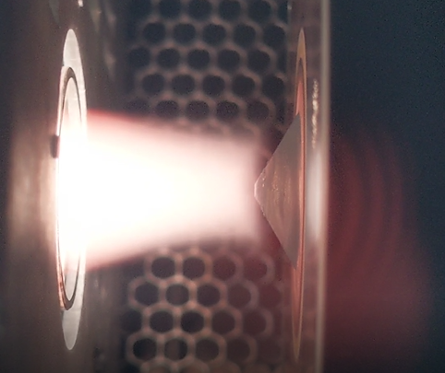
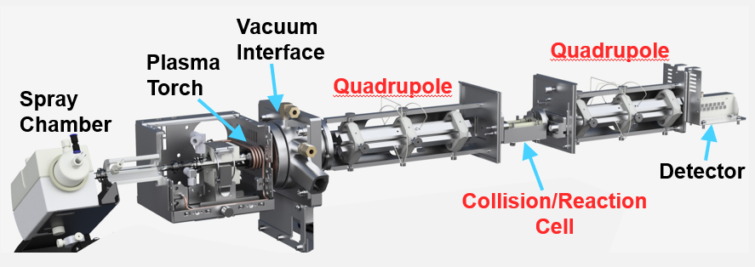
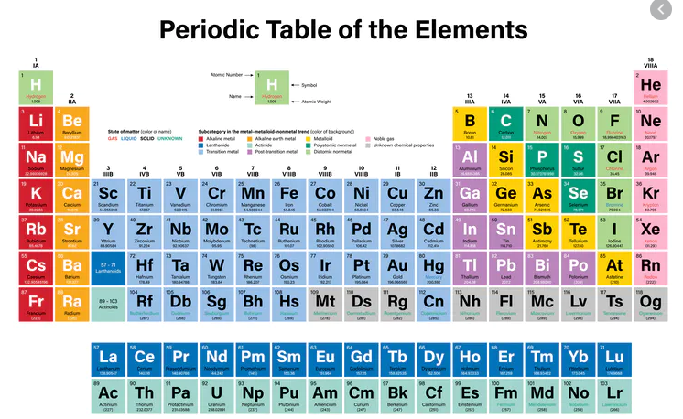
Elemental ICP-MS/MS
Plasma ion source (≈10,000 K)
Elemental MS/MS
CRC
Q1
Q2
¹⁹⁷Au³⁵Cl⁺
²³²Th⁺
¹⁹⁷Au³⁵Cl⁺
²³²Th⁺
232
248
²³²Th¹⁶O⁺
O₂
Notes:
Interferences can come from both the plasma (e.g., Ar) and the sample matrix (e.g, Cl from the HCl used in sample prep)

Slide 5
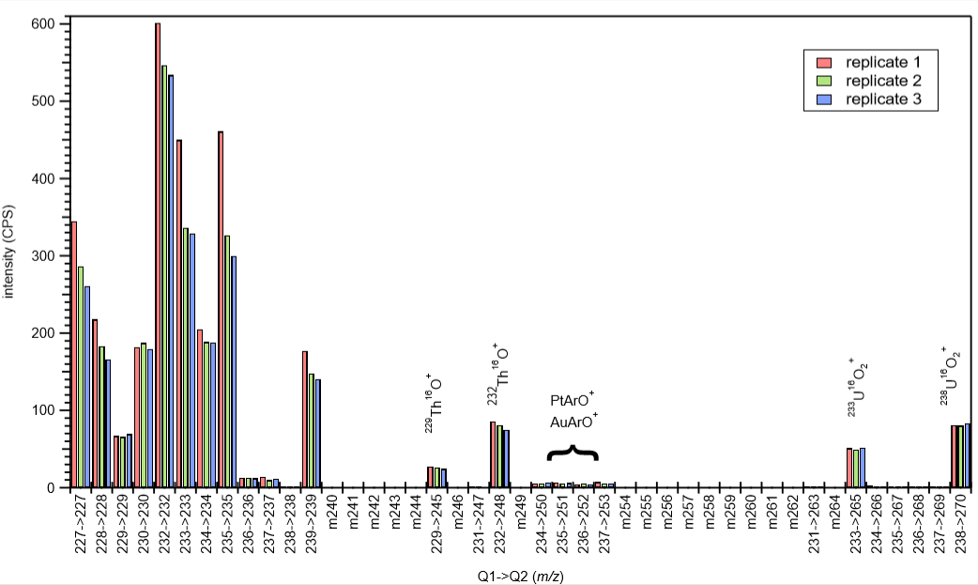
‘Mass Shift’ method – resolving spectral overlap
100 ppq ²²⁹Th and ²³³U in 10 ppm each of W, Ir, Pt, and Au
Th⁺ + O₂ → ThO⁺ + O
U⁺ + O₂ → UO₂⁺
Harouaka K., et al., J. Anal. At. Spectrom., 2020, 35, 2859
Notes:
Here is a recent publication using O2 showing the utility of mass shifting. We were able to mass shift Th and U away from polyatomic interferences using O2 as the reaction gas and achieve absolute detection limits in the fg range.
Emphasize concentrations here…

Slide 6
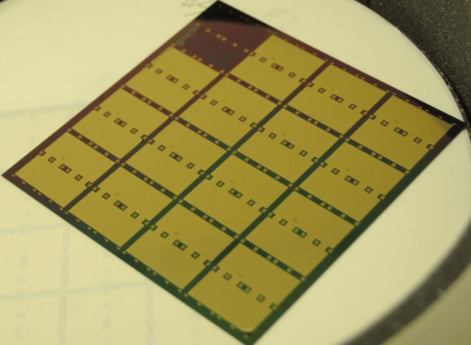
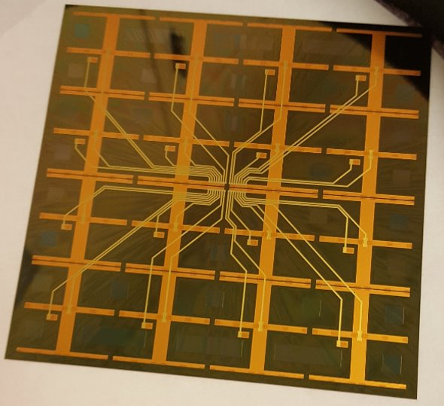
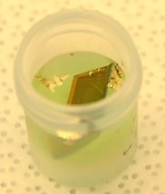
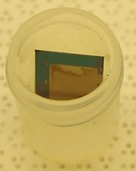
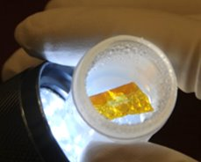
Example 1: Interposer
Back
Material | Mass Fraction
SiO₂ | 0.56%
Cu | 3.60%
Ti | 0.22%
Ni | 2.36%
Pd | 0.32%
Au | 0.07%
Polyimide | 0.67%
Si | 92.20%
Front
Metals digestion​
Aqua regia at RT
Si/SiO₂/Ti digestion​
Mixture of HNO₃ and HF at RT
Polyimide digestion​
HNO₃ in a microwave
Notes:
These are the parts that are problematic (specifically Au) – Au is almost never without Pt (which also causes problem)
This is why it’s critical to know what the samples are made of and how much of the material is there. It not only tells us how to dissolve but also how much can be put on the instrument (before problems appear)

Slide 7
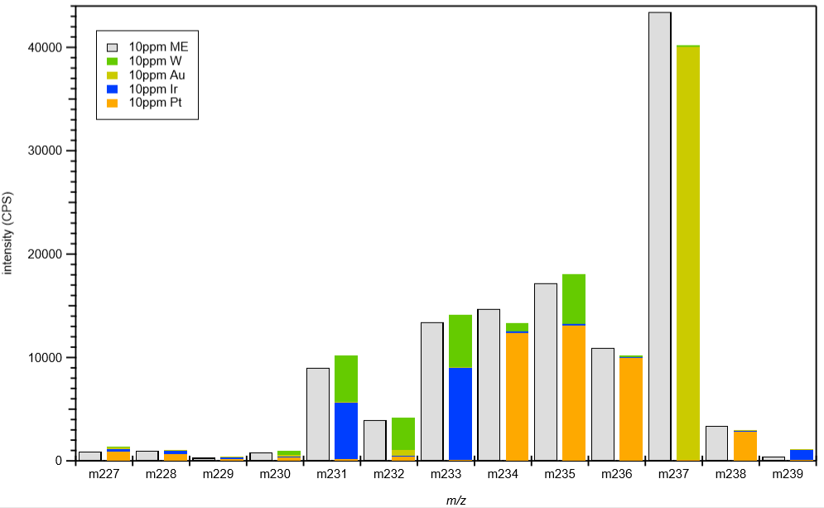
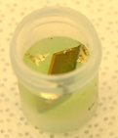
Example 1: Interposer
AuCl⁺ and AuAr⁺ interferences
10ppm Multi-element
10 ppm W
10 ppm Au
10 ppm Ir
10 ppm Pt
Intensity (CPS)
227 228 229 230 231 232 233 234 235 236 237 238 239
m/z
Using O₂ reaction gas, analyte mass shift :
²³²Th⁺ + O₂ → ThO⁺ + O
²³⁸U⁺ + O₂ → UO₂⁺
Metals Fraction
 |  |  | Th-232 |  | U-238 |  | Th-232 |  | U-238
Replicate | Sample wt (g) | Au (g) | pg/g sample | ± inst | pg/g sample | ± inst | µBq/Kg | ± inst | µBq/Kg | ± inst
1 | 0.2122 | 0.015 | 0.7 | 0.2 | 1.42 | 0.17 | 2.9 | 0.8 | 18 | 2
2 | 0.2026 | 0.014 | 0.4 | < LOD | 0.72 | 0.08 | 1.6 | < LOD | 9 | < LOD
Harouaka K., et al., J. Anal. At. Spectrom., 2020, 35, 2859

Slide 8
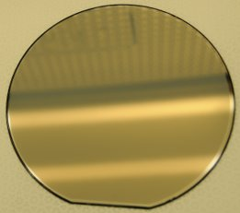
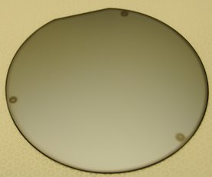
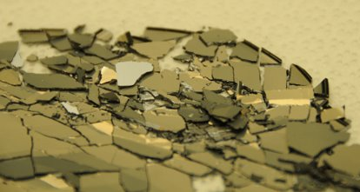
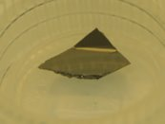
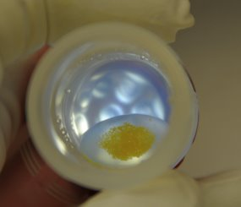
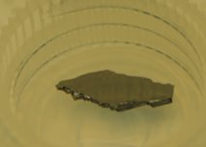
Example 2: Si wafers (containing W)
Full dissolution with tracer (²²⁹Th and ²³³U), followed by precipitation of W (as WO₃):​
Interferences still present after removal of 99% of W
Notes:
W interferences from plasma: WO3 and WO3H

Slide 9
Example 2: Si wafers (containing W)
Using N₂O reaction gas, analyte mass shift :
²³²Th⁺ + N₂O → ThO₂⁺
²³⁸U⁺ + N₂O → UO₂⁺
WO₃⁺ and WO₃H⁺ interferences
Th
U
ThO₂
UO₂
10ppm Multi-element
10 ppm W
10 ppm Au
10 ppm Ir
10 ppm Pt
Intensity (CPS)
m/z | 229 | 232 | 233 | 238 |  | 261 | 264 | 265 | 270
 | Th | Th | U | U |  | ThO₂ | ThO₂ | UO₂ | UO₂
9
 | U-238 |  | U-238
 | pg/g | ± inst | µBq/Kg | ± inst
Replicate 1 | 0.07 | < LOD | 0.9 | < LOD
Replicate 2 | 0.24 | 0.04 | 3.0 | 0.5
Replicate 3 | 0.05 | < LOD | 0.6 | < LOD
227 228 229 230 231 232 233 234 235 236 237 238 239
m/z
Notes:
Thorium left out due to additional complexities and interactions between W and Th

Slide 10
Example 3: K/Ca/Fe assay of dust using NH₃
Potassium provides different challenges
Interferences from argon plasma
ArH⁺
³⁹K⁺ (93.3%) = ³⁸Ar¹H⁺
⁴⁰K⁺ (0.01%) = ⁴⁰Ar⁺
⁴¹K⁺ (6.7%) = ⁴⁰Ar¹H⁺
³⁶Ar (0.34%)
³⁸Ar (0.06%)
⁴⁰Ar (99.6%)
Di Vacri ML, et al., Nuclear Inst and Methods in Physics Research, A, 2021, 994.

Slide 11
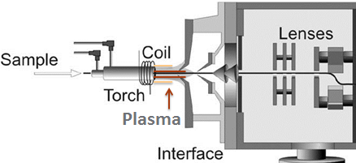
Example 3: K/Ca/Fe assay of dust using NH₃
Cool plasma
Quadrupole 1
Octopole
reaction cell
Quadrupole 2
m/z=39
m/z=39
³⁹K⁺
³⁸ArH⁺
³⁹K⁺
Detector
³⁸ArH⁺
H₃¹⁸O(H₂¹⁶O)⁺
H₃¹⁸O(H₂¹⁶O)⁺
10%NH₃
90% He
 | ⁴⁰K µBq day⁻¹ cm⁻²
PFA vial | 3.3 ± 0.5 *10⁻⁵
Si Coupon | 1.5 ± 0.5 *10⁻⁵
Di Vacri ML, et al., Nuclear Inst and Methods in Physics Research, A, 2021, 994.
Notes:
29-day exposure time
Analyzed as natural K – used to calculate 40K
Method also applicable for Ca and Fe which have plasma interferences in a similar mass range

Slide 12
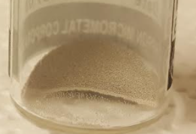
Summary
Achieve lower Th and U detection limits with ICP-MS/MS methods in difficult matrices
O₂ and N₂O gases have been used regularly for mass shift of U and Th
Other gases have been investigated to determine utility under various circumstances
NH₃ + cool plasma provides optimal conditions for K analysis
Method is applicable to a wide variety of difficult matrices that are typically problematic
Sn, W, Au, Ir, Mo, Pb, etc.
Pre-processing is difficult/time consuming or just not available
Allows for more rapid analyses
ICP-MS/MS methods can be used along with improved sample preparation methods to achieve even lower detection limits

Slide 13
This work was supported by the Office of Defense Nuclear Nonproliferation Research and Development within the U.S. Department of Energy’s National Nuclear Security Administration and Pacific Northwest National Laboratory, which is operated by Battelle Memorial Institute for the U.S. Department of Energy under contract DE-AC05-76RLO1830

Slide 14
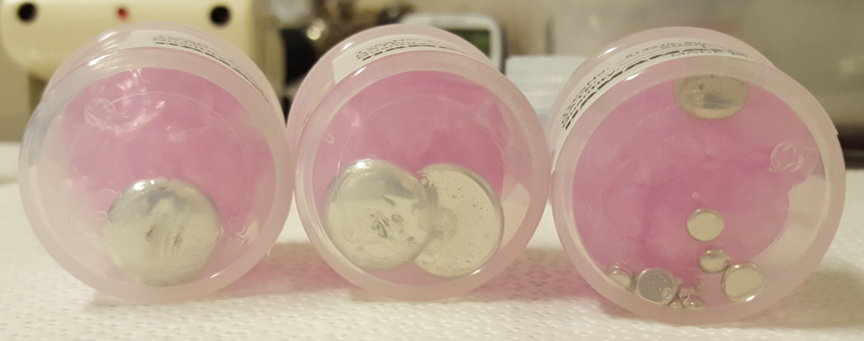
Example 1: Sn/Cu and Sn/Au Solder
SnCu
SnCu
SnAu
SnAu
Sn₂⁺
AuAr⁺ and AuCl⁺

Slide 15
Example 1: Sn/Cu and Sn/Au Solder
Using O₂ reaction gas, analyte mass shift:
²³²Th⁺ + O₂ → ThO⁺ + O
²³⁸U⁺ + O₂ → UO₂⁺
 |  |  | Th-232 |  | U-238 |  | Th-232 |  | U-238
Description | Replicate | sample wt [g] | pg/g | ± inst | pg/g | ± inst | µBq/Kg | ± inst | µBq/Kg | ± inst
SnCu A solder | 1 | 0.8401 | 6 | 3 | 30 | < LOD | 25 | 12 | 372 | < LOD
 | 2 |  | 4 | < LOD | 30 | < LOD | 16 | < LOD | 372 | < LOD
 | 3 |  | 3 | < LOD | 19 | < LOD | 12 | <LOD | 236 | < LOD
SnCu B solder | 1 | 0.7032 | 2 | < LOD | 15 | < LOD | 8 | < LOD | 186 | < LOD
 | 2 |  | 3 | < LOD | 20 | < LOD | 12 | < LOD | 248 | < LOD
 | 3 |  | 15 | 4 | 20 | < LOD | 62 | 16 | 248 | < LOD
SnAu solder | 1 | 0.4771 | 8 | 4 | 32 | 13 | 32 | 16 | 397 | 161
 | 2 | 0.2601 | 8 | 5 | 16 | < LOD | 32 | 20.5 | 198 | < LOD
 | 3 | 0.6712 | 2 | < LOD | 17 | < LOD | 8 | < LOD | 211 | < LOD
AuSn solder balls | 1 | 0.0253 | 68 | 14 | 16 | 7 | 279 | 57 | 198 | 87
 | 2 | 0.0327 | 17 | 3 | 90 | 20 | 70 | 12 | 1116 | 248
 | 3 | 0.0345 | 2 | < LOD | 15 | < LOD | 8.2 | < LOD | 186 | < LOD
Notes:
This is without separating the U/Th from the Sn matrix after quick dilution (i.e., not taking days to separate matrix)
Achieving ppt level detection limits

