Slide 1

Radon daughter plate-out
as a background source in nEXO
Dmitry Chernyak
on behalf of the nEXO collaboration
The University of Alabama

Slide 2
Motivation: Radon daughter background
      Radon daughters can deposit on the nEXO detector surfaces while they are exposed to air:
$${}_{}^{222}{Rn\underset{→}{\begin{aligned}α \\ 3.82 d\end{aligned}}{}_{}^{218}{Po\underset{→}{\begin{aligned}α \\ 3.1 m\end{aligned}}{}_{}^{214}{Pb\underset{→}{\begin{aligned}β \\ 27.1 m\end{aligned}}{}_{}^{214}{Bi}\underset{→}{\begin{aligned}β \\ 19.9 m\end{aligned}}{}_{}^{214}{Po}}}\underset{→}{\begin{aligned}α \\ 164 μs\end{aligned}}{}_{}^{210}{Pb\underset{→}{\begin{aligned}β \\ 22.2 y\end{aligned}} {}_{}^{210}{Bi\underset{→}{\begin{aligned}β \\ 5.0 d\end{aligned}}{}_{}^{210}{Po\underset{→}{\begin{aligned}α \\ 138 d\end{aligned}}{}_{}^{206}{Pb}}}}}$$
²²²Rn daughters attach to surfaces of nEXO materials → accumulation of ²¹⁰Pb → growth of ²¹⁰Po →
→ possible (α, n) reactions on low-Z nuclei → neutrons can create ¹³⁷Xe and background events in the active LXe
Detector part | Area [m²] | ²¹⁰Po activity
TPC vessel | 7.84 | 4.7 mBq/m²
SiPMs | 11.43 | 200 mBq/m²
Sapphire rods | 0.5 | 1.0 Bq/m²
Charge backing | 2.54 | 1.1 Bq/m²
Interposer | 11.43 | 218 mBq/m²
Inner cryostat liner | 40.72 | 2.4 Bq/m²
Monte Carlo studies were performed to quantify how much ²¹⁰Po can be present on each component to contribute 0.063% to the background or less.
What are allowable air exposure durations?
We need to know the ²¹⁰Pb activity growth rate

Slide 3
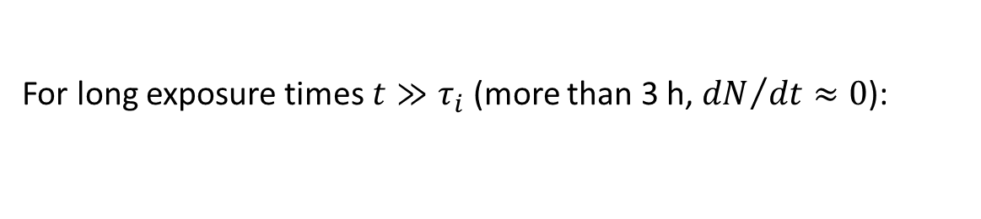
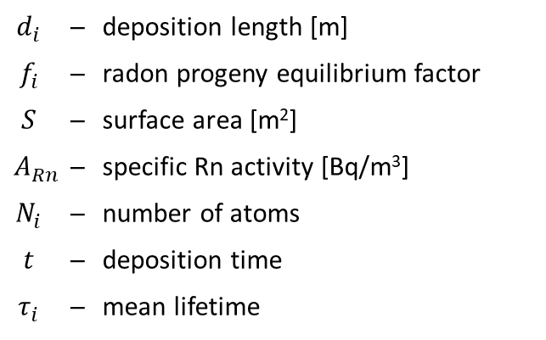

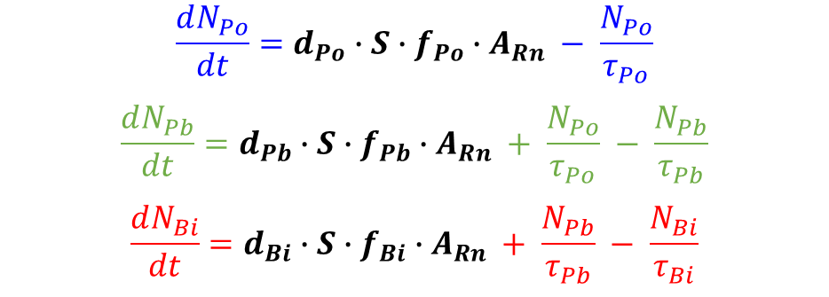
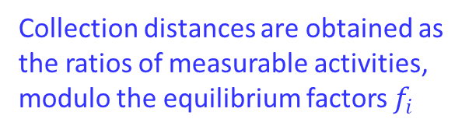
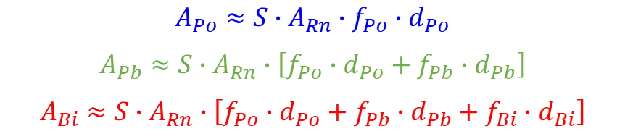
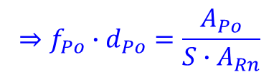
Radon daughter attachment problem: Growth
The growth rates for ²¹⁸Po, ²¹⁴Pb, and ²¹⁴Bi are
²¹⁸Po rate of change proportional to number of ²¹⁸Po atoms in air, not ²²²Rn
$$\frac{dN_{Po}}{dt}=d_{Po}∙S∙f_{Po}∙A_{Rn} − \frac{N_{Po}}{τ_{Po}}$$
$$\frac{dN_{Pb}}{dt}=d_{Pb}∙S∙f_{Pb}∙A_{Rn} + \frac{N_{Po}}{τ_{Po}} − \frac{N_{Pb}}{τ_{Pb}}$$
$$\frac{dN_{Bi}}{dt}=d_{Bi}∙S∙f_{Bi}∙A_{Rn} + \frac{N_{Pb}}{τ_{Pb}} − \frac{N_{Bi}}{τ_{Bi}}$$
$$d_{i}$$ | ─ | deposition length [m]
$$f_{i}$$ | ─ | radon progeny equilibrium factor
$$S$$ | ─ | surface area [m²]
$$A_{Rn}$$ | ─ | specific Rn activity [Bq/m³]
$$N_{i}$$ | ─ | number of atoms
$$t$$ | ─ | deposition time
$$τ_{i}$$ | ─ | mean lifetime
For long exposure times $t≫τ_{i}$ (more than 3 h, ${dN}/{dt}≈0$):
$$⇒f_{Po}∙d_{Po}=\frac{A_{Po}}{S∙A_{Rn}}$$
$$A_{Po}≈S∙A_{Rn}∙f_{Po}∙d_{Po}$$
$$A_{Pb}≈S∙A_{Rn}∙\left[{f_{Po}∙d}_{Po}+f_{Pb}∙d_{Pb}\right]$$
$$A_{Bi}≈S∙A_{Rn}∙\left[f_{Po}∙{d_{Po}+f_{Pb}∙d}_{Pb}+f_{Bi}∙d_{Bi}\right]$$
Collection distances are obtained as the ratios of measurable activities, modulo the equilibrium factors $f_{i}$
Every ²¹⁴Bi decay creates a ²¹⁰Pb atom. The rate of growth $R_{210Pb}$ $\left[\frac{Bq}{m^{2}∙s}\right]$ of the ²¹⁰Pb surface activity is
$$R_{210Pb}=\frac{A_{Rn}}{τ_{210Pb}}∙\left[f_{Po}∙{d_{Po}+f_{Pb}∙d}_{Pb}+f_{Bi}∙d_{Bi}\right]$$
Effective collection length

Slide 4
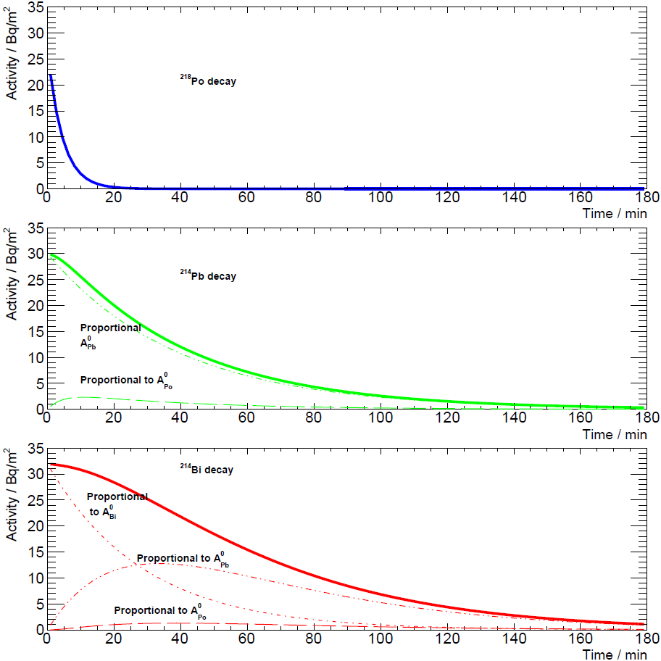
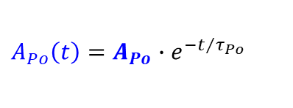

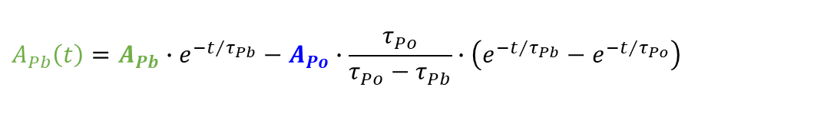
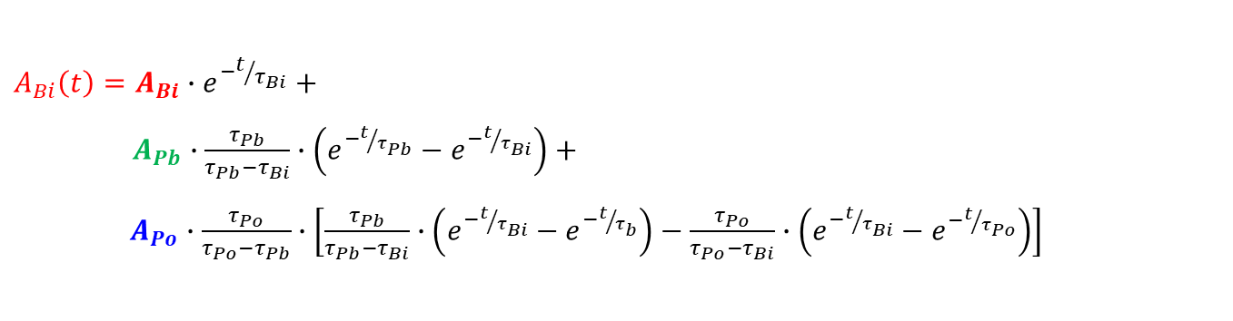
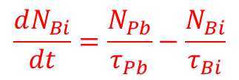
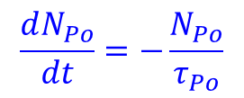
Radon daughter attachment problem: Decay
After removing samples from contact with air, the decay rates for ²¹⁸Po, ²¹⁴Pb, and ²¹⁴Bi are
$$\frac{dN_{Po}}{dt}=−\frac{N_{Po}}{τ_{Po}}$$
$$\frac{dN_{Pb}}{dt}=\frac{N_{Po}}{τ_{Po}}−\frac{N_{Pb}}{τ_{Pb}}$$
$$\frac{dN_{Bi}}{dt}=\frac{N_{Pb}}{τ_{Pb}}−\frac{N_{Bi}}{τ_{Bi}}$$
The solutions of these equations are
$$A_{Po}\left(t\right)=A_{Po}∙e^{−t/{τ_{Po}}}$$
$$A_{Pb}\left(t\right)=A_{Pb}∙e^{−t/{τ_{Pb}}}−A_{Po}∙\frac{τ_{Po}}{τ_{Po}−τ_{Pb}}∙\left(e^{−t/{τ_{Pb}}}−e^{−t/{τ_{Po}}}\right)$$
$$A_{Bi}\left(t\right)=A_{Bi}∙e^{−t/{τ_{Bi}}}+$$
$A_{Pb}∙\frac{τ_{Pb}}{τ_{Pb}−τ_{Bi}}∙\left(e^{−t/{τ_{Pb}}}−e^{−t/{τ_{Bi}}}\right)$ $+$
$A_{Po}∙\frac{τ_{Po}}{τ_{Po}−τ_{Pb}}∙$ $\left[\frac{τ_{Pb}}{τ_{Pb}−τ_{Bi}}∙\left(e^{−t/{τ_{Bi}}}−e^{−t/{τ_{b}}}\right)−\frac{τ_{Po}}{τ_{Po}−τ_{Bi}}∙\left(e^{−t/{τ_{Bi}}}−e^{−t/{τ_{Po}}}\right)\right]$
Get the effective collection length by measuring the time dependence of ²¹⁸Po and ²¹⁴Po (daughter of ²¹⁴Bi) α-particles

Slide 5
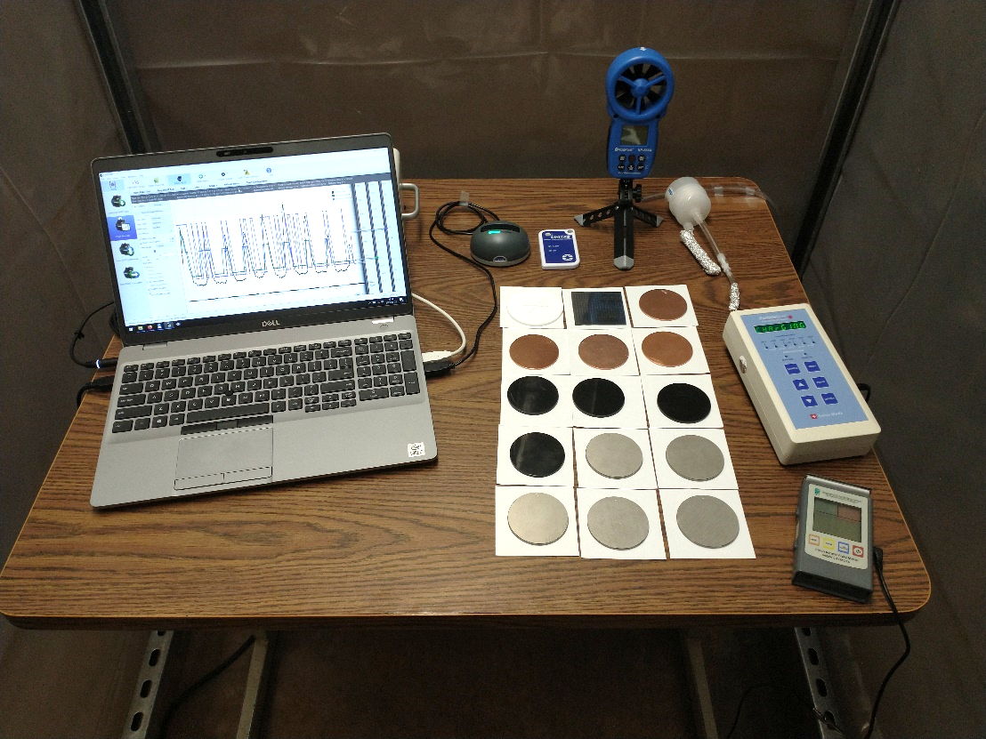
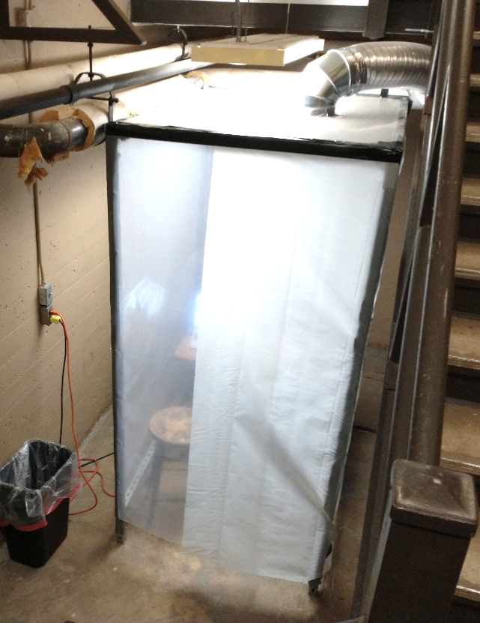
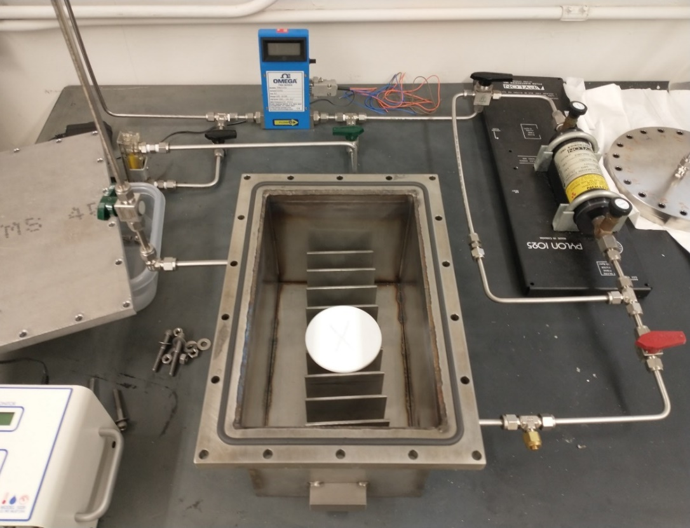
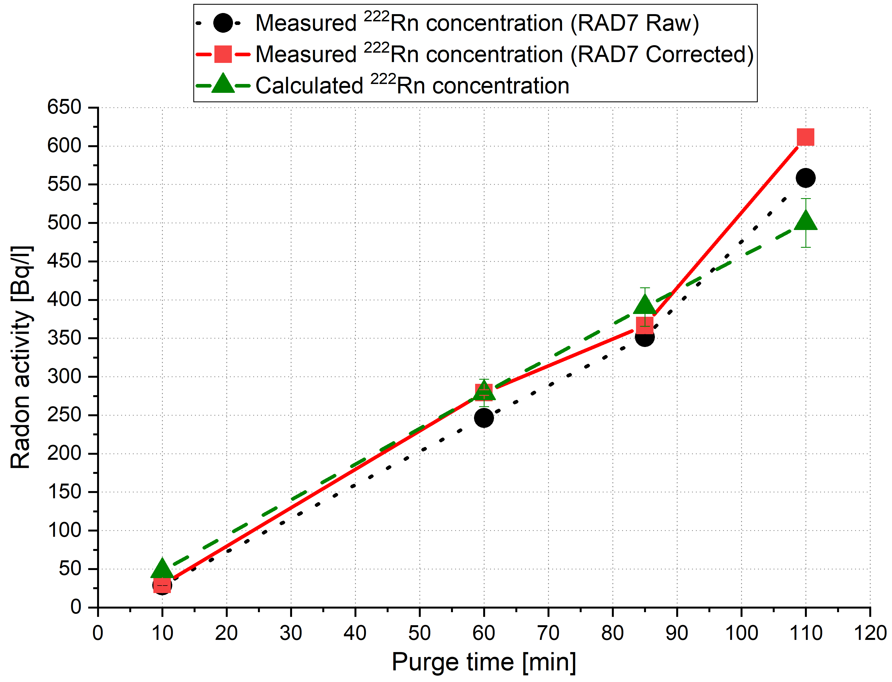
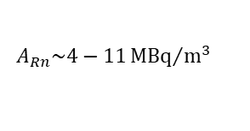

Sample exposure
Samples were exposed to air in a basement lab with high ²²²Rn activity
$$A_{Rn}\sim 50−400{Bq}/{m^{3}}$$
$$A_{Rn}\sim 4−11{MBq}/{m^{3}}$$
Basement lab exposure:
      The following environmental parameters were monitored and recorded:
        Temperature
        Relative humidity
        Pressure
        Radon concentration
        Filtered airflow
        Airborne particle concentrations
        Sample surface charge
      Some parameters can be controlled to create specific conditions
Rn source exposure:
      Purge box with the high-activity PYLON RN-1025 ²²²Rn source
      Radon activity can be controlled by nitrogen flow and exposure time
      Radon activity was calibrated using Durridge RAD7 detector

Slide 6
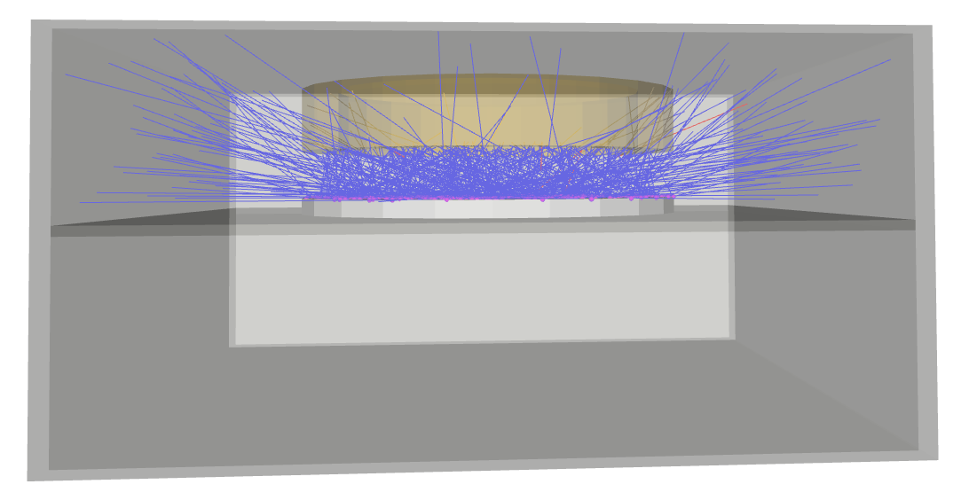
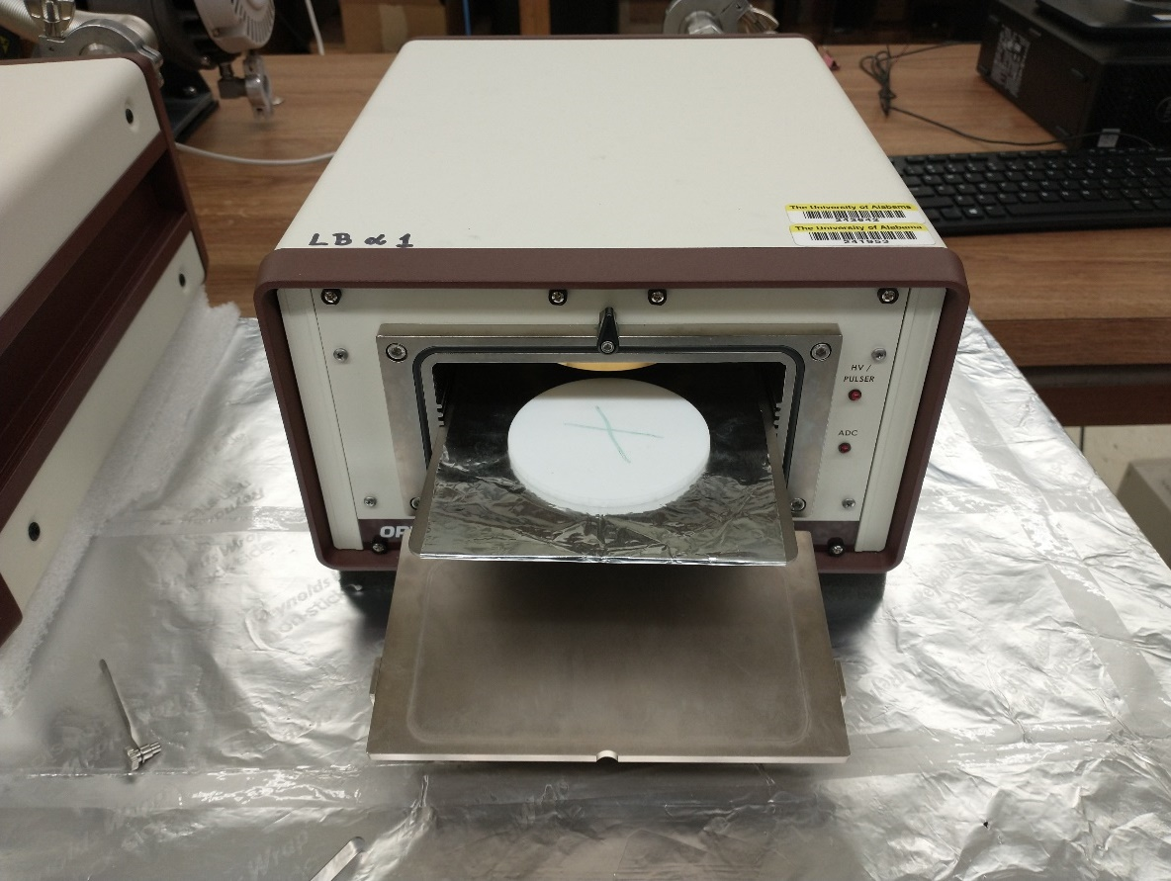
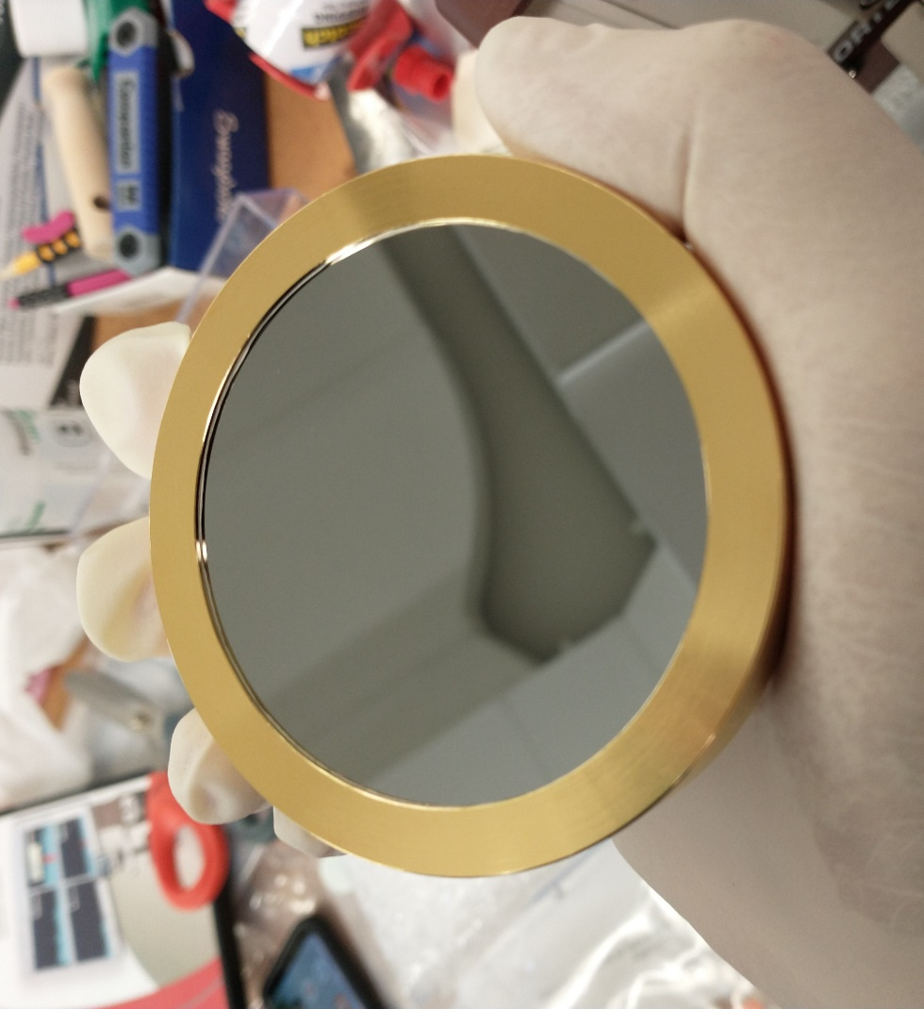
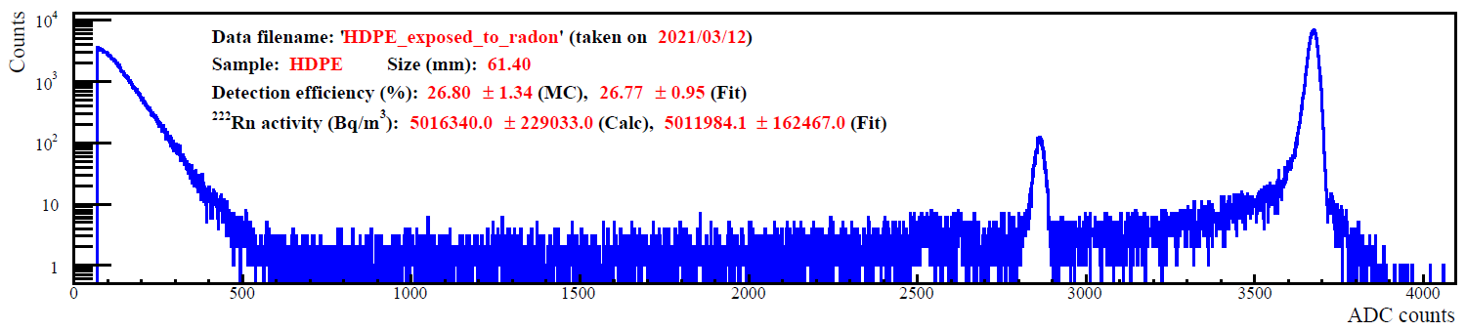
Measurements
Samples were measured using ORTEC Alpha Mega alpha spectrometer with the ULTRA-AS low-background silicon detector
      GEANT4 simulation was used to estimate the detection efficiency for each sample
Number of measurements
Sample | Basement | Rn source
Copper | 391 | 14
SiPM | 96 | 6
HDPE | 138 | 7
Teflon | 133 | 11
Nickel | 123 | —
Fused Silica | 76 | —
Carbon Fiber | 58 | —
Metallized Silica | 55 | —
Sapphire | 57 | —
²¹⁴Po
²¹⁸Po

Slide 7
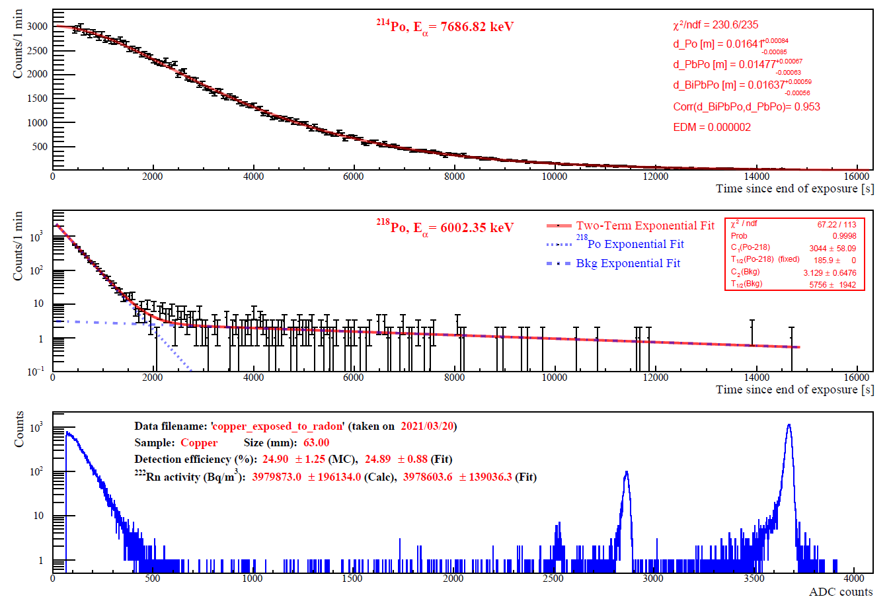
Radon source results
      Use of the radon source verified the time fit
      Effective collection lengths are similar for all samples
Sample | Number of measurements | Average effective collection length [m]
Copper | 14 | 0.020 ± 0.008
SiPM | 6 | 0.028 ± 0.008
HDPE | 7 | 0.016 ± 0.006
Teflon | 11 | 0.016 ± 0.003
²¹⁴Po
²¹⁸Po
Standard deviations reported

Slide 8
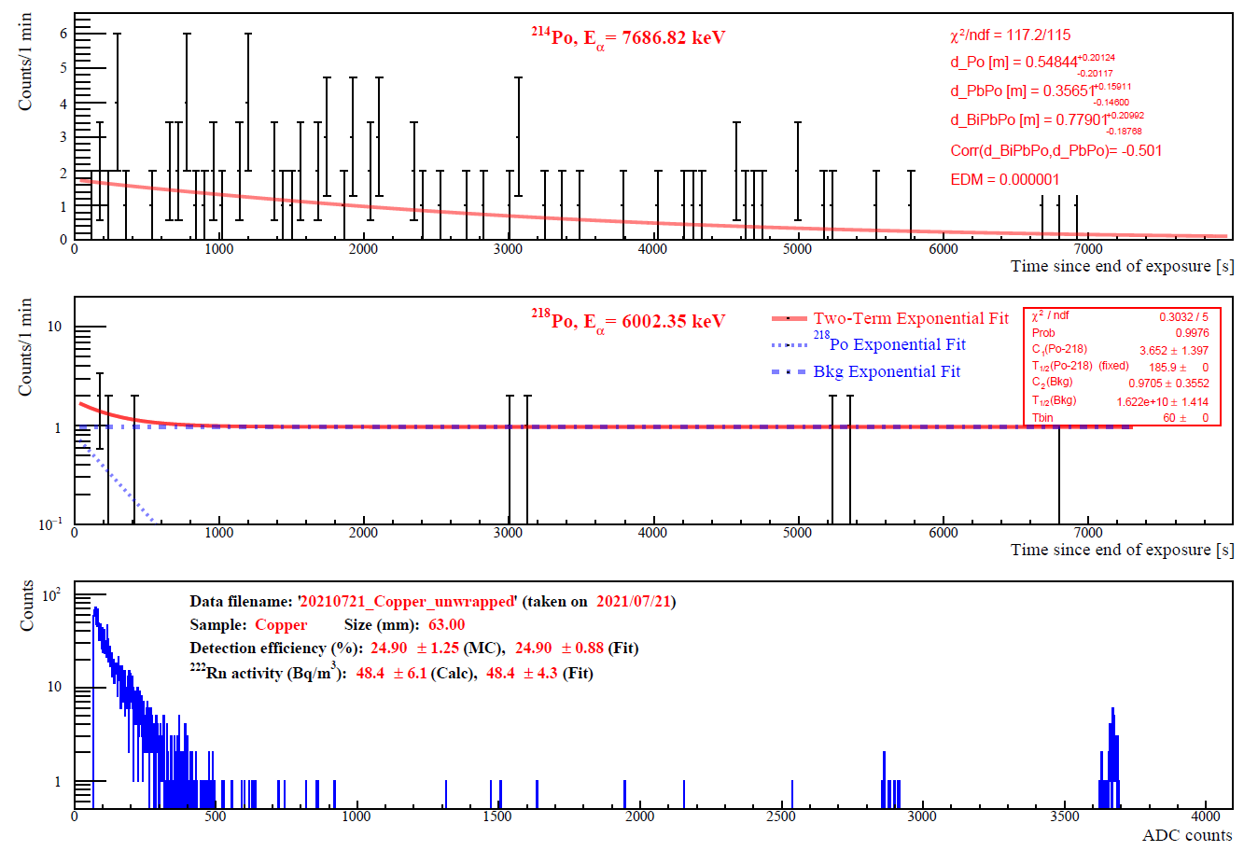
Basement lab conditions
Samples were exposed to the basement air in the following conditions:
Fan ON High: Tent closed, air exchanges 2.89 min⁻¹
Fan ON Low: Tent closed, air exchanges 0.36 min⁻¹
Fan OFF: Tent closed, air exchanges 0 min⁻¹
Fan OFF: Tent opened, air exchanges 0 min⁻¹
Surface biased using HV
Surface covered with paper tissue
²¹⁴Po
²¹⁸Po
Fan ON High and Low airflows have 400 and 50 times higher volume exchange rates than one at SNOLAB, respectively.
²¹⁸Po detection of about 16 atoms
Measurements are essentially background free

Slide 9
Detailed attachment results

Slide 10
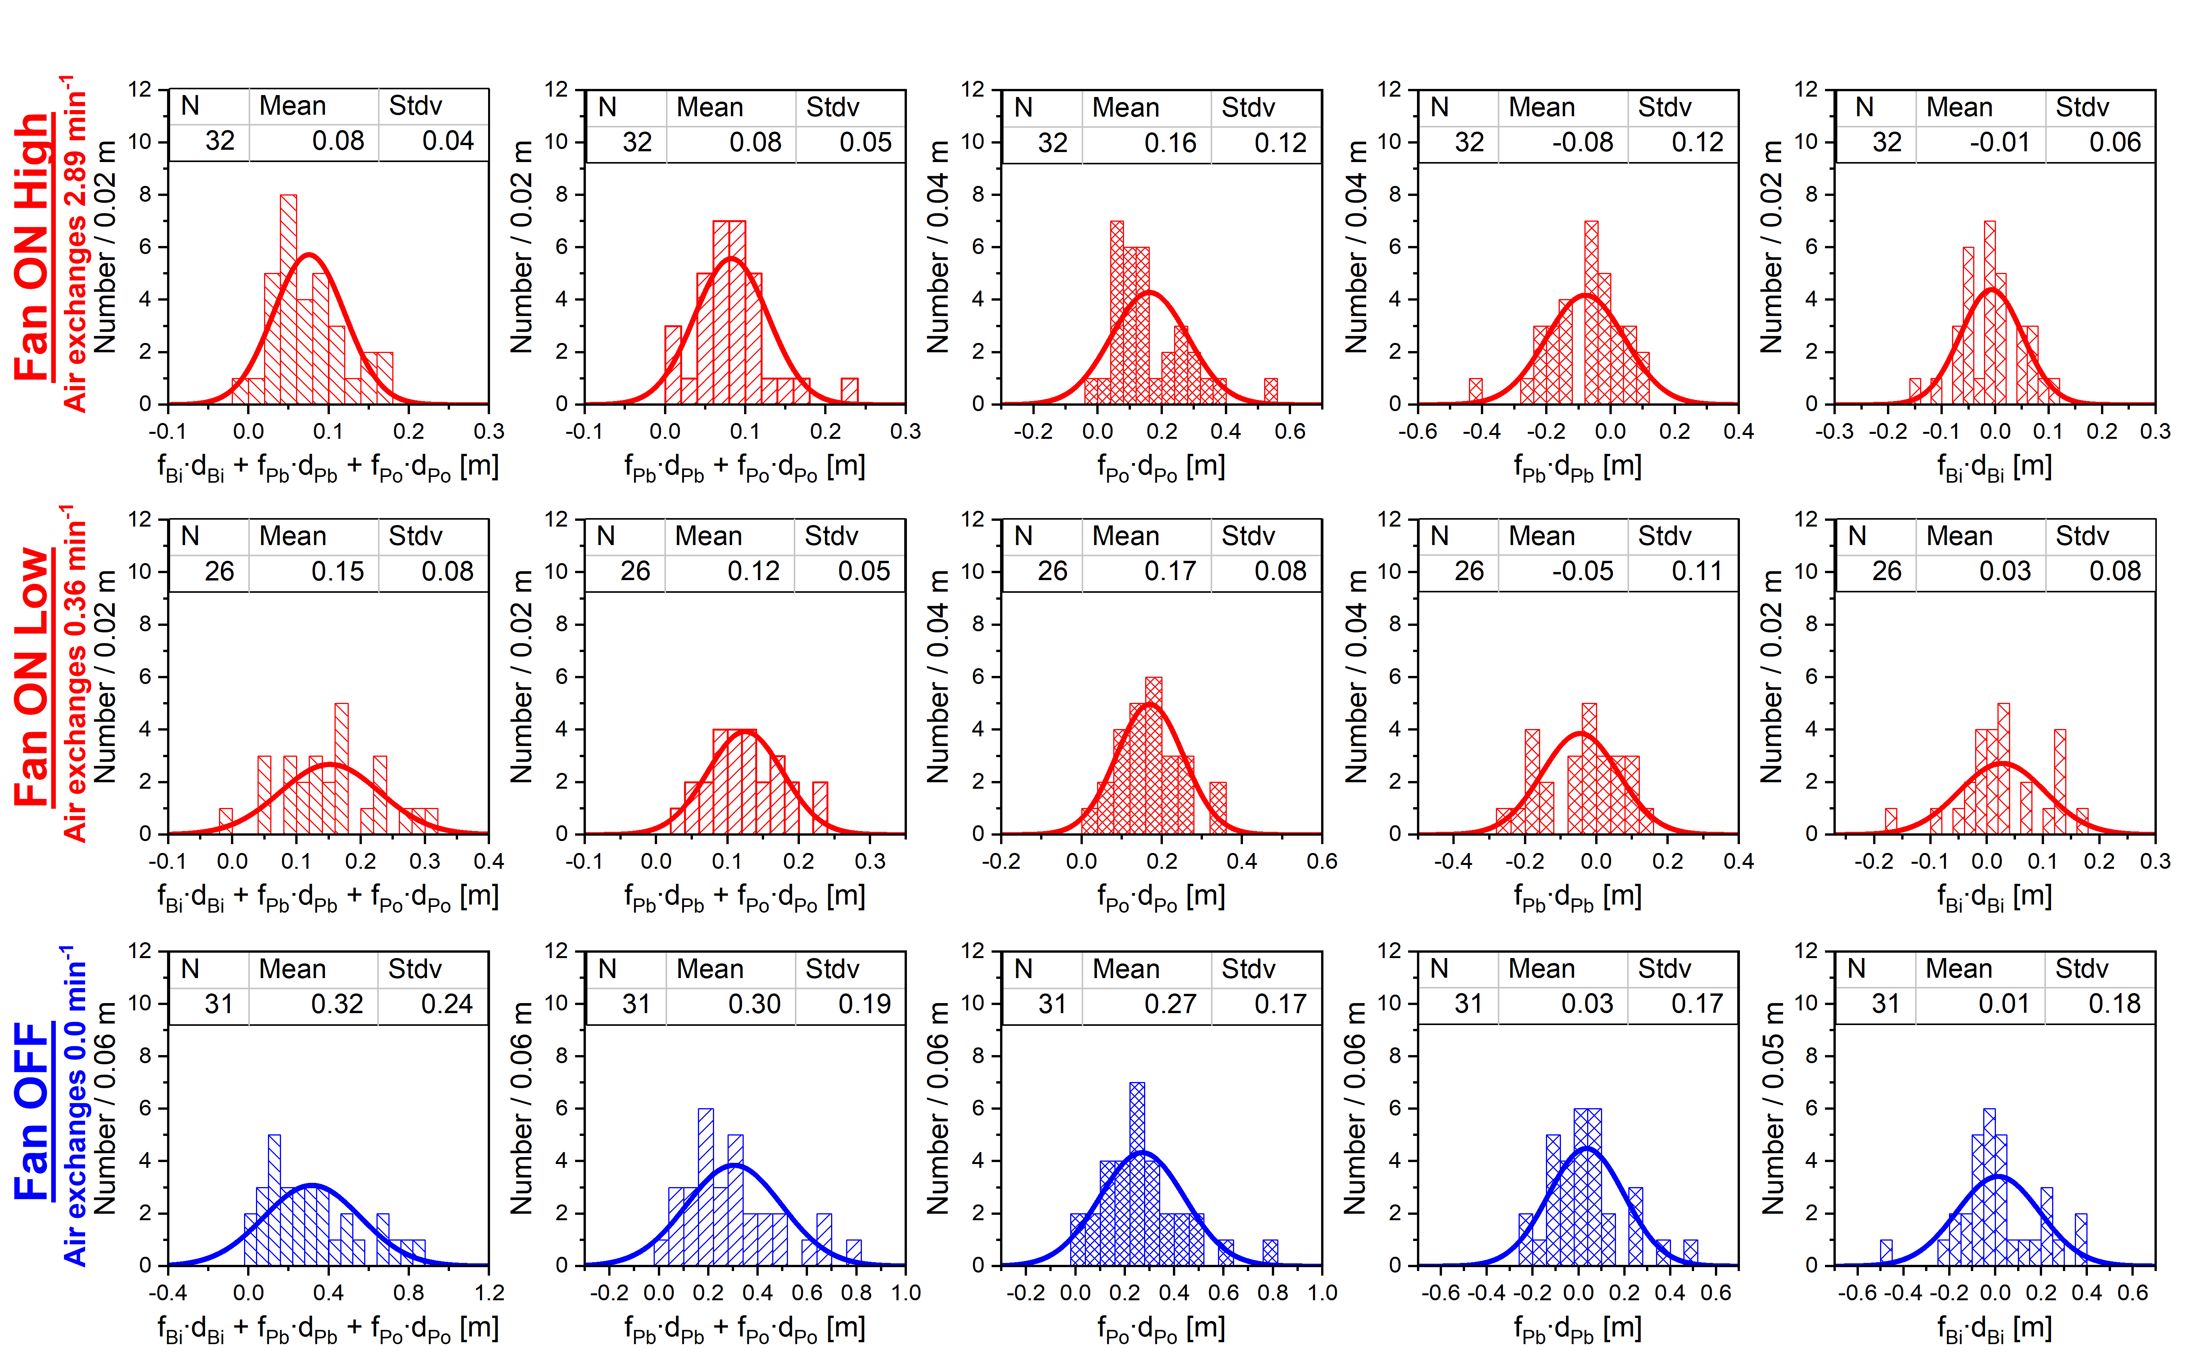
Basement lab results: Copper

Slide 11
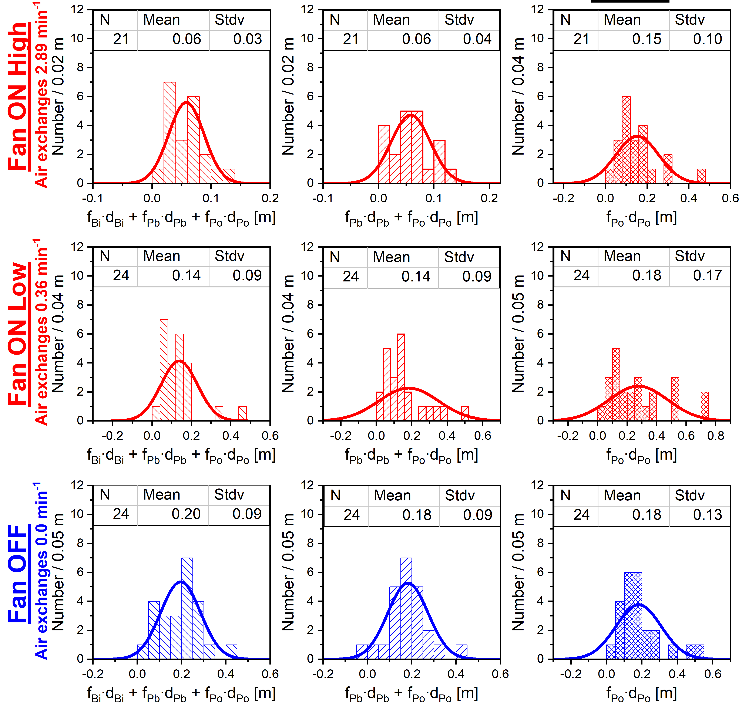
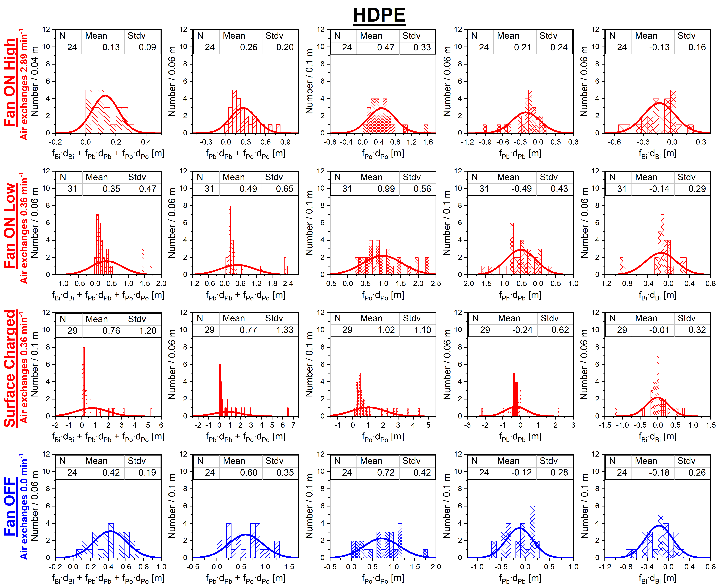
Basement lab results: SiPM and HDPE
SiPM
HDPE

Slide 12
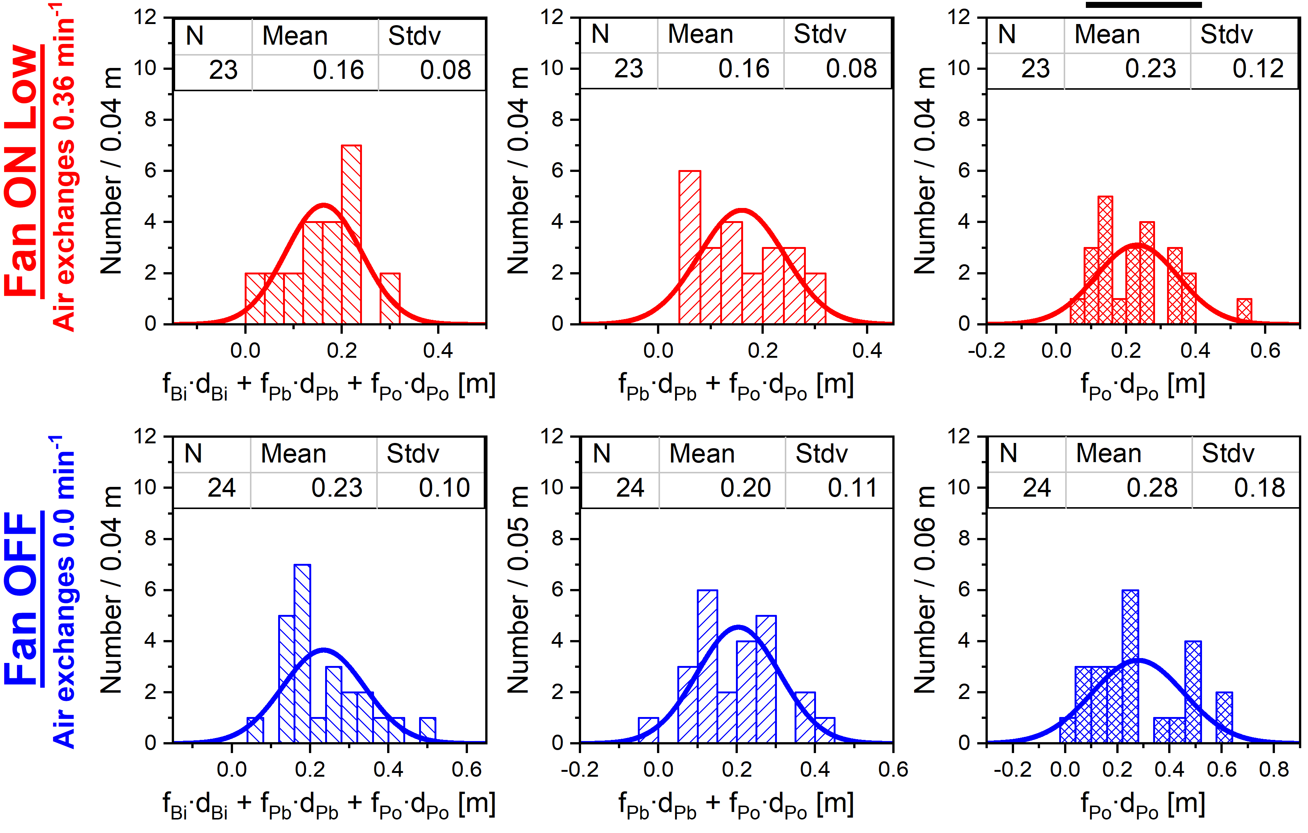
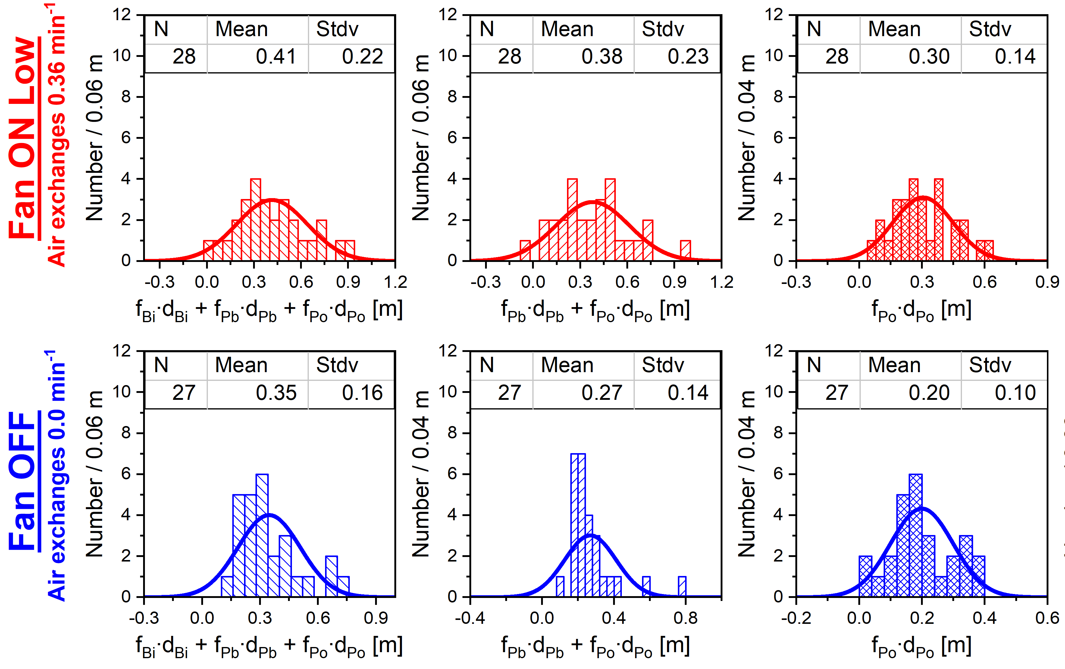
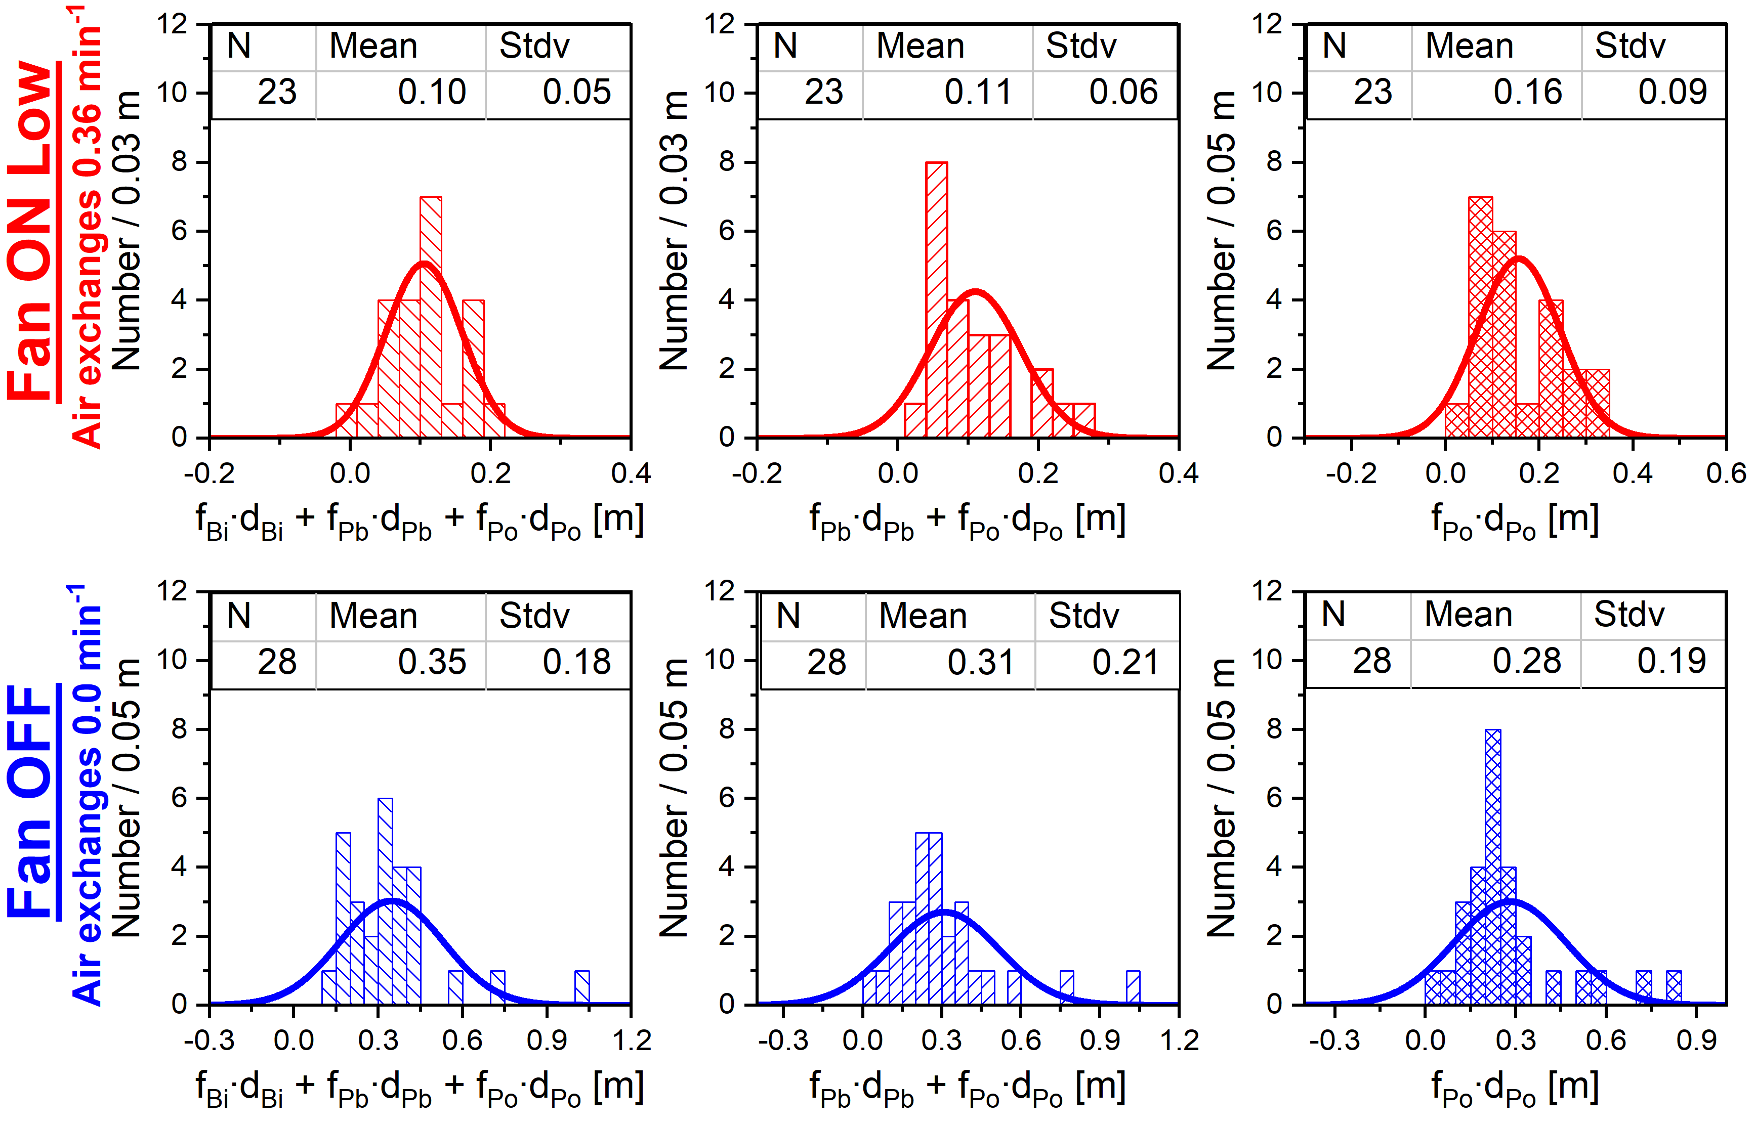
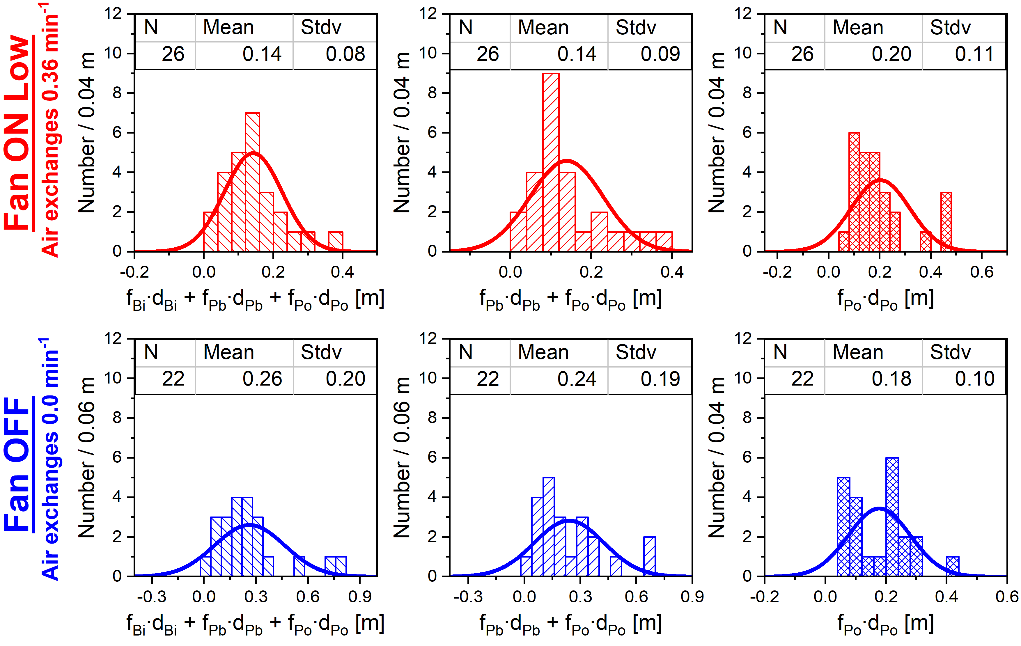
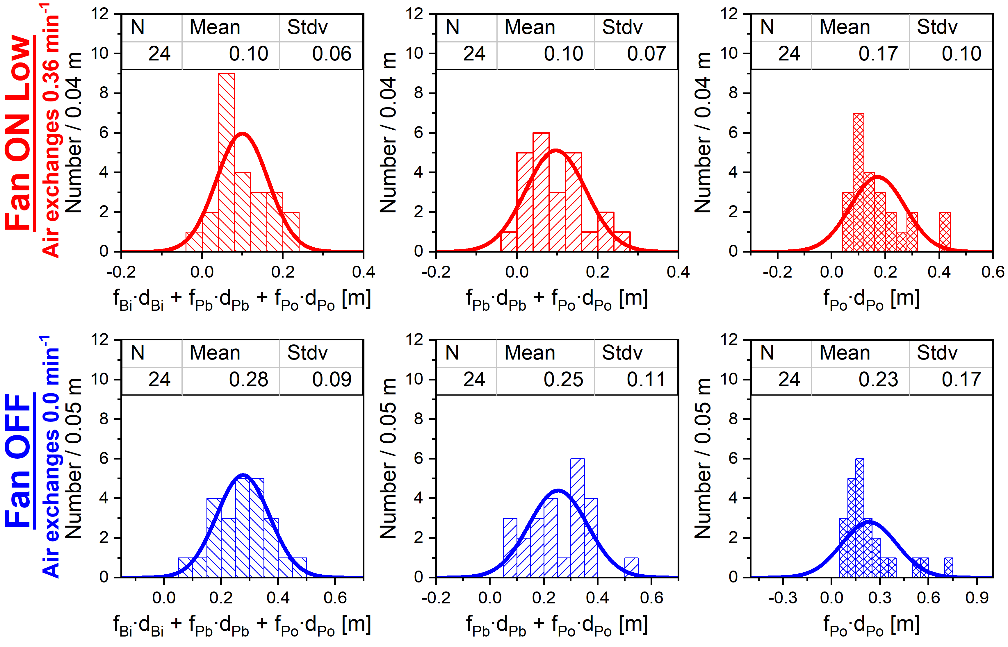
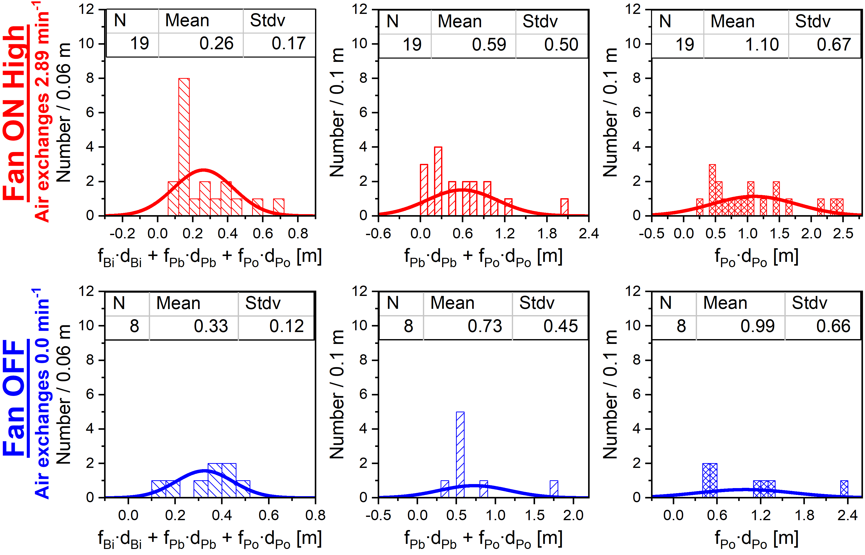
Basement lab results: Other materials
Carbon Fiber
Sapphire
Nickel
Metallized Silica
Fused Silica
Teflon

Slide 13
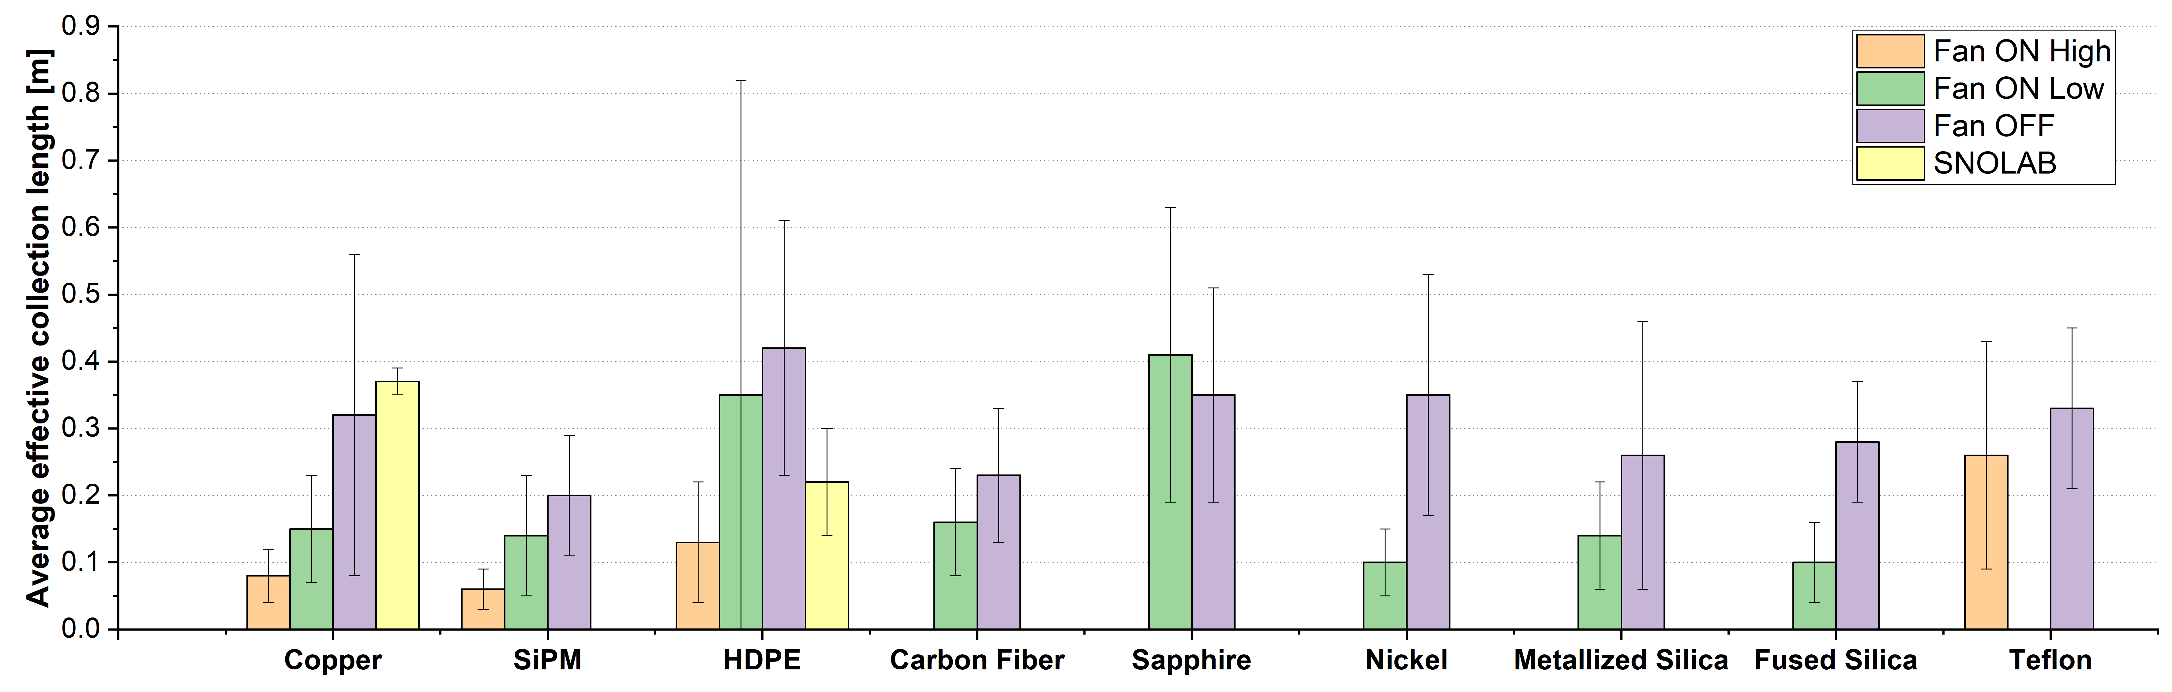
Basement lab results: All materials
At a radon concentration of 135 Bq/m³ and an allowable ²¹⁰Po activity of 4.7 mBq/m² the allowed exposure time is 30.5 hours, assuming the ²¹⁰Po activity equals that of ²¹⁰Pb
      No pronounced materials dependence observed for measured materials
      Average effective collection length is lower for higher air volume exchange rates

Slide 14
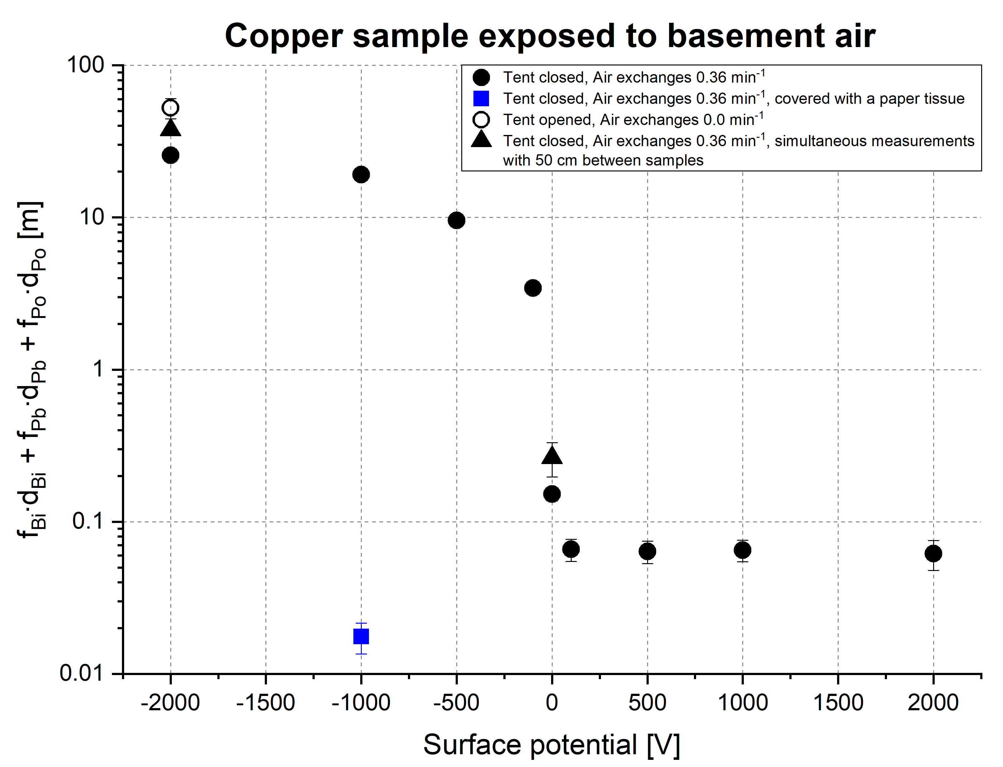
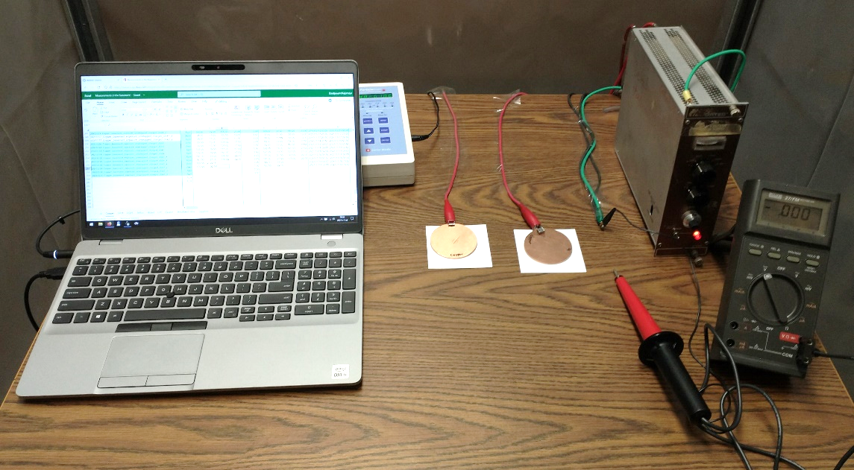
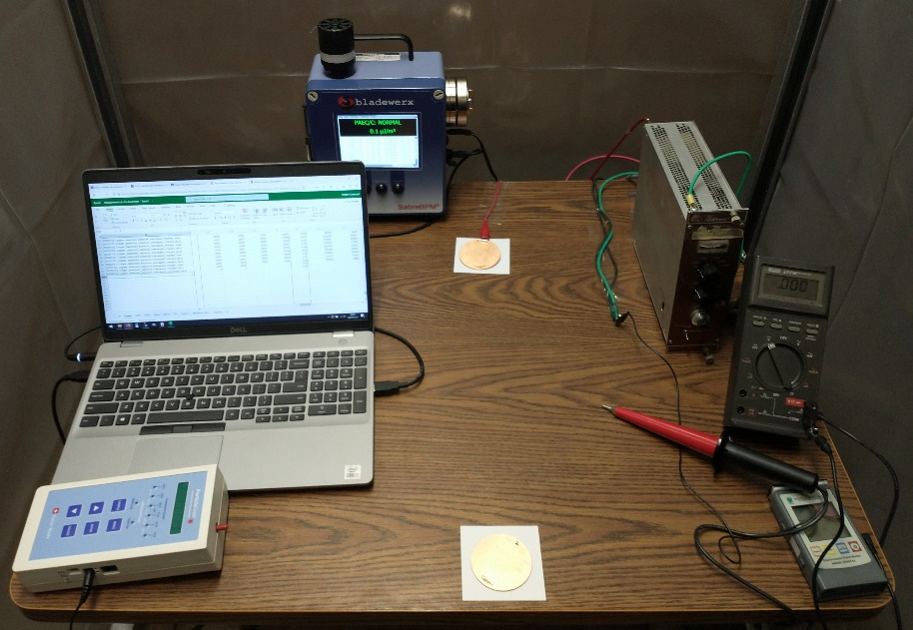
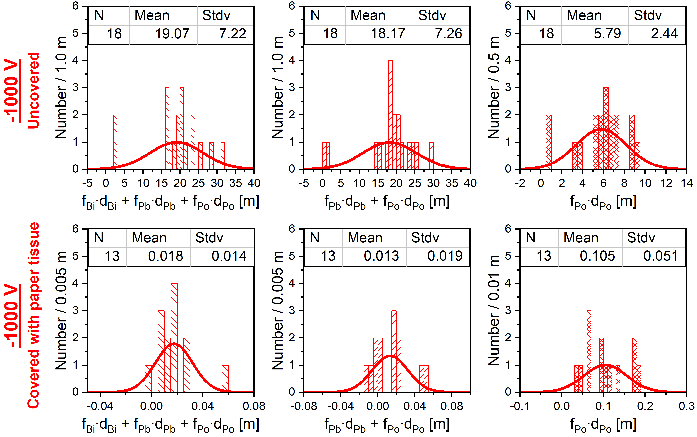
Basement lab results : Biased Copper
Attachment reduction can be achieved by biasing or covering with a Kimwipe (factor 1059 ± 250 reduction due to coverage observed at -1000 V biasing).

Slide 15
Radon progeny activities and equilibrium factor
Equilibrium factor for ²¹⁸Po was measured using Bladewerx Sabre BPM² alpha/beta monitor

Slide 16
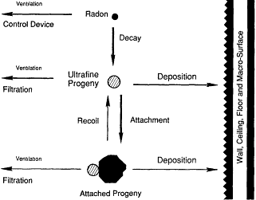
Comparison of results with Jacobi model
Copper measurement results were compared with Jacobi model.
The idea behind the Jacobi model is straight forward: account for all disappearance mechanisms, assuming steady state.
According to the Jacobi deposition model Fan OFF conditions are closest to SNOLAB environment.
Our application of Jacobi model can’t predict effective collection lengths quantitatively, but only qualitatively.
Comparative Dosimetry of Radon in Mines and Homes. National Academies Press, 1991
Volume exchange rate, min⁻¹ | Clean tent | Effective collection length [m] | Average effective collection length [m] | ²¹⁸Po equilibrium factor [a.u.]
 |  | Jacobi model | Measured | Jacobi model |  | Measured
 |  |  |  | Diffusive attachment to surfaces | Tuned attachment velocity
2.89 | Closed | 0.0028 | 0.08 ± 0.04 | 0.071 | 0.047 | 0.012 ± 0.003
0.36 | Closed | 0.017 | 0.15 ± 0.08 | 0.36 | 0.15 | 0.062 ± 0.019
0.0 | Closed | 0.13 | 0.23 ± 0.07 | 0.84 | 0.83 | 0.34 ± 0.09
 | Opened | 0.18 | 0.32 ± 0.24 | 0.93 | 0.93 | 0.45 ± 0.11
0.0070 | SNOLAB | 0.17 | 0.37 ± 0.02 | 0.94

Slide 17
Summary
      ²¹⁰Po surface radioactivity can contribute to a background of the nEXO experiment through nuclear (α, n) reactions
      Radon daughters in the air are not in equilibrium. Equilibrium factors are subject to change, introducing additional variability of the attachment observables
      Attachment lengths observed in a lab were much larger than those in a small exposure box coupled with a radon source
      Effective collection length was found to not depend strongly on the measured material
      Current implementation of Jacobi model indicates that radon daughter equilibrium conditions at SNOLAB are closest to Fan OFF data at UA
      Attachment reduction can be achieved by biasing or covering material with a Kimwipe tissue

Slide 18

nEXO Collaboration

