Slide 1
Exploration of Methods to Remove Implanted ²¹⁰Pb and ²¹⁰Po Contamination from Silicon Surfaces
Isaac Arnquist, Ray Bunker, Zdenek Dohnalek,
Ma Runze, Nic Uhnak
https://arxiv.org/pdf/2206.06407.pdf

Slide 2
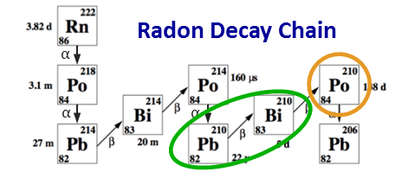
Motivation
Environmental radon
is everywhere!
²¹⁰Pb surface backgrounds are a concern for many experiments (e.g., Super CDMS, OSCURA, DAMIC, LZ, NEWS-G) and they will continue to be an important consideration in future dark matter experiments
New surface treatment techniques to mitigate this background may provide greater flexibility and/or more cost-effective solutions
Radon exposure during
detector fabrication and
testing results in ²¹⁰Pb
surface contamination
²¹⁰Pb
detector housing
detector
²¹⁰Po
²¹⁰Bi
adjacent detector
Notes:
Mention Pb-210 study in the bulk and how flash plating helps.

Slide 3
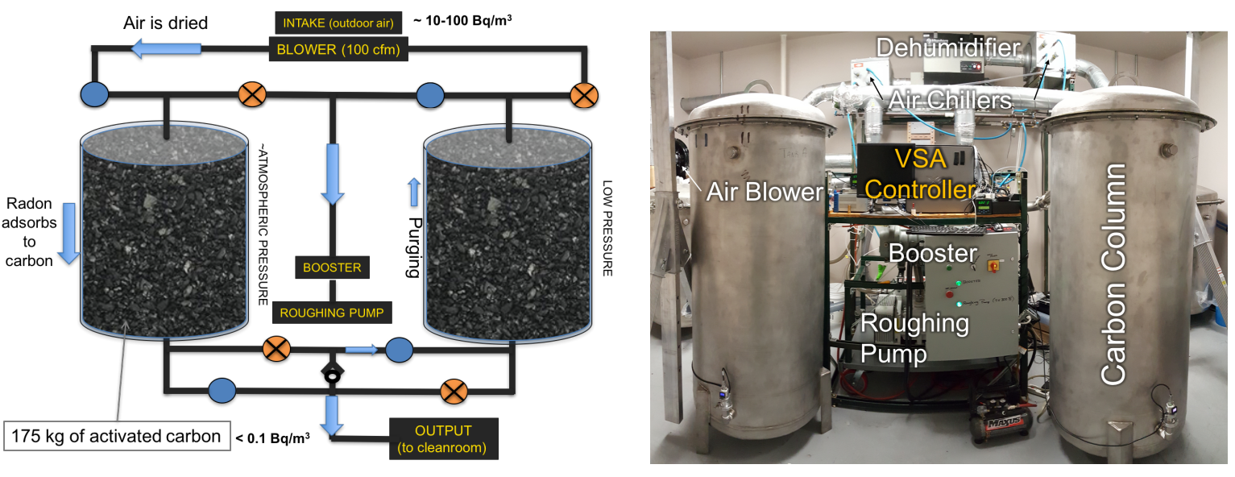
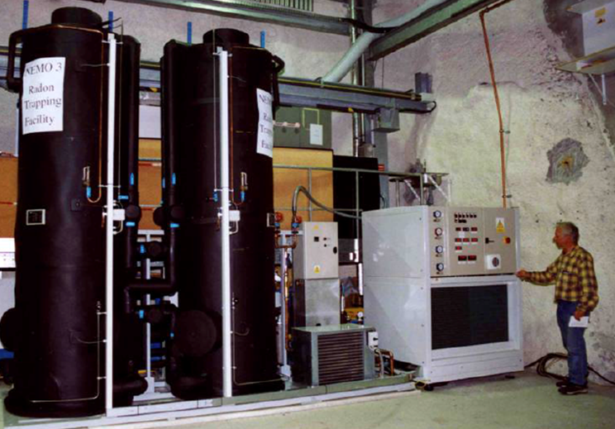
Combatting Radon – Rn Suppressed Cleanrooms
AIP Conference Proceedings 1921, 050002 (2018); https://doi.org/10.1063/1.5018995
This solution requires significant infrastructure
Picture of the Ateko System used for the NEMO Experiment
Notes:
there’s also the commercially sourced continuous-flow cryogenic column approach

Slide 4
Combatting Radon – Cleaning Surfaces
Methods for removal of radon progeny surface contamination have been explored on a variety of materials (e.g, copper, polymers, stainless steel, semiconductor crystals)
Cleaning steps mainly focus on etching and/or electropolishing, typically at >10 um levels
Some examples:
Electropolish of Stainless steel: Schnee et al, AIP LRT Conference Proceeding (2013)
Cu etching and electroplating: Bunker et al, NIM A, 2020
Polymers (PTFE) Leaching: Bruenner et al, Eur Phys. J. 2021
Metals (Cu, SS, Ge) etching and electropolishing: Zuzel et al, AIP LRT Conference Proceeding (2018)
Silicon crystal sidewall etching: Street et al, NIM A, 2020
Cleaning methods allow for added flexibility and Rn progeny mitigation steps cannot be stringently controlled

Slide 5
Outline of our Approach
This work will focus on the removal of Rn progeny from silicon, a very important material in ULB physics experiments
Creation of Pb/Po-implanted Silicon Samples
Assessing Surface Activity Assay via ²¹⁰Po alpha counting
Cleaning Approaches:
Wet Chemistry (non-etching)
Thermal Treatments (“bake-out”)
Dry and Wet Etching

Slide 6
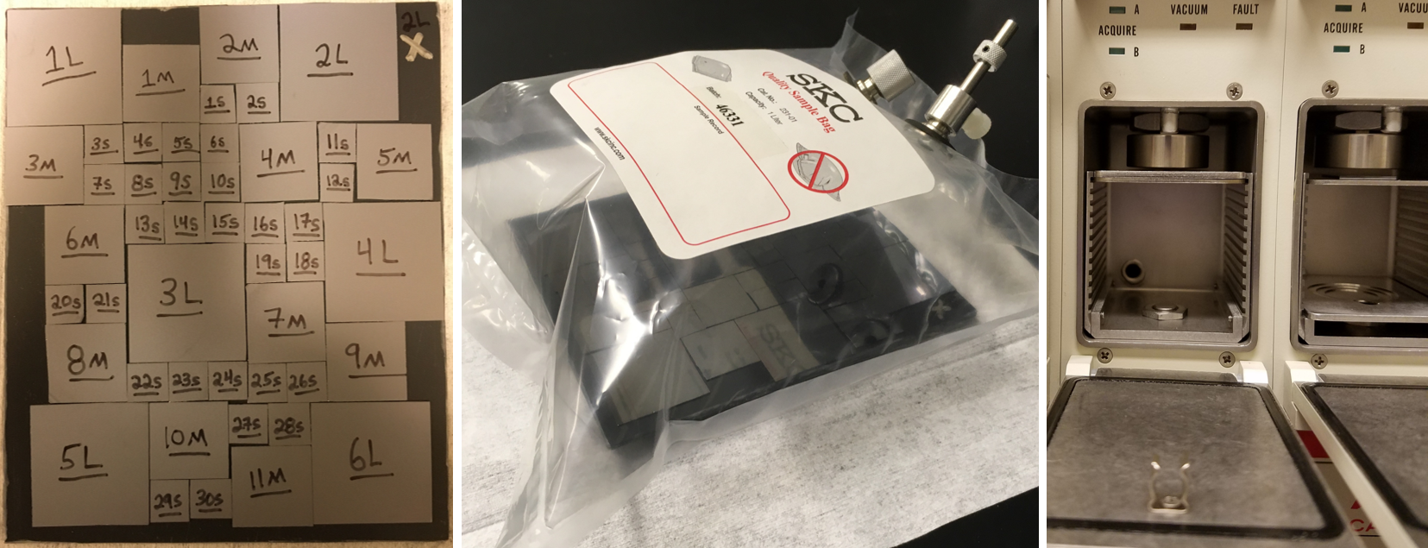
Our Approach
Diced coupons, labeled on the backside
Coupons submitted to ²²²Rn source in Tedlar bag
α-counting chamber setup for measuring coupons
Were able to operate in a detectable non-rad-controlled “sweet spot”

Slide 7
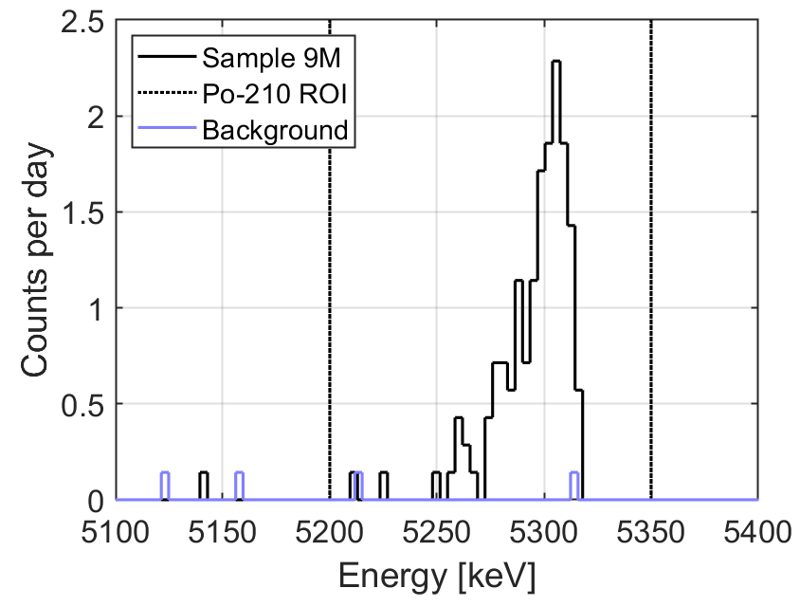
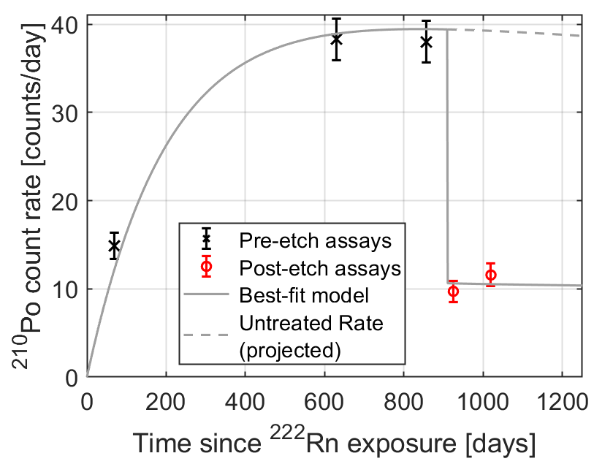
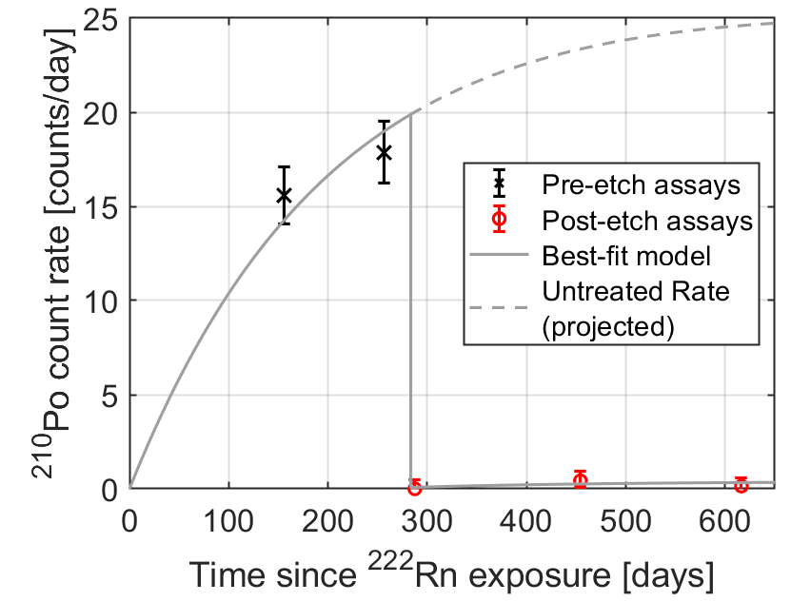
²¹⁰Po Alpha Detection, Assessing Cleaning Effectiveness
²¹⁰Pb in-growth is determined through multiple measurements over time (see backup slides for more details)
Cleaning step is administered
Multiple measurements are conducted to understand ²¹⁰Po and ²¹⁰Pb removal
Example spectrum of Coupon 9M
In-growth/reduction of Coupon 6L
In-growth/reduction of Coupon 6M

Slide 8
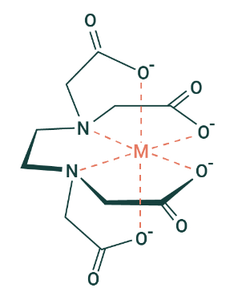
Removal of Rn progeny from Surfaces – Non-Etch Wet Chemical Methods
Solutions explored:
Water Rinse – removal through polar solvent rinse
Nitric Acid Leach– removal through polar solvent, oxidation, and M⁺ and H⁺ exchange with electron rich Si-O—O-Si and Si-O⁻ binding sites
Chelating Ion Leach
Pb
Po
Po
Pb
Pb
Pb
Po
Pb
Pb
Pb
Po
Pb
Po
Pb
Pb
Pb
Pb
Po
Pb
Po
Pb
Crystalline Silicon
Ethylenediamine tetraacetic acid (EDTA)– metal complex; EDTA coordinates with di-, tri-, and quadra-valent metal ions very tightly

Slide 9
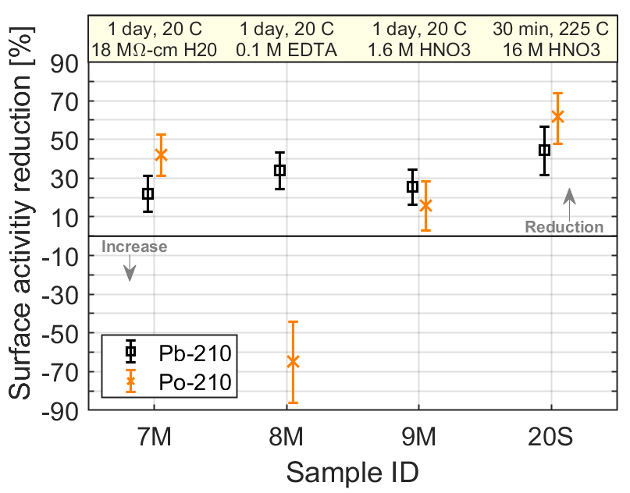
Non-Etch Wet Chemical Methods Results
In general, surface reduction of ²¹⁰Pb from submersing in solutions is ~ 25-40%
Water seems to be as effective as using acid or EDTA
Increasing temp in an enclosed microwave system and HNO₃ concentration does not seem to greatly increase removal
EDTA results for ²¹⁰Po are interesting
More studies required, but the working hypothesis: EDTA is contaminated with ²¹⁰Pb/²¹⁰Po and is ineffective at removing ²¹⁰Po
Take home message: chelating agents (e.g., buffered systems, EDTA, etc.) are extremely effective at complexing with metal cations, and will likely come metal-bound to a certain degree

Slide 10
Removal of Rn-progeny from Surfaces – Bake Out….or Bake In
First tests utilized a tube furnace (see left) for studies at ~950ºC for 12 hours in air and N₂ flush gas environments
Follow-up test utilized a vertical muffle furnace in a static air furnace at 1200ºC for 13 days
Speciation of Pb and Po is not known, but Pb and Po have boiling points of 1750 and 960ºC, respectively,
→ could migrate and/or vaporize
Radon progeny may bake out or bake in
→ either way could provide utility for ULB physics
Cover Gas Flow (N₂ or Air)
Pb
Po
Pb
Po
Po
Pb
Pb
Po
Po
Pb
Pb
Po
Pb
Po

Slide 11
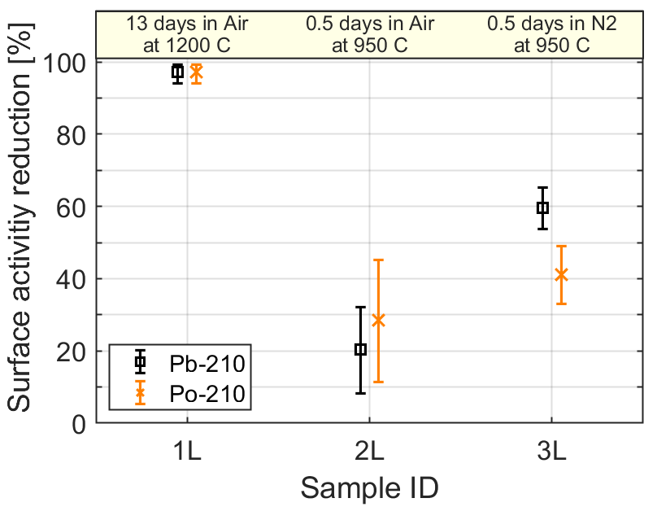
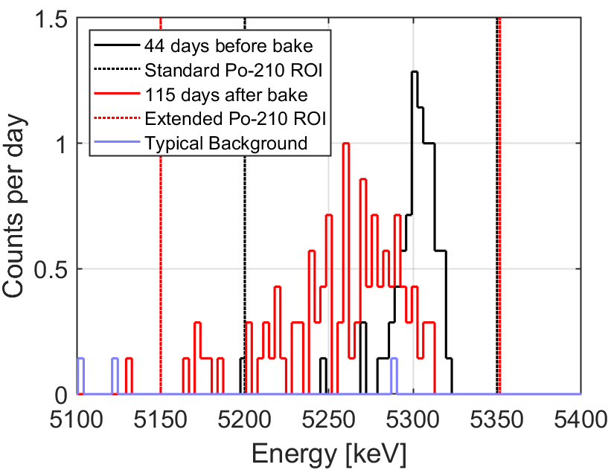
Bake-out Results
Longer and hotter bake resulted in near complete removal of radon progeny
Shorter bakes at reduced temperature partially reduced activity from surface progeny
Spectra for 2L and 3L (shown bottom right) show broadening of 5.3 MeV ²¹⁰Po peak
Attributed to migration of implanted progeny to greater depths
Heating in air may also add additional oxide layers to silicon surface making progeny at/near the surface less likely to vaporize away

Slide 12
Removal of Rn-progeny from Surfaces – Wet (HF) and Dry (Plasma Sputtering) Etching
Plasma etching
Sputter etched using a rastered ULVAC-PHI focused ion beam (Ne⁺) in a vacuum chamber of 10⁻¹⁰ torr.
Removal of 20-, 50-, and 100-nm depths required 0.5, 1.25, and 2.5 hr, which was determined from a calibration run in which 480 nm was removed in 12 hour
HF etching
Selective depth etching was controlled by adding stoichiometric amounts of HF in excess HNO₃ to remove varying depths
Si dissolves to SiF₄ and/or H₂SiF₆, which evaporates, unlocking the implanted progeny and allowing dissolution/removal
Ne⁺ Source
Ne⁺
Ne⁺
Ne⁺
Pb
Po
Pb
Po
Po
Pb
Pb
Po
Po
Pb
Pb
Po
Pb
Po

Slide 13
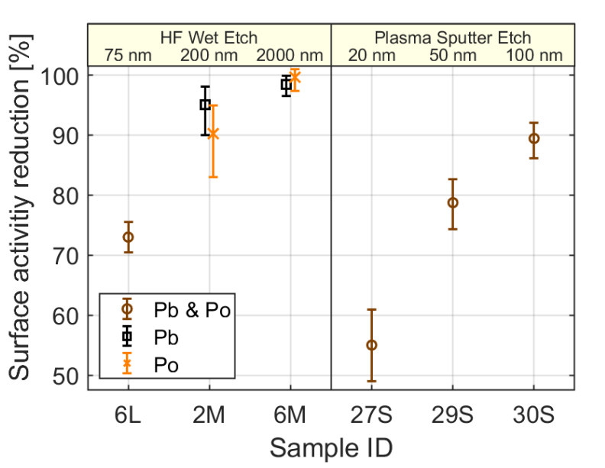
Etching Results
Wet and dry etching of the silicon is highly effective at removing radon progeny, particularly at depths >100 nm where >90% of the surface progeny is removed
Optical Profilometry of “20 nm” sputter etch
Dry etching seems to be more effective at removing radon progeny as a function of depth

Slide 14
Summary and Prognostication
Focused on the removal of Rn progeny from silicon surfaces
First such study exploring thermal methods and dry etching
All methods (wet chemistry, heat treatments, and etching) are at least partially effective for removal of implanted radon progeny
Baking and etching methods were developed to completely remove radon progeny from materials
Approaches may be implementable during different phases of detector construction of silicon devices in order to remove ²¹⁰Pb and ²¹⁰Po
Other materials, like Ti, fused silica, ceramics, etc., should also benefit from similar cleaning steps
Similar methods may be employable to mitigate ²²⁶Ra in materials where removing the ²²²Rn progenitor is important
e.g., titanium, stainless steel, gas handling equipment, getters, etc.

Slide 15
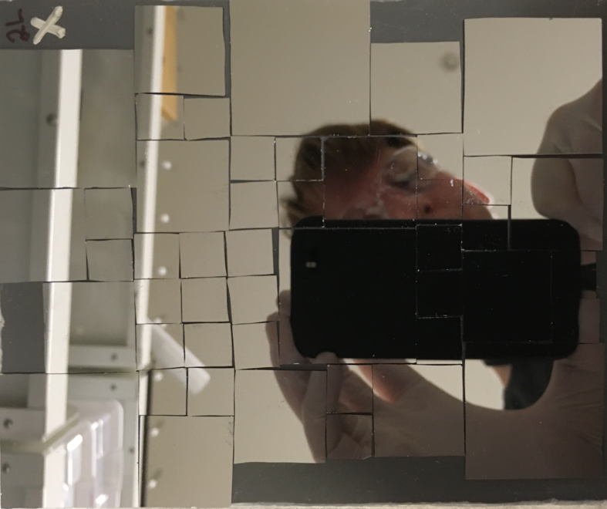
Acknowledgments
Shannon Morley for assistance in preparing silicon coupons
Brian Glasgow and Grant Spitler for operation of the alpha counters
Derek Cutforth for backing of coupon 1L in the vertical muffle furnace
PNNL LDRD funding under the Nuclear Physics, Particle Physics, Astrophysics, and Cosmology Initiative

Slide 17
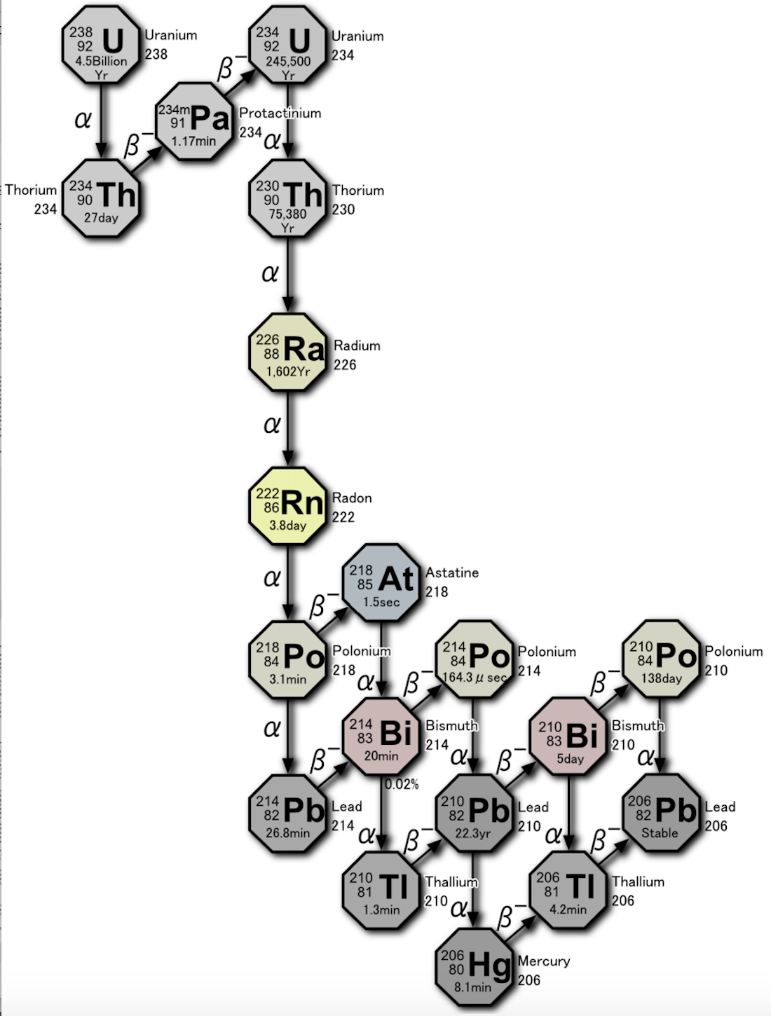
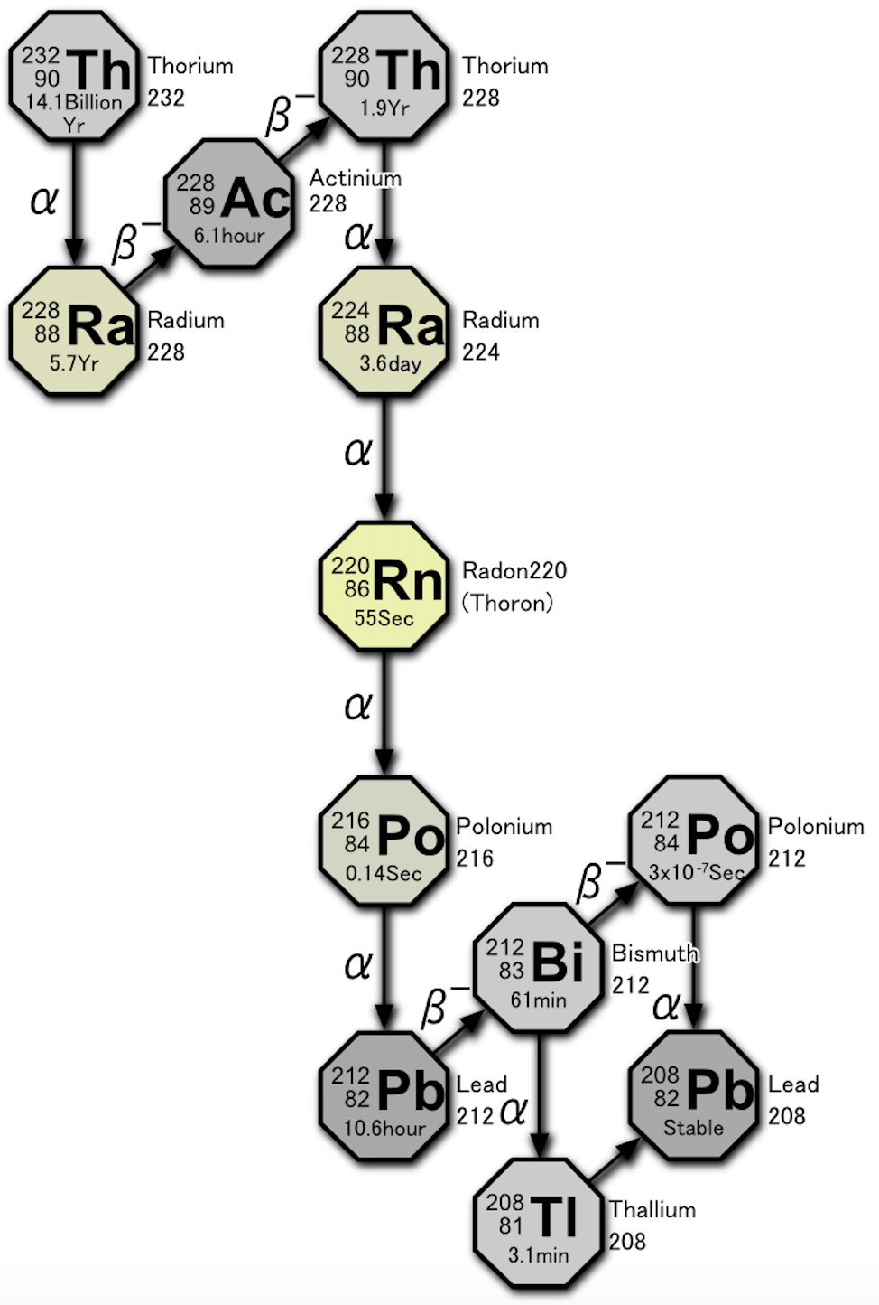
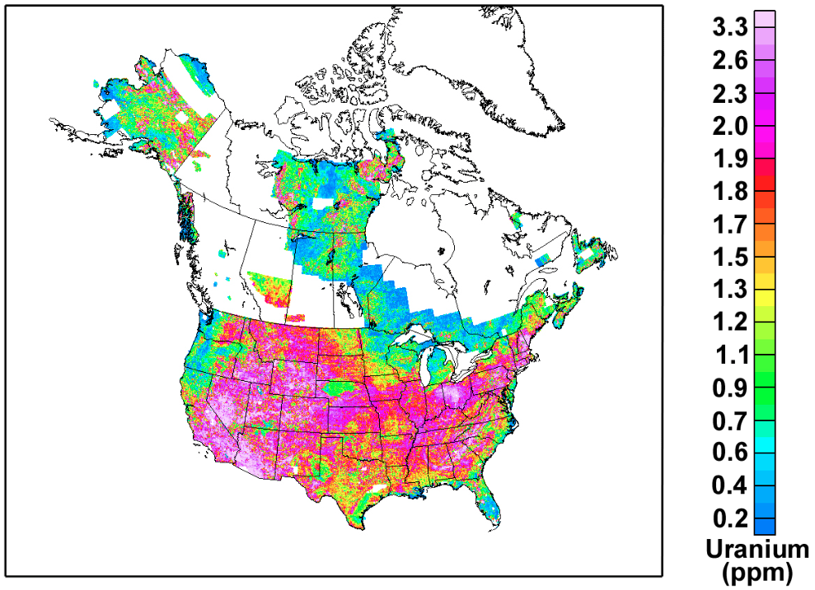
Material surface contamination
Uranium-238
Thorium-232
Dust (radioactive) particulate fallout
Content in the soil:
K ~ 1.4 E+4 ppm
Th ~ 7.2 ppm
U ~ 1.2 ppm
Bq/kg
https://pubs.usgs.gov/of/2005/1413/maps.htm
For reference:
1 ppt Th = 4.1 μBq ²³²Th/kg
1 ppt U =12.4 μBq ²³⁸U/kg
1 ppb ^{nat}K = 30.5 μBq ⁴⁰K/kg
Images from
By Tosaka - Own work, CC BY 3.0, https://commons.wikimedia.org/w/index.php?curid=5531106

Slide 18
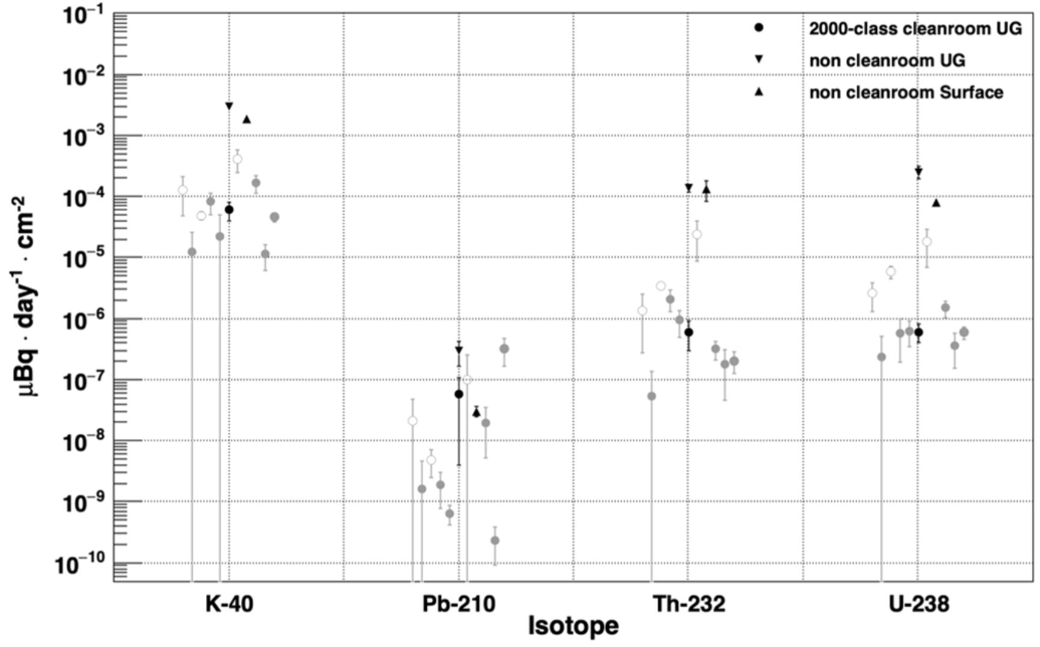
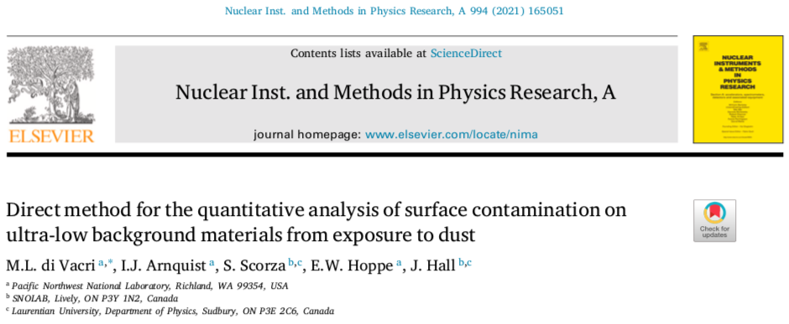
Dust contaminant fallout rates: a direct method for quantitative analysis
Direct ultrasensitive determination for ThUK
ICP-MS can measure radioactive elements AND stable elements to get complete elemental “fingerprint” of the dust composition
→ Allows for a better inference of ²¹⁰Pb and ²²⁶Ra levels from fuller understanding
Collections can be taken with many reps, many locations, or varying times.
If interested, please reach out to me or Maria Laura di Vacri (PNNL)
Collection media. L: ultralow background PFA vials. R: Si coupons
 | LOD [pg·day⁻¹·cm⁻²]
K | 2.2E-02
Pb | 1.8E-04
Th | 2.6E-06
U | 4.5E-06

Slide 19
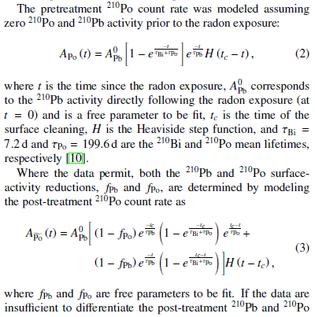
Back-up slides

