Slide 1
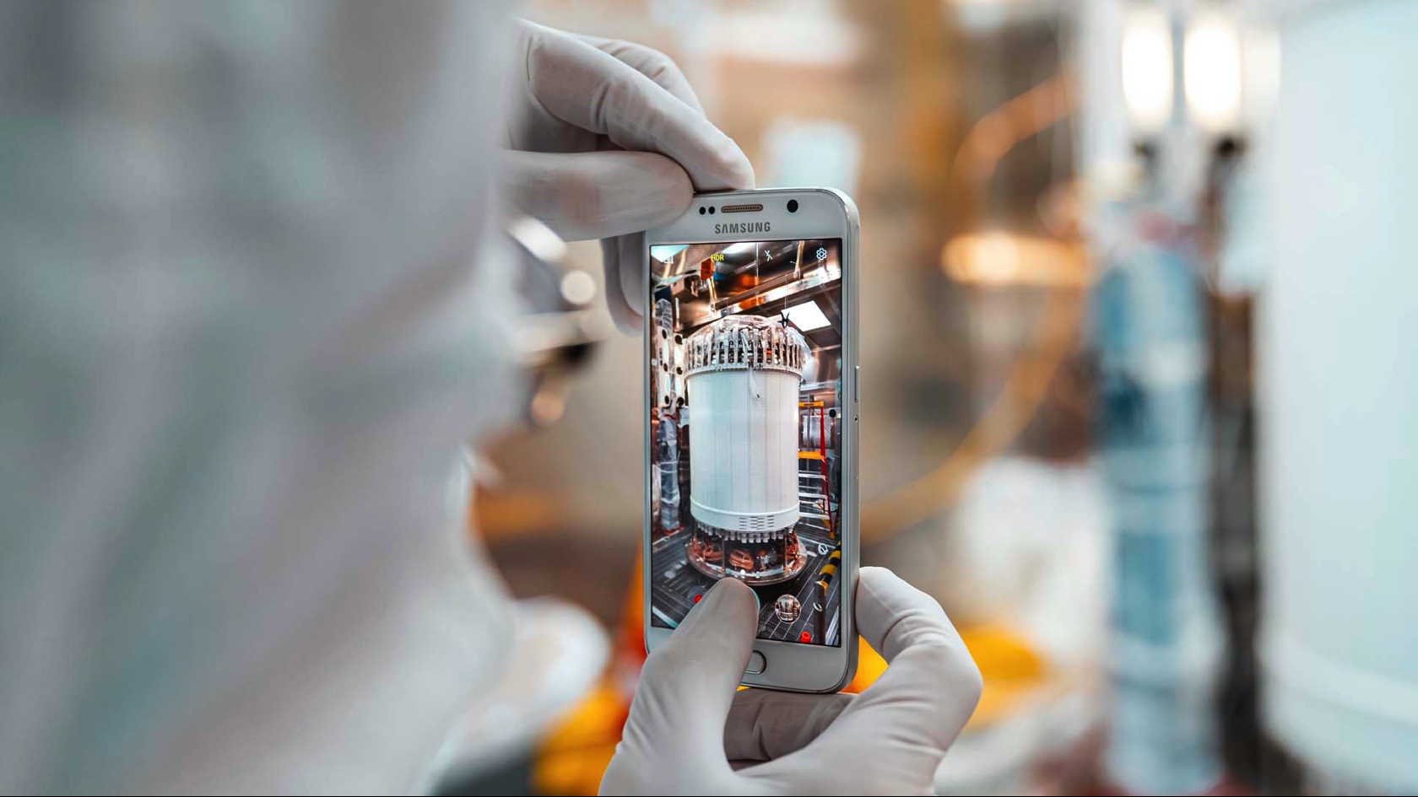
Sense and Sensitivity
Confronting the radiological screening challenges for next-generation rare event detectors
XinRan Liu
The University of Edinburgh

Slide 2
Overview
1
Current Landscape
2
Future Backgrounds Requirements
3
Current UK Assay Capabilities
4
R&D Upgrades

Slide 3
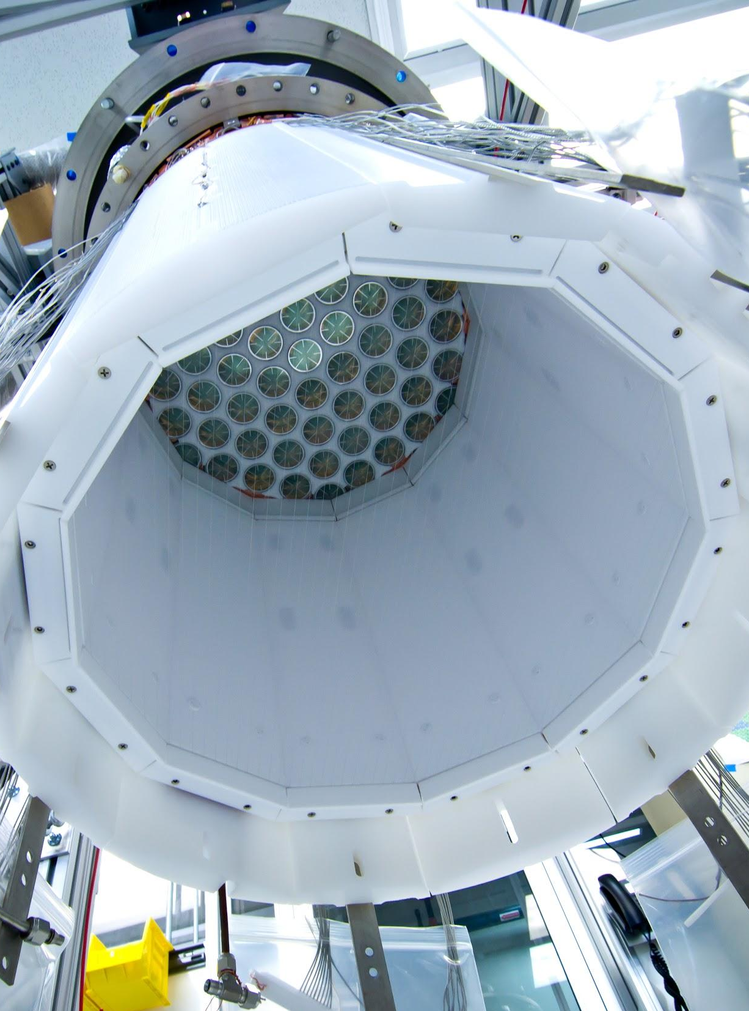
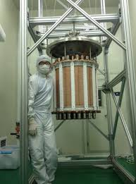
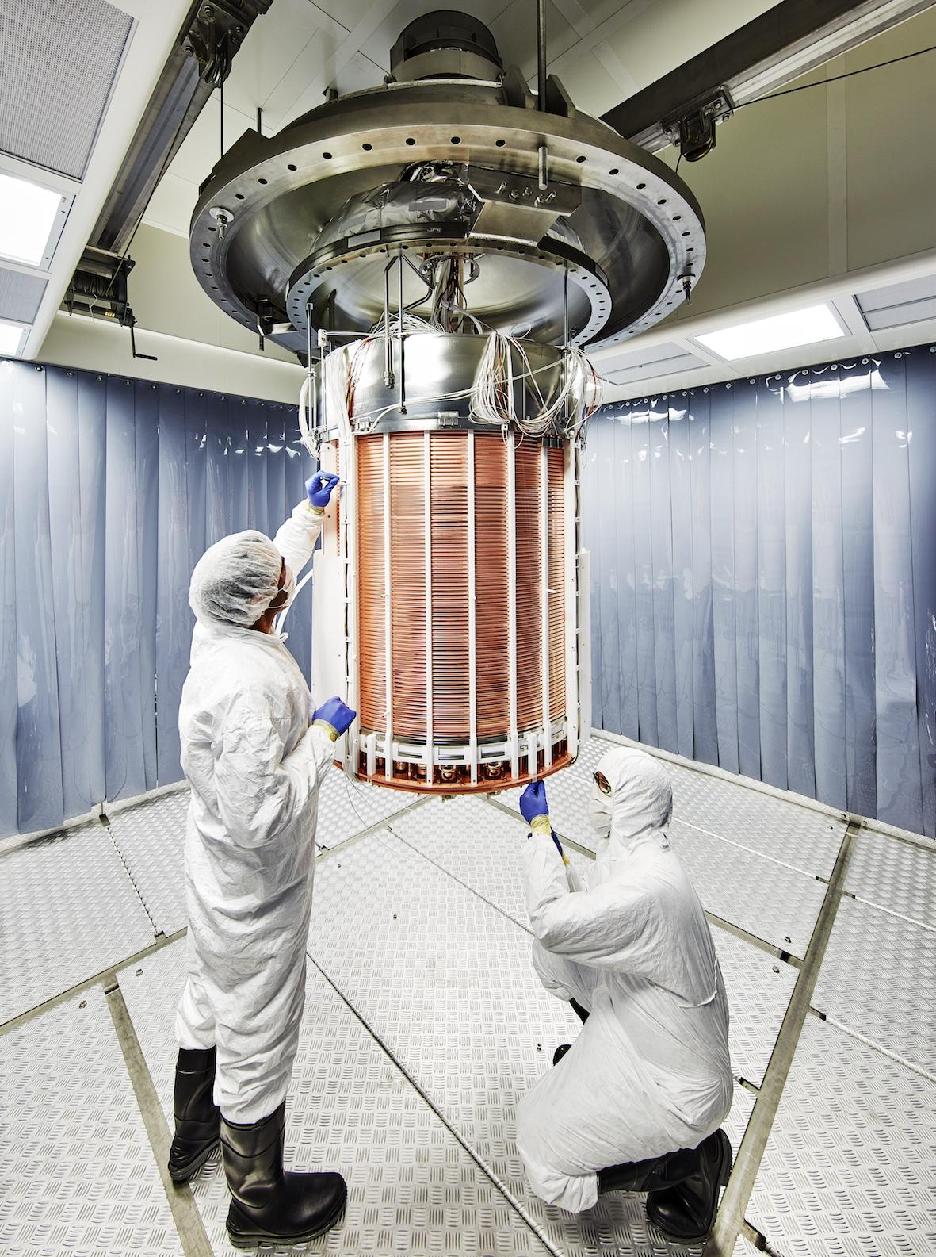
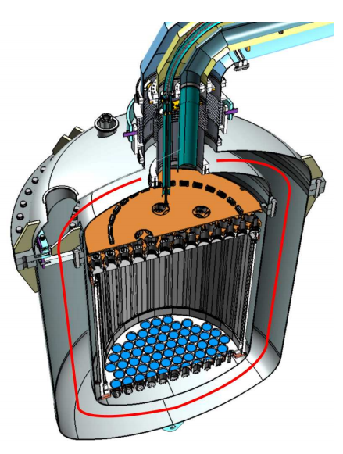
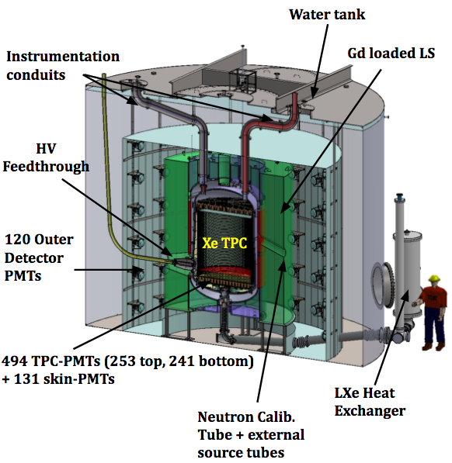
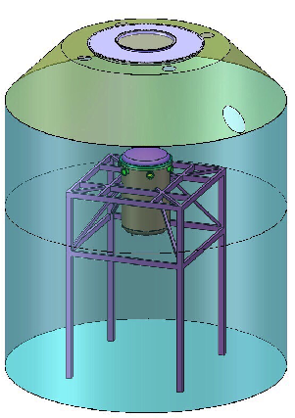
Liquid Xenon Experiments
LUX
PANDAX-II
XENON1T
XENONnT
LZ
PandaX – 4T
250 kg
(100 kg)
580 kg
(362 kg)
2,000 kg
(1,042 kg)
5,900 kg
(4,000 kg)
7,000 kg
(5,600 kg)
4,000 kg
(2,800 kg)
2013
2016
2017
2022 + 5 live years
2022 + 3 live years
202x + 5 live years
3.4x10⁻⁴⁶ cm²
2.5x10⁻⁴⁶ cm²
7.7x10⁻⁴⁷ cm²
2.6x10⁻⁴⁸ cm²
1.4x10⁻⁴⁸ cm²
6 x10⁻⁴⁸ cm²
Typical detector improvements:
Mass
Detector components
Detection and analysis methods
Improve background

Slide 4
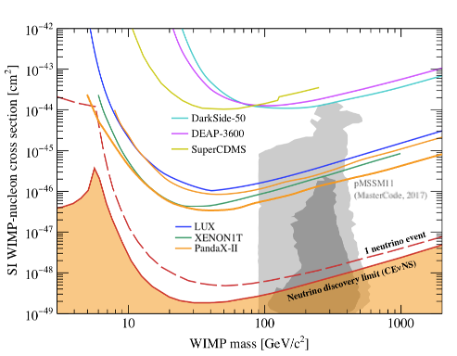
Current Landscape

Slide 5
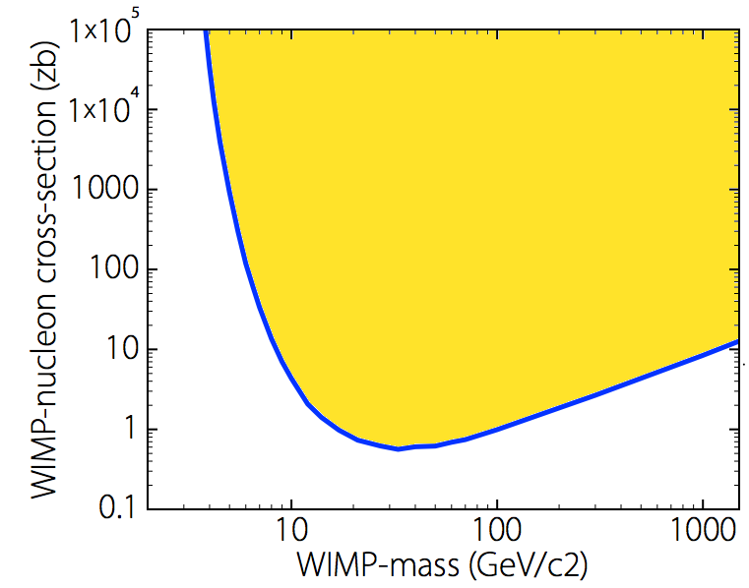



NO unicorns
in this magical forest
Current Landscape
Maybe here?

Slide 6


Slide 7
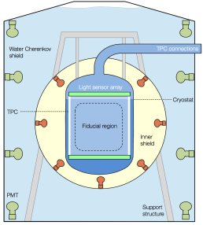
Liquid Xenon Experiments
LUX
PANDAX-II
XENON1T
XENONnT
LZ
PandaX – 4T
250 kg
(100 kg)
580 kg
(362 kg)
2,000 kg
(1,042 kg)
5,900 kg
(4,000 kg)
7,000 kg
(5,600 kg)
4,000 kg
(2,800 kg)
2013
2016
2017
2020 + 5 live years
2020 + 3 live years
2020 + 5 live years
3.4x10⁻⁴⁶ cm²
2.5x10⁻⁴⁶ cm²
7.7x10⁻⁴⁷ cm²
2.6x10⁻⁴⁸ cm²
1.4x10⁻⁴⁸ cm²
6 x10⁻⁴⁸ cm²
Darwin/G3
Typical detector improvements:
Mass
Detector components
Detection and analysis methods
Improve background
50,000 kg
(40,000 kg)
2023 + 7 live years
1x10⁻⁴⁹ cm²

Slide 8
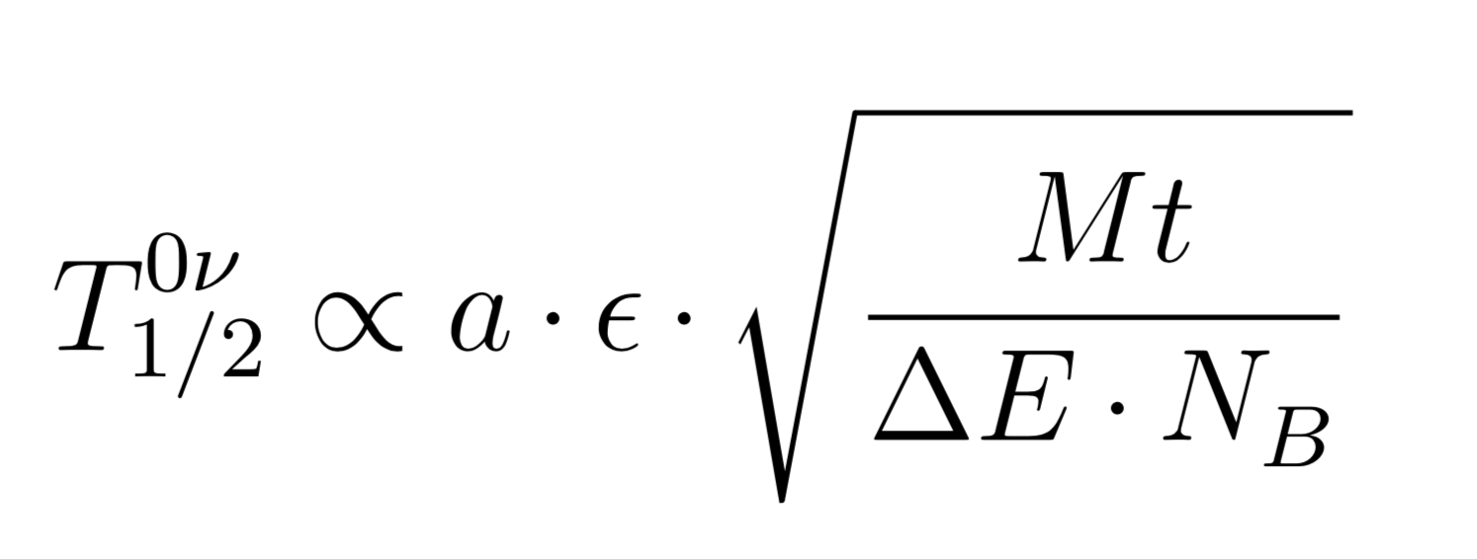
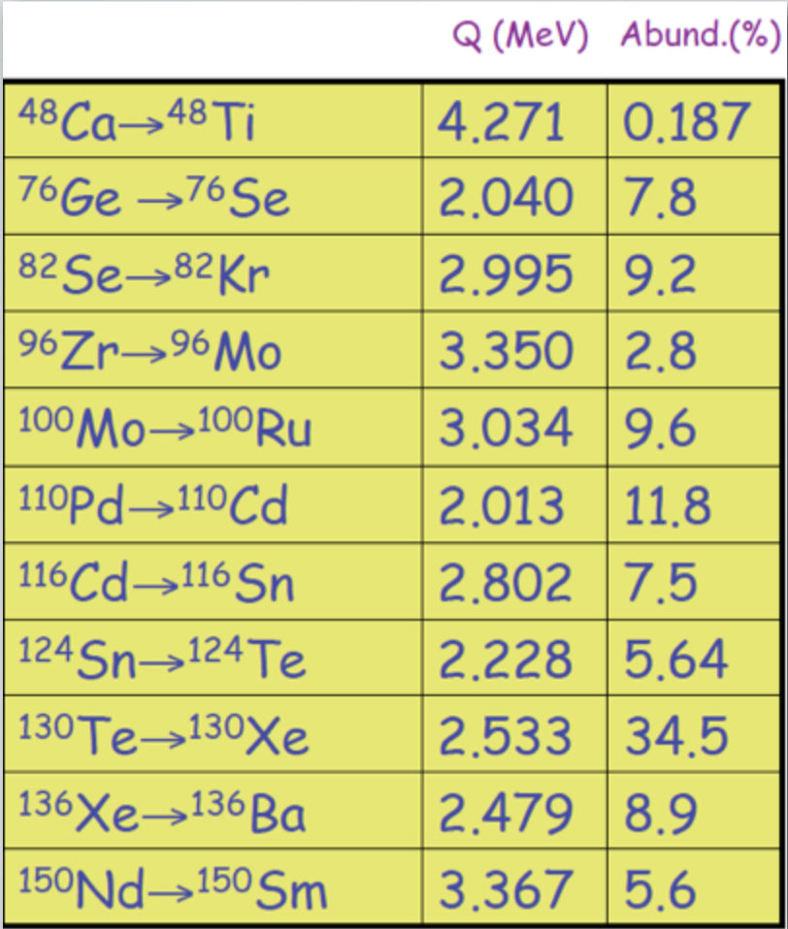
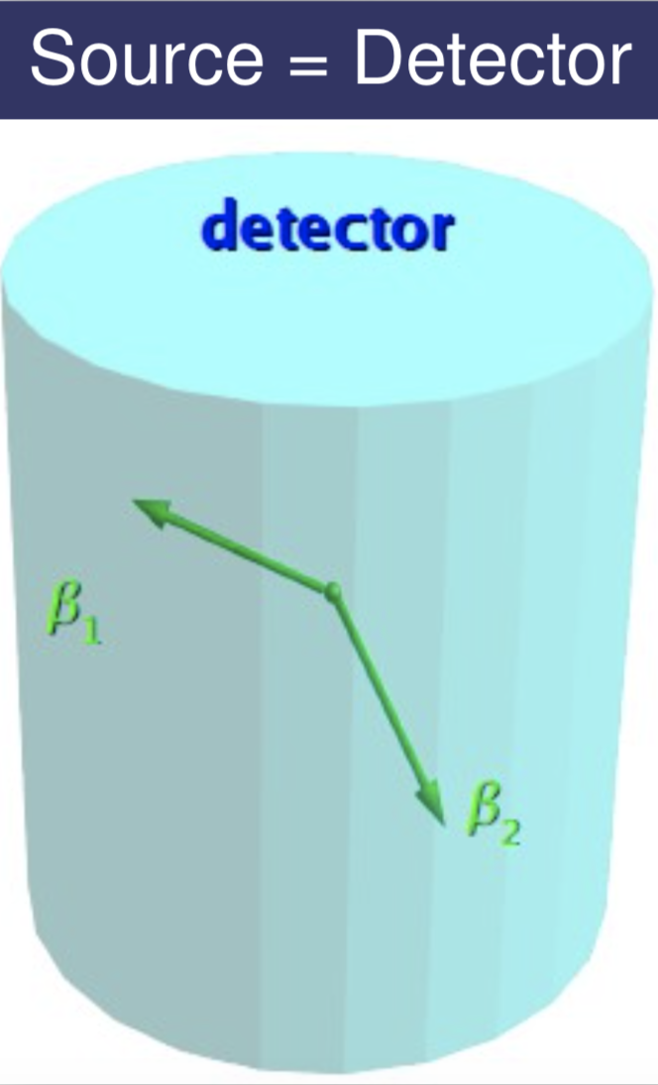
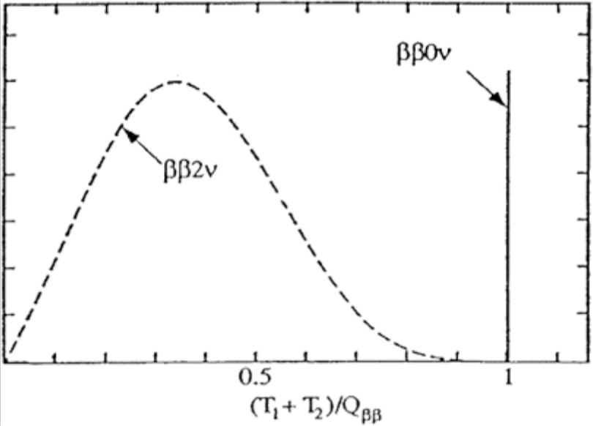
Neutrinoless Double Beta Decay
Detector recipe:

Slide 9
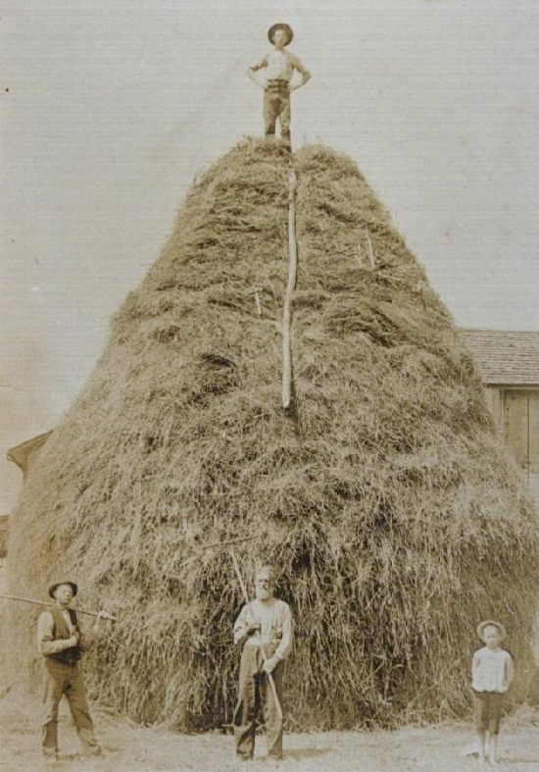
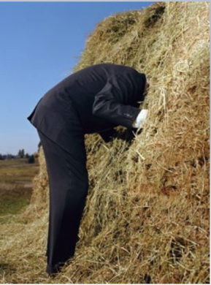
The Challenge
The earth is unfortunately a radioactive planet and in the case of Dark Matter and $0νββ$, the ‘signature’ of each process are similar to that of natural radioactivity.

Slide 10


The Challenge
Requirements for next generation dark matter and 0vbb experiments:
  Upgrade HPGE to reach < 10 μBq/kg levels
  Increase radon emanation throughput with greater sensitivity
  Improve surface alpha radioassay sensitivities
  Improve ICPMS sensitivity to < ppt/ppq levels
  Coordinated international efforts to cross calibrate existing facilities and continued improvements.
Golden rule: Everything is radioactive, quantify
panic level via screening.

Slide 11
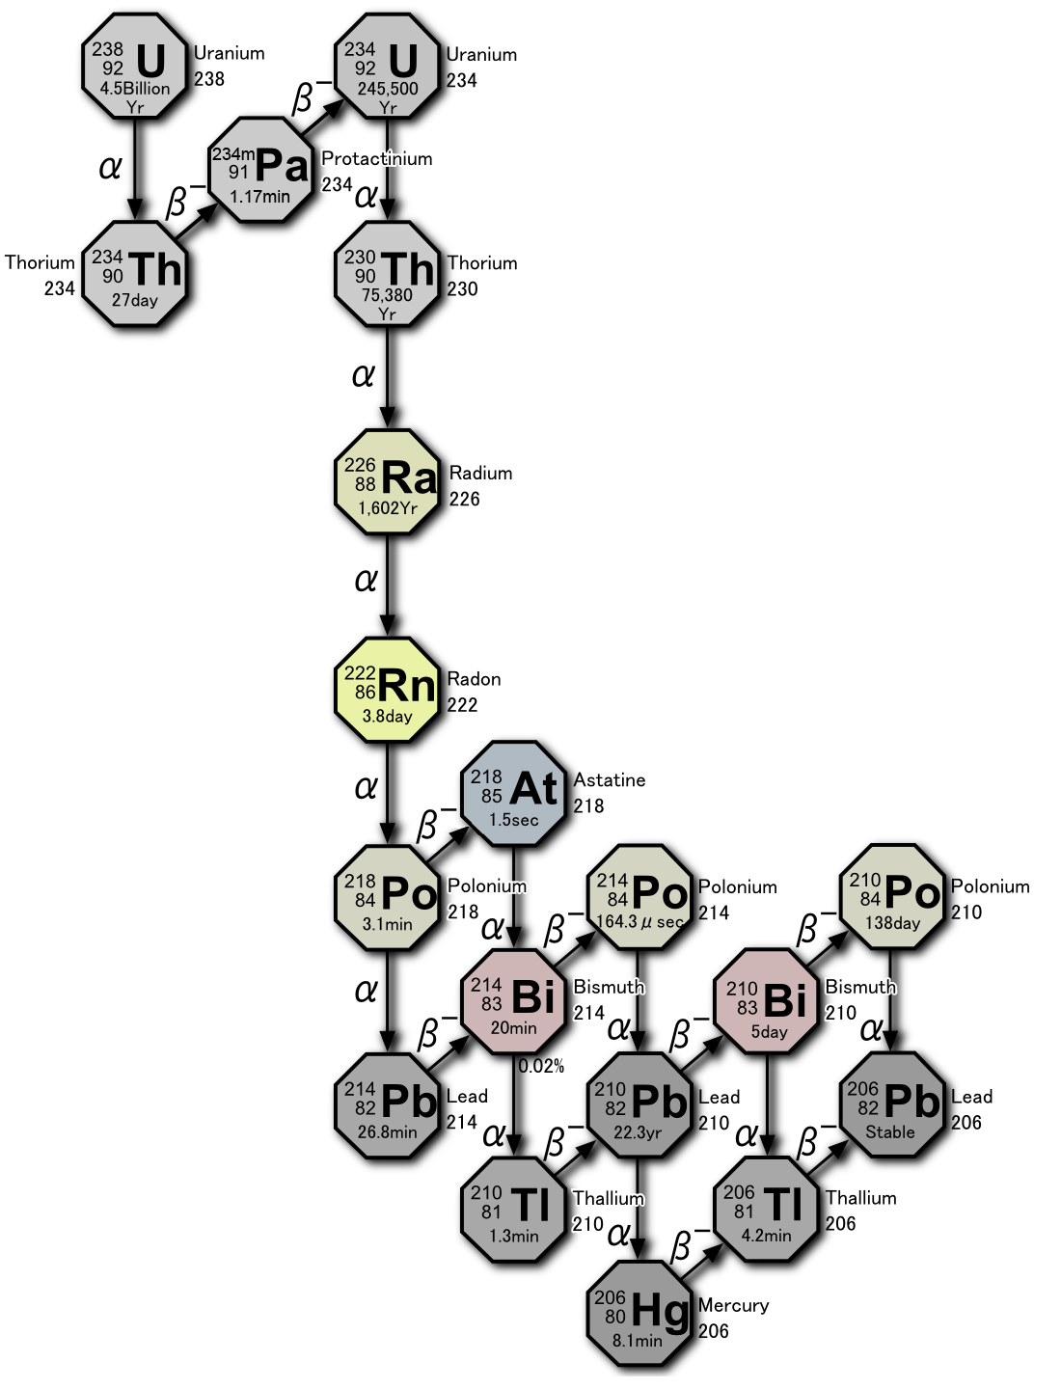
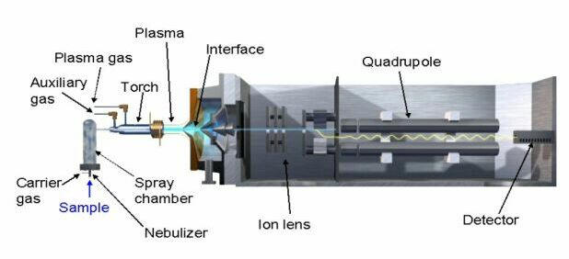
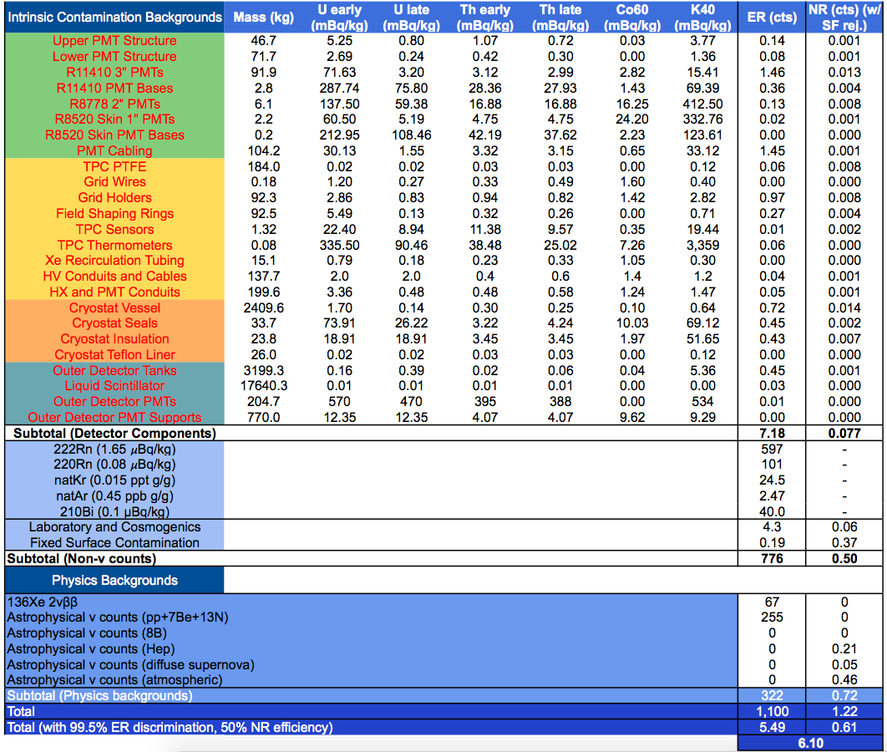
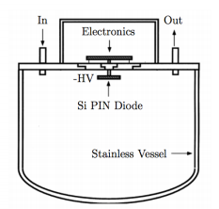
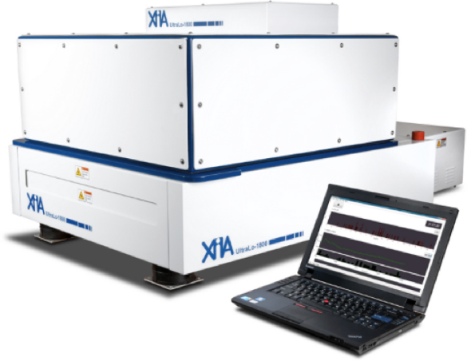
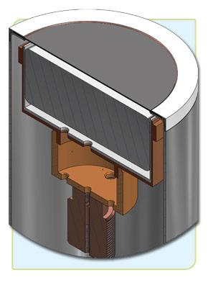
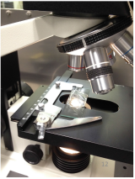
The Solution
Mass Spectrometry, NAA
Radon Emanation
Gamma-ray Spectroscopy
Alpha detectors
Optical Microscopy

Slide 12

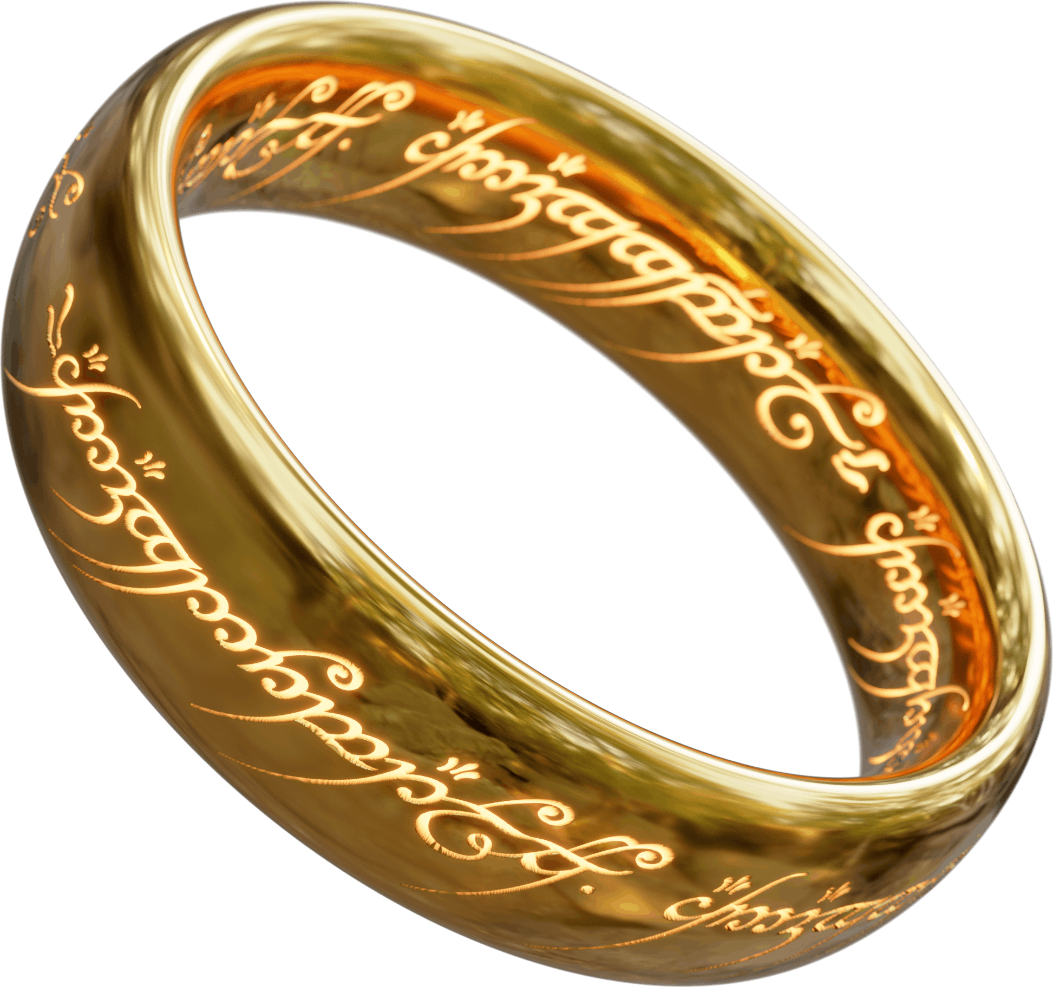
One Lab To Rule Them All
Boulby UnderGround Screening (BUGS) Facility
A jewel in the crown of the Boulby Underground Laboratory
Facility designed to become a centre of excellence for material assay and cleanliness
Class 1,000 cleanroom
Hugely important to G3 DM and 0vββ material selection
Nitrogen produced onsite, argon delivered weekly
Minimal Rn reduction required, ~2.5 Bq/m³ ambient

Slide 13
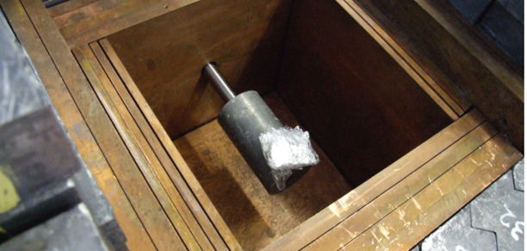
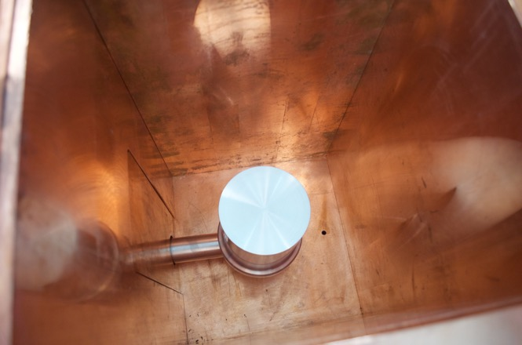
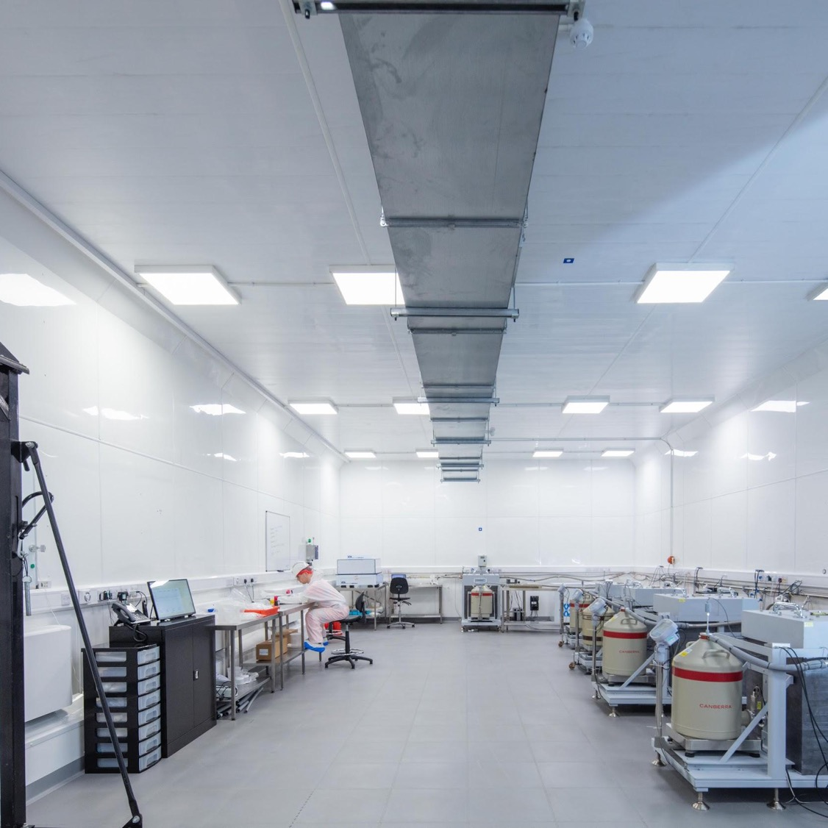
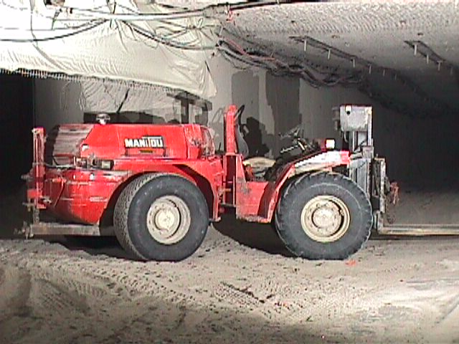
Gamma-ray Spectroscopy
The ambitious programme to reboot and expand the UK underground screening facility launched in 2013.
2013
Starts with refurbishment of the existing p-type coax – renamed Lunehead
In 2016 added 3 S-ULB detectors in purpose-built castles inside a new class 1k cleanroom.
In 2021 S-ULB SAGe well detector commissioned
2016
2022

Slide 14
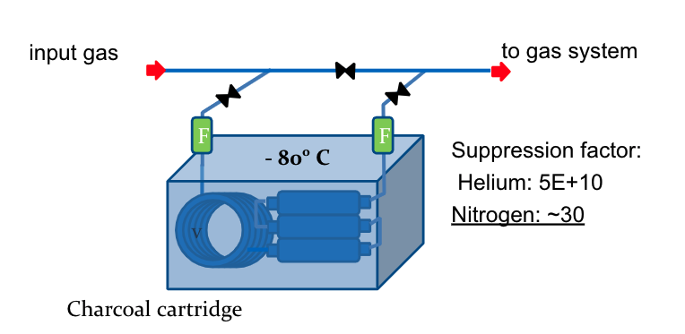
Radon Removal System
A radon removal system was designed and built, capable of removing the radon from the carrier gas by up to 10 orders of magnitude depending on the gas.

Slide 15
Germanium Detector Background
P. Scovell
Belmont
160% (3.2kg) p-type

Slide 16
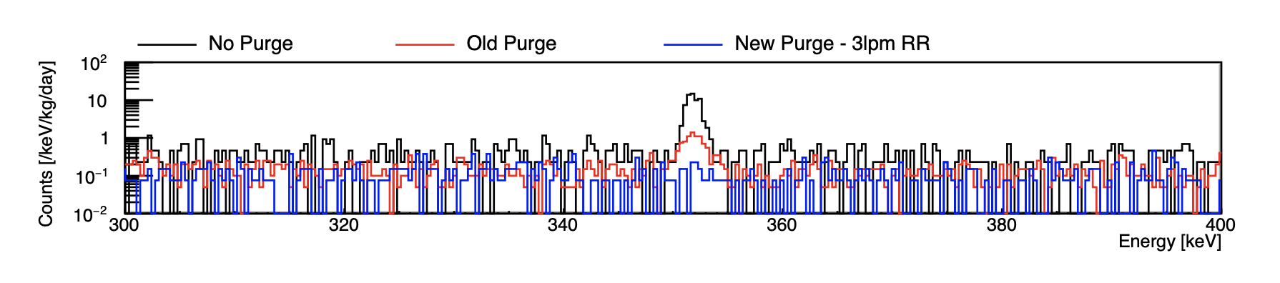
Germanium Detector Background
P. Scovell
Belmont
160% (3.2kg) p-type
²¹⁴Pb at 352 keV – 150x reduction

Slide 17
Germanium Detector Background
P. Scovell
New S-ULB SAGe well performance.
Detector | Relative Efficiency or type | Count rate (/kg/day)
Detector | Relative Efficiency or type | 351 keV (²¹⁴Pb) | 609 keV (²¹⁴Bi) | 238 keV (²¹²Pb) | 1461 keV (⁴⁰K) | 2615 keV (²⁰⁸Tl)
Roseberry | BE6530 | 0.15(7) | 0.15(7) | 0.8(3) | 0.8(2) | 0.2(1)
Chaloner | BE5030 | 5(1) | 4(1) | 7(1) | 8.4(14) | 2.1(5)
Belmont | 160% | 0.7(2) | 0.4(1) | 0.13(6) | 1.0(2) | 0.3(1)
Merrybent | 100% | 2.5(3) | 1.8(3) | 0.3(1) | 1.9(3) | 0.8(2)
Lunehead | 100% | 5.6(5) | 4.7(4) | 8.3(5) | 9.1(6) | 2.0(3)
Lumpsey | SAGe-Well | 104(2) | 60(2) | 166(3) | 7.0(6) | 12(1)
1.1(7)
1.3(3)
1.1(7)
1.7(7)
0.7(2)

Slide 18
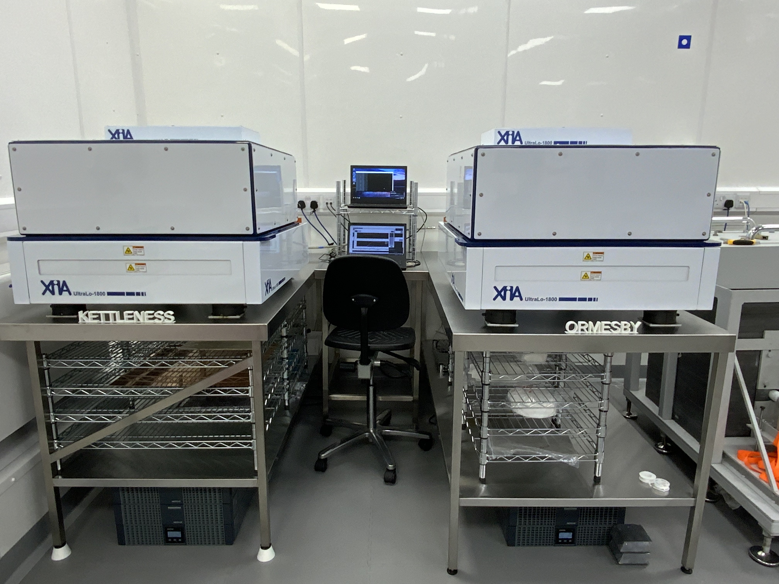
XIA UltraLo 1800 – Alphas
As of 2021, two XIA UltraLo-1800 surface alpha counters running at Boulby – Kettleness & Ormesby.
Installed liner to reduce detector backgrounds.
Factor three improvement compared to surface lab due to more cosmics which can mimic background events.
Surface: 1 mBq/m² Bulk: 30 mBq/kg
Sample | Duration (hrs) | Alphas | Surface Area (cm²) | Emissivity (⍺/khr/cm²) | Activity (mBq/m²)
Background (SS Tray) | 168 | 342 | 1800 | 1.24 ± 0.07 | 6.88 ± 0.38
Background (PTFE Liner) | 168 | 103 | 1800 | 0.38 ± 0.04 | 2.12 ± 0.22
PNNL Copper | 168 | 13 | 707 | 0.13 ± 0.04 | <0.72 ± 0.22

Slide 19
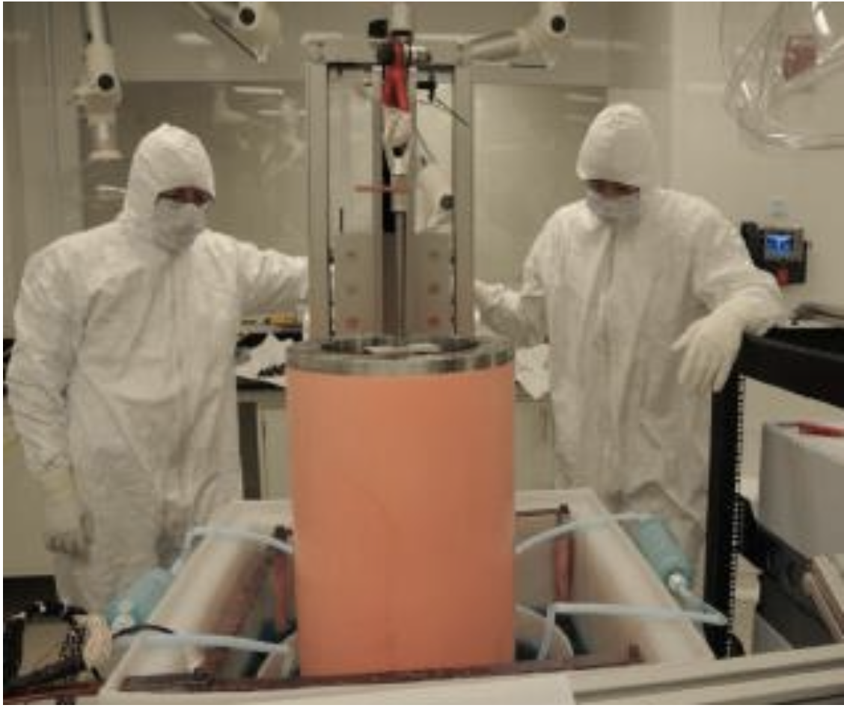
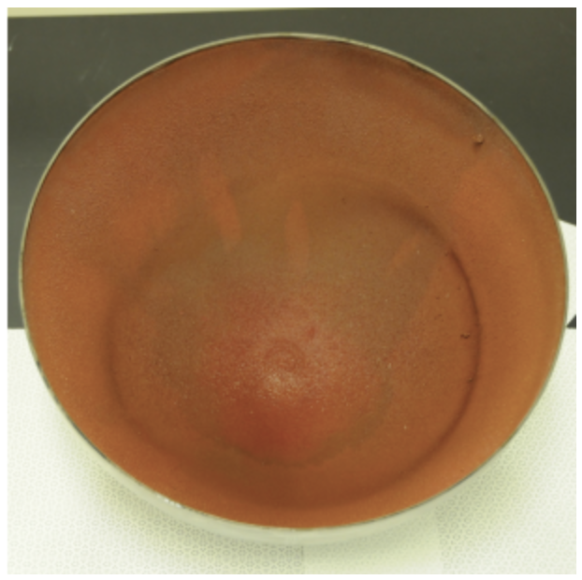
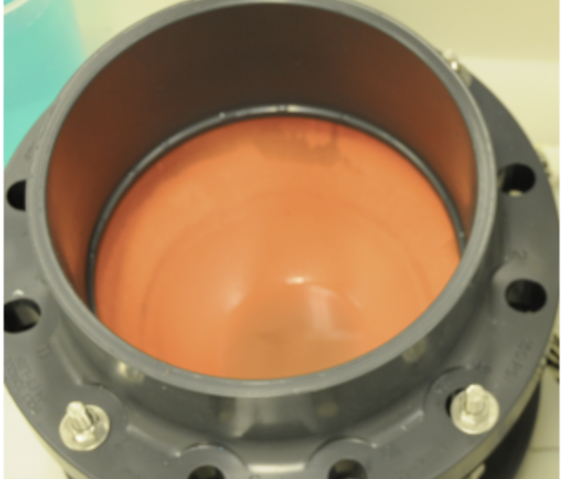

Electroforming Copper
STFC awarded funding for ‘scope, feasibility and costing’ study of establishing an electroplating facility in Boulby.
  Lead by NEWS-G and ECuME experience.
Survey ongoing to assess UK interest.
https://www.surveymonkey.co.uk/r/7JLT2DW
Still open and takes <2 minutes.
This is highly complementary to the BUGS facility and existing detectors.

Slide 20
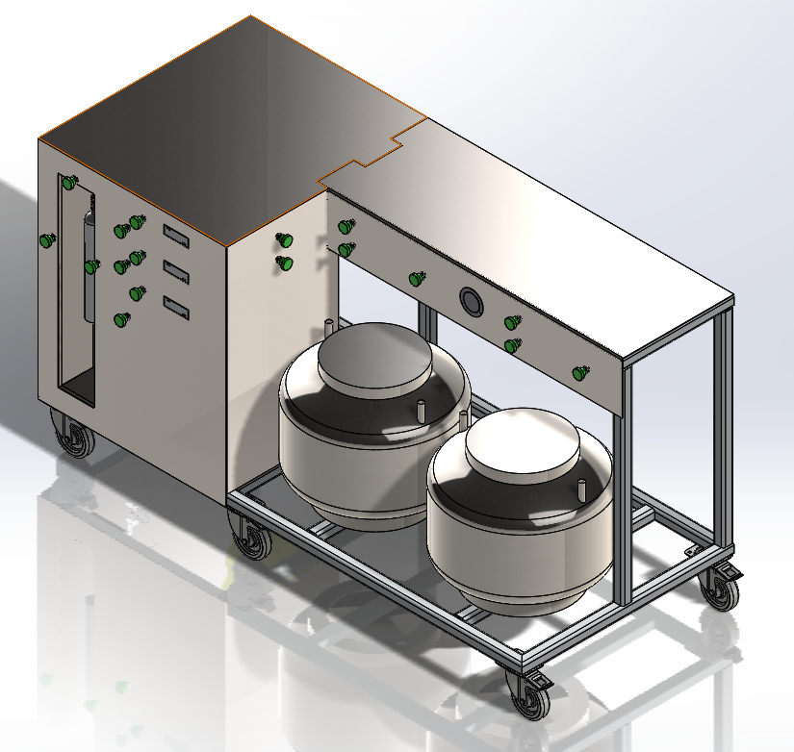
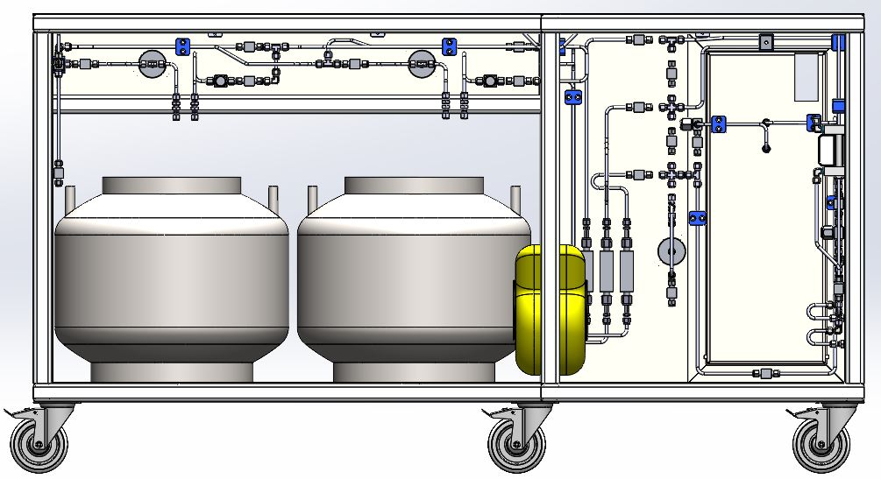
Boulby Radon Emanation System

Slide 21
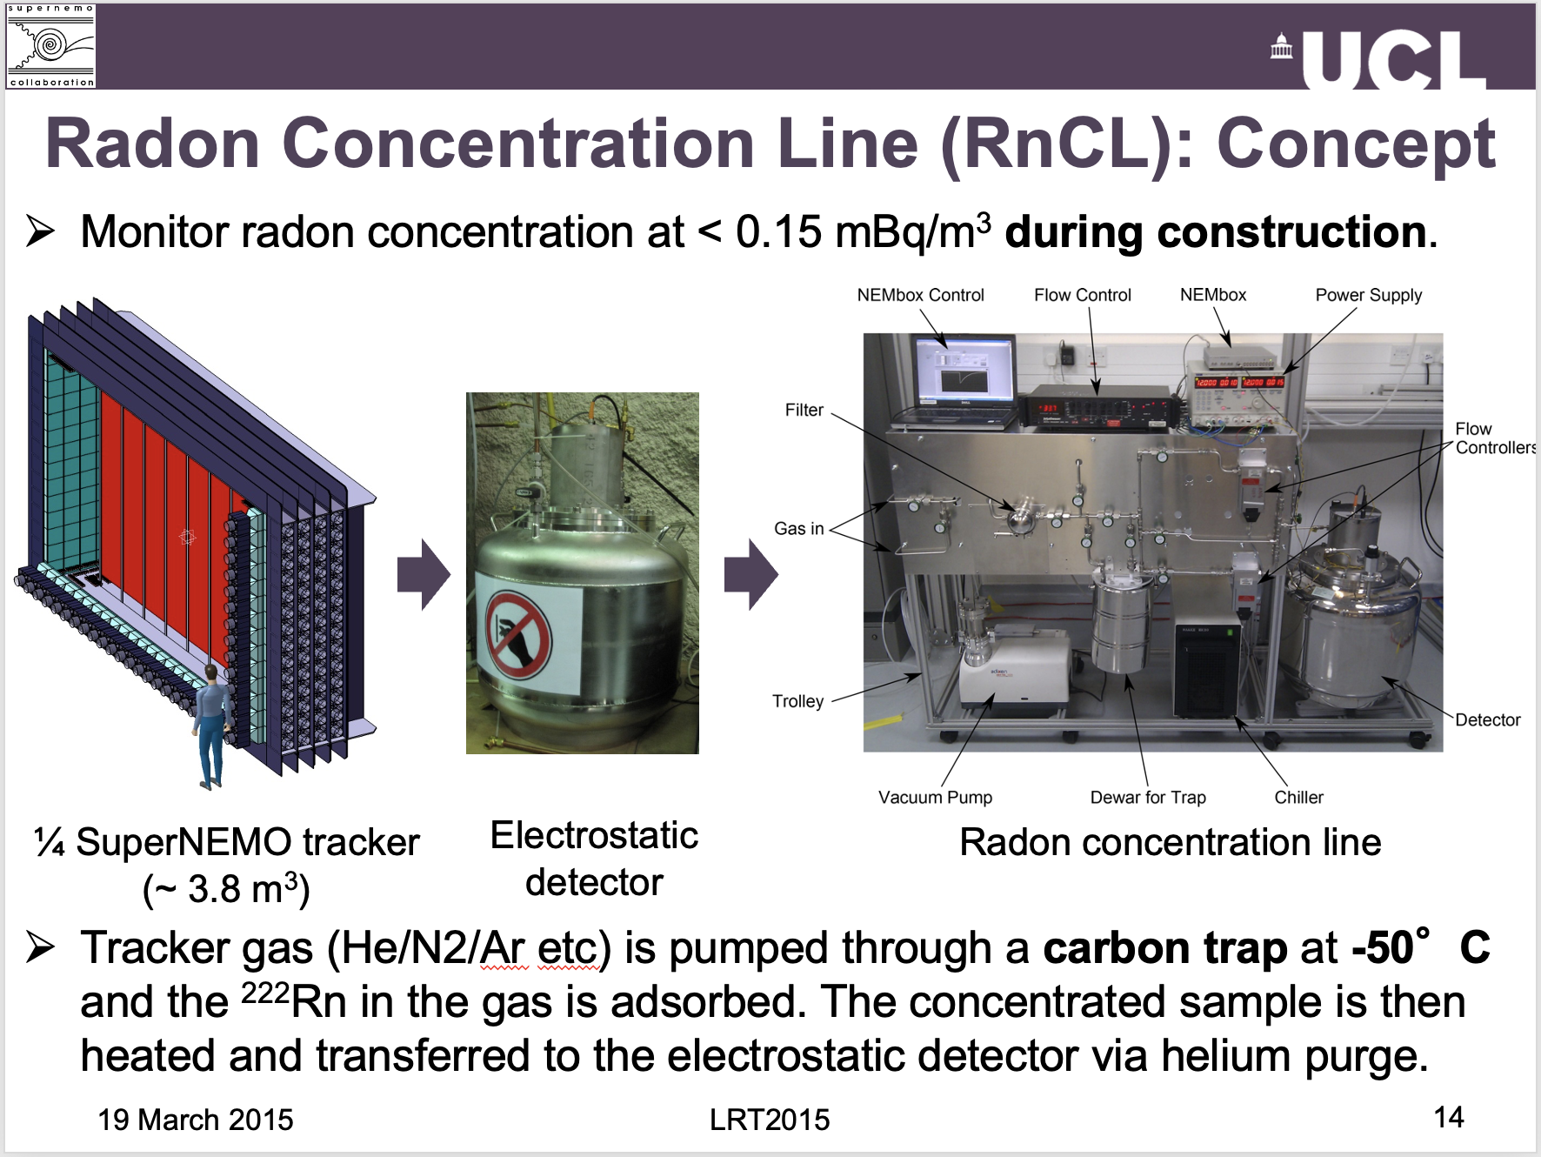

Slide 22
The Boulby Radon Facility - Sensitivity
Sensitivity based on the performance of the UCL system, but there are several upgrades.
  New detector has lower background - factor 4.
  New detector must use nitrogen instead of helium, demonstrated comparable detection efficiency.
  The new system is entirely constructed by swagelok with integrated external components.
Large Volumes of gas at ~ 5 μBq/m³
Radon Emanation ~ 100 μBq per sample

Slide 23

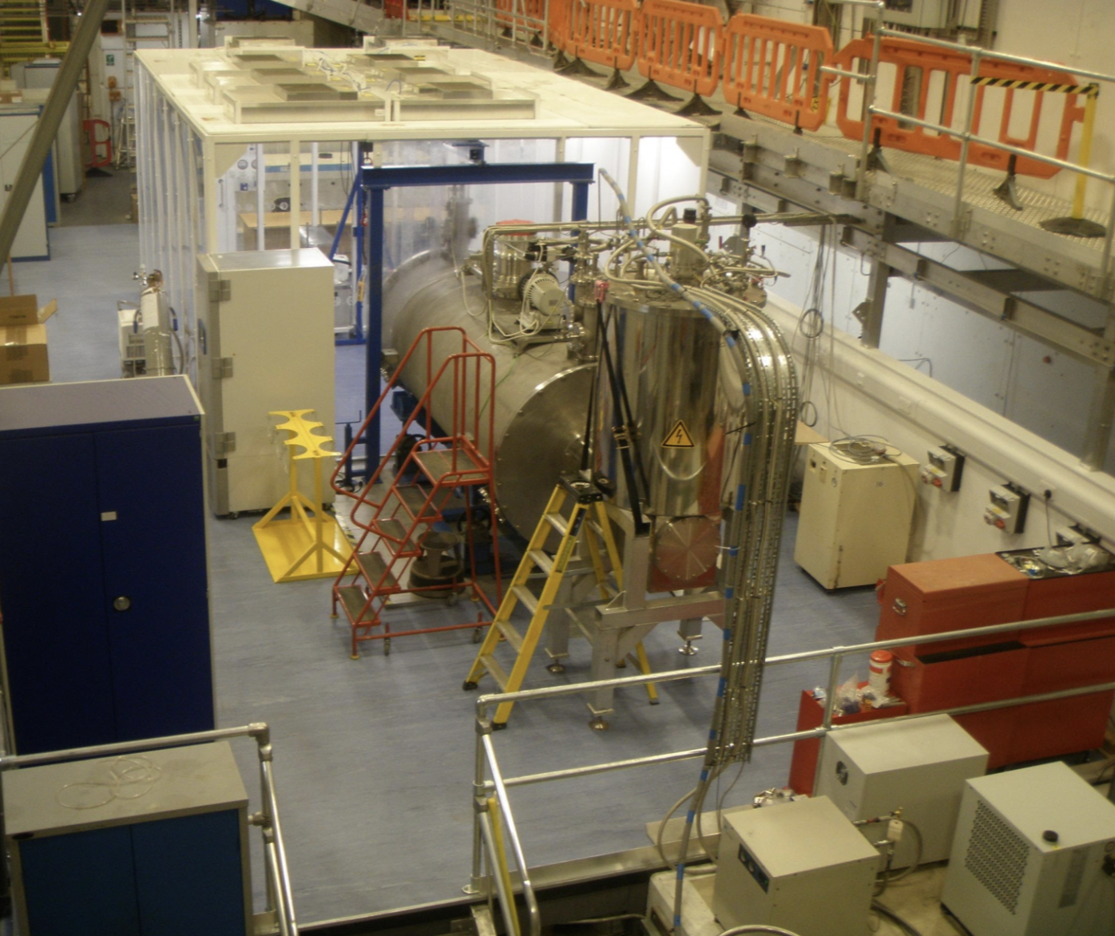

Cold Radon Emanation Facility
E. Perry
Goal: to deliver a world-leading sensitivity ~1 uBq/m³ to ²²²Rn emanated from materials at temperatures of *relevance to rare-event searches.
*e.g., LXe & LAr temperatures.
The worlds first cryogenic radon emanation system.
2 emanation chambers available:
A 2.7 L chamber, operational at several fixed temperatures.
A 200 L chamber, which can be cooled and stabilised at temperatures down to ~77 K.
  Allows measurements of whole detector components.
  Enables studies of emanation rate as a function of temperature.
Emily Perry - Poster 3!

Slide 24
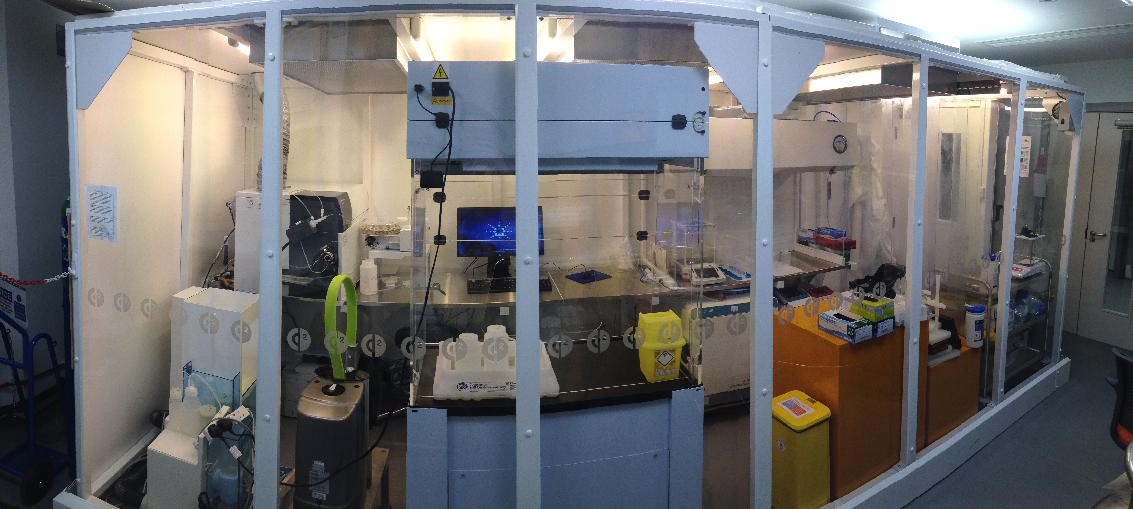

J. Dobson
ICPMS
Dedicated low-background facility at UCL inside a iso 6 cleanroom.
Fast: 1-2 samples/day
Sensitivity of 10 ppt for ²³⁸U & ²³²Th
Requires expertise in sample preparation.

Slide 25
Outlook
We have started R&D programme.
We would like to establish BUGS as a center of excellence for screening and cleanliness and the UK as the world leader in material assay.
We need to develop new assay techniques
  Multi HPGE in coincidence
  Cold Radon Emanation
  Improved surface and bulk alpha sensitivity - new detectors
  Watch this space!
“Yesterday’s discovery is today’s calibration…”
(R. Feynman)
“… and tomorrow’s background”
(V. Telegdi)

Slide 26
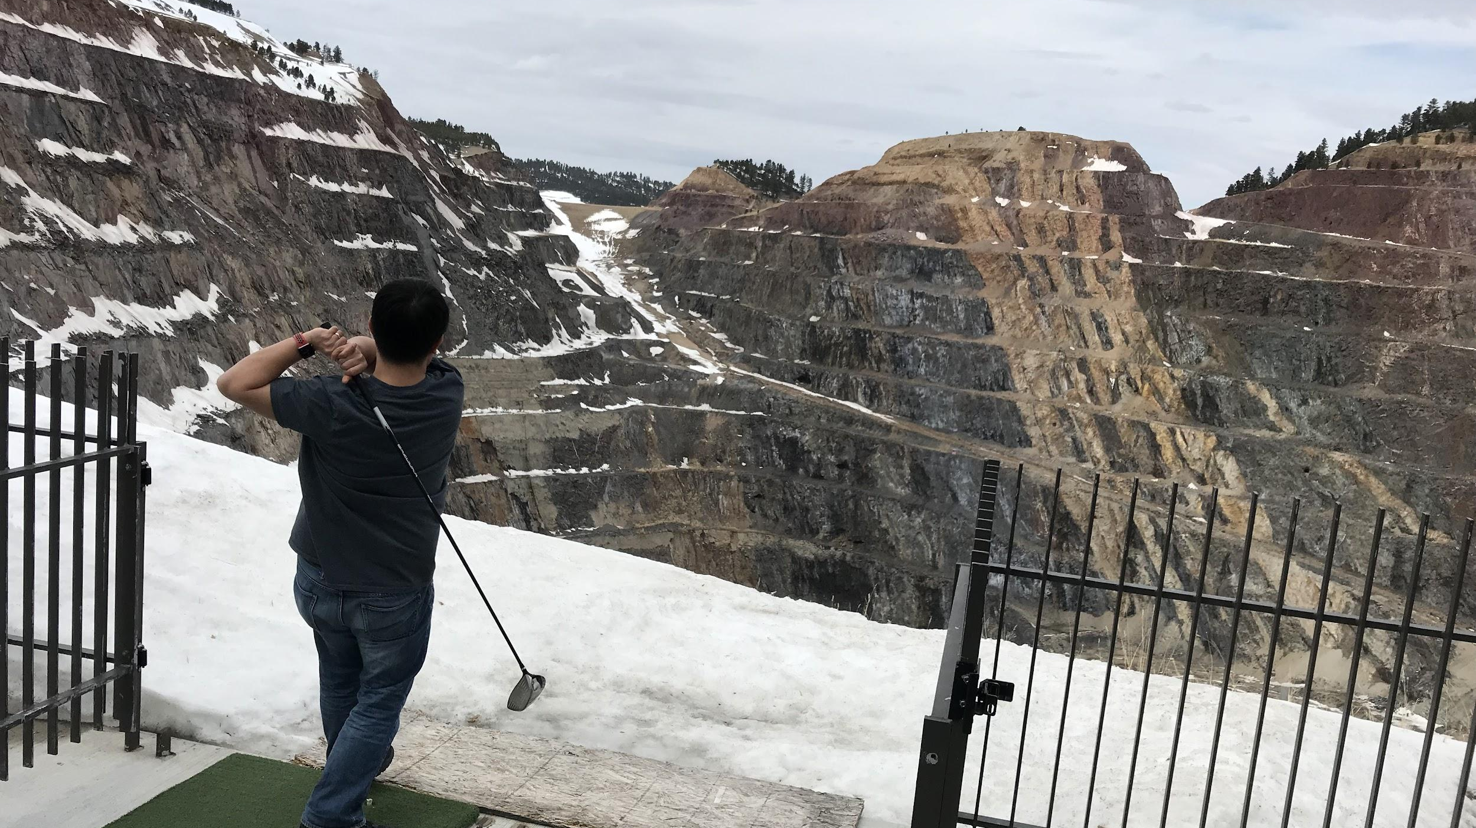
Thank you for listening!
Any Questions?

