Slide 1
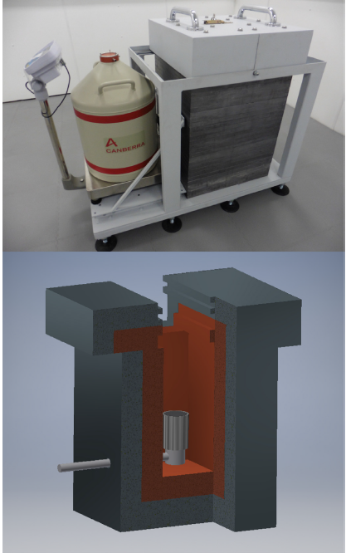
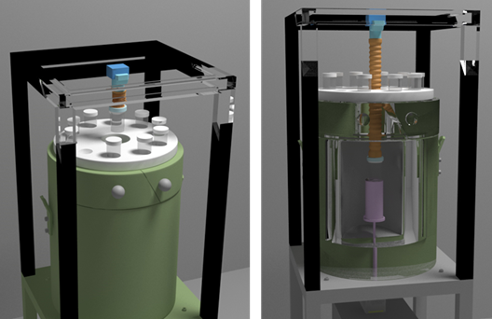
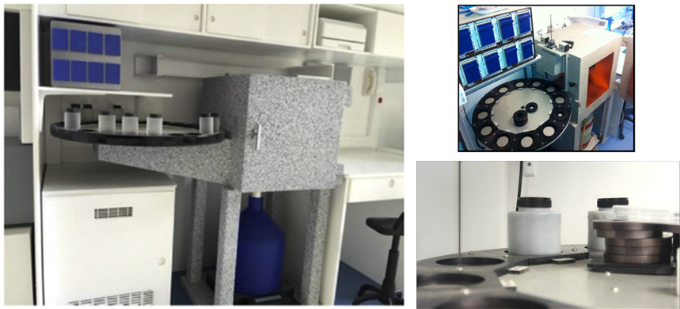
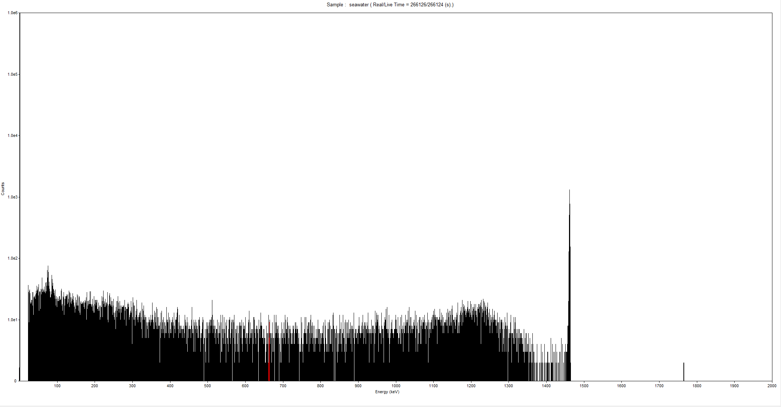
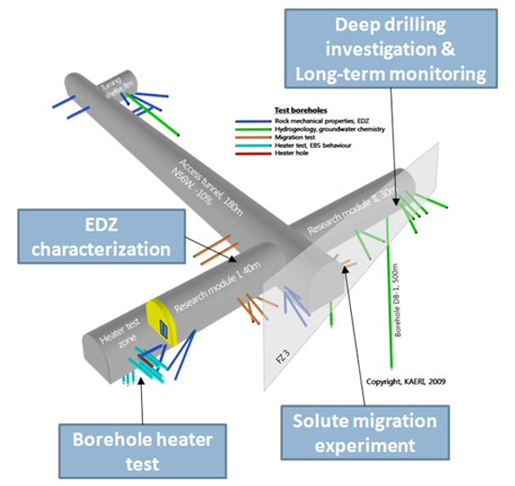
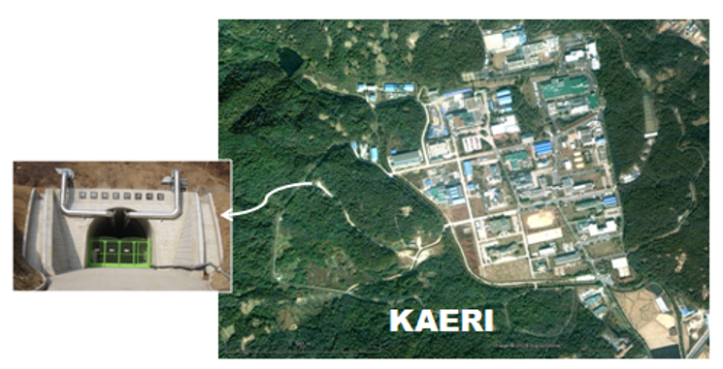
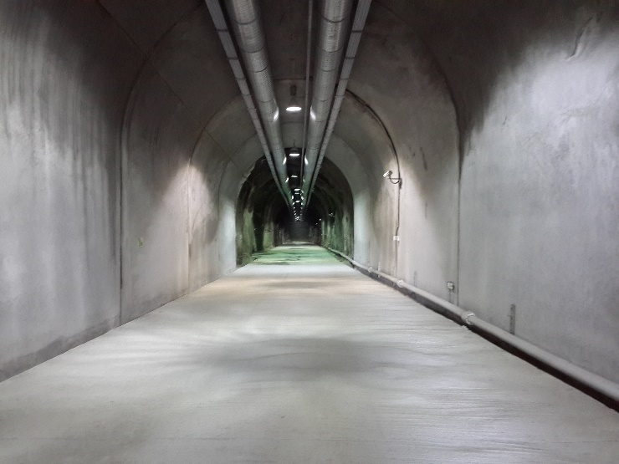
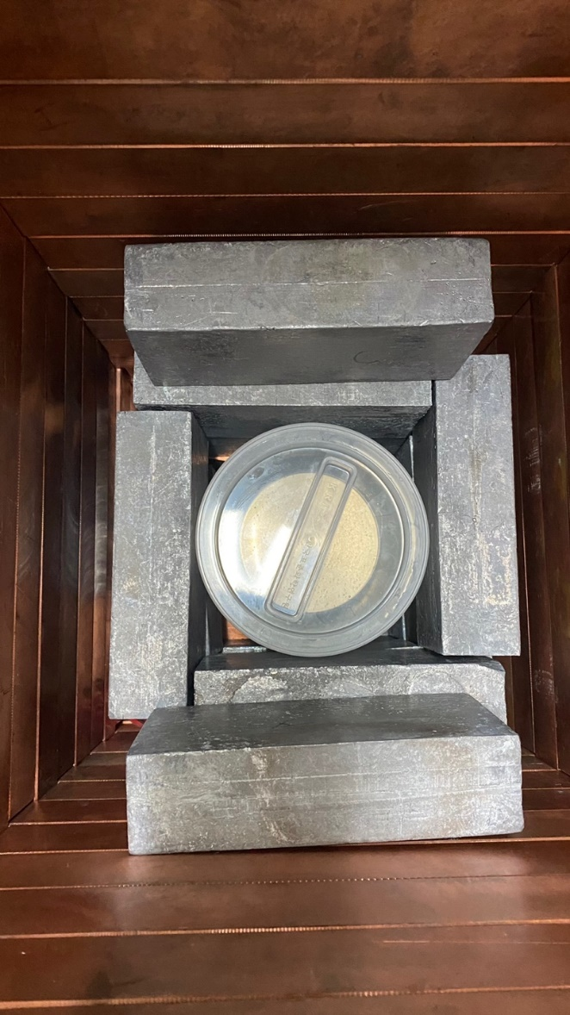
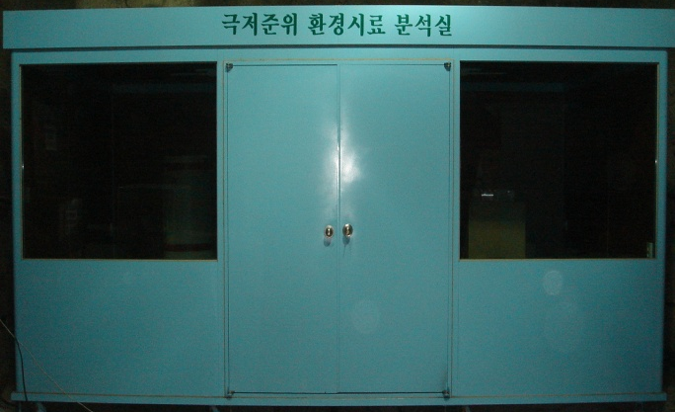
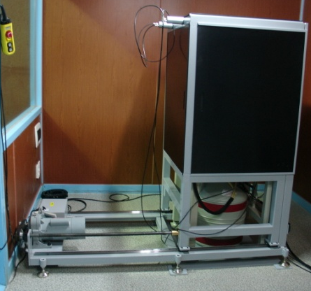
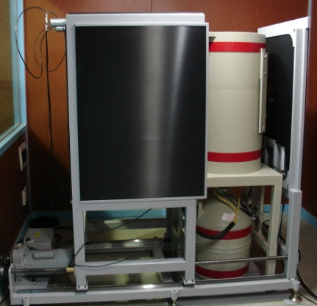
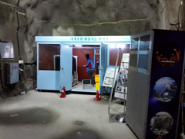
Chang-Jong Kim*, Mee Jang, Jong-Myoung Lim *Email : cjkim@kaeri.re.kr Environmental Radioactivity Assessment Team, KAERI(Korea Atomic Energy Research Institute)
Suggestion of mobile ultra-low background HPGe system
ABSTRACT
Suggested mobile system
Most underground laboratories (UL) were originally constructed for studies of fundamental physics, such as dark matter and neutrino-less double beta decay experiments. The fundamental physics experiments mentioned require ultra-sensitive detection at underground. Similarly, ultra-low background facility is invaluable for studies of radionuclides analysis from the perspective of reducing the background radiation from cosmic ray. Especially, gamma spectrometry system using HPGe detector is one of main radionuclides analysis equipment in underground laboratories. However, since the system is focused on measuring detector material for physics experiment and sensitive to contamination, there is a limit to applying it to general environmental samples such as seawater, sediment, etc. And underground environment is disadvantageous in accessibility when many samples need to be analyzed, such as the recent issue due to Fukushima contaminated water. Our team judge that ultra-low background HPGe system would be effective for seawater sample in terms of shortening radionuclides analysis time of pretreatment and measurement. So, we are designing a mobile system that can be moved to vehicle. A system to satisfy minimum detectable activity of under 10 mBq is considered as a target of Cs-137 radionuclide, and research on the optimization between shielding technique and the meter water equivalent. In this paper, there are conceptual design of mobile ultra-low background HPGe system.
A disadvantage of the underground environment is that it is difficult to access.. This makes it difficult to install and dismantle the measurement system and exchange samples. The mobile system allows the system to operate immediately without the installation period of equipment, and in an emergency, it can utilize not only the underground environment but also public tunnels.
Source : The BUGS low-background gamma spectroscopy facility
Automatic sample changer
In addition, sample replacement can be easily performed by applying an automatic sample exchanger like below.
Measurement of seawater sample (CC1 single HPGe, Acknowledgement : Y2L lab of CUP in Korea IBS)
METHODOLOGY
This is result of measurement (about 270000 sec) of seawater sample of 1L Marinelli beaker. Since the radioactive concentration of ⁴⁰K of normal seawater is 10 to 15 Bq/L, compton continuum of ⁴⁰K affects the background of ROI of ¹³⁷Cs. Although only ¹³⁷Cs can be separated through chemical separation, we would like to evaluate the MDA for direct measurement to reduce the time required in an emergency.
Previous study
⁴⁰K
¹³⁷Cs ROI
Discussion about system MDA
~ 40 m underground
Cosmic veto background reduction
using automatic plastic scintillator system
System | Sample | Measurement time (sec) | MDA of ¹³⁷Cs (mBq/L)
UL (100% HPGe) | Seawater 1L | 80000 | 6
UL (100% HPGe) | ¹³⁷Cs separation in seawater 1L |  | 2
GL (30% HPGe) | ¹³⁷Cs separation in seawater 1L |  | 60
UL : Underground Laboratory(Y2L, CC1), GL : General Laboratory(KAERI) CC1 shielding : lead 15 cm, copper 10 cm, lead 5 cm Y2L : ~ 700 m underground from the surface, Depth(m.w.e.) : ~ 2000 m
The KAERI(Korea Atomic Energy Research Institute) established an underground research facility (~200 m) for disposal of high-level waste in 2009 and has experience in establishing and operating an low-level HPGe system in some of the spaces. Currently, the laboratory has been withdrawn for operational reasons(constant temperature and humidity, electrical problems), and based on this experience, a new ultra-low-level HPGe system is planned.
CONCLUSION
The MDA of ¹³⁷Cs measured at 80000 seconds with CC1 detector of Y2L lab of CUP in korea is about 6 mBq/L. It was confirmed that the detection ability was 10 times better than that of general laboratory conditions, and MDA could be further lowered through cs-137 separation and increase in measurement time. Based on this result, mobile ultra-low background HPGe system will be designed and manufactured.
Environmental Radioactivity Assessment Team

