Slide 1
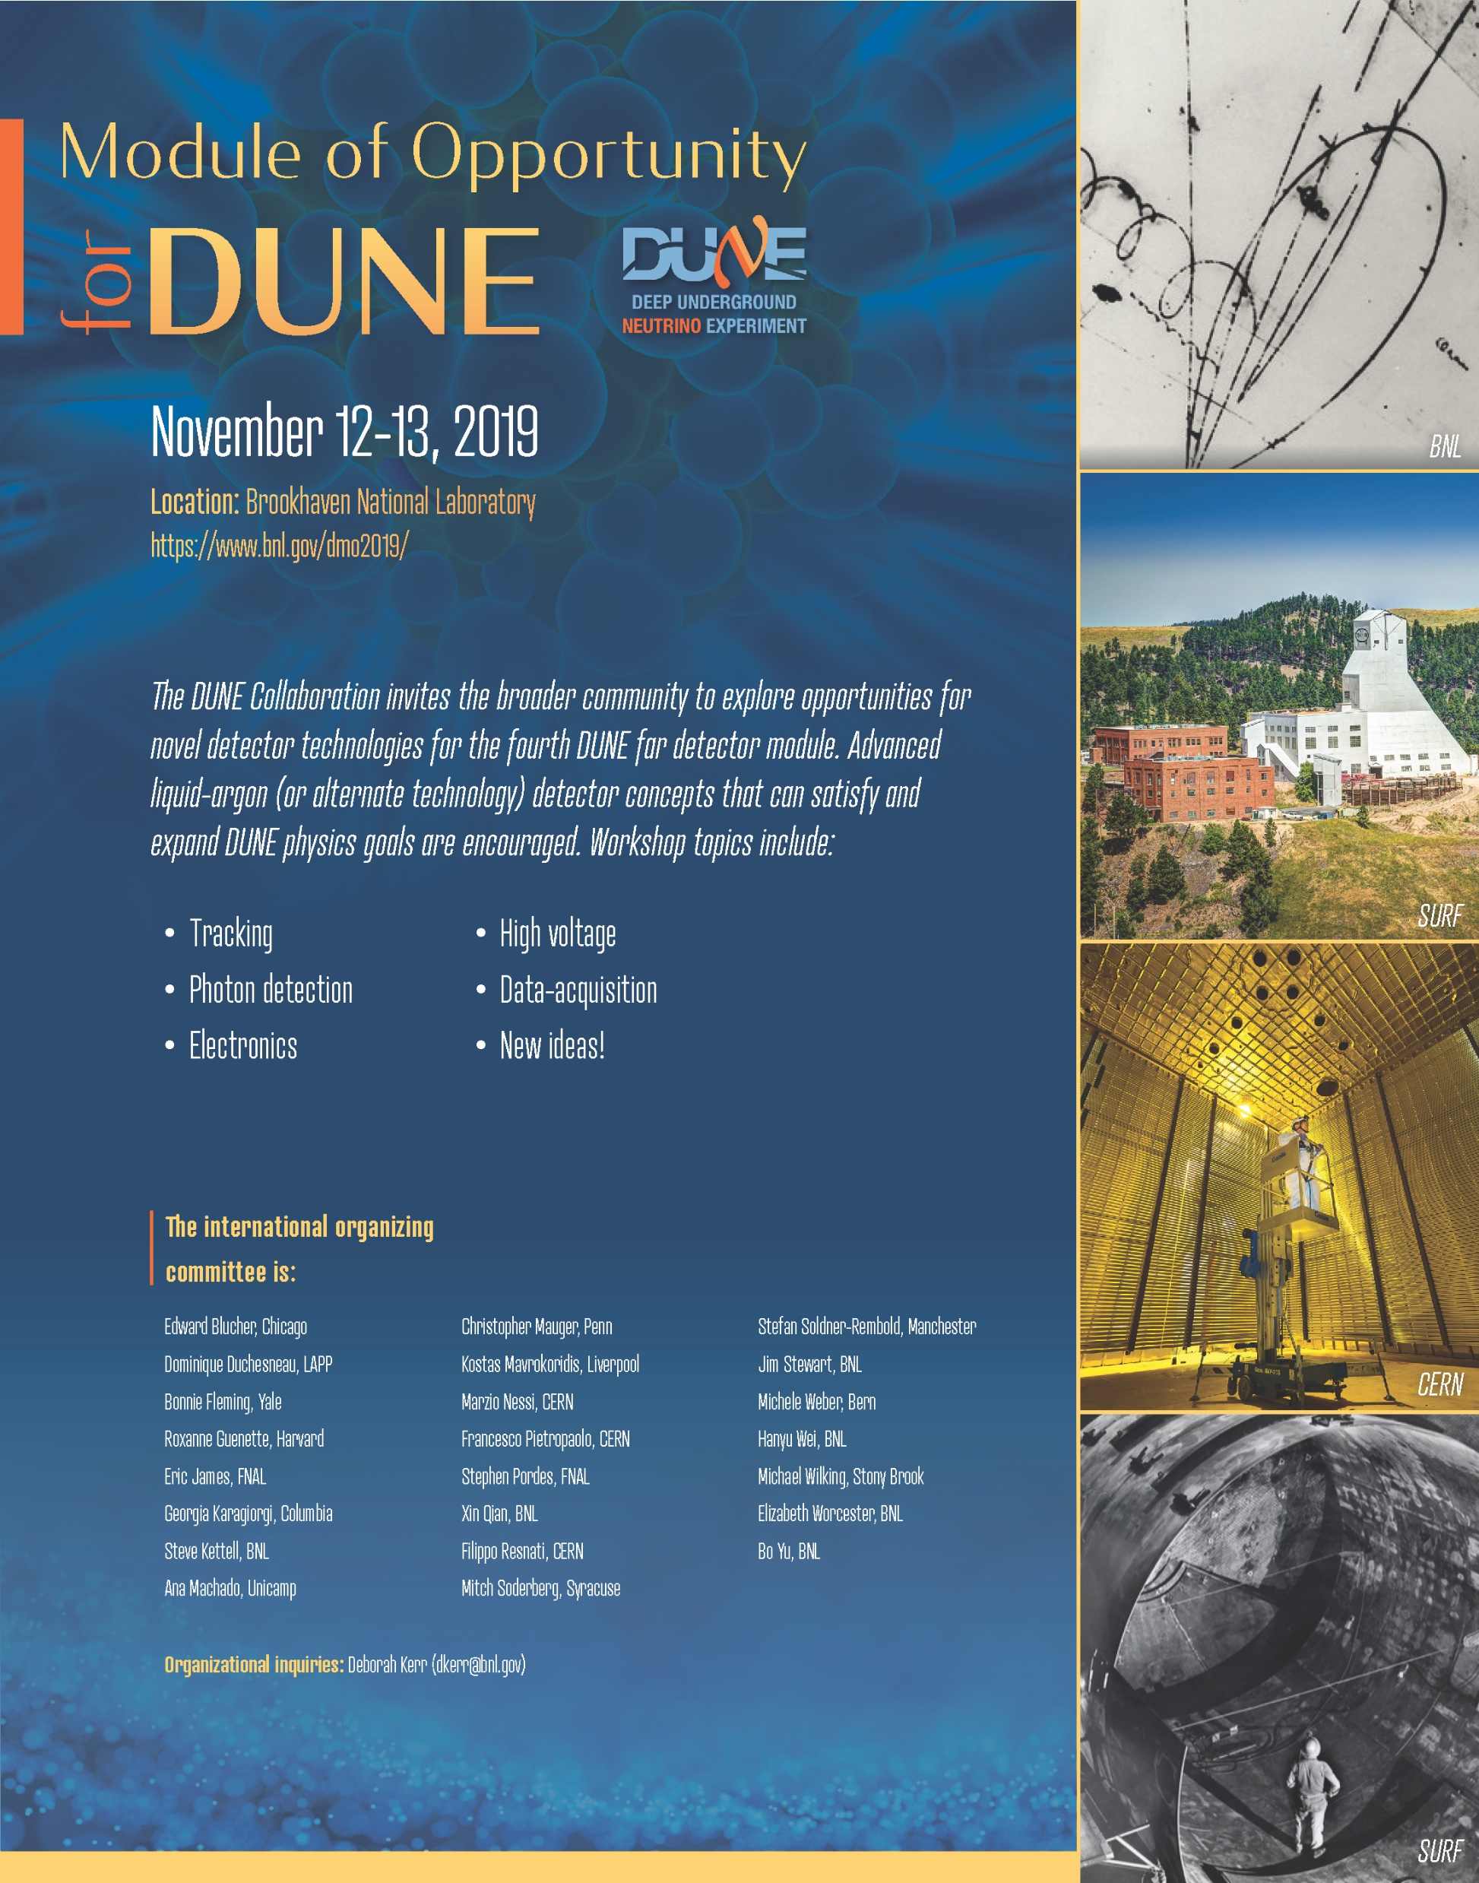
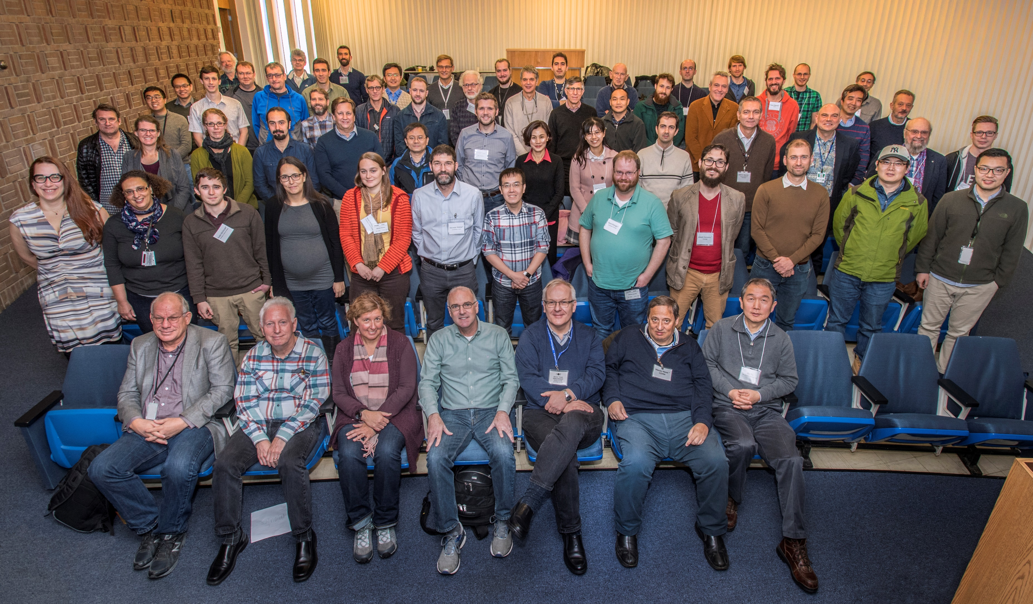
DUNE Module of Opportunity (MooD) Workshop (Nov 2019)

Slide 2
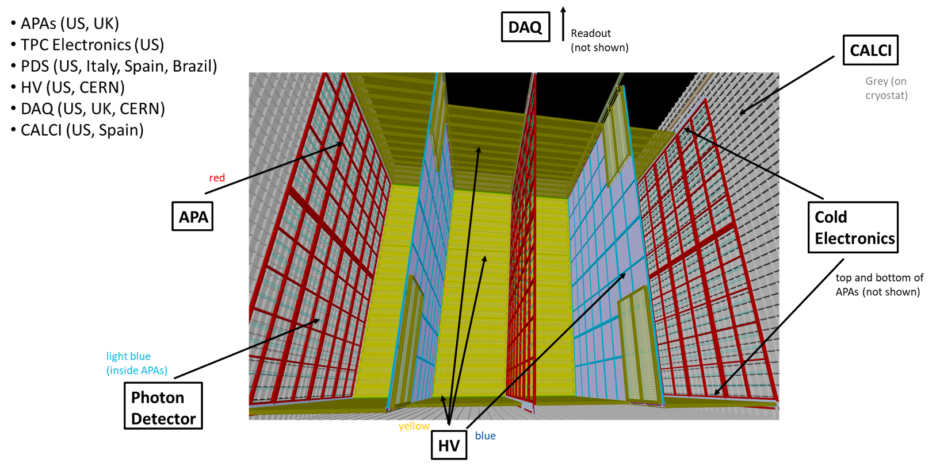
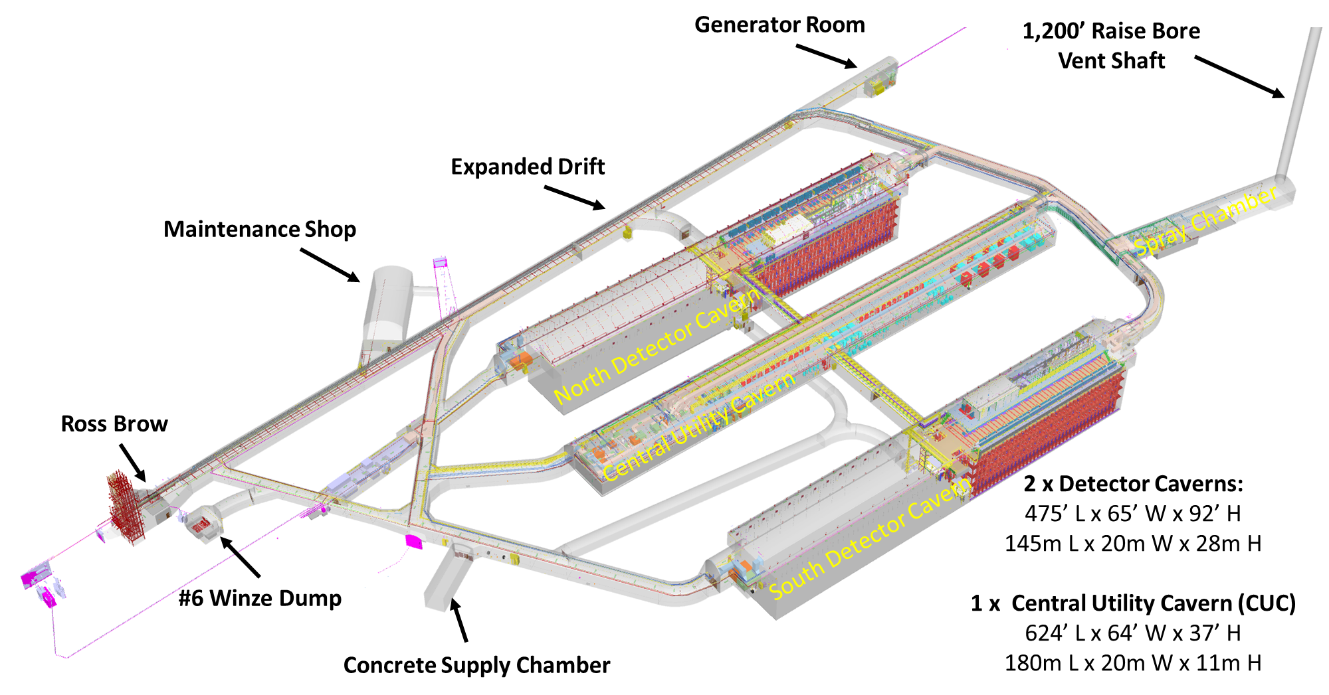
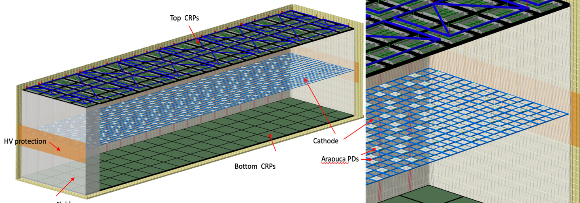
2022 Update!
LBNF/DUNE will build two far detector modules
Excavated space for two additional modules (~17kt LAr equivalent)
new
FD1 : Horizontal Drift
FD1
FD2
FD2: Vertical Drift
Top Drift Electronics (TDE)
DAQ
Charge Readout Planes (CRP)
CALCI
  CRP (France, US, CERN)
  TPC Electronics (France, Japan, US)
  PDS (US, Italy, Spain, Brazil, France)
  HV (US, CERN, France)
  DAQ (UK, CERN, Canada, US, Czech Republic)
  CALCI (US, Spain)
HV
Bottom Drift Electronics (BDE)
Photon Detector System (PDS)

Slide 3
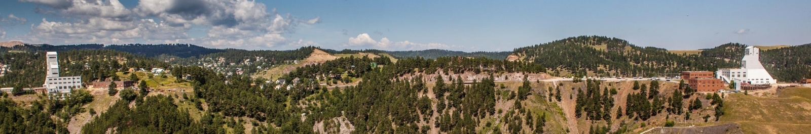
Project “Far Site” at Sanford Underground Research Facility (SURF) in Lead, SD
new
Ross shaft headframe
Yates shaft headframe
SURF is located at the former Homestake Gold Mine, in Lead SD
Property transferred to South Dakota Science and Technology Authority (SDSTA) to create and operate underground science facility
SDSTA operates SURF under a cooperative agreement with DOE-OHEP
DOE has leased areas for LBNF facilities from SDSTA; construction easements in place for access and temporary construction use
FRA has a memorandum of understanding with SDSTA with respect to LBNF/DUNE-US project support, services and responsibilities

Slide 4
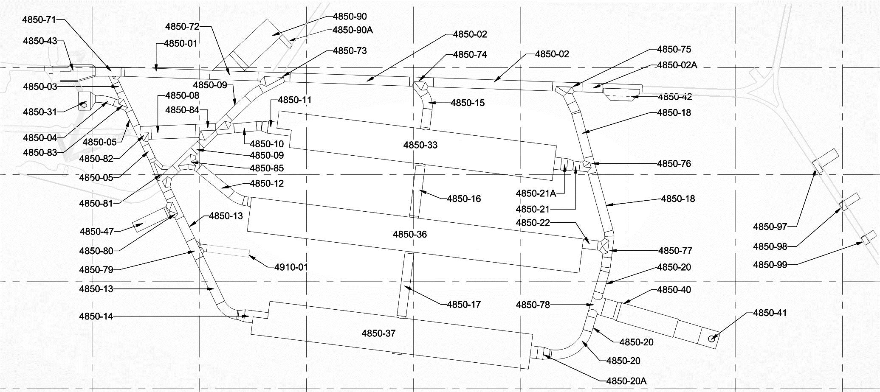
May 6 2022
new
Total Excavation Complete 27%
Temporary Concrete Batch Plant Location
West Access Drift
East Access Drift
South Access Drift
Cut 1
Pilot Drift
Spray Chamber
Excavation Direction (Red Team)
Excavation Direction (Blue Team)
Excavation Completed
Excavation and Shotcrete Complete
Concrete Complete

Slide 5
new

Slide 6
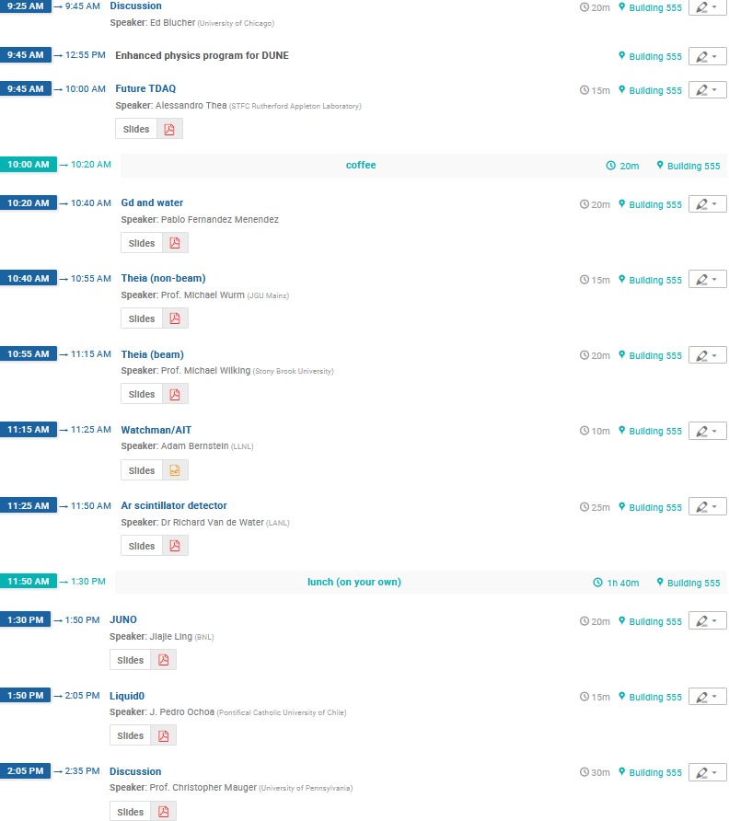
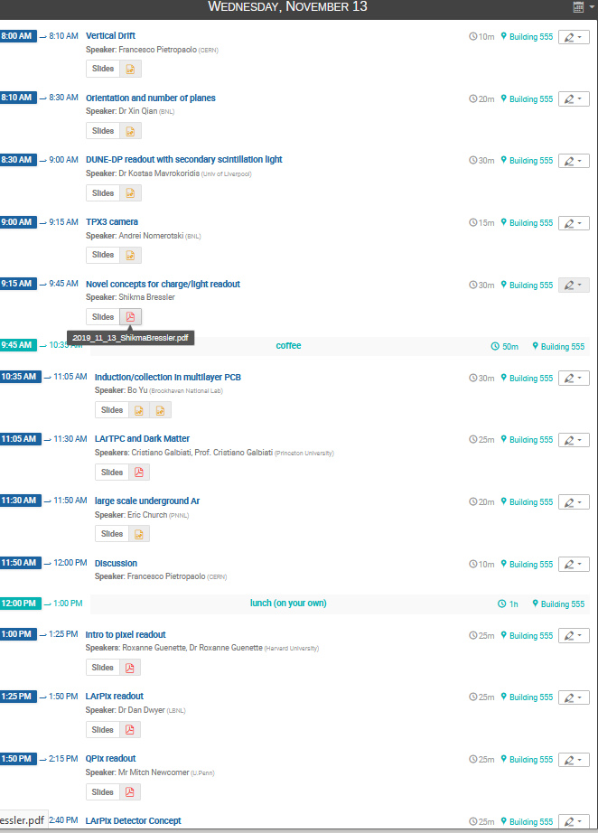
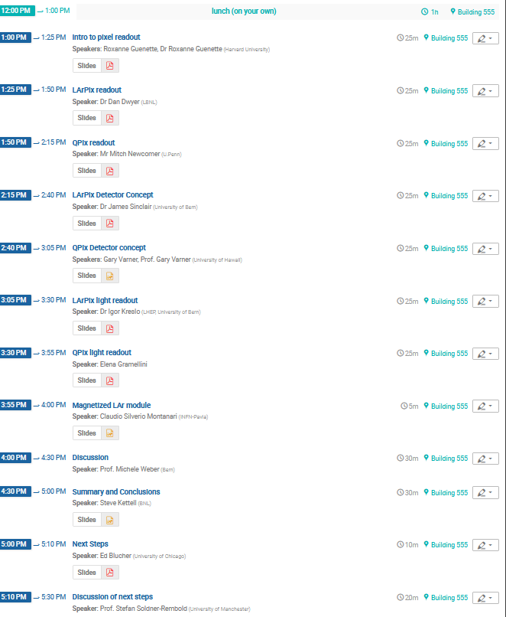
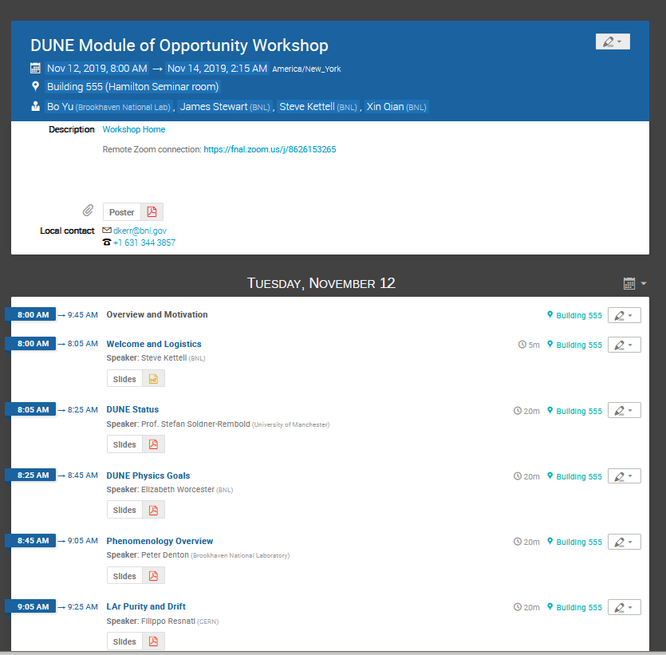
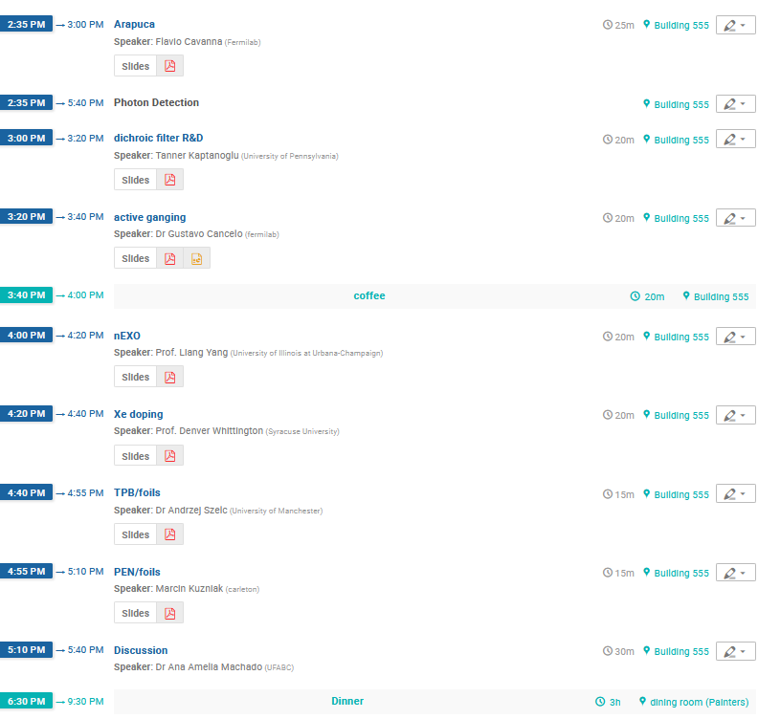
MooD workshop agenda
Main workshop sessions
LArTPC projective charge readout
LArTPC pixel charge readout
LArTPC light readout
Other technologies

Slide 7
impressions of MooD workshop…
Many very interesting and exciting ideas
Compelling case for further development of noble liquid TPCs and other ideas
Generated enthusiasm and ideas
Development effort continues…
LBNF project will build an outstanding underground facility and beam:
  …there is space for additional detectors
  A clear need to advance detector development towards the Module(s) of Opportunity

Slide 8
Progress since MooD
Vertical drift:
  Many ideas on charge and light readout are now implemented in FD2
  Vertical drift is a leading candidate for FD3-4
Pixels:
  Significant progress in pixel development with LArPIX for LAr-ND (see also SoLAr)
Theia, SoLAr, SLoMo
…

Slide 9
Progress since MooD
Theia: An Advanced Optical Neutrino Detector
https://arxiv.org/pdf/1911.03501.pdf

Slide 10
Progress since MooD
Theia: An Advanced Optical Neutrino Detector

Slide 11
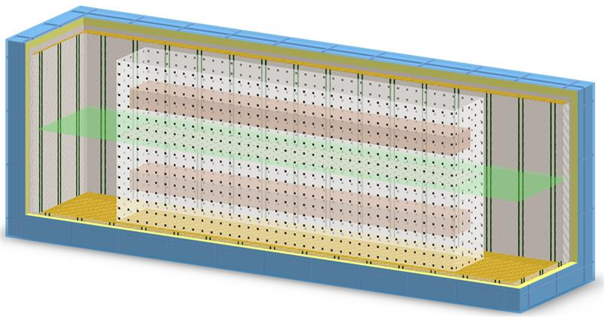
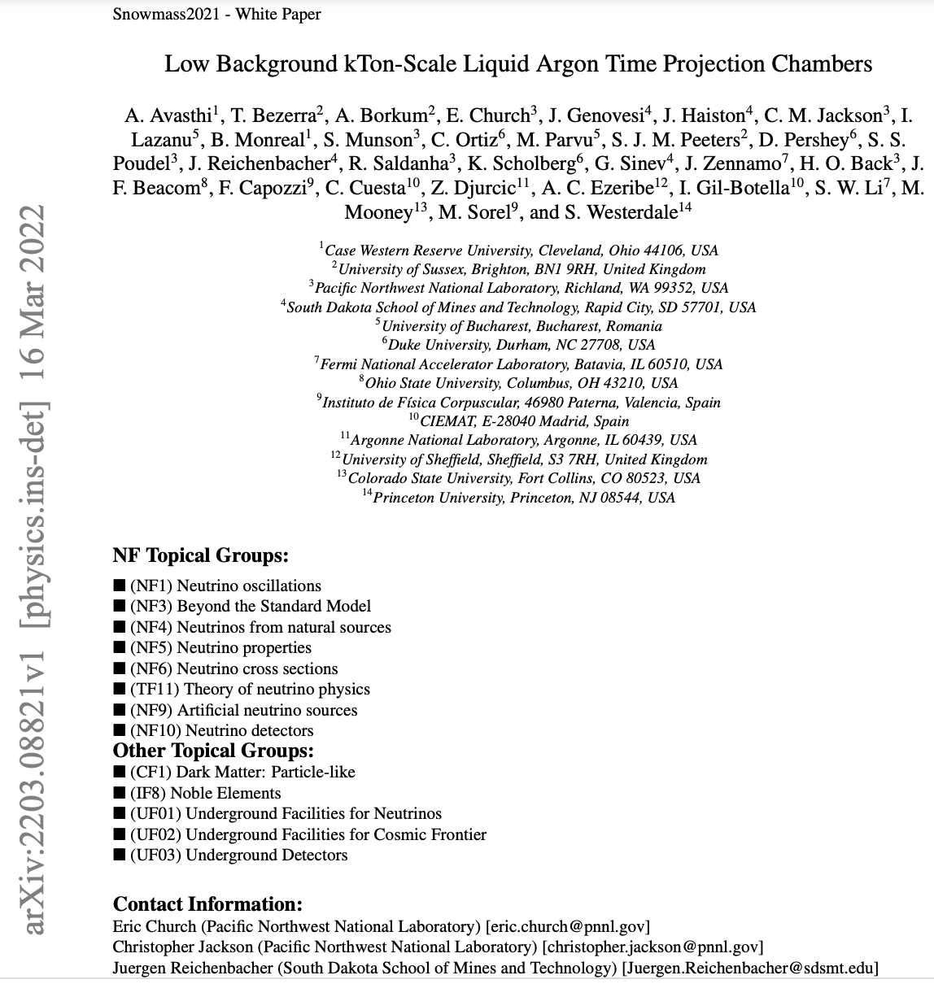
Progress since MooD
Low Background kT-Scale Liquid Argon Time Projection Chambers
https://arxiv.org/pdf/2203.08821.pdf
1-3 kton fiducial volume(s)
Acrylic box
Cryostat
Charge readout planes
Central cathode
SiPMs
Water shielding
Low background underground argon

Slide 12
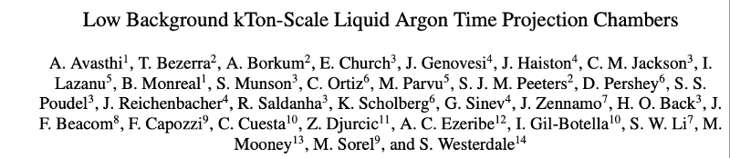
A Low Background DUNE-like Module: SLoMo* (SURF Low Background Module)
There is significant interesting physics to be done in large LArTPCs below current thresholds of ~10MeV.
physics
    Solar neutrino measurements
    Supernovae detection
    Supernovae Coherent ν-Nuclear elastic scattering (CEvNS) “glow”
    0νββ search
    WIMP Dark Matter search
Might hope for module 3,4 for DUNE to look like this
  “DO NO HARM” to the main physics program
Eric Church
CoSSURF 2022

Slide 13
Progress since MooD
SoLAr: Solar Neutrinos in Liquid Argon
https://arxiv.org/pdf/2203.07501.pdf

Slide 14
Progress since MooD
Snowmass2021 - Letter of Interest
Q-Pix: Kiloton-scale pixelated liquid noble TPCs
https://www.snowmass21.org/docs/files/summaries/IF/SNOWMASS21-IF7_IF8-NF10_NF0_Jonathan_Asaadi-079.pdf
Snowmass2021 Letter of Interest: An R&D Collaboration for
Scalable Pixelated Detector Systems
https://www.snowmass21.org/docs/files/summaries/IF/SNOWMASS21-IF7_IF8-NF10_NF0-UF3_UF0_Dan_Dwyer-171.pdf
Development of LArTPC Vertical Drift Solutions with
PCB Anode Readouts for DUNE
https://www.snowmass21.org/docs/files/summaries/NF/SNOWMASS21-NF10_NF0-IF9_IF8_Xin_Qian-123.pdf
… many others

Slide 15

… next steps
LBNF will complete excavation of the far site (for 4 detectors) in 2024
DUNE currently has resources to build two far detectors (FD1-horizontal drift and FD2-vertical drift). Expect completion in ~2029.
Natural to plan for R&D towards improvements for FD3-4.
Since MooD-2019 many ideas put forward in Snowmass
  LArTPC based on vertical drift
  LArTPC with pixel readout
  Low background combinations of noble liquids
  Water/scintillator-based detectors
Many ideas to add to the main DUNE program

Slide 16
…next steps
Following successful MooD workshop at BNL in 2019
  DUNE is planning some followup:
    Collaboration meeting parallel session on Module of Opportunity next week (Thursday May 19 at 14:00 CDT).
    DUNE followup workshop in Spain (October?)
Feed Snowmass/P5 and international planning
Many stakeholders in addition to DUNE: DOE, SURF/SDSTA, FNAL,…
…

Slide 17
Backup

Slide 18
ARAPUCA Light Detection
Light Readout
X-arapuca developments
Xe-doping
Reflective foils
active signal ganging
large arrays of SiPMs
power over fiber (SiPM at HV)
Reflective Foils
Andrzej, Marcin
Flavio
Xe doping
Denver

Slide 19
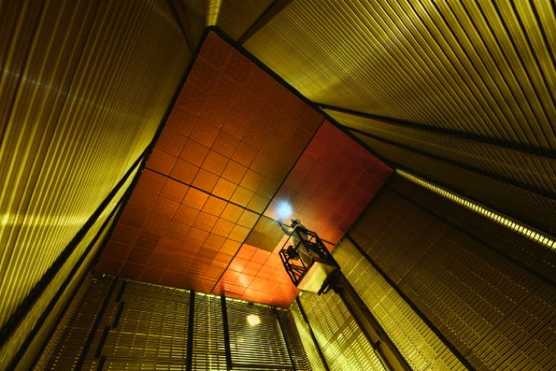
Vertical Drift LArTPC
Charge Readout
First introduced at the CERN mini workshop in June 2019
Based on the simple assembly concept of DP field cage
6m drift, 300KV technology almost acquired.
Reduced purity requirements compared to 12m DP drift
Modular and easy to install
Francesco
cryostat
Dedicated R&D program at CERN carried out to replace LArTPC wire chamber with perforated multilayer printed circuit board (PCB). Fragile wires replaced by robust copper strips:
  Ionization electrons are focused through PCB holes
  Strips in front and intermediate layers sense induction signal
  Strips on last plane collect ionization electrons.
Idea was driven by improvements w.r.t. wire chambers:
  Components can be mass produced commercially
  Anode plane is robust, without risk of broken wires, simpler support structure
  Possibility of integrating FE electronics on PCB
  Better segmentation/modularity, test full readout before installation
  Take advantage of technological development of wide area Thick-Gems at CERN.
Unit = 3m x 3m
anode
Support wires
6m drift
Cathode (300KV)
6m drift
anode

Slide 20
Sourcing LRUA for DUNE could be a reality
DarkSide/Underground Ar
DarkSide: combined neutrino oscillation, dark matter and 0νββ experiment: LArTPC with ¹³⁶Xe doping
Cristiano, Eric
Argon is not generally looked for in underground gas fields
PNNL working with to explore large scale underground argon sources
  Supplier: Major U.S. gas producer/supplier (not disclosed at company request)
  Production rate: ~5,000 tonnes/year
    Can start in about 2 years
  Ballpark cost: x3 regular argon
  NOTE: These are very rough estimates.
  Further refinement require expression of true interest from DUNE
Next steps for physics:
  Reminder: DarkSide source is the only proven source (i.e., extremely low ³⁹Ar)
  Measure ³⁹Ar levels from new potential source
  For ⁴²Ar level, new assay method required – expected to be VERY low

Slide 21
LArPix
Pixel readout ideas for LArTPC
Dan
LArPIX prototyping program for Near Detector
Deployment in ND-LAr
Ideas for FD module #4

Slide 22
QPix
Mitch

Slide 23
Intro to DUNE
Stefan

Slide 24
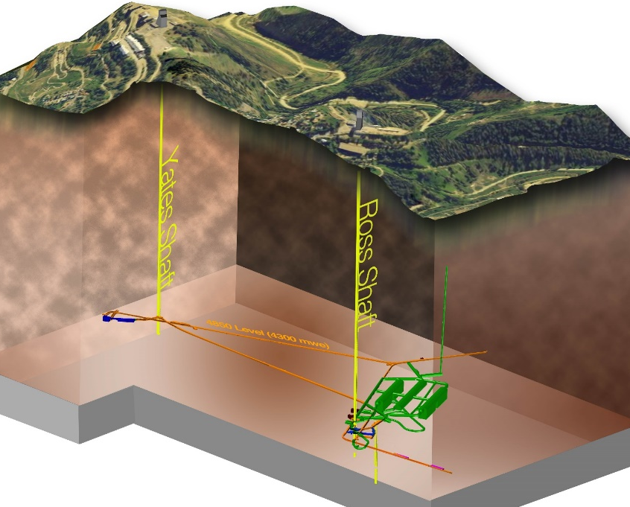
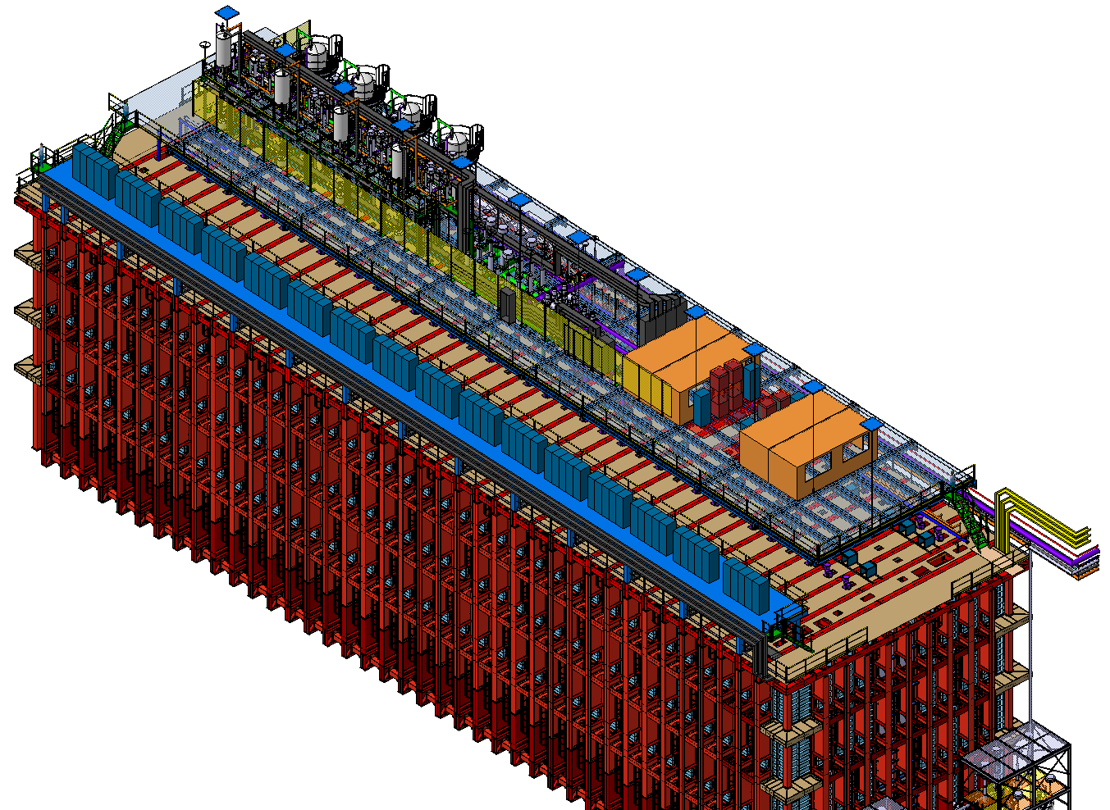
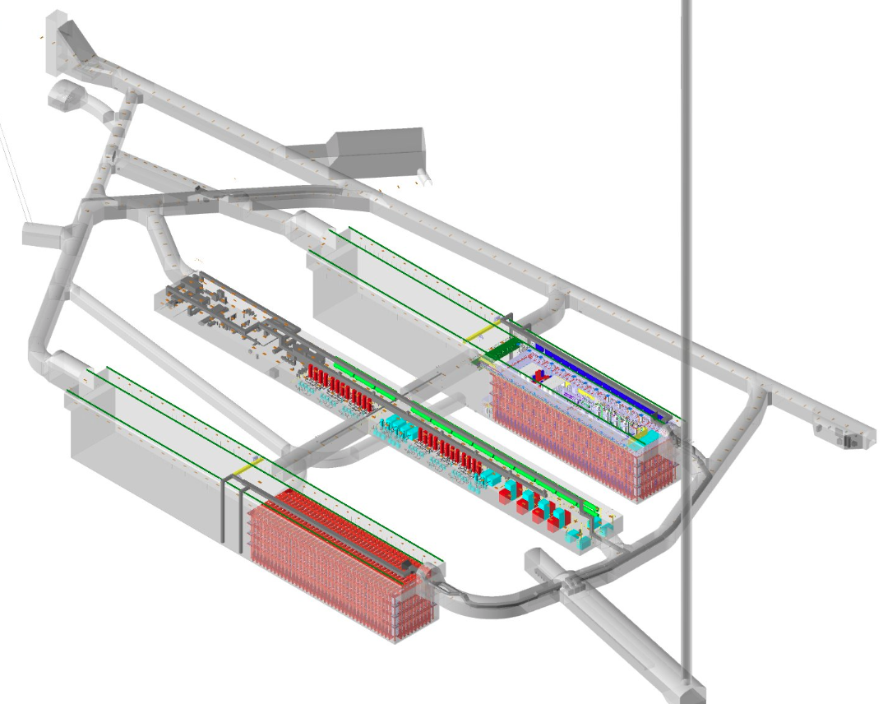

LBNF/DUNE at Sanford Lab (SURF)
Ross shaft headframe
Yates shaft headframe
14 Jul 2020
Sanford Lab Reliability
Projects FY16 – 20
  Ross shaft rehab
  Hoist motor rebuild, …
Pre-Excavation
FY17 - 20
  Rock disposal systems
  Ross headframe
  upgrade, …
Excavation/
Construction FY21 – 24
  Brow/CUC/Drifts/Utilities/building/caverns
Conventional Facilities:
  Surface and shaft Infrastructure
  Drifts and caverns for detectors
Cryostats & Cryogenics:
  Four membrane cryostats
  LN2 refrigeration system
  LAr purification systems
  70kt LAr
DUNE Detectors
  4 detectors
CD-3a Scope
4850L caverns and drift layout
18m
66m

