Slide 1
Diversity and Ecological Niche Preferences of Subsurface-Adapted Methanotrophic Bacteria from SURF.
Lee Krumholz
University of Oklahoma
Norman, OK
Department of microbiology and plant biology

Slide 2
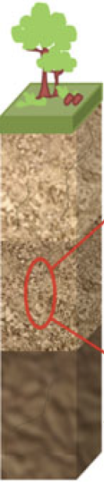
Rationale of exploring methanotrophs (methane oxidizing bacteria) in the subsurface
Chemolithoautotrophy and interaction that occur in the local environment which fuels the biosphere
X
No light input
Energy sources
Fe²⁺
HS⁻
Increasing temperature and pressure,
deficient oxygen
S⁰
Biomass Pools
CO₂
H₂
NH₄⁺
Methanotroph?
Mn²⁺
CH₄
Notes:
In subsurface ecosystem, as depth increases, the microbes living in there have to deal with multiple environmental stresses, including. ……But surprisingly, the biomass pools of subsurface biosphere are often comparable to those measured in surface ecosystem. The first reason is chemolithoautotrophs can serve as the primary producer through utilizing a broad range of energy sources. Secondly local bio-interactions can maximize the community-wide productivity. On the other hand, as methane is common and abundant in subsurface biosphere, methanotrophy is supposed to sustain the subsurface microbial ecosystem as well.

Slide 3
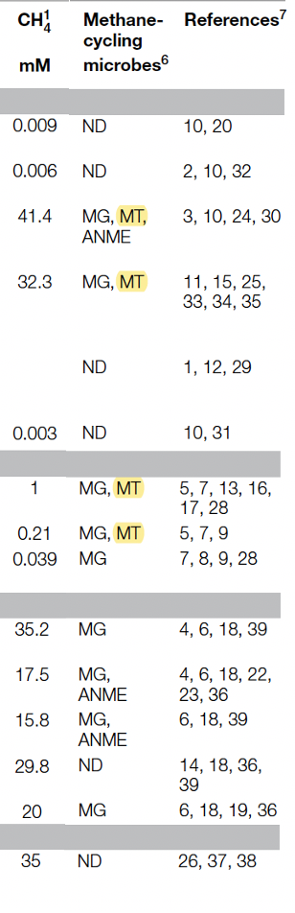
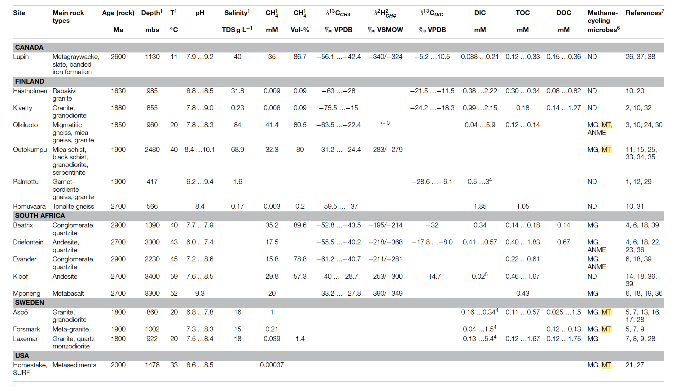
Methanotrophic ecology is poorly understood in subsurface ecosystem
Characteristics of several deep terrestrial subsurface sites where microbes contributing to the methane cycle have been detected.
MT (aerobic methanotrophs) were much less frequently recorded than MG (methanogens).
Crystalline rock aquifer
Knowledge gap (Ecological/ Adaptation role?):
  Methane sink/ Interactions/ Novelty and adaptive potentials are unclear.
Gold mines
Kietavainen and Purkamo, 2015
Notes:
However, methanotrophic ecology in subsurface ecosystem is still poorly understood. Because deep terrestrial subsurface is hard to access, only 3 ecosystems were relatively well-studied, and where methane-cycling microbes have been detected. In the first two ecosystems, what you can see here is that MG were detected in almost every environments, whereas MT were detected in only a few. Due to lack studies looking into these aerobic methanotrophs, these 3 roles of aerobic methanotrophs in these two ecosystems are still unclear.

Slide 4
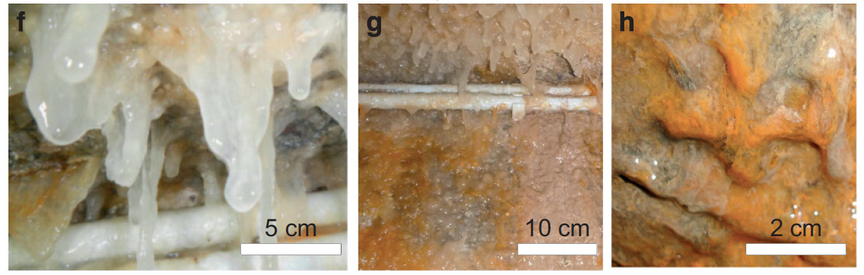
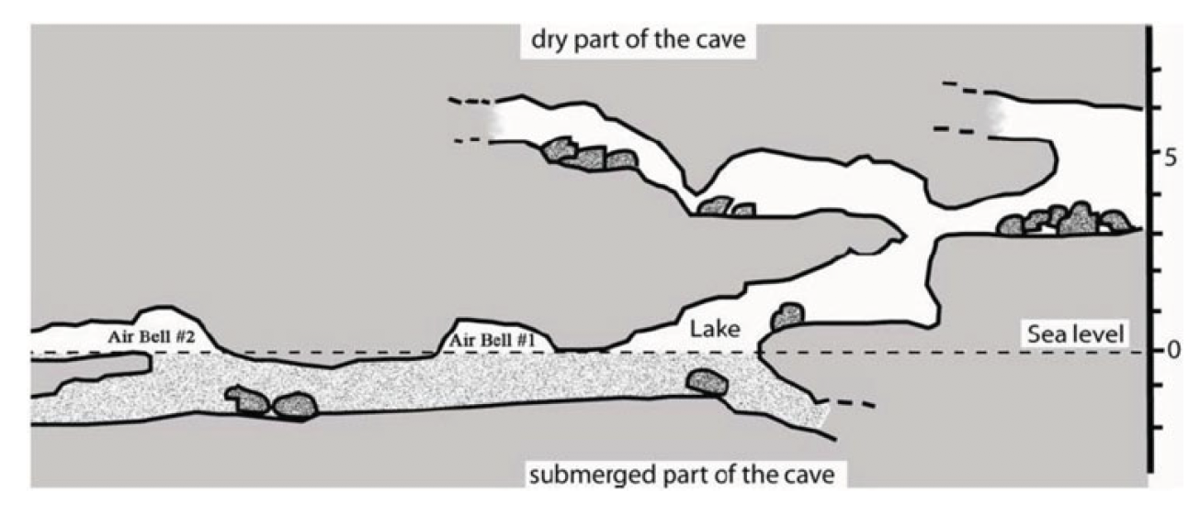
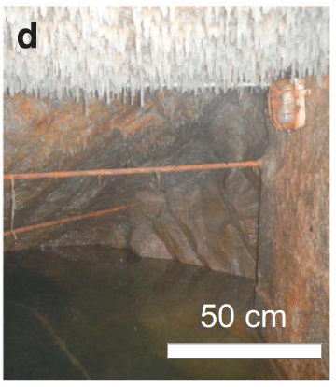
Methanotrophic ecology in subsurface ecosystem
Movile Cave
German spring cave
Air pockets (CH₄ + O₂)
Surface water and floating mat (DNA-SIP): aerobic methanotrophs sustain a diverse heterotrophic community.
  Hutchens et al., 2004
Biofilms in a German cave contain a high abundance and diversity of aerobic methanotrophs
Karwautz et al., 2018
Notes:
The 3rd subsurface ecosystem we can access is the cave. In movile cave, DNA-SIP experiment indicated that aerobic methanotrophs inhabiting the surface water and floating mat in air pockets can sustain a diverse heterotrophic community. In another spring cave, different types of biofilms collected in the air pocket have a high abundance and diversity of aerobic methanotrophs However, with lack of isolates and genomes recovered from caves, the adaptation role of aerobic methanotrophs in this ecosystem remains largely unknown.

Slide 5
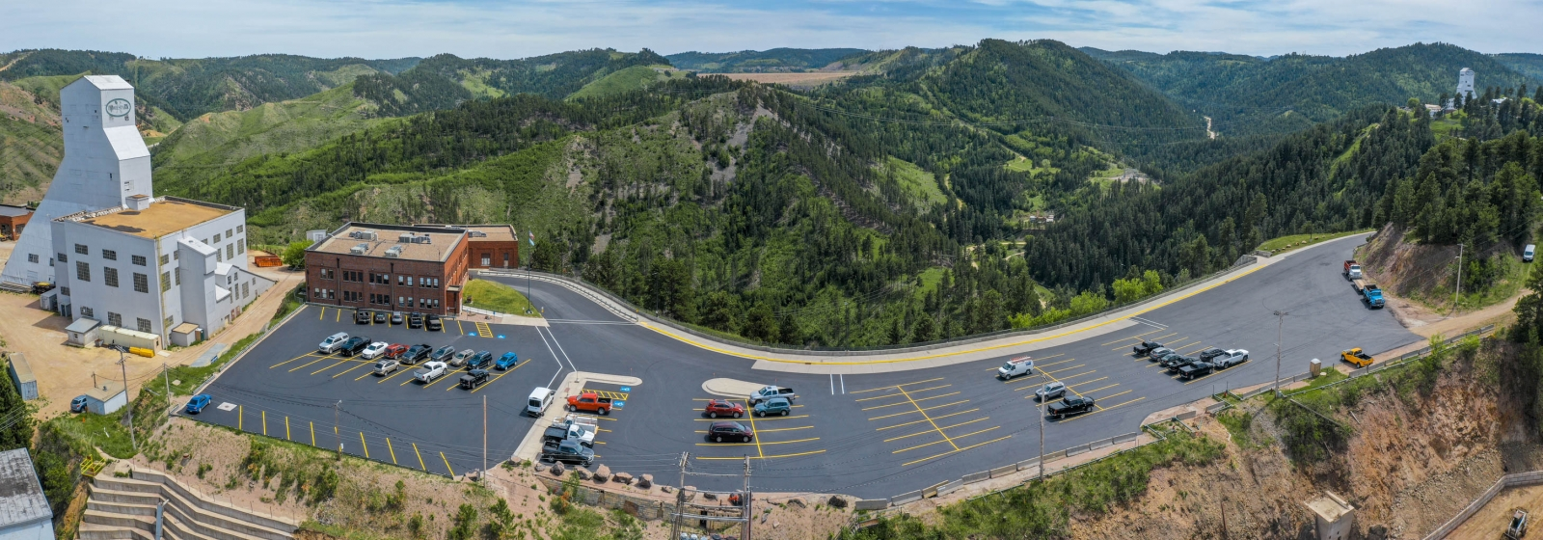
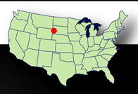
Sanford Underground Research Facility (SURF): a new portal into
deep subsurface biosphere
~370 miles of tunnels
Up to 8,100 L
Notes:
In this study, the Sanford underground research facility, SURF (located in South Dakota) will be used (not utilized) as a new portal to characterize methanotrophic communities living in deep subsurface biosphere. This is the overview of homestake gold mine. After running 125 years, this mine was transitioned into a dedicated facility for underground research, and its operations are funded by DOE. Through this two main shafts, we can access to different underground levels for scientific exploration. SURF maintains 370 miles of tunnels that reach up to 8,100 ft below the ground.

Slide 6
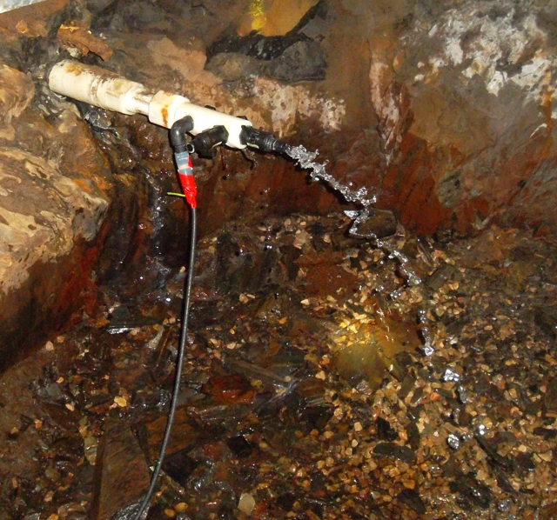
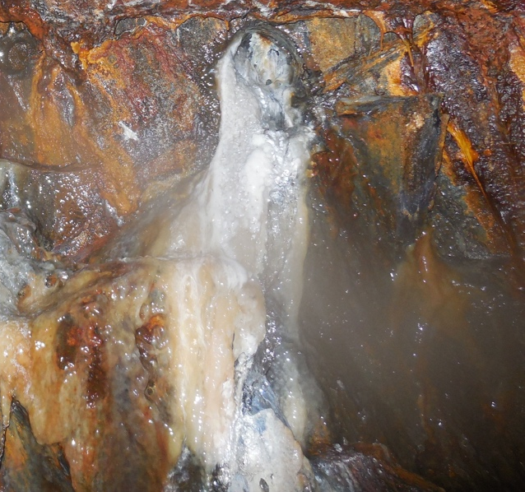
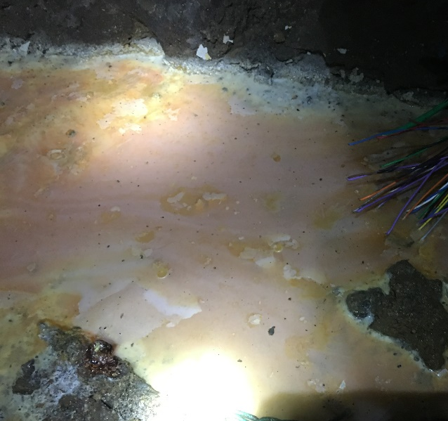
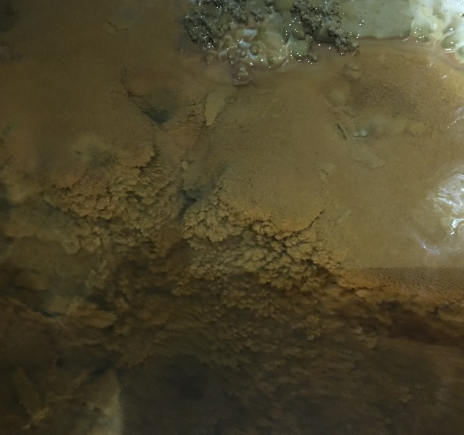
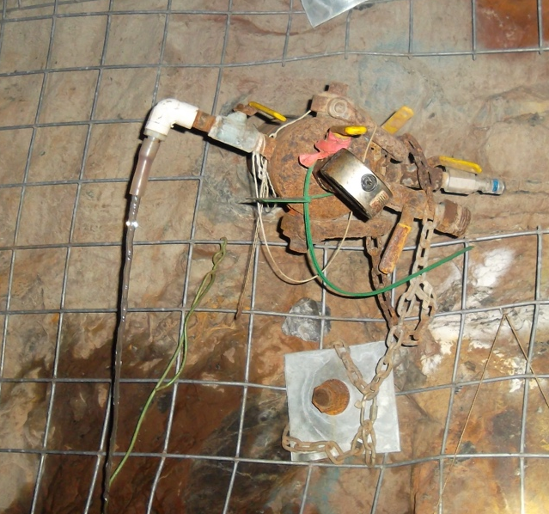
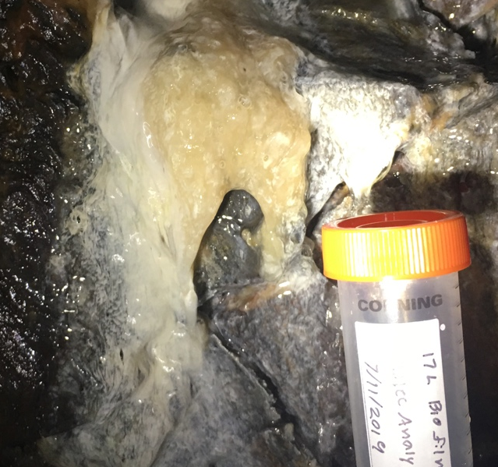
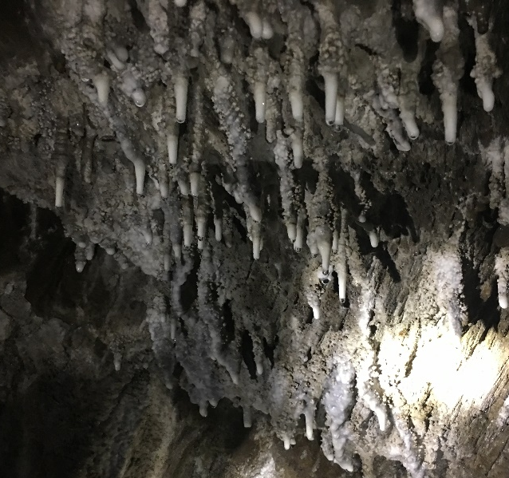
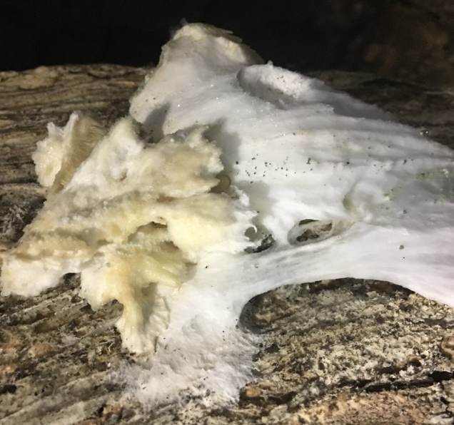
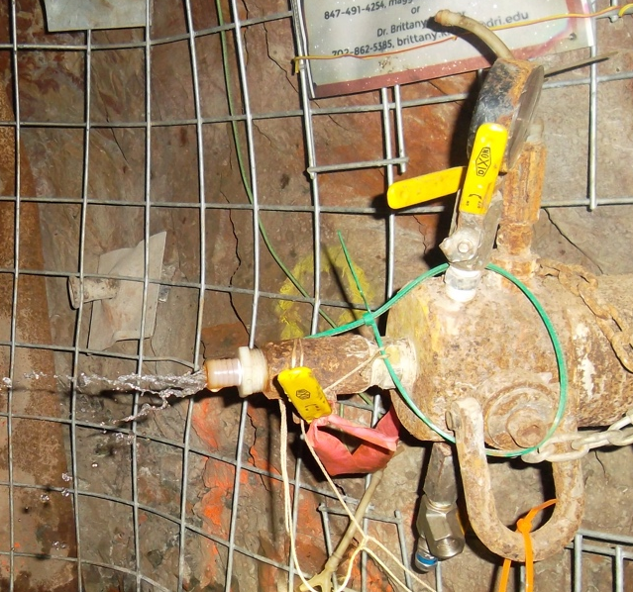
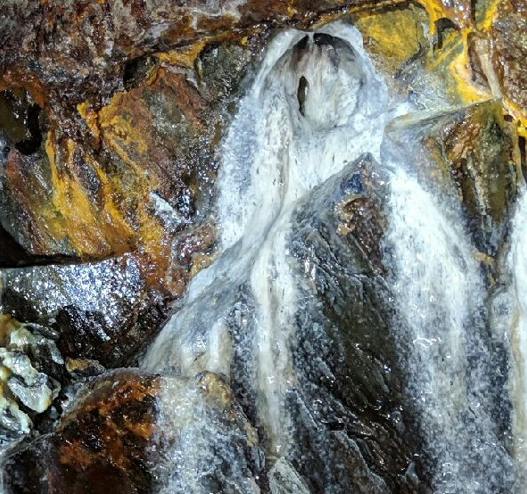
Sampling sites at SURF
SURF 4,850L
SURF 1,700L
Diversity: Distributions of methanotrophs in different mine niches?
Borehole 8
Wall Biofilm
Planktonic methanotrophs
in O₂-deficient groundwater:
(SURF ≈ Rock aquifer)
Attached methanotrophs
in microoxic habitats
(SURF tunnel materials ≈ Cave air pockets)
Ecological role: Methanotrophs serve as the primary producers in mine biofilm similarly to those reported in cave biofilm?
Underwater Pink Deposit
Underwater Brown Crust
Borehole B
Orange Black Biofilm
Adaptation role: Indigenous to subsurface (prerequisite)? Is there any novel subsurface-adapted methanotrophs in SURF?
Borehole D
White Biofilm
White Ceiling Stalactite
White Fungus
Notes:
Here, we collected ten types of different samples at SURF from two different depth. At the deeper level, 4850ft below the ground, we collected groundwaters from three different boreholes, named as borehole 8/B/D. Three different biofilms attached on the tunnel wall were also collected from the same depth level. This biofilm with unique orange back color was distinct with other two white biofilms. At the shallow level, 1700 ft below the ground, we collected pink deposit and brown crust located under shallow water, white stalactite from the top of tunnel, and white fungus from a rotted log. This sampling effort would allow us to understand the distribution of planktonic methanotrophs in O2-deficient groundwaters, and the attached methanotrophs in tunnel microoxic habitats. Secondly, for better understanding of ecological role, we want to test if methanotrophs can serve as ….? To explore their adaptation role, I firstly need to confirm they are not the contaminants from surface environments, and next check is there any novel subsurface-adapted methanotrophs in SURF. In the following slides, I will talk about my findings related to these 3 questions.

Slide 7
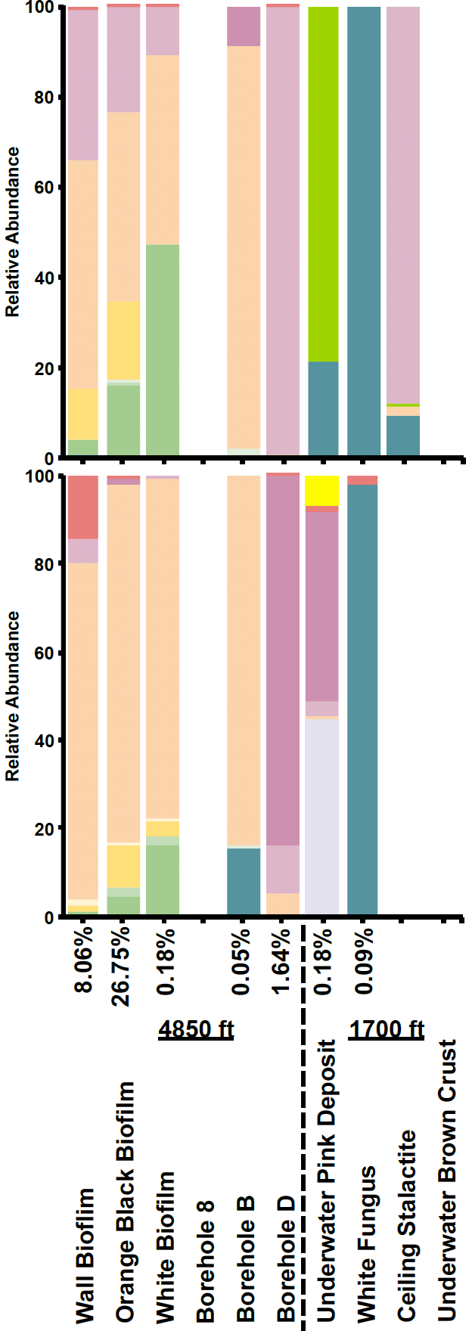
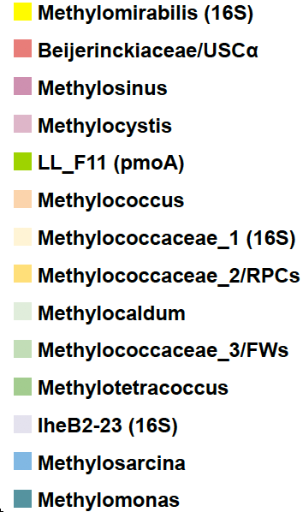
Composition of methane-oxidizing bacteria (MOB)
Bacterial 16S rRNA gene
Functional marker gene pmoA
Methylococcus
Methylococcus
Absent: Borehole 8 and Brown Crust
Enriched: Biofilms
Notes:
This slide demonstrates the composition of methanotrophic communities among SURF samples by targeting 16S gene and pmoA gene respectively. The percentage numbers indicate the ratio of MOB in bacterial communities. Based on the 16S gene analysis, we were not able to detect methanotrophs in these 3 samples: fluid of borehole 8, stalactite and underwater brown crust. Because the increasing sensitivity of pmoA primer, we could detect them in one of those samples, indicating methanotrophs were present at a very low concentration in stalactite and absent in the other two samples. Methanotrophs were mainly enriched in biofilm samples with relative abundance reaching up to ~27% in orange black biofilm, which was dominated by Methylococcus. But here taxonomical classification cannot tell us the relationship of our OTUs to other known isolates or environmental clones. To figure out this, we need to further perform phylogenetic analysis.

Slide 8
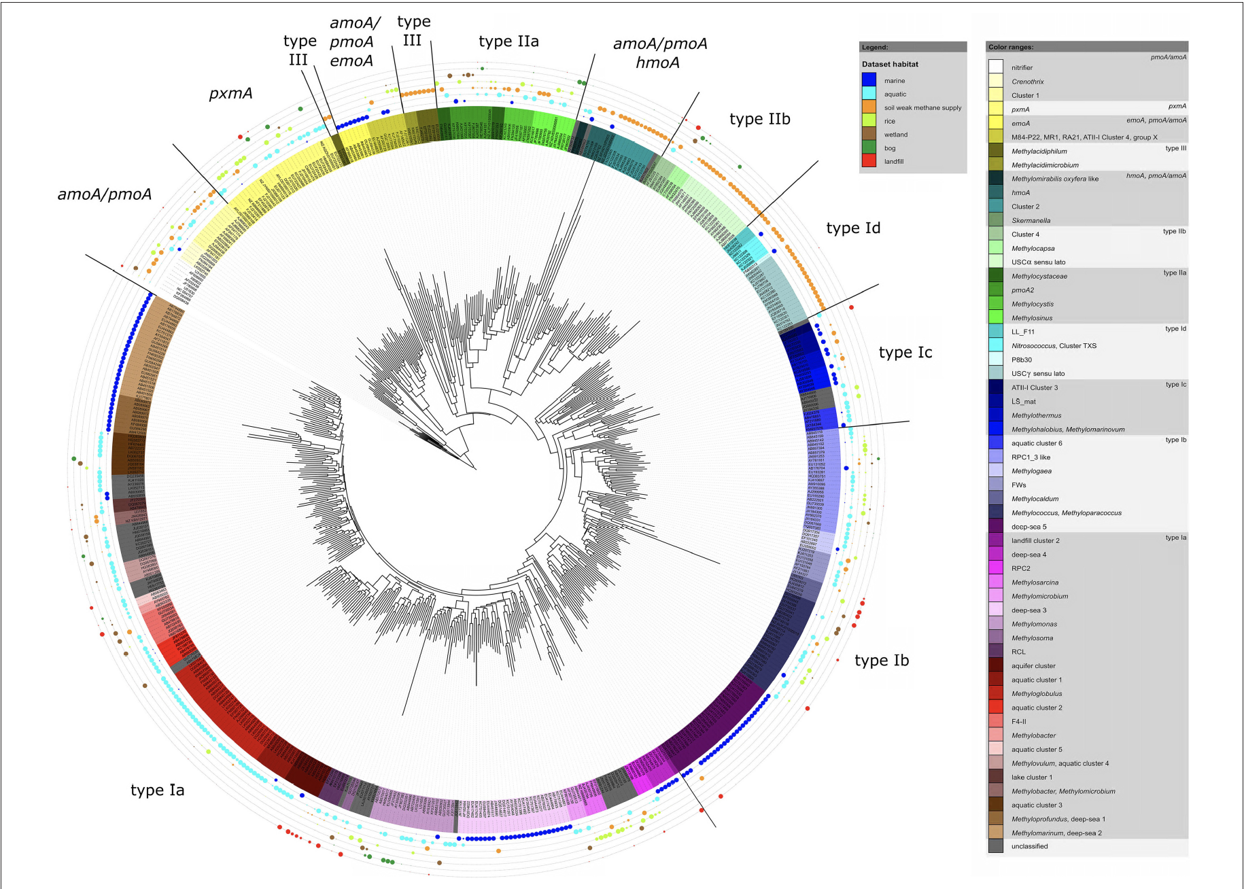
Background about relationship between phylogenetic diversity and habitat preferences uncovered by pmoA tree - Knief, Front Microbiol (2015)
Rationale for in-depth phylogenetic analysis:
Q1: What is the habitat preferences of my subsurface methanotrophs?
Q2: ? Do they form into a subsurface cluster with their neighbors?
Knief, 2015
Notes:
This is a pmoA phylogenetic tree from this literature, and I am using it to further clarify why we want to do the phylogenetic analysis. The most interesting thing here is that they included the habitat origin information for each OTU as indicated by the color of dots on the rings, and in this way they constructed the relationship between phylogenetic diversity and habitat preferences. For example, we can see as indicated by the blue dots, these OTU-associated methanotrophs likely prefer to live in marine habitat and they cluster altogether to form into a distinct subcluster within the type Ib clade. This observation leads to my 2 questions: Q1: What is the habitat preferences of my subsurface methanotrophs? Can they form into a subsurface clusters with their neighbors? Q2: Can individual species thrive under multiple environmental conditions?

Slide 9
ARB’s Neighbor joining tree (16S rRNA gene)
Notes:
In the next two slides, I will show you the phylogenetic analysis results. will talk about the 16S gene tree in this slide, and then introduce the pmoA gene tree in next slide. This is the Neighbor joining phylogenetic tree derived from 16S rRNA gene. In this tree, methanotrophic lineages are distinguished with outside range colors. There are totally 15 query OTU sequences as indicated by blue and red colors. The blue color indicated the following pmoA gene sequence analysis also retrieved the corresponding query sequences from the same lineages, while the red color suggested these four query sequences were only retrieved through 16S rRNA gene analysis. The 15 query OTUs were respectively grouped into Ia, Ib, IIa, IIb clades and NC10 phylum. Interestingly, 6 OTUs as highlighted by the black triangle were closest to clone sequences exclusively derived from other subsurface habitats, including…… and they can form into subsurface clusters with their neighbors, indicating they are indigenous to subsurface with adaptive potentials. OTUs include a pie chart, with color showing distribution of their reads among surf samples. The size of the pies corresponds to the OTU total read counts. Type Ib-affiliated reads were predominately distributed in 3 biofilm samples as indicated by red, dark orange and yellow color, while type IIa-affiliated reads were mainly retrieved from fluids of borehole D as indicated by blue color, while several lineages-affiliated reads were confined to underwater pink deposit. This implied individual methanotrophic species tended to occupy different ecological niches in SURF, which is associated with specific environmental condition.

Slide 10
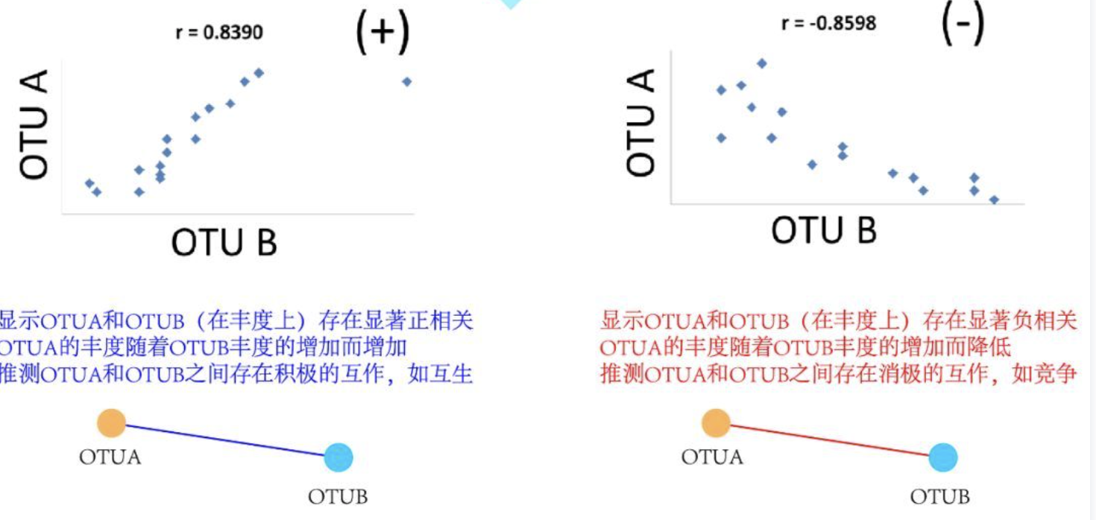
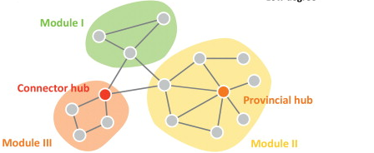
Association Network Background
Theory
SURF Biofilms
(12 samples)
OTUA
OTUA
Methanotroph
OTUB
(Methanotroph)
OTUB
(Methanotroph)
OTUA
OTUA
acetate, formate, succinate, etc.
OTUB
OTUB
Topology Feature
Module: a subset of nodes that show a relatively high level of within module connectivity and a relatively low level of inter-module connectivity.
Highly connected to several modules.
Connector hub
Module hub: highly connected to many nodes in their own modules.
Van den Heuvel et al., 2013; Guimera and Nunes, 2005
Notes:
As mentioned before, methanotrophs living in cave biofilm can sustain associated microbes by providing them with the methane derived organic matters, making us to speculate that methanotrophs in SURF biofilms did the same job. So here we used network analysis to evaluate their roles on interactions. Before showing the results of network, I’d like to give a brief introduction of its theory. Here, we have 3 types of biofilms, each having 4 biological replicates. If two microbes interact with each other in biofilm, their abundance are supposed to be co-changed across these 12 samples. If their abundances are positively correlated, two microbes might have mutualistic interactions, while if negatively correlated, they might have competitive interactions. As reflecting on network, the two interactions are represented by red and blue edges between OTU nodes. In the network, nodes can be clustered into different modules. The nodes within the same module are more tightly connected with each other, but less connected with the nodes in other modules. Looking into each module, some nodes are highly connected to many nodes in their own modules, called module hubs. Some nodes could work as the bridge for linking to several modules, called as connector hubs. These hubs play an important role in regulating the interactions in the system.

Slide 11
Methanotrophs fuel the interactions in SURF biofilms
The OTU co-occurrence association network of the bacterial community in SURF biofilms
Distribution of nodes based on their topological features
Thiobacillus, Burkholderiaceae, Bryobacter, Dongia, Hyphomonas, Ignavibacteriales, Kryptoniales, Microscillaceae, Phycisphaeraceae and Thermodesulfovibrionia
Notes:
Based on this theory, we conducted correlation for each pair of OTUs. Finally, only OTUs with significantly correlations were plotted on this association network. The labels denote the most resolved taxonomic classification of each OTU node. Particularly, six methanotrophic OTU nodes were labeled with red color. To further explore the correlation patterns, nodes were clustered into 3 modules as indicated by the node colors. Next, (within-module and among-module) connectivities of each OTU node were calculated and summarized on this plot. Interestingly, two methanotrophic OUT nodes otu6 and otu78 likely served as module hubs as having higher within-module connectivity. With having higher among-module connectivity, another methanotrophic OTU node otu408 likely acted as connector between these two modules. These topological features indicated that methanotrophs were the keystone species to fuel the bio-interactions in SURF biofilms. As positively correlated with all 3 methanotrophic nodes, these lineage members were identified to potentially cooperate with methanotrophs in biofilms. The sulphur-oxidizing bacteria Thiobacillus with having the highest within module connectivity here was found to be enriched with methanotroph in cave, suggesting they may also contribute to subsurface food web. While other putative partners were mainly involved in heterotrophic turnover.

Slide 12
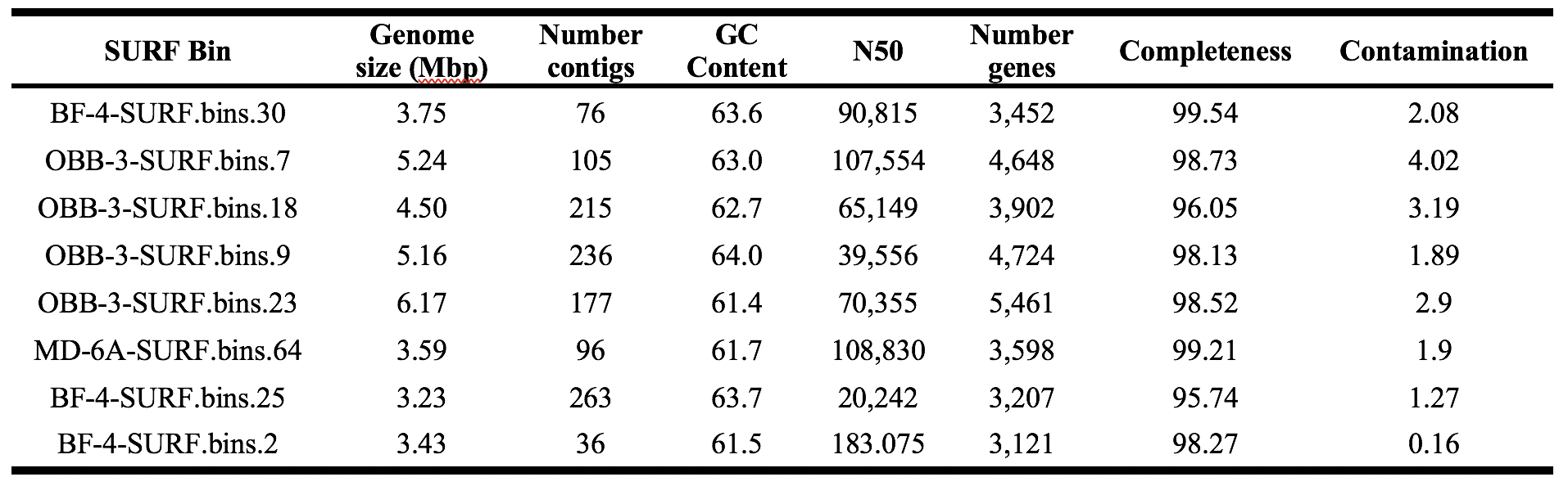
Next two slides:
1.Novel Methanotrophs?
2.Subsurface-adapted traits?

Slide 13
Novel (Gamma) methanotrophs with adapted traits occur in SURF
Phylogenomic tree
Gamma-proteobacteria
OBB-3-SURF.bins.30:
EnvZ-OmpR (osmotic stress response)
BaeS-BaeR (envelope stress response)
HydH-HydG (metal tolerance)

Slide 14
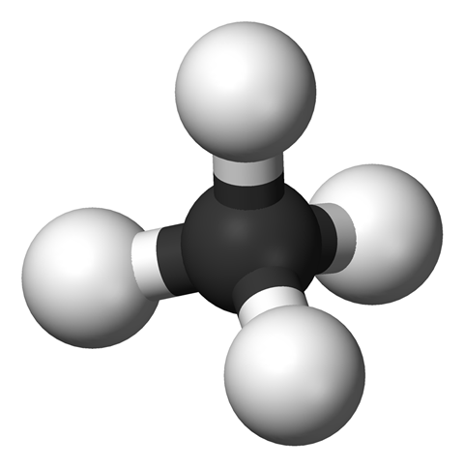
Summary: first study characterizing methanotrophic communities in non-cave subsurface ecosystem
Distribution:
  - Diverse (Ia Ib Id IIa IIb, NC10);
  - Abundant (27%);
  - Niche preferences
Novelty and Adaptation:
  uncultivated lineages:
    - Amplicon: novel genera in type Ia Id IIb
    - MAGs: novel species in type Ib IIa
    - MAGs: adapted traits
SURF Methanotrophs
Interaction:
  Abundant type Ib: primary producer in biofilms

Slide 15


Acknowledgements
Grad Student and Postdoc
  Chuang Li
SURF
  Tom Regan
  Jaret Heise
Collaborators
  Dr. Rajesh Sani
  Dr. Krithi Sankaranarayanan

