Slide 1

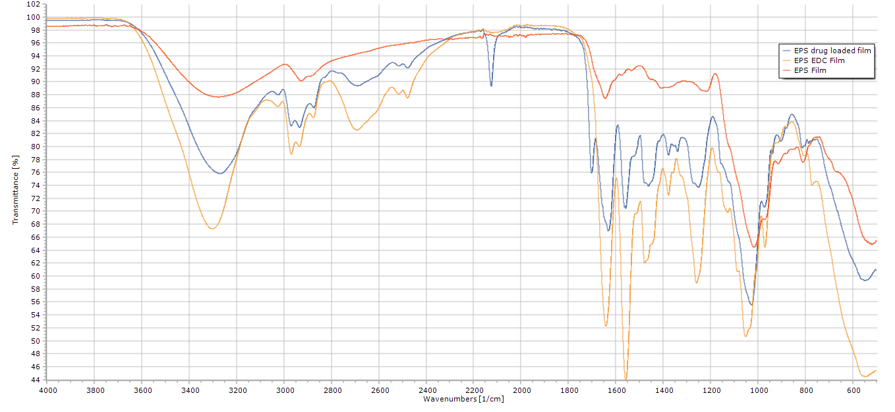
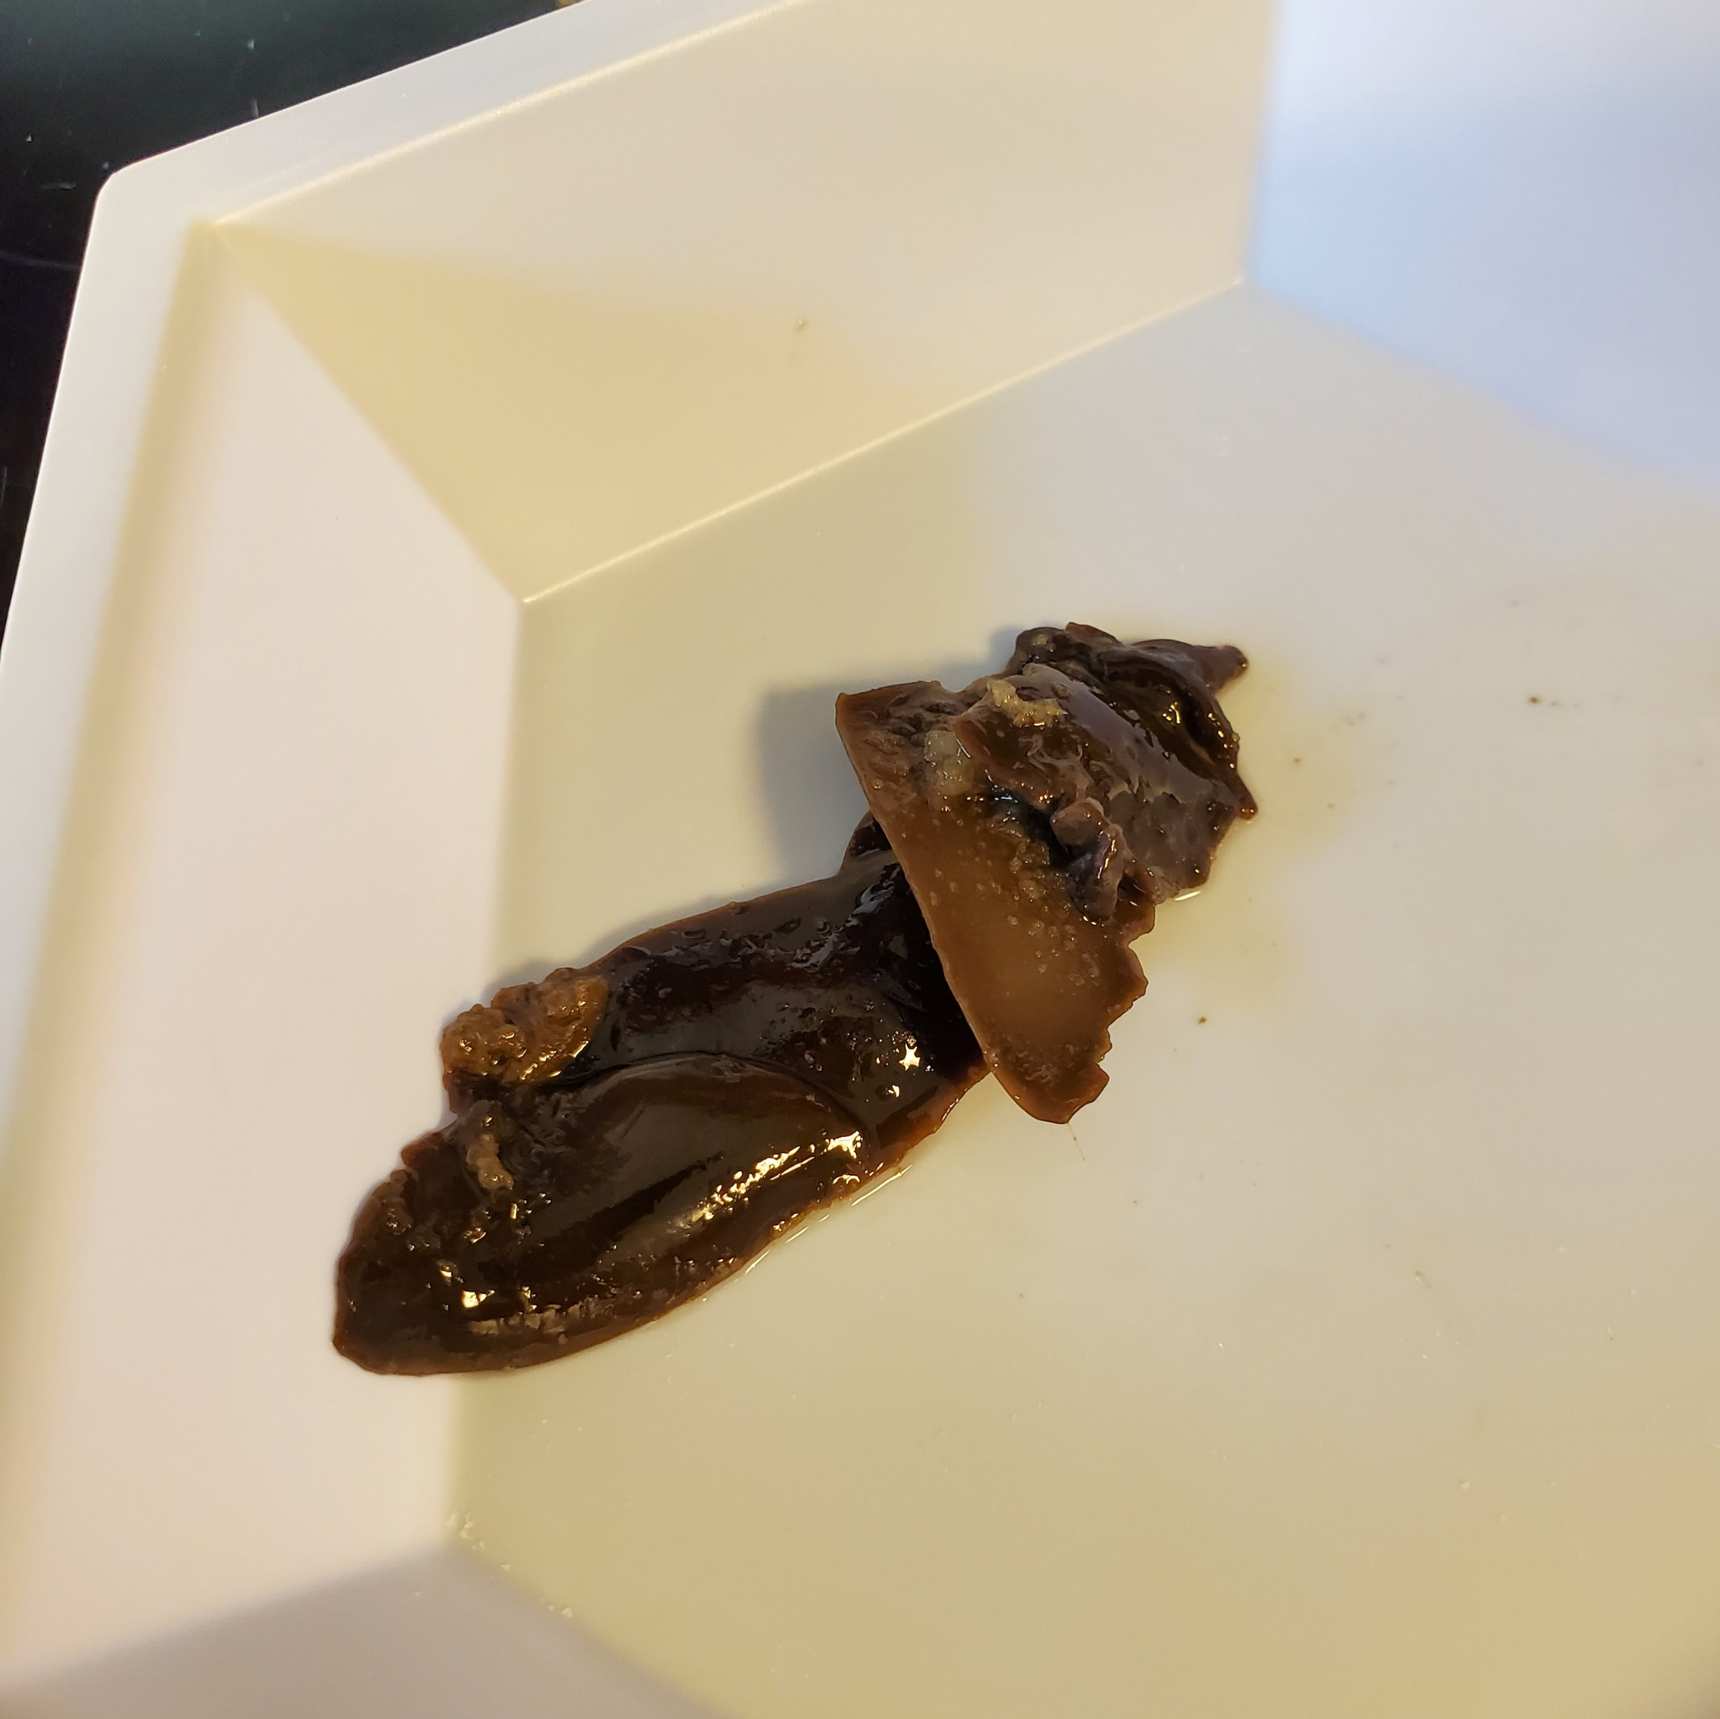
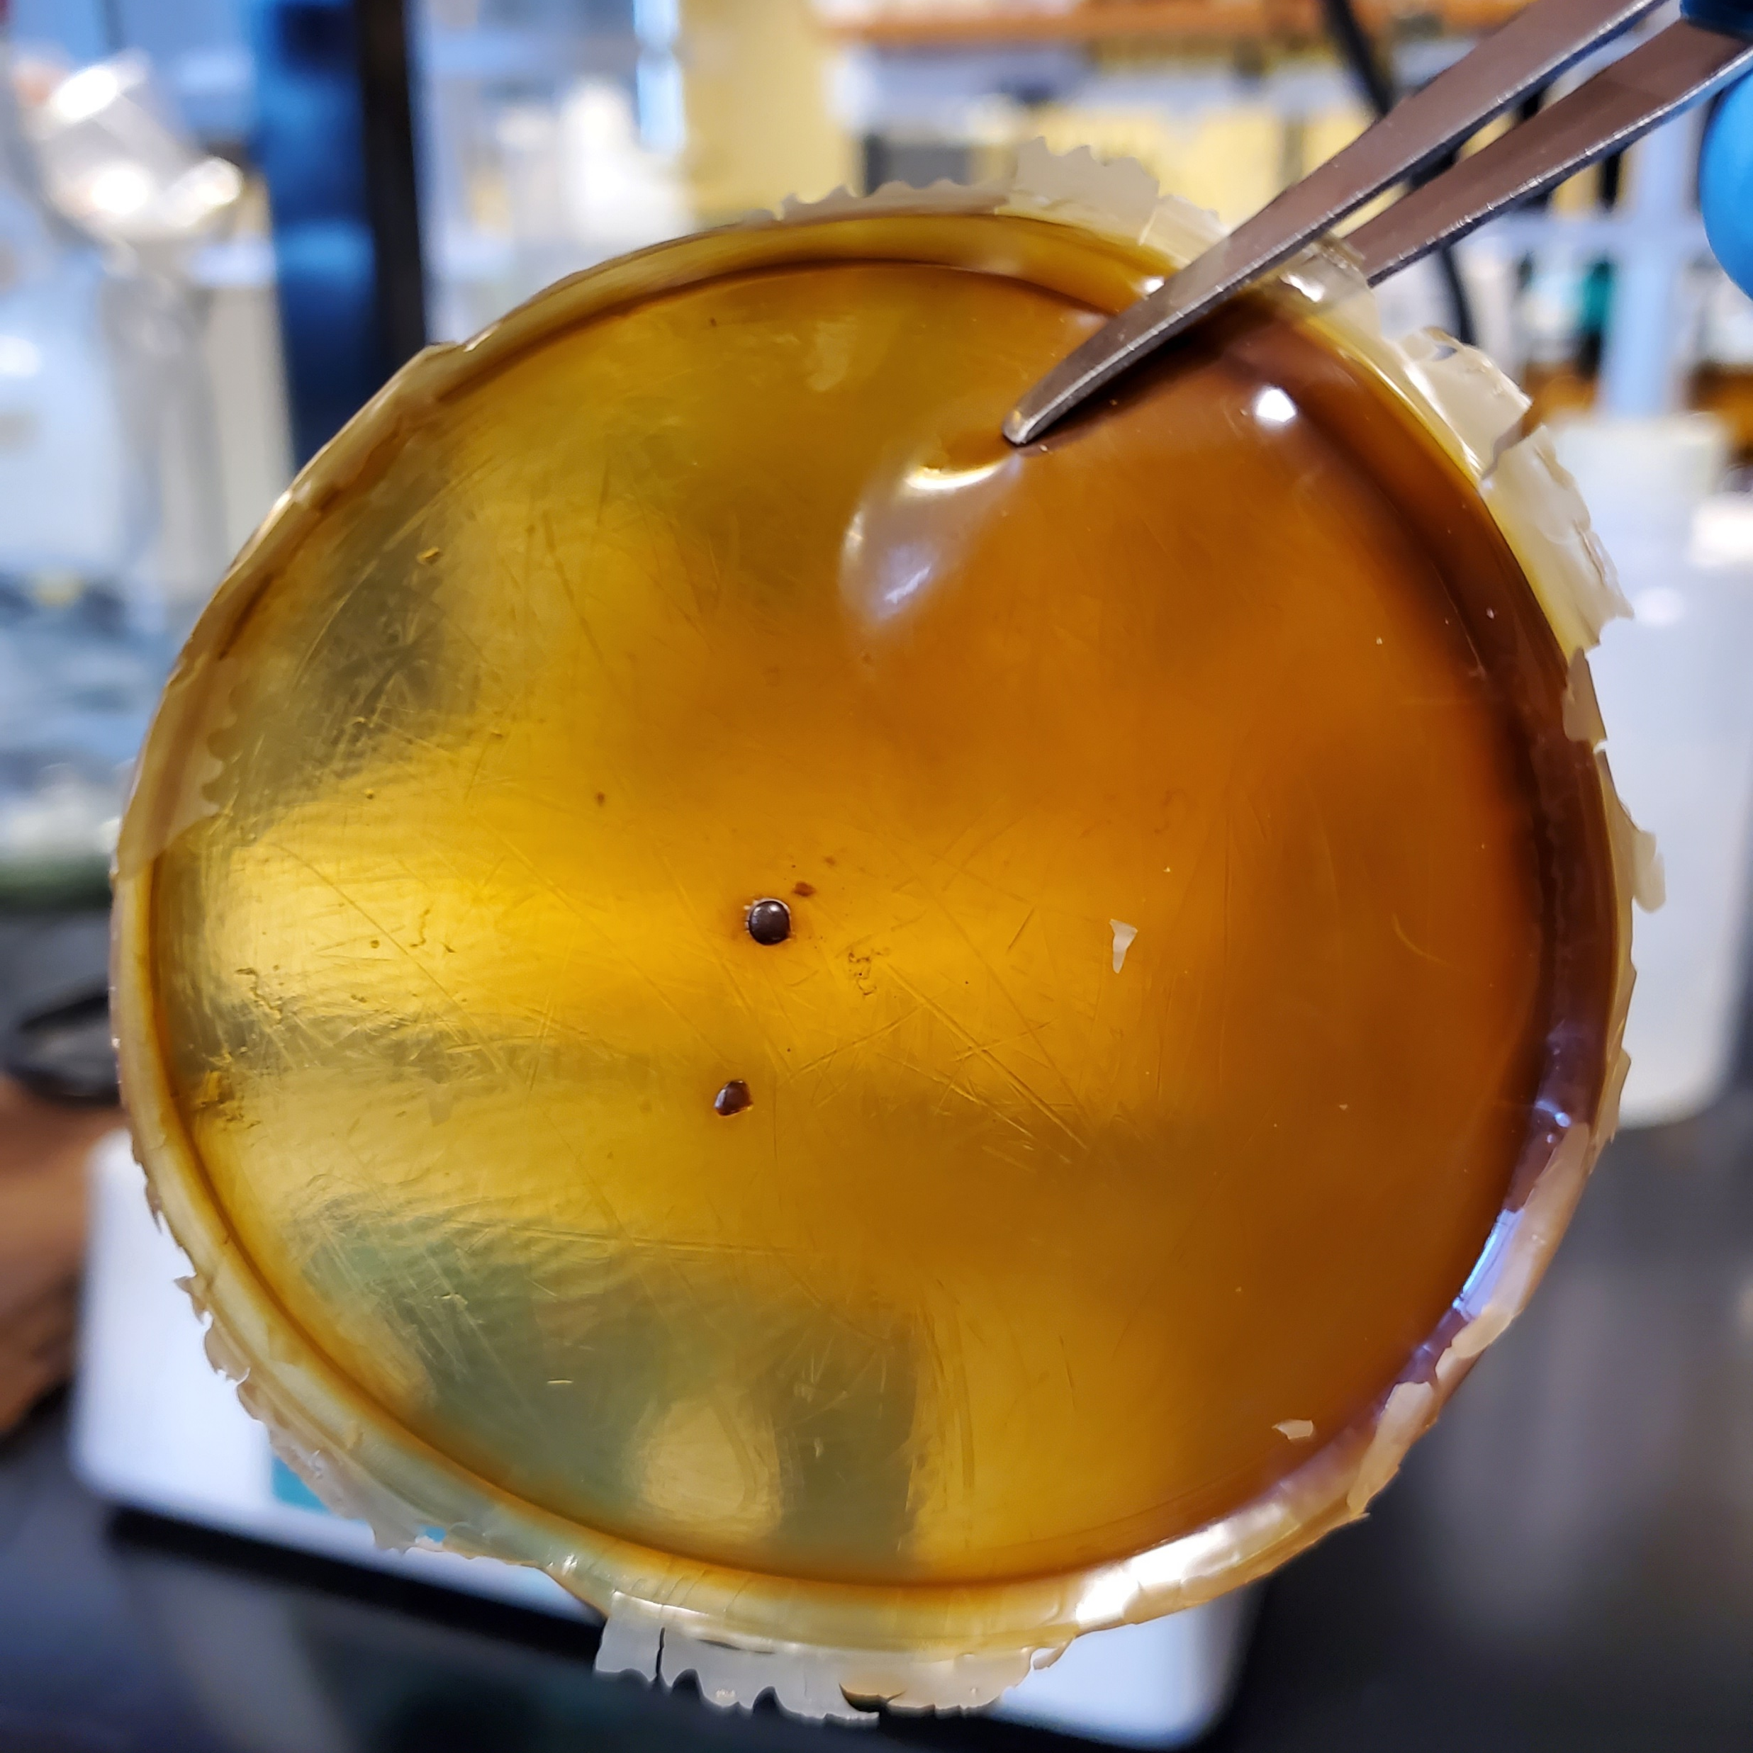
Thermophilic Exopolysaccharide Films:
A Potential Device for Local Drug Delivery
Joseph M. Laubach^{1,3}, Rajesh K. Sani^{2,3}
¹Department of Biomedical Engineering, South Dakota School of Mines and Technology, Rapid City, SD 57701, USA
²Department of Chemical and Biological Engineering, South Dakota School of Mines and Technology, Rapid City, SD 57701, USA
³BuG ReMeDEE Consortium, South Dakota School of Mines and Technology, Rapid City, SD 57701, USA
Joseph.Laubach@mines.sdsmt.edu, Rajesh.Sani@sdsmt.edu
Introduction
Amikacin Uptake Confirmation
Antibiotic Release Rate
Geobacillus sp. WSUCF1 is a thermophilic bacterium capable of producing exopolysaccharides (EPSs). EPSs are either secreted from inside of the cell or synthesized completely outside of the cell by enzymes located on the cell wall. It is understood that their role is to offer protection to the cell against environmental factors, as well as assist the microbe with adhesion and contribute to cell-to-cell interactions. Microbial EPSs are carbohydrate polymers that have been noted to degrade within the body via natural biological processes, are known to be non-cytotoxic, contain several reactive functional groups, and most are inherently antimicrobial. Drug delivery systems as patches or films not only avoids first-pass metabolism, but also provides pain-free administration, assists patients with dysphagia, has increased patient compliance, and can be self-administered. Additionally, the patch or film can be removed at any time to cease the transfer of the drug to the body [1, 2]
Entire antibiotic-loaded EPS film placed in 50 mL centrifuge tube filled with PBS.
1 mL samples extracted at select time points (n = 3).
Peak at ~1700 cm⁻¹ – carbonyl group (present in amikacin)
Peak at ~2150 cm⁻¹ – nitrile or C = N intermediate (carbodiimide crosslinking)
Antibiotic Elution Activity
Motivation
Cell Viability
Antibiotic activity against 25 µL S. Aureus in 1.8 mL TSB was determined using 200 µL of the remaining elution.
Positive control = S. Aureus treated w/ high concentration antibiotic standard (n = 3).
Commonly used synthetic polymers for drug delivery applications have been related to issues regarding toxicity, immunogenicity, unwanted polymer-drug interactions, drug loading, and harmful degradation products. More so, purification is a common and vital procedure that adds to the cost of development [3-8]. Additionally, the primary limitation of utilizing microbial biopolymers normally involves the bioprocessing methods of EPSs where expensive carbon-rich feedstocks, like sugars, are required.
Human keratinocytes (ATCC PCS-200-011) and skin-tissue fibroblasts (ATCC CCL-110) exposed to sample of EPS film and examined for up to 72 hours (n = 4).
EPS Film Assembly
Discussions and Conclusions
  Initial draft of the film exhibited slight extended release up to 12 hours
  Cell viability assays revealed minor to no cytotoxicity.
  Antibiotic activity against S. Aureus was shown to be unaffected by loading and elution processes.
The crude EPS was dissolved in a 50 mL centrifuge tube with distilled water at a concentration of 5% (w/v). Glycerol was added as a plasticizer at a concentration 30% (g glycerol/g crude EPS), although 20% to 40% is acceptable. 5% w/w EDC was added to the solution followed by 5% w/w amikacin. The solution was then vortexed until a homogeneous liquid was apparent. 20 mL of the EPS solution was poured into a PTFE evaporating dish and allowed to cure within a dry heat oven for 24 hours.
Ongoing Research
  Examining loading capabilities, effectiveness, and changes in mechnical properties when involving other antibiotics and chemotherapeutics.
  Investigating methods of bypassing stratum corneum.
Nwodo, Uchechukwu U., Ezekiel Green, and Anthony I. Okoh. International journal of molecular sciences 13.11 (2012): 14002-14015.
Mandelli, F., et al. Extremophiles 21.4 (2017): 775-788.
Santoro, Marco, et al. Advanced drug delivery reviews 107 (2016): 206-212.
Nampoothiri, K. Madhavan, Nimisha Rajendran Nair, and Rojan Pappy John. Bioresource technology 101.22 (2010): 8493-8501.
Chen, Guo-Qiang, and Martin K. Patel. Chemical reviews 112.4 (2011): 2082-2099.
Qi, Yizhi, et al. Nature biomedical engineering1.1 (2017): 0002.
Knop, Katrin, et al. Angewandte chemie international edition 49.36 (2010): 6288-6308.
Alimohammadi, Younes Hanifehpour, and Sang Woo Joo. Asian Pac J Cancer Prev 15 (2014): 517-535.
Acknowledgements
This work was supported by the funding from the National Science Foundation, and the departments of Biomedical Engineering and Chemical and Biological Sciences at South Dakota School of Mines & Technology.
Both cell lines maintained a high viability when exposed to the film.

