Slide 1
Fourth Conference on Science at the Sanford Underground Research Facility
Investigating the novel ISS Methylobacterium species for PHA biosynthesis
Presenter: Wageesha Sharma²
Co-authors: Dr. David Salem², Dr. Nitin Singh¹, Dr. Kasthuri Venkateswaran¹ and Dr. Rajesh Sani²
1. NASA Jet Propulsion Laboratory, Pasadena, CA
2. CNAM-Bio Center and Chemical and Biological Engineering Department, SD Mines, Rapid city, SD

Slide 2
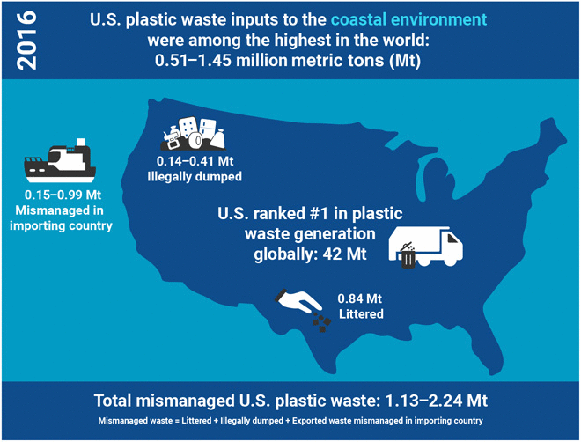
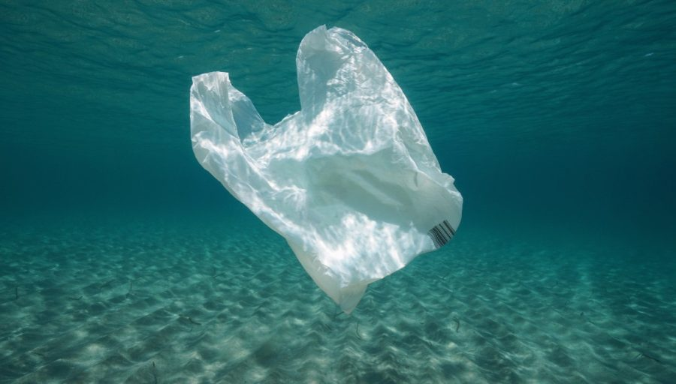
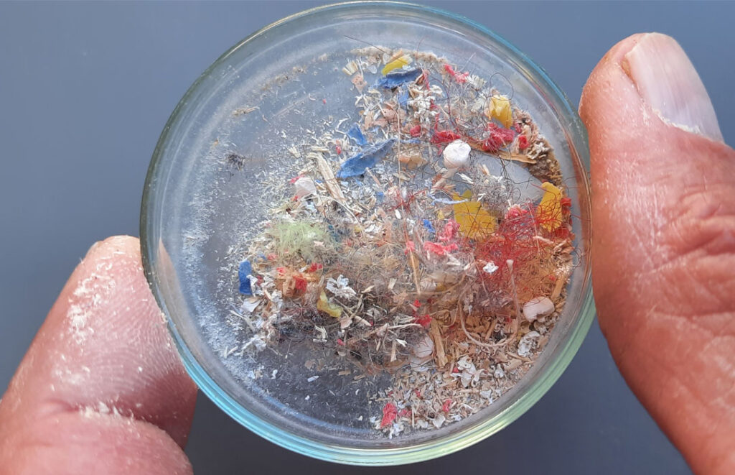
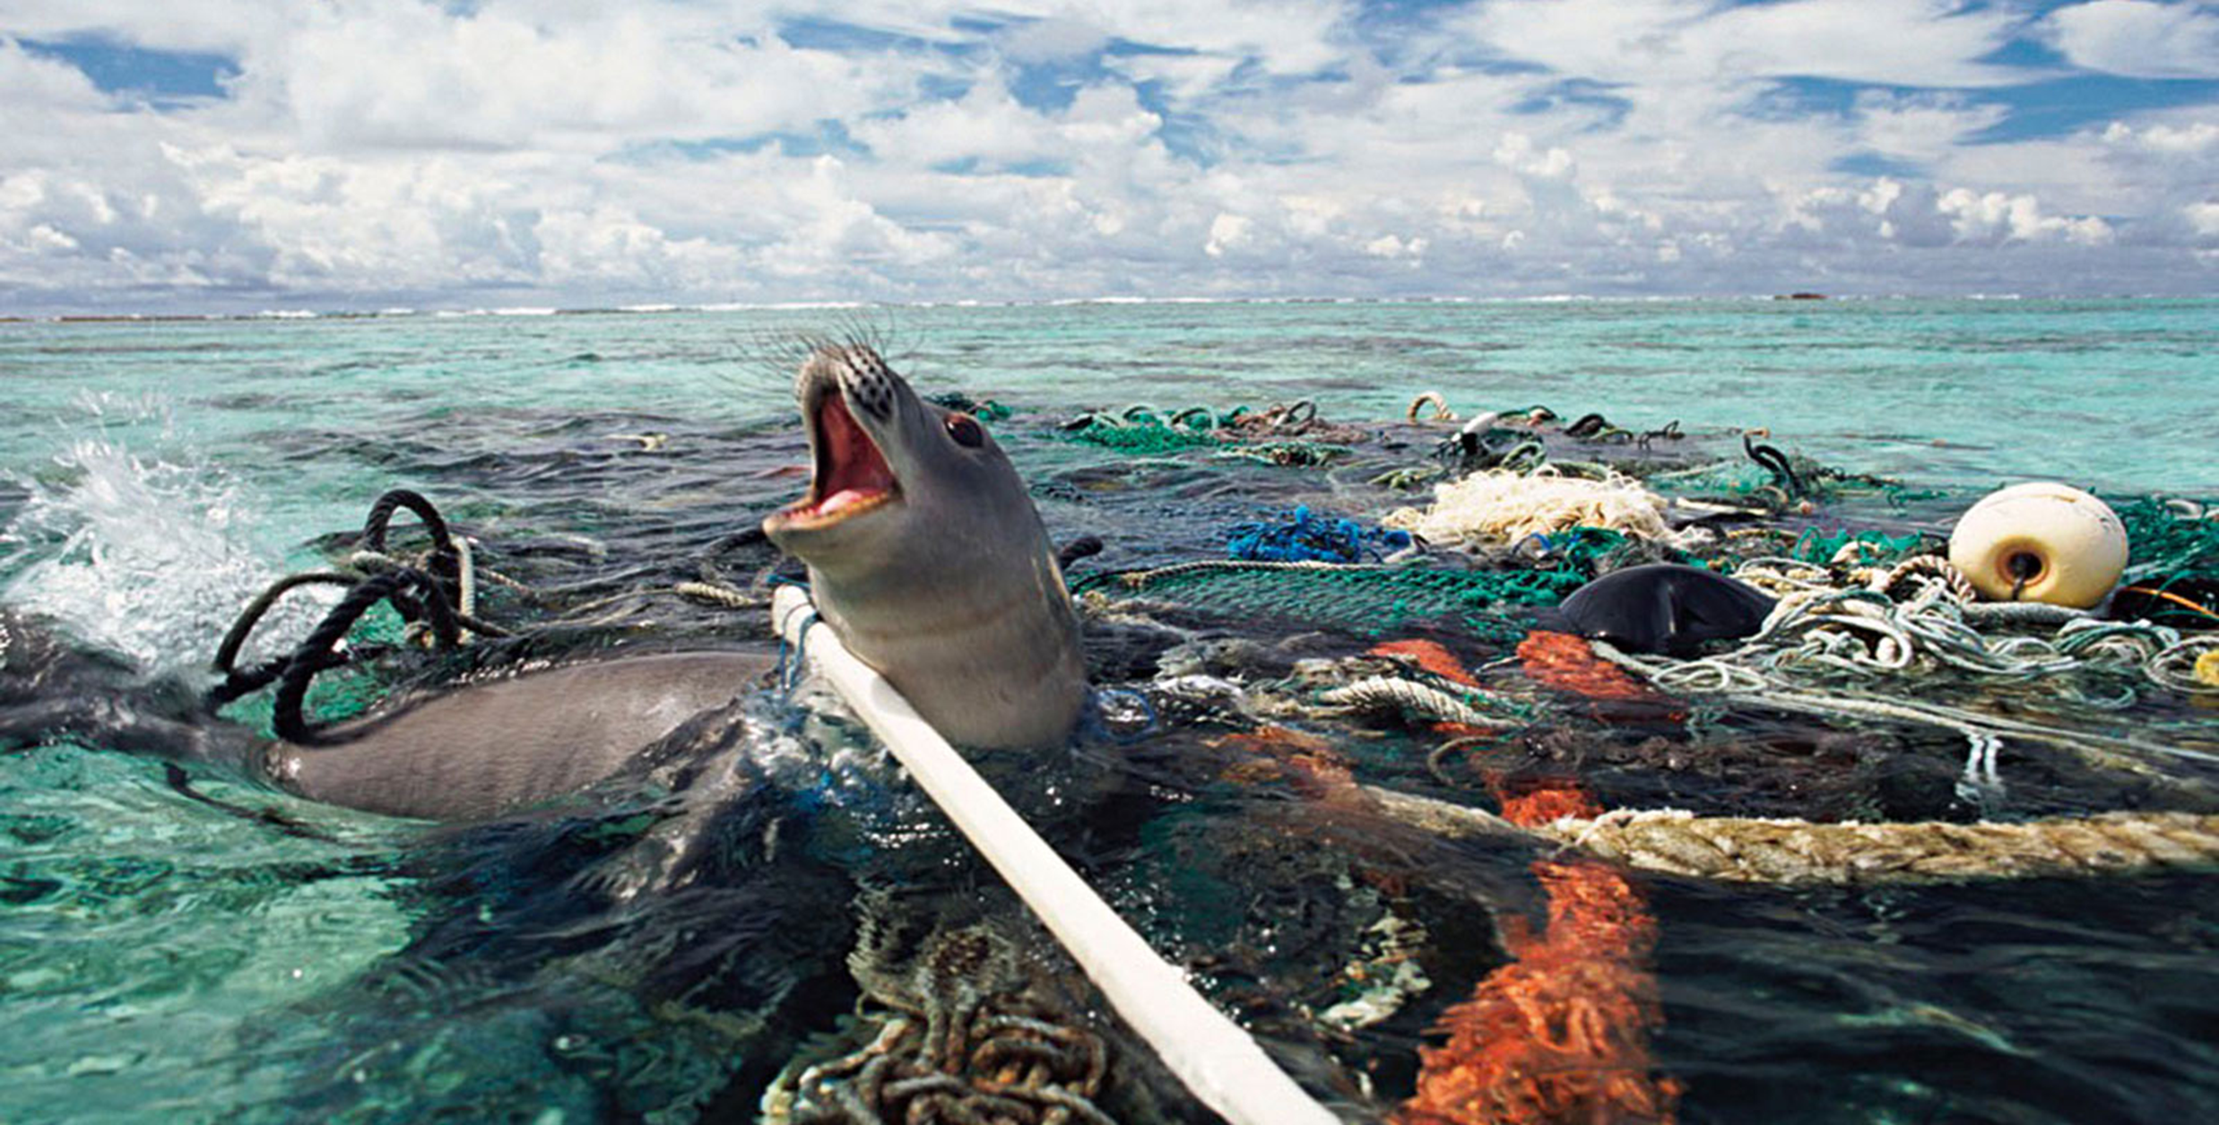
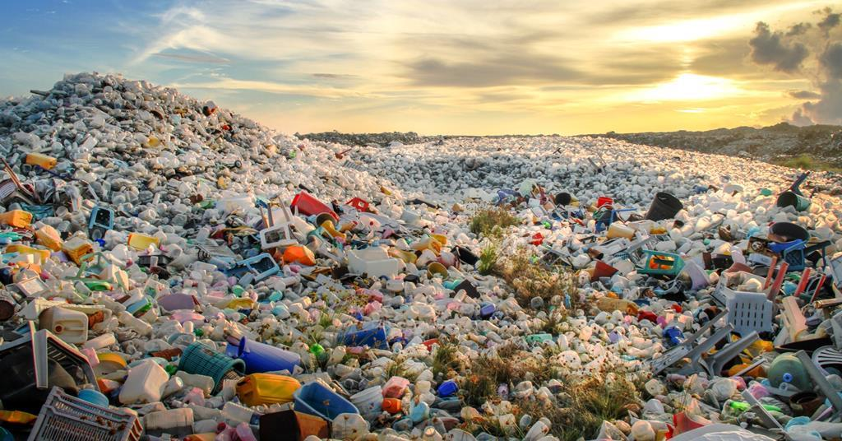
Around 70,000 microplastics are consumed by an average person each year.
Nearly 300 million tones of plastic waste are produced every year.
Plastic wastage is growing at an annual rate of 9%.
1 million marine animals die due to plastic pollution every year.
The US is the world’s top generator of plastic waste.
75% of all plastic produced has become waste.
It takes around 500-1,000 years for plastics to decompose.
About 91% of plastic is not recycled

Slide 3
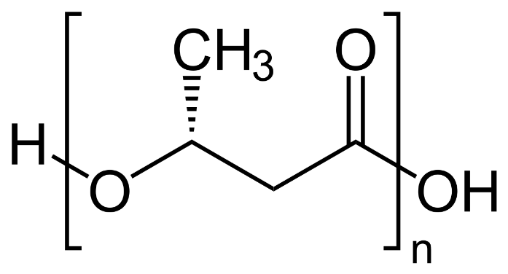
RESEARCH CONCEPT
PHA
Biodegradability
Non-toxicity
Superior Thermo-mechanical attributes
PHA market size is projected to reach USD 121 million by 2025
Driver: Governments’ focus on green procurement policies
Microbial biosynthesis pathway employed
Restraints: Higher price compared to conventional polymers
Challenges: Manufacturing technology still in its initial phase
Opportunities: Emergence of new raw materials
PHA Polymer Molecular Structure
Substrate, bacterial species, culturing conditions
POLYMER PROPERTIES
Research Interest
To explore PHA producers with properties having desirable functionality.
To investigate the novel Methylobacterium species isolated from International Space Station (ISS) for potential of PHA biosynthesis.
Composition of sub-unit

Slide 4
WHY ISS STRAINS?
Methylobacterium ajmalii (aj.ma’li.i. N.L. gen. n. ajmalii named after Ajmal Khan, a renowned Indian scientist on biodiversity).
Characteristics
Isolation Location
Higher number of stress tolerance genes, especially the oxidative stress response factors under microgravity conditions
Optimum temperatures range: 25 and 30°C (no growth 7, 37 and 45 °C); pH 6.0 to 8.0.
Exhibited poor tolerance to salt (0 to 1%).
Three ISS strains were different from the closest genomic relative M. indicum in assimilating glucose, malic acid, maltose, mannitol, potassium gluconate, and trisodium citrate.
International Space Station (ISS)
Screened Novel ISS Strains
JC-0023 (IF7SW-B2): Methylobacterium ajmalii
JC-0089 (IIF4SW-B5): Methylobacterium ajmalii
JC-1176 (I1-R3): Methylorubrum rhodesianum
Species/Strain | NCBI Accession No. | Isolation Location | Genome size(bp) | G+C content(%)
Methylobacterium ajmalii IF7SW-B2 | JACWCTOOOOOOOOO | Lab 3 Overhead | 6,802,552 | 71.07
Methylobacterium ajmalii IIF1SW-B5 | JACWCUOOOOOOOOO | Cupola | 6,593,618 | 71.0.3
Methylobacterium ajmalii IIF4SW-B5 | JACWCVOOOOOOOOO | Dining Table | 6,534,937 | 70.77
Methylorubrum rhodesium I1-R3 | JACWCWOOOOOOOOO | HEPA Filter | 6,159,250 | 68.96

Slide 5
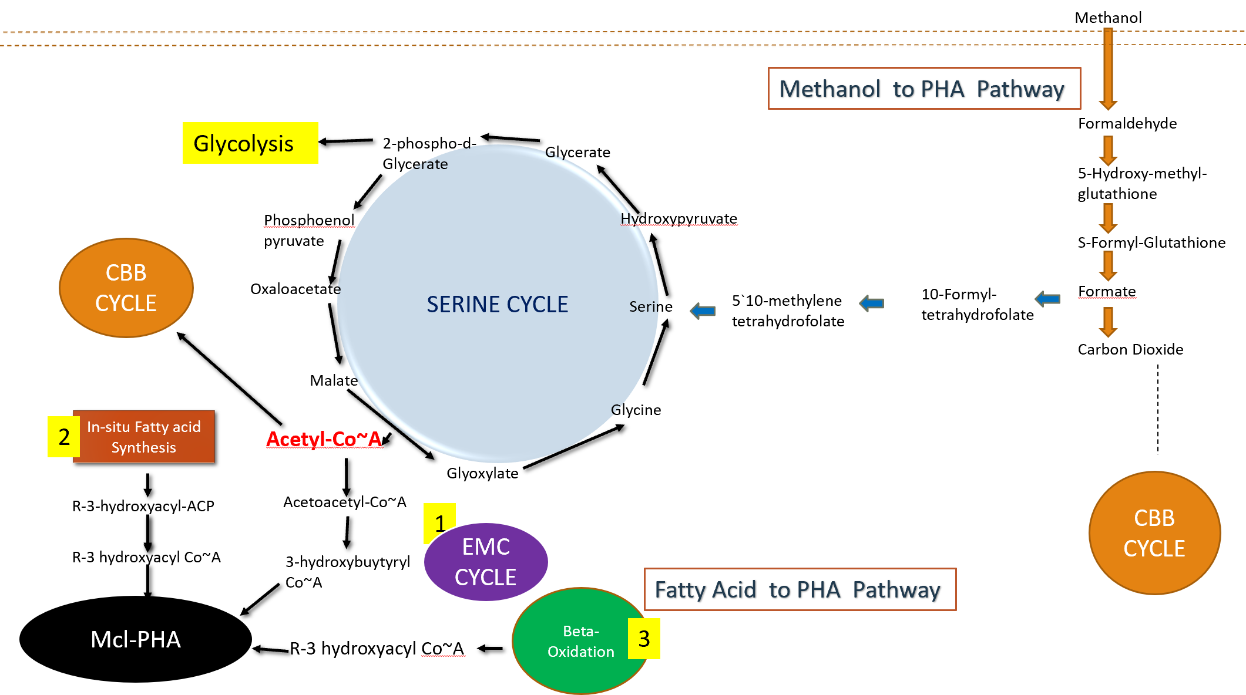
CHOICE OF SUBSTRATE
Substrate
Research Objectives
Research Objectives
Methane Gas: No Methane monooxygenase found
Methanol : 0.5% v/v optimized concentration
PHA production by Serine Pathway
Soyabean Oil : 7:3 (Oil :MM) optimized condition in emulsion form.
(Abundant carbon source in South Dakota)
> Consists of Fatty Acids, thus PHA production
by ß-Oxidation Pathway
Comprehensive in-silico analysis of the whole genome sequences and metabolic pathways entailed in carbon source to PHA production.
Optimization of growth conditions for efficient substrate metabolism and PHA accumulation.
Molecular targeting of PHA synthase gene in the Methylobacterium strains.
PHA extraction and characterization using biophysical techniques to determine physical, thermal, and mechanical properties.
Comparative data account analysis for ideal industrial candidate.

Slide 6
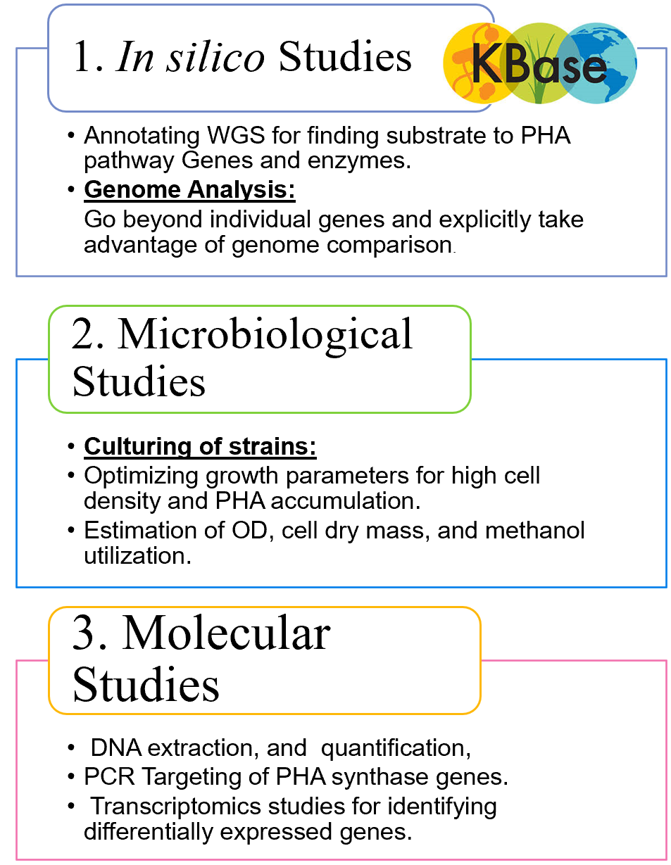
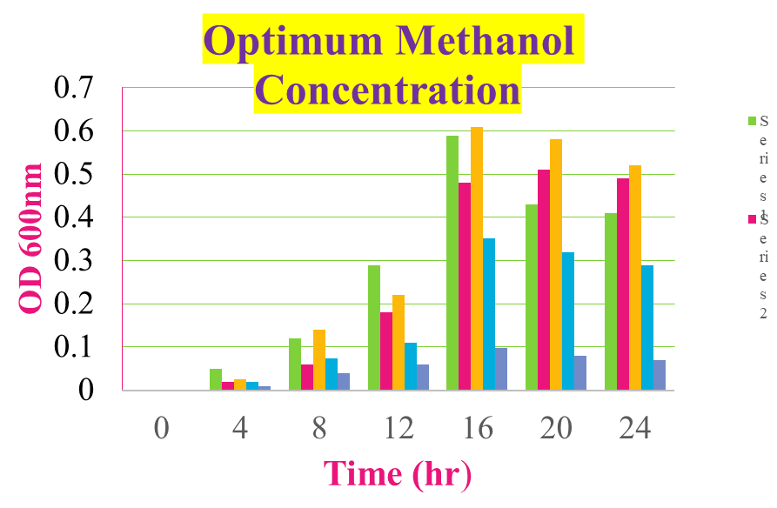
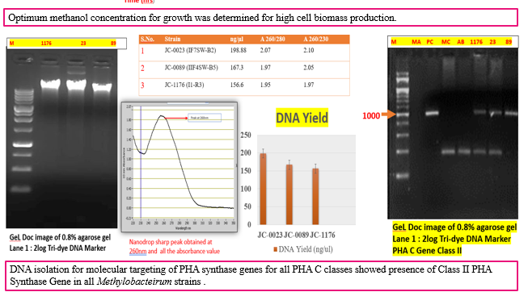
METHODOLOGY & RESULTS

Slide 7
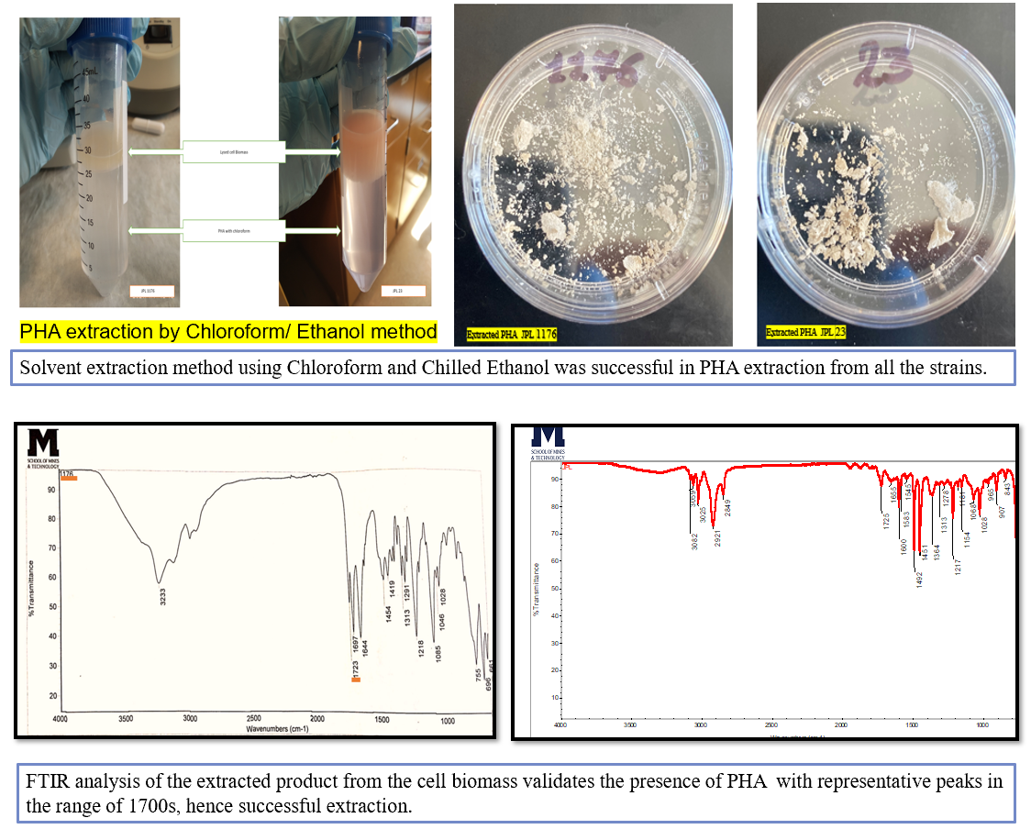
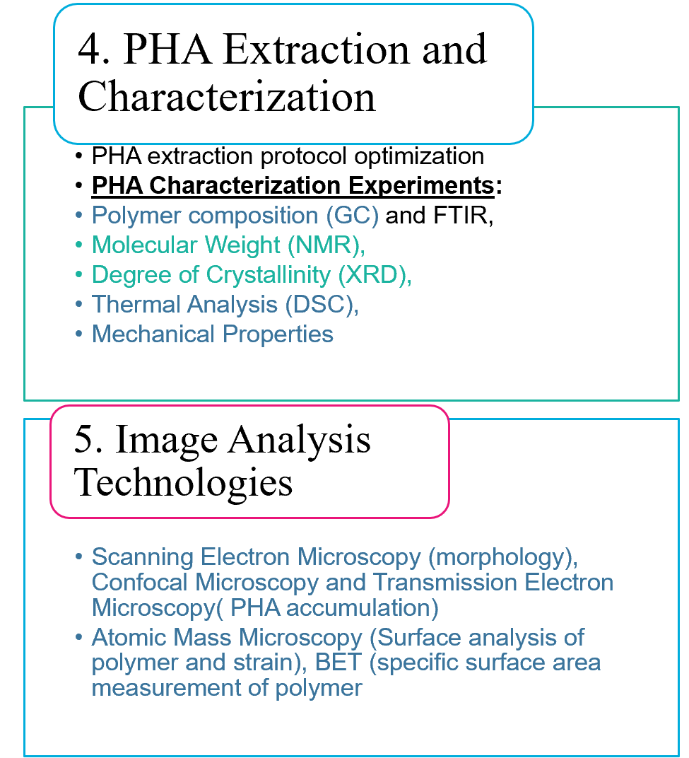
METHODOLOGY & RESULTS
METHODOLOGY & RESULTS

Slide 8
METHODOLOGY & RESULTS

Slide 9
CONCLUSION
No methane assimilation capability observed.
Present study shows that the novel ISS strains are capable of metabolizing methanol and soyabean oil, and synthesizing PHA.
The PHA extraction was successfully accomplished by the ultrasonication mediated solvent extraction method using chloroform and chilled ethanol, and di-methyl carbonate.
Biomechanical studies validates that the extracted product is PHA, and characterized the produced PHA as amorphous in nature.
Comparative account of all the studies will provide the ideal strains for industrial scaling up of the PHA biosynthesis process.

Slide 10
REFERENCES
Sudesh, Kumar, H. Abe, and Yoshiharu Doi. "Synthesis, structure and properties of polyhydroxyalkanoates: biological polyesters." Progress in polymer science 25, no. 10 (2000): 1503-1555
Bijlani, Swati, Nitin K. Singh, V. V. Eedara, Appa Rao Podile, Christopher E. Mason, Clay CC Wang, and Kasthuri Venkateswaran. "Methylobacterium ajmalii sp. nov., isolated from the International Space Station." Frontiers in microbiology 12 (2021): 534.
Ilyas, R. A., S. M. Sapuan, Abudukeremu Kadier, Mohd Sahaid Kalil, Rushdan Ibrahim, M. S. N. Atikah, N. Mohd Nurazzi et al. "Properties and characterization of PLA, PHA, and other types of biopolymer composites." In Advanced Processing, Properties, and Applications of Starch and Other Bio-Based Polymers, pp. 111-138. Elsevier, 2020.
https://seedscientific.com/plastic-waste-statistics/
https://www.marketsandmarkets.com/Market-Reports/pha-market-395.html
https://www.sdsoybean.org/topics/soy-uses/

Slide 11
THANK YOU
ANY QUESTIONS?

