Slide 1


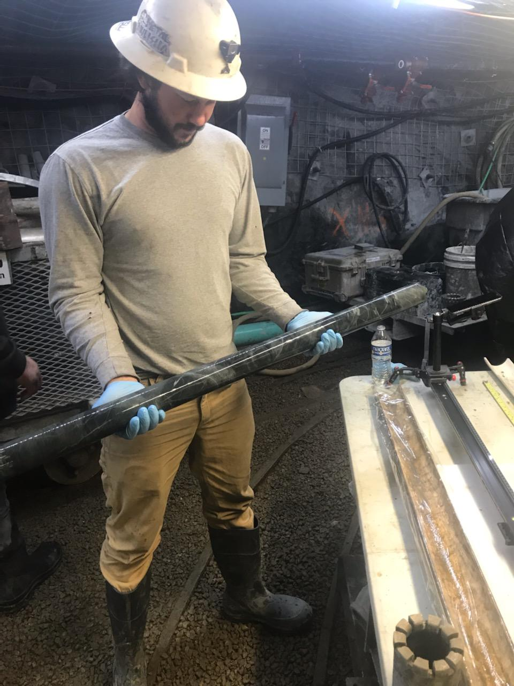
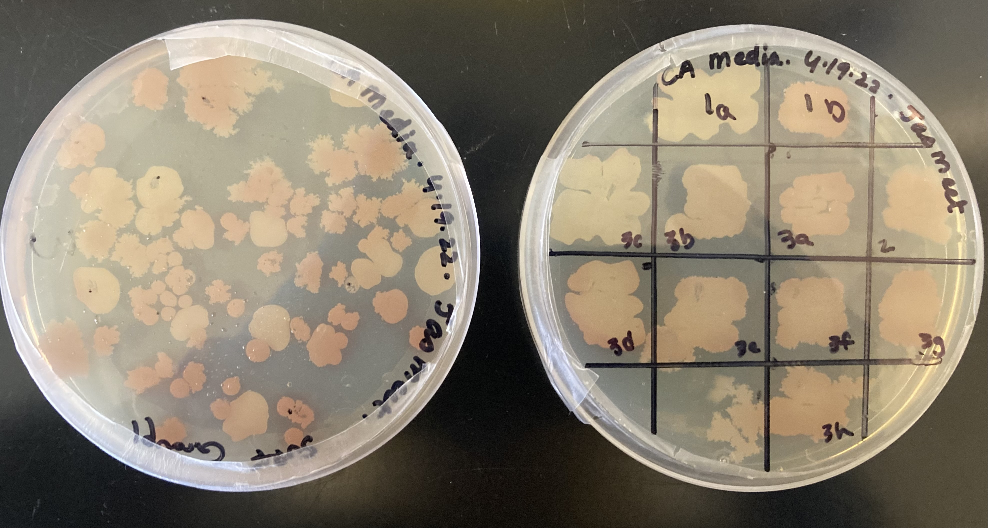
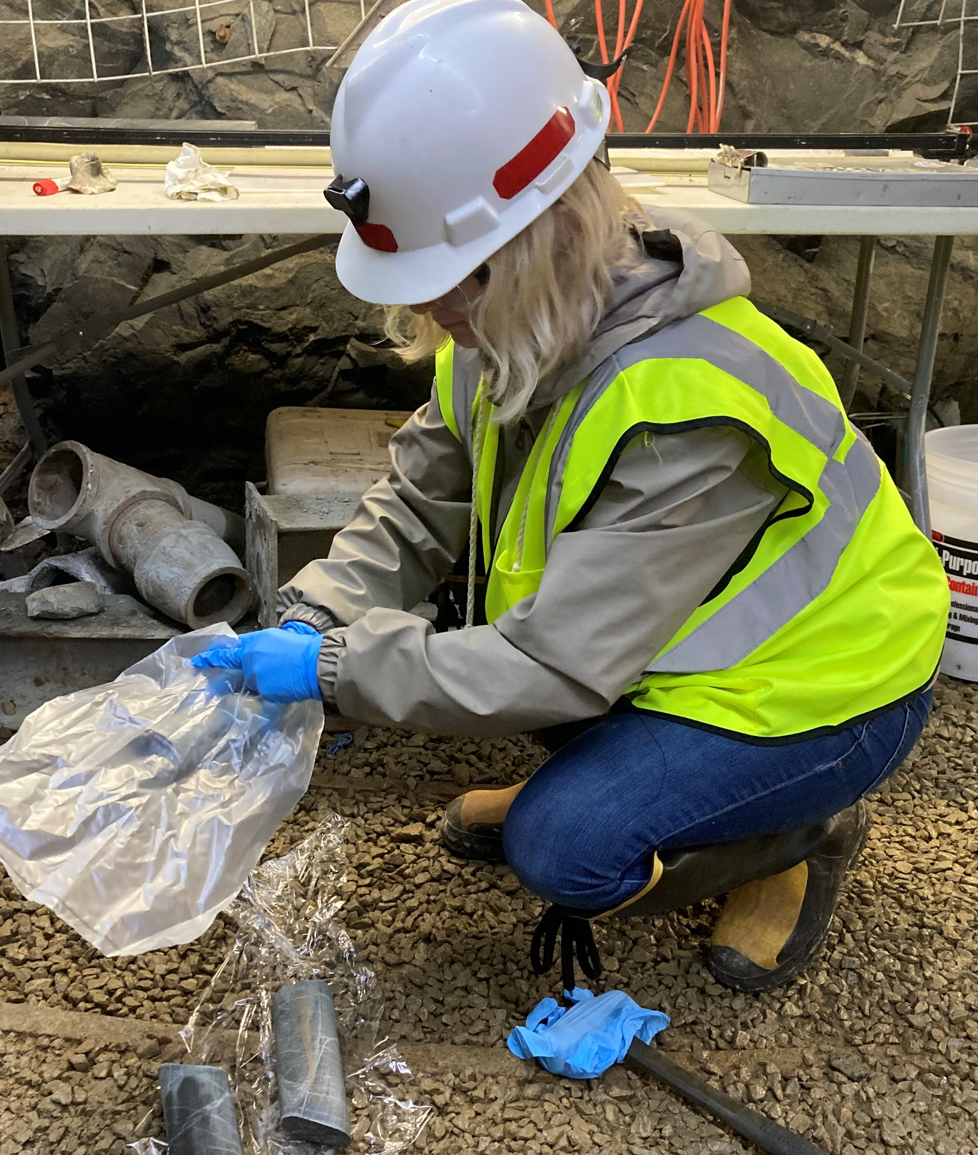


Accelerated carbon sequestration from thermophilic microbes
Magan Vaughn¹, Jasmeet Kaur², Tanvi Govil³, Dr. Rajesh Sani³, Dr. Bret Lingwall⁴
¹Department of Chemistry, Biology and Health Sciences, South Dakota Mines, Rapid City, SD, USA; ²Department of Biotechnology and Bioinformatics, Jaypee University of Information Technology, Solan, India; ³Department of Chemical and Biological Engineering, South Dakota Mines, Rapid City, SD, USA; ⁴Department of Civil and Environmental Engineering, South Dakota Mines, Rapid City, SD, USA
Carbon Dioxide Sequestration
Enrichment of SURF Samples for Carbonic Anhydrase
Analysis of Bacterium in SURF Group I
Carbon dioxide is a greenhouse gas and major contributor to climate change
Carbon dioxide dissociates in water into carbonate ions. In the presence calcium, magnesium and iron ions a solid, stable carbonate is formed.
This process can be accelerated through carbonic anhydrase producing microbes
Carbonic anhydrase converts carbon dioxide into carbonate ions
The Sanford Underground Research Facility (SURF) provides a unique environment to investigate novel carbonic anhydrase producing microbes
Extremophilic bacteria produce stable enzyme that can be used for carbon capture
L 1a 1b 2 3a 3b 3c 3d 3e 3f
L 3g 3h
Figure 1: Growth of SURF samples every 24 hours
Our Goal
Figure 4: Agarose gel electrophoresis on 16s colony PCR from isolated colonies
Table 1: Species of bacteria
Explore Sanford Underground Research Facility (SURF) for novel carbonic anhydrase bacterium through metagenomics and meta-transcriptomics
Enrich SURF samples for carbonic anhydrase producing bacterium
Isolate bacteria and perform 16s colony PCR to determine bacteria present
Investigate the thermophilic bacterium Geobacillus sp. WSUCF1 for carbonic anhydrase production
 | Species | Query Cover | Pecent Identitiy
1a | Bacillus subtilis | 85% | 96.89%
1b | Bacillus tequilensis | 88% | 95.40%
2 | Bacillus infantis | 79% | 97.35%
3a | Bacillus lichenformis | 82% | 94.23%
3b | Bacillus halotolerans | 88% | 95.19%
3c | Bacillus rugosus | 94% | 94.81%
3d | Bacillus cereus | 84% | 97.58%
3f | Bacillus velevzensis | 91% | 97.21%
3g | Bacillus megaterium | 91% | 96.79%
3h | Bacillus inaquosorum | 87% | 98.32%
Figure 2: Carbonic anhydrase activity from SURF samples every 24 hours
Sites and Samples used for this study
Carbonic Anhydrase Production of Geobacillus sp. WSUCF1
Sanford Underground Research Facility, SD, USA
(SURF, 30°C)
Figure 3: Spread plate (left) of SURF Group I samples and isolated bacterium (right) from SURF Group I samples
Samples were collected from boreholes drilled in SURF
Samples were separated into four groups based on depth from bore hole
  Group I: 0-50 m
  Group II: 51-100 m
  Group III: 101-150
  Group IV: 151-200
Acknowledgment
Table 2: Carbonic anhydrase activity from Geobacillus sp. WSUCF1 with different media
We are grateful for financial support from the National Science Foundation (NSF 2026: EAGER: Award # 2033577). Support from the Composite and Nanocomposite Advanced Manufacturing – Biomaterials Center (CNAM-Bio) is also acknowledged.
Sanford Underground Research Facility, SD, USA
Ongoing Work
Completion of isolation from remaining SURF samples
Completion of metagenomic and meta-transcriptomics to understand
Meta-transcriptomics to understand the functional microbiome characteristics

