Slide 1
May 11, 2022
Development of high-resolution InSb detectors at USD
Seminar
Presented By
Supported By:
NSF OISE-1743790
PIRE GEMADARC Collaboration
Mathbar Singh Raut
Dongming Mei
Sanjay Bhattarai
Hao Mei
(University of South Dakota )

Slide 2
Outline
02
Introduction and Motivation
Czochralski method
Ge crystal growth at USD
Indium Antimonide Crystal
Introduction
Comparison with Ge crystal
Crystal growth parameters
Crystal Characterization
InSb Crystal Growth Chalanges
Purity and Stoichiometry
Dislocation
Dopant segregation
Striation
05/11/2022
Mathbar Singh Raut
CoSSURF Materials Science

Slide 3
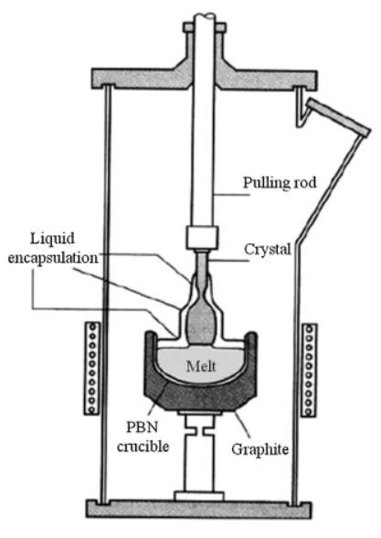
CZ method
03
Depletion depth $d$ of planar detector
$d=\sqrt{2∈V_{0}/eN}$
where, $V_{0}$ is the applied bias voltage, N is the net impurity concentration in the crystal, $e$ is the charge of electron and $∈$is the dielectric constant of Ge.
Net Impurity Concentration should be ${\sim 10}^{10}/cm^{3}$ for full depletion of a ~cm thick detector.
Dislocation density 300-10000$/cm^{2}$
Homogenous Impurity concentration along the detector.
CZ method achieves much lower around 500 EPD $cm^{−2}$
Seed crystal ((100) Ge) is dipped into the molten Ge
Withdraw slowly, while maintaining the temperature of melt just above the melting point.
The rate of crystal pulling and temperature ( via power supply) of melt are adjusted to control the growth of the crystal
05/11/2022
Mathbar Singh Raut
CoSSURF Materials Science

Slide 4
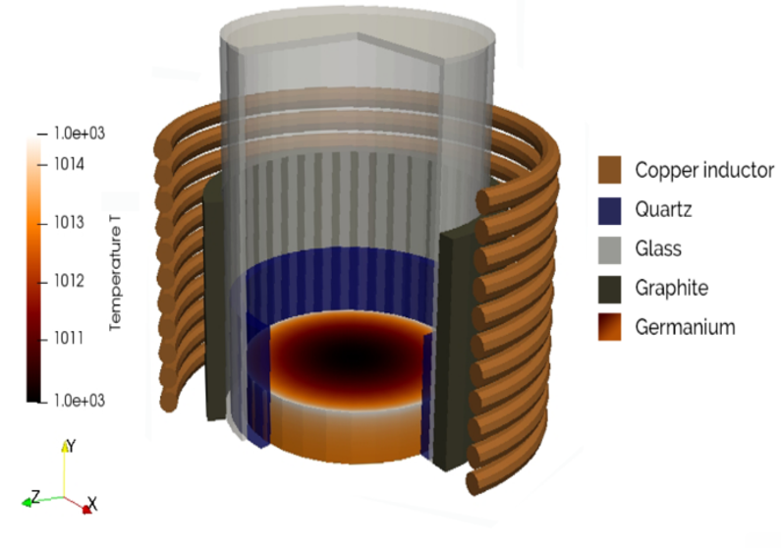
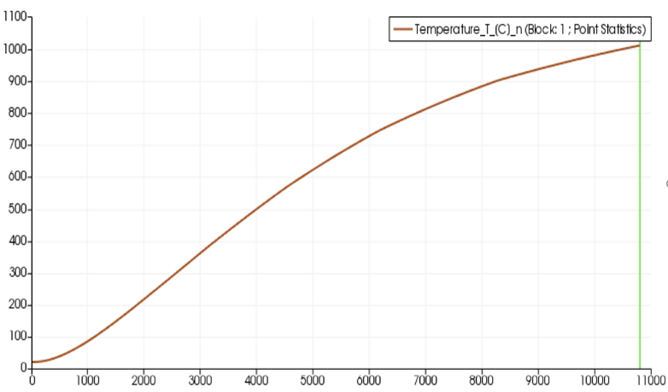
Melting
04
Temperature ( C )
Image: Simulation of our furnace by using CENOS induction heating software
Power supply of 11 KW with a current of 104 A
Takes 2-2.5 hours to melt 3.5 Kg Ge (melting point 937.4$℃$)
Time ( s )
Fig: Simulation results very close to real melting process
05/11/2022
Mathbar Singh Raut
CoSSURF Materials Science

Slide 5
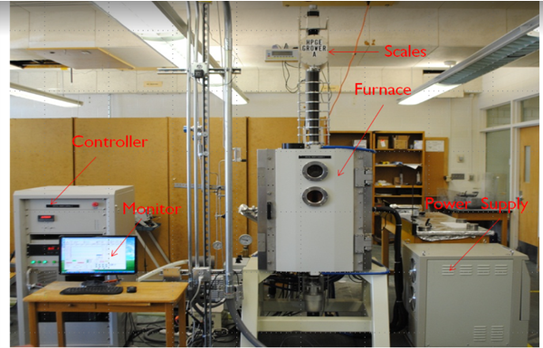
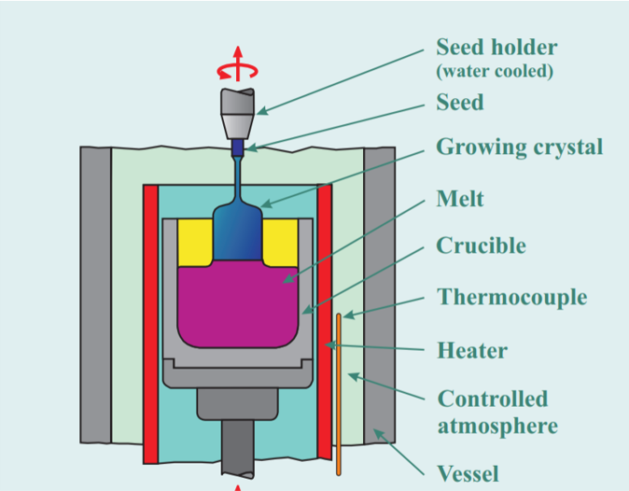
Crystal Growth at USD
05
Material preparation
ZR ingots of concentration of $≈{10}^{11}cm^{−3}$ are etched with $1 HF:3 HNO_{3}$ etchant
Dried with compressed nitrogen gas
Crucible cleaning
Deep cleaned by same etchant
Image: Crystal growth facility at USD
05/11/2022
Mathbar Singh Raut
CoSSURF Materials Science

Slide 6
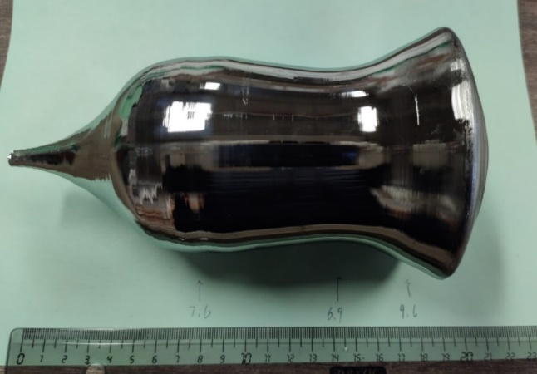
Diameter Control
06
The diameter (D) of the crystal is given by
$\sqrt{4×\frac{dw}{dt}/(pπρ_{s}+(\frac{dw}{dt}.ρ_{s})}/R^{2}ρ_{l})$
$\frac{dw}{dt}$= Rate of change of weight
$p$= Pull rate
$R$= Crucible radius
$ρ_{s}$= Density of solid Ge
$ρ_{l}$= Density of liquid Ge
05/11/2022
Mathbar Singh Raut
CoSSURF Materials Science

Slide 7
InSb: an introduction
07
InSb is a zincblende III-V semiconductor widely used in infrared imaging and magnetic field sensing
Highly sensitive mid-wave infrared sensing (3-5 μm)
Inherently weaker bond strength, soft and high electron mobility
Dark-grey silvery metal pieces or powder
Above 500 ⁰C, antimony and antimony oxide vapor liberate
Narrow bandgap of 0.17 eV at 300 K and 0.23 eV at 80 K
Breakdown Field = 1000 V $cm^{−1}$
Mobility electrons ≤ $7.7×10^{4} cm^{2}V^{−1}s^{−1}$
Mobility Holes ≤ $850 cm^{2}V^{−1}s^{−1}$
Diffusion coeff.(e) ≤ $2×{10}^{3} cm^{2}s^{−1}$
Diffusion coeff.(h) ≤ $22 cm^{2}s^{−1}$
Thermal Velocity(e) = $9.8×{10}^{5} m^{−1}s^{−1}$
Thermal velocity(h) ≤ $1.8×{10}^{5} cm^{−1}s^{−1}$
Ref : Littler, C. L., D. G. Seller, Appl. Phys. Lett. 46,10 (1985) 986-988.
05/11/2022
Mathbar Singh Raut
CoSSURF Materials Science

Slide 8
Energy resolution
08
Efficiency per mole at least 9.3 times of Ge as photoelectric effect varies with Z⁵
Single event Compton scattering scales as Z, i.e. InSb would have Peak-to-Compton ratio 6 times better than Ge
$$Δ E_{F}=2.355{\left(FεE_{γ}\right)}^{\frac{1}{2}}$$
F → is Fano factor
$E_{γ}$→ is the gamma energy
$ε$ → is the average energy needed to form an electron-hole pair
$ε$ scales with the band gap and Fano factor comparable to Ge → yields resolution for InSb better than that of Ge at least by factor of 2.
Peak-to-Compton ratio → 12 times better than Ge.
05/11/2022
Mathbar Singh Raut
CoSSURF Materials Science

Slide 9
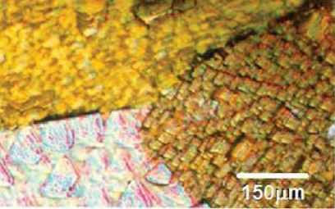
InSb crystal growth parameters
09
The chamber walls of the CZ growth system
→ quartz tube of 7.0 cm diameter
An inner quartz tube of 5.0 cm diameter → to control temperature gradient
Graphite crucible used = 3.8 cm in diameter → mounted on third quartz tube
Growth atmosphere = hydrogen flux
Flux = 3.5 ltr/min
Pulling speed = 2.0 cm/hrs
Rotational speed = 20 rev/min
Heated about 1 hour to 700 ⁰C to get melt
Image : Metallographic picture of an InSb ingot polycrystalline
05/11/2022
Mathbar Singh Raut
CoSSURF Materials Science

Slide 10
A few challenges
10
1. Problem of complete charge collection
2. Problem of compensation
In Ge, mobilities differ only by factor of 2
Drifting in reasonable amount of time
Drifting in InSb is almost impossible
Drifting n-type is necessary
Smallest anion F- is many times larger than Li+
Small band gap makes drifting at elevated temp. unfeasible
$$η=\frac{Q}{Q_{0}} =\frac{λ_{e}}{L} \left( 1−exp\left[ −\frac{L−x}{λ_{e}}\right]\right)+\frac{λ_{h}}{L} \left(1−exp\left[ −\frac{x}{λ_{h}}\right]\right)$$
$$λ_{e}=μ_{e}τ_{e} E$$
$$λ_{h}=μ_{h}τ_{h} E$$
Slow hole mobility is the potential source of problem
Resolution to be equal with Ge, $\frac{λ_{h}}{L}$ requires > 10
Severe limitation on the size of high-quality detectors
Factors to be controlled
Purity and stoichiometry
Dislocation density
Anisotropic dopant segregation
Growth striations
05/11/2022
Mathbar Singh Raut
CoSSURF Materials Science

Slide 11
Purity and stoichiometry
11
Impact both crystal quality and electrical properties
Key factors to control purity and stoichiometry
Feedstock purity
Requires on the order of 5N to 7N purity
Zone refining:
Tellurium ( k = 0.9) making ZR very inefficient
Melt stoichiometry
Increased occurrence of twins
Under normal growth conditions, a small window exists, effects negligible even when ratio deviates slightly from 1:1
At any temperature > absolute zero, there exists a finite equilibrium concentration of point defects ( vacancies, antisites and self-interstitials)
Point defects increase the configurational entropy which decreases the free energy of the crystal
The deviation for InSb in the max. range of (0.5-1)$×{10}^{18} cm^{−3}$ indium excess
05/11/2022
Mathbar Singh Raut
CoSSURF Materials Science

Slide 12
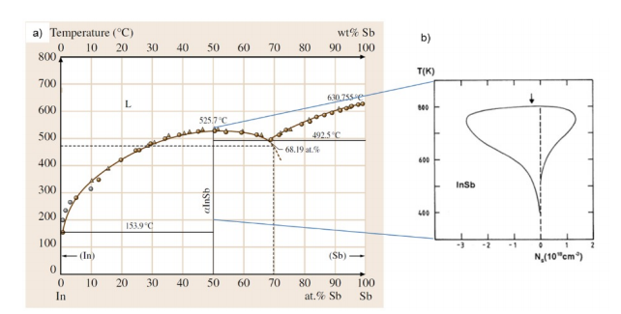
Purity and Stoichiometry
12
Sb evaporation rate
High relative vapor pressure of Sb
At the melting point of InSb ( 800 K ), indium and antimony have vapor pressures of ${10}^{−8} and {10}^{−2}$ torr
Precautions or control measures:
Should be grown in limited timeframe
Heating the furnace walls to prevent condensation
Controlling gas pressure and flow rate in the chamber
Avoiding overheating at initial meltdown
Sb evaporation rate increases exponentially with T, so the temp. set-point should not be over shot
Figure: (a) Equilibrium phase diagram of InSb with (b) magnification of the α-InSb solidus line
05/11/2022
Mathbar Singh Raut
CoSSURF Materials Science

Slide 13
Dislocation
13
Defect formation energy is much lower compared to Si and Ge
Edge or screw-type or both
Adversely affect charge transport within the materials
Produce dangling atomic bonds and strain fields that scatter and/or trap charge carriers
Effectively reduces the charge carrier mobility and lifetime
Creates higher resistance in detector junctions, poor signal to noise ratio, and inconsistent detector response
The first highly likely chance for dislocation formation occurs when the seed is dipped into the melt
Largest sources:
Stress on the crystal from thermal gradients
Impurities at the growth interface
Relatively poor thermal conductivity → outside of the crystal will cool faster creating thermal stress
05/11/2022
Mathbar Singh Raut
CoSSURF Materials Science

Slide 14
14
Thank you !
Questions ???
05/11/2022
Mathbar Singh Raut CoSSURF Materials Science

