Slide 1
Search for Dark Photons Utilizing Advanced Germanium Detectors
Sanjay Bhattarai , Dongming Mei
UNIVERSITY OF SOUTH DAKOTA
This work is done under the collaboration PIRE-GEMADARC. It was sponsored by NSF OISE-1743790

Slide 2
Motivations
Research and development of advanced germanium detector with low energy threshold for low mass dark photon detection.
Utilizing home-grown crystals at USD to develop new Ge detectors with internal charge amplification
Use a low-energy threshold to optimize the number of events.

Slide 3
Introduction
U (1) gauge symmetry mediated by a massive spin-1 boson called a “dark photon”
Kinetically Mix with Standard Model (SM) Photon by a small coupling $k$ through a Lagrangian term:
$$ℒ_{A_{D}}=\frac{1}{2}kF_{μν}F_{D}^{μν}$$
$F_{μν}$= Field strength of SM photon
$F_{D}^{μν}$= Field strength of dark photon
Through this mixing, the dark photon would couple to electromagnetically-charged SM particles analogously to the SM photon.
May have very small mass unlike ordinary photon.
FIGURE: Example of a one-loop diagram that could create a kinetic mixing. In this case, the massive particle M has both electromagnetic and dark charge.

Slide 4
Detection
Since neither the mass of the dark photon ($m_{v})$ nor its coupling ($k)$ are known a priori, each experiment’s design is tailored to search for it in a specific range in the mass vs. coupling parameter space.
Sources and Characteristics:
Astrophysical sources: Sun is the main source. Dark Halo is another source.
Difference in flux between dark halo and solar sources.
Abundance in flux from the Sun.
We propose the direct detection technique using advanced HPGe detectors with internal charge amplification.

Slide 5
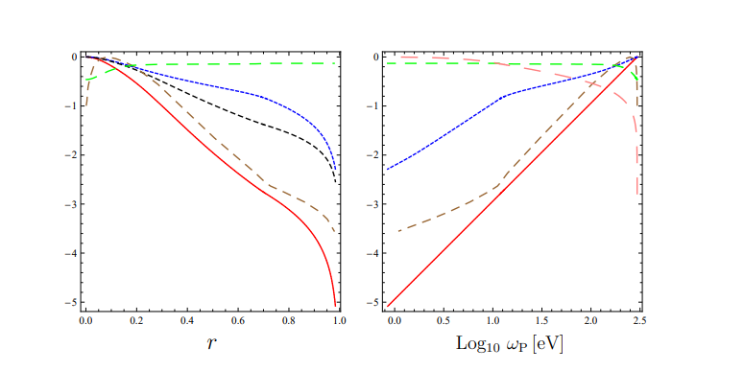
Solar Dark Photons Flux
For transverse dark photons
Mass $m_{γ^{′}}$= 0.1eV, $k={10}^{−10}$
Flux= ${\left(\frac{dφ}{dw}\right)}_{T}=2.7×{10}^{28}E^{−2.98}exp(−\frac{E}{1.4})×k^{2}×m_{γ^{′}}^{4}$ ; $E=w/keV$
For longitudinal dark photons ($1 eV<w<300 eV$);
${ Resonace frequency(w}_{p})=w(eV)$
Flux = ${\left(\frac{dφ}{dw}\right)}_{L}=$ $\frac{\frac{2r^{2}}{R_{∅}^{2}}\sqrt{w^{2}−m_{γ^{′}}^{2}}}{\frac{π^{2}dw_{p}^{2}}{dr}(e^{\frac{w}{T}}−1)}$ $m_{γ^{′}}^{2}k^{2}$
For $w>300 eV$
${\left(\frac{dφ}{dw}\right)}_{L}$=$5.7×{10}^{33}×w^{−4}e^{−w/1.7}k^{2}$ $m_{γ^{′}}^{2}$
Radial cordinate inside sun
Figure : Values of solar parameters for this work ; temperature T (blue), radial coordinate r (pink), $\frac{dw_{p}^{2}}{dr}$(brown) normalized to their largest values 1350 eV, $6.96×{10}^{8} m$ and $5.8×{10}^{−4} eV^{2}m^{−1}$
Temperature
Ref: J. Redondo, J. Cosmol. Astropart. Phys. 07 (2008) 008

Slide 6
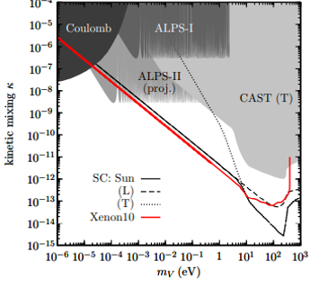
Ref: H. An, M. Pospelov, and J. Pradler, Phys. Lett. B 725, 190 (2013)

Slide 7
Event rate
For detector of mass M and volume V
Event rate = $\frac{V}{M}×\{flux_{L}×absorption rate_{L}(Γ_{L})+flux_{T}×absorption rate_{T}(Γ_{T})\}$
Here, $Γ_{L}=\frac{k^{2}m_{γ^{′}}^{2}n_{A}v^{−1}σ_{abs}}{w^{2}{\left|∈_{r}\right|}^{2}}$
${ Γ}_{T}=$ ${k^{2}n_{A}v}^{−1}σ_{abs}$
Where, $σ_{abs}$ is photoabsorption cross-section, $n_{A}$is atomic density , $v^{−1}$ is the velocity of dark photons
Ref: B. L. Henke, E. M. Gullikson and J. C. Davis, Atom. Data Nucl. Data Tabl. 54, no. 2, 181 (1993).

Slide 8
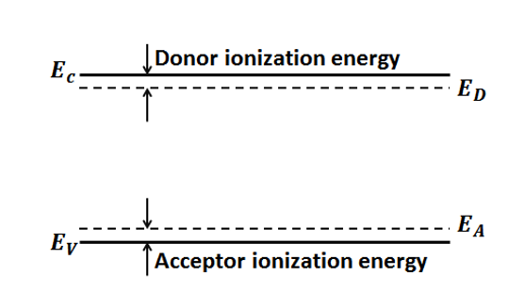
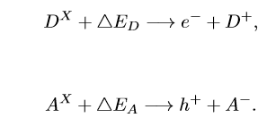
Phonon impurity interaction
Phonons with energy 0.037eV and 0.026eV can ionize or excite impurities to produce charge carriers.(ionization energy of impurities~0.01eV)
$$D^{X}=Neutral donors$$
$$A^{X}=Neutral acceptors$$
$$ΔE_{D}=energy absorbed by neutral donors$$
$ΔE_{A}$=energy absorbed by neutral acceptors
$D^{+}=$Daughter donor charged impurity
$A^{−}=$Daughter acceptor charged impurity
At low temperatures (~4k), impurities freezes to neutral impurities ,scattering of phonons is dominated by these neutral impurities
D.-M. Mei, G.-J. Wang, H. Mei, G. Yang, J. Liu, M. Wag-ner, R. Panth, K. Kooi, Y.-Y. Yang, and W.-Z. Wei, TheEuropean Physical Journal C78, 187 (2018).

Slide 9
Proposed detector
Multistrip planar Ge detector of mass about 1 Kg with impurity level of $\left(1−3\right)×{10}^{10}/cm^{3}$ and has a dimension of $9×7×3 cm^{3}$.
Ge crystal that guarantees a uniform distribution of impurities to provide a homogeneous electric field near the anode
Guarantee reliable cooling of the crystal, since the critical electric field and amplification factor depend on the free path of charge carriers, which in turn depend on the temperature.
Amplifaction factor of $\sim 1000$
1. Anode strips
2. Cathode
3. Guard electrodes
A. S. Starostin and A. G. Beda, Phys. Atom. Nucl. 63 (2000) 1297-1300, arXiv:hepex/0002063v1.

Slide 10
Ionization probability
The probability for a neutral acceptor state to be ionized in a p-type detector is
$$f(E_{A})=1−\frac{1}{1+4e^{(E_{A}−E_{F})/}k_{B}T}$$
$E_{F}$= Fermi energy level
$E_{F}−E_{V}=kTln(\frac{N_{V}}{N_{A}})$ Where $N_{V}=2{\left(2πm∗\frac{kT}{h^{2}}\right)}^{3/2}$
$m∗=$effective mass of hole
$$f\left(E_{A}\right)=1−\frac{1}{1+4exp⁡[(−\left(E_{F}−E_{V}\right)+\left(E_{A}−E_{V}\right))/kT]}$$
$E_{A}−E_{V}$= Phonon Energy

Slide 11
Absorption probability of phonon
The ionization or excitation cross section of both over-charged and neutral impurities=$σ=5×{10}^{−13}cm^{2}$
Absorption probability $p$ is given by
$p$=$1−e^{−d/λ}$
where $λ=\frac{1}{N_{A}σ}$
d=average distance diffused before anharmonic decay

Slide 12
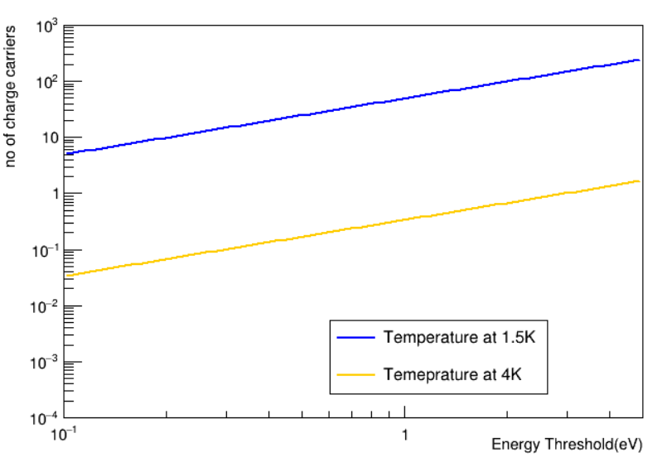
Number of charge carriers
The number of charge carriers created by the ionization or excitation of impurities
$$N_{carriers}=\sum_{i}{n_{i}p_{i}f_{i}}$$
For ith phonon with ionization probabaility $f_{i }$and absorption probability $p_{i}.$
$N_{carriers}=\sum_{i}{{\left(\frac{E_{threshold}}{0.026}\right)}_{i}}$ ($1−e^{−d_{i}/λ}$) ($1−\frac{1}{1+4exp⁡[(−\left(E_{F}−E_{V}\right)+{\left(E_{A}−E_{V}\right)}_{i})/kT]}$)
$E_{F}−E_{V}=kTln(\frac{N_{V}}{N_{A}})$ Where $N_{V}=2{\left(2πm∗\frac{kT}{h^{2}}\right)}^{3/2}$
$m∗=$effective mass of hole=0.29m_{e}

Slide 13
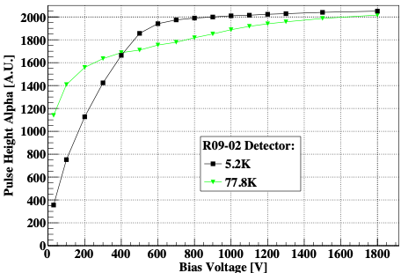
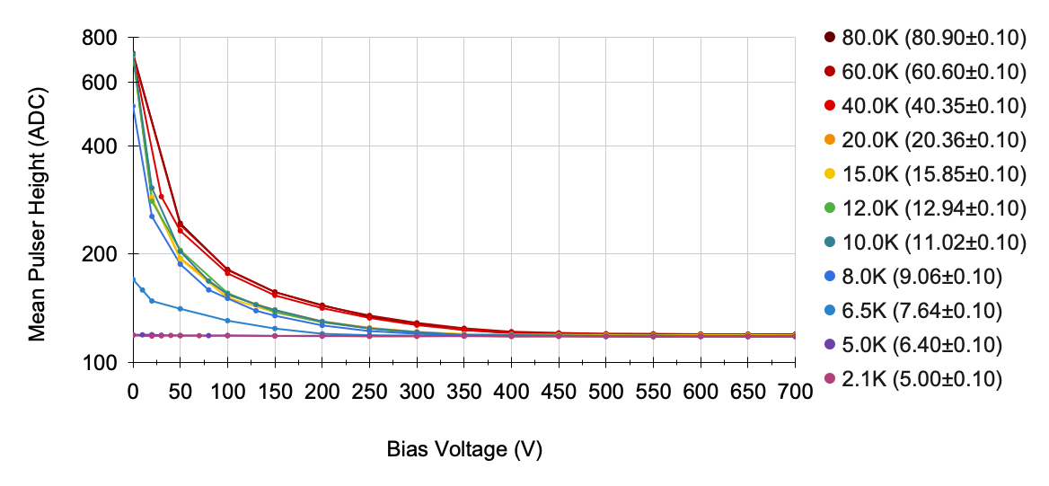
HPGe detector at low temperature
At high electric field and low temperature we can achieve internal charge amplification
At low temperature , detector not required to deplete
Plots Source: Rajendra Pant’s experiment with detector of impurity concentration $\sim {10}^{10}/cm^{3}$

Slide 14
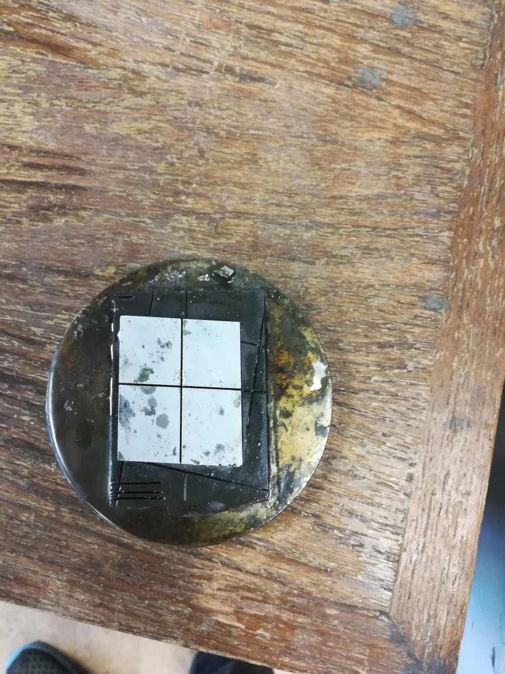
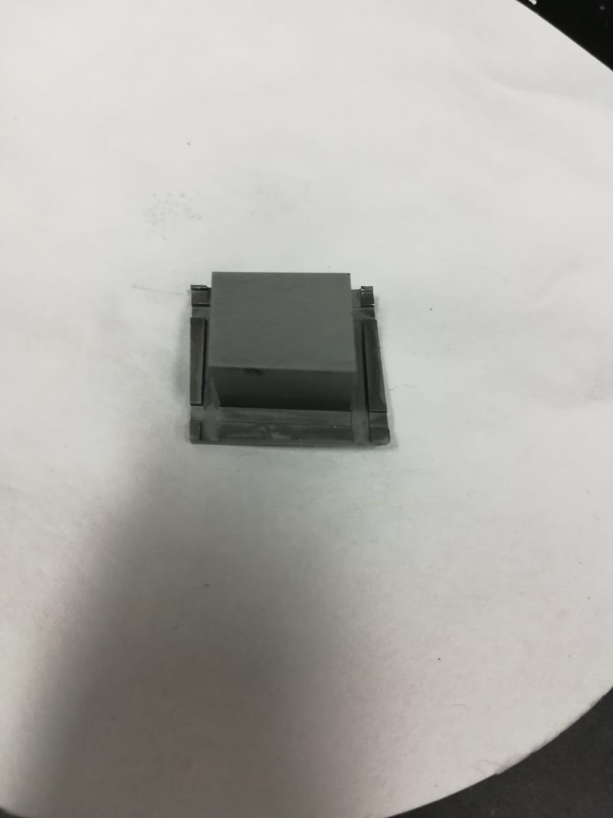
Future Work
Fabricate two planar detectors; a p-type and n–type each with impurity level ${\sim 10}^{12}/cm^{3}$.
Higher the impurity higher the phonons.
Test at low tempearutre, depletion not required.
Fabrictae point contact detector , test at high field and low temperature to observe internal charge amplification.

Slide 15
Conclusion
Low mass solar dark photon can be detected using advanced germanium detector of threshold 0.1 eV.
Background study for the project yet to be studied.
Crystal growth and zone refining yields the high purity germanium of desired impurities ; detector yet to be fabricated.

Slide 16
THANK YOU

