Slide 1
HP-Ge Crystal Growth at USD
Hao Mei, Sanjay Bhattarai, Mathbar Raut,
and Dongming Mei
The University of South Dakota
May 11, 2022

Slide 2
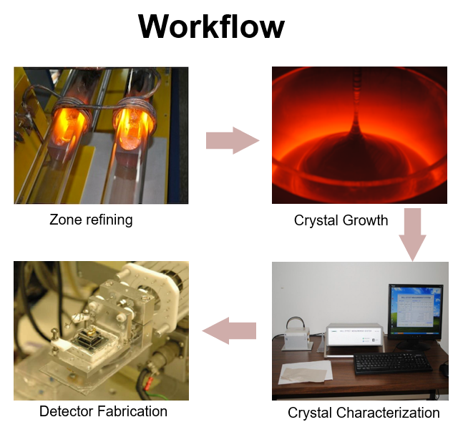
Motivation
Requirements
Mobility
Detector grade requires $>35000 cm^{2}/V∙s$.
Impurity
Less than $3×{10}^{10}/cm^{3}$.
Dislocation density
$300−10000/cm^{2}$.
Sizes
5 to 10 cm in diameter.
1 to 7 cm in length.

Slide 3
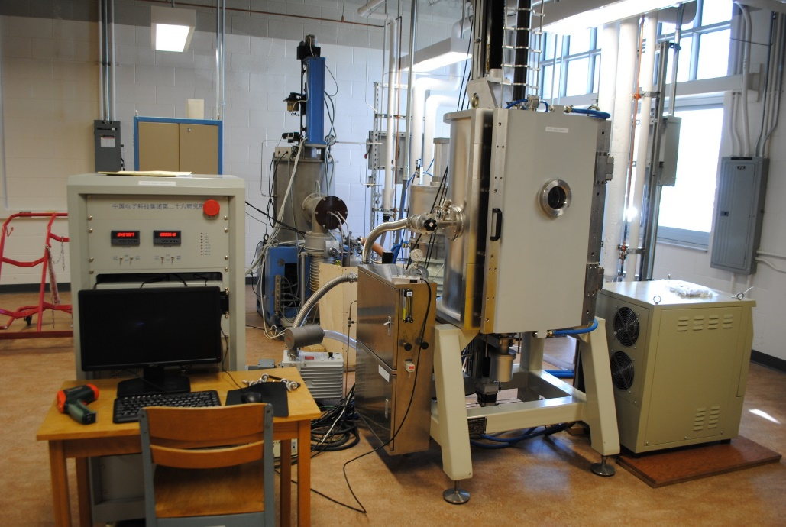
Crystal Growth
Crystal growth facility at USD
A precisely cut seed crystal is dipped into the molten Ge and withdrawn slowly, while maintaining the temperature of the melt just above the melting point.
The rate of crystal pulling, and the thermal field are adjusted to control the growth of the crystal.
Crystal Growth Process

Slide 4
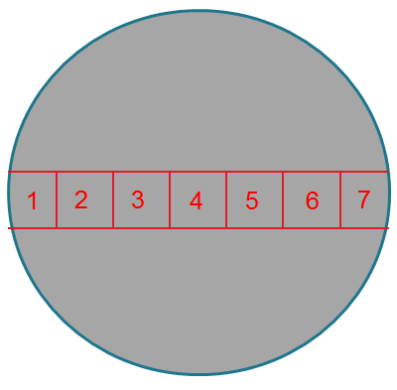
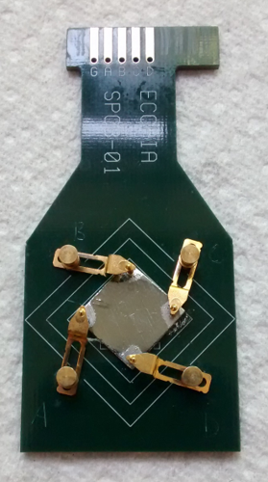
Hall Effect Measurement
Schematic diagram showing the location of the samples cut from the wafers.
The four corners of the sample are scratched by ohmic contacts. Depends on the conductivity type of the crystal, the contacts are different.$\left[1\right]$
Van der Pauw Hall effect measurement system
$\left[1\right].$M.-S. Raut, et al., Journal of Instrumentation, Volume 15, October 2020
Resistivity $ρ=R_{s}∙d$
Hall Voltage $V_{H}=−\frac{IBw}{nqdw}=−\left(\frac{1}{nq}\right)\frac{IB}{d}$
Hall Mobility $μ=\frac{1}{qnρ}=\frac{\left|V_{H}d\right|}{IBρ}$
Carrier Concentration: $n=−\frac{IB}{qtV_{H}}$

Slide 5
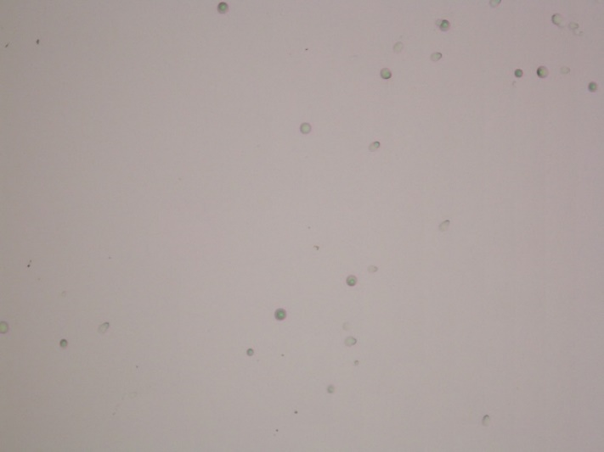
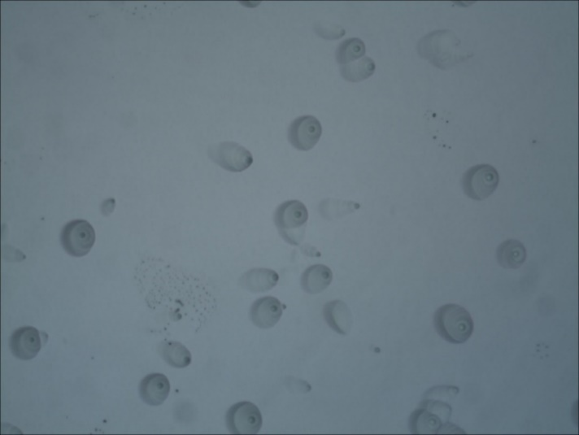
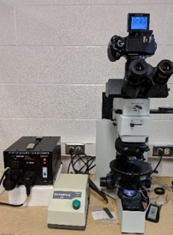
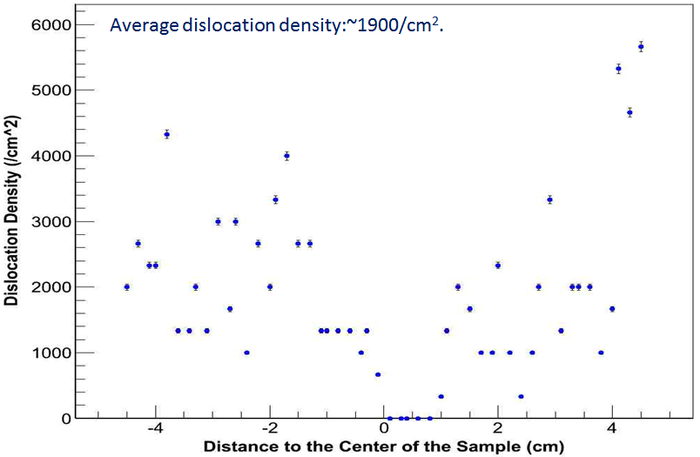
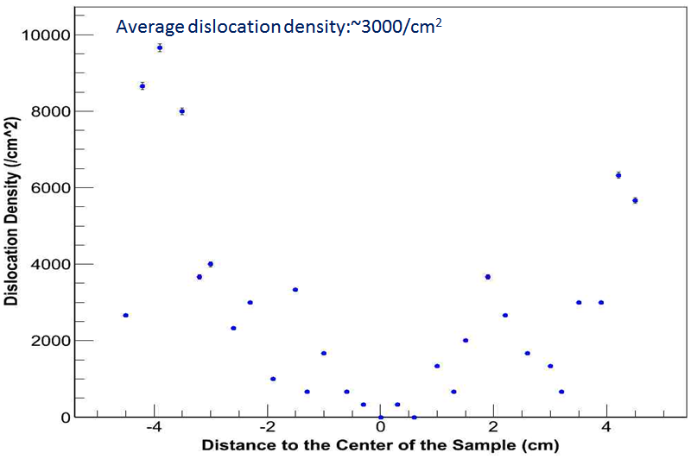
Dislocation Measurement
Cutting
Polishing
Etching2
HF: HNO3:Acetic acid=5:10:11 with 30 mg iodine
Etching1
HNO3:HF=3:1
10X
50X
Dislocations observation under microscope
Full view of the dislocation distribution on the whole slice

Slide 6
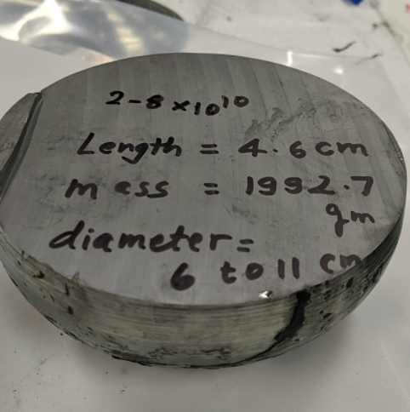
Crystal Growth at USD
Crystal 01/04/2021C
Mass:5480g
Position | Concentration (/$cm^{3})$ | Mobility ($cm^{2}/Vs)$ | Resistivity ($Ωcm)$
Neck | 2.06E12 | 4.15E4 | 7.31E1
S1 | 3.61~8.86E10 | 5.85E3~2.61E4 | 6.63E3~1.21E4
S2 | 2.57~8.93E10 | 2.95~3.58E4 | 1.95~8.24E3
S3 | -3.94~-5.33E11 | 6.71E3~1.20E4 | 9.76E2~2.36E3
Tail | - | - | -
neck
S1
S3
S2
Detector grade crystal:
Mass: 1922g
Thickness: 4.6cm
Diameter:11cm
High-purity germanium crystals with diameters up to 12 cm were grown by the Czochralski method. Red lines shows the position of the cutting slices for characterization of the HP-Ge crystal.

Slide 7
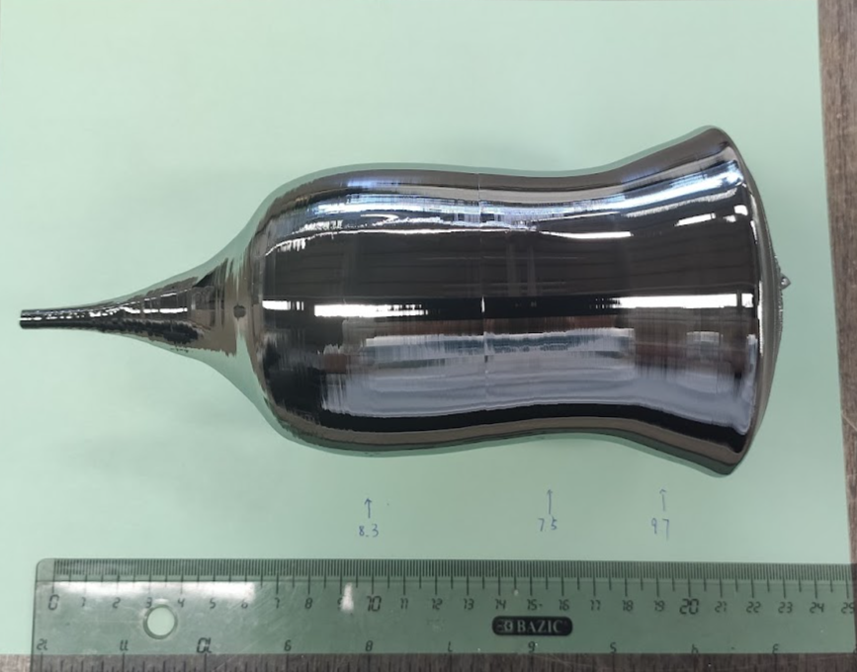
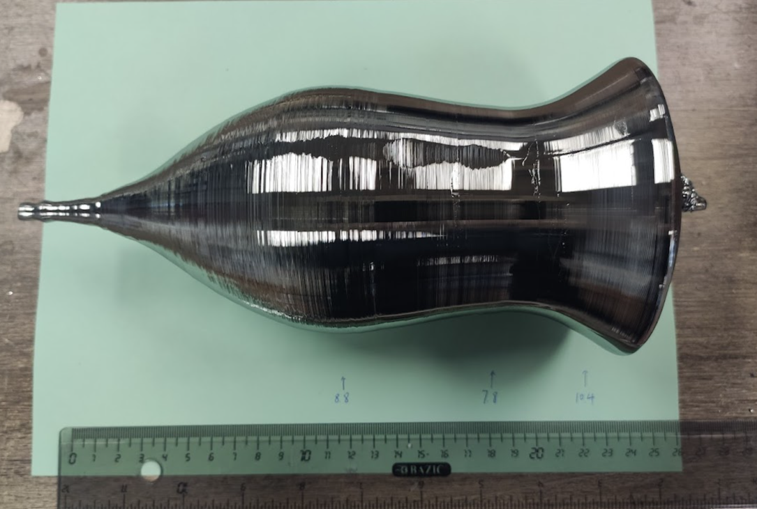
Crystal Growth at USD
Crystal grew on 10/07/2021 from grower A with mass of 3957g.
To enhance the chance to have a detector-grade region from the grown crystal, we have been trying to increase the mass of input materials. We have successfully increased the mass of the crystals from 3.5kg to 4kg for one of our crystal growers (grower A).
Despite the thermal field for grower A is quite different from that in the other grower (grower C can grow crystal up to 6.2kg with diameter ~11cm), the diameters and shapes are controlled well, demonstrating our ability to grow HP-Ge crystals with large diameters.
Crystal grew on 10/14/2021 from grower C with mass of 5283g.

Slide 8
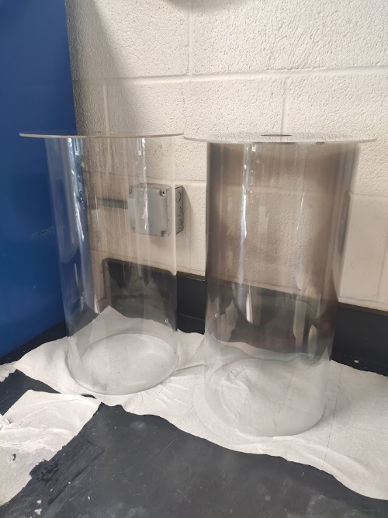
Crystal Growth at USD
10/21/2021
10/28/2021
In addition, we are also investigating the effect of the chamber pressure on the thermal field and gas flow rate during crystal growth.
Pros:
Stable gas flow rate.
The gas flow rate shows less fluctuation. Occasionally it will increase, barely decrease.
Less chance to have poly, even with visible amount of graphite on melt surface.
Less outside air backflow.
Much more visible during crystal growth for grower C.
The glass cylinder are cleaner than before.
Cons:
Thermal field has been changed.
Need more data to control the diameter.
The digital scale gets disfunction when pressure > 6 psi.
Still looking for the best chamber pressure for crystal growth.

Slide 9
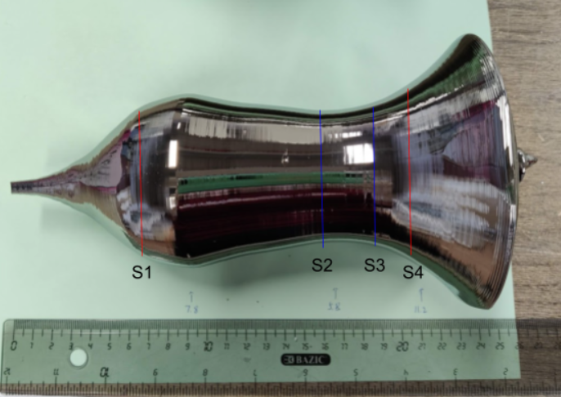
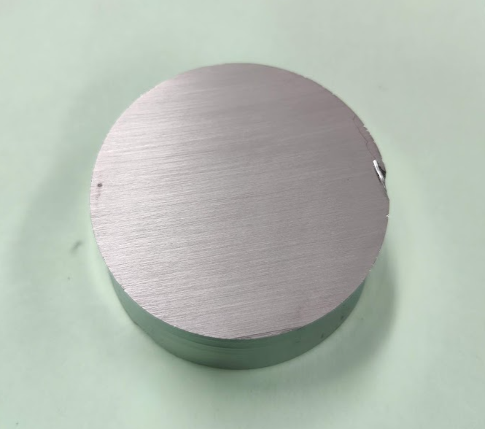
Crystal Growth at USD
Position | Concentration (/$cm^{3})$ | Mobility ($cm^{2}/Vs)$ | Resistivity ($Ωcm)$
Neck | 7.96E11 | 1.09E4 | 7.19E2
S1 | 2.45~3.18E11 | 1.71~5.49E4 | 3.58E2~1.49E3
S2 | 5.79~9.17E10 | 2.55~3.13E4 | 2.17~4.23E3
S3 | -2.94~-5.53E10 | 2.43~3.74E4 | 4.64~5.69E3
S4 | -5.51~-6.31E11 | 1.47~3.36E4 | 3.12~6.74E2
Tail | -1.25E13 | 2.91E4 | 1.72E1
Crystal 01/04/2021C.
Mass:5480g
Mass: 364g
Diameter: 5.9cm
Thickness:2.45cm
Crystal on 03-31-2022A with a mass of 4050g. The detector grade region is at 55-60% location along the axial direction. The Hall effect measurements show the total impurity level of this crystal is slightly higher than we expected and further purification is needed.

Slide 10
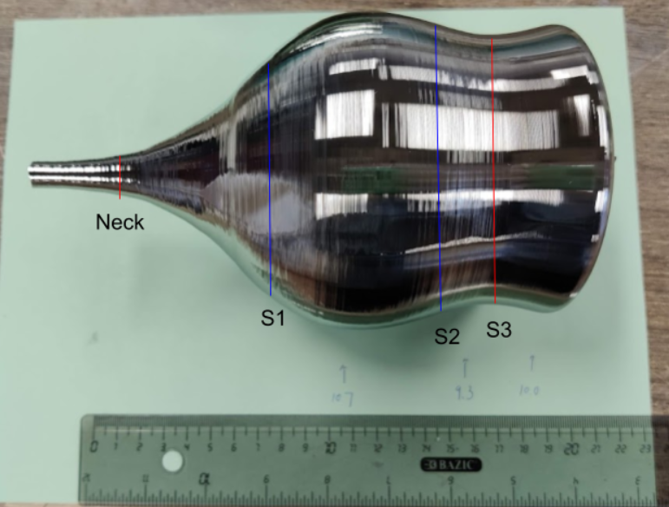
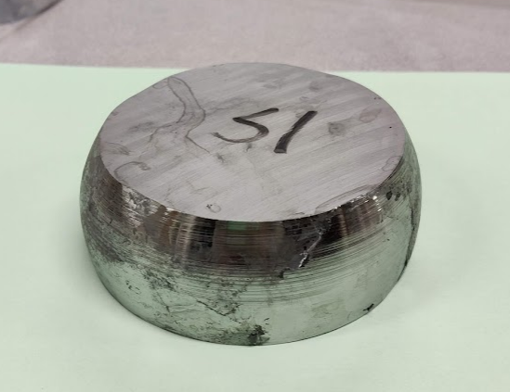
Crystal Growth at USD
Position | Concentration (/$cm^{3})$ | Mobility ($cm^{2}/Vs)$ | Resistivity ($Ωcm)$
Neck | - | - | -
S1 | 1.34~5.22E10 | 2.38~4.49E4 | 3.11E3~1.57E4
S2 | -5.21~-7.27E10 | 2.43~2.98E4 | 3.53~4.02E3
S3 | -1.60~-2.42E11 | 2.34~3.22E4 | 1.21E3
Tail | -8.69E12 | 1.63E4 | 4.41E1
Mass: 1929g
Diameter: 11.1cm(bottom) 9.6cm(top)
Thickness: 4.0cm
Crystal on 04-07-2022C with a mass of 5398g. The detector grade region is at 20-55% location along the axial direction.

Slide 11
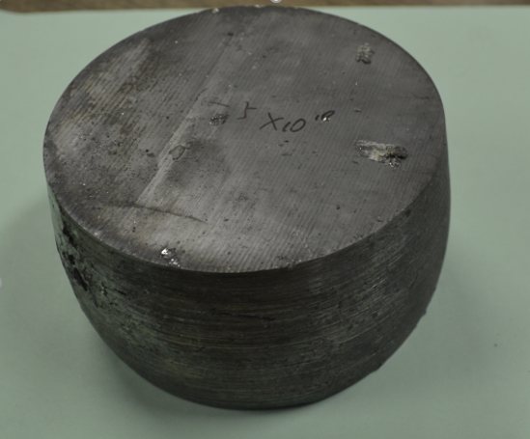
Detector-Grade Crystals Summary
31.9kg detector grade crystals at USD:
39 detector grade crystals. 3 detector grade crystals (2928g) this year so far.
Impurity level: $3.77×{10}^{9}\sim 7×{10}^{10}/cm^{3}$.
Average diameter: 8.5 cm.
Average thickness: 2.5 cm.
21
11
4
3
Mass: 2247g
Diameter: 10cm
Thickness: 5.4cm
Impurity Level:
$$2.06×{10}^{10}(top)\sim 2.68×{10}^{10}/cm^{3}\text{(}\text{bottom}\text{)}$$
22
6
6
5

Slide 12
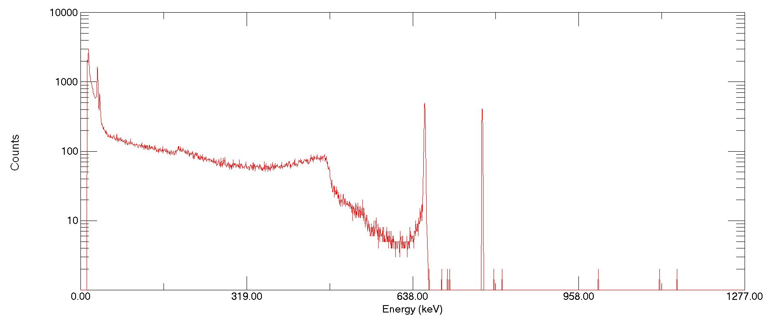
Energy Spectrum of Cs-137
Energy spectrum from a Cs-137 source measured with the detector USD-R03. The source was positioned facing the detector top. The bias voltage of -2500 V was applied to the bottom electrical contact on the detector while the signals were measured from the top.

Slide 13
Conclusions
At USD, we have successfully built a production chain that can purify the Ge raw materials, grow detector-grade HP-Ge crystals, and fabricate them into Ge detectors.
A well-controlled segregation method and thermal field are used to control the distribution of impurities during crystal growth to meet the requirements for detector-grade Ge crystals.
We are investigating some essential parameters to improve the quality of the crystal; we will continue to investigate and develop the influential parameters for the entire HP-Ge development chain.

Slide 14
Thanks!

