Slide 1
Baryon Number Violation Searches in DUNE
Tyler D. Stokes for the DUNE Collaboration
CoSSURF 2022
May 12, 2022

Slide 2
The Deep Underground Neutrino Experiment (DUNE)
Flagship project of Fermilab
Will construct 1.2 MW $ν$ beam with upgrade plans to 2.4 MW
Near detector will utilize a suite of detectors
Far detectors will utilize Liquid Argon Time Projection Chambers (LArTPCs)
Total Far detector mass: 70 kt of LAr
1347 collaborators
204 institutions in 33 countries + CERN

Slide 3
DUNE At SURF
DUNE Far detectors will sit 1.5 km underground
Four far detector modules each composed of 17.5 kt of LAr
In this talk we assume each detector has 10 kt of fiducial volume
Cryostats are each 65.8 m long, 18.9m wide and 17.8m tall

Slide 4
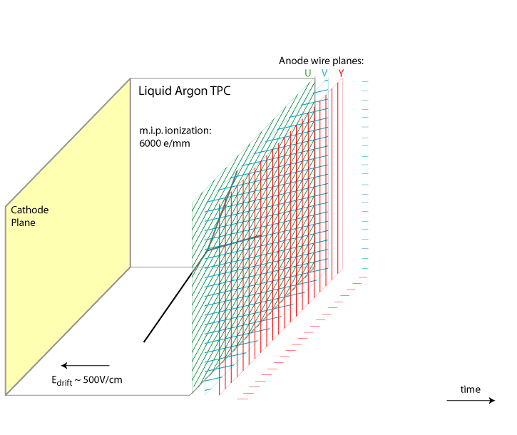
LArTPC: How They Work
A large uniform liquid argon volume
Electric field applied across drift volume
ionizing particles create free charge
Electrons drift towards anode planes
3 wire planes each yield 2D images of wire coordinate and drift coordinate
Optical System provide t₀
The collected charge is proportional to the energy deposition ($dE/dX$)

Slide 5
LArTPC Excellence
https://iopscience.iop.org/article/10.1088/1748-0221/15/12/P12004
3D Bubble Chamber-like images
Can classify complex topologies
Can reconstruct $K^{±}$ from nucleon decay events
Example data events from Prototype DUNE Detector
A 6 GeV/c Pion candidate
6 GeV/c Kaon candidate
Cosmic air shower candidate

Slide 6
Baryon Number Violation
Nucleon Decay

Slide 7
Baryon Number Violation: Nucleon Decay
Leading Candidate Channels
$p→K^{+}\overline{ν}$
$p→e^{+}π^{0}$
$n→{e^{−}K}^{+}$
The Golden Channel: $p→K^{+}\overline{ν}$
LArTPC has an advantage with charged Kaons over Water Cherenkov detectors
Charged kaon can be fully reconstructed in LArTPC, while in water Cherenkov it falls below the Cherenkov threshold
Key Features:
Kaon Bragg peak near muon vertex
Kaon decay daughters create a distinct signal
Key Difficulties:
Decay products may undergo Final State Interactions (FSI) within Argon nucleus
Kaon may lose energy and become more difficult to reconstruct
Background: atmospheric neutrino CC and NC interactions

Slide 8
$p→K^{+}\overline{ν}$ Event Displays
A BDT multivariate analysis is used to classify events
A high scoring signal MC event
A high scoring atmospheric MC event
$$p→K^{+}\overline{ν}$$
$$K^{+}→μ^{+}ν_{μ}$$
$$μ^{+}→e^{+}{ν_{e}\overline{ν}}_{μ}$$
Drift Time
Drift Time
$$p$$
$$μ^{−}$$
$$e^{+}$$
$$μ^{+}$$
$$e^{−}$$
$$K^{+}$$
https://link.springer.com/article/10.1140/epjc/s10052-021-09007-w

Slide 9
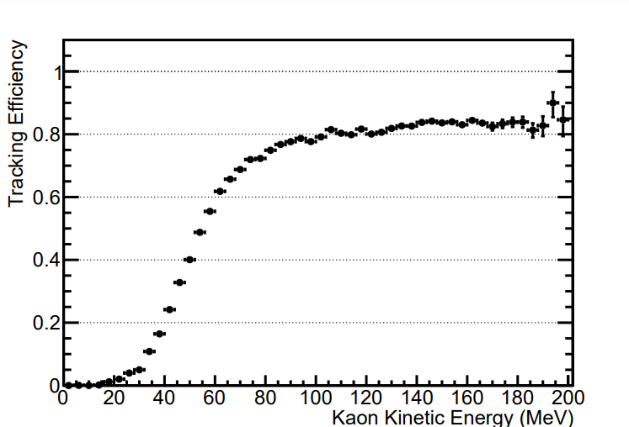
Kaon FSI Effects
Top Left: Kaon kinetic energy without and with FSI
Top Right: Kaon tracking efficiency
Ongoing work for improving low energy Kaon reconstruction
https://link.springer.com/article/10.1140/epjc/s10052-021-09007-w

Slide 10
$p→K^{+}\overline{ν}$ Sensitivity
https://link.springer.com/article/10.1140/epjc/s10052-021-09007-w
Kaon tracking efficiency: 58%
With improved reconstruction this can be greatly improved
30% signal efficiency
Main limiting factor in signal efficiency is K/p separation
3x10⁻⁶ background suppression
1 background per Mton-year or 25 years of data
Systematics:
2% on signal from FSI uncertainties
20% on background from neutrino flux and cross-section uncertainties
Expected Sensitivity
400 kt-year exposure with no observed events → a limit of 1.3x10³⁴ years
Current Limit by SK
5.9x10³³ years
https://journals.aps.org/prd/abstract/10.1103/PhysRevD.90.072005

Slide 11
$n→e^{−}K^{+}$ Sensitivity
Similar analysis to $p→K^{+}\overline{ν}$
Additional electron shower
Invariant mass ~1 GeV
Background: atmospheric neutrinos
Signal efficiency: 47%
400 kt-year exposure → A limit of 1.1x10³⁴ years
Current Limit by Fréjus
3.2x10³¹ years
https://www.sciencedirect.com/science/article/pii/037026939191479F

Slide 12
$p→e^{+}π^{0}$ Sensitivity
Signature: 3 EM showers
Invariant mass ~1 GeV
Background: atmospheric neutrinos
Preliminary analysis based on MC Truth
Reconstruction only approximated
400 kt-year exposure → A limit of 8.17x10³³ years to 1.1x10³⁴ years
Depending upon reconstruction
Can reach SK limit by doubling exposure
Current Limit by SK
2.4x10³⁴ years
https://journals.aps.org/prd/abstract/10.1103/PhysRevD.102.112011

Slide 13
Baryon Number Violation
Neutron-antineutron Transformations ($n→\overline{n})$

Slide 14
Baryon Number Violation: $n→\overline{n}$
We know neutral particles are capable of oscillation
$K^{0}↔{\overline{K}}^{0}$, $B^{0}↔{\overline{B}}^{0}, D^{0}↔{\overline{D}}^{0}$
Neutrons are predicted to also oscillate by several BSM theories
Neutrons bound in a nucleus can oscillate as well as free neutrons
Inside nucleus oscillated neutrons would quickly annihilate
Their oscillation times can be related with a suppression factor
$$τ_{bound}=R⋅τ_{free}^{2}$$
R varies for different nuclei
$R\sim 6.66×{10}^{22}s^{−1}$ for ${}_{26}^{56}{Fe}$ is used for this analysis
Future works will use the newly calculated: $R\sim 5.6×{10}^{22}s^{−1}$ for ${}_{18}^{40}{Ar}$
Phys. Rev. D 101, 036008 (2020)
https://journals.aps.org/prd/abstract/10.1103/PhysRevD.78.016002

Slide 15
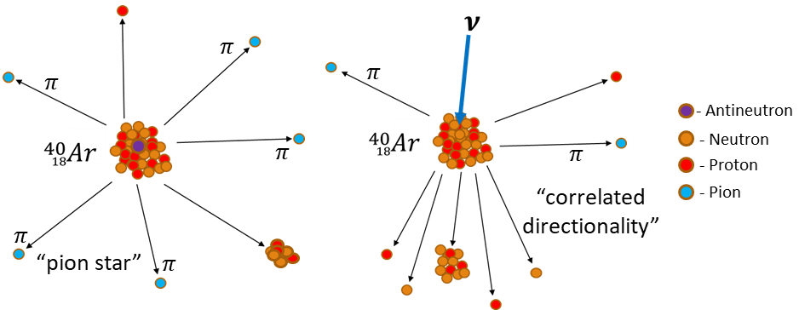
$n→\overline{n}$ Expected Topologies
Annihilation produces multiple pions
So called “pion star”
FSI can yield nucleon knock outs
Main background are NC atmospheric events
$$p$$
https://indico.fnal.gov/event/44472/contributions/192778/

Slide 16
$n→\overline{n}$ Event Displays
A BDT multivariate analysis is used to classify events
$$n\overline{n}→nπ^{0}π^{0}π^{+}π^{−}$$
A high scoring atmospheric MC event
A high scoring signal MC event
Drift Time
Drift Time
https://link.springer.com/article/10.1140/epjc/s10052-021-09007-w

Slide 17
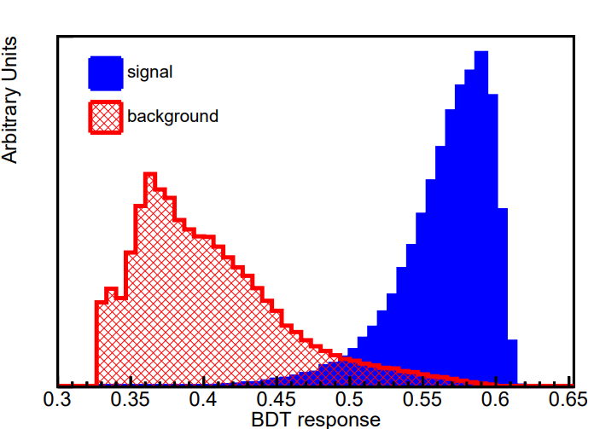
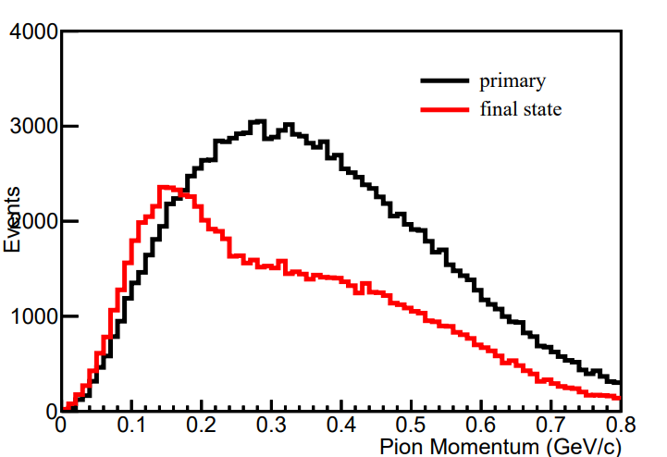
$n→\overline{n}$ Oscillation Limits
Similar multi-variate approach as in the nucleon decay studies
Bound neutron limit: $6.45×1032$ years
@ 90% CL with 400 kt-year exposure
Free neutron oscillation limit: $5.53×108 s$
~2x improvement over current best limit
Current Limit by SK
3.6x10³² years
https://www.sciencedirect.com/science/article/pii/037026939191479F
https://link.springer.com/article/10.1140/epjc/s10052-021-09007-w

Slide 18
Summary
LArTPC technology offers unique advantages in nucleon decay searches
At full scale (400 kt-year exposure) DUNE will be competitive with large water Cherenkov experiments in rare process searches
$p→K^{+}\overline{ν}$ : Improvement on current limits with more potential as reconstruction and particle identification improve
$n→e^{−}K^{+}$ : $≳2$ order of magnitude improvement over current limits
$p→e^{+}π^{0}$ : preliminary study suggests current limits reachable after double exposure
$n→\overline{n}$ : $≳2$ factor improvement expected over current limits

Slide 19
Thank you for time!
Questions?

