Slide 1
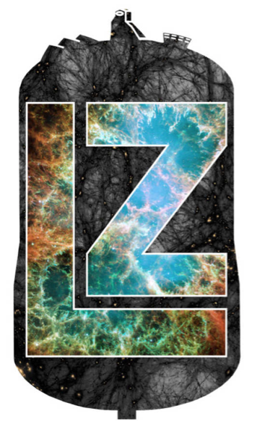

Low-Energy Neutrino Interactions in the LZ Experiment
Matthew Szydagis, UAlbany
May 12, 2022 CoSSURF, SDSMT

Slide 2
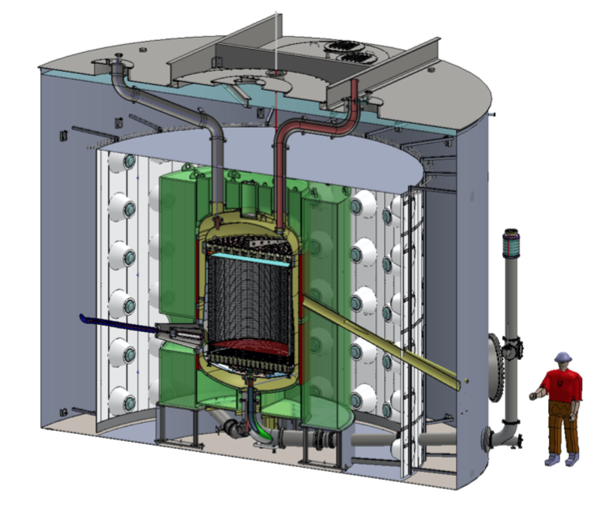
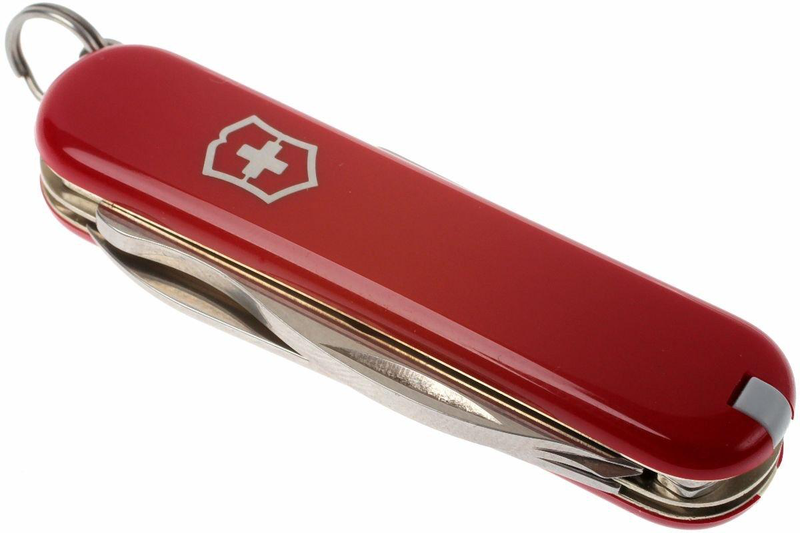

What is LZ?
(LUX-ZEPLIN)
A flagship Dept. of Energy Gen-2 WIMP dark matter direct-detection experiment
  Running now
But it can do much more than seek dark matter: a powerful machine with diverse physics objectives
  2 great examples are solar neutrinos (⁸B) and supernova neutrinos
  But there are many others: axions and other non-WIMP dark matter, neutrinoless double-beta decay, neutrino magnetic moment, atmospheric neutrinos
Multiple layers
  Water, Gd-loaded liquid scintillator (OD or outer detector), LXe skin veto, TPC
In same location as a predecessor LUX, at the 4850’ level in the Davis cavern, here at

Slide 3
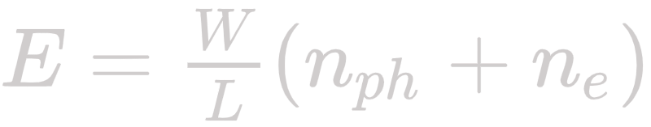
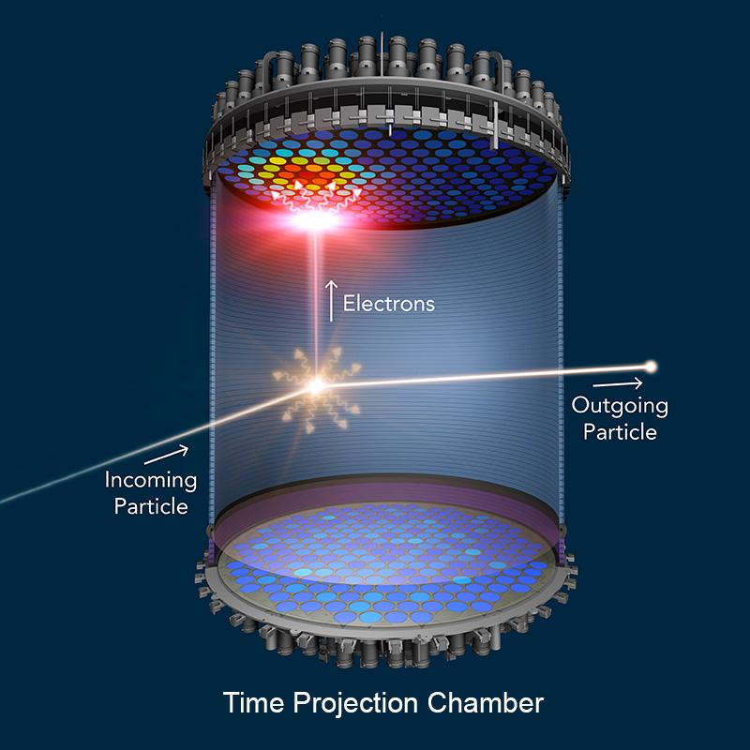
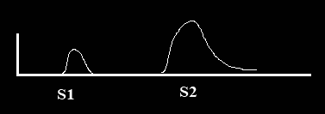


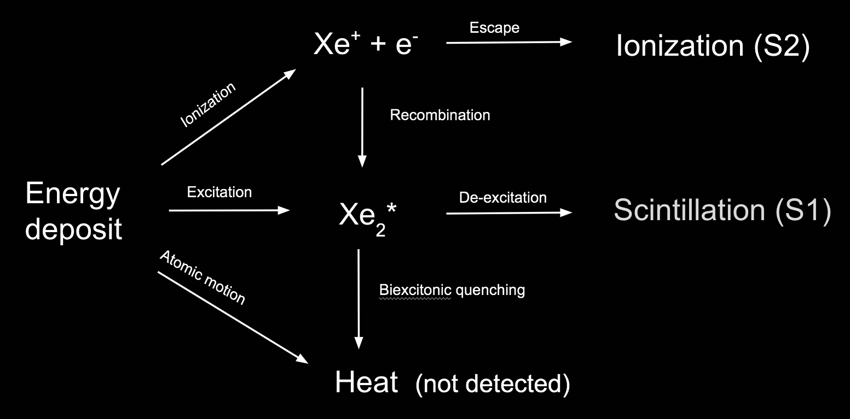
Two-Phase TPC at the Heart
Time
LZ: 7 tonne active volume, ~5.6 tonne fiducial expected
SLAC
GXe
We typically use “position-corrected” S1 and S2 signals (S1c and S2c), characterizing the “actual” yields to remove the detector-specific variations
LXe
Energy Deposit
The Microphysics of Signal Production in L(Xe)
Particles that multiply scatter will only provide 1 S1, but 1 S2 for each vertex of scattering

Slide 4
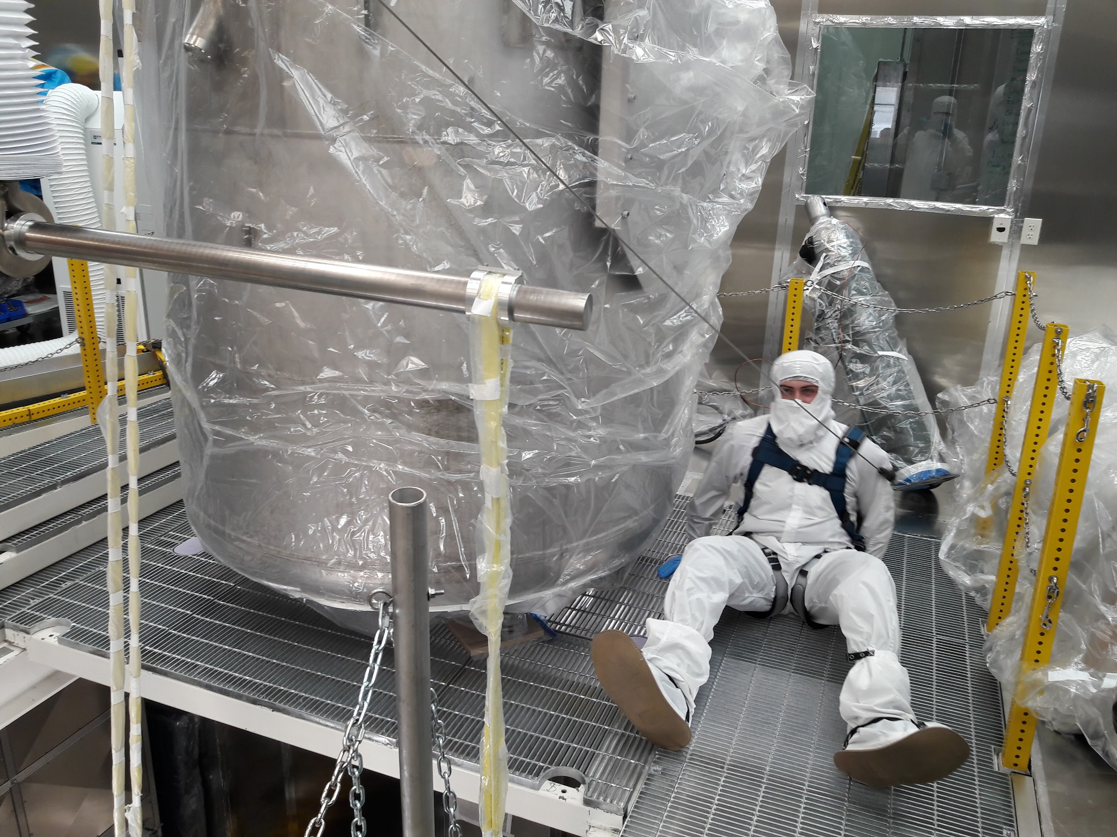
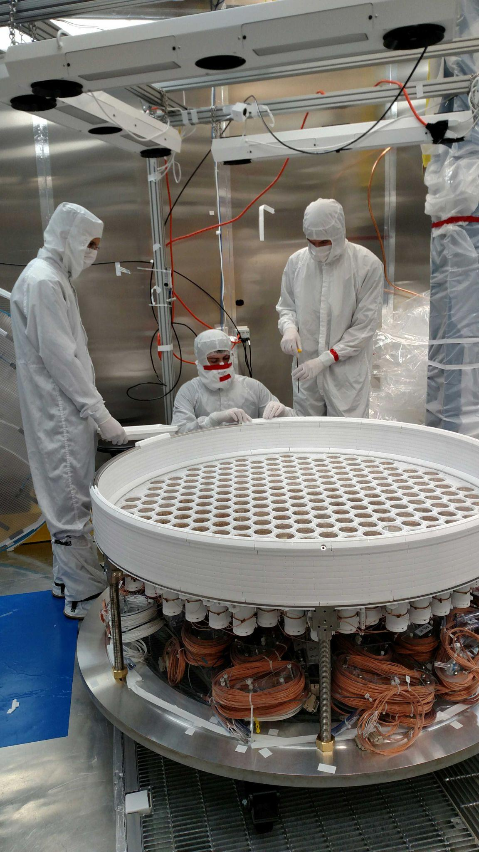
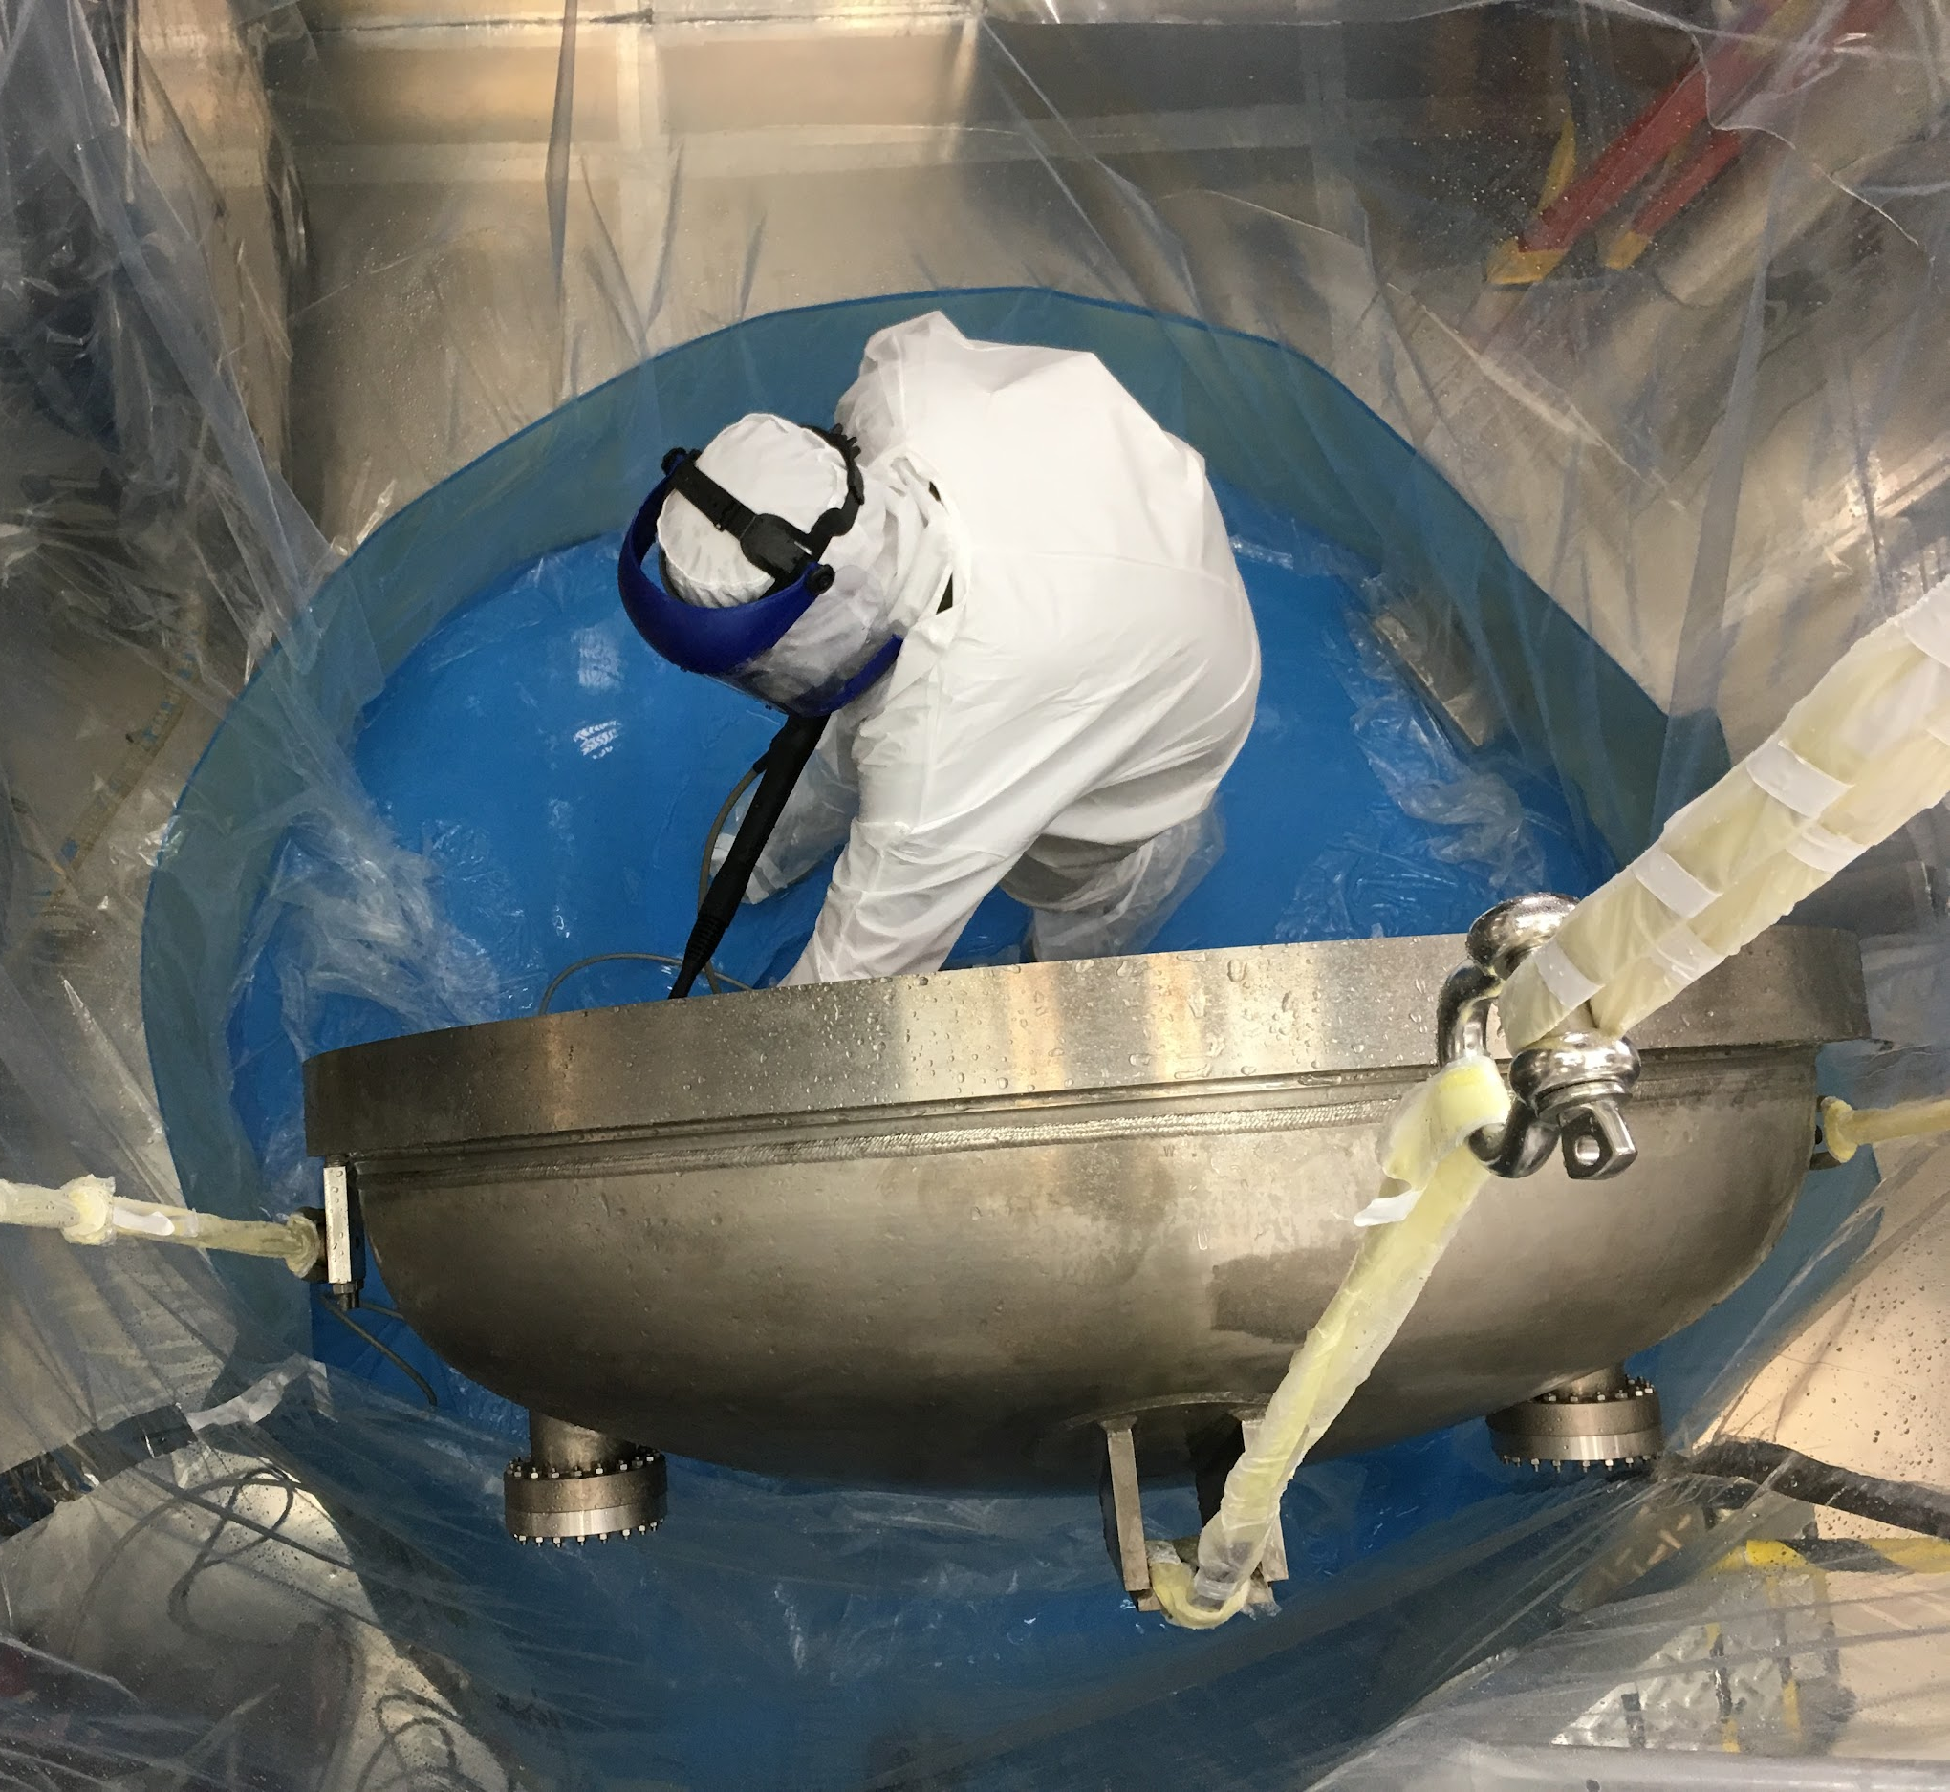
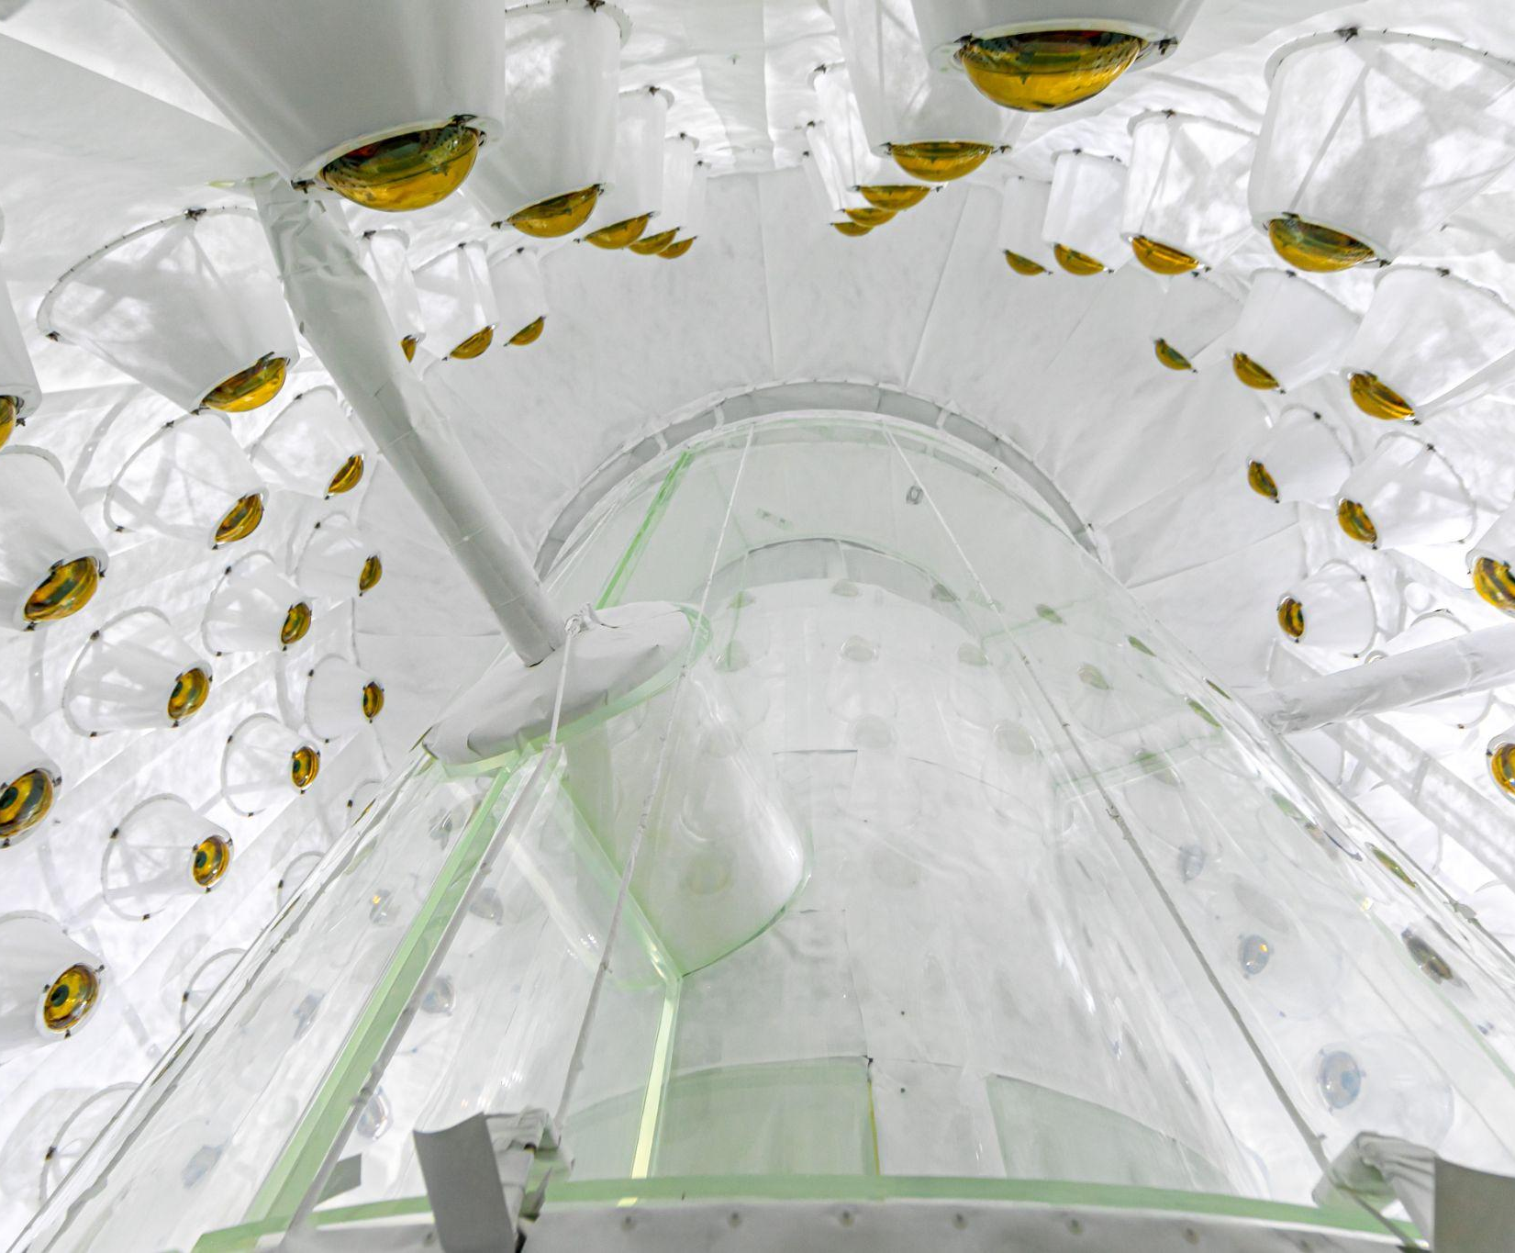
Image credits: Matt Kapust, SURF; and various LZ Collab members

Slide 5
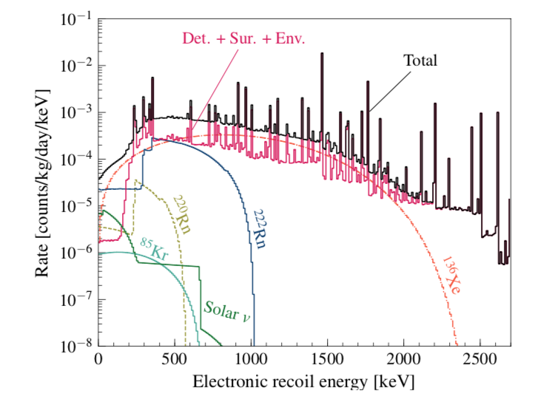
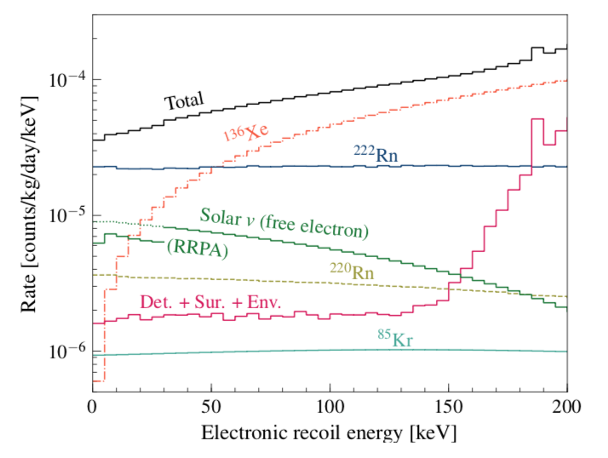
Signals and Backgrounds
One scientist’s background is another’s signal!
  Upper plot fuller range, lower plot zoomed in at low energies
  One individual’s “low energy” (DUNE) is another’s very high (us!)
If you make a direct dark matter detector big enough you start to become a decent neutrino experiment
  This is true for both electronic recoils (ER) and nuclear recoils (NR)
journals.aps.org/prd/abstract/10.1103/PhysRevD.101.052002
https://arxiv.org/pdf/1802.06039.pdf

Slide 6
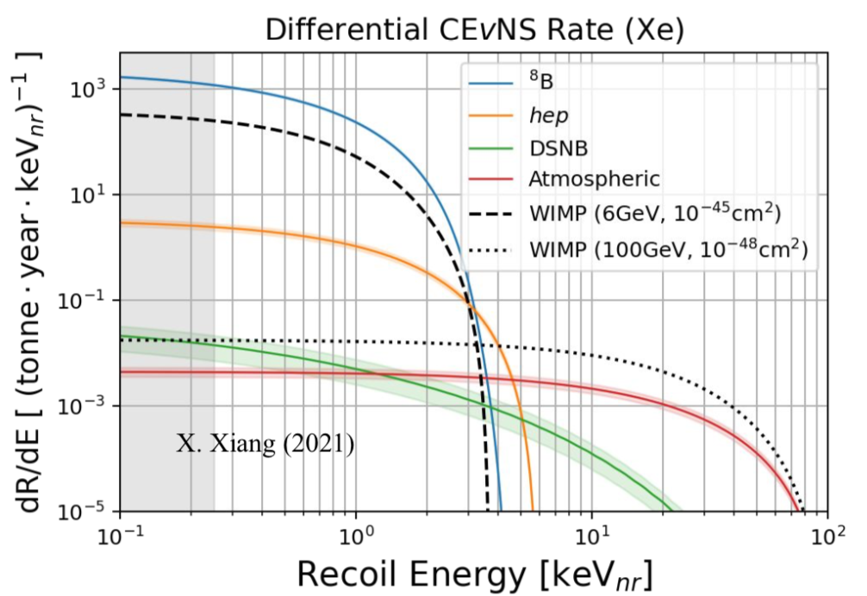
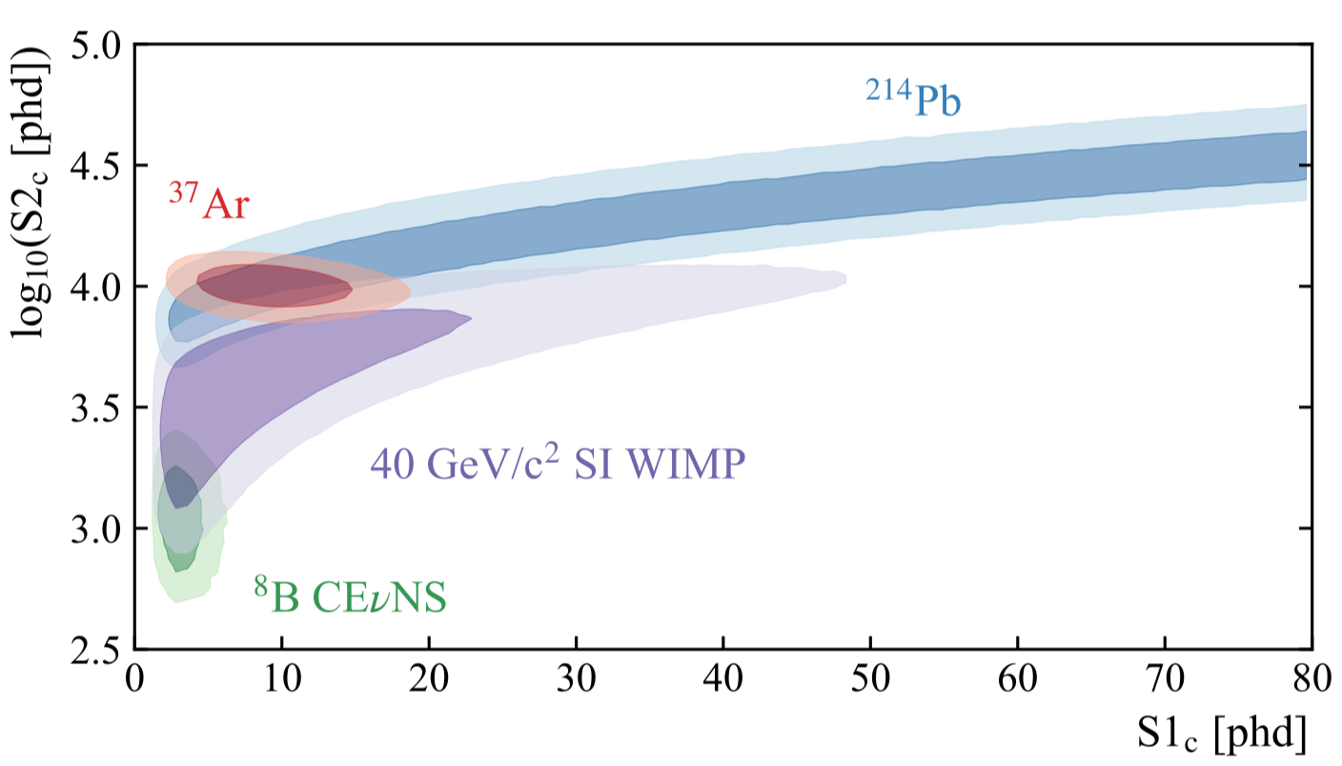
Boron-8 (⁸B)
Looks like low-mass WIMP (~6 GeV/c^2 in mass). hep there too
  In terms of its falling-exponential-like energy spectrum (of recoils)
  Looks very different (lower) than “standard NR band”
  Guaranteed new (physics) BG -- as we scaled up from LUX and ZEPLIN
Expecting ~40 ⁸B events in 1,000 live-days of LZ
  Exact number depends on thresholds, and charge and light yields
  Many more with “S2-only” analysis possible
Don’t confuse neutrino energies with Xe recoil energies (down to keV)
https://arxiv.org/pdf/2201.02858.pdf
(very separate from ER BGs)

Slide 7
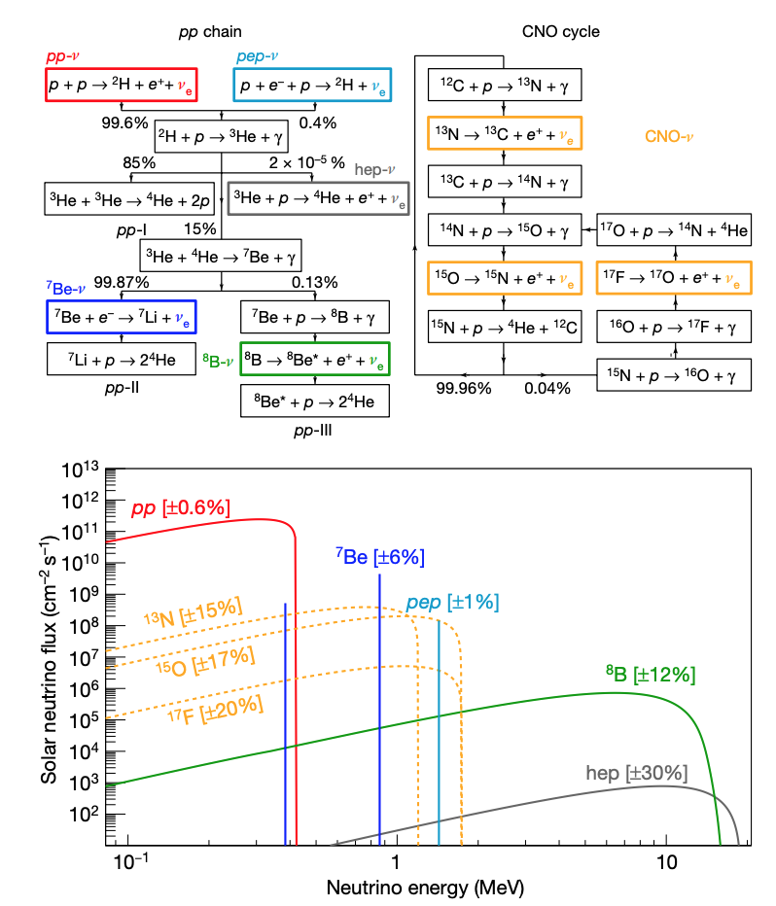
Standard Solar Cycle
Where are the Boron-8 neutrinos coming from?
Overview, left: https://www.nature.com/articles/s41586-018-0624-y.pdf (Figure 1)

Slide 8
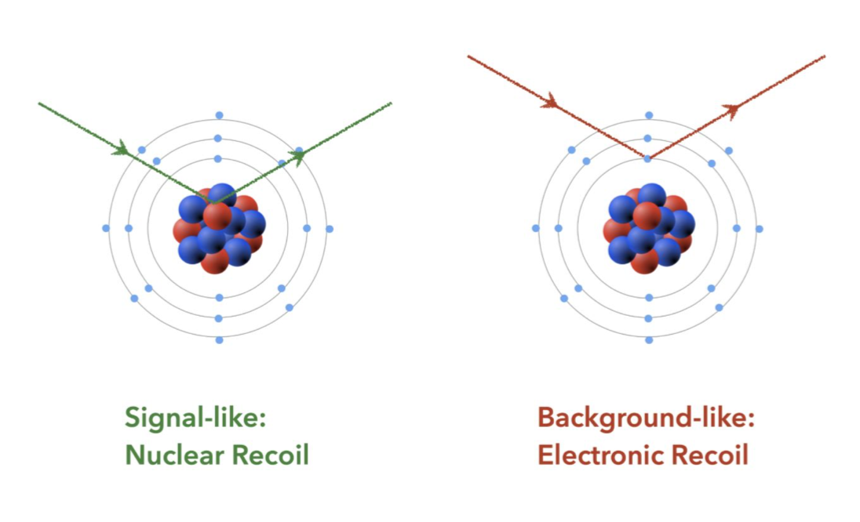
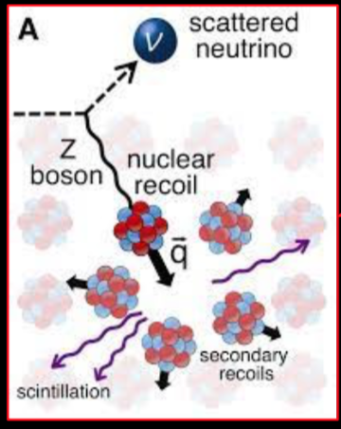
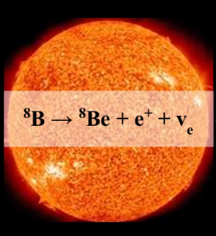
Solar Physics => Beyond Standard Model Physics
For ⁸B, CEvNS in general
Signal-like:
Nuclear Recoil
Background-like:
Electron(ic) Recoil
Discrimination of these very solid, and well understood: https://doi.org/10.1103/PhysRevD.102.112002
May be able to check solar model (how much of different kinds of nuclear fusion). Neutral current -> total ⁸B rate
As well as look for deviations from the Standard Model cross-section for CEvNS for ⁸B neutrinos in LXe and/or NSI (non-standard interactions)? Nuclear physics form factor ~1
  NSI from excess of events; light sterile neutrino from deficit
First, light & charge yield uncertainties must be addressed

Slide 9
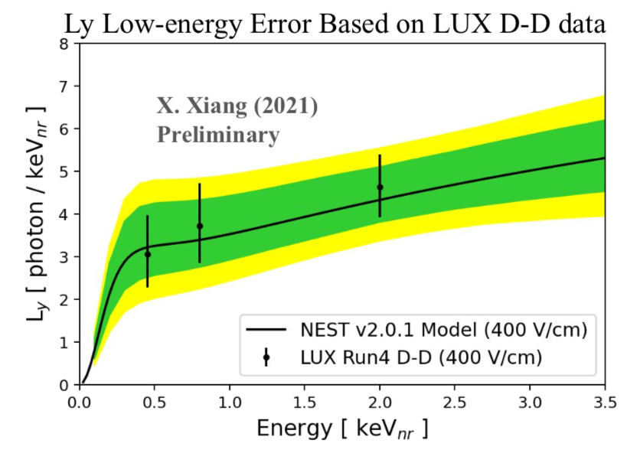
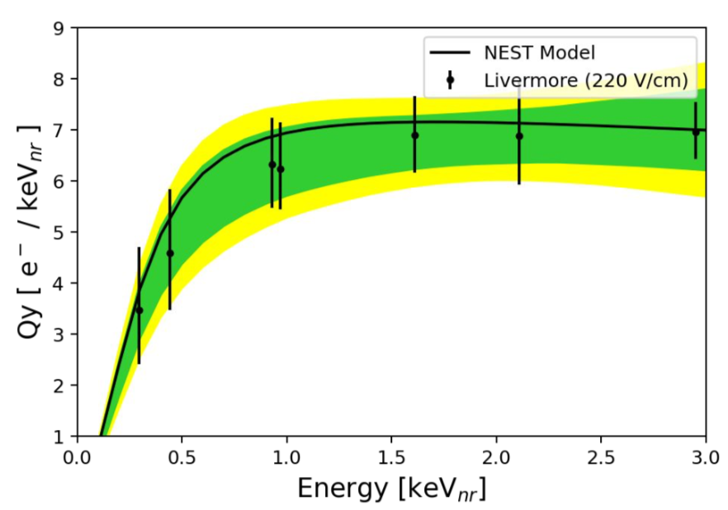
How Many Quanta?
⁸B neutrinos may provide “natural” constraint!
  Will have to disentangle from NSI-caused differences in flux
  Can combine with other calibrations for help (D-D, D reflector, H reflector, ⁸⁸YBe)
  4.4% uncertainty on the flux from SNO, Borexino
The biggest issue is light yield: the uncertainty at low E’s
  And what is the value period below 0.5 keV?
  Does it stay flat or go up? (unlikely, even if possible mathematically)
Other challenges: BGs
  Accidental coincidence (of rogue S1s and S2)
  Single/multiple-e-’s boiling out
~20% effect! on 8B rate (Preliminary: depends on PMT coincidence level)
better known, and secondary issue (6% effect)
What causes this turnover? Lindhard “quenching” taking over from growing e- escape prob as the energy goes to 0
https://doi.org/10.1103/PhysRevD.102.092004 (LUX)

Slide 10
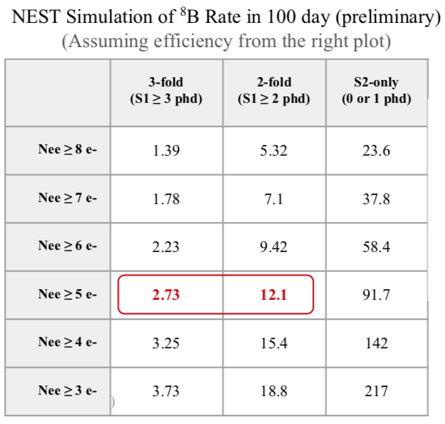
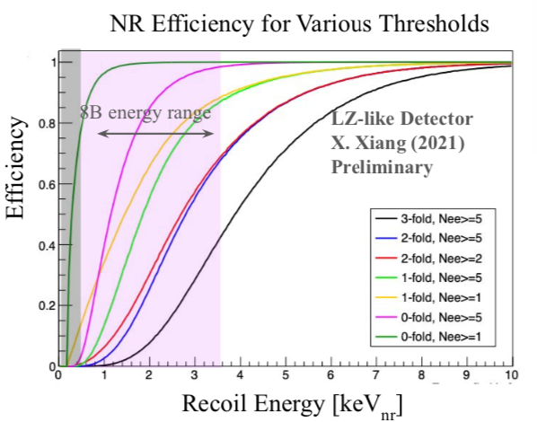
#Photons, Electrons => # ⁸B events in LZ
lower plot)
Catching only the tail end of 8B bubbling up above the nominal threshold of few keV (NR)
Nevertheless, a discovery and measurement is practically inevitable, given LZ’s planned run time (at least 1,000 live-days)
“Tricks” we can play
  Lower PMT coincidence if only for part of detector and/or temporarily
  Much more: https://doi.org/10.1103/PhysRevLett.122.131301, https://journals.aps.org/prd/abstract/10.1103/PhysRevD.101.042001, https://arxiv.org/abs/1904.08979, https://journals.aps.org/prd/abstract/10.1103/PhysRevD.104.012011, https://arxiv.org/abs/2101.08753
2PE effect => 1 S1, light-element doping (to lower the threshold, not increase cross-section: Hugh Lippincott, HydroX), Migdal effect, ionization-channel-only searches, machine learning, et al.

Slide 11
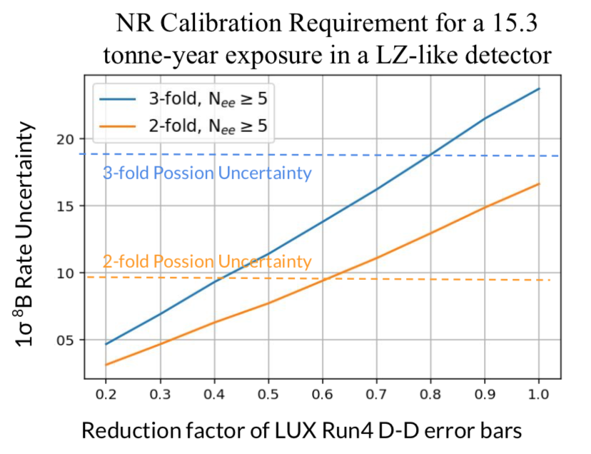
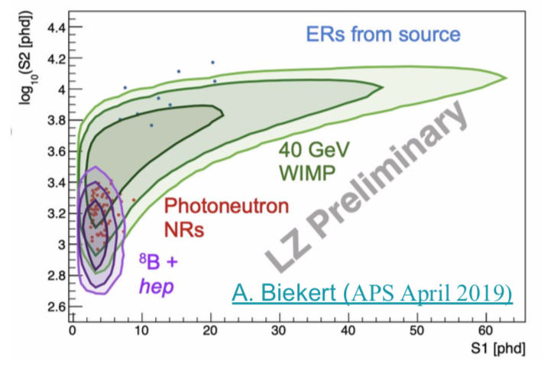
Sources of Uncertainties
Last slide was all averages or expectation values
Need to beat down both the statistical uncertainties and systematics
  Latter includes the intrinsic uncertainties from calibration: see right plot
  More calibrations (like more D-D, so just more stats/events) but also more diverse types
Poisson fluctuations for small counts, on top of being at tail of (not perfect Gaussian) distribution
Xin Xiang, Brown U., LZ

Slide 12
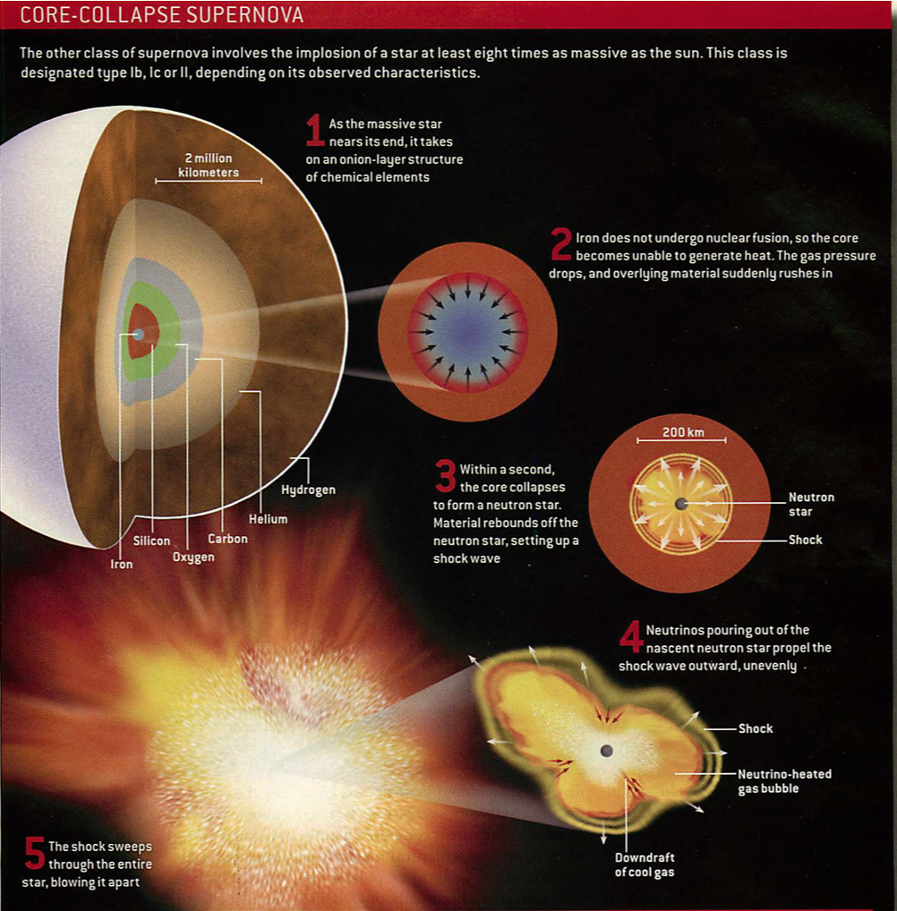
Switching Gears to Different Stars:
Boom!
Scientific American, 2006
Neutronization spike
  Useful for multilateration
Possible black hole formation (vs. neutron star: mass dependent)

Slide 13
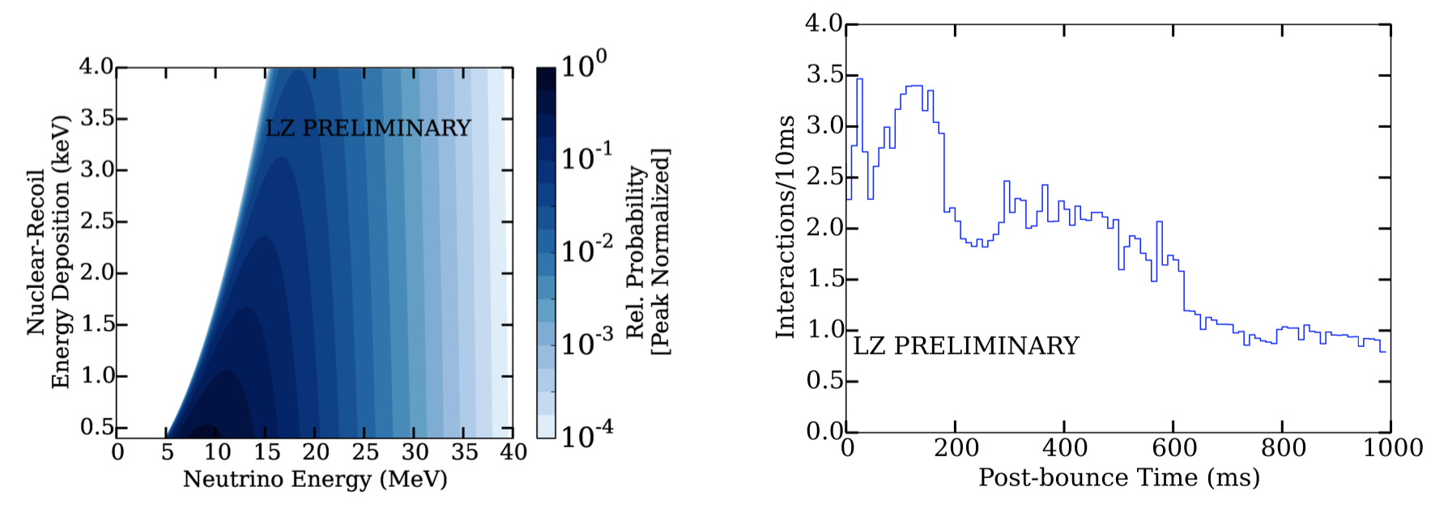
Core-Collapse Supernova Explosion
(Left) The relative probability distribution for a neutrino energy deposition in LXe. We present the case where the incident neutrino flux has an average E of 10 MeV and a spectral profile from the accretion phase.
(Right) The expected neutrino interaction rate in LZ from a 27 solar-mass supernova (SN) at 10 kpc assuming a detection energy threshold of 0.5 keV (aggressive). About 184 ± 13 ν interactions are expected in the first second and 357 ± 19 in total.
https://iopscience.iop.org/article/10.1088/1748-0221/13/02/C02024

Slide 14
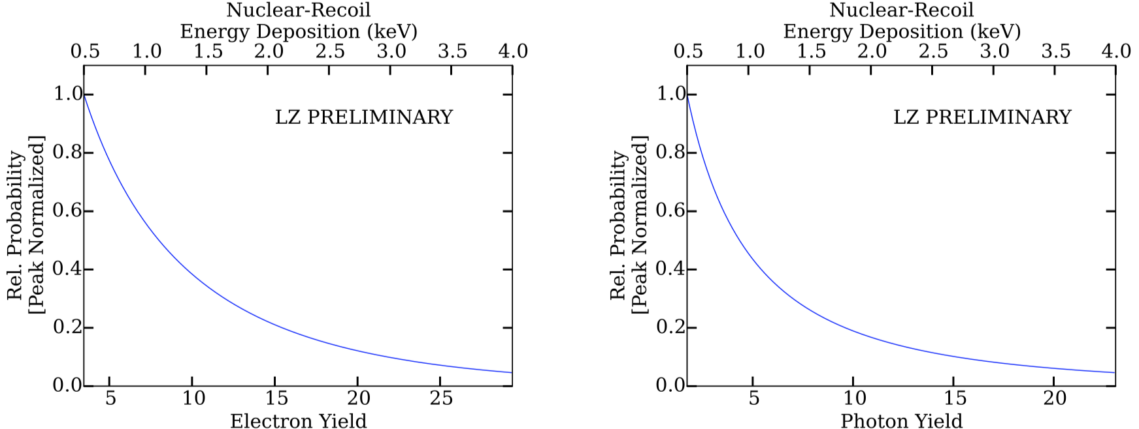
Supernova Neutrino Signal in LZ
The e⁻ (Left) and photon (Right) yields, predicted by NEST (taking mean yields models at face value sans errors, fluctuations) for an incident ν spectrum with an average E=10 MeV and spectral profile from the accretion phase.
Just like in DUNE, right at threshold, but many orders of magnitude lower in energy. (A unique window on SNs?)
S2-only analysis will likely be very useful, depending on BGs from grid wires
https://arxiv.org/pdf/1801.05651.pdf
Dev Khaitan, Rochester

Slide 15
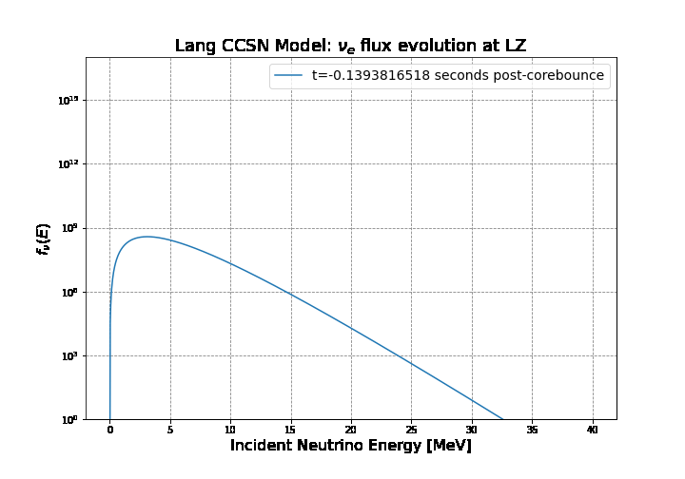
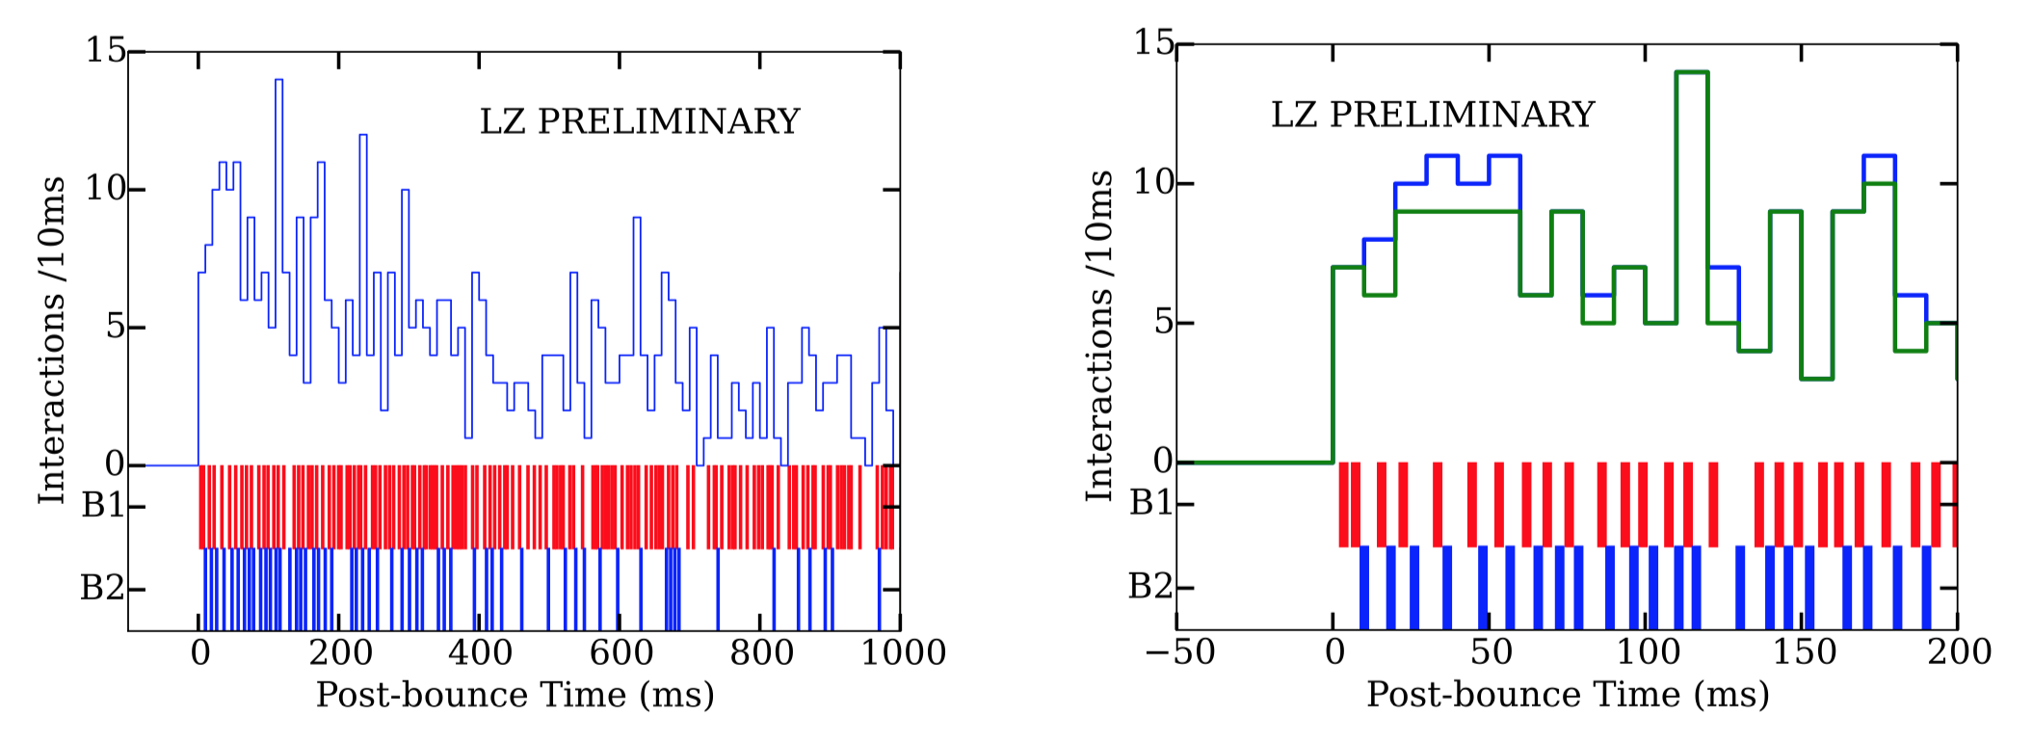
Time Profile for Sim SN Event in LZ
Animated gif (PPT file only)
Elise McCarthy, Rochester
Below the profile the bands indicated by ‘B1’ & ‘B2’ indicate the times when DAQ Buffer #1 and DAQ Buffer #2 were active
(Left) For the 1 s of the event shown, there were 42 background interactions and 447 neutrino interactions, and 470 out of the 489 total # of interactions were recorded
(Right) A zoom in on the first 200 ms of the trigger time analysis that indicates the total number of interactions (blue) and those that were recorded (green). It is during this phase of the SN that most of the neutrino interactions are missed.

Slide 16
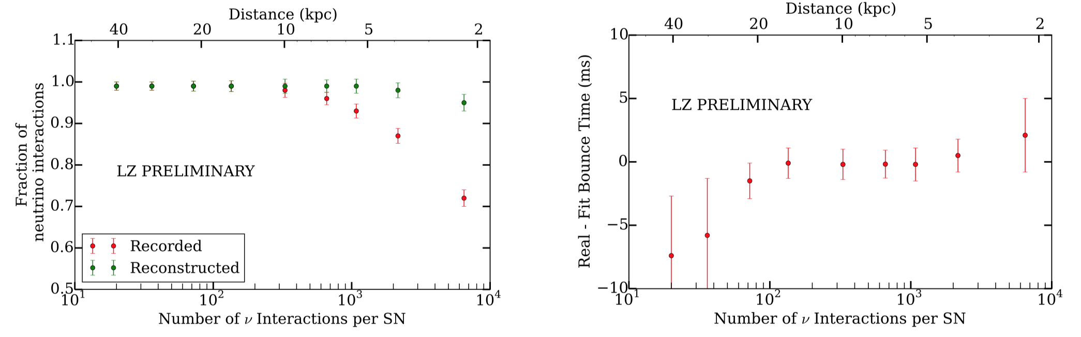
Conclusions on Supernovae
(Left) Fraction of recorded (red) and reconstructed (green) neutrino interactions. This fraction is presented versus number of neutrino interactions and distance from a 27 solar-mass SN (Betelgeuse 11 solar masses, 0.2 kpc away)
(Right) Recon bounce t of SN. The error bars in both plots indicate the statistical error associated with the simulated population. (Note 1987a was 51.4 kpc, ~20 solar mass)
LZ is part of SNEWS. (Perhaps we are “due” for a SN?? :)

Slide 17
Atmospheric Neutrinos, Inside the “Fog”
<= Boron-8
But what is the rest of this orange stuff here??

Slide 18
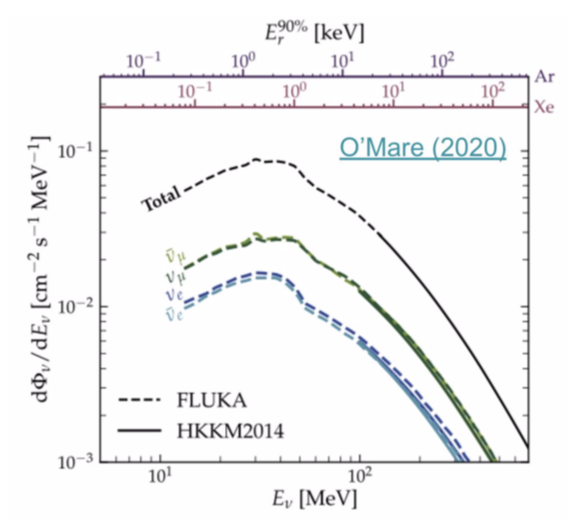
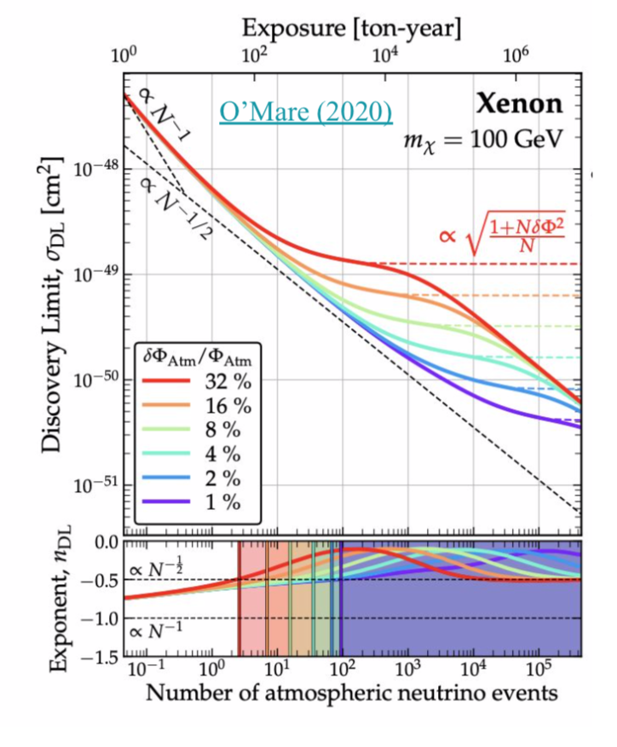
Atm. ν Uncertainty
Currently 20% @neutrino energies < 0.1 GeV (or 15% for < 1 GeV overall)
  Theory (journals.aps.org/prd/abstract/10.1103/PhysRevD.83.123001). No measurements (sub-GeV)
Future constraints: DUNE, HyperK, JUNO, others

Slide 19
Summary
LZ does more than just WIMPs, and does more than just dark matter (direct detection) in general
  Two-phase (primarily liquid) Xenon TPC
CEνNS
  Boron-8 from the Sun and supernova neutrino bursts from core-collapse supernovae
  Atmospheric neutrinos within the fog or floor
Coherent neutrino scattering in LZ useful for many different kinds of physics -- from nuclei and atoms to the Sun and supergiant stars
Future (G3?) pp solar, CNO (charge current), hep

Slide 20

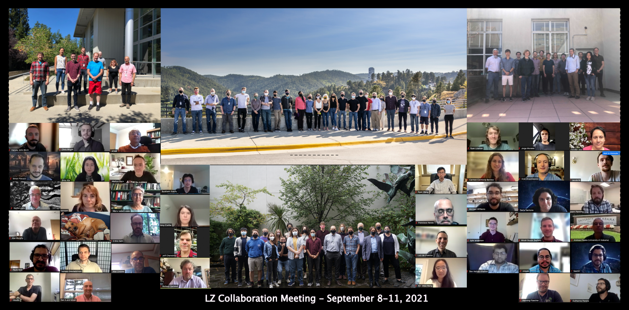





LZ (LUX-ZEPLIN) Collaboration
35 Institutions: 250 scientists, engineers, and technical staff
@lzdarkmatter
Black Hills State University
Brandeis University
Brookhaven National Laboratory
Brown University
Center for Underground Physics
Edinburgh University
Fermi National Accelerator Lab.
Imperial College London
Lawrence Berkeley National Lab.
Lawrence Livermore National Lab.
LIP Coimbra
Northwestern University
Pennsylvania State University
Royal Holloway University of London
SLAC National Accelerator Lab.
South Dakota School of Mines & Tech
South Dakota Science & Technology Auth.
STFC Rutherford Appleton Lab.
Texas A&M University
University at Albany, SUNY
University of Alabama
University of Bristol
University College London
University of California Berkeley
University of California Davis
University of California Los Angeles
University of California Santa Barbara
University of Liverpool
University of Maryland
University of Massachusetts, Amherst
University of Michigan
University of Oxford
University of Rochester
University of Sheffield
University of Wisconsin, Madison
US UK Portugal Korea
https://lz.lbl.gov/
(here today!)
me!
Thanks to our sponsors and participating institutions!
U.S. Department of Energy Office of Science

Slide 21
Backup

Slide 22
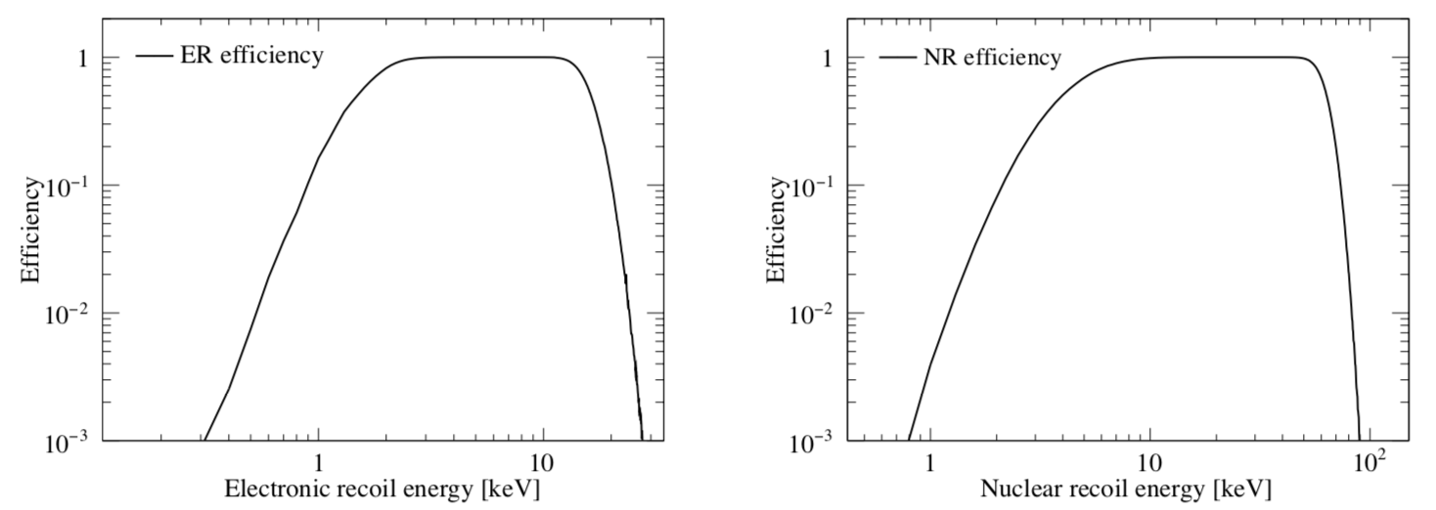
LZ (Projected, Simulated) Efficiencies

Slide 23
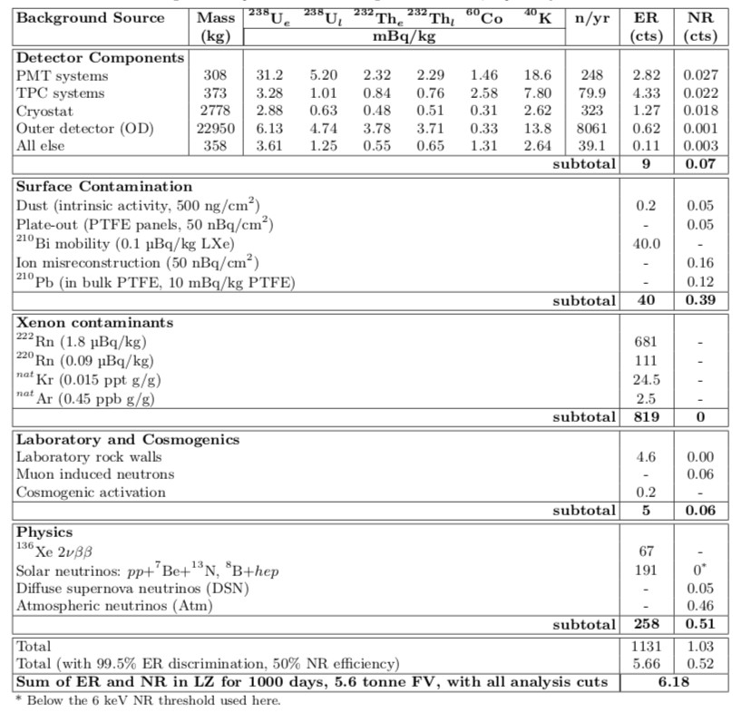
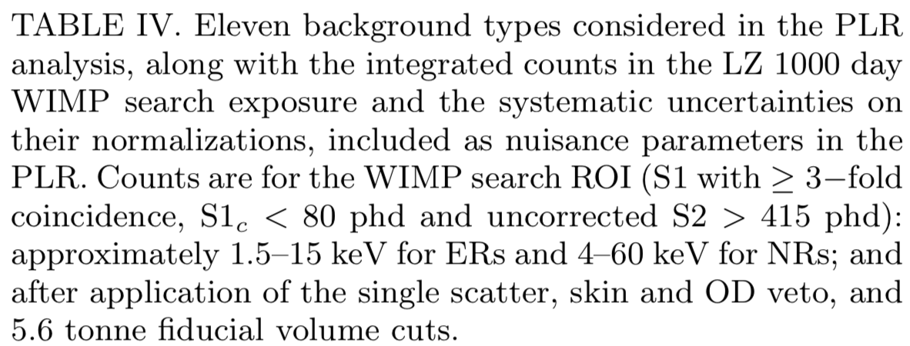
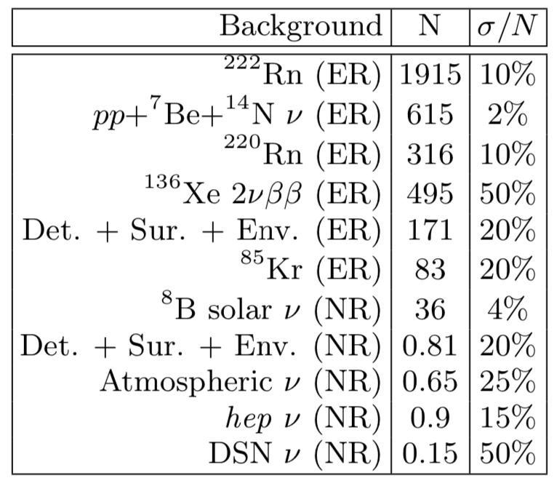
Backgrounds

Slide 24
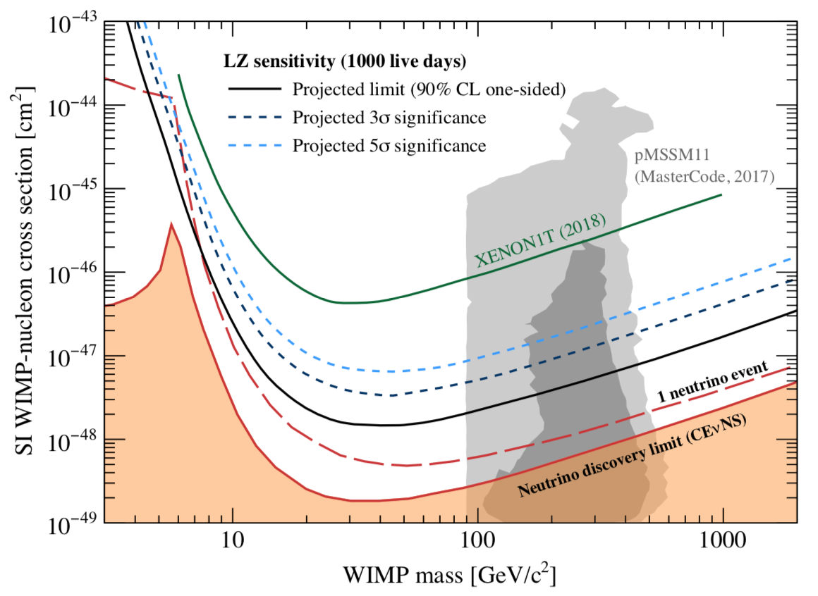
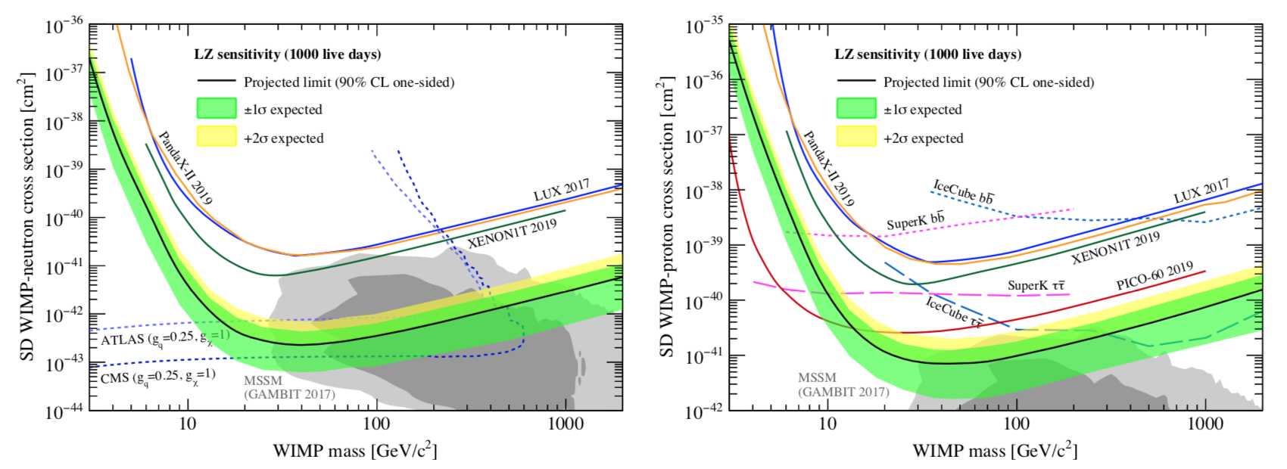
Discovery Potential, SD Sensitivities
(above “limit” of course)
(EFT operator searches also possible)

Slide 25
DC = Dark Count

