Slide 1
Omnitrophota encompasses diverse and hyperactive nanobacteria within SURF and beyond: Putative metabolic traits and host-dependent lifestyles
Brian P. Hedlund (UNLV)
SURF, South Dakota

Slide 2
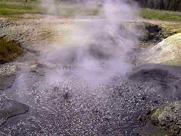
Revised bacterial tree
Obsidian Pool
Photo credits: Yellowstone RCN

Slide 3
Ca. Omnitrophus
Full-sized coccus, magnetic, sulfur-oxidizer (dsr), nitrogen-fixer (nif), autotroph (rTCA)
Est. 3.4 Mb genome
Candidatus Omnitrophus
magneticus SKK-01
Mangetosomes
Elemental sulfur

Slide 4
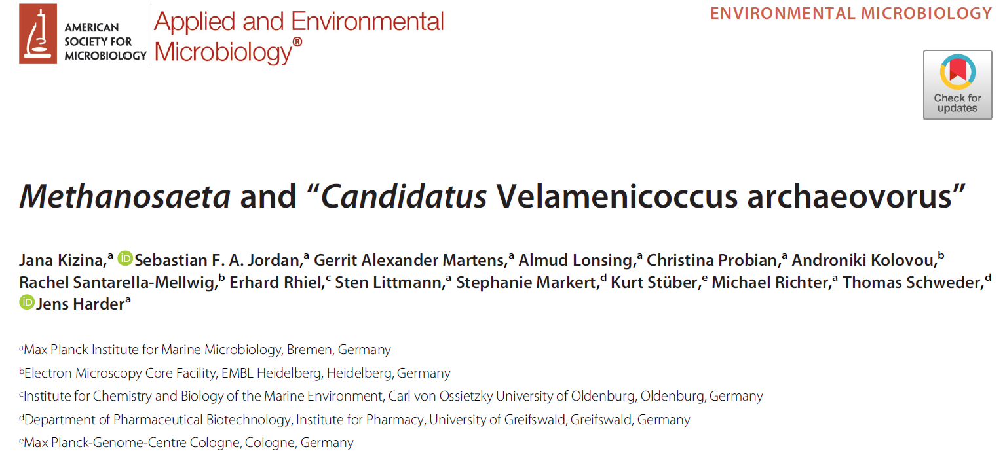
Limonene-degrading methanogenic culture started 1999
DIC
Candidatus Velamenicoccus archaeovorus & Methanosaeta
Infected Methanosaeta filament
Arch rRNA DAPI Lipid

Slide 5
Ca. Velamenicoccus
200-300 nm nanobacteria, 1.97 Mb genome
Epibiont of archaea and bacteria – kills some hosts (e.g., Methanosaeta)
Stimulated by contact with host
39,678 AA surface protein (44 domains) overexpressed in attached cells (coat/velamen?)
Degradation of host cell polysaccharides (LPS?)
Predicted homoacetogen
Infected Methanosaeta filament
Methanosaeta DAPI
Ca. Velamenicoccus

Slide 6
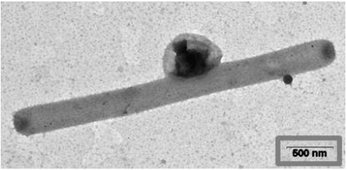
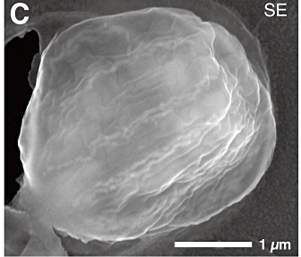
Study Objectives
Wikicommons
Systematics: Expand Omnitrophota genomic datasets (phylogeny/taxonomy)
Ecology: Where do they live?
Parasitism/predation: (i) cell size; (ii) genomic features; (iii) “hyperactivity”
Metabolism: Catabolic strategy
vs

Slide 7
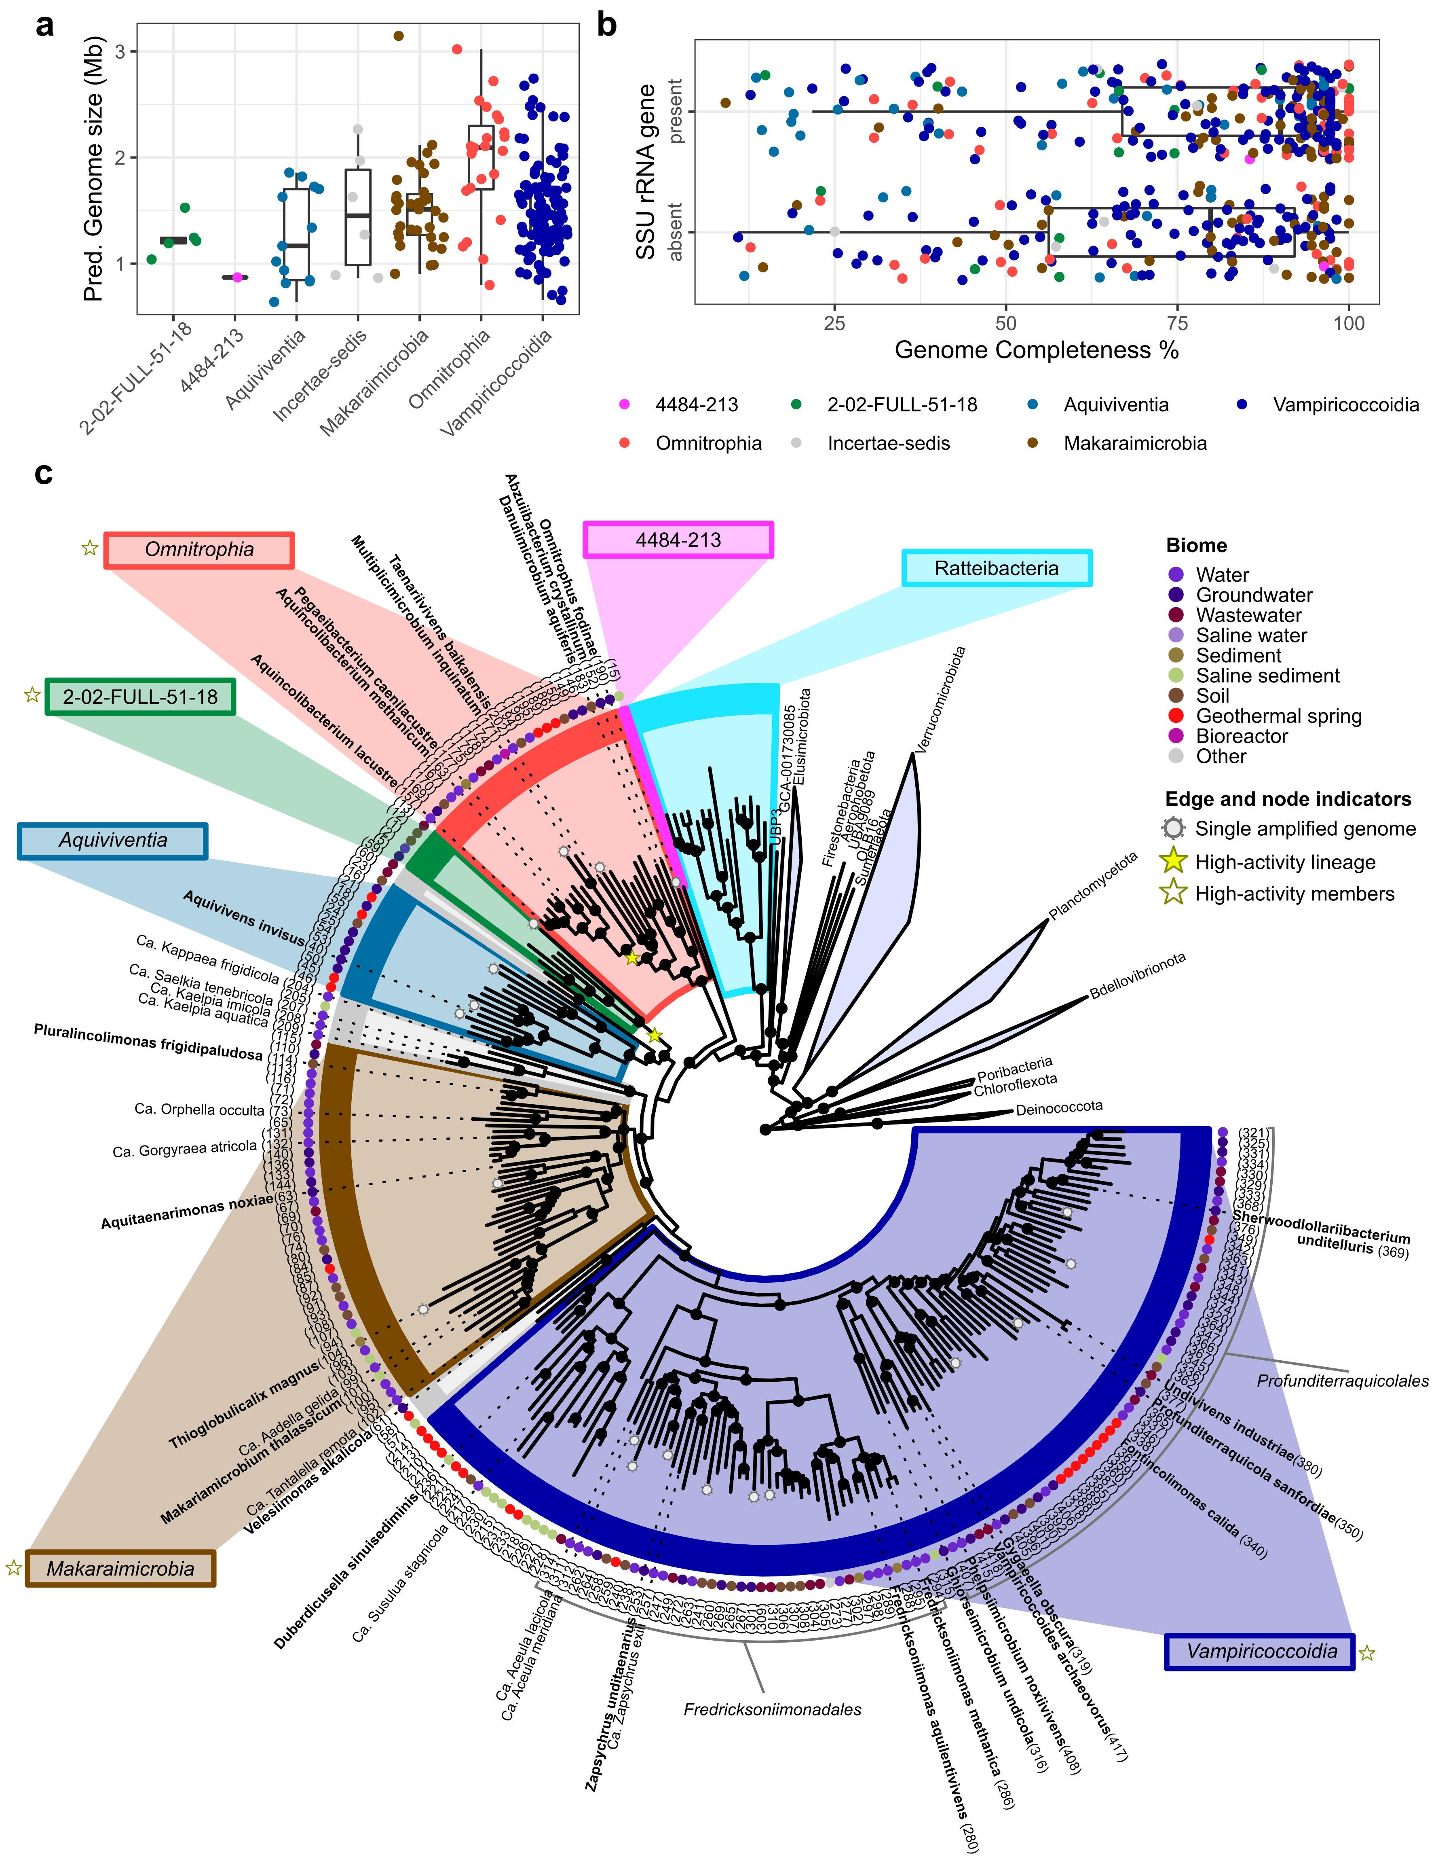
Genomic Expansion & Systematics
Overview & systematics
421 genomes, 276 species (95% ANI), 6 classes
(Rejected GTDB class Kol11 based on lack of monophyly)
346 Metagenome-assembled genomes (MAGs)
75 Single-amplified genomes (SAGs)
Small genomes (most <2 Mb)

Slide 8
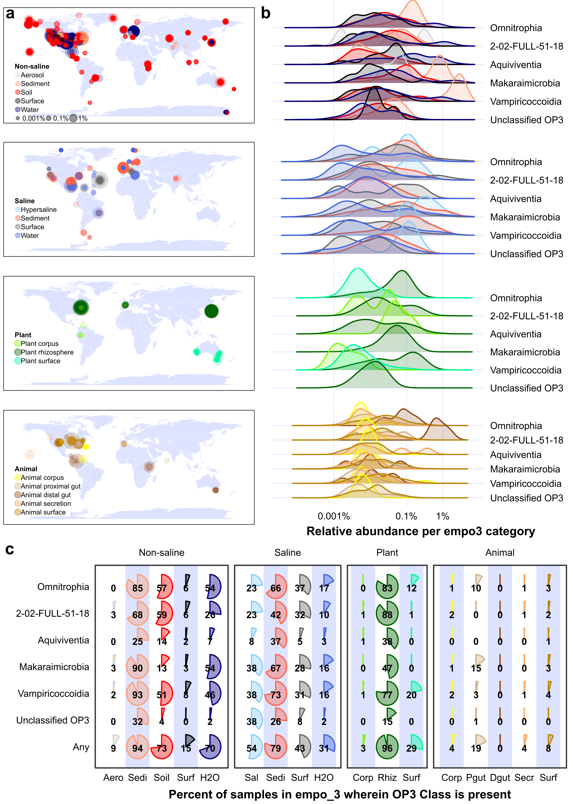
Ecology
Distribution & abundance
Built Silva classifier with 16S rRNA genes from genomes
Searched Earth Microbiome Project (>25,000 samples)
Prevalence: 65%
Favorite habitats: Sediments (94%) and rhizosphere soils (96%)

Slide 9
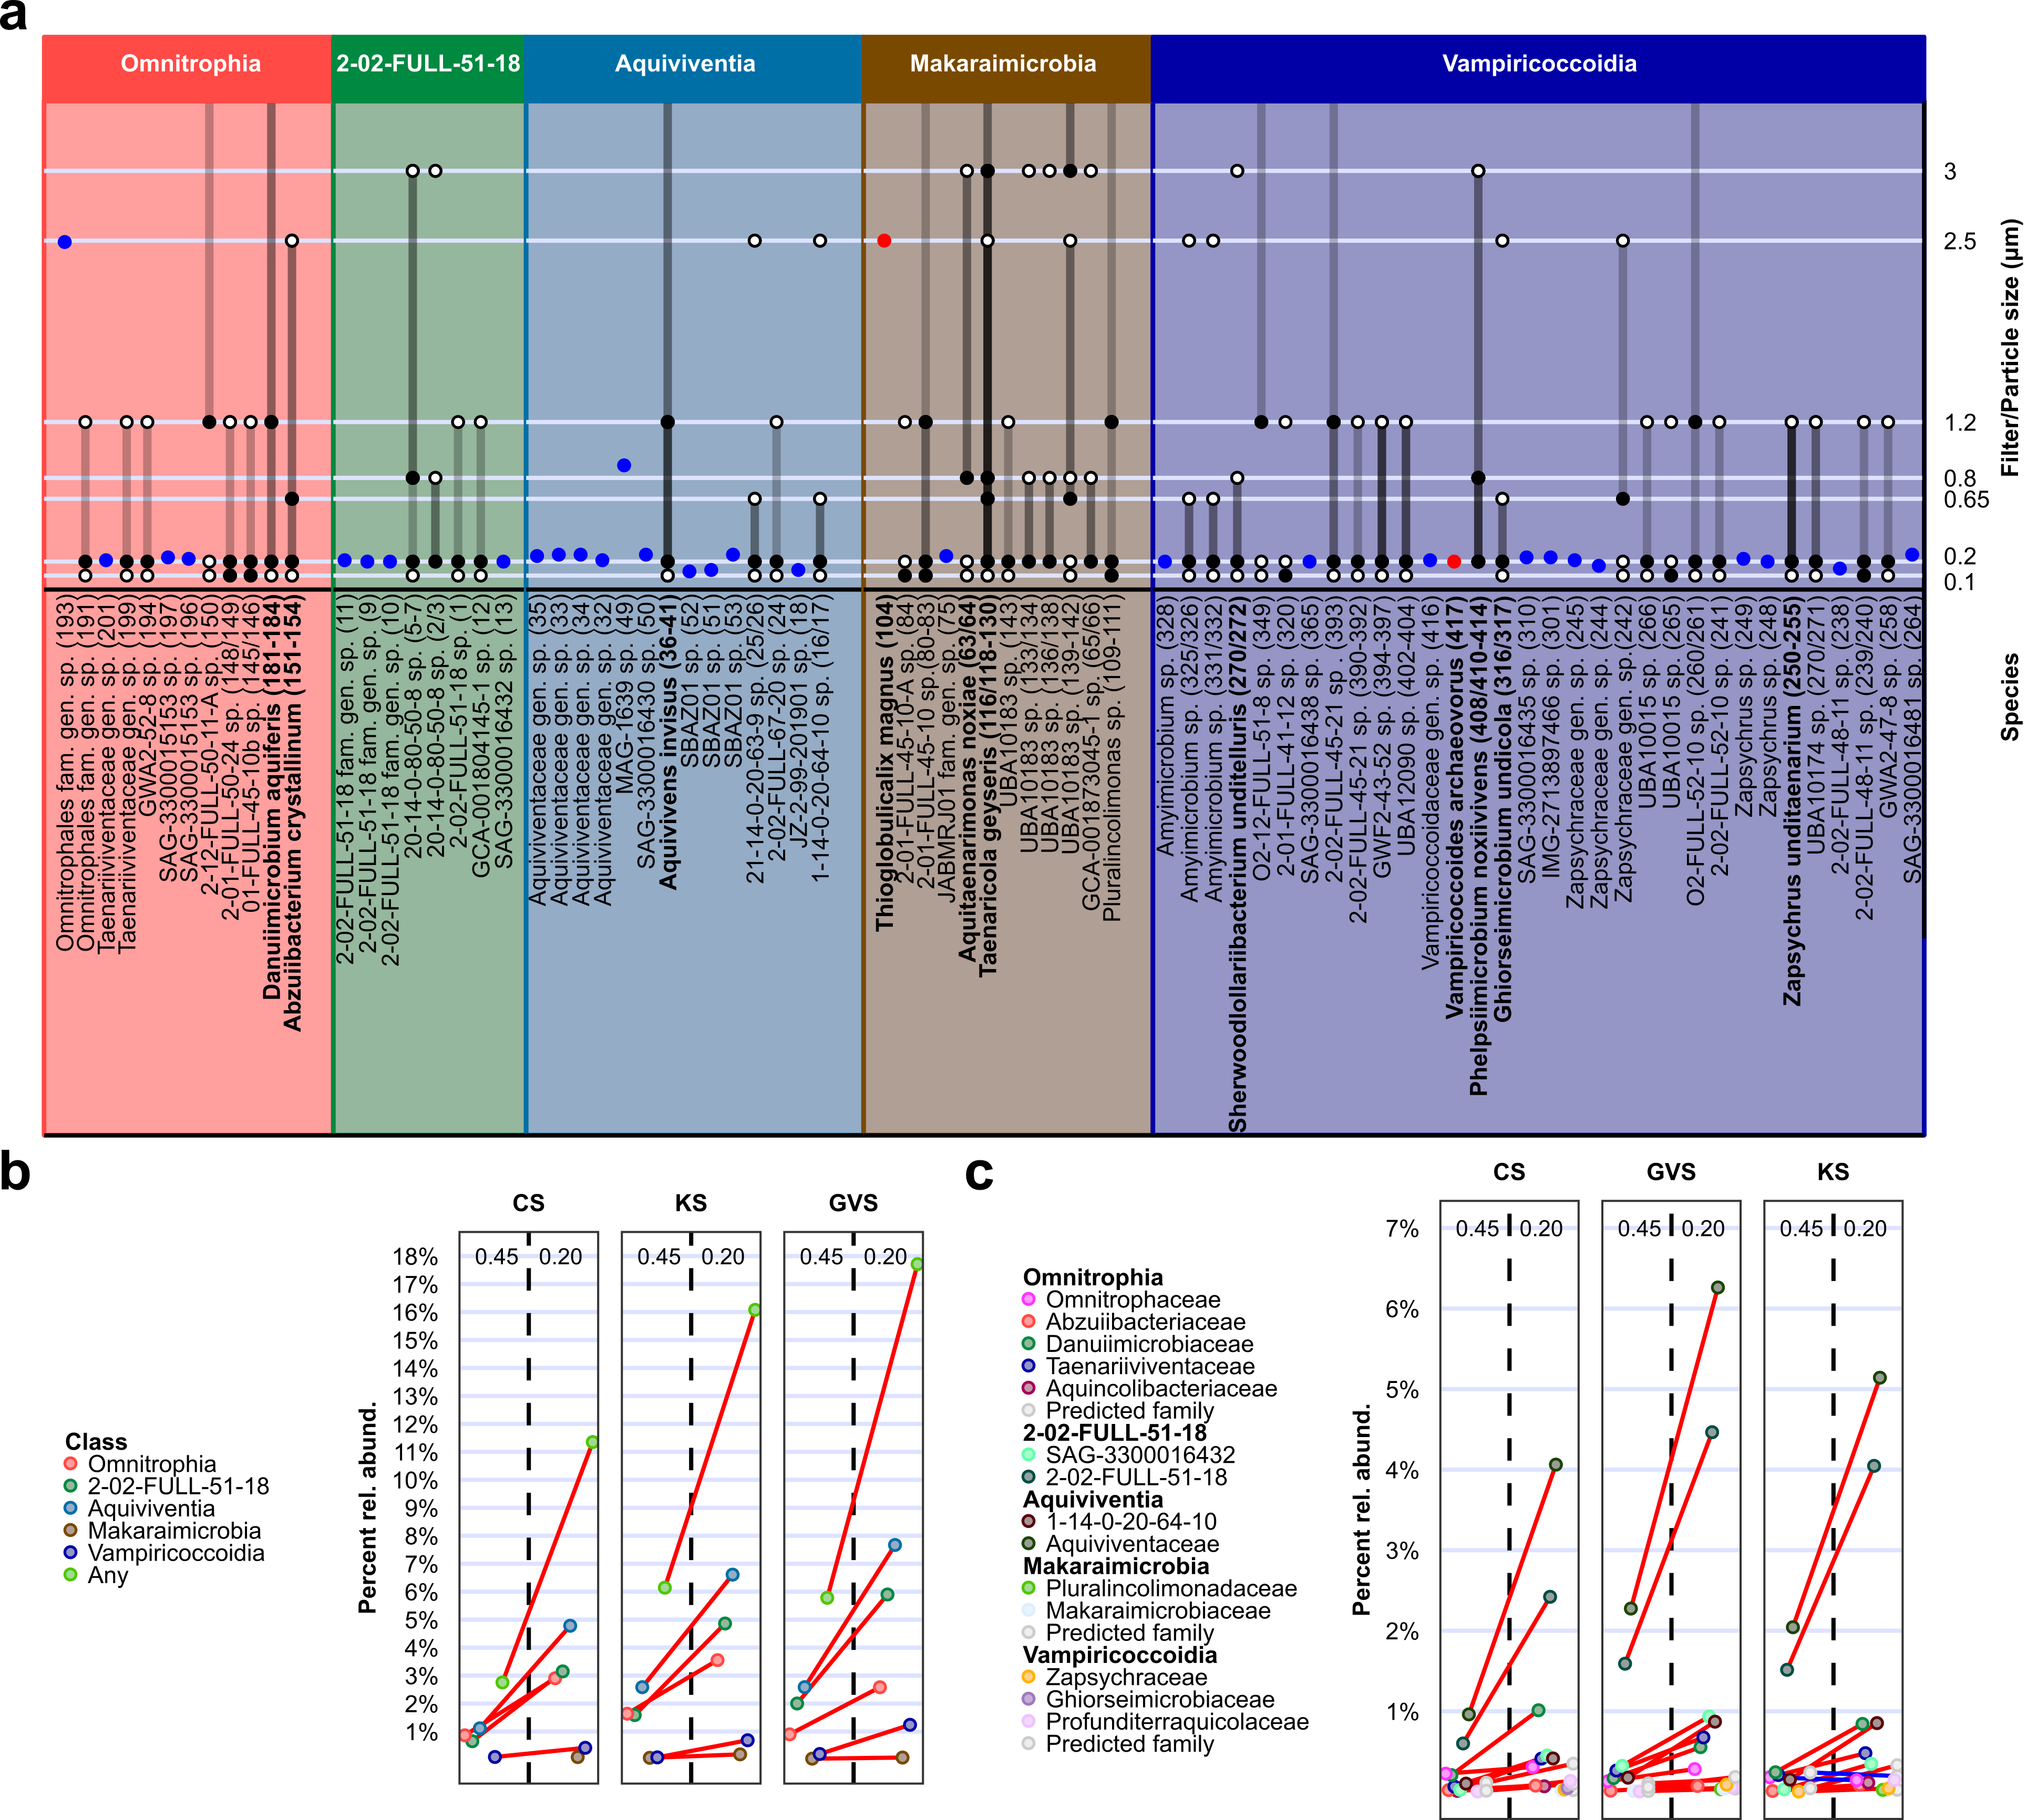
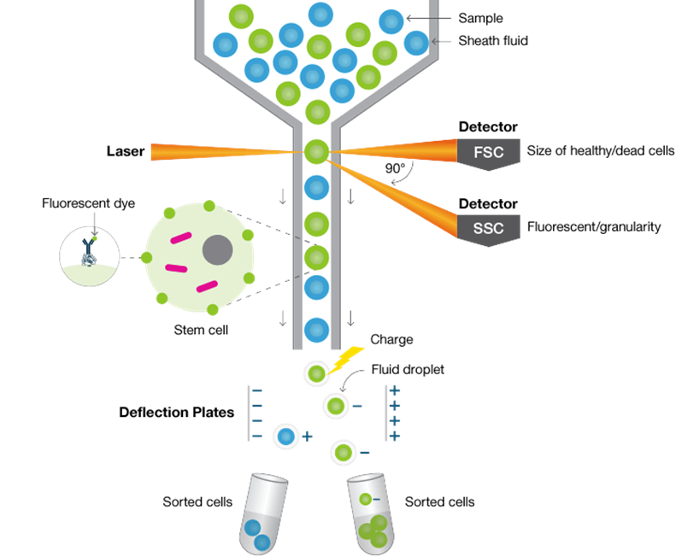
Parasitism/
predation
(cell size)
Biorad
Multiple lines of evidence
Single-cell genomics (size estimated during FACS; blue – R. Stepanauskas)

Slide 10
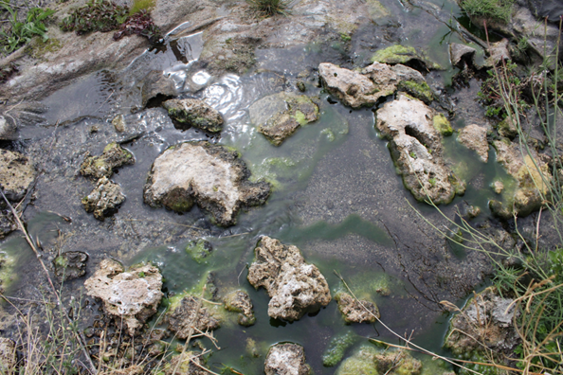
Parasitism/predation
(cell size)
Tandem filtration (Ariel Friel)
Kiup Spring (Ariel Friel)
Multiple lines of evidence
Single-cell genomics (size estimated during FACS; blue – R. Stepanauskas)
Metagenomics (size estimated by differential size filtration; grey – J. Banfield)
16S rRNA gene amplicons (size estimated by differential size filtration; also noted by Proctor et al., 2018)
Most cells <450 nm (larger in Makariamicrobia)

Slide 11
Parasitism/predation
(genomic features)
Surface motility
Genomic whiffs of symbiosis
Surface motility: Mycoplasma-like system used on euk. cells (also in Ca. Dependentiae & Ca. Saccharimonadia)
Tight adherence
Attachment?
ATP stealing

Slide 12
Obligate predators
Facultative predators
Wikicommons
“Hyperactivity” based on ¹⁸O and ¹³C uptake (DNA qSIP)

Slide 13
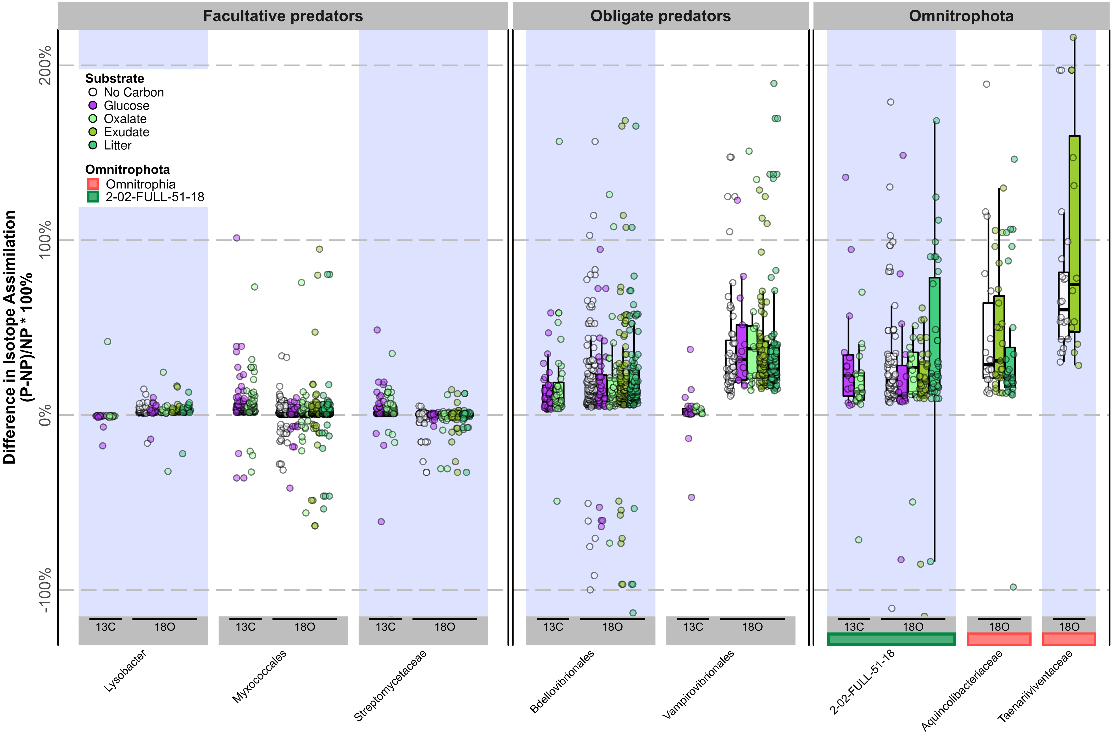
Parasitism/predation
(“Hyperactivity”)
Hyperactivity
Omnitrophia & 2-02-FULL-51-18 (also Black Sea sediments: Makariamicrobia & Velamenicoccia (Souminen et al., 2021))
Other classes absent/rare in soils

Slide 14
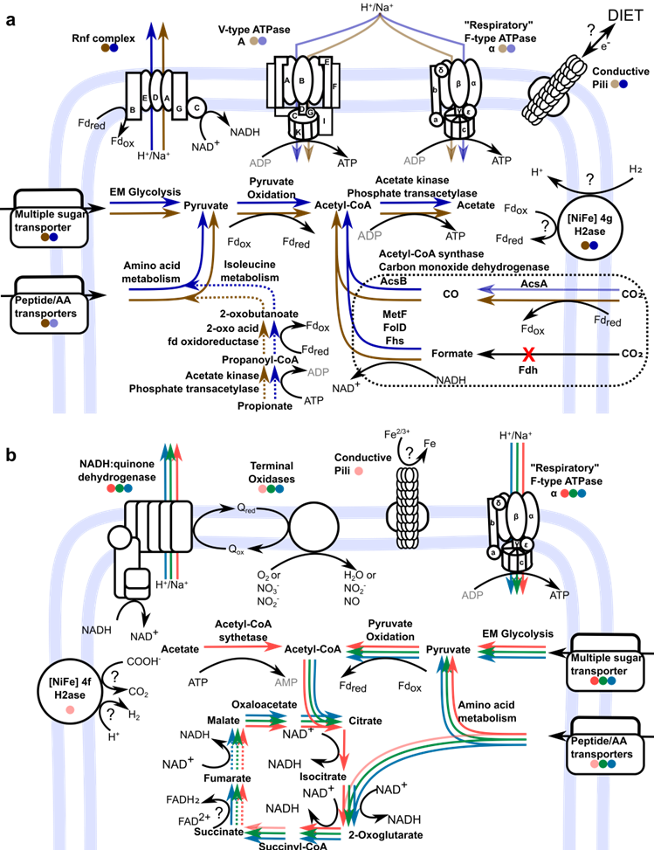
Metabolism
Catabolic strategy
Strictly anaerobic acetogens: Makariamicrobia & Velamenicoccia
Diverse respirations (most facultative anaerobes): Omnitrophia, Aquiviventia, 2-02-Full-51-18
All have catabolic & anabolic capacity (missing genes poorly characterized)

Slide 15
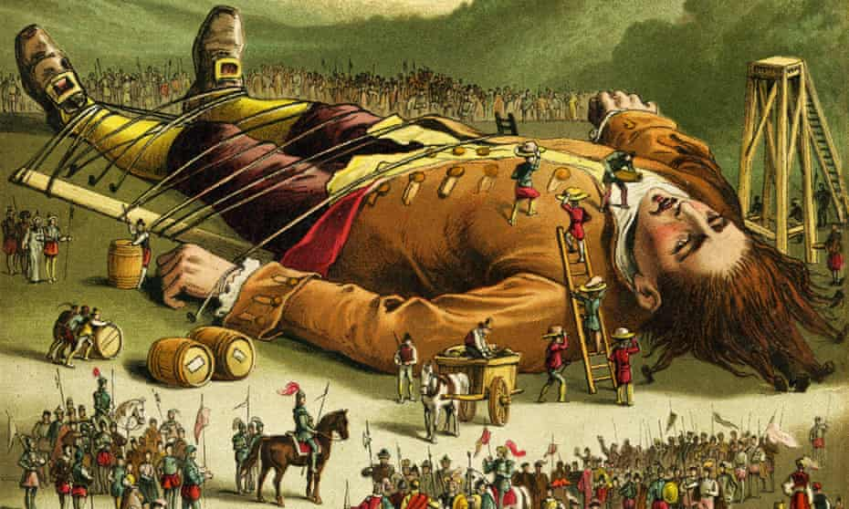
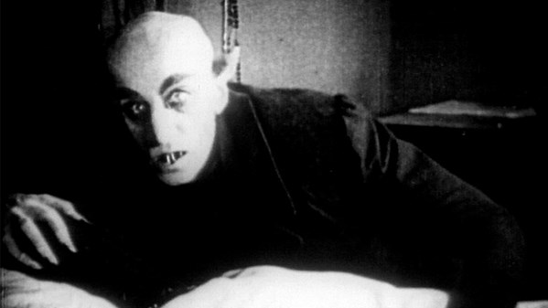
Study Objectives
Wikicommons
Wikicommons
Systematics: Expand Omnitrophota genomic datasets (phylogeny/taxonomy)
Ecology: Where do they live?
Parasitism/predation: (i) cell size; (ii) genomic features; (iii) “hyperactivity”
Metabolism: Catabolic strategy
vs
Nosferatu (1922)

Slide 16
