Slide 1
Geotechnical Monitoring and structural support as part of the lbnf project
Presented by:
Brett E Belzer
Staff consultant, Rock Mechanics
2022

Slide 2
Presentation overview
Pre excavation phase of the LBNF project
Third party testing
Noise and Vibration Monitoring
Main excavation phase of the lbnf project
Geotechnical monitoring
Multiple point borehole extensometers
Inclinometers
Seismographs
Data Acquisition
Structural Support Tasks

Slide 3
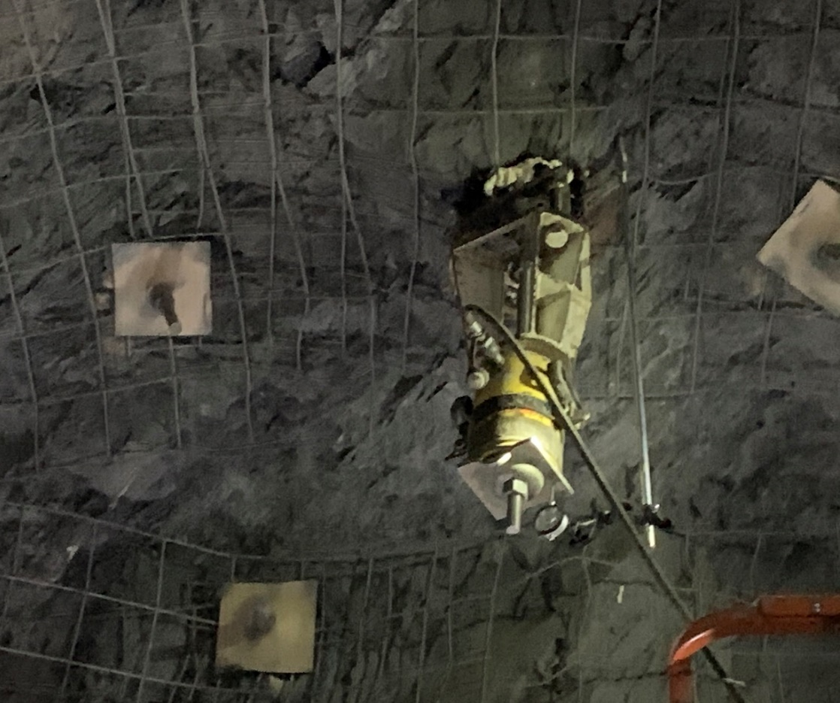
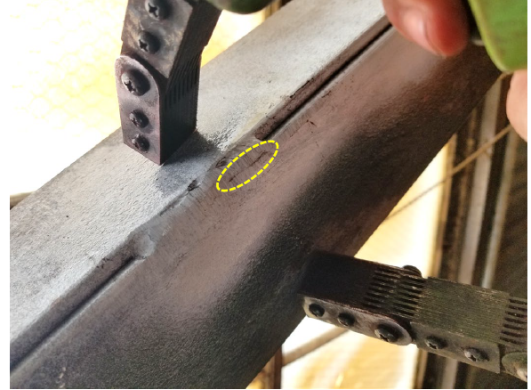
Pre excavation phase of the LBNF project
Third party testing
Rock Pull Testing UG
Steel Inspections at Ross Shaft Headframe
Magnetic particle
Visual inspection
Earthworks
Density testing
Concrete and grout testing
Micropiles for conveyor bents

Slide 4
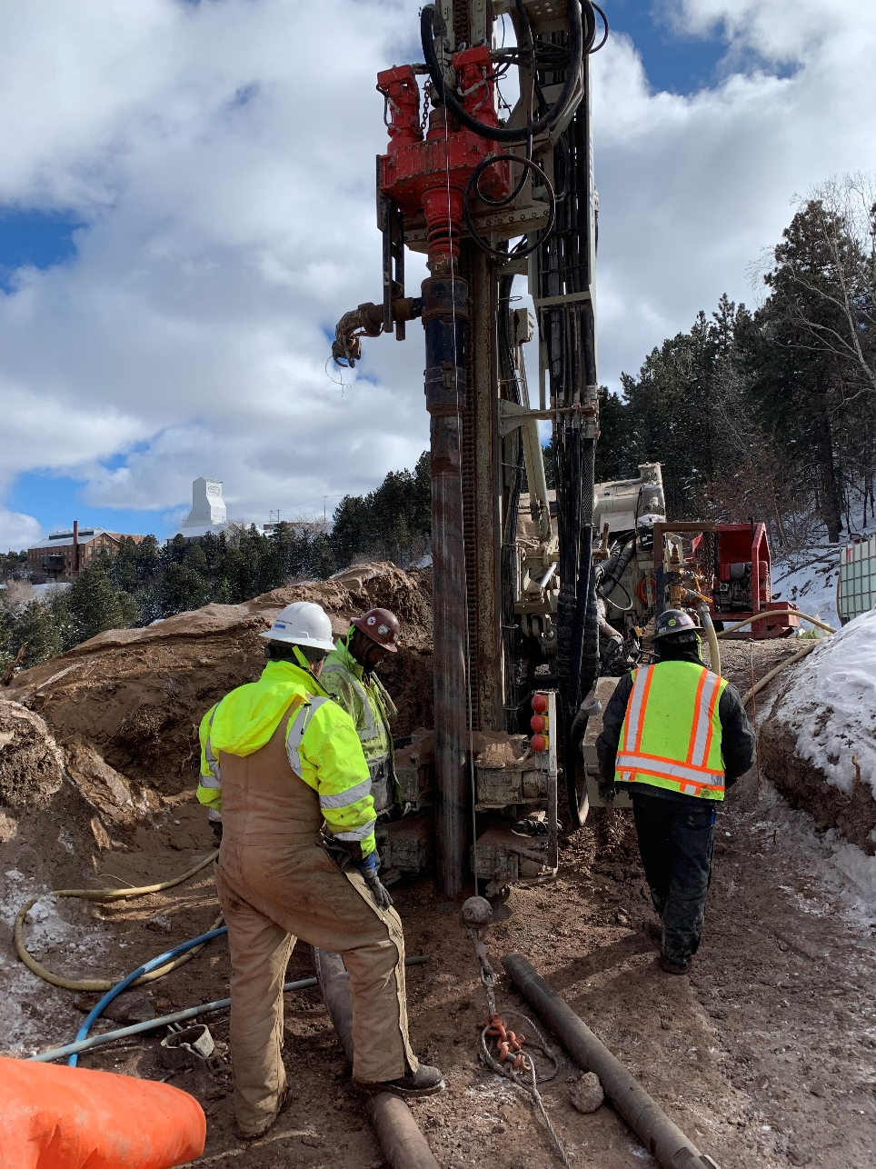
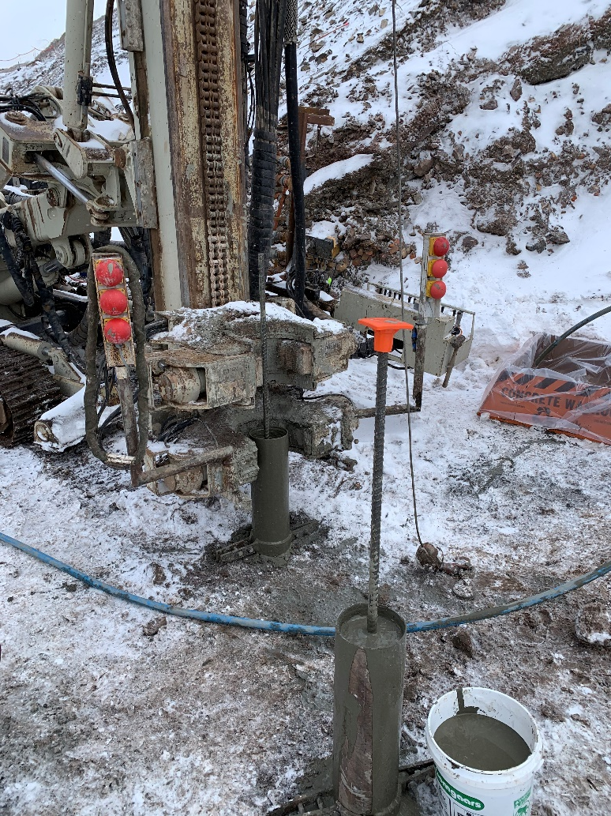
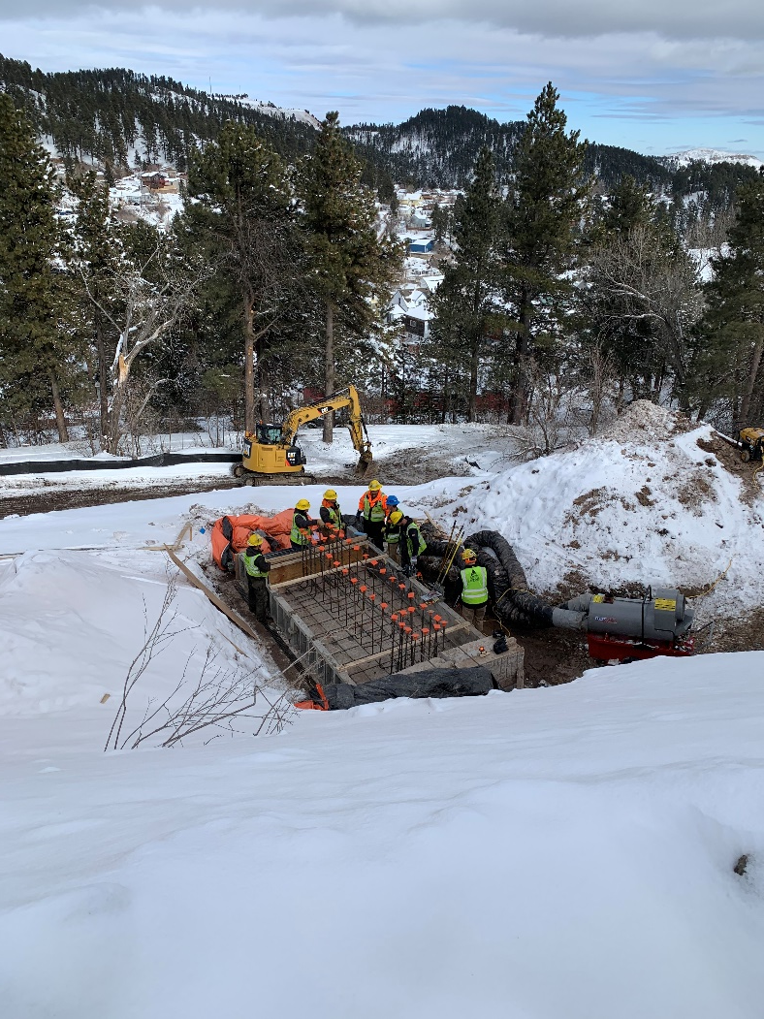
Pre excavation phase of the LBNF project
Third party testing
Micropiles for conveyor bents

Slide 5
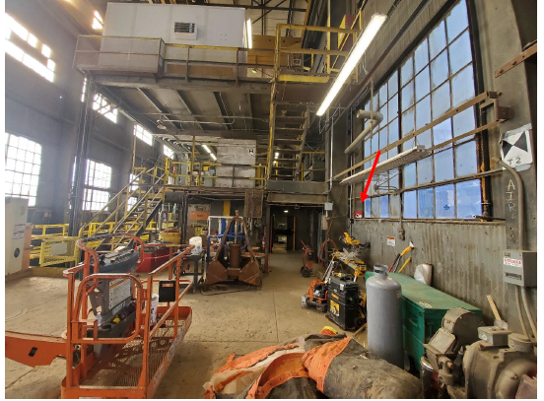
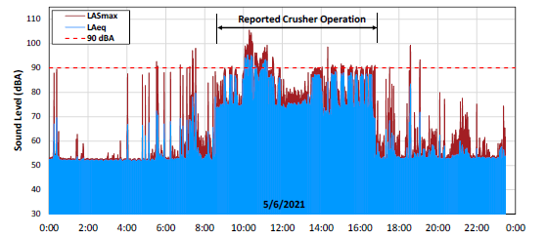
Pre excavation phase of the LBNF project
Noise and Vibration Monitoring
OSHA 8-hour time weighted average (TWA) threshold of 85 dBA as an action level and 90 dBA as the permissible exposure limit (PEL)
Instantel Minimate Pro 4 and Minimate microphone. Highest computed was 83.7 dBA

Slide 6
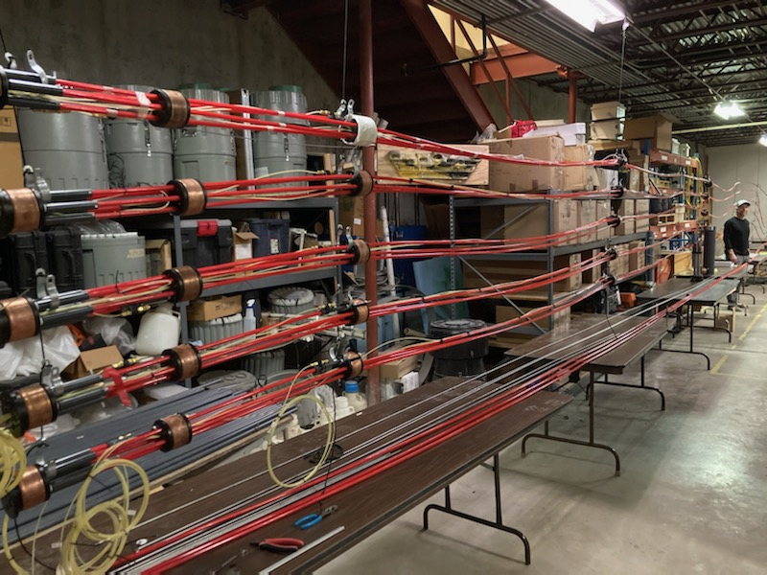
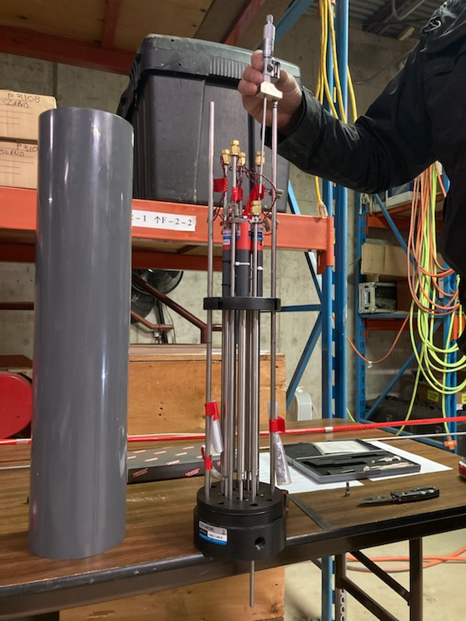
main excavation phase of the LBNF project
Geotechnical Monitoring – 2021 to 2024
Multiple point borehole extensometers (MPBX) x 64 total will be installed
Inclinometers
Seismographs

Slide 7
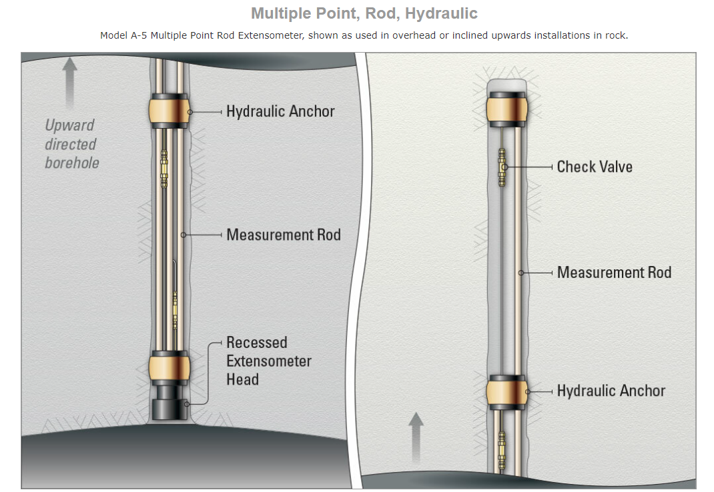
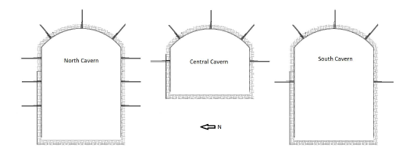
Multiple point borehole extensometers
Multiple point borehole extensometers –Geokon Model 1250 A-5 with hydraulic anchors

Slide 8
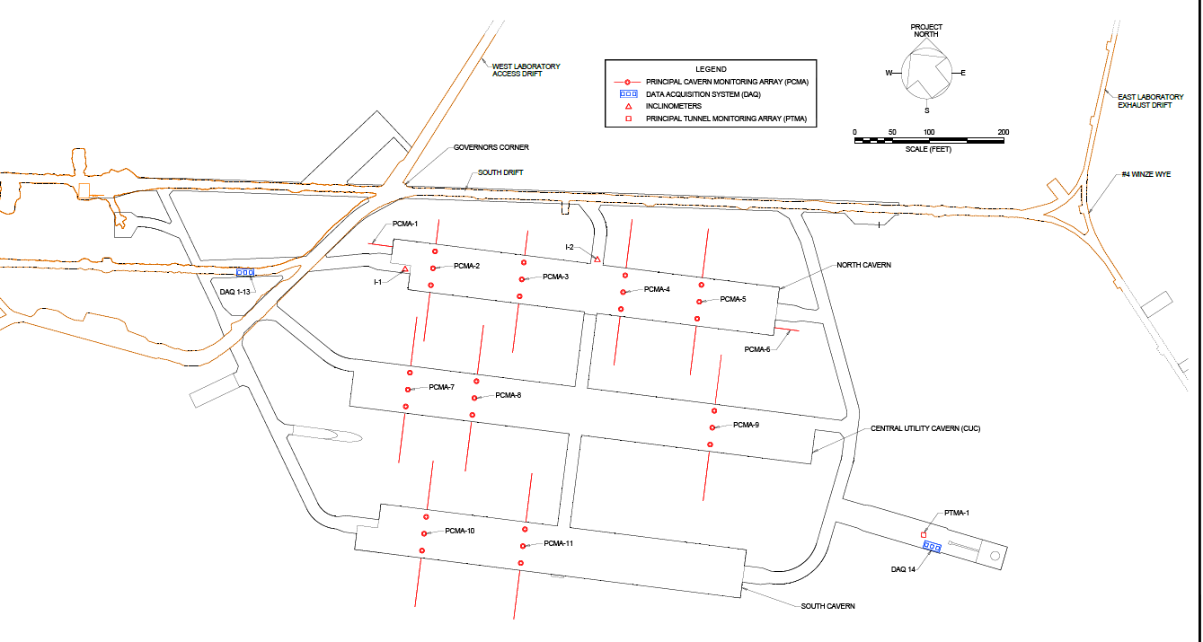
Multiple point borehole extensometers

Slide 9
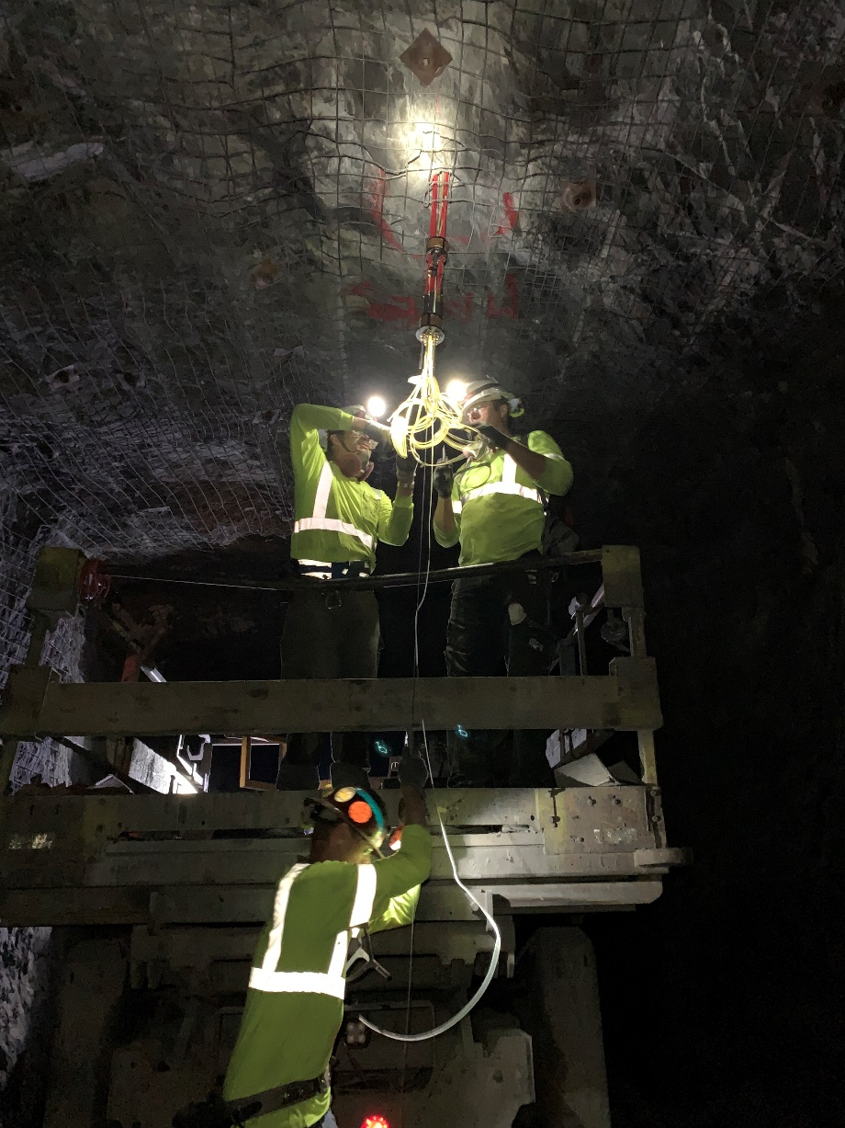
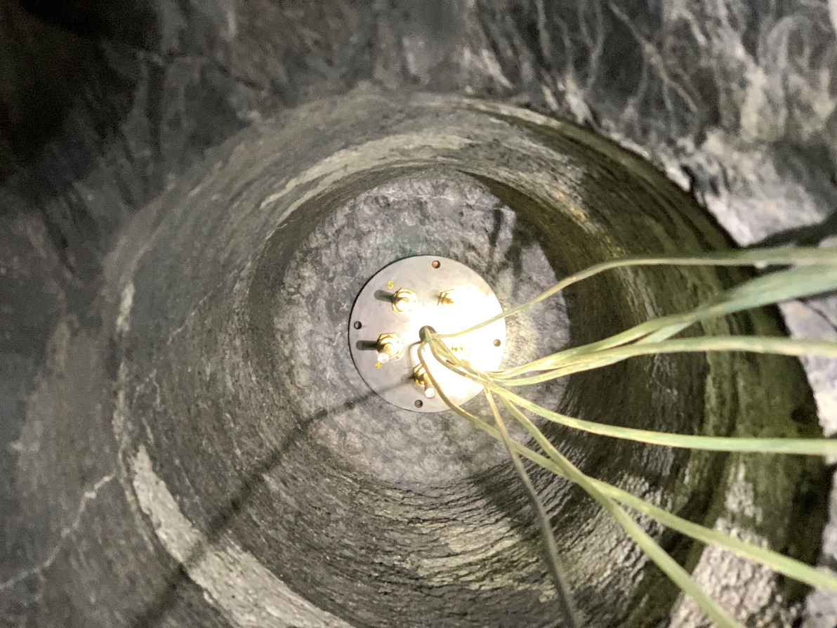
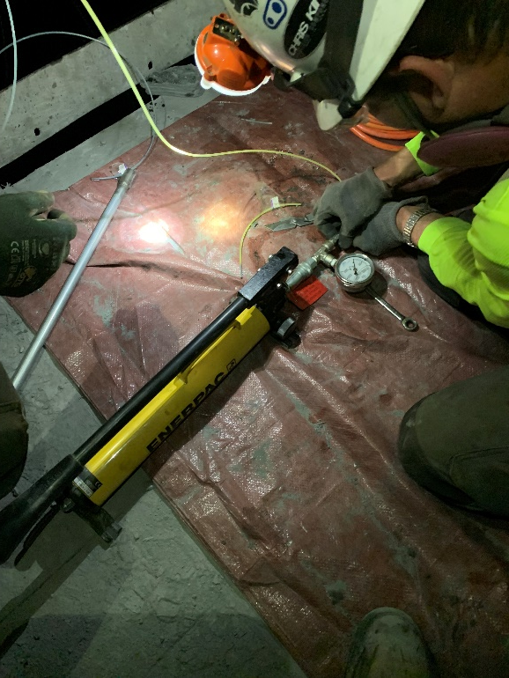
main excavation phase of the LBNF project
Multiple point borehole extensometer installation

Slide 10
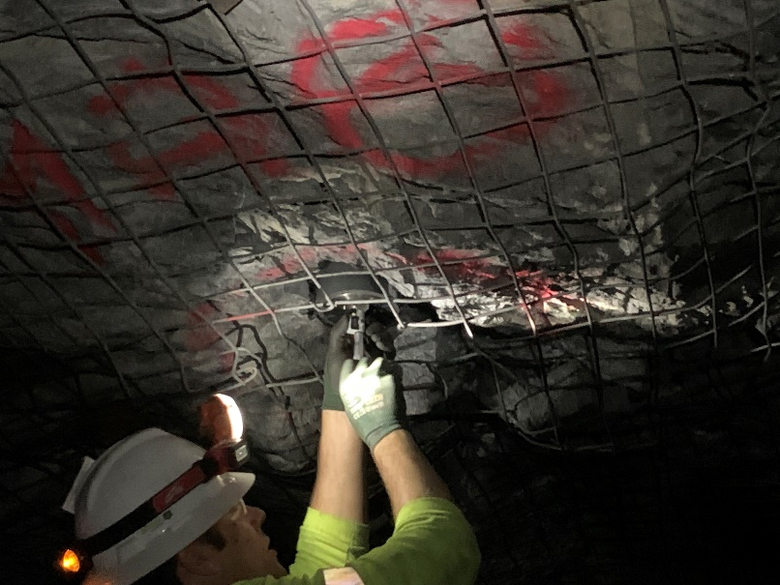
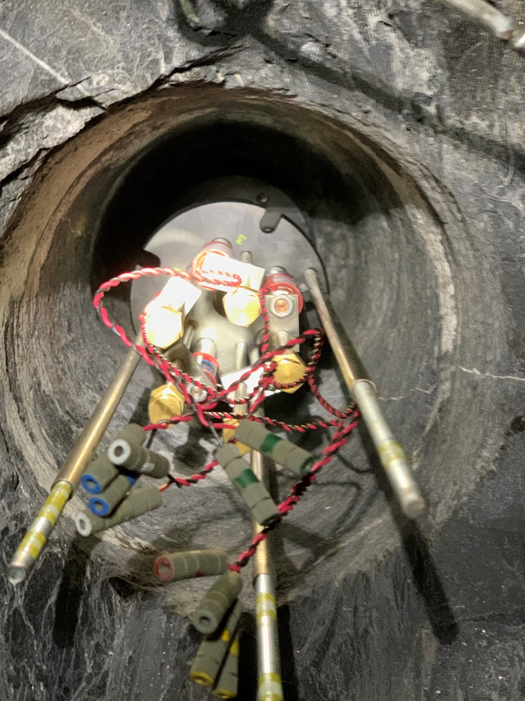
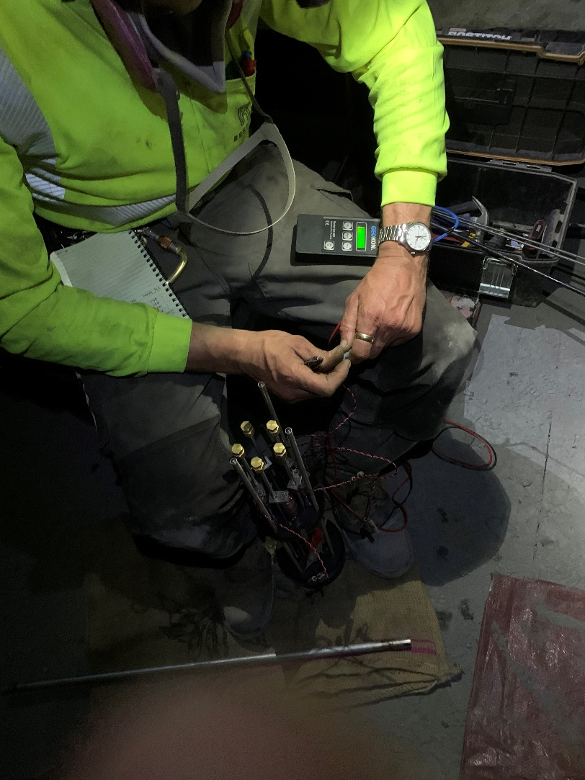
main excavation phase of the LBNF project
Multiple point borehole extensometer installation

Slide 11
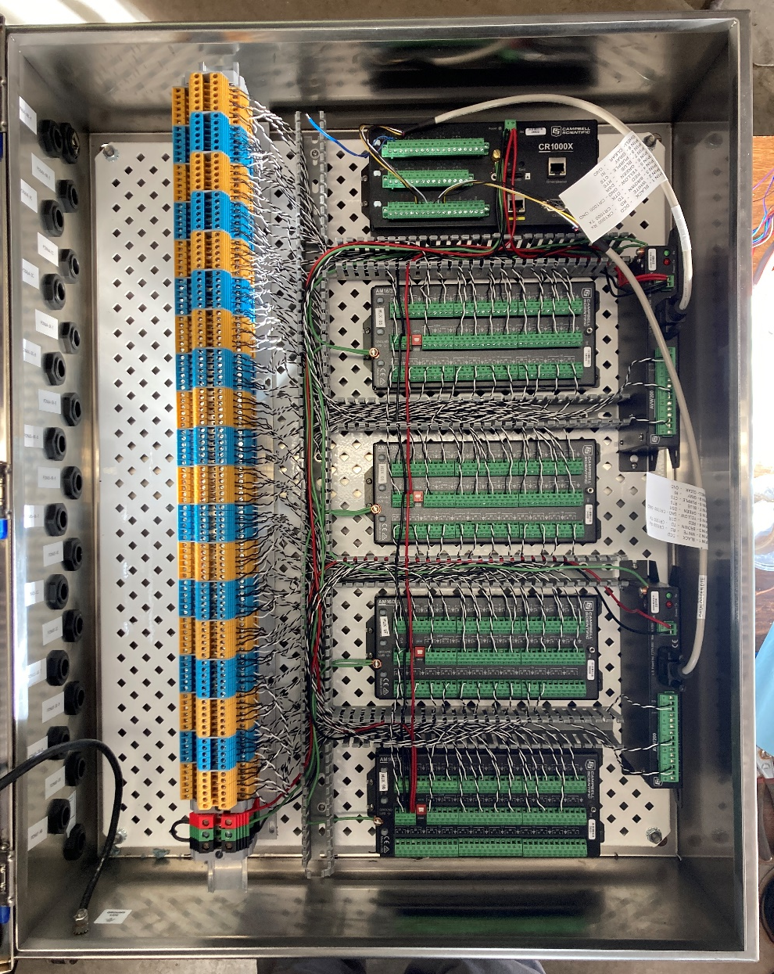
main excavation phase of the LBNF project
Central data management system
Canary Systems MultiLogger and ML WEB are used to program the loggers
ML Web is the user interface used to view and interpret the data
Remote connection via VPN
Geokon Model 8600-2 Dataloggers and Multiplexors
Dataloggers read MPBX every 2 minutes

Slide 12
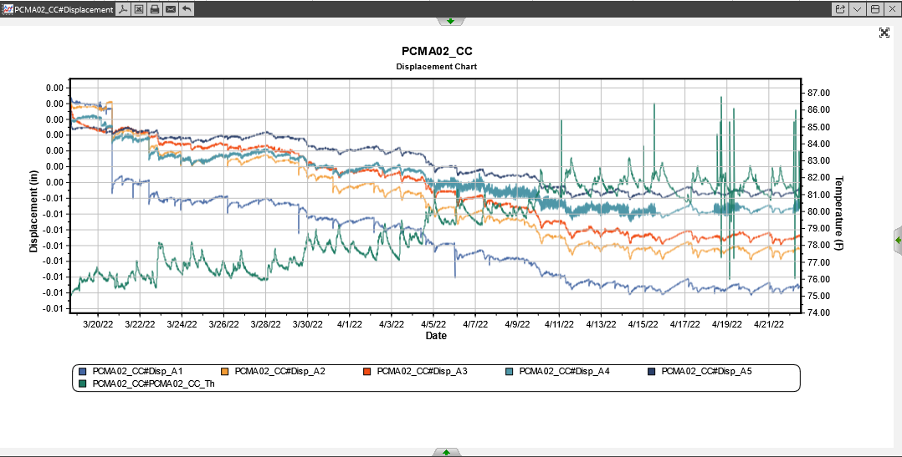
main excavation phase of the LBNF project
Central data management system Canary ML WEB

Slide 13
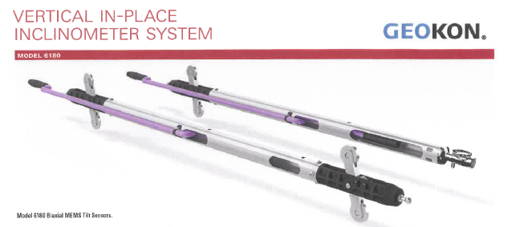
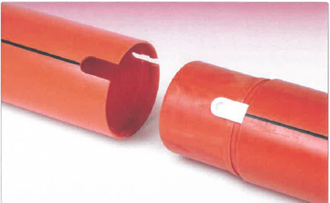
main excavation phase of the LBNF project
Inclinometers -Tilt Meter
Geokon Model 6180 – 70 ft long
Casing

Slide 14
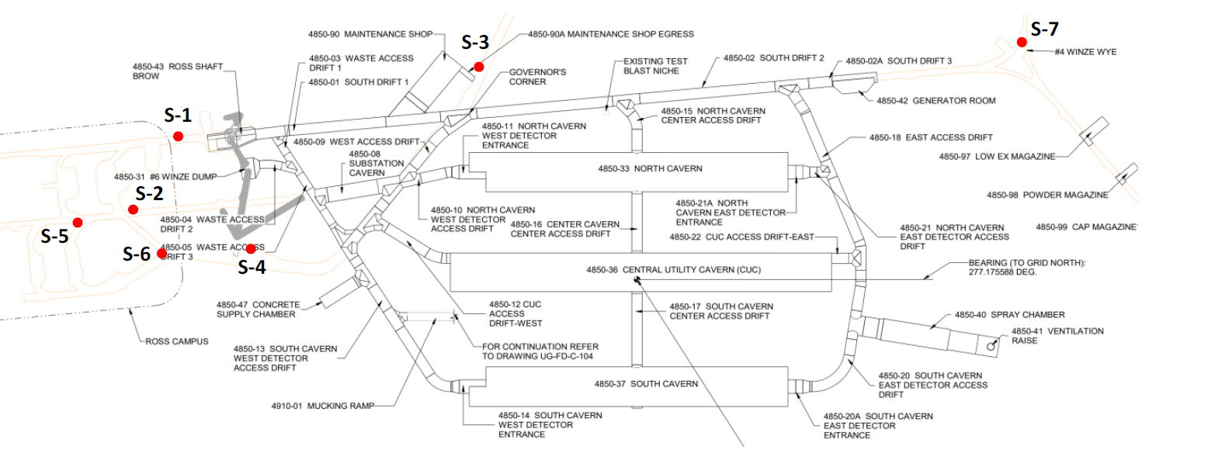
Noise and Vibration Monitoring
Seismographs

Slide 15
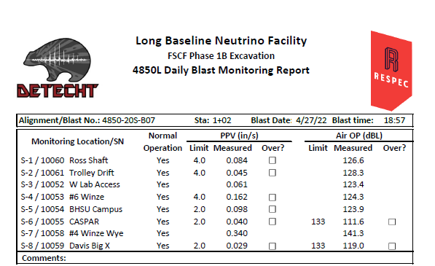
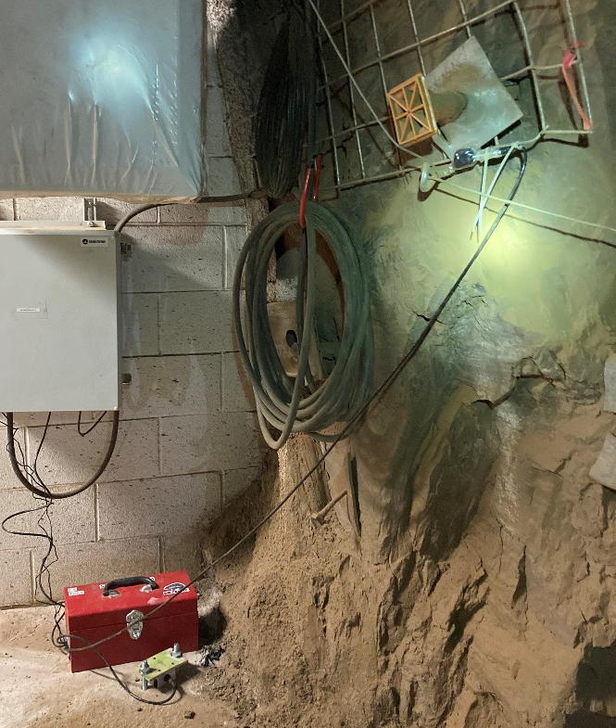
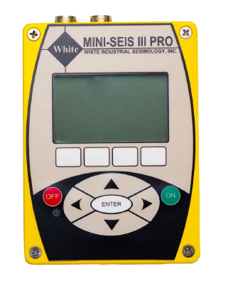
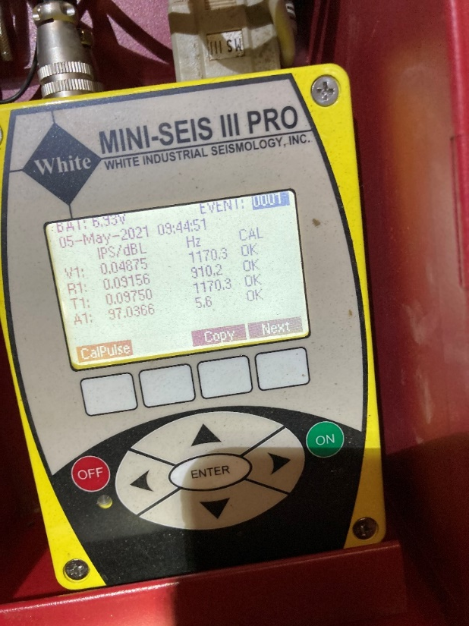
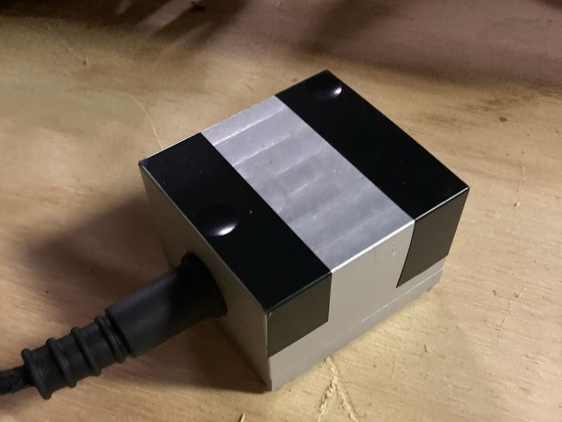
Noise and Vibration Monitoring
Daily Reporting

Slide 16
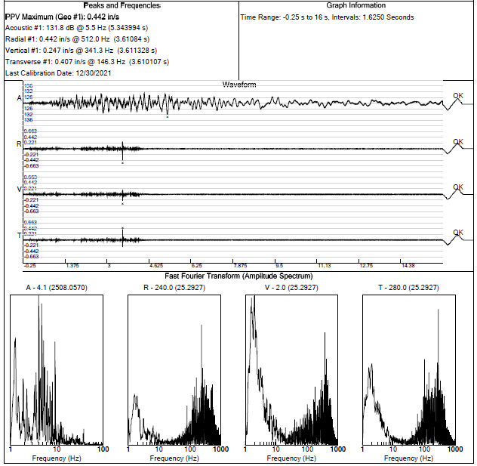
Noise and Vibration Monitoring
Daily Reporting

Slide 17
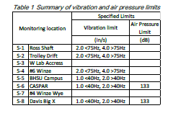
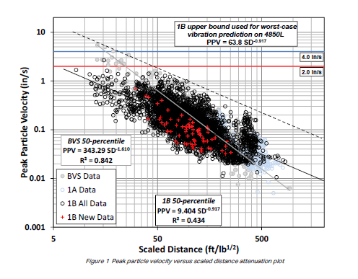
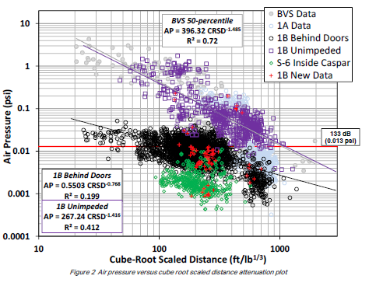
Noise and Vibration Monitoring
Weekly Attenuation Reporting

Slide 18
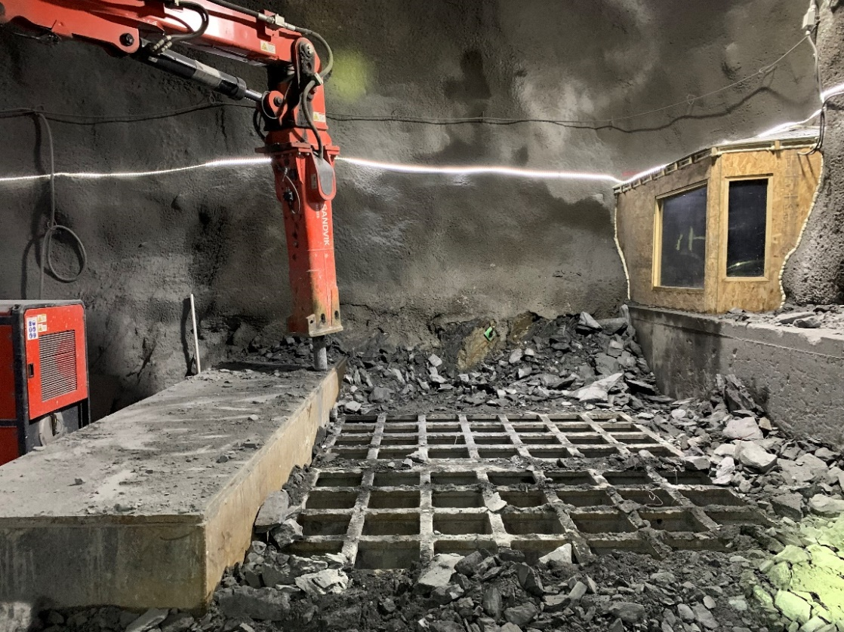
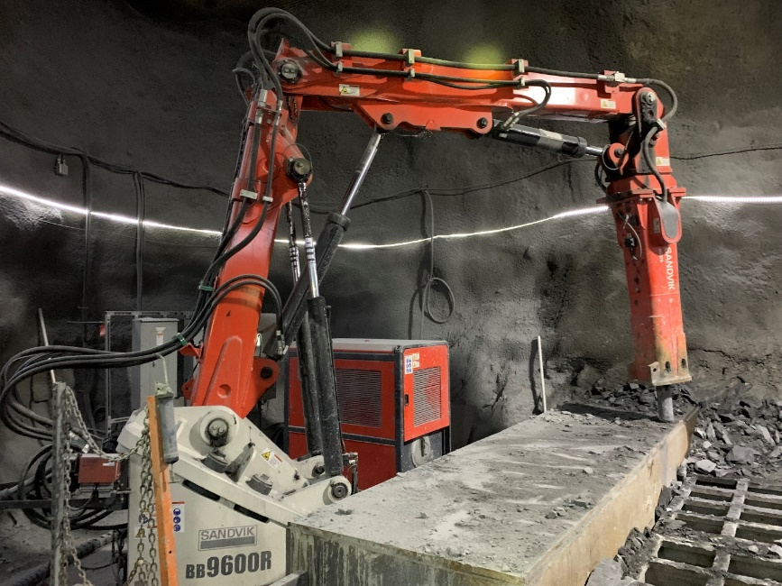
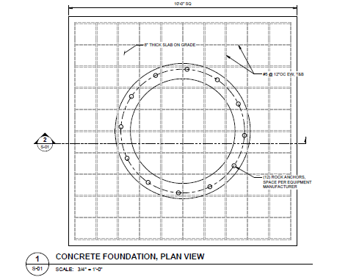
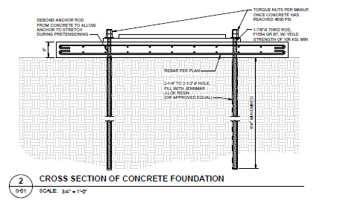
main excavation phase of the LBNF project
Structural support tasks
Grizzly rock breaker foundation

Slide 19
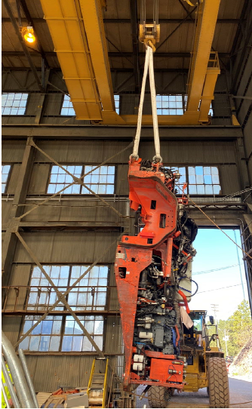
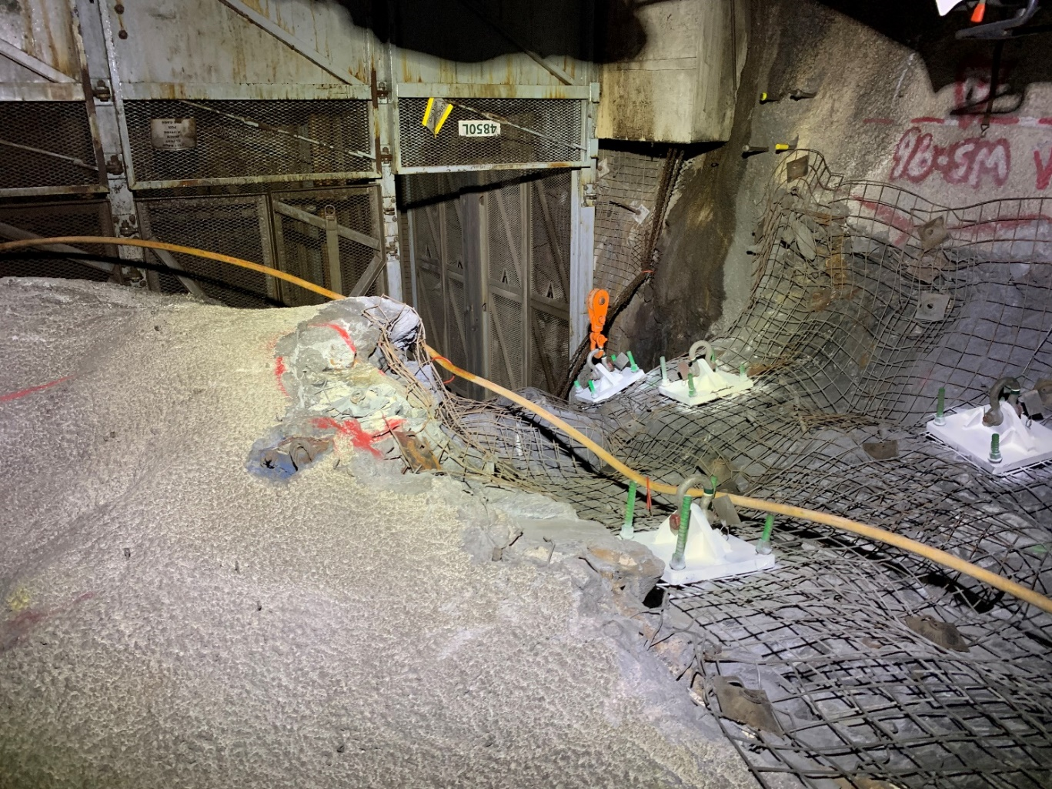
main excavation phase of the LBNF project
Structural support tasks
Lift Reviews

Slide 20
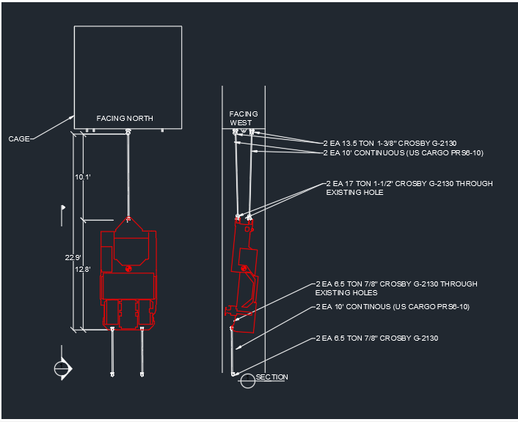
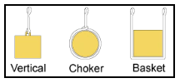
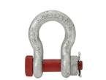
Structural Lift Reviews
Slings and Shackles checks
Lifting Steps
Vertical Cage Capacity – 13,500 lbs
Side Load Capacity of the Cage – 2,000 lbs

Slide 21
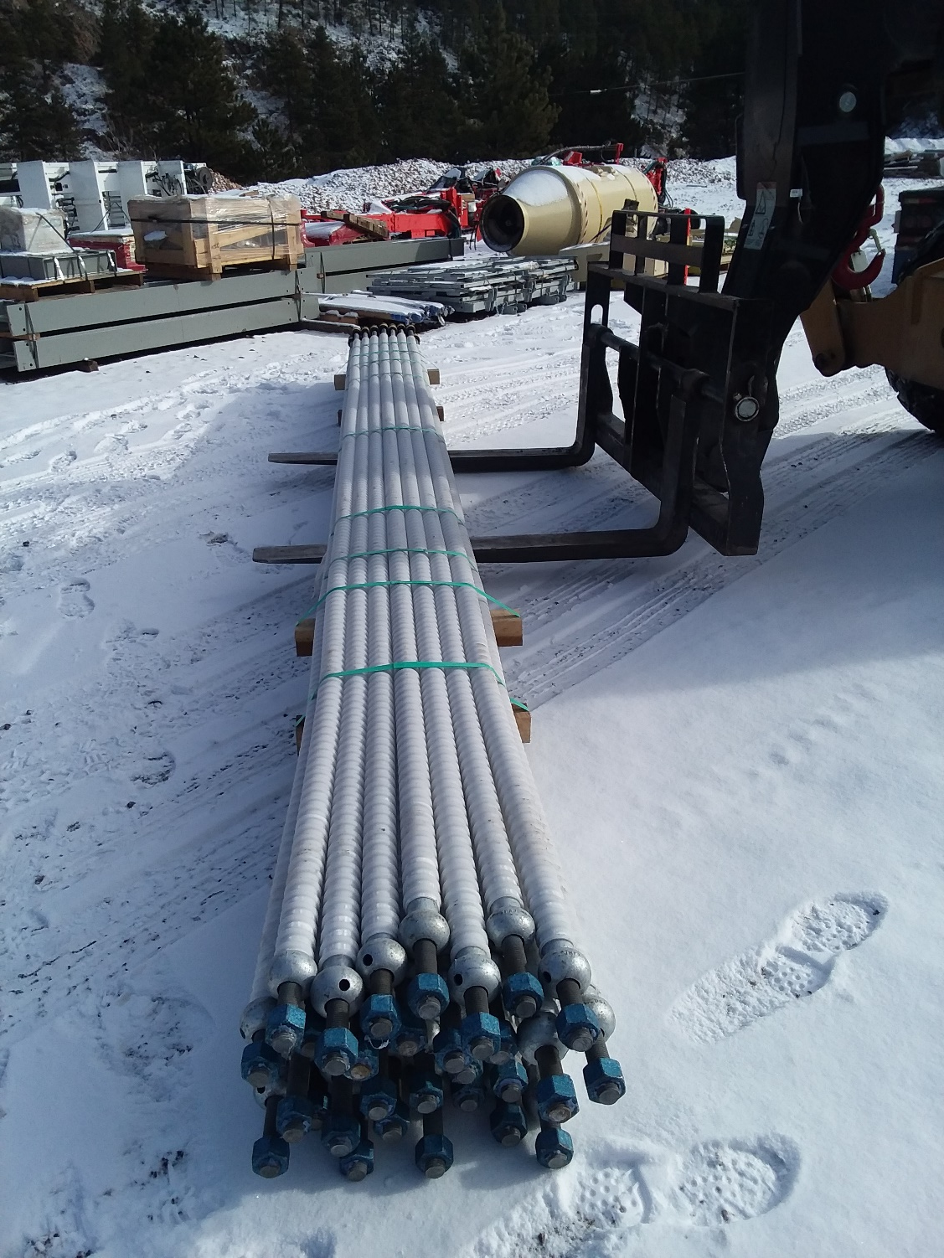
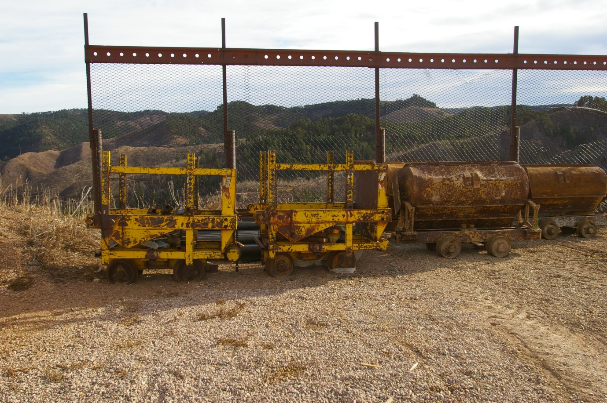
Structural Lift Reviews
Zimmerman car
20-ft long CT Bolts

Slide 22
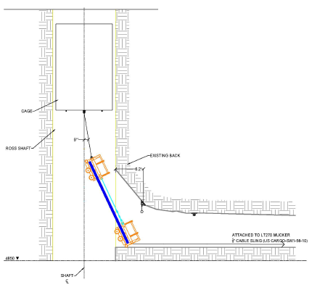
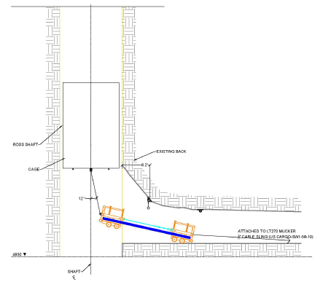
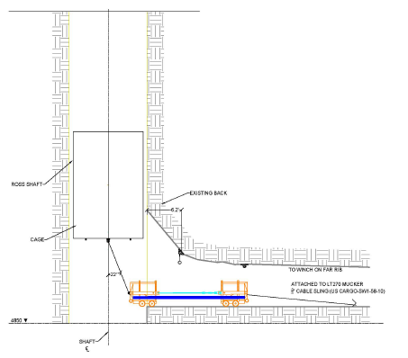
Structural Lift Reviews
Zimmerman car
20-ft long CT Bolts

Slide 23
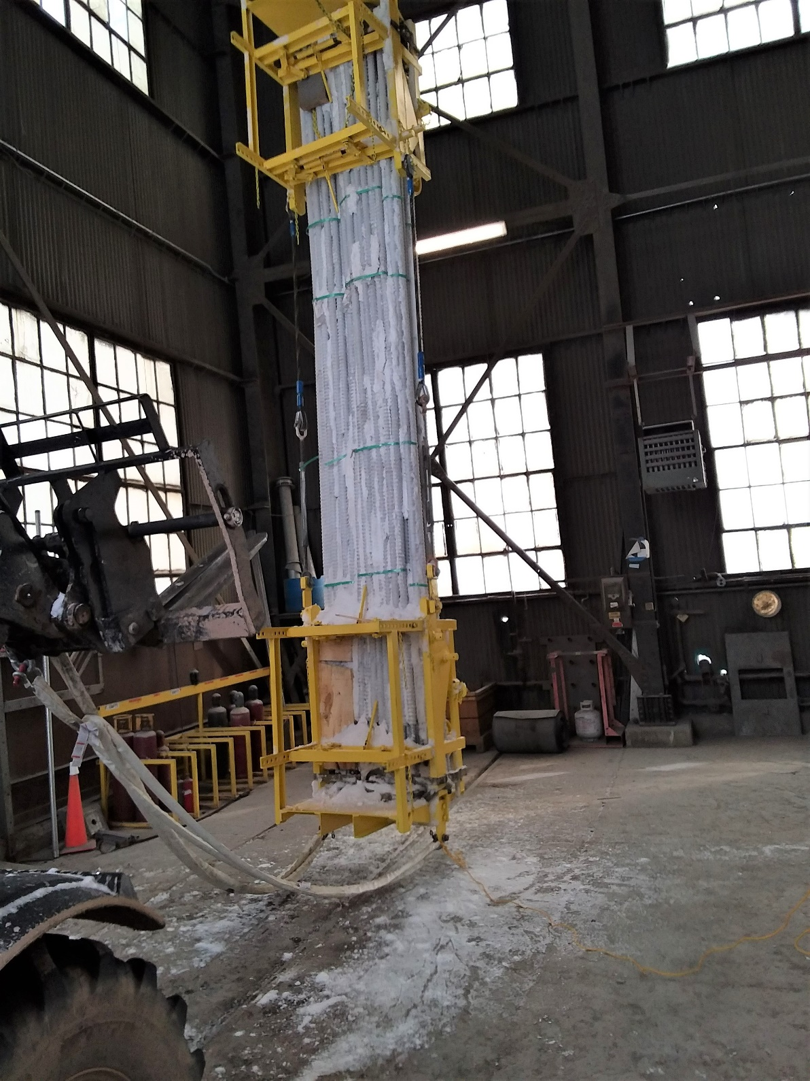
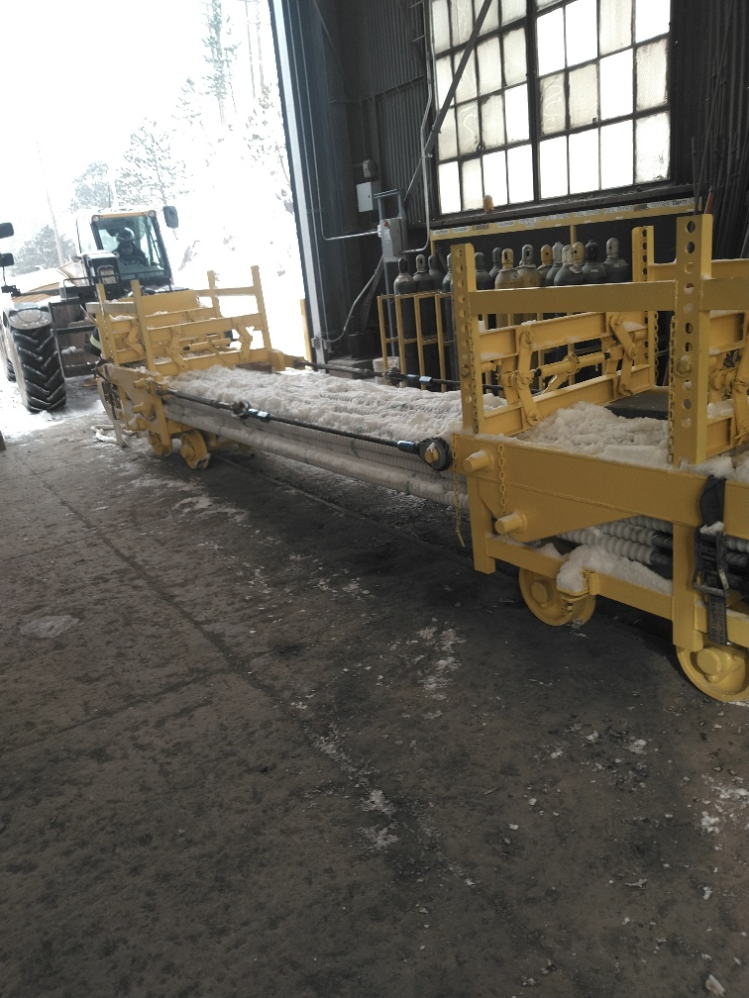
Structural Lift Reviews
Zimmerman car
20-ft long CT Bolts
Test Pick

Slide 24
Imagine having access to a think tank with hundreds of diversely talented engineers, scientists, programmers, and developers under one roof—that’s RESPEC.
Questions?

