Slide 1
Building Cultural Bridges
Sacred He Sapa (Black Hills) & the Lakota
Presented by Jace DeCory, Lakota, Cheyenne River Sioux Tribe
Oceti Sakowin Oyate (Seven Council Fires People)

Slide 3
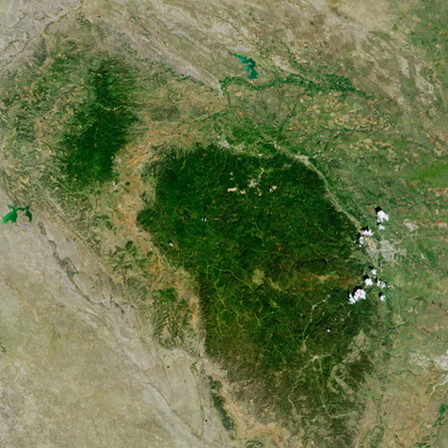

Slide 4
He Sapa – Paha Sapa – Black Hills The Heart of Everything…
Sacred Land of the Lakota & other Tribal Nations
Lakota claim aboriginal Indian Title – right of possession, use & occupation
Recognized Indian Title based on Ft. Laramie Treaties of 1851 and 1868
Treaty recognized Lakota title of 60 million acres, including the Black Hills
1866-1868, Lakota fought Powder River War with U.S. to protect buffalo herds & land; ended with 1868 Treaty
Created 26 million acre reservation – all of present day S.D. west of Missouri, including Black Hills, “… for the absolute & undisturbed use & occupation….”
1874 – Custer led military expedition into BH; violation of Treaty; Gold Rush!
June 25, 1876, Lakota + allies defeated Custer at Little Big Horn in MT
Congress passed “Sell or Starve” Act - Agreement of 1877 (loss of Black Hills)

Slide 5
The Black Hills Are Sacred The Black Hills Are Not For Sale
Indian Claims Commission Act of 1946 – monetary compensation, not ancestral lands
Long-standing legal/court battles and litigation regarding Black Hills claims
June 30, 1980, U.S. affirmed 1974 ICC ruling - Lakota entitled to $102 million for He Sapa
In support of this ruling, the Court found that “a more ripe and rank case of dishonorable dealings will never, in all probability, be found in our history.”
The Lakota have rejected the money (now 1.3 billion +)
No compensation offered/awarded for millions of dollars worth of gold taken from He Sapa
Since Homestake Mine’s closing in 2002, we must continue to protect Unci Maka (Grandmother Earth) from further desecration through respectful use and handling of water, minerals, rocks and materials associated with this sacred landscape
Periodic smudging and tobacco offerings left to please spirit ancestors & that which is holy

Slide 6
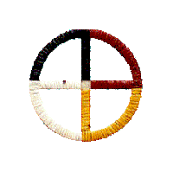
Tiwahe – Household/Home Oyate – Nation/People
Lakota Values: respect, generosity, courage, fortitude, compassion, prayer = wisdom
Woonspe/Teachings: Frank Fools Crow (Mato Wanbli – Eagle Bear), Scholastica Mad Bear + many other elder relatives
Tiospaye/Extended Family: relatives by birth, marriage & adoption
Medicine Wheel: 4 winds, 4 directions, 4 colors, 4 nations

Slide 7
Paha Sapa - Black Hills He Sapa - Black Mountains
“We all come from one source…the blood of inyan.” (Albert White Hat, Sicangu Lakota)
Wamakaskan Ocanku – “the path of the animals” or Ki Inyanka Ocanku, the “The Race Track” which surrounds “the heart of all that is”…Paha Sapa or He Sapa. The Great Lakota Race Track - red formation surrounding He Sapa is from the animals’ blood that was shed during the race
Tatanka or Pte Ahinape or Pte Tali Yapa (Buffalo Gap) – Where the buffalo come out; entrance to the Sacred Hoop of Paha Sapa – starting point of the Lakota Race; eastern gate of the hocoka(n)
Mato Tipila (Bear Lodge) – Pte San He Paha (Grey Buffalo Horn Butte) - Devil’s Tower, near where sacred Cannupa came from; Sun Dances held near this site during summer solstice; summer solstice ceremonies of rebirth & renewal (June)
Inyan Kara – Inyan Kaga - Motion of the Stone (last active volcano in BH area) Stone Mt., where stones were secured for the inipi; great stone maker - rock gatherer) —brought stones for tomahawks; also a site for projectile points – 10,000+ yr. old flint knapping site is located here; Tunkan Oyate - renewal of stones; associated with childbirth (May)
Wasun Wiconiya Wakan or Washun Niye - Sacred Wind Breath - or Maka Oniye (Breath of the Earth) or Pte Kinapapi – where the buffalo come out - Wind Cave - Lakota Emergence – The Pte Oyate emerged from a cave as ikce wicasa - common man/people
Okawita Paha - Gathering Place/Hill (Mt. of the People); Wakinyan Paha/Thunder Mt., Wakinyan Wahohpi – Thunderbird’s Nest or Hihan Kaga Paha (Owl Created or Resembles An Owl Mt.) –
Black Elk Peak - Spring equinox (March/April) Welcome back the Wakinyan Oyate; prayers for no drought or illness; give thanks for water/plants - gifts from Wakinyan - Thunder/Lightening Spirit
Mato Paha - Bear Butte (also called Mato Wakan or Paha Wakan) - prayer site for vision quests/fasting (hanbleciyapi “crying for a vision”); Lakota people convened every seven years at Bear Butte for Council meetings (Fasting is mainly done in May through August today.)
Pe Sla Paha – Bald (Top) Mt. or Pte TaHocoka – Center for the great buffalo altar; considered center of universe in the Black Hills ; Wiping of Tears ceremony; Wopila (thank you) for all life, past & present, spring/April
“Every kind of society needs these kinds of sacred places because they help to instill a sense of social cohesion in the people and remind them of the passage of generations that have brought them to the present. A society that cannot remember and honor its past is in peril of losing its soul.”
- Vine Deloria, Jr. (Lakota, Standing Rock)
(compiled/revised by Jace DeCory, Asst. Professor Emeritus//BHSU 2017)

Slide 8
Preservation of Culture & Language Conclusions and Q & A
These lands hold the memory of our ancestors…
Ancient sites tied to ehanni stories, and special ceremonies held at each
Wazipa -(container) He Sapa - home to animals, food & plants for medicine
Must protect and honor these sacred places against unwise development
Work together to preserve and celebrate our shared history
We are all responsible for our future generations…
Pilamiyaye – Thank you Mitakuye Oyasin – We are all related

Slide 9
Ms. Jace DeCory, Asst. Professor Emeritus American Indian Studies College of Liberal Arts Black Hills State University
605-722-8648 Spearfish, SD jace.decory@bhsu.edu
For our ancestors, our relatives, our children and grandchildren to come….

