Slide 1
Status of the XENONnT Dark Matter Search Experiment
CoSSURF 2022 - May 13, 2022
Shengchao Li li4006@pudue.edu
ON BEHALF OF

Slide 2
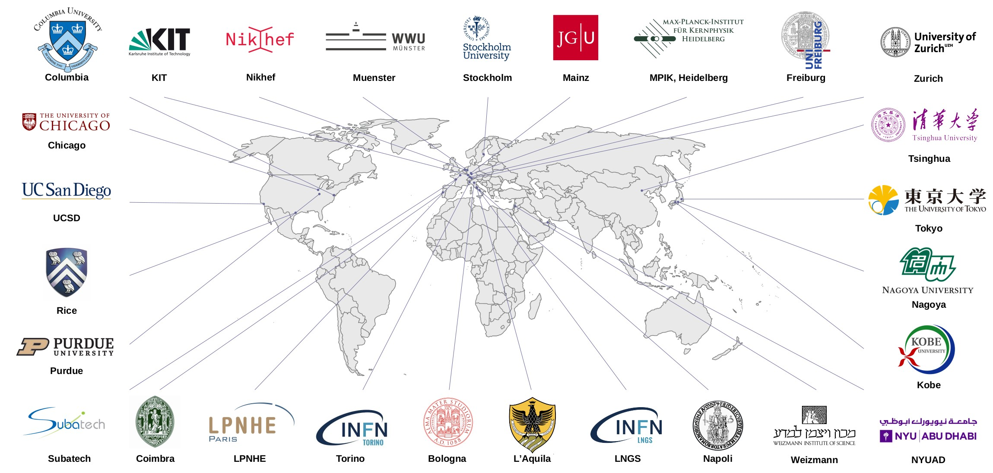
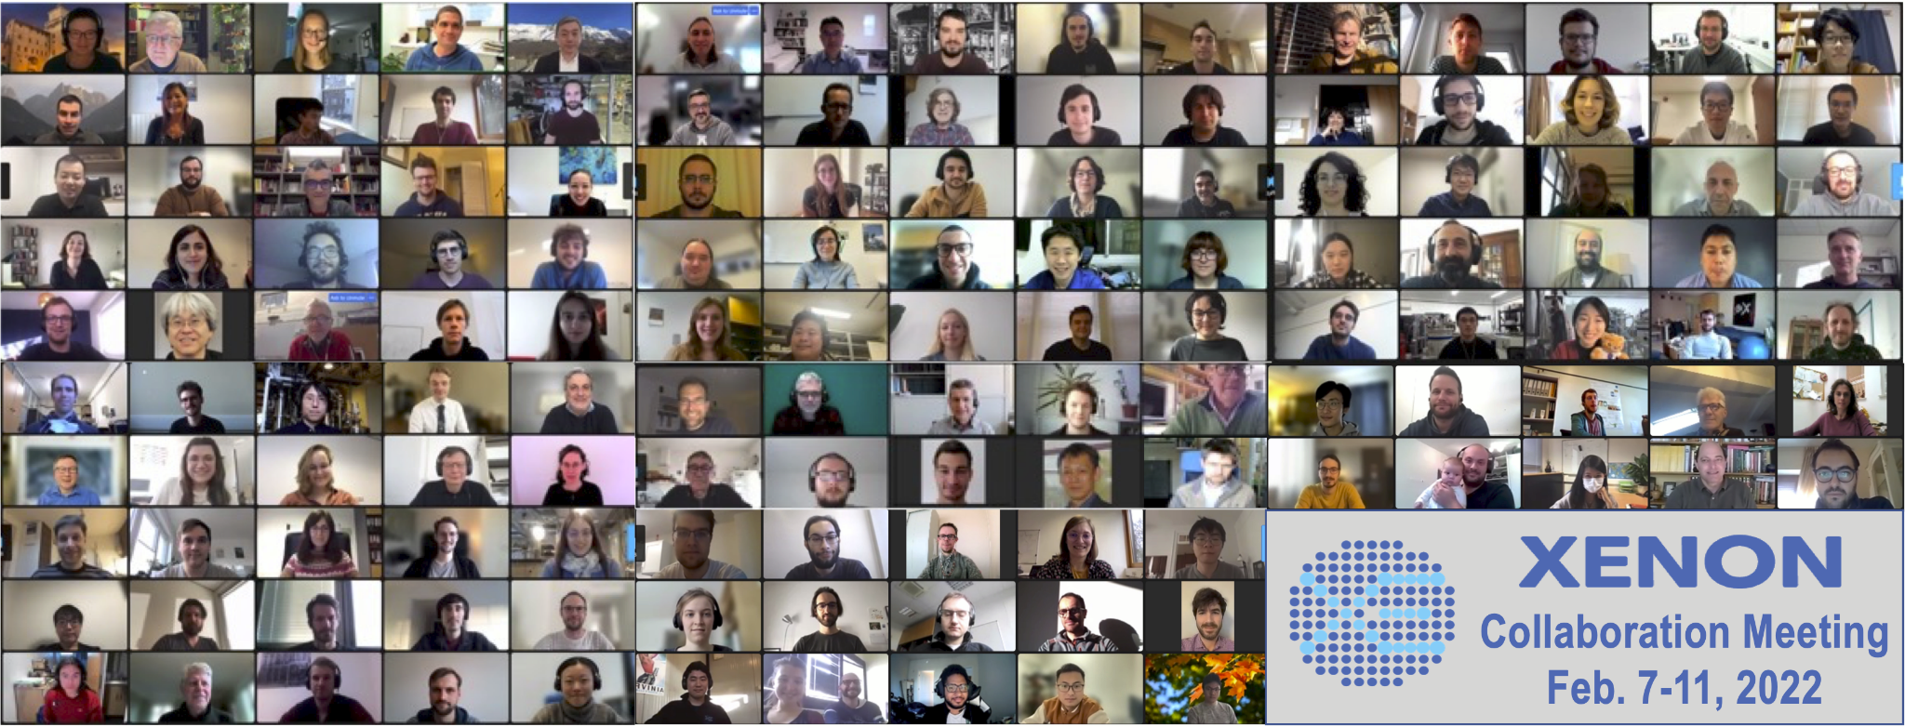
XENON Collaboration
~170 scientists
Shengchao Li | CoSSURF 2022 | May 13, 2022
2

Slide 3
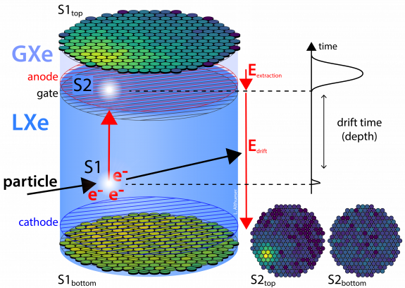
XENON Dual-phase Time Projection Chamber
Redundant signals for each event
prompt scintillation light (S1)
delayed signal from charge extracted into gas phase (S2)
Full 3D position reconstruction
x-y from PMT hit pattern
z from drift time
Discrimination between electronic recoil (ER) vs. nuclear recoil (NR)
charge to light ratio (S2/S1)
Shengchao Li | CoSSURF 2022 | May 13, 2022
3

Slide 4
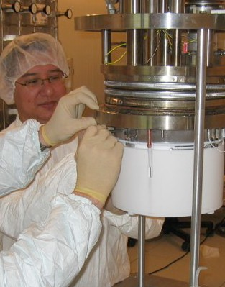
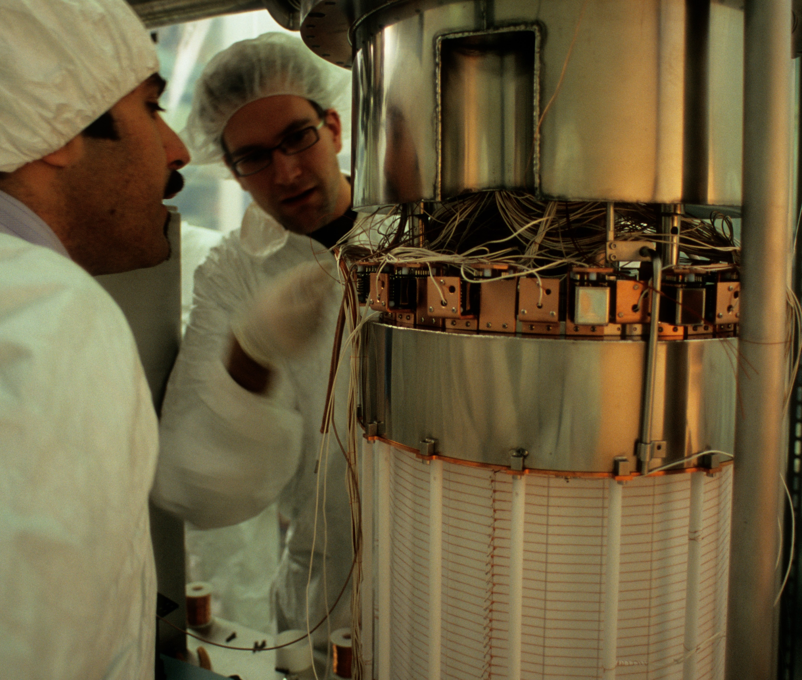
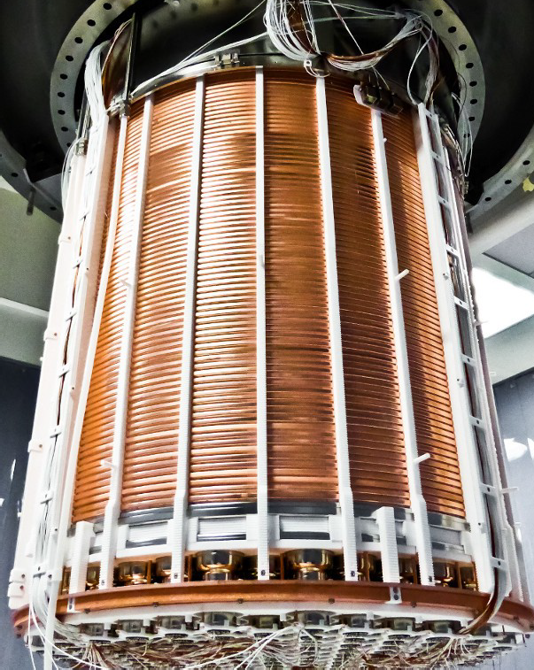
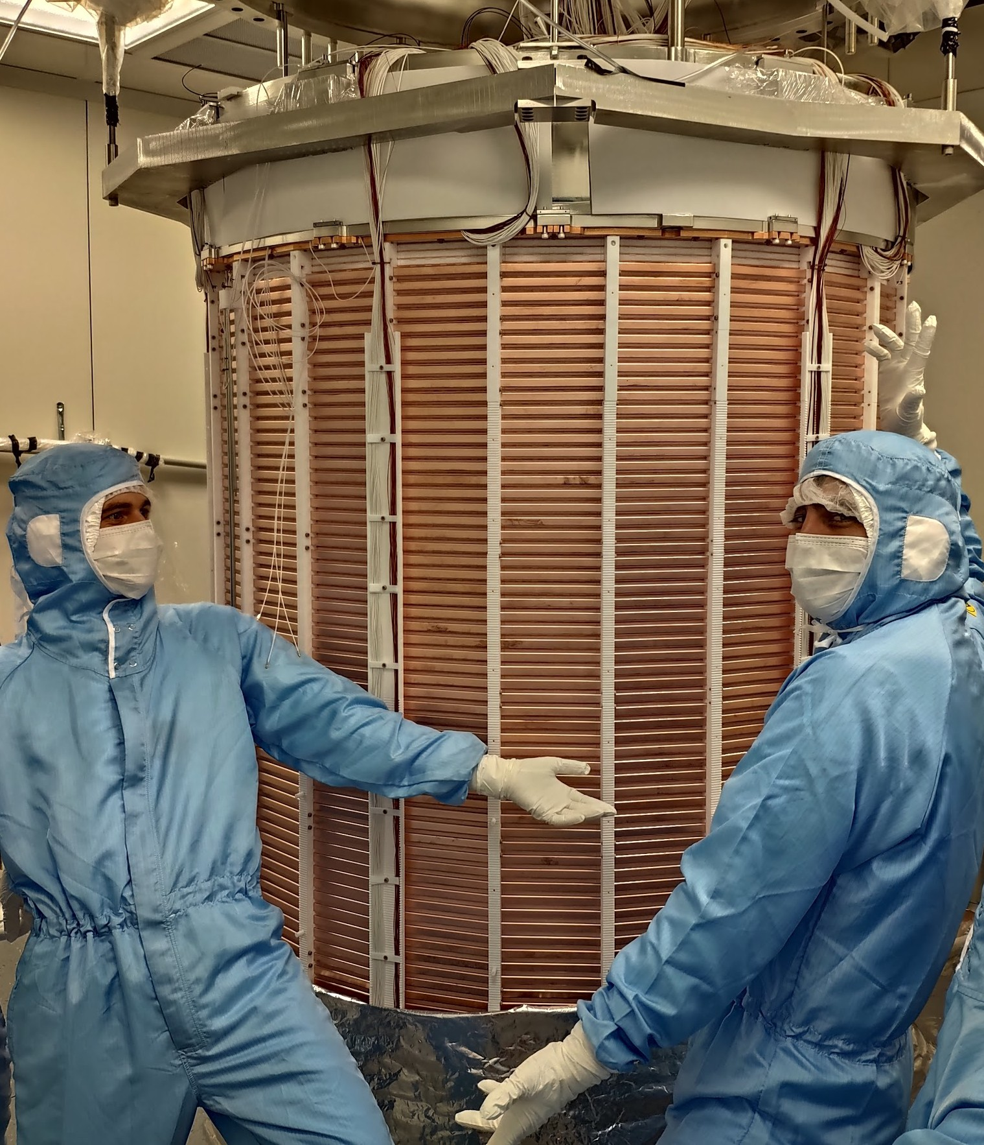
XENON Time Projection Chambers (TPCs)
XENON10 | XENON100 | XENON1T | XENONnT (predicted)
2005 - 2007 | 2008 - 2016 | 2012 - 2018 | 2019 - 2026
14 kg Xe | 62 kg Xe | 2 tonne Xe | 5.9 tonne Xe
~10⁻⁴³ cm² | ~10⁻⁴⁵ cm² | ~10⁻⁴⁷ cm² | (~10⁻⁴⁸) cm²
~2M background ER events/(keV t y) | 1800 background ER events/(keV t y) | 82 background ER events/(keV t y) | (2) background ER events/(keV t y)
4
Laboratori Nazionali del Gran Sasso (3400 m.w.e)
Shengchao Li | CoSSURF 2022 | May 13, 2022
4

Slide 5
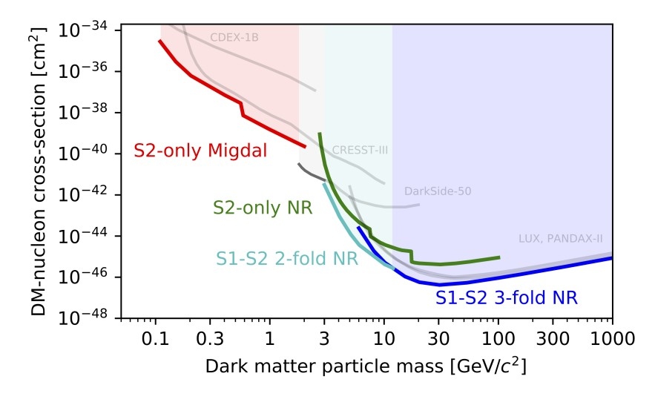
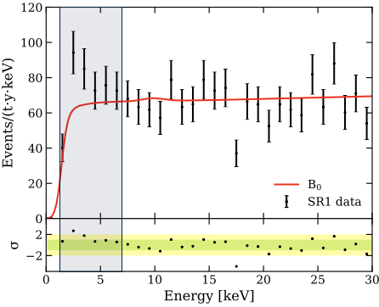
Scientific Results from XENON1T
(data taken 2016-2018)
3.3 sigma excess
PRL 119, 181301 First DM results
PRL 121, 111302 One ton × year WIMP search
PRL 122, 141301 Spin-dependent WIMPs
PRL 122, 071301 WIMP-pion interaction
PRD 103, 063028 Inelastic scattering
PRD 102, 072004 Low energy ER excess
PRL 123, 251801 S2-only DM search
PRL 123, 241803 Light DM via Migdal
Nature 568, 2019 2$ν$ double electron capture
PRL 126, 091301 ⁸B solar neutrino
..and more to come
Shengchao Li | CoSSURF 2022 | May 13, 2022
5

Slide 6
Upgrade from XENON1T to XENONnT
JCAP 11 (2020) 031
To gain more than 1 order of magnitude in DM sensitivity:
Larger fiducial volume
Low electron recoil background
Low neutron induced background
4 tonne
1/6 of XENON1T SR1 level
1 event in 20 ton × year exposure
Shengchao Li | CoSSURF 2022 | May 13, 2022
6

Slide 7
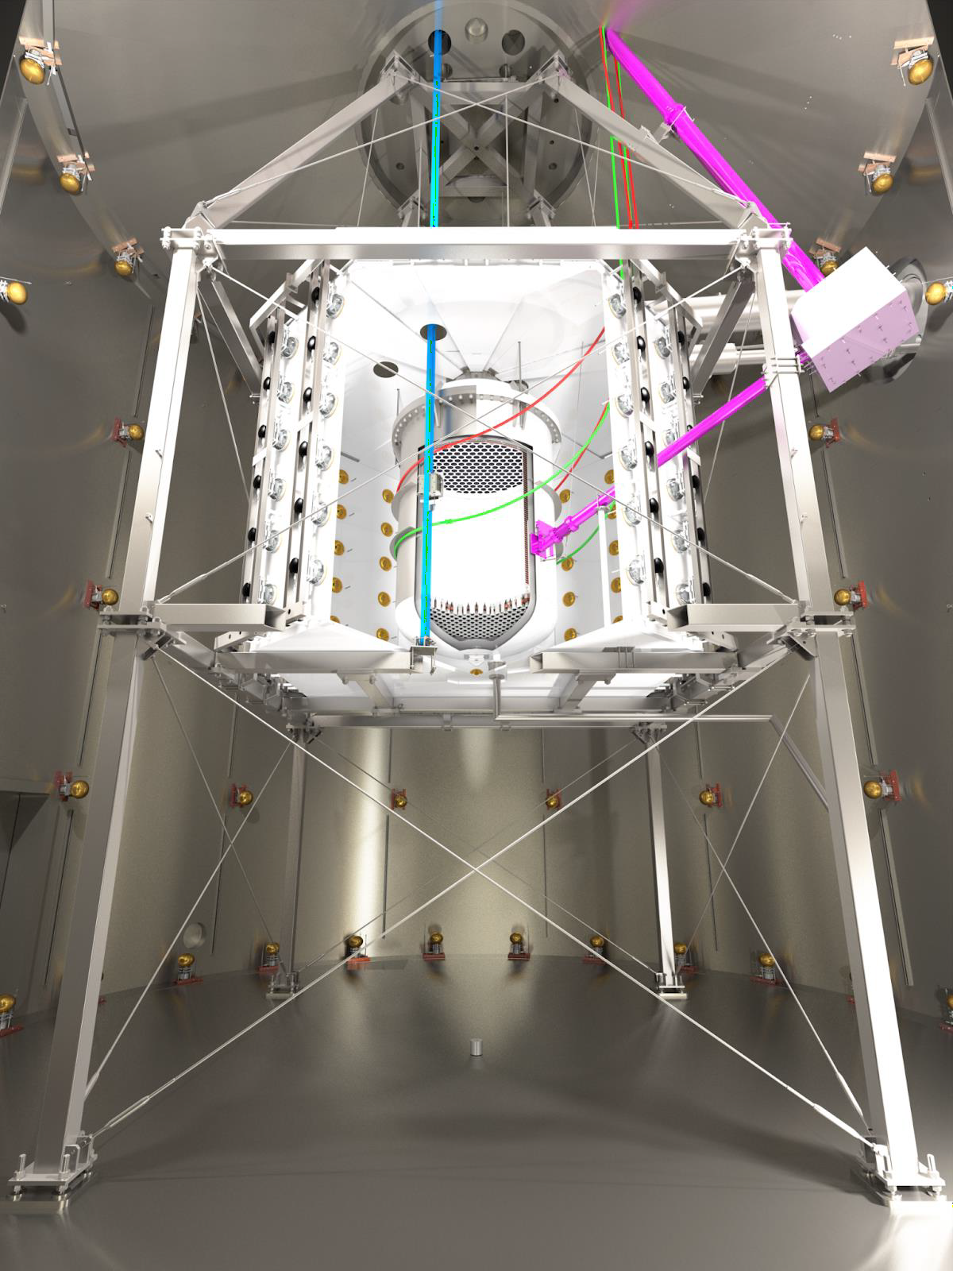
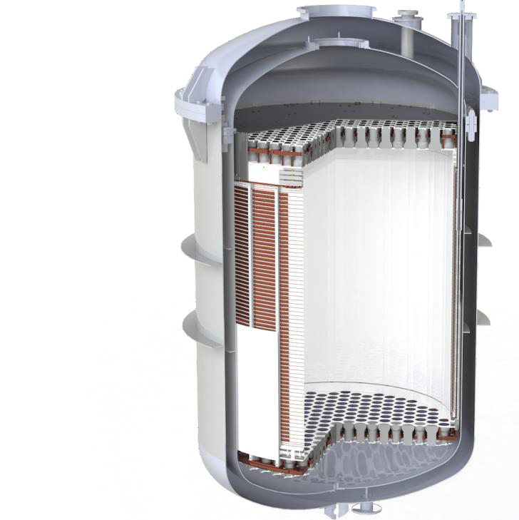
XENONnT Detector Upgrades
Larger TPC than XENON1T
Active Xe mass 2t -> 5.9t
Drift length 1m -> 1.5 m
PMTs 248 -> 494
Improved surrounding systems
Two calibration tubes
One neutron generator pipe
Neutron veto system
M uon veto system
3x
Tunable field shaping rings
1.5x
2x
Larger detectors need a higher purity to reach the same level of charge collection
Minimal use of PTFE to reduce material background
Shengchao Li | CoSSURF 2022 | May 13, 2022
7

Slide 8
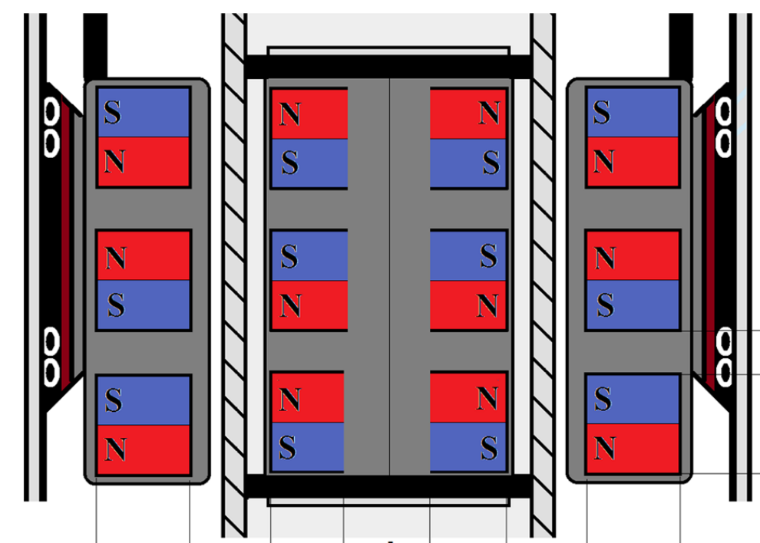
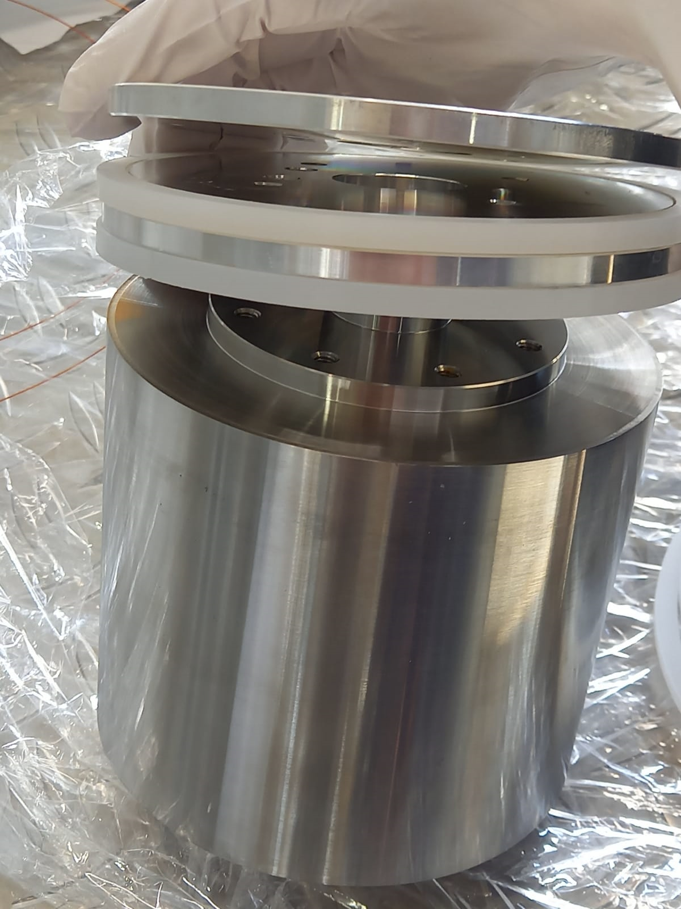
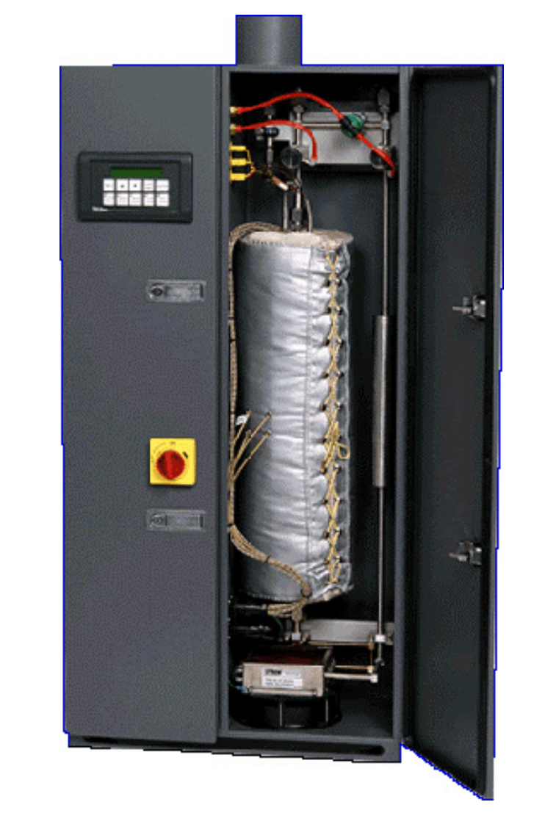
GXe Purification System
EPJC 78 (2018) 604
Magnetically coupled piston pumps for complete isolation
Clean components with (330 ± 60) μBq Rn emanation rate
Xe flow 100 slpm
1.5 bar at MagPump inlet
Two pumps for redundancy
drive
piston
noble gas
Rn clean gaskets
Piston chamber
SAES
getter x2
Shengchao Li | CoSSURF 2022 | May 13, 2022
8

Slide 9
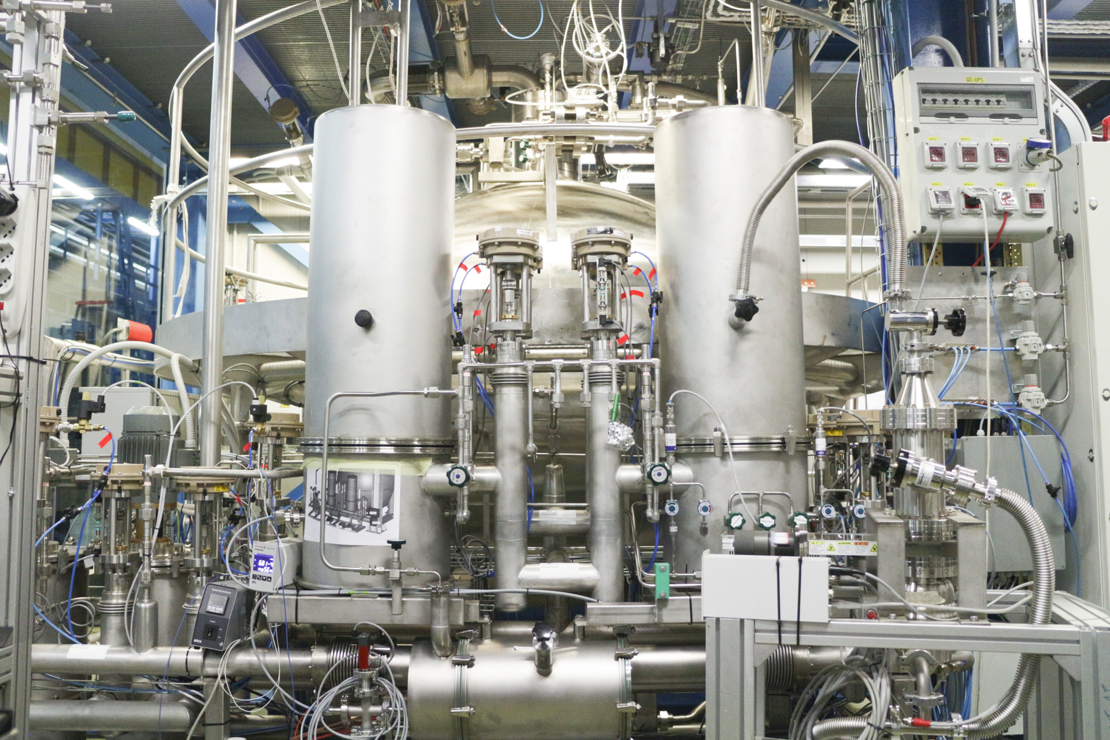
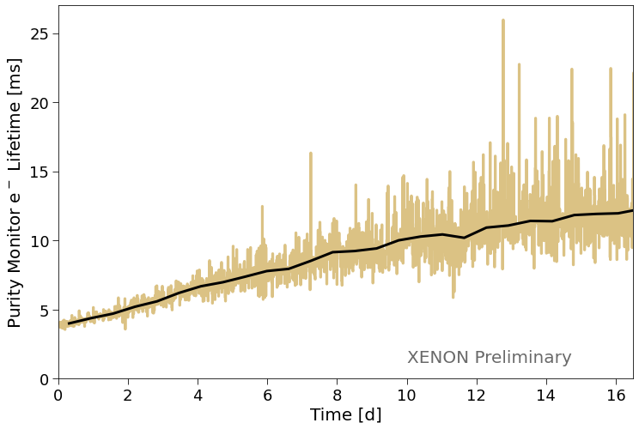
LXe Purification System
with 8.5t Xe in cryostat
Two sets of customized filters:
ultra-low radon level
replaceable/regenerable
Purity monitoring with a dedicated device via electron lifetime
High flow of 2 LPM (=350 kg/h) :
electron lifetime reached 5 ms in 5 days
over time stable at >10 ms
 | Max drift time | Electron lifetime | e⁻ surviving full drift
XENON1T | 0.67 ms | 0.65 ms | 30%
XENONnT | ~2 ms | >10 ms | 80%
Shengchao Li | CoSSURF 2022 | May 13, 2022
9

Slide 10
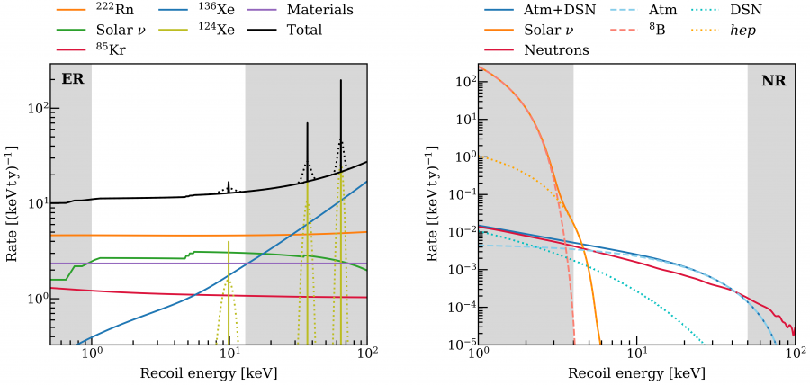
Predicted Background and Their Mitigation
JCAP 11 (2020) 031
Electronic Recoil
Nuclear Recoil
XENONnT projection
XENONnT projection
²²²Rn emanation from material
⁸⁵Kr from natural krypton
Xe isotopes: ¹²⁴Xe ECEC and ¹³⁶Xe 2$ν\text{ββ}$ decay
Solar neutrinos
Radiogenic neutrons
Cosmogenic neutrons
CEνENs from Atm+DSN and solar neutrinos
Distillation + Radiopurity
Neutron Veto
Distillation
Muon Veto
Shengchao Li | CoSSURF 2022 | May 13, 2022
10

Slide 11
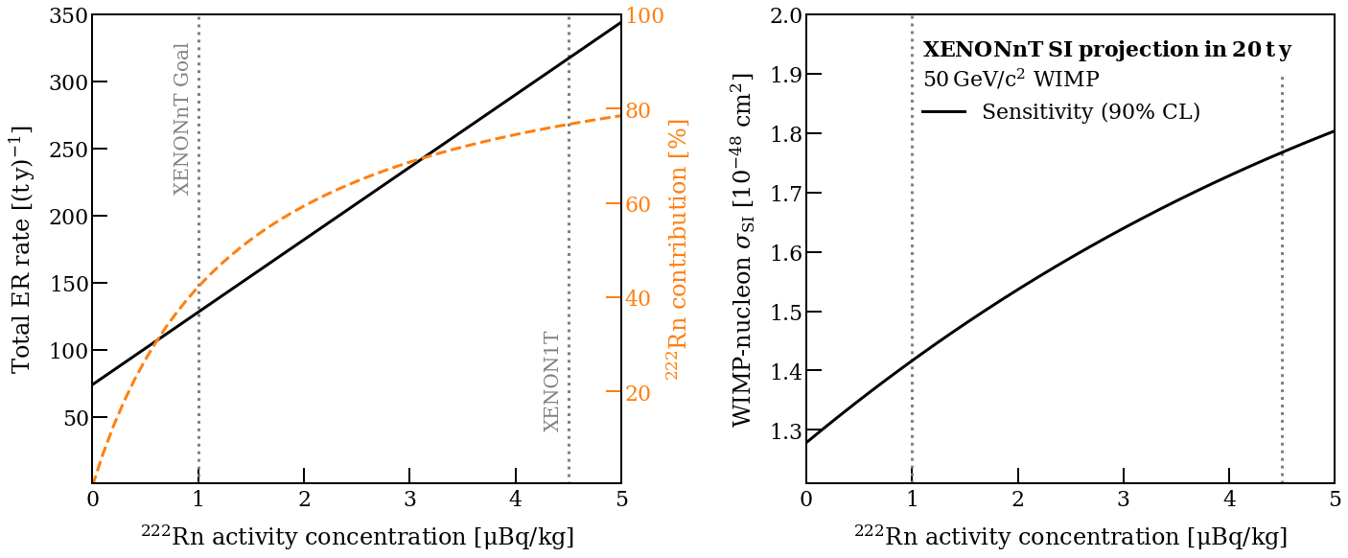
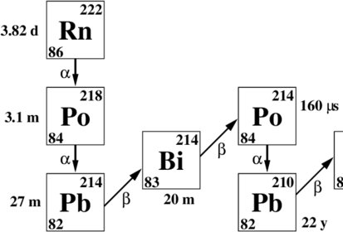
Suppression of ²²²Rn background is the key
JCAP 11 (2020) 031
Low energy β-decays from ²²²Rn is a major background in both ER and NR bands (via leakage)
Successful reduction of ²²²Rn drives the improvement on the final sensitivity
Strategy: AVOID or REMOVE
Shengchao Li | CoSSURF 2022 | May 13, 2022
11

Slide 12
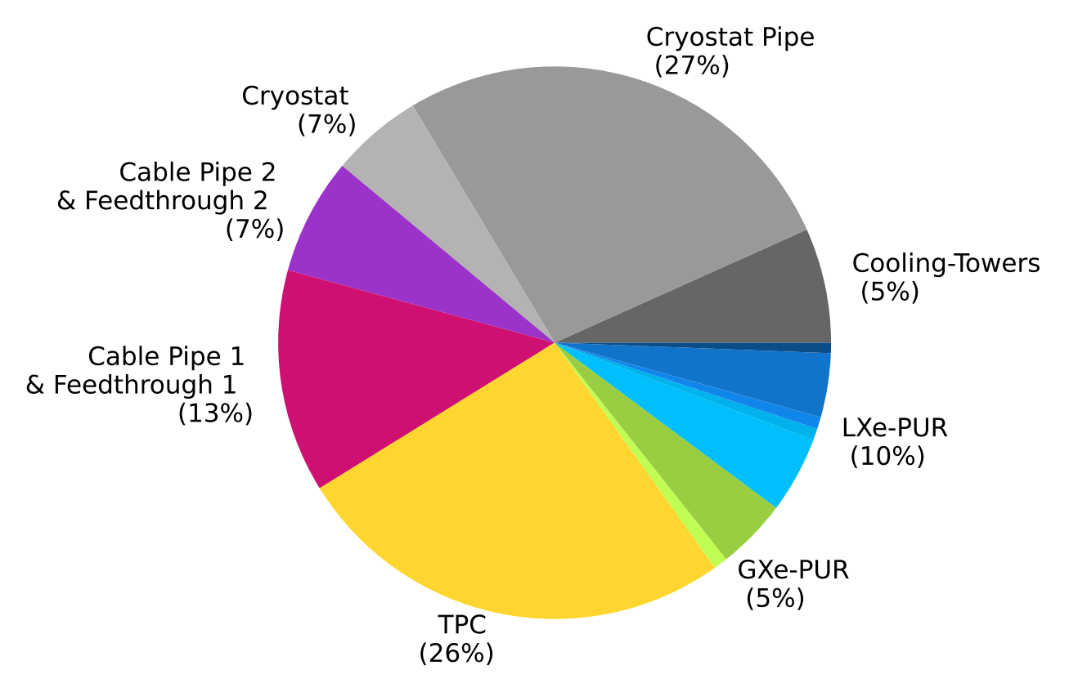
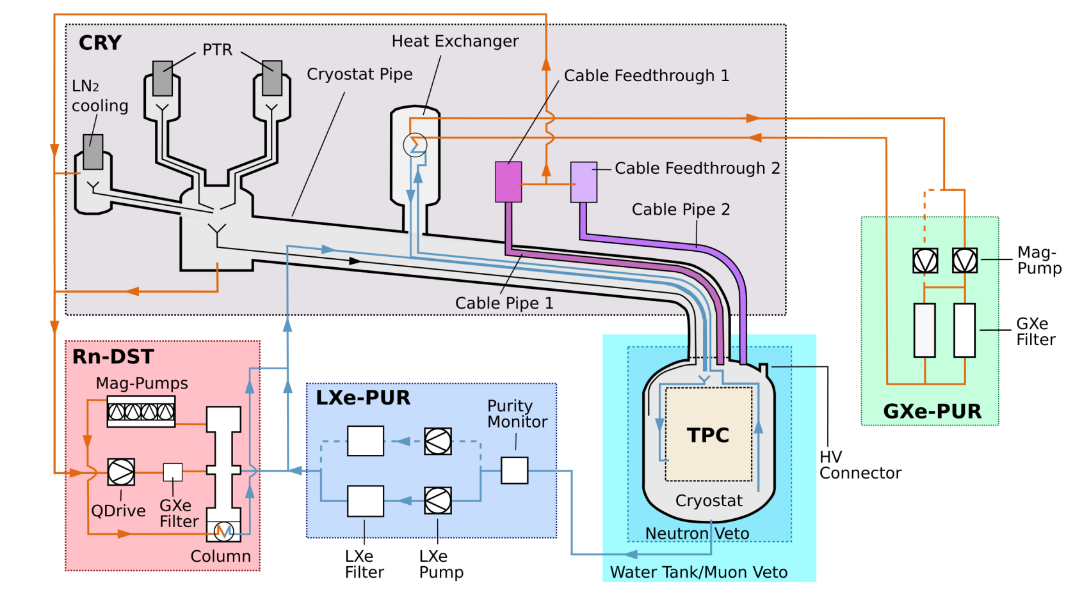
Material Screening and Cleaning
2112.05629 [accepted EPJC]
Cleanliness procedures
Radioassay program:
gamma-ray/mass spectrometry
²²²Rn emanation measurement
Identify Rn source over subsystems
Rn emanation rate:
4.2 µBq/kg (simulated)
1/3 of 1T level
Shengchao Li | CoSSURF 2022 | May 13, 2022
12

Slide 13
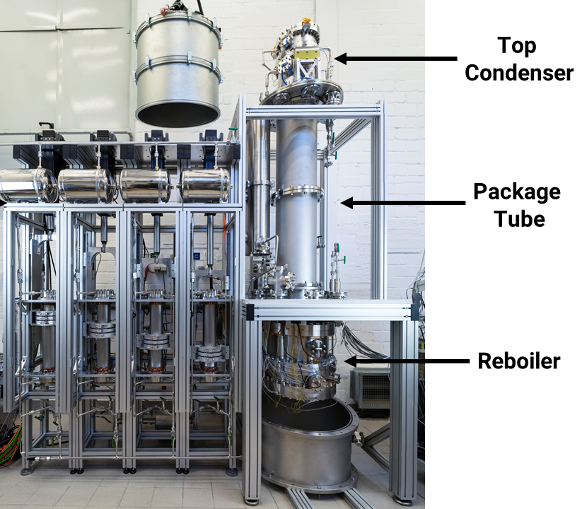
Radon Distillation Column
MagPump x4
Separate Rn from Xe via vapor pressure difference
Cryogenic distillation
Clean component
Rn-free mag-pump
Can operate with both LXe and GXe
XENONnT strategy:
2x with high flow distillation column for sources inside LXe
2x by GXe extraction to remove Rn before entering TPC
EPJC (2017) 77 358
EPJC 81 (2021) 337
EPJC 78 (2018) 604
Low Rn
Trap less volatile Rn until it decays
High Rn
Shengchao Li | CoSSURF 2022 | May 13, 2022
13

Slide 14
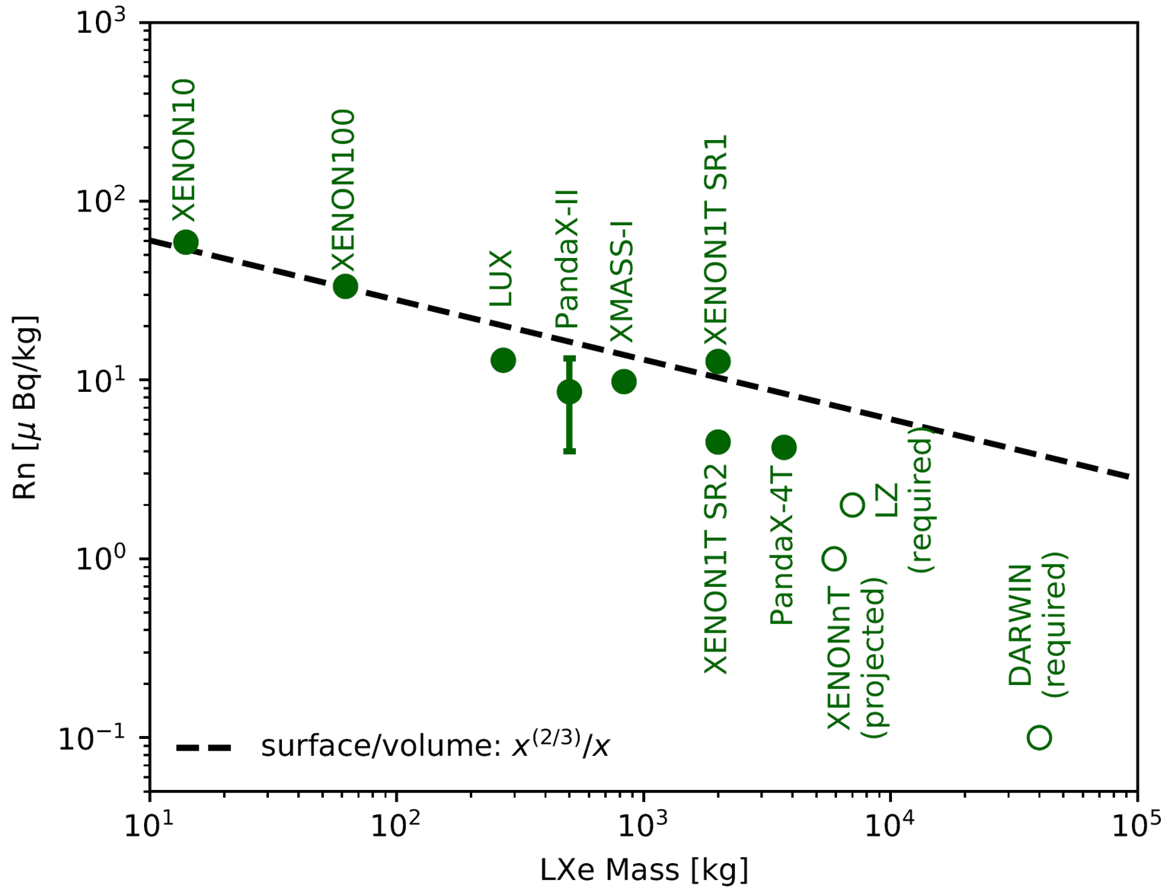
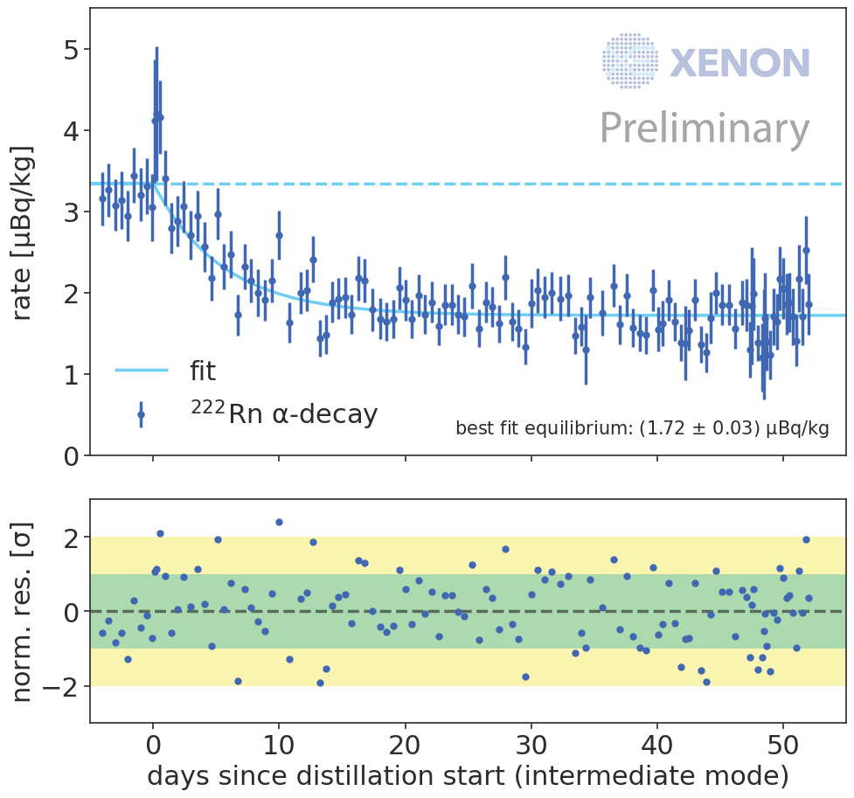
Radon Distillation Column Performance
nT goal: 1 µBq/kg
²²²Rn/Xe = 10⁻²⁵
GXe-only mode shows Rn reduction:
3.3 µBq/kg -> 1.7 µBq/kg
Lowest ²²²Rn/Xe level in operating LXe TPC
Expect below 1µBq/kg with additional LXe mode
Shengchao Li | CoSSURF 2022 | May 13, 2022
14

Slide 15
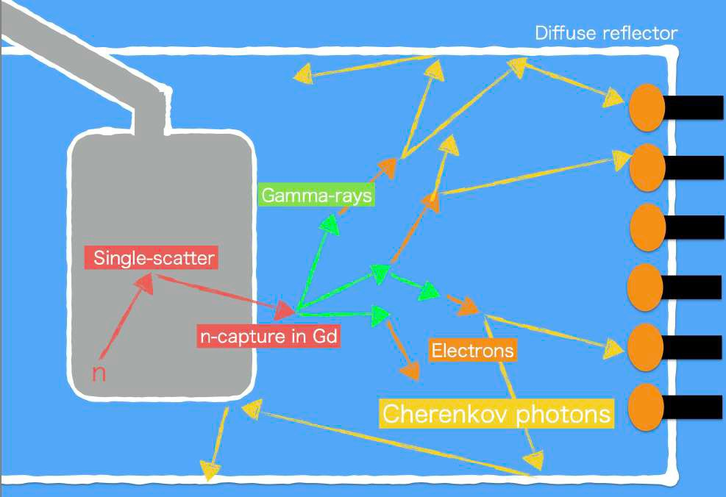
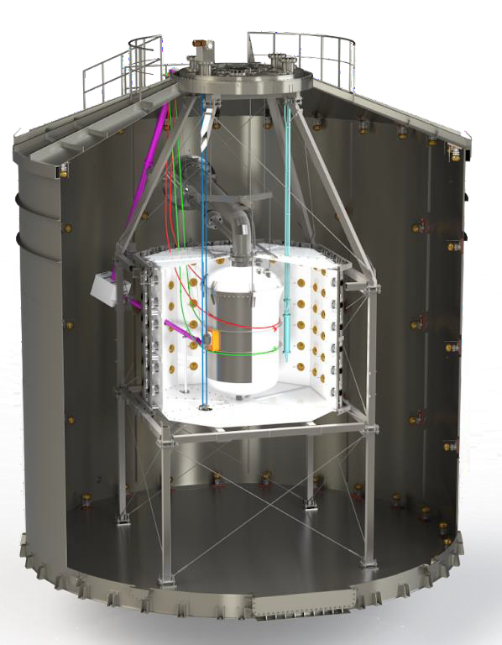
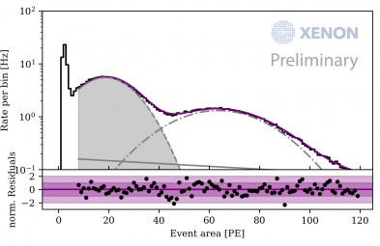
Neutron Veto System
Gd-Water Cherenkov detector
33m³, with 120 PMTs inside ePTFE panels
87% expected neutron tagging efficiency with Gd-doped water
JCAP (2020) 11 031
Trigger on 4.4 MeV AmBe, 90% efficiency in detecting neutron capture with demi-water
Translate to 65% tagging efficiency with water (match with sim)
2.2 MeV from ²H
4.4 MeV from AmBe
Goal: <1 evt / (20 t × yr)
Shengchao Li | CoSSURF 2022 | May 13, 2022
15

Slide 16
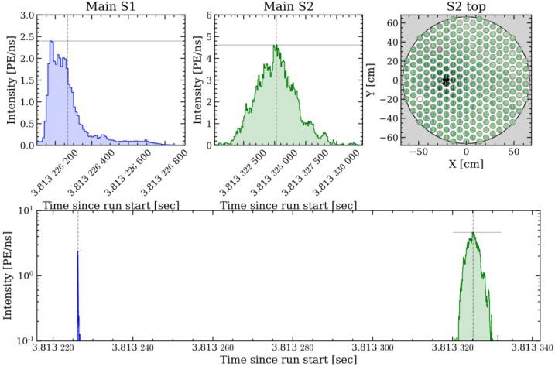
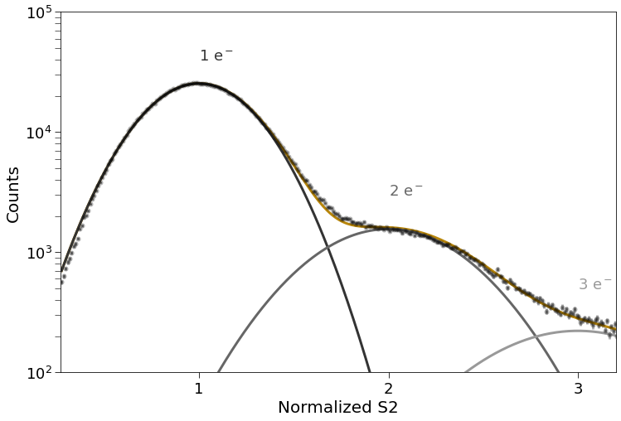
Initial Science Run Performance
XENONnT has been taking data consistently in triggerless mode (open-source package: strax, straxen)
PMTs have stable gains thanks to the LED calibration, average QE is 34%
Good single-electron resolution
 | Light collection | S1 resolution @41.5keV | S2 resolution
1T | 14% | 8% | 13.7%
nT* | 17% | 7.6% | 15.1%
*preliminary result
Shengchao Li | CoSSURF 2022 | May 13, 2022
16

Slide 17
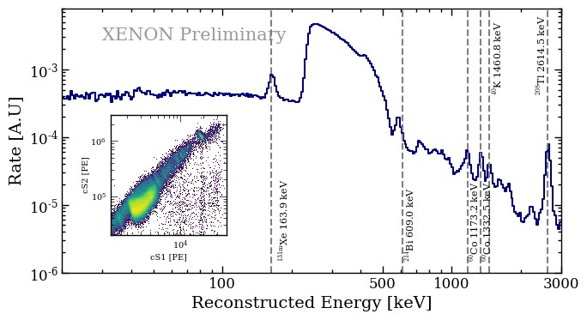
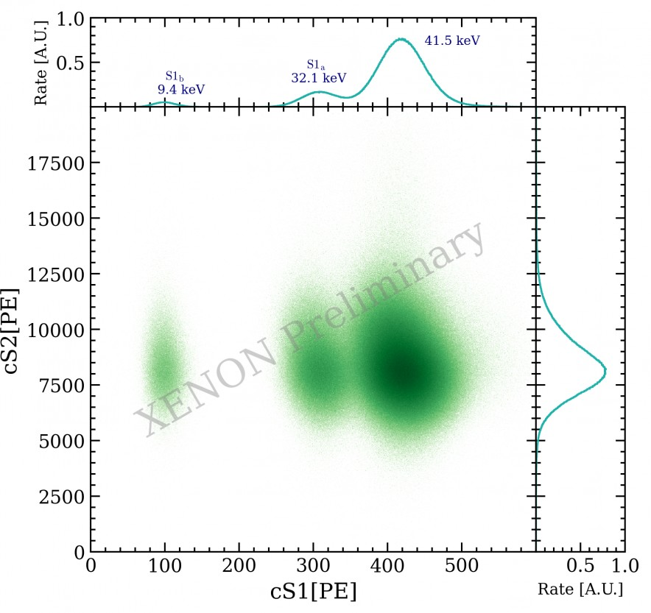
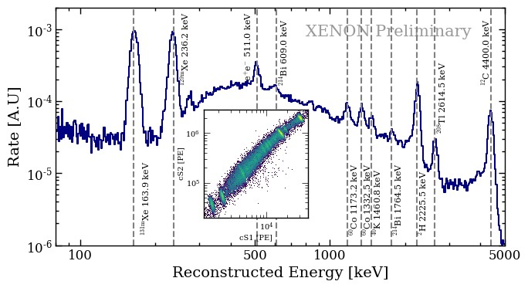
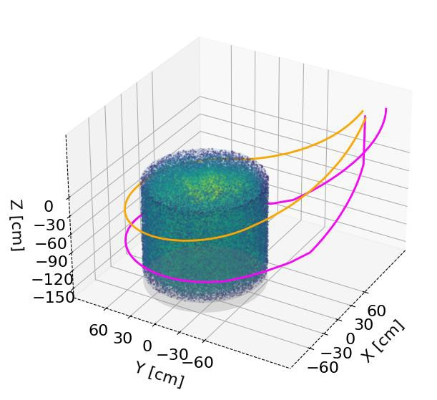
XENONnT Calibration Campaign
^{83m}Kr: spatial homogeneity and position dependent TPC response
²²⁰Rn: model low energy ER band
AmBe: model low energy NR band
²²⁰Rn
AmBe
^{83m}Kr
Shengchao Li | CoSSURF 2022 | May 13, 2022
17

Slide 18
XENONnT Science Goals: WIMP Search
JCAP (2020) 11 031
4 tons fiducial volume with 5 year time span
SI WIMP sensitivity (90% C.L.):
1.4×10⁻⁴⁸ cm² @ 50 GeV/c²
Approaching designed exposure, both ²²²Rn and neutron background will have high impact to final sensitivity
Shengchao Li | CoSSURF 2022 | May 13, 2022
18

Slide 19
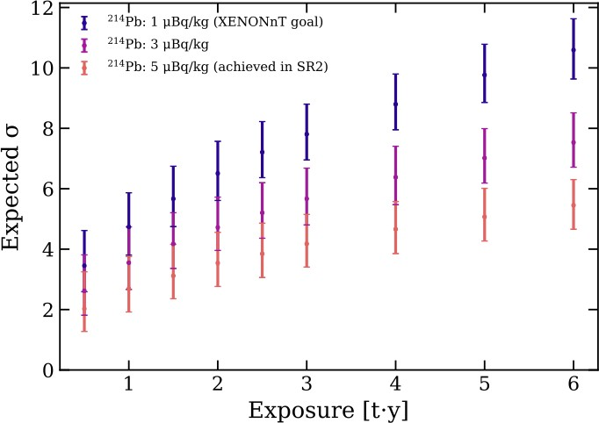
XENONnT Science Goals: ER Excess Investigation
The first few months of XENONnT data will either confirm or reject the excess with high significance
If the excess persists, we can differentiate hypothesis for its origin unambiguously:
E.g., B₀+ ³H +solar axion model v.s. B₀+ ³H model at 5σ
Shengchao Li | CoSSURF 2022 | May 13, 2022
19

Slide 20
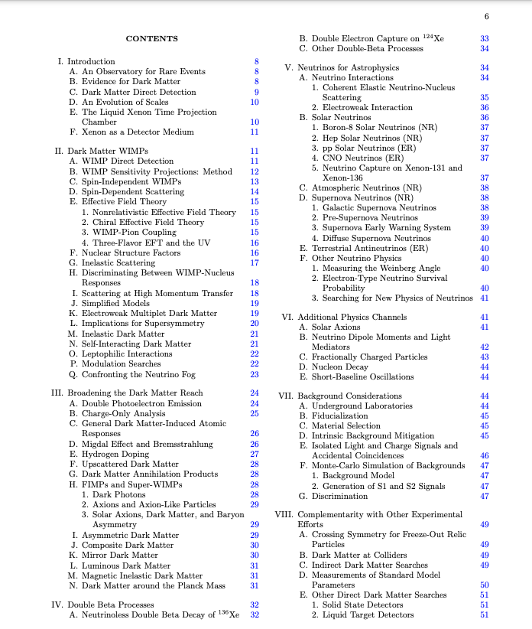
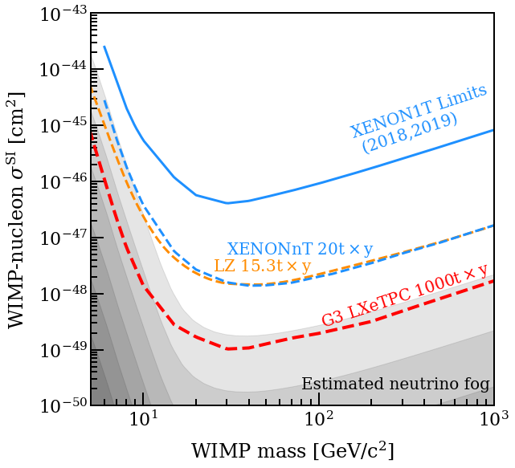
What if XENONnT does not see dark matter?
2203.02309
The “neutrino fog” is still far away with current iteration of WIMP experiments
Interesting neutrino physics emerges through 0νββ search and a variety of astrophysical sources
Generation-3 LXe TPC will be the ultimate multi-purpose observatory to advance new physics
Joining forces from LZ & XENON
G3 whitepaper [2203.02309]
500+ authors, 77 pages,
40 figures, 1262 references
(courtesy of K. Morå)
Shengchao Li | CoSSURF 2022 | May 13, 2022
20

Slide 21
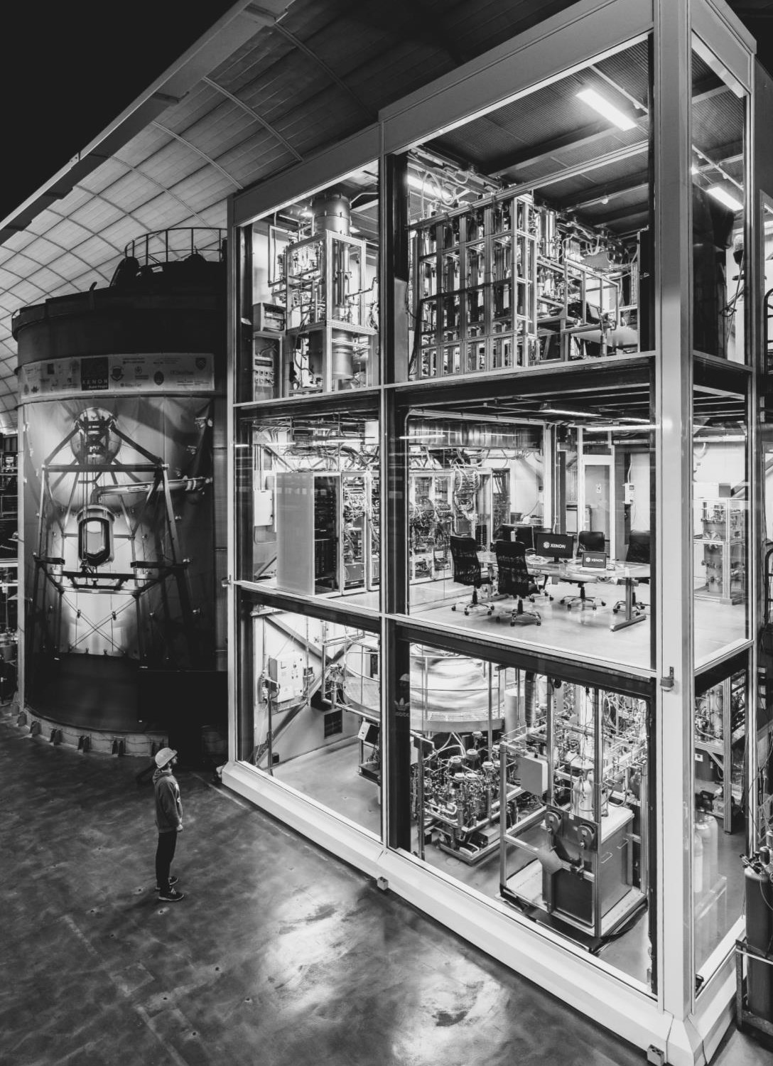
Conclusions
XENONnT direct detection experiment will improve the current WIMP limit by more than an order of magnitude, and deliver better understandings on the ER excess.
The newly developed neutron veto, LXe purification system and radon distillation column after XENON1T will further suppress backgrounds in the detector.
The experiment has been taking data since 2020 in very stable condition, with the result from the initial science run to be released soon.
Stay tuned!
http://xenonexperiment.org
XENONexperiment
xenon_experiment
@xenonexperiment
Shengchao Li | CoSSURF 2022 | May 13, 2022
21

Slide 22
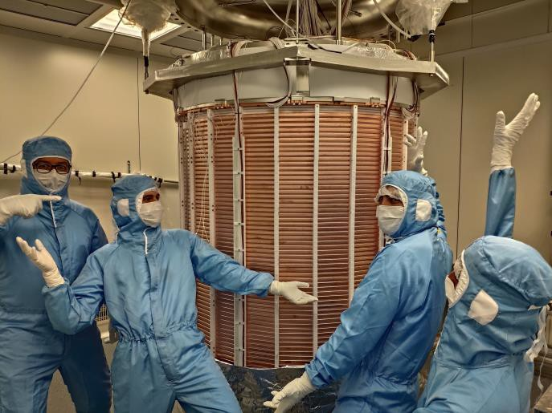
Backup Slides
Shengchao Li | CoSSURF 2022 | May 13, 2022
22

Slide 23
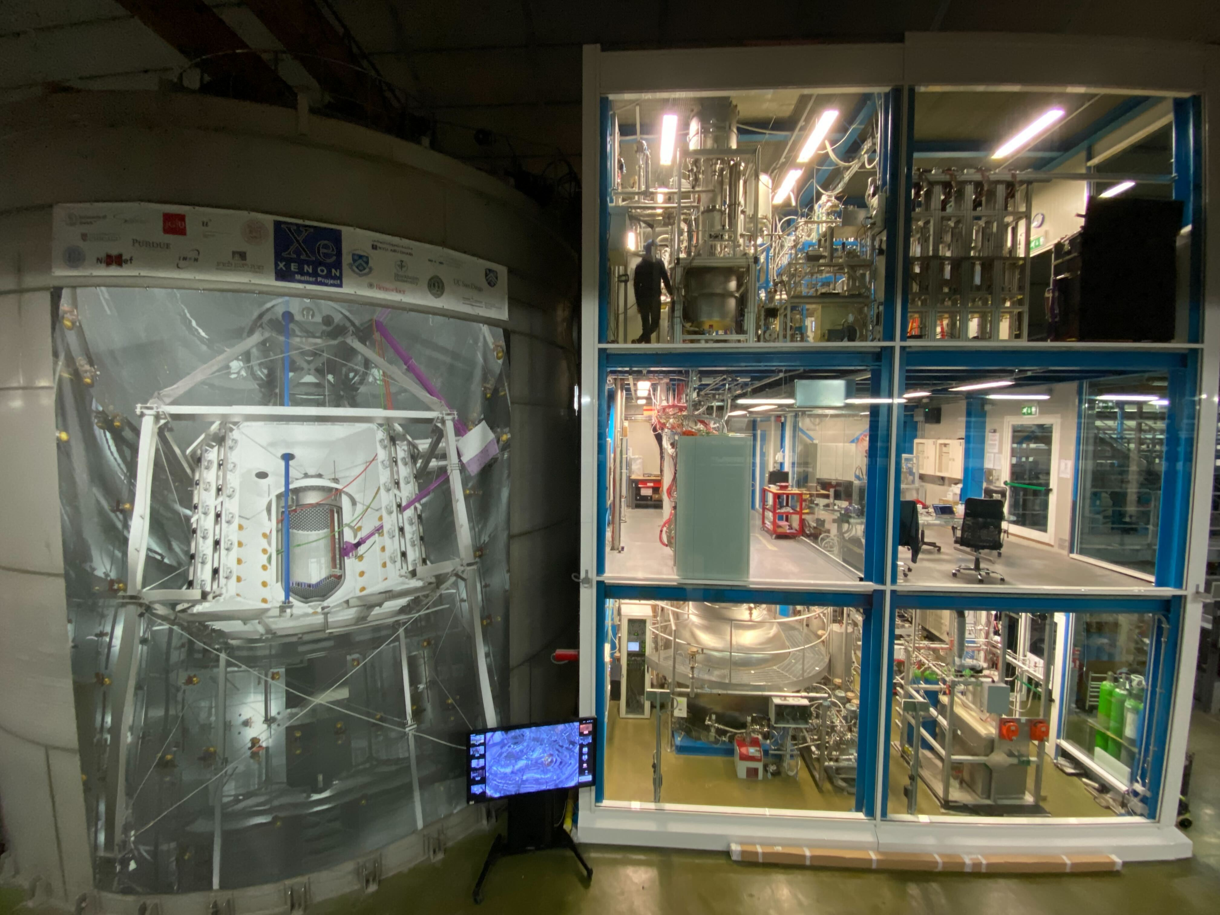
XENONnT Subsystems
Cryogenics system,
LXe/GXe purification,
Rn distillation column
Slow control,
Data acquisition
Online Kr distillation,
Xe recovery system
Shengchao Li | CoSSURF 2022 | May 13, 2022
23

Slide 24
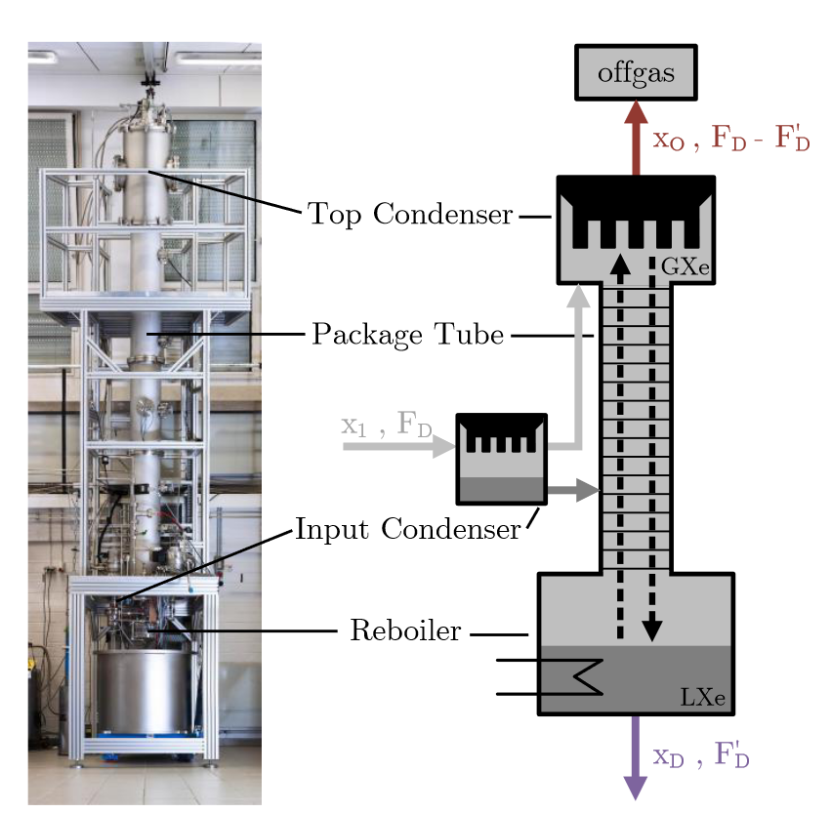
Krypton Distillation Column
EPJC 77 (2017) 275
2112.12231
Process speed at 8.3 slpm (=3kg/h)
Kr reduction factor of 10⁴–10⁵
Delivers final concentration level of < 48 ppq ^{nat}Kr/Xe in the system
Also useful for removing ³⁷Ar after calibration
Kr, Ar
Xe
Shengchao Li | CoSSURF 2022 | May 13, 2022
24

Slide 25
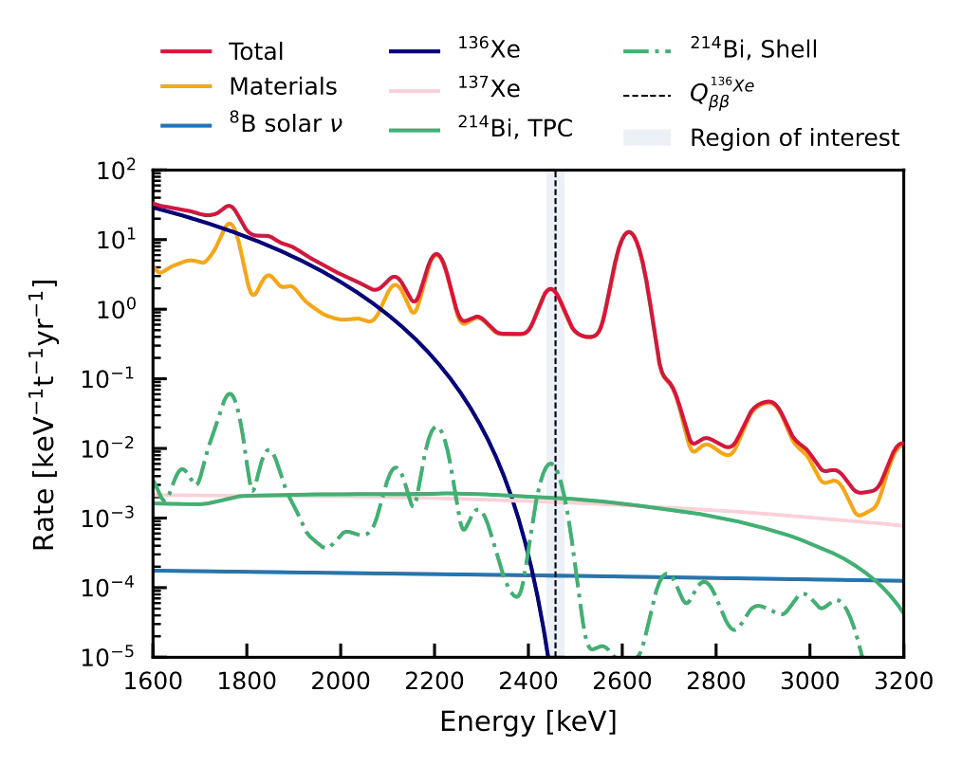
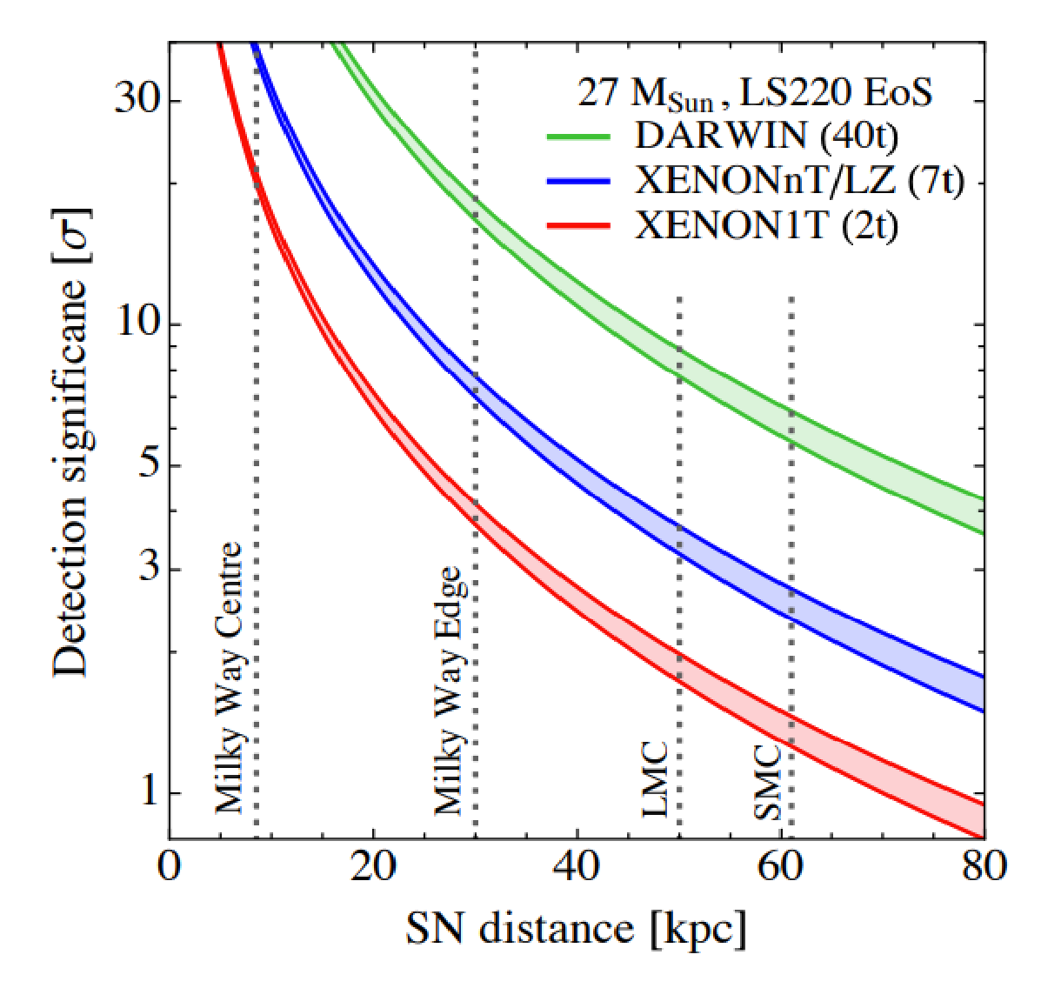
XENONnT Science Goals: Neutrino Physics
8.9% abundance
¹³⁶Xe 0$ν\text{ββ}$:
2205.04158
R. Lang et al.
PRD (2016) 10 103009
SNEWS 2.0
Shengchao Li | CoSSURF 2022 | May 13, 2022
25

