Slide 1



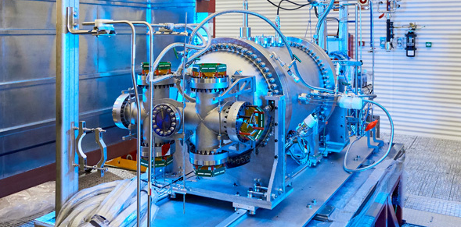
Searching for 0νββ Decay with High Pressure Xenon Gas Time Projection Chambers
Leslie Rogers on behalf of the NEXT Collaboration
Argonne National Laboratory

Slide 2



Implications of a robust observation of 0νββ
e⁻
1) Lepton number conservation is violated
2) Massive fermions exist that are their own antiparticle
3) There are other mass generating mechanisms in nature beyond the Higgs mechanism
4) Could measure the mass of the neutrino
ν
0νββ
Detection Strategies
NEXT Detectors
  Past
  Current
  Future
ν
2νββ
e⁻
Conserves Lepton number
0=+2-2= 0
e⁻
x
0νββ
e⁻
Violates Lepton number
0≠2

Slide 3
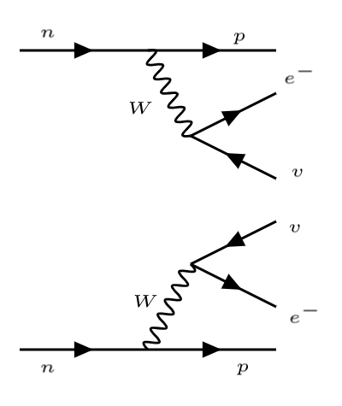
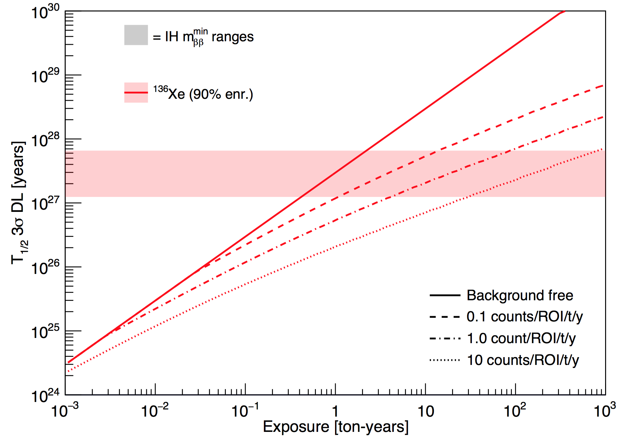
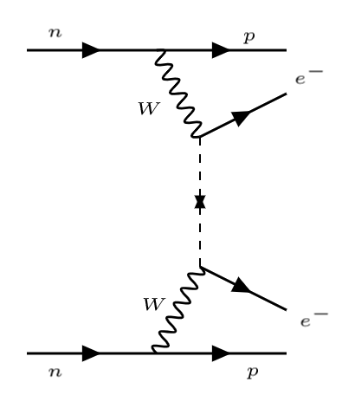


Rare Decay Search
Double beta decay is already a rare decay, neutrinoless even more so
Ultimately a ton-scale experiment with excellent background rejection (<1 ct/ROI/t/y) is the key to crossing the IH in finite time
0νββ
Detection Strategies
NEXT Detectors
  Past
  Current
  Future
$$T_{1/2}^{2ν}≈{10}^{19−21} yrs$$
Run for 2-3 years
Inverted Heirarchy
Run for 15 years
Run for 100 years
Run for 1000 years
1000 kg experiment
3
$$T_{1/2}^{0ν}>{10}^{26} yrs$$

Slide 4
Design Requirements
All 0νββ detectors are chasing 3 main things:
  A large volume
  Extremely low or nonexistent backgrounds
  Great energy resolution
0νββ
Detection Strategies
NEXT Detectors
  Past
  Current
  Future
4

Slide 5
Candidate Isotopes for 0νββ Decay
Q_{ββ} must be above gamma-ray backgrounds
Need high enough natural abundance to extract large quantities
0νββ
Detection Strategies
NEXT Detectors
  Past
  Current
  Future
Candidate | Q_{ββ} (MeV) | Abund. (%)
⁴⁸Ca → ⁴⁸Ti | 4.27 | 0.19
⁷⁶Ge → ⁷⁶Se | 2.04 | 7.8
⁸²Se → ⁸²Kr | 3 | 9.2
⁹⁶Zr → ⁹⁶Mo | 3.35 | 2.8
¹⁰⁰Mo → ¹⁰⁰Ru | 3.03 | 9.6
¹¹⁰Pd → ¹¹⁰Cd | 2.01 | 11.8
¹¹⁶Cd → ¹¹⁶Sn | 2.8 | 7.5
¹²⁴Sn → ¹²⁴Te | 2.23 | 5.6
¹³⁰Te → ¹³⁰Xe | 2.53 | 34.5
¹³⁶Xe → ¹³⁶Ba | 2.48 | 8.9
¹⁵⁰Nd → ¹⁵⁰Sm | 3.37 | 5.6
NEXT Detectors
5

Slide 6
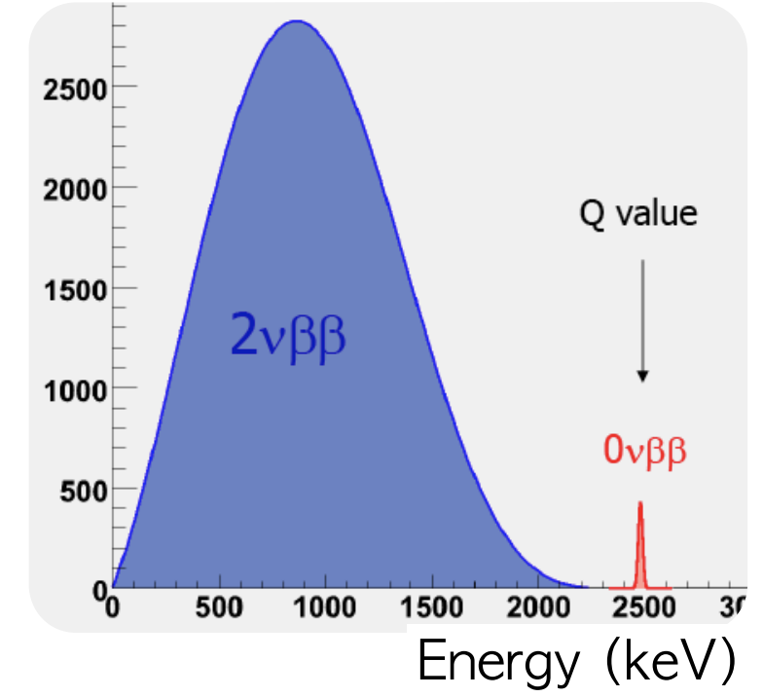
Event Energy
For a neutrinoless decay all the energy produced will go into the two electrons
A double beta decay event with exactly the decay energy of the isotope in question means it is neutrinoless!
0νββ
Detection Strategies
NEXT Detectors
  Past
  Current
  Future
Q value
6
JHEP 10 (2019) 51

Slide 7
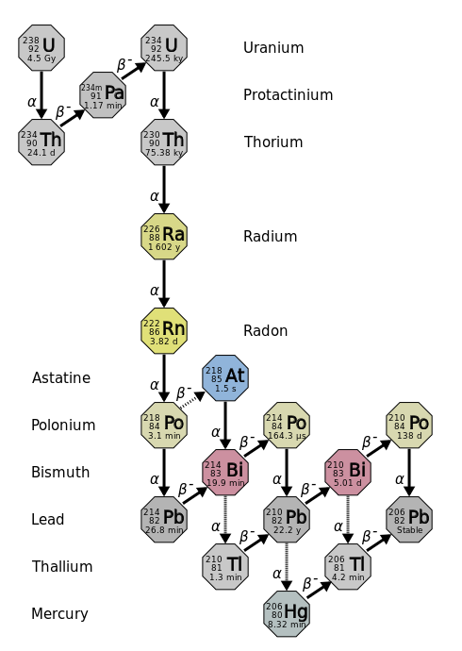
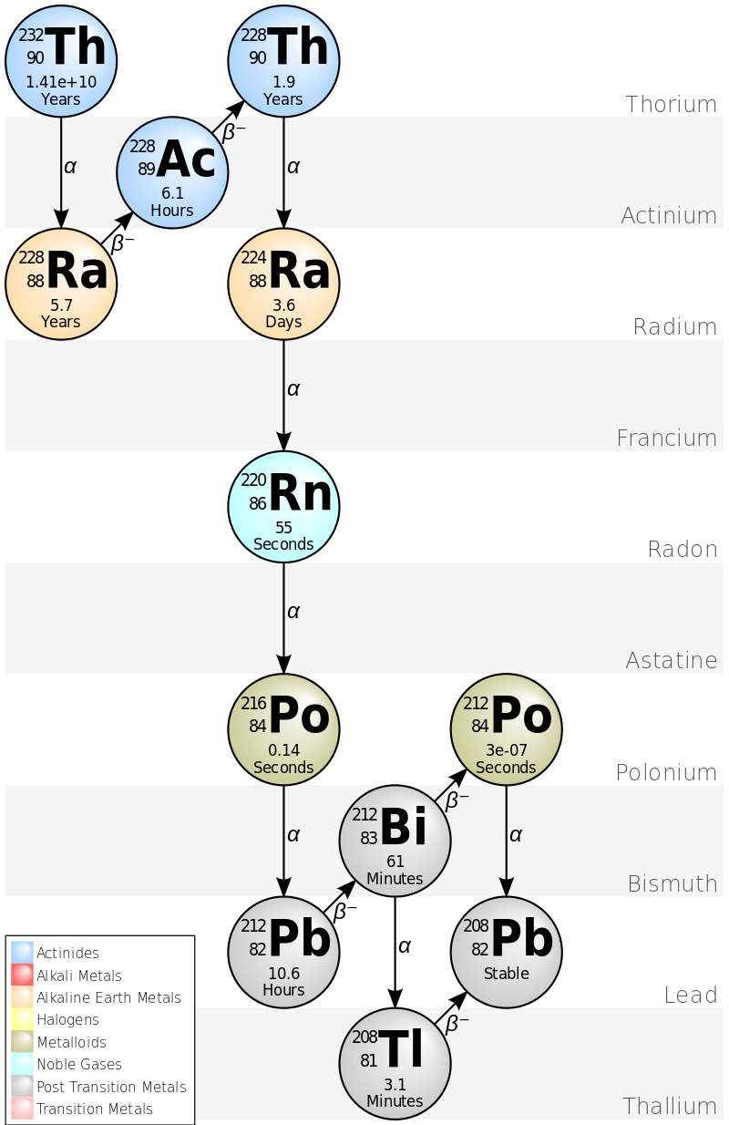
Backgrounds for 0νββ Decay
The main backgrounds in these detectors are ²¹⁴Bi and ²⁰⁸Tl from uranium and thorium chains
Energy resolution of <1% FWHM is vital for distinguishing between the two types of beta decay and rising above the ²¹⁴Bi photoelectric peak
0νββ
Detection Strategies
NEXT Detectors
  Past
  Current
  Future
Q value
7
JHEP 10 (2019) 51
NEXT-100 background models

Slide 8
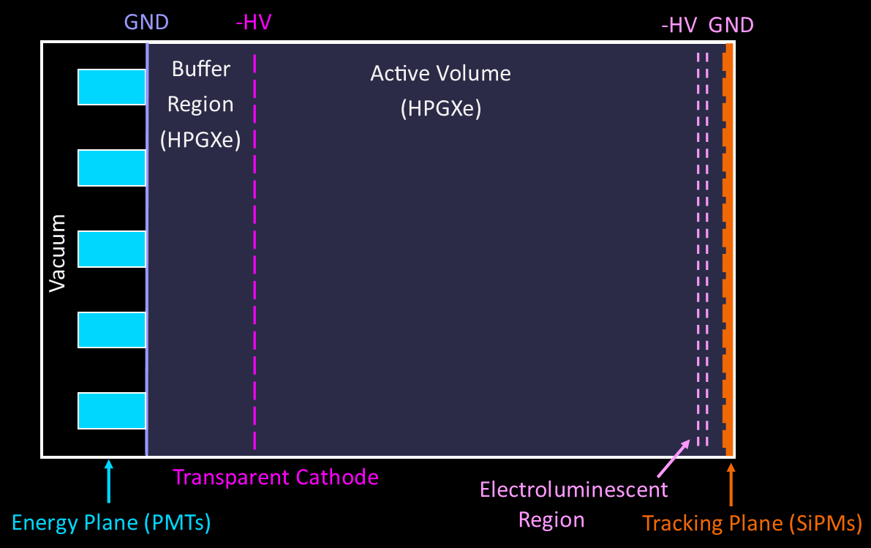
Basic Principles of the NEXT Detector
0νββ
Detection Strategies
NEXT Detectors
  Past
  Current
  Future
NEXT is a time projection chamber that drifts charged particles from their initial position to a light amplification plane
Electrons that reach the readout plane first were produced closer, i.e. smaller z dimension, and those further away take longer to get there, projecting time into a z component
electrons
γ (172 nm)
8

Slide 9
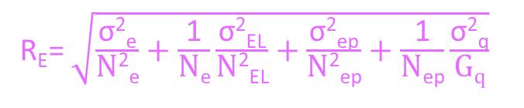
Advantages of Xenon Gas
Bolotnikov, & Ramsey NIMA, 396, 360–370
Measuring ionization only (@662 keV)
Low density allows ionized electrons to be drifted towards the electroluminescent region before they recombine with xenon ions
Low Fano factor means the number of electrons created along the ionization path is well correlated with the original energy of the betas
Fluctuation-less EL gain combined with low Fano factor produces energy resolution comparable with solid-state technologies in a ton-scale TPC experiment
Liquid
0νββ
Detection Strategies
NEXT Detectors
  Past
  Current
  Future
Recombination
Limited gas
Gas
Electroluminescence
EL plus Ionization
NEXT
R_{E}= $\sqrt{\frac{\text{σ}\text{2}\text{e}}{\text{N}\text{2}\text{e}}+\frac{\text{1}}{\text{N}\text{e}}\frac{\text{σ}\text{2}\text{EL}}{\text{N}\text{2}\text{EL}}+\frac{\text{σ}\text{2}\text{e}\text{p}}{\text{N}\text{2}\text{e}\text{p}}+\frac{\text{1}}{\text{N}\text{e}\text{p}}\frac{\text{σ}\text{2}\text{q}}{\text{G}\text{q}}}$
9
γ
γ
Systematic contributions from detector imperfections
Recombination (depends on gas pressure, composition, Efield)
Depends on EL gain fluctuations
e⁻ +Xe → 2e⁻+ Xe⁺
e⁻ +Xe → e⁻+Xe* → e⁻+2Xe+γ
e- +Xe → e-+Xe* → e-+2Xe+γ
Notes:
Low fluctuations on the energy required for ionization is quantized as a low Fano factor

Slide 10
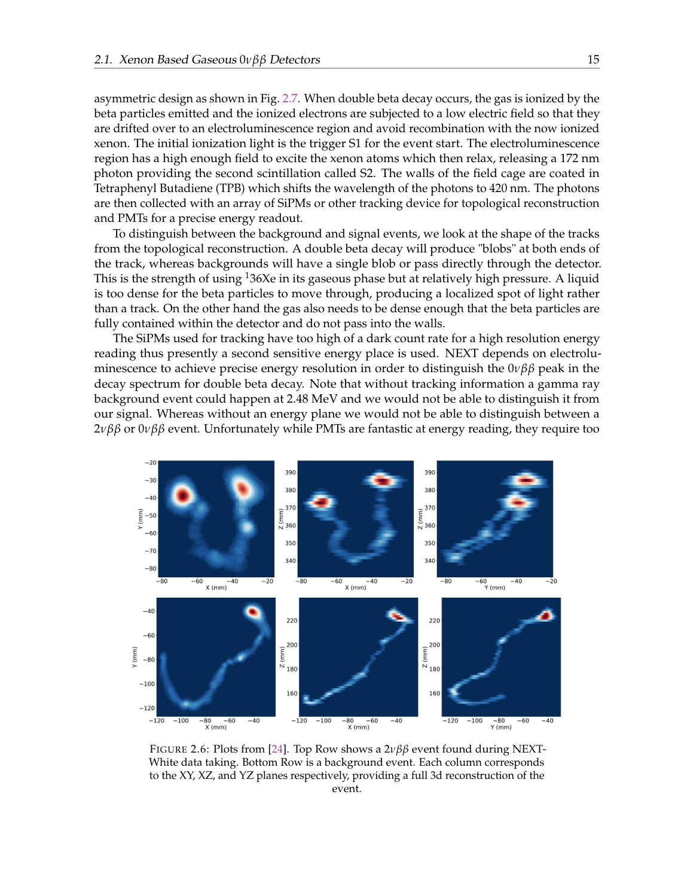
Event Topology
0νββ
Detection Strategies
NEXT Detectors
  Past
  Current
  Future
Lower density gas allows powerful single-vs-multi electron topological rejection
A “blob” indicates the end deposit of energy as a high energy electron comes to rest
A track with two blobs indicates two beta particles released simultaneously, i.e. double beta decay
Active background rejection rather than self shield uses isotope efficiently
Signal-like event
Background-like event
10
JHEP 2021 (10), 7 2021

Slide 11
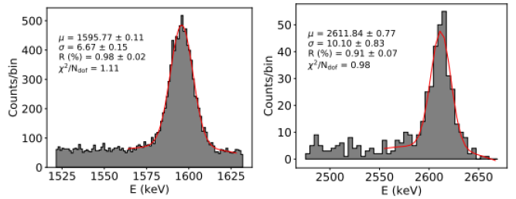
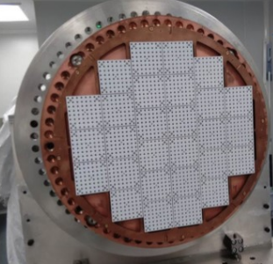
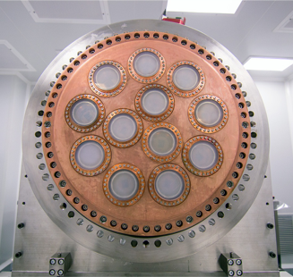
Basic Principles of the NEXT Detector
208Tl double escape and photopeaks
0νββ
Detection Strategies
NEXT Detectors
  Past
  Current
  Future
electrons
γ (172 nm)
11

Slide 12
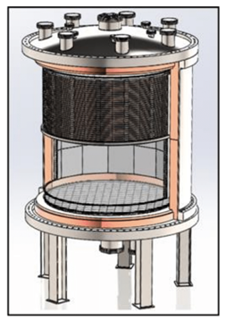
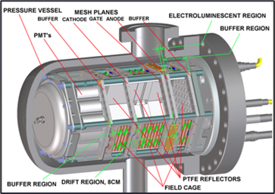
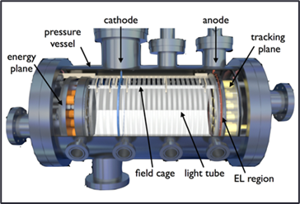
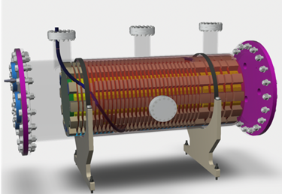
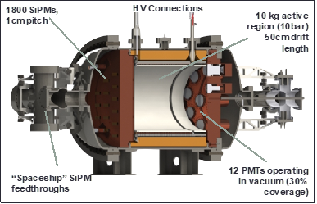
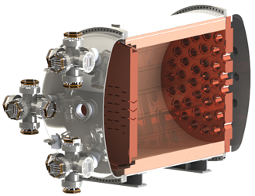
Sequence of NEXT Detectors
NEXT-HD with Barium Tagging
0νββ
Detection Strategies
NEXT Detectors
  Past
  Current
  Future
NEXT-DBDM
NEXT-DEMO
NEXT-CRAB
NEXT-White
NEXT-100
12
NEXT-HD

Slide 13
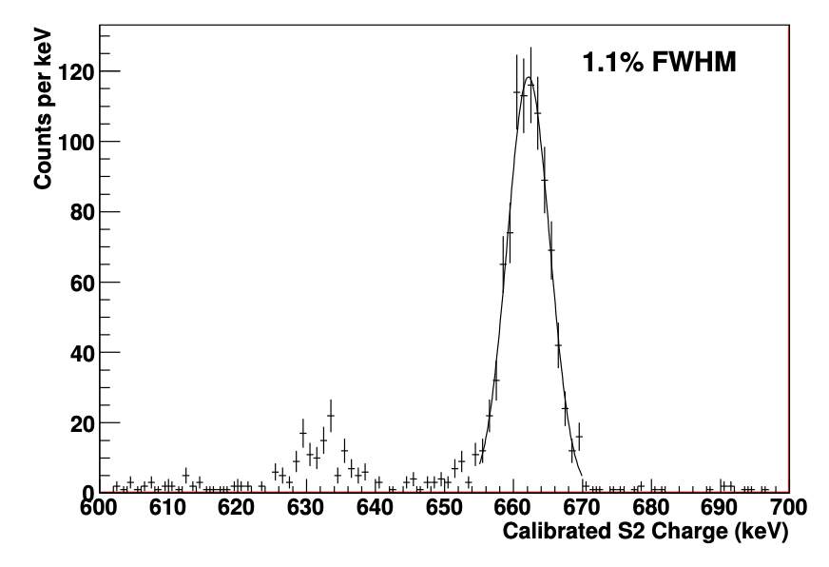
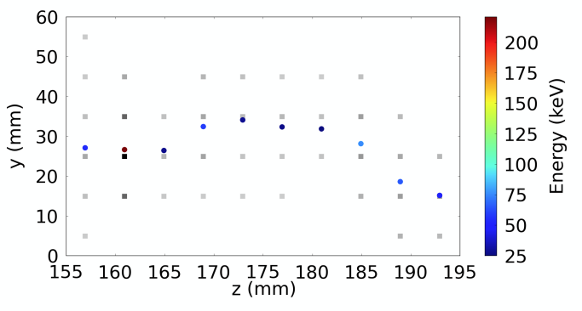
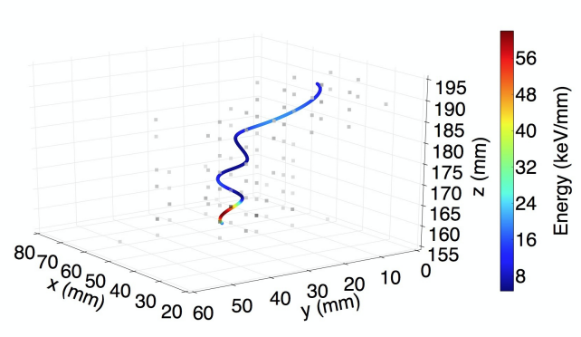
Sequence of NEXT Detectors
NEXT-DBDM demonstrated energy resolution capabilities and NEXT-DEMO proved the concept of topological reconstruction
NEXT-HD with Barium Tagging
0νββ
Detection Strategies
NEXT Detectors
  Past
  Current
  Future
NEXT-DBDM
NEXT-DEMO
NEXT-CRAB
NEXT-White
NEXT-100
13
NEXT-HD
Nucl. Instrum. Meth. A 708 (2013) 101
2013 JINST 9 P09011

Slide 14
Sequence of NEXT Detectors
NEXT-HD with Barium Tagging
0νββ
Detection Strategies
NEXT Detectors
  Past
  Current
  Future
NEXT-DBDM
NEXT-DEMO
NEXT-CRAB
NEXT-White
NEXT-100
14
NEXT-White recently decommissioned after taking data for 5 years with a run time of 481 days
NEXT-HD

Slide 15
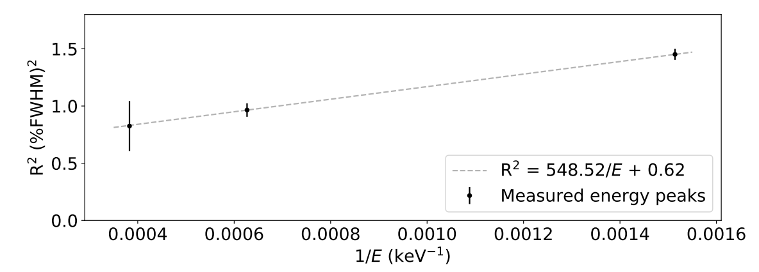
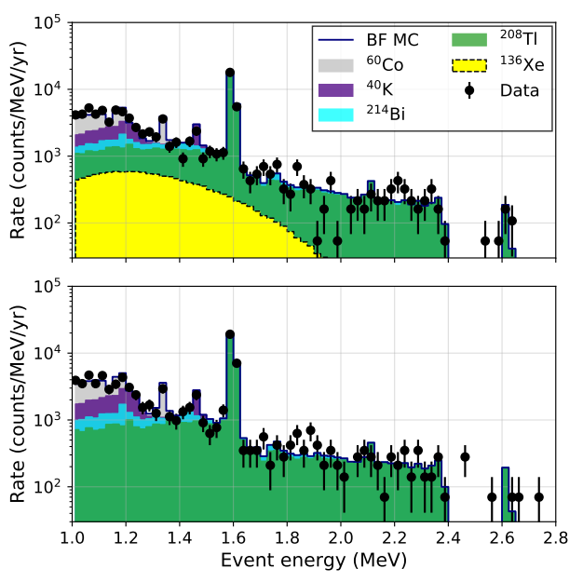
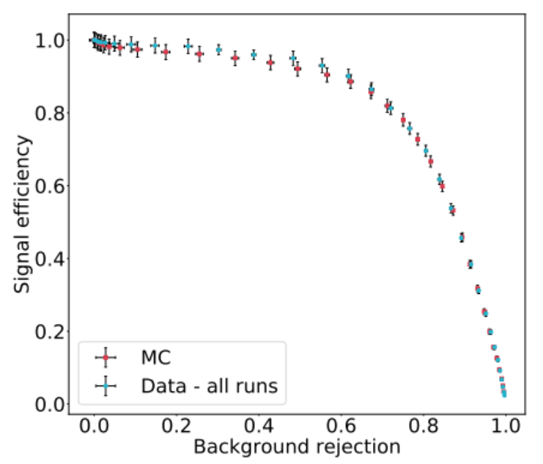
NEXT-White
Strong data and monte carlo agreement from topological cuts tuned with double escape peaks from ²²⁸Th source
Energy calibrations show <1% FWHM at Q_{ββ}
Q value
0νββ
Detection Strategies
NEXT Detectors
  Past
  Current
  Future
JHEP (2019) no.10, 230
15
JHEP (2019) no.10, 052
Phys. Rev. C (2022) 105, 055501

Slide 16
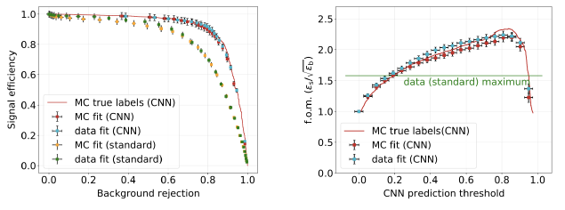
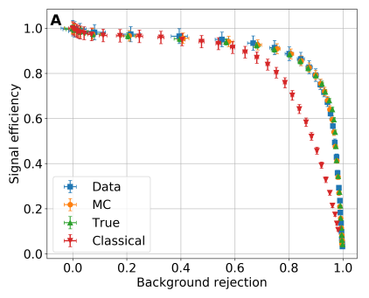
NEXT-White
0νββ
Detection Strategies
NEXT Detectors
  Past
  Current
  Future
JHEP (2021) no 10, 189
Used CNNs with great success, reducing backgrounds to 10% while still maintaining 65% signal efficiency
Have now added Lucy-Richardson Deconvolution to improve track reconstruction and cuts
(L-R)
(L-R)
(L-R)
16
JHEP (2021) no.10, 146

Slide 17
Sequence of NEXT Detectors
NEXT-100 is being commissioned now and is a demonstrator for technology scalable to the tonne-scale
NEXT-HD with Barium Tagging
0νββ
Detection Strategies
NEXT Detectors
  Past
  Current
  Future
NEXT-DBDM
NEXT-DEMO
NEXT-CRAB
NEXT-White
NEXT-100
NEXT-HD
17

Slide 18
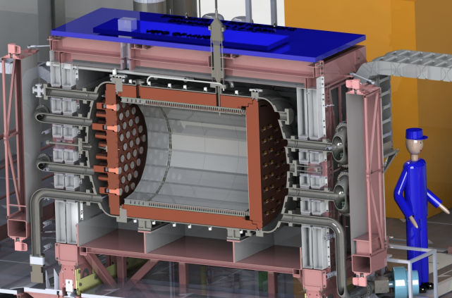
NEXT-100
0νββ
Detection Strategies
NEXT Detectors
  Past
  Current
  Future
Modified structural designs capable of being scaled to tonne-scale
Improved radioactive budget
Expected background index of 4 x 10⁻⁴ counts/keV/kg/yr
Will reach a sensitivity of 6 x 10²⁵ years after a run of 3 years
18

Slide 19
Sequence of NEXT Detectors
NEXT-CRAB was the prototype for NEXT-100 and is now exploring technology scalable beyond the tonne-scale
NEXT-HD with Barium Tagging
0νββ
Detection Strategies
NEXT Detectors
  Past
  Current
  Future
NEXT-DBDM
NEXT-DEMO
NEXT-CRAB
NEXT-White
NEXT-100
NEXT-HD
19

Slide 20
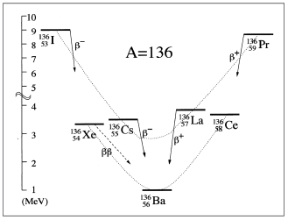
What if we can suppress backgrounds to zero?
Observation of barium ion daughter in coincidence with topological signal can completely suppress the radiological backgrounds
0νββ
Detection Strategies
NEXT Detectors
  Past
  Current
  Future
Xe¹³⁶ -> Ba²⁺+2e+2ν(0ν)
20

Slide 21
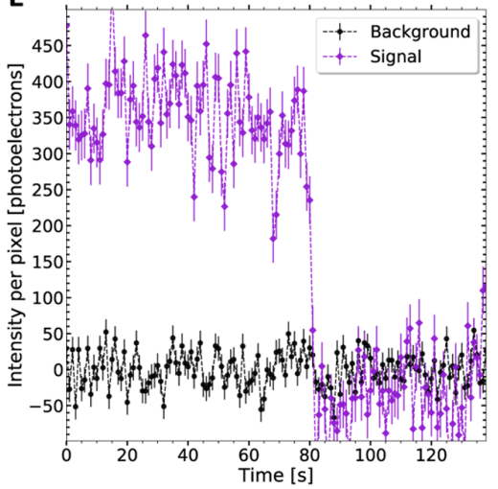
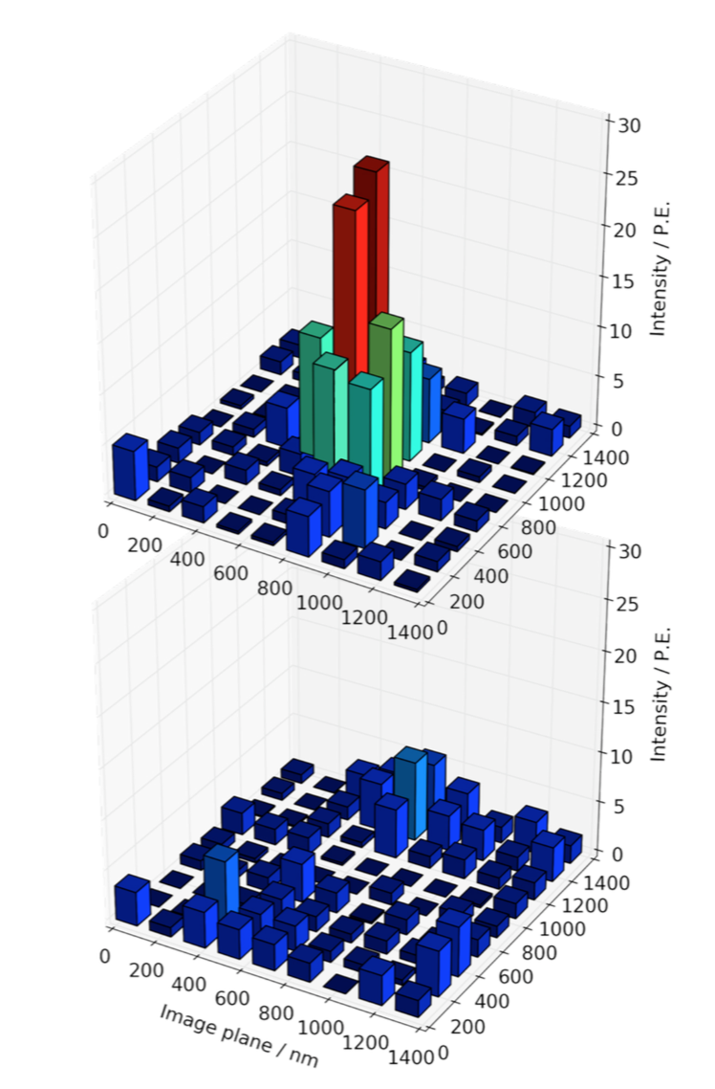
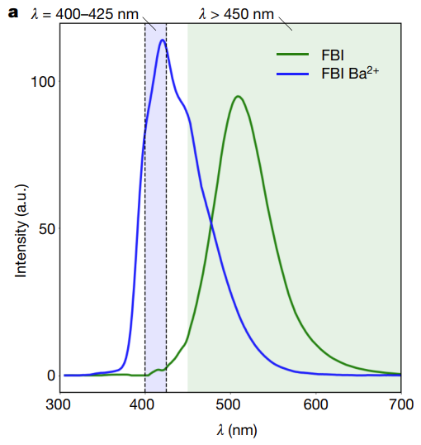
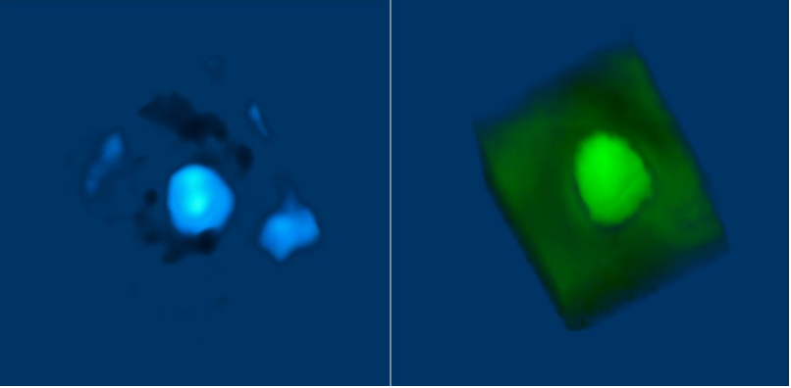
Barium Tagging
Two different methods are being explored to tag when the barium ions come in contact at the cathode plane
  Fluoresce off-on molecules
  Color-shifting molecules
0νββ
Detection Strategies
NEXT Detectors
  Past
  Current
  Future
ACS Sens. 2021, 6, 192-202
Nature 583, 48-54 2020
21

Slide 22
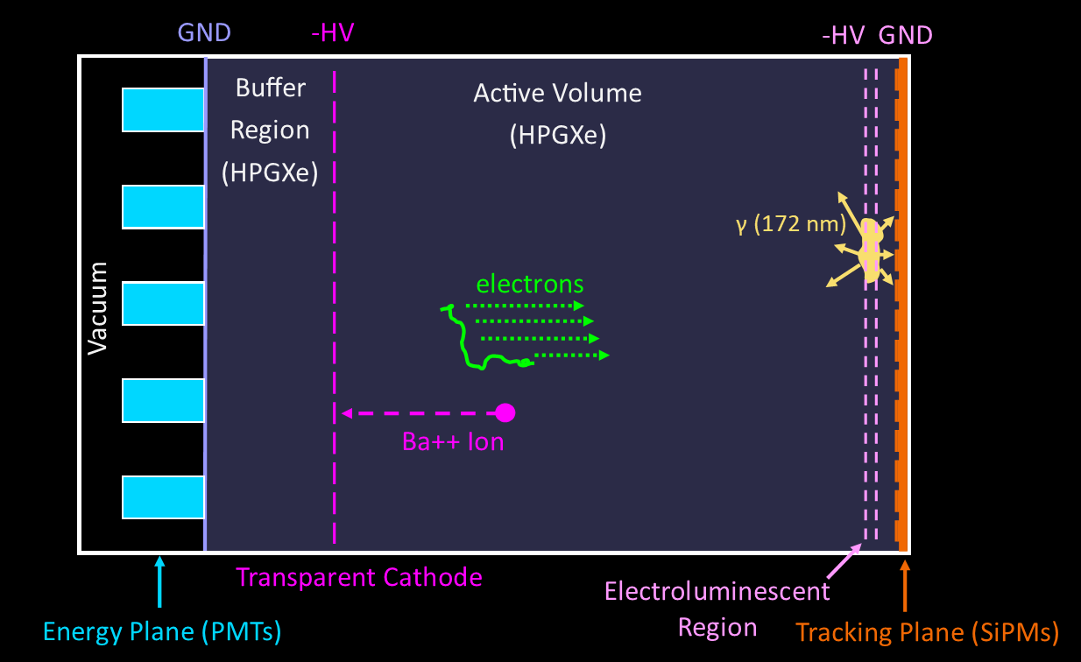
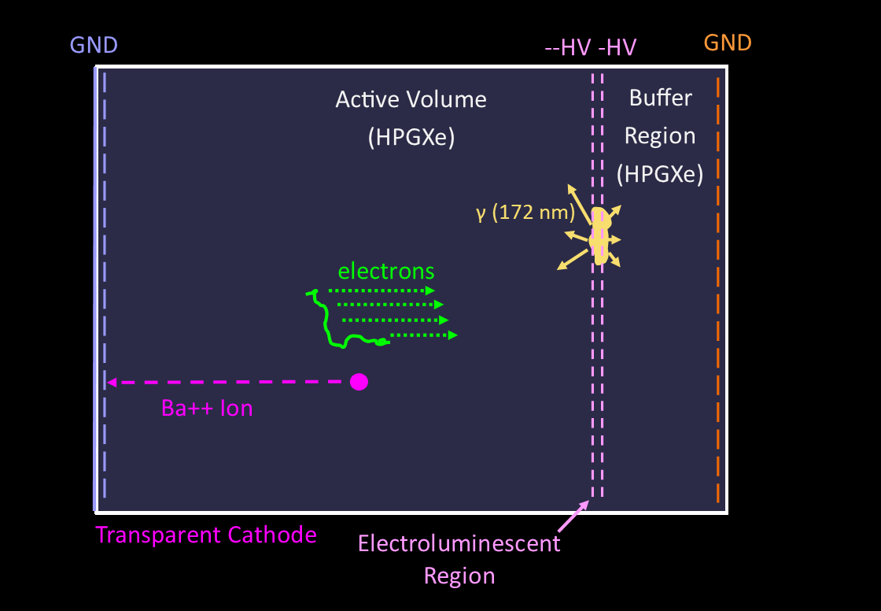
Changes to Accommodate Barium Tagging
0νββ
Detection Strategies
NEXT Detectors
  Past
  Current
  Future
To get barium to the chemosensors we need the Cathode to be at ground
This moves the buffer region to the EL side, making light collected by SiPMs too diffuse for a clear image
The Barium tagging sensors will cover the plane blocking light collection for the PMTs
ACS Sens. 2021, 6, 192-202
Nature 583, 48-54 2020
22

Slide 23
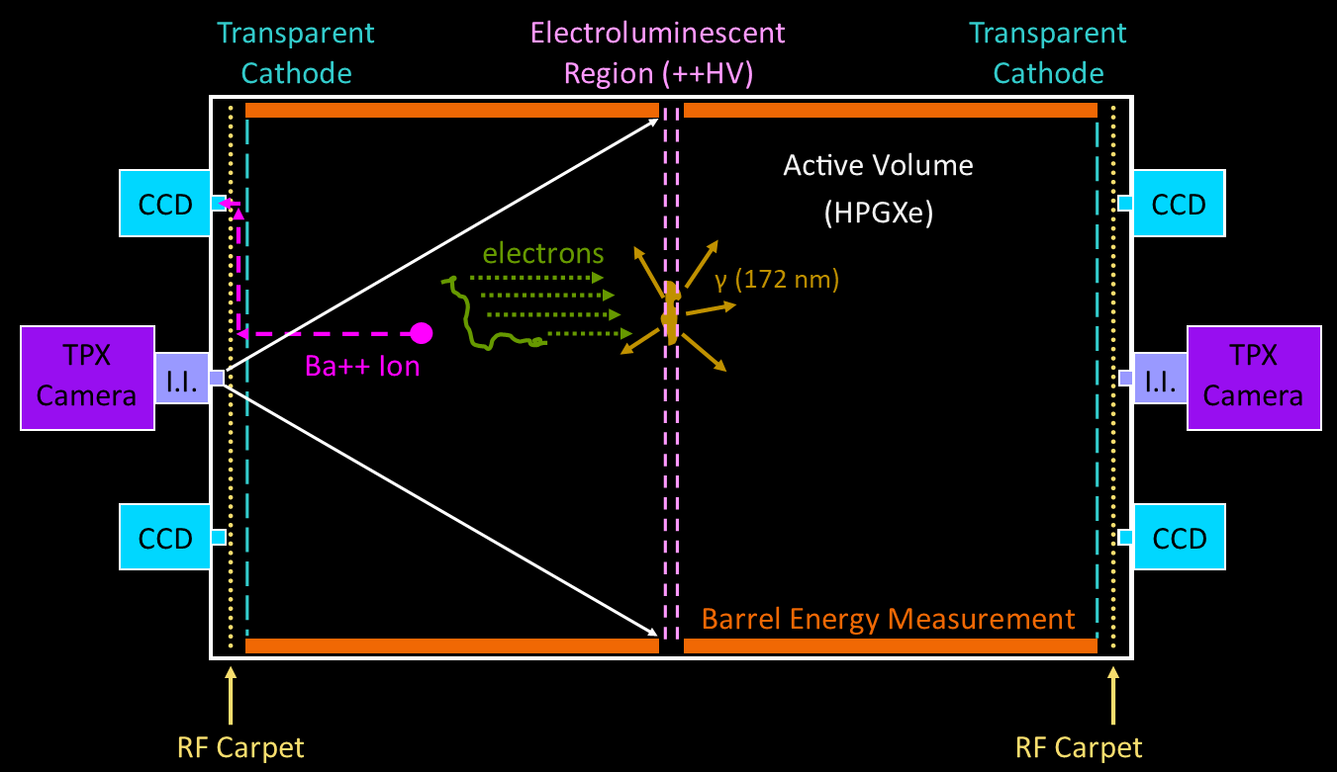
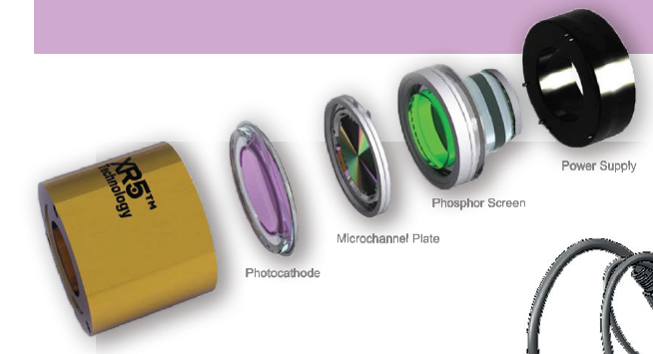
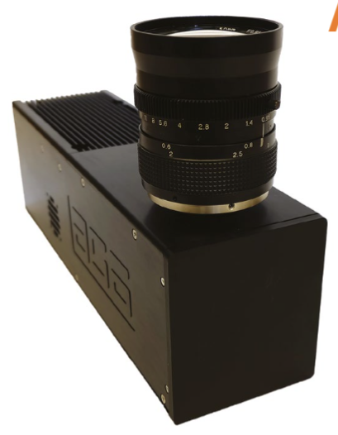
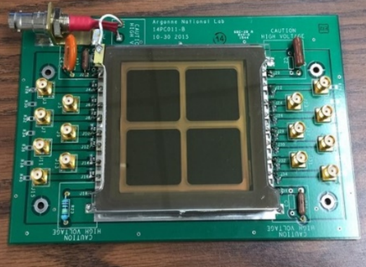
NEXT Camera Readout and Barium Tagging
Replacing SiPMs with direct VUV camera tracking
Designing custom microchannel-plate photo-multipliers for energy measurements around the barrel of the detector
In the next 5 to 10 years we hope to deploy a 100-kg scale background free detector somewhere deep underground
0νββ
Detection Strategies
NEXT Detectors
  Past
  Current
  Future
23
Image
Intensifier
TPX3Cam
MCP-PMTs

Slide 24
Sequence of NEXT Detectors
NEXT-HD with Barium Tagging
0νββ
Detection Strategies
NEXT Detectors
  Past
  Current
  Future
NEXT-DBDM
NEXT-DEMO
NEXT-CRAB
NEXT-White
NEXT-100
24
NEXT-HD is the ton-scale and beyond goal, with and without Barium tagging, combining features from all previous demonstrators.
NEXT-HD

Slide 25
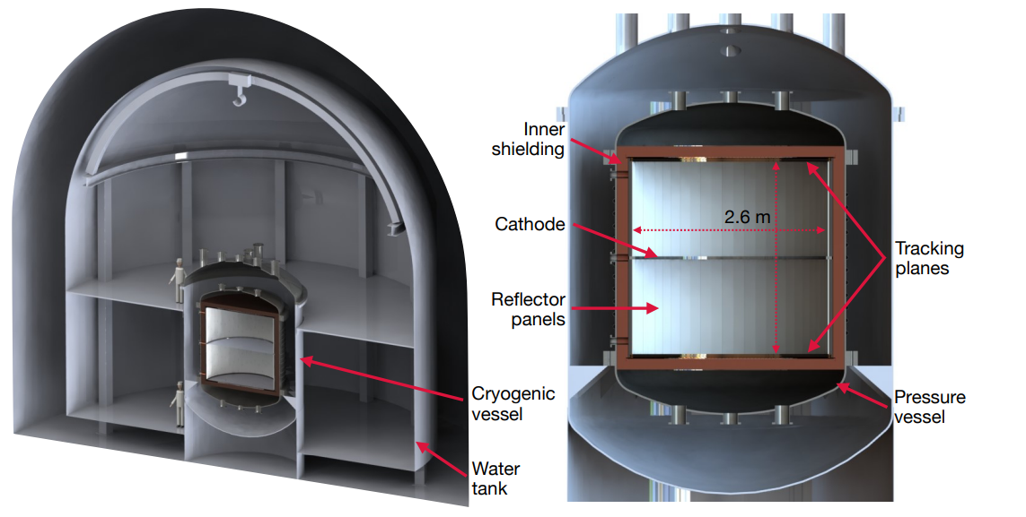
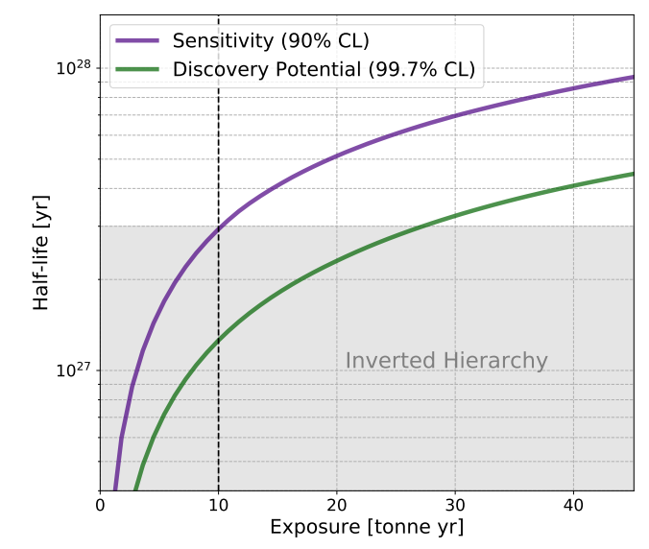
NEXT-HD
To cross the inverted hierarchy line a ton scale is needed, this will be NEXT-HD
Symmetric design, reducing length electrons drift and improving diffusion losses
No PMTs will be used, reducing the radiogenic backgrounds
Housed in a water chamber reducing cosmogenic backgrounds
0νββ
Detection Strategies
NEXT Detectors
  Past
  Current
  Future
25
arXiv:2005.06467
(accepted by JHEP)

Slide 26
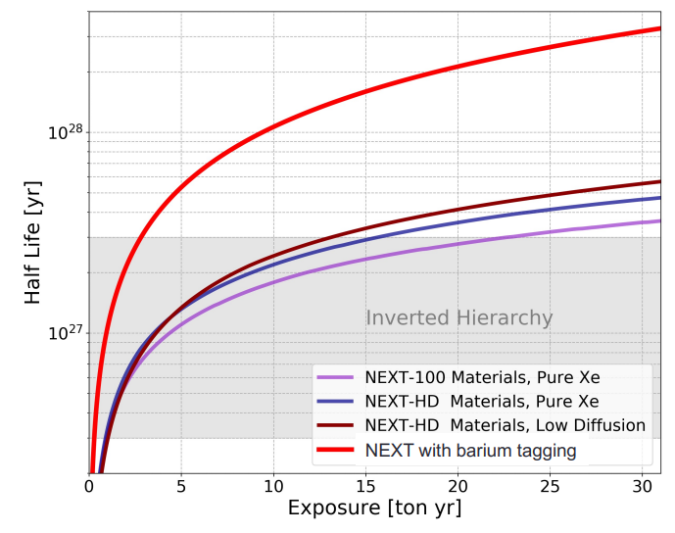
NEXT-HD + Barium Tagging
To go beyond the inverted hierarchy line we need even lower backgrounds and larger detectors
Adding Barium tagging at the cathode ends drastically increases the half life reach of the detector as it will be virtually background free
0νββ
Detection Strategies
NEXT Detectors
  Past
  Current
  Future
+ Barium
Tagging
To increase the active volume we can have multiple background free detectors; the original ton, but also multiple smaller detectors
26

Slide 27
Final Remarks
NEXT-White has finished taking data and met performance targets with topological identification and energy resolution
NEXT-100 construction is underway with projections of a world leading background index in xenon
NEXT-CRAB construction is underway and if successful will prove a scalable background-free technique for the search of neutrinoless double beta decay
NEXT-HD design is being developed with sensitivities capable of crossing the inverted hierarchy
Barium Tagging R&D is ongoing with single ion sensitivity demonstrated with both off-on and color-switching chemosensors
27

