Slide 1
AMoRE
Searching for 0ν ββ decay of ¹⁰⁰Mo
Jungho So on behalf of AMoRE collaboration

Slide 2
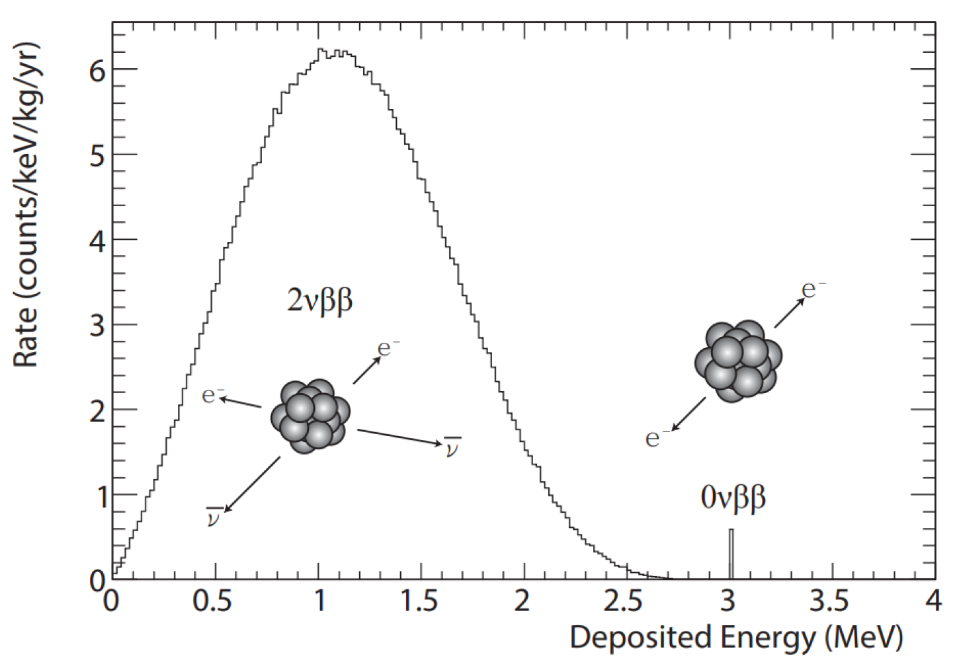
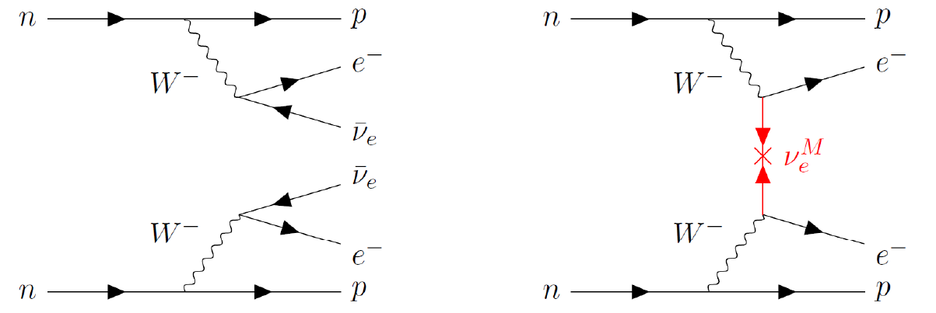
Neutrinoless Double Beta Decay
0ν ββ decay
Massive ν
Majorana particle
Extended SM model
>10²⁵ year of half life
2ν ββ decay
2nd order beta decay
Rare nuclear decay
>10¹⁸ years of half life
(Z, A) → (Z+2, A) + 2e⁻ + 2anti-ν_{e} (ΔL = 0, conserved)
(Z, A) → (Z+2, A) + 2e⁻ (ΔL = 2, violated)
0ν DBD is forbidden by Standard Model for lepton number violation.
Majorana ν can be confirmed (unique experimental approach)
Absolute mass of ν

Slide 3
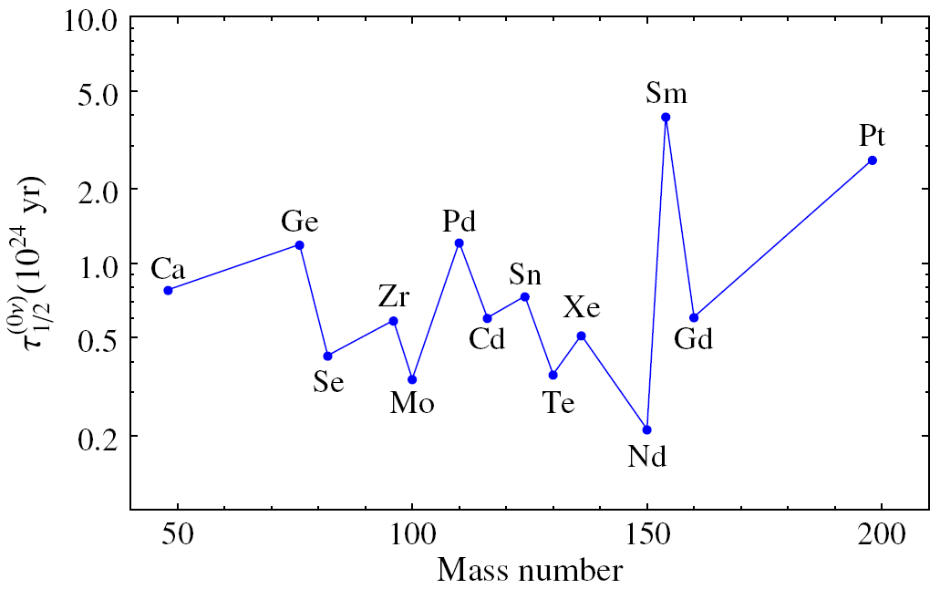
0ν ββ decay Exps.
Candidates | Q_{ββ}(MeV) | N.A. (%)
⁴⁸Ca→⁴⁸Ti | 4.268 | 0.187
⁷⁶Ge→⁷⁶Se | 2.039 | 7.8
⁸²Se→⁸²Kr | 2.998 | 8.8
⁹⁶Zr→⁹⁶Mo | 3.356 | 2.8
¹⁰⁰Mo→¹⁰⁰Ru | 3.034 | 9.7
¹¹⁰Pd→¹¹⁰Cd | 2.017 | 11.7
¹¹⁶Cd→¹¹⁶Sn | 2.813 | 7.5
¹²⁴Sn →¹²⁴Te | 2.293 | 5.8
¹³⁰Te→¹³⁰Xe | 2.528 | 34.1
¹³⁶Xe→¹³⁶Ba | 2.458 | 8.9
¹⁵⁰Nd→¹⁵⁰Sm | 3.371 | 5.6
Phase space factor (~Q_{ββ}⁵)
Phys. Rev. Lett. 109, 042501 (2012)
Higher Q-value is better to achieve zero background experiment

Slide 4
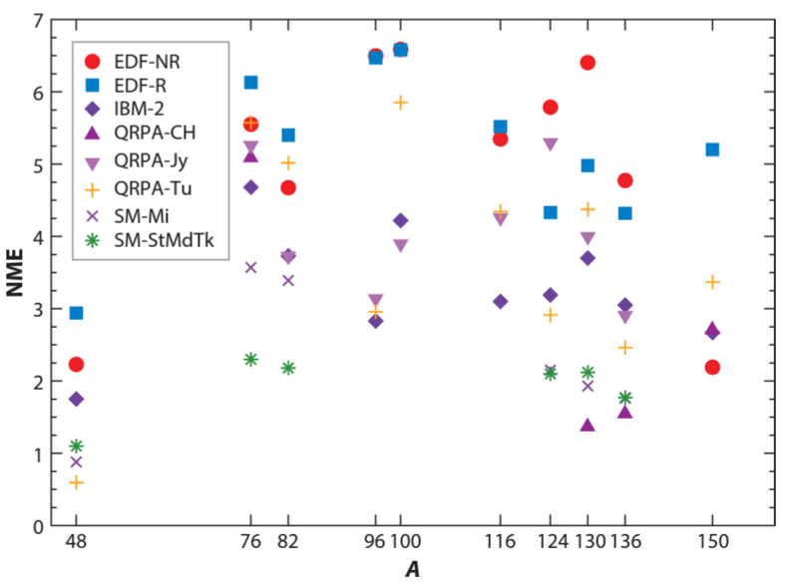
0ν ββ decay Exps.
Candidates | Q_{ββ}(MeV) | N.A. (%)
⁴⁸Ca→⁴⁸Ti | 4.268 | 0.187
⁷⁶Ge→⁷⁶Se | 2.039 | 7.8
⁸²Se→⁸²Kr | 2.998 | 8.8
⁹⁶Zr→⁹⁶Mo | 3.356 | 2.8
¹⁰⁰Mo→¹⁰⁰Ru | 3.034 | 9.7
¹¹⁰Pd→¹¹⁰Cd | 2.017 | 11.7
¹¹⁶Cd→¹¹⁶Sn | 2.813 | 7.5
¹²⁴Sn →¹²⁴Te | 2.293 | 5.8
¹³⁰Te→¹³⁰Xe | 2.528 | 34.1
¹³⁶Xe→¹³⁶Ba | 2.458 | 8.9
¹⁵⁰Nd→¹⁵⁰Sm | 3.371 | 5.6
Nuclear Matrix Element
Large uncertainty, model dependent
Motivate searching for various isotopes
¹⁰⁰Mo is one of the best candidate
Ref. Annu. Rev. Nucl. Part. Sci. 2019. 69:219–51

Slide 5
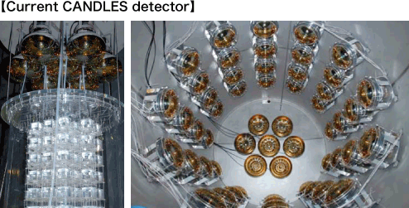
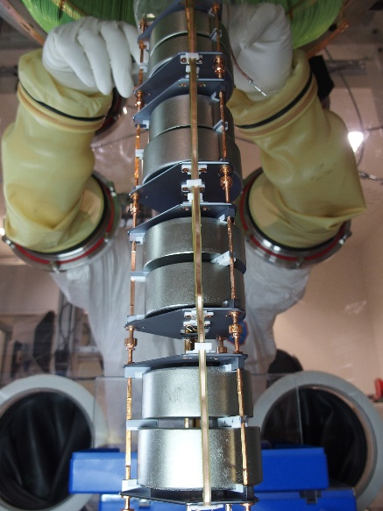
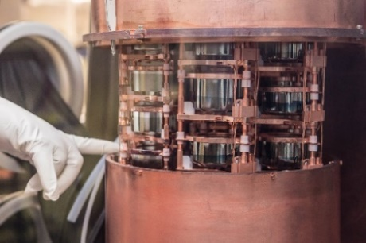
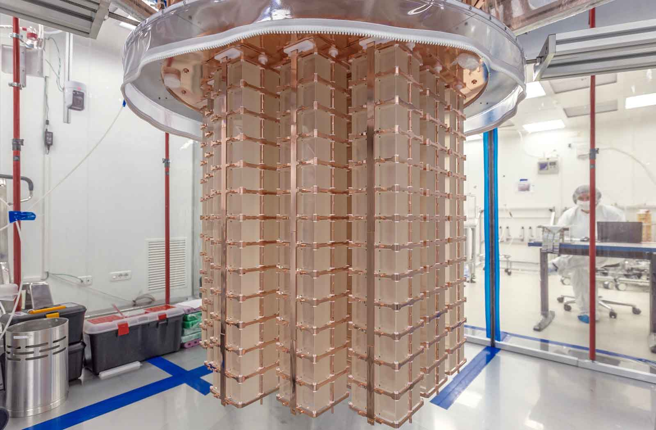
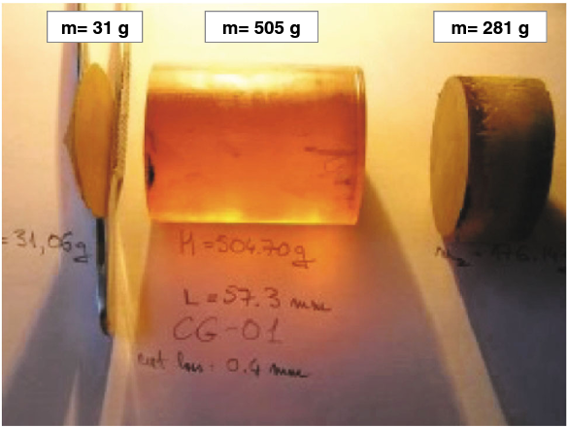
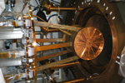
0ν ββ decay Exps.
GERDA, MAJORANA
Ge crystal
Candidates | Q_{ββ}(MeV) | N.A. (%)
⁴⁸Ca→⁴⁸Ti | 4.268 | 0.187
⁷⁶Ge→⁷⁶Se | 2.039 | 7.8
⁸²Se→⁸²Kr | 2.998 | 8.8
⁹⁶Zr→⁹⁶Mo | 3.356 | 2.8
¹⁰⁰Mo→¹⁰⁰Ru | 3.034 | 9.7
¹¹⁰Pd→¹¹⁰Cd | 2.017 | 11.7
¹¹⁶Cd→¹¹⁶Sn | 2.813 | 7.5
¹²⁴Sn →¹²⁴Te | 2.293 | 5.8
¹³⁰Te→¹³⁰Xe | 2.528 | 34.1
¹³⁶Xe→¹³⁶Ba | 2.458 | 8.9
¹⁵⁰Nd→¹⁵⁰Sm | 3.371 | 5.6
CANDLE
CaF scintillating crystal
CUPID-0
ZnSe scintillating crystal
CUORE
TeO₂ crystal
Aurora
CdWO₄ crystal
EXO, KamLAND-Zen
Liquid Xe

Slide 6
Why ¹⁰⁰Mo?
Candidates | Q_{ββ}(MeV) | N.A. (%)
⁴⁸Ca→⁴⁸Ti | 4.268 | 0.187
⁷⁶Ge→⁷⁶Se | 2.040 | 7.8
⁸²Se→⁸²Kr | 2.995 | 8.8
⁹⁶Zr→⁹⁶Mo | 3.350 | 2.8
¹⁰⁰Mo→¹⁰⁰Ru | 3.034 | 9.7
¹¹⁰Pd→¹¹⁰Cd | 2.013 | 11.7
¹¹⁶Cd→¹¹⁶Sn | 2.802 | 7.5
¹²⁴Sn →¹²⁴Te | 2.228 | 5.8
¹³⁰Te→¹³⁰Xe | 2.533 | 34.1
¹³⁶Xe→¹³⁶Ba | 2.479 | 8.9
¹⁵⁰Nd→¹⁵⁰Sm | 3.367 | 5.6
One of the largest Q-value
  High decay probability
  Efficient background suppression, but….
Calorimetric experiment using molybdate scintillator
Availability of enriched ¹⁰⁰Mo in 0.1 tone ~ 1 tone scale
  High natural abundance : 9.7 %
  Enrichment by gas centrifuge method

Slide 7
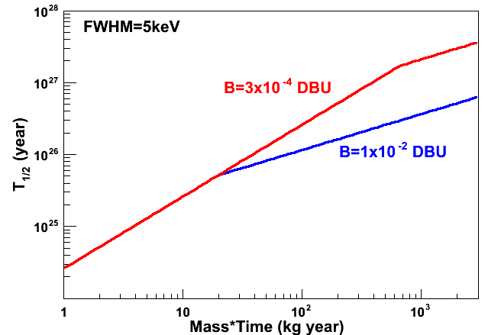
Zero background experiment
M = mass of detector in kg,
A = mass number of candidate isotope
a = ββ isotope concentration (Enrichment),
T = measured time in years
ε : Detection efficiency
b : events in ROI
AMoRE-200kg
Zero background, large mass, long time measurement
Quite challenging experiment
ΔE : Detector performance
ckky
When b = 0,
ckky
AMoRE-10kg
Goal : Zero background experiment
ckky
counts/ (keV kg year)

Slide 8
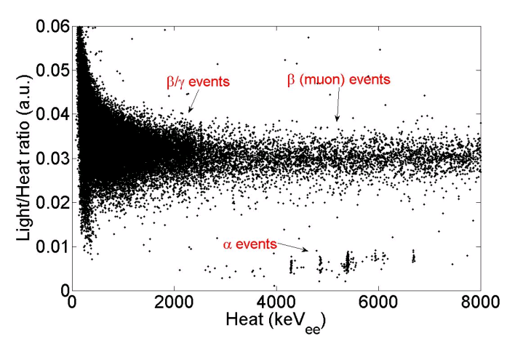
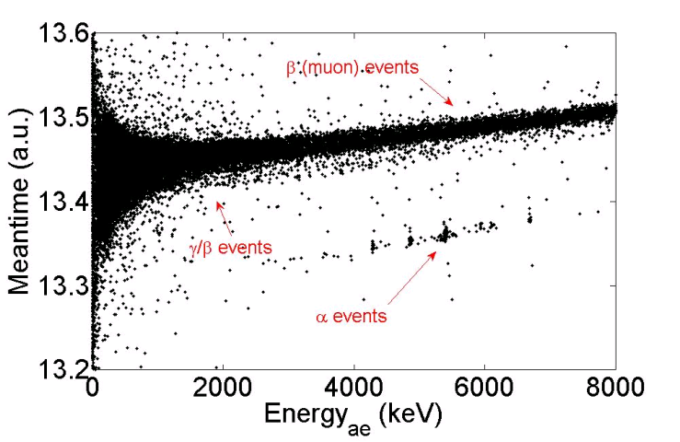
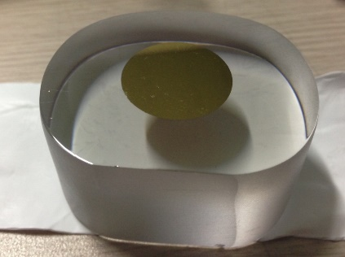
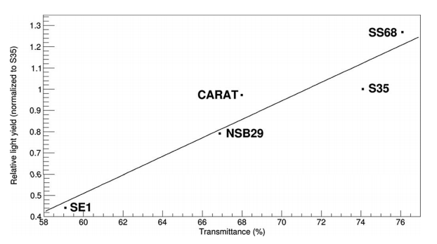
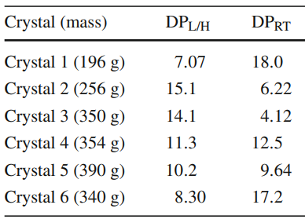
Detection technique of AMoRE
Crystal scintillator (source = detector)
MMC (low temp. detector)
Photon detector (Light)
Crystal 3
DP by PSD : 4.12
Crystal 2
DP by PSD : 6.22
Crystal 5
DP by PSD : 9.64
Phonon detector (Heat)
Crystal 4
DP by PSD : 12.5

Slide 9
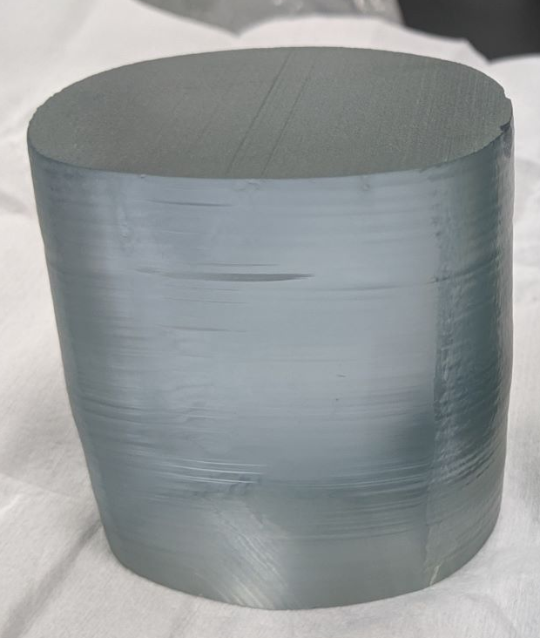
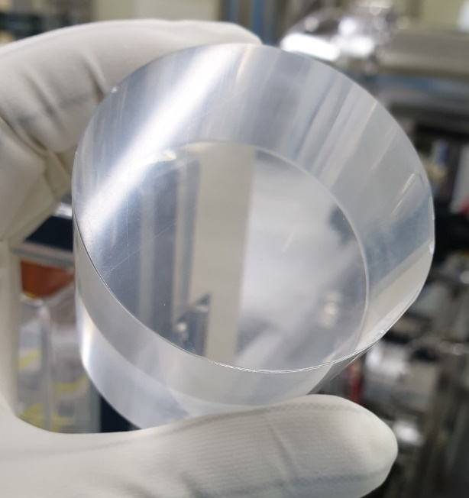
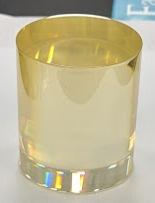
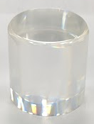
MoO₃ based Crystal Scintillators
 | Inter. BG | LY at 10 K (%) | Density (g/cm³) | Melt. Point (℃) | Hygroscopic
CaMoO₄ | High (⁴⁸Ca) | 100 | 4.2 | ~1450 | No
Li₂MoO₄ | Lower | 5 | 3.0 | ~700 | Middle
PbMoO₄ | Under study (²¹⁰Pb) | 10 | 6.8 | ~1065 | No
Na₂Mo₂O₇ | Under study | 140 | 3.7 | ~600 | Weak
CaMoO₄
Li₂MoO₄
PbMoO₄
Na₂Mo₂O₇

Slide 10
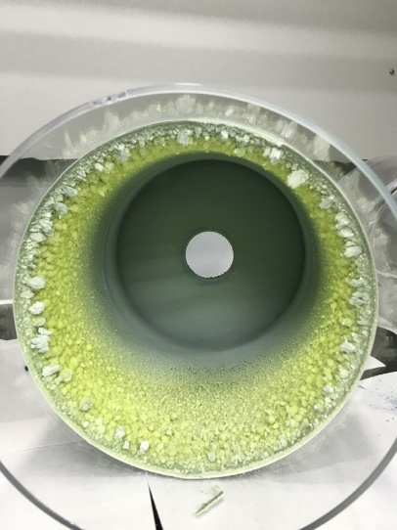
Purification of Raw powders
¹⁰⁰MoO₃
sublimation under low vacuum
5 kg/month purification capacity by Center for Underground Physics(IBS)
Li₂CO₃
Wet chemistry and column chromatography
5.5 kg/month purification capacity by CUP(IBS)
experiment # | Al, ppb | K, ppb | Cr, ppb | Mn, ppb | Fe, ppb | Ni, ppb | Cu, ppb | W, ppb | Sr, ppb | Ba, ppb | Pb, ppb | Th, ppt | U, ppt
Raw ¹⁰⁰MoO₃ powder (lot #3497) | 1399 | 938 | <300 | <30 | 504 | 1073 | <200 | 670 | 4 | 11 | 4.0 | 70 | 257
Purified products (examples)
1 | 585 | 409 | <200 | <30 | 39 | <20 | <200 | 33 | <0.15 | 3.9 | 0.33 | <10 | <7
11 | 630 | 253 | <400 | <30 | 26 | <20 | <200 | 43 | <0.20 | <3.0 | <0.20 | <9 | <6
21 | <30 | 246 | <200 | <30 | 33 | <20 | <200 | 38 | <0.15 | <3.0 | <0.5 | <10 | <7
31 | <30 | 150 | <200 | <30 | 26 | <20 | <200 | 648 | <0.15 | <3.0 | <0.5 | <10 | <7
51 | <100 | 146 | <200 | <30 | 18 | <20 | <200 | 601 | <0.15 | <3.0 | <0.4 | <10 | <7
sample | ⁴⁰K, mBq/kg | ²²⁸Ac, mBq/kg | ²²⁸Th, mBq/kg | ²²⁶Ra, mBq/kg | K, ppb | Sr, ppb | Ba, ppb | Pb, ppt | Th, ppt | U, ppt
Li₂CO₃ | HPGe@CUP |  |  |  | ICP-MS@CUP
Initial material | <16.59 | 6.33 ± 1.28 | 5.47 ±0.67 | 57.38 ± 3.15 | 426 | 6 | 35 | 1397 | 8 | 156
PURIFIED powder | <6.02 | <1.96 | <1.86 | <1.1 | <60 | 0.5 | 61 | <80 | <6 | <6

Slide 11
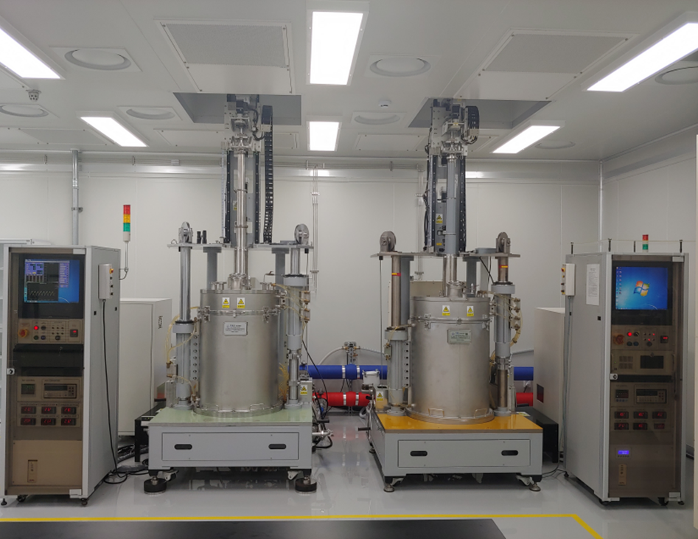
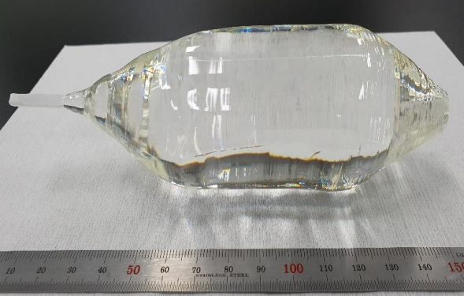
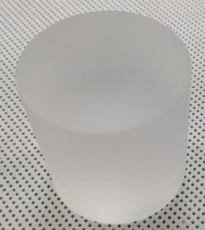
Crystal growth at IBS (Li₂MoO₄)
50(D) mm X 50(H) mm
~ 300 g
Two Czochralski setups at IBS (one more under preparation)
Purified Li₂CO₃ and ¹⁰⁰MoO₃ powders for growing
Total 17.4 kg of Li₂MoO₄ crystals in 2021 (after cut and polishing ~ 6.7 kg)

Slide 12
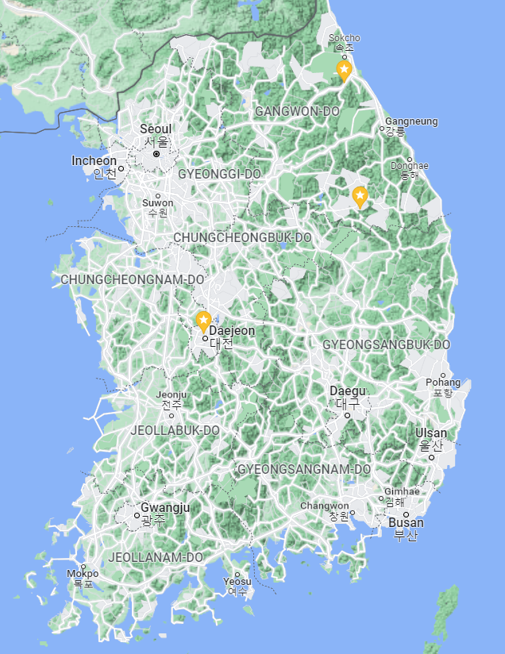
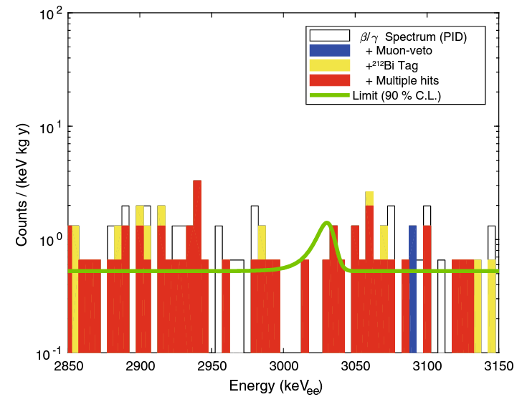
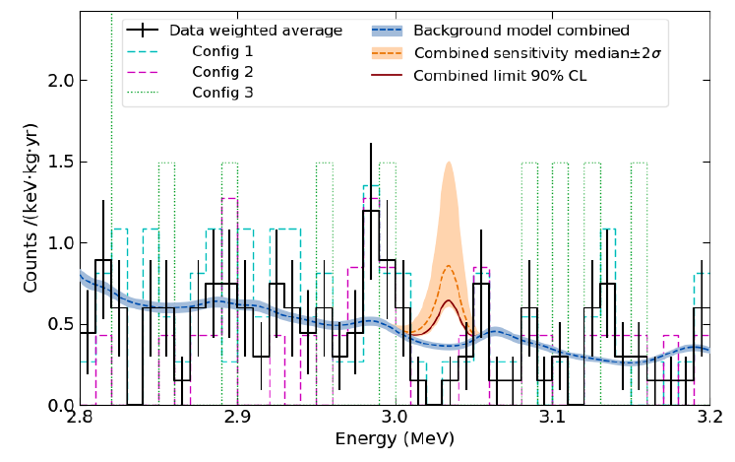
AMoRE
Neutrinoless double beta decay of ¹⁰⁰Mo
Y2L (~700m)
~3 hours drive
AMoRE-pilot Ref. EPJC (2019) 79:791
Period : 2015 ~ 2018
Detector : ^{48dep}Ca¹⁰⁰MoO₄ (6 crystals, ~1.9 kg)
Technique : Metallic Magnetic Calorimeters
Exposures : 111 kg∙days
Half-life limit : 9.5 x 10²² years (90% C.L.)
Effective Majorana ν mass : < 1.2 ~ 2.1 eV (g_{A} = 1.27)
IBS HQ
Final half life limit updated
3.4 x 10²³ years (90% C.L.)
Q^{0ν}_{ββ} of ¹⁰⁰Mo : 3,034 keV

Slide 13
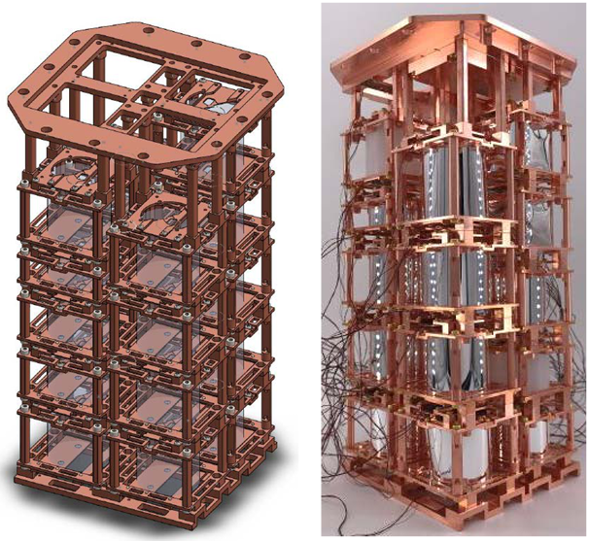
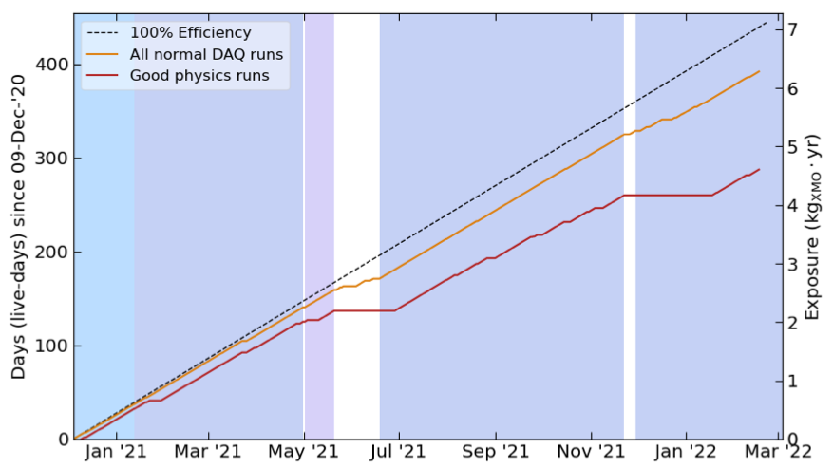
AMoRE
Neutrinoless double beta decay of ¹⁰⁰Mo
Y2L (~700m)
~3 hours drive
AMoRE-I (on going)
Time schedule : 2021 ~ 2023
Detector (6.2 kg)
  - ^{48dep}Ca¹⁰⁰MoO₄ (13 crystals, ~4.6 kg)
  - Li₂¹⁰⁰MoO₄ (5 crystals, ~1.6 kg)
Technique : Metallic Magnetic Calorimeters
Background requirement : < 10⁻² ckky
Sensitivity goal : 7.0 x 10²⁴ year <m_{ββ}> : 140~270 meV
IBS HQ

Slide 14
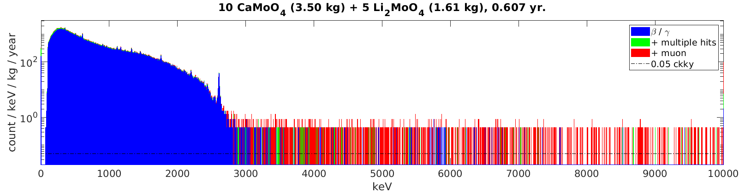
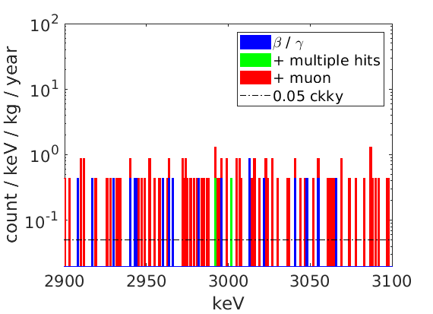
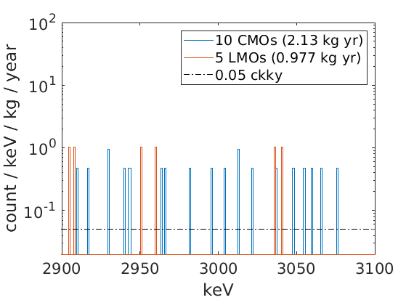
AMoRE
Neutrinoless double beta decay of ¹⁰⁰Mo
Y2L (~700m)
~3 hours drive
AMoRE-I (on going)
The background is dominated by the 2ν ββ decay of ¹⁰⁰Mo.
Preliminary
IBS HQ
2.9-3.1 MeV | CMO | LMO | Total
# of bkg. events | 21 | 6 | 27
ckky | 0.049 | 0.031 | 0.044

Slide 15
AMoRE
Neutrinoless double beta decay of ¹⁰⁰Mo
Y2L (~700m)
~3 hours drive
AMoRE-pilot (2019)
BG level in ROI : 0.45 ckky
Q^{0ν}_{ββ} of ¹⁰⁰Mo : 3,034 keV
IBS HQ
AMoRE-I (2022)
BG level in ROI : 0.044 ckky
10 times lower
Q^{0ν}_{ββ} of ¹⁰⁰Mo : 3,034 keV

Slide 16
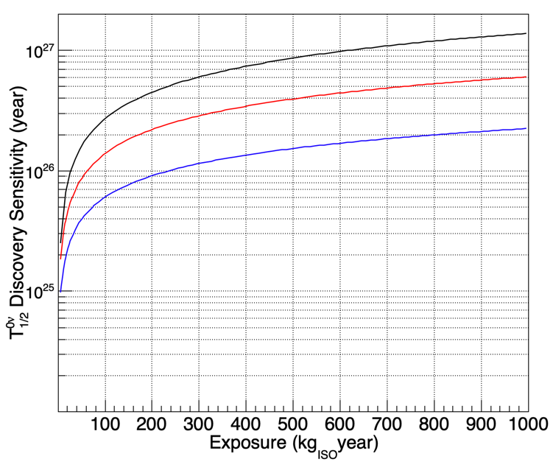
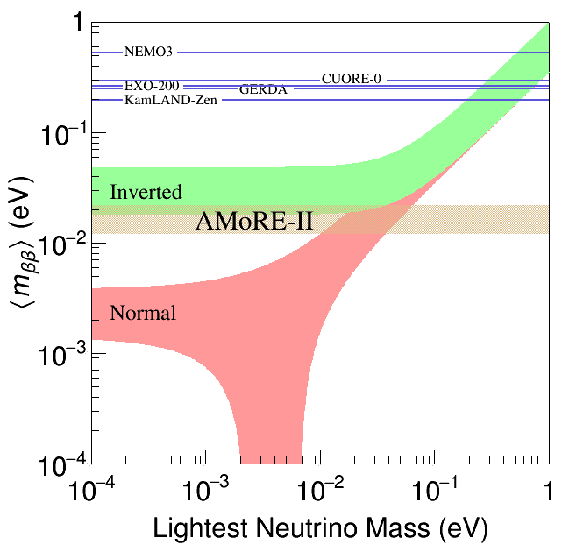
AMoRE
Neutrinoless double beta decay of ¹⁰⁰Mo
AMoRE-II
Time schedule : 2023 ~ 2027
Detector : Li₂¹⁰⁰MoO₄ (~700 crystals, 200 kg)
Technique : Metallic Magnetic Calorimeters
Background requirement : < 10⁻⁴ ckky
Sensitivity goal : 8.0 x 10²⁶ year, <m_{ββ}> : 13~23 meV
Yemilab (~1000m)
~2.5 hours drive
IBS HQ
b=1 x 10⁻⁵ ckky
(goal)
b=1 x 10⁻⁴ ckky
(requirement)
b=1 x 10⁻³ ckky
AMoRE-II exposure

Slide 17
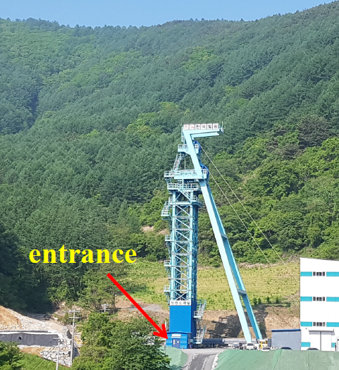
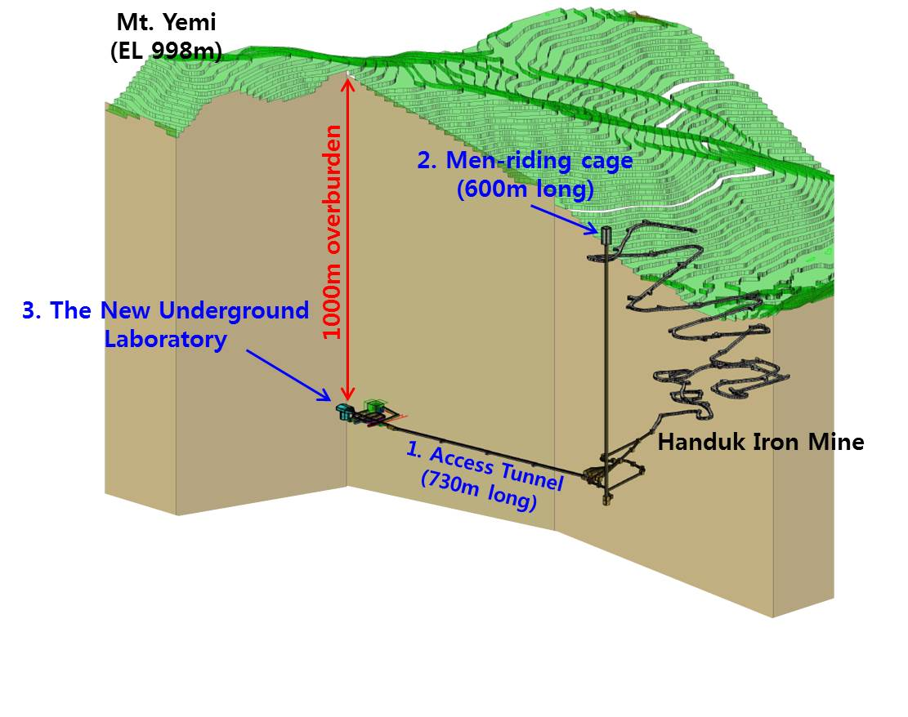
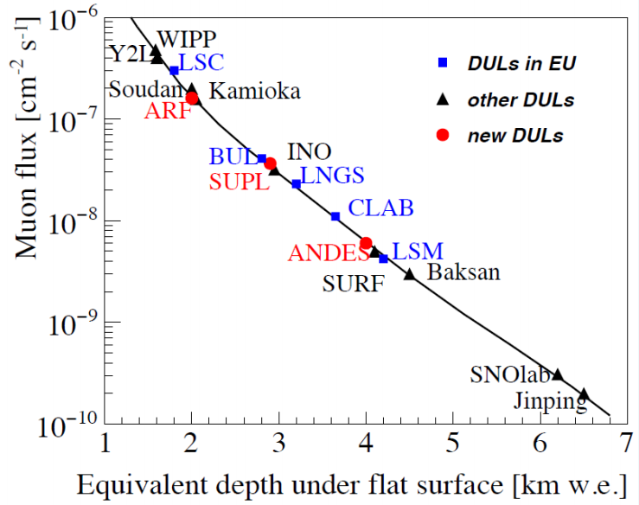
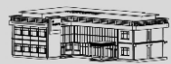
Yemilab (new underground lab)
Ref. Inter. Jour. Mod. Phys. A Vol. 32, No. 30 (2017) 1743001
4. Ground office
Yemilab
Up to 5 people
4 m/s, 150 sec
Ramp way
~30 min by car
782m long
Shaft
Access tunnel by car (782 m)

Slide 18
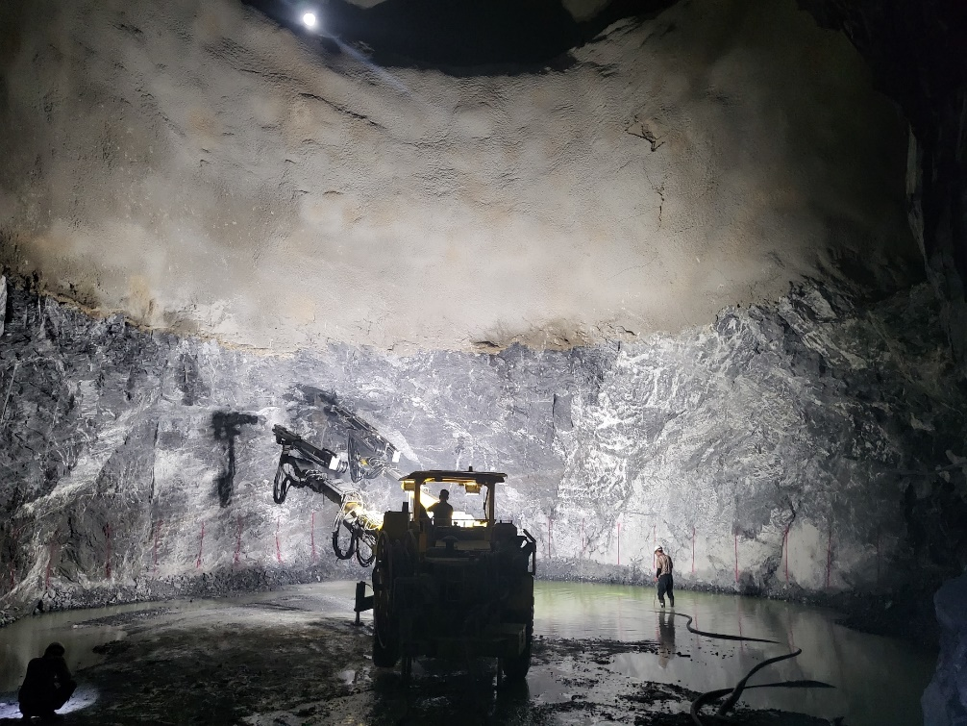
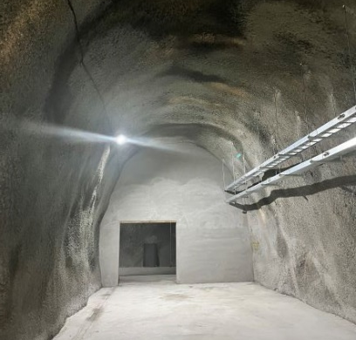
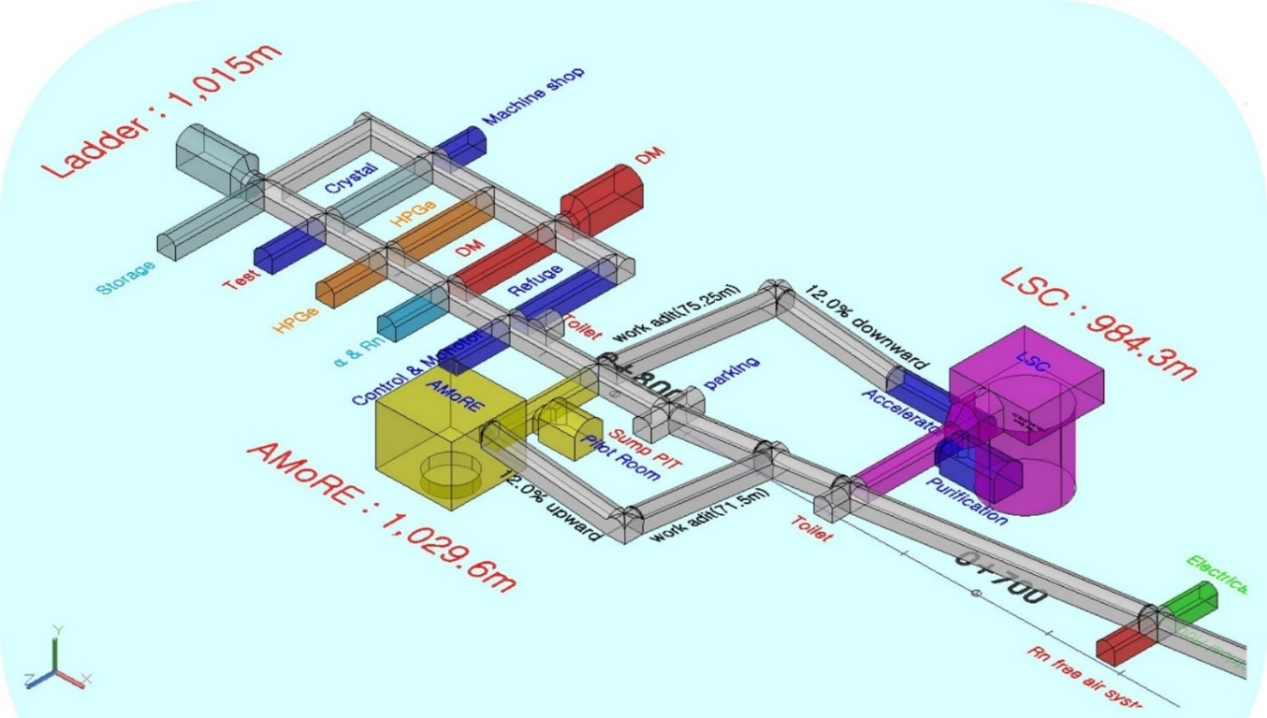
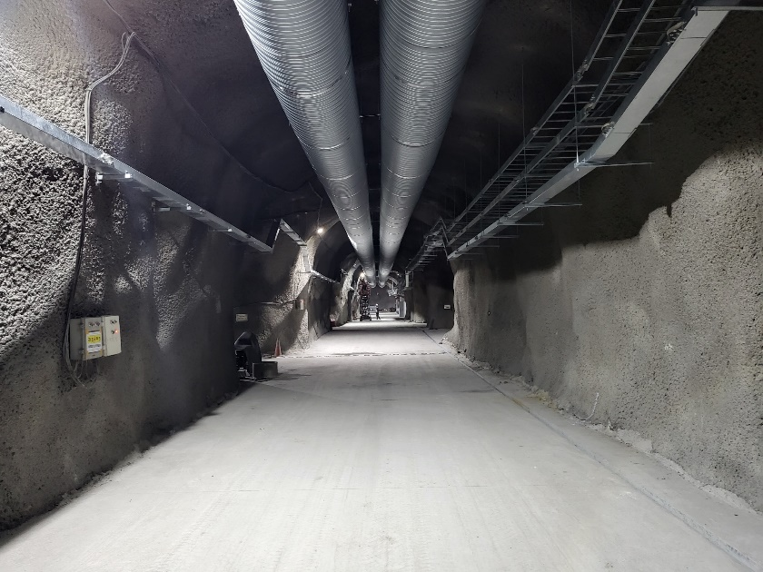
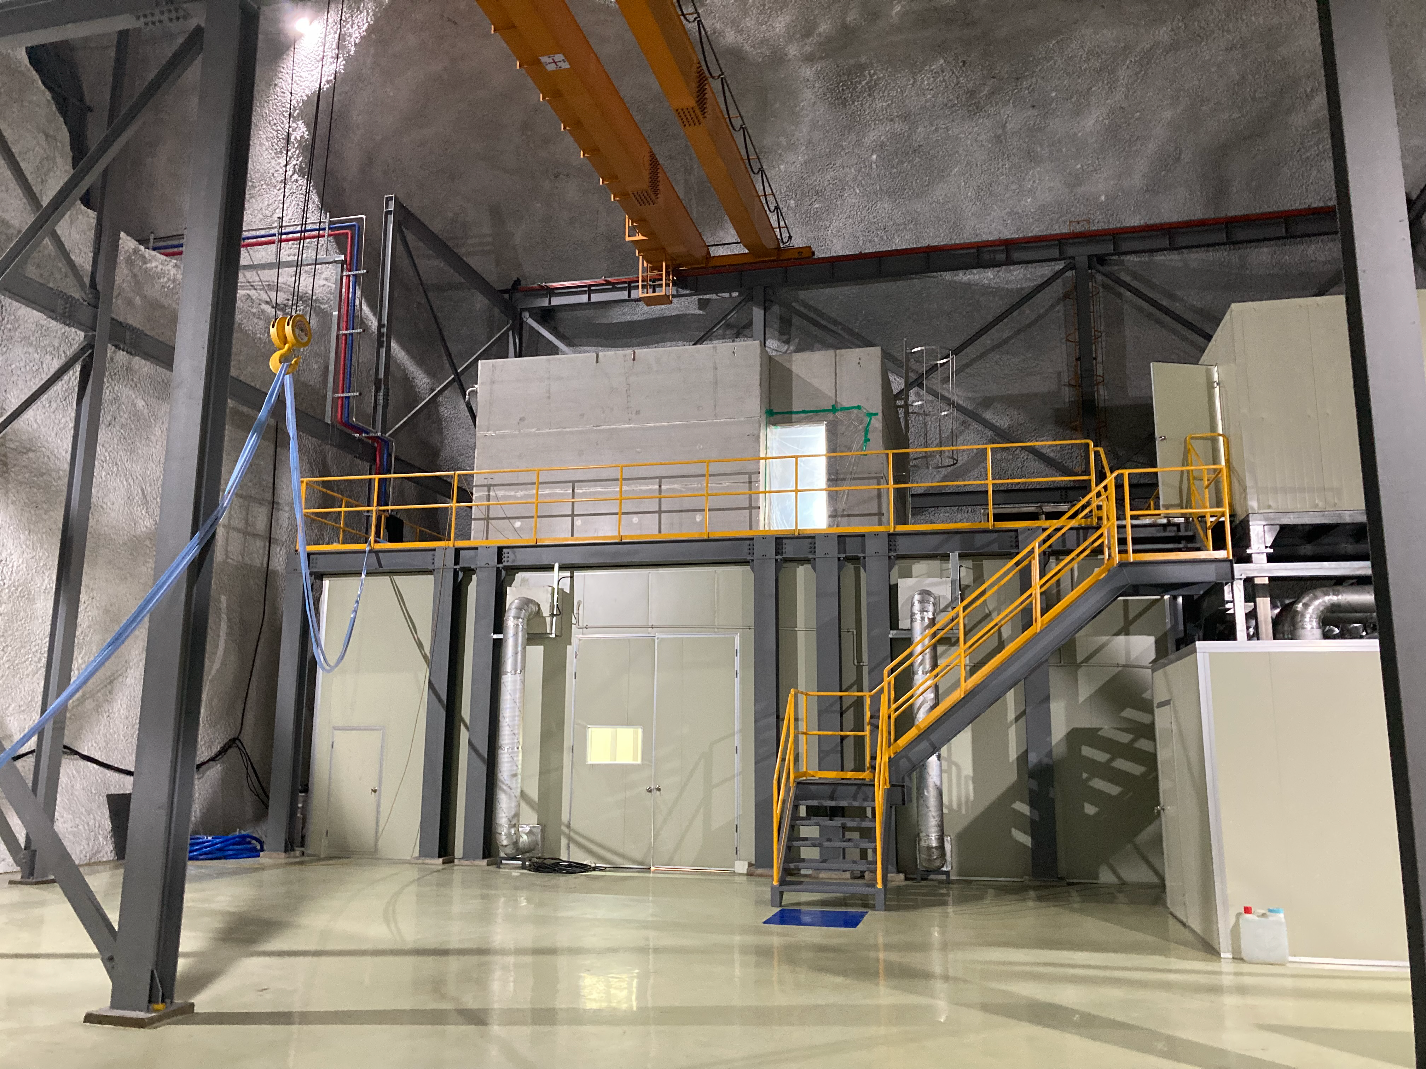
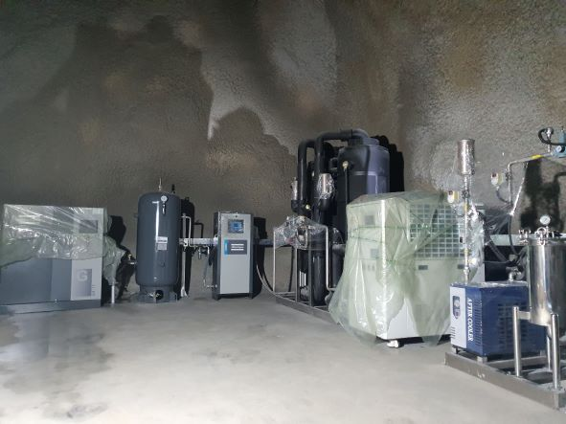
Yemilab (Construction)
Refuge space
Yemilab entrance
Radon Reduction System
∙ Target level : ~20 mBq/m³
∙ Supply capacity : 50 m³/h
∙ No PCW requirement
∙ Humidity < 2,000 ppm

Slide 19
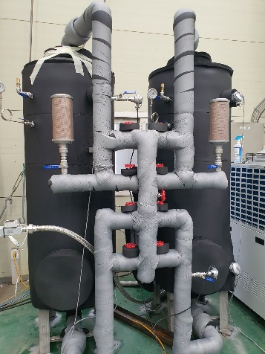
New Radon Reduction System
Dual line supply : 200 cmh
Single line supply : 100 cmh
100 cmh
User
Air Comp. #1
Dryer #1
Chiller #1
Active charcoal tank
100 cmh
Air receiver
tank
Air Comp. #2
Cold Trap
Dryer #2
Chiller #2

Slide 20
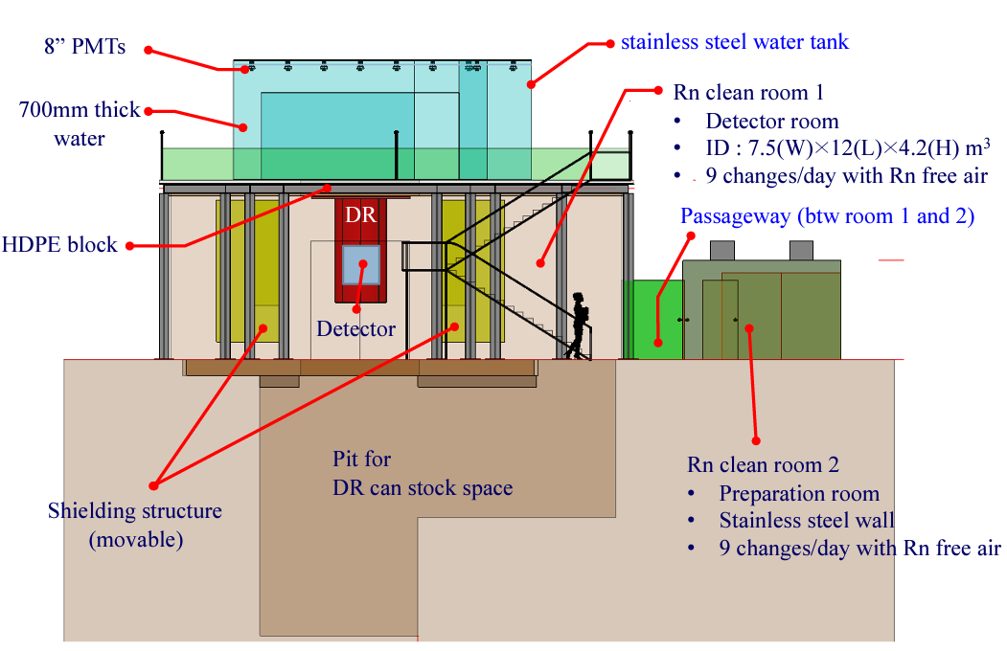
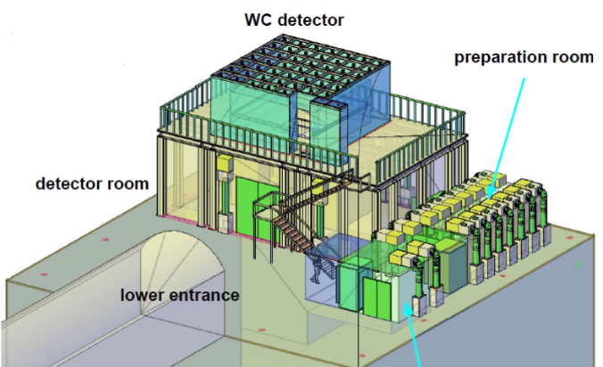
AMoRE-II cavern
Preparation room
100 class
Detector room
10,000 class
Construction until September 2022
Changing room
10,000 class

Slide 21
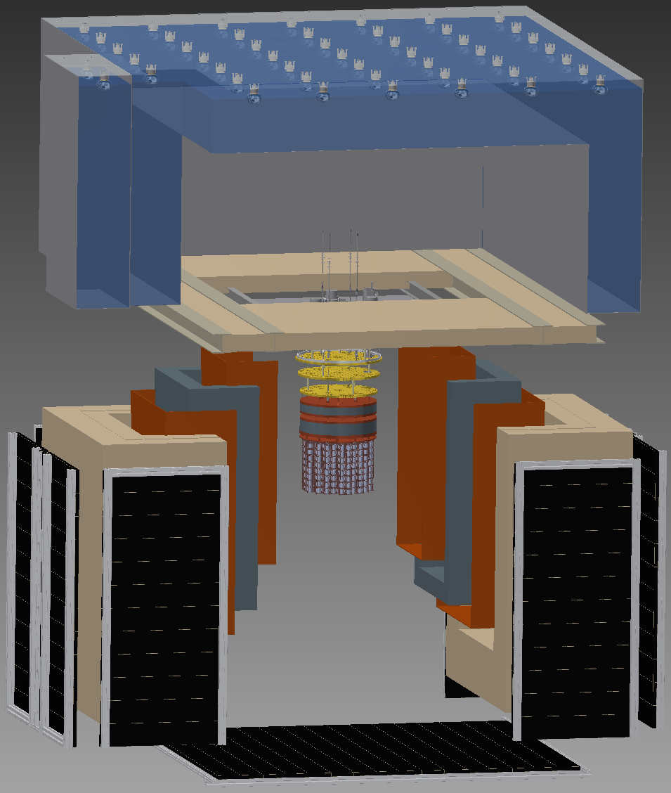
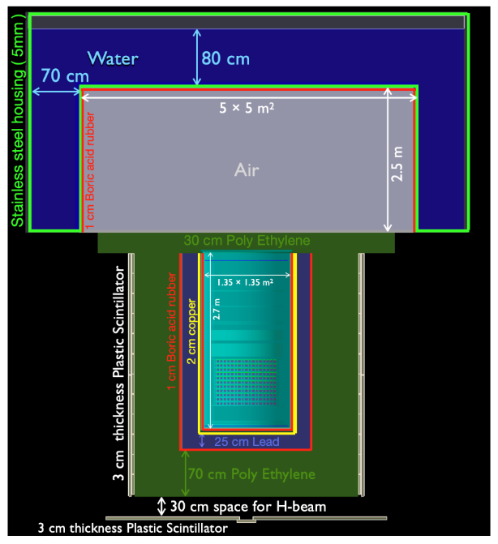
AMoRE-II Shielding

Slide 22
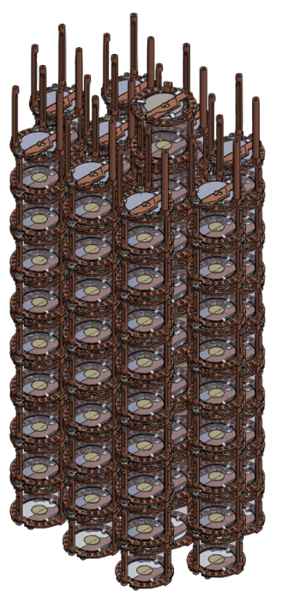



Detector modules for AMoRE-II
90 modules for the 1st stage : ~ 27 kg of Li₂MoO₄ crystals
Top
SQUID & MMC sensor (Light)
Light absorber (Si wafer)
Crystal supporter(Teflon)
Phonon collector Au film diameter 14mm Thickness 300nm
SQUID & MMC sensor (Heat)
Bottom

Slide 23


Cryostat for AMoRE-II
Single Pulse tube
Triple Pulse tubes
4 K
Leiden, customized
New cryostat for
AMoRE-II
Cryostat for
AMoRE-pilot and I
10 mK
Inner 1000 mm
Inner 408 mm
Outer 1300 mm
1 mW @ 100 mK, 7 μW @ 10 mK
Cooling test : 6 days using LN₂ precooling
Vibration, wiring and further tests at IBS HQ now
Planning to move Yemilab late this year.
Outer 650 mm

Slide 24




Material assay (HPGe)
100% HPGe Canberra
Dedicated Shielding System
Top & bottom: Pb (10 cm)+Cu (10 cm)
Side: Pb (15 cm)+Cu (10 cm)
Inner : Greek Ancient lead 5 cm
Net count rate of background (50~4000 keV)
mHz | 2015 | 2018 | 2019 | 2020 | 2021
> 50 keV | 8.1 | 7.9 | 7.8 | 7.9 | 8.0
100% HPGe Canberra
Dedicated Shielding System
Normal Pb(10 cm) + Goslar Pb(10 cm) + Cu(10 cm)
Net count rate of background (50~3500 keV)
mHz | 2017 | 2018 | 2019 | 2020 | 2021
> 50 keV | 9.5 | 7.9 | 6.8 | 6.2 | 6.1

Slide 25





14ch array HPGe
Ref.
NIMA 992 (2021) 165020
# Background rate (2021)
- Single hit : 90.4 ± 0.3 [event/kg/day]
- Double hit : 5.74 ± 0.07 [event/kg/day]
Total 980 % (14ch, 70% each)
Larger sample capacity. (MoO₃ powder)
Radon reduced air environment.
High dense material assay (Cu, Pb)
Rare process search
  - ⁵⁰V, 2ν ββ decay ¹⁰⁰Mo, ¹⁸⁰Ta metastable

Slide 26





Material assay (α counter, ICP-MS)
Operating in Y2L
FWHM resolution ~ 10%
Multi ch. Silicon α counter
Better for thick samples
Need to reduce the self BG
Next year at Yemilab
5.3 MeV (²¹⁰Po)
Lowest level of emissivity :
1.7 ± 0.7^{tot} × 10⁻⁴ counts/cm²/hr

Slide 27


Background requirements for AMoRE-II
Each parts
AMoRE-II requirements
Lots of samples have been measured.
Cross check between different methods.
Continued for future experiments.

Slide 28




Geant4 simulation of the AMoRE-II
BG sources | BG in ROI (x 10⁻⁵ counts/keV kg yr)
Cosmic muons | 0.275 ± 0.0159
Radiogenic neutrons | 0.301 ± 0.0107
Rock gammas (²³⁸U) | < 1.03 (90% C.L.)
Lead Shield (²³⁸U) | 0.994 ± 0.0495
Clamps | 0.65
Total BG rate in ROI | 3.25 ± 0.0761
Sim. Geometry
Lead shield gamma
Rock gamma
Detector modules
Geant4 result : ~ 10⁻⁵ ckky in ROI (meet goal)
Keep update BG assay & M.C. simulation.

Slide 29


Summary
Yemilab is under construction for the future underground experiments.
  - AMoRE-II will be the first experiment in Yemilab.
AMoRE-II construction is on going for the hundreds kg scale.
  - 90 Li₂¹⁰⁰MoO₄ crystals (~27 kg) will be installed early of next year (2023).
AMoRE-II (Yemilab), beyond the AMoRE-I (Y2L) is coming soon!!!

