Slide 1
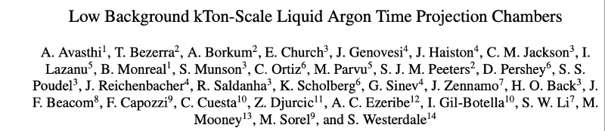
A Low Background DUNE-like Module: SLoMo* (SURF Low Background Module)
Eric Church
CoSSURF 2022
* Naming Election results still being certified
Notes:
Stock Image

Slide 2
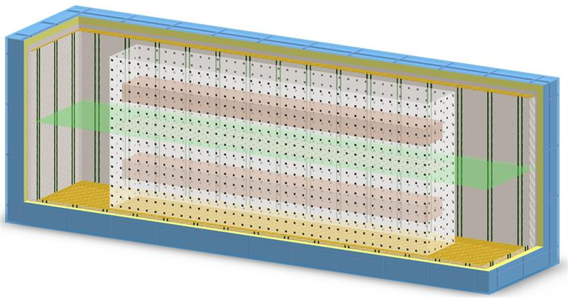
Expanding the DUNE
Physics Scope
There is significant interesting physics to be done in large LArTPCs below current thresholds of ~10MeV.
physics
    Solar neutrino measurements
    Supernovae detection
    Supernovae Coherent ν-Nuclear elastic scattering (CEvNS) “glow”
    0νββ search
    WIMP Dark Matter search
Might hope for module 3,4 for DUNE to look like this
  “DO NO HARM” to the main physics program

Slide 3
Detector Properties for Low-Energy
Physics
  Vertical-Drift
    Bulk argon, without many internal components: for radiopurity
    Fiducialization and self-shielding
  Enhanced radiopurity
    Low radioactivity underground argon (7-17kT)
    Strengthened detector materials radiopurity requirements
      (do not require DM experiment levels!)
    Improved radon control
  Additional shielding
    40cm water or plastic outside
  Low threshold readout
    SiPM hits
  Enhanced Photon Detection System (PDS)
    Reflectors, SiPMs, Increased coverage

Slide 4
WIMP Dark Matter Sensitivity
A limiting case is WIMP Dark Matter Detection. Requiring…
  Low Backgrounds
  Low Thresholds
  Order (100) photons detected
    for Pulse Shape Discrimination
      To subtract all γ/β backgrounds
https://arxiv.org/abs/2005.04824
JINST 15 P092026 (2020)
--Church, Jackson, Saldanha
The DarkSide-20k exposure is 20 tons over a planned 10 years for a total of 200 ton-yrs, while the proposal for a DUNE-like module is 3 years of a 1 kt mass for a 3 kt-yr exposure.

Slide 5
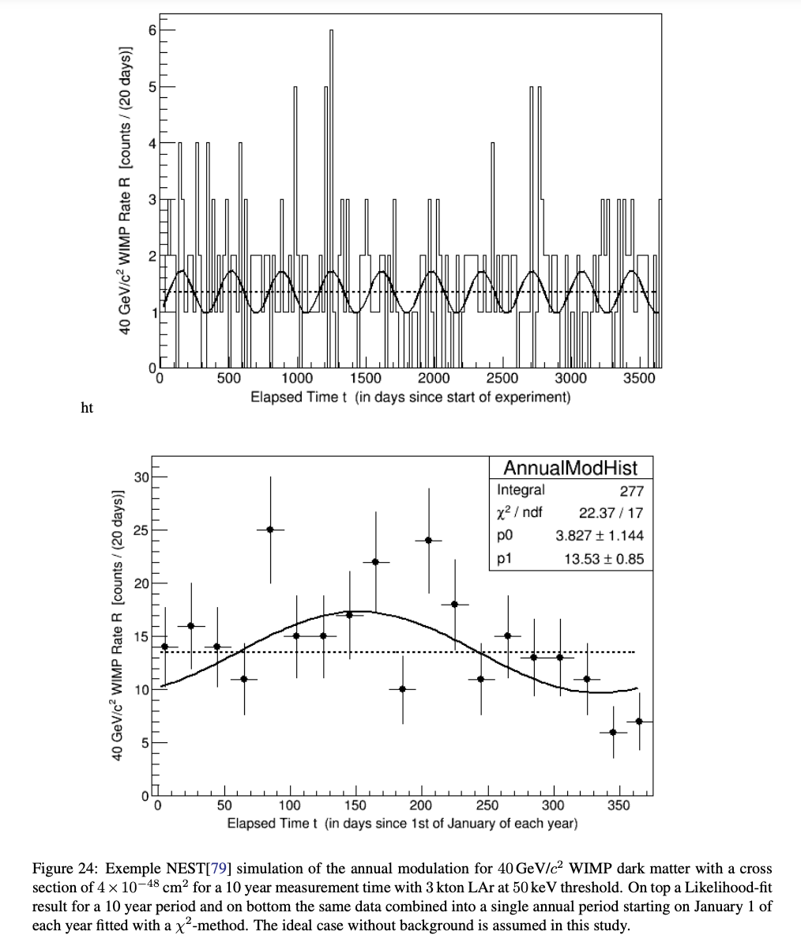
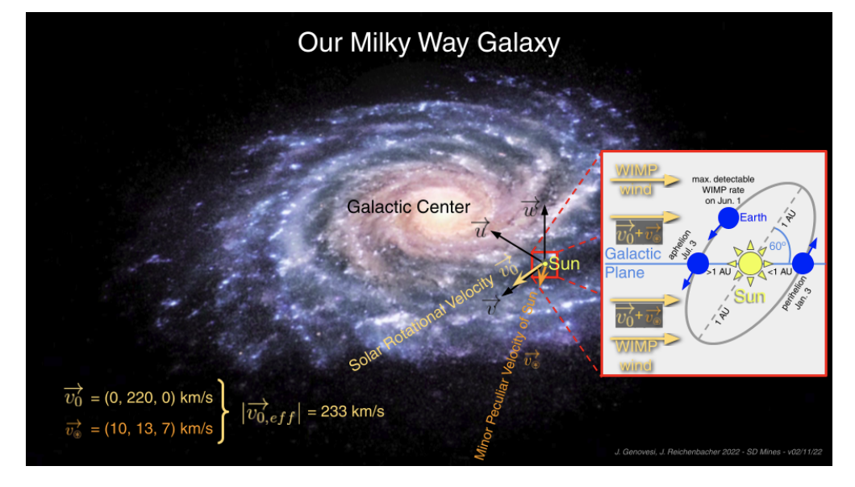
Dark Matter seasonality
If LZ finds a signal at M_{WIMP}~40 GeV/c² a 10 year follow-up measurement in SLoMo can find a seasonality signal
Jack Genovesi, Juergen Reichenbacher

Slide 6
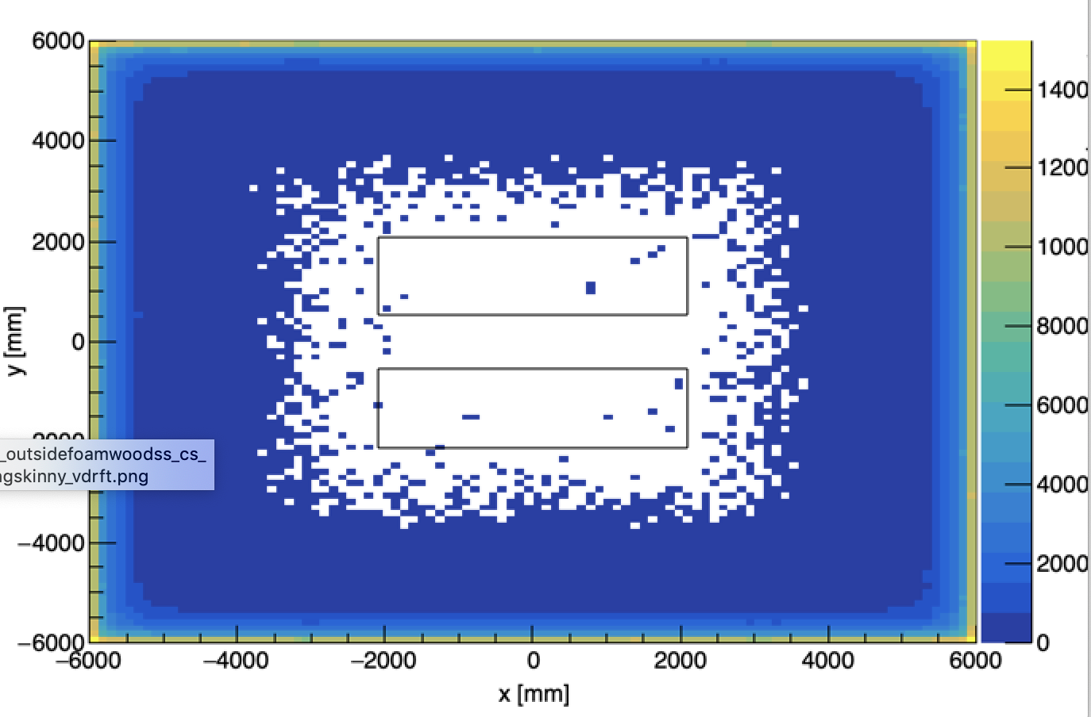
Fiducialization Drops Neutron Background Significantly
100 keV threshold for n.r.
2E-9/cm3/sec from cold cryostat steel only (cleaner than default DUNE)
9.4 neutrons -
(2.6 multisite)
  =>6.8 n’s per kton/yr

Slide 7
Vertical Drift Module – Upgrade Concept
1-3 kton fiducial volume(s)
Acrylic box
Cryostat
Charge readout planes
Central cathode
SiPMs
Water shielding
Low background underground argon

Slide 8
Simulation Code – Standalone G4 code, with Optical Photons to explore the design concept
github.com/echurch/rdecay02
  branch:liquid_deception
There’s a pretty simple, complete README
  Start by installing ROOT, G4, marley on your machine
  branch:liquid_deception
Everything is controlled in config file, e.g. ../macros/marley_optphys.mac

Slide 9
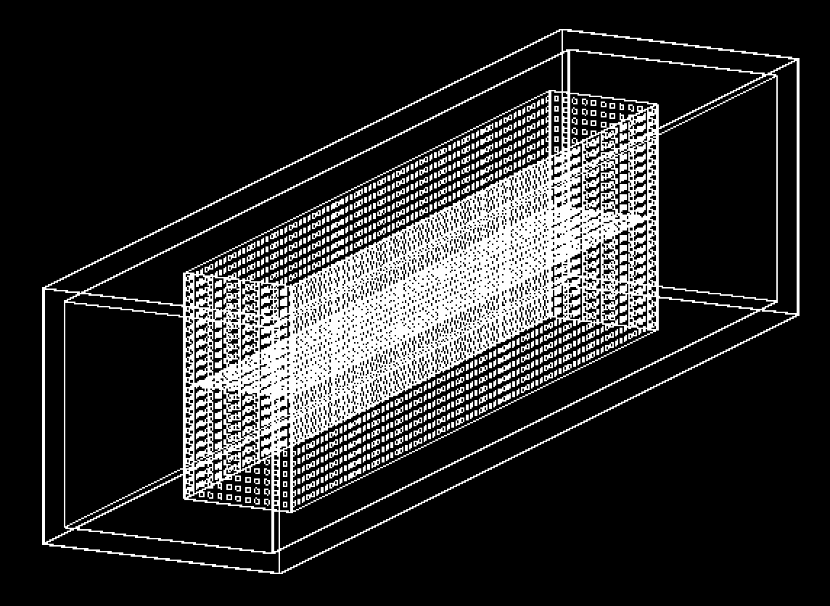
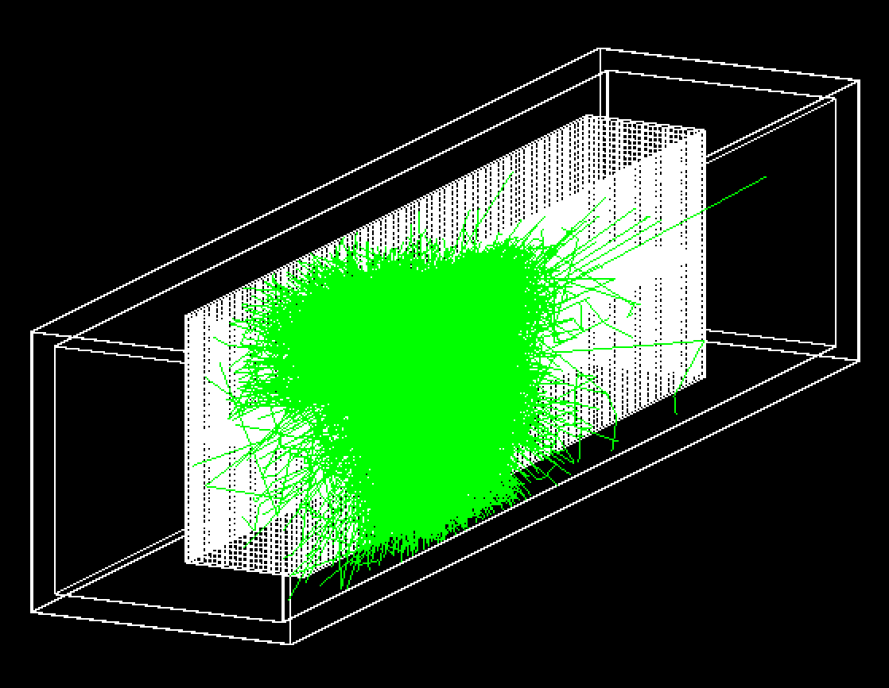
SiPMs and Optical Photons
Optical Photons from a typical 100 MeV neutron
5x5 cm^2 DarkSide-like SiPM modules
covering acrylic box walls and cathode

Slide 10
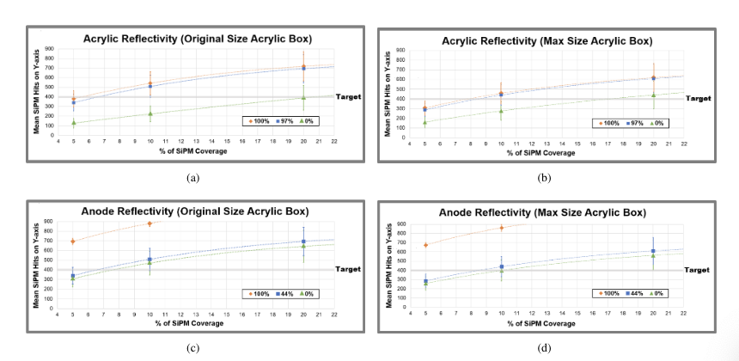
Optical Photon Detector
Studies
For q.e.=0.25 we need 400 hit SiPMs to get 100 detected photons, to allow PSD.
These plots show for 97% reflective acrylic walls and 44% reflective G10 we can achieve
requirements at only 10% SiPM coverage either on Acrylic walls at Original Size or even all
the way out at field cage (“Max Size”)

Slide 11
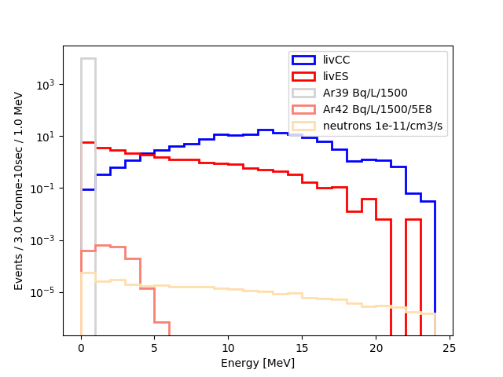
Supernovae at 10kpc
⁴²Ar /= 500 here beyond
atmospheric Ar composition.
Clearly a detector of this type allows to see CC/ES spectrum to much lower thresholds.
Radon neglected in this study. Presume will control via material selection, improved detector cleaning, argon recirculation and reconstructions techniques (e.g. alpha tagging)
Blue/Gray arrows show rough current DUNE
module trigger and data thresholds (due to high n captures)

Slide 12
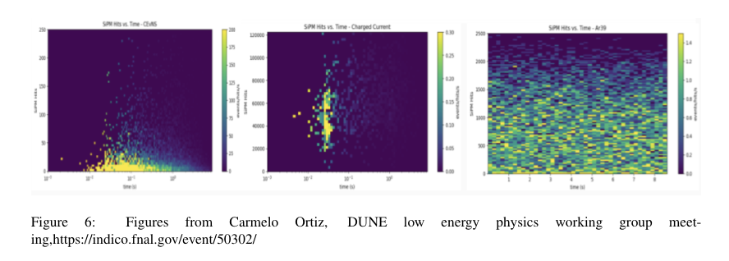
CEvNS in SuperNova Neutrinos
A sufficient photon detection system in a low background detector can see the low energy but plentiful photons from CEvNS in a 2kT fiducial volume from a SN explosion
N_SIPM
time
Carmelo Ortiz, Duke
CEvNS “glow” on left, triggered by CC observation center, sits above the steady
³⁹Ar on right for UAr, and fades over the 10 seconds of observation of this SN at 10 kpc.

Slide 13
Energy Resolution
Detecting as much light as possible leads to better event energy resolution via Q+L
This is borne out by studies
  NEST, JINST 5(1):13, 2021.
  LArIAT, PhysRev D 101, 012010, 2020.
It is an outstanding simulation task for us to show this to be true in our proposed geometry
  Requires in-time CRP charge collection and SiPM light detection and
  A reconstruction process
  Neither of which is currently present in our simulation
We presume 2% at 1 MeV is possible in our detector

Slide 14
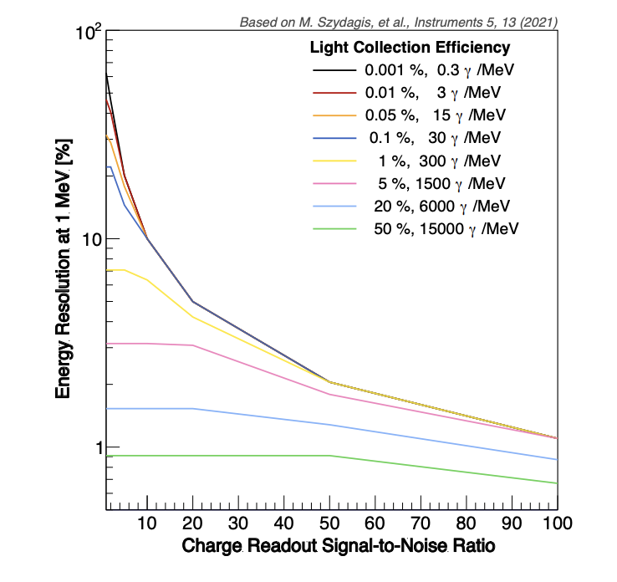
Energy Resolution from NEST
NEST, JINST 5(1):13, 2021.
arXiv 2203.14700
2%

Slide 15
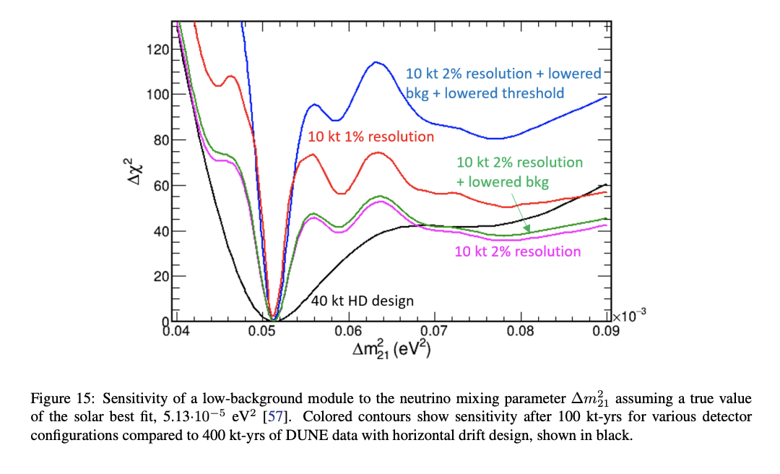
Improved solar result
Standard 3-neutrino oscillation parameter Δm²₂₁ is determined precisely -- with low backgrounds and high energy resolutions offered by light+charge measurement in this module

Slide 16
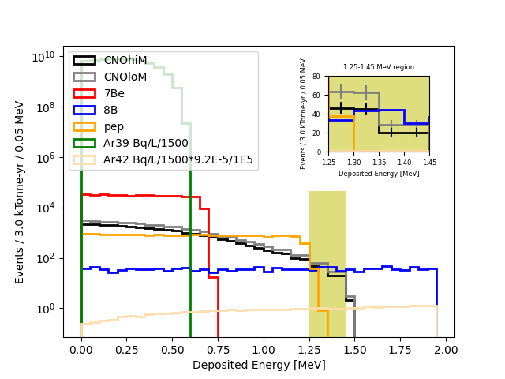
CNO Solar
⁴²Ar /= 1E5 here beyond
atmospheric Ar composition.
40
With UAr we expect very low ⁴²Ar rates. Among other implications, this leads to the ability for detecting CNO solar νs and distinguishing HM/LM flux. Neutron rate is low due to requirement on cold cryoskin.
CNO flux from https://iopscience.iop.org/article/10.3847/1538-4357/835/2/202/pdf. With further x0.5 survival applied. Only stats errors shown

Slide 17
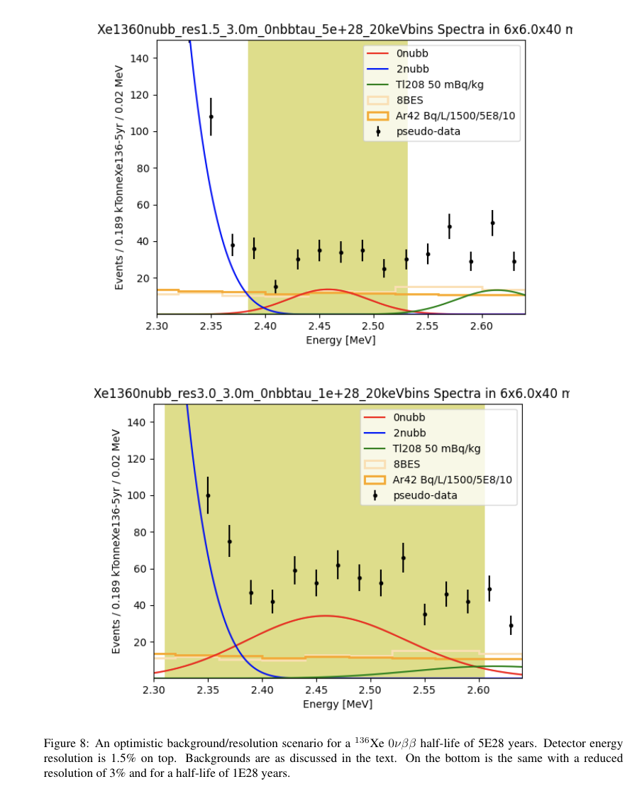
¹³⁶Xe 0νββ
⁴²Ar /= 5000 here beyond
atmospheric Ar composition.
A 3% ¹³⁶Xe loading over 5 years in a 2 kT LAr box can allow
a significant measurement of 0νββ.
σ/Q=1.5%, τ_{hl}=5E28 yrs
These half-lives are at limits and beyond that of nEXO sensitivity
These plots are unique in that we need
good energy resolution.
Curves assume a not-yet-demonstrated charge+light resolution of 1.5% and 3%.
σ/Q=3%, τ_{hl}=1E28 yrs
Suggested also by:
J. Zennamo and F. Psihas and A. Mastbaum, https://doi.org/10.48550/arXiv.2203.14700

Slide 18
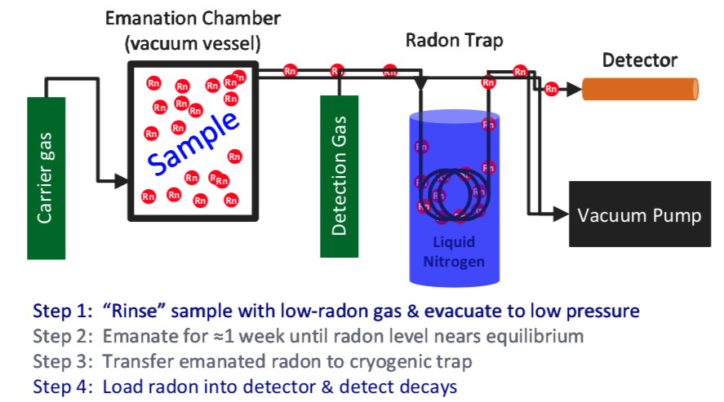
Radon
A big caveat for all preceding plots is that the ²²²Rn
  swirling around in the Argon and emanating from materials is under control via filtering and recirculating.
  and in some cases is further cut with use of a Bi-Po gamma-alpha coincidence
This requires further study – at PNNL, other places

Slide 19
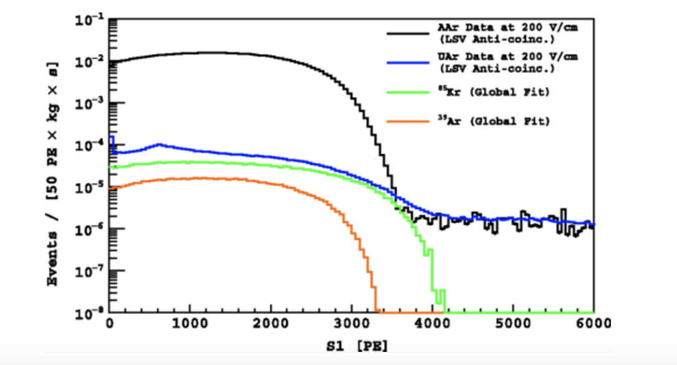
Underground Argon
Low radioactivity underground argon has been demonstrated in DarkSide-50 [ds50], with a factor 1400 reduction in 39Ar and no observation of 42Ar.
  We assume x1500 39Ar and x5000(0) 42Ar reduction for these studies
Demonstration of large-scale sources capable of filling DUNE-like module has not been shown (DarkSide source is too small)
  PNNL is in discussion with several commercial gas producers
  Could be as low as 3x cost of atmospheric argon, 5kT/yr production rate
Darkside50, Phys. Rev. D, 93:081101, Apr 2016

Slide 20
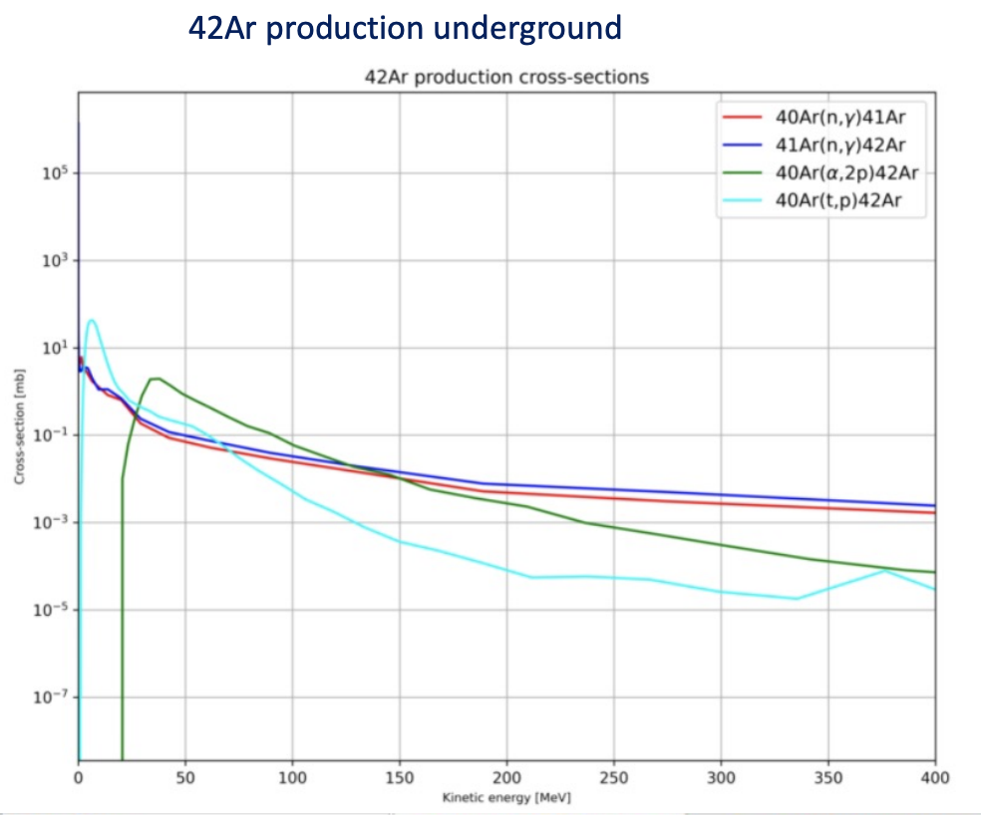
⁴²Ar
Assuming gas pocket is small enough, and no 42Ar diffusion from rock : we expect 8 orders of magnitude smaller 42Ar content in underground argon at 500mwe
  Smaller, happily, than already-low estimates considered in our studies
Sagar Sharma Poudel, PNNL
https://meetings.aps.org/Meeting/APR22/Session/G12.4

Slide 21
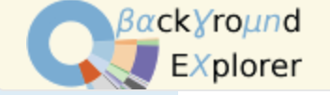
QA/QC in a Low Background Module
Building a kTon-scale module radioactively clean will require significant quality control
Brand new radiopurity.org for the wider low-background community
  https://indico.ific.uv.es/event/6178/contributions/15934/
Tools for managing assays and cleanliness are built
  for modules 1 and 2
  and then for subsequent modules
bgexplorer, a Background model to show properties of radioactive contributions in the detector/cavern.
  https://github.com/bloer/bgexplorer
  Soon a DUNE instance at bgexplorer.pnnl.gov

Slide 22
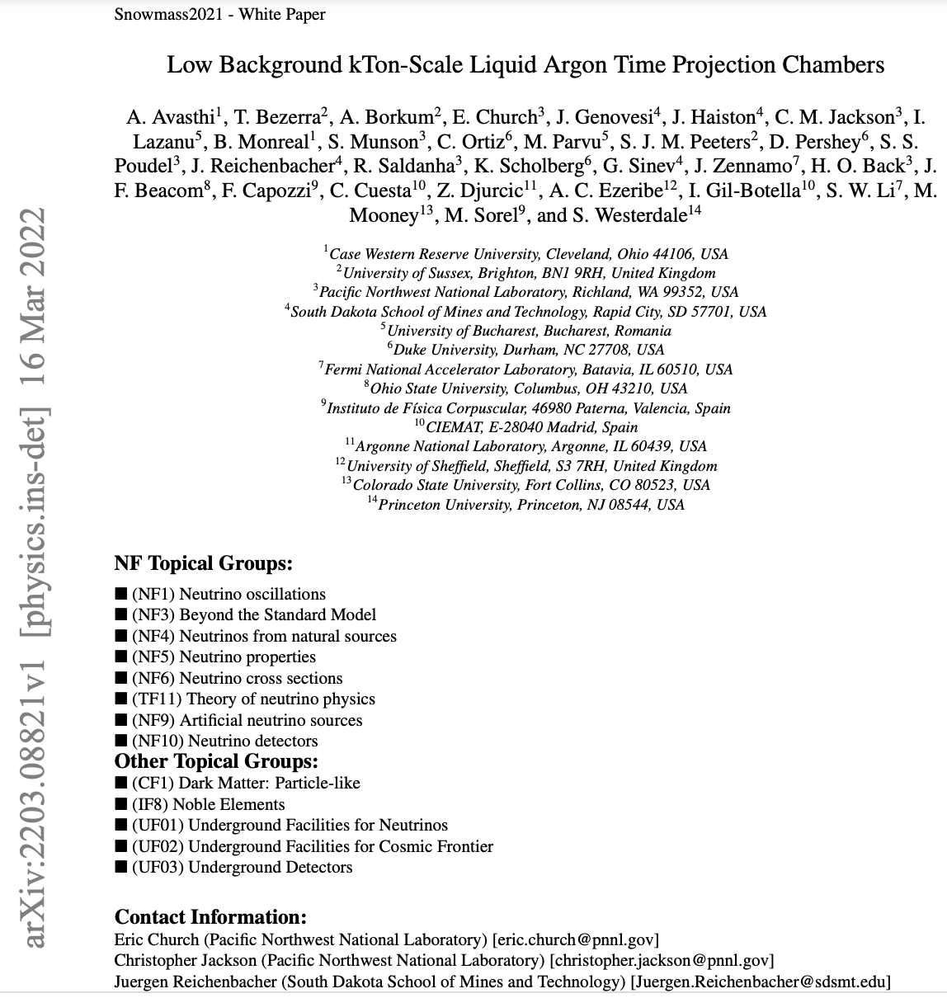
Snowmass
Snowmass Whitepaper submitted
We are still meeting every 4 weeks to develop this into a journal paper, by September.
We anticipate being actively involved in Seattle and beyond.

Slide 23
Conclusion
Opportunity to enhance DUNE physics program with a low background Far Detector module
Concept being developed includes:
  Fiducialized bulk argon module, Enhanced radiopurity, Increased shielding, Low radioactivity underground argon, Increased photon detection
Physics enhancements include:
  Increase supernova neutrino sensitivity, supernova CEvNS glow, precision solar neutrino measurements, neutrinoless double beta decay, WIMP dark matter detection
  No detriment to mainline DUNE goals
Snowmass White Paper submitted. Journal article in preparation.

