Slide 1

The SuperCDMS Experiment Overview
University of South Dakota
Ruslan Podviianiuk
on behalf of SuperCDMS collaboration
May, 2022

Slide 2
Outlook
Dark matter
SuperCDMS experiment
  SuperCDMS in SNOLAB
  Concept
  Shielding
  Detectors
  Electronics and trigger
Projected sensitivity
Conclusions

Slide 3
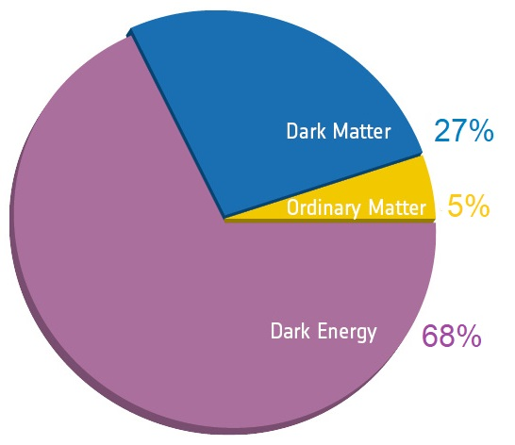
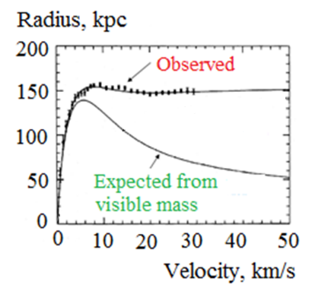
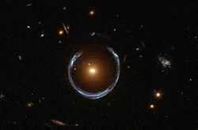
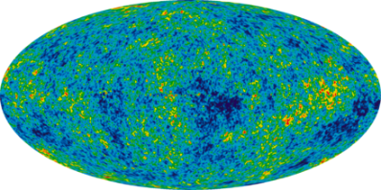
Composition of matter in the universe
Galaxy rotation
curves
Gravitational
lensing
Anisotropy of
CMB
From cosmological observations physicists believe that the universe comprises:
27% dark matter, only 5% atoms and 68% dark energy
Around 95% of universe is not baryonic
Dark matter has not been directly observed. The existence and properties of dark matter are inferred from its various gravitational effects such as:
  motions of visible matter
  gravitational lensing
  cosmic microwave background
Image credit: ESA/Planck, planck.cf.ac.uk/results/
Notes:
The nonbaryonic dark matter includes neutrinos and possibly hypothetical entities such as axions or super symmetric particle.

Slide 4
Detection of the dark matter
Dark matter types and candidates
Dark matter
Hot, HDM
Warm, WDM
Cold, CDM
Combinations
Particles that travel
with ultra-relativistic velocities. Strong and
electromagnetic
interaction
Candidates: neutrino
Intermediate between
HDM and CDM. Interaction only via gravity
Candidates: gravitons, sterile neutrinos
Particles move slowly compared
to speed of light, interact very
weakly with ordinary matter and electromagnetic radiation
Candidates: WIMPs, axions, MACHOs
Indirect detection of DM is based on the technique of observing the radiation produced
in DM annihilation: gamma-rays, neutrinos, and antimatter
Direct detection is based on the measurement of the recoil energy of nuclei as WIMPs scatter off them

Slide 5
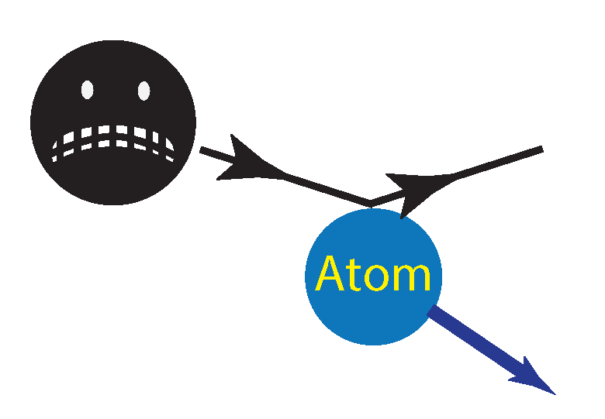
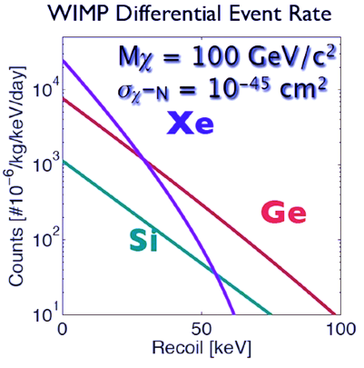

Weakly Interacting Massive Particles (WIMPs)
May only interact through gravitational and weak forces
Extremely difficult to detect
WIMPs rarely induce nuclear recoils
Number of times a dark matter particle transfers a given amount of energy to a nucleus
WIMP
Target
Causes target nuclei recoil
Galactically bound, $v$ of order 10⁻³c
Predicted by theory, but no confirmed experimental detection
Mass of the detector
Probability of
detection
increase
increase
Time of measurement
Easier to detect but the event rate is lower

Slide 6
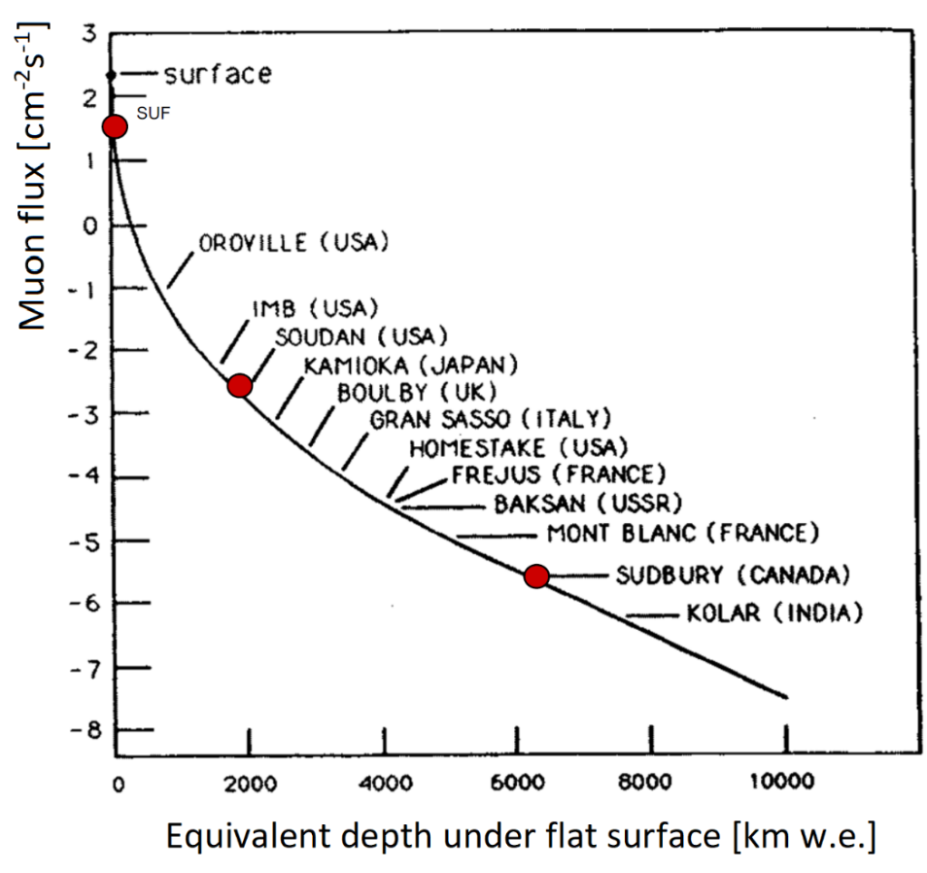
Super Cryogenic Dark Matter Search experiment
PAST
CDMS experiment evolution
PRESENT
• CDMS I
at the Stanford Underground Facility:
first experiment to probe for
supersymmetric WIMPs
• SuperCDMS SNOLAB
continue the legacy, explore new parameter space and new interactions
CDMS looks for scattering interactions of
low-mass (< 10 GeV/c²) dark matter
particles with standard model particles
• CDMS II
at the Soudan Underground Laboratory:
world leading limits on WIMPs for
nearly a decade
SNOLAB vs Soudan
• 10³ reduction in cosmic rays
• 250 reduction in μ-induced n’s
• SuperCDMS Soudan:
New detector technologies (iZIP and CDMSlite)
target low-mass dark matter
SNOLAB

Slide 7
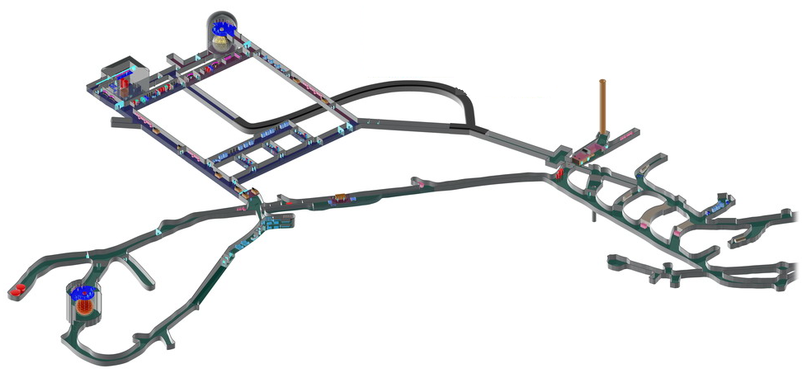
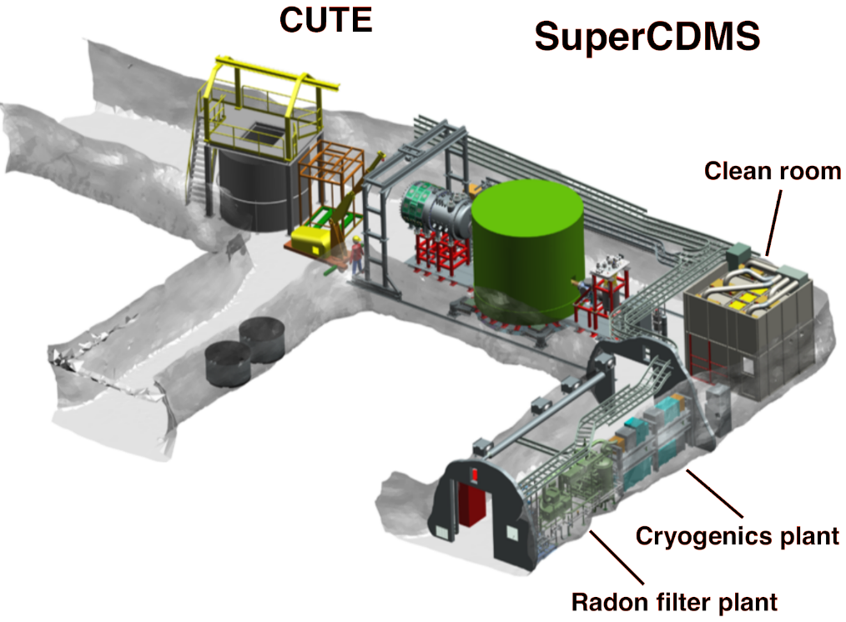
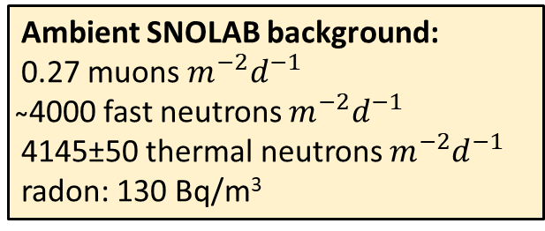
Super Cryogenic Dark Matter Search in SNOLAB
SuperCDMS site
SNOLAB
2070 m
̴6010 m.w.e.
SuperCDMS Utilities and Experiment
Ambient SNOLAB background:
0.27 muons$m^{−2}d^{−1}$
̴4000 fast neutrons $m^{−2}d^{−1}$
4145±50 thermal neutrons $m^{−2}d^{−1}$
radon: 130 Bq/m³

Slide 8
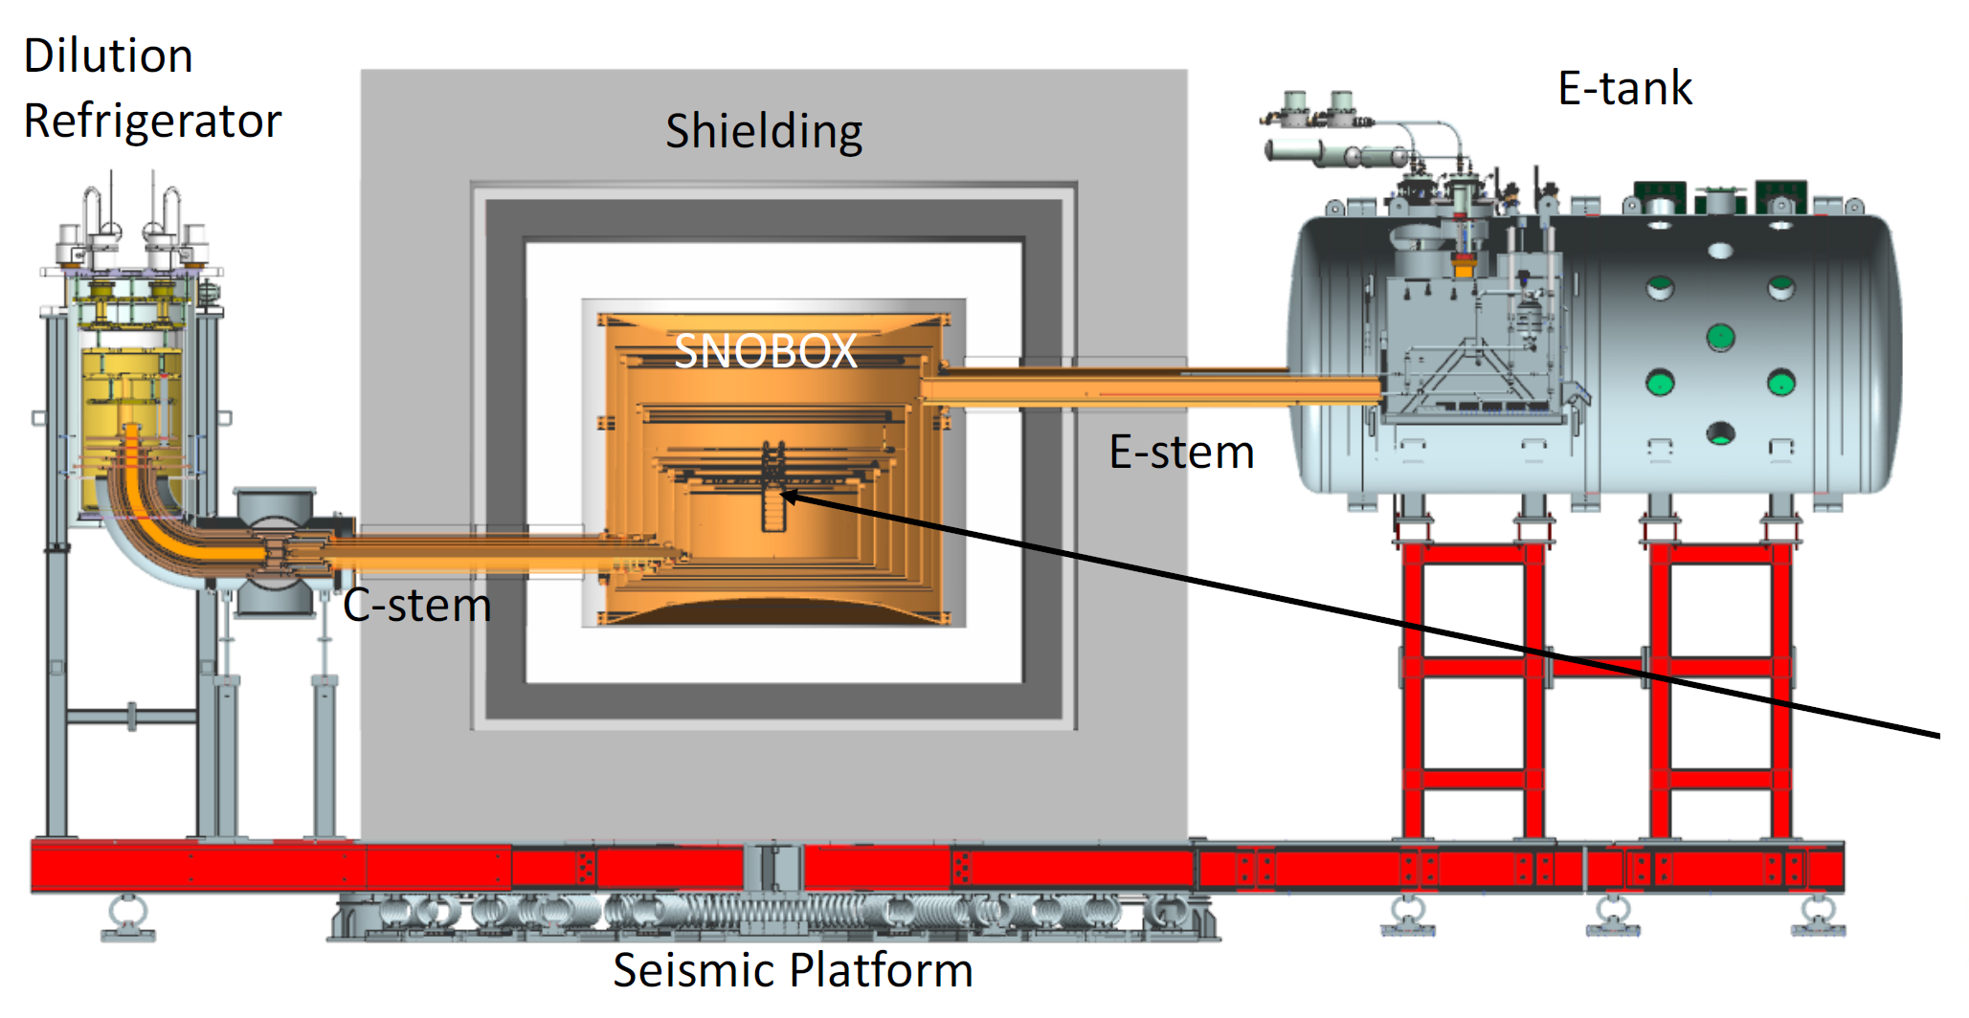
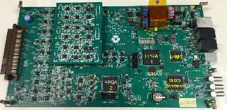
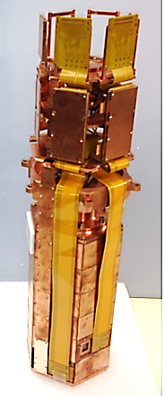
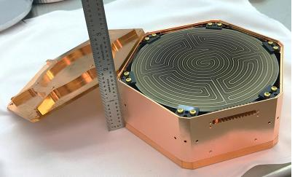
SuperCDMS experiment design
DCRC boards
15 mK
E-tank
Detector
tower
Seismic platform
C-Stem (cold) is stem for heat conduction to a dilution refrigerator
E-tank is the vacuum
bulkhead where the detector readout boards (DCRCs) connect
Detector
housing
Shielding:
Cu cans
Inner neutron shield
Pb gamma shield
Outer neutron shield
E-Stem (electronic) carries signals out from the detectors

Slide 9
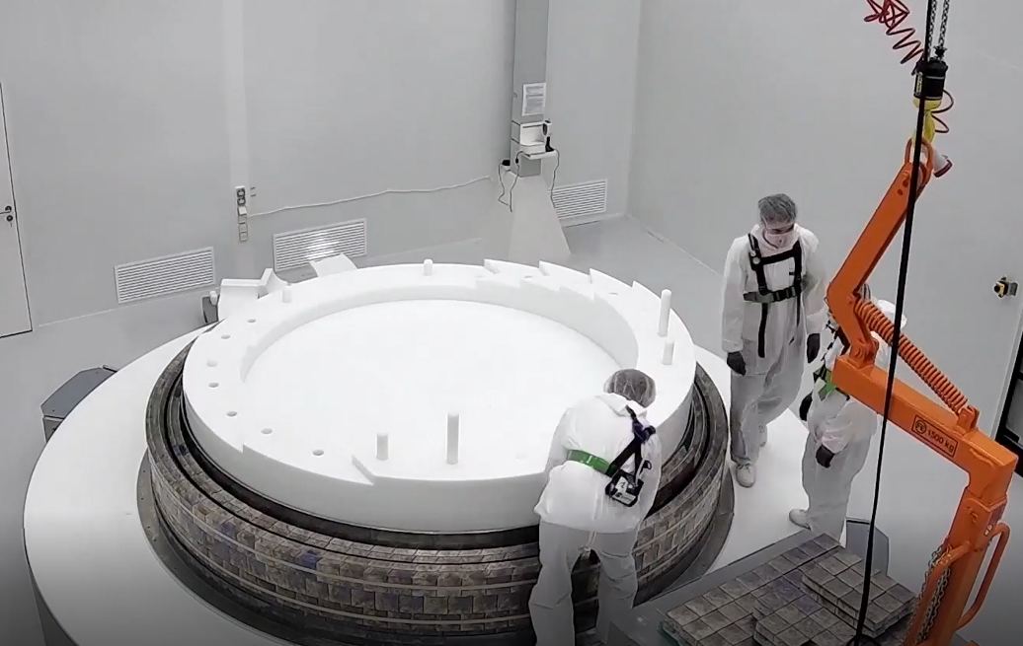
Low-background lead/poly shield
Outer neutron shield
Radon barrier
Gamma ray shield
Inner neutron shield
Copper cans of cryostat system
61 cm outer neutron water shield
in modular stainless steel tanks
41 cm inner poly shield
Archaeological lead cast in assayed crucibles
All materials assayed by ICPMS and HPGe
Copper
cryostat
Shield preassembled at the vendor’s facility
Metal liner
B-field < 5 mT
23 cm lead gamma ray shield
Radon barrier <1 Bq/m³
High-density poly base
Inner 1 cm of Pb: 0.08 Bq/kg ²¹⁰Pb
< 0.4 mBq/kg U/Th/K

Slide 10
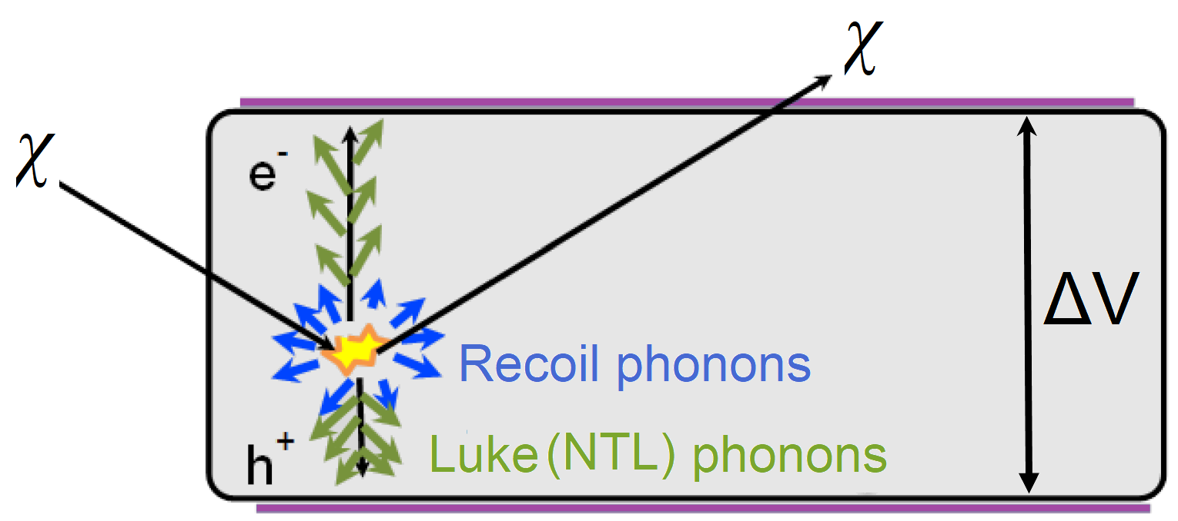

SuperCDMS detectors
$$E_{tot}=E_{r}+e∆VN_{e^{−}/h^{+}}$$
Total phonon energy
Recoil
energy
Luke
phonon
energy
Electron
1. Low ΔV: Recoil phonons dominate
Particle
interaction with
Recoil
produces
2. High ΔV: NTL phonons dominate
Nucleus
Electron-hole pairs
Phonons
Emission of primary Recoil phonons:
Majority of recoil energy not invested to electron-hole pairs production and released as phonons
- Produced electron-hole pairs relax to the bandgap releasing energy as phonons
- When the charge carriers (electron or hole) find a partner with which to recombine, they release
energy as phonons
Drifting charge carriers (e⁻/h⁺) across a potential ΔV generate a large number of Luke
phonons (NTL effect)

Slide 11
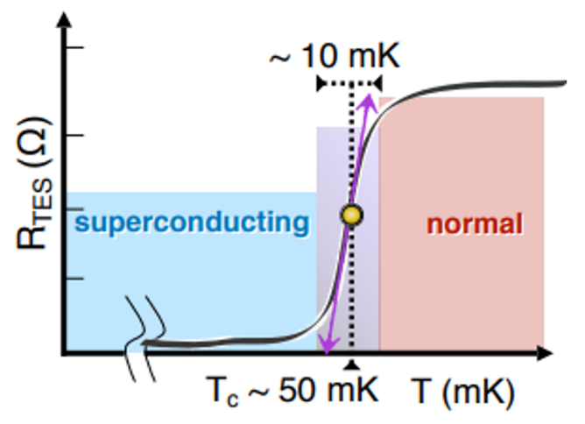
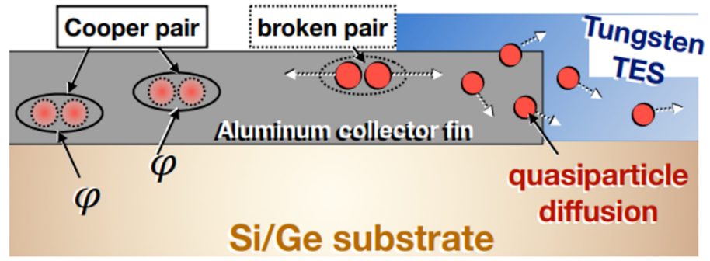
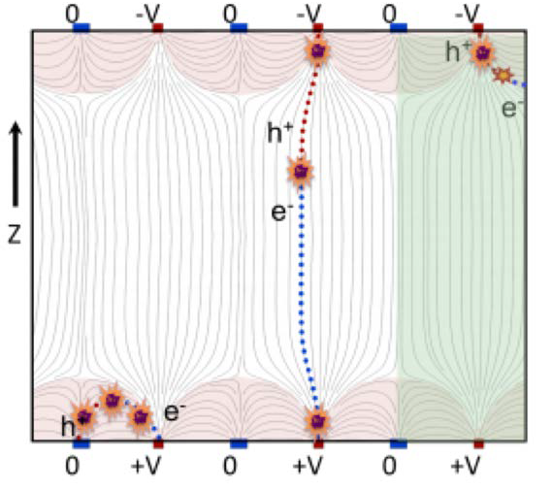
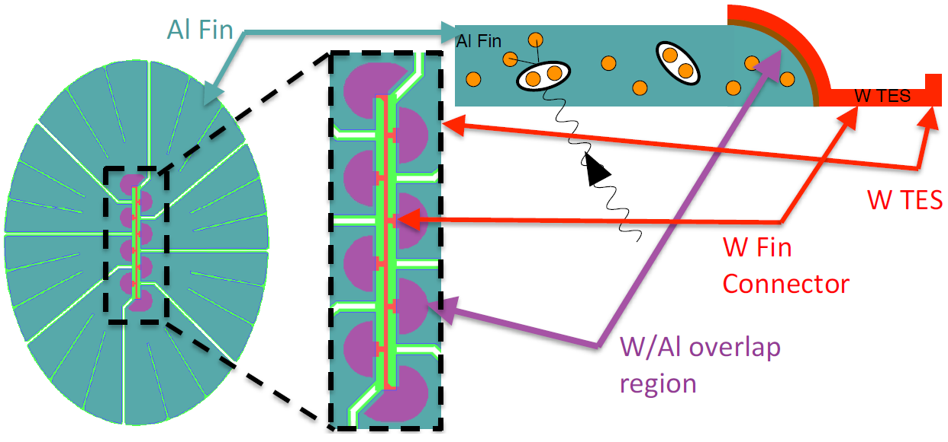
SuperCDMS detectors, sensors
Phonons, measured via Quasi-particle trap and Electrothermal feedback
Transition Edge Sensors (QETs)
Phonons break Cooper pairs in the aluminum fins
Generating quasi-particles which diffuse into tungsten TES
Temperature of a tungsten TES increases on a μsec timescale
In the superconducting phase transition, quasi-particle
diffusing from the aluminum deposit energy to the tungsten
Then, the TES resistance sharply increases when heated
Charge, measured via interleaved electrodes
Phonon sensor design

Slide 12
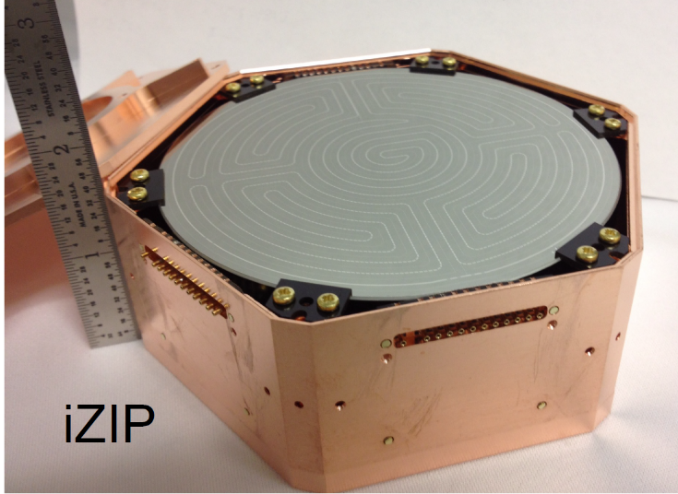
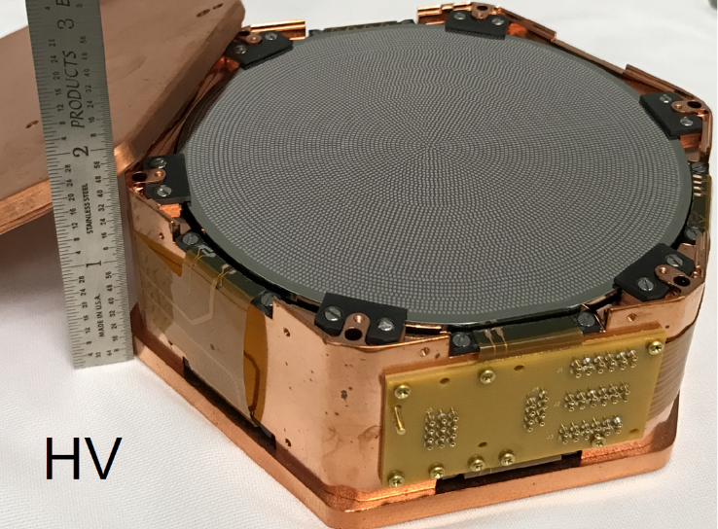
12 phonon, 4 charge channels
sensitive to ≥5GeV/c² DM
Ge(Si) σ_{ph}=50(25) eV σ_{ch}= 160(180) eV
SuperCDMS detectors
Interleaved Z-sensitive Ionization and Phonon
(iZIP) detector:
Low bias voltage ̴4 V
Luke (NTL) phonons negligible
Prompt phonon and ionization signals
Allow discrimination between electron (ER) and nuclear recoil (NR) events and surface rejection
Ge(Si) threshold_{ph}=350(175) eV, threshold_{ch} ̴1 keV
Low background
iZIP
12 phonon channels
sensitive to sub-GeV DM
Ge(Si) σ_{ph}=10(5) eV
High voltage (HV) detector:
High bias voltage ̴100 V
NTL phonons dominate
No ER/NR discrimination
Ge(Si) threshold_{ph}=70(35) eV
Low threshold
HV
Position sensitive, Ø100 mm, h=33.3 mm
mass: Ge(Si)=1.39kg(0.61 kg)

Slide 13
Planned detector layout at SNOLAB
Tower 1
Tower 2
Tower 3
Tower 4
iZIP
HV
HV
iZIP
Tower
iZIP
HV
HV
iZIP
24 detectors
both Ge and Si
12 – iZIP, 12 – HV
Total mass ~30 kg
iZIP
HV
HV
iZIP
iZIP
HV
HV
iZIP
iZIP
HV
HV
iZIP
iZIP
HV
HV
iZIP
Technical goal T<30 mK
 | Germanium | Silicon
HV | Low threshold for low mass DM, larger exposure, no ³²Si background | Lowest threshold for low mass DM, sensitive for lowest DM masses
iZIP | Nuclear recoil discrimination, understand Ge background | Nuclear recoil discrimination, understand Si background

Slide 14
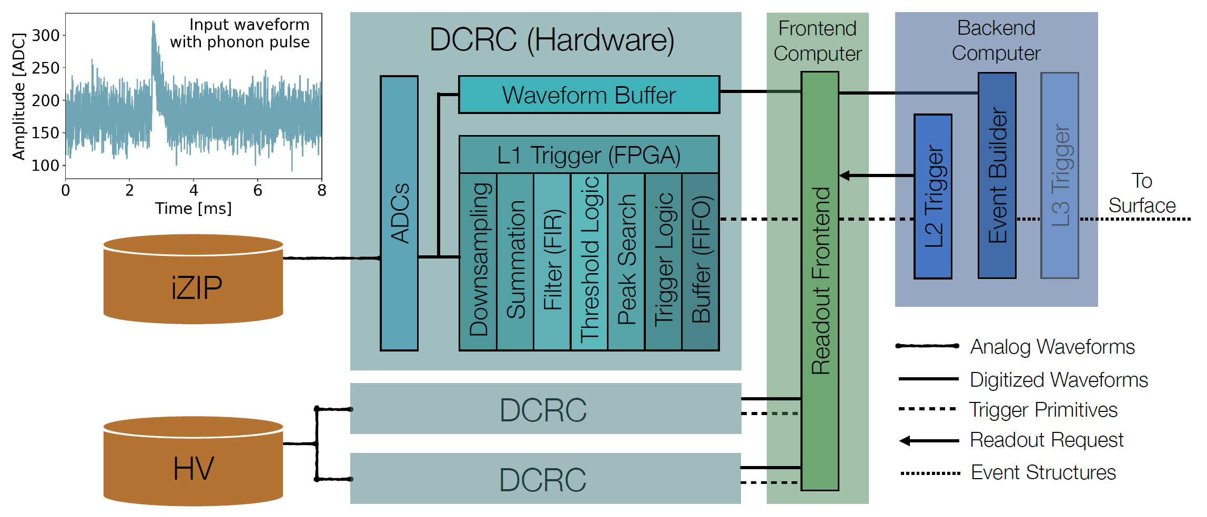
SuperCDMS SNOLAB electronics and trigger
DCRC – Detector Control and Readout Card
DCRC operations: setting detector biasing and feedback parameters, performance of analog to digital conversion of detector signals, operation with LEDs for detector, neutralization and thermometers
MIDAS – Maximum Integrated Data Acquisition System
MIDAS a general purpose data acquisition system for small and medium scale experiments

Slide 15
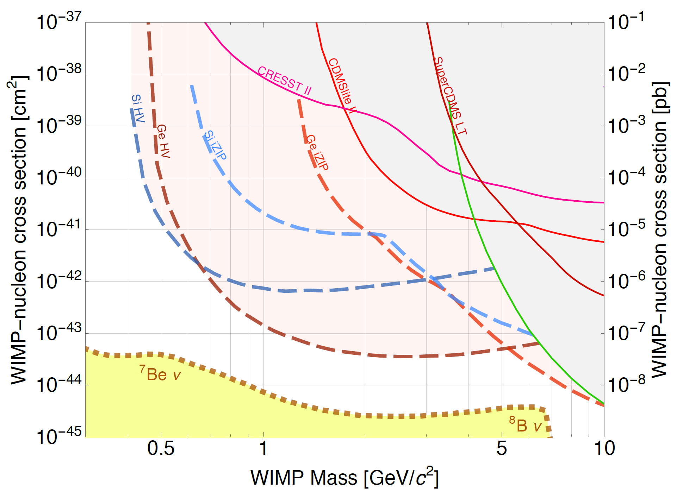
SuperCDMS projected WIMP sensitivity
HV detectors can reach these limits
with 2 years of exposure
iZIP detectors that allow ER/NR discrimination will provide information about the origin of background sources
Phys. Rev. D 95, 082002
These sensitivity limits are determined using the optimum interval method which does not incorporate any specific knowledge of background sources
A more sophisticated analysis that takes into account known sources of background, and uses data taken over the full 5-year timescale, would improve the sensitivity estimates

Slide 16





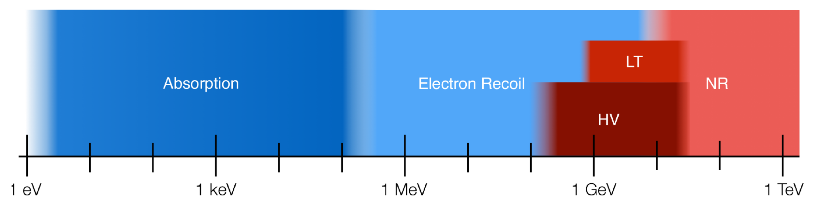
SuperCDMS: A broadband DM search
Traditional Nuclear Recoil iZIP, Background free >5 GeV
Low Threshold Nuclear Recoil iZIP, limited discrimination >1 GeV
HV mode HV, no discrimination 0.3 - 10 GeV
Electron recoil HV, no discrimination 0.5 MeV - 10 GeV
Absorption (Dark Photons, ALPs) HV, no discrimination 1 eV - 500 keV

Slide 17
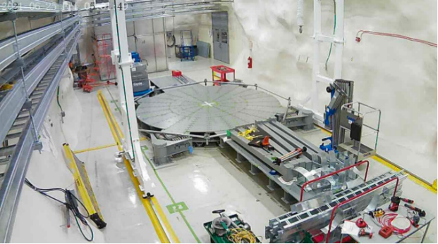
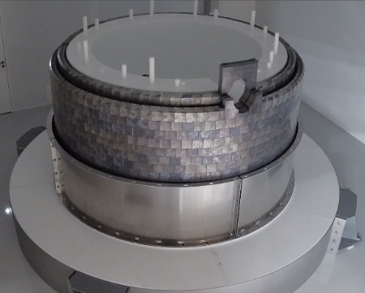
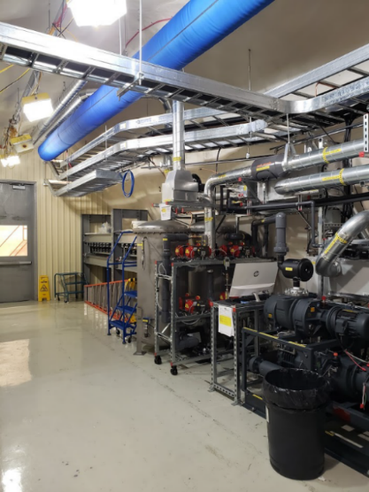
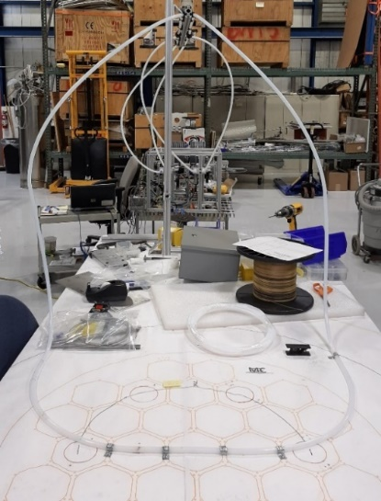
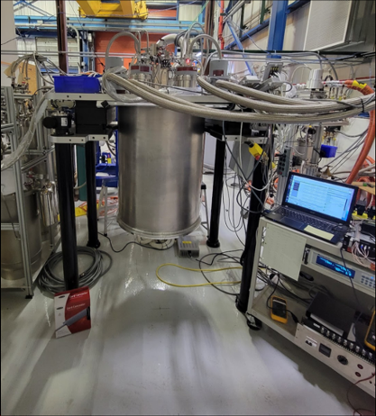
SuperCDMS installation in progress
Component deliveries to SNOLAB by the construction project
Seismic Platform
Plan | Status
Seismic Platform | Installed
3T Gantry Crane | Installed
Radon Reduction System | Installed
Cleanroom | Installed
DAQ | Installed
Computing | Offsite, data transferred to SLAC and others
Calibration | Preparing to ship
Readout Electronics | Complete
Dilution Refrigerator | Received from vendor
Shielding | Received from vendor
Detector Towers | Scheduling The Work
SNOBOX | In Development
Shielding
Radon Reduction
System
Calibration
Dilution Refrigerator
Plan is to start commissioning run in 2023!

Slide 18

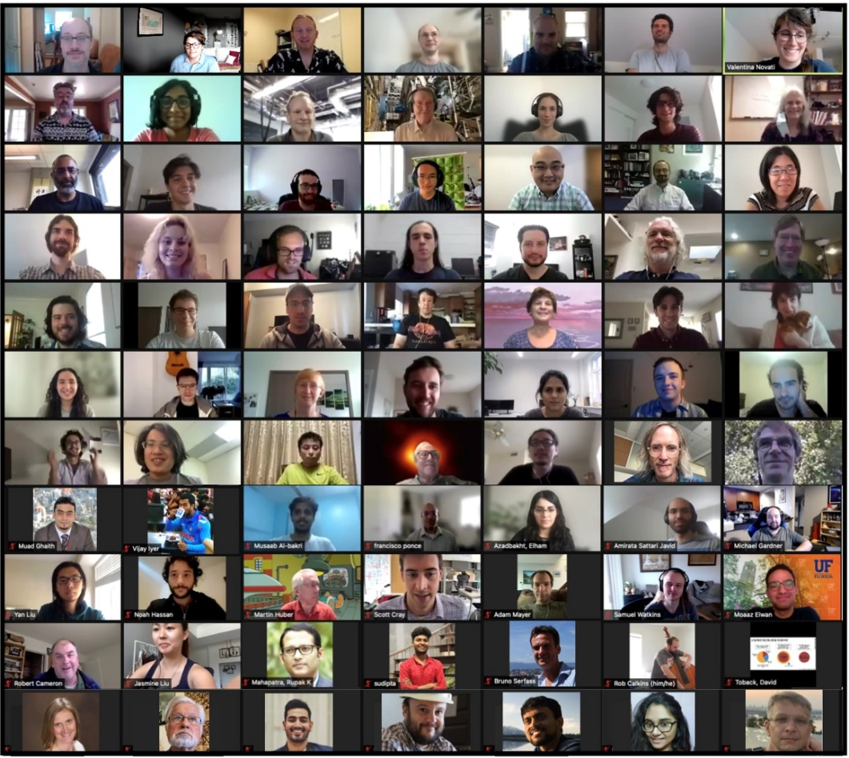

~130 scientists at 27 institutions
including 3 US national labs and
2 Canadian labs
SCDMS online Collaboration Meeting, August 2021

Slide 19
Conclusions
Detector fabrication, readout electronics, cryogenic and calibration systems are complete
Testing and characterization are happening at test facilities
SuperCDMS SNOLAB commissioning starts in 2023
First underground detector testing with opportunities for early science in 2024
First science run with full detector payload early 2024. First result in early 2025
Broadband sensitivity to new dark matter candidates

Slide 20
Backup

Slide 21
Low-background lead/poly shield
Outer neutron shield
Gamma ray shield
Reduce MeV neutrons from cavern wall by ̴10⁶,
̴20 for μ-induced neutrons (GeV)
Reduces MeV gammas from cavern wall by ̴10⁵
Inner layer is 1 cm ancient lead, ²¹⁰Pb < 1 Bq/kg
Reduce Bremsstrahlung ²¹⁰Bi in shield by factor of ̴20
61 cm outer neutron water shield
in modular stainless steel tanks
Radon barrier
Aluminum sheet banded around the lead shield with taped joints
Reduce ̴100 Bq/m³ to < 0.1 Bq/m³ (mine air)
41 cm inner poly shield
Inner neutron shield
  Stacked 2’’ thick poly sheets
  Reduces neutron rate by >10 μ-induced neutron from rock
  Neutron from lead
  Absorbs Backscatter from SNOBOX vacuum cans
  No neutron “reflection” from lead
Copper
cryostat
Metal liner
B-field < 5 mT
Copper Cans of Cryostat System
23 cm lead gamma ray shield
6.7 cm of copper in nested cans (SNOBOX)
Copper is radiopure compared to lead
Final gamma shield
Reduce residual gammas by x 25
Reduces Brem from ²¹⁰Bi β-decay by x 20
Radon barrier <1 Bq/m³
High-density poly base

Slide 22
SNOLAB backgrounds
Dominant background: in-crystal ³H, ³²Si, ⁶⁸Ge
Line-of-sight contamination from ²¹⁰Pb
Material and cavern contamination: ⁴⁰K, ⁶⁰Co

Slide 23
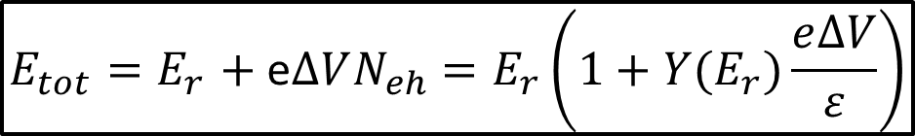

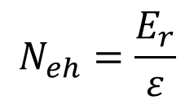
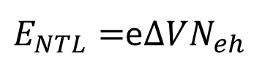
SuperCDMS detectors are very sensitive
ΔV is bias voltage
The energy contribution from NTL phonons
$E_{NTL}=$e$∆VN_{eh}$
The total energy generated by recoiling particle
$$E_{tot}=E_{r}+E_{NTL}$$
ε is the average energy required to produce 1eh pair for an
electron recoil (in Ge 3eV, in Si 3.8 eV)
$$N_{eh}=\frac{E_{r}}{ε}$$
$$E_{tot}{=E}_{r}+ \text{e}∆VN_{eh}=E_{r}\left(1+Y(E_{r})\frac{e∆V}{ε}\right)$$
1. Low bias voltage: NTL phonons negligible
2. High bias voltage: NTL phonons dominant

Slide 24
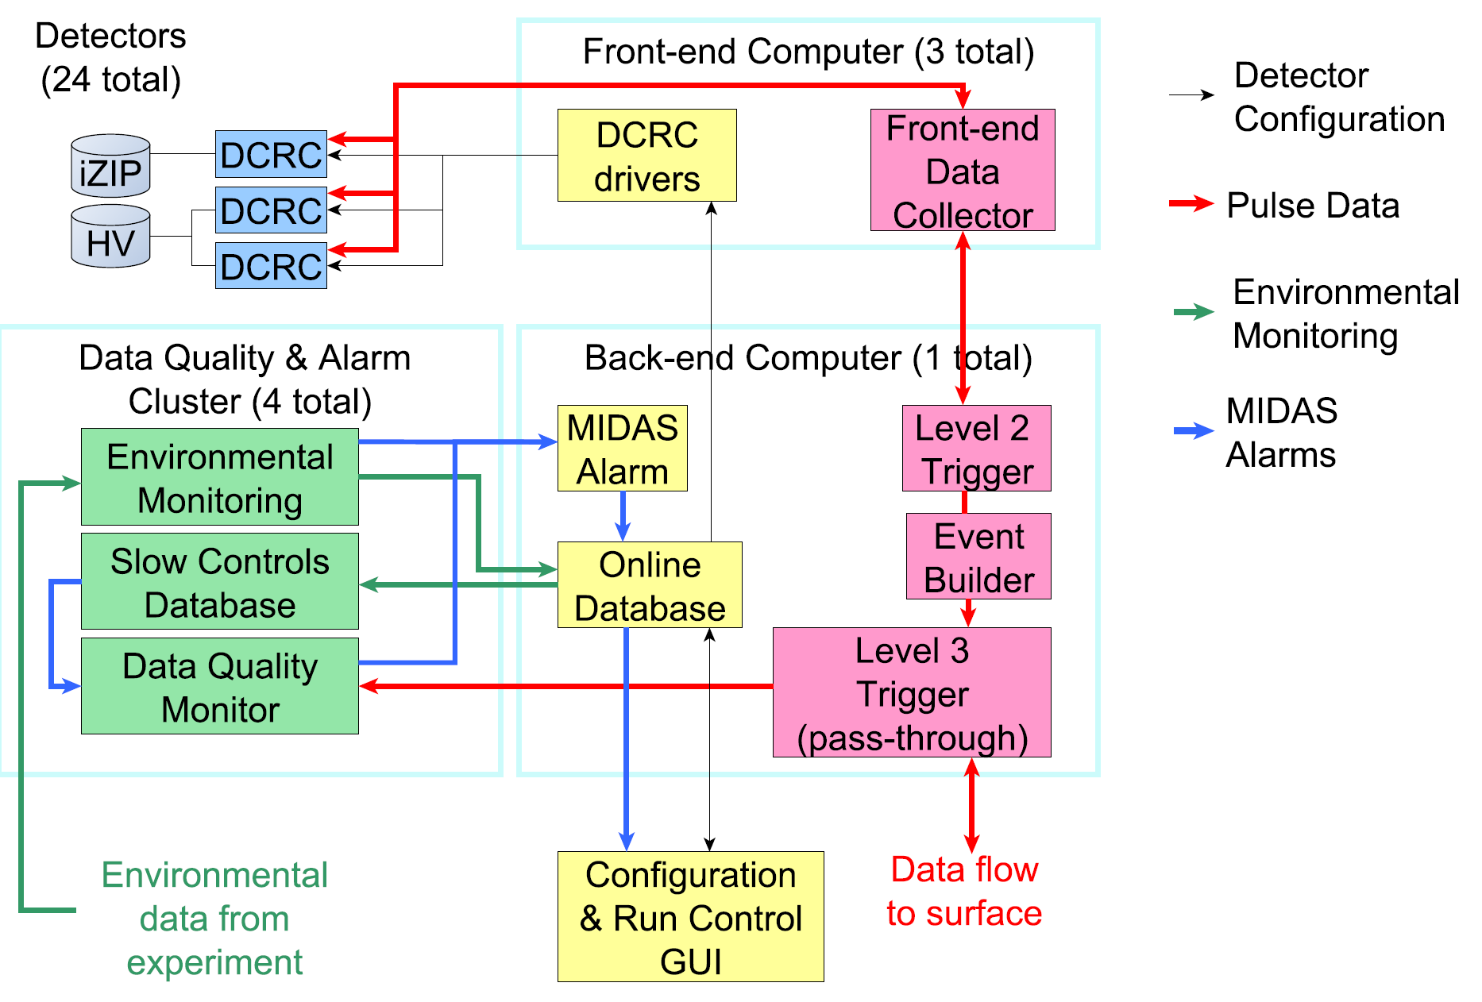
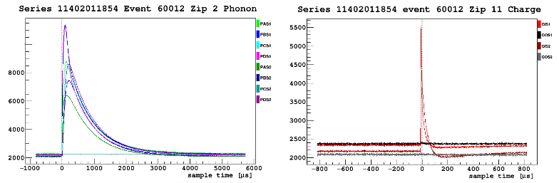
SuperCDMS SNOLAB electronics and trigger
MIDAS Maximum Integrated Data Acquisition
flexible C++ based DAQ system
3 levels of triggering:
Level 1 – hardware trigger
Level 2, 3 – software triggers
Sampling frequencies:
Ionization: 2.5 MHz
Phonon: 625 kHz
3000 μs phonon
100 μs Ionization
DCRC Detector Control and Readout Cards
DCRC operations:
- setting detector biasing and
feedback parameters
- performance of analog to digital
conversion of detector signals
- operation with LEDs for detector
neutralization and thermometers
MIDAS organized around Online Database (ODB),
Includes standard DAQ, event builder, run scheduler
and “watchdog” system to detect and recover hung
client processes. Supports ROOT, allows real-time analysis

Slide 25

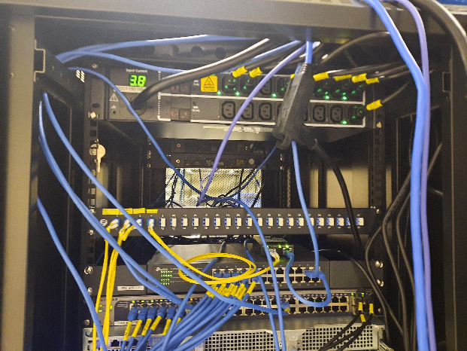

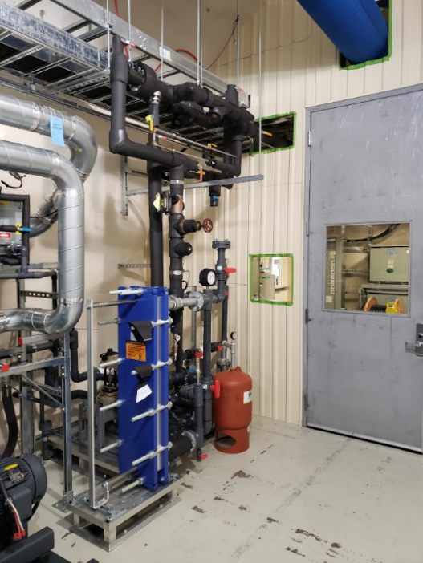

SuperCDMS installation in progress
Inner lead and
polyethylene shield
Seismic platform
Hardware
Radon filter system
Chilled waterloop
Calibration system
Plan is to start
commissioning
run in 2023!

Slide 26

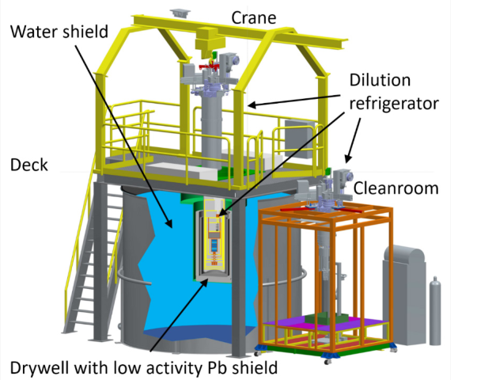
SuperCDMS test facilities
CUTE, Cryogenic Underground TEst facility at SNOLAB
Purpose of this facility is to provide an opportunity to test detector properties that cannot be tested above ground or in an unshielded facility, due to the impact of the high background rate
Capacity of testing 1 SuperCDMS detector tower
Base temperature ~12 mK (with detectors installed)
Background few events/(keV kg d) below few keV
~6 events/(keV·kg·day)
Running prototypes of HV SNOLAB detectors
to study performance
Possibility of early science result
Towers 1 and 2 arrive this June
Towers 3 and 4 arrive this September

Slide 27

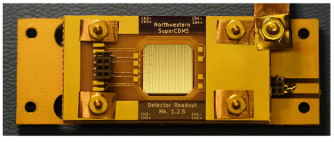
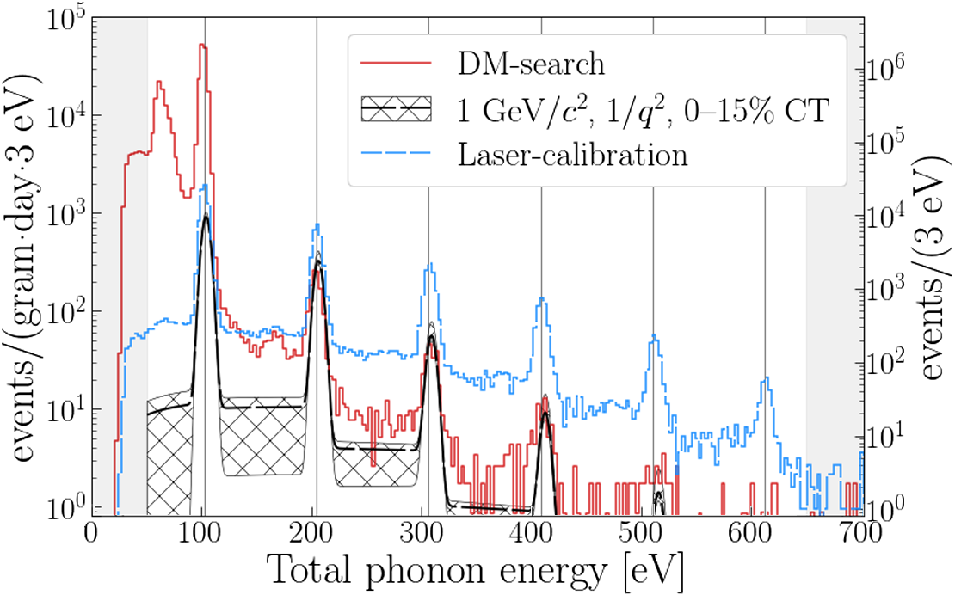
SuperCDMS test facilities
NEXUS, Northwestern EXperimental Underground Site at Fermilab
HVeV high voltage eV resolution
detectors
Gram scale detectors
Resolution: single electron-hole pair
Ideal for studying charge transport in Si and Ge
Sensitivity to a variety of sub-GeV DM models with gram·day exposures
D.W. Amaral et al, Phys. Rev. D 102, 091101 (2020)

Slide 28
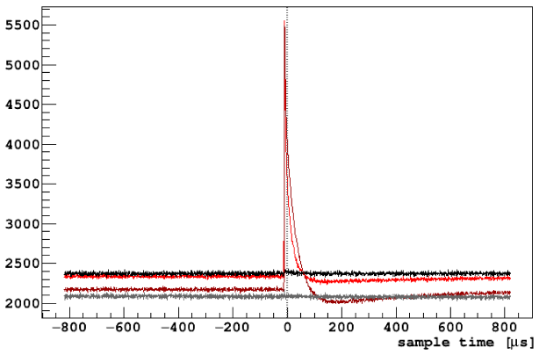
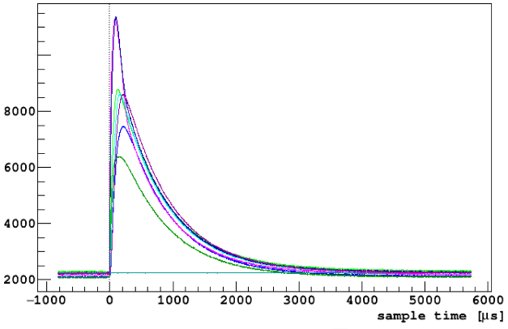
SuperCDMS, waveforms
100 μs Ionization signal
3000 μs phonon signal
Sampling frequencies:
Ionization: 2.5 MHz
Phonon: 625 kHz

