Slide 1
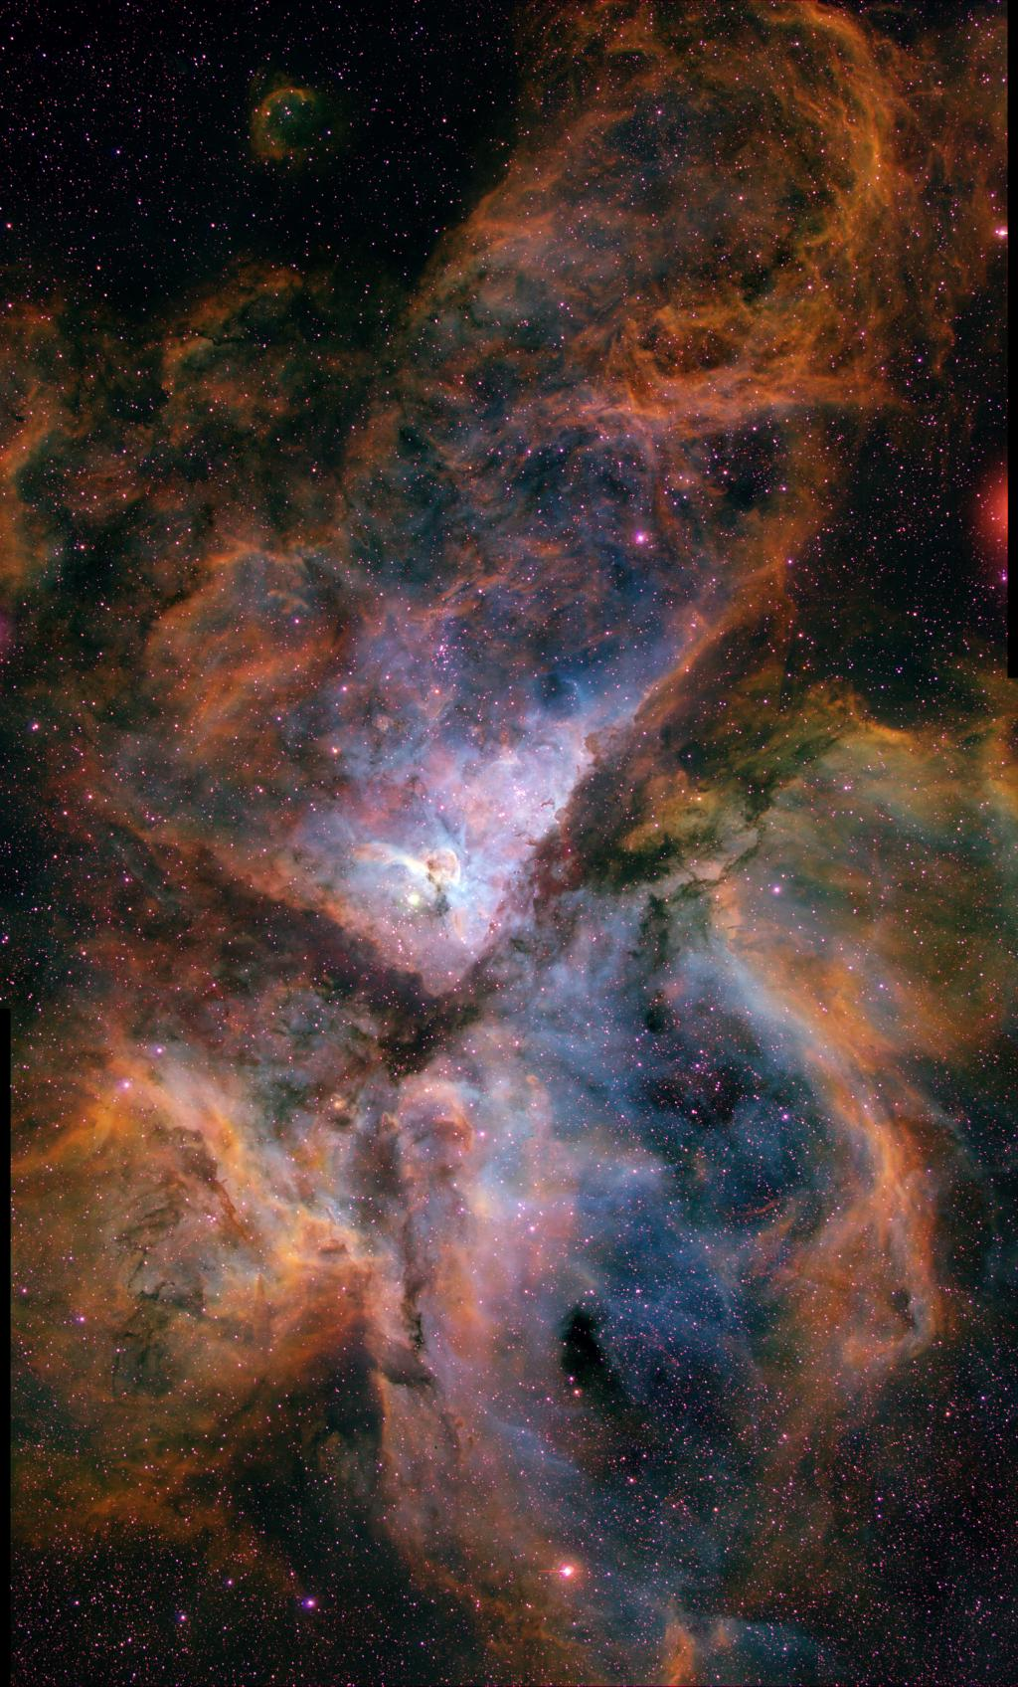
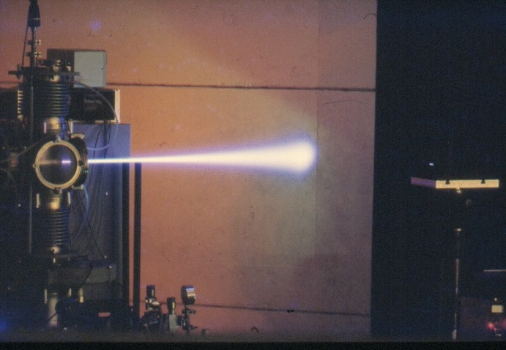
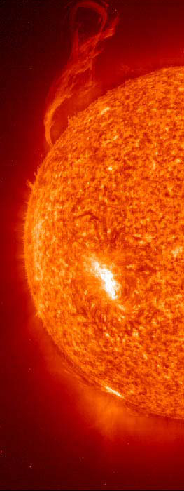
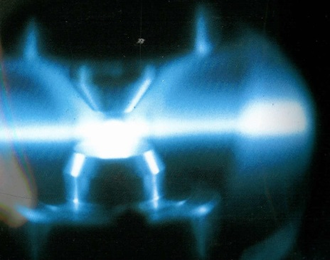
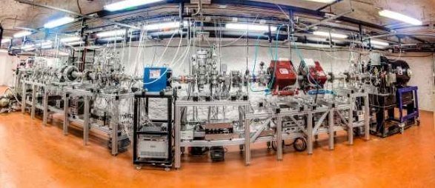
CASPAR
Compact Accelerator System for Astrophysical Reactions
Frank Strieder
South Dakota School of Mines & Technology
SURF User Association General Meeting – September 28th, 2021

Slide 2
What is Nuclear Astrophysics?
study energy generation processes
in stars
study nucleosynthesis of the elements
What is the origin of the elements?
What powers the stars?
How do stars form and evolve?
How old is the universe?
…
MACRO-COSMOS
intimately related to
MICRO-COSMOS
NUCLEAR PHYSICS
KEY for understanding

Slide 3
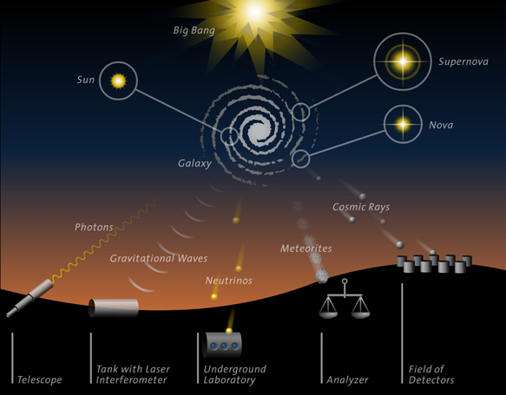
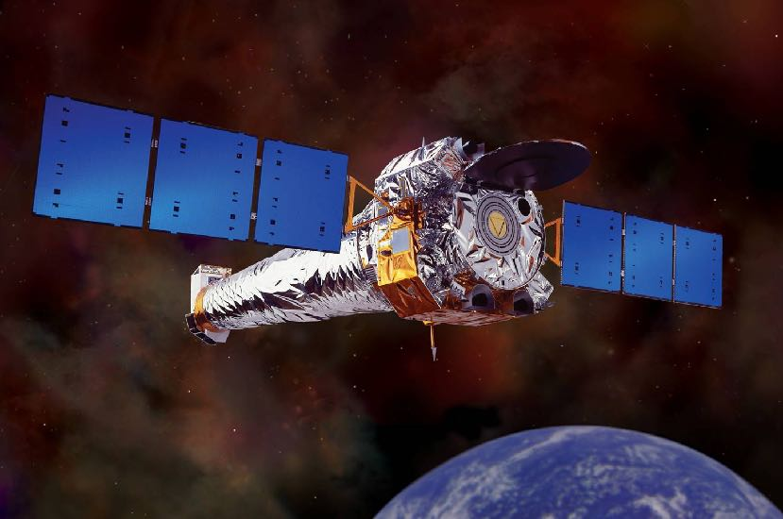
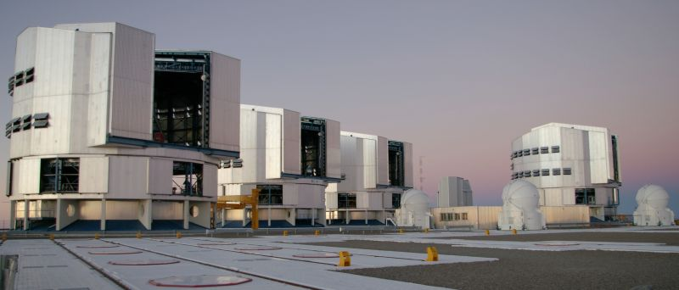
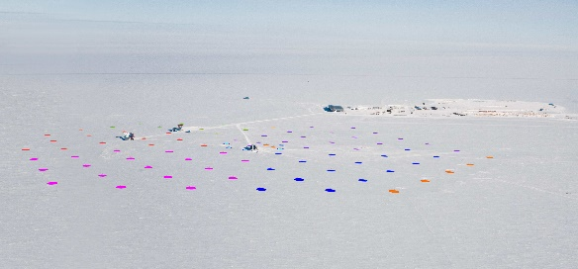
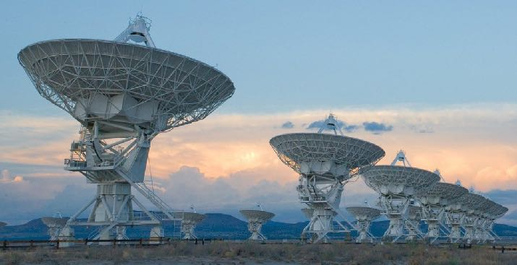

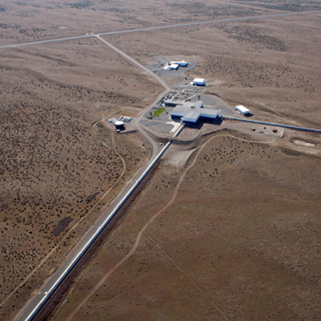
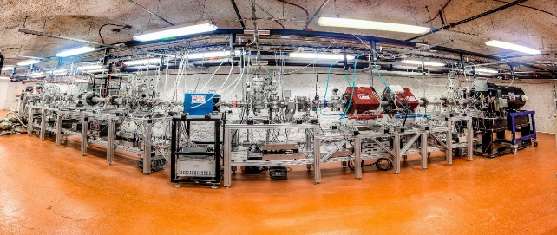
Nuclear Astrophysics is observation driven science

Slide 4
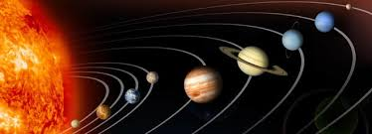
Isotopic Solar Abundances
Features:
distribution everywhere similar
12 orders-of-magnitude span
H ~ 75%
He ~ 23%
C → U ~ 2% (“metals”)
D, Li, Be, B under-abundant
exponential decrease up to Fe
peak near Fe
almost flat distribution beyond Fe

Slide 5
Solar Absorption Spectrum

Slide 6
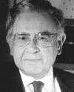
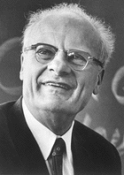
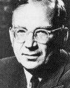

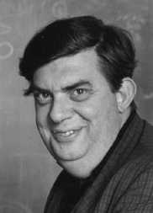
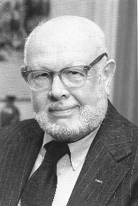
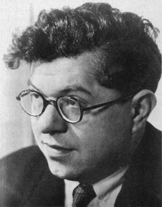
What is the Origin of these Elements?
first idea: Big-Bang nucleosynthesis
later: Stellar nucleosynthesis
all elements formed from protons and neutrons
sequence of n-captures and β decays
soon after the Big Bang
elements synthesised inside the stars
nuclear processes
well defined stages of stellar evolution
Alpher, Bethe & Gamow (“α β γ”)
Phys. Rev. 73 (1948) 803
Burbidge, Burbidge, Fowler & Hoyle (B²FH)
Rev. Mod. Phys. 29 (1957) 547

Slide 7
Big Bang Nucleosynthesis
t ~ 1 s ⇒ T ~ 7×10⁹ K
sea of neutrons & protons
t ~ 250 s ⇒ T ~ 10⁹ K
all neutrons consumed
n + p → d + γ
d + p → ³He +γ
³He + n → ⁴He + γ

Slide 8
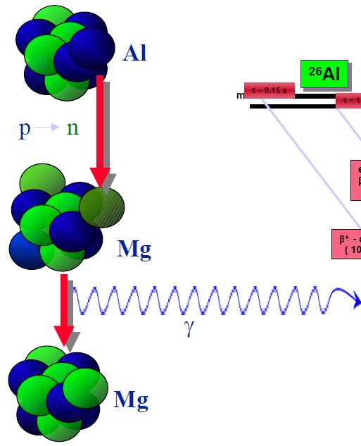
Galactic radioactivity
²⁶Al decay
²⁶Al
decay half-life:
720,000 y
²⁶Mg*
photon energy:
1.809 MeV
²⁶Mg

Slide 9
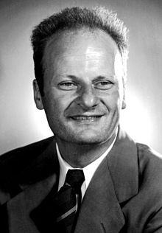
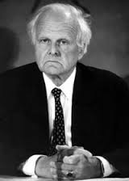
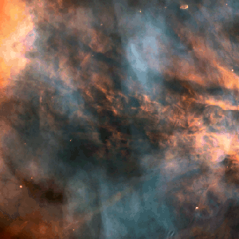
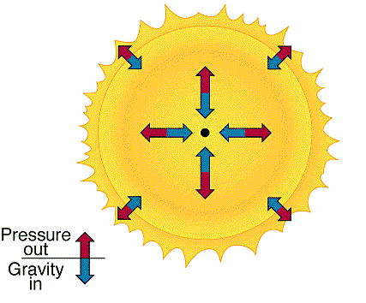
Stellar Nucleosynthesis - Principles of Stellar Evolution
1937 - 1939
gravitational contraction of gas (mainly H) increase of central temperature
if T high enough “nuclear burning” takes place
HYDROGEN BURNING (1st equilibrium)
4H → ⁴He + 2β⁺ + 2ν + 26 MeV
ash
of nuclear burning
energy source
Hans Bethe
C. F. von Weizsäcker
gravitational collapse is halted ⇒ star undergoes phase of hydrostatic equilibrium
MAIN SEQUENCE STARS

Slide 10
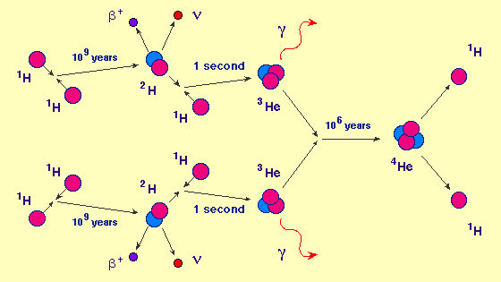
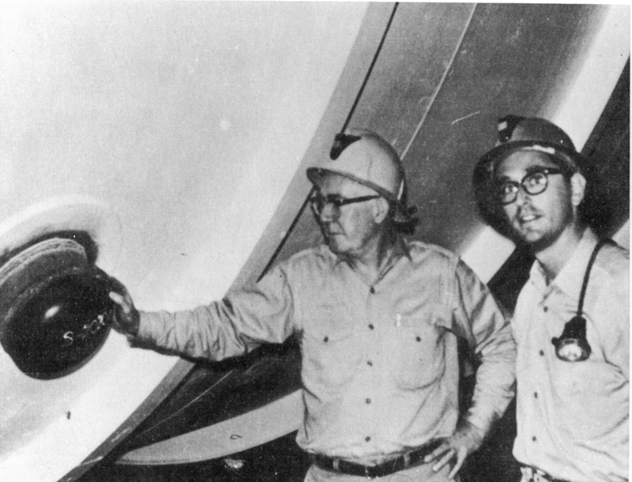
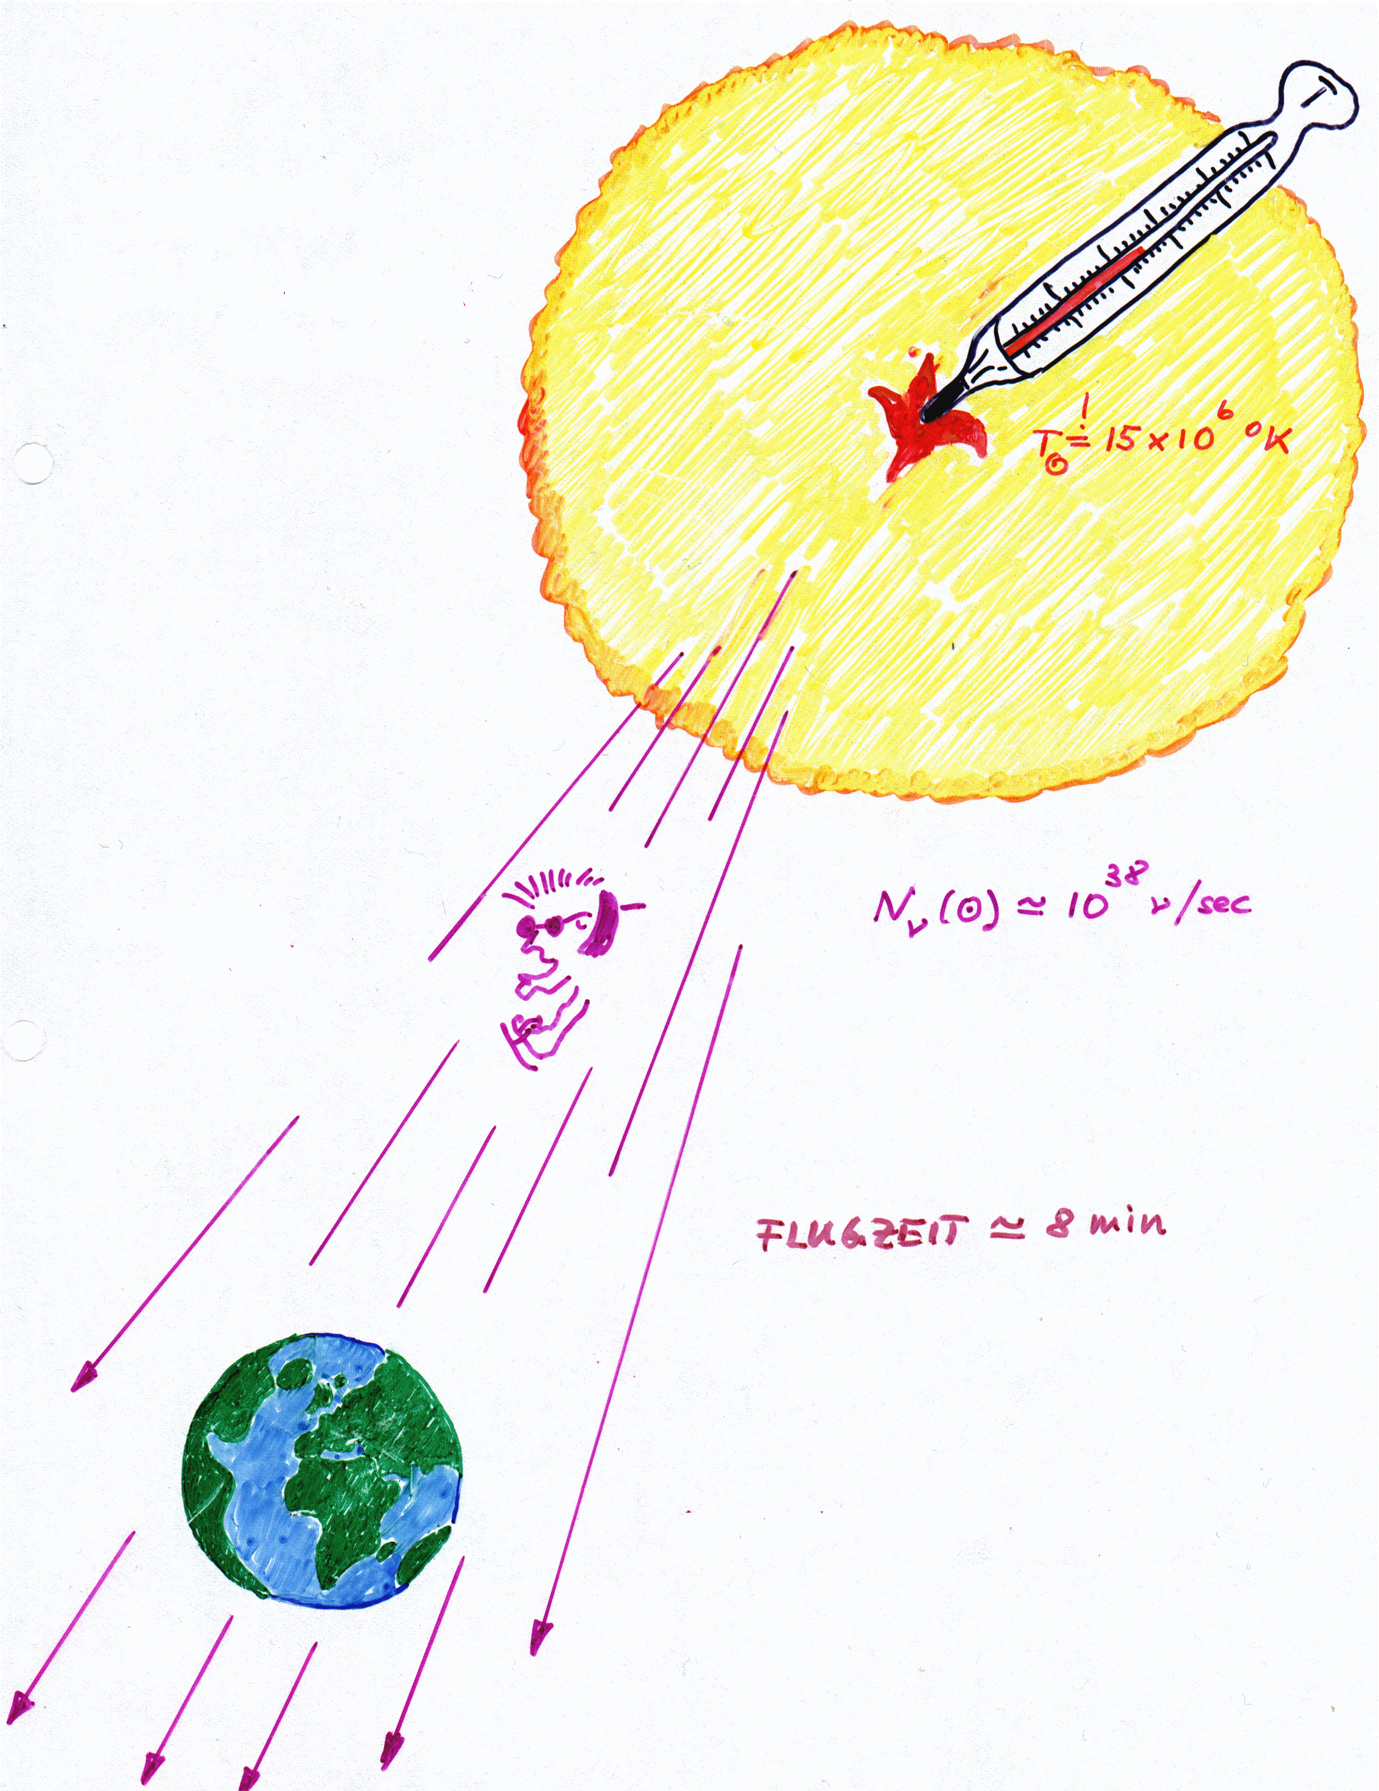
Stellar Nucleosynthesis - Principles of Stellar Evolution
γ
Evidence for nuclear energy generation in the Sun?
1 million years
solar spy
=
solar neutrinos
⇒ 10 billion ν/sec/cm²
on earth
travel time ≈ 8 min
Ray Davis
&
John Bahcall
at Homestake Mine

Slide 11
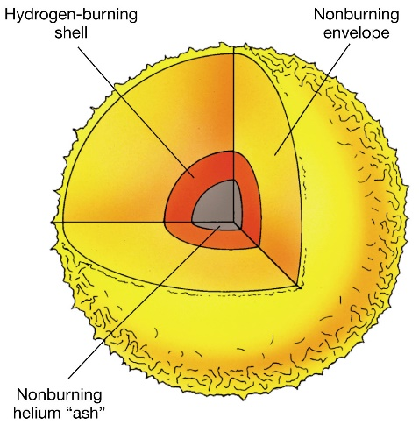
Stellar Nucleosynthesis - Principles of Stellar Evolution
H exhausted in core
isothermal He core
contraction sets in
temperature
increases
H-burning shell
contracting core
expanding envelope
R ~ 10-100 R_{i} ⇒ T_{s} ~ 3-4x10³ K
RED GIANT STARS
Wien’s law: λ_{max}T = const.
when T ~ 10⁸ K and ρ ~ 10³ gcm⁻³ (minimum mass ~ 0.5 M)
HELIUM BURNING (2nd equilibrium)
3α → ¹²C
¹²C(α,γ)¹⁶O
+ 8 MeV
nuclear burning ashes
energy source

Slide 12
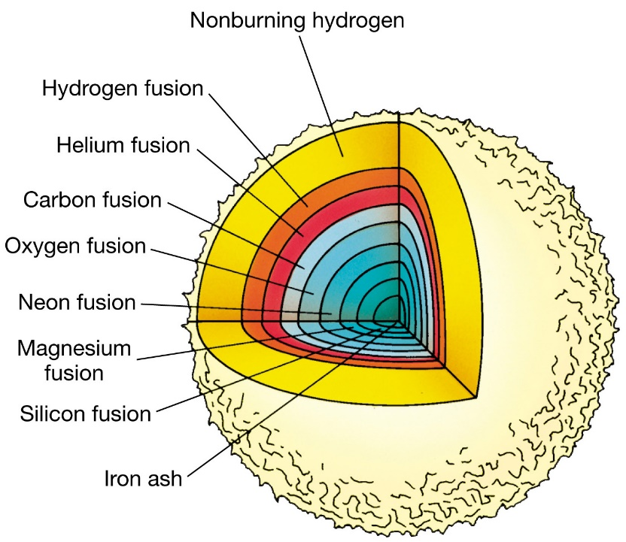
Stellar Nucleosynthesis - Principles of Stellar Evolution
¹²C/¹⁶O BURNING
… ¹²C ashes = Ne, Na, Mg
… ¹⁶O ashes = Al, … Si
SUPER RED-GIANT STARS
major ash = ²⁸Si
²⁸Si MELTING
major ash = ⁵⁶Fe
PRE-SUPERNOVA STARS
further reactions become endothermic
final gravitational collapse
SUPERNOVA EXPLOSION (type II)
remnant: neutron star or black hole
M ≥ 8 M

Slide 13
Nucleosynthesis beyond Iron
What about the synthesis of
elements heavier than iron?

Slide 14
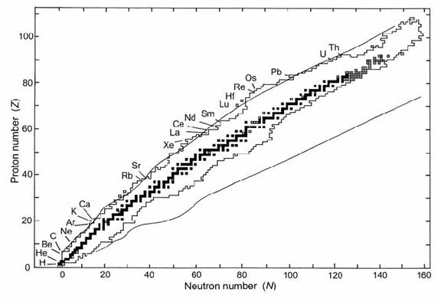
Nucleosynthesis beyond Iron – Chart of the Nucei

Slide 15
s-only
Zr
⁸⁰Br, t_{1/2}=17 min, 92 % (β⁻), 8 % (β⁺)
Y
s -process
Sr
(n,γ)
Rb
p-only
Kr
Br
(β⁻)
proton number
Se
(β⁺)
As
⁸⁵Kr, t_{1/2}=11 a
Ge
Ga
⁷⁹Se, t_{1/2}=65 ka
Zn
r-only
Cu
Ni
Co
⁶⁴Cu, t_{1/2}=12 h, 40 % (β⁻), 60 % (β⁺)
Fe
neutron number
⁶³Ni, t_{1/2}=100 a
finished, press left mouse button to continue
press left mouse button to continue
press left mouse button to continue
press left mouse button to continue
press left mouse button to continue
press left mouse button to continue
press left mouse button to continue
press left mouse button to continue
press left mouse button to continue
press left mouse button to continue
press left mouse button to continue
press left mouse button to continue

Slide 16
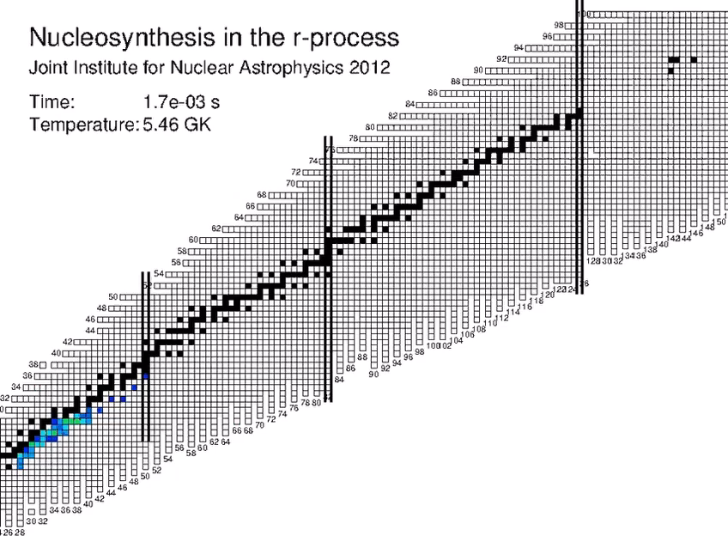
Nucleosynthesis beyond Iron – r Process

Slide 17
Isotopic Solar Abundances
Data sources:
Earth Moon, meteorites,
stellar (Sun) spectra, cosmic rays...
courtesy of Nicole Vassh, UND

Slide 18
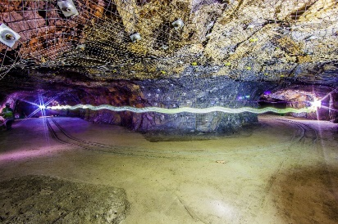
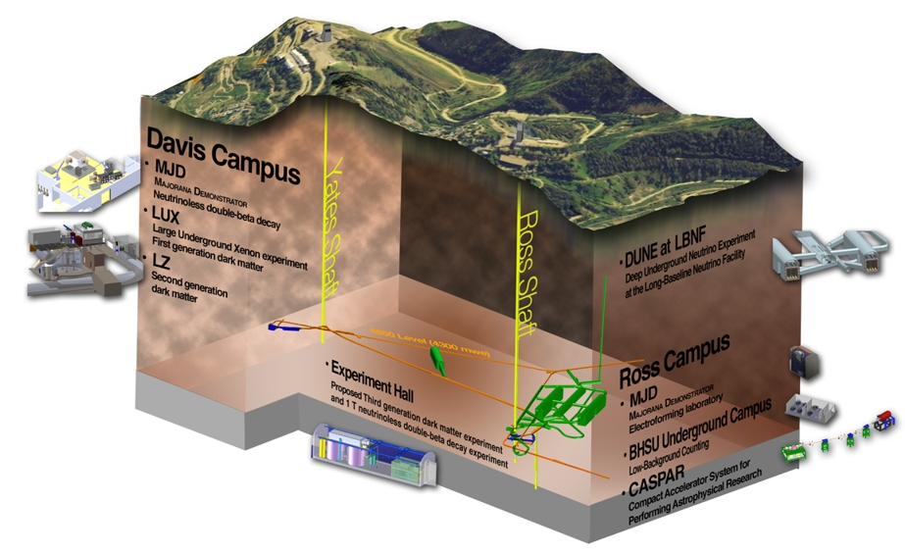
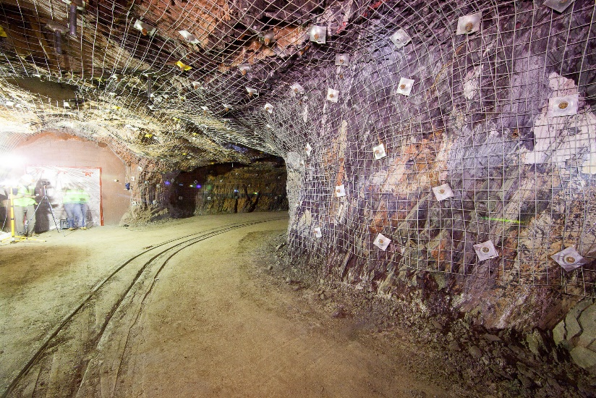
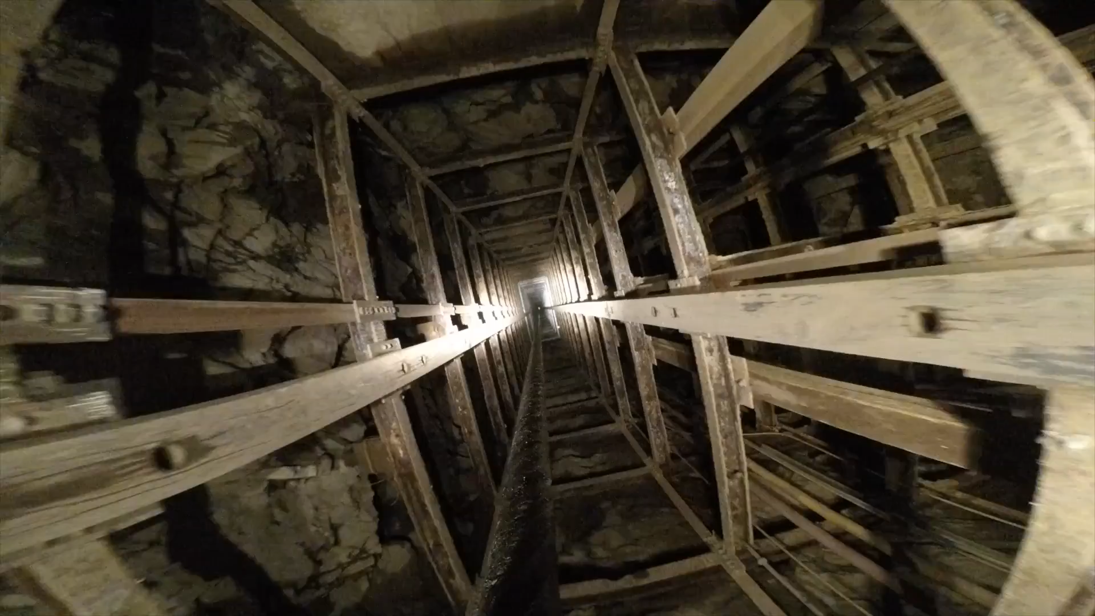
Sanford Underground Research Facility

Slide 19
Sanford Underground Research Facility - Background

Slide 20

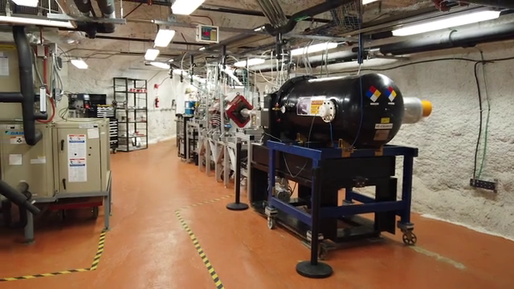
Compact Accelerator System for Performing Astrophysical Research
First US Underground Accelerator
at
Studies of stellar neutron sources in the Laboratory
Understanding of Origin of the Elements

Slide 21
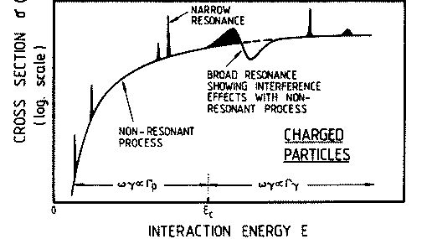
Nuclear reactions at astrophysical energies
nuclear reactions important to provide energy and the neutrons for nucleosynthesis
e.g. pp chain, ¹³C + α → ¹⁶O + n or ²²Ne + α → ²⁵Mg + n
V
E_{r+1}
occurs at specific energies
cross section has STRONG energy dependence
E_{r}
incident nucleus
E
σ
0
E₂
r₀
r
E₁
astrophysical
temperature/energy
range
range accessible
with experiments

Slide 22
CASPAR Experimental Program
Reactions measured at CASPAR:
²²Ne(α,n)²⁵Mg
¹¹B(α,n)¹⁴N
¹⁴N(p,γ)¹⁵O
²²Ne(α,γ)²⁶Mg
¹⁸O(α,γ)²²Ne
⁷Li(α,γ)¹¹B
neutron sources
γ-ray spectroscopy

Slide 23
CASPAR Experimental Program
Reactions measured at CASPAR:
²²Ne(α,n)²⁵Mg
¹¹B(α,n)¹⁴N
¹⁴N(p,γ)¹⁵O
²²Ne(α,γ)²⁶Mg
¹⁸O(α,γ)²²Ne
⁷Li(α,γ)¹¹B
neutron sources
γ-ray spectroscopy

Slide 24
CASPAR Experimental Program
Reactions measured at CASPAR:
²²Ne(α,n)²⁵Mg
¹¹B(α,n)¹⁴N
¹⁴N(p,γ)¹⁵O
²²Ne(α,γ)²⁶Mg
¹⁸O(α,γ)²²Ne
⁷Li(α,γ)¹¹B
neutron sources
γ-ray spectroscopy

Slide 25
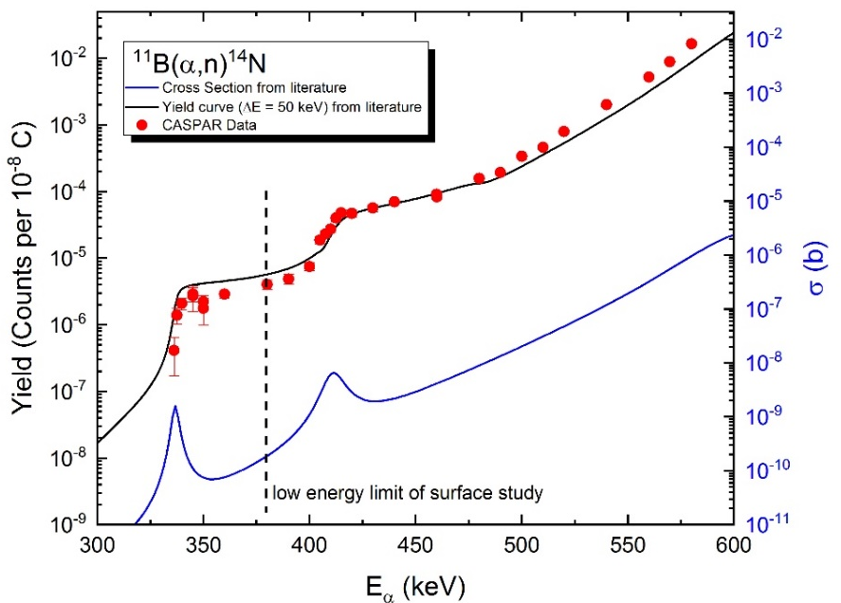
CASPAR Experimental Program
Reactions measured at CASPAR:
²²Ne(α,n)²⁵Mg
¹¹B(α,n)¹⁴N
¹⁴N(p,γ)¹⁵O
²²Ne(α,γ)²⁶Mg
¹⁸O(α,γ)²²Ne
⁷Li(α,γ)¹¹B
neutron sources
γ-ray spectroscopy

Slide 26
CASPAR Experimental Program
Reactions measured at CASPAR:
²²Ne(α,n)²⁵Mg
¹¹B(α,n)¹⁴N
¹⁴N(p,γ)¹⁵O
²²Ne(α,γ)²⁶Mg
¹⁸O(α,γ)²²Ne
⁷Li(α,γ)¹¹B
neutron sources
γ-ray spectroscopy

Slide 27
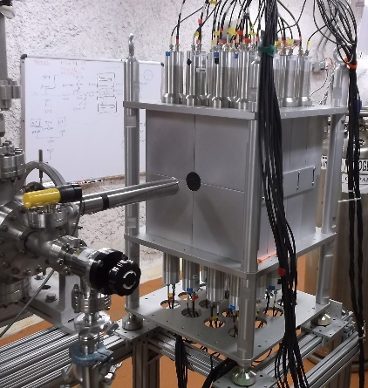
CASPAR Experimental Program
Reactions measured at CASPAR:
²²Ne(α,n)²⁵Mg
¹¹B(α,n)¹⁴N
¹⁴N(p,γ)¹⁵O
²²Ne(α,γ)²⁶Mg
¹⁸O(α,γ)²²Ne
⁷Li(α,γ)¹¹B
neutron sources
γ-ray spectroscopy

Slide 28
CASPAR Experimental Program
Reactions measured at CASPAR:
²²Ne(α,n)²⁵Mg
¹¹B(α,n)¹⁴N
¹⁴N(p,γ)¹⁵O
²²Ne(α,γ)²⁶Mg
¹⁸O(α,γ)²²Ne
⁷Li(α,γ)¹¹B
neutron sources
γ-ray spectroscopy
²⁷Al(p,γ)²⁸Si

Slide 29
CASPAR Experimental Program
Reactions measured at CASPAR:
²²Ne(α,n)²⁵Mg
¹¹B(α,n)¹⁴N
¹⁴N(p,γ)¹⁵O
²²Ne(α,γ)²⁶Mg
¹⁸O(α,γ)²²Ne
⁷Li(α,γ)¹¹B
neutron sources
γ-ray spectroscopy

Slide 30



Slide 31

Thank you for your attention!

