Slide 1
Quantum Sensors for Rare Event Searches
Matt Pyle
9/14/21
QIS Collaboration Meeting 2021

Slide 2
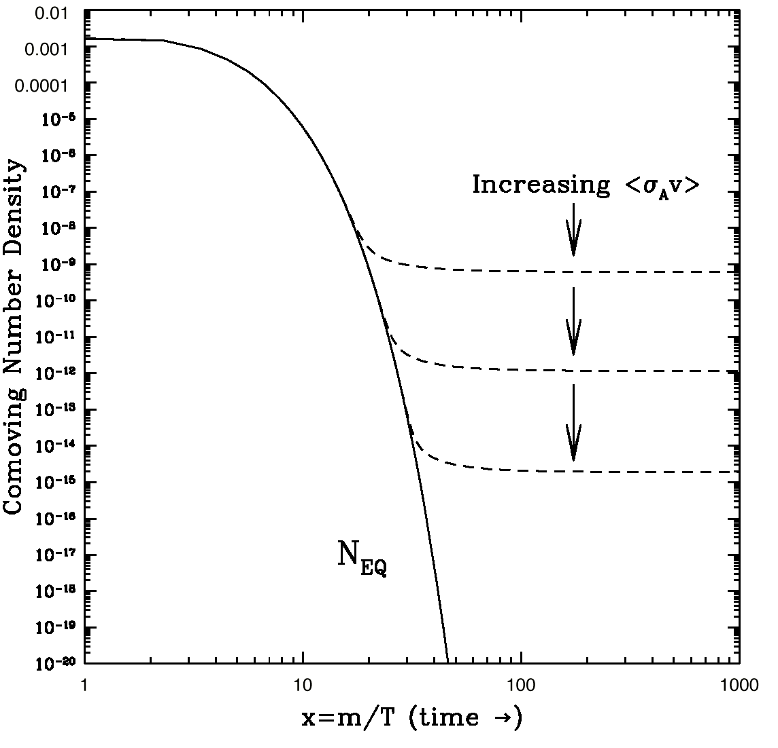
10 Years Ago: A Focus on WIMPs
keV
10 GeV
10¹⁹ GeV
10⁻²² eV
WIMPS
Relic DM density suggests weak-scale cross sections
New physics (and particles) at the weak scale could solve the hierarchy problem
Notes:
Main idea: 10 years ago the majority of the experimental community was searching for WIMPs
DM Constraints:
10^-22 eV: size of the galaxy
< 100 eV: Fermions are degenerate
< 3 keV: warm DM limit
WIMPs: 10GeV < M < 100TeV (above 100TeV WIMP won’t freeze out)
Hiearchy problem:
- Why do different forces have such enormously different strengths
- Why is the Higgs mass so much lighter than the plank scale

Slide 3
Today: Search for Dark Matter Everywhere
10⁻²² eV
keV
10 GeV
10¹⁹ GeV
WIMPS
Dark Sectors: DM + New Mediators
This Talk
1meV
100MeV
Many Well Motivated DM Models at Light Mass
US Cosmic Visions: New Ideas in Dark Matter: 1707.04591

Slide 4
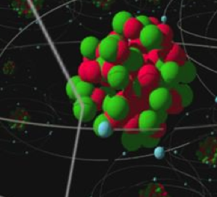
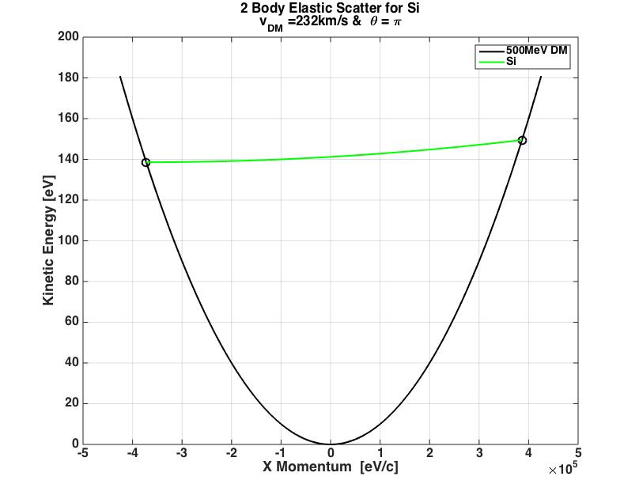
Kinematics: 2 Body Elastic Nuclear Scattering
DM
When M_{n}>> M_{DM}
Recoil Energy Scales as M_{DM}². Transfer of DM kinetic energy is really inefficient for elastic 2 Body Scatters when M_{n} >> M_{DM}

Slide 5
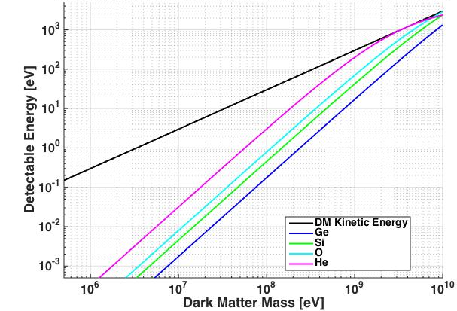
Light Mass Dark Matter: Elastic Nuclear Scattering
<v>
_{𝛳=0}
1 meV
Yikes!
Energy Sensitivity is Primary Design Driver

Slide 6
Ionization Production in eV Scale Nuclear Recoils
<v>, 𝛳=0
Frenkel Defect Dislocation Energy in Si: ~ 15 eV
Electronic Bandgap in Silicon
For DM <~ 200MeV, no ionization expected from NR

Slide 7
Coherent Vibrational Excitation Regime
Coherent Vibrational modes
Below O(10 MeV), we need to start thinking about DM nucleus interactions in terms of coherent vibrational mode production

Slide 8
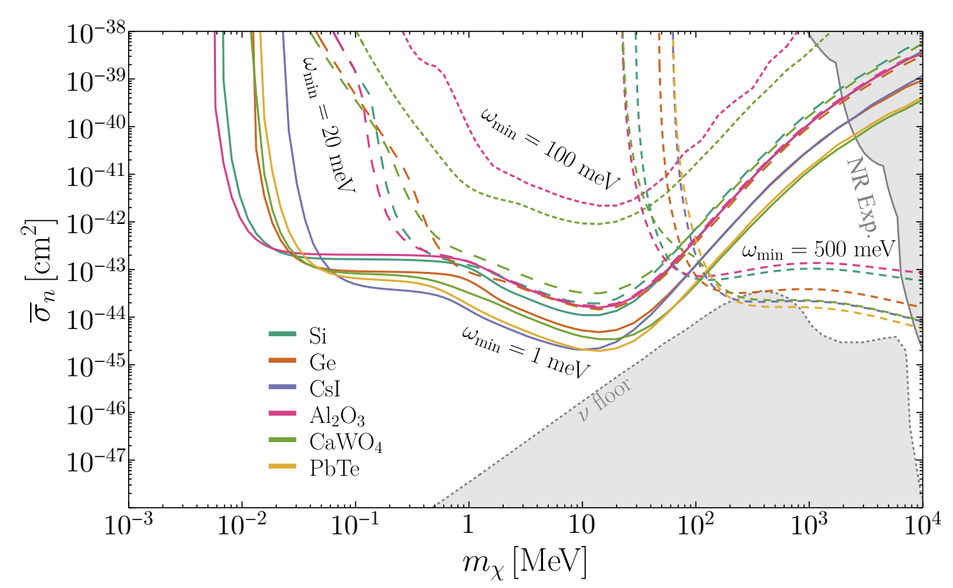
Phonon Sensitivity Curves
Heavy Mediator Single Phonon Sensitivity
Zurek, Griffin, et al: 1910.10716
Exposure: 1kgyr
No Backgrounds
1910.10716
Detectors with ~20meV single phonon sensitivity needed to really probe this space

Slide 9
Single phonon sensitivity -> quantum sensing technology

Slide 10
Everything Else Easier: Detector Size
Interaction Rate scales with 1/M_{DM}
Light mass dark matter searches are tabletop!
LZ needs 10 tons to get to 10⁻⁴⁷ cm² at 100GeV, Light Mass DM searches only needs 1kg to reach the same level at 10MeV

Slide 11
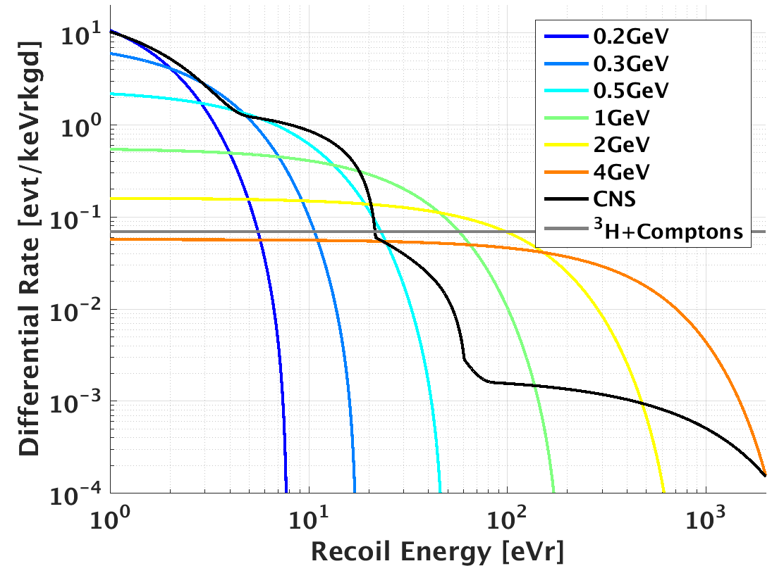
Everything Else Easier: Flat Radiogenic Backgrounds
PP
⁷Be
PEP
⁸B
σ=10⁻⁴³cm²
Smaller DM masses have less overlap with flat backgrounds!

Slide 12
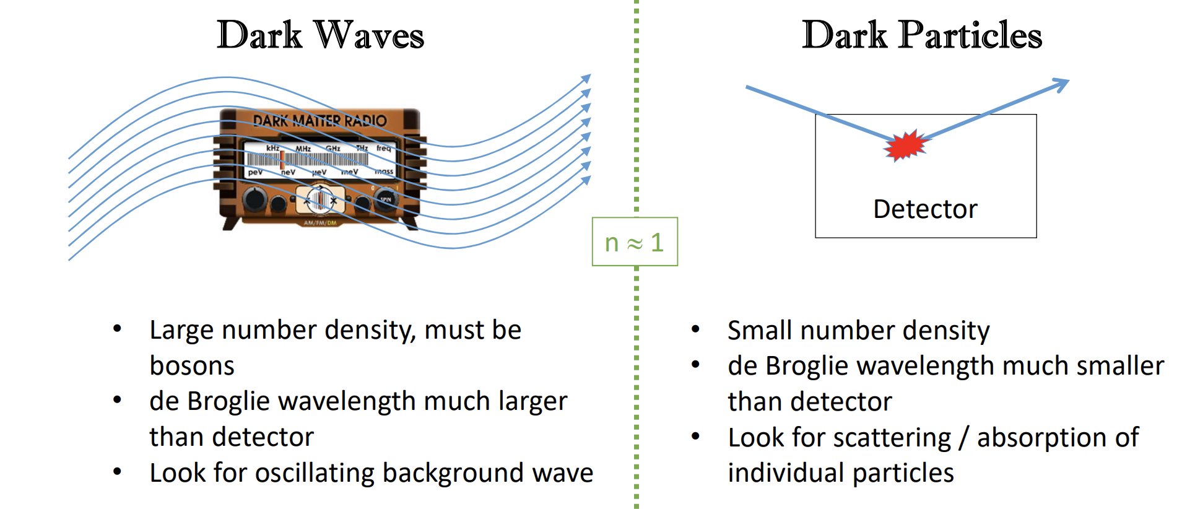
Ultralight DM: Minimal Radiogenic Background Overlap with Signal
10⁻²² eV
keV
10 GeV
10¹⁹ GeV
WIMPS
Dark Sectors: DM + New Mediators
Experiments: DMRADIO, HAYSTAC, ADMX, ABRACADABRA, CASPER, … very vibrant scientific area
Heavy use of quantum sensing technology
But … minimal overlap with radiogenic backgrounds -> no planning for underground running
Unless your quantum sensor itself needs a low background environment
1meV

Slide 13
SURF+ Quantum Sensing Sweet Spot:
1meV <M_{DM}< 1GeV
10⁻²² eV
keV
10 GeV
10¹⁹ GeV
WIMPS
Dark Sectors: DM + New Mediators
This Talk
10meV
100MeV

Slide 14
But … there seem to be lots of “Detector Backgrounds” <100eV that aren’t flat☹

Slide 15
Quantum Sensors for Light Mass Dark Matter Work Program
1) Understand and Mitigate Background Rates in the 1meV-100eV range
2) Develop Ultra-Sensitive Vibration Technologies
2a) TES based
(SuperCDMS, SPICE, HeRALD)
2b) MKID+ Quantum Sensors

Slide 16
1a) Stress Related Microfracture Events

Slide 17
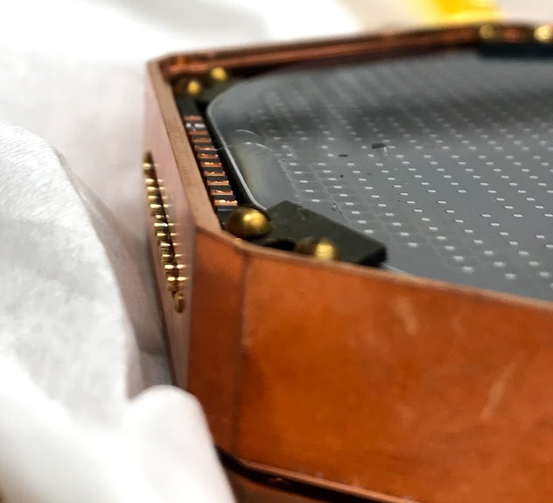
Cryogenic Photon Detector (CPD) @SLAC
Sam
11g 4.5cm³ Si detector
TES based athermal phonon sensors (simply more mature)
sensitivity = 4eV (rms)

Slide 18
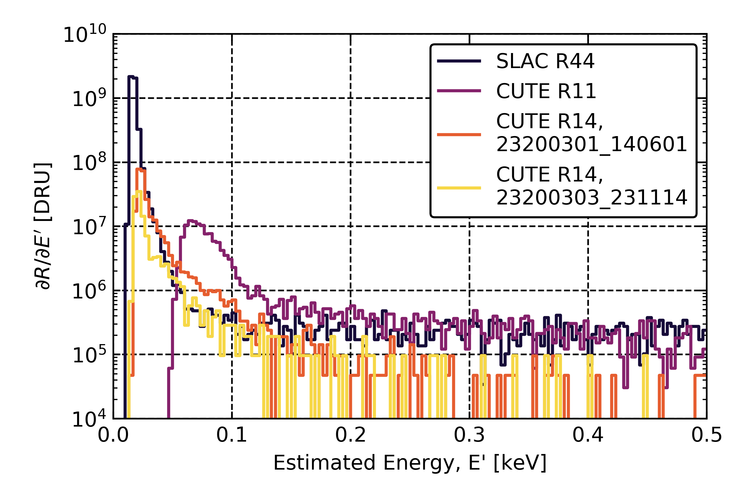
Event Rate: Same @CUTE and SLAC
Sam
1-5keV: 1000 dru
x100 larger than CUTE background
x10 larger than any possible Radon contamination

Slide 19
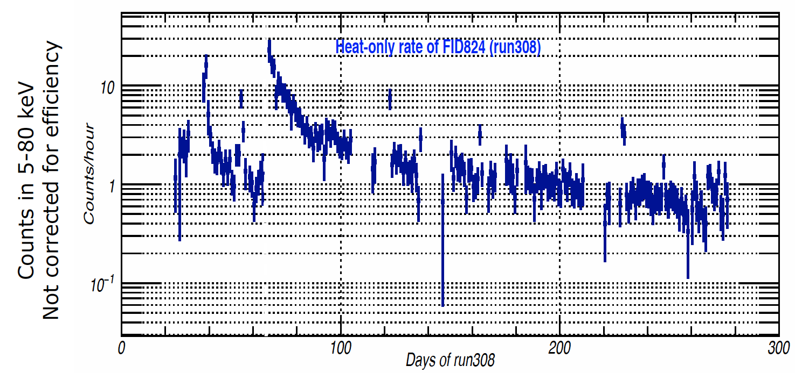
Rate Variation with time since cooldown
From J. Billard
EDELWEISS (but similar qualitative behavior seen by CPD and CRESST)

Slide 20
Low Energy Excess Facts:
Same above and below ground -> not sourced by neutrons or gammas
Time since cooldown variation -> not sourced by neutrons or gammas
E > O(10 eV) -> can’t be long lived electronic states
Way worse for CPD than CDMS2 Si in 1-5keV range -> CPD exasperates the problem
Zero Yield:
  EDELWEISS (apples to apples)
  CDMSlite and CPD (not apples to apples)
Only hypothesis that fits these facts: stress induced micro-fractures

Slide 21
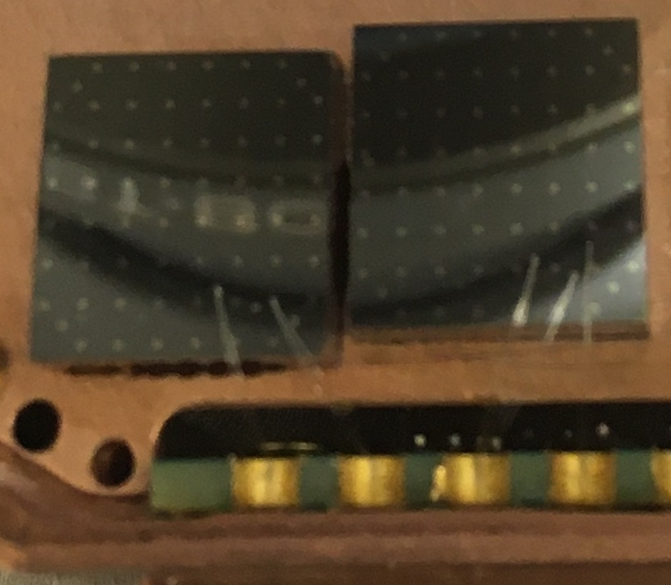
Solution: Minimal Stress Holding Strategies
The smallest possible normal force is just the weight …. don’t clamp the crystal.
resting
glued

Slide 22
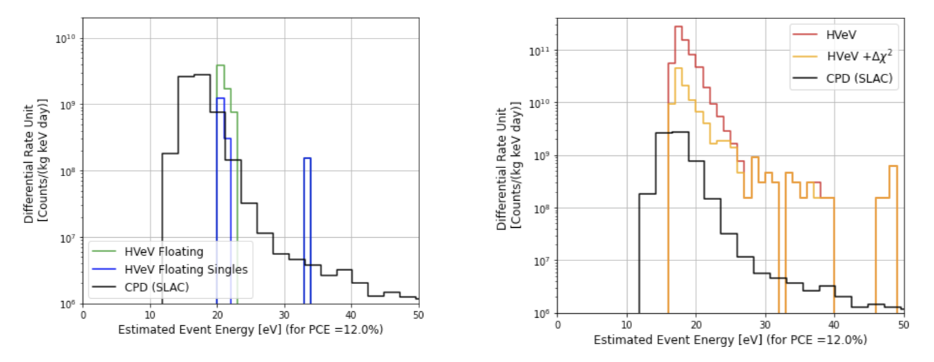
Initial Results: Extremely Promising
Bill
Resting
Glued
We’ve shown that thermal stress in GE varnish produce 5Hz/cm² of low energy microfractures
  Big Caveat: this is for GE varnish, not cirlex clamps!

Slide 23
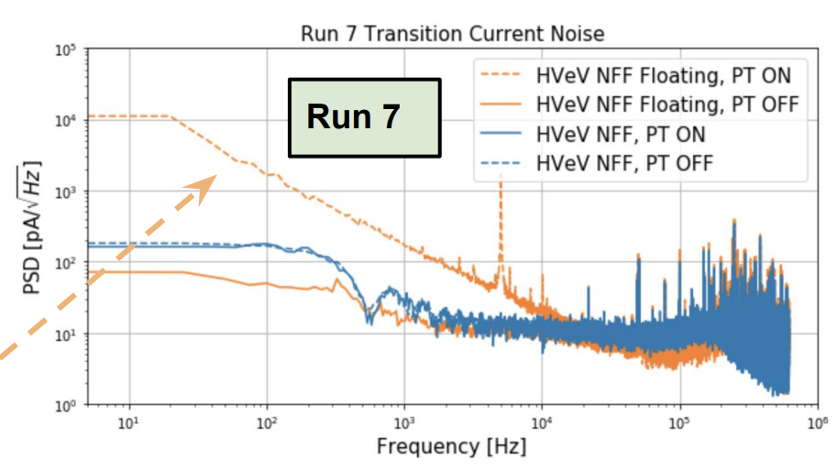
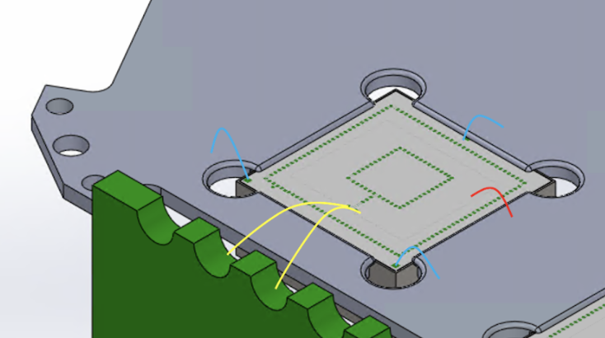
Complications: Increased Vibration Susceptibility
Bill
Resting support design significantly more susceptible to vibrational rubbing than cirlex clamps or glue ☹
  Seen at UCB and CUTE
  PT off data good
1cm² Hanging Design
Option 1: Internal double mass vibration
decoupler (Sam)
Option 2: hanging design
  Idea: Nader & Bernard
  Google Sycamore Quantum Computer hangs from wire bonds
  Least amount of infrastructure change at CUTE
Siddhant/Roger

Slide 24
1b) EMI and IR Noise Mitigation

Slide 25
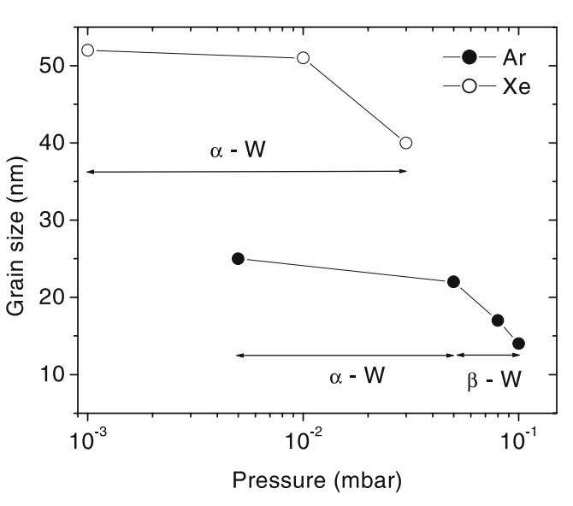
Low Tc W Film Fabrication (TAMU)
What’s set W Tc? 2 crystal configurations
  Alpha: T_{c}=15mK
  Beta: T_{c}~ 3K
Goal: produce a stress free, alpha phase W film
Bouziane et al: Xe plasma produces better alpha films
  P. Brink found and developed work program
  CRESST did too!
Appl. Phys. A 81, 209–215 (2005)
TAMU:
  Upgraded SEGI and AJA with Xenon gas
  50 films made and Tc measured at LBL
  Tc=28mK film produced
Future work program
  Optimize for Tc, alpha, stress at the same time … we really want slightly compressed W (Xe) films @300K
  Reproducible 15<Tc<20mK

Slide 26
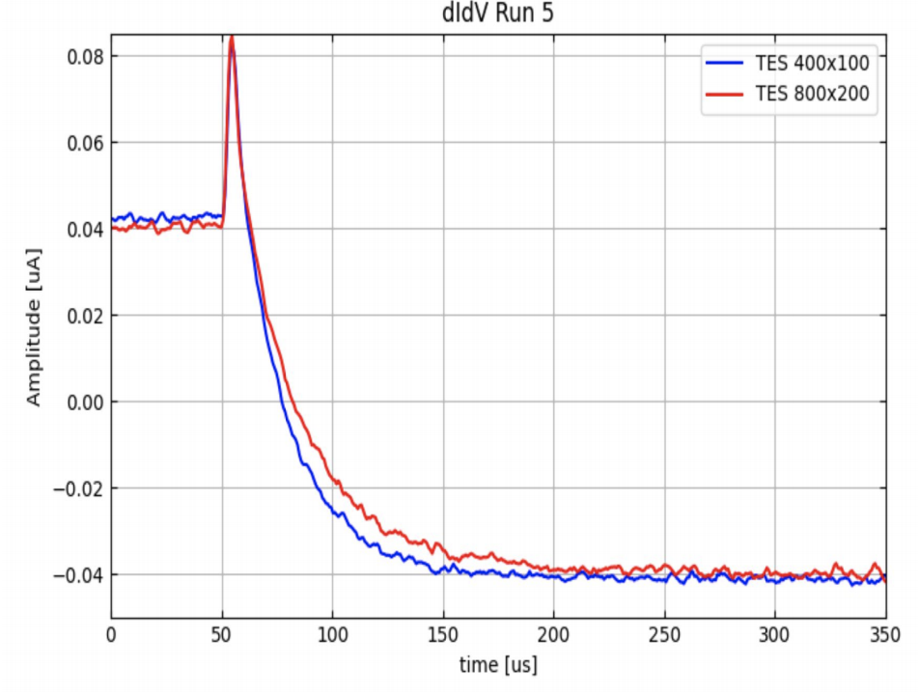
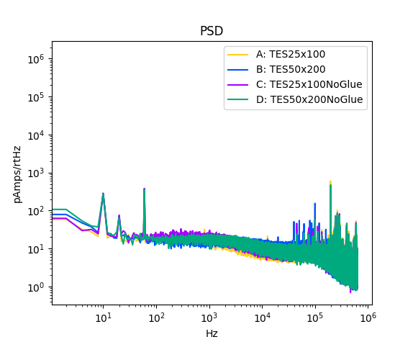
TES Characterization and EMI Mitigation
25umx100umx40nm W TES at 59mK
Achieved Required Performance
  Bias Power (P₀): 20fW for 25x100
  Falltime: 70us
  Estimated Resolution: 29meV (world leading)
23us falltime
x4 power ratio suggests ~<2fW parasitic power on lines … much smaller bias powers possible now!
PT off

Slide 27
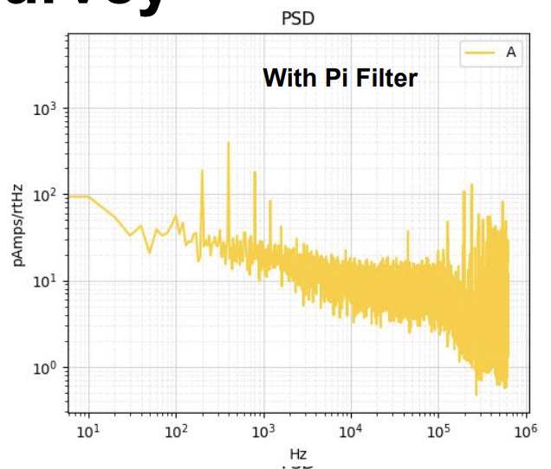
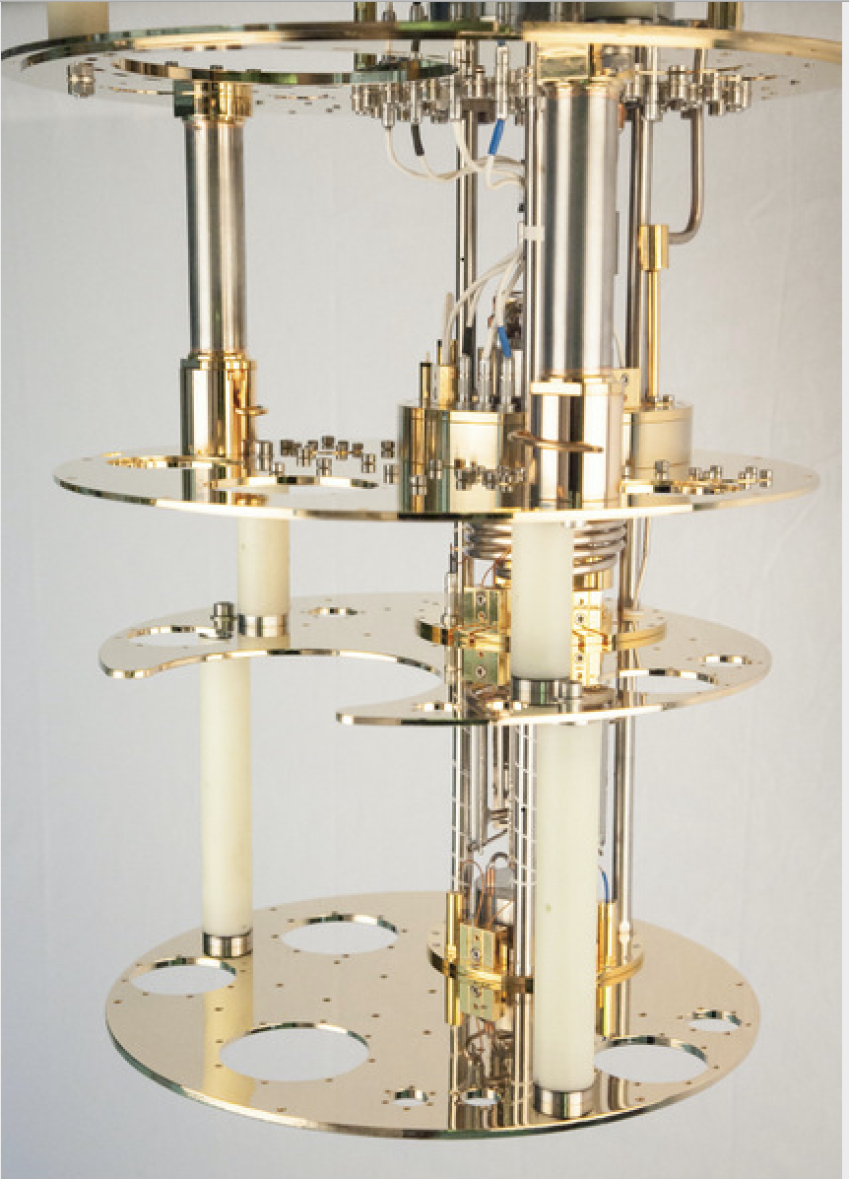
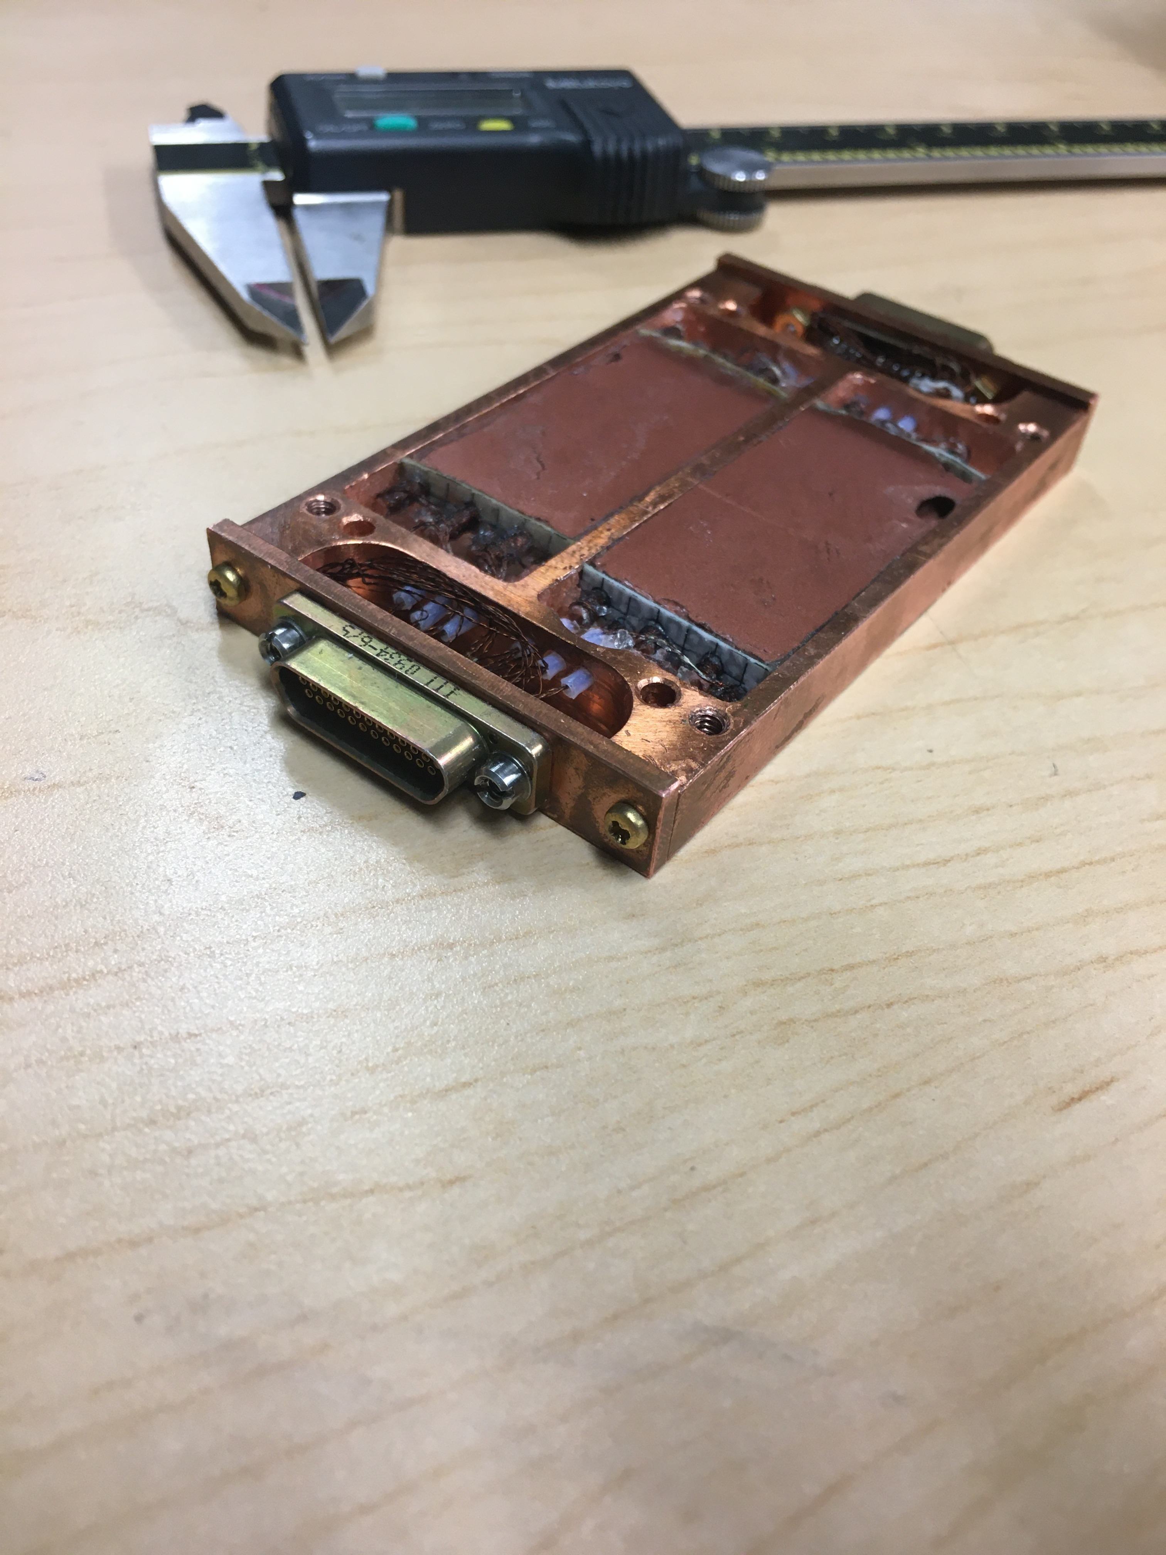
EMI Mitigation Improvements
Measure EMI shielding effectiveness with 200Hz modulation of 800MHz EMI … still have leakage
300K:
  Replace o-rings with Al gaskets -> this run
  Better filtering on fridge thermometry
200Hz amplitude modulation of 800MHz EMI
Make the 4K thermal shields into Faraday cages with line filtering
Steal copper powder filter from Martinis, Devoret, Clarke (PRB 35.4682 1987)

Slide 28
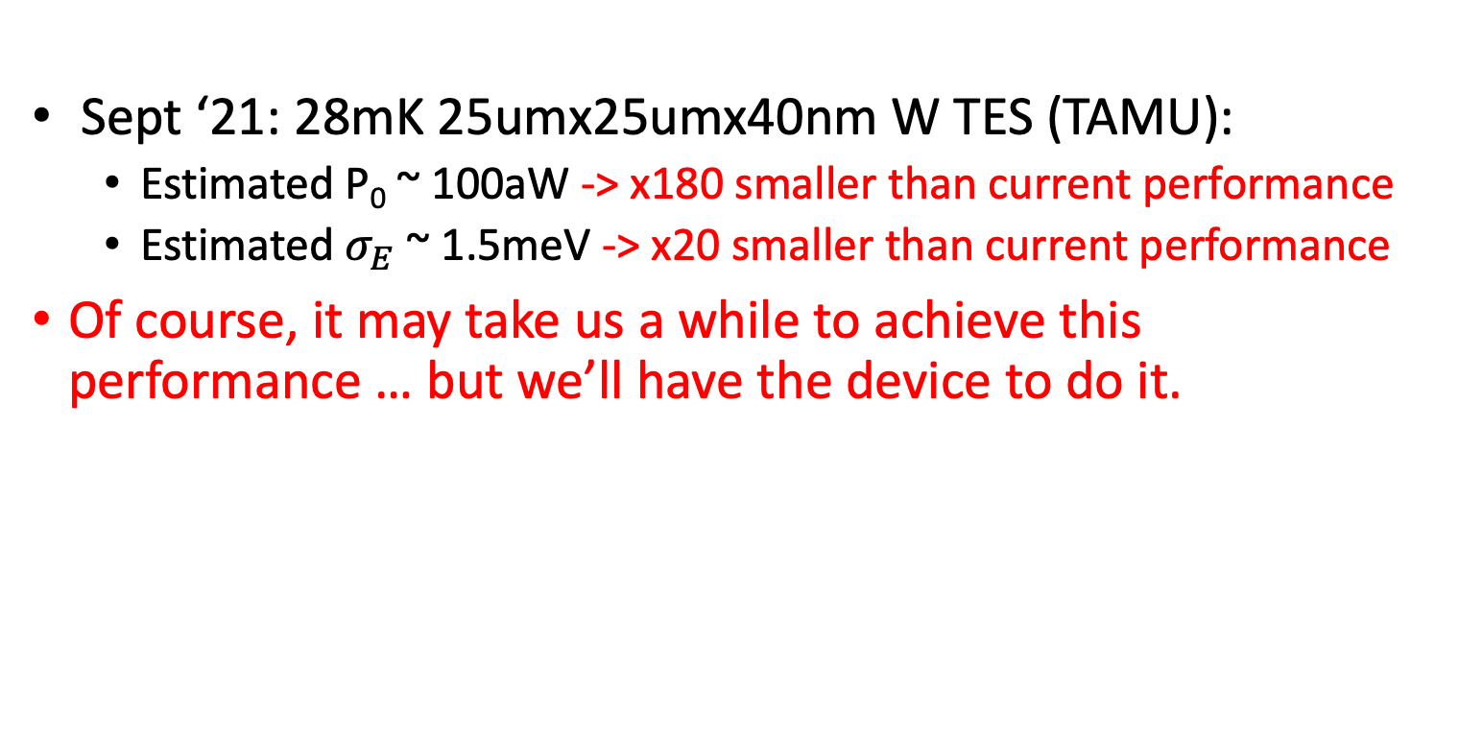
Near Term Future: decrease volume/T_{c}
Sept ‘21: 28mK 25umx25umx40nm W TES (TAMU):
  Estimated P₀ ~ 100aW -> x180 smaller than current performance
  Estimated $σ_{E}$ ~ 1.5meV -> x20 smaller than current performance
Of course, it may take us a while to achieve this performance … but we’ll have the device to do it.

Slide 29
Summary:
10meV-100MeV Dark Matter
  Theoretically well motivated
  Low’ish radiogenic backgrounds -> perfect for SURF
  Single phonon/photon sensitivity needed -> quantum sensors
  Small 100g-1kg
Work Program:
  Detector Backgrounds / Dark Counts
  Improve Sensing Technology

Slide 30
Backup

Slide 31
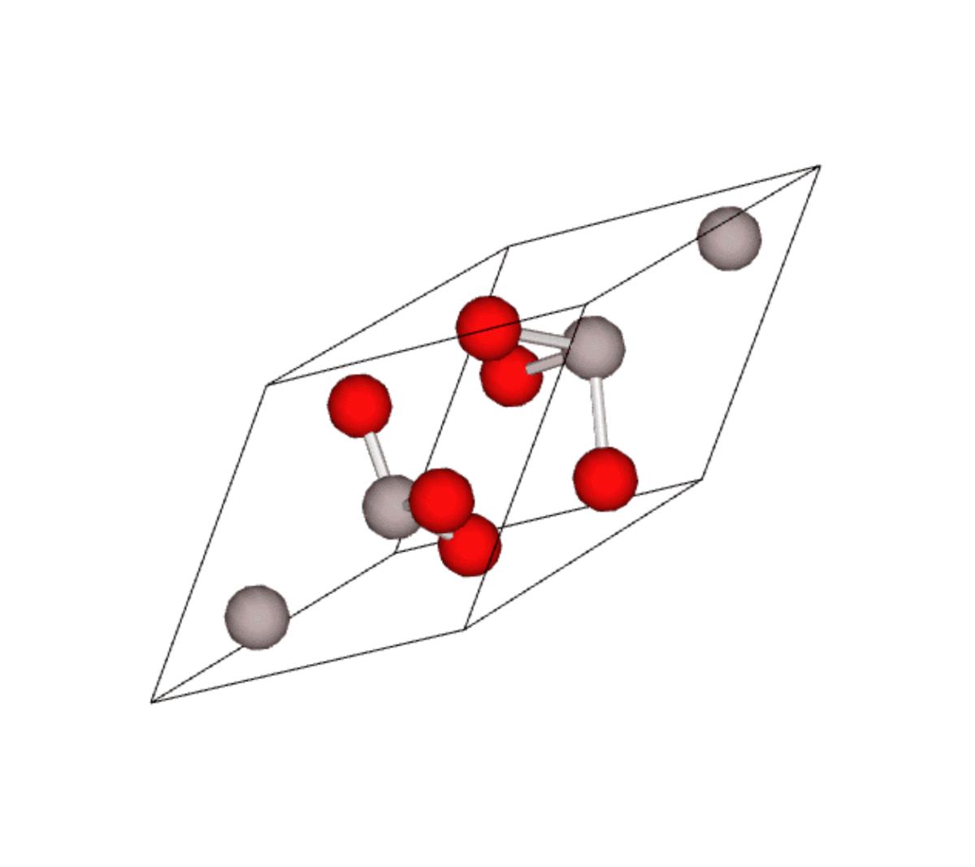
Optical Phonons
Acoustic:
Optical:
Sapphire
Due to their gapped nature, optical phonons are kinematically matched to IR and light mass DM!
Knapen, Lin, Pyle, & Zurek: 1712.06598
Energy [meV]
1712.06598
Momentum

Slide 32
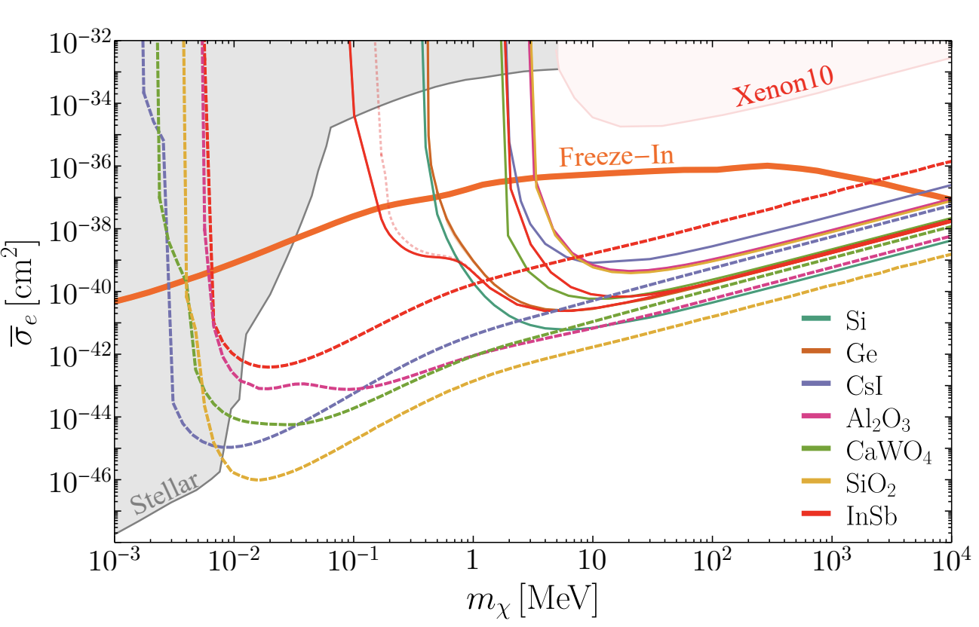
Dark Photon Couplings: Polar Crystals
In ionic crystals, optical phonons are oscillating electric dipoles!
Very large coupling to photons (black in the IR)… Very large coupling to the dark photons
30-100meV phonon sensitivities required
Scattering via Light Dark Photon
Exposure: 1kgyr
1910.10716

Slide 33
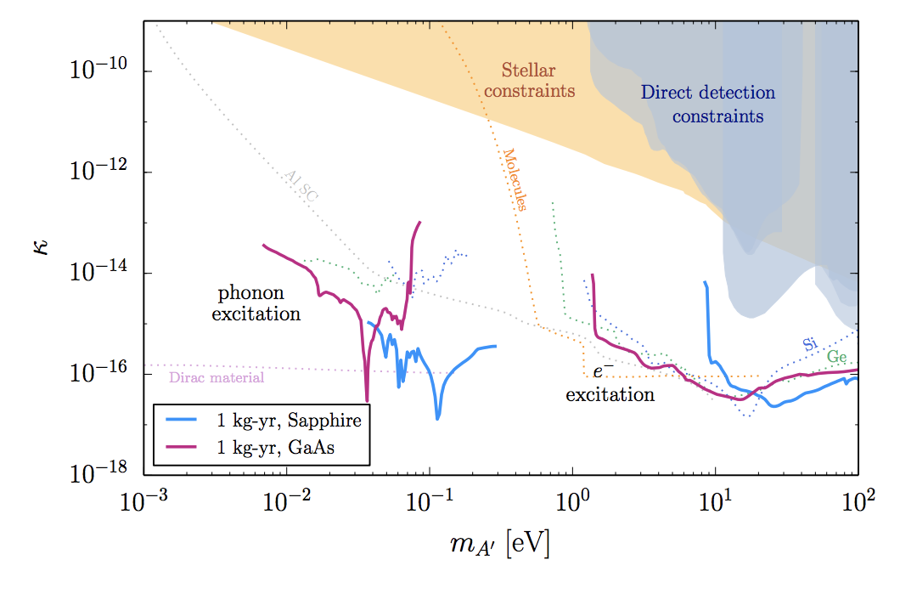
Sapphire: Lot’s of Optical Phonon Bands
1807.10291
Sapphire is a complex crystal with 10 atoms in its unit cell. Dark Matter can interact with lots of different modes
Dark Photon Dark Matter Absorption
1807.10291
To search for thermal DM down to keV masses via scattering and ultracold bosonic DM to 30 meV, we need a detector sensitive to a single optical phonon

Slide 34
Other Signal Channels for Interacting with Light Mass Dark Matter

Slide 35
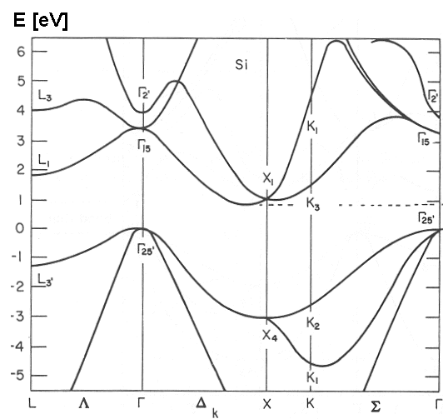
Inelastic e⁻ Recoils in Semiconductors
Band Diagram for Si
e- excitation momentum and energy scales in semiconductors well matched to 1 MeV-100MeV DM
Essig et al: 1108.5383
Energy [eV]
Momentum
v_{esc}
Detector Requirement: Sensitivity to single e/h pairs (1 eV ) with negligible dark count rate
<v>

Slide 36
Inelastic e- Recoils: Scintillating Crystals
Use a low bandgap scintillating crystal (GaAs, NaI) and couple to a single photon sensitive large area detector with no dark count rate
Penalty: Scintillation Production Efficiency
Derenzo et al: 1607.01009

Slide 37
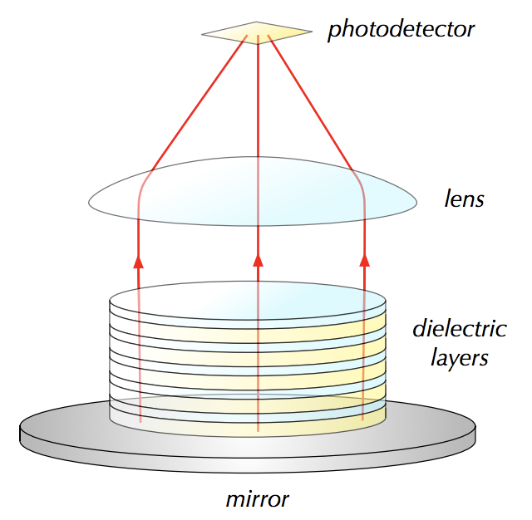
Optical/IR Haloscope
Baryakhtar, Huang, Lasenby
1803.11455
Momentum matching via multilayer stack
Requirements: Single photon sensitivity with no dark counts

Slide 38
Building Detectors with Sensitivity to Single Phonons, Single IR Photons, and Single e/h (without Luke-Neganov Gain)

Slide 39
100meV Excitation Sensitivity -> Low Temperature Detectors
300K = 26meV
To sense 100meV excitations we’ll need to cool the detector down to near absolute zero
Use superconducting detector technology
  MKIDs
  Transition edge sensors
  SNSPD (only for photon applications)

Slide 40

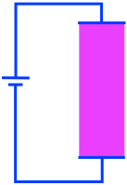
The Simplest Thermal Calorimeter
R
Transition Edge Sensor (TES):
  A superconducting metal film (W) that is externally biased so as to be within its superconducting/normal transition
  Must use low Tc and very small volume TES -> hard to get gram-day exposures when your TES (25umx25umx40nm) is 500fg … only directly useful for IR Haloscope
T

Slide 41
R&D: ultra sensitive TES
Build and test simple TES test structures for noise is performance
Tests at SLAC SuperCDMS test facility
2004.10257
Tungsten TES
  Tc= 41mK
  40nm thick

Slide 42
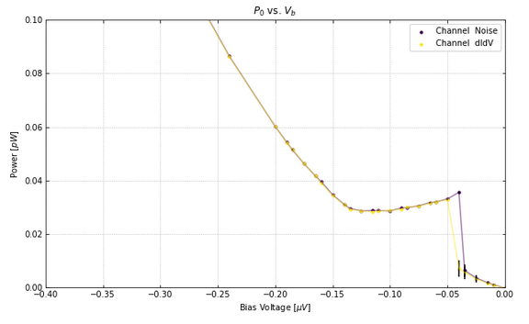
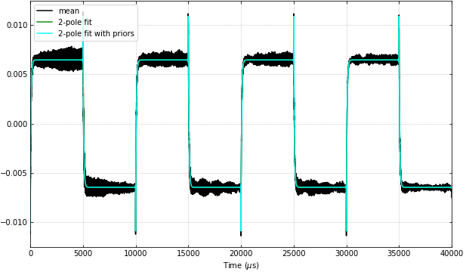
100um x400um TES Characterization
TES Power vs TES Bias Voltage
Normal Resistance: 630mOhm
Bias Power: 35fW
  Your average CMB TES: 1 pW
  Slight calibration error
Bias Power (pW)
2004.10257
TES Response to Square Wave Jitter
Bias Voltage (uV)
Complex Impedance
  Simple 2 pole TES dynamical model perfectly fits response
TES falltime: ~66us (2.4kHz)
  Relatively fast
TES Current (uA)
2004.10257
Time (us)

Slide 43
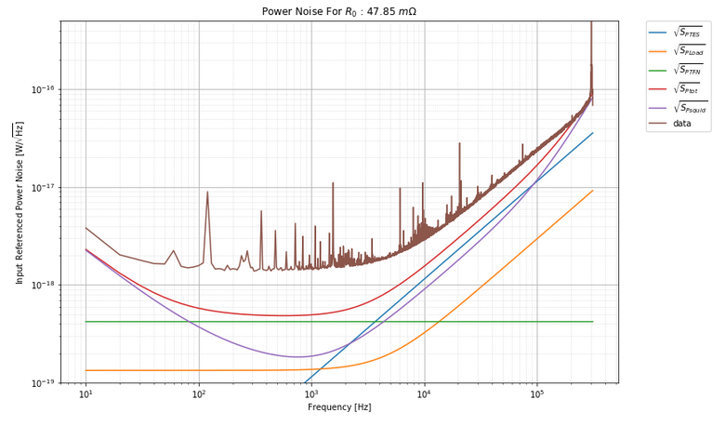
100um x400um TES Noise
Noise matches theory to within x2.5
  S_{ptot} = 1.5x10⁻¹⁸ W/rtHz
Relatively high sensor bandwidth (2.4kHz)
𝛔_{E} = 40 meV
Lots of environmental noise mitigation work to do
2004.10257

Slide 44
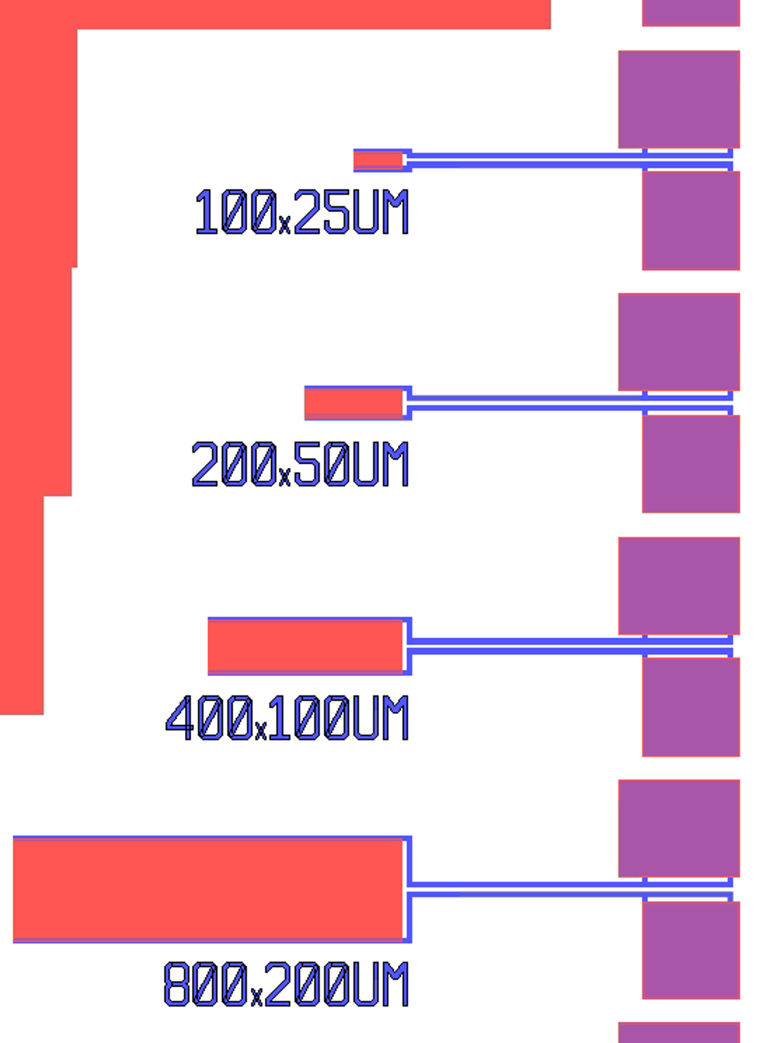
More Sensitivity -> Decrease Volume
Volume (40nm thick) | Bias Power | Expected Sensitivity
25x25um² | 0.5 fW | 5meV
100x25um² | 2.2 fW | 10meV
200x50um² | 9 fW | 20meV
400x100um² | 35 fW | 40meV
200x500: barely operates
100x25um: completely normal
We have 5 fW of DC environmental parasitic power hitting our TES. Our current primary challenge is to continue to improve environmental isolation!
2004.10257

Slide 45
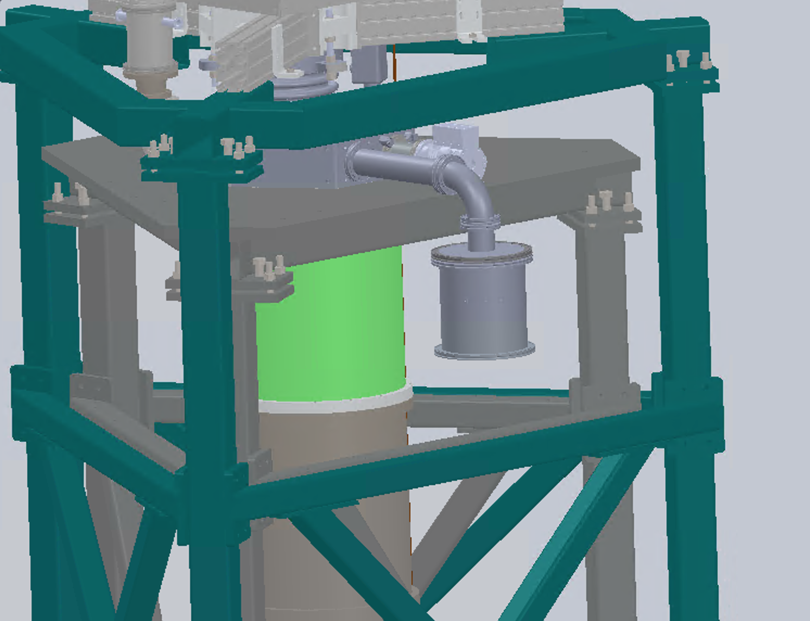
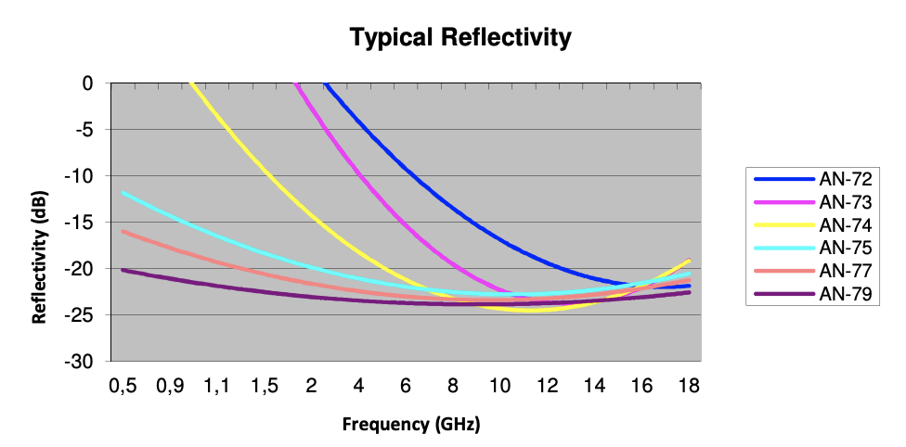
Faraday Cage #1 -> Dilution Fridge
If your E&M signal can get out, the environmental EMI can get in!
Need to carefully filter all signal lines breaching the faraday cage
Eccosorb AN79
ISO K Al gaskets
(Not rubber o-ring)
Eccosorb reflectivity
3MHz Pi Filters

Slide 46
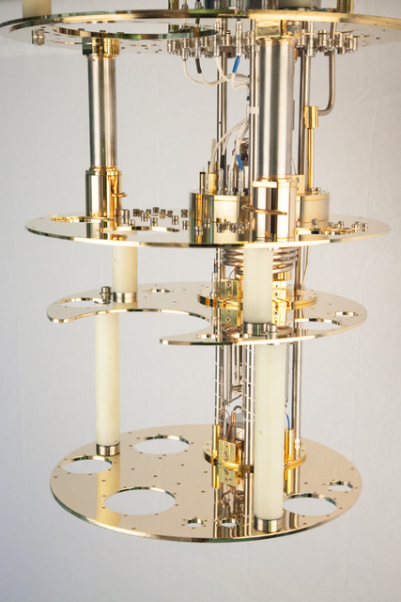
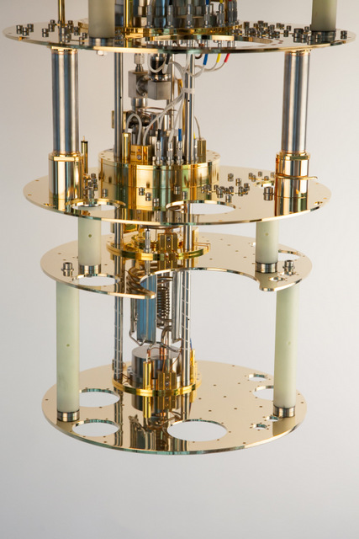
Faraday Cages 2 & 3: 4K & 10mK
Inner thermal shields would act as additional Farday Cages … if there were filters on all the lines.
Bock Black for IR light leaks
Steal copper powder filter from Martinis, Devoret, Clarke (PRB 35.4682 1987)
Bock Black
SENSORS
Bock Black
Bock Black

Slide 47
Phonon Detectors

Slide 48
2nd most simple thermal calorimeter
Couple the sensor to a large volume insulator -> low heat capacity

Slide 49
Problem: Decoupling between the Sensor and Absorber
Kapitza boundary conductance scale as as T³
e⁻/phonon thermal conductance scales as T⁴
As T is decreased, it’s harder and harder to keep the sensor thermally coupled to the absorber
Energy leaks out of the absorber through G_{ab} before its measured
TES sensitive to power fluctuations through G_{tb}
Physical clamps that support the absorber

Slide 50
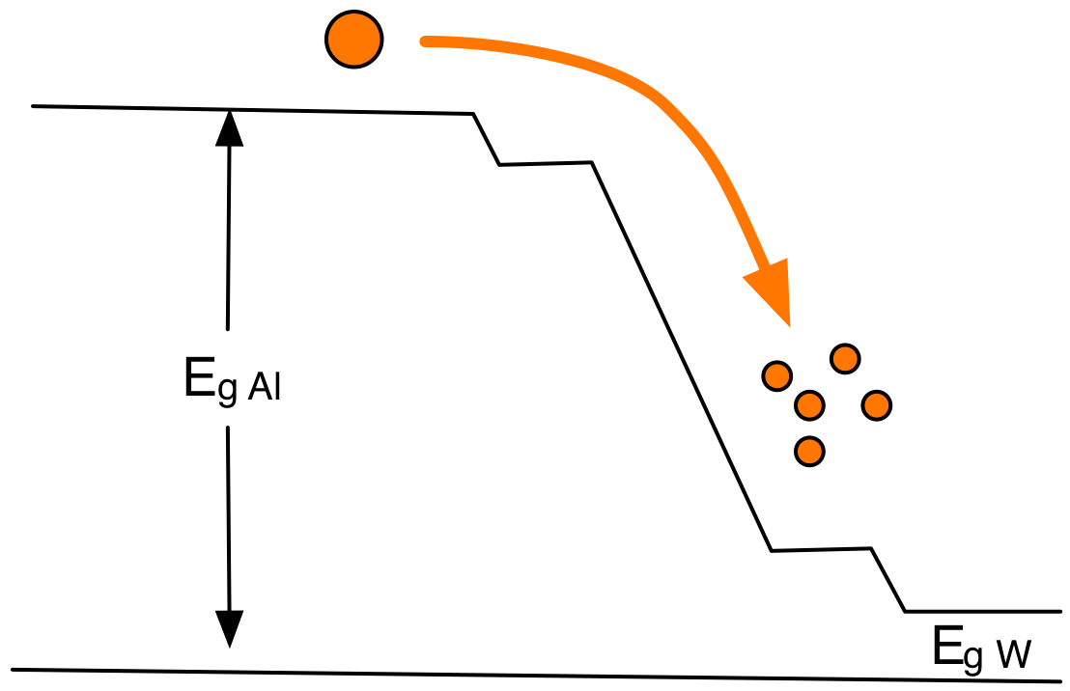
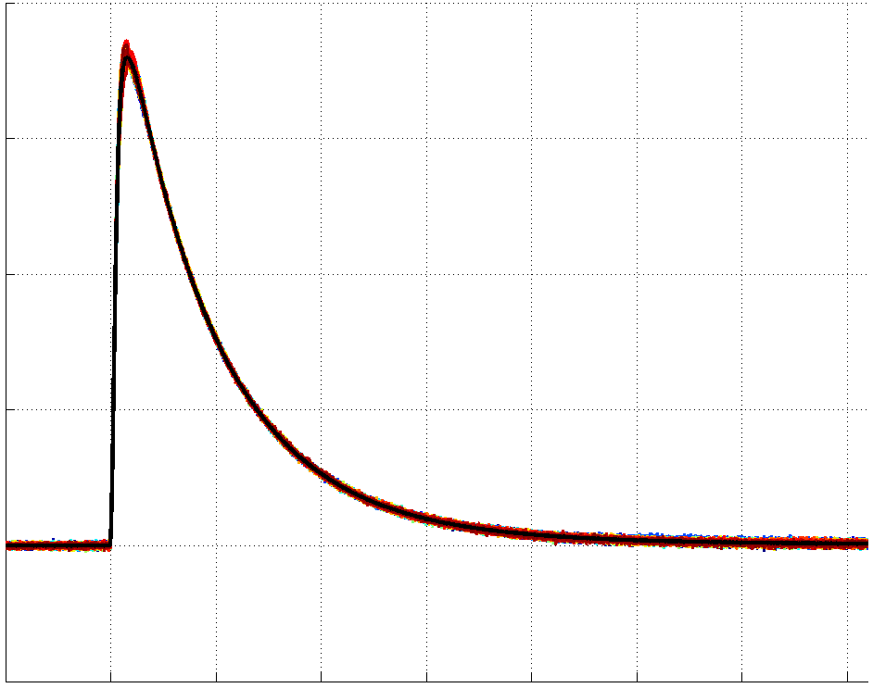
Athermal Phonon Sensor Technology
Collect and Concentrate Athermal Phonon Energy into Sensor
R
T

Slide 51
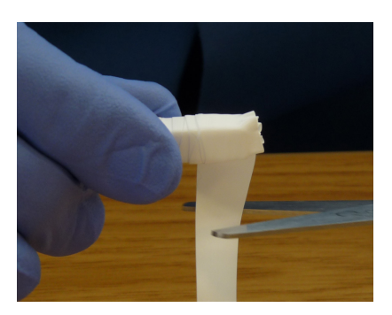
Excitation Detectors & Volume Scaling
Scintillator
PMT
Scintillator
Reflector
PMT
Will these detectors have the same energy sensitivity?
Yes, if:
Lifetime of the athermal excitation (photon) is really long
Excitation absorption dominated by sensor
Position Sensitivity

Slide 52
Optimizing the Athermal Phonon Excitation Detectors
Absorber
Absorber
TES
TES
Minimize the number/volume of the TES sensors instrumented on the surface to the point that you begin to see the bare surface thermalization rate

Slide 53
Athermal Phonon Sensor Sensitivity Scaling
Power Noise for various G
Phonon Power Noise [W/rtHz]
G
Lower 𝑣_{sensor} (lower T_{c}) if 𝑣_{signal} < 𝑣_{sensor}
Lower 𝑣_{signal} (decrease Al coverage) if 𝑣_{signal} > 𝑣_{sensor}
You can always say on VT_{c}³ scaling (in principle)
45mK-> 10mK: 2eV -> 20meV

Slide 54
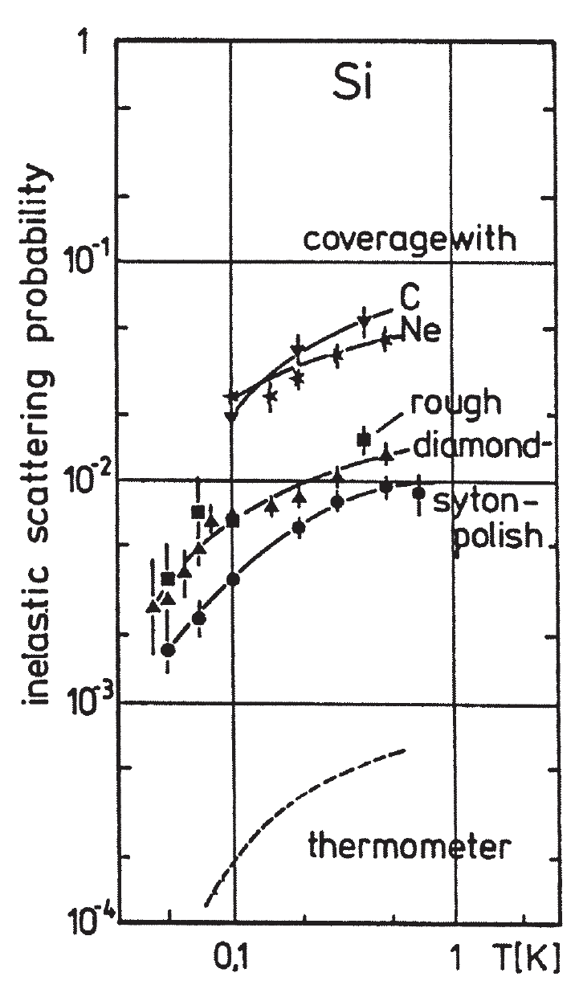
Athermal Phonon Thermalization at Surfaces
Athermal phonon surface thermalization probability found to depend upon
  Crystal
  Surface roughness
  Surface cleanliness
(W. Knaak et al, Phonon Scattering in Condensed Matter V,1986)
0.1%-1% of the crystal surface covered with athermal phonon sensors … 1/1000-1/100 thermalization probability needed
Si, Ge -> ok

Slide 55
Step 2: Make the Athermal Phonon Sensor
Measured Phonon Collection Efficiency = 20% -> 40% (theoretical limit)
R&D Work Plan
  Optimize Collector/TES (W/Al) interface
  Improve quasi-particle trapping in collector fin

Slide 56
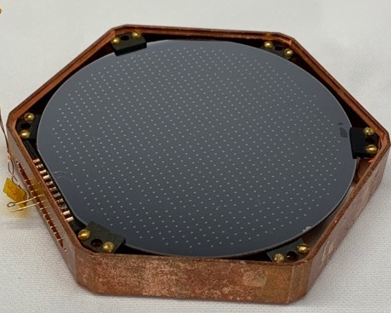
Step 3: Fabricate Sensors on Crystal

Slide 57
Athermal Phonon R&D
Matt Pyle
For
T. Aramaki, P. Brink, J. Camilleri, C. Fink, R. Harris, Y. Kolomensky, R. Mahapatra, N. Mirabolfathi, R.Partridge, M. Platt, B. Sadoulet, B. Serfass, S. Watkins, T. Yu
2007.14289

Slide 58
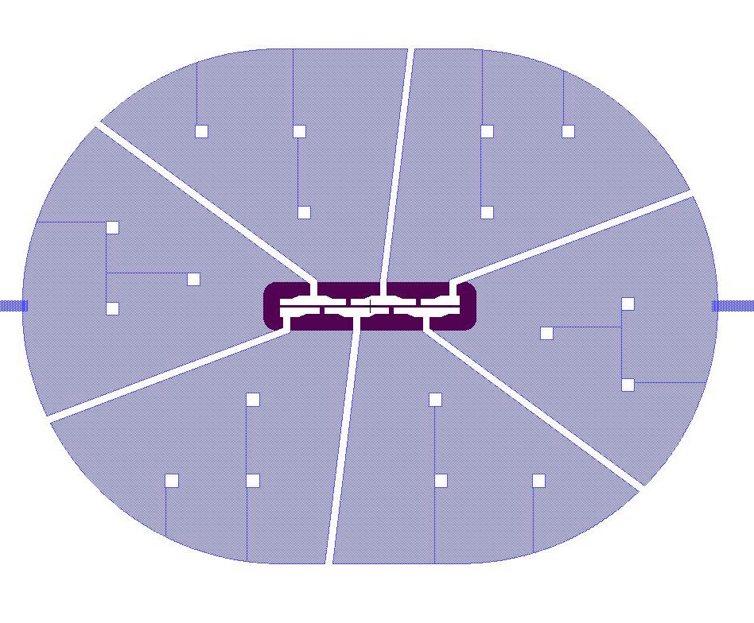
Cryogenic Photon Detector (CPD)
  3” diameter Si wafer (45.6 cm^2)
  1mm thick
  Distributed athermal phonon sensors minimize phonon collection time (as fast as it can be for its size)
    Athermal Phonon collection time estimated to be ~20us
    2.5% sensor coverage
2007.14289

Slide 59
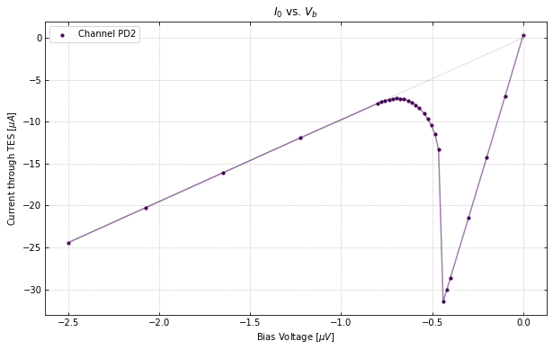
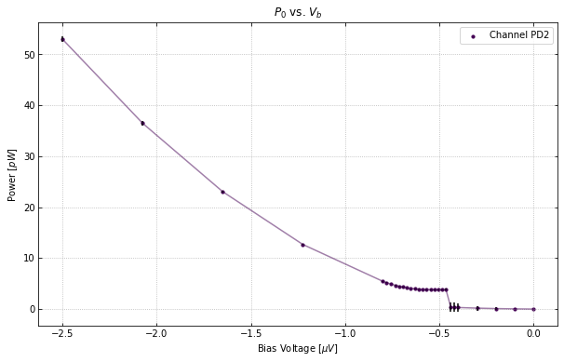
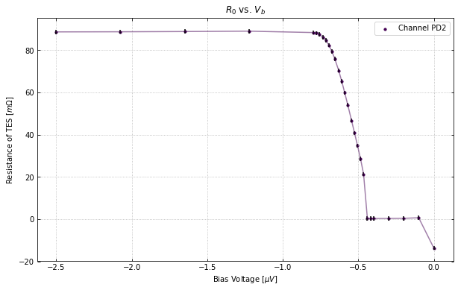
Measured Performance: Tc & IV
  T_{c}= 41.5mK
  IV curves show that the detector and electronics are behaving well
    Rn = 88 mOhms (300mOhm Expected … TES too wide!)
    Rp = 8 mOhms
    Bias Power (P₀) = 3.9 pW (1.4pW expected)
    Rn does not vary as a function of QET bias
Bias power flat in transition
2007.14289

Slide 60
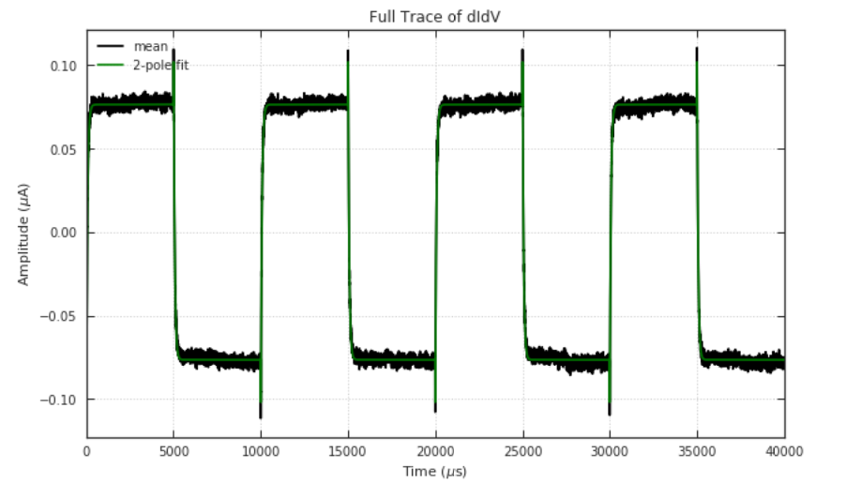
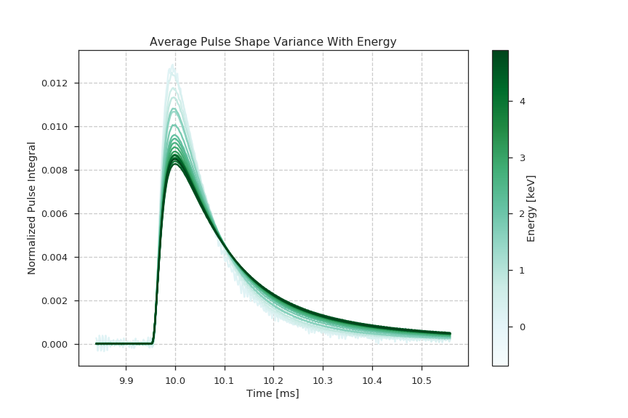
Measured Performance: dIdV
TES sensor pretty fast @ 60us. However, it’s not as fast as the estimated athermal phonon collection (20us)
Therefore, we expect phonon signals to have a 20us rise time (athermal phonon collection) and a 60us fall time. Seen for low energy comptons in average pulse shape!
Pulse shape varies with energy due to local TES saturation.
2007.14289

Slide 61
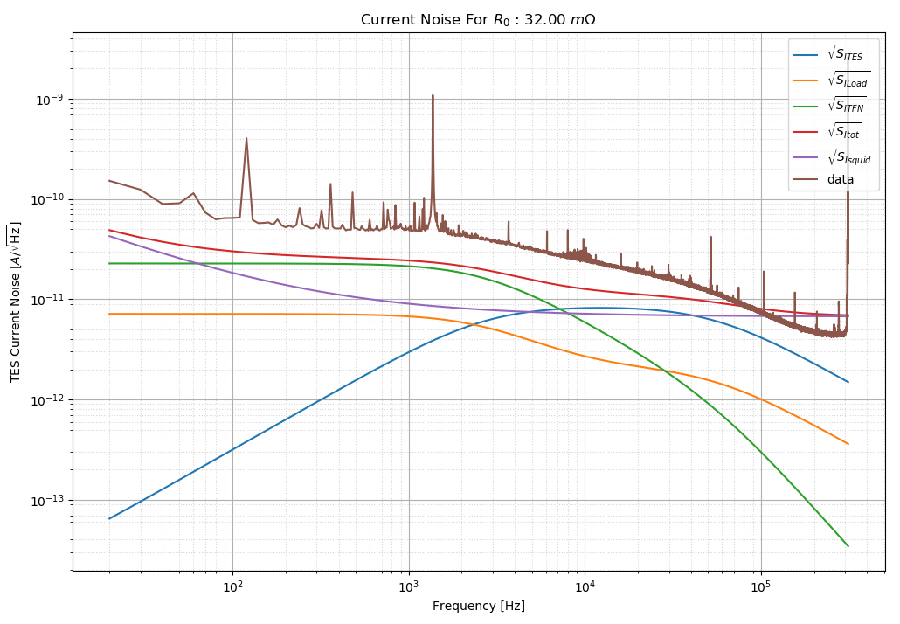
Measured/Theoretical Noise
2007.14289
Noise ~x1.5 worse than theoretical expectations
Lots of lines from pulse tube and turbo pump
TFN seems too large …

Slide 62
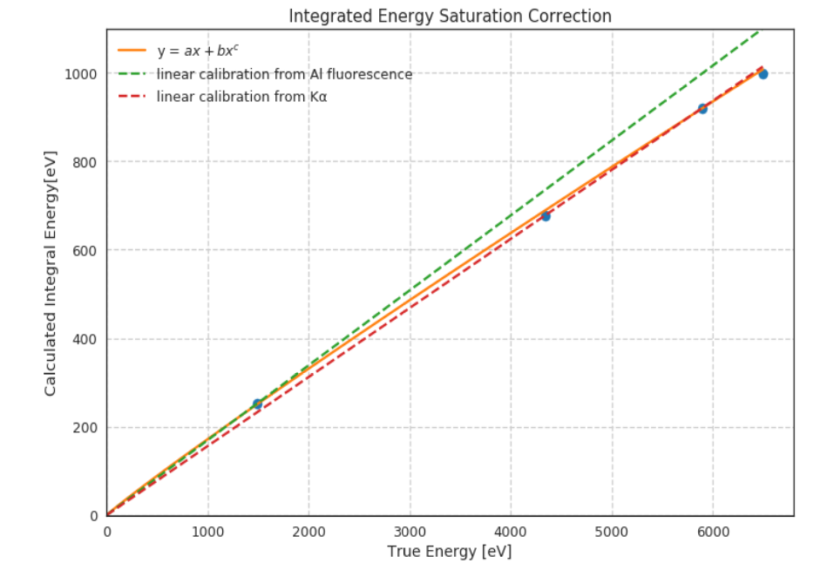
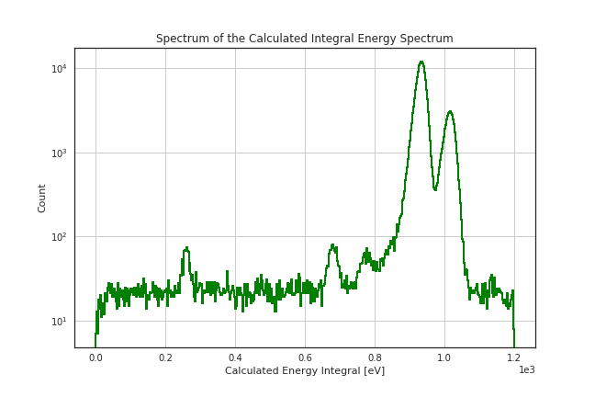
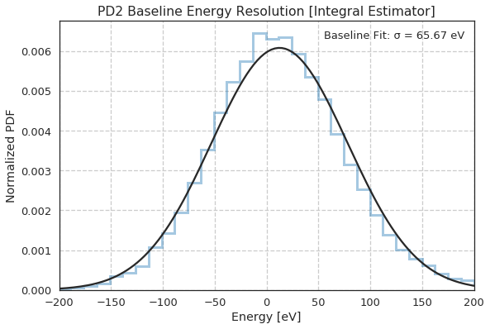
Integral Estimators for relative ⁵⁵Fe calibration
Since pulse shape has significant variation with energy, we must use noisy but minimally biased DC estimators to fit the ⁵⁵Fe calibration lines
⁵⁵Fe K_{𝛼}
@5.9keV
17% Athermal Phonon Collection Efficiency
Al Fluoresence @ 1.49 keV
2007.14289

Slide 63


Calibrating Pulse Shape Dependent Energy Estimators to the DC estimator (Pulse Tube On)
_{+0.0}
𝜎_{E} =3.9 ± 0.25 eV (stat)_{-0.7} (sys)
Baseline Resolution
2007.14289

Slide 64
First Dark Matter Search
In collaboration with SuperCDMS, we ran the CPD detector at the SLAC surface test facility
  Significantly limited by cosmogenic backgrounds
  10gd exposure
World leading DM sensitivity from 87-140 MeV
Just the beginning …
2007.14289

Slide 65
First Dark Matter Search
20 gram-day DM search completed at SLAC in collaboration with SuperCDMS … results any day
Now Running in SNOLAB CUTE Facility
2007.14289

Slide 66
Prototype Design Estimated Sensitivities
New 1cm³ Prototype Test Design
# TES | 100
TES Dimensions | 50um x 2um x40 nm
TES Rn | 320mOhm
Fin Length | 125um
W/Al Overlap | 15um
Fractional Al Coverage | 1%
Tc | 40mK
Bias Power | 48fW
Power Noise | 5.1e-19 W/rtHz
Phonon absorption time | 106us
Sensor fall time | 97us
Collection efficiency | 19%
σ_{E} | 219 meV
With a Si Absorber: single e/h sensitivity without Luke-Neganov gain. Can be used for inelastic electronic recoil DM
World Leading Elastic Nuclear Recoil DM search potential

Slide 67

Summary:
Far IR photon detectors, and Athermal Phonon Small Volume detectors are a promising technique to search for 10meV-100meV Dark Matter
Current Progress:
  3” large are photon detector 3.9eV resolution
  100x400um TES test chip: 40meV resolution
  Running photon detector at CUTE soon
R&D Plan: Towards single phonon/single phonon sensing
  Decrease environmental noise
  Increase TES sensitivity: lower Tc
  Fabricate on a variety of crystal substrates (SiO₂)
  Study how phonon surface themalization depends on surface roughness.
  Improve Collection efficiency: optimize W/Al interface

