Slide 1
Sanford Lab, Sept 15, 2021.
Some Comments on the
Nature of Rock Mechanics/Rock Engineering
Charles Fairhurst
Prof. Emeritus, Univ. of Minnesota

Slide 2
Earthquake Prediction.
Frank Press
Scientific American, May 1975. Volume 232, No. 5 pp.14-23
“Recent technical advances have brought this long-sought goal within reach. With adequate funding, several countries including the United States could achieve reliable long-term and short-term forecasts in a decade.”
Earthquake Prediction -still not possible. almost 50 years later.
\
Large earthquake very likely in Southern California within next several years
\
Computed Tomography (CT scan) and MRI were introduced in the mid 1970’s.

Slide 3
The Field is the Laboratory
Engineering projects in rock are usually large –scale; 3D discontinuities (joints, faults) play important role in engineering response.
Rock is also heterogeneous. In some regions it is ‘critically stressed’ –in others it is very stable
Rock in-situ is subject to tectonic and gravitational stresses (also heterogeneous) - and has been for many millions of years.
Cannot test engineering design in such situations in a classical lab.
We can test these designs by computer models -optimize design, then apply and observe in the field.
…………………………………………………..
Christine Detournay. "Findings from Numerical Modeling at the Site of a High Dam* on the Jinsha River".
Sept.16th 10 A.M. GMT.– and available for viewing later at https://isrm.net/page/show/1614?tab=1615
* Baihetan Dam -16,000MW (World’s largest Concrete Arch Dam)

Slide 4
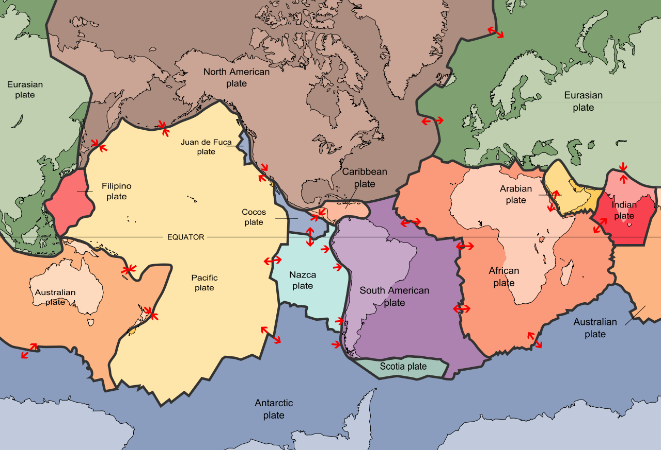
China
China
Tectonic Plates and Boundary Motions –
origin of lateral * stresses in rock
(* Gravity generates vertical stresses)

Slide 5
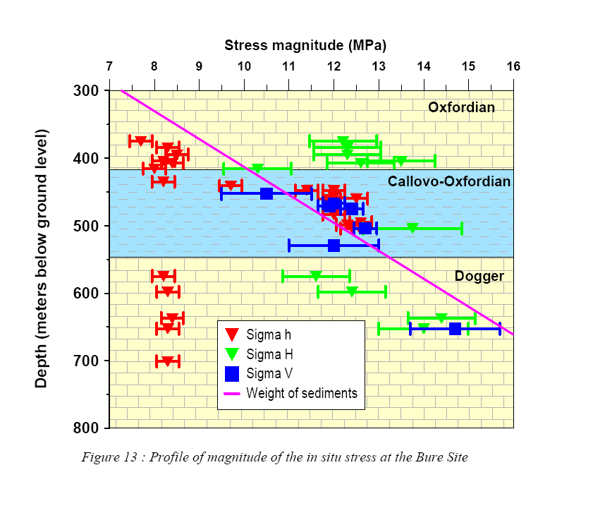
Rock has had many millions of years
to adjust to imposed stresses.
Limestone
σ_{H} > σ_{V} > σ_{h}
Argillite
(indurated clay)
σ_{H} = σ_{V} = σ_{h}
Limestone
σ_{V} > σ_{H} > σ_{h}
Earth is
‘Critically Stressed’
in some places -
but not everywhere!
In Situ Stresses Change with Rock Type
(Underground Research Laboratory, Bure. France)

Slide 6
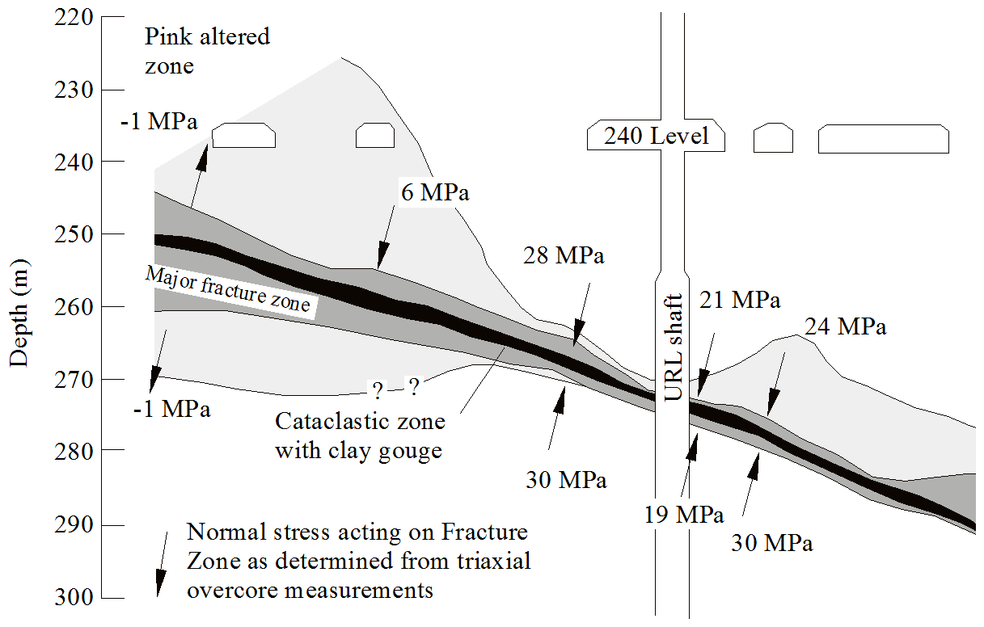
20m
Observed Variability of Normal Stress Across a Thrust Fault at the URL, Pinawa, Canada.

Slide 7
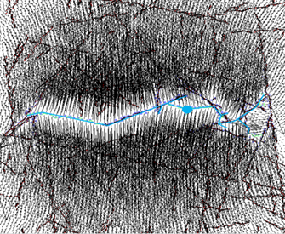
Propagation of Hydraulic Fracture in Jointed Rock
Problems are Three-Dimensional !!
Two-Dimensional
Simulation
BoreholeIinjection

Slide 8
Three-Dimensional
Propagation
of
Hydraulic Fractures
in
Jointed Rock
……………
Initial View - from Side
Pre-existing crack –Vertical (red)
Propagating Crack - Horizontal
Damjanac, B. C.Detournay, P.A. Cundall (2015) Application of particle and lattice codes to simulation of hydraulic fracturing.
Computational Particle Mechanics, Nov 2015
ISSN 2196-4378 Comp. Part. Mech. DOI 10.1007/
s40571-015-0085-0

Slide 9
Hypothetical Design of an EGS Project.
FORGE (Frontier Observatory for Research in Geothermal Energy) Univ. of Utah (2018) [$140 million]

Slide 10
SubTer
See also
https://www.energy.gov/under-secretary-science-and-energy/subsurface-science-technology-engineering-and-rd-crosscut-subter
https://www.energy.gov/eere/forge/forge-home
Pettitt, W et al;(2011). ”Fracture network engineering for hydraulic fracturing.”
The Leading Edge, 30(8), 844-853. https://library.seg.org/doi/abs/10.1190/1.3626490

Slide 11
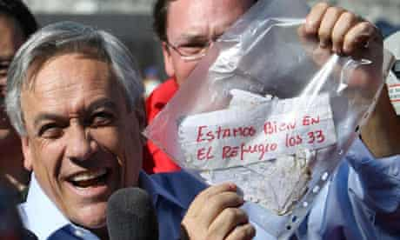
“One small step for man; one giant leap for mankind!”
Seen and heard in real time on TV from Moon ( 384.000 km from Earth ) July 24, 1964
Chilean Mine Accident
\August 5, - Oct 19, 2010 (46 years later)
Thirty-three men, trapped 700 meters (2,300 ft) underground and 5 kilometers (3 mi) from the mine's entrance. were rescued after 69 days.[
Three separate drilling rig teams, nearly every Chilean government ministry, the United
States's space agency, NASA, and a dozen corporations from around the world cooperated in completing the rescue.
\
https://en.wikipedia.org/wiki/2010_Copiap%C3%B3_mining_accident
President of Chile announcing "Estamos bien en el refugio los 33" (We are well in the shelter, the 33 of us)”
Seventeen days after the accident, a note was found taped to a drill bit pulled back to the surface.

Slide 12
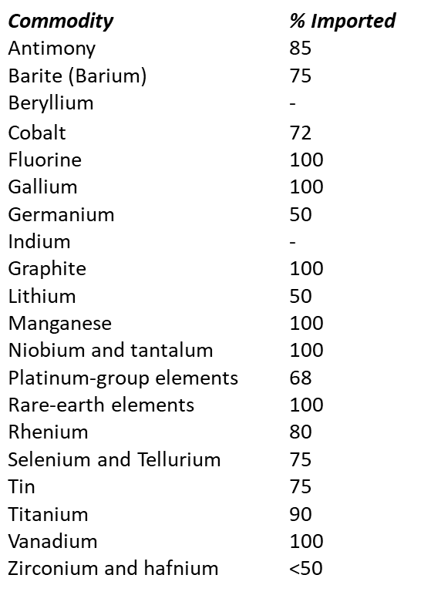
Unlike fossil fuels, there are no alternatives to minerals.
Critical minerals
are essential to a wide range of leading technologies, ranging from aircraft and automotive components to electronics and telecommunications devices, and from displays to photovoltaics.³
US is dependent on 35 minerals critical to economy & national security.
heavily dependent on imports for these minerals.
has been aware of this vulnerability for 50 years.
Main import countries China, Canada
For details see
https://www.usgs.gov/news/interior-releases-2018-s-final-list-35-minerals-deemed-critical-us-national-security-and

Slide 13
There has been no advance in tunneling in past 50 years!
My aim is to increase rate of excavation, and reduce cost of excavation,
Each by a factor of ten
\ Elon Musk (Founder of The Boring Company)

Slide 14
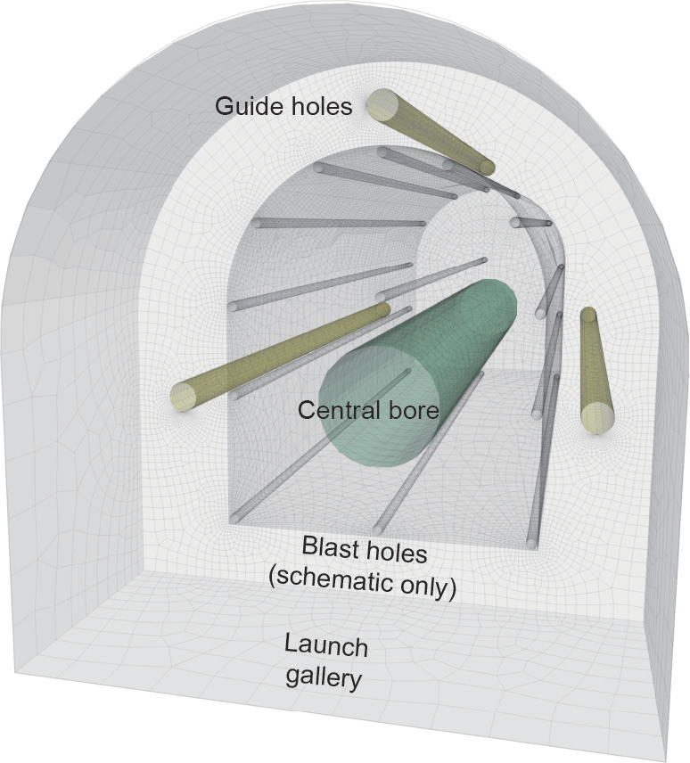
Why are we limited to ratio
burden /diameter ~1 ?

